Slide 1
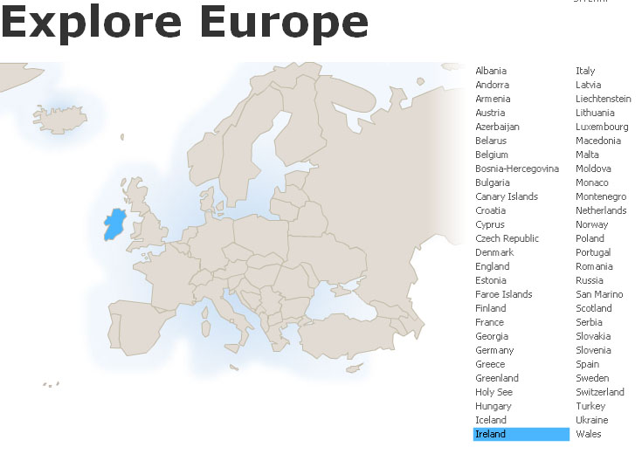
Ireland
Tim Roufs
© 2010-2024

Slide 2
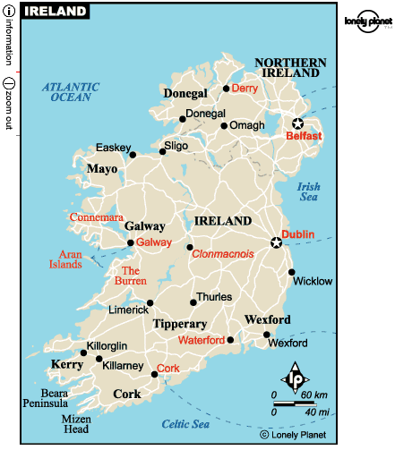

Slide 3
Northern Ireland
is part
of
“The
United Kingdom
. . .”

Slide 4
officially
called
“The
United Kingdom
of
Great Britain
and
Northern Ireland”
usually shortened to
the United Kingdom,
the UK,
or Britain

Slide 6
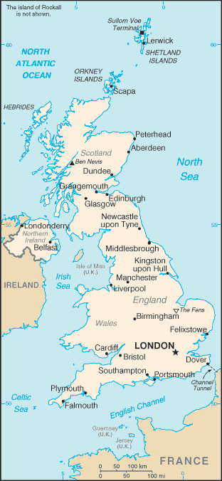
so
Northern Ireland
. . .
https://www.cia.gov/cia/publications/factbook/geos/uk.html

Slide 7
The
United Kingdom
(UK)
includes
England
Scotland
Wales
Northern Ireland
https://www.cia.gov/cia/publications/factbook/geos/uk.html

Slide 8
so
Northern Ireland
“belongs”
with
The
United Kingdom
(UK)
along with
England
Scotland
Wales
https://www.cia.gov/cia/publications/factbook/geos/uk.html

Slide 9
Northern Ireland
is part
of
“The
United Kingdom
. . .”

Slide 10
Today
we’re going to
have a look at the
The more “traditional” part of Ireland --
The Aran Islands
Galway
Connemara
and
Clare County
Area.
This the area most
Noteworthy for
anthropological
and cimatographical
Research.

Slide 11
Today
we’re going to
have a look at the
The more “traditional” part of Ireland --
The Aran Islands
Galway
Connemara
and
Clare County
Area.
This the area most
Noteworthy for
anthropological
and cimatographical
Research.

Slide 12
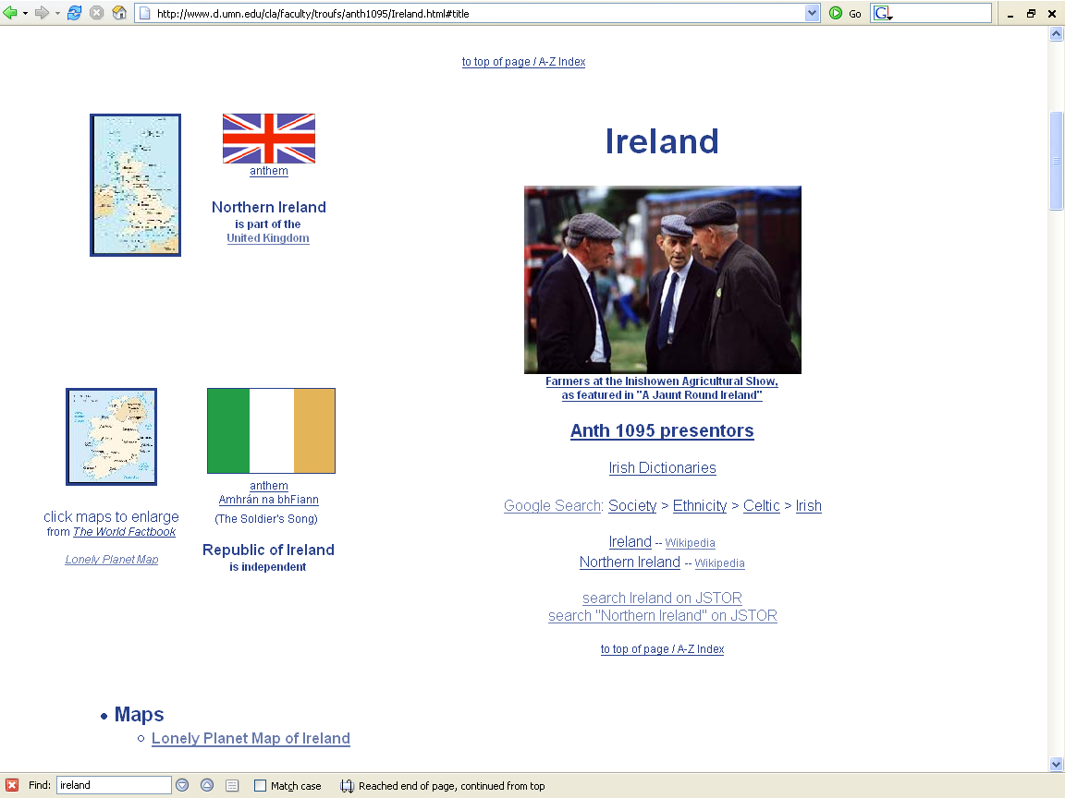

Slide 13
“units of analysis” may include:
  a “culture area” (anthropological term)
  a country
  a divided/partitioned segment of a nation or country
  a culture
    “Irish”
  a “subculture”
    “Irish Travelers” (“Tinkers”, “Gypsies”)
      (“Travelers” are not “Rom”, “Gypsies”)
    Irish Catholics
  a region
  a community / city
  the family
  one person
  types of people and institutions, cross-culturally…

Slide 14
a “culture area”
(anthropological term)
as a
Unit of Analysis:
Europe

Slide 15
a country
as a
Unit of Analysis:
Ireland

Slide 16
a divided / split segment
of a
nation or country
(Nation-State)
as a
Unit of Analysis:
Northern Ireland
Republic of Ireland

Slide 17
a culture
as a
Unit of Analysis:
“The Irish”

Slide 18
a “subculture”
as a
Unit of Analysis:
e.g., “Irish Catholics”

Slide 19
a “subculture”
as a
Unit of Analysis:
e.g., “Travelers”
(“Tinkers”, “Gypsies”)

Slide 20
a region
as a
Unit of Analysis:
The Irish Countryman
“Kerrymen”

Slide 21
a region
as a
Unit of Analysis:
The Aran Islands

Slide 22
the community
as a
Unit of Analysis:
e.g., Inish Oirr
(“Inish Beag”)

Slide 23
the community
as a
Unit of Analysis:
e.g., Dubliners

Slide 24
the individual
as a
Unit of Analysis:
e.g., Nan

Slide 25
types of people
and institutions, cross-culturally
as various
Units of Analysis:
e.g., “peasants”

Slide 26
a region
as a
Unit of Analysis:
The Aran Islands

Slide 28
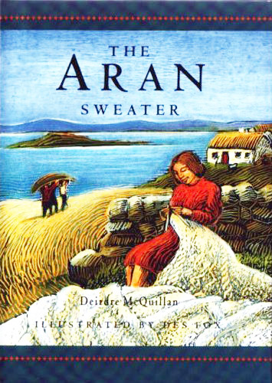
Notes:
11/19/2023
28

Slide 29
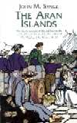
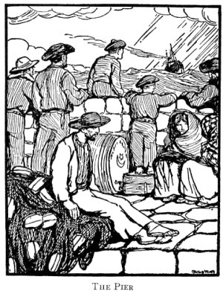
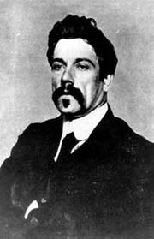
The Aran Islands
by J. M. Synge
[1907]
“The classic account of life and lore in the
Spiritual heart of Ireland
By the author of The Playboy of the Western World.”
1907

Slide 30
From the back cover of the Dover Reprint of 1998. (Emphasis added)
“The classic account of life and lore in the
spiritual heart of Ireland
by the author of The Playboy of the Western World”
[1907]
“At the suggestion of W. B. Yeats, John Millington Synge spent a few weeks
each year from 1898 to 1902 on the Aran Islands, a secluded region west of
Galway Bay that symbolized the Eden of the Irish cultural renaissance. Even
at the dawn of the twentieth century, Aran’s farmers and fisherfolk lived in a
manner no different from that of their ancestors, and Synge’s record of his
experiences among them offers a unique perspective on Ireland’s ancient
customs and spiritual values.”
. . .
“Readers of this remarkably sensitive narrative will share the author’s enchantment
with the simplicity of island life. Synge deftly evokes the smell of seaweed,
the murmur of Gaelic, and the spirited islanders’ magnificent words
and gestures. Students of anthropology and Celtic literature, as well as anyone
who fancies a grand yarn, will treasure this gemlike work.”
. . .

Slide 31
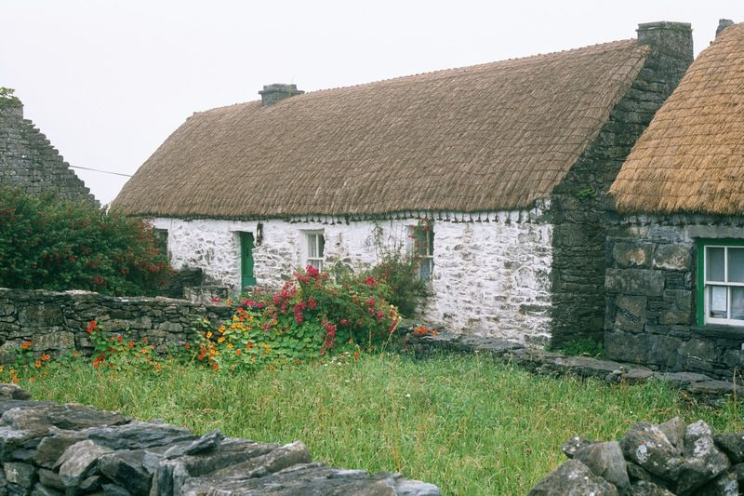
Synge's cottage on Inishmaan, now turned into a museum
Synge's cottage on Inishman, now turned into a museum
http://en.wikipedia.org/wiki/John_Millington_Synge

Slide 32
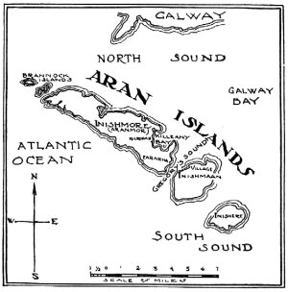
The Aran Islands
John M. Synge
1907
(full-text on-line)
Author of The Playboy of the Western World
He is best known for the play The Playboy of the Western World,
which caused riots in Dublin during its opening run at the Abbey
in January 1907 .

Slide 33
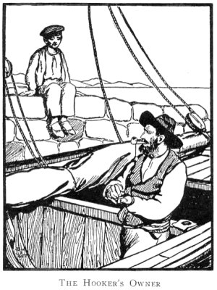
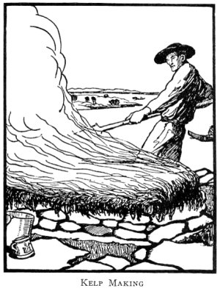

Slide 34
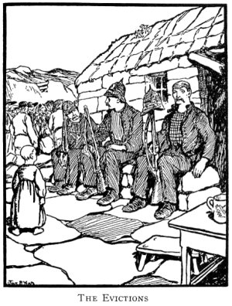
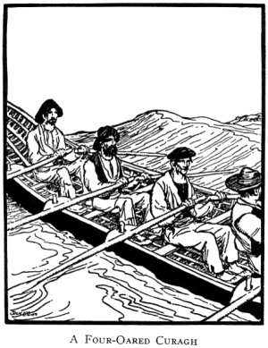

Slide 35
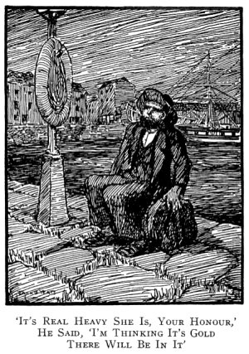
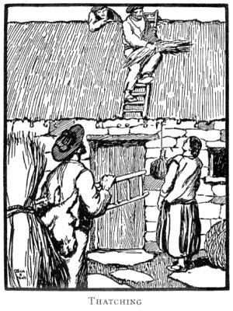

Slide 36
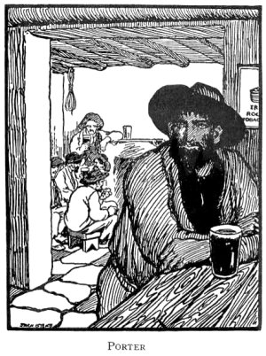
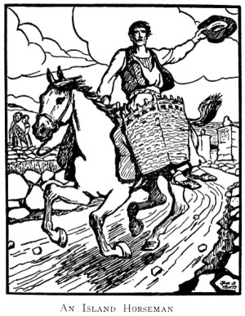

Slide 37
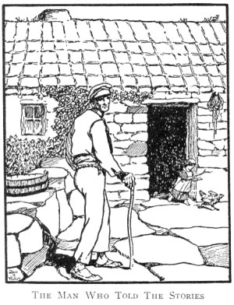

Slide 38
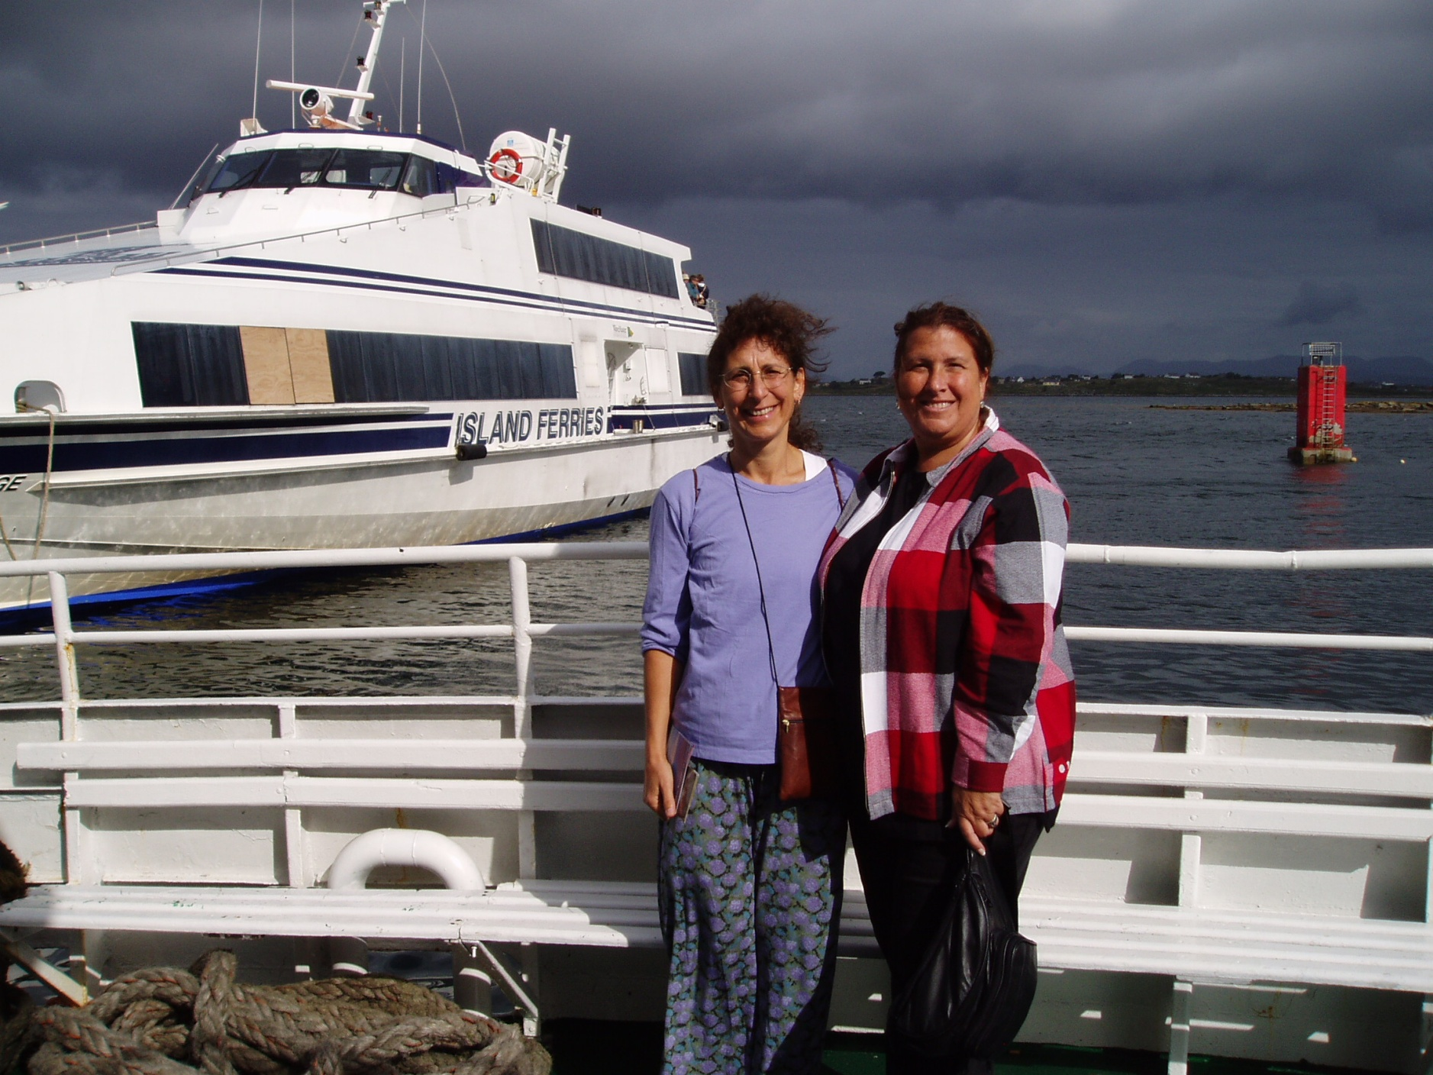

Slide 39
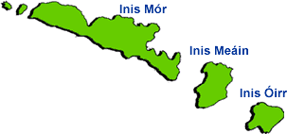
The Aran Islands
Inisheer, the smallest island, is only two miles long and one and one-half miles wide

Slide 41

. . . backed up in image by the film
Man of Aran
(77 min, 1934, B&W)
  Robert J. Flaherty,
  Colman “Tiger” King,
  Maggie Dirrane, and
  Michael Dirrane

Slide 42
the classic ethnography of Ireland is
  Conrad Arensburg’s The Irish Countryman
  set in County Clare
  backed up in image by the film Man of Aran
Susan Parman, Europe in the Anthropological Imagination, pp. 11 - 14

Slide 43
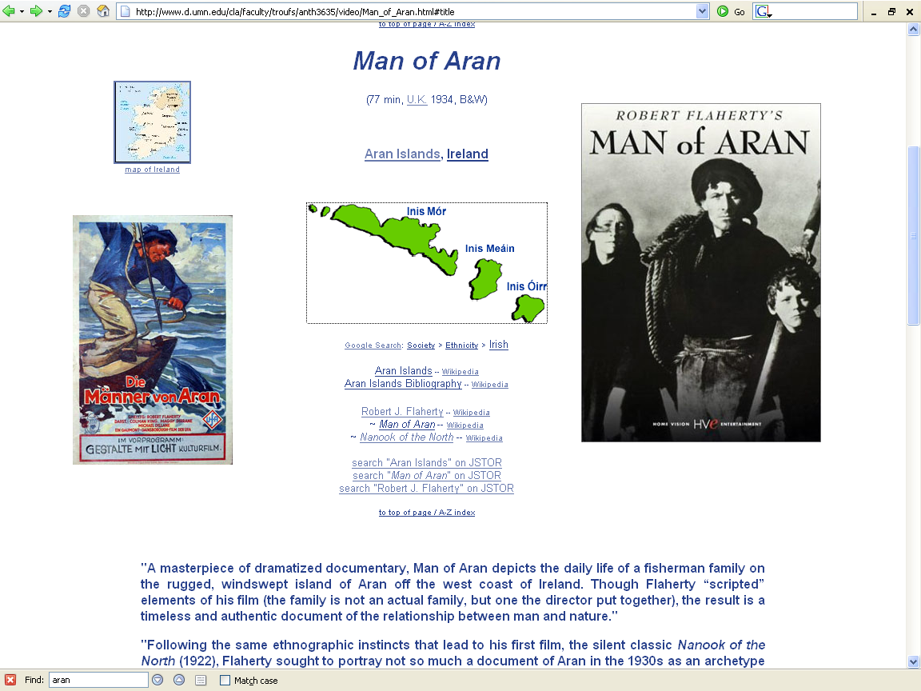
http://www.d.umn.edu/cla/faculty/troufs/anth3635/video/Man_of_Aran.html#title

Slide 44

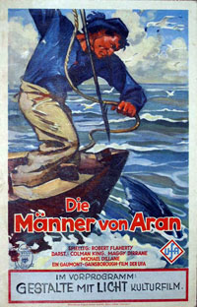

Slide 45
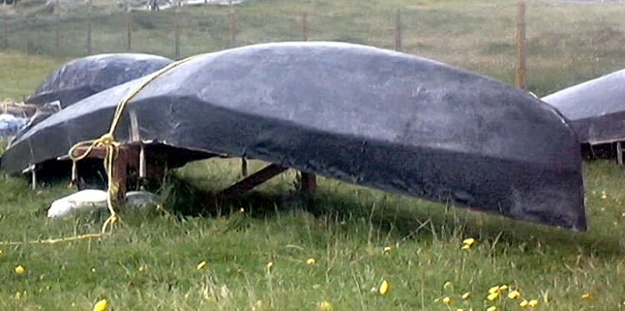
curagh
http://irishislands.info/oilphoto/Aran/InisOirr/inisoirr_thumb.html

Slide 46
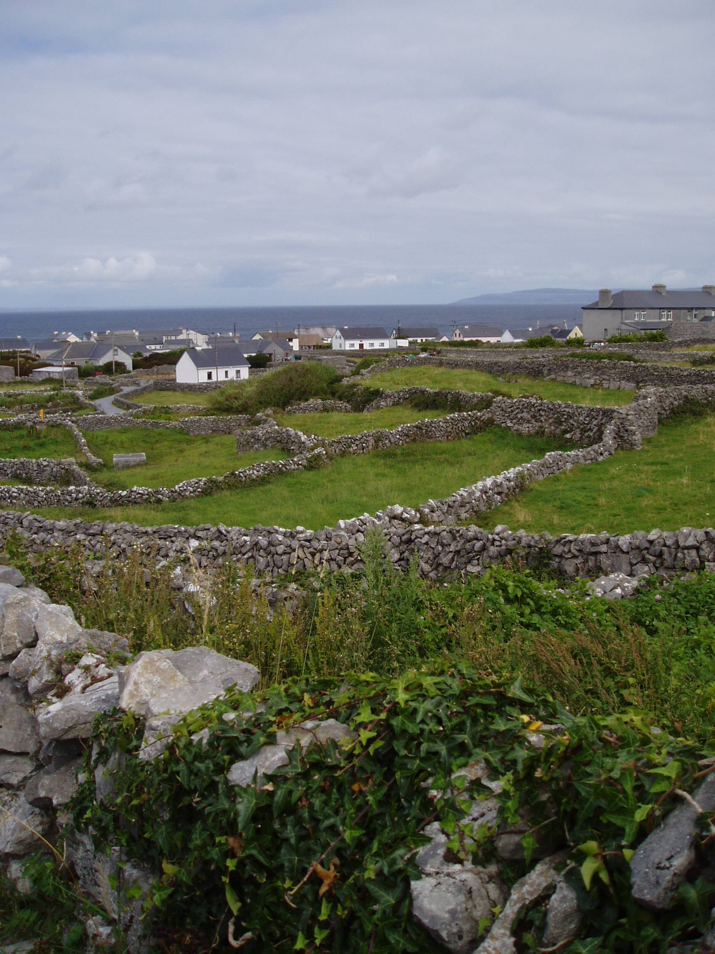

Slide 47
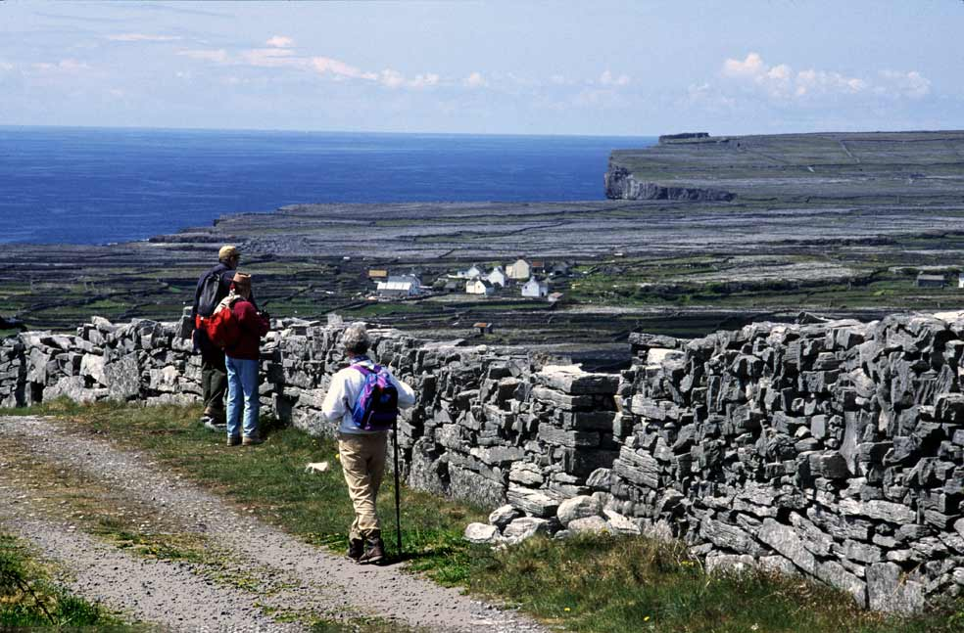
http://www.irishways.com/Aran-Islands-1.jpg

Slide 48
the community
as a
Unit of Analysis:
e.g., Inish Oirr
(“Inish Beag”)

Slide 50
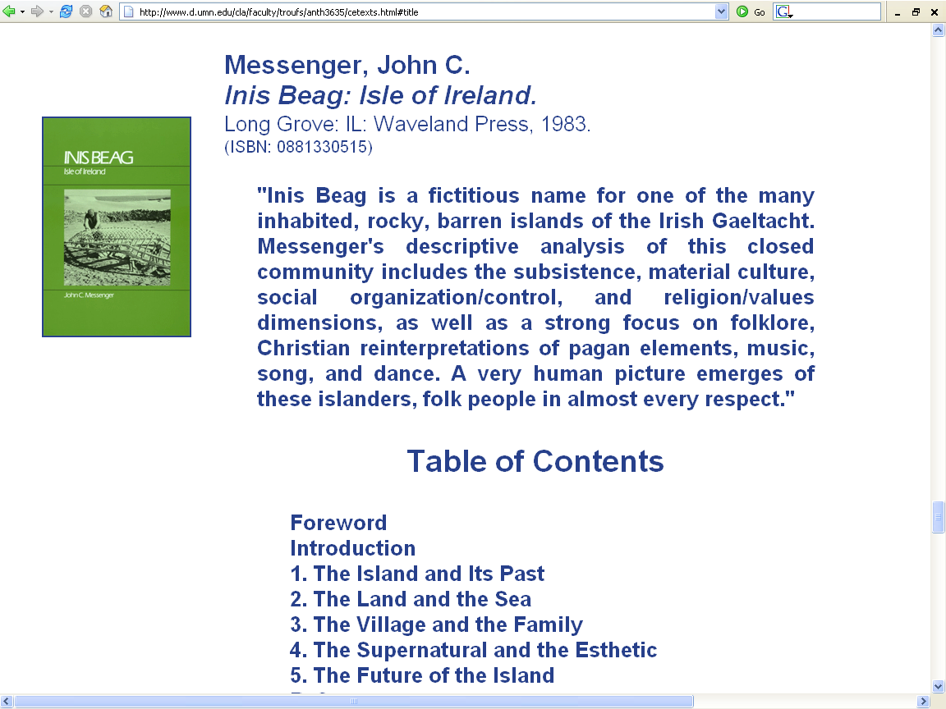

Slide 51
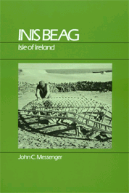
Inis Beag
Gaelic: "Little Island"
John C. Messenger
Inis Beag: Isle of Ireland.
Long Grove: IL: Waveland Press, 1983.
http://www.d.umn.edu/cla/faculty/troufs/anth3635/cetexts.html#InisBeag

Slide 52
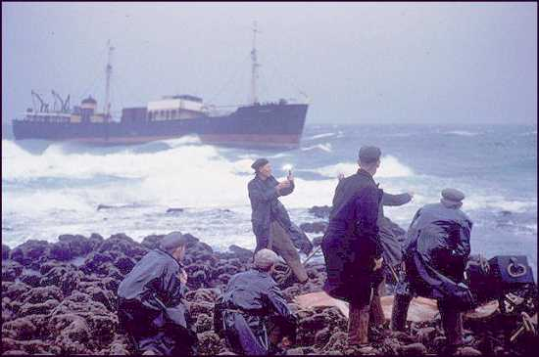
The shipwreck Plassey
Messenger 1983 (SAE)

Slide 53
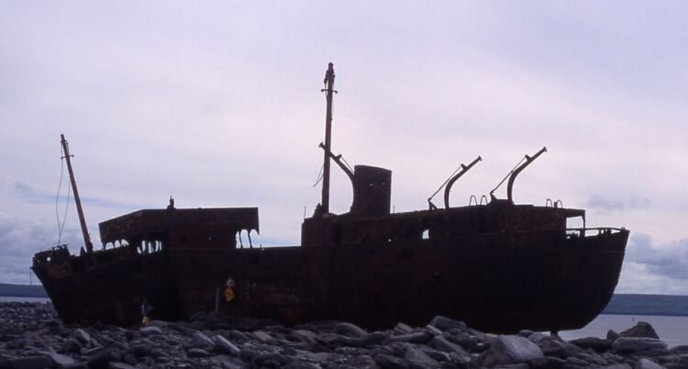
The shipwreck Plassey
http://irishislands.info/oilphoto/Aran/InisOirr/101currach8_jpg.html

Slide 54
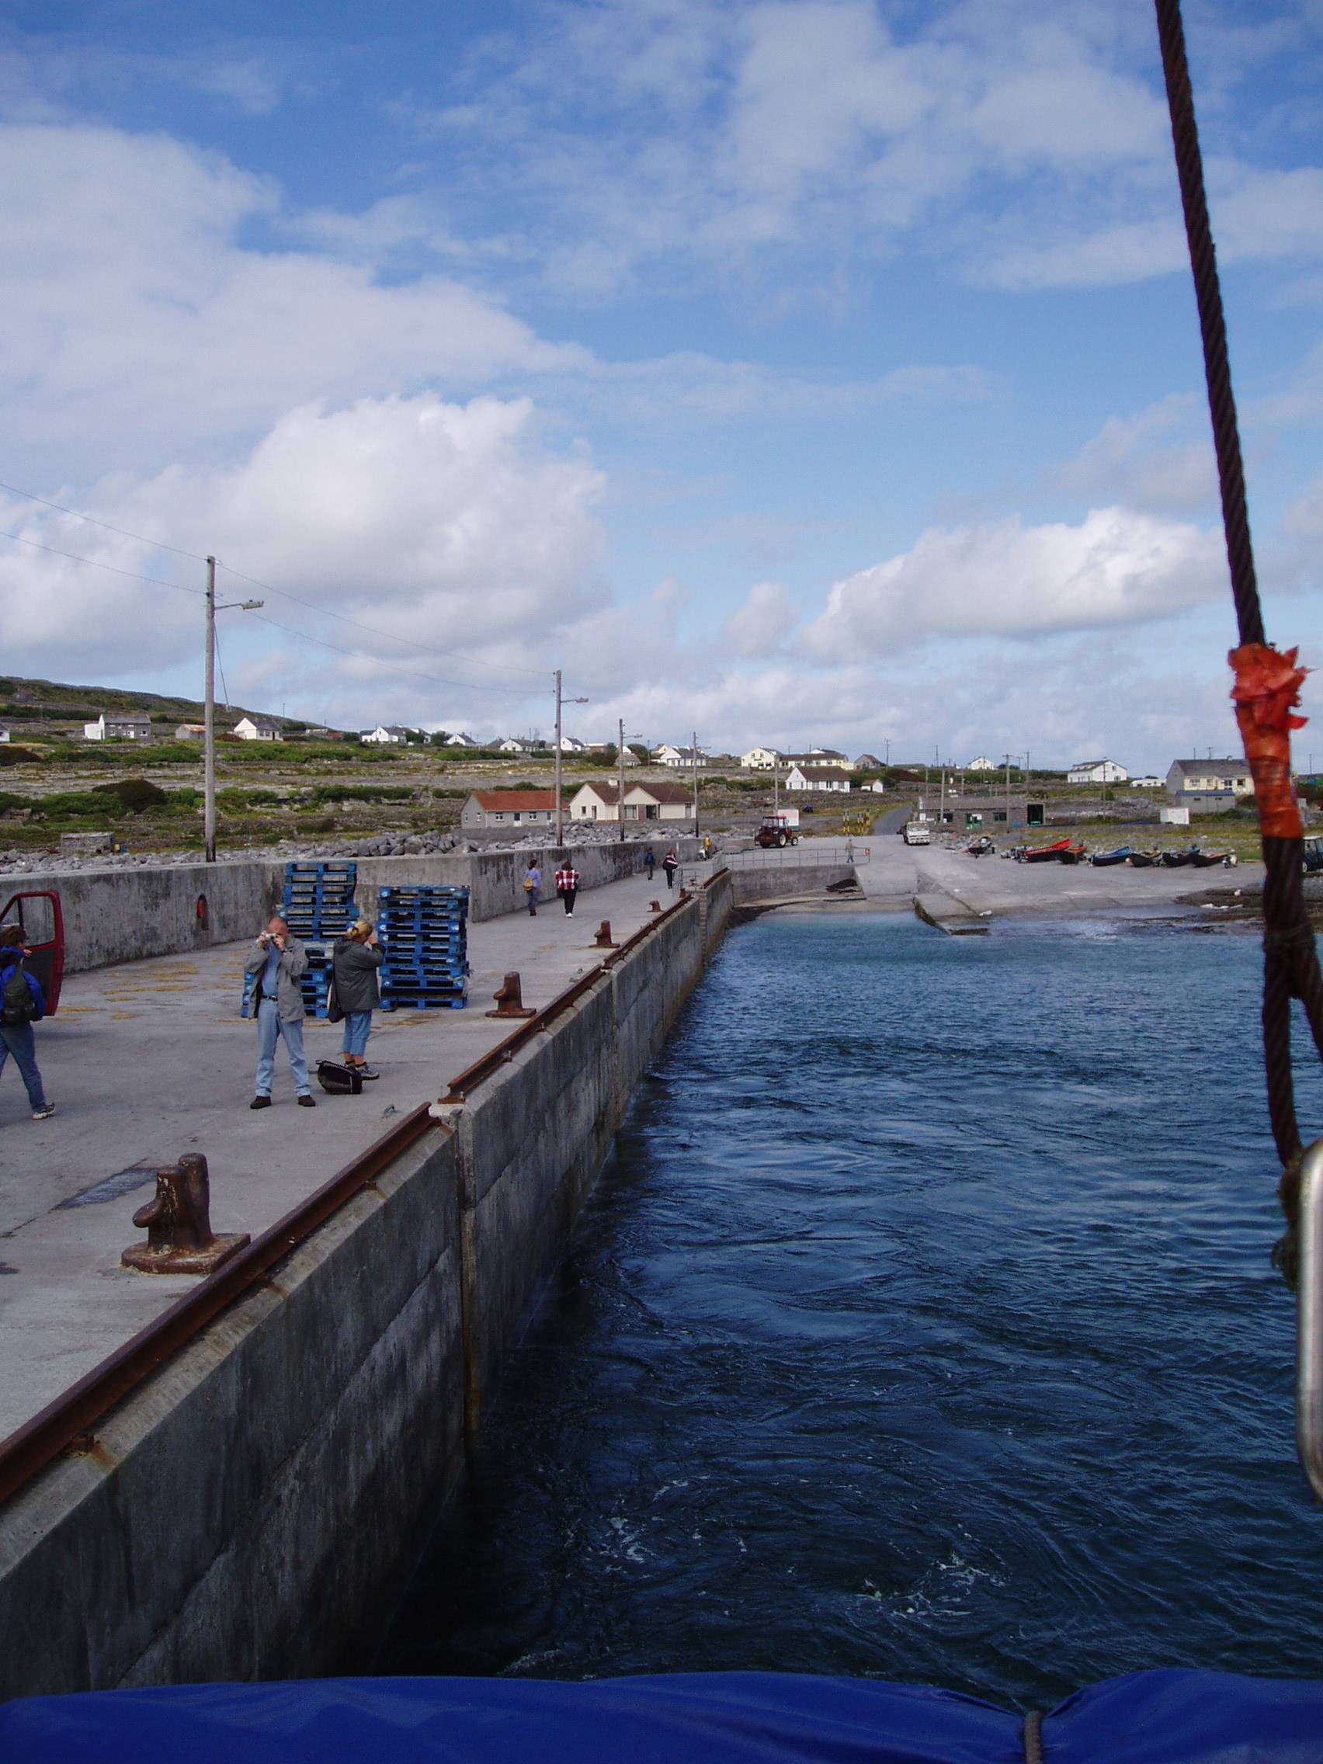

Slide 55
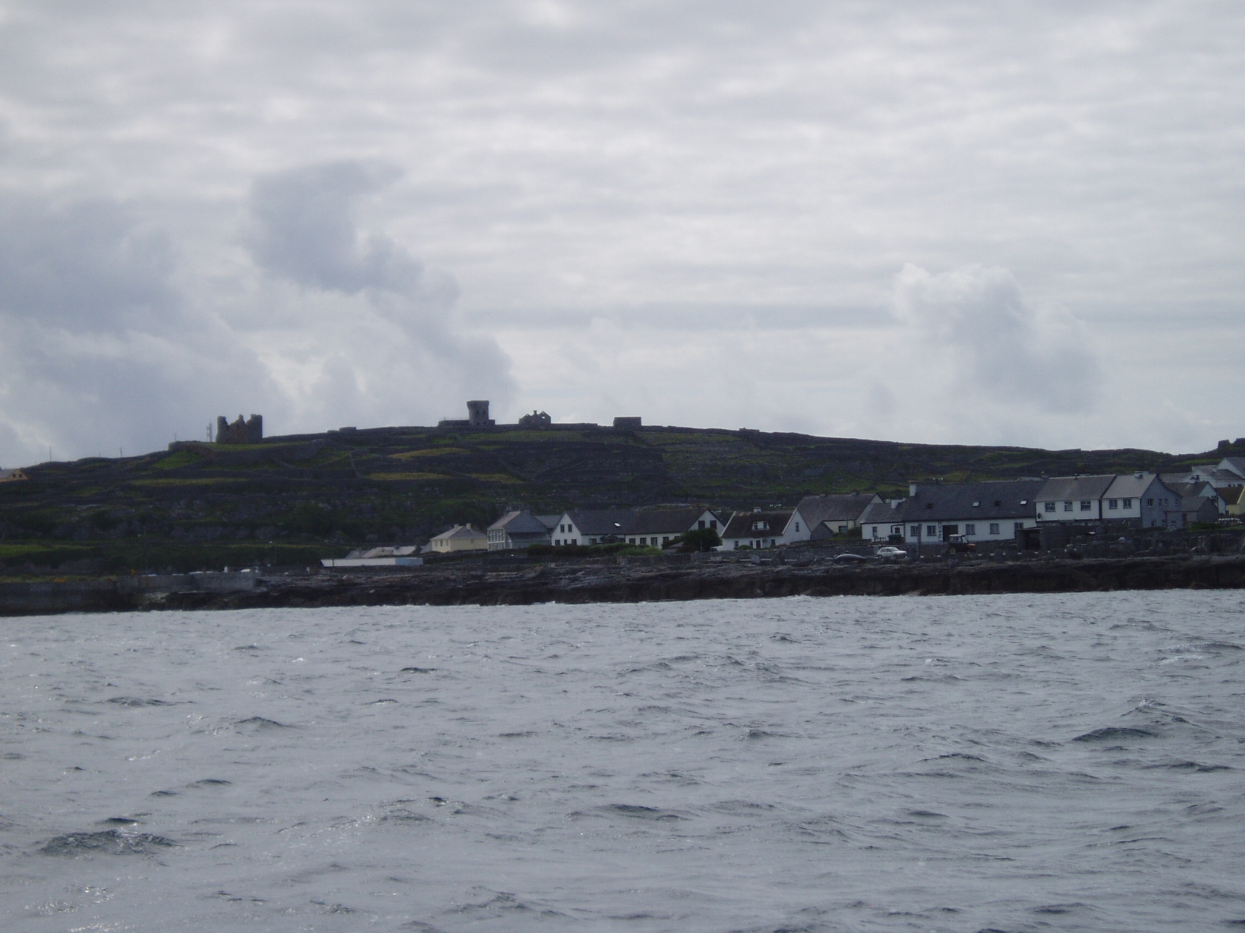

Slide 56
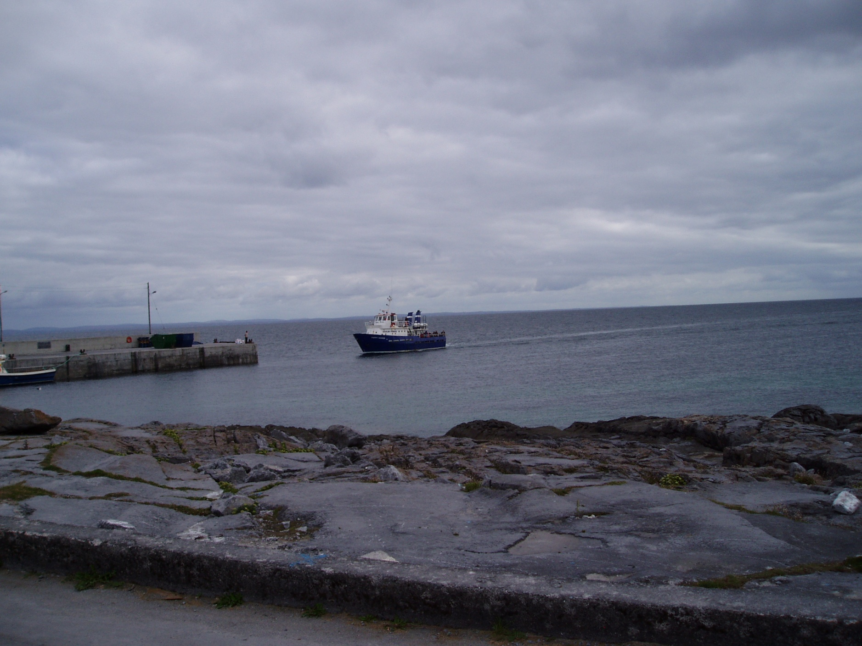

Slide 57
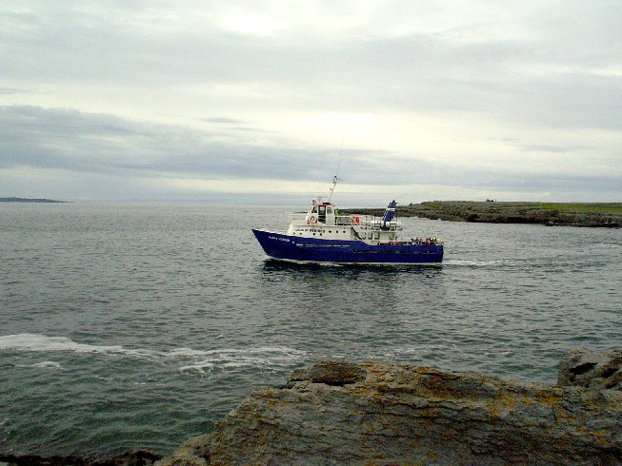
Take the Happy Hooker

Slide 58
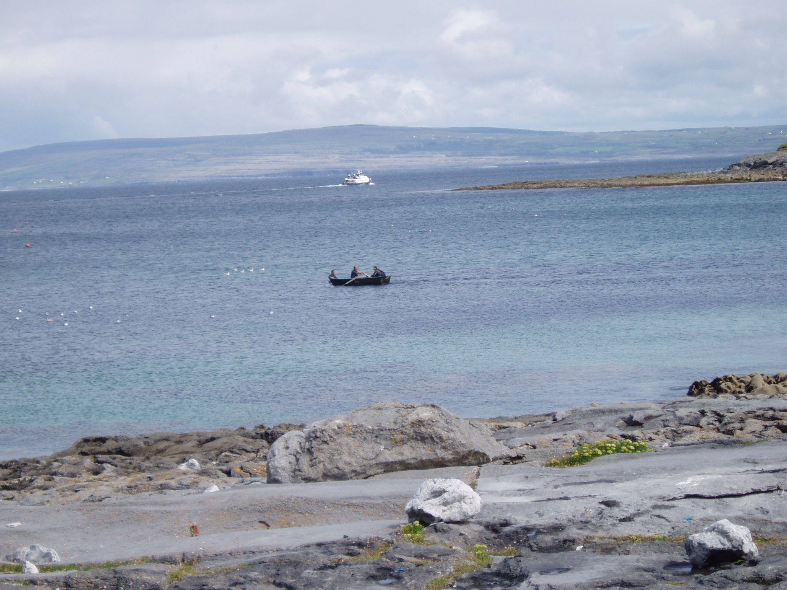

Slide 59
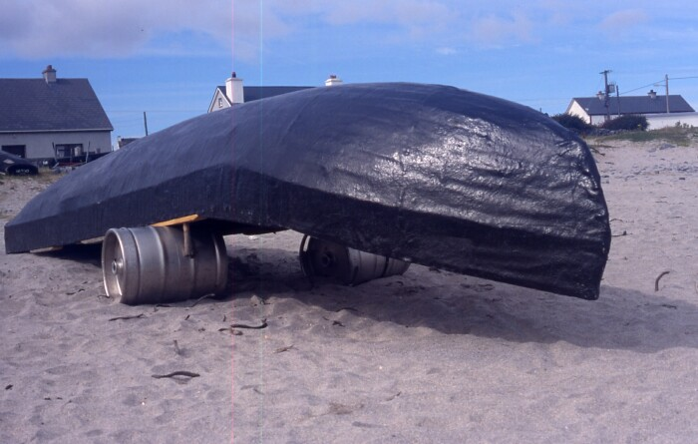
curagh
http://irishislands.info/oilphoto/Aran/InisOirr/101currach8_jpg.html

Slide 60
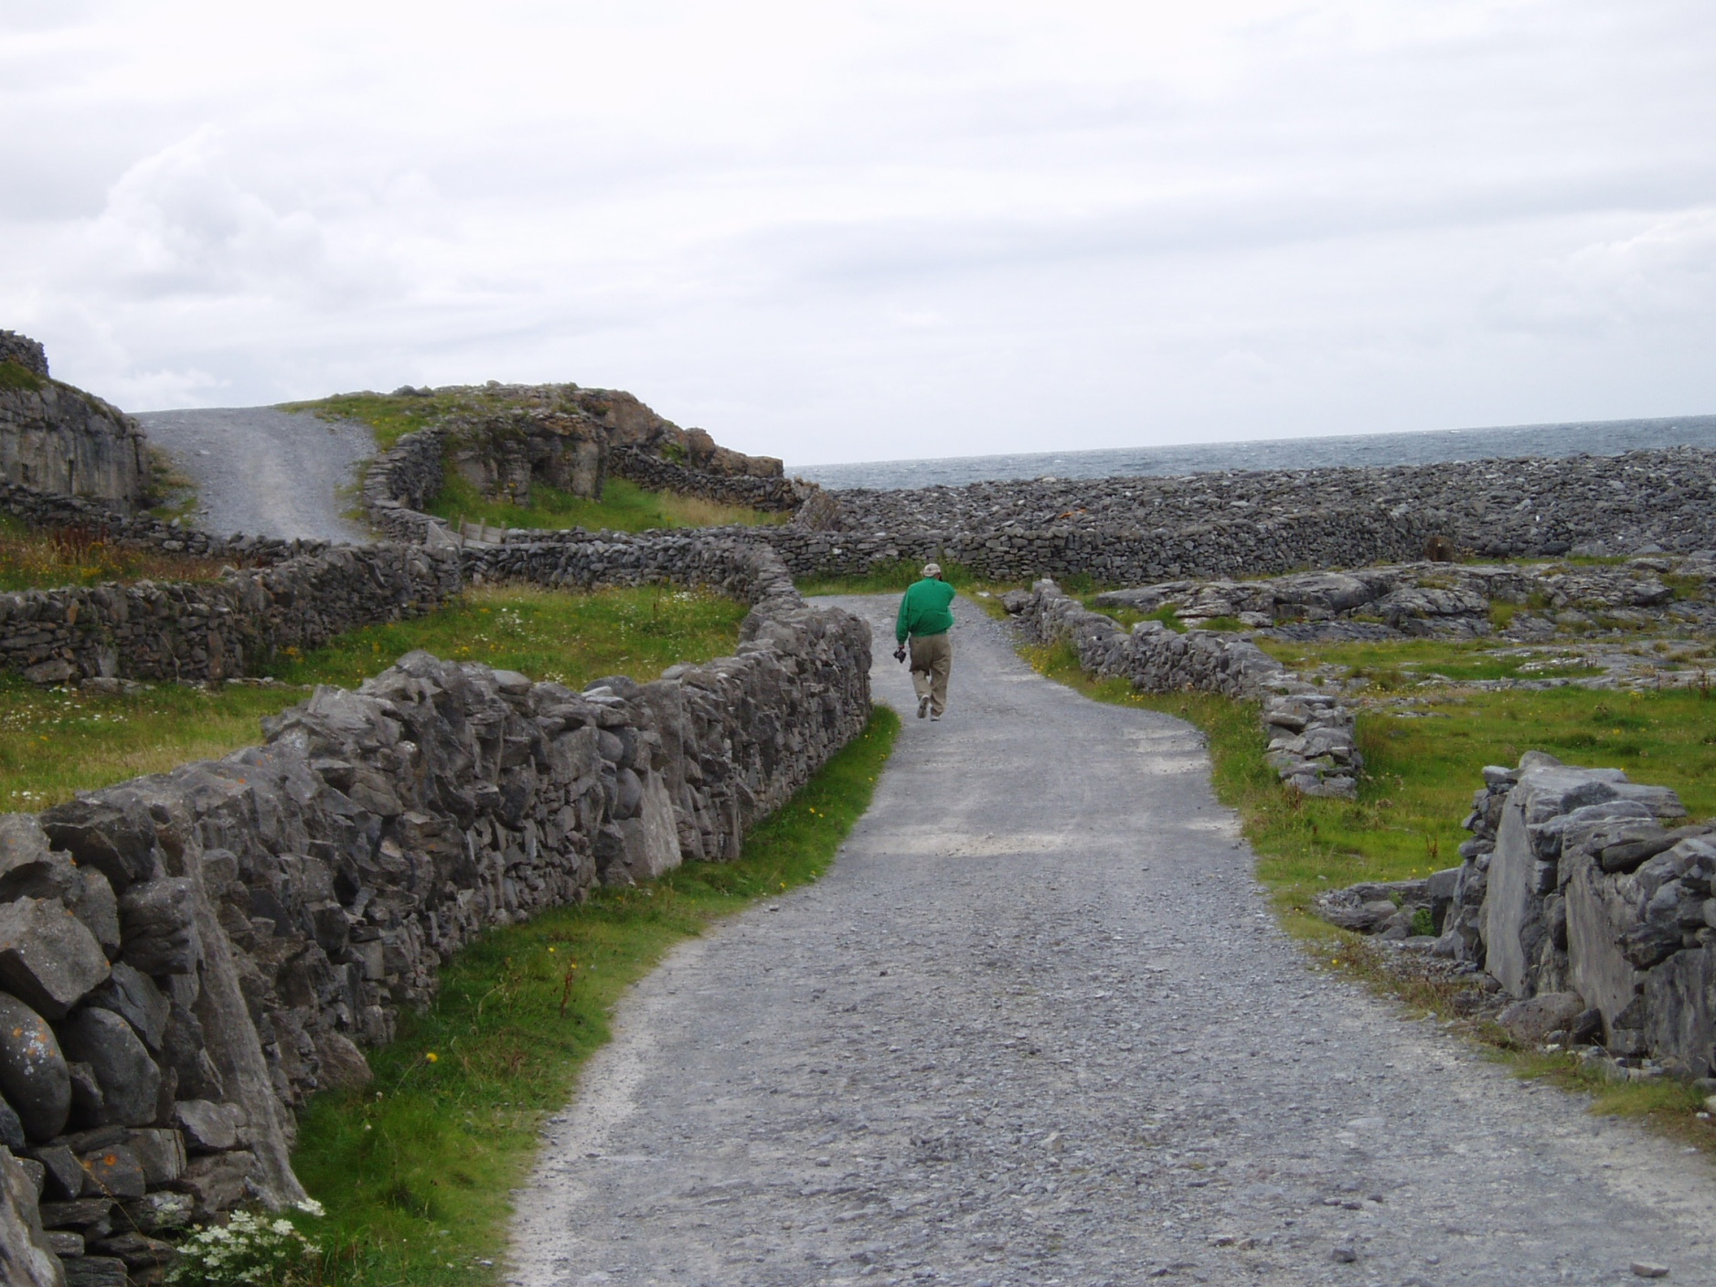

Slide 61
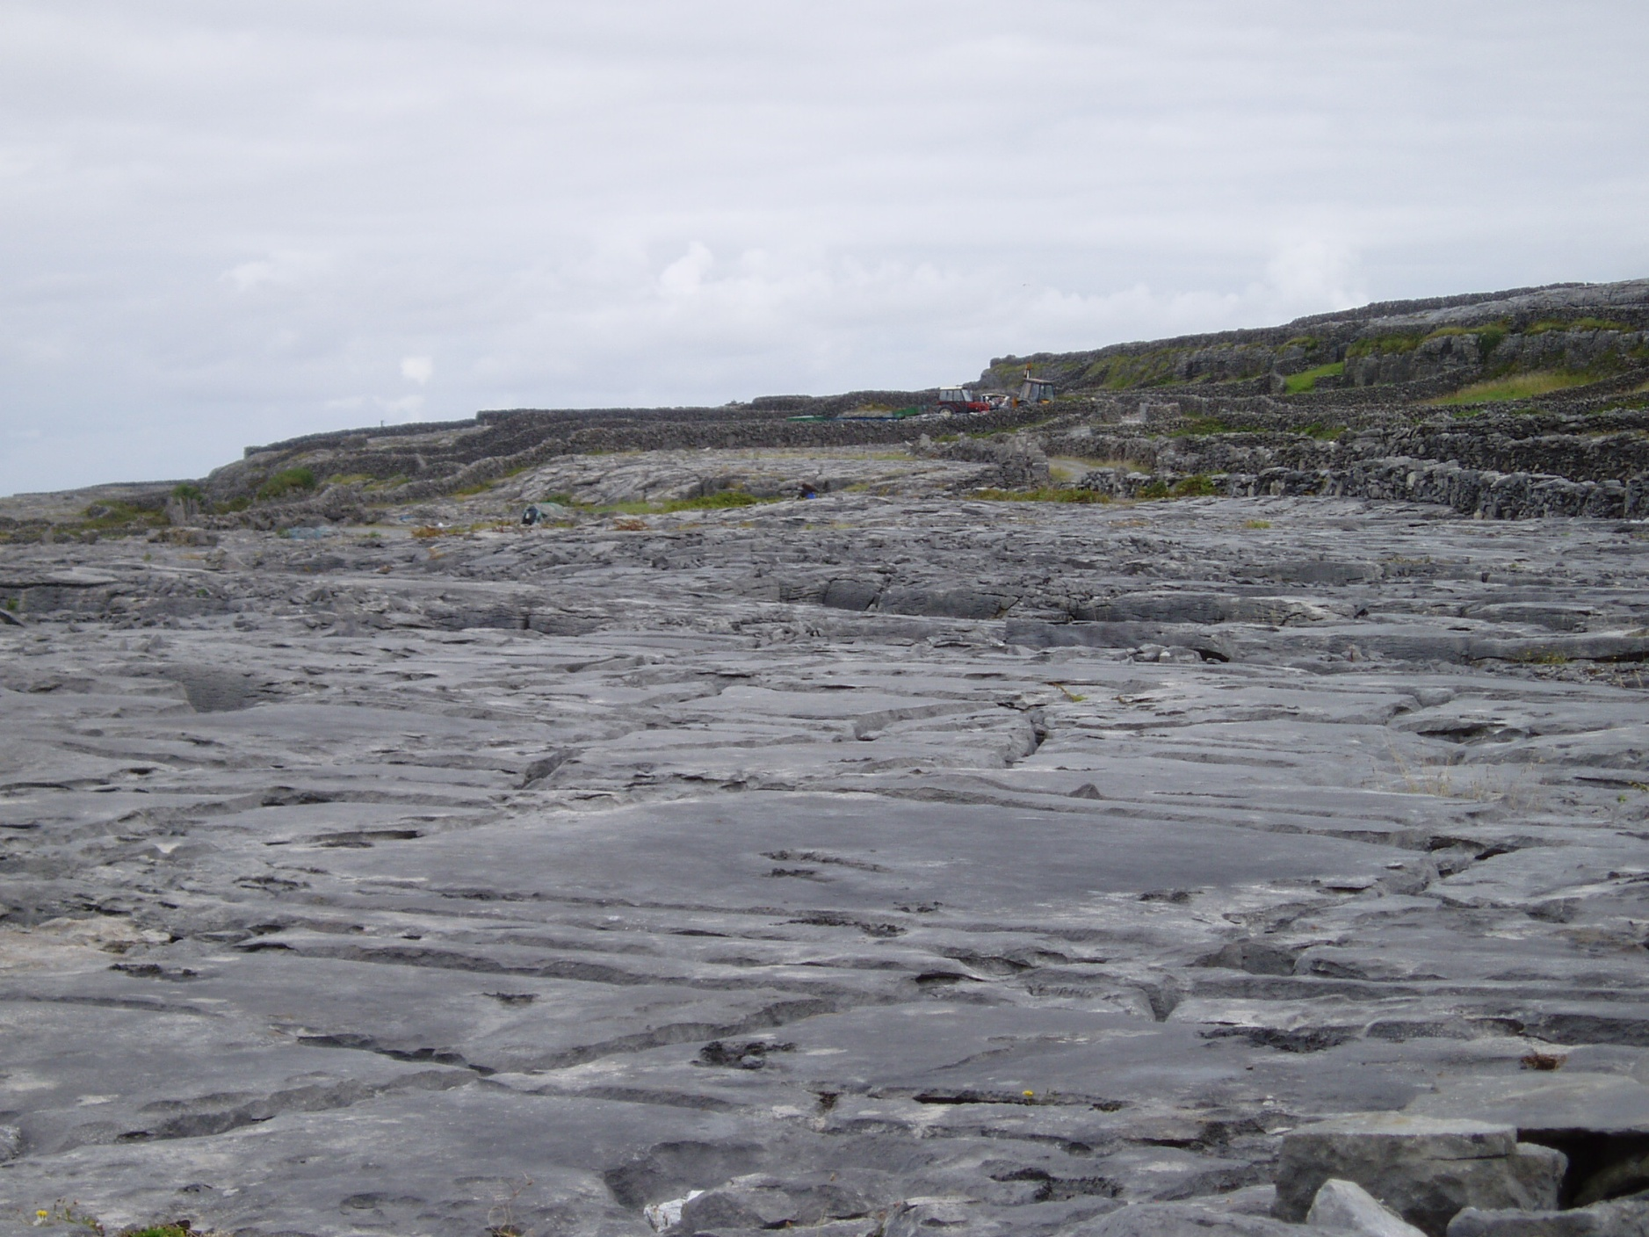

Slide 62
The shipwreck Plassey
http://irishislands.info/oilphoto/Aran/InisOirr/101currach8_jpg.html

Slide 63
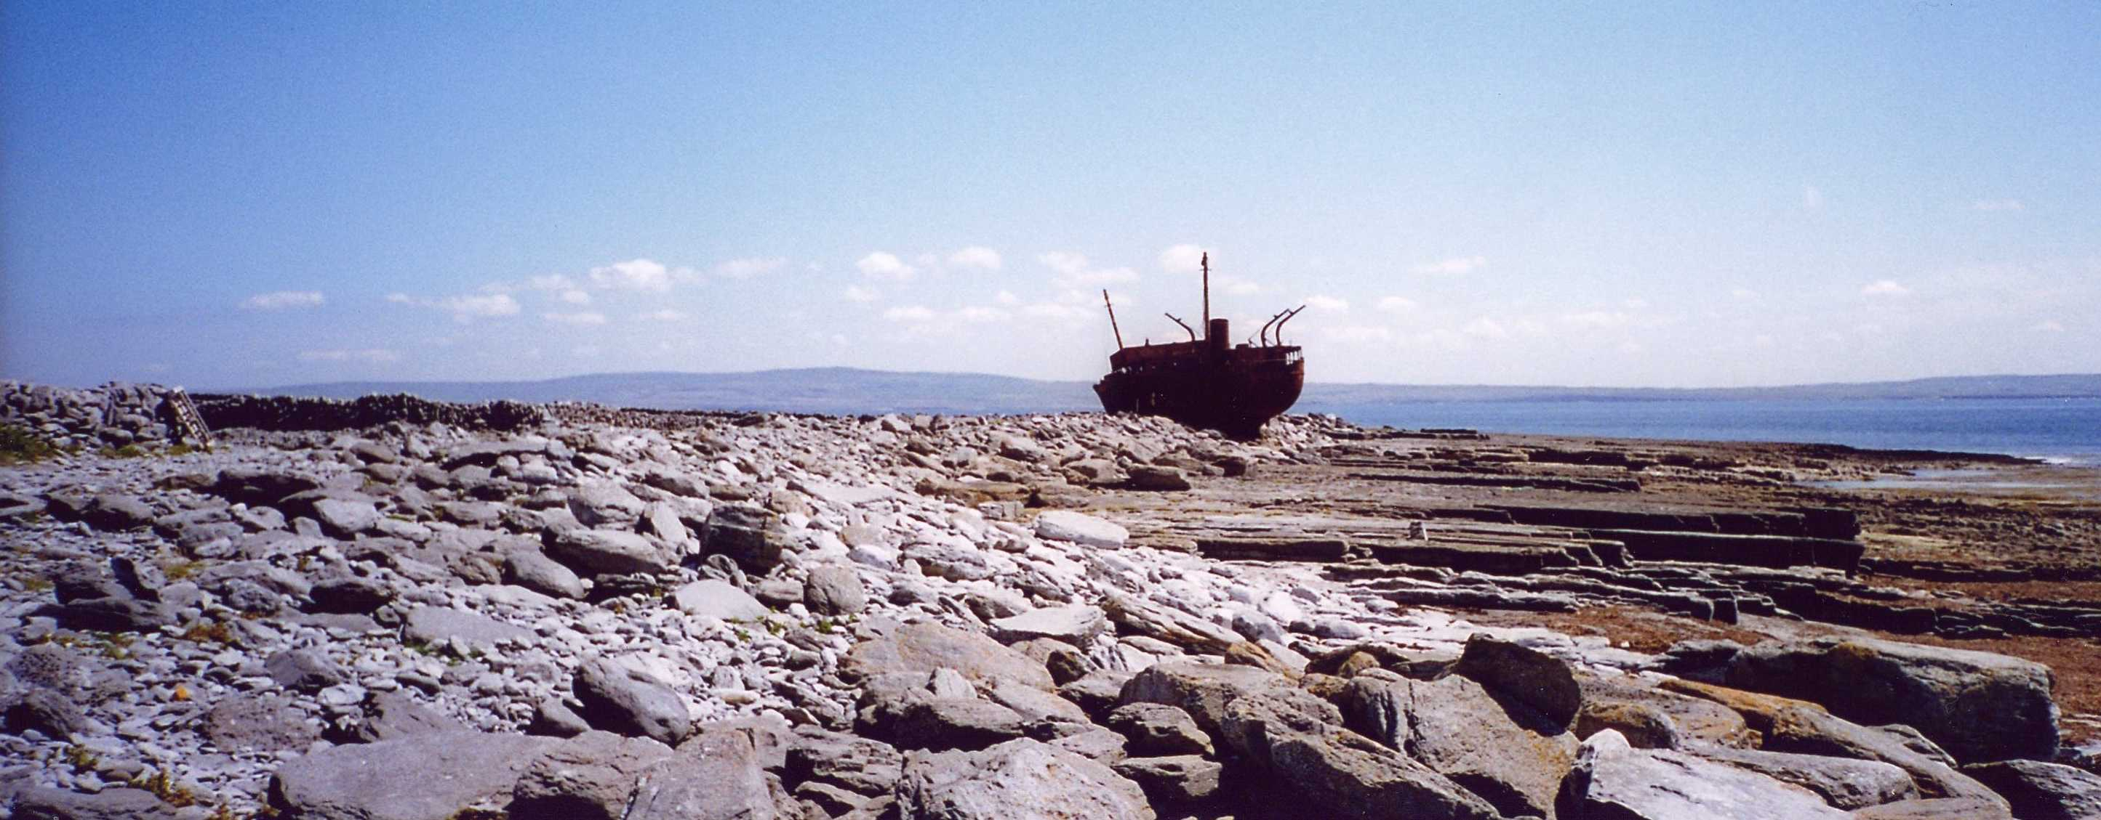
The shipwreck Plassey
http://www.seb75.com/CoGalway31.htm

Slide 64
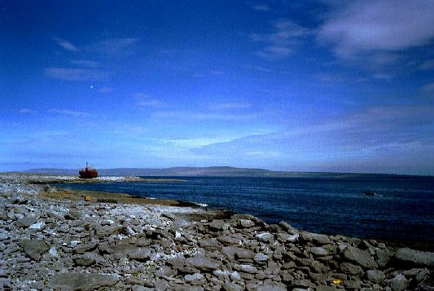
More on “The Burren” in a short while
The Burren, off in the backgroun
http://www.bodhran-info.de/Inis/image12.html

Slide 65
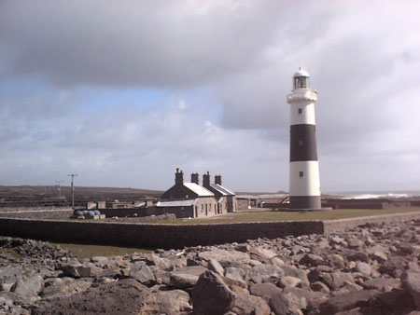
http://www.aontasogra.org/aranislands.html

Slide 66
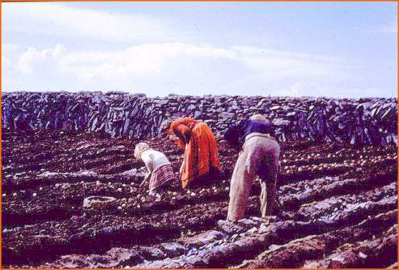
Messenger 1983 (SAE)

Slide 67
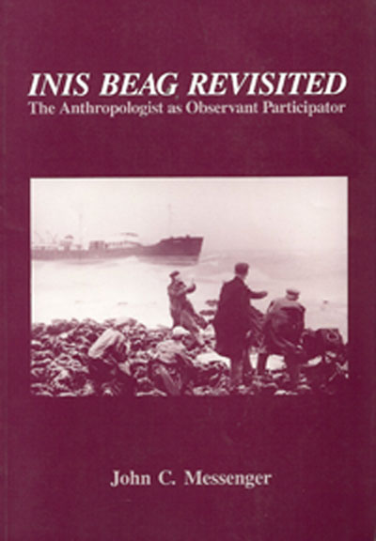
INIS Beag Revisited:
The Anthropologist as Observant Participator
Salem, WI: Sheffield. (Reprint edition August 1989).
The 1983 version was entitled An Anthropologist At Play:
Ballad-mongering in Ireland and its Consequences for Research

Slide 68
“Classics" in the Anthropology of Europe
John C. Messenger
1971 Sex and Repression in an Irish Folk Community. In Human Sexual Behavior: Variations in the Ethnographic Spectrum, by Donald S. Marshall and Robert C. Suggs. Englewood Cliffs, New Jersey: Prentice- Hall.
1978 The Golden Chain: A Study of the Structure, Function, and Patterning of Comparatico in a South Italian village. American Ethnologist 5:116- 136.
Parman's classic picks -- Tony Galt

Slide 69
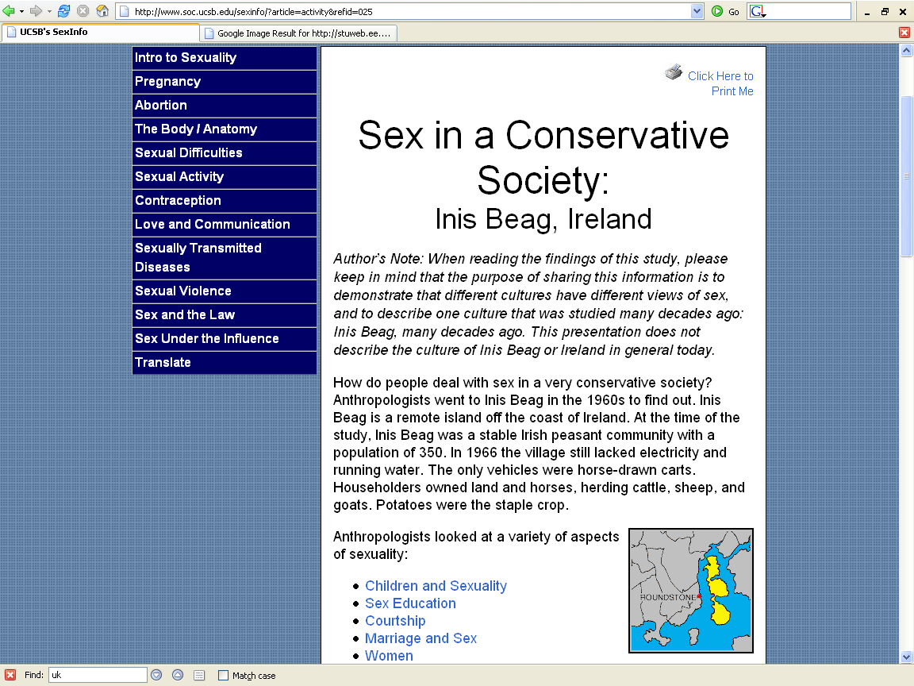
http://www.soc.ucsb.edu/sexinfo/?article=activity&refid=025

Slide 70
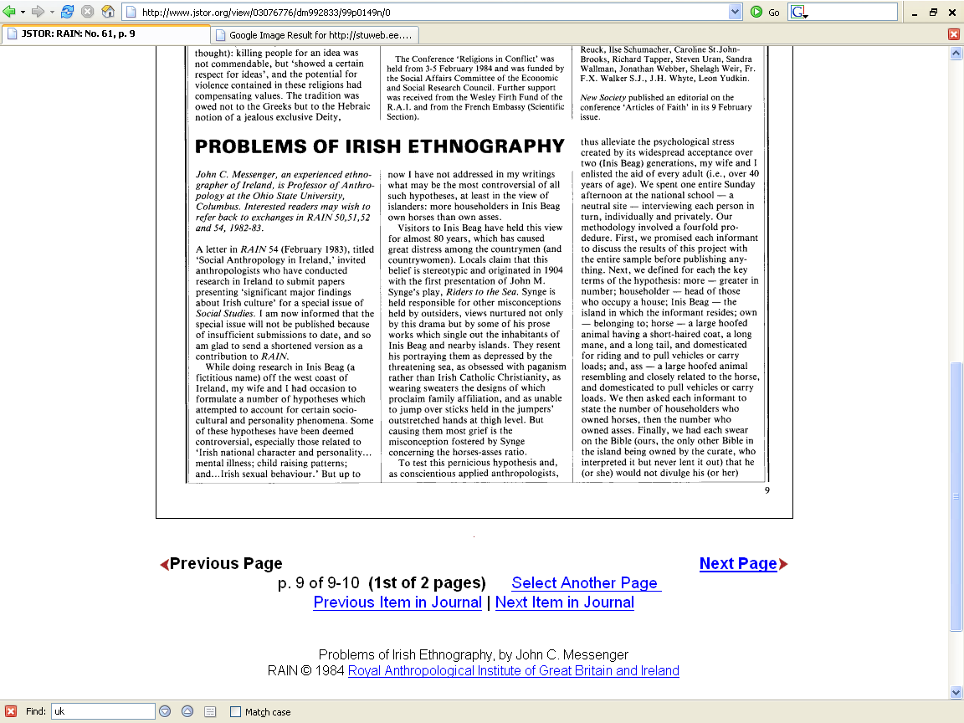

Slide 71
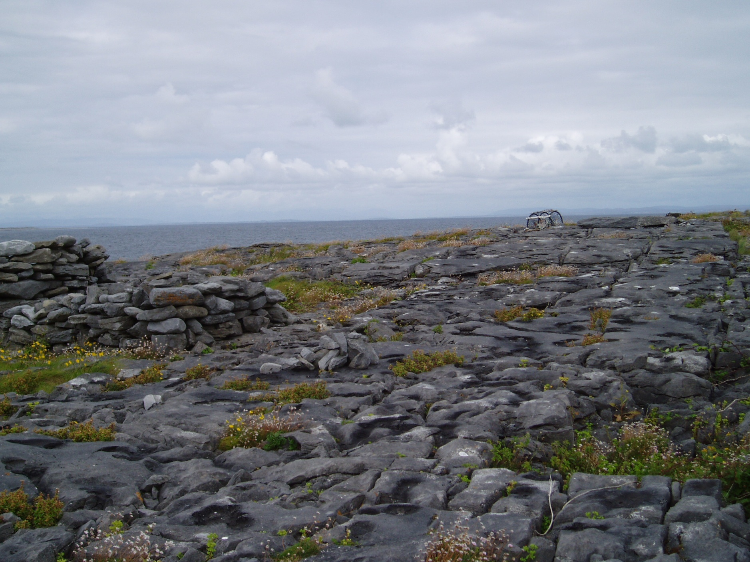

Slide 72
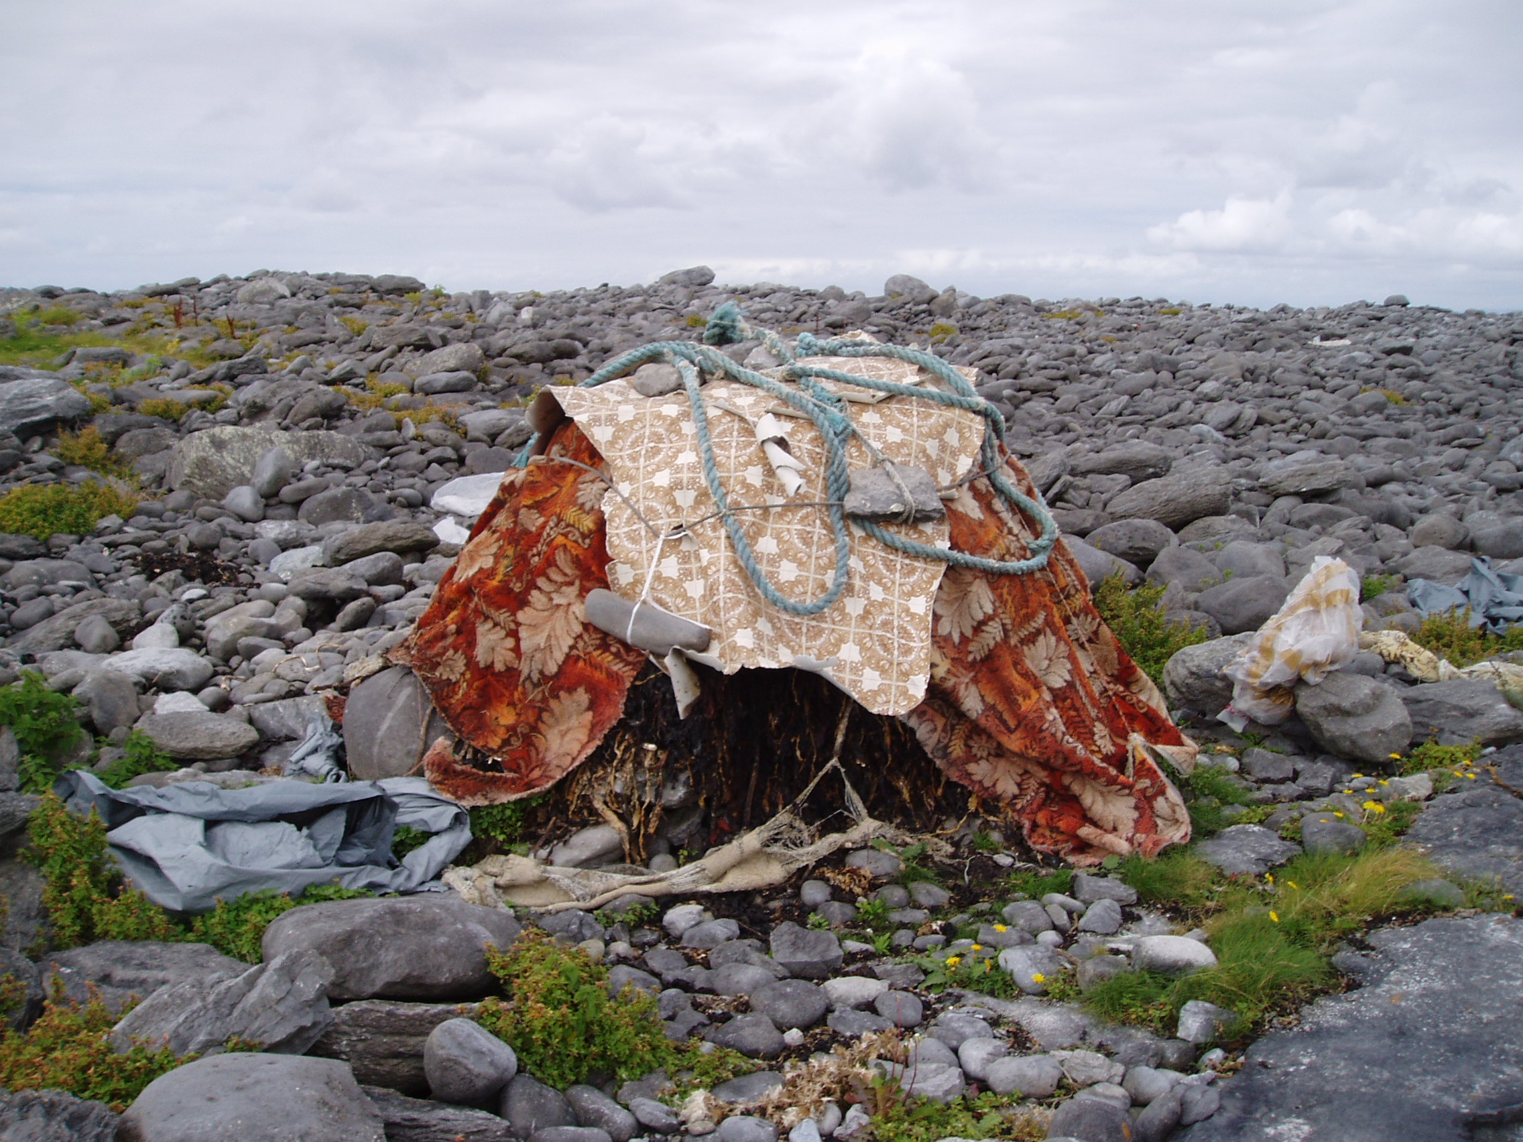

Slide 73
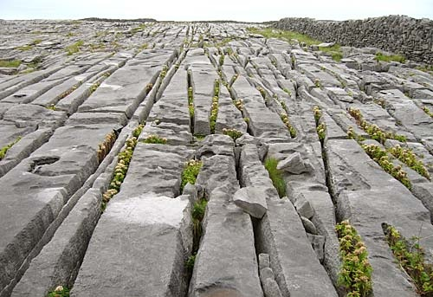
http://www.fethard.com/news_archive/cnews.050926.html

Slide 74
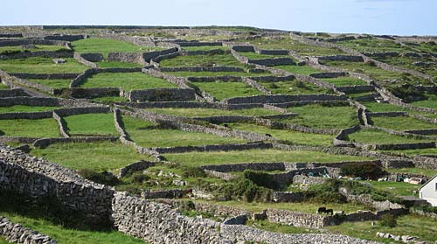
http://www.fethard.com/news_archive/cnews.050926.html

Slide 75
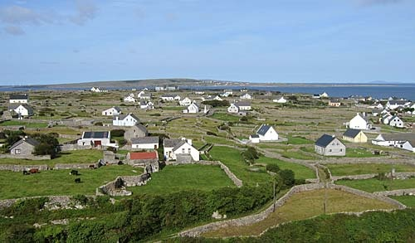
http://www.fethard.com/news_archive/cnews.050926.html

Slide 76

The sunken church, a bronze age site, St. Gobnait's church
http://www.fethard.com/news_archive/cnews.050926.html

Slide 77

http://irishislands.info/oilphoto/Aran/InisOirr/101currach8_jpg.html

Slide 78

http://irishislands.info/oilphoto/Aran/InisOirr/105teampallc2_jpg.html

Slide 79


http://www.savilerowclub.com/annai/knit.htm

Slide 80

Mairead's cottage where the workshop takes place on Inish Oirr
http://beknitted.blogspot.com/2004_08_01_beknitted_archive.html

Slide 81


Slide 82


Slide 83


Slide 84


Slide 85


Slide 86

http://www.aransinger.com/

Slide 87

Lasairfhíona (pronounced Lah-sah-reena) is a
singer/songwriter deeply
rooted in the sean-nós singing style of her home
on Inishere, Aran Islands,
and equally, her innovative approach to Irish
music and her new slant on
traditional singing makes her endeavors more
appealing. The result is a
magical mosaic of sound, as refreshing and as
unpredictable as a showery
day inside in Aran. A graduate in Celtic Studies
from Trinity College Dublin,
a broad range of contemporary music has
influenced her singing.
http://www.aransinger.com/abiography.html

Slide 88

Ended here, Tuesday, 26 March 2019
http://www.cliffs-of-moher-cruises.com/aran_island.html
http://www.aransinger.com/

Slide 89
Ended here, Tuesday, 26 March 2019
Rem: distracted driving presentation on Thursday
http://www.cliffs-of-moher-cruises.com/aran_island.html
http://www.aransinger.com/

Slide 90

Aran Island singer, Lasairfhíona
http://www.cliffs-of-moher-cruises.com/aran_island.html
http://www.aransinger.com/

Slide 91


Slide 92


Slide 93


Slide 94


Slide 95


Slide 96


Slide 97

O'Brien Castle area
http://www.seb75.com/CoGalway31.htm

Slide 98

O'Brien Castle
http://beknitted.blogspot.com/2004_08_01_beknitted_archive.html

Slide 99

Weaving baskets at Aras Eanna, the arts and cultural centre

Slide 100

Weaving baskets at Aras Eanna, the arts and cultural centre

Slide 103
Galway

Slide 104
Galway Bay
If you ever go across the sea to Ireland
Be it only at the closing of your day
You can sit and watch the moon rise over Cladagh
And see the sun go down on Galway Bay
Just to see again the ripple on the trout stream
The women in the meadow making hay
Or to sit beside a turf fire in a cabin
And watch the barefoot gasuns at their play
For the breezes blowing o'er the sea from Ireland
Are perfumed by the heather as they blow
And the women in the highlands diggin' pratties
Speak a language that the strangers do not know
(BREAK)
And the strangers came and tried to teach us their ways
And scorned us for being what we are
But they might as well go chasing after moonbeams
Or light a penny candle on a star
And if there's going to be a life hereafter
And somehow I feel sure there's going to be
I will ask my god to let me spend my heaven
In that dear isle across the Irish Sea

Slide 105
Clifton, County Galway
Clochán, "the stepping stones"

Slide 106

The Aran Islands are off over here in the distance,
looking almost due South
Clifton, County Galway, looking toward the Aran islands

Slide 107
Kylemore Castle and Abbey
County Galway

Slide 108

Kylemore Castle and Abbey
http://www.hoganstand.com/general/identity/extras/clergy/stories/kylemore.htm

Slide 109
County Clare

Slide 110

http://national.mobhaile.ie/lookwest/CountyClare/tabid/138/Default.aspx

Slide 111

Conrad Arensberg
1937 The Irish Countryman.
  New York: Macmillan.
  ”the earliest example of anglophone Europeanist anthropology”

Slide 112
the classic ethnography of Ireland is
  Conrad Arensburg’s The Irish Countryman
  set in County Clare
  backed up in image by the film Man of Aran
Susan Parman, Europe in the Anthropological Imagination, pp. 11 - 14

Slide 113


Slide 115
The Burren

Slide 116
From Inishoirr you can see
The wrecked ship
Plassey
The Burren in the far distance,
looking southeast
The Burren, off in the background
http://www.bodhran-info.de/Inis/image12.html

Slide 117
The Cliffs of Mohar

Slide 118

www.danheller.com/ireland.html

Slide 119

www.wtopnews.com/?nid=456&sid=1358866#

Slide 120

The Cliffs of Mohar are in The Burren, near the castle
http://www.jetsettersmagazine.com/archive/jetezine/hotels/ireland/gregans/castle.html

Slide 121

http://folk.uio.no/davidwi/gallery/IRE/ireland2.html

Slide 122
a “subculture”
as a
Unit of Analysis:
e.g., “Travelers”
(“Tinkers”, “Gypsies”)

Slide 125

http://www.waterville-insight.com/kerrymap.html

Slide 127
“Classics" in the Anthropology of Europe
Sharon B. Gmelch
1986 Groups that Don't Want in: Gypsies and other Artisan, Trader, and Entertainer Minorities. Annual Review of Anthropology 15:307-330.
Parman's classic picks -- Tony Galt

Slide 128


The Irish Tinkers: The Urbanization of an Itinerant People
by George Gmelch
1985

Slide 129
the individual
as a
Unit of Analysis:
e.g., Nan

Slide 130


Slide 131

Sharon Gmelch
Nan: The Life of an Irish Traveling Woman, Revised Edition.
Long Grove: IL: Waveland Press, 1991.
(ISBN: 0881336025)
http://www.d.umn.edu/cla/faculty/troufs/anth3635/cetexts.html#Nan

Slide 132
Analysis, misc.

Slide 133
for many years the island model of peasant / community studies dominated Europeanist anthropology, and to some extent continues to do so
  whether or not the peasant community was on an island, the community itself was treated as a self-contained unit
  see Kertzer’s discussion of the anthropological yearning for “the simplicity of a manageable field setting . . . Where . . . The scale is human, and the cow dung wafts through the air”
Susan Parman, Europe in the Anthropological Imagination, pp. 11 - 14

Slide 134
for many years the island model of peasant / community studies dominated Europeanist anthropology, and to some extent continues to do so
  whether or not the peasant community was on an island, the community itself was treated as a self-contained unit
  see Kertzer’s discussion of the anthropological yearning for “the simplicity of a manageable field setting . . . Where . . . The scale is human, and the cow dung wafts through the air”
Susan Parman, Europe in the Anthropological Imagination, pp. 11 - 14

Slide 135
the research that came out of this school of thought emphasized
    self-sufficiency
    and isolation
rather than . . .
Susan Parman, Europe in the Anthropological Imagination, pp. 11 - 14

Slide 136
. . . rather than
    regional / national linkages
    migration
    tourism
    urbanization
Susan Parman, Europe in the Anthropological Imagination, pp. 11 - 14

Slide 137
peasant studies and community studies by and large perpetuated the island model of anthropological units of study with its concomitant notions of . . .
Susan Parman, Europe in the Anthropological Imagination, pp. 11 - 14

Slide 138
  tradition
  conservatism
  homogeneity
    in ideology if not in fact, as Brettell points out in Parman
  egalitarianism
  organic solidarity
  cultural essences
  as opposed to . . . the notion of culture as . . .
Susan Parman, Europe in the Anthropological Imagination, pp. 11 - 14

Slide 139
  tradition
  conservatism
  homogeneity
    in ideology if not in fact, as Brettell points out in Parman
  egalitarianism
  organic solidarity
  cultural essences
  as opposed to . . . the notion of culture as . . .
Émile Durkheim
Susan Parman, Europe in the Anthropological Imagination, pp. 11 - 14

Slide 140


