Slide 1
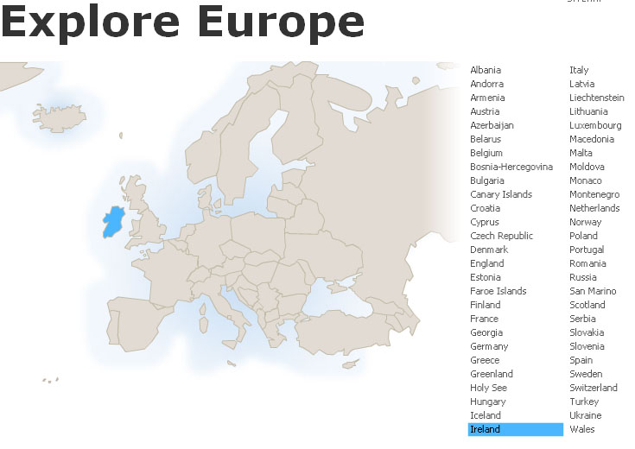
Ireland
Tim Roufs
© 2010-2024

Slide 2
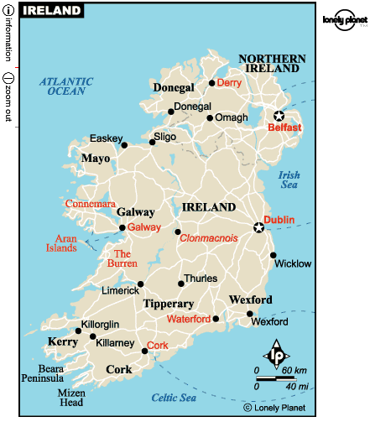

Slide 3
Northern Ireland
is part
of
“The
United Kingdom
. . .”

Slide 4
officially
called
“The
United Kingdom
of
Great Britain
and
Northern Ireland”
usually shortened to
the United Kingdom,
the UK,
or Britain

Slide 5
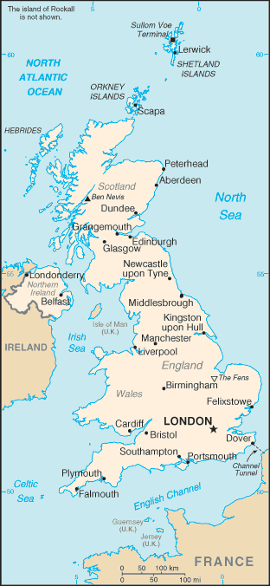
The
United Kingdom
(UK)
includes
England
Scotland
Wales
Northern Ireland
https://www.cia.gov/cia/publications/factbook/geos/uk.html

Slide 6
so
Northern Ireland
. . .
https://www.cia.gov/cia/publications/factbook/geos/uk.html

Slide 7
so
Northern Ireland
“belongs”
with
The
United Kingdom
(UK)
along with
England
Scotland
Wales
https://www.cia.gov/cia/publications/factbook/geos/uk.html

Slide 9
Dingle

Slide 10
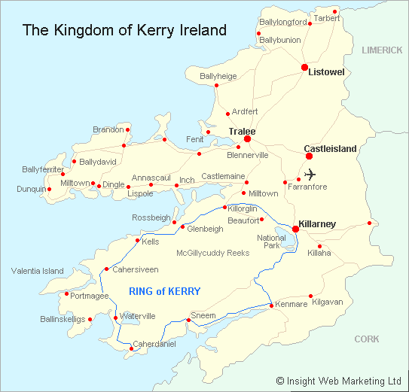
Dingle Peninsula
http://www.waterville-insight.com/kerrymap.html

Slide 11
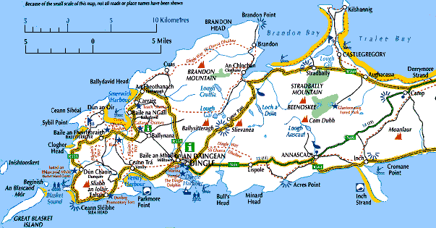
myweb.tiscali.co.uk/stkhc/Dingle%20maps.htm

Slide 12
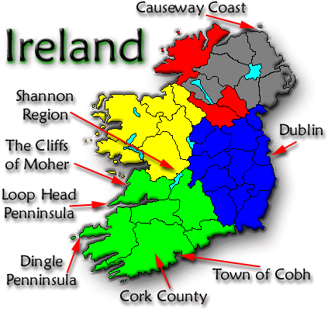
www.danheller.com/ireland.html

Slide 13
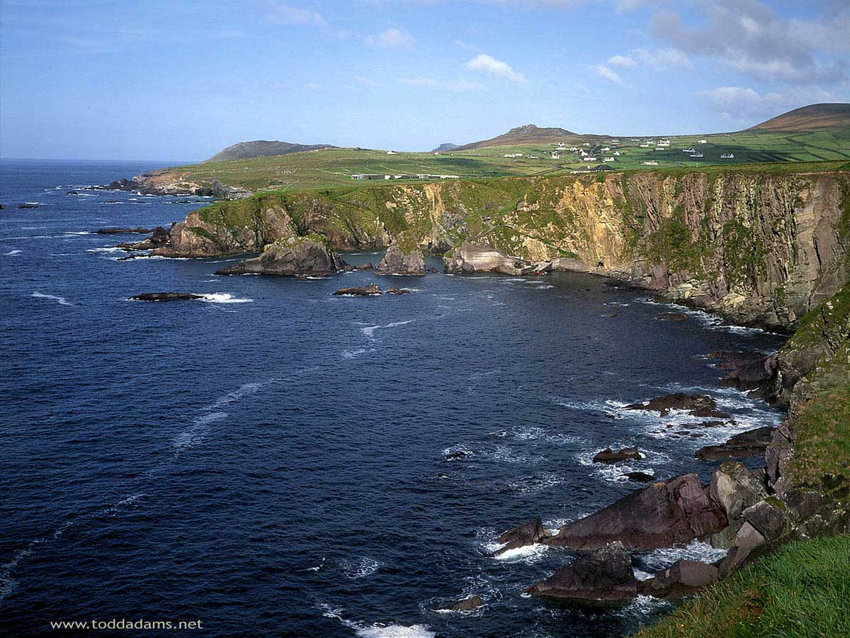
Rocky coastline of the Dingle Peninsula
http://toddadams.net/images/wallpaper/

Slide 14
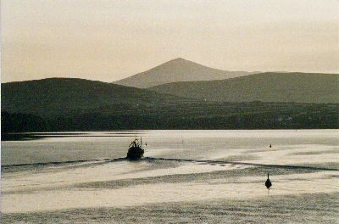
Sunset on Dingle Bay
www.sitatof.ch/ireland/k24.html

Slide 15
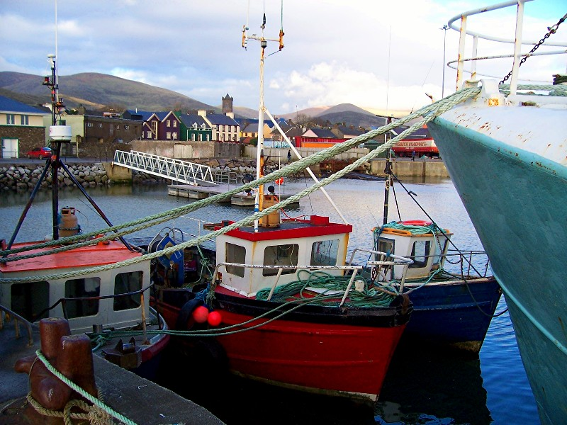
www.trekearth.com/.../Ireland/photo142208.htm

Slide 16
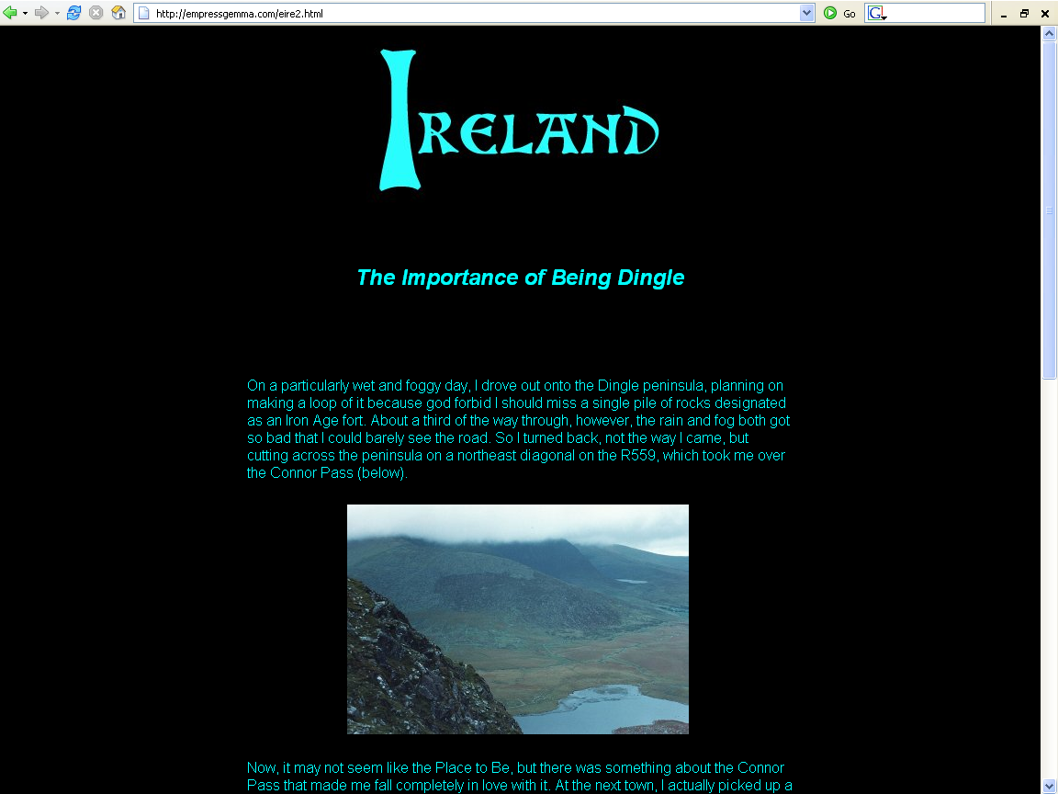
http://empressgemma.com/eire2.html

Slide 17
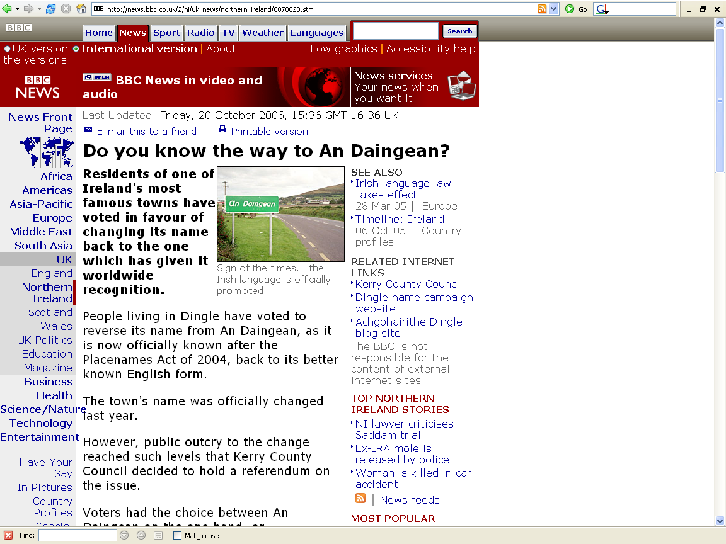
http://news.bbc.co.uk/2/hi/uk_news/northern_ireland/6070820.stm

Slide 18

http://www.dinglename.com/

Slide 19
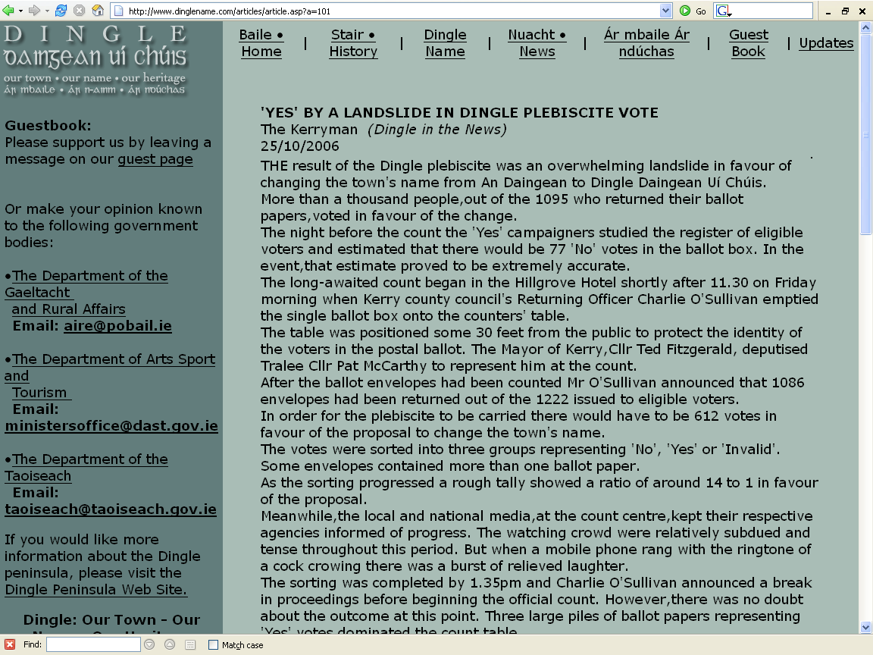
http://www.dinglename.com/articles/article.asp?a=101

Slide 20
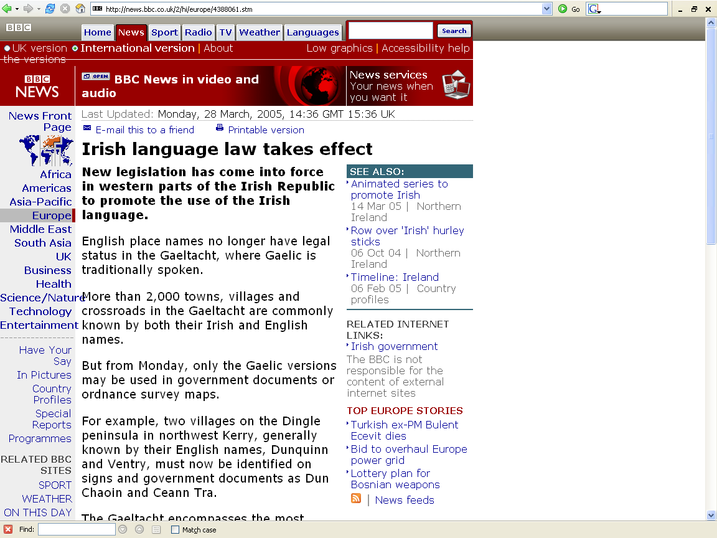
http://news.bbc.co.uk/2/hi/europe/4388061.stm

Slide 21
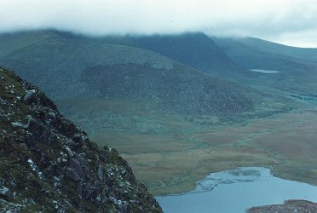
http://empressgemma.com/eire2.html

Slide 22
Ring of Kerry

Slide 23
http://www.waterville-insight.com/kerrymap.html

Slide 24
Bantry Bay

Slide 25
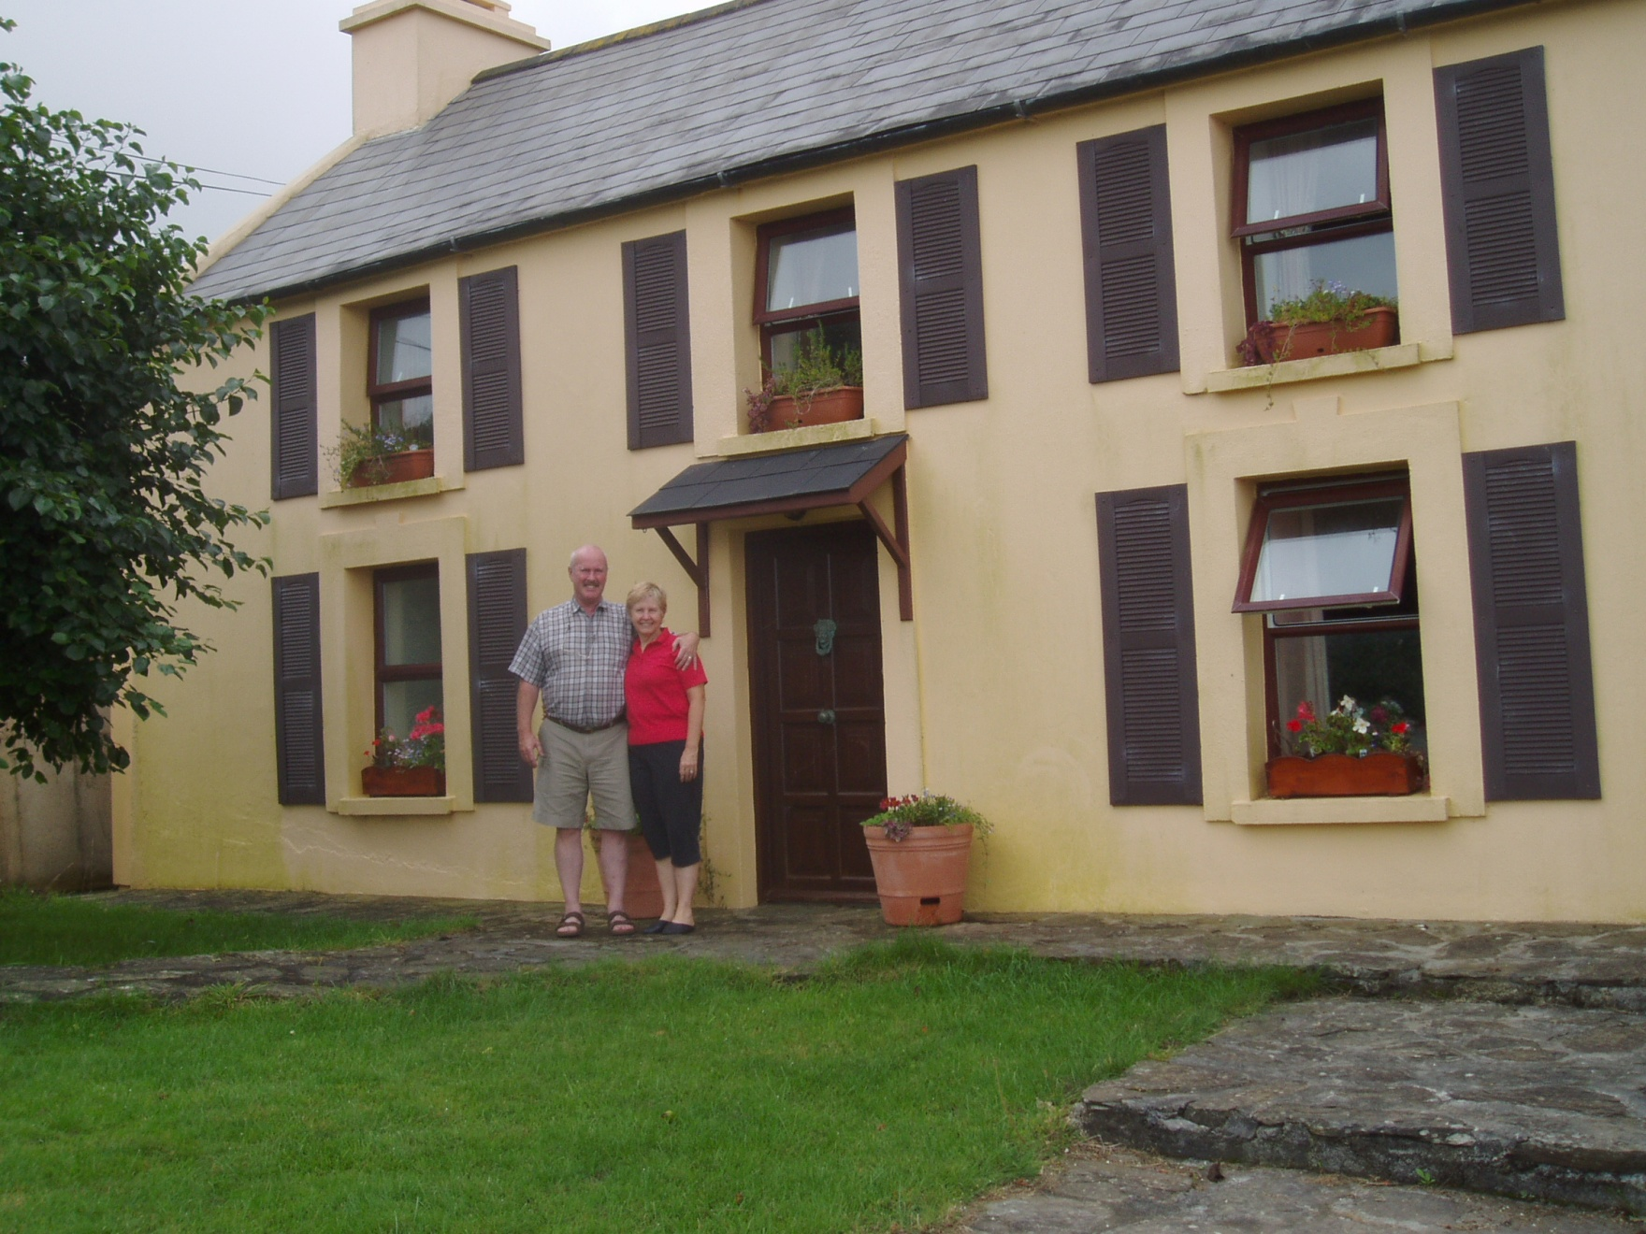

Slide 27
Cork

Slide 28
www.danheller.com/ireland.html

Slide 29
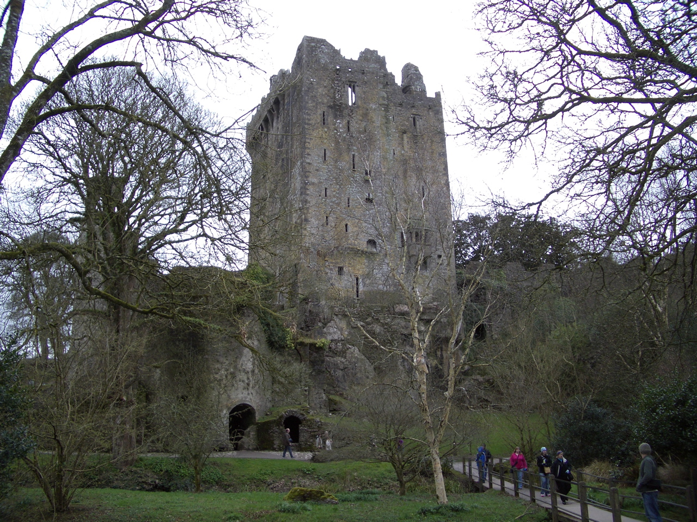
Blarney Castle
http://rockwellclan.com/euroSPR06/euroSPR06-Pages/Image21.html

Slide 30
Smyth hotel

Slide 31
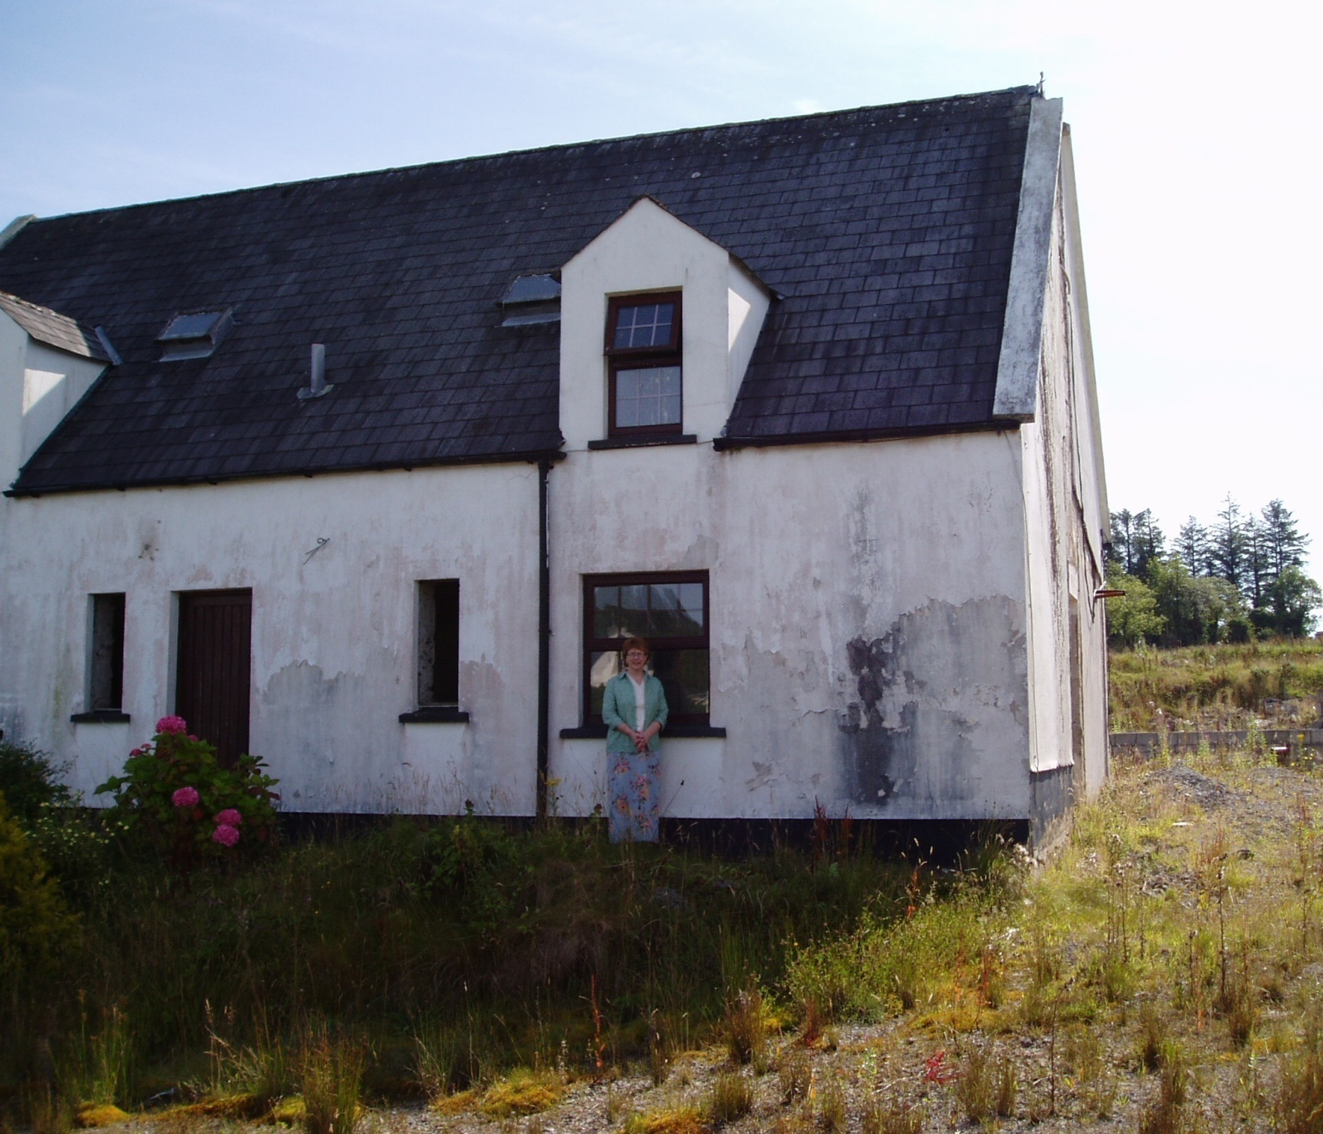
Kim Smyth Roufs at the remains of the Smyth Village Hotel

Slide 32
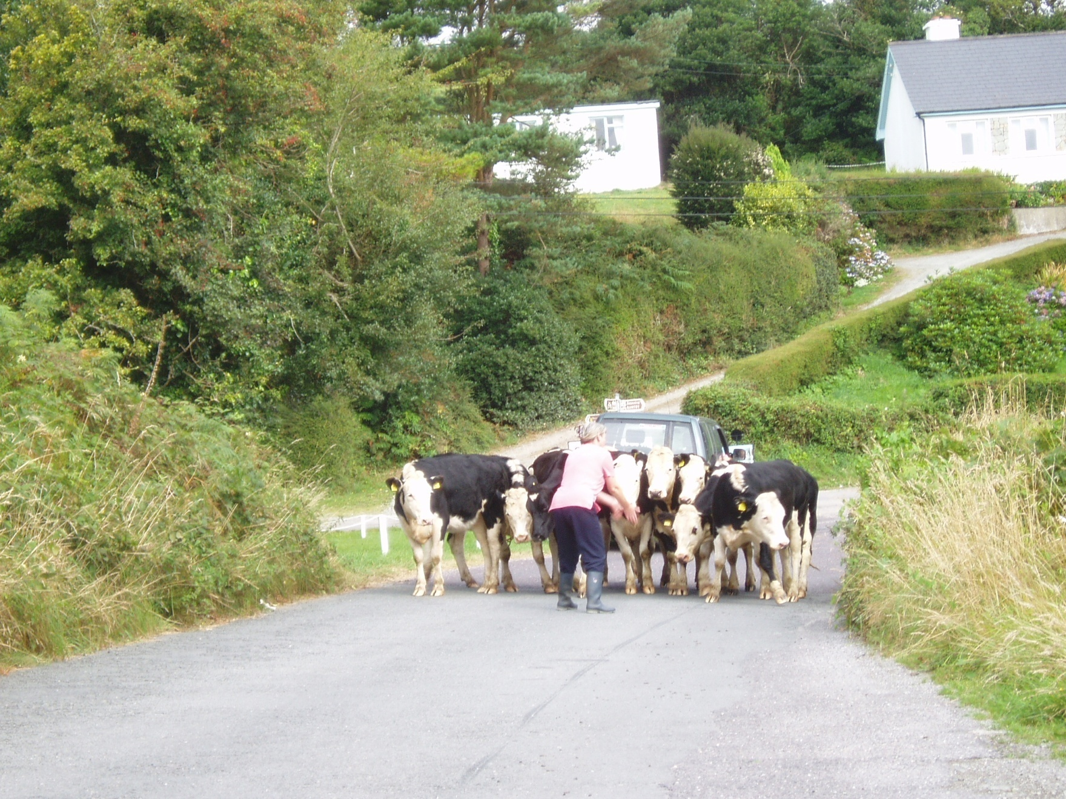

Slide 34
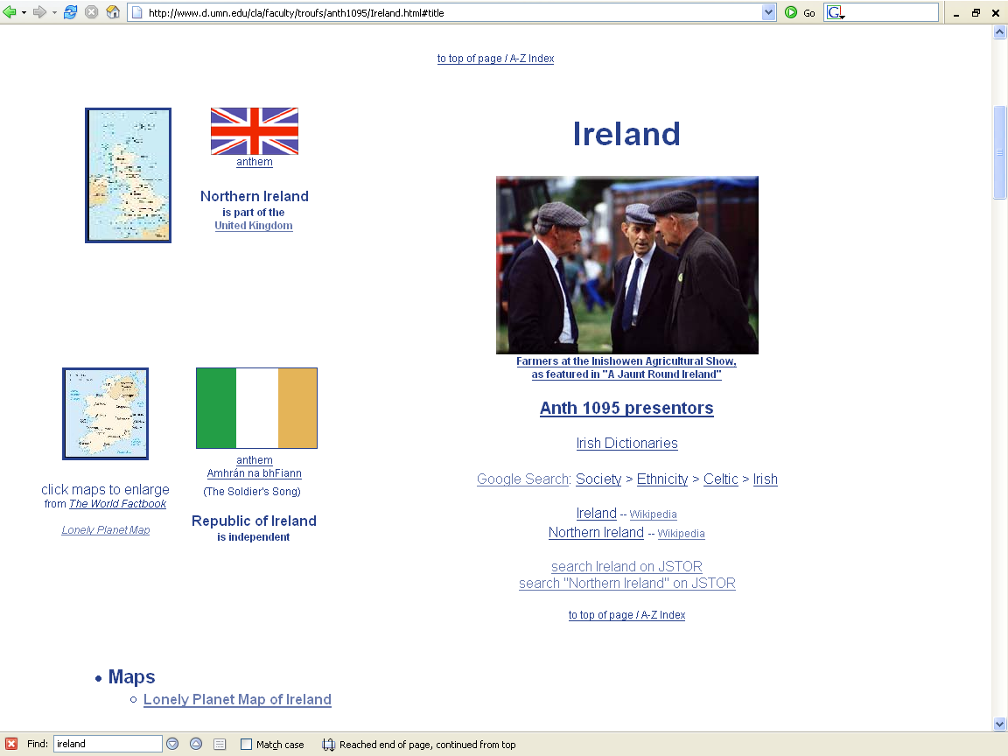

Slide 35
a “subculture”
as a
Unit of Analysis:
e.g., “Travelers”
(“Tinkers”, “Gypsies”)

Slide 38
http://www.waterville-insight.com/kerrymap.html

Slide 40
“Classics" in the Anthropology of Europe
Sharon B. Gmelch
1986 Groups that Don't Want in: Gypsies and other Artisan, Trader, and Entertainer Minorities. Annual Review of Anthropology 15:307-330.
Parman's classic picks -- Tony Galt

Slide 41

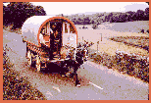
The Irish Tinkers: The Urbanization of an Itinerant People
by George Gmelch
1985

Slide 42
the individual
as a
Unit of Analysis:
e.g., Nan

Slide 43
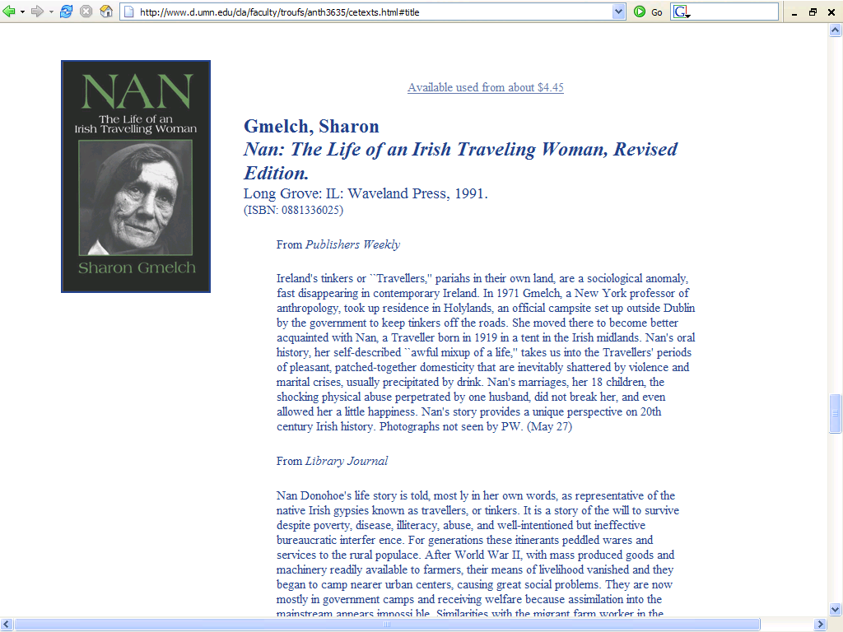

Slide 44

Sharon Gmelch
Nan: The Life of an Irish Traveling Woman, Revised Edition.
Long Grove: IL: Waveland Press, 1991.
(ISBN: 0881336025)
http://www.d.umn.edu/cla/faculty/troufs/anth3635/cetexts.html#Nan

