Slide 1
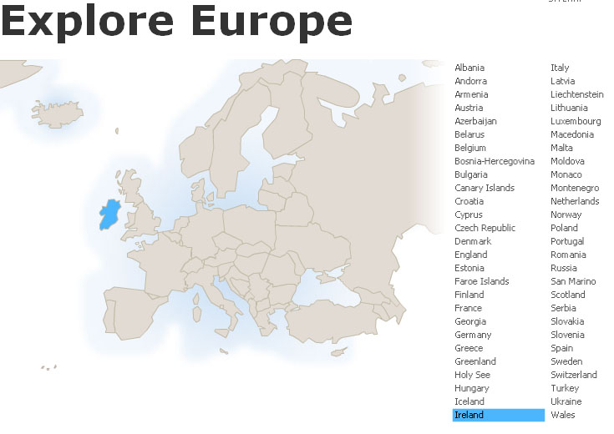
Ireland
Tim Roufs
© 2010-2024

Slide 2
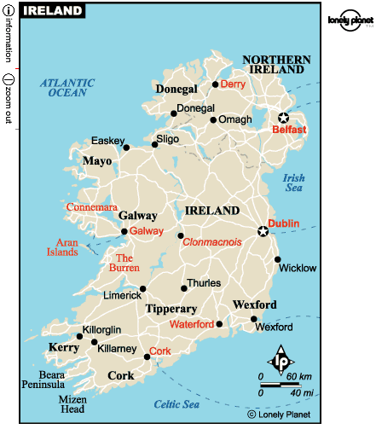

Slide 3
Northern Ireland
is part
of
“The
United Kingdom
. . .”

Slide 4
officially
called
“The
United Kingdom
of
Great Britain
and
Northern Ireland”
usually shortened to
the United Kingdom,
the UK,
or Britain

Slide 5
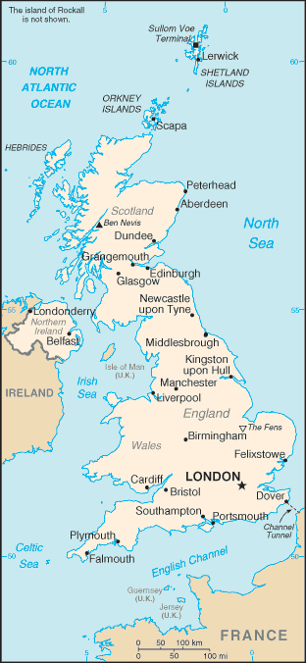
The
United Kingdom
(UK)
includes
England
Scotland
Wales
Northern Ireland
https://www.cia.gov/cia/publications/factbook/geos/uk.html

Slide 6
so
Northern Ireland
. . .
https://www.cia.gov/cia/publications/factbook/geos/uk.html

Slide 7
so
Northern Ireland
“belongs”
with
The
United Kingdom
(UK)
along with
England
Scotland
Wales
https://www.cia.gov/cia/publications/factbook/geos/uk.html

Slide 8
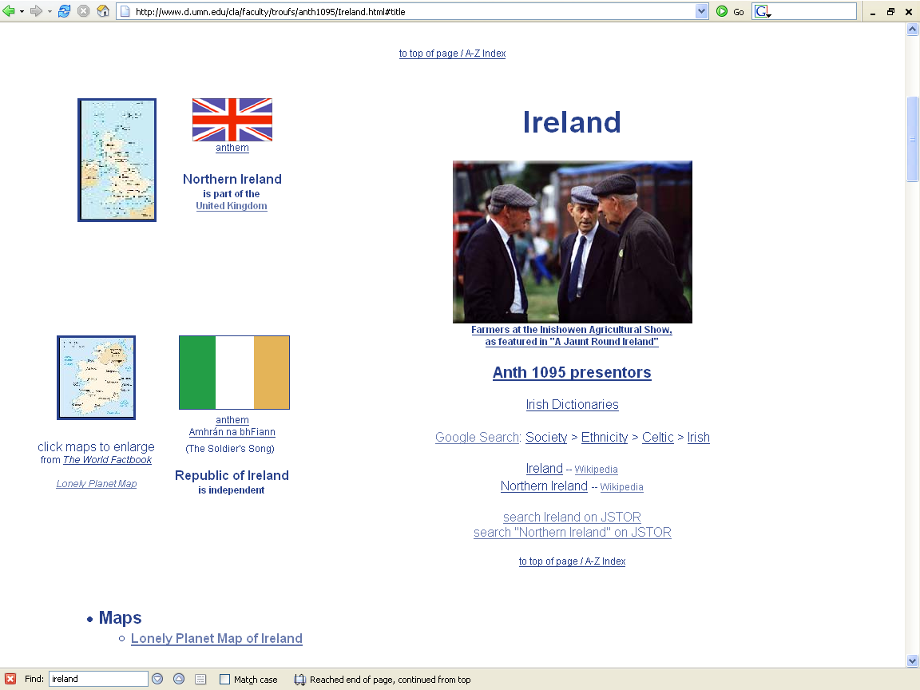

Slide 9
“units of analysis” may include:
  a “culture area” (anthropological term)
  a country
  a divided/partitioned segment of a nation or country
  a culture
    “Irish”
  a “subculture”
    “Irish Travelers” (“Tinkers”, “Gypsies”)
      (“Travelers” are not “Rom”, “Gypsies”)
    Irish Catholics
  a region
  a community / city
  the family
  one person
  types of people and institutions, cross-culturally

Slide 10
the community / city
as a
Unit of Analysis:
e.g., Dubliners

Slide 12
Dublin

Slide 13


Slide 14
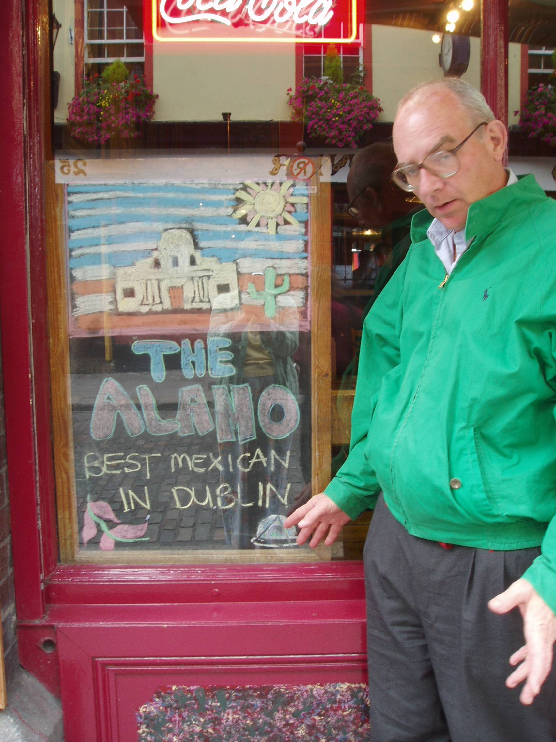

Slide 15
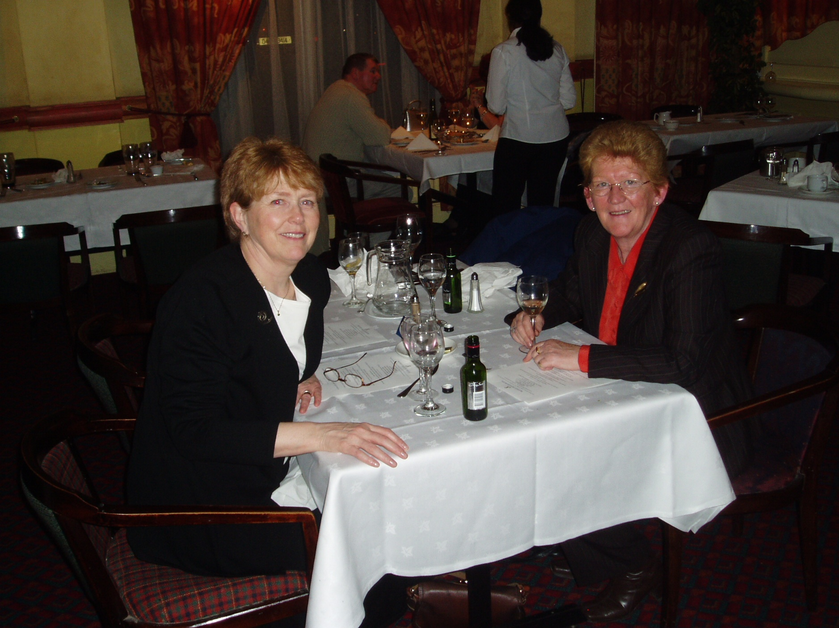

Slide 17
Newgrange

