Slide 1
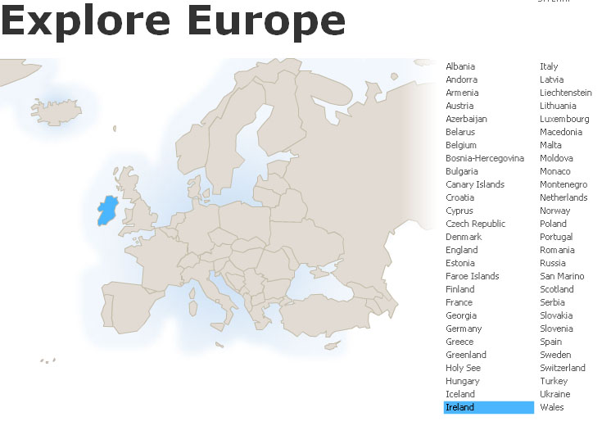
Newgrange
Ireland
Tim Roufs
© 2010-2024

Slide 2
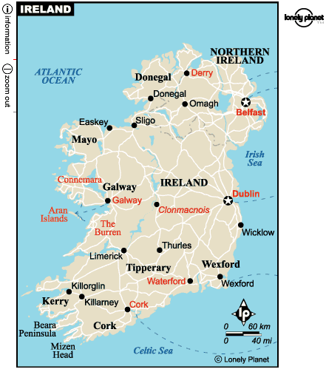
REM: Northern Ireland
is part
of
“The
United Kingdom
. . .”

Slide 3
REM: Northern Ireland
is part
of
“The
United Kingdom
. . .”

Slide 4
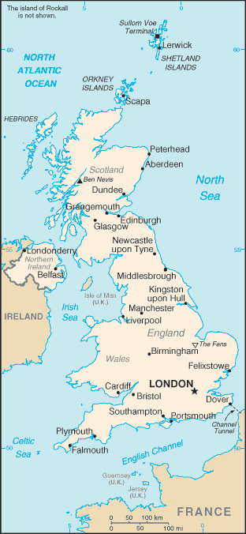
The
United Kingdom
(UK)
includes
England
Scotland
Wales
Northern Ireland
https://www.cia.gov/cia/publications/factbook/geos/uk.html

Slide 5
Newgrange

Slide 6
Newgrange
is in the Republic of Ireland

Slide 7
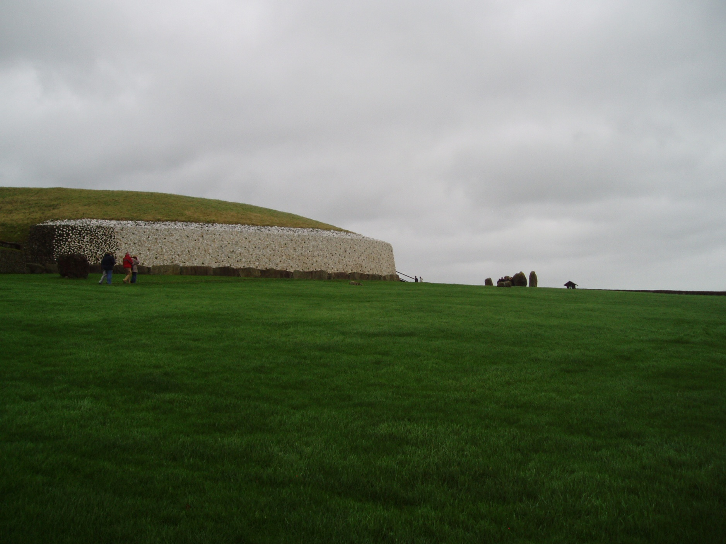
Newgrange
https://www.newgrange.com/

Slide 8
Newgrange is a Neolithic monument in the Boyne Valley, County Meath
It was constructed about 5,200 years ago (3,200 B.C.) which makes it older than Stonehenge and the Great Pyramids of Giza.
Newgrange
https://www.newgrange.com/

Slide 9
Newgrange is a large circular mound 85 m (279 ft) in diameter and 13 m (43 ft) high with a 19m (63 ft) stone passageway and chambers inside.
The mound is ringed by 97 large kerbstones, some of which are engraved with symbols called megalithic art.
Newgrange
https://www.newgrange.com/

Slide 10
Newgrange was built by a farming community that prospered on the rich lands of the Boyne Valley.
Knowth and Dowth are similar mounds that together with Newgrange have been designated a World Heritage Site by UNESCO.
Newgrange
https://www.newgrange.com/

Slide 11
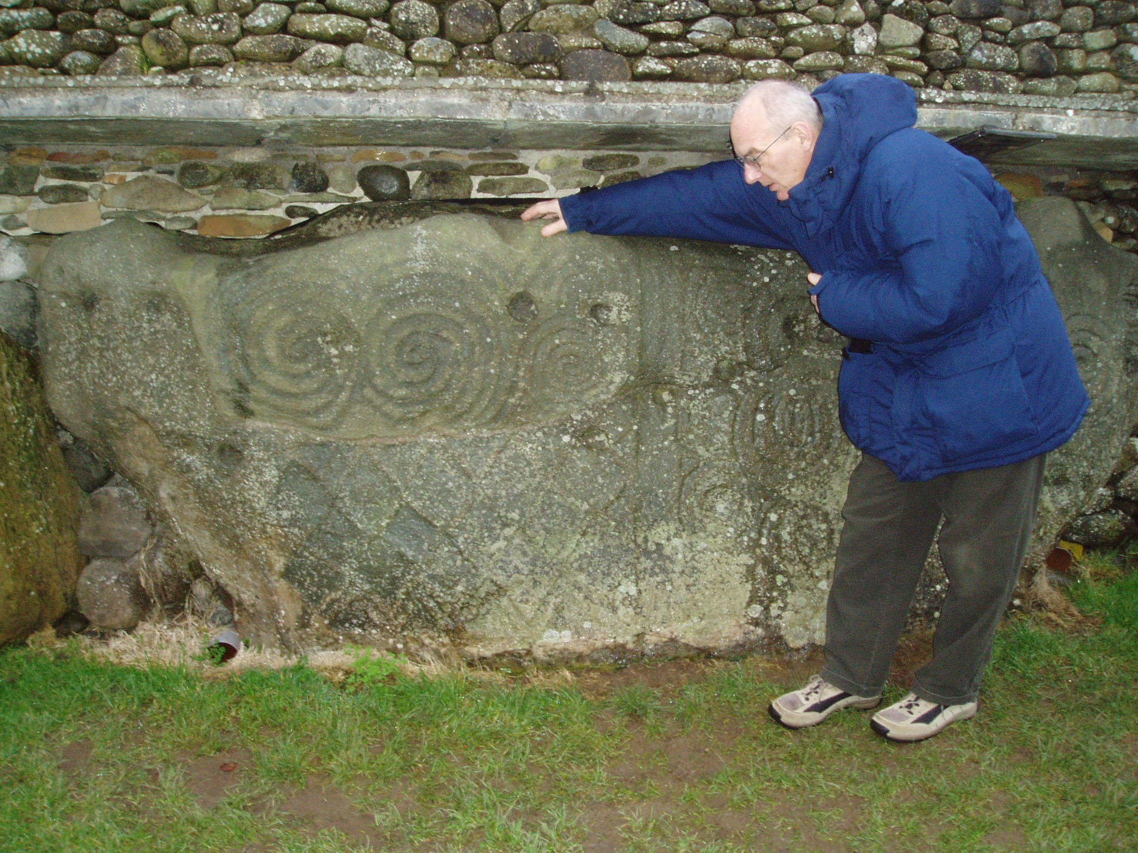

Slide 12
The mound is ringed by 97 large kerbstones, some of which are engraved with symbols called megalithic art.
https://www.newgrange.com/

Slide 13
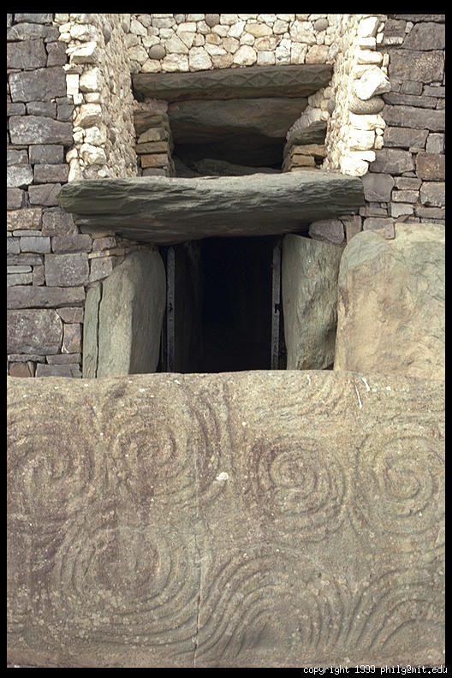
https://www.newgrange.com/
http://www.photo.net/photo/pcd3815/newgrange-87.tcl

Slide 14
Archaeologists classified Newgrange as a passage tomb, however Newgrange is now recognised to be much more than a passage tomb. Ancient Temple is a more fitting classification, a place of astrological, spiritual, religious and ceremonial importance, much as present day cathedrals are places of prestige and worship where dignitaries may be laid to rest.
https://www.newgrange.com/

Slide 15
Newgrange is best known for the illumination of its passage and chamber by the winter solstice sun. Above the entrance to the passage at Newgrange there is a opening called a roof-box.
https://www.newgrange.com/

Slide 16
Its purpose is to allow sunlight to penetrate the chamber on the shortest days of the year, around December 21st, the winter solstice. At dawn, from December 19th to 23rd, a narrow beam of light penetrates the roof-box and reaches the floor of the chamber, gradually extending to the rear of the chamber.
https://www.newgrange.com/

Slide 17
http://www.photo.net/photo/pcd3815/newgrange-87.tcl

Slide 18
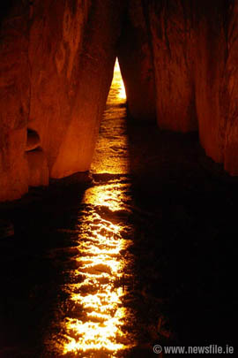
As the sun rises higher, the beam widens within the chamber so that the whole room becomes dramatically illuminated. This event lasts for 17 minutes, beginning around 9am. The accuracy of Newgrange as a time-telling device is remarkable when one considers that it was built 500 years before the Great Pyramids and more than 1,000 years before Stonehenge.
Astronomy of Newgrange
http://www.mythicalireland.com/ancientsites/newgrange-facts/astronomy.php

Slide 19
Astronomy of Newgrange
http://www.mythicalireland.com/ancientsites/newgrange-facts/astronomy.php

Slide 20
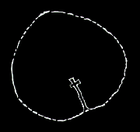
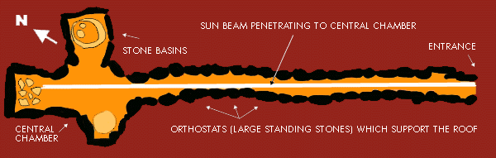
Plan of Newgrange
with interior passage aligned to Winter Solstice sunrise
Diagram of the passage inside Newgrange of the passage inside Newgrange
http://www.global-vision.org/dream/dreamch4.html

Slide 21
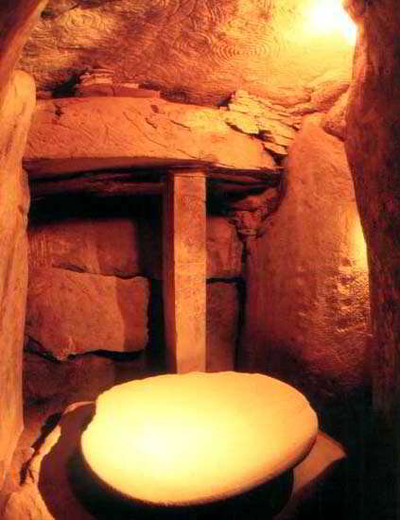
http://homepage.univie.ac.at/franz.kerschbaum/analog/pages/newgrange.htm

Slide 22
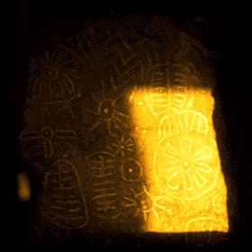
A beam of sunlight spolights 6,000 year-old solar symbol petroglyph Sunrise,
Autumn Equinox, Cairn T
Loughcrew, Ireland
© 1999 Martin Byrne
http://www.global-vision.org/dream/dreamch4.html

Slide 23
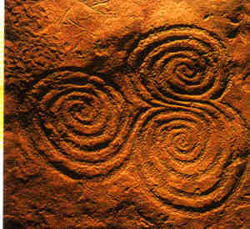
Newgrange is known for its Tri-spiral Etchings

Slide 24
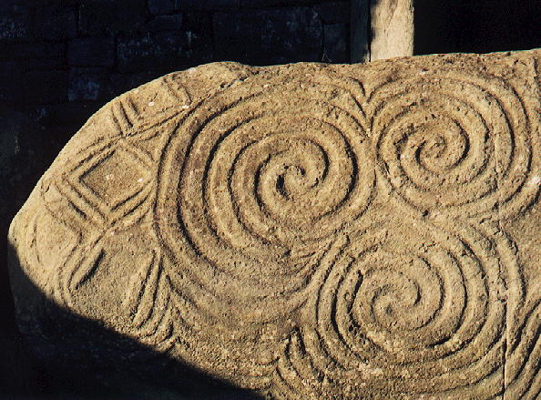
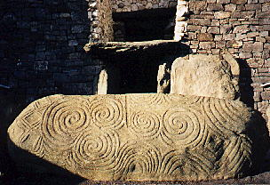
Tri-spiral Etchings on Newgrange Entrance Stone
Newgrange, one of three passage tombs in Bru na Boinne, was built over 5,000 years ago

Slide 25


Newgrange
in County Meath, Ireland, is a large prehistoric passage grave, dated around 3500 BC. It has wonderful carvings of double spirals, which are not normally thought of as mazes. However Robert Graves in "The White Goddess" pointed out that if you trace with your finger a passage from the edge to the centre, you can also return to the outside again along a different path. He suggested that it was a symbol of Death and Rebirth. The coloured diagram shows the two paths.
http://www.gwydir.demon.co.uk/jo/maze/simple.htm

Slide 26
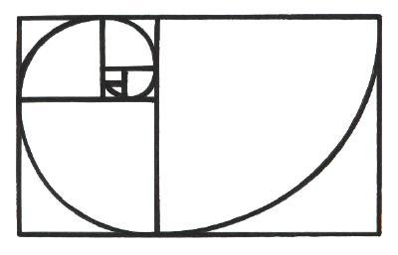
THE FIBONACCI SPIRAL
The Fibonacci Spiral is an outward growing spiral whose growth is regulated by a series of numbers that's known as the "Fibonacci Number Sequence". This important series of numbers is created by adding the last two numbers together in order to create the next...as in, 0, 1, 1, 2, 3, 5, 8, 13, 21, 34, & so forth. It's an attempt to replicate a spiral of divine proportions that has neither a beginning nor an end, that's commonly known as the "Golden Mean Ratio" (or phi ratio, 1.6180339). This unique spiral illustrates for us the perfect harmony and proportion of nature's natural growth pattern. But whilst It's quite difficult to get our heads round something that has no beginning, we find we can get quite close to this divine spiral by employing the Fibonacci analogue sequence, that offers very little difference between the two.
www.medwaycropcircle.co.uk/article6.htm

Slide 27
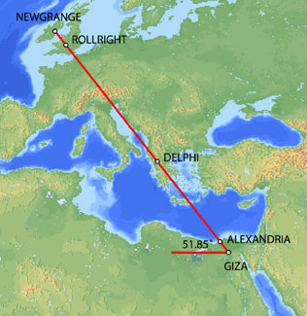
Some suggest Newgrange is part of a much larger alignment that also included Delphi in Greece and the pyramids of Egypt . . .
home.hiwaay.net/~jalison/Art5.html

Slide 28
As well as locations
in other countries . . .

Slide 29
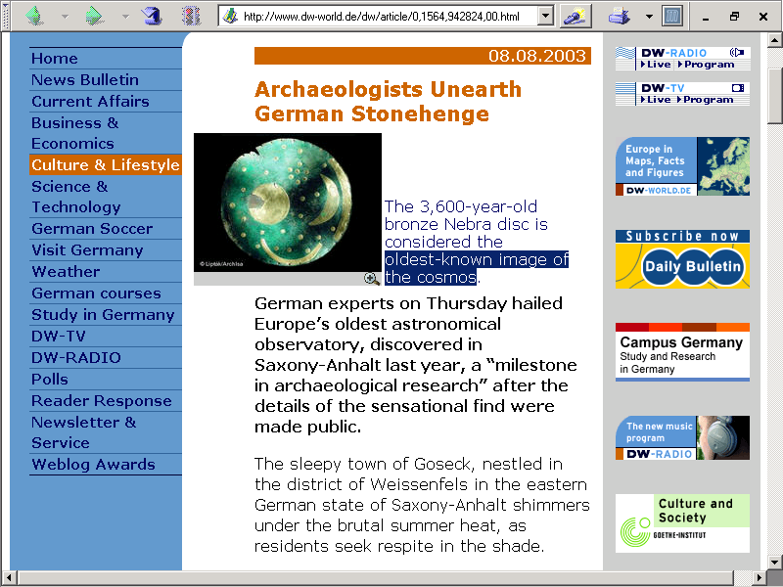
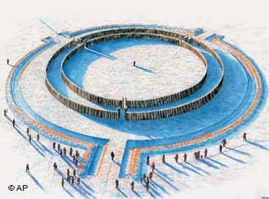
http://www.dw-world.de/dw/article/0,1564,942824,00.html

Slide 30
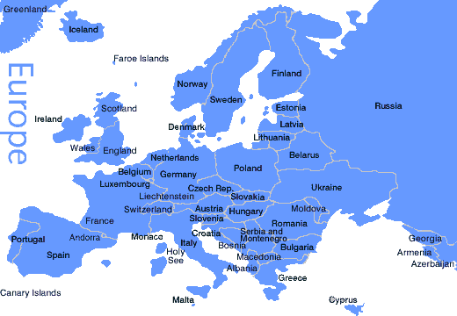
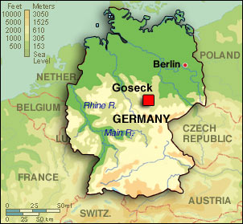
http://www.thefab.net/topics/culture_history/hg06_german-stonehenge_01.htm

Slide 31
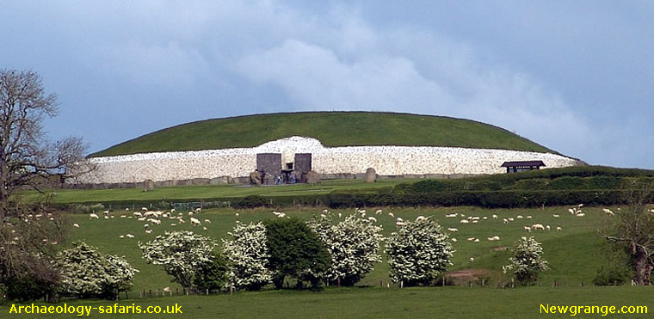
https://www.newgrange.com/

