Slide 1
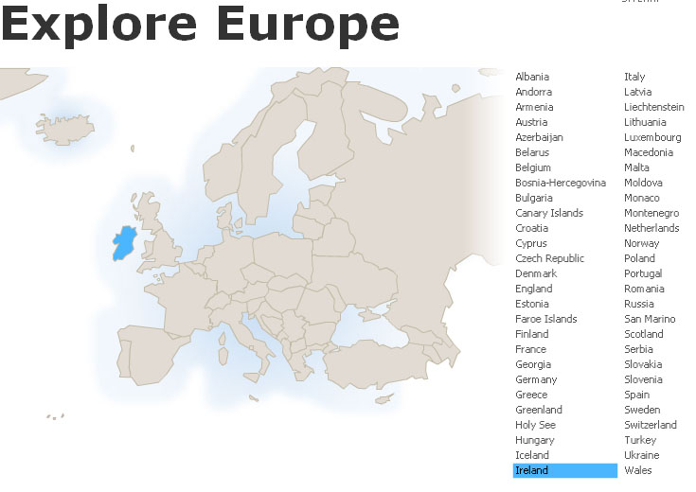
Ireland
Tim Roufs
© 2010-2024

Slide 2
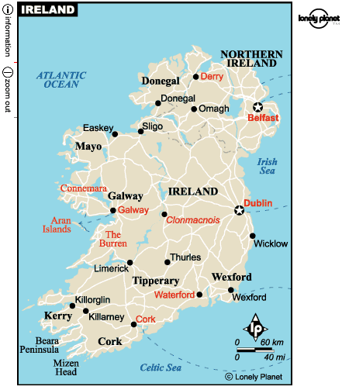

Slide 3
Northern Ireland
is part
of
“The
United Kingdom
. . .”

Slide 4
officially
called
“The
United Kingdom
of
Great Britain
and
Northern Ireland”
usually shortened to
the United Kingdom,
the UK,
or Britain

Slide 5
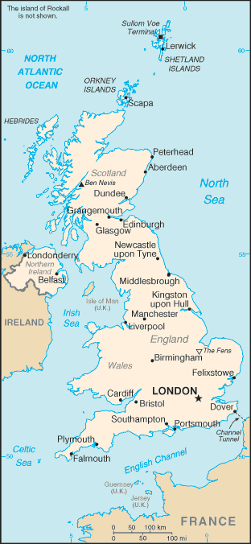
The
United Kingdom
(UK)
includes
England
Scotland
Wales
Northern Ireland
https://www.cia.gov/cia/publications/factbook/geos/uk.html

Slide 6
so
Northern Ireland
. . .
https://www.cia.gov/cia/publications/factbook/geos/uk.html

Slide 7
so
Northern Ireland
“belongs”
with
The
United Kingdom
(UK)
along with
England
Scotland
Wales
https://www.cia.gov/cia/publications/factbook/geos/uk.html

Slide 8
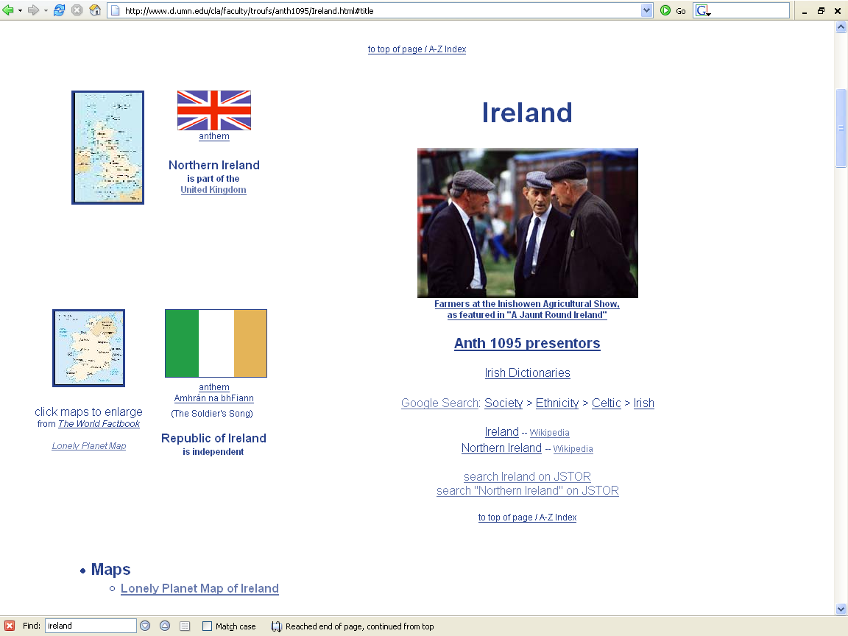

Slide 9
“units of analysis” may include:
  a “culture area” (anthropological term)
  a country
  a divided/partitioned segment of a nation or country
  a culture
    “Irish”
  a “subculture”
    “Irish Travelers” (“Tinkers”, “Gypsies”)
      (“Travelers” are not “Rom”, “Gypsies”)
    Irish Catholics
  a region
  a community / city
  the family
  one person
  types of people and institutions, cross-culturally

Slide 10
a “culture area”
(anthropological term)
as a
Unit of Analysis:
Europe

Slide 11
a country
as a
Unit of Analysis:
Ireland

Slide 12
a divided / split segment
of a
nation or country
(Nation-State)
as a
Unit of Analysis:
Northern Ireland
Republic of Ireland

Slide 13
a culture
as a
Unit of Analysis:
“The Irish”

Slide 14
a “subculture”
as a
Unit of Analysis:
e.g., “Irish Catholics”

Slide 15
a “subculture”
as a
Unit of Analysis:
e.g., “Travelers”
(“Tinkers”, “Gypsies”)

Slide 16
a region
as a
Unit of Analysis:
The Irish Countryman
“Kerrymen”

Slide 17
a region
as a
Unit of Analysis:
The Aran Islands

Slide 18
the community
as a
Unit of Analysis:
e.g., Inish Oirr
(“Inish Beag”)

Slide 19
the community / city
as a
Unit of Analysis:
e.g., Dubliners

Slide 20
the individual
as a
Unit of Analysis:
e.g., Nan

Slide 21
types of people
and institutions, cross-culturally
as various
Units of Analysis:
e.g., “peasants”

Slide 22
a region
as a
Unit of Analysis:
The Aran Islands

Slide 24
Analysis, misc.
Notes:
24

Slide 25
“units of analysis” may include:
  a “culture area” (anthropological term)
  a country
  a divided/partitioned segment of a nation or country
  a culture
    “Irish”
  a “subculture”
    “Irish Travelers” (“Tinkers”, “Gypsies”)
      (“Travelers” are not “Rom”, “Gypsies”)
    Irish Catholics
  a region
  a community / city
  the family
  one person
  types of people and institutions, cross-culturally

Slide 27
A cultural metaphor
as a
Unit of Analysis:
e.g.,
“Irish Conversations”

Slide 28
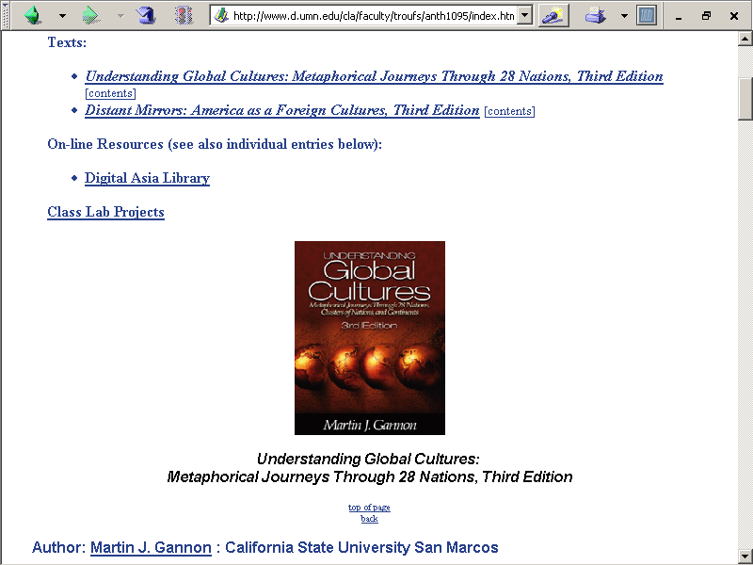
http://www.d.umn.edu/cla/faculty/troufs/anth1095/index.html#text

Slide 29
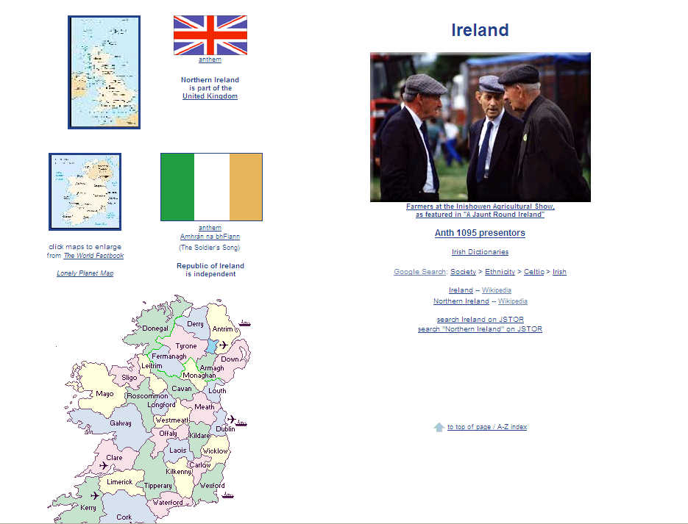
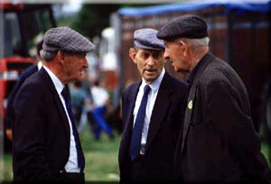
www.d.umn.edu/cla/faculty/troufs/anth1095/Ireland.html#title

Slide 30
“units of analysis” may also include:
  a nation
    (“national character studies”)
  the item or action itself
    (including “processes”)
  a “cultural metaphor”
  (analogy, by means of cultural metaphors)

Slide 31
Cultural Metaphors
“Metaphors
are not stereotypes”
– Martin J. Gannon
Why?

Slide 32
Four Generic Types of Cultures
Horizontal Individualism / Equality Matching Cultures
  Ch. 10 The German Symphony
  Ch. 11 The Swedish Stuga
  Ch. 12 Irish Conversations

Slide 33
Fig. 1.2. Four Generic Types of Cultures (p. 15)
POWER DISTANCE | INDIVIDUALISM COLLECTIVISM
 | Low (horizontal) High (vertical) | Equality Matching (interval) | Community Sharing (nominal)
 |  | Market Pricing (ratio) | Authority Ranking (ordinal)

Slide 34
Four Generic Types of Cultures
Horizontal Individualism / Equality Matching Cultures
  equality matching
  also dominant in Scandinavian nations
      Sweden
      Norway
  all individuals are considered equal, even when some are taxed heavily

Slide 35
Four Generic Types of Cultures
Horizontal Individualism / Equality Matching Cultures
  it is expected that those who cannot make individual contributions to the common good will do so at a later time if possible

Slide 36
http://www.d.umn.edu/cla/faculty/troufs/anth1095/index.html#text

Slide 37
Cultural Metaphors
Unit of analysis in the book = the nation or national culture
Other “units of analysis” may include:
  one person
  the family
  the community
  a region
  a culture

Slide 38
Fig. 1.1. Process, Goals, and Expression of Emotions (p. 12)
Open Expression of Emotions and Feelings
Degree to Which Process Must Be Emphasized Before Goals Can Be Discussed |  | Lower | Higher
 | Lower | England, Ireland, and Scotland | United States and Germany
 | Higher | China, Japan, and India | Mexico, Spain, and Italy
More on the “Four-Stage Model” later, time permitting

Slide 39
Fig. 1.1. Process, Goals, and Expression of Emotions (p. 12)
Open Expression of Emotions and Feelings
Degree to Which Process Must Be Emphasized Before Goals Can Be Discussed |  | Lower | Higher
 | Lower | England, Ireland, and Scotland | United States and Germany
 | Higher | China, Japan, and India | Mexico, Spain, and Italy
More on the “Four-Stage Model” later, time permitting

Slide 40
“units of analysis” may include:
  a “culture area” (anthropological term)
  a country
  a divided/partitioned segment of a nation or country
  a culture
    “Irish”
  a “subculture”
    “Irish Travelers” (“Tinkers”, “Gypsies”)
      (“Travelers” are not “Rom”, “Gypsies”)
    Irish Catholics
  a region
  a community / city
  the family
  one person
  types of people and institutions, cross-culturally

Slide 41
“units of analysis” may also include:
  a nation
    (“national character studies”)
  the item or action itself
    (including “processes”)
  a “cultural metaphor”

Slide 43
Analysis, misc.

Slide 44
“units of analysis” may include:
  a “culture area” (anthropological term)
  a country
  a divided/partitioned segment of a nation or country
  a culture
    “Irish”
  a “subculture”
    “Irish Travelers” (“Tinkers”, “Gypsies”)
      (“Travelers” are not “Rom”, “Gypsies”)
    Irish Catholics
  a region
  a community / city
  the family
  one person
  types of people and institutions, cross-culturally

Slide 46
“units of analysis” may include:
  one person (e.g., Paul Buffalo)
  the family (e.g., Strodtbeck, see later)
  the community
  a region (“culture area”)
  a culture
    “Irish”
    “Chinese”
    “Mexicans”
    “Bedouins”

Slide 47
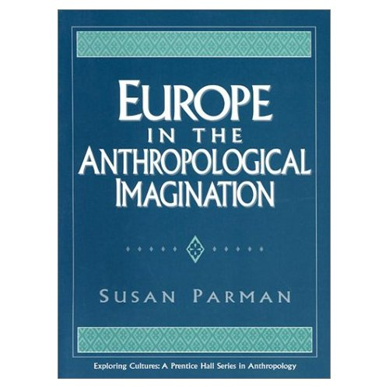
“Master Ethnographic Texts” are
“. . . ethnographies considered so important that they influence future research and affect how an audience of present and future anthropologists perceive a people”
Susan Parman, Europe in the Anthropological Imagination, pp. 11 - 14

Slide 48
“[Jose E.] Limón defines ‘master ethnographic texts’ as texts that have or will ‘deeply influence the structure of later ethnographies’ and that often affect the way the world views the people they represent”
(Limón 1991, 116)
Susan Parman, Europe in the Anthropological Imagination, p. 92

Slide 49
for many years the island model of peasant / community studies dominated Europeanist anthropology, and to some extent continues to do so
  whether or not the peasant community was on an island, the community itself was treated as a self-contained unit
  see Kertzer’s discussion of the anthropological yearning for “the simplicity of a manageable field setting . . . Where . . . The scale is human, and the cow dung wafts through the air”
Susan Parman, Europe in the Anthropological Imagination, pp. 11 - 14

Slide 50
for many years the island model of peasant / community studies dominated Europeanist anthropology, and to some extent continues to do so
  whether or not the peasant community was on an island, the community itself was treated as a self-contained unit
  see Kertzer’s discussion of the anthropological yearning for “the simplicity of a manageable field setting . . . Where . . . The scale is human, and the cow dung wafts through the air”
Susan Parman, Europe in the Anthropological Imagination, pp. 11 - 14

Slide 51
the research that came out of this school of thought emphasized
    self-sufficiency
    and isolation
rather than . . .
Susan Parman, Europe in the Anthropological Imagination, pp. 11 - 14

Slide 52
. . . rather than
    regional / national linkages
    migration
    tourism
    urbanization
Susan Parman, Europe in the Anthropological Imagination, pp. 11 - 14

Slide 53
peasant studies and community studies by and large perpetuated the island model of anthropological units of study with its concomitant notions of . . .
Susan Parman, Europe in the Anthropological Imagination, pp. 11 - 14

Slide 54
  tradition
  conservatism
  homogeneity
    in ideology if not in fact, as Brettell points out in Parman
  egalitarianism
  organic solidarity
  cultural essences
  as opposed to . . . the notion of culture as . . .
Susan Parman, Europe in the Anthropological Imagination, pp. 11 - 14

Slide 55
  tradition
  conservatism
  homogeneity
    in ideology if not in fact, as Brettell points out in Parman
  egalitarianism
  organic solidarity
  cultural essences
  as opposed to . . . the notion of culture as . . .
Émile Durkheim
Susan Parman, Europe in the Anthropological Imagination, pp. 11 - 14

Slide 56
“units of analysis” may include:
  one person (e.g., Paul Buffalo)
  the family (e.g., Strodtbeck, see later)
  the community
  a region (“culture area”)
  a culture
    “Irish”
    “Irish Travellers” (“Gypsies”)
    “Rom” (“Gypsies”)
    “Basques”
    Catalans

Slide 57
“units of analysis” may include:
  one person (e.g., Paul Buffalo)
  the family (e.g., Strodtbeck, see later)
  the community
  a region (“culture area”)
  a culture
    “Irish”
    “Irish Travellers” (“Gypsies”)
    “Rom” (“Gypsies”)
    “Basques”
    Catalans

Slide 58
a cultural metaphor
(analogy, by means of cultural metaphors)
as a
Unit of Analysis

Slide 59
Cultural Metaphors
“Metaphors
are not stereotypes”
– Martin J. Gannon
Why?

Slide 60
“units of analysis” may also include:
  a nation
    (“national character studies”)
  the item or action itself
    (including “processes”)
  a “cultural metaphor”
  (analogy, by means of cultural metaphors)

Slide 61
http://www.d.umn.edu/cla/faculty/troufs/anth1095/index.html#text

Slide 62
Four Generic Types of Cultures
Horizontal Individualism / Equality Matching Cultures
  Ch. 10 The German Symphony
  Ch. 11 The Swedish Stuga
  Ch. 12 Irish Conversations

Slide 63
Fig. 1.2. Four Generic Types of Cultures (p. 15)
POWER DISTANCE | INDIVIDUALISM COLLECTIVISM
 | Low (horizontal) High (vertical) | Equality Matching (interval) | Community Sharing (nominal)
 |  | Market Pricing (ratio) | Authority Ranking (ordinal)

Slide 64
Four Generic Types of Cultures
Horizontal Individualism / Equality Matching Cultures
  equality matching
  dominant in Scandinavian nations
    Sweden
    Norway
  all individuals are considered equal, even when some are taxed heavily

Slide 65
Four Generic Types of Cultures
Horizontal Individualism / Equality Matching Cultures
  it is expected that those who cannot make individual contributions to the common good will do so at a later time if possible

Slide 66
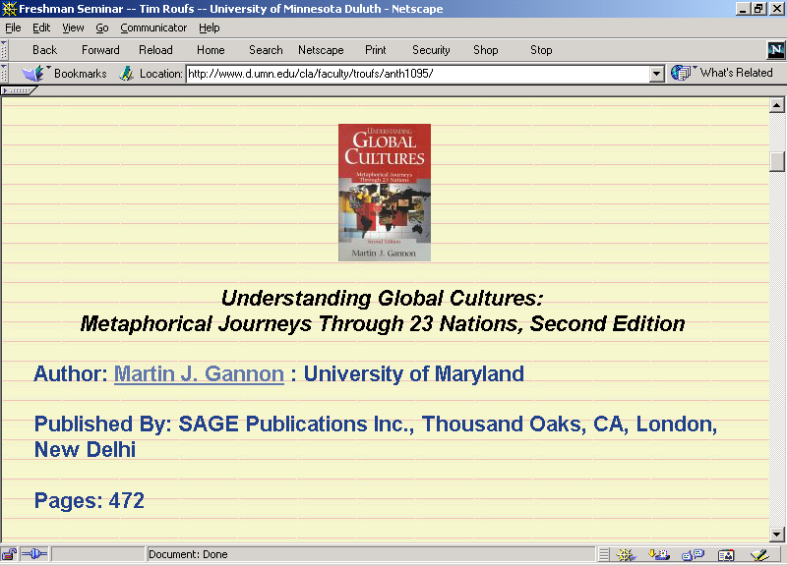

Slide 67
Cultural Metaphors
Unit of analysis in the book = the nation or national culture
Other “units of analysis” may include:
  one person (e.g., Paul Buffalo)
  the family (e.g., Strodtbeck)
  the community
  a region
  a culture

Slide 68
Culture Counts
  and it counts quit a bit

Slide 69
Geert Hofstede (1991)
IBM study demonstrated that national culture explained 50% of the differences in attitudes in IBM’s 53 countries (p. 5)

Slide 70
Fig. 1.1. Process, Goals, and Expression of Emotions (p. 12)
Open Expression of Emotions and Feelings
Degree to Which Process Must Be Emphasized Before Goals Can Be discussed |  | Lower | Higher
 | Lower | England, Ireland, and Scotland | United States and Germany
 | Higher | China, Japan, and India | Mexico, Spain, and Italy
More on the “Four-Stage Model” later

Slide 71
“units of analysis” may include:
  one person (e.g., Paul Buffalo)
  the family (e.g., Strodtbeck, see later)
  the community
  a region (“culture area”)
  a culture
    “Irish”
    “Irish Travellers” (“Gypsies”)
    “Rom” (“Gypsies”)
    “Basques”
    Catalans

