Slide 1
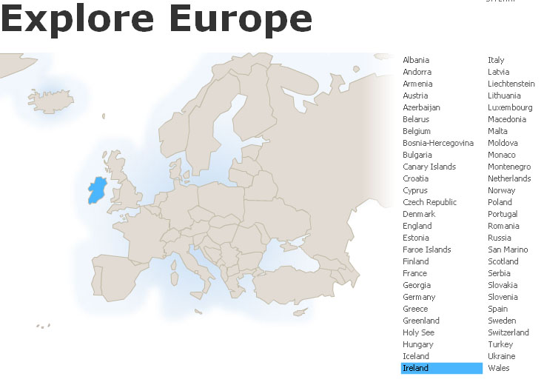
Ireland
Tim Roufs
© 2010-2024

Slide 2
“Ireland” ?

Slide 3
What do you think of
when someone says . . .
“Ireland” ?

Slide 4
What do you think of
when someone says . . .
“Ireland” ?
or “Irish” ?

Slide 5
What do you think of
when someone says . . .
“Ireland” ?
or “Irish” ?
It probably depends on
who’s talking
and the context . . .

Slide 6
What do you think of
when someone says . . .
“Ireland” ?
or “Irish” ?
And it is probably influenced somewhat by . . .

Slide 7
What do you think of
when someone says . . .
“Ireland” ?
or “Irish” ?
stereotypes
common images

Slide 8
What do you think of
when someone says . . .
“Ireland” ?
or “Irish” ?
stereotypes
common images

Slide 9
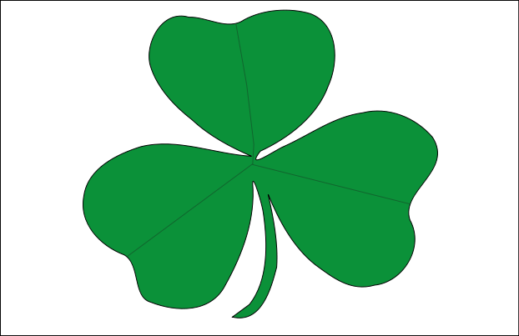
http://en.wikipedia.org/wiki/Ireland

Slide 10

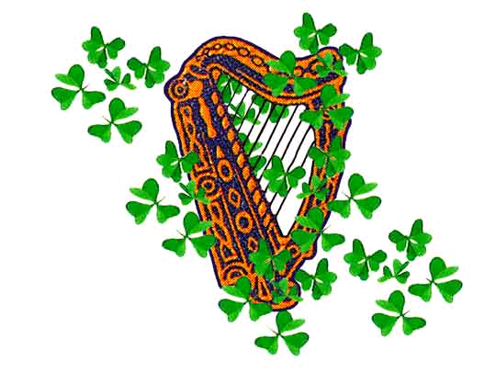
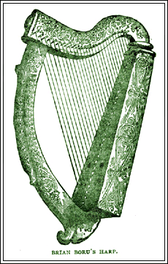
www.our-ireland.com/celtic-harps.html

Slide 11
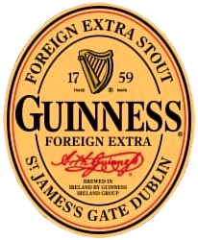
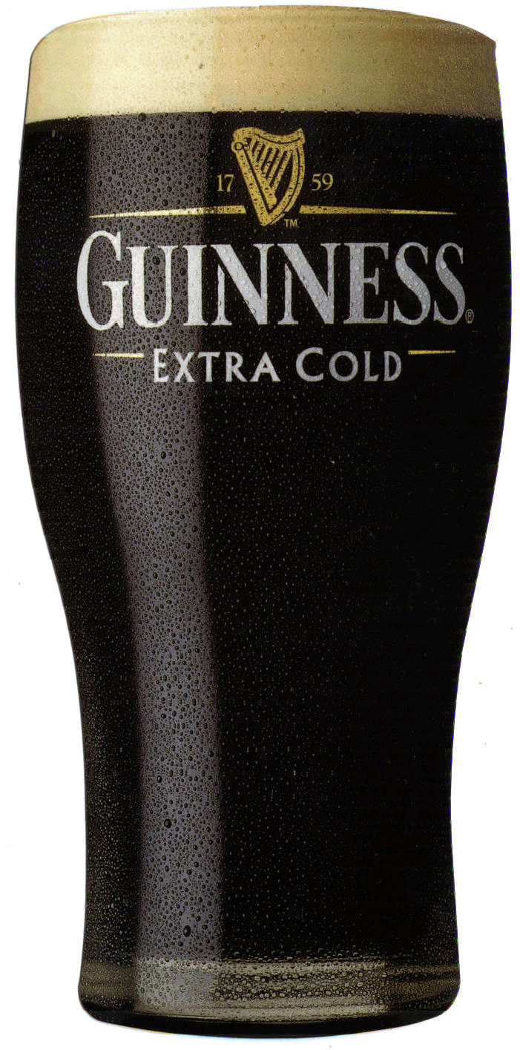
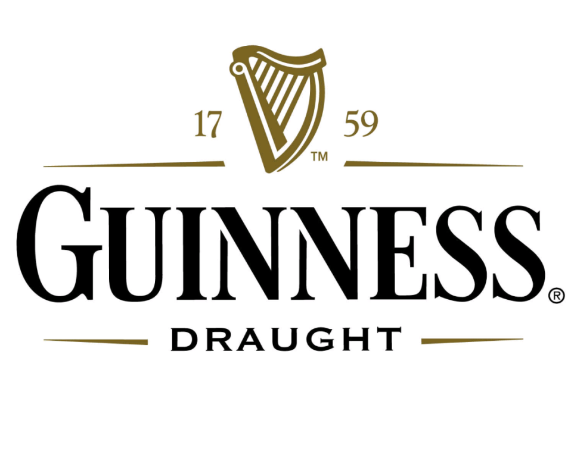

Slide 12
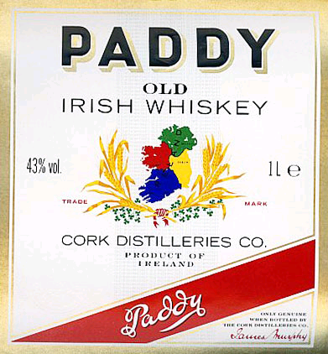
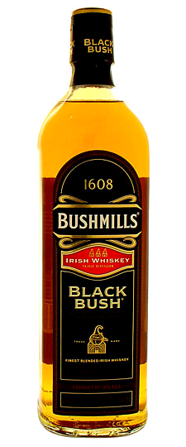
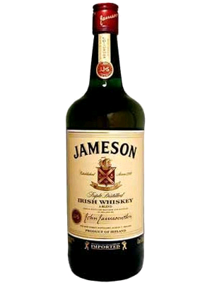
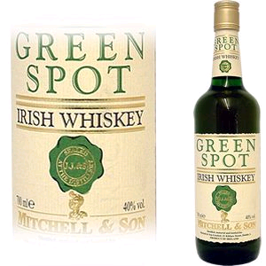


Slide 13

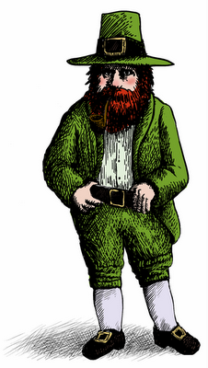
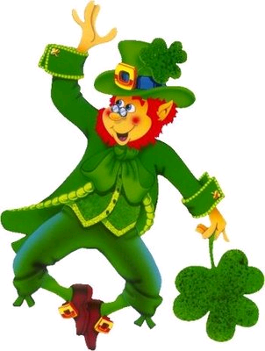

Slide 14

www.nd.edu/

Slide 15
Why is is OK to have
“The Fighting Irish”
as a university team name,
but not
“The Fighting Sioux ?” . . .
www.nd.edu/

Slide 16

www.nd.edu/

Slide 17
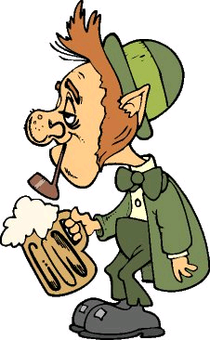

Slide 18
Why is is OK to have
use drunken Irish caricatures
drunken “Sioux” ? . . .

Slide 19
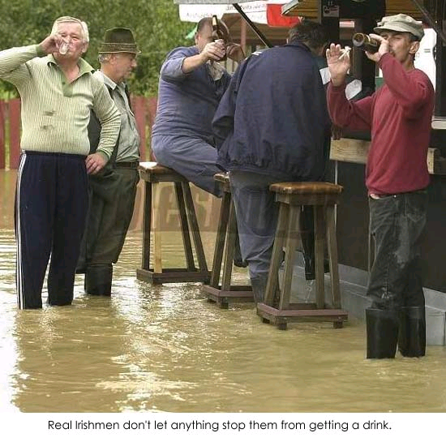
www.thefunnybox.com/2006/06/

Slide 20
Could you print a picture
and caption
like this in the Duluth paper
if it were from Red Lake ? . . .
www.thefunnybox.com/2006/06/

Slide 21

Irish Prime Minister on Immigration
17 March 2017
Channel 4 News
http://metro.co.uk/2017/03/17/irish-pm-trolls-donald-trump-on-immigration-right-in-front-of-him-6516244/

Slide 22
NINA
www.thefunnybox.com/2006/06/

Slide 23
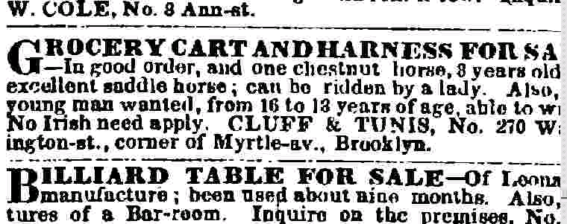

NINA
www.thefunnybox.com/2006/06/

Slide 24
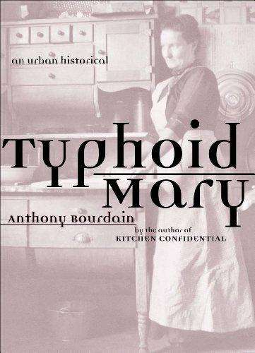
Mary Mallon
(1869 –1938)
“Typhoid Mary”
An Irish immigrant cook for 7 affluent families in the New York City area from 1900 to 1907.
From 1907 on “Typhoid Mary” became synonymous with the outbreak and spread of contagious diseases.
London: Bloomsbury, 2010.

Slide 25
Mary Mallon
(1869 –1938)
“Typhoid Mary”
An Irish immigrant cook for 7 affluent families in the New York City area from 1900 to 1907.
From 1907 on “Typhoid Mary” became synonymous with the outbreak and spread of contagious diseases.
And that didn’t help the image of Irish immigrants in America.
London: Bloomsbury, 2010.

Slide 26
Mary Mallon
(1869 –1938)
“Typhoid Mary”
An Irish immigrant cook for 7 affluent families in the New York City area from 1900 to 1907.
The first person in the United States identified as an asymptomatic carrier of typhoid, she is thought to have infected 51 people, 3 of whom died with typhoid fever.
“Typhoid Mary” had become synonymous with the spread of disease.
Wikipedia
London: Bloomsbury, 2010.

Slide 27
Mary Mallon
(1869 –1938)
“Typhoid Mary” was forced into isolation after it was discovered that she was a healthy carrier of Salmonella typhi and died after nearly 30 years in isolation.
London: Bloomsbury, 2010.

Slide 28
The New NINA ?
www.thefunnybox.com/2006/06/

Slide 29
The New NINA ?
www.thefunnybox.com/2006/06/

Slide 30
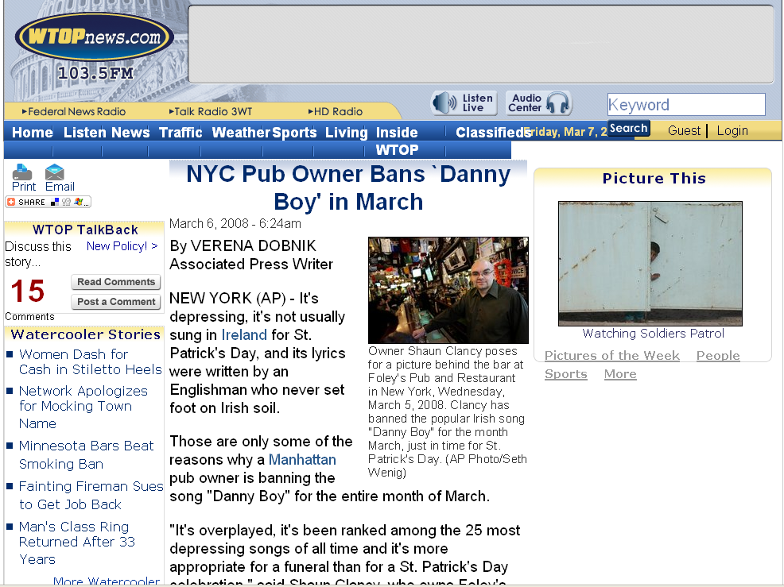
www.wtopnews.com/?nid=456&sid=1358866#

Slide 31
What do you think of
when someone says . . .
“Ireland” ?
or “Irish” ?
more serious images and notions include . . .

Slide 32
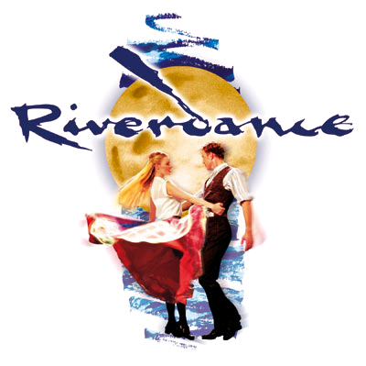

Slide 33
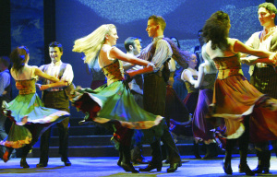
"Riverdance" features Irish music and dance. The show began playing in the 1990s and makes its final stop in Duluth on March 4-5.
A 'Riverdance' Farewell in Duluth
Ann Klefstad Duluth News Tribune
Published Thursday, February 28, 2008
[PHOTO BY JOAN MARCUS]

Slide 34
The show arose, he says, at a time in the 1990s when Ireland was finally getting some sense of confidence. “Even though we got our independence in the [1920s] it took until the [1990s] ’til we were confident about the value of our culture, and stopped being embarrassed,” Erskine said. “Suddenly we had money, we had work, people were beginning to immigrate to Ireland. And along came ‘Riverdance,’ and we were ready.”
If it had happened 10 years earlier, it wouldn’t have worked, Erskine said. He remembers how tentative the early days were. Their first engagement in London was typical. “We thought, ‘It’s an Irish dance show, why would anyone want to watch it in London?’ We booked the hall for 10 days, but we were there for two and a half years.”
A 'Riverdance' Farewell in Duluth
Ann Klefstad Duluth News Tribune
Published Thursday, February 28, 2008

Slide 35
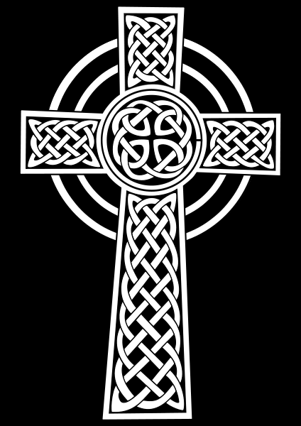
common Irish designs
combine “pagan” and Christian motifs
http://en.wikipedia.org/wiki/Celtic_cross

Slide 36
common Irish designs
combine “pagan” and Christian motifs
In this case, for e.g., the cross,
the sun/moon, and eternity
http://en.wikipedia.org/wiki/Celtic_cross

Slide 37
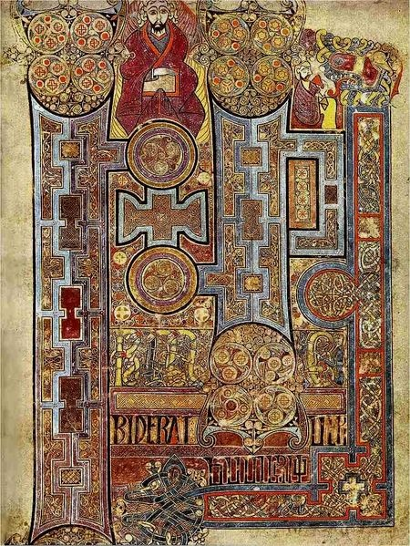
The
“Book of Kells”
is one of the most famous illuminated manuscripts in the world
Book of Kells,
Folio 292r, Incipit to John. In principio erat verbum.
http://en.wikipedia.org/wiki/Ireland

Slide 38
Pay attention to the various areas and regions in Ireland . . .
As well as the various
“units of analysis” . . .

Slide 39
Pay attention to the various areas and regions in Ireland . . .
As well as the various
“units of analysis” . . .

Slide 40
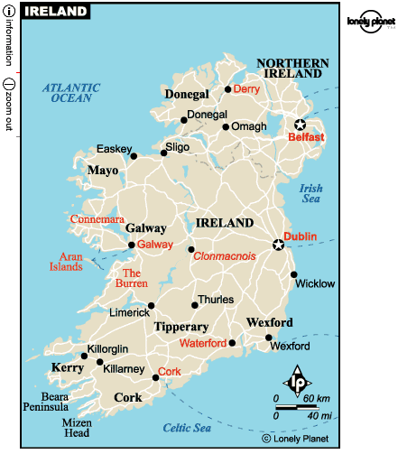

Slide 41
The Aran Islands

Slide 42
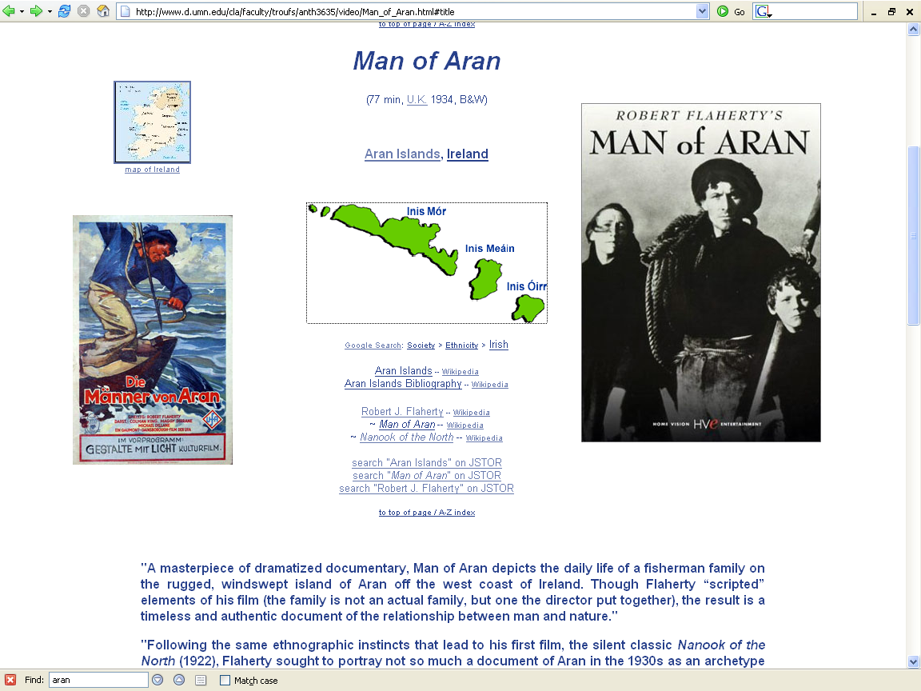
http://www.d.umn.edu/cla/faculty/troufs/anth3635/video/Man_of_Aran.html#title

Slide 43
Northern Ireland
is part
of
“The
United Kingdom
. . .”

Slide 45
Northern Ireland
is part
of
“The
United Kingdom
. . .”

Slide 46
officially
called
“The
United Kingdom
of
Great Britain
and
Northern Ireland”
usually shortened to
the United Kingdom,
the UK,
or Britain

Slide 47
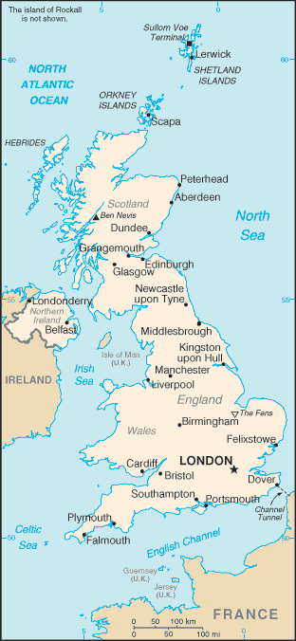
The
United Kingdom
(UK)
includes
England
Scotland
Wales
Northern Ireland
https://www.cia.gov/cia/publications/factbook/geos/uk.html

Slide 48
so
Northern Ireland
. . .
https://www.cia.gov/cia/publications/factbook/geos/uk.html

Slide 49
so
Northern Ireland
“belongs”
with
The
United Kingdom
(UK)
along with
England
Scotland
Wales
https://www.cia.gov/cia/publications/factbook/geos/uk.html

Slide 50
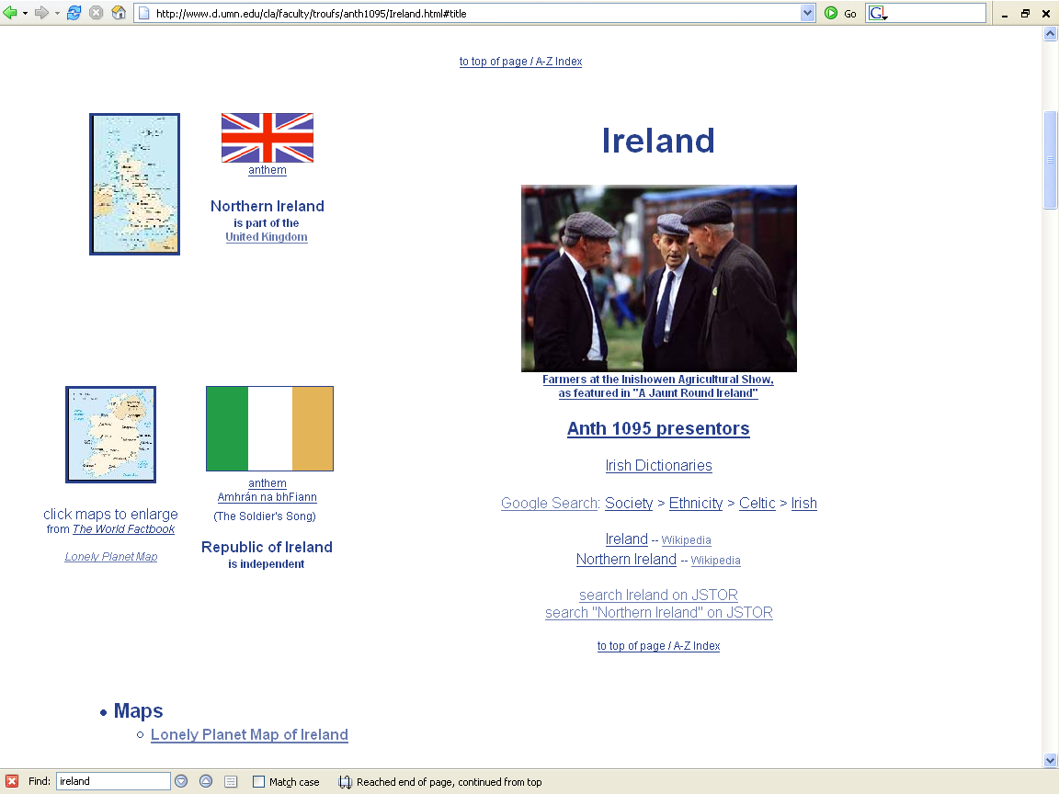
Northern Ireland
Republic of Ireland

Slide 51
“units of analysis” may include:
  the world
  a “culture area” (anthropological term)
  a country / nation
    a divided/partitioned segment of a nation or country / nation
  a culture
    “Irish”
  a “subculture”
    “Irish Travelers” (“Tinkers”, “Gypsies”)
      (“Travelers” are not “Rom”, “Gypsies”)
    Irish Catholics
  a region
  a community / city
  the family
  one person
  types of people and institutions, cross-culturally . . .
  an item or action itself
  a “cultural metaphor”

Slide 52
a “culture area”
(anthropological term)
as a
Unit of Analysis:
Europe

Slide 53
a “culture area”
(anthropological term)
as a
Unit of Analysis:
Europe

Slide 54
a country
as a
Unit of Analysis:
Ireland

Slide 55
a country
as a
Unit of Analysis:
Ireland

Slide 56
a divided / split segment
of a
nation or country
(Nation-State)
as a
Unit of Analysis:
Northern Ireland
Republic of Ireland

Slide 57
a divided / split segment
of a
nation or country
(Nation-State)
as a
Unit of Analysis:
Northern Ireland
Republic of Ireland

Slide 58
a culture
as a
Unit of Analysis:
“The Irish”

Slide 59
a “subculture”
as a
Unit of Analysis:
e.g., “Irish Catholics”

Slide 60
another “subculture”
as a
Unit of Analysis:
e.g., “Travelers”
(“Tinkers”, “Gypsies”)

Slide 61
a region
as a
Unit of Analysis:
The Irish Countryman
(county Clare)
“Kerrymen”

Slide 62
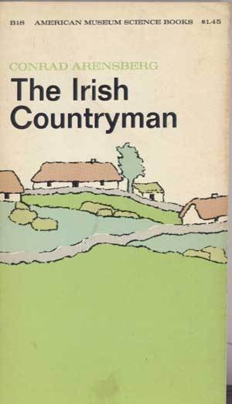
a region
as a
Unit of Analysis:
The Irish Countryman
(county Clare)
“Kerrymen”

Slide 63
another region
as a
Unit of Analysis:
The Aran Islands

Slide 64
the community
as a
Unit of Analysis:
e.g., Inish Oírr (“Inish Beag”)

Slide 65
the community / city
as a
Unit of Analysis:
e.g., Dubliners

Slide 66


Slide 67
the individual
as a
Unit of Analysis:
e.g., Nan

Slide 68
types of people
and institutions,
cross-culturally
as various
Units of Analysis:
e.g., “peasants”

Slide 69
a closer look at a region
as a
Unit of Analysis:
The Aran Islands

Slide 70
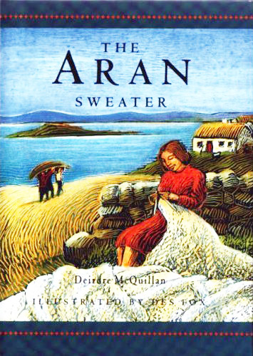
Notes:
11/19/2023
70

Slide 71
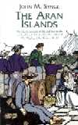
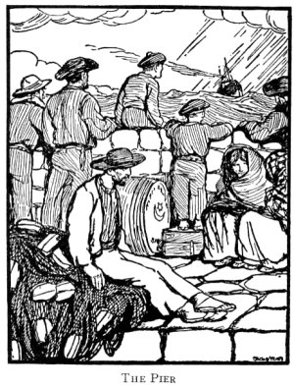
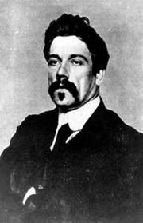
The Aran Islands
by J. M. Synge
[1907]
“The classic account of life and lore in the
Spiritual heart of Ireland
By the author of The Playboy of the Western World.”
1907

Slide 73
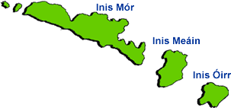
The Aran Islands
Inis Oírr, the smallest island, is only two miles long and one and one-half miles wide

Slide 74
The Aran Islands
Inis Oírr, the smallest island, is only two miles long and one and one-half miles wide

Slide 75
http://www.d.umn.edu/cla/faculty/troufs/anth3635/video/Man_of_Aran.html#title

Slide 76
The Aran Islands
Inis Oírr, the smallest island, is only two miles long and one and one-half miles wide

Slide 78
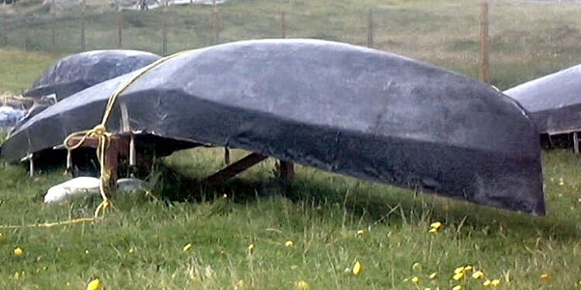
curagh
http://irishislands.info/oilphoto/Aran/InisOirr/inisoirr_thumb.html

Slide 79
a visual “trope” of the Aran Islands
curagh
http://irishislands.info/oilphoto/Aran/InisOirr/inisoirr_thumb.html

Slide 80
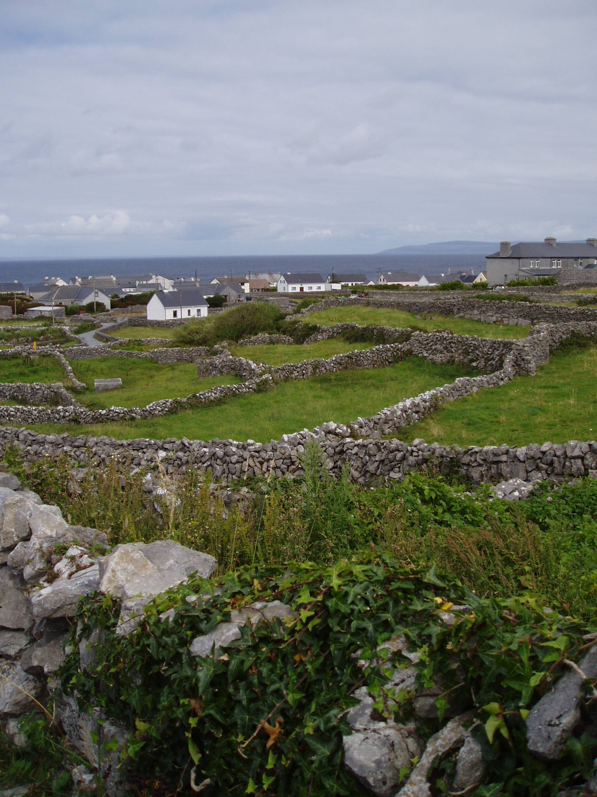
the Galway side of Inis Oírr

Slide 81
the community
as a
Unit of Analysis:
e.g., Inish Oírr
(“Inish Beag”)

Slide 83
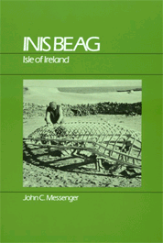
Inis Beag
(pseudonym)
Gaelic: "Little Island"
Inis Oírr
(official name)
John C. Messenger
Inis Beag: Isle of Ireland.
Long Grove: IL: Waveland Press, 1983.
http://www.d.umn.edu/cla/faculty/troufs/anth3635/cetexts.html#InisBeag

Slide 84
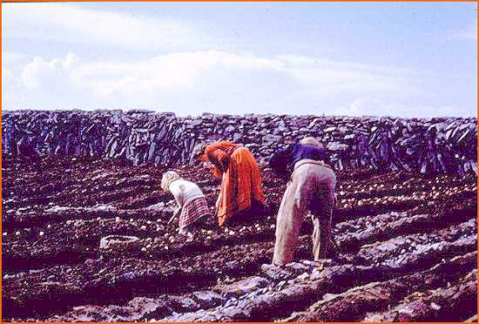
Messenger 1983 (SAE)

Slide 85
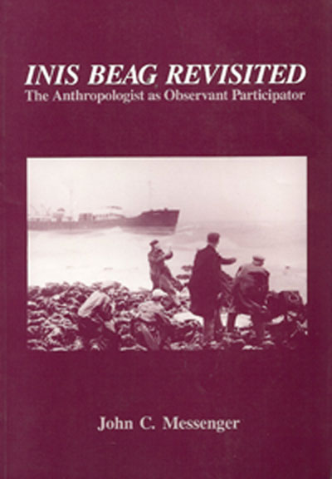
Inis Oírr
INIS Beag Revisited:
The Anthropologist as Observant Participator
Salem, WI: Sheffield. (Reprint edition August 1989).
The 1983 version was entitled An Anthropologist At Play:
Ballad-mongering in Ireland and its Consequences for Research

Slide 86
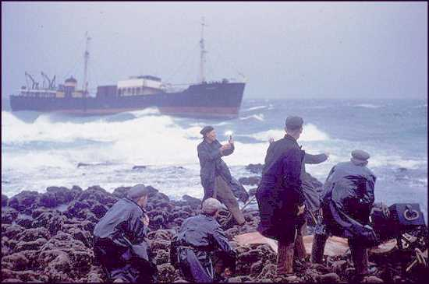
The shipwreck Plassey on Inis Oírr
Messenger 1983 (SAE)

Slide 87
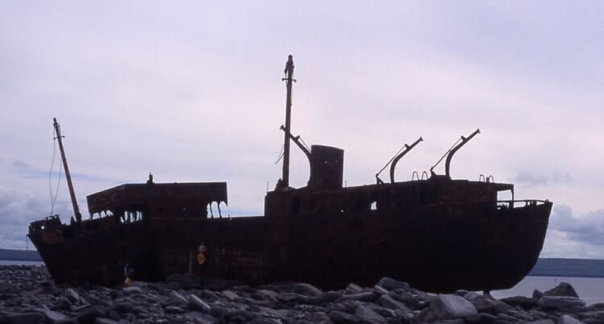
The shipwreck Plassey on Inis Oírr
http://irishislands.info/oilphoto/Aran/InisOirr/101currach8_jpg.html

Slide 88
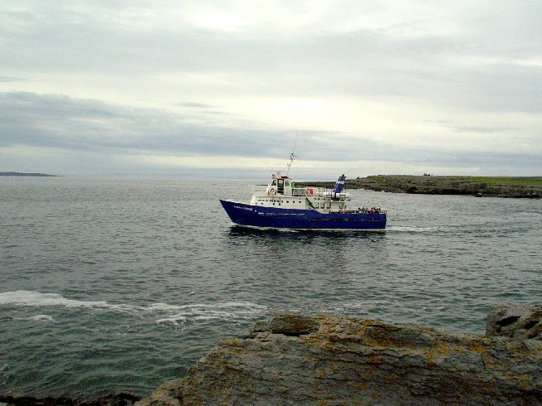
Take the Happy Hooker

Slide 89
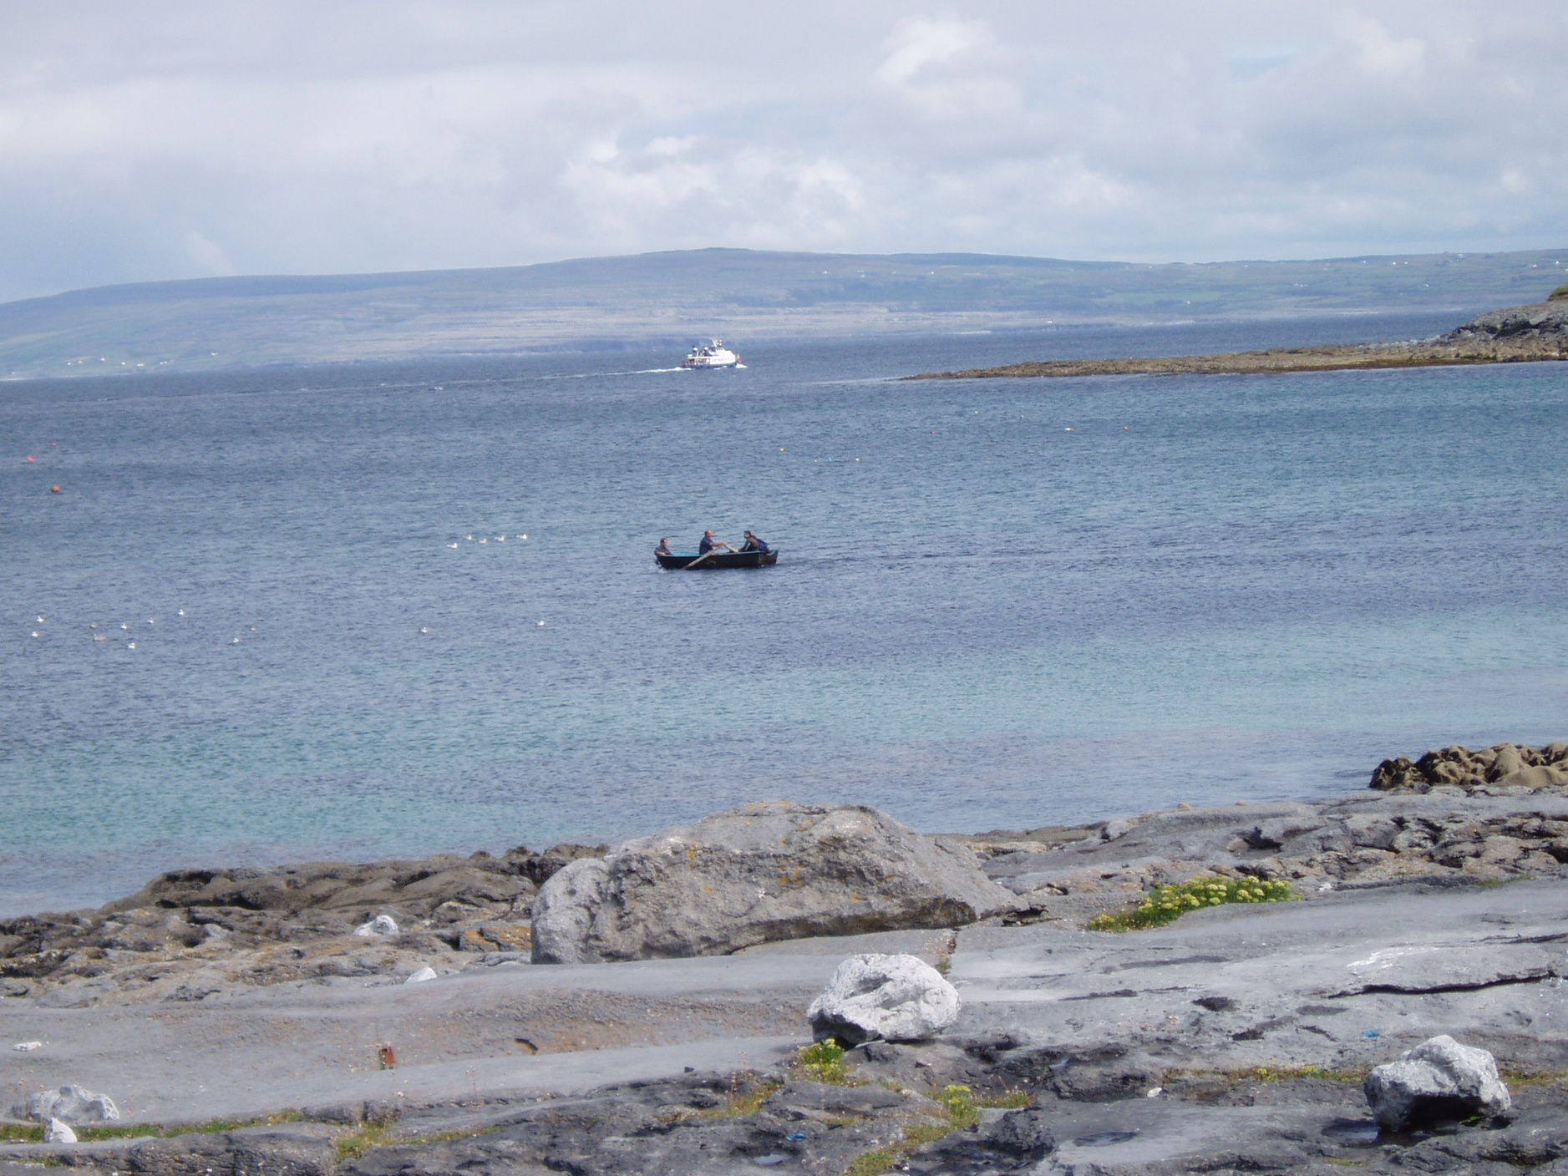
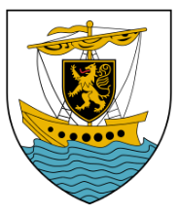
Galway area on “the mainland”

Slide 91
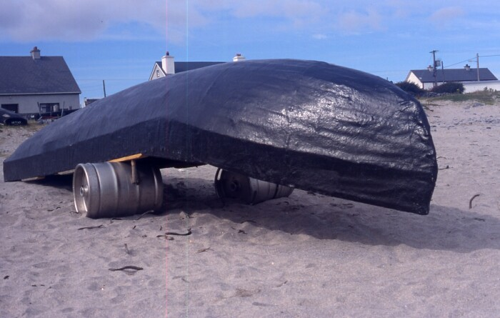
curagh
http://irishislands.info/oilphoto/Aran/InisOirr/101currach8_jpg.html

Slide 92
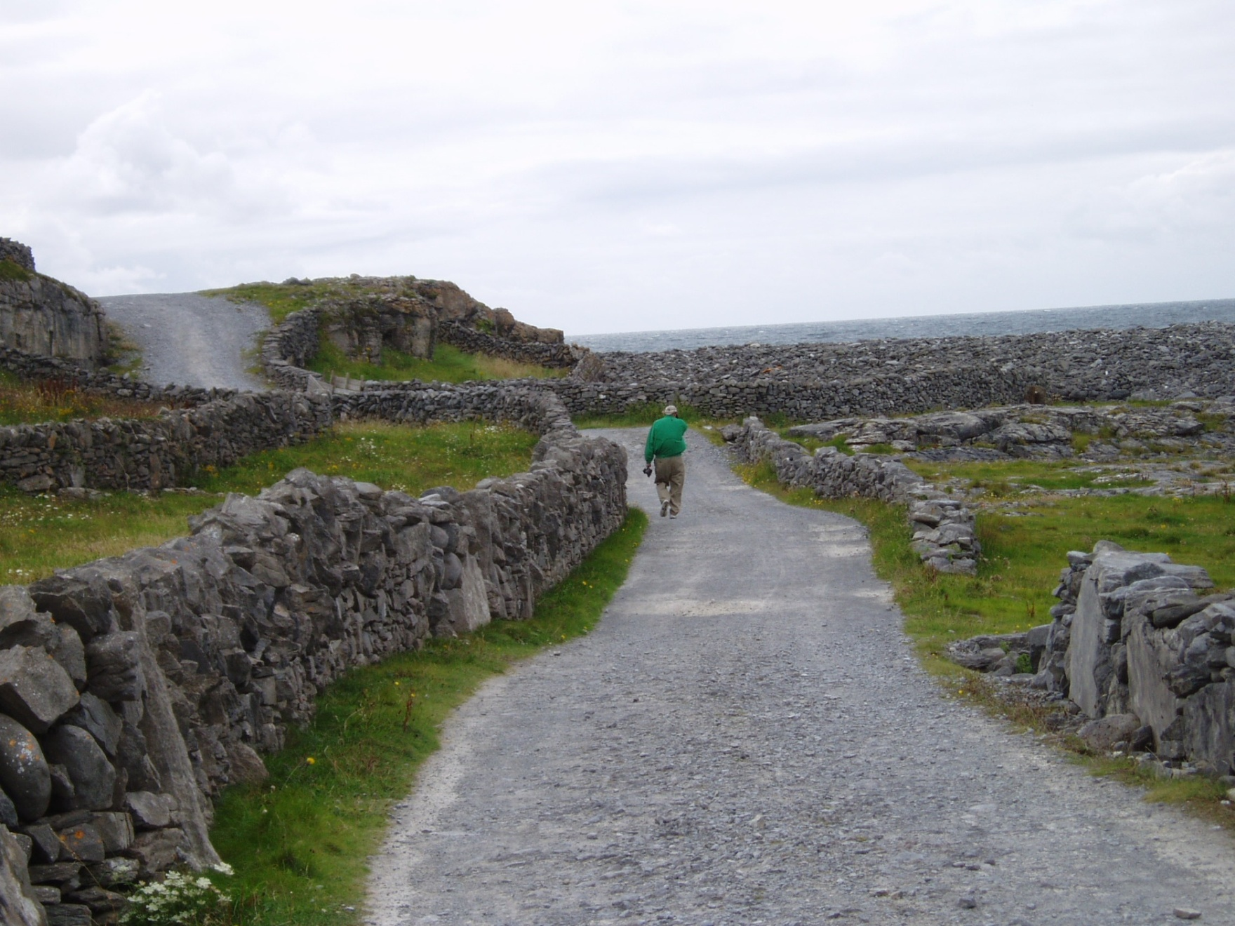
Tim Roufs on his favorite walk around the entire island of Inis Oírr

Slide 93
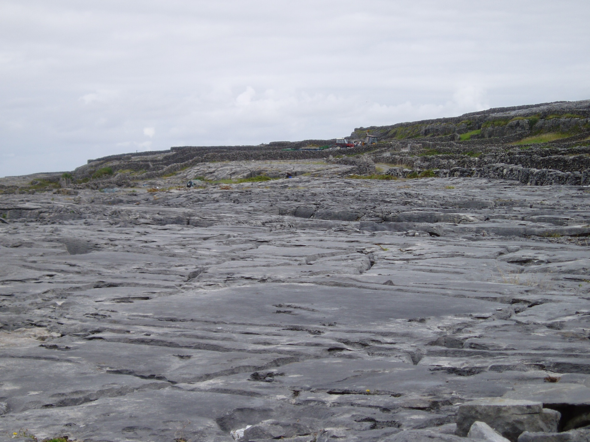
the surface on the windward side of Inis Oírr

Slide 94
The shipwreck Plassey on Inis Oírr
http://irishislands.info/oilphoto/Aran/InisOirr/101currach8_jpg.html

Slide 95
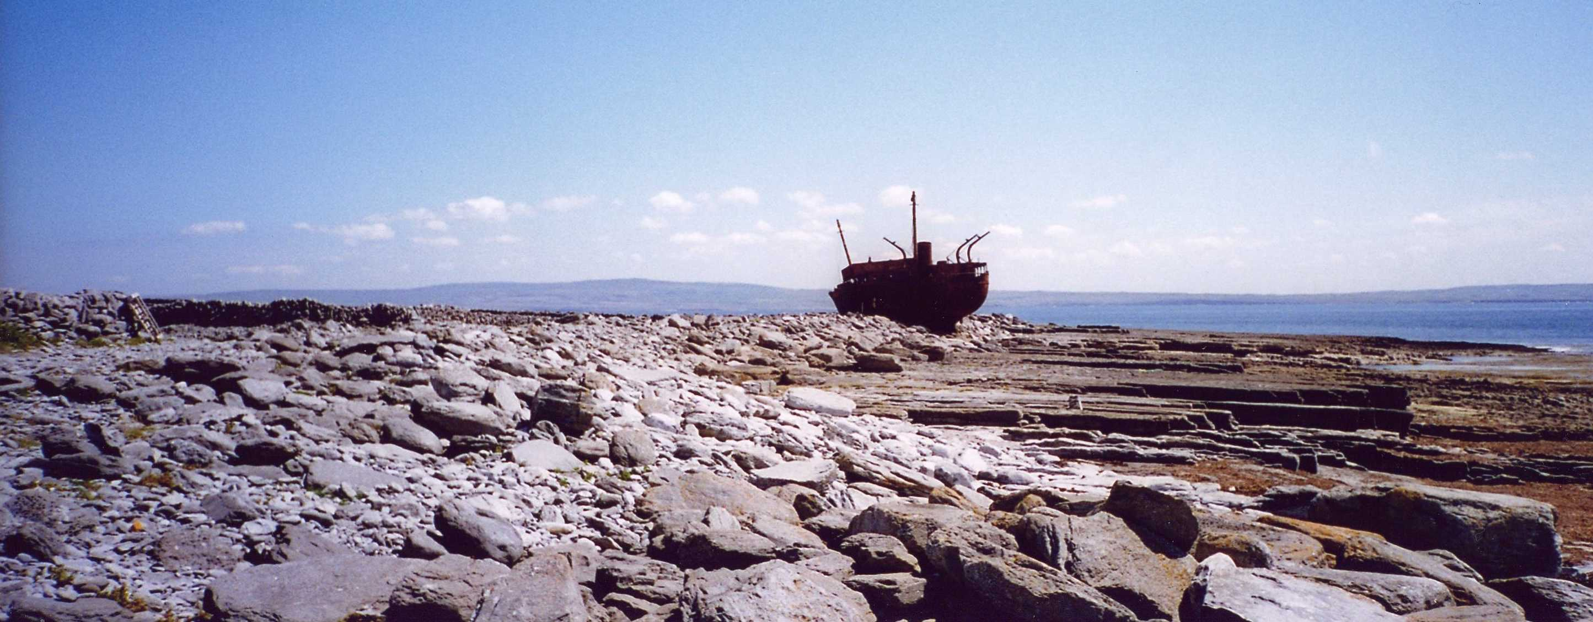
The shipwreck Plassey on Inis Oírr
http://www.seb75.com/CoGalway31.htm

Slide 96
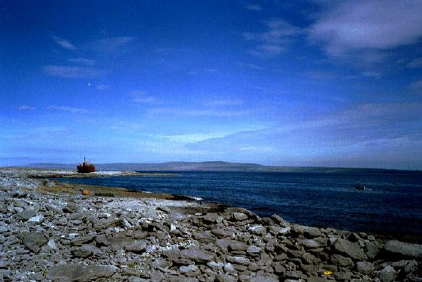
More on this in a short while
The Burren, off in the backgroun
http://www.bodhran-info.de/Inis/image12.html

Slide 97
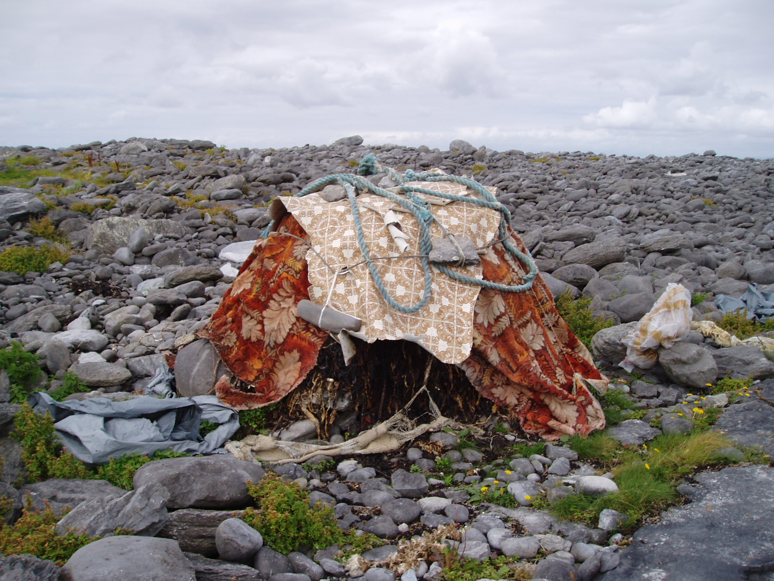
storage hut on Inis Oírr

Slide 98
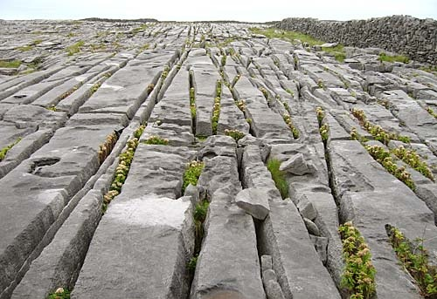
Inis Oírr
http://www.fethard.com/news_archive/cnews.050926.html

Slide 99
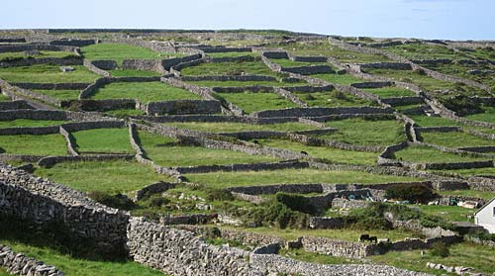
Inis Oírr
http://www.fethard.com/news_archive/cnews.050926.html

Slide 100

Inis Oírr
http://www.fethard.com/news_archive/cnews.050926.html

Slide 101

The sunken church, a bronze age site, St. Gobnait's church
http://www.fethard.com/news_archive/cnews.050926.html

Slide 102

Inis Oírr
http://irishislands.info/oilphoto/Aran/InisOirr/101currach8_jpg.html

Slide 103

design on tombstone at Inis Oírr cemetary
http://irishislands.info/oilphoto/Aran/InisOirr/105teampallc2_jpg.html

Slide 104

Somerset knitters make jumpers for bald chickens
BBC News (25 February 2010)

Slide 105


the famous “Irish fisherman” sweaters
http://www.savilerowclub.com/annai/knit.htm

Slide 106

Mairead's cottage where the workshop takes place on Inis Oírr
http://beknitted.blogspot.com/2004_08_01_beknitted_archive.html

Slide 107

Kim Roufs and friend at Mairead's cottage on Inis Oírr

Slide 108

ladies knitting at Mairead's cottage on Inis Oírr

Slide 109

Kim Roufs’ kitting project at Mairead's cottage on Inis Oírr

Slide 110
Somerset knitters make jumpers for bald chickens
BBC News (25 February 2010)

Slide 111

http://www.aransinger.com/
The “Aran Singer” from Inis Oírr

Slide 112


The “Aran Singer” from Inis Oírr
http://en.wikipedia.org/wiki/Lasairfh%C3%ADona

Slide 113

The “Aran Singer” from Inis Oírr on world tour
http://www.smu.ca/academic/arts/irish/conferences.html

Slide 114

The “Aran Singer” from Inis Oírr on world tour
http://www.smu.ca/academic/arts/irish/conferences.html

Slide 115


Aran Island singer, Lasairfhíona
http://www.cliffs-of-moher-cruises.com/aran_island.html
http://www.aransinger.com/

Slide 116

Kim Roufs checking remodeling project on Inis Oírr

Slide 117


Edna O’Brien, noted Irish author

Slide 118



Edna O’Brien, noted Irish author

Slide 119

Tim Roufs and local Inis Oírr “guide”

Slide 120
After several days of touring the island of Inis Oírr with the local “guide” -- with Prof. Roufs continually asking many questions --
Prof. Roufs asked the guide,
“have you ever ridden in a curagh?
The wonderful and normally very patient young guide very kindly turned to Prof. Roufs (as you will see in the next picture) and asked him . . .

Slide 121
After several days of touring the island of Inis Oírr with the local “guide” -- with Prof. Roufs continually asking many questions --
Prof. Roufs asked the guide,
“have you ever ridden in a curagh?
The wonderful and normally very patient young guide very kindly turned to Mr. Roufs (as you will see in the next picture) and asked him . . .

Slide 122

“Mr. Roufs, don’t you know ANYTHING? . . .

Slide 123

O'Brien Castle on Inis Oírr

Slide 124
O'Brien Castle

Slide 125

O'Brien Castle area
http://www.seb75.com/CoGalway31.htm

Slide 126

Weaving baskets at Aras Eanna, the arts and cultural centre

Slide 127
Continuing on “anticlockwise” around the southern coast of the Republic of Ireland . . .

Slide 129
Galway

Slide 130
Galway
Probably best known for the song . . .

Slide 131
Galway Bay
If you ever go across the sea to Ireland
Be it only at the closing of your day
You can sit and watch the moon rise over Cladagh
And see the sun go down on Galway Bay
Just to see again the ripple on the trout stream
The women in the meadow making hay
Or to sit beside a turf fire in a cabin
And watch the barefoot gasuns at their play
For the breezes blowing o'er the sea from Ireland
Are perfumed by the heather as they blow
And the women in the highlands diggin' pratties
Speak a language that the strangers do not know
(BREAK)
And the strangers came and tried to teach us their ways
And scorned us for being what we are
But they might as well go chasing after moonbeams
Or light a penny candle on a star
And if there's going to be a life hereafter
And somehow I feel sure there's going to be
I will ask my god to let me spend my heaven
In that dear isle across the Irish Sea

Slide 132
the West Coast of Ireland is the most traditional part of the Republic . . .

Slide 133
Clifton, County Galway
Clochán, "the stepping stones"

Slide 134

The Aran Islands are off over here in the distance,
looking almost due South
Clifton, County Galway, looking toward the Aran islands

Slide 135
Kylemore Castle and Abbey
County Galway

Slide 136

Kylemore Castle and Abbey
http://www.hoganstand.com/general/identity/extras/clergy/stories/kylemore.htm

Slide 137
a region
as a
Unit of Analysis:
The Irish Countryman
(county Clare)
“Kerrymen”

Slide 138
County Clare

Slide 139
Conrad Arensberg
1937 The Irish Countryman.
  New York: Macmillan.
  ”the earliest example of anglophone Europeanist anthropology”

Slide 140
the classic ethnography of Ireland is
  Conrad Arensburg’s The Irish Countryman
  set in County Clare
  backed up in image by the film Man of Aran
Susan Parman, Europe in the Anthropological Imagination, pp. 11 - 14

Slide 141

  County Claire

Slide 142

Doolin, County Clare

Slide 143
Doolin, County Clare
is one of the more traditional villages, especially noted as a center of traditional Irish music . . .
Dúlainn in Gaelic

Slide 145
The Burren

Slide 146
From Inishoirr you can see
The wrecked ship
Plassey
the Burren in the far distance,
looking southeast
The Burren, off in the background
http://www.bodhran-info.de/Inis/image12.html

Slide 147
The Cliffs of Mohar

Slide 148

www.wtopnews.com/?nid=456&sid=1358866#

Slide 149

The Cliffs of Mohar are in The Burren, near the castle
http://www.jetsettersmagazine.com/archive/jetezine/hotels/ireland/gregans/castle.html

Slide 150

The Cliffs of Mohar
http://folk.uio.no/davidwi/gallery/IRE/ireland2.html

Slide 151
a “subculture”
as a
Unit of Analysis:
e.g., “Travelers”
(“Tinkers”, “Gypsies”)

Slide 152


The Irish Tinkers: The Urbanization of an Itinerant People
by George Gmelch
1985

Slide 153
Common region of the Irish “Travelers”

Slide 154
Common region of the Irish “Travelers”

Slide 155
Common region of the Irish “Travelers”

Slide 156
Common region of the Irish “Travelers”

Slide 157

Common region of the Irish “Travelers”
http://www.waterville-insight.com/kerrymap.html

Slide 158
The “Ring of Kerry”

Slide 159
the individual
as a
Unit of Analysis:
e.g., Nan

Slide 160

Sharon Gmelch
Nan: The Life of an Irish Traveling Woman, Revised Edition.
Long Grove: IL: Waveland Press, 1991.
(ISBN: 0881336025)
http://www.d.umn.edu/cla/faculty/troufs/anth3635/cetexts.html#Nan

Slide 162
a region
as a
Unit of Analysis:
Dingle peninsula

Slide 163
Dingle

Slide 164
Dingle Peninsula
The Dingle Peninsula
http://www.waterville-insight.com/kerrymap.html

Slide 165

The Dingle Peninsula
myweb.tiscali.co.uk/stkhc/Dingle%20maps.htm

Slide 166

www.danheller.com/ireland.html

Slide 167

Rocky coastline of the Dingle Peninsula
http://toddadams.net/images/wallpaper/

Slide 168

Sunset on Dingle Bay
www.sitatof.ch/ireland/k24.html

Slide 169

The Dingle Peninsula
www.trekearth.com/.../Ireland/photo142208.htm

Slide 170

The Dingle Peninsula
http://empressgemma.com/eire2.html

Slide 171

http://news.bbc.co.uk/2/hi/uk_news/northern_ireland/6070820.stm

Slide 172

http://www.dinglename.com/

Slide 173

http://www.dinglename.com/articles/article.asp?a=101

Slide 174

http://news.bbc.co.uk/2/hi/europe/4388061.stm

Slide 175

The Dingle Peninsula
http://empressgemma.com/eire2.html

Slide 176
Ring of Kerry

Slide 177
The “Ring of Kerry”
http://www.waterville-insight.com/kerrymap.html

Slide 178
Bantry Bay
The “Ring of Kerry”

Slide 179

Sean and Kathy Cuddihy at their “Cottage” in The “Ring of Kerry”

Slide 181
Cork

Slide 182

Blarney Castle, Home of the Famed “Blarney Stone”
http://rockwellclan.com/euroSPR06/euroSPR06-Pages/Image21.html

Slide 183
Smyth hotel

Slide 184

Kim Smyth Roufs at the remains of the Smyth Village Hotel

Slide 185

Cows have the right of way in Ireland (and Scotland)

Slide 186

Tim Roufs entering the “Tunnel of Ignorance”

Slide 187

The internationally famous
“Irish National Stud”
www.berthouse.net/local_amenities.html

Slide 188


The internationally famous
“Irish National Stud”

Slide 189

The internationally famous
“Irish National Stud”
www.galenfrysinger.com/dublin.htm

Slide 190

The internationally famous
“Irish National Stud”
www.pedigreequery.com/

Slide 191

Gill & Macmillan, 2009.

Slide 192
Ireland is quickly losing it’s traditional farms and its image as an agricultural country based on traditional farms . . .
Gill & Macmillan, 2009.

Slide 193

there are relatively few traditional farms left, other than those which are now museums . . .
Muckross Traditional Farms
http://www.destinationkillarney.ie/muckross-traditional-farms/

Slide 194
Muckross Traditional Farms
http://www.destinationkillarney.ie/muckross-traditional-farms/

Slide 196
Dublin

Slide 197

Boxty is a traditional Irish dish . . .

Slide 198

The best (and only, at the time) Mexican Restaurant in Dublin . . .

Slide 199

Kim
Irish and Irish-American cousins celebrate in Dublin . . .

Slide 200
Kim
Kim Smyth Roufs’ ancestors came to America in a ship like the . . .
Irish and Irish-American cousins celebrate in Dublin . . .

Slide 201

Jeanie Johnson, Dublin, a 154 ft. 2 in. replica of an 1847 three-masted ocean-going barque that brought emigrants from Ireland to North America, and then timber back to Europe.

