Slide 1
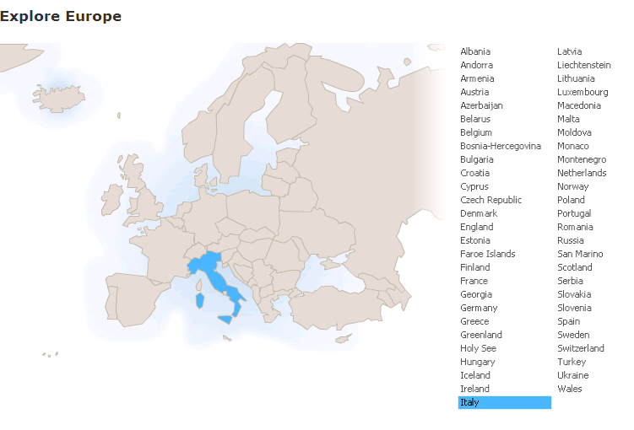
Run in “Slide Show” mode.
Use your up / down arrow keys and / or
your space bar to advance the slides
Immigration /
Emigration
Italy
© 2009-2026 Timothy G. Roufs, University of Minnesota Duluth

Slide 2
Italy
© 2009-2026 Timothy G. Roufs, University of Minnesota Duluth

Slide 3
Immigration /
Emigration
Italy
© 2009-2026 Timothy G. Roufs, University of Minnesota Duluth

Slide 4
Italy’s contemporary immigrant/emigrant situation reflects a complex history, geography, ecology, demographic make up, world view, and so forth
. . .

Slide 5
So first, a bit of history and background . . .

Slide 6
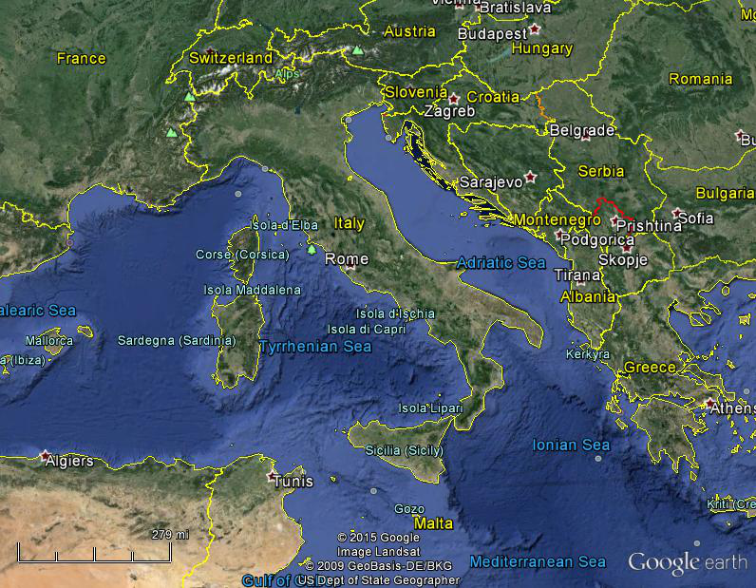
Italy, and her current neighbors . . .
Notes:
6

Slide 7
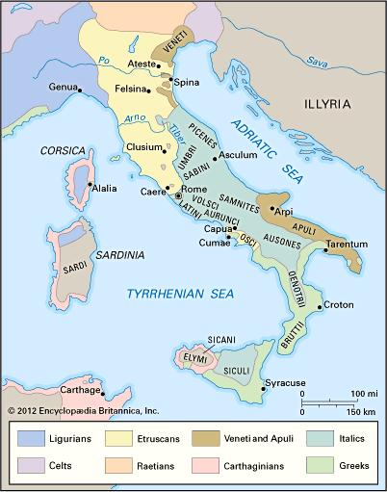
ancient Italic peoples:
Distribution of peoples of ancient Italy ca. 500 B.C.
©Encyclopædia Britannica, Inc.
https://www.britannica.com/topic/history-of-Italy
Notes:
7

Slide 8
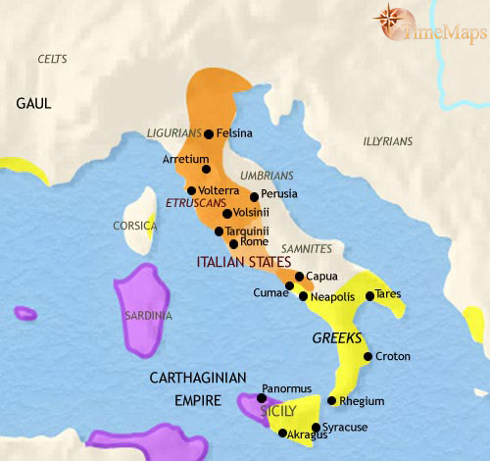
500 B.C.
http://www.timemaps.com/history/italy-500bc
Notes:
8

Slide 9
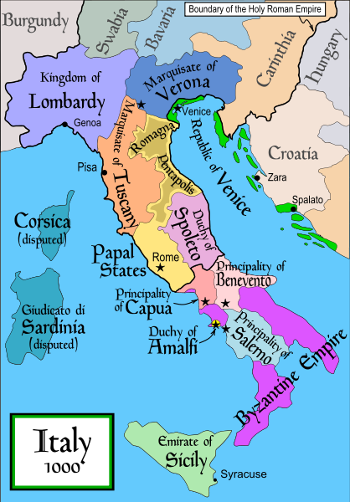
1000
Italy was divided for centuries into small kingdoms and city-states
http://en.wikipedia.org/wiki/Italy
Notes:
9

Slide 10
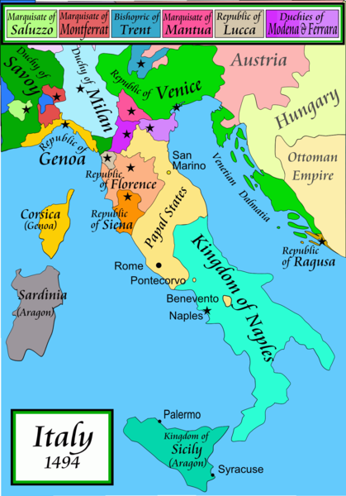
1494
Italy was divided for centuries into small kingdoms and city-states
http://en.wikipedia.org/wiki/Italy
Notes:
10

Slide 11
In 1494 Christopher Columbus from Genoa went on his second voyage to the New World
Italy was divided for centuries into small kingdoms and city-states
http://en.wikipedia.org/wiki/Italy
Notes:
11

Slide 12
In 1494 Christopher Columbus from Genoa is on his second voyage to the New World
Christopher Columbus was a sugar merchant from Genoa, married to the daughter of a sugar merchant from Madeira, Felipa Perestrello.
Columbus was looking for a way around Venice’s monopoly on things like sugar. . . .
Italy was divided for centuries into small kingdoms and city-states
http://en.wikipedia.org/wiki/Italy
Notes:
12

Slide 13
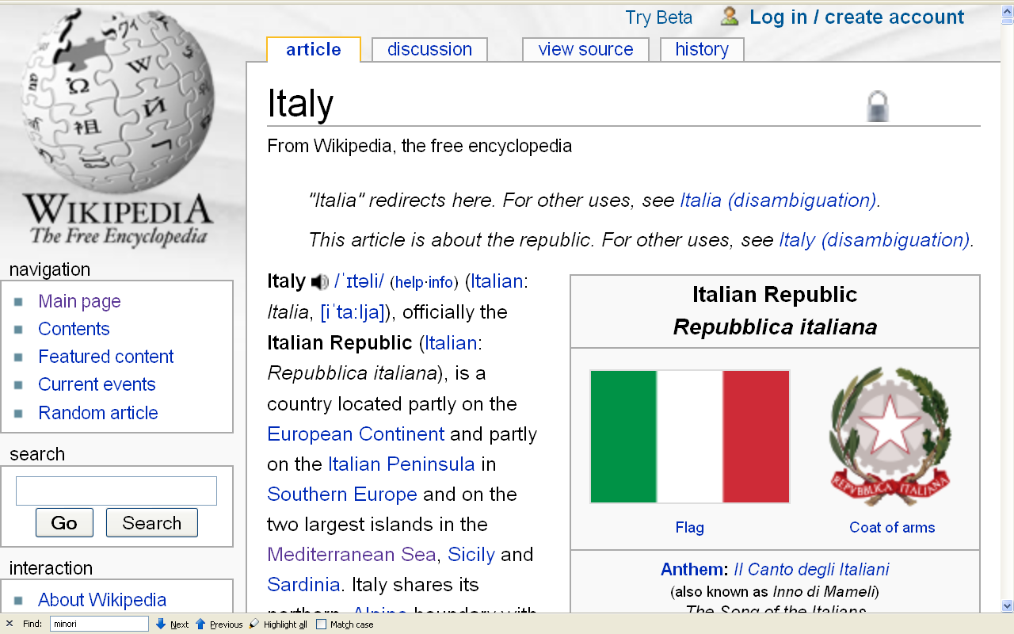
Formation of Italy
Unification —17 March 1861
Republic —2 June 1946
http://en.wikipedia.org/wiki/Italy
Notes:
13

Slide 14
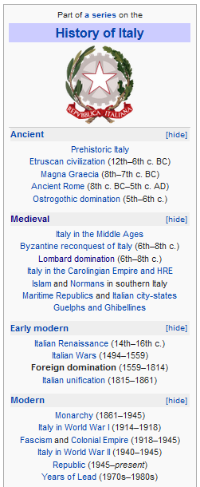
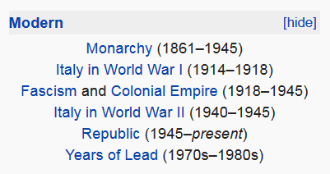
http://en.wikipedia.org/wiki/History_of_Italy_during_foreign_domination_and_the_unification
Notes:
14

Slide 15
http://en.wikipedia.org/wiki/History_of_Italy_during_foreign_domination_and_the_unification
Notes:
15

Slide 16
Formation of Italy
Unification —17 March 1861
Republic —2 June 1946
http://en.wikipedia.org/wiki/Italy
Notes:
16

Slide 17
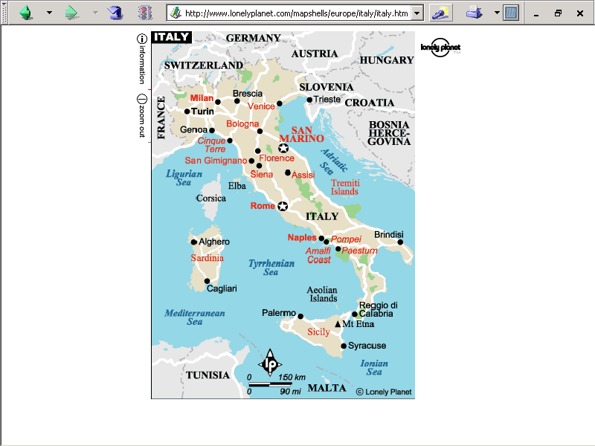
population size
60,964,931 (2024 est.)
https://www.worldometers.info/world-population/italy-population/

Slide 18
Note
Sicily

Slide 19
Note
Sardinia

Slide 20
Note
Kingdom of Tavolara
(unrecognized micronation)
https://en.wikipedia.org/wiki/Kingdom_of_Tavolara

Slide 21
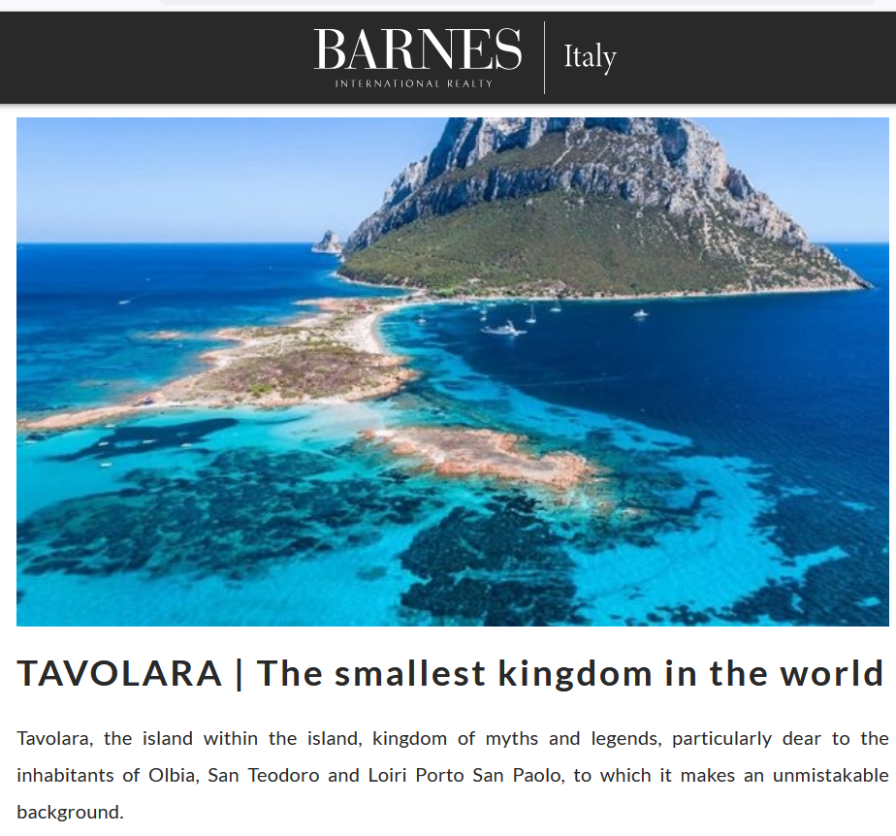
https://barnes-italy.com/tavolara-the-smallest-kingdom-in-the-world/
Notes:
21

Slide 22
Note
Corsica
(French)
Notes:
22

Slide 23
Principality of Seborga
(unrecognized micronation)
Note
https://en.wikipedia.org/wiki/Seborga
Notes:
23

Slide 24

Notes:
24

Slide 25
Note
Rome

Slide 26
The Holy See
(The Vatican)
an independent country
Note
Notes:
26

Slide 27
Note
Notes:
27

Slide 28
Note
The Most Serene Republic
of San Marino
an independent country
Notes:
28

Slide 29
Gannon and Pillai classify Italy as one of the
“Cleft National Cultures”
that they discuss

Slide 30
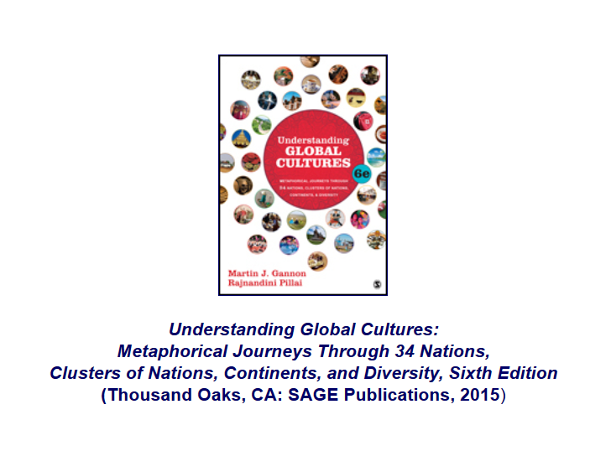
http://www.d.umn.edu/cla/faculty/troufs/anth1095/index.html#text

Slide 31
“Cleft National Culture”
    one in which the regions, and subcultures of the diverse ethnic groups,
    are difficult to integrate

Slide 32
in a nutshell . . .

Slide 33
Gannon and Pillai's
European Cultural Metaphors include
Ch. 19 The Italian Opera
Ch. 20 Belgian Lace
Ch. 22 The Turkish Coffehouse
Ch. 31 The Russian Ballet
Ch. 32 Estonian Singing
Ch. 33 The Polish Village Church
Ch. 34 The Spanish Bullfight
Ch. 35 The Portuguese Bullfight
Italy is culturally divided
“North - South”

Slide 34
Martin J. Gannon and Rajnandini Pillai
Understanding Global Cultures
The country is divided into two main regions
“Continental Italy” (aka “The North”)
  The Alps
  The northern Italian plain
“Mediterranean Italy” (aka “The South”)
  The Italian peninsula and the islands
www.d.umn.edu/cla/faculty/troufs/anth1095/index.html#Gannon

Slide 35
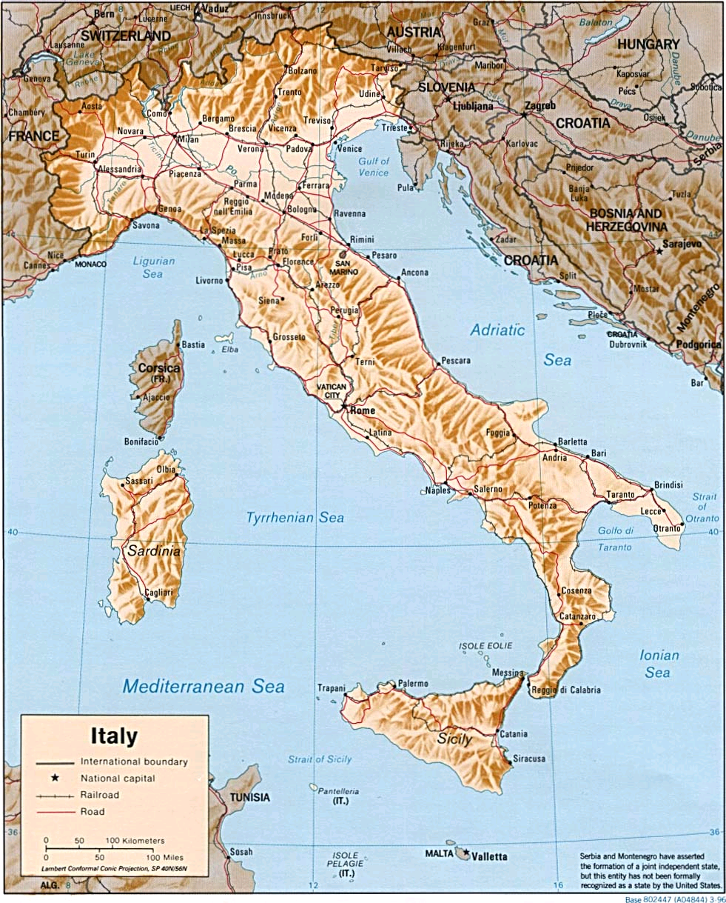
http://www.reliefweb.int/rw/RWB.NSF/db900LargeMaps/SKAR-64GDTU?OpenDocument

Slide 36
Martin J. Gannon and Rajnandini Pillai
Understanding Global Cultures
The Apennine mountains run directly down the peninsula’s center, and its northern range almost completely cuts off the north from the south
  This geographical division has led to extreme regionalism
www.d.umn.edu/cla/faculty/troufs/anth1095/index.html#Gannon

Slide 37
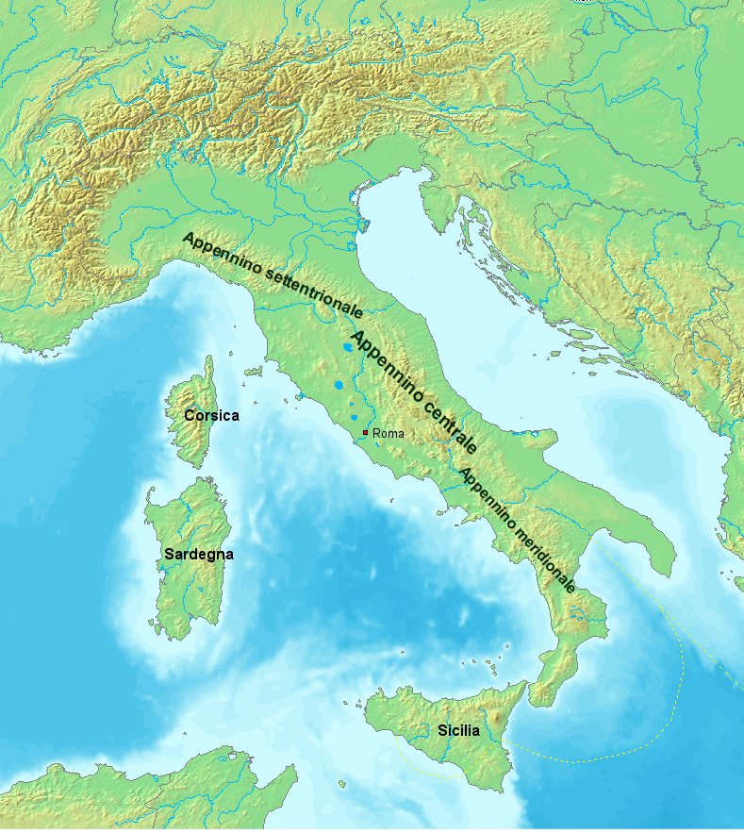
https://en.wikipedia.org/wiki/Apennine_Mountains

Slide 38
Martin J. Gannon and Rajnandini Pillai
Understanding Global Cultures
The Apennine mountains run directly down the peninsula’s center, and its northern range almost completely cuts off the north from the south
  Many Italians view Italy as two separate nations
    The wealthier, industrial north
    The poorer, more agrarian south
www.d.umn.edu/cla/faculty/troufs/anth1095/index.html#Gannon

Slide 39
Sometimes the northern region is called
Padania . . .
Some even arguing that it should be an independent country . . .
https://en.wikipedia.org/wiki/Padanian_nationalism

Slide 40

Sometimes the northern region is called
Padania . . .
Some even arguing that it should be an independent country . . .
https://en.wikipedia.org/wiki/Padanian_nationalism

Slide 41
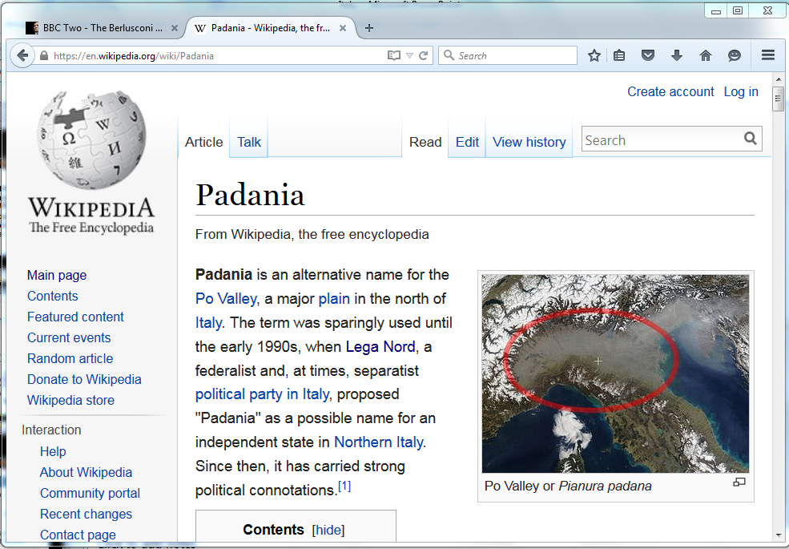
https://en.wikipedia.org/wiki/Padania
Notes:
41

Slide 42
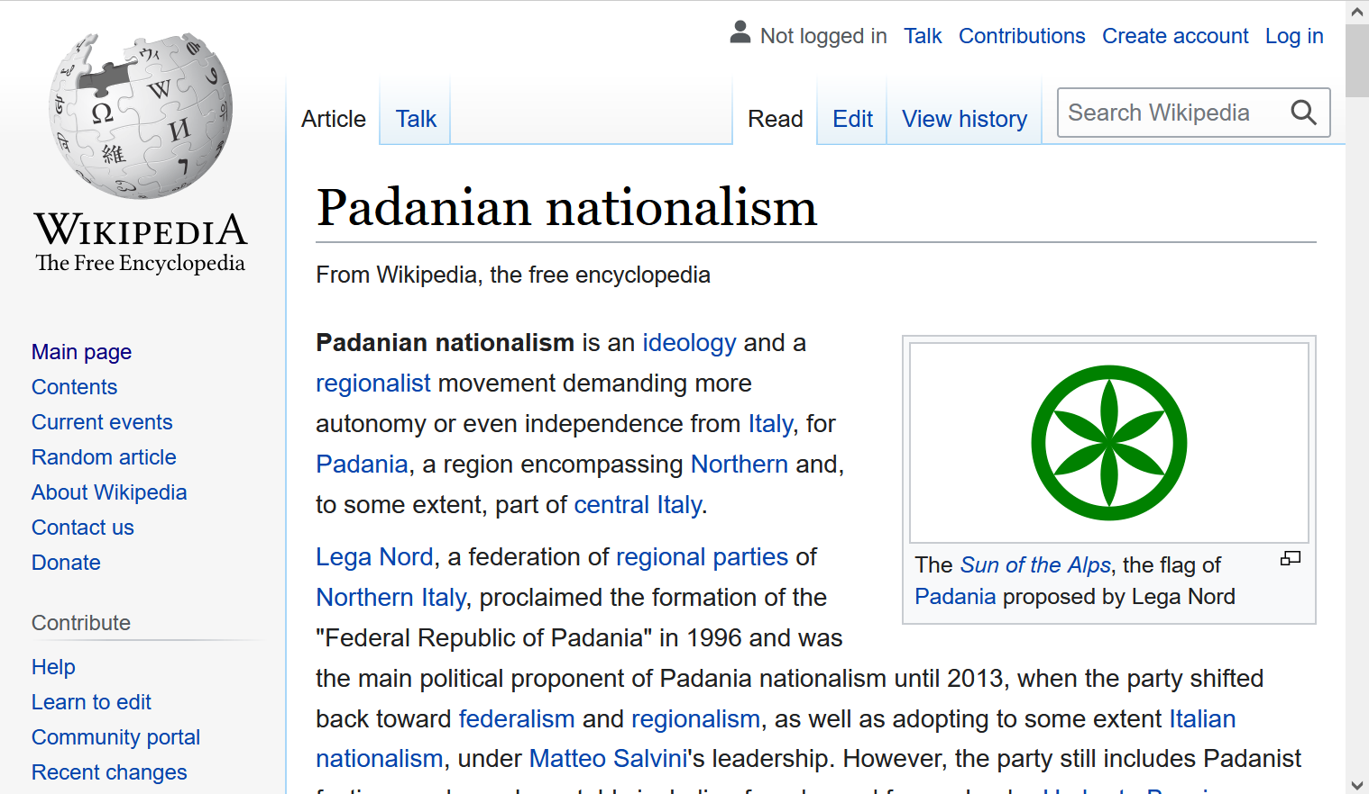
https://en.wikipedia.org/wiki/Padanian_nationalism
Notes:
42

Slide 43
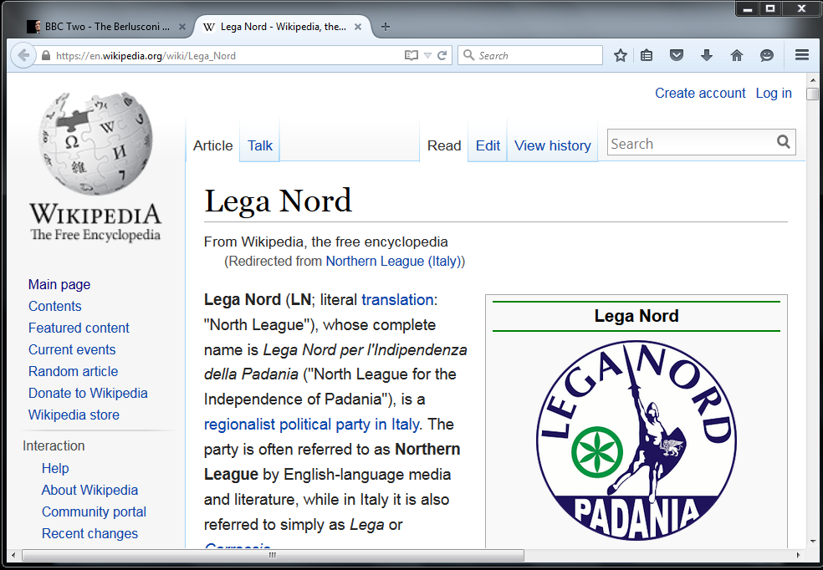
http://en.wikipedia.org/wiki/Northern_League_%28Italy%29
Notes:
43

Slide 44
Basic Demographics
Italy

Slide 45
note. . .
population size
61,021,855 (2023 est.)
https://www.worldometers.info/world-population/italy-population/

Slide 46
Demographics
Italy has the fourth-largest population in the European Union and the 24th-largest population worldwide
The population density, at over
201.7 persons per km²
(over 522.4 / mi²)
is the fifth highest in the European Union
The highest density is in Northern Italy, as that one-third of the country contains almost half of the total population
Wikipedia
http://en.wikipedia.org/wiki/Italy#Demographics

Slide 47
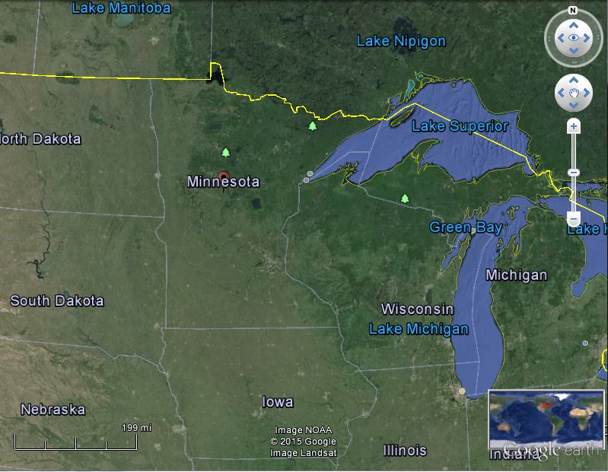
Coparisons with Minnesota
Population:
Italy: 60,964,931 (2024 est.)
Minnesota: 5,705,494 (2020 Census)
Population Density:
Italy: 532 / mi² (206 / km²)
Minnesota: 71.0 / mi² (27.4 / km²)

Slide 48
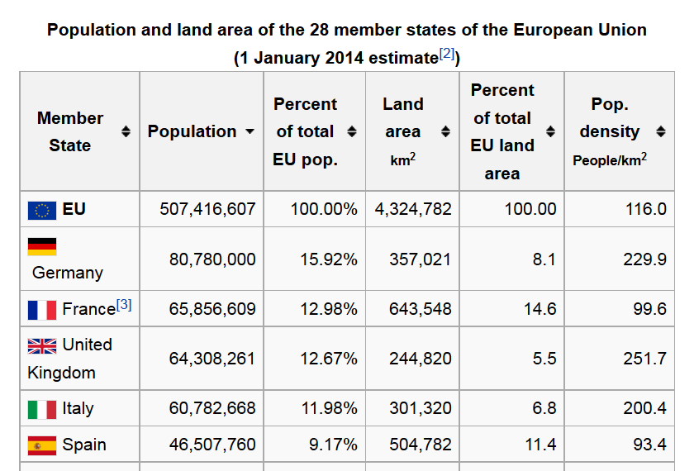
https://en.wikipedia.org/wiki/Demographics_of_the_European_Union#Population_by_nation
Notes:
48

Slide 49
Demographics
The highest population density is in Northern Italy,
as that one-third of the country contains almost half of the total population
Wikipedia
http://en.wikipedia.org/wiki/Italy#Demographics

Slide 50
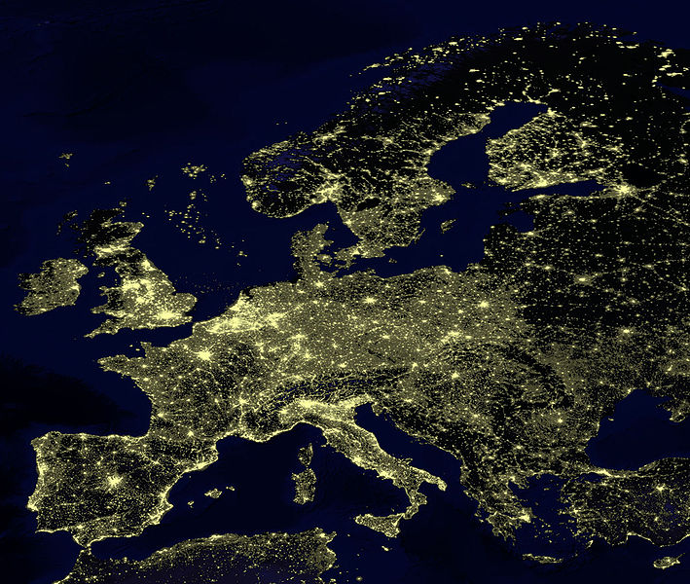
for Europe, at least, earthlight photos give you a sense of population density
https://commons.wikimedia.org/wiki/File:Earthlights_2002.jpg
Notes:
50

Slide 51
https://commons.wikimedia.org/wiki/File:Earthlights_2002.jpg
Notes:
51

Slide 52
Oslo
Stockholm
St. Petersburg
Edinburgh
Glasgow
Copenhagen
London
Brussels
Paris
Milan
Venice
Rome
Madrid
Naples
Athens
https://commons.wikimedia.org/wiki/File:Earthlights_2002.jpg
Notes:
52

Slide 53
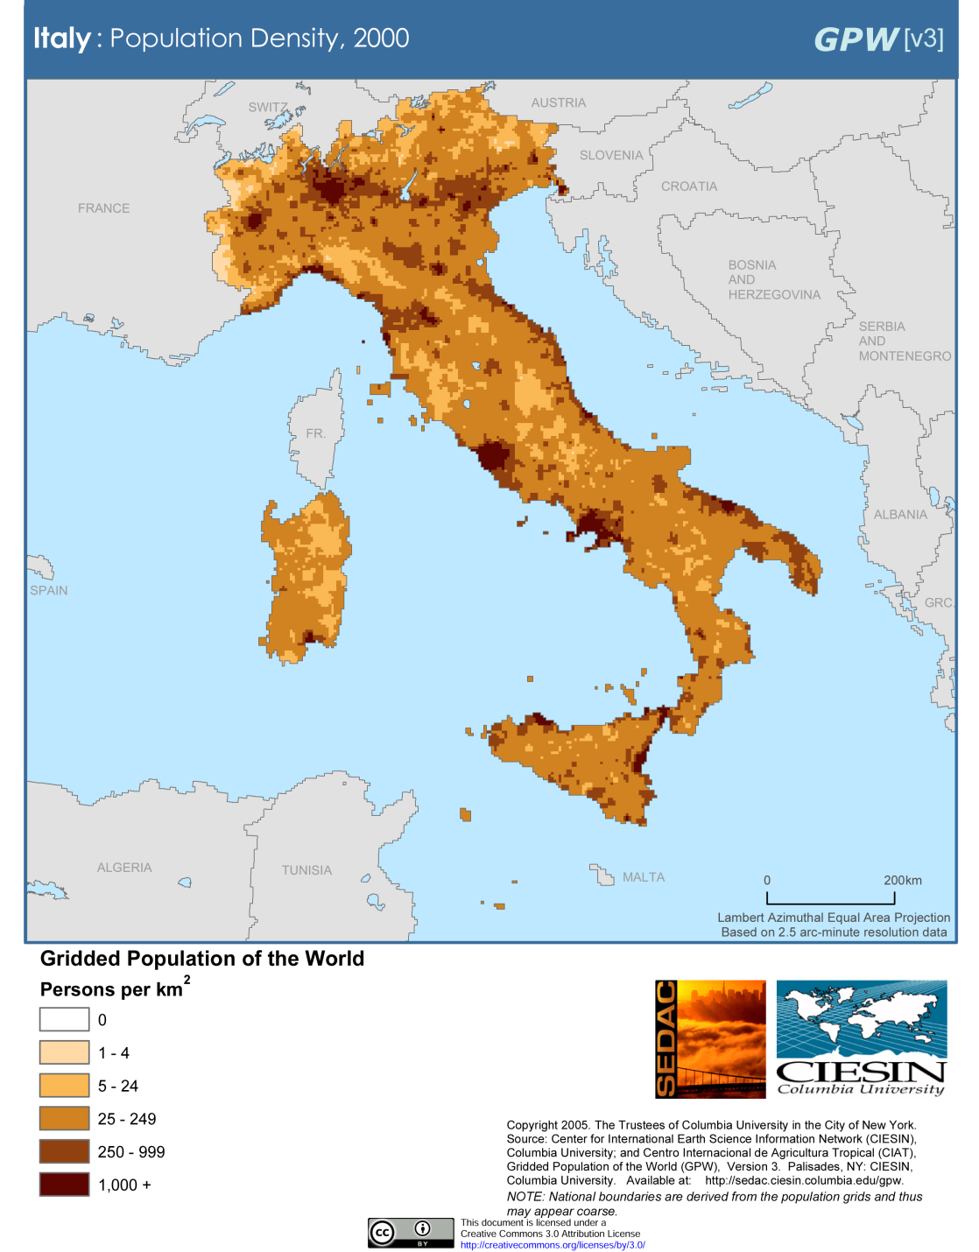
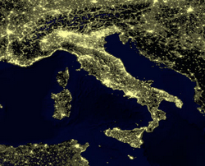
Milan
Venice
Rome
Milan
Venice
Naples
Rome
Naples
Population Density (2000)
Wikipedia
http://en.wikipedia.org/wiki/Italy#Demographics

Slide 54
Demographics
urban population:
72% of total population
(2023)
rate of urbanization: 0.27% annual rate of change
(2020-2025 est.)
Infant mortality rate:
total: 3.1 deaths/1,000 live births
(2023 est.)
country comparison to the world: 210
Life expectancy at birth:
total population: 82.8 years
(2023 est.)
country comparison to the world: 19
CIA World Factbook
https://www.cia.gov/the-world-factbook/countries/italy/

Slide 55
Demographics
Ethnic Groups
In the North
  German-Italians
  French-Italians
  Slovene-Italians
In the South
  Albanian-Italians
  Greek-Italians
CIA World Factbook
https://www.cia.gov/library/publications/the-world-factbook/geos/it.html

Slide 56
the main languages of Italy reflect the main ethnic groups,
at least in the north,
and include . . .

Slide 57
Italy’s
Languages
Italian (official)
German
  parts of Trentino-Alto Adige region are predominantly German speaking
French
  small French-speaking minority in Valle d'Aosta region (near France)
Slovene
  Slovene-speaking minority in the Trieste-Gorizia area (near Slovenia)
include . . .
CIA World Factbook
https://www.cia.gov/the-world-factbook/countries/italy/

Slide 58
Main Languages
Italian (official)
German
  parts of Trentino-Alto Adige region are predominantly German speaking
French
  small French-speaking minority in Valle d'Aosta region (near France)
Slovene
  Slovene-speaking minority in the Trieste-Gorizia area (near Slovenia)
CIA World Factbook
https://www.cia.gov/the-world-factbook/countries/italy/

Slide 59
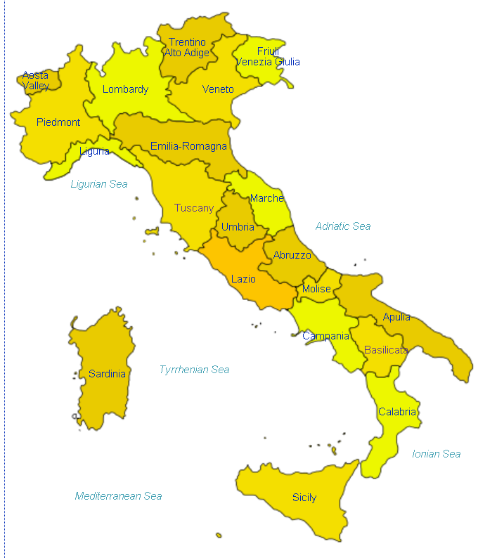
German
http://en.wikipedia.org/wiki/Regions_of_Italy
Notes:
59

Slide 60
Main Languages
Italian (official)
German
  parts of Trentino-Alto Adige region are predominantly German speaking
French
  small French-speaking minority in Valle d'Aosta region (near France)
Slovene
  Slovene-speaking minority in the Trieste-Gorizia area (near Slovenia)
CIA World Factbook
https://www.cia.gov/the-world-factbook/countries/italy/

Slide 61
French
http://en.wikipedia.org/wiki/Regions_of_Italy
Notes:
61

Slide 62
Main Languages
Italian (official)
German
  parts of Trentino-Alto Adige region are predominantly German speaking
French
  small French-speaking minority in Valle d'Aosta region (near France)
Slovene
  Slovene-speaking minority in the Trieste-Gorizia area (near Slovenia)
CIA World Factbook
https://www.cia.gov/the-world-factbook/countries/italy/

Slide 63
Slovene
http://en.wikipedia.org/wiki/Regions_of_Italy
Notes:
63

Slide 64
http://en.wikipedia.org/wiki/Regions_of_Italy
Notes:
64

Slide 65
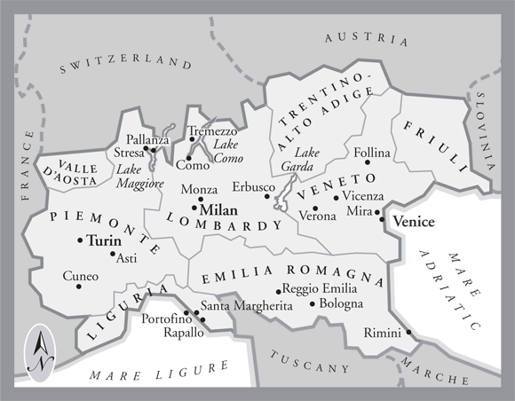

In northern Italy people in three regions speak a different primary language,
in addition to Italian . . .
German
Slovene
French
Italian
is spoken throughout Italy
Tuscany
www.jdbassc.com/maps/map_southern_italy.asp
Notes:
65

Slide 66
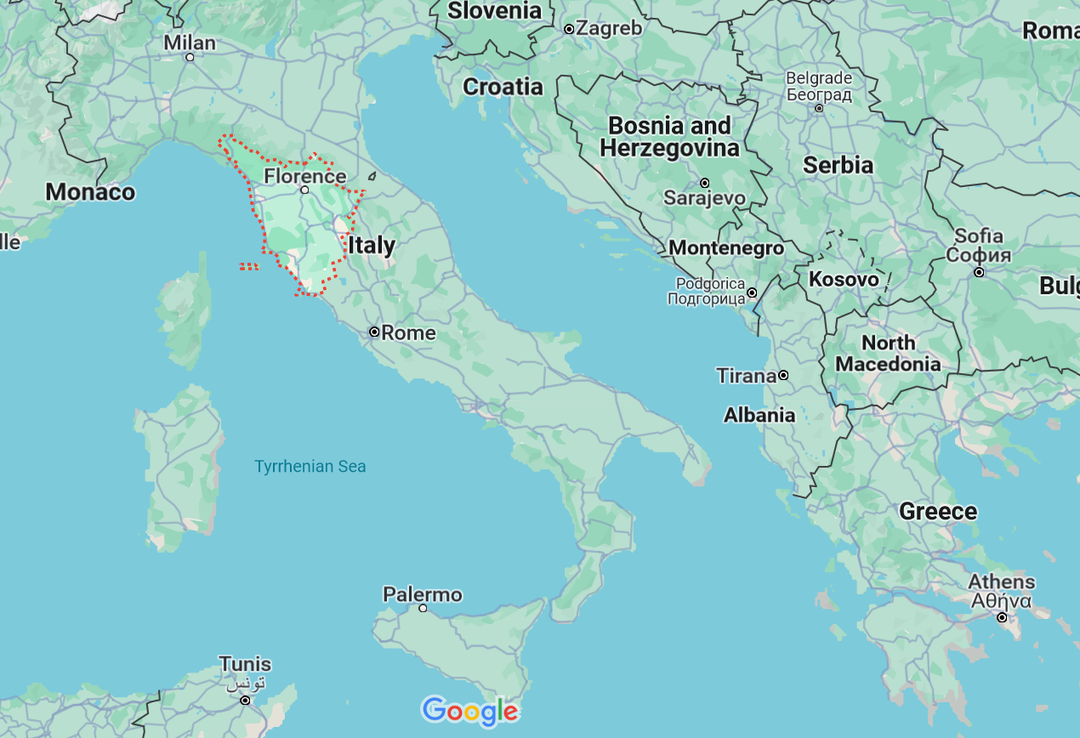

German
French
Slovene
Tuscany
Italian
In the neighboring Tuscany region
they speak Italian, which historically was based on the Florentine dialect . . .

Slide 67
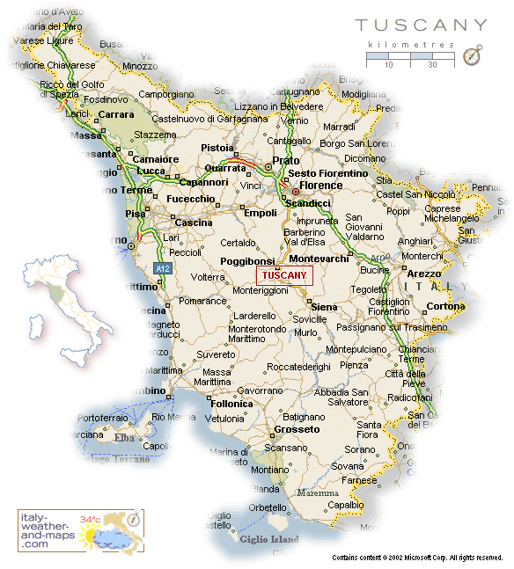
Florence
Pisa
http://healthmap.files.wordpress.com/2009/12/tuscany-map.gif

Slide 68
Italian
throughout
http://en.wikipedia.org/wiki/Regions_of_Italy
Notes:
68

Slide 69
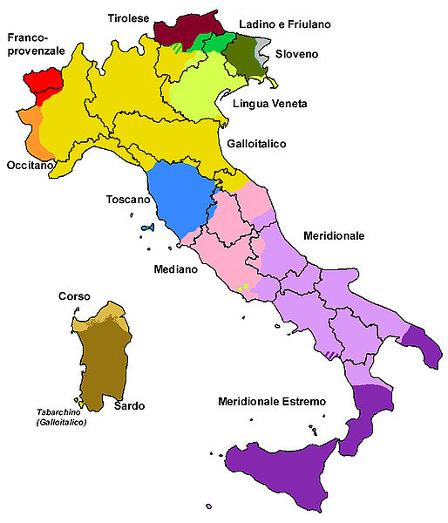
all the languages include . . .
Official language(s) | Italian
Regional language(s) | German, Neapolitan, Slovene, Piedmontese, Sardinian, Sardinian, Tabarchino, Sassarese, Gallurese, Ladin, Cimbrian, Mocheno, Venetian
Minority language(s) | Albanian, Catalan, German, Greek, Slovene, Croatian, French, Franco-Provençal, Friulian, Ladin, Occitan, Sardinia
Main immigrant language(s) | Romanian, Berber, Maghrebi Arabic, Albanian
Main foreign language(s) | English (25%) Spanish (17%) French (14%)
Dialects of Italy by Group
http://en.wikipedia.org/wiki/List_of_languages_of_Italy
Notes:
69

Slide 70
Martin J. Gannon and Rajnandini Pillai
Understanding Global Cultures
The Italian history of invasions has produced many dialects, each the product of the particular regional invader
  The language of Italy consists of
  both local dialects and Italian,
  a derivative of the Tuscan language
  Although linguistic variations are disappearing to some extent due to the homogenizing effects of television and telecommunications, Italians still cling to the notion of having their own regional dialect
www.d.umn.edu/cla/faculty/troufs/anth1095/index.html#Gannon

Slide 71
Martin J. Gannon and Rajnandini Pillai
Understanding Global Cultures
The vocal selections of the chorus in the Italian opera are directly comparable to the many regional variations of the Italian language
Although each section is important to the harmony of the chorus, each has its own melody
www.d.umn.edu/cla/faculty/troufs/anth1095/index.html#Gannon

Slide 72
Dialects of Italy by Group
http://en.wikipedia.org/wiki/List_of_languages_of_Italy
Notes:
72

Slide 73
1494
compare these
with the old kingdoms
Dialects of Italy by Group
http://en.wikipedia.org/wiki/List_of_languages_of_Italy
Notes:
73

Slide 74
1000
1494
compare these
with the old kingdoms
Dialects of Italy by Group
http://en.wikipedia.org/wiki/List_of_languages_of_Italy
Notes:
74

Slide 75
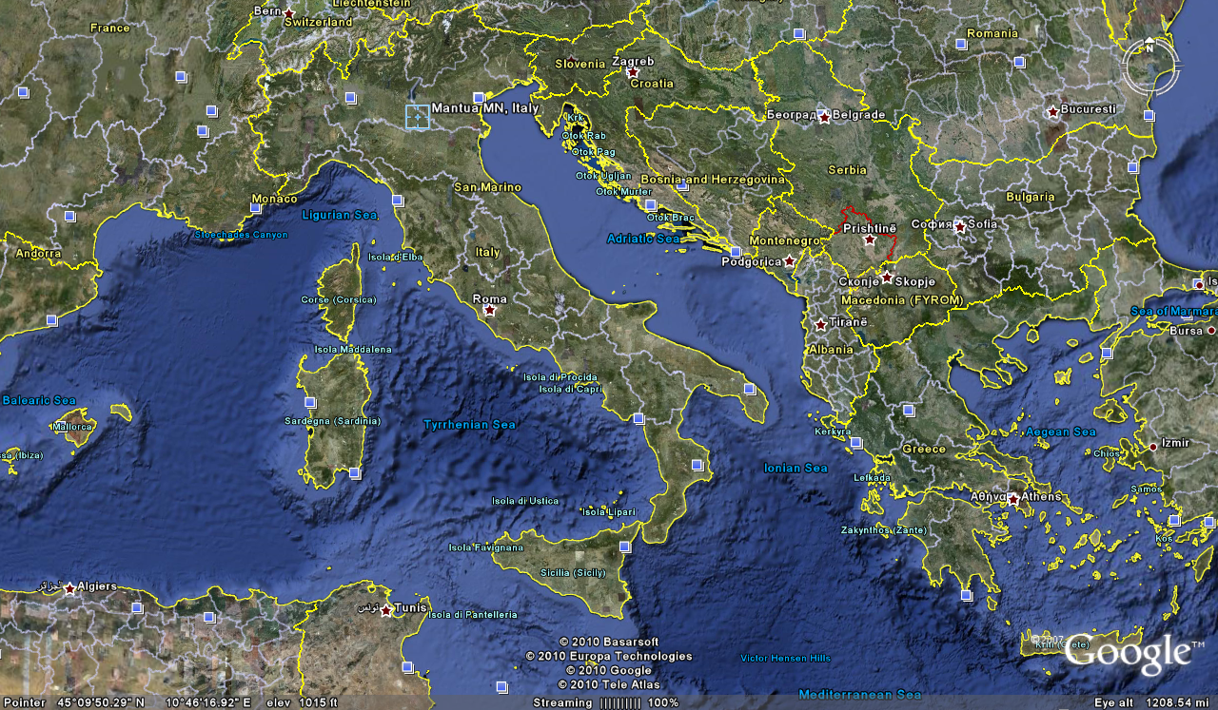

Cosimo Vassallo
is from
Palermo, Sicily
Letizia Colajanni
and
Cosimo Vassallo
/

Slide 76
Cossimo lives in
Mantova
503 miles away
(by air)
/
Letizia Colajanni
and
Cosimo Vassallo

Slide 77
If Cosimo speaks Italian with
his Palermo accent in
Montova, some
will have difficult understanding him
/
Cosimo Vassallo
is from
Palermo, Sicily
Letizia Colajanni
and
Cosimo Vassallo
/

Slide 78
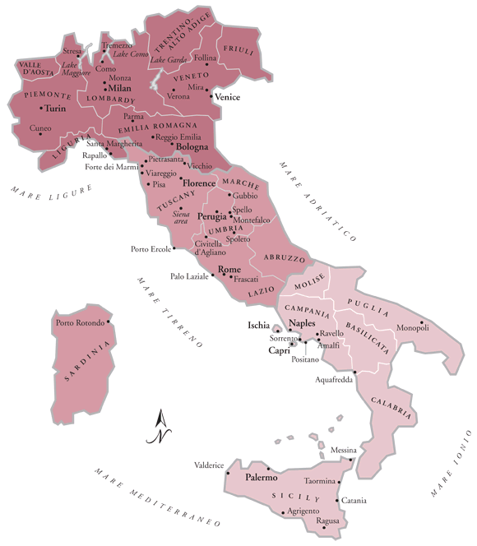
/
My friend Martin Aricochi
who lives in
Brixen (Bressanone), Italy, spoke German until he went to school,
www.jdbassc.com/maps/map_southern_italy.asp
Notes:
78

Slide 79
/
My friend Martin Aricochi
who lives in
Brixen (Bressanone), Italy, spoke German until he went to school,
and they still speak German at home
www.jdbassc.com/maps/map_southern_italy.asp
Notes:
79

Slide 80
the main religions include . . .

Slide 81
Demographics
Religions
Roman Catholic 80%-90%
  approximately
  about one-third regularly attend services
Other 10-20%%
  includes “mature Protestant” and Jewish communities
  and a growing Muslim immigrant community
CIA World Factbook
https://www.cia.gov/library/publications/the-world-factbook/geos/it.html

Slide 82
Demographics
Religions
Roman Catholic 80%-90%
  approximately
  about one-third regularly attend services
Other 10-20%%
  includes “mature Protestant” and Jewish communities
  and a growing Muslim immigrant community
CIA World Factbook
https://www.cia.gov/library/publications/the-world-factbook/geos/it.html

Slide 83
Literacy
definition: age 15 and over can read and write
    total population: 99.2%
    male: 99.4%
    female: 99%
(2018 est.)
CIA World Factbook
https://www.cia.gov/library/publications/the-world-factbook/geos/it.html

Slide 84
One really important feature about Italy is their very low population growth rate,
a rate so low it will eventually cause big problems
(if not changed) . . .

Slide 85
Demographics
total fertility rate in Italy:
1.26 children born / 1,000 woman
(2024 est.)
country comparison to the world: 219
10.7 deaths / 1,000 population
(2021 est.)
country comparison to the world: 24
That means not enough children are being born to sustain the population . . .
CIA World Factbook
https://www.cia.gov/the-world-factbook/countries/italy/

Slide 86

Demographics
Population: 60,964,931
(2024 est.)
country comparison to the world: 24
Population growth rate: -0.08%
(2024 est.)
country comparison to the world: 201
65 years and over: 23.6%
(2024 est.)
CIA World Factbook
https://www.cia.gov/the-world-factbook/countris/italy/

Slide 87
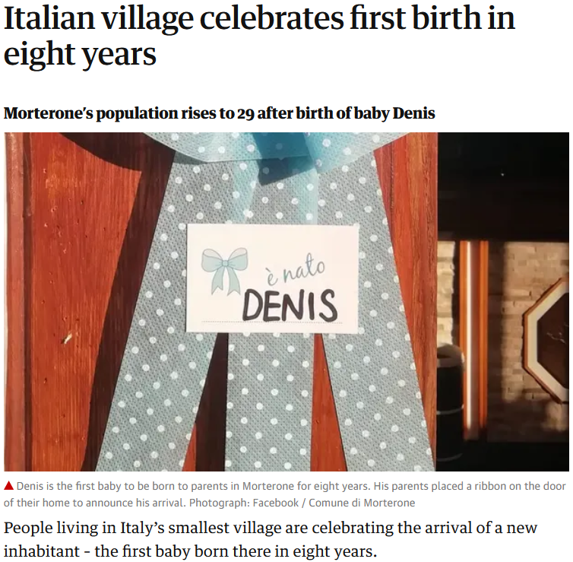

21 Jul 2020
https://www.theguardian.com/world/2020/jul/21/italian-village-morterone-celebrates-first-birth-in-eight-years?CMP=Share_iOSApp_Other

Slide 88
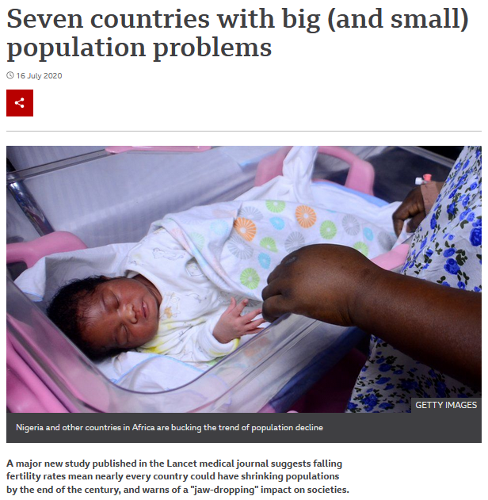

16 Jul 2020
Including Italy
https://www.bbc.com/news/world-53424726

Slide 89
Demographics
total fertility rate in Italy:
1.26 children born / 1,000 woman
(2024 est.)
country comparison to the world: 219
an overall total fertility rate of 2.1 is needed for the population in an area
to remain stable,
assuming no immigration or emigration occurs . . .
10.7 deaths / 1,000 population
(2021 est.)
country comparison to the world: 24
CIA World Factbook
https://www.cia.gov/the-world-factbook/countries/italy/

Slide 90
Demographics
total fertility rate in Italy:
1.26 children born / 1,000 woman
(2024 est.)
country comparison to the world: 209
The low birth rate is a huge
slow-moving crisis . . .
and unless something
is eventually done,
Italy as we know it will disappear . . .
10.7 deaths / 1,000 population
(2021 est.)
country comparison to the world: 24
net migration rate:
3.2 migrant(s) / 1,000 population
(2021 est.)
country comparison to the world: 34
CIA World Factbook
https://www.cia.gov/the-world-factbook/countries/italy/

Slide 91



Martin J. Gannon and Rajnandini Pillai
Understanding Global Cultures
“Although Italian culture is justifiably renowned, it is in danger of extinction, as are the cultures of some other developed nations. It has one of the lowest fertility rate among nations: 1.19 children per woman. After Sweden, Italy has the oldest population among nations, with 16.1% of its population over 65.”
1.26
22.1
[23.6%]
[2024 est.]
www.d.umn.edu/cla/faculty/troufs/anth1095/index.html#Gannon

Slide 92
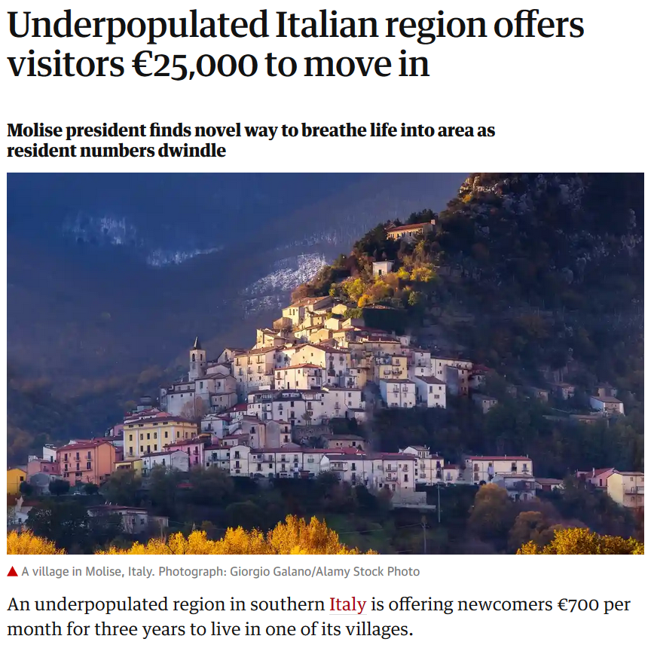
Wed 11 Sep 2019
https://www.theguardian.com/world/2019/sep/11/underpopulated-italian-region-molise?CMP=Share_iOSApp_Other

Slide 93
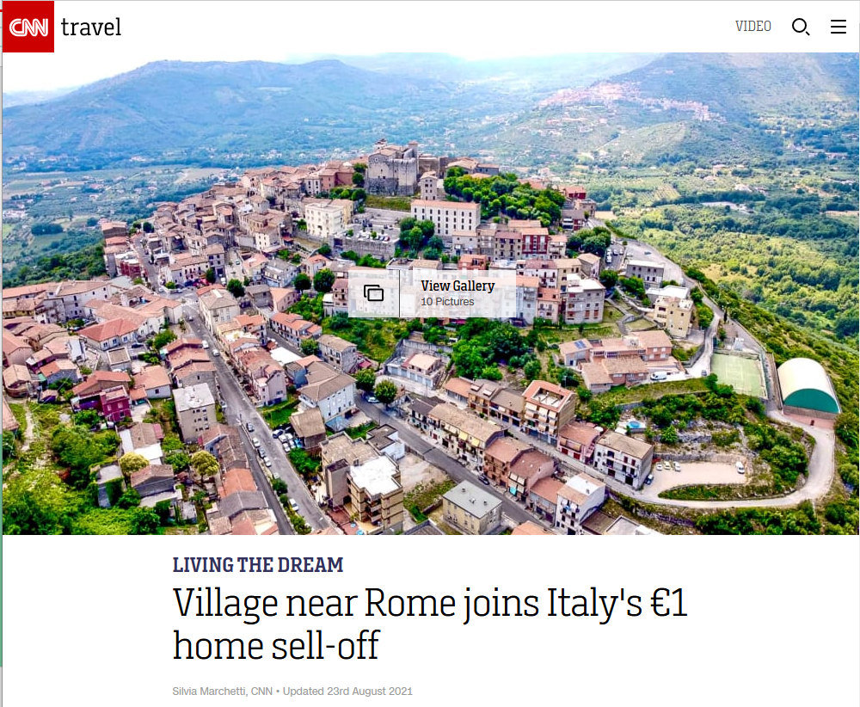





$1.18 USD
23 August 2021
http://edition.cnn.com/travel/article/italy-one-euro-homes-maenza-rome/index.html

Slide 94
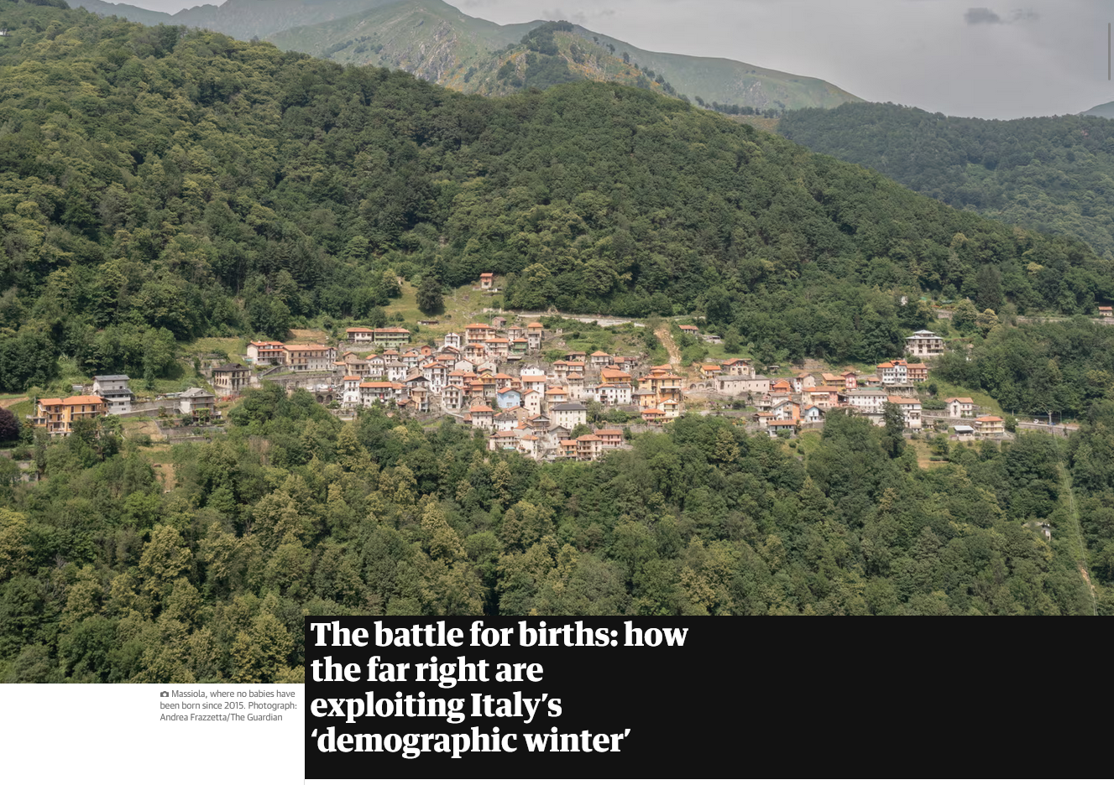
23 August 2021
https://www.theguardian.com/world/2023/oct/07/italy-births-far-right-demographic-winter?CMP=Share_iOSApp_Other

Slide 95
Demographics
total fertility rate in Italy:
1.26 children born / 1,000 woman
(2024 est.)
country comparison to the world: 209
and in the meantime, there will be big problems trying to support
an aging population . . .
10.7 deaths / 1,000 population
(2021 est.)
country comparison to the world: 24
net migration rate:
3.2 migrant(s) / 1,000 population
(2021 est.)
country comparison to the world: 34
CIA World Factbook
https://www.cia.gov/the-world-factbook/countries/italy/

Slide 96
Demographics
Population: 60,964,931
(2024 est.)
country comparison to the world: 24
Population growth rate: -0.08%
(2024 est.)
country comparison to the world: 201
65 years and over: 23.6%
(2024 est.)
CIA World Factbook
https://www.cia.gov/the-world-factbook/countries/italy/

Slide 97
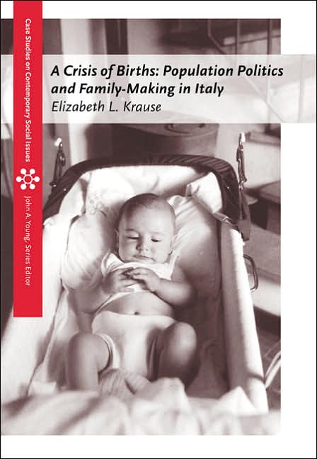
This is detailed in Betsy Krause’s excellent book
Elizabeth L. Krause
A Crisis of Births:
Population Politics and Family-Making in Italy
Belmont, CA: Thompson Wadsworth, 2005.
http://www.d.umn.edu/cla/faculty/troufs/anth3635/cetexts.html#CrisisofBirths

Slide 98
Here’s how that works . . .

Slide 99
If you like formulas, here’s the formula:
∆p = (b-d) + (i-e)
∆p = population change
b = births
d = deaths
I = immigration
e = emigration

Slide 100
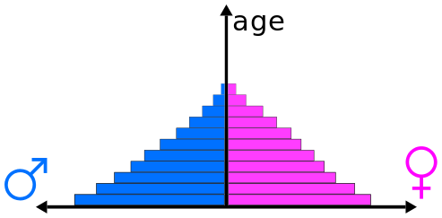
Population Pyramids
reflect population composition and change
https://en.wikipedia.org/wiki/Population_pyramid
Notes:
100

Slide 101
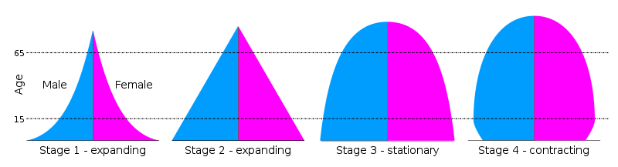
Population Pyramids for 4 Stages of the Demographic Transition Model
“. . . the transition from high birth and death rates to low birth and death rates as a country develops from a pre-industrial to an industrialized economic system”
population is expanding
https://en.wikipedia.org/wiki/Population_pyramid
https://en.wikipedia.org/wiki/Demographic_transition
Notes:
101

Slide 102
Population Pyramids for 4 Stages of the Demographic Transition Model
“. . . the transition from high birth and death rates to low birth and death rates as a country develops from a pre-industrial to an industrialized economic system”
population is expanding
https://en.wikipedia.org/wiki/Population_pyramid
https://en.wikipedia.org/wiki/Demographic_transition
Notes:
102

Slide 103
Population Pyramids for 4 Stages of the Demographic Transition Model
“. . . the transition from high birth and death rates to low birth and death rates as a country develops from a pre-industrial to an industrialized economic system”
population is stationary
https://en.wikipedia.org/wiki/Population_pyramid
https://en.wikipedia.org/wiki/Demographic_transition
Notes:
103

Slide 104
Population Pyramids for 4 Stages of the Demographic Transition Model
“. . . the transition from high birth and death rates to low birth and death rates as a country develops from a pre-industrial to an industrialized economic system”
population is contracting
https://en.wikipedia.org/wiki/Population_pyramid
https://en.wikipedia.org/wiki/Demographic_transition
Notes:
104

Slide 105
a major problem occurs with the large and growing
“dependent population”
(those not in the work force who must be supported by those in the work force)

Slide 106
“dependent population” =
the number of people that have to be supported by those of working age
Usually, it’s
(the population aged 0-14 + those 65 and over)
divided by
(the total population 15-64)

Slide 107
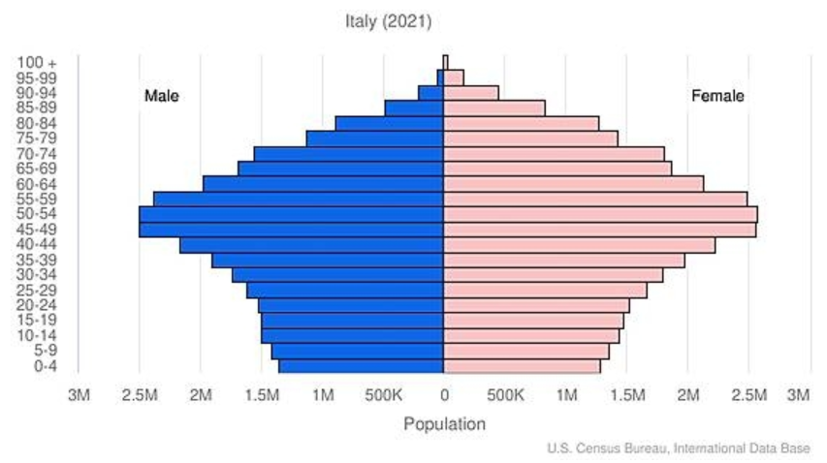
Population Pyramid
“dependent population”
“dependent population”
CIA World Factbook
https://www.cia.gov/the-world-factbook/countries/italy/
Notes:
107

Slide 108
Population Pyramid
People who have to support the “dependent population”
male
female
CIA World Factbook
https://www.cia.gov/the-world-factbook/countries/italy/
Notes:
108

Slide 109
Population Pyramid
Every 5 years
the lines move up one level
CIA World Factbook
https://www.cia.gov/the-world-factbook/countries/italy/
Notes:
109

Slide 110

Population Pyramid
And the “bulge”,
combined with the shrinking base groups, could be a big problem in the future as it moves up
CIA World Factbook
https://www.cia.gov/the-world-factbook/countries/italy/
Notes:
110

Slide 111

Population Pyramid
And the “bulge”,
combined with the shrinking base groups, could be a big problem in the future as it moves up
CIA World Factbook
https://www.cia.gov/the-world-factbook/countries/italy/
Notes:
111

Slide 112
Population Pyramid
And the “bulge”,
combined with the shrinking base groups, could be a big problem in the future as it moves up
CIA World Factbook
https://www.cia.gov/the-world-factbook/countries/italy/
Notes:
112

Slide 113
Population Pyramid
And the “bulge”,
combined with the shrinking base groups, could be a big problem in the future as it moves up
CIA World Factbook
https://www.cia.gov/the-world-factbook/countries/italy/
Notes:
113

Slide 114
Population Pyramid
And the “bulge”,
combined with the shrinking base groups, could be a big problem in the future as it moves up
CIA World Factbook
https://www.cia.gov/the-world-factbook/countries/italy/
Notes:
114

Slide 115
Population Pyramid
And the “bulge”,
combined with the shrinking base groups, could be a big problem in the future as it moves up
CIA World Factbook
https://www.cia.gov/the-world-factbook/countries/italy/
Notes:
115

Slide 116
Population Pyramid
And the “bulge”,
combined with the shrinking base groups, could be a big problem in the future as it moves up
CIA World Factbook
https://www.cia.gov/the-world-factbook/countries/italy/
Notes:
116

Slide 117
Population Pyramid
And the “bulge”,
combined with the shrinking base groups, could be a big problem in the future as it moves up
CIA World Factbook
https://www.cia.gov/the-world-factbook/countries/italy/
Notes:
117

Slide 118
Population Pyramid
And the “bulge”,
combined with the shrinking base groups, could be a big problem in the future as it moves up
CIA World Factbook
https://www.cia.gov/the-world-factbook/countries/italy/
Notes:
118

Slide 119
Population Pyramid
This bulge is a big problem
because it means that there
will eventually be lots of old people
(not working)
and fewer people who
are in the workforce to support them
combined with children
not in the workforce
for the workers to also support
CIA World Factbook
https://www.cia.gov/library/publications/the-world-factbook/geos/it.html
Notes:
119

Slide 120

so Italy has lots of seniors
(not in the work force) . . .

Slide 121
so Italy has lots of seniors
(not in the work force) . . .
and their younger population is contracting (therefore eventually fewer in the work will be forced to support those who are not) . . .

Slide 122
that is to say Italy has a large and growing
“dependent population”
(those not in the work force who must be supported by those in the work force)

Slide 123
to further complicate things, looking at the problem regionally . . .
and that causes further problems for the southern region,
the poorer part . . .

Slide 124
young people entering into the workforce want to go north (to the richer areas, or to another country) to find work . . .
and that causes further problems for the southern region,
the poorer part . . .

Slide 125
young people entering into the workforce want to go north (to the richer areas, or to another country) to find work . . .
and that causes further problems for the southern region,
the poorer part . . .

Slide 126
young people entering into the workforce want to go north (to the richer areas, or to another country) to find work . . .
and it causes problems for families because Italian families generally do not like their young to leave the area of their family home . . .

Slide 127
Wed 11 Sep 2019
https://www.theguardian.com/world/2019/sep/11/underpopulated-italian-region-molise?CMP=Share_iOSApp_Other

Slide 128
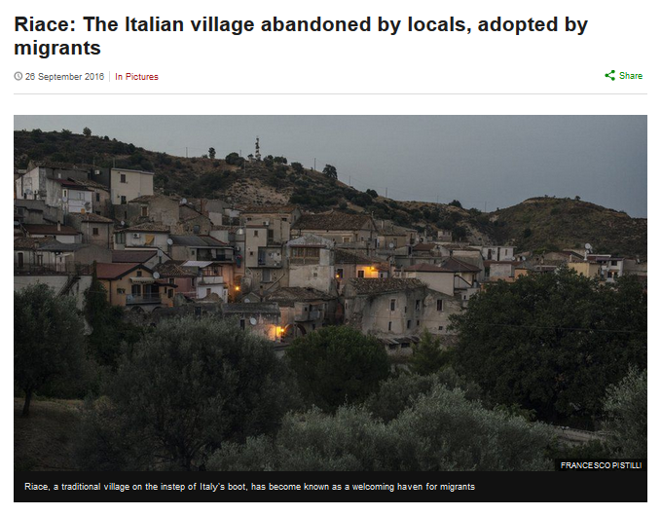
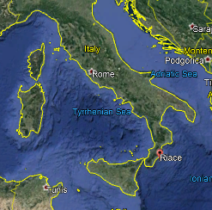
http://www.bbc.com/news/in-pictures-37289713

Slide 129
and these problems, in both the North and South,
go back a long ways . . .
and that causes further problems for the southern region,
the poorer part . . .

Slide 130
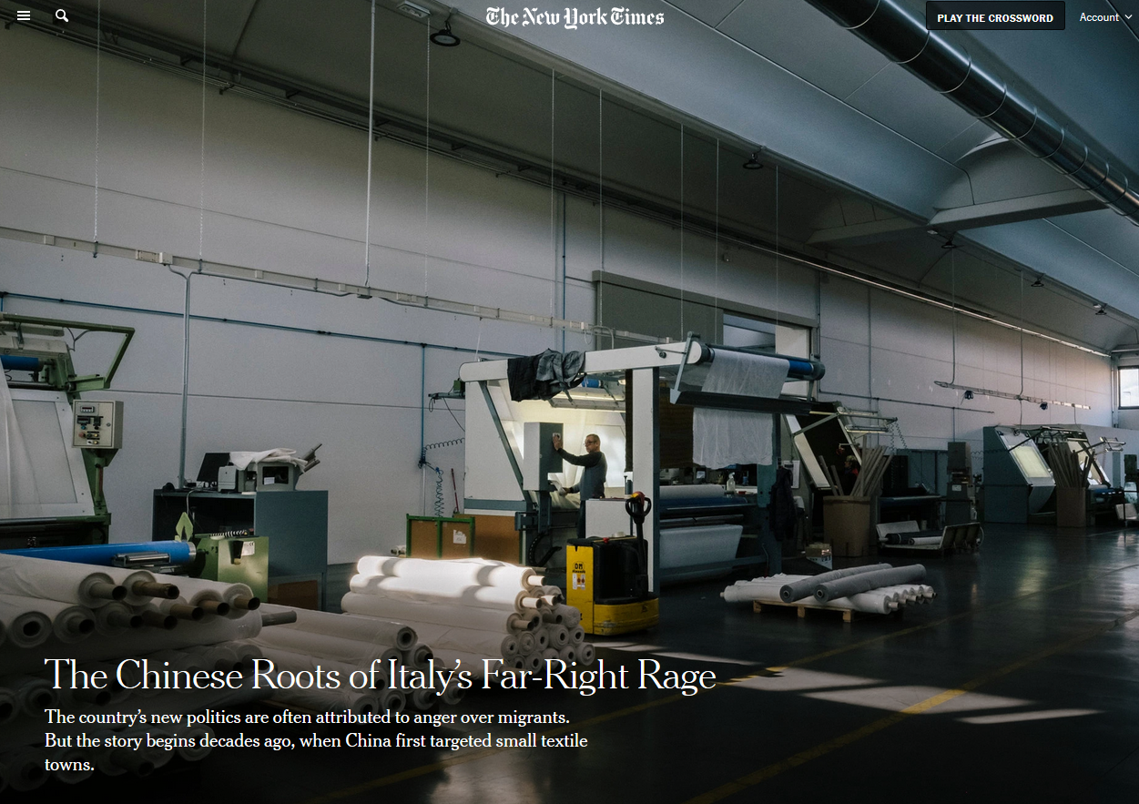
5 Dec 2019
Source

Slide 131
5 Dec 2019
And issues related to immigration have already severely affected Italian politics . . .
This is discussed in Betsey Krause’s book . . .
Source

Slide 132
and Italians often live long lives . . .
which makes the economics of the demographic situation worse . . .

Slide 133
Demographics
total fertility rate in Italy:
1.26 children born / 1,000 woman
(2024 est.)
country comparison to the world: 219
10.7 deaths / 1,000 population
(2021 est.)
country comparison to the world: 24
That means not enough children are being born to sustain the population . . .
CIA World Factbook
https://www.cia.gov/the-world-factbook/countries/italy/

Slide 134
Demographics
Population: 60,964,931
(2024 est.)
country comparison to the world: 24
Population growth rate: -0.08%
(2024 est.)
country comparison to the world: 201
65 years and over: 23.6%
(2024 est.)
CIA World Factbook
https://www.cia.gov/the-world-factbook/countris/italy/

Slide 135
21 Jul 2020
https://www.theguardian.com/world/2020/jul/21/italian-village-morterone-celebrates-first-birth-in-eight-years?CMP=Share_iOSApp_Other

Slide 136
16 Jul 2020
Including Italy
https://www.bbc.com/news/world-53424726

Slide 137
Demographics
total fertility rate in Italy:
1.26 children born / 1,000 woman
(2024 est.)
country comparison to the world: 219
an overall total fertility rate of 2.1 is needed for the population in an area
to remain stable,
assuming no immigration or emigration occurs . . .
10.7 deaths / 1,000 population
(2021 est.)
country comparison to the world: 24
CIA World Factbook
https://www.cia.gov/the-world-factbook/countries/italy/

Slide 138
Demographics
total fertility rate in Italy:
1.26 children born / 1,000 woman
(2024 est.)
country comparison to the world: 209
The low birth rate is a huge
slow-moving crisis . . .
and unless something
is eventually done,
Italy as we know it will disappear . . .
10.7 deaths / 1,000 population
(2021 est.)
country comparison to the world: 24
net migration rate:
3.2 migrant(s) / 1,000 population
(2021 est.)
country comparison to the world: 34
CIA World Factbook
https://www.cia.gov/the-world-factbook/countries/italy/

Slide 139
Martin J. Gannon and Rajnandini Pillai
Understanding Global Cultures
“Although Italian culture is justifiably renowned, it is in danger of extinction, as are the cultures of some other developed nations. It has one of the lowest fertility rate among nations: 1.19 children per woman. After Sweden, Italy has the oldest population among nations, with 16.1% of its population over 65.”
1.26
22.1
[23.6%]
[2024 est.]
www.d.umn.edu/cla/faculty/troufs/anth1095/index.html#Gannon

Slide 140
Wed 11 Sep 2019
https://www.theguardian.com/world/2019/sep/11/underpopulated-italian-region-molise?CMP=Share_iOSApp_Other

Slide 141
$1.18 USD
23 August 2021
http://edition.cnn.com/travel/article/italy-one-euro-homes-maenza-rome/index.html

Slide 142
23 August 2021
https://www.theguardian.com/world/2023/oct/07/italy-births-far-right-demographic-winter?CMP=Share_iOSApp_Other

Slide 143
Demographics
total fertility rate in Italy:
1.26 children born / 1,000 woman
(2024 est.)
country comparison to the world: 209
and in the meantime, there will be big problems trying to support
an aging population . . .
10.7 deaths / 1,000 population
(2021 est.)
country comparison to the world: 24
net migration rate:
3.2 migrant(s) / 1,000 population
(2021 est.)
country comparison to the world: 34
CIA World Factbook
https://www.cia.gov/the-world-factbook/countries/italy/

Slide 144
Demographics
Population: 61,021,855
(2023 est.)
country comparison to the world: 24
Population growth rate: -0.11%
(2023 est.)
country comparison to the world: 202
65 years and over: 23.31%
(2023 est.)
CIA World Factbook
https://www.cia.gov/the-world-factbook/countries/italy/

Slide 145
This is detailed in Betsy Krause’s excellent book
Elizabeth L. Krause
A Crisis of Births:
Population Politics and Family-Making in Italy
Belmont, CA: Thompson Wadsworth, 2005.
http://www.d.umn.edu/cla/faculty/troufs/anth3635/cetexts.html#CrisisofBirths

Slide 146
Here’s how that works . . .

Slide 147
Population change =
births minus deaths
plus net migration
(immigration minus emigration)

Slide 148
If you like formulas, here’s the formula:
∆p = (b-d) + (i-e)
∆p = population change
b = births
d = deaths
I = immigration
e = emigration

Slide 149
Population Pyramids
reflect population composition and change
https://en.wikipedia.org/wiki/Population_pyramid
Notes:
149

Slide 150
Population Pyramids for 4 Stages of the Demographic Transition Model
“. . . the transition from high birth and death rates to low birth and death rates as a country develops from a pre-industrial to an industrialized economic system”
population is expanding
https://en.wikipedia.org/wiki/Population_pyramid
https://en.wikipedia.org/wiki/Demographic_transition
Notes:
150

Slide 151
Population Pyramids for 4 Stages of the Demographic Transition Model
“. . . the transition from high birth and death rates to low birth and death rates as a country develops from a pre-industrial to an industrialized economic system”
population is expanding
https://en.wikipedia.org/wiki/Population_pyramid
https://en.wikipedia.org/wiki/Demographic_transition
Notes:
151

Slide 152
Population Pyramids for 4 Stages of the Demographic Transition Model
“. . . the transition from high birth and death rates to low birth and death rates as a country develops from a pre-industrial to an industrialized economic system”
population is stationary
https://en.wikipedia.org/wiki/Population_pyramid
https://en.wikipedia.org/wiki/Demographic_transition
Notes:
152

Slide 153
Population Pyramids for 4 Stages of the Demographic Transition Model
“. . . the transition from high birth and death rates to low birth and death rates as a country develops from a pre-industrial to an industrialized economic system”
population is contracting
https://en.wikipedia.org/wiki/Population_pyramid
https://en.wikipedia.org/wiki/Demographic_transition
Notes:
153

Slide 154
a major problem occurs with the large and growing
“dependent population”
(those not in the work force who must be supported by those in the work force)

Slide 155
“dependent population” =
the number of people that have to be supported by those of working age
Usually, it’s
(the population aged 0-14 + those 65 and over)
divided by
(the total population 15-64)

Slide 156
Population Pyramid
“dependent population”
“dependent population”
CIA World Factbook
https://www.cia.gov/the-world-factbook/countries/italy/
Notes:
156

Slide 157
Population Pyramid
People who have to support the “dependent population”
male
female
CIA World Factbook
https://www.cia.gov/the-world-factbook/countries/italy/
Notes:
157

Slide 158
Population Pyramid
Every 5 years
the lines move up one level
CIA World Factbook
https://www.cia.gov/the-world-factbook/countries/italy/
Notes:
158

Slide 159
Population Pyramid
And the “bulge”,
combined with the shrinking base groups, could be a big problem in the future as it moves up
CIA World Factbook
https://www.cia.gov/the-world-factbook/countries/italy/
Notes:
159

Slide 160
Population Pyramid
And the “bulge”,
combined with the shrinking base groups, could be a big problem in the future as it moves up
CIA World Factbook
https://www.cia.gov/the-world-factbook/countries/italy/
Notes:
160

Slide 161
Population Pyramid
And the “bulge”,
combined with the shrinking base groups, could be a big problem in the future as it moves up
CIA World Factbook
https://www.cia.gov/the-world-factbook/countries/italy/
Notes:
161

Slide 162
Population Pyramid
And the “bulge”,
combined with the shrinking base groups, could be a big problem in the future as it moves up
CIA World Factbook
https://www.cia.gov/the-world-factbook/countries/italy/
Notes:
162

Slide 163
Population Pyramid
And the “bulge”,
combined with the shrinking base groups, could be a big problem in the future as it moves up
CIA World Factbook
https://www.cia.gov/the-world-factbook/countries/italy/
Notes:
163

Slide 164
Population Pyramid
And the “bulge”,
combined with the shrinking base groups, could be a big problem in the future as it moves up
CIA World Factbook
https://www.cia.gov/the-world-factbook/countries/italy/
Notes:
164

Slide 165
Population Pyramid
And the “bulge”,
combined with the shrinking base groups, could be a big problem in the future as it moves up
CIA World Factbook
https://www.cia.gov/the-world-factbook/countries/italy/
Notes:
165

Slide 166
Population Pyramid
And the “bulge”,
combined with the shrinking base groups, could be a big problem in the future as it moves up
CIA World Factbook
https://www.cia.gov/the-world-factbook/countries/italy/
Notes:
166

Slide 167
Population Pyramid
This bulge is a big problem
because it means that there
will eventually be lots of old people
(not working)
and fewer people who
are in the workforce to support them
combined with children
not in the workforce
for the workers to also support
CIA World Factbook
https://www.cia.gov/library/publications/the-world-factbook/geos/it.html
Notes:
167

Slide 168
so Italy has lots of seniors
(not in the work force) . . .

Slide 169
so Italy has lots of seniors
(not in the work force) . . .
and their younger population is contracting (therefore eventually fewer in the work will be forced to support those who are not) . . .

Slide 170
that is to say Italy has a large and growing
“dependent population”
(those not in the work force who must be supported by those in the work force)

Slide 171
to further complicate things, looking at the problem regionally . . .
and that causes further problems for the southern region,
the poorer part . . .

Slide 172
young people entering into the workforce want to go north (to the richer areas, or to another country) to find work . . .
and that causes further problems for the southern region,
the poorer part . . .

Slide 173
young people entering into the workforce want to go north (to the richer areas, or to another country) to find work . . .
and that causes further problems for the southern region,
the poorer part . . .

Slide 174
young people entering into the workforce want to go north (to the richer areas, or to another country) to find work . . .
and it causes problems for families because Italian families generally do not like their young to leave the area of their family home . . .

Slide 175
http://www.bbc.com/news/in-pictures-37289713

Slide 176
and Italians often live long lives . . .
which makes the economics of the demographic situation worse . . .

Slide 177
Demographics
Population: 60,964,931
(2024 est.)
country comparison to the world: 24
Population growth rate: -0.08%
(2024 est.)
country comparison to the world: 201
65 years and over: 23.6%
(2024 est.)
CIA World Factbook
https://www.cia.gov/the-world-factbook/countries/italy/

Slide 178
Demographics
urban population:
72% of total population
(2023)
rate of urbanization: 0.27% annual rate of change
(2020-2025 est.)
Infant mortality rate:
total: 3.1 deaths/1,000 live births
(2024 est.)
country comparison to the world: 207
Life expectancy at birth:
total population: 83 years
(2024 est.)
country comparison to the world: 19
CIA World Factbook
https://www.cia.gov/the-world-factbook/countries/italy/

Slide 179
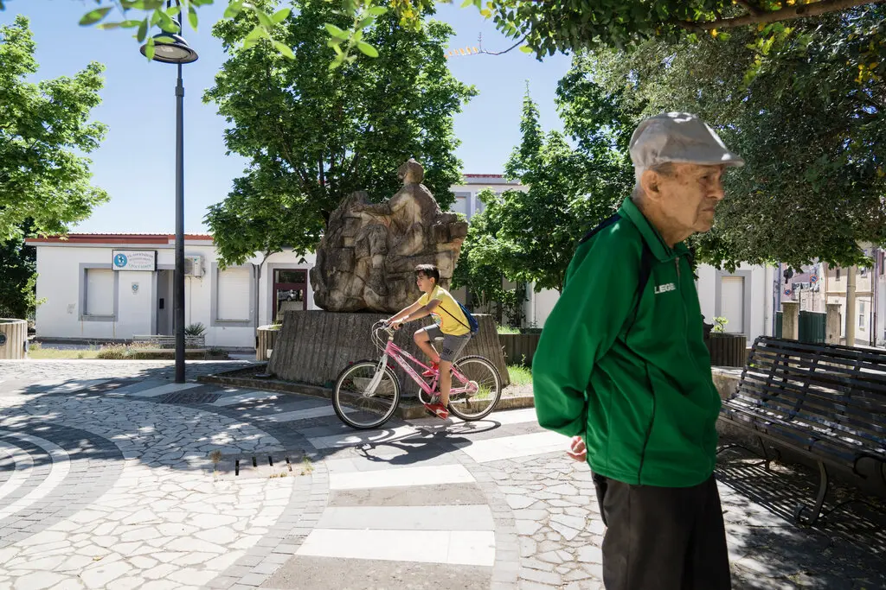
13 July 2022
Who’s the Oldest of Them All?
Two towns in Sardinia battle for the distinction of having the longest-living residents. One has the imprimatur of Guinness World Records.
https://www.nytimes.com/2022/07/13/world/europe/italy-sardinia-perdasdefogu-seulo-longevity.html?smid=em-share

Slide 180
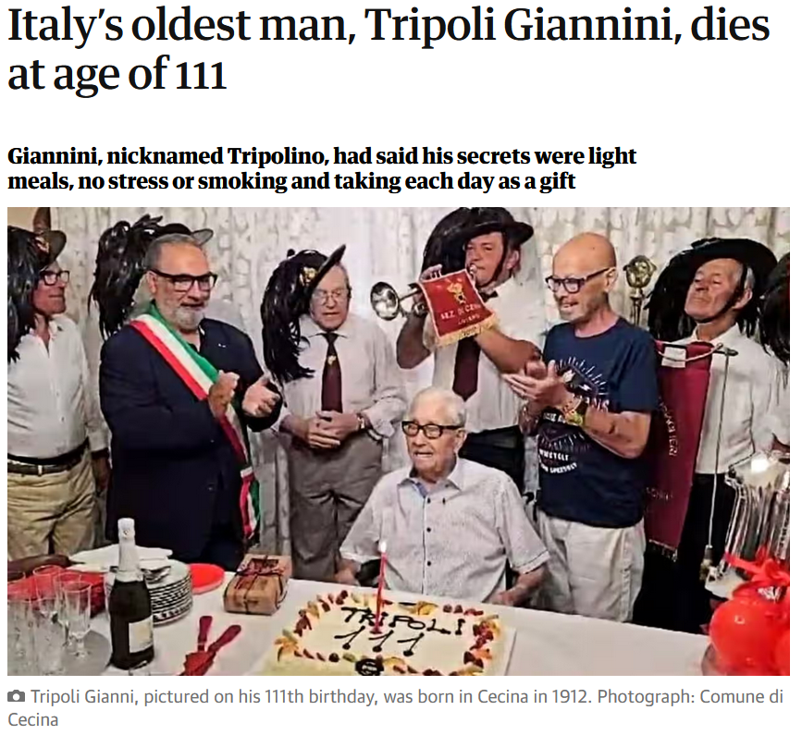
1 January 2024
https://www.theguardian.com/world/2024/jan/01/italys-oldest-man-tripoli-giannini-dies-at-age-of-111?CMP=share_btn_link

Slide 181
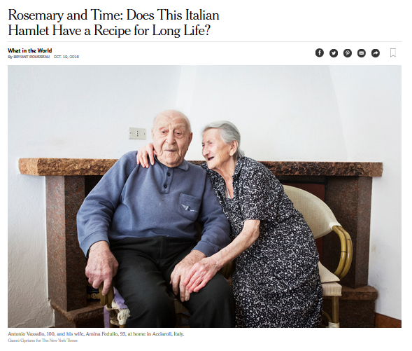
http://www.nytimes.com/2016/10/20/world/what-in-the-world/rosemary-and-time-does-this-italian-hamlet-have-a-recipe-for-long-life.html?emc=edit_ne_20161019&nl=evening-briefing&nlid=60046204&te=1
Notes:
181

Slide 182

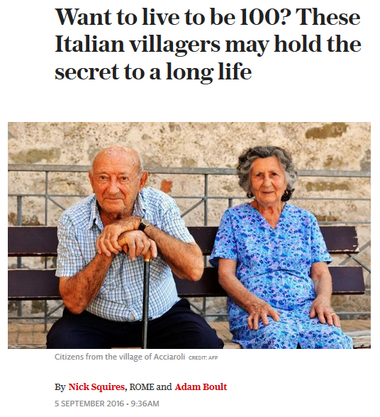
http://www.telegraph.co.uk/news/2016/09/05/want-to-live-to-be-100-these-italian-villagers-may-hold-the-secr/
Notes:
182

Slide 183
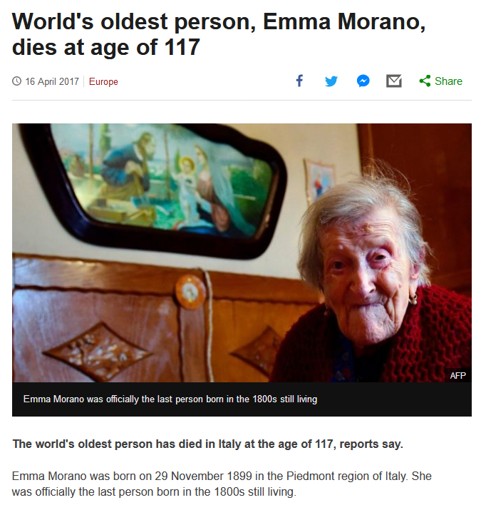
http://www.bbc.com/news/world-europe-39610937
Notes:
183

Slide 184
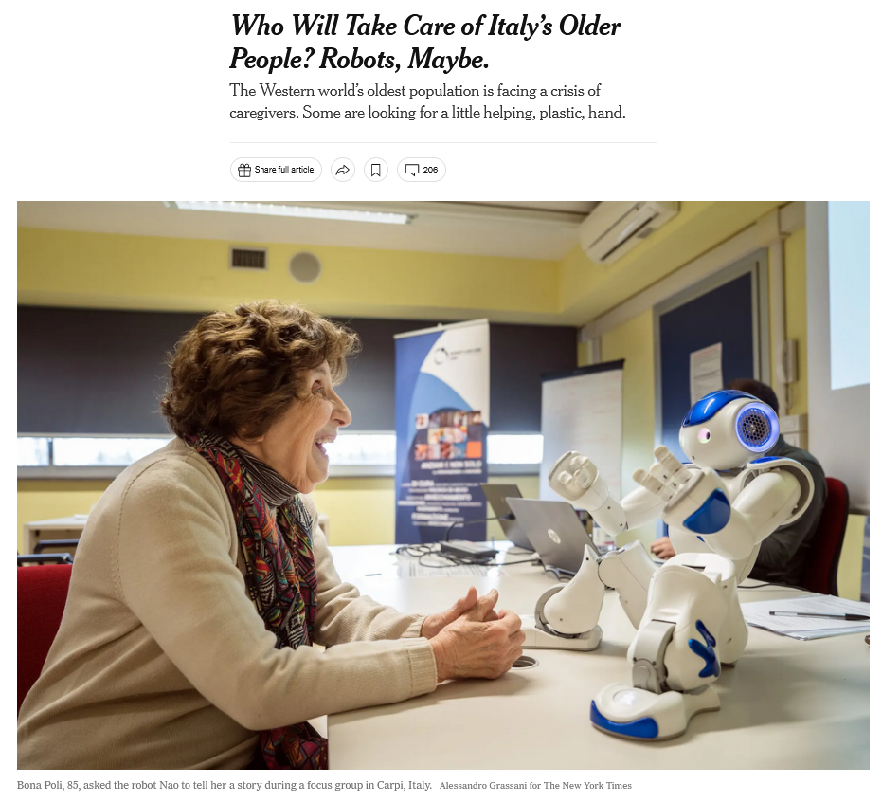
27 March 2023
https://www.nytimes.com/2023/03/25/world/europe/who-will-take-care-of-italys-older-people-robots-maybe.html?smid=nytcore-ios-share&referringSource=articleShare
Notes:
184

Slide 185
Demographics
total fertility rate:
1.26 children born / 1,000 woman
(2024 est.)
country comparison to the world: 219
11.2 deaths / 1,000 population
(2024 est.)
country comparison to the world: 22
net migration rate:
3.4 migrant(s) / 1,000 population
(2024 est.)
country comparison to the world: 33
CIA World Factbook
https://www.cia.gov/the-world-factbook/countries/italy/

Slide 186
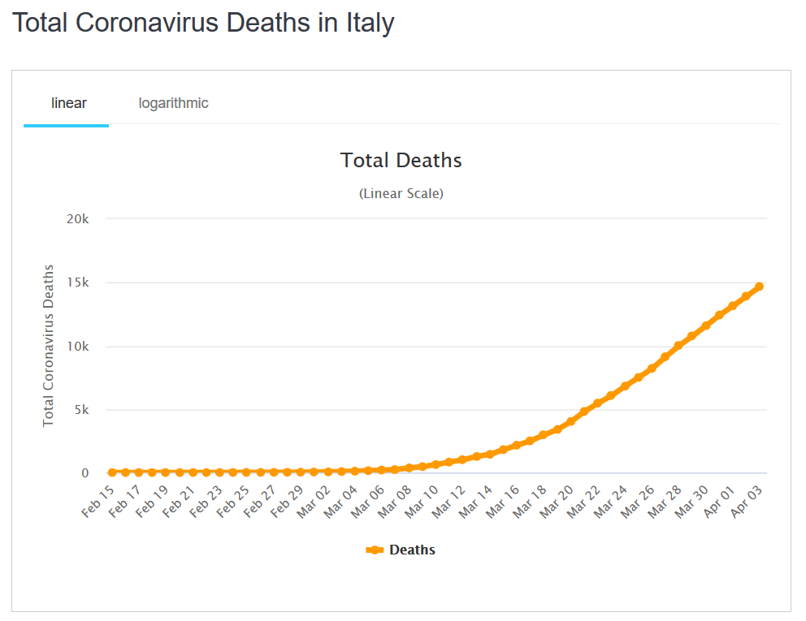
Demographics
total fertility rate:
1.47 children born / 1,000 woman
(2020 est.)
country comparison to the world: 204
death rates changed with Covid-19
(2020 est.)
10.7 deaths / 1,000 population
(2020 est.)
country comparison to the world: 48
net migration rate:
4.1 migrant(s) / 1,000 population
(2015 est.)
country comparison to the world: 29
03 April 2020
CIA World Factbook
https://www.worldometers.info/coronavirus/country/italy/

Slide 187
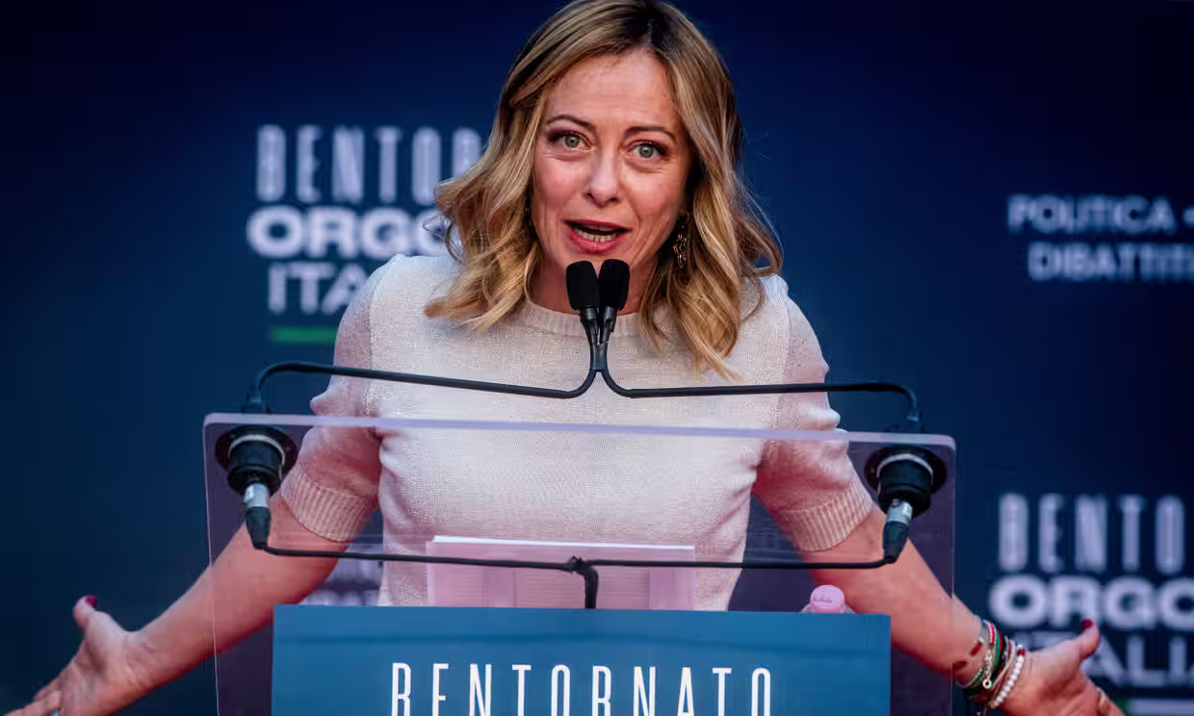
“The issue of the country’s demographic crisis is shooting up the political agenda because Giorgia Meloni’s nationalistic government sees in the birthrate – as did Benito Mussolini – a symbol of patriotic vigour.”
Meloni in Rome, 17 December 2023.
Photograph: Alessandro Serran/Shutterstock

Slide 188
What else?

Slide 189
Population Pyramid
And all of that also means both their labor force and markets are shrinking over time . . . unless the pattern changes
(which is might with Covid-19)
CIA World Factbook
https://www.cia.gov/the-world-factbook/countries/italy/
Notes:
189

Slide 190
Population Pyramid
And all of that also means both their labor force and markets are shrinking over time . . . unless the pattern changes
(which is might with Covid-19)
CIA World Factbook
https://www.cia.gov/the-world-factbook/countries/italy/
Notes:
190

Slide 191
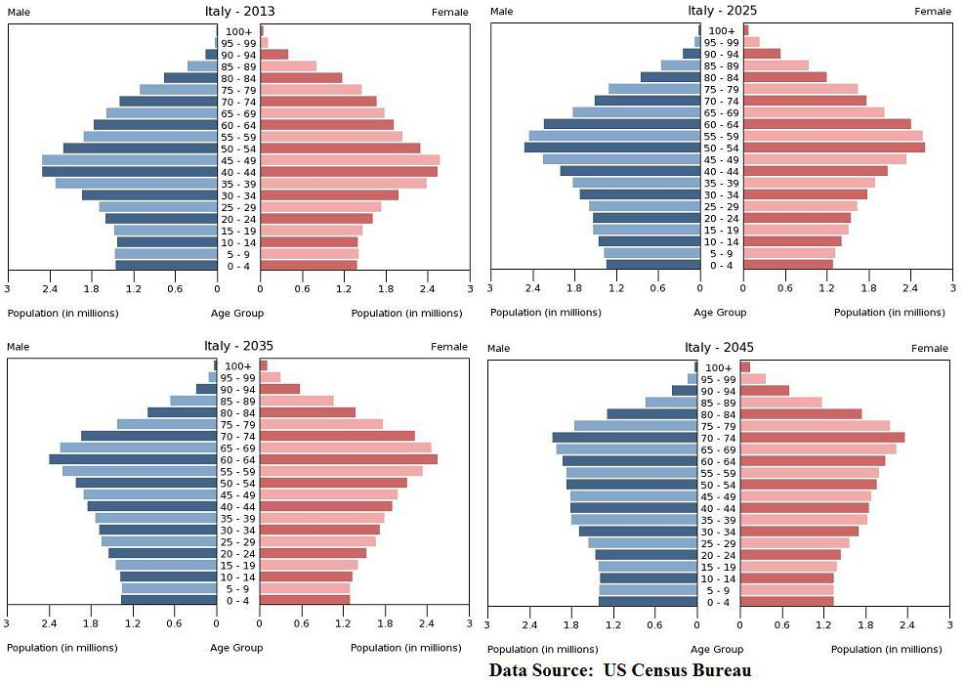






Italy Faces Ugly Future Without Reforms, Eurozone Exit -- Jake Huneycutt, Huneycutt Capital + Research
http://seekingalpha.com/article/1246651-italy-faces-ugly-future-without-reforms-eurozone-exit
Notes:
191

Slide 192
One solution to the demographic problem is to bring in outsiders (immigration) . . .
BUT . . .

Slide 193
One solution to the demographic problem is to bring in outsiders (immigration) . . .
BUT . . .

Slide 194
Population Pyramid
they can import people for the work force, but they only want certain kinds of people
(basically skilled, who are not immigrants of the boats from Africa or the Near East, or from Afghanistan)
CIA World Factbook
https://www.cia.gov/the-world-factbook/countries/italy/
Notes:
194

Slide 195
Population Pyramid
they can import people for the work force, but they only want certain kinds of people
(basically skilled, who are not immigrants of the boats from Africa or the Near East, or from Afghanistan)
CIA World Factbook
https://www.cia.gov/the-world-factbook/countries/italy/
Notes:
195

Slide 196
And the migration picture has been rapidly changing since 2015, with Italy, Greece, and Hungary under
“unprecedented pressure”
http://en.wikipedia.org/wiki/Italy
Notes:
196

Slide 197
5 Dec 2019
And issues related to immigration have already severely affected Italian politics . . .
This is discussed in Betsey Krause’s book . . .
Source

Slide 198
as immigration to Italy
is high . . .
and immigration
is a hot political issue . . .

Slide 199
so although Italy really needs immigrants for its labor force,
it wants to have only certain kinds of immigrants . . .
and also limit the numbers of immigrants . . .

Slide 200
Demographics
total fertility rate:
1.26 children born / 1,000 woman
(2024 est.)
country comparison to the world: 219
11.2 deaths / 1,000 population
(2024 est.)
country comparison to the world: 22
net migration rate:
3.4 migrant(s) / 1,000 population
(2024 est.)
country comparison to the world: 33
CIA World Factbook
https://www.cia.gov/the-world-factbook/countries/italy/

Slide 201
as immigration to Italy
is high . . .
and immigration
is a hot political issue . . .

Slide 202


4 January 2024
Italian Premier Meloni says curbing migrant arrivals from Africa is about investment, not charity
https://apnews.com/article/italy-eu-africa-migration-strategy-energy-bfffac3ff93ad2a97aead324caa11130

Slide 203

18 August 2021
https://www.nytimes.com/2021/08/18/world/europe/afghanistan-refugees-europe-migration-asylum.html

Slide 204


28 August 2021
https://www.jhalak.com/global-news-Italy-pushing-for-special-G20-meeting-on-Afghanistan-83161

Slide 205

Notes:
205

Slide 206


http://www.bbc.com/news/world-europe-34278886
Notes:
206

Slide 207
Martin J. Gannon and Rajnandini Pillai
Understanding Global Cultures
“Still, the population is large, and these trends are likely to reverse. Also, there are many people who want to immigrate to Italy, and in fact, there are countless numbers of illegal aliens crossing its borders daily. Thus, although Italy will probably change, its cultural base should be relatively secure, at least for the foreseeable future.”
www.d.umn.edu/cla/faculty/troufs/anth1095/index.html#Gannon

Slide 208


Slide 209
so although Italy really needs immigrants for its labor force,
it wants to have only certain kinds of immigrants . . .
and also limit the numbers of immigrants . . .

Slide 210
and to complicate the situation still further . . .

Slide 211
Martin J. Gannon and Rajnandini Pillai
Understanding Global Cultures
“Still, the population is large, and these trends are likely to reverse. Also, there are many people who want to immigrate to Italy, and in fact, there are countless numbers of illegal aliens crossing its borders daily. Thus, although Italy will probably change, its cultural base should be relatively secure, at least for the foreseeable future.”
www.d.umn.edu/cla/faculty/troufs/anth1095/index.html#Gannon

Slide 212
Martin J. Gannon and Rajnandini Pillai
Understanding Global Cultures
“Still, the population is large, and these trends are likely to reverse. Also, there are many people who want to immigrate to Italy, and in fact, there are countless numbers of
illegal aliens crossing its borders daily. Thus, although Italy will probably change, its cultural base should be relatively secure, at least for the foreseeable future.”
www.d.umn.edu/cla/faculty/troufs/anth1095/index.html#Gannon

Slide 213
Demographics
total fertility rate:
1.26 children born / 1,000 woman
(2024 est.)
country comparison to the world: 219
11.2 deaths / 1,000 population
(2024 est.)
country comparison to the world: 22
net migration rate:
3.4 migrant(s) / 1,000 population
(2024 est.)
country comparison to the world: 33
CIA World Factbook
https://www.cia.gov/the-world-factbook/countries/italy/

Slide 214


https://www.statista.com/statistics/624866/top-immigrant-nationalities-declared-upon-landing-italy/

Slide 215


Immigration to Italy
If you are interested
in this situation,
check link below for details . . .
https://en.wikipedia.org/wiki/Immigration_to_Italy

Slide 216




16 August 2021
https://www.dailysabah.com/world/europe/number-of-migrants-arriving-in-italy-doubles-in-12-months

Slide 217



28 August 2021
https://thehill.com/policy/international/569879-italian-coast-guard-rescues-fishing-boat-with-over-500-migrants-on-board

Slide 218
Martin J. Gannon and Rajnandini Pillai
Understanding Global Cultures
“Still, the population is large, and these trends are likely to reverse. Also, there are many people who want to immigrate to Italy, and in fact, there are countless numbers of illegal aliens crossing its borders daily. Thus, although Italy will probably change, its cultural base should be relatively secure, at least for the foreseeable future.”
And they’re willing to risk dying to get there . . .
www.d.umn.edu/cla/faculty/troufs/anth1095/index.html#Gannon

Slide 219
Thousands of migrants
drown each year
trying to reach Greece or Italy . . .
http://www.bbc.com/news/world-europe-24583286

Slide 220

http://www.bbc.com/news/world-europe-24583286

Slide 221
and to complicate the situation still further . . .

Slide 222
Martin J. Gannon and Rajnandini Pillai
Understanding Global Cultures
“Still, the population is large, and these trends are likely to reverse. Also, there are many people who want to immigrate to Italy, and in fact, there are countless numbers of illegal aliens crossing its borders daily. Thus, although Italy will probably change, its cultural base should be relatively secure, at least for the foreseeable future.”
www.d.umn.edu/cla/faculty/troufs/anth1095/index.html#Gannon

Slide 223


Europe’s Open Back Door: Italian Migration Up 50% in 2023
Giorgia Meloni
4 January 2024
https://europeanconservative.com/articles/news/europes-open-back-door-italian-migration-up-50-in-2023/
Notes:
\\\

Slide 224
Martin J. Gannon and Rajnandini Pillai
Understanding Global Cultures
“Still, the population is large, and these trends are likely to reverse. Also, there are many people who want to immigrate to Italy, and in fact, there are countless numbers of
illegal aliens crossing its borders daily. Thus, although Italy will probably change, its cultural base should be relatively secure, at least for the foreseeable future.”
www.d.umn.edu/cla/faculty/troufs/anth1095/index.html#Gannon

Slide 225


6 October 2023
Sunak, Meloni demand more urgency to combat migration
‘We are two of the closest friends in Europe today,’ British and Italian leaders write.
https://www.politico.eu/cdn-cgi/image/width=1920,quality=80,onerror=redirect,format=auto/wp-content/uploads/2023/10/06/GettyImages-1674680061-scaled.jpg
Notes:
225

Slide 226

http://www.bbc.com/news/world-europe-32371348
Notes:
226

Slide 227

http://www.bbc.com/news/world-africa-32311358
Notes:
227

Slide 228



04 August 2021
https://www.michigansthumb.com/news/article/Italy-presses-EU-nations-to-open-ports-to-rescued-16362678.php

Slide 229


16 April 2018
http://www.bbc.com/news/world-africa-32332767

Slide 230

http://www.bbc.com/news/world-europe-24583286

Slide 231
Martin J. Gannon and Rajnandini Pillai
Understanding Global Cultures
“One final example of externalization is somewhat disturbing, in that
Italy is experiencing difficulty integrating the large number of legal and illegal immigrants
flooding into their country,
particularly those from the African nations of Morocco, Nigeria, Senegal, and Tunisia.”
www.d.umn.edu/cla/faculty/troufs/anth1095/index.html#Gannon

Slide 232
Martin J. Gannon and Rajnandini Pillai
Understanding Global Cultures
The poorest Italians are most affected in that they feel that these immigrants are taking jobs away from them.
Many Italians are upset by a trend of increasing “disturbing incidents” of violence against the immigrants
  They have “externalized” the problem dramatically in newspapers, on television, and in the traditional piazza
www.d.umn.edu/cla/faculty/troufs/anth1095/index.html#Gannon

Slide 233

22 May 2019
https://www.nytimes.com/2019/05/22/world/europe/italy-palermo-immigrants-salvino.html

Slide 234

9 Aug 2019
https://www.nytimes.com/2019/08/09/business/italy-economy-debt.html

Slide 235

http://news.bbc.co.uk/2/hi/europe/8450083.stm

Slide 236

http://news.bbc.co.uk/2/hi/europe/8504591.stm

Slide 237

Martin J. Gannon and Rajnandini Pillai
Understanding Global Cultures
“Although such outbreaks of violence are common in many societies, these
Italians are confronting the problem in an open manner involving everyone in the society,
and solutions are gradually being implemented.”
www.d.umn.edu/cla/faculty/troufs/anth1095/index.html#Gannon

Slide 238



10 January 2010
http://news.bbc.co.uk/2/hi/europe/8450657.stm

Slide 239



19 April 2015
http://www.bbc.com/news/world-africa-32366035

Slide 240



6 September 2015
http://www.bbc.com/news/world-europe-34162844

Slide 241




29 September 2019
Spirce

Slide 242





21 August 2021
https://www.indiatoday.in/world/story/vatican-urges-world-welcome-afghan-refugees-taliban-takeover-1843600-2021-08-21

Slide 243
“The Schengen Agreement”

Slide 244
It is important to note that people can move freely within the EU and certain other countries because of
“The Schengen Agreement” . . .

Slide 245







https://en.wikipedia.org/wiki/Schengen_Agreement

Slide 246

Schengen Agreement
1995
“There are 26 countries in Schengen - 22 EU members and four non-EU.
Those four are:
Iceland and Norway (since 2001),
Switzerland (since 2008) and Liechtenstein (since 2011).”
http://www.bbc.com/news/world-europe-13194723

Slide 247
Schengen Agreement
1995
http://www.bbc.com/news/world-europe-13194723

Slide 248
“A surge of desperate migrants from the Middle East and Africa has put unprecedented pressure on EU countries, especially Italy, Greece, and Hungary.”
Schengen Agreement
1995
http://www.bbc.com/news/world-europe-13194723

Slide 249
It is expected that those
asylum seekers who are admitted will compete with current residents at the bottom of the social scale for existing low-paying jobs.
This quite likely will be a continuing source social unrest.
Schengen Agreement
1995
http://www.bbc.com/news/world-europe-13194723

Slide 250
Martin J. Gannon and Rajnandini Pillai
Understanding Global Cultures
The poorest Italians are most affected in that they feel that these immigrants are taking jobs away from them.
www.d.umn.edu/cla/faculty/troufs/anth1095/index.html#Gannon

Slide 251
and, in the end, as in other countries, many “take it out” on and blame the immigrants and migrants for their problems . . .

Slide 252
and, in the end, as in other countries, many “take it out” on and blame the immigrants and migrants for their problems . . .
and that becomes a huge political problem in Italy and throughout Europe . . .

Slide 253
“The Dublin Regulation”
gives EU member states the right to transfer migrants to the first country of entry to the EU
https://en.wikipedia.org/wiki/Dublin_Regulation

Slide 254
“The Dublin Regulation”
essentially gives EU member states the right to transfer migrants to the first country of entry to the EU
https://en.wikipedia.org/wiki/Dublin_Regulation

Slide 255




https://en.wikipedia.org/wiki/Dublin_Regulation

Slide 256
And what are the mostly likely “ . . . responsible
Member State[s] . . . through which the asylum seeker[s] first entered the EU”?

Slide 257
The so-called
PIIGS
of Europe . . .
Portugal, Italy, Ireland, Greece, and Spain
https://en.wikipedia.org/wiki/PIGS_(economics)

Slide 258

ITALY
SPAIN
PORTUGAL
Portugal, Italy, Ireland, Greece, and Spain
http://www.bbc.com/news/world-europe-24583286

Slide 259
demographic features combined with economic indices and policies led to the
derogatory classification
of Italy as one of the
PIIGS of Europe . . .

Slide 260
Portugal, Italy, Ireland, Greece, and Spain
Notes:
260

Slide 261

Portugal, Italy, Ireland, Greece, and Spain
https://en.wikipedia.org/wiki/PIGS_%28economics%29
Notes:
261

Slide 262
https://en.wikipedia.org/wiki/PIGS_%28economics%29
Notes:
262

Slide 263

These are a problem because they have huge public sector debt with no growth . . . and a rapidly expanding “dependent population”
(old people and children not in the work force)
Author: Rannpháirtí anaithnid
https://en.wikipedia.org/wiki/PIGS_%28economics%29
Notes:
263

Slide 264
Author: Rannpháirtí anaithnid
https://en.wikipedia.org/wiki/PIGS_%28economics%29
Notes:
264

Slide 265

http://www.bbc.com/news/world-europe-24583286

Slide 266


http://www.bbc.com/news/world-middle-east-34224619

Slide 267

http://www.bbc.com/news/world-europe-24636868
Notes:
267

Slide 268

http://www.bbc.com/news/world-europe-24636868
Notes:
268

Slide 269
What about “outsiders”?

Slide 270
  The Overture
  Pageantry and Spectacle
  Voice
  Externalization
  5. Chorus and Soloists
Outsiders
Italy
www.d.umn.edu/cla/faculty/troufs/anth1095/index.html#Gannon

Slide 271
Italians have generally been
leery of outsiders . . .
And, generally speaking, everyone is considered to be an outsider except members of the family . . .

Slide 272
Italians have generally been
leery of outsiders . . .
And, generally speaking, everyone is considered to be an outsider except members of the family . . .
www.d.umn.edu/cla/faculty/troufs/anth1095/index.html#Gannon

Slide 273
Martin J. Gannon and Rajnandini Pillai
Understanding Global Cultures
Many Italians do not put much faith in what others say . . .
www.d.umn.edu/cla/faculty/troufs/anth1095/index.html#Gannon

Slide 274
Martin J. Gannon and Rajnandini Pillai
Understanding Global Cultures
The characteristics of the chorus and soloist can also be applied to other aspects of Italian culture . . .
  Italians tend to be individualistic people, yet they place importance on the group . . .
    The family is the primary group that influences individuals
www.d.umn.edu/cla/faculty/troufs/anth1095/index.html#Gannon

Slide 275
Martin J. Gannon and Rajnandini Pillai
Understanding Global Cultures
The characteristics of the chorus and soloist can also be applied to other aspects of Italian culture . . .
  Italians tend to be individualistic people, yet they place importance on the group . . .
    The family is the primary group that influences individuals
www.d.umn.edu/cla/faculty/troufs/anth1095/index.html#Gannon

Slide 276
Martin J. Gannon and Rajnandini Pillai
Understanding Global Cultures
  Closeness within the family is strong,
  and family members tend to be
  much less trustful of those outside it
    This helps to explain why Italians,
    like operatic singers,
    are emotionally passionate toward friends and extended family
www.d.umn.edu/cla/faculty/troufs/anth1095/index.html#Gannon

Slide 277
Martin J. Gannon and Rajnandini Pillai
Understanding Global Cultures
  Closeness within the family is strong,
  and family members tend to be
  much less trustful of those outside it
    This helps to explain why Italians,
    like operatic singers,
    are emotionally passionate toward friends and extended family
www.d.umn.edu/cla/faculty/troufs/anth1095/index.html#Gannon

Slide 278
Martin J. Gannon and Rajnandini Pillai
Understanding Global Cultures
Italians also try to avoid risk and uncertainty in everyday life,
preferring friends over strangers
and familiar over new or strange situations,
as their behavior in the piazza and externalization would confirm
www.d.umn.edu/cla/faculty/troufs/anth1095/index.html#Gannon

Slide 279
Martin J. Gannon and Rajnandini Pillai
Understanding Global Cultures
As indicated earlier, the north of Italy has been very successful economically
  Most of this success is due to the existence of small firms specializing in particular products
  These firms both compete and cooperate with one another
    If one firm cannot honor an order, a neighboring firm will help it produce the product so that the commitment can be kept
    At the same time, firms will cut prices to move ahead of neighboring competitors
www.d.umn.edu/cla/faculty/troufs/anth1095/index.html#Gannon

Slide 280
Martin J. Gannon and Rajnandini Pillai
Understanding Global Cultures
These types of close business relationships echo
family and village patterns
that are also expressed in the opera
www.d.umn.edu/cla/faculty/troufs/anth1095/index.html#Gannon

Slide 281
Martin J. Gannon and Rajnandini Pillai
Understanding Global Cultures
The characteristics of the chorus and soloist can also be
applied to other aspects of Italian culture . . .
    The family is the primary group that influences individuals
    Whenever important decisions are made, the individual usually consults with family members to get their opinion and evaluation of the situation
    Although the family’s opinion is important, the final evaluation is made by the individual
www.d.umn.edu/cla/faculty/troufs/anth1095/index.html#Gannon

Slide 282
Martin J. Gannon and Rajnandini Pillai
Understanding Global Cultures
The influence of the group is also felt in
the business environment
  In business meetings people will externalize their feelings and opinions about a subject
  They will listen to everyone’s ideas and freely give their own opinions
  Business meetings tend to be productive in Italy due to the openness displayed by everyone
www.d.umn.edu/cla/faculty/troufs/anth1095/index.html#Gannon

Slide 283
Martin J. Gannon and Rajnandini Pillai
Understanding Global Cultures
This overall fearful, suspicious attitude may be partially due to a quality upon which Italians place a high value . . .
cleverness
www.d.umn.edu/cla/faculty/troufs/anth1095/index.html#Gannon

Slide 284
Martin J. Gannon and Rajnandini Pillai
Understanding Global Cultures
Whereas the family is the group that, above all else, dramatically influences the individual,
another important group,
the political party,
can be the difference between employment and unemployment
www.d.umn.edu/cla/faculty/troufs/anth1095/index.html#Gannon

Slide 285
Martin J. Gannon and Rajnandini Pillai
Understanding Global Cultures
Italians move from group to group, feeling little remorse when doing so because
they tend to be skeptical of all groups besides the family
www.d.umn.edu/cla/faculty/troufs/anth1095/index.html#Gannon

Slide 286
Martin J. Gannon and Rajnandini Pillai
Understanding Global Cultures
Members of groups often create
powerful coalitions
that are
used for gaining power and influence
  These subcultures, groups, and parties allow for intergroup bargaining and dealing to gain coordination and cooperation between all involved
www.d.umn.edu/cla/faculty/troufs/anth1095/index.html#Gannon

Slide 287
Martin J. Gannon and Rajnandini Pillai
Understanding Global Cultures
In Geert Hofstede’s study
of the cultural values of 53 countries,
Italians cluster with those countries emphasizing a large power distance between groups in society,
that is, they tend to accept the fact that some groups are and perhaps should be more powerful than others,
and they act accordingly
(1991)
www.d.umn.edu/cla/faculty/troufs/anth1095/index.html#Gannon

Slide 288
Martin J. Gannon and Rajnandini Pillai
Understanding Global Cultures
Italy has a political system that since World War II has been based on
proportional representation from many minor political parties
  There are more than 40 parties in the Chamber of Deputies
  This system was put in place to guard against the rise of one-party rule, as happened under Fascism
www.d.umn.edu/cla/faculty/troufs/anth1095/index.html#Gannon

Slide 289
Martin J. Gannon and Rajnandini Pillai
Understanding Global Cultures
the political system tends
to be extremely inefficient
  because of the changes of government
  and the system “tends to be corrupt”
    “kickbacks” are “a regular business practice”
    that is estimated to add 15% to 20% to the final price
www.d.umn.edu/cla/faculty/troufs/anth1095/index.html#Gannon

Slide 290
  The Overture
  Pageantry and Spectacle
  Voice
  Externalization
  5. Chorus and Soloists
Immigrants
Italy
www.d.umn.edu/cla/faculty/troufs/anth1095/index.html#Gannon

Slide 291
there’s the issue of politics . . .
relatively dynamic politics
. . .

Slide 292
there’s the issue of politics . . .
relatively dynamic politics
. . .

Slide 293
Recent Politics
Italy
© 2009-2020 Timothy G. Roufs, University of Minnesota Duluth

Slide 294
The latest government in Italy . . .

Slide 295

26 September 2022
https://www.bbc.com/news/world-europe-63029909

Slide 296



25 September 2022
https://www.npr.org/2022/09/24/1124685476/giorgia-meloni-italy-election

Slide 297
25 September 2022
Most far-right leader since WWII
69th Government in Italy since 1946
leader of Fratelli d'Italia,
the Brothers of Italy party
with Neo-Fascist roots
Italy's first female prime minister
Meloni's opposition to immigration
animated her and her base
“An astute political operative”
https://www.npr.org/2022/09/24/1124685476/giorgia-meloni-italy-election

Slide 298
25 September 2022
Most far-right leader since WWII
leader of Fratelli d'Italia,
the Brothers of Italy party
with Neo-Fascist roots
https://www.npr.org/2022/09/24/1124685476/giorgia-meloni-italy-election

Slide 299

https://en.wikipedia.org/wiki/Brothers_of_Italy

Slide 300
25 September 2022
Meloni's opposition to immigration
animated her and her base
https://www.npr.org/2022/09/24/1124685476/giorgia-meloni-italy-election

Slide 301
25 September 2022
https://www.npr.org/2022/09/24/1124685476/giorgia-meloni-italy-election

Slide 302


Martin J. Gannon and Rajnandini Pillai
Understanding Global Cultures
Sergio Mattarella
is the President of the Italian Republic
(since 3 February 2015)
Giorgia Meloni
is the nation's Prime Minister
(President of the Council of Ministers)
(Since 22 October 2022)
www.d.umn.edu/cla/faculty/troufs/anth1095/index.html#Gannon

Slide 303
Martin J. Gannon and Rajnandini Pillai
Understanding Global Cultures
Sergio Mattarella
is the President of the Italian Republic
(since 3 February 2015)
Giorgia Meloni
is the nation's Prime Minister
(President of the Council of Ministers)
(Since 22 October 2022)
The President is the “head of state”
www.d.umn.edu/cla/faculty/troufs/anth1095/index.html#Gannon

Slide 304
Martin J. Gannon and Rajnandini Pillai
Understanding Global Cultures
Sergio Mattarella
is the President of the Italian Republic
(since 3 February 2015)
Giorgia Meloni
is the nation's Prime Minister
(President of the Council of Ministers)
(Since 22 October 2022)
The Prime Minister is the “head of government”
www.d.umn.edu/cla/faculty/troufs/anth1095/index.html#Gannon

Slide 305
Martin J. Gannon and Rajnandini Pillai
Understanding Global Cultures
Italy has rapidly changing governments
  69 since World War II
  (an average of one every 1.14 years.)
69th government with
Giorgia Meloni
as of 22 October 2022
www.d.umn.edu/cla/faculty/troufs/anth1095/index.html#Gannon

Slide 306

Mario Draghi
was (2021)
68th government
(“technocratic”)
https://www.theguardian.com/world/2021/feb/06/mario-draghi-secures-support-from-key-parties-to-form-new-italian-government

Slide 307
Mario Draghi
was (2021)
68th government
(“technocratic”)
https://www.theguardian.com/world/2021/feb/06/mario-draghi-secures-support-from-key-parties-to-form-new-italian-government

Slide 308

In 2018 . . .
Notes:
308

Slide 309

In 2018 . . .
Notes:
309

Slide 310

In 2018 . . .
Notes:
310

Slide 311

Notes:
311

Slide 312
http://en.wikipedia.org/wiki/History_of_Italy_during_foreign_domination_and_the_unification
Notes:
312

Slide 313
Formation of Italy
Unification —17 March 1861
Republic —2 June 1946
http://en.wikipedia.org/wiki/Italy
Notes:
313

Slide 314


3 February 2021
Italy forms a governo tecnico—“technocratic government” (technical government)—consisting of people with expert skills, with no necessary connection to other political forces, in emergency situations caused by parliamentary stalemate(s).
https://atalayar.com/en/content/draghi-tasked-forming-technocratic-government-italy

Slide 315


31 January 2021
https://www.economist.com/the-economist-explains/2021/01/31/why-does-italy-go-through-so-many-governments

Slide 316


31 January 2021
https://italicsmag.com/2021/01/25/italy-is-ungovernable-thats-the-point-government-crisis/

Slide 317
talks of other
“devolutions” / secessions . . .
are many . . .

Slide 318


Slide 319
Notes:
319

Slide 320

Cosimo Vassallo
A new district in Northern Italy
was just established in 2009
Tim Roufs
Notes:
320

Slide 321
In Italy
the comune
(plural comuni)
is the basic administrative division of both provinces and regions, and may be properly approximated in casual speech by the English word township or municipality
Tim Roufs
Notes:
321

Slide 322

township or municipality
http://en.wikipedia.org/wiki/Municipalities_of_Italy
Notes:
322

Slide 323

Administrative divisions of Italy:
Regions (black borders)
Provinces (grey borders)
Comuni (white borders)
http://en.wikipedia.org/wiki/Municipalities_of_Italy
Notes:
323

Slide 324
Some Background to the Country
The Regions Revisited
Italy

Slide 325


Nov 6 2019
Molise
https://www.wetheitalians.com/default/italian-region-doesnt-exist
Notes:
325

Slide 326
Martin J. Gannon and Rajnandini Pillai
Understanding Global Cultures
Italy is classified by Gannon as a
“Cleft National Culture”
    one in which the subcultures of the diverse ethnic groups are difficult
    to integrate
www.d.umn.edu/cla/faculty/troufs/anth1095/index.html#Gannon

Slide 327
Martin J. Gannon and Rajnandini Pillai
Understanding Global Cultures
The country is divided into two main regions
“Continental Italy” (aka “The North”)
  The Alps
  The northern Italian plain
“Mediterranean Italy” (aka “The South”)
  The Italian peninsula and the islands
www.d.umn.edu/cla/faculty/troufs/anth1095/index.html#Gannon

Slide 328
Martin J. Gannon and Rajnandini Pillai
Understanding Global Cultures
The Appenine mountains run directly down the peninsula’s center, and its northern range almost completely cuts off the north from the south
  This geographical division has led to extreme regionalism
www.d.umn.edu/cla/faculty/troufs/anth1095/index.html#Gannon

Slide 329
Martin J. Gannon and Rajnandini Pillai
Understanding Global Cultures
The Appenine mountains run directly down the peninsula’s center, and its northern range almost completely cuts off the north from the south
  Many Italians view Italy as two separate nations
    The wealthier, industrial north
    The poorer, more agrarian south
www.d.umn.edu/cla/faculty/troufs/anth1095/index.html#Gannon

Slide 330
http://www.reliefweb.int/rw/RWB.NSF/db900LargeMaps/SKAR-64GDTU?OpenDocument

Slide 331
Martin J. Gannon and Rajnandini Pillai
Understanding Global Cultures
  In the 11th century King Frederico established an autocratic form of government in the south that was both politically and economically successful
    But his successors corrupted it
    The Mafia arose as the middlemen between the kings and the people, which tended to reinforce corruption
www.d.umn.edu/cla/faculty/troufs/anth1095/index.html#Gannon

Slide 332

Wed 30 Oct 2019
https://www.theguardian.com/world/2019/oct/30/italy-mafia-networks-are-more-complex-and-powerful-says-minister?CMP=Share_iOSApp_Other

Slide 333

Thu 26 Dec 2019
https://www.theguardian.com/world/2019/dec/26/peace-goodwill-and-mafia-murders-mark-christmas-in-italy?CMP=Share_iOSApp_Other

Slide 334

Wed 15 Jan 2020
https://www.theguardian.com/world/2020/jan/15/sicilian-police-launch-dawn-raids-in-eu-subsidies-sting?CMP=Share_iOSApp_Other

Slide 335

Thurs 20 June 2019
https://www.theguardian.com/world/2019/jun/20/tomatoes-italy-mafia-migrant-labour-modern-slavery?CMP=Share_iOSApp_Other

Slide 336
Martin J. Gannon and Rajnandini Pillai
Understanding Global Cultures
The civic traditions of the north and south
of Italy originated from
different sources
and these traditions have persisted for centuries
(Robert Putnam 1991)
www.d.umn.edu/cla/faculty/troufs/anth1095/index.html#Gannon

Slide 337
Martin J. Gannon and Rajnandini Pillai
Understanding Global Cultures
In the
north
there has been a centuries-long legacy of
civic involvement through guilds
and democratic elections
that has held corruption in check
www.d.umn.edu/cla/faculty/troufs/anth1095/index.html#Gannon

Slide 338
Martin J. Gannon and Rajnandini Pillai
Understanding Global Cultures
Today,
the north of Italy is as successful as or more successful than Germany,
whereas the south
languishes in poverty
even though millions of dollars have been devoted to eradicating it
www.d.umn.edu/cla/faculty/troufs/anth1095/index.html#Gannon

Slide 339
Martin J. Gannon and Rajnandini Pillai
Understanding Global Cultures
. . . the Northern League . . . periodically seeks to create
two separate nations in Italy
But the economically prosperous north depends heavily on emigration from the south for its workforce
www.d.umn.edu/cla/faculty/troufs/anth1095/index.html#Gannon

Slide 340
Martin J. Gannon and Rajnandini Pillai
Understanding Global Cultures
the north and south
are closely linked to one another culturally, even though there are regional differences
www.d.umn.edu/cla/faculty/troufs/anth1095/index.html#Gannon

Slide 341
Martin J. Gannon and Rajnandini Pillai
Understanding Global Cultures
“Although Italian culture is justifiably renowned, it is in danger of extinction, as are the cultures of some other developed nations. It has one of the lowest fertility rate among nations: 1.19 children per woman. After Sweden, Italy has the oldest population among nations, with 16.1% of its population over 65.”
1.24
22.1
[23.31%]
[2023 est.]
www.d.umn.edu/cla/faculty/troufs/anth1095/index.html#Gannon

Slide 342

http://news.bbc.co.uk/2/hi/europe/7500605.stm

Slide 343
Martin J. Gannon and Rajnandini Pillai
Understanding Global Cultures
Because the entire community or audience is involved in the unfolding of the drama, several issues and factors come into play that involve numerous individuals
  It is not an accident that the Italians have not specialized in one-person stage shows or dramas
www.d.umn.edu/cla/faculty/troufs/anth1095/index.html#Gannon

Slide 344
Martin J. Gannon and Rajnandini Pillai
Understanding Global Cultures
Thus, Italy, while
primarily stressing individualism, is
oriented toward
specific aspects
of groupism or collectivism
www.d.umn.edu/cla/faculty/troufs/anth1095/index.html#Gannon

Slide 345
Martin J. Gannon and Rajnandini Pillai
Understanding Global Cultures
Even though individuals might not give the country as a whole much consideration,
they place great importance
on local and regional affiliation
www.d.umn.edu/cla/faculty/troufs/anth1095/index.html#Gannon

Slide 346
  The Overture
  Pageantry and Spectacle
  Voice
  Externalization
  5. Chorus and Soloists
The importance of both the chorus and the soloists,
which reflects the unity of Italian culture (chorus)
but also regional variations, particularly between the north and south
Italy
www.d.umn.edu/cla/faculty/troufs/anth1095/index.html#Gannon

Slide 347
Martin J. Gannon and Rajnandini Pillai
Understanding Global Cultures
When Italians created the opera around 1600, there were no soloists
  The first great Italian composer, Claudio Monteverdi, basically used different parts of the chorus to express the ideas and emotions
  However, singers vied with one another for the spotlight and gradually soloists became prominent
www.d.umn.edu/cla/faculty/troufs/anth1095/index.html#Gannon

Slide 348
Martin J. Gannon and Rajnandini Pillai
Understanding Global Cultures
“The tension and balance between
the chorus and soloists
epitomize the struggles between
the northern and southern regions,
in that each region retains certain
easily perceptible characteristics
among its inhabitants.”
www.d.umn.edu/cla/faculty/troufs/anth1095/index.html#Gannon

Slide 349
  The Overture
  Pageantry and Spectacle
  Voice
  Externalization
  5. Chorus and Soloists
Home Townism
Italy
www.d.umn.edu/cla/faculty/troufs/anth1095/index.html#Gannon

Slide 350
Martin J. Gannon and Rajnandini Pillai
Understanding Global Cultures
Most Italians define themselves by
the town where they were born,
and there is a sharp contrast between northern and southern Italy
www.d.umn.edu/cla/faculty/troufs/anth1095/index.html#Gannon

Slide 351
Martin J. Gannon and Rajnandini Pillai
Understanding Global Cultures
“The people from the [northern and southern] regions are similar in that
they love life and enjoy
creating the illusion of a show.”
“However, the difference between the people from these two regions is that
southerners tend
to cling to past ways of living
whereas many northerners look toward the future.”
www.d.umn.edu/cla/faculty/troufs/anth1095/index.html#Gannon

Slide 352
Martin J. Gannon and Rajnandini Pillai
Understanding Global Cultures
To most
northerners,
wealth
is the way to ensure the lasting defense and prosperity of the family and close friends
  “The northerner is perpetually trying to acquire wealth in its various forms”
    S/he wants a job, a good job, and then a better job
    S/he also wants the scientific and technical knowledge that will ensure better paid employment and advancement
www.d.umn.edu/cla/faculty/troufs/anth1095/index.html#Gannon

Slide 353
Martin J. Gannon and Rajnandini Pillai
Understanding Global Cultures
many
southerners,
on the other hand,
want above all
to be obeyed, admired,
respected, and envied
They want wealth too, but frequently
as an instrument to influence people
Southerners are preoccupied with
commanding the respect of the audience throughout the many operas of life
www.d.umn.edu/cla/faculty/troufs/anth1095/index.html#Gannon

Slide 354
Martin J. Gannon and Rajnandini Pillai
Understanding Global Cultures
many southerners,
be they wealthy or poor,
want the gratitude of powerful friends and relatives,
the fear of their enemies,
and the respect of everybody
Southerners seek wealth as a means of commanding obedience and respect from others
www.d.umn.edu/cla/faculty/troufs/anth1095/index.html#Gannon

Slide 355
Martin J. Gannon and Rajnandini Pillai
Understanding Global Cultures
in the south the culture centers around death
  The Italians worry that the operatic drama of life will fall apart when a family member dies
  The experience of dying and the fear of not being able to react properly to such an event has forced southerners to create a complex strategy to enable them to face and conquer death
  The purpose of these rituals is to re-establish contact between the living and the dead, because according to southern beliefs, the family includes both the living and the dead
www.d.umn.edu/cla/faculty/troufs/anth1095/index.html#Gannon

Slide 356
Martin J. Gannon and Rajnandini Pillai
Understanding Global Cultures
Each family member has reciprocal rights and duties, and people tend to attach great value to these obligations
  The dead have to protect the living
  The living have to keep alive the memory of the dead
www.d.umn.edu/cla/faculty/troufs/anth1095/index.html#Gannon

Slide 357
Martin J. Gannon and Rajnandini Pillai
Understanding Global Cultures
People whose families used to be
southern farmers brought their deep-rooted traditions to the north
  Some of these traditions and skills enabled many southerners to move their families from farming into the commercial market
  The tradition of keeping ownership within the family combined with the skill of managing a diverse product mix and willingness to work long hours, makes the new entrepreneurs able to compete effectively with their European neighbors
www.d.umn.edu/cla/faculty/troufs/anth1095/index.html#Gannon

Slide 358
and, of course, huge public sector debt and deficit budgets complicates almost everything
. . .

Slide 359
  The Overture
  Pageantry and Spectacle
  Voice
  Externalization
  5. Chorus and Soloists
public debt
Italy
www.d.umn.edu/cla/faculty/troufs/anth1095/index.html#Gannon

Slide 360
Martin J. Gannon and Rajnandini Pillai
Understanding Global Cultures
However, Italy is facing major economic problems, and
its public debt is still large
www.d.umn.edu/cla/faculty/troufs/anth1095/index.html#Gannon

Slide 361
Martin J. Gannon and Rajnandini Pillai
Understanding Global Cultures
However, Italy is facing major economic problems, and
its public debt is large
131.8% of GDP
(2017 est.)
https://www.cia.gov/the-world-factbook/countries/italy/#introduction
www.d.umn.edu/cla/faculty/troufs/anth1095/index.html#Gannon

Slide 362
Martin J. Gannon and Rajnandini Pillai
Understanding Global Cultures
However, Italy is facing major economic problems, and
its public debt is still large
$49,060 per capita
(2017 est.)
https://en.wikipedia.org/wiki/List_of_countries_by_government_debt
www.d.umn.edu/cla/faculty/troufs/anth1095/index.html#Gannon

Slide 363
Author: Rannpháirtí anaithnid
https://en.wikipedia.org/wiki/PIGS_%28economics%29
Notes:
363

Slide 364

http://en.wikipedia.org/wiki/List_of_countries_by_public_debt

Slide 365








Zimbabwe
Italy
Hungary
United States
https://en.wikipedia.org/wiki/List_of_countries_by_government_debt

Slide 366
Martin J. Gannon and Rajnandini Pillai
Understanding Global Cultures
Some governments
in villages and even large towns
do not have the money to manage critical services . . .
www.d.umn.edu/cla/faculty/troufs/anth1095/index.html#Gannon

Slide 368


www.cbsnews.com/stories/2008/06/27/ap/entertainment/main4215219.shtml

Slide 369


19 October 2023
European court says Italy violated rights of residents near Naples over garbage crisis
https://static.independent.co.uk/2023/10/19/13/Italy_Naples_Trash_82494.jpg?quality=75&width=990&height=614&fit=bounds&format=pjpg&crop=16%3A9%2Coffset-y0.5&auto=webp

Slide 370
Martin J. Gannon and Rajnandini Pillai
Understanding Global Cultures
To maintain a leading role in the European Union,
Italy must change this situation . . .
and they’re still working on
the problem . . .
www.d.umn.edu/cla/faculty/troufs/anth1095/index.html#Gannon

Slide 371

http://news.bbc.co.uk/2/hi/europe/8548994.stm

Slide 372
Martin J. Gannon and Rajnandini Pillai
Understanding Global Cultures
“This, then, is Italy.
It is still a grand and larger-than-life society whose citizens
love pageantry and spectacle,
emphasize a range of voices
in everyday life,
externalize emotions and feelings,
and feel a commitment to the town and region of the country
in which they were born. . . .”
www.d.umn.edu/cla/faculty/troufs/anth1095/index.html#Gannon

Slide 373
Immigration /
Emigration
Italy
© 2009-2026 Timothy G. Roufs, University of Minnesota Duluth

