Slide 1
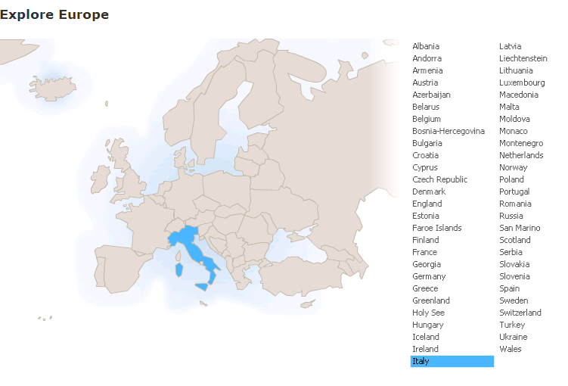
Run in “Slide Show” mode.
Use your up / down arrow keys and / or
your space bar to advance the slides
Master Works
and Classics
Italy
© 2009-2026 Timothy G. Roufs, University of Minnesota Duluth

Slide 2
Italy
© 2009-2026 Timothy G. Roufs, University of Minnesota Duluth

Slide 3
Master Works
and Classics
Italy
© 2009-2026 Timothy G. Roufs, University of Minnesota Duluth

Slide 4
Italy’s contemporary situation reflects a complex history, geography, ecology, demographic make up, world view, and so forth
. . .

Slide 5
So first, a bit of history and background . . .

Slide 6
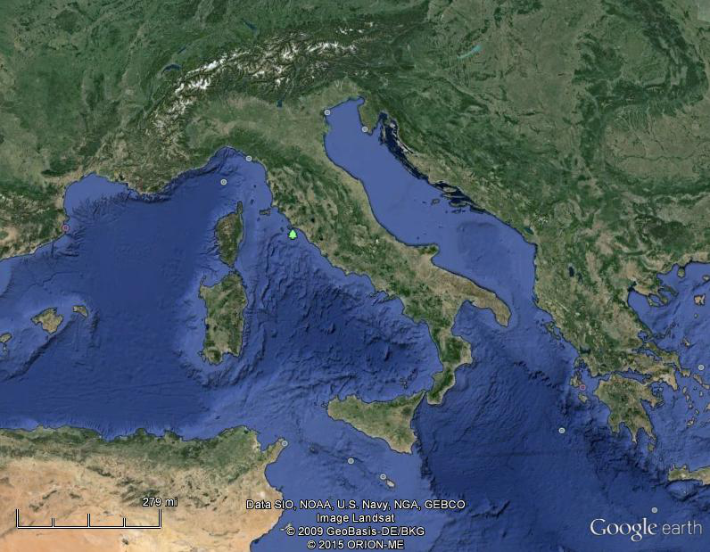
Of all European countries Italy, “the boot,” is probably the most recognizable . . .
Notes:
6

Slide 7
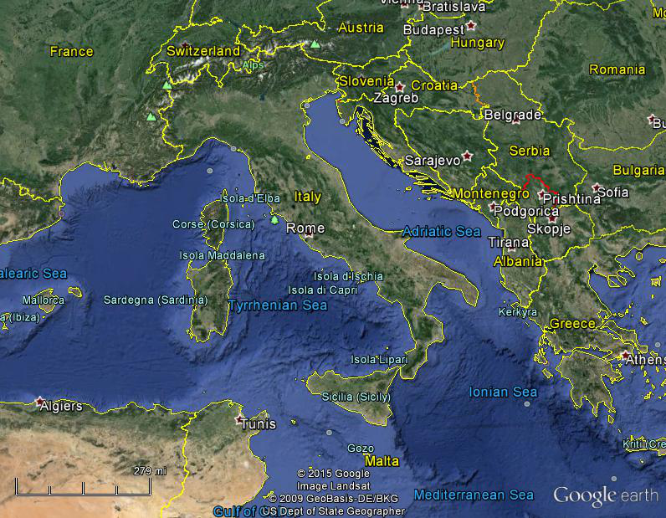
Italy, and her current neighbors . . .
Notes:
7

Slide 8
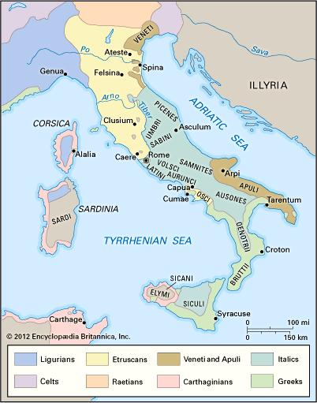
ancient Italic peoples:
Distribution of peoples of ancient Italy ca. 500 B.C.
©Encyclopædia Britannica, Inc.
https://www.britannica.com/topic/history-of-Italy
Notes:
8

Slide 9
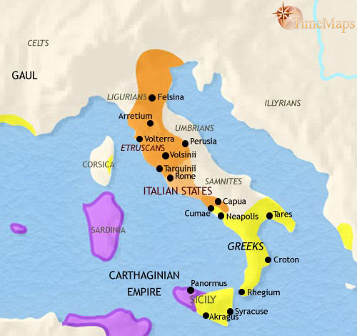
500 B.C.
http://www.timemaps.com/history/italy-500bc
Notes:
9

Slide 10
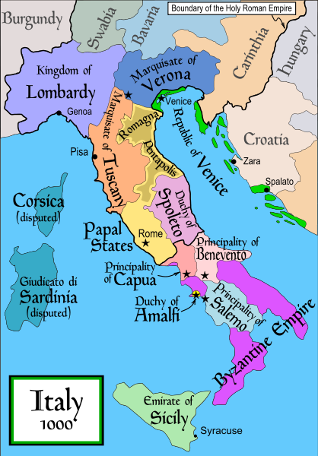
1000
Italy was divided for centuries into small kingdoms and city-states
http://en.wikipedia.org/wiki/Italy
Notes:
10

Slide 11
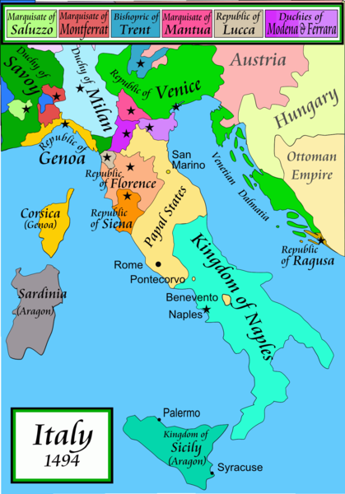
1494
Italy was divided for centuries into small kingdoms and city-states
http://en.wikipedia.org/wiki/Italy
Notes:
11

Slide 12
1494
Italy was divided for centuries into small kingdoms and city-states
http://en.wikipedia.org/wiki/Italy
Notes:
12

Slide 13
In 1494 Christopher Columbus from Genoa went on his second voyage to the New World
Italy was divided for centuries into small kingdoms and city-states
http://en.wikipedia.org/wiki/Italy
Notes:
13

Slide 14
In 1494 Christopher Columbus from Genoa is on his second voyage to the New World
Christopher Columbus was a sugar merchant from Genoa, married to the daughter of a sugar merchant from Madeira, Felipa Perestrello.
Columbus was looking for a way around Venice’s monopoly on things like sugar. . . .
Italy was divided for centuries into small kingdoms and city-states
http://en.wikipedia.org/wiki/Italy
Notes:
14

Slide 15
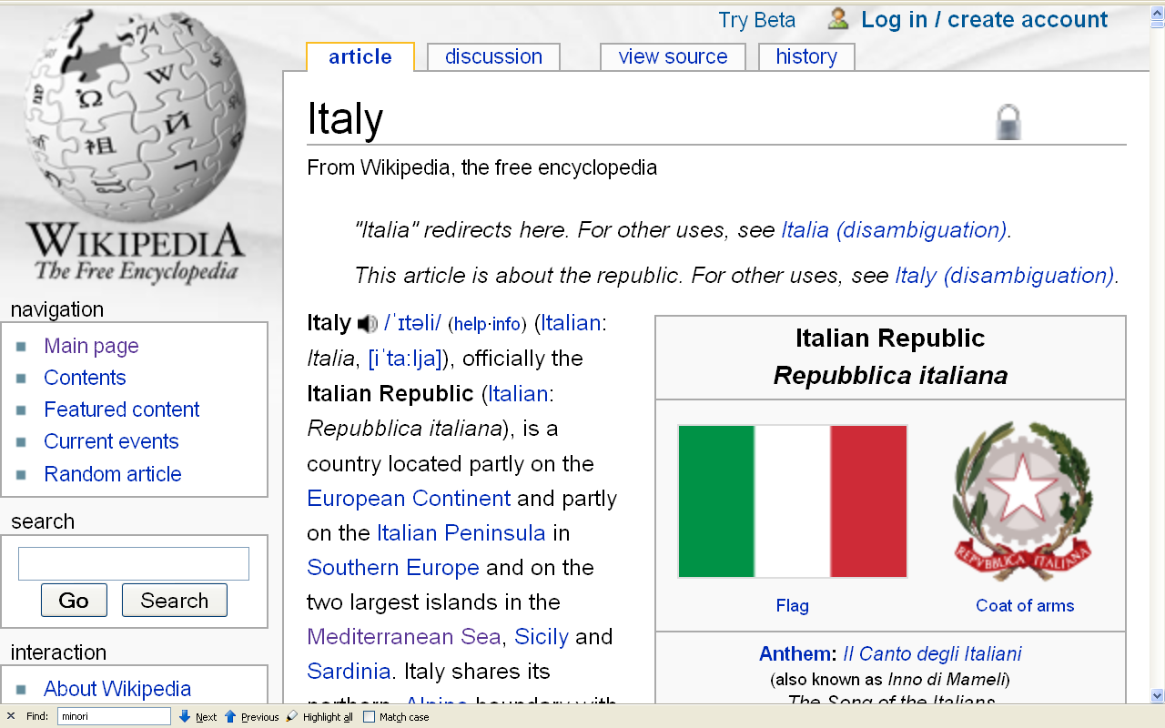
Formation of Italy
Unification —17 March 1861
Republic —2 June 1946
http://en.wikipedia.org/wiki/Italy
Notes:
15

Slide 16
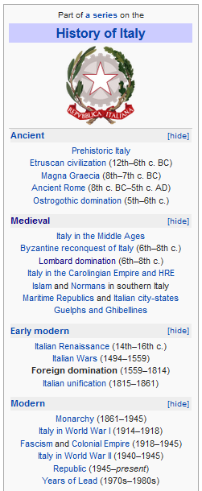
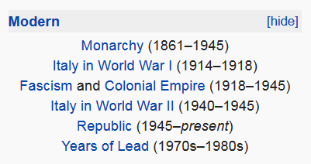
http://en.wikipedia.org/wiki/History_of_Italy_during_foreign_domination_and_the_unification
Notes:
16

Slide 17
http://en.wikipedia.org/wiki/History_of_Italy_during_foreign_domination_and_the_unification
Notes:
17

Slide 18
Formation of Italy
Unification —17 March 1861
Republic —2 June 1946
http://en.wikipedia.org/wiki/Italy
Notes:
18

Slide 19
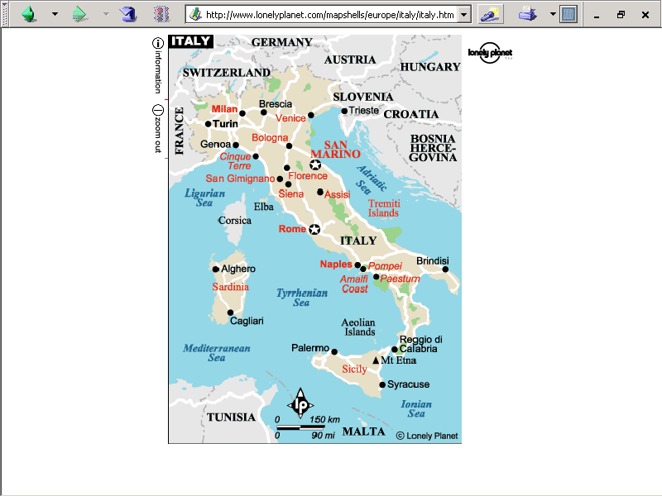
population size
61,021,855 (2023 est.)
https://www.worldometers.info/world-population/italy-population/

Slide 20
Note
Sicily

Slide 21
Note
Sardinia

Slide 22
Note
Kingdom of Tavolara
(unrecognized micronation)
https://en.wikipedia.org/wiki/Kingdom_of_Tavolara

Slide 23
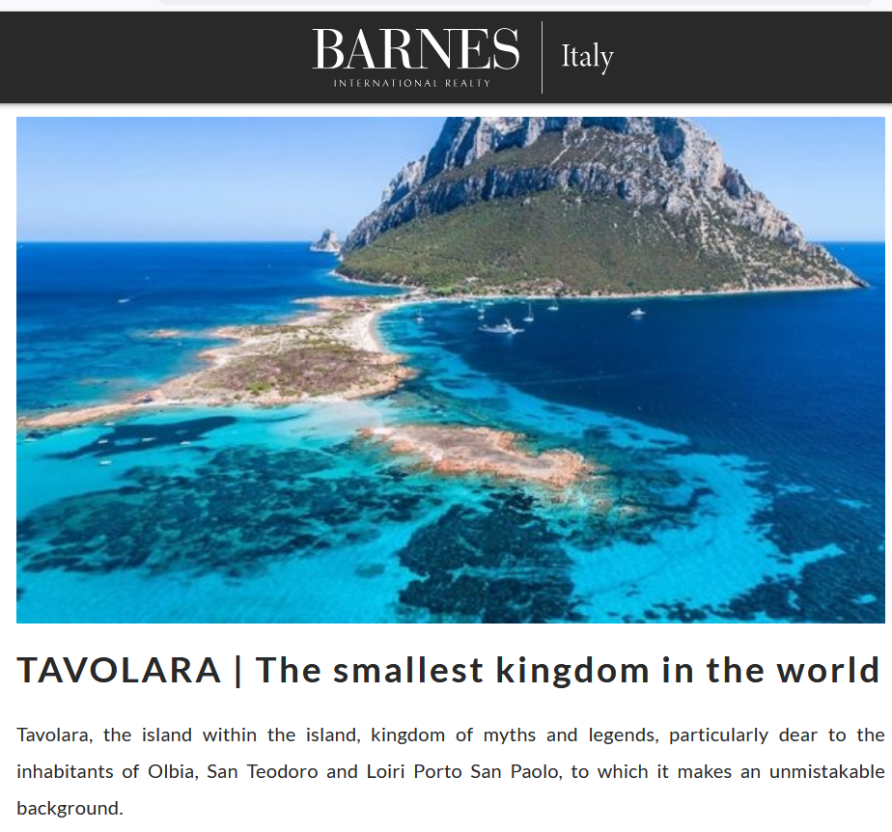
https://barnes-italy.com/tavolara-the-smallest-kingdom-in-the-world/
Notes:
23

Slide 24
Note
Corsica
(French)
Notes:
24

Slide 25
Principality of Seborga
(unrecognized micronation)
Note
https://en.wikipedia.org/wiki/Seborga
Notes:
25

Slide 26

Notes:
26

Slide 27
Note
Rome

Slide 28
The Holy See
(The Vatican)
an independent country
Note
Notes:
28

Slide 29
Note
Notes:
29

Slide 30
Note
The Most Serene Republic
of San Marino
an independent country
Notes:
30

Slide 31
Master Works
and Classics
Italy

Slide 32
major anthropological studies of Italy . . .

Slide 33
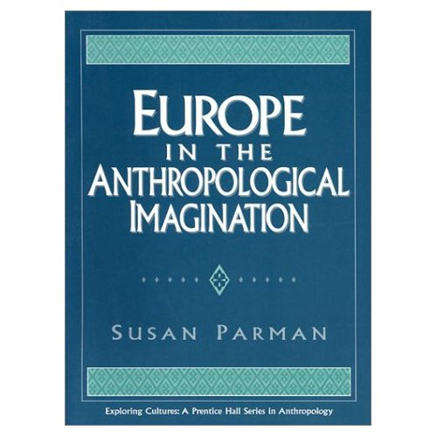
A good brief
historical overview . . .
David I. Kertzer,
Ch. 5 “Representing Italy,”
pp. 70-79
Kertzer is an early “Urban Anthropologist”
Parman, Susan.
Europe in the Anthropological Imagination.
Upper Saddle River, NJ: Prentice Hall, 1998.
(ISBN: 0133374602)
www.d.umn.edu/cla/faculty/troufs/anth1095/index.html#Gannon

Slide 34
the classic ethnography of Italy is Charlotte Gower Chapman’s study of a small Sicilian community of Milocca…
Susan Parman, Europe in the Anthropological Imagination, pp. 11 - 14

Slide 35
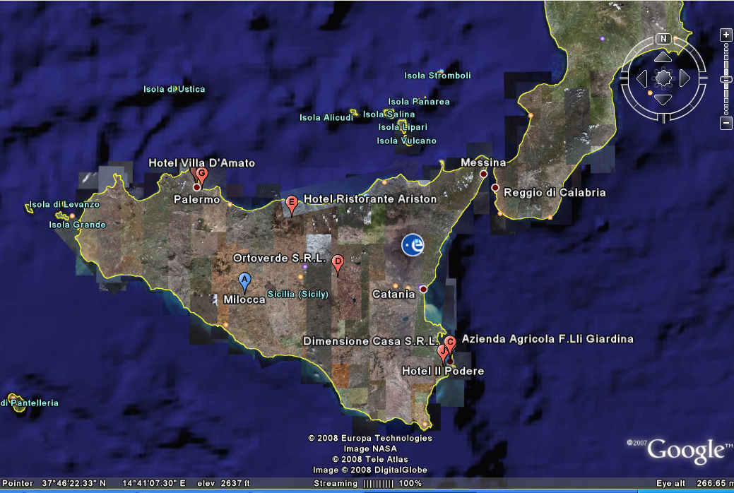
Milocca: A Sicilian Village
Charlotte Gower Chapman

Slide 36

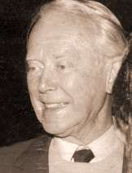
another classic ethnography of the region is . . .
Julian Alfred Pitt-Rivers
1954 People of the Sierra
Chicago: University of Chicago Press
1963 Mediterranean Countrymen: Essays in the Social Anthropology of the Mediterranean
Julian Alfred Pitt-Rivers, et al
Paris: Mouton

Slide 37
certain regions have become affiliated with certain research problems
Susan Parman, Europe in the Anthropological Imagination, pp. 11 - 14

Slide 38
in Anthropology one goes to ...
  Ireland to study peasants
  Norway and England to study networks
  The Mediterranean to study gender roles, honor / shame values, and patron-client relationships
Susan Parman, Europe in the Anthropological Imagination, pp. 11 - 14

Slide 39
in Anthropology one goes to ...
  Ireland to study peasants
  Norway and England to study networks
  The Mediterranean to study gender roles, honor / shame values, and patron-client relationships
Susan Parman, Europe in the Anthropological Imagination, pp. 11 - 14

Slide 40
art historians prefer France and Italy
    The Louvre Museum (Musée du Louvre) in Paris, France, is the largest museum in the world
    Florence, the “birthplace” of the Renaissance
Susan Parman, Europe in the Anthropological Imagination, pp. 11 - 14

Slide 41
However, as David I. Kertzer notes in his review of American anthropologists working in Italy, most work [in Italy] continues to be done on islands and in the rural south
Susan Parman, Europe in the Anthropological Imagination, pp. 11 - 14

Slide 42
in addition, anthropologists often are drawn to border regions
Susan Parman, Europe in the Anthropological Imagination, pp. 11 - 14

Slide 43
In addition, anthropologists often are drawn to border regions…
    Saunders near the French border
    Holmes near the Yugoslav border
    Ward on the Austrian border
    Cole and Wolf spanning the Austrian-Italian border
Susan Parman, Europe in the Anthropological Imagination, pp. 11 - 14

Slide 44
Nancy F. Breuner
1992 Cult of the Virgin Mary in Southern Italy and Spain. Ethos 20:66-95.
Parman's classic picks -- Tony Galt

Slide 45
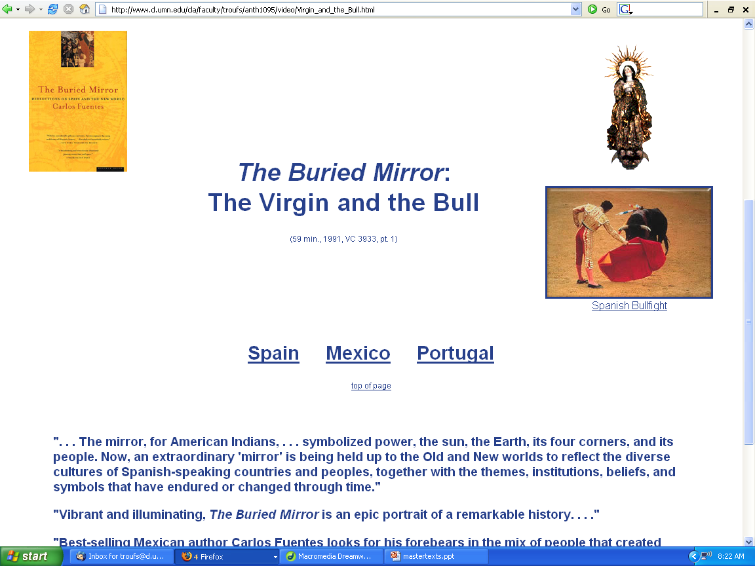

Slide 46
the chapters in Parman suggest that there has been a tendency in the history of the anthropology of Europe to ...
  exoticize the familiar
  create syndromes of difference
    such as “honor and shame”
  and to stress the study of the rural, the semiliterate folk, the small scale, preferably on islands
Susan Parman, Europe in the Anthropological Imagination, pp. 11 - 14

Slide 47
David I. Kertzer
Europe in the Anthropological Imagination
David D. Gilmore, ed. Honor and Shame and the Unity of the Mediterranean. American Ethnologist. 15:813-814
http://www.d.umn.edu/cla/faculty/troufs/anth3635/cetexts.html#Parman

Slide 48
David I. Kertzer
Europe in the Anthropological Imagination
Michael Herzfeld (1987, p. 11) “the extension of ethnography to the circum-Mediterranean has created a need for exoticizing devices to justify research in what is otherwise a familiar cultural backyard”
  Kertzlier: “He notes that anthropologists’ concentrations on such topics as honor and shame, presented as hallmarks of these cultures, along with the unremitting village-level focus of so much of the anthropology done there, furthers this distancing, rendering the otherwise dangerously familiar into the satisfying exotic” (71)
http://www.d.umn.edu/cla/faculty/troufs/anth3635/cetexts.html#Parman

Slide 49
David I. Kertzer
Europe in the Anthropological Imagination
“. . . In the field the air should smell of
cow dung, not car exhaust”
(71)
http://www.d.umn.edu/cla/faculty/troufs/anth3635/cetexts.html#Parman

Slide 50
David I. Kertzer
Europe in the Anthropological Imagination
“Judging from the anthropological literature, one might well conclude that Italy is a nation of peasants living in remote and desolate villages”
(Kertzer 1983, 52)
http://www.d.umn.edu/cla/faculty/troufs/anth3635/cetexts.html#Parman

Slide 51
David I. Kertzer
Europe in the Anthropological Imagination
“...For me [Kertzer] the value of urban anthropology stemmed from the belief that social life followed basically similar principles everywhere and that the division between the principles governing urban and rural life was largely artificial” (72)
http://www.d.umn.edu/cla/faculty/troufs/anth3635/cetexts.html#Parman

Slide 52
David I. Kertzer
Europe in the Anthropological Imagination
“Indeed, over the centuries there has been a constant flux of population between cities and their rural hinterland in Italy, belying scholars’ apparent categorical imperative to contrast ‘city-dwellers’ with ‘peasants’” (72)
http://www.d.umn.edu/cla/faculty/troufs/anth3635/cetexts.html#Parman

Slide 53
David I. Kertzer
Europe in the Anthropological Imagination
“The professional anglophone anthropology of Italy dates back to the work of Charlotte Gower Chapman who was a graduate student at the University of Chicago in the 1920s. . . .”
  Robert Redfield, her mentor, had just completed his study Tepotzlan, Mexico
http://www.d.umn.edu/cla/faculty/troufs/anth3635/cetexts.html#Parman

Slide 54
David I. Kertzer
Europe in the Anthropological Imagination
the classic ethnography of Italy is Charlotte Gower Chapman’s study of a small Sicilian community of Milocca . . .
Susan Parman, Europe in the Anthropological Imagination, pp. 11 - 14

Slide 55
Milocca: A Sicilian Village
Charlotte Gower Chapman

Slide 56
David I. Kertzer
Europe in the Anthropological Imagination
Charlotte Gower Chapman’s Ph.D. dissertation research focused on the Sicilian-American community of Chicago
http://www.d.umn.edu/cla/faculty/troufs/anth3635/cetexts.html#Parman

Slide 57
David I. Kertzer
Europe in the Anthropological Imagination
“It is worth reflecting on the fact that, even in the 1920s, anthropological research in an American city could be met with approval, as long as the focus was on an ethnic enclave. Yet, by contrast, in planning to undertake anthropological research in Europe, all efforts were made to locate the most remote rural community possible.” (73)
http://www.d.umn.edu/cla/faculty/troufs/anth3635/cetexts.html#Parman

Slide 58
David I. Kertzer
Europe in the Anthropological Imagination
Charlotte Gower Chapman herself describes Milocca as “by no means typical” of Sicilian communities, being “much smaller” and “more isolated” than the average (73)
http://www.d.umn.edu/cla/faculty/troufs/anth3635/cetexts.html#Parman

Slide 59
David I. Kertzer
Europe in the Anthropological Imagination
“...[Milocca] was ‘an hour’s walk from the end of the nearest highway, and more than two hours form the nearest railroad station’” (73)
  Chapman sought out a small village despite the fact that even Sicily’s agricultural population lived primarily in large communities (sometimes referred to as agro-towns) (73)
http://www.d.umn.edu/cla/faculty/troufs/anth3635/cetexts.html#Parman

Slide 60
David I. Kertzer
Europe in the Anthropological Imagination
“Thus, the preferred anthropological peasant community was not even typical of peasant settlements, since the most typical were presumably too large for satisfactory anthropological treatment.” (73)
http://www.d.umn.edu/cla/faculty/troufs/anth3635/cetexts.html#Parman

Slide 61
David I. Kertzer
Europe in the Anthropological Imagination
Chapman’s work reflects two features that would mark the development of anglophone anthropology of Italy
    The equation of anthropology with the study of the rural (indeed, the less-literate-the-better) folk
    The preference for anthropological work on Italy’s to big islands – Sicily and Sardinia (73)
http://www.d.umn.edu/cla/faculty/troufs/anth3635/cetexts.html#Parman

Slide 62
David I. Kertzer
Europe in the Anthropological Imagination
The pattern of the ahistorical community studies set in Italy’s most remote areas—almost entirely in the mainland south and the two islands—continued as a number of foreign anthropologists began to venture into Italy in the 1950s and early 1960s
  Topics such as honor and sham on the cultural level, and local-level patterns of family, kinship, and patron-client relations on the social level, dominated the work done in these years (73-74)
http://www.d.umn.edu/cla/faculty/troufs/anth3635/cetexts.html#Parman

Slide 63
David I. Kertzer
Europe in the Anthropological Imagination
Major changes began to take place in the late 1960s, changes traceable to developments in anthropology that can only be understood against the broader context of what was going on in the American society at the time. (74)
http://www.d.umn.edu/cla/faculty/troufs/anth3635/cetexts.html#Parman

Slide 64
David I. Kertzer
Europe in the Anthropological Imagination
“The influence of various forms of leftist political currents in the United States and Europe led to both a heightened interest in political economy and a new view of the poor that saw them not folkloristically but, in adaptive terms, as victims of exploitation.” (74)
http://www.d.umn.edu/cla/faculty/troufs/anth3635/cetexts.html#Parman

Slide 65
David I. Kertzer
Europe in the Anthropological Imagination
“Back then many of us were exercised about the ’culture of poverty’ thesis propounded by Oscar Lewis and taken up by Daniel Moynihan and others in the American public policy arena.” (74)
http://www.d.umn.edu/cla/faculty/troufs/anth3635/cetexts.html#Parman

Slide 66


Oscar Lewis
  Life in a Mexican Village: Tepoztlan Restudied
  1951 Urbana, IL: University of Illinois Press.
became models

Slide 67
David I. Kertzer
Europe in the Anthropological Imagination
American Anthropology in Italy, 1975-1994
  The choice of research sites made by American anthropologists working in Italy continued their “attachment to working on Italy’s to main islands”
      Including at least 7 anthropologists on Sicily alone
      at least 3 anthropologists for Sardinia (75)
http://www.d.umn.edu/cla/faculty/troufs/anth3635/cetexts.html#Parman

Slide 68
David I. Kertzer
Europe in the Anthropological Imagination
American Anthropology in Italy, 1975-1994
  By contrast, 5 anthropologists have published work in Central Italy
  Of the 13 American scholars who have published monographs 1975-1994 based on Italian fieldwork, only 3 did their work in the northern half of the country (that is north of Umbria) (76)
http://www.d.umn.edu/cla/faculty/troufs/anth3635/cetexts.html#Parman

Slide 69
David I. Kertzer
Europe in the Anthropological Imagination
American Anthropology in Italy, 1975-1994
  By contrast, 5 anthropologists have published work in Central Italy
  Of the 13 American scholars who have published monographs 1975-1994 based on Italian fieldwork, only 3 did their work in the northern half of the country (that is north of Umbria) (76)
http://www.d.umn.edu/cla/faculty/troufs/anth3635/cetexts.html#Parman

Slide 70
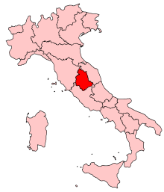
David I. Kertzer
Europe in the Anthropological Imagination
American Anthropology in Italy, 1975-1994
  By contrast, 5 anthropologists have published work in Central Italy
  Of the 13 American scholars who have published monographs 1975-1994 based on Italian fieldwork, only 3 did their work in the northern half of the country (that is north of Umbria) (76)
http://www.d.umn.edu/cla/faculty/troufs/anth3635/cetexts.html#Parman

Slide 71
David I. Kertzer
Europe in the Anthropological Imagination
There is “...Not only a heavy concentration in the southern third of the country, but a strong tendency for the relatively few anthropologists working in the northern two-thirds of the country to work in small, generally peripheral communities.”
Although the northern third of the country is primarily urban, and filled with important cities like Milan, Turin, Genoa, and Venice, not to mention such important provincial centers as Brescia, Verona, Parma, and Modena, American anthropologists have studiously avoided such centers.” (76)
http://www.d.umn.edu/cla/faculty/troufs/anth3635/cetexts.html#Parman

Slide 72
David I. Kertzer
Europe in the Anthropological Imagination
Adding British anthropologists to Kertzer’s analysis would not alter the picture of where the anthropologists have chosen to work
  The best British anthropology conducted in Italy have been done in the rural south
      John Davis’s (1973) study of Pisticci
      Caroline White’s (1980) study of the Fucino area (78)
http://www.d.umn.edu/cla/faculty/troufs/anth3635/cetexts.html#Parman

Slide 73
David I. Kertzer
Europe in the Anthropological Imagination
Those doing historical research, rather than fieldwork, partially escape this pattern
    Horn (1991, 1994), Milan
    Yanagisako (1991), Como (78)
http://www.d.umn.edu/cla/faculty/troufs/anth3635/cetexts.html#Parman

Slide 74
David I. Kertzer
Europe in the Anthropological Imagination
And there have “important recent developments in the American anthropology of Italy” which are beginning to highlight…
  small industry in central Italy
  combined use of ethnography, oral history, and archival research in Sicily to provide valuable insights into the historical decline of fertility in Italy (76)
http://www.d.umn.edu/cla/faculty/troufs/anth3635/cetexts.html#Parman

Slide 75
David I. Kertzer
Europe in the Anthropological Imagination
Looking at the problem areas rather than the research site . . .
  Diverse works focus more on history than on contemporary ethnography
    Italy has been one of the most productive sites in the move of American anthropology towards history (76-77)
http://www.d.umn.edu/cla/faculty/troufs/anth3635/cetexts.html#Parman

Slide 76
David I. Kertzer
Europe in the Anthropological Imagination
Looking at the problem areas rather than the research site . . .
  Diverse works focus more on history than on contemporary ethnography
    Italy has been one of the most productive sites in the move of American anthropology towards history (76-77)
http://www.d.umn.edu/cla/faculty/troufs/anth3635/cetexts.html#Parman

Slide 77
David I. Kertzer
Europe in the Anthropological Imagination
Diverse works focus more on history than on contemporary ethnography
    Medical topics
    Demographic topics
    Studies of the impact of out-migration and household organization
    Role of the state and science in regulating reproduction in the Fascist era
    Transformation of sharecropping
    Institutionalization of infant abandonment (76-77)
http://www.d.umn.edu/cla/faculty/troufs/anth3635/cetexts.html#Parman

Slide 78
David I. Kertzer
Europe in the Anthropological Imagination
These studies often combine a focus on culture and social life with the recognition of the role of the state in producing historical change (77)
http://www.d.umn.edu/cla/faculty/troufs/anth3635/cetexts.html#Parman

Slide 79
David I. Kertzer
Europe in the Anthropological Imagination
Other studies include ...
  Galt’s work on the impact of economic change on family organization in an Apulian community
  John Davis’s “pioneering work on economy and kinship” in Pisticci, which illustrates why and how the historical dimension is so crucial to current anthropological work (77)
http://www.d.umn.edu/cla/faculty/troufs/anth3635/cetexts.html#Parman

Slide 80
David I. Kertzer
Europe in the Anthropological Imagination
These studies examine culture and social organization as ever-changing processes, and recognize the importance of using archival sources alongside the more traditional ethnographic methods (77)
http://www.d.umn.edu/cla/faculty/troufs/anth3635/cetexts.html#Parman

Slide 81
David I. Kertzer
Europe in the Anthropological Imagination
Conclusion
  The self-critical mood identified variously with postmodernism, reflexivity, and anti-imperialism is important
    “Are we engaged in manufacturing a bogus Other, in exoticizing the familiar?”
    “And to the extent that we seem to be guilty of such impulses, what accounts for them?” (77)
http://www.d.umn.edu/cla/faculty/troufs/anth3635/cetexts.html#Parman

Slide 82
David I. Kertzer
Europe in the Anthropological Imagination
Conclusion
  The self-critical mood identified variously with postmodernism, reflexivity, and anti-imperialism is important
    “Are we engaged in manufacturing a bogus Other, in exoticizing the familiar?”
    “And to the extent that we seem to be guilty of such impulses, what accounts for them?” (77)
http://www.d.umn.edu/cla/faculty/troufs/anth3635/cetexts.html#Parman

Slide 83
David I. Kertzer
Europe in the Anthropological Imagination
Conclusion
  The self-critical mood identified variously with postmodernism, reflexivity, and anti-imperialism is important
    “Are we engaged in manufacturing a bogus Other, in exoticizing the familiar?”
    “And to the extent that we seem to be guilty of such impulses, what accounts for them?” (77)
“Reluctantly,
I think we have to plead guilty to these charges.”
http://www.d.umn.edu/cla/faculty/troufs/anth3635/cetexts.html#Parman

Slide 84
David I. Kertzer
Europe in the Anthropological Imagination
One other related reason for this [other than those discussed earlier in Kertzer’s article]: “Our still deeply rooted commitment to a model of field research that—vilify it all we like—continues to rest on the community study model. In sort, in the sixty-five years since Charlotte Chapman got the Prefect of Sicily to order the mayor to order the midwife to put her up and be sure she got to know what she wanted to know about Milocca (and one can only imagine what the Prefect thought this American woman was doing in such a village), we still pine for the simplicity of a manageable field setting, one we can get a handle on, one where people will know who we are, where the social boundary is clear, the scale is human, and the cow dung wafts thought the air.”
http://www.d.umn.edu/cla/faculty/troufs/anth3635/cetexts.html#Parman

Slide 85
David I. Kertzer
Europe in the Anthropological Imagination
Since Kertzer’s article (1998) some important works have been done not following the “traditional” pattern . . .
http://www.d.umn.edu/cla/faculty/troufs/anth3635/cetexts.html#Parman

Slide 86

Betsy Krause’s excellent book
Elizabeth L. Krause
A Crisis of Births:
Population Politics and Family-Making in Italy
Belmont, CA: Thompson Wadsworth, 2005.
http://www.d.umn.edu/cla/faculty/troufs/anth3635/cetexts.html#CrisisofBirths

Slide 87
and sometimes Italy speaks for herself . . .

Slide 88
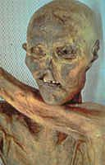
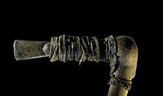
The Iceman’s Ax
Ötzi the Iceman
Bolzano, Italy

Slide 89


Slide 90
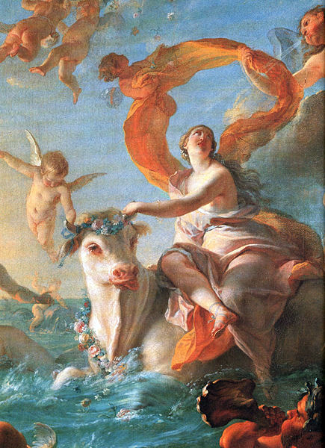
Europa and the Bull
Enlèvement d'Europe
Nöel-Nicolas Coypel, c. 1726

Slide 91

2026 Lamborghini Revuelto
All yours for around $609,000.
https://www.caranddriver.com/lamborghini/revuelto

Slide 92


Slide 93


Slide 94

2024 Alfa Romeo Stelvio Quadrifoglio
https://www.alfaromeousa.com/cars/giulia/quadrifoglio

Slide 95


Slide 96
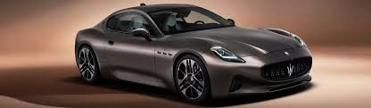
2026 Maserati GranTurismo

Slide 97


Slide 98
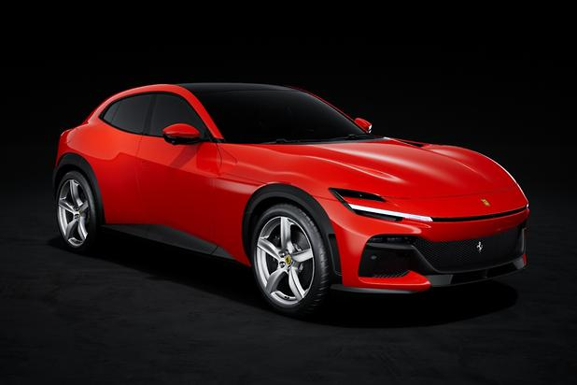
2026 Ferrari Purosangue
starting at about $400,000
https://www.caranddriver.com/ferrari/purosangue

Slide 100
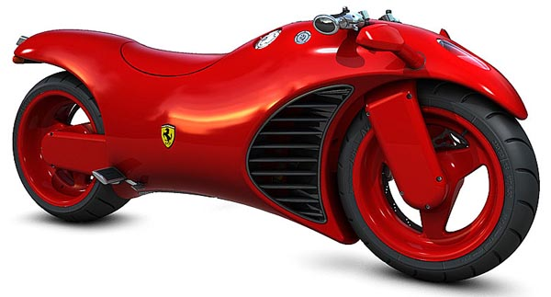

Slide 101


Slide 102
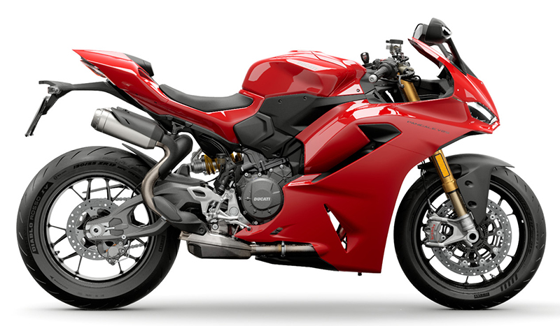
2026 Ducati Panigale V4
$19,595.00
https://www.wheelsinmotionmc.com/inventory/v1/Current/Ducati/Panigale/Panigale-V4/Red--Chatsworth-California---21336901?format=print

Slide 103


Slide 104
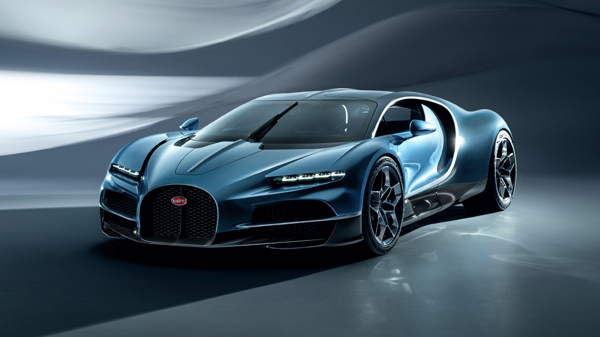
2026 Bugatti Tourbillion
Price: About $3.9 Million
https://auto.hindustantimes.com/auto/cars/2026-bugatti-tourbillon-hypercar-breaks-cover-with-1-775-bhp-445-kmph-top-speed-41718953938862.html

Slide 105
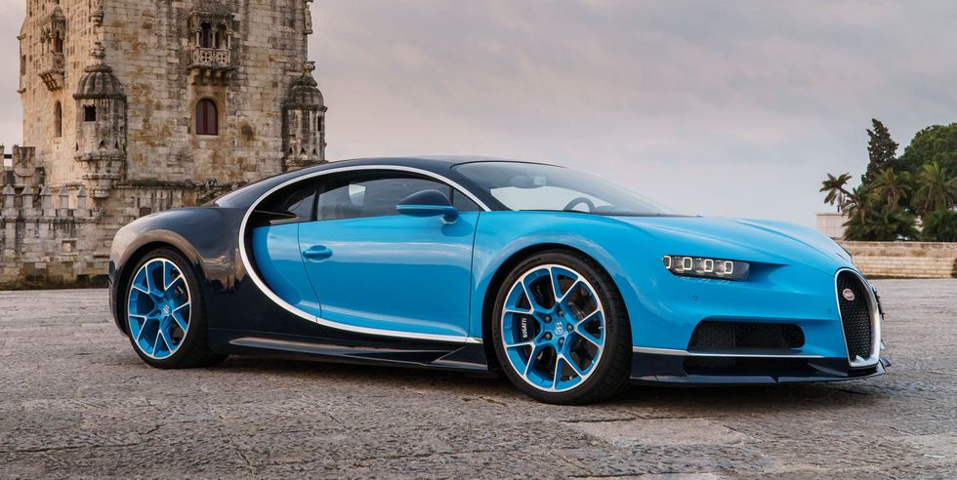
2022 Bugatti Chiron
Price: $3.6-$3.9 Million

Slide 106


Bugatti Niniette 66 yacht is a 1,000-hp Chiron for the Water

Slide 107


Slide 108
Martin J. Gannon and Rajnandini Pillai
Understanding Global Cultures
“The reliance on spectacle must be clearly grasped if one wants to understand the Italians.
Spectacle helps people solve most of their problems, and it governs public and private life.
It is one of the reasons that Italians have always excelled in activities in which impressions are important . . .
opera
architecture
industrial / technological design
decoration
and yes, even toilets
www.d.umn.edu/cla/faculty/troufs/anth1095/index.html#Gannon

Slide 109

Laufen Alessi One wall-hung toilet and bidet
ILBAGNOALESSI
Stefano Giovannoni
Designer

Slide 110


https://gestione.aetitalia.it/download/sito/d27bded_sanitarisquarefoto23.jpg

Slide 111

https://gestione.aetitalia.it/download/sito/d27bded_sanitarisquarefoto23.jpg

Slide 112

Cielo
Italy
https://www.ceramicacielo.it/en/products/smile/floor+mounted+wc+%26+bidet/back+to+wall+one+hole+bidet/111

Slide 113
And even the Italian trains
are beautiful . . .

Slide 114
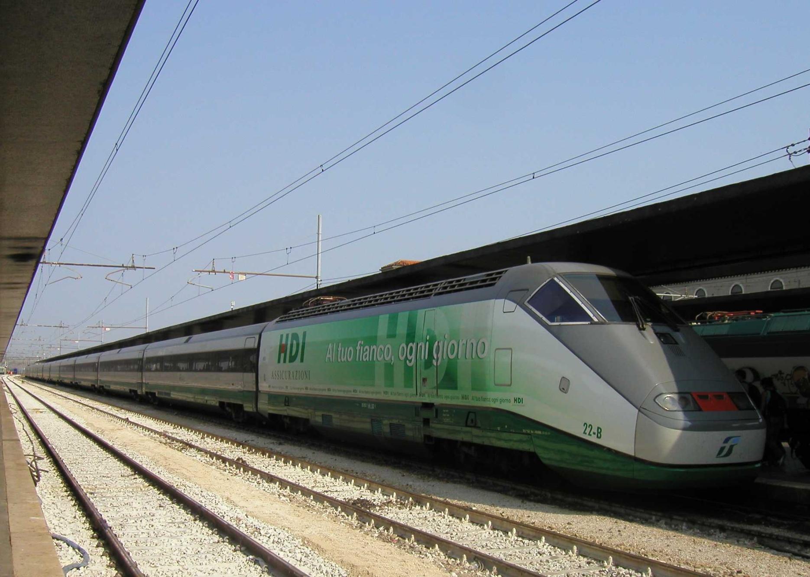
The Carolinian stopping
in Raleigh, North Carolina
in "Phase V" livery.
Wikipedia
Trenitalia series ETR 500 at Venezia S.Lucia
http://commons.wikimedia.org/wiki/File:Trenitalia-series-ETR500.jpg

Slide 115
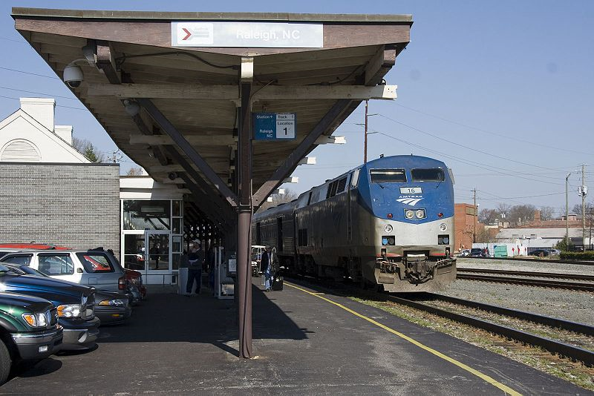
compare the Italian train to the U.S.A. train
The Carolinian stopping
in Raleigh, North Carolina
in "Phase V" livery.
Wikipedia
Trenitalia series ETR 500 at Venezia S.Lucia
http://commons.wikimedia.org/wiki/File:Trenitalia-series-ETR500.jpg

Slide 116
Martin J. Gannon and Rajnandini Pillai
Understanding Global Cultures
“The reliance on spectacle must be clearly grasped if one wants to understand the Italians.
Spectacle helps people solve most of their problems, and it governs public and private life.
It is one of the reasons that Italians have always excelled in activities in which impressions are important . . .
opera
architecture
industrial / technological design
decoration
landscape gardening
cinema
fashions
www.d.umn.edu/cla/faculty/troufs/anth1095/index.html#Gannon

Slide 117
Martin J. Gannon and Rajnandini Pillai
Understanding Global Cultures
“The reliance on spectacle must be clearly grasped if one wants to understand the Italians.
Spectacle helps people solve most of their problems, and it governs public and private life.
It is one of the reasons that Italians have always excelled in activities in which impressions are important . . .
opera
architecture
industrial / technological design
decoration
landscape gardening
cinema
fashions
www.d.umn.edu/cla/faculty/troufs/anth1095/index.html#Gannon

Slide 118

https://fashionista.com/2025/10/milan-fashion-week-spring-2026-trends

Slide 119

21 June 2023
Milan men’s fashion week spring/summer 2026
https://media.cnn.com/api/v1/images/stellar/prod/gettyimages-2221371544.jpg?q=w_1480,c_fill/f_webp

Slide 120
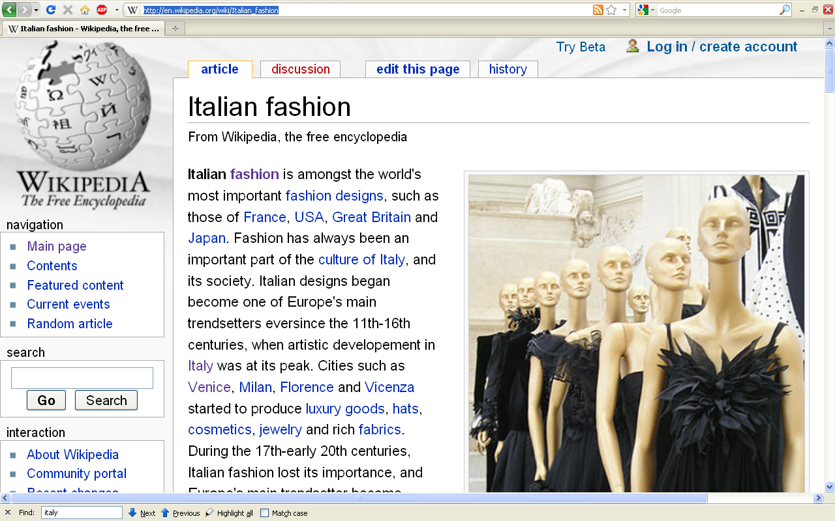
http://en.wikipedia.org/wiki/Italian_fashion

Slide 121
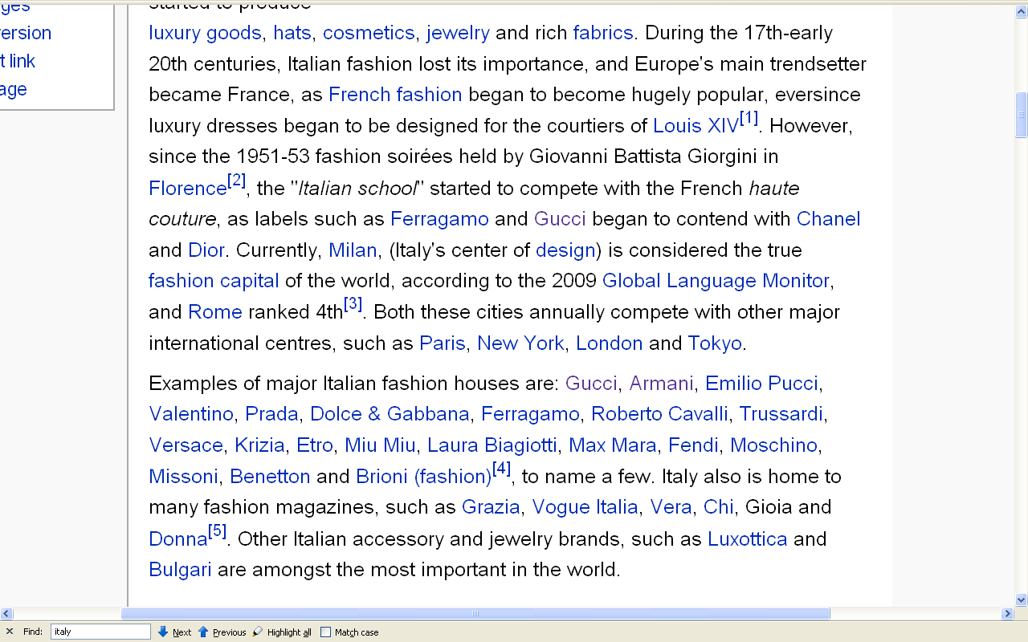
http://en.wikipedia.org/wiki/Italian_fashion

Slide 122
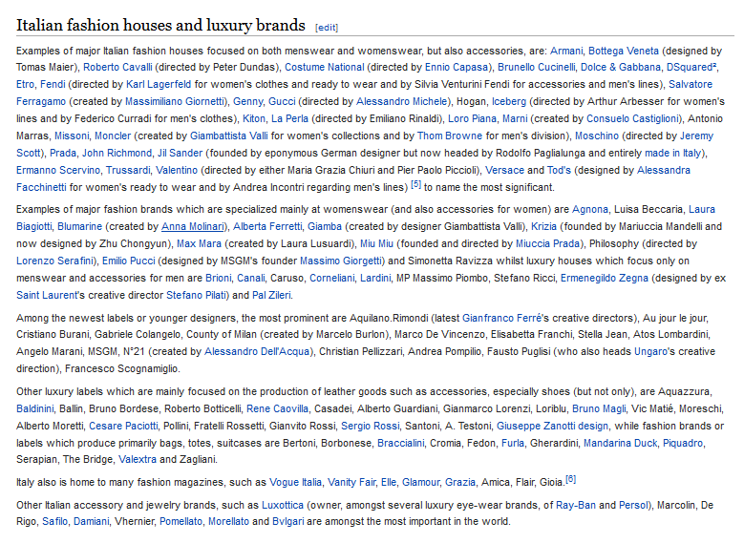
the list of
Italian fashion houses and luxury brands
is seemingly endless . . .
https://en.wikipedia.org/wiki/Italian_fashion#Italian_fashion_houses_and_luxury_brands

Slide 123


Slide 124
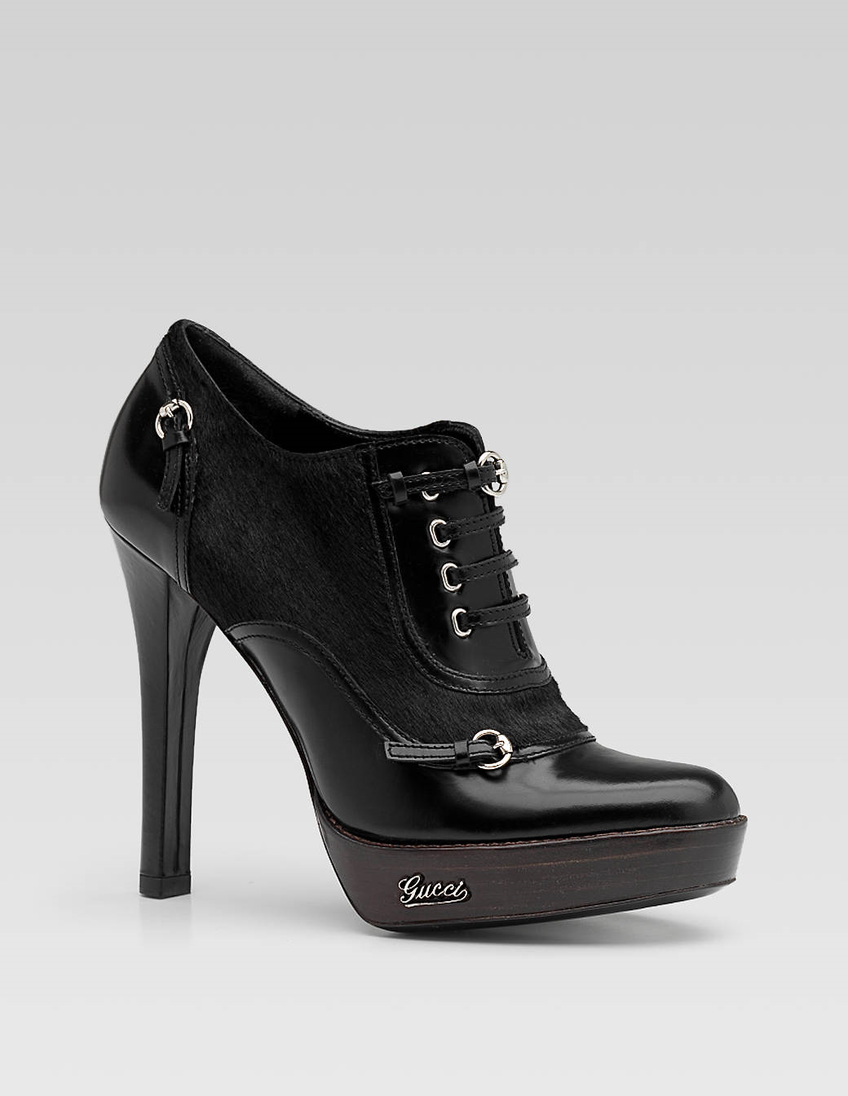

Slide 125

Gucci
$3,750

Slide 126
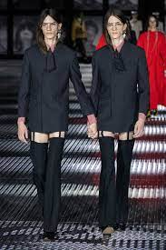

Slide 127


Slide 128


Slide 129

GIORGIO ARMANI
“the blue eyed designer ”
http://www.fashionavecpassion.com/an-emporio-armani-brand-new-fashion-ss15-the-futuristic-classic/

Slide 130



Slide 131
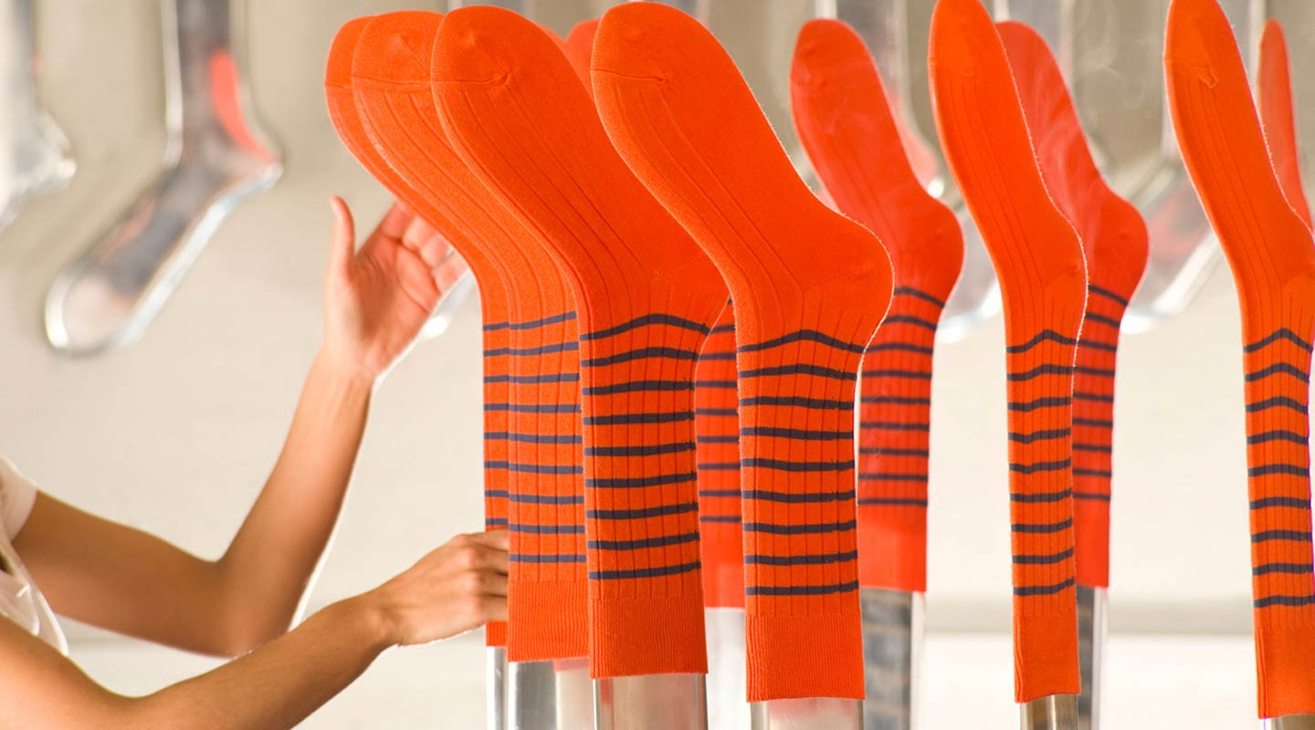

Slide 132
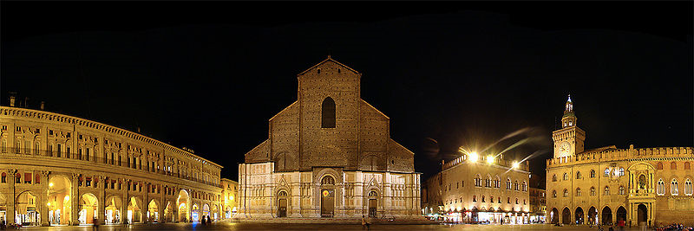
Bologna
http://en.wikipedia.org/wiki/Bologna

Slide 133
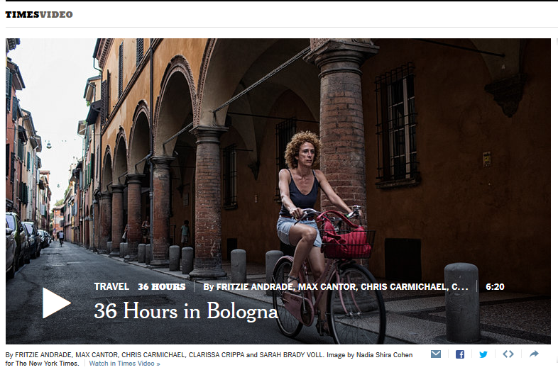
http://nyti.ms/1FFtb3D

Slide 134
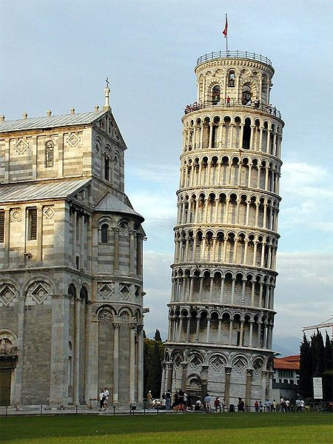
“Leaning Tower”
Pisa
http://en.wikipedia.org/wiki/Leaning_Tower_of_Pisa

Slide 135
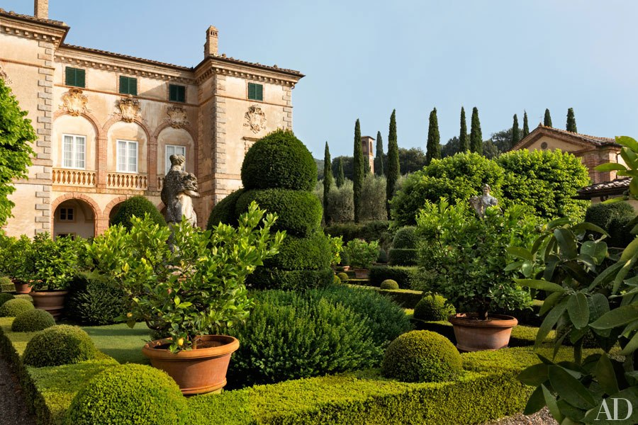
Garden façade of Villa Cetinale
17th-century Tuscany
http://www.architecturaldigest.com/decor/2014-05/ned-lambton-villa-cetinale-siena-italy-slideshow

Slide 136
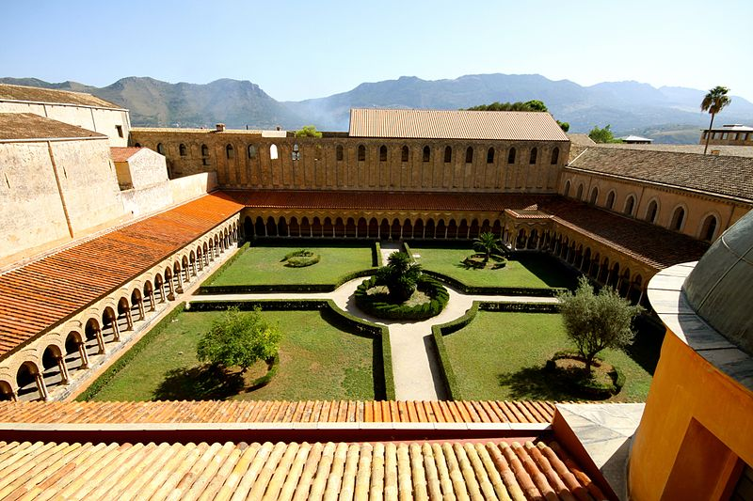
The cloister of the Abbey of Monreale, Sicily, Italy
http://www.suggestkeyword.com/aXRhbGlhbiBnYXJkZW5z/

Slide 137
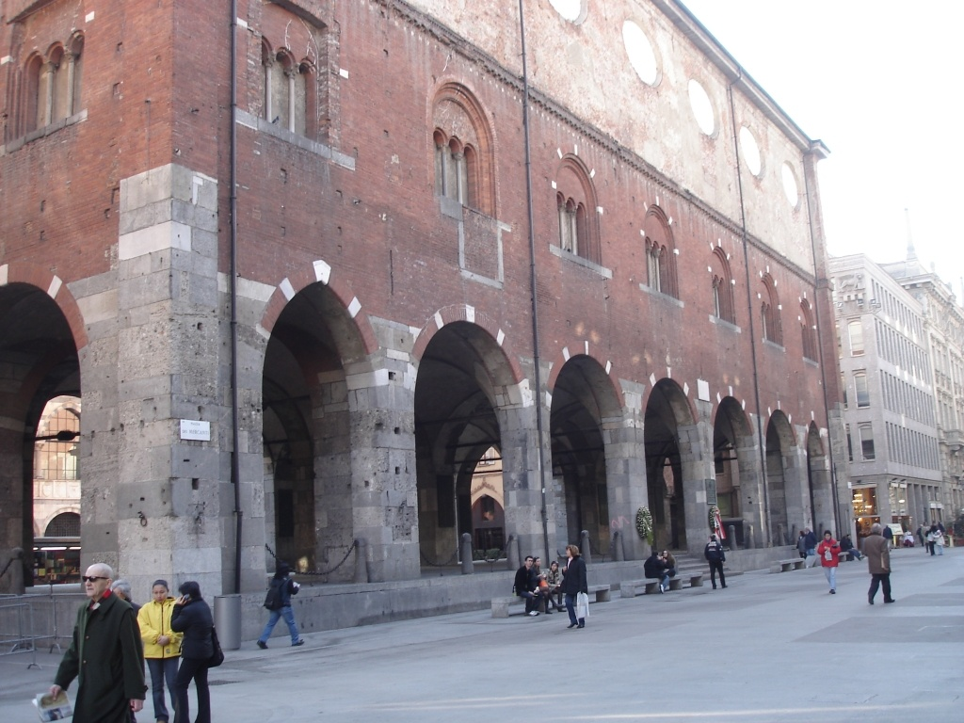
Piazza dei Mercanti, Milan
http://tintore.org/cgi-bin/article.cgi?article_id=110

Slide 138
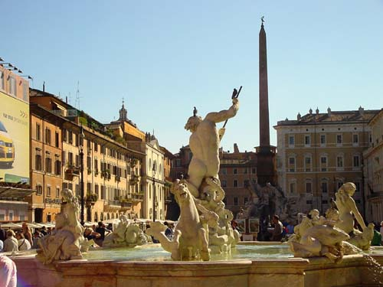
Fontana del Nettuno in Piazza Navone, Rome
http://www.traveladventures.org/continents/europe/romefountains01.shtml

Slide 139
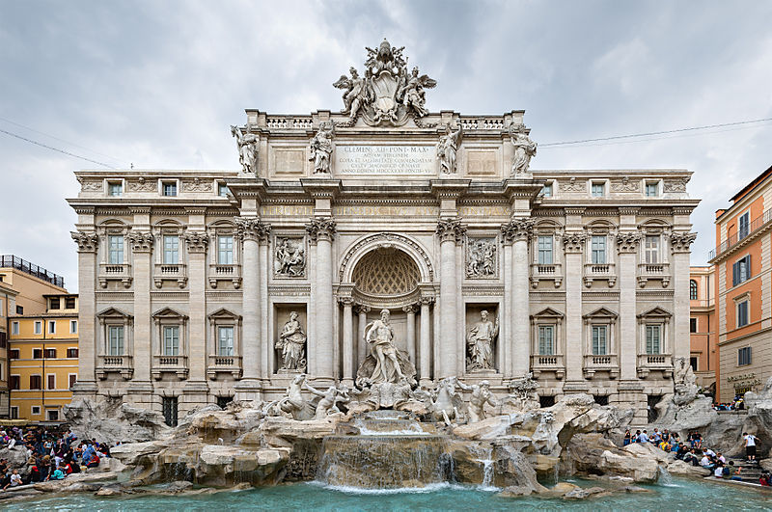
Trevi Fountain, Rome
https://en.wikipedia.org/wiki/Trevi_Fountain

Slide 140
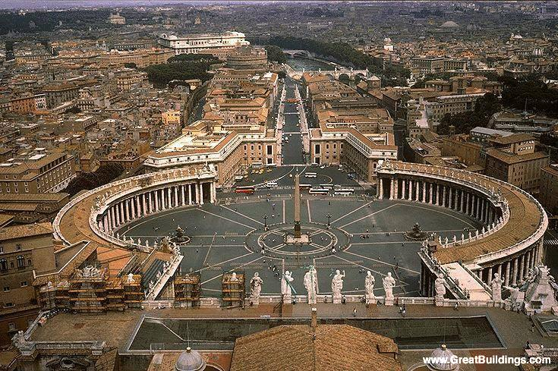
Piazza of St. Peters, The Holy See
http://dl.lib.brown.edu:8080/exist/mjp/plookup.xq?id=BerniniGiovanni

Slide 141
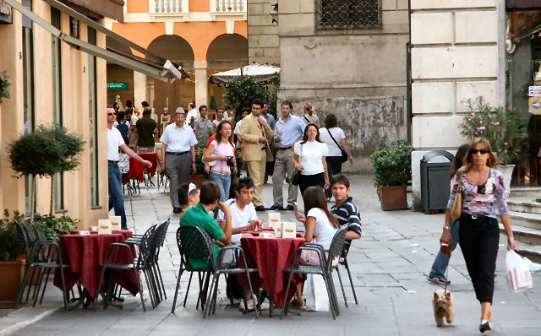
Bar in Piazza dei Signori, Vicenza, Northern Italy
www.bed-breakfast-italy.com/bars.htm

Slide 142
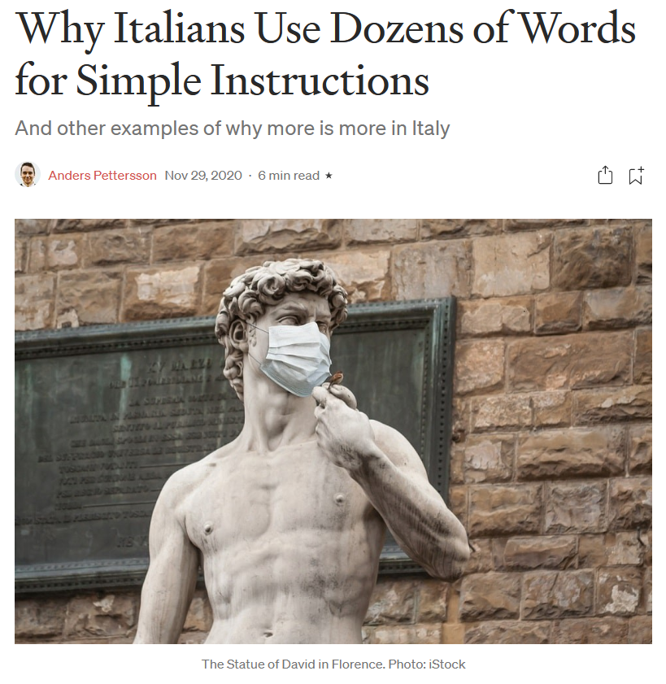

29 Nov 2020
https://humanparts.medium.com/why-italians-use-dozens-of-words-for-simple-instructions-b3e499f2f0df

Slide 143
Martin J. Gannon and Rajnandini Pillai
Understanding Global Cultures
Oral communication in Italy is something of a show itself
Speaking is punctuated by elaborate gestures, befitting the Italian operatic tradition
Whatever the section of the country, Italians talk with their hands
  Quick, agile, expressive movement of the hands, arms, and shoulders contribute emphasis and sincerity to the spoken words and facial expressions
www.d.umn.edu/cla/faculty/troufs/anth1095/index.html#Gannon

Slide 144
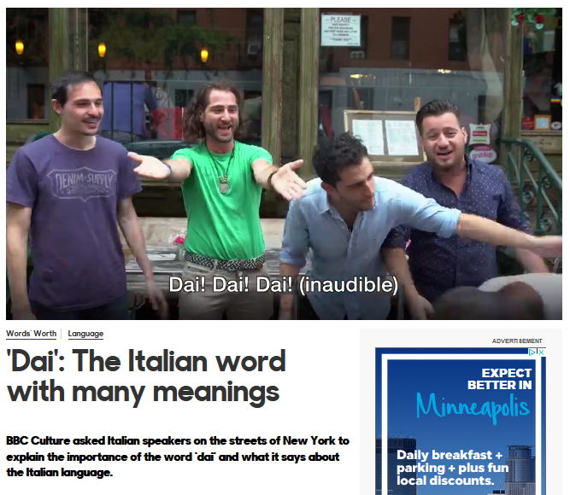

http://www.bbc.com/culture/story/20171207-dai-the-italian-word-with-many-meanings

Slide 145

The Hand Gesture Heard Round the World
Emperor Augustus
ruled Rome
27 BC to AD 14
6 January 2024
https://www.nytimes.com/2024/01/06/opinion/tommy-devito-football-italian.html?smid=nytcore-ios-share&referringSource=articleShare

Slide 146



Giants' Tommy DeVito shares the origin behind his pinched fingers touchdown celebration
26 November 2023
https://www.cbssports.com/nfl/news/giants-tommy-devito-shares-the-origin-behind-his-pinched-fingers-touchdown-celebration/
https://brobible.com/sports/article/giants-played-sopranos-theme-song-tommy-devito-entrance/

Slide 147
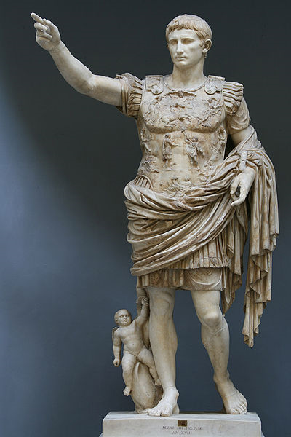
Martin J. Gannon and Rajnandini Pillai
Understanding Global Cultures
“Italians tend to believe that their language is the most beautiful one in the world.”
  Italians put great emotion into their language, speaking with passion, rhythm, and changing tonality
Emperor Augustus
ruled Rome
27 BC to AD 14
www.d.umn.edu/cla/faculty/troufs/anth1095/index.html#Gannon

Slide 148

Martin J. Gannon and Rajnandini Pillai
Understanding Global Cultures
“Italians tend to believe that their language is the most beautiful one in the world.”
  Italians put great emotion into their language, speaking with passion, rhythm, and changing tonality
Sophia Loren
ruled Hollywood,
at the 2009 Academy Awards
Emperor Augustus
ruled Rome
27 BC to AD 14
www.d.umn.edu/cla/faculty/troufs/anth1095/index.html#Gannon

Slide 149
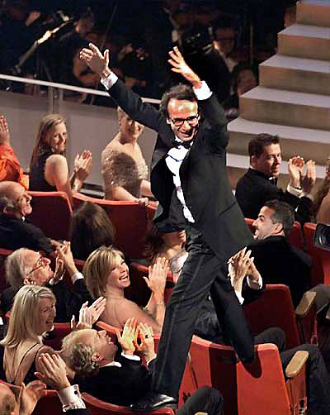
Martin J. Gannon and Rajnandini Pillai
Understanding Global Cultures
“Italians tend to believe that their language is the most beautiful one in the world.”
  Italians put great emotion into their language, speaking with passion, rhythm, and changing tonality
Roberto Benigni
71st Academy Awards
Best Foreign Film
Best Actor
1999
www.d.umn.edu/cla/faculty/troufs/anth1095/index.html#Gannon

Slide 150
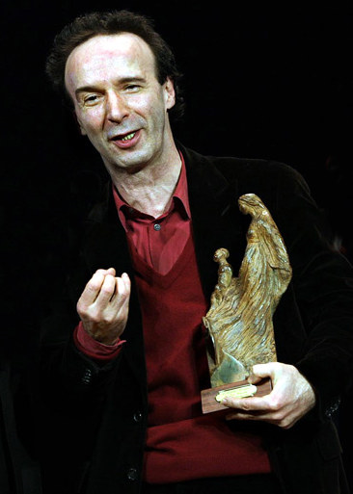
Martin J. Gannon and Rajnandini Pillai
Understanding Global Cultures
“Italians tend to believe that their language is the most beautiful one in the world.”
  Italians put great emotion into their language, speaking with passion, rhythm, and changing tonality
Roberto Benigni
2006
www.d.umn.edu/cla/faculty/troufs/anth1095/index.html#Gannon

Slide 151
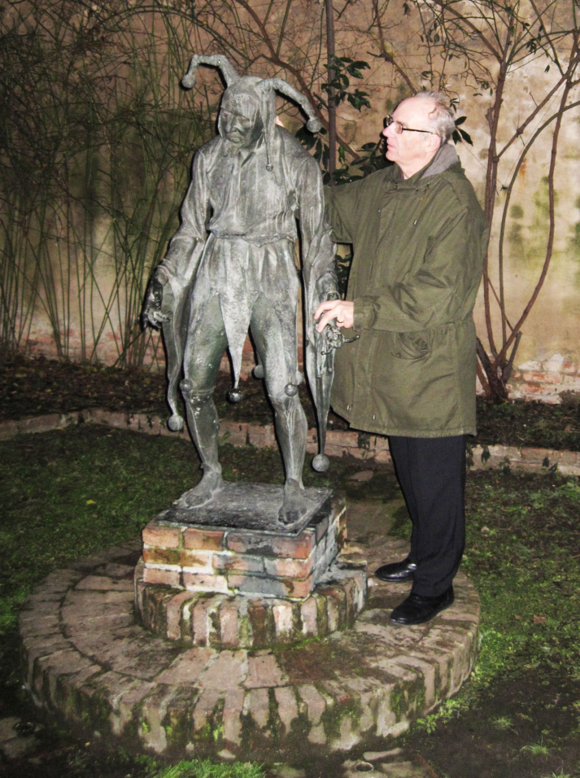

Giuseppe Verdi
Rigoletto
(on the left)
Mantova, Italy

Slide 152

http://en.wikipedia.org/wiki/Aida

Slide 153

http://www.nedgallagher.com/journal/images/aida.jpg

Slide 154

Lucia di Lammermoor – Gaetano Donizetti (1797-1848)
<http://tours.360wichita.com/234/newsletter/lucia_di_lammermoor02_360connect.jpg>

Slide 155


Cavalleria
Rusticana
North
South
http://en.wikipedia.org/wiki/Tosca

Slide 156



North or South?
http://en.wikipedia.org/wiki/Tosca

Slide 157

North or South?
http://en.wikipedia.org/wiki/Tosca

Slide 158

“Paparazzi”
. . . originated in the 1960 film La dolce vita directed by Federico Fellini
Federico Fellini
Original movie poster by Giorgio Olivetti
http://giornale.regione.marche.it/archivio/num0400/art09.htm

Slide 159

Martin J. Gannon and Rajnandini Pillai
Understanding Global Cultures
“Italians tend to believe that their language is the most beautiful one in the world.”
“I speak Spanish to God,
Italian to women,
French to men
and
German to my horse”
Attributed to King Charles V
King of Spain and Holy Roman Emperor
1500–1558
www.d.umn.edu/cla/faculty/troufs/anth1095/index.html#Gannon
https://en.wikipedia.org/wiki/Charles_V,_Holy_Roman_Emperor

Slide 160
Federico Fellini
Original movie poster by Giorgio Olivetti
http://giornale.regione.marche.it/archivio/num0400/art09.htm

Slide 161
Famous quotes . . .
“She opened up a book of poems and handed it to me written by an Italian poet from the 13th century and every one of them words rang true and glowed like burning coal pouring off of every page like it was written in my soul from me to you.”
Bob Dylan
1941 –
This one by . . .
www.d.umn.edu/cla/faculty/troufs/anth1095/index.html#Gannon

Slide 162

http://www.nytimes.com/2016/10/14/arts/music/bob-dylan-nobel-prize-literature.html?smid=fb-nytimes&smtyp=cur&_r=0

Slide 163
Martin J. Gannon and Rajnandini Pillai
Understanding Global Cultures
“This, then, is Italy.
It is still a grand and larger-than-life society whose citizens
love pageantry and spectacle,
emphasize a range of voices
in everyday life,
externalize emotions and feelings,
and feel a commitment to the town and region of the country
in which they were born. . . .”
www.d.umn.edu/cla/faculty/troufs/anth1095/index.html#Gannon

Slide 164
Master Works
and Classics
Italy

