Slide 1

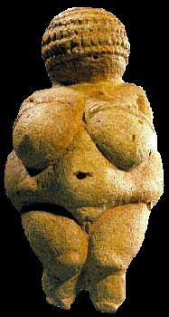
Use your up/down arrow keys and/or
your space bar to advance the slides
University of Minnesota Duluth
Tim Roufs
© 2010-2013
http://www.d.umn.edu/cla/faculty/troufs/anth1602/

Slide 2
Welcome to
Prehistoric Cultures
University of Minnesota Duluth
Tim Roufs
© 2010-2013
http://www.d.umn.edu/cla/faculty/troufs/anth1602/

Slide 3
Welcome to
Prehistoric Cultures
This will be a great course . . .
you will see
http://www.d.umn.edu/cla/faculty/troufs/anth1602/

Slide 4

First thing . . .
(if you are not already in Moodle)
go to your
2
course management site
and check it out . . .

Slide 5
How do you find
2
in the first place?

Slide 6
Further instructions follow,
but if you want,
and your browser permits,
clicking on the URL that follows
in the next slide
will take you to your Moodle home . . .
(your browser may require that you double-click)
There is another link at the end of this program

Slide 7
https://moodle2.umn.edu/
(your browser may require that you double-click)
If your browser does not allow you to click on the above URL just enter it in your browser window . . .
Continue on here for further instructions . . .
There is another link at the end of this program

Slide 8
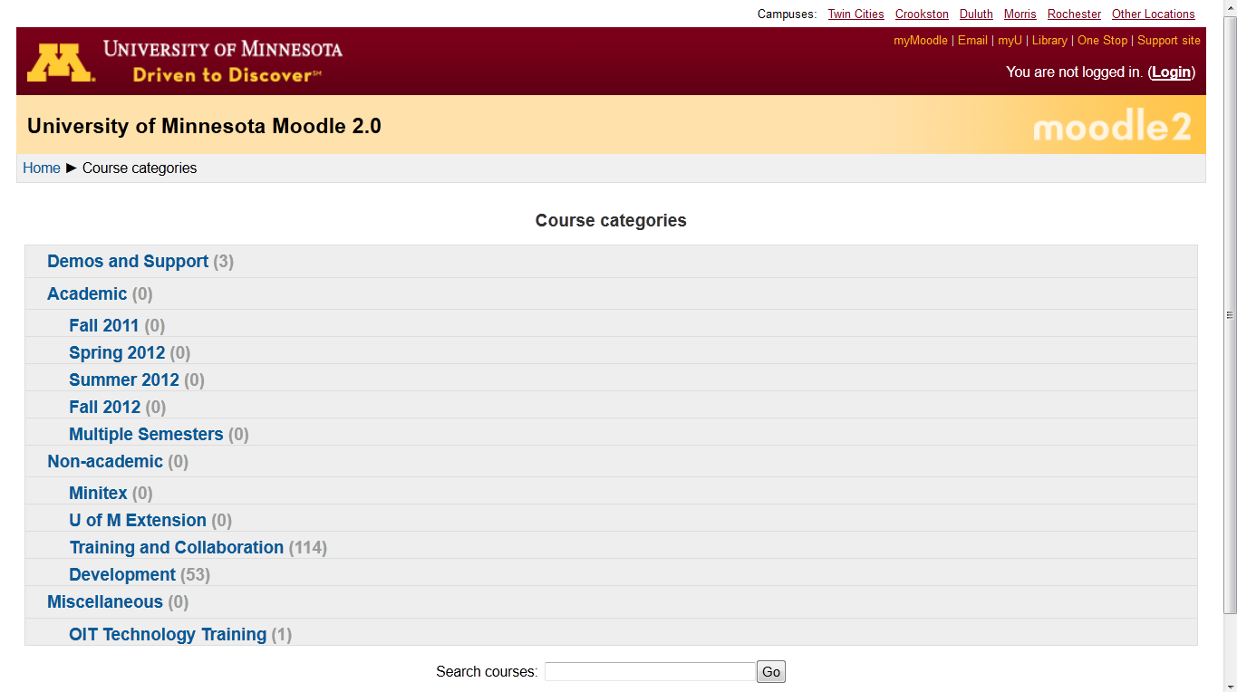
Your Moodle screen will look something like this . . .
Be sure to log in

Slide 9
Your Moodle screen will look something like this . . .
Be sure to log in

Slide 10
Your log-in page will look something like the following . . .
Log in using your “x.500” information . . .
(that’s the log-in information you use for your e-mail)
https://moodle.umn.edu/

Slide 11
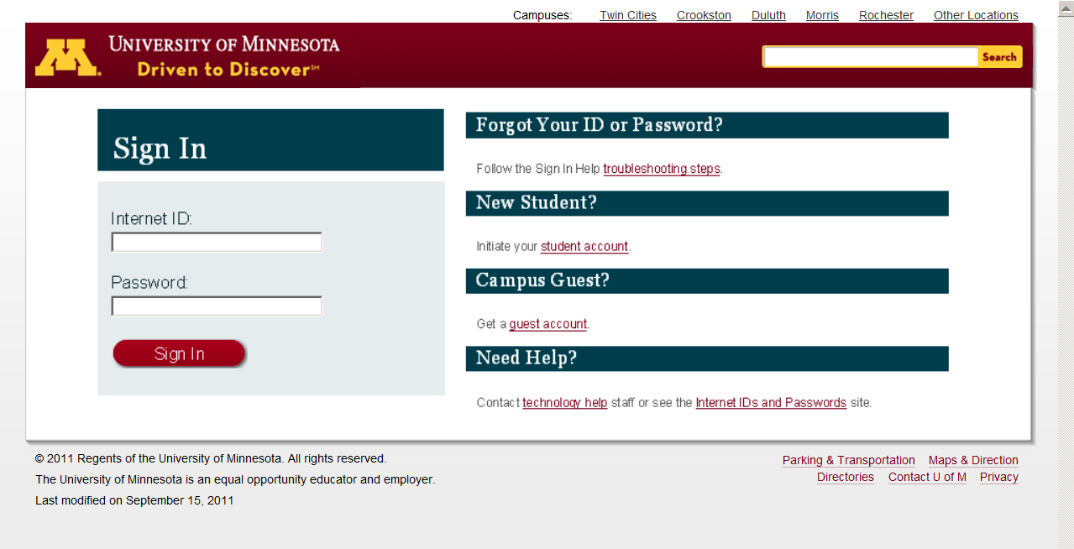
Log in using your “x.500” information . . .

Slide 12
Your Moodle screen
will look
something like the following . . .

Slide 13
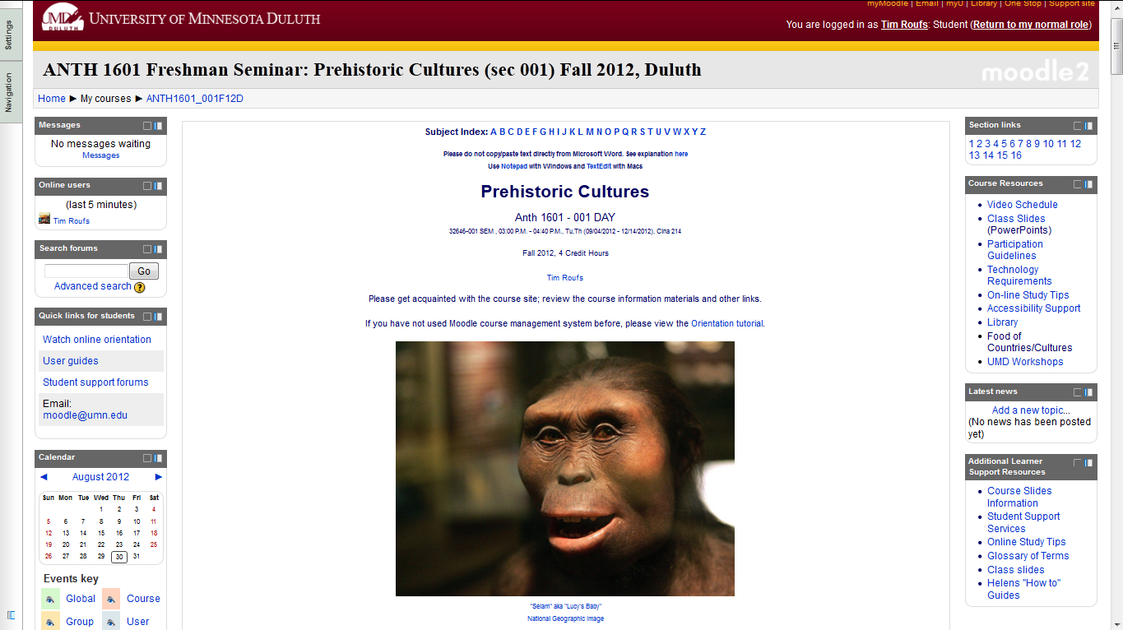
Your Moodle screen will look something like this . . .

Slide 14
or . . .

Slide 15
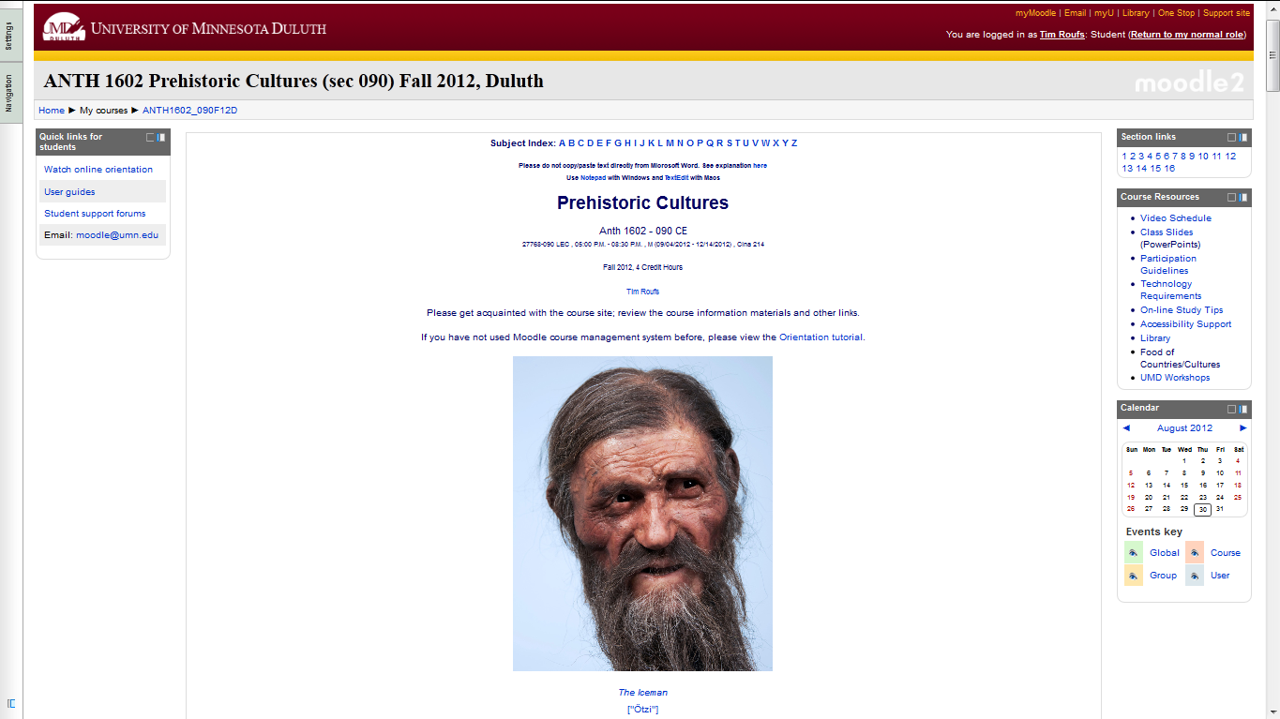
Your Moodle screen will look something like this . . .

Slide 16
And the listing for Week 1
will look something like this . . .

Slide 17
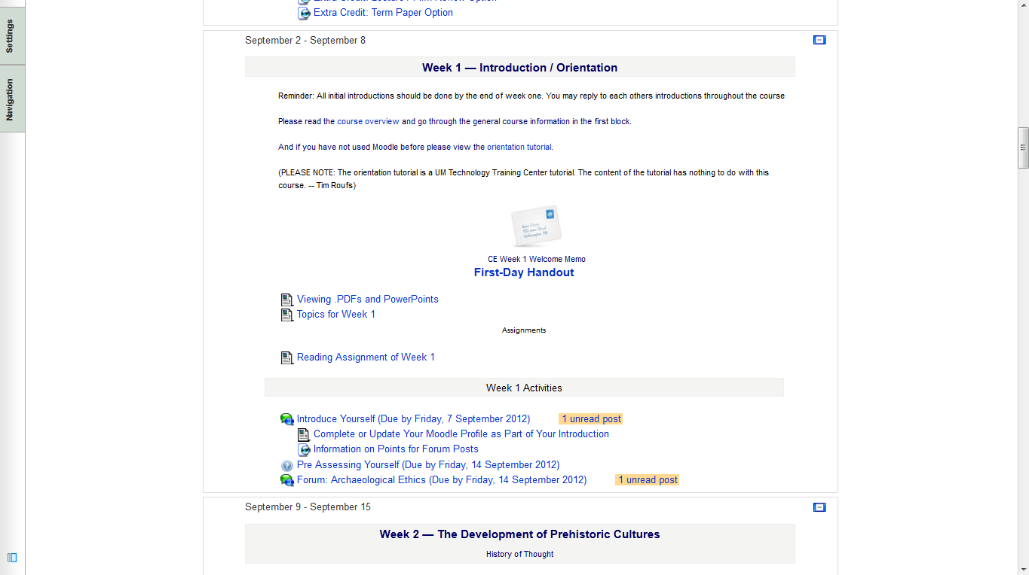

Slide 18
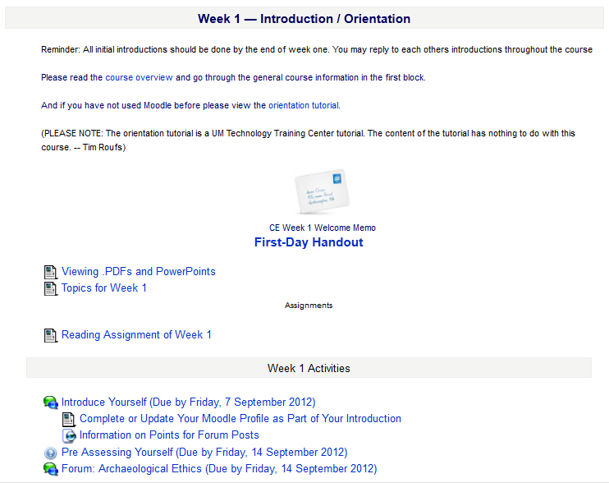
There are usually three main parts to the listing of a week . . .

Slide 19
1. Topics for the Week . . .

Slide 20
2. Readings for the Week . . .

Slide 21
and 3. Activities for the week . . .

Slide 22

The first week . . .
    introduce yourself
    and, just for the fun of it, have a look around at the rest of the materials

Slide 23
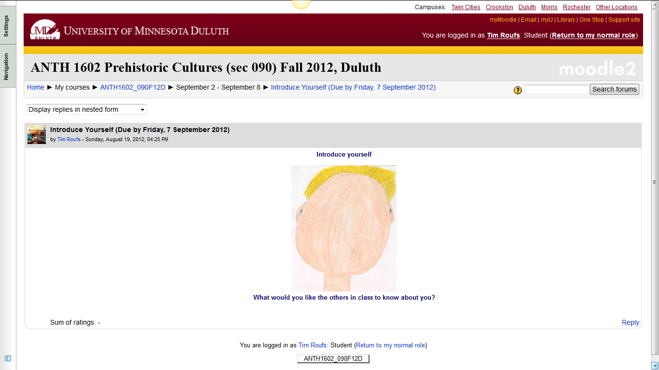
And the Introduction Page will look something like this . . .

Slide 24
The first week . . .
    introduce yourself
    and, just for the fun of it, have a look around at the rest of the materials
    be sure to Update Your Moodle Profile
    as part of your introduction

Slide 25
The first week . . .
    introduce yourself
    and, just for the fun of it, have a look around at the rest of the materials

Slide 26
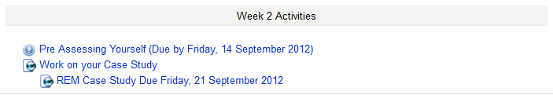
Week 2 . . .
    do the Pre-Assessment
    work on your Case Study
    and, just for the fun of it, have a look around at the rest of the materials

Slide 27
And the “Pre Assessment” Materials
will look something like the following . . .

Slide 28
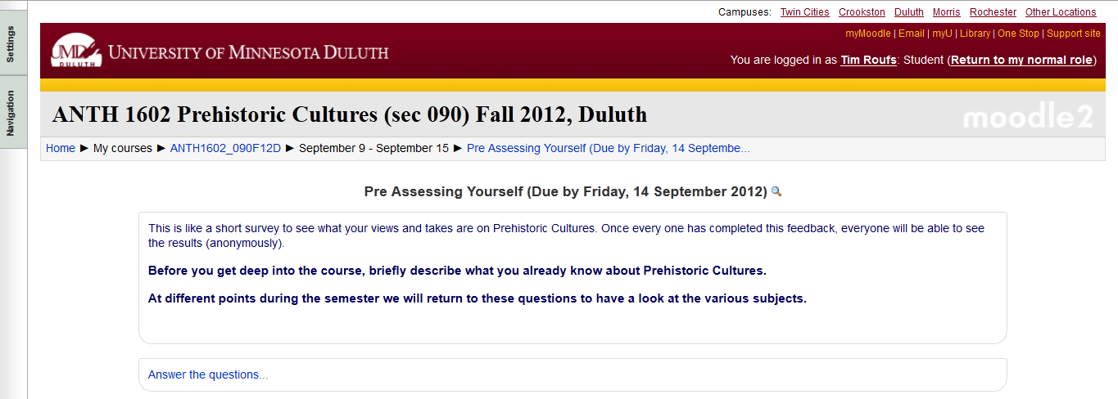
And the “Pre Assessment” Materials will look something like this . . .

Slide 29
Week 2 . . .
    do the Pre-Assessment
    work on your Case Study
    and, just for the fun of it, have a look around at the rest of the materials

Slide 30
Week 2 . . .
    do the Pre-Assessment
    join in on the Forum Discussion
    and, look around some more, just for the fun of it

Slide 31
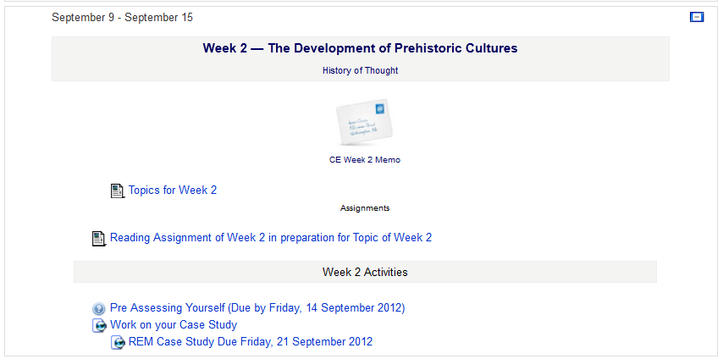
Week 2 . . .
    do the Pre-Assessment
    join in on the Forum Discussion
    then look around still more,
    just for the fun of it

Slide 32
You may also access your Moodle folder via the Main UMD WebPage . . .
www.d.umn.edu

Slide 33
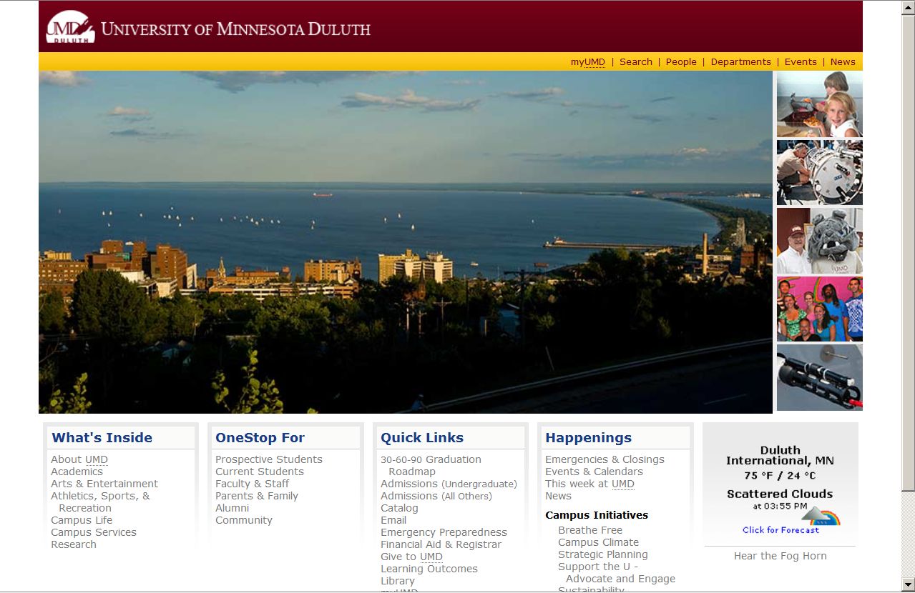
Main UMD WebPage . . .
(this image changes)
www.d.umn.edu

Slide 34
click on “OneStop For Current Students” . . .
(not the image that will appear)
www.d.umn.edu

Slide 35
Main UMD WebPage . . .
(this image changes)
www.d.umn.edu

Slide 36
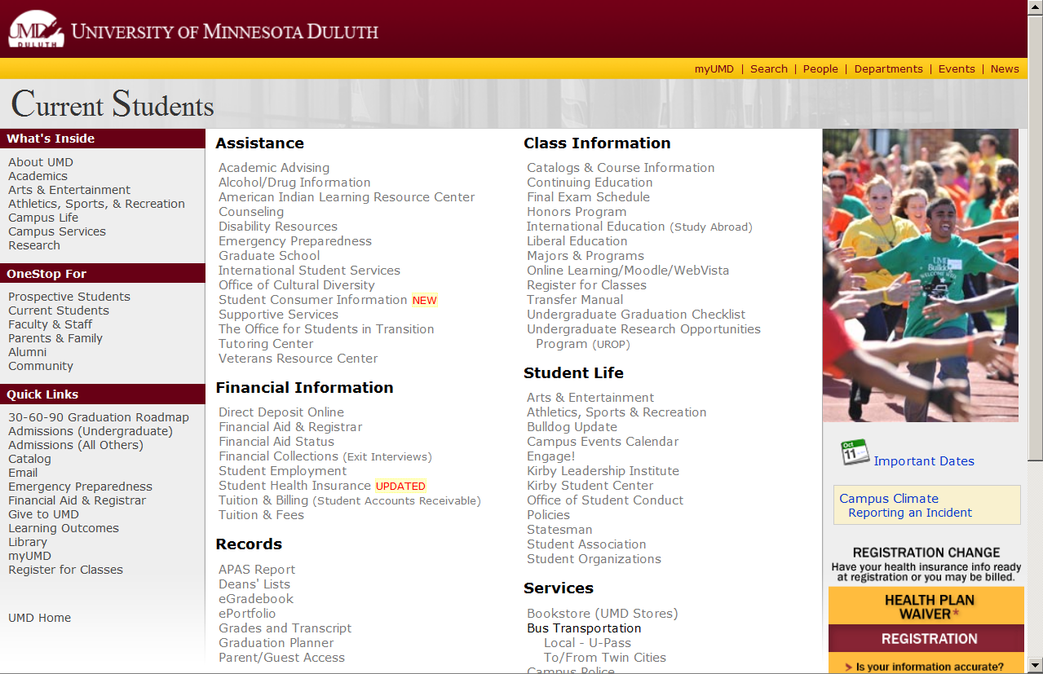
scroll down
http://www.d.umn.edu/students/

Slide 37
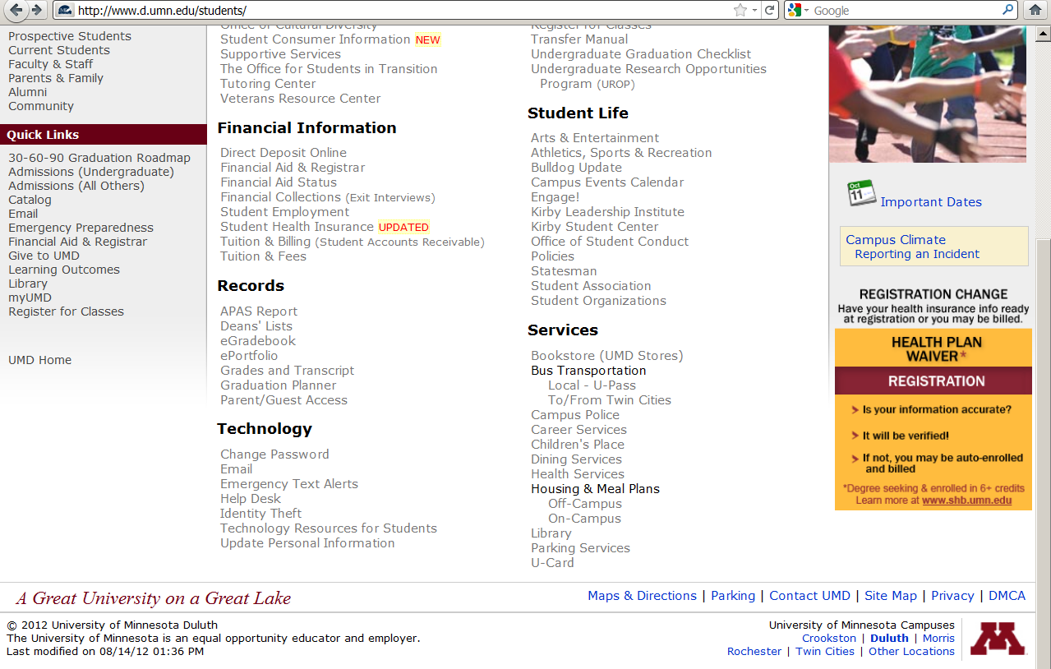
click on “Technology Resources for Students” . . .

Slide 38
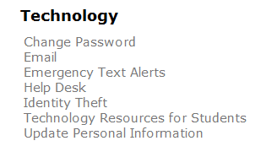
click on “Technology Resources for Students” . . .
http://www.d.umn.edu/itss/students/

Slide 39
then click on “Moodle Support” . . .
http://www.d.umn.edu/itss/students/

Slide 40
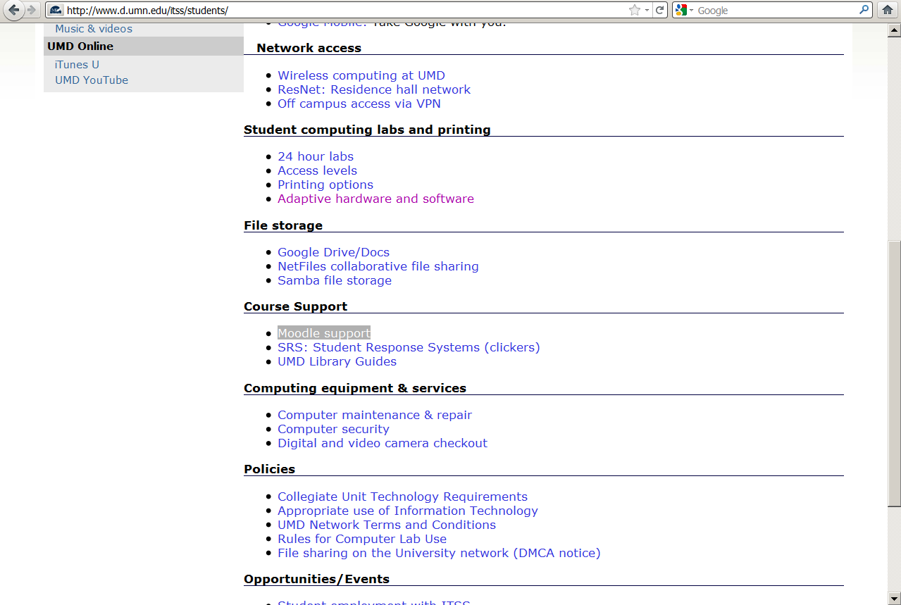
click on “Moodle Support” . . .
http://www.d.umn.edu/itss/students/

Slide 41
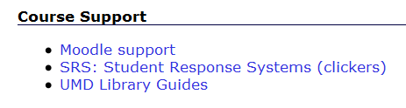
click on “Moodle Support” . . .
http://www.d.umn.edu/itss/students/

Slide 42
Your log-in page will look something like the following . . .
Log in using your “x.500” information . . .
(that’s the log-in information you use for your e-mail)
https://moodle.umn.edu/

Slide 43
Log in using your “x.500” information . . .

Slide 44
Your Moodle “home” will look something like the following . . .
https://moodle.umn.edu/

Slide 45
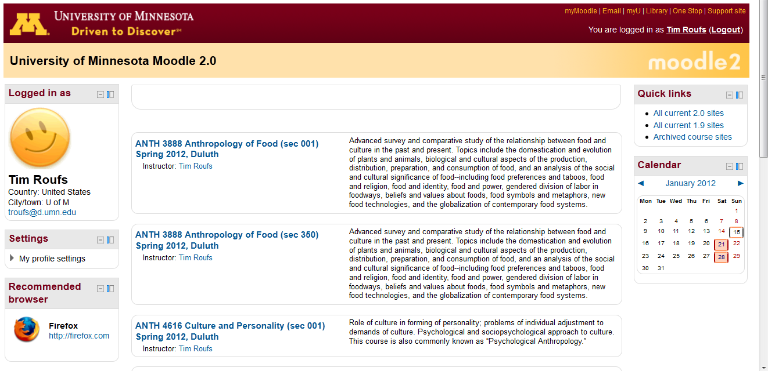
Your Moodle “home” will look something like this . . .
https://moodle.umn.edu/

Slide 46
Your Moodle “home” will look something like this . . .
scroll down if necessary
https://moodle.umn.edu/

Slide 47
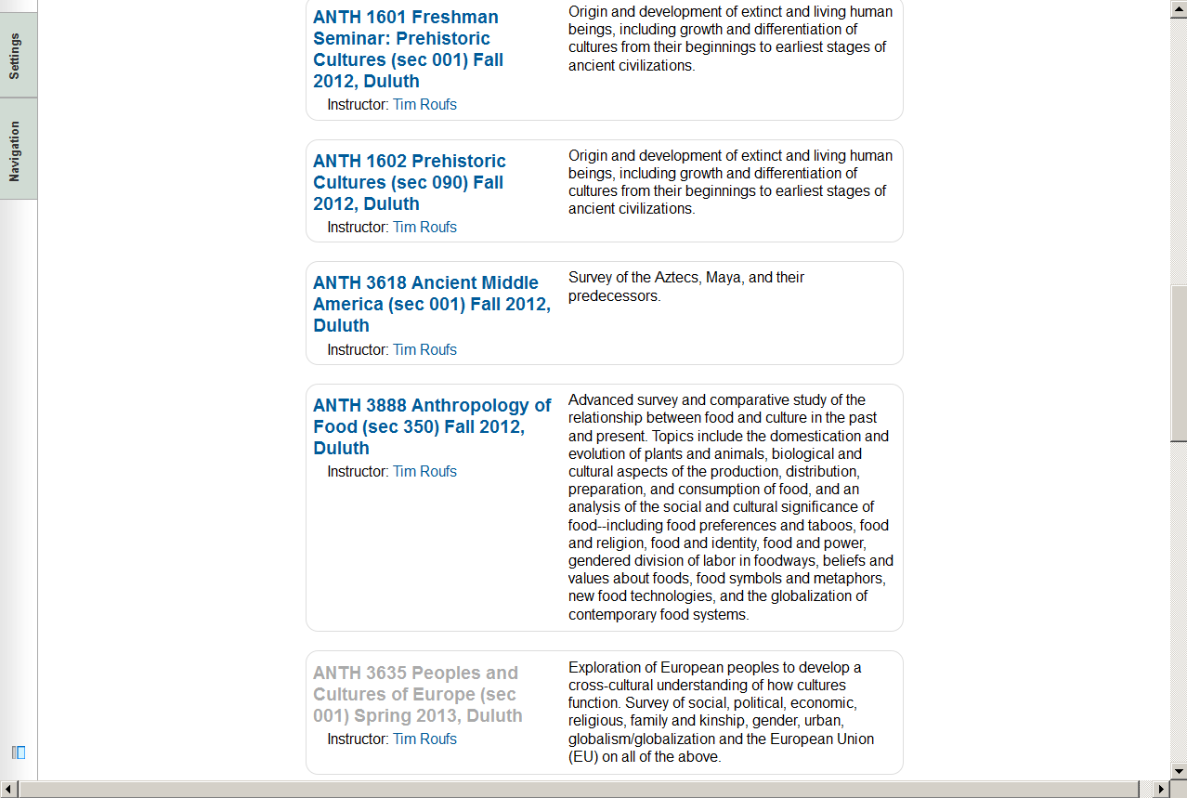
Your Moodle “home” will look something like this . . .

Slide 49
Select Prehistoric Cultures . . .
https://moodle.umn.edu/

Slide 50
Your Moodle “home” will look something like this . . .

Slide 51
The “First-Day” Handout information contains the basic information . . .
It look something like the following . . .
https://moodle.umn.edu/

Slide 52
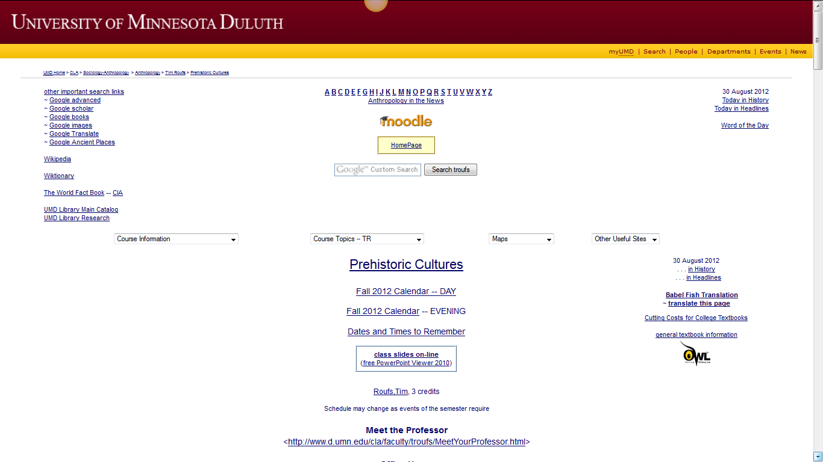
“First-Day” Handout information . . .

Slide 53
“First-Day” Handout information . . .
scroll down

Slide 54
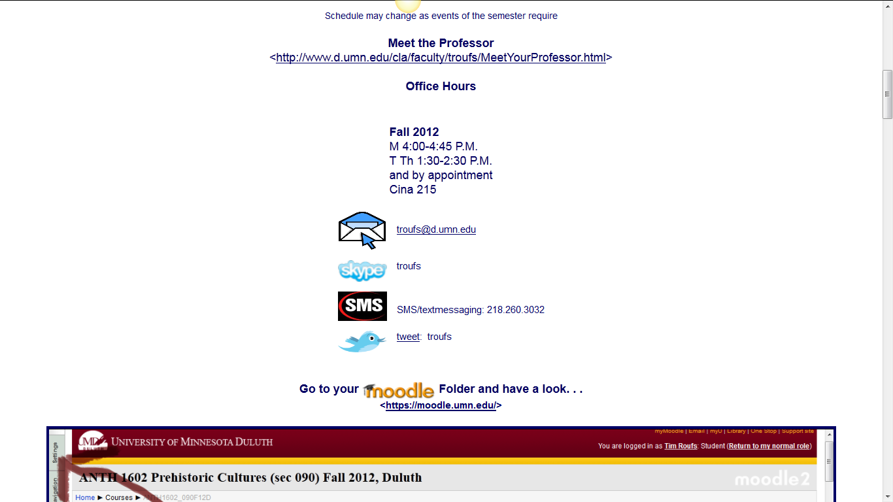
Basic Contact information . . .

Slide 55
Basic Contact information . . .

Slide 56
Basic Contact information . . .
scroll down

Slide 57
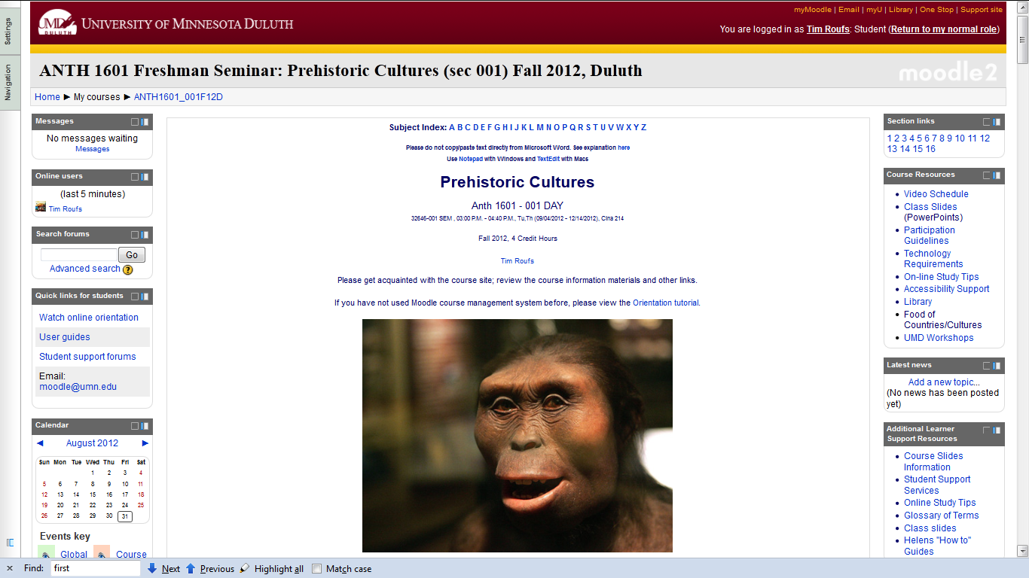
Moodle “Block 1” DAY

Slide 58
Moodle “Block 1” DAY
scroll down

Slide 59
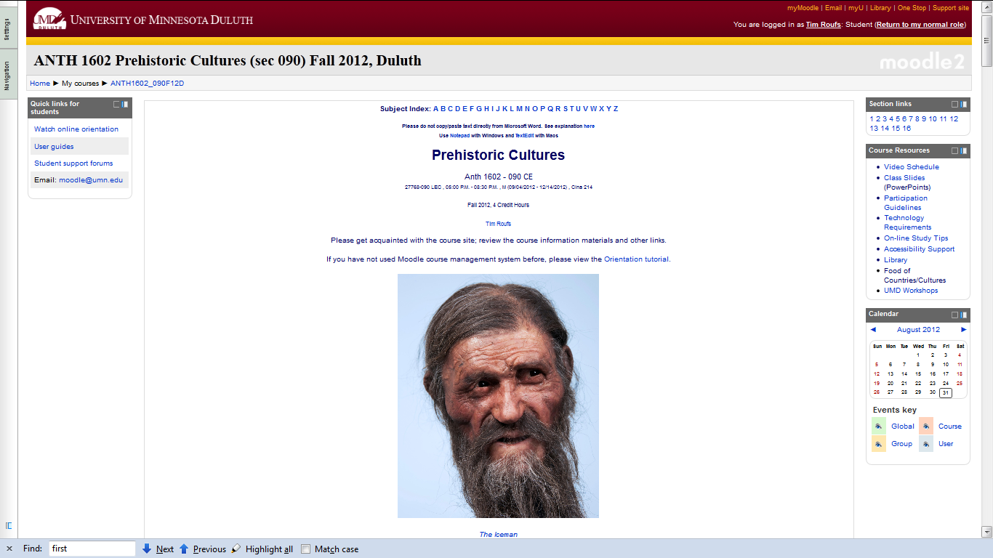
Moodle “Block 1” CE

Slide 60
Moodle “Block 1” CE
scroll down

Slide 61
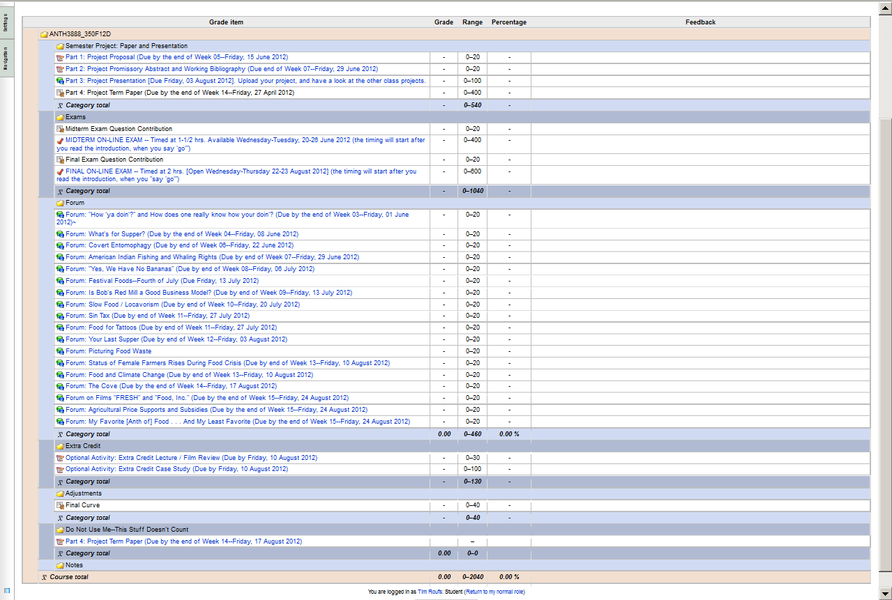
Moodle Grader

Slide 62
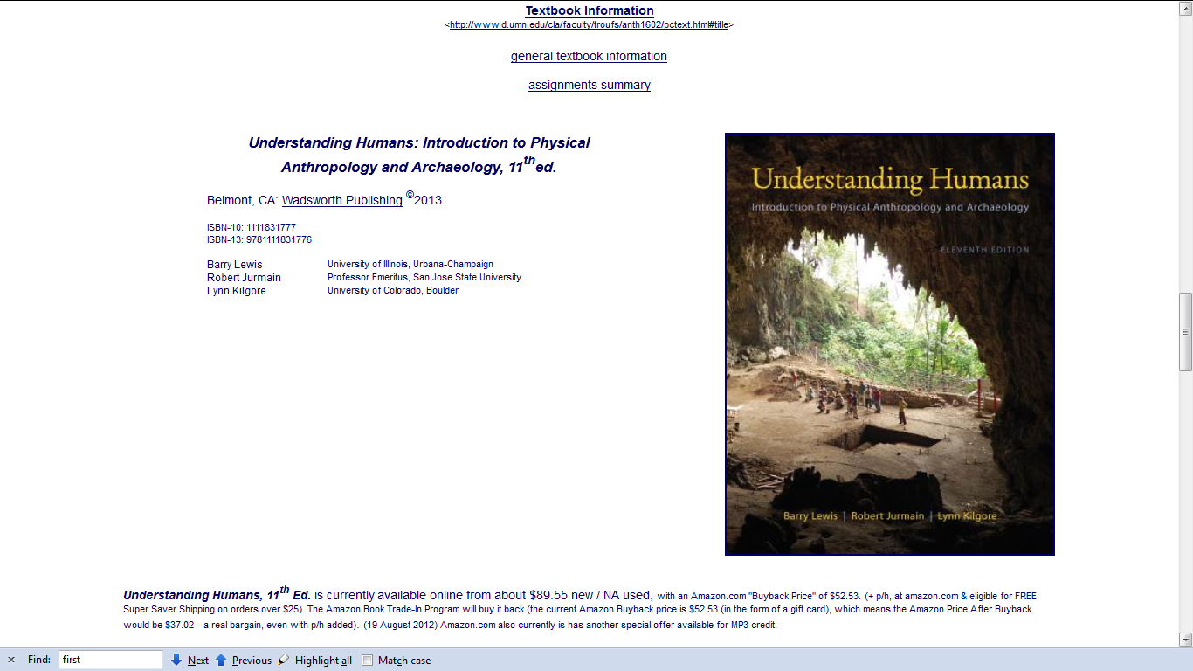
Basic Text Information

Slide 63
Basic Text Information
including information on purchasing texts . . .

Slide 64
Governing Procedures
pay attention to . . .

Slide 65
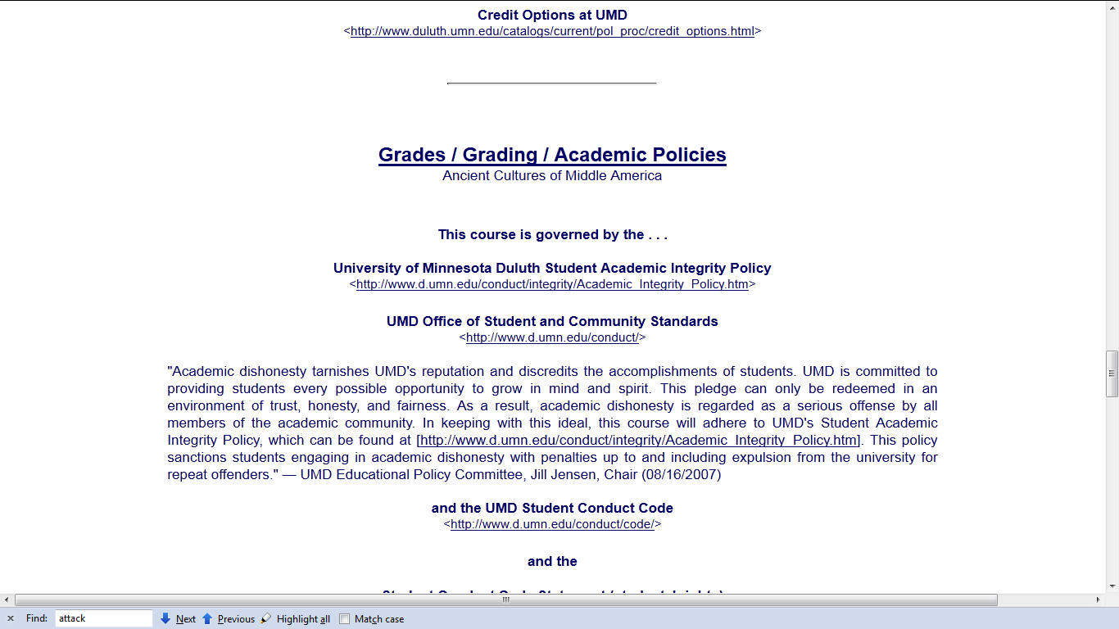
Governing Procedures

Slide 66
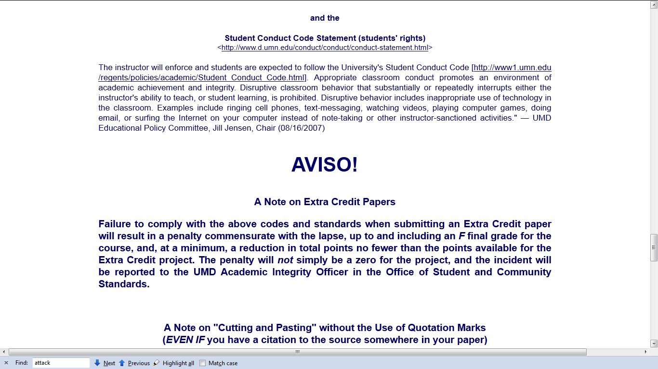
Governing Procedures

Slide 67
Governing Procedures
Governing Procedures
note on Extra Credit Papers

Slide 68
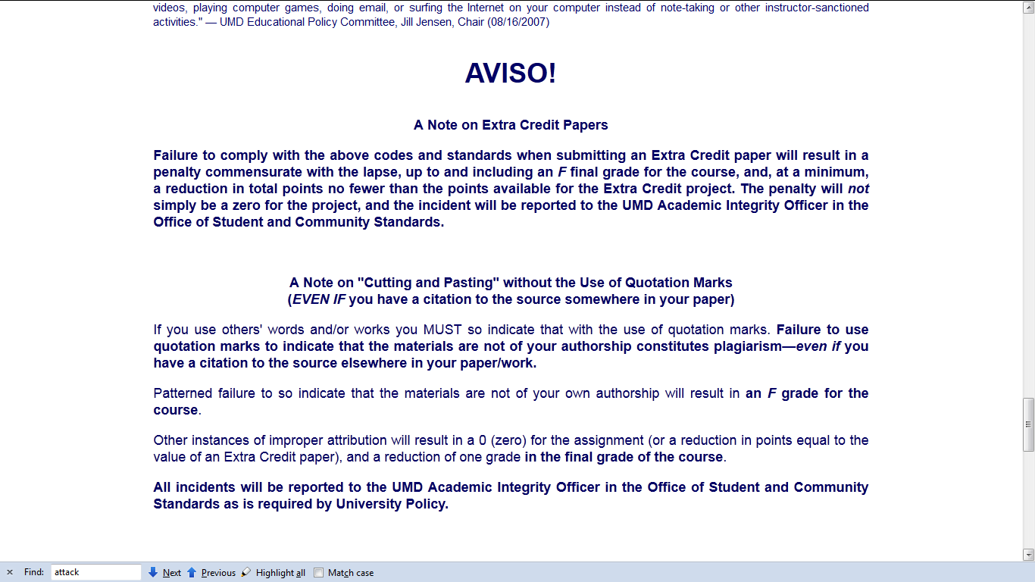
Governing Procedures

Slide 69
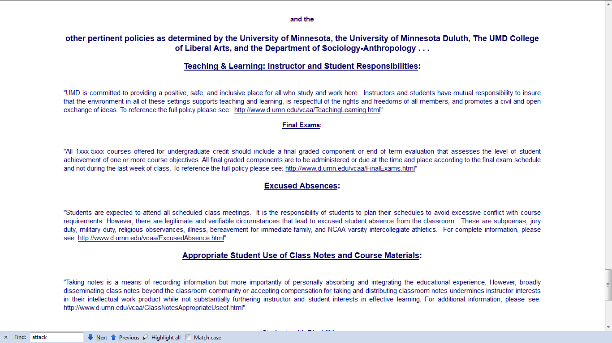
Governing Procedures

Slide 70
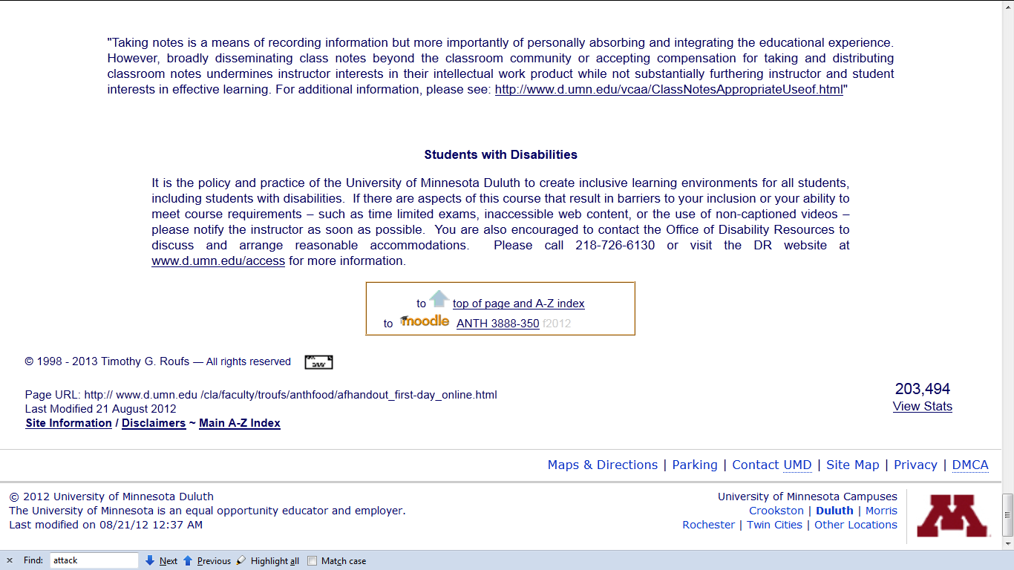
Special Facilities Information

Slide 71
Back to the
Moodle main page
“Block 1”

Slide 72
Back to the
Moodle main page
“Block 1”
scroll down

Slide 73
Back to the
Moodle main page
“Block 1”

Slide 74
Back to the
Moodle main page
“Block 1”
scroll down

Slide 75
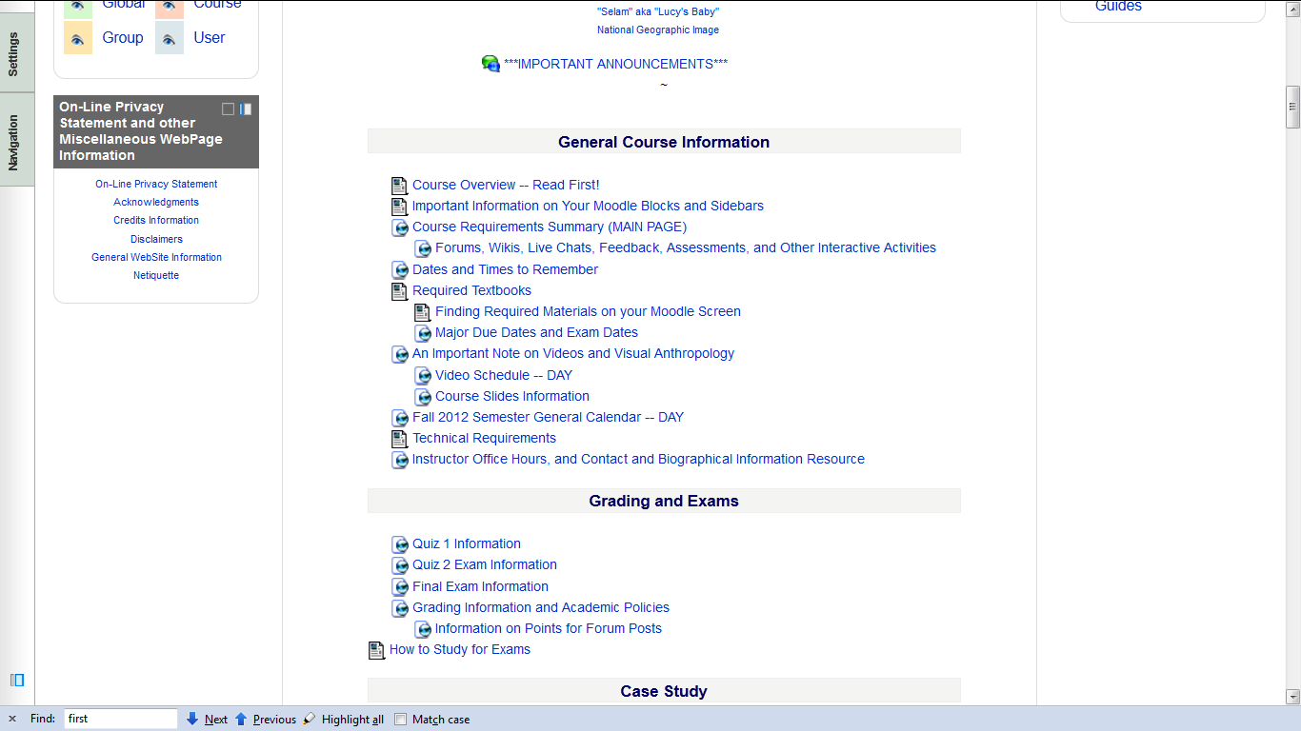

Slide 76
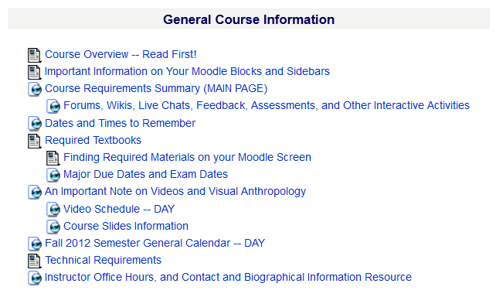

Slide 78
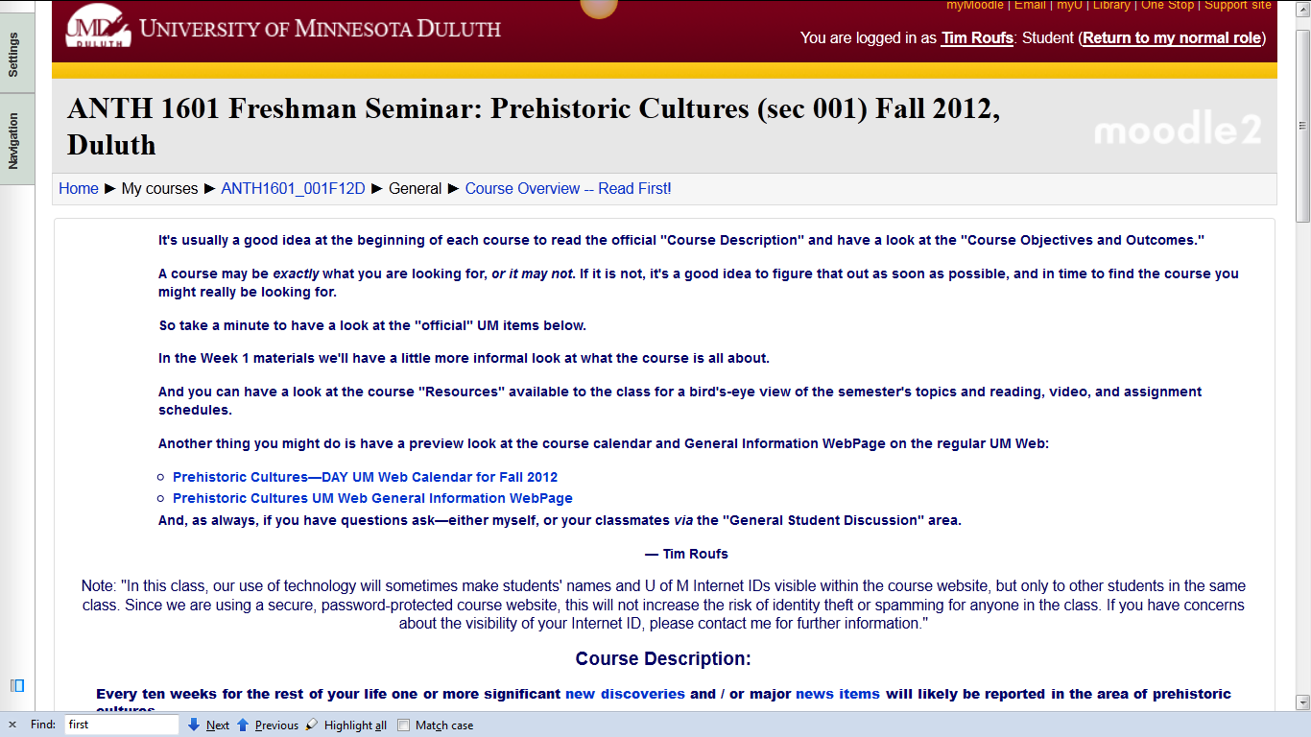

Slide 79
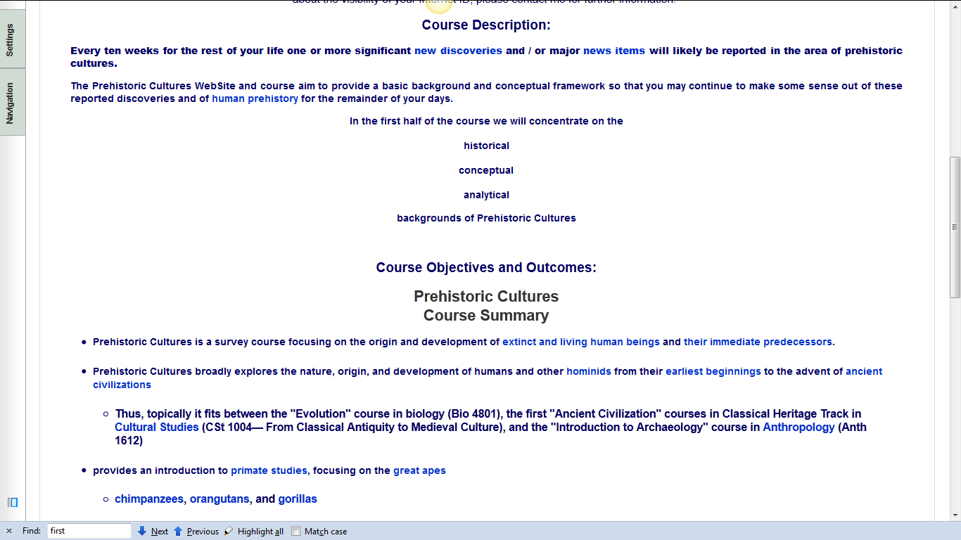

Slide 80
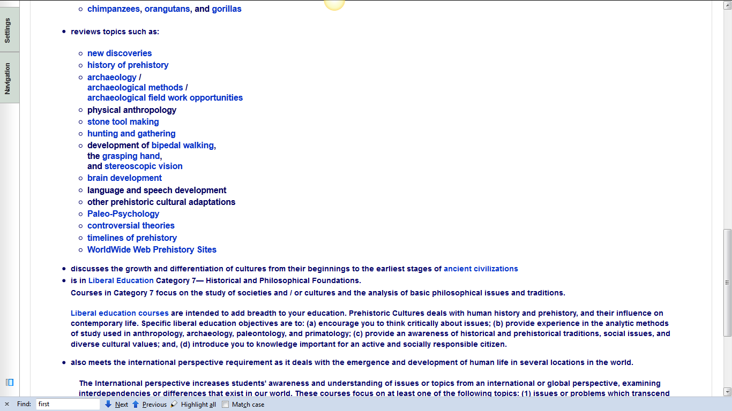

Slide 81
requirements, due dates, options, and grades

Slide 82
click here for grades link
requirements, due dates, options, and grades

Slide 83
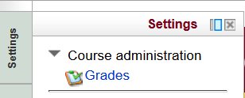
requirements, due dates, options, and grades

Slide 84
requirements, due dates, options, and grades

Slide 85
requirements, due dates, options, and grades

Slide 86
click here for grades link
requirements, due dates, options, and grades

Slide 87
requirements, due dates, options, and grades

Slide 88
requirements, due dates, options, and grades

Slide 89
Your Gradebook
will look something like this

Slide 90
this is the best place to check requirements, due dates, options, and grades . . .

Slide 91
Back to the
Moodle main page
“Block 1”

Slide 92
Back to the
Moodle main page
“Block 1”

Slide 93
“Major Due Dates” is a handy site

Slide 94
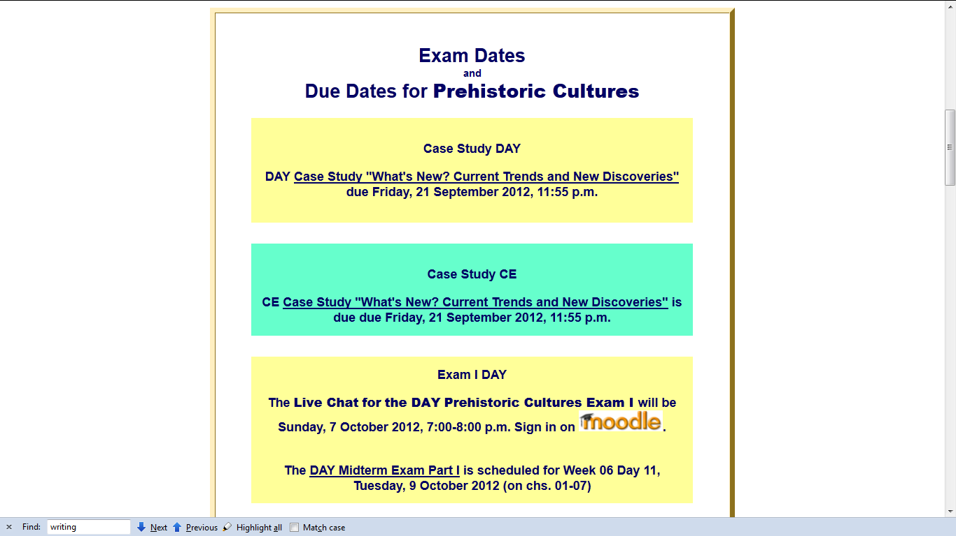

Slide 95
“Dates to Remember” is a handy site

Slide 96
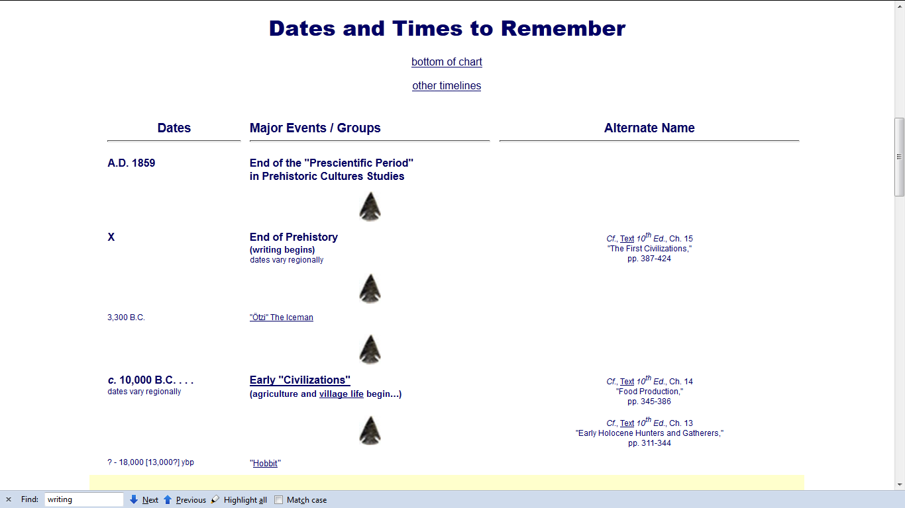

Slide 97
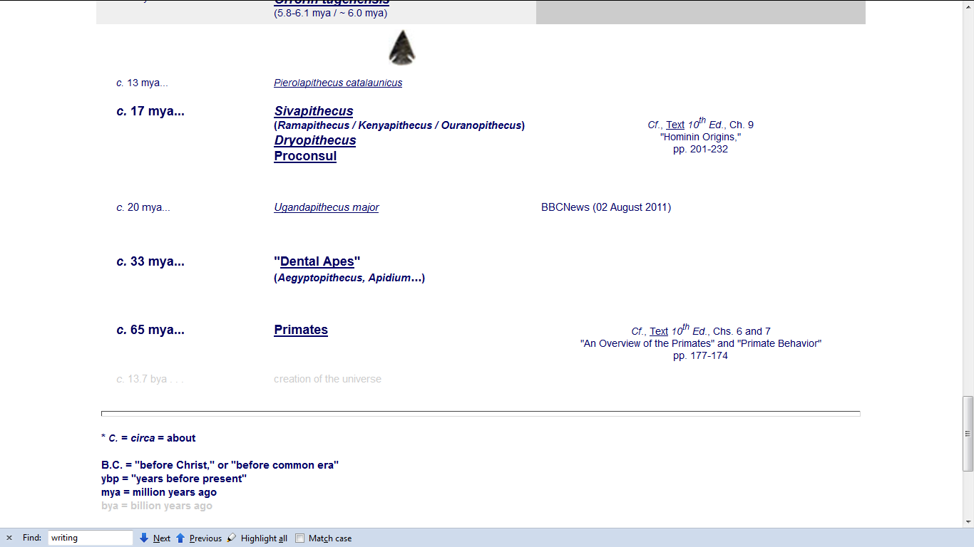

Slide 98
Back to the
Moodle main page
“Block 1”
scroll down

Slide 99
Back to the
Moodle main page
“Block 1”
scroll down

Slide 100
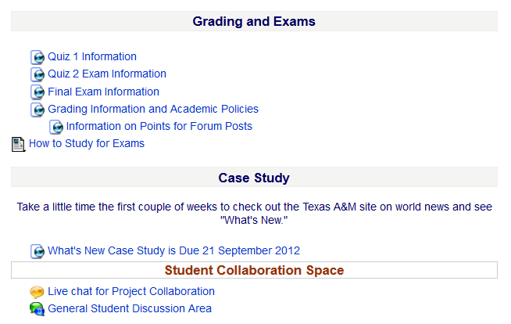

Slide 103
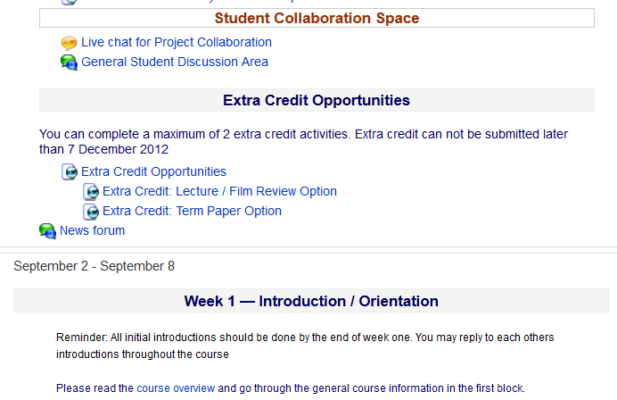

Slide 104
Back to the
Moodle main page
“Block 1”
REM

Slide 105
Back to the
Moodle main page
“Block 1”
REM

Slide 106
Readings Assignments . . .

Slide 107
Back to the
Moodle main page
“Block 1”
scroll down

Slide 108
Back to the
Moodle main page
“Block 1”
scroll down

Slide 109
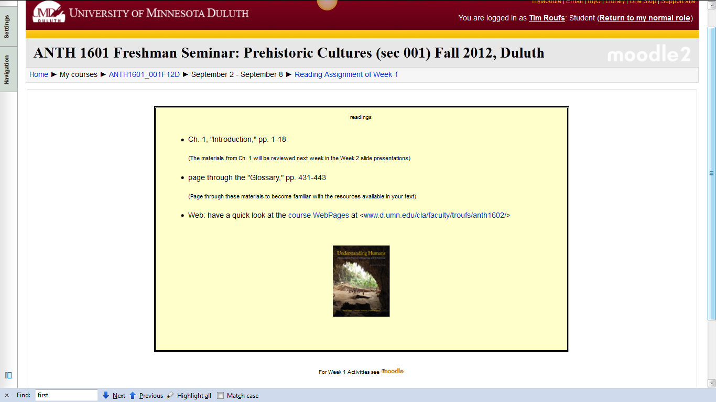
Reading Assignments for Week 1

Slide 110
and Activities for the week . . .

Slide 111
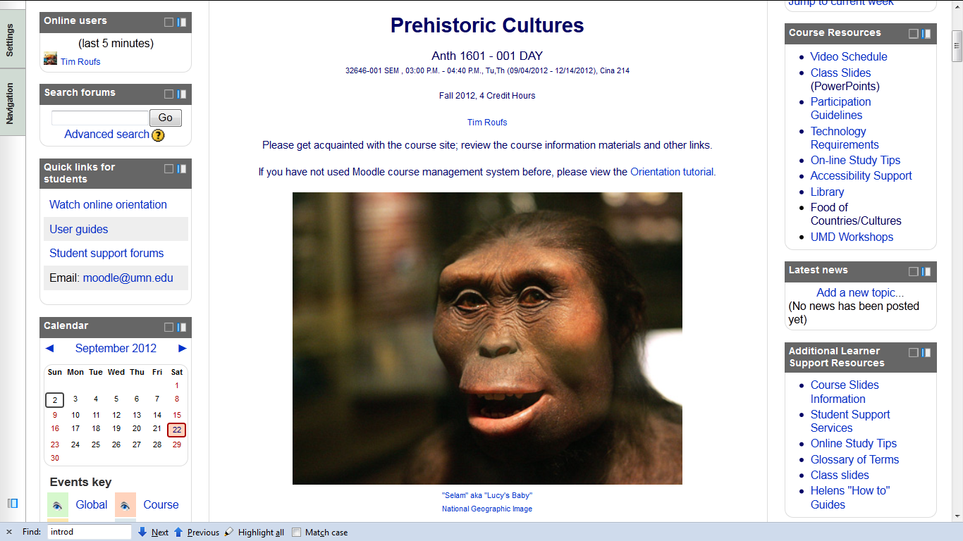
and, if you haven’t already done so,
have a look at the
Orientation Materials

Slide 112


Slide 113
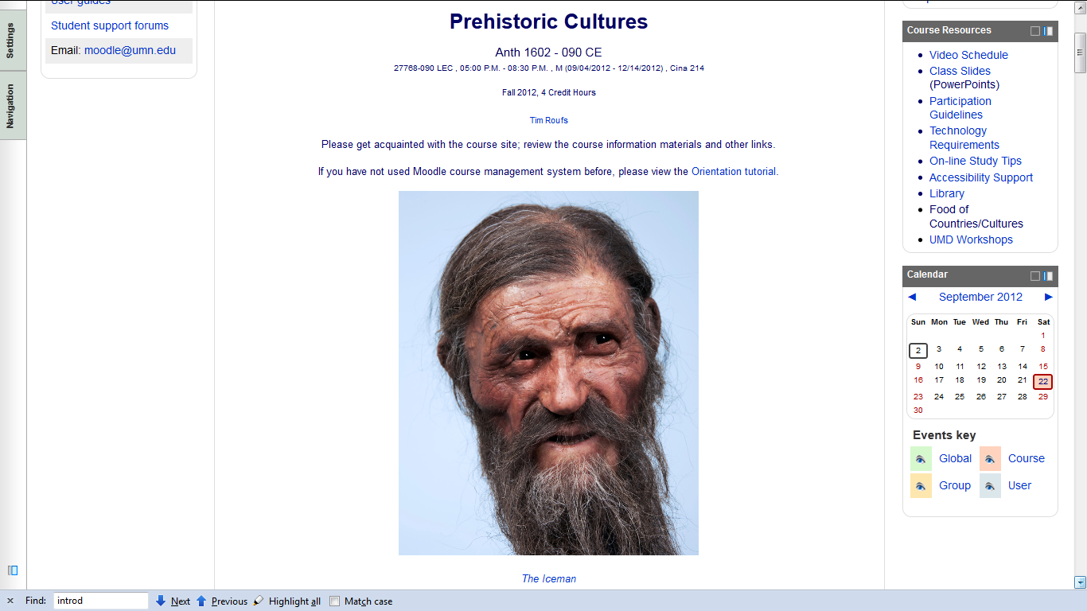
and, if you haven’t already done so,
have a look at the
Orientation Materials

Slide 115
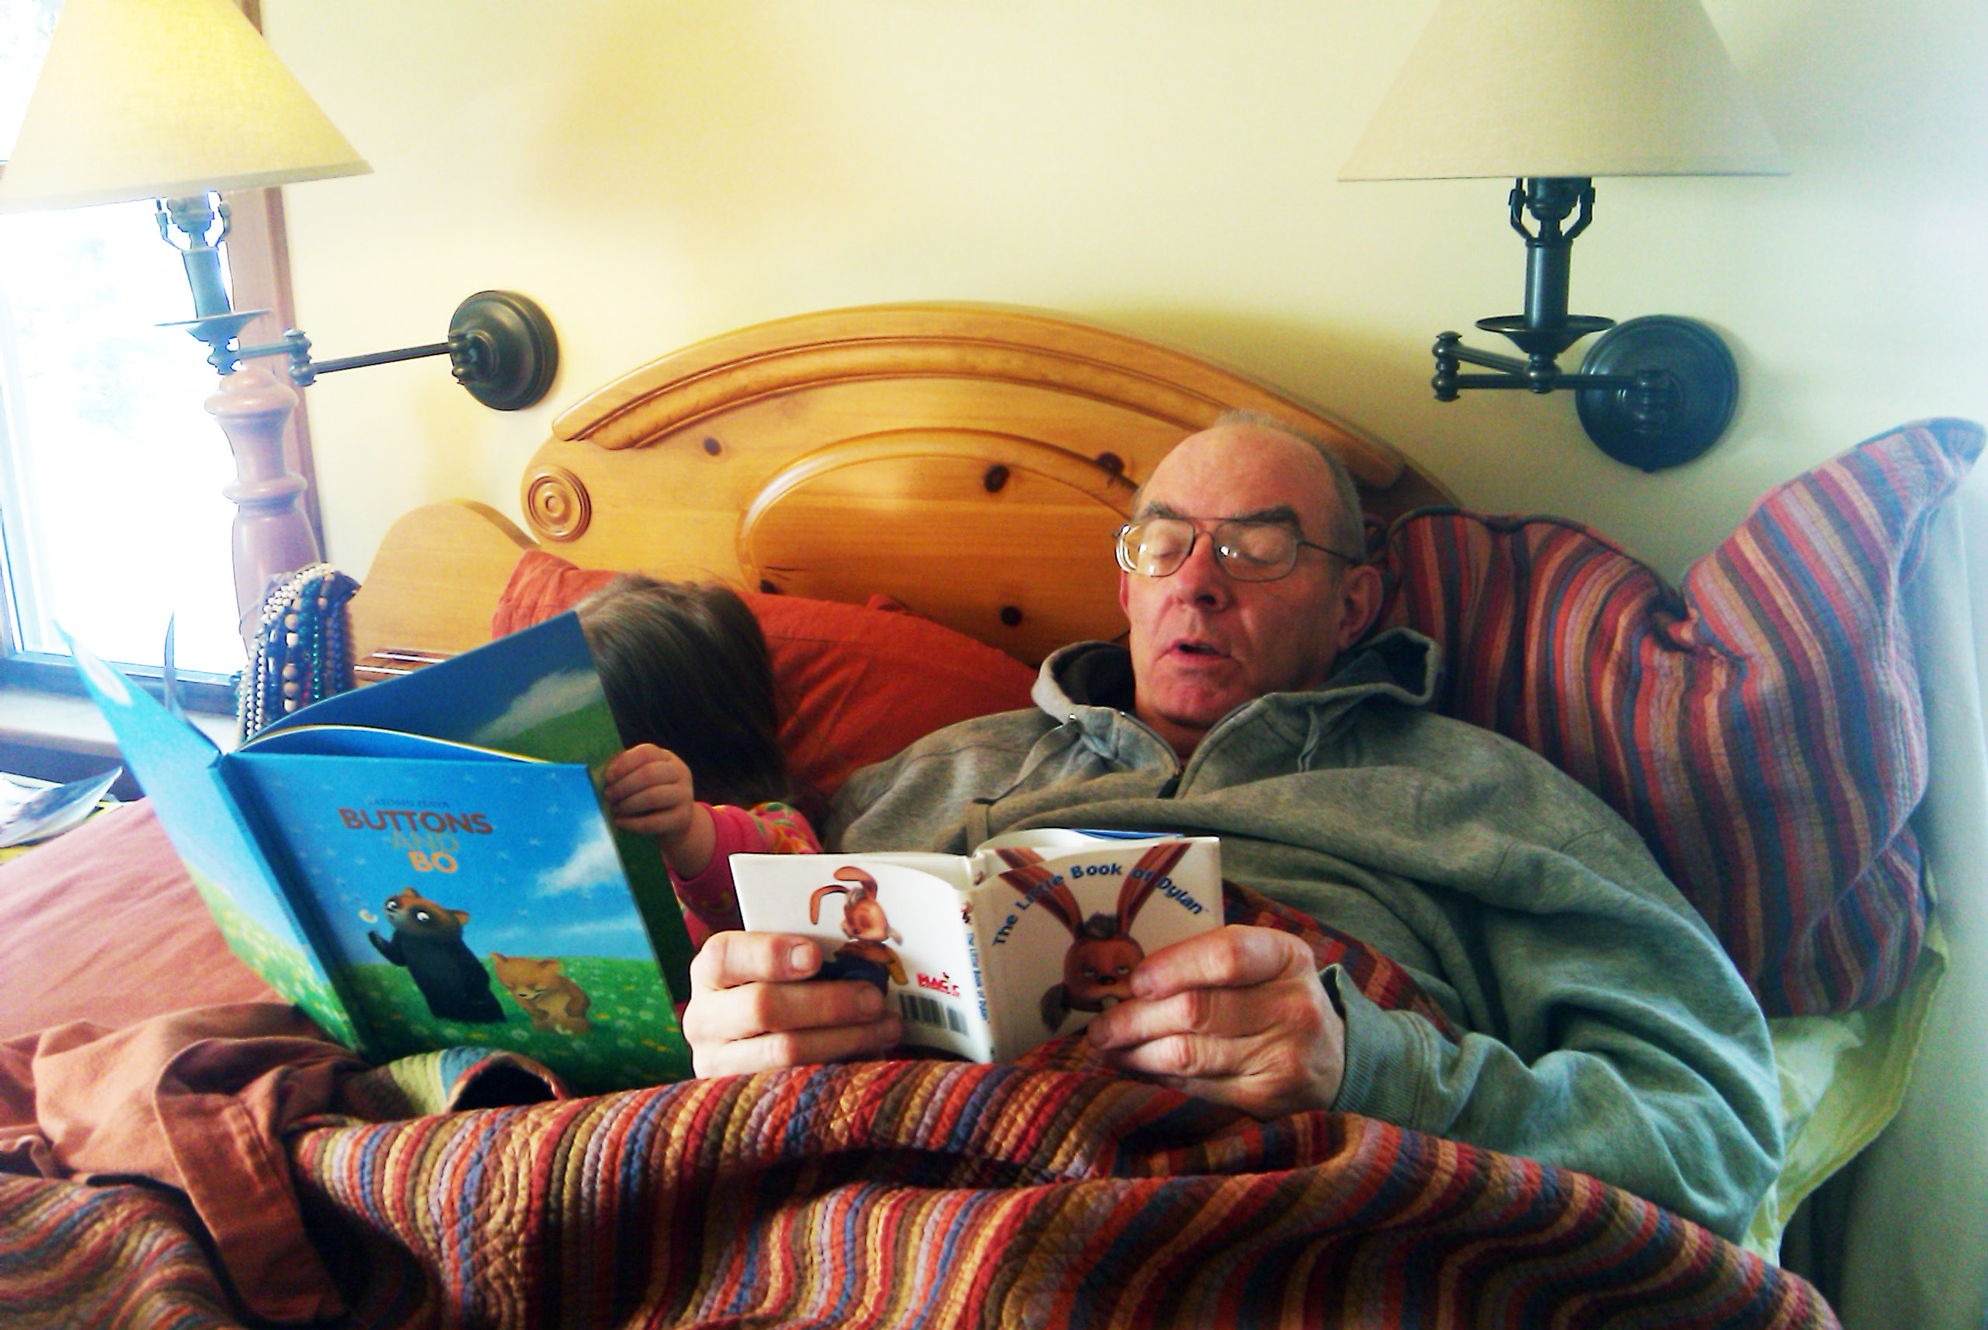
And, for the fun of it,
have a look at the
“Meet Your Professor” Materials

Slide 116
Why?

Slide 117
Research shows that people who know a little about their teachers . . .

Slide 118
Research shows that people who know a little about their teachers . . .
Learn more . . .

Slide 119
Research shows that people who know a little about their teachers . . .
Learn more . . .
Remember it better . . .

Slide 120
Research shows that people who know a little about their teachers . . .
Learn more . . .
Remember it better . . .
Have more fun learning . . .

Slide 121
one more piece
of useful information . . .

Slide 122
At the very top of “Block 1” you will see an alphabet.
Clicking on a letter will bring you to a page that indexes course WebPages for virtually all of the scheduled topics and items in the course.

Slide 123
At the very top of “Block 1” you will see an alphabet.
Clicking on a letter will bring you to a page that indexes course WebPages for virtually all of the scheduled topics and items in the course.

Slide 124
This information is very useful

Slide 125
How useful?

Slide 126
Moodle “Block 1” CE

Slide 127
At the very top of “Block 1” you will see an alphabet.
Clicking on a letter will bring you to a page that indexes course WebPages for virtually all of the scheduled topics and items in the course.

Slide 128
This information is very useful

Slide 129
How useful?

Slide 130
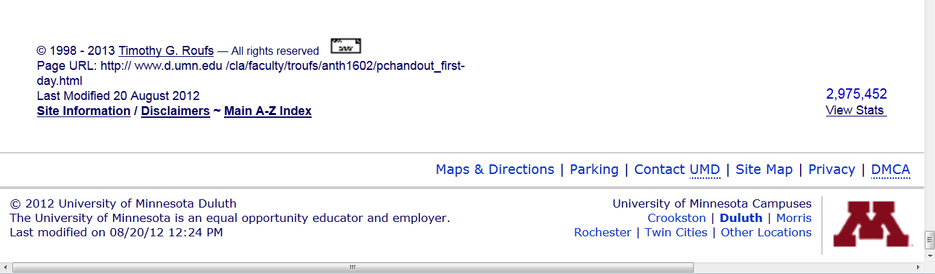
in the last few years there has been almost
three million page visits to the
Prehistoric Cultures course pages . . .

Slide 131
to access a topic simply click on a letter to go to an index page . . .

Slide 132
to access a topic simply click on a letter to go to an index page . . .

Slide 133
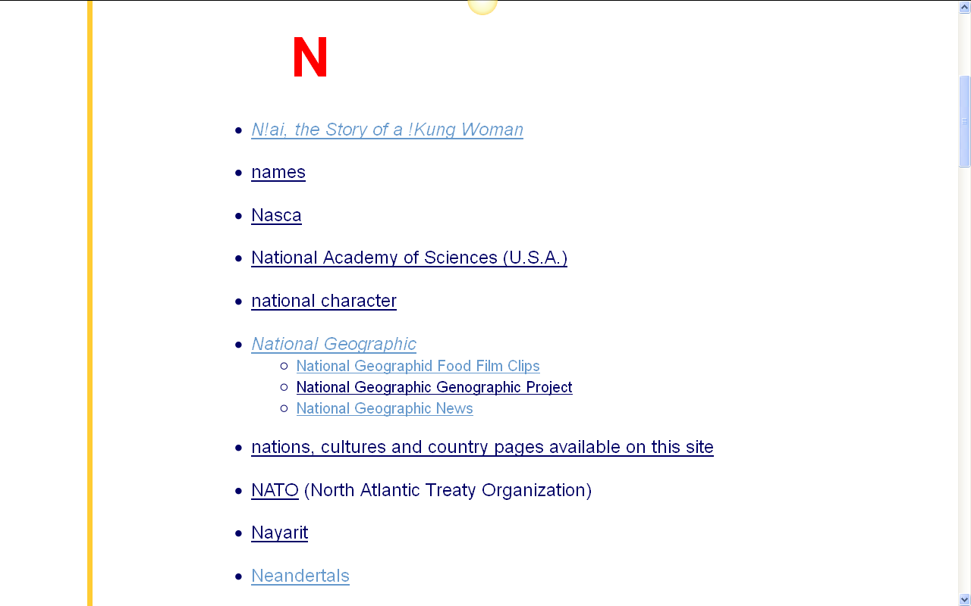
and from the index page click on the item you want . . .

Slide 134
and from the index page click on the item you want . . .
scroll down for more items

Slide 135
and from the index page click on the item you want . . .

Slide 136
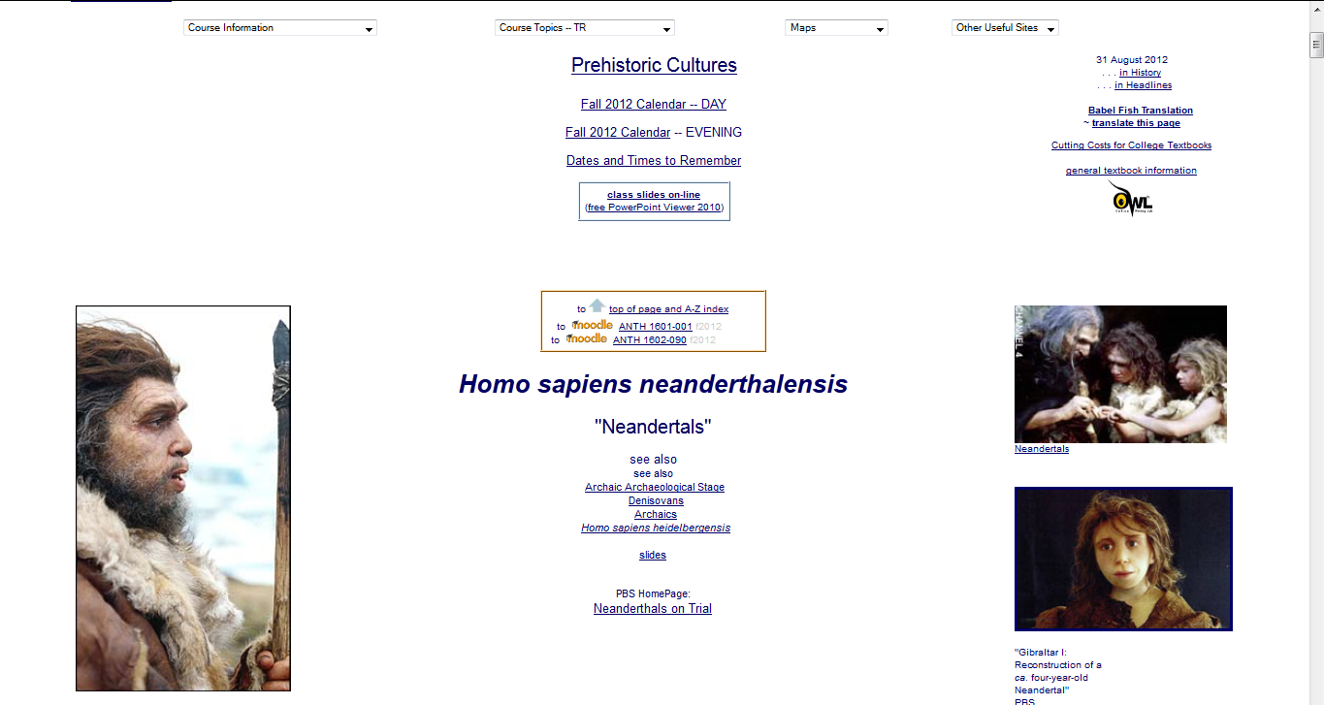
voilá

Slide 137

Laptops
Welcome
(in fact, they’re encouraged)

Slide 138
Next . . .

Slide 139
scroll down

Slide 140
scroll down

Slide 142
Next . . .
our first “field trip” . . .
(to see . . .)
Yanomamö:
A Multidisciplinary Study

Slide 143

Next . . .
our first “field trip” . . .
(to see . . .)
Yanomamö:
A Multidisciplinary Study
http://crispytomato.blogspot.com/2011/03/yanomamo-swag.html

Slide 144
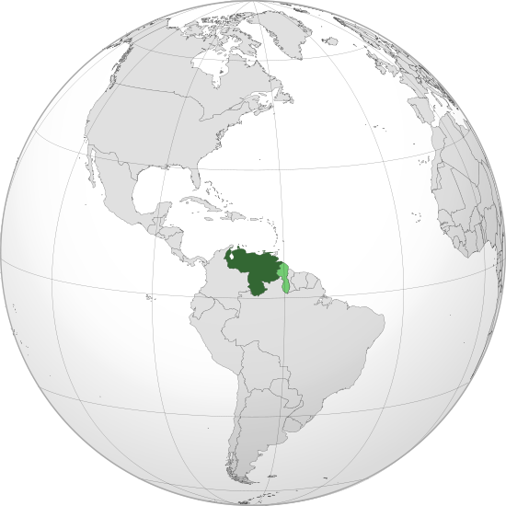
Area controlled by Venezuela is in dark green.
Claimed but uncontrolled regions are in light green.
http://en.wikipedia.org/wiki/Venezuela

Slide 145
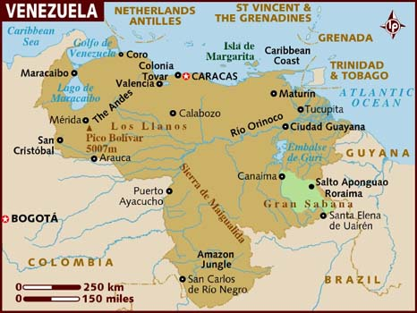

Slide 146

http://rosettapanglossia.longnow.org/wiki/index.php/Yanomam%C3%B6_Language

Slide 147

Next . . .

Slide 148

And then . . .

Slide 149

And then . . .

Slide 150

Our second “field trip” . . .

Slide 151
And then . . .

Slide 152
If your browser allows,
clicking on this URL
should take you to your Moodle home . . .
https://moodle2.umn.edu/
(your browser may require that you double-click)
If your browser does not allow you to click on the above URL just enter it in your browser window . . .

Slide 153

Once again . . .
Welcome to
Prehistoric Cultures
Enjoy your stay!
University of Minnesota Duluth
Tim Roufs
© 2010-2013
http://www.d.umn.edu/cla/faculty/troufs/anth1602/

Slide 154


