Slide 1
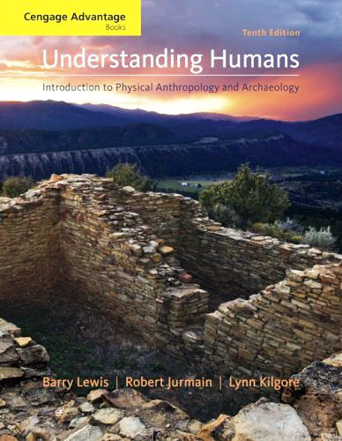
Kinds of Earlier
Major Finds
and
Announcements:
Contemprary
Non-Human Primates
Prehistoric Cultures
Tim Roufs’ section ©2009

Slide 2


Slide 3
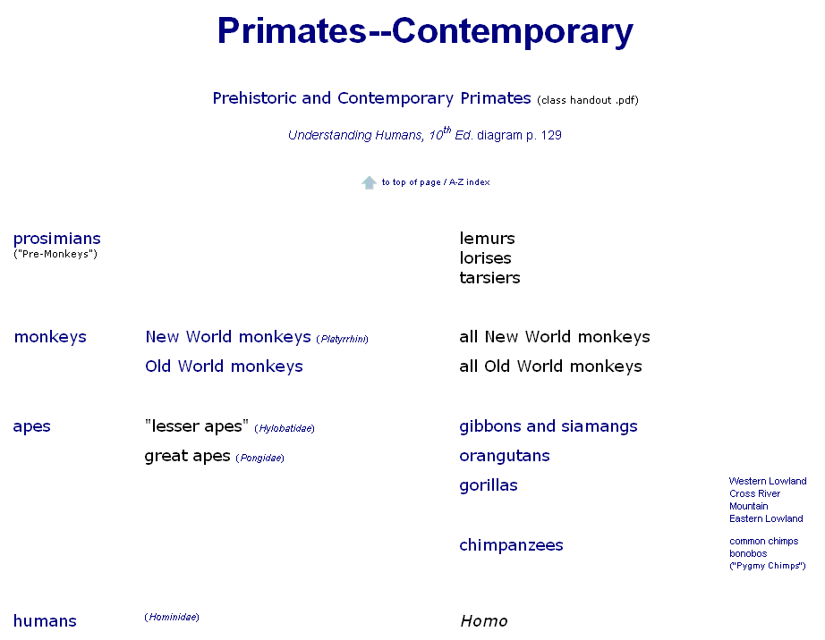

Slide 4
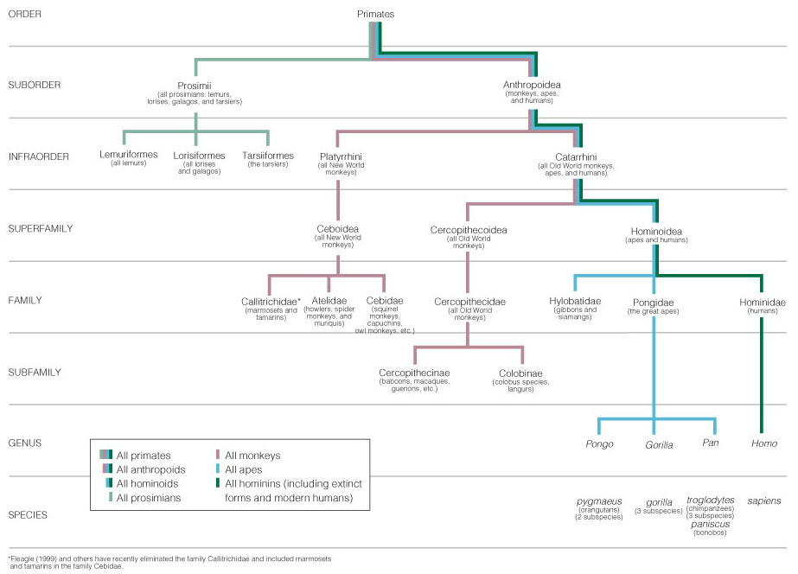
Primate taxonomic classification
Understanding Humans, 10th ed., p. 129

Slide 5
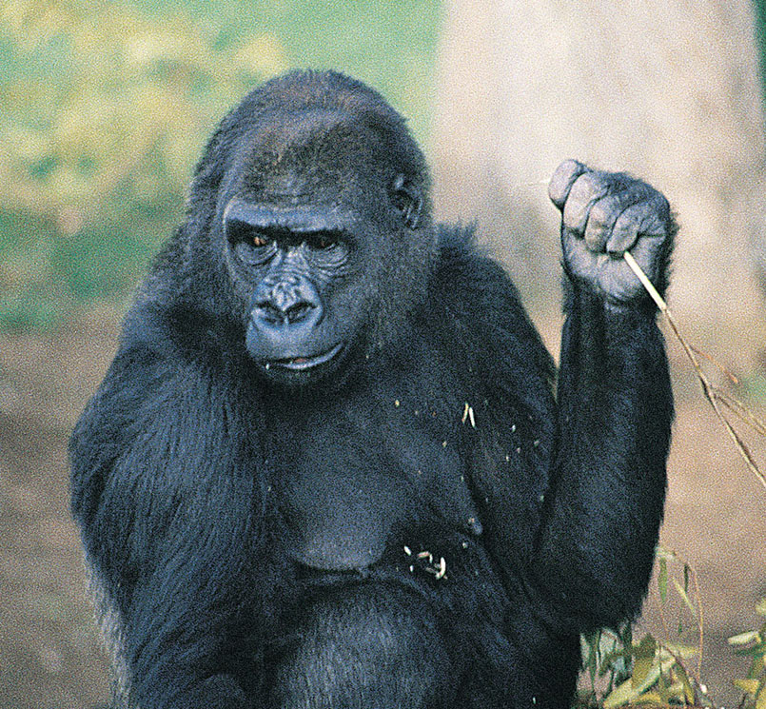
Gorillas
Understanding Humans 10th Ed., p. 140

Slide 6
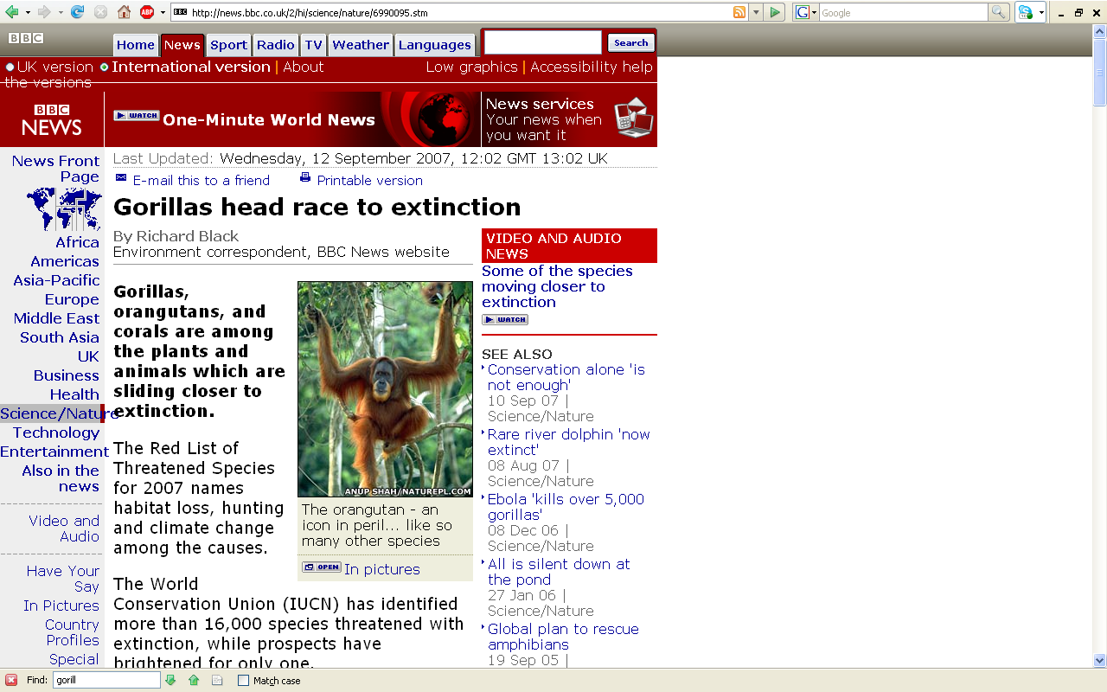
http://news.bbc.co.uk/2/hi/science/nature/6990095.stm

Slide 7
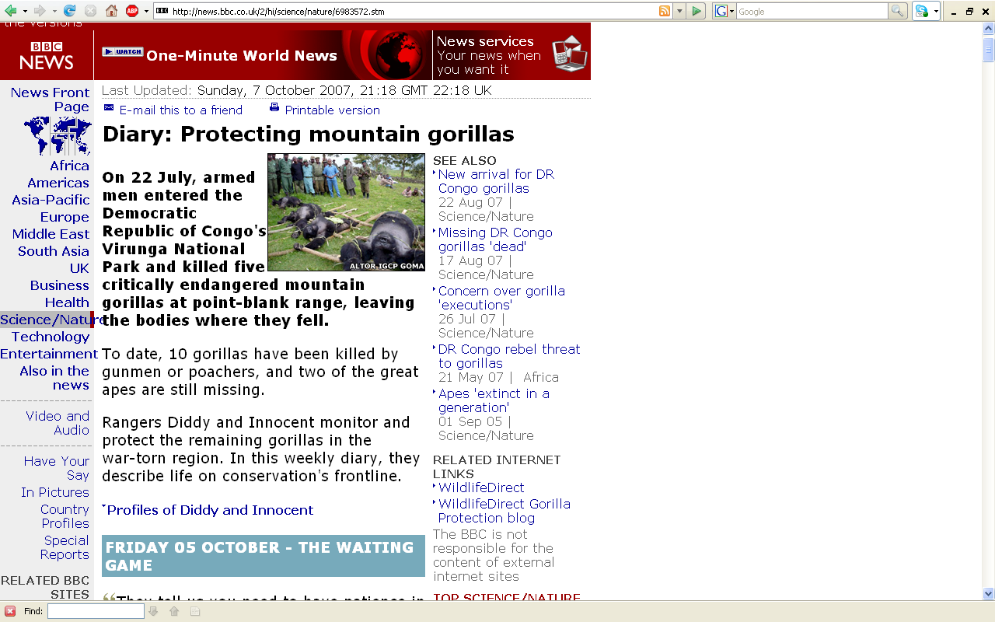
http://news.bbc.co.uk/2/hi/science/nature/6983572.stm

Slide 8
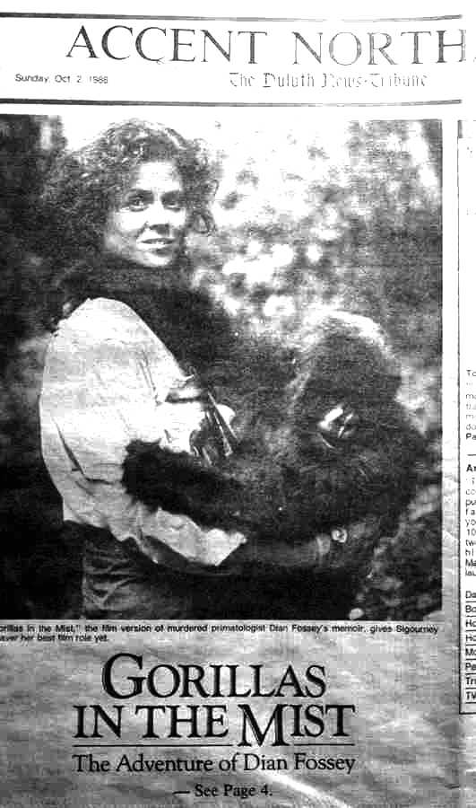

Slide 9
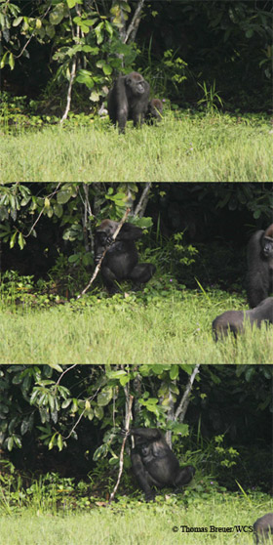
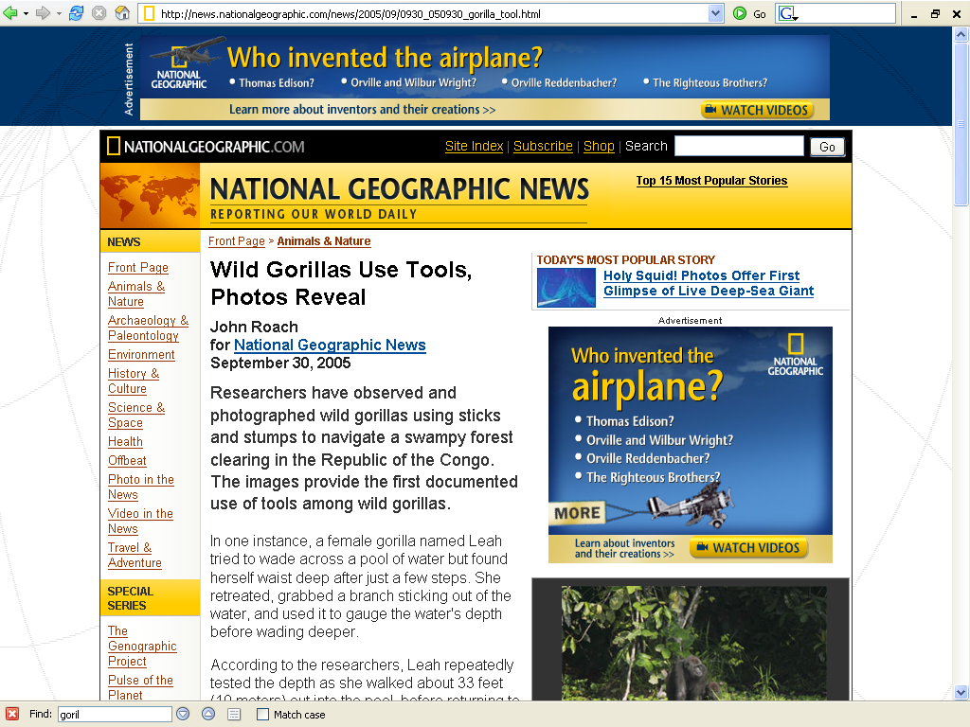
http://news.nationalgeographic.com/news/2005/09/0930_050930_gorilla_tool.html

Slide 10
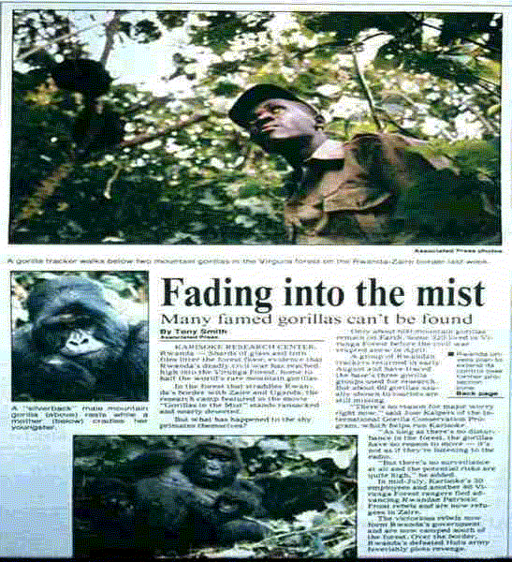

Slide 11
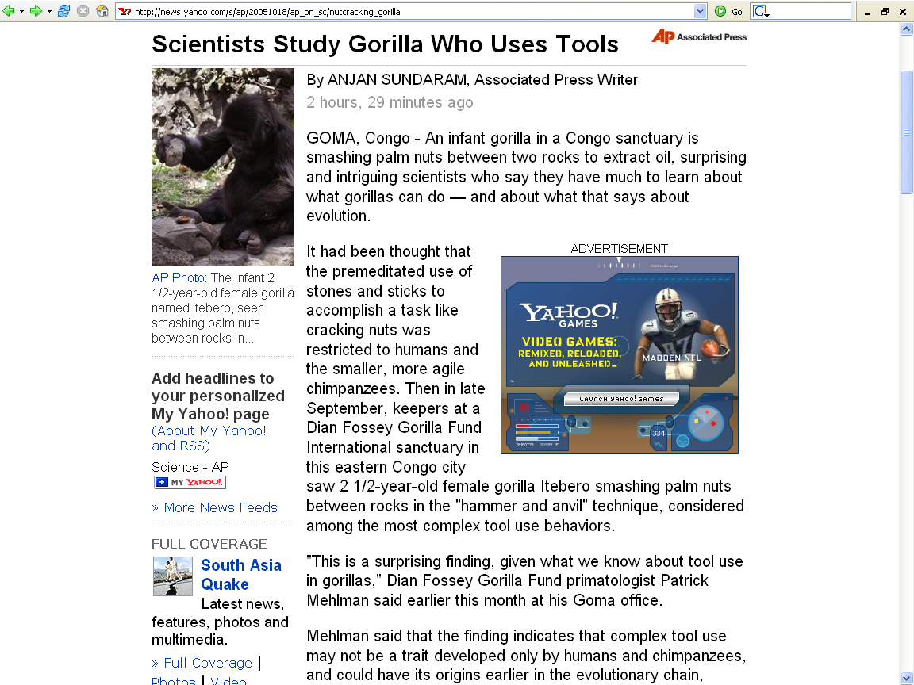
18 October 2005
http://news.yahoo.com/s/ap/20051018/ap_on_sc/nutcracking_gorilla

Slide 12
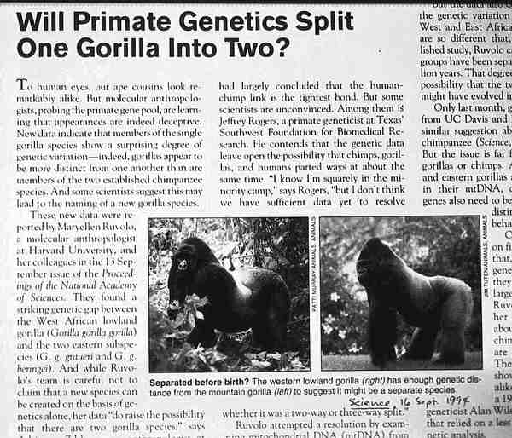

Slide 13
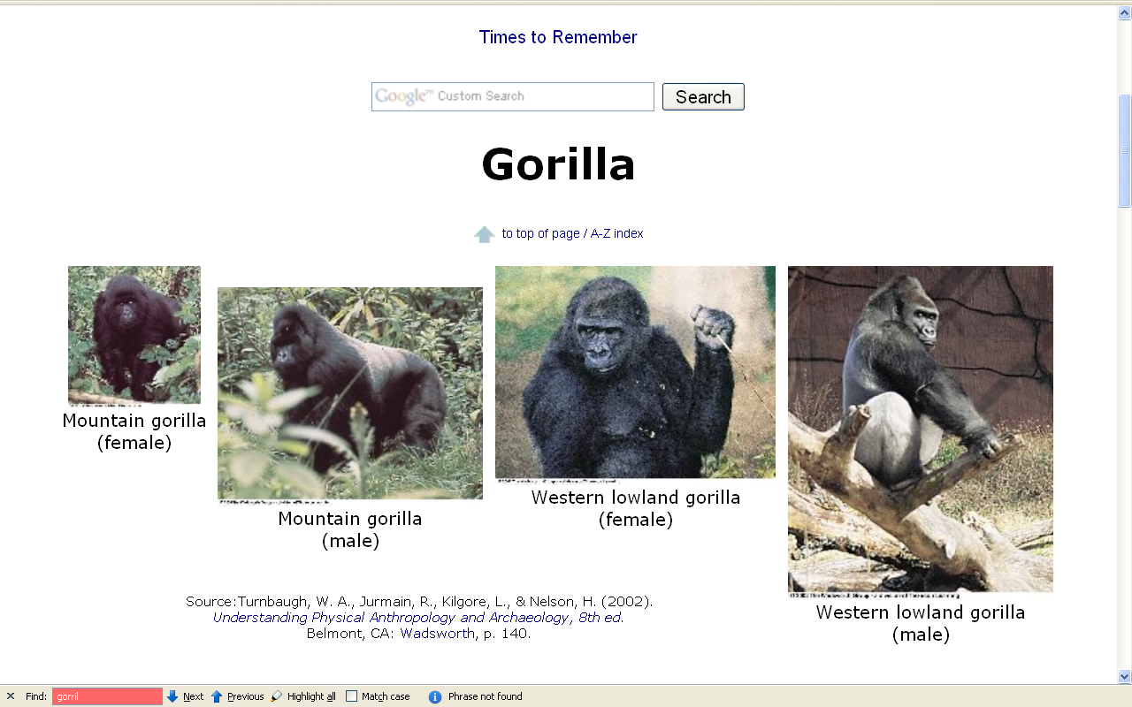

Slide 14
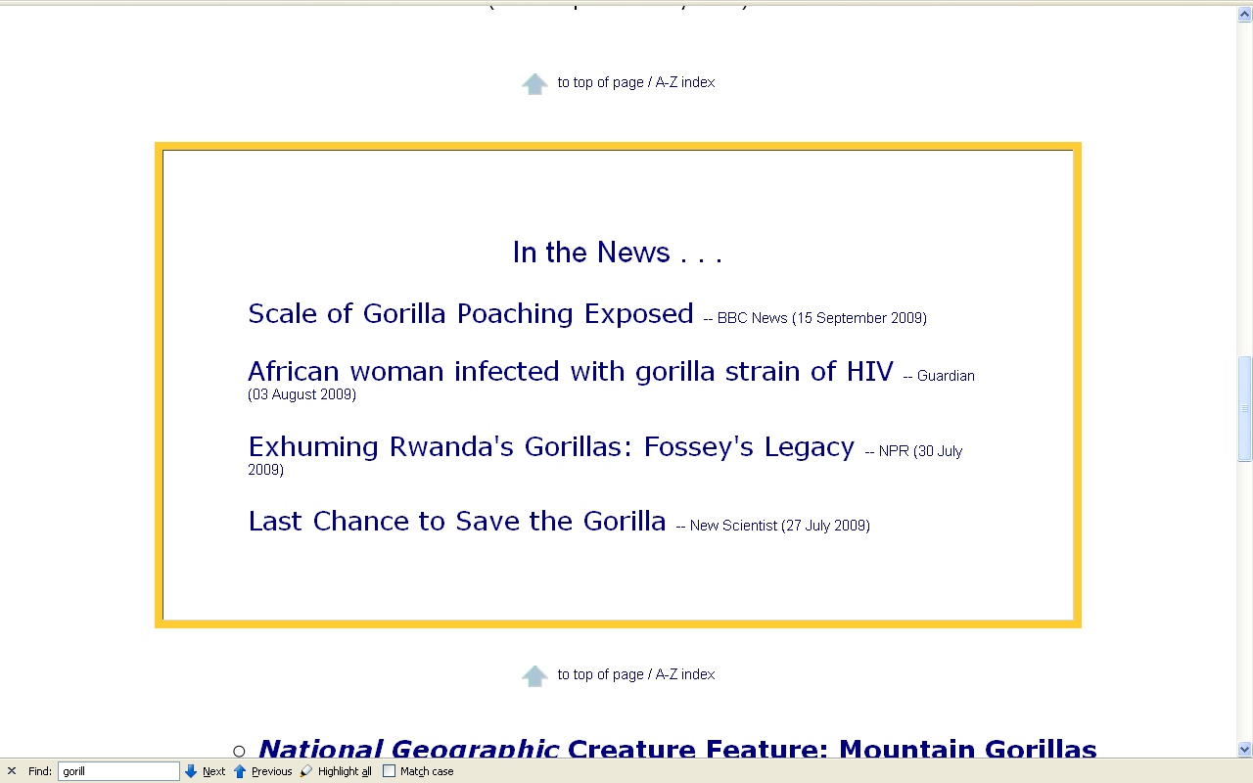

Slide 15
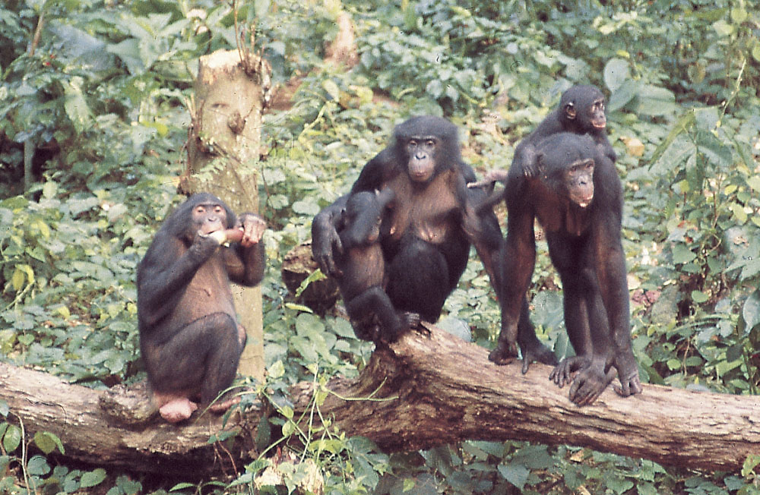
Chimps
Understanding Humans 10th Ed., p. 143

Slide 16
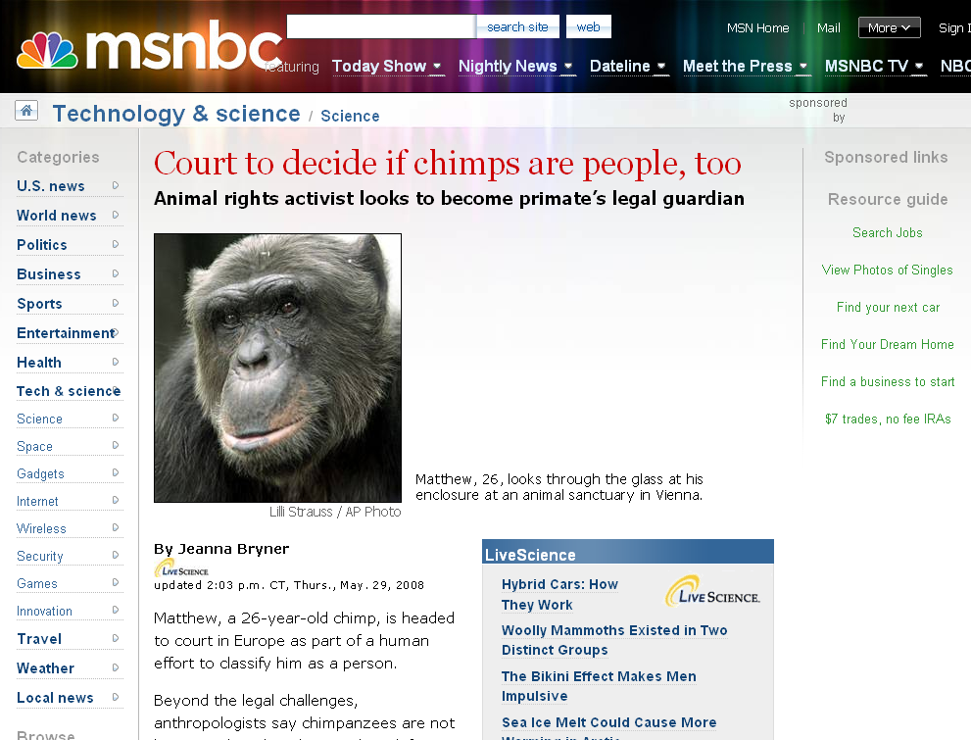
www.msnbc.msn.com/id/24878149/
Notes:
16

Slide 17
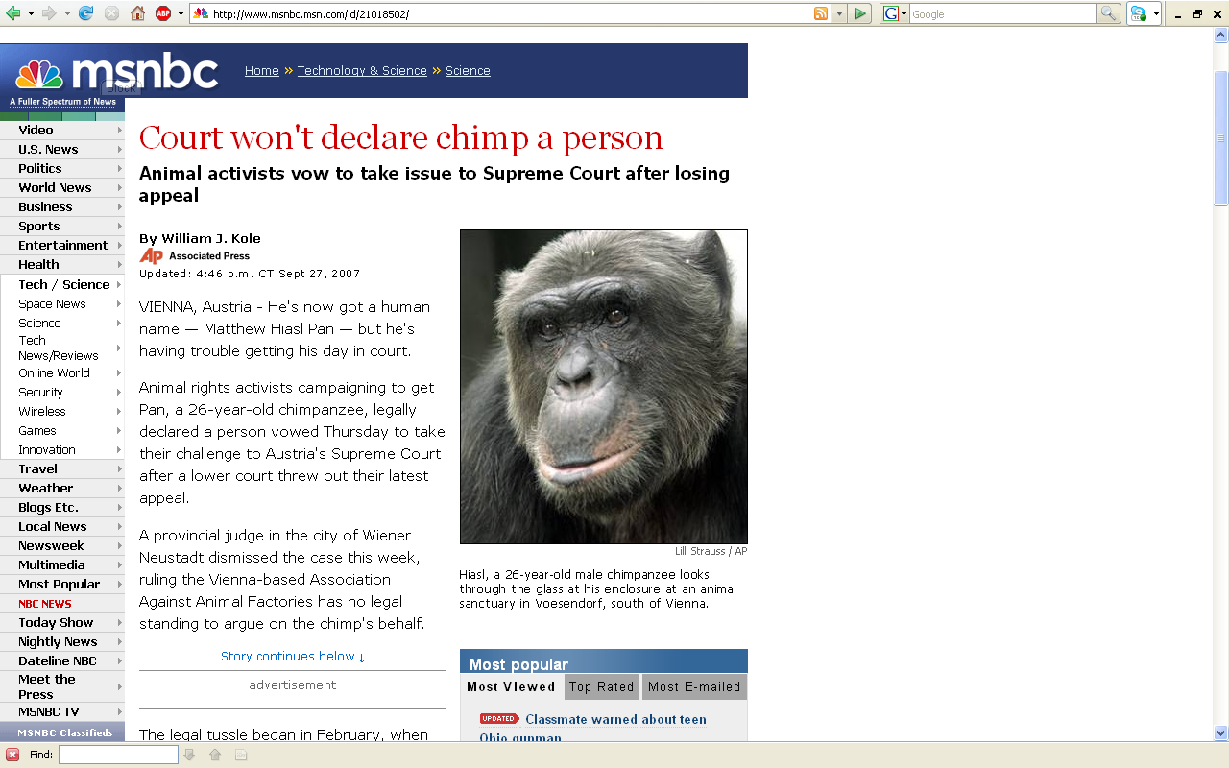
www.msnbc.msn.com/id/21018502/

Slide 18
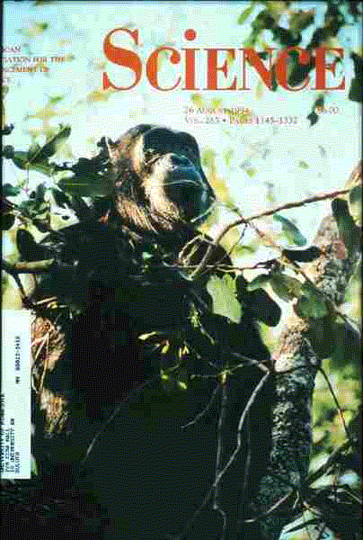

Slide 19


Slide 20
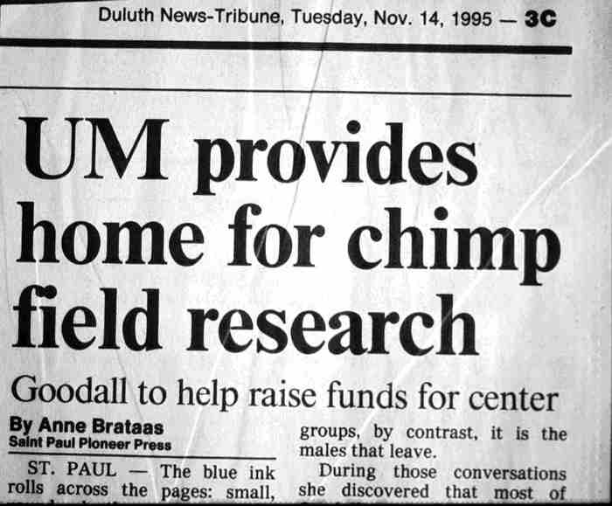

Slide 21
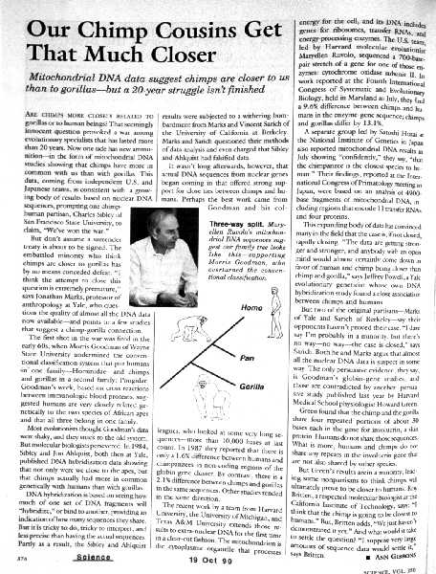

Slide 22
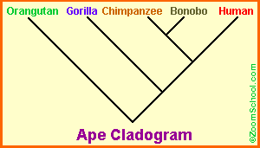
EnchantedLearning.com

Slide 23
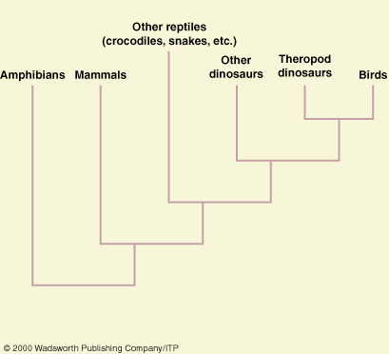
This is not a cladogram

Slide 24
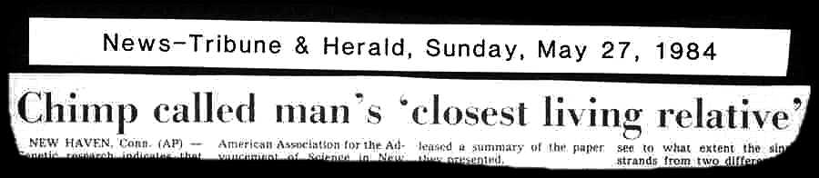

Slide 25
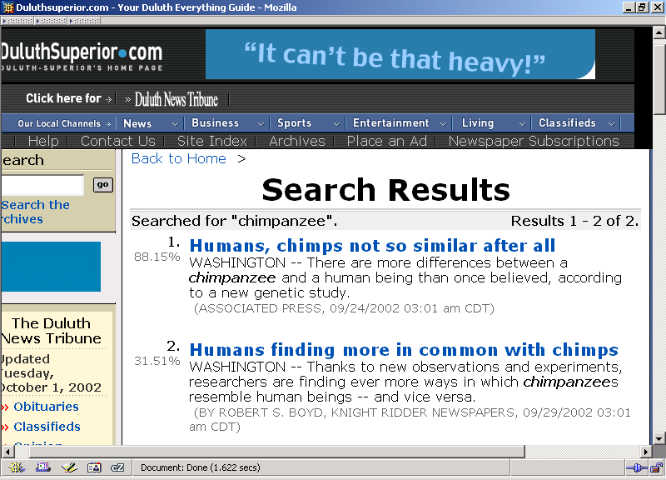

Slide 26
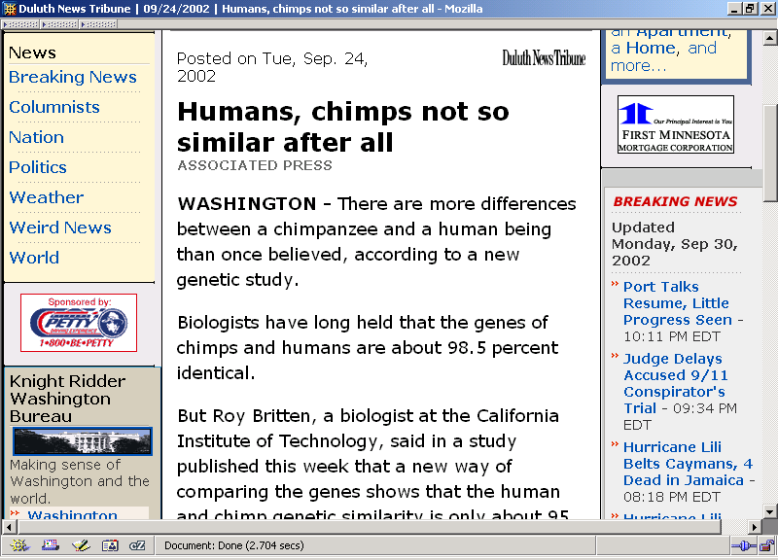

Slide 27
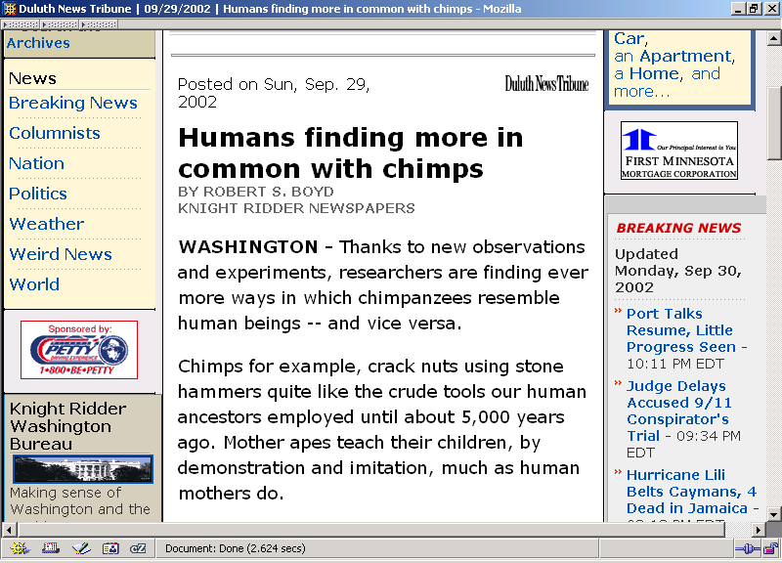

Slide 28
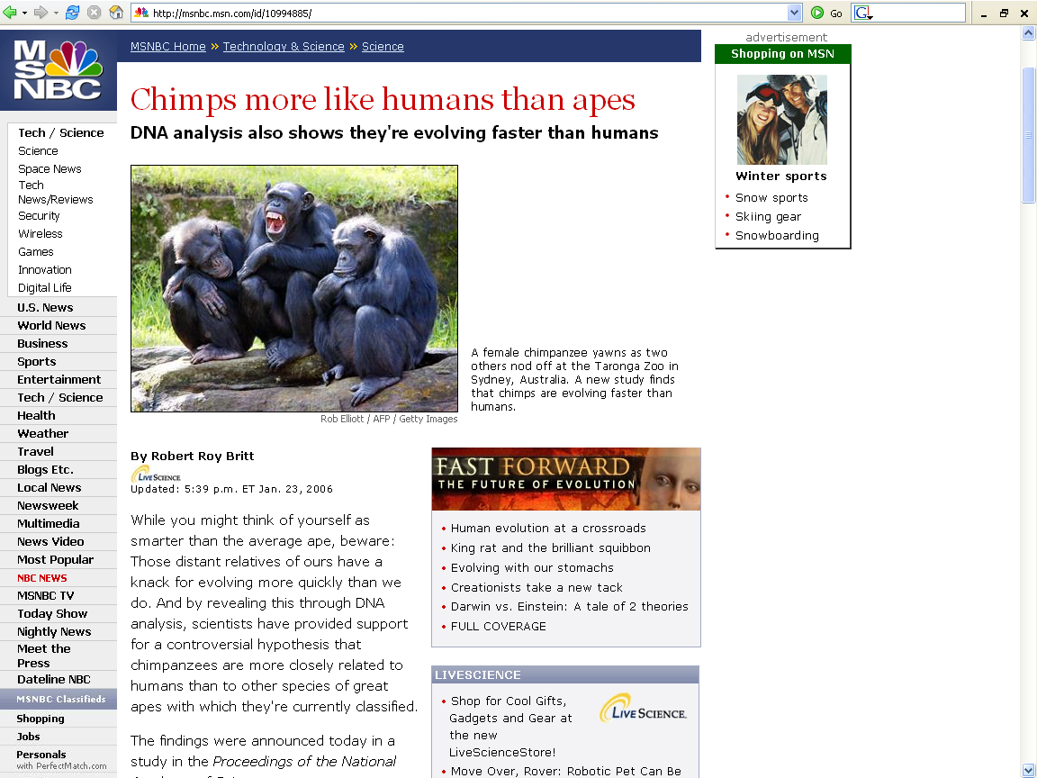
http://msnbc.msn.com/id/10994885/

Slide 29
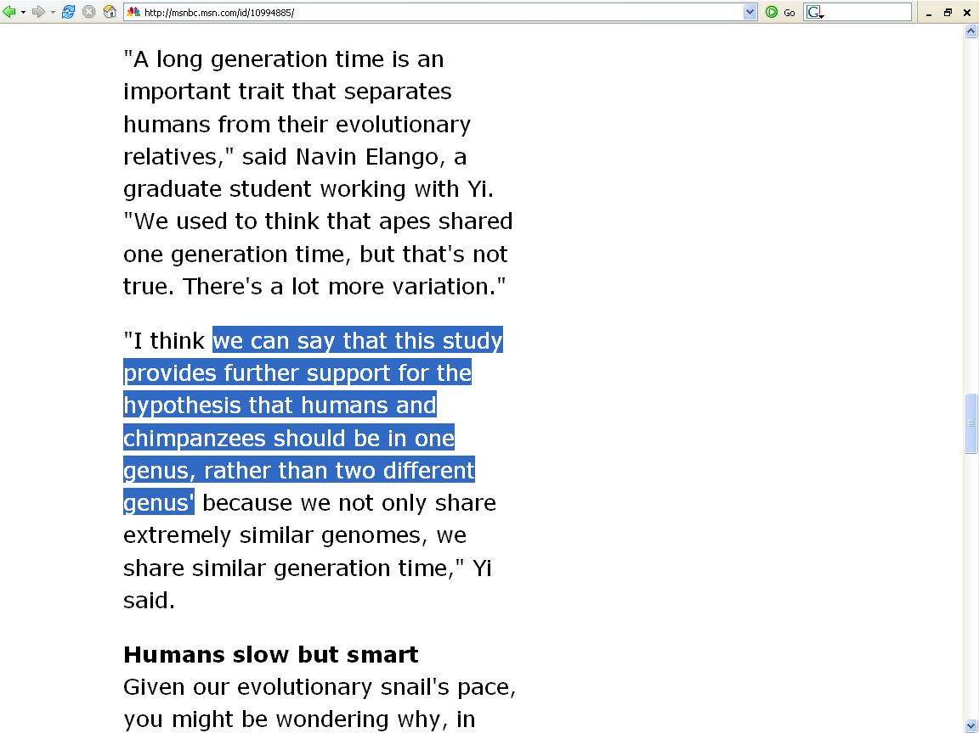
http://msnbc.msn.com/id/10994885/

Slide 30
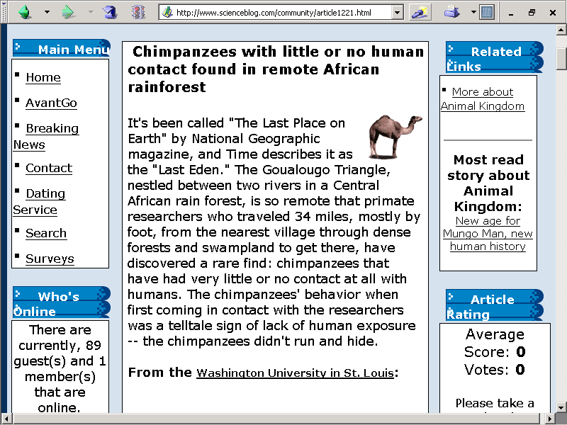
4 September 2003

Slide 31
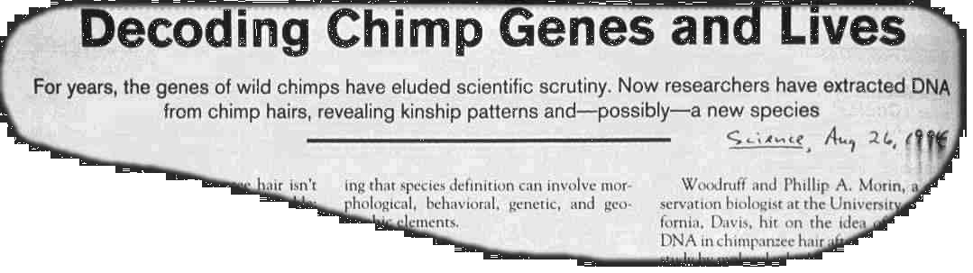

Slide 32
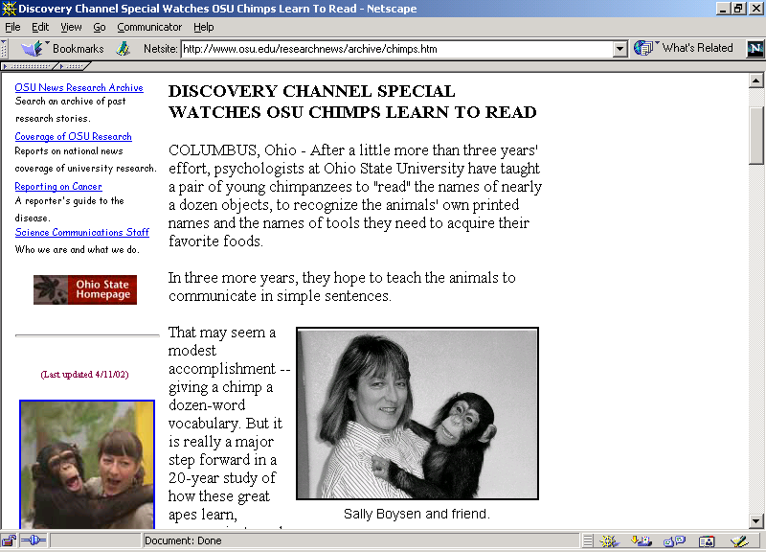

Slide 33
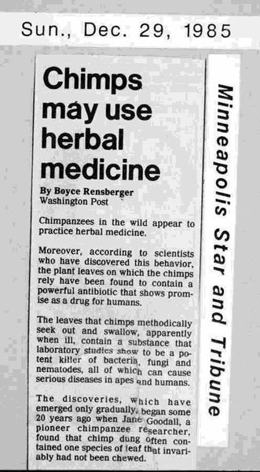

Slide 34
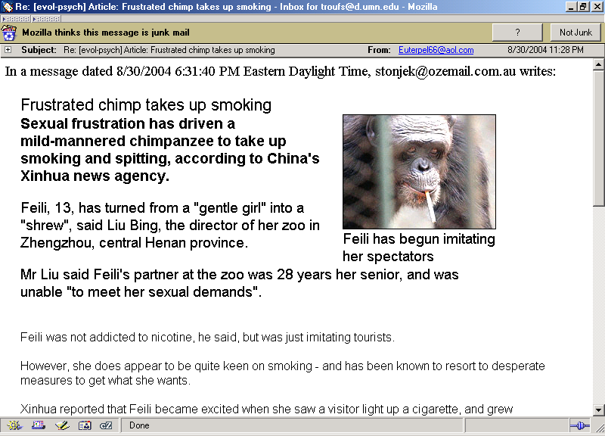

Slide 35


Slide 36
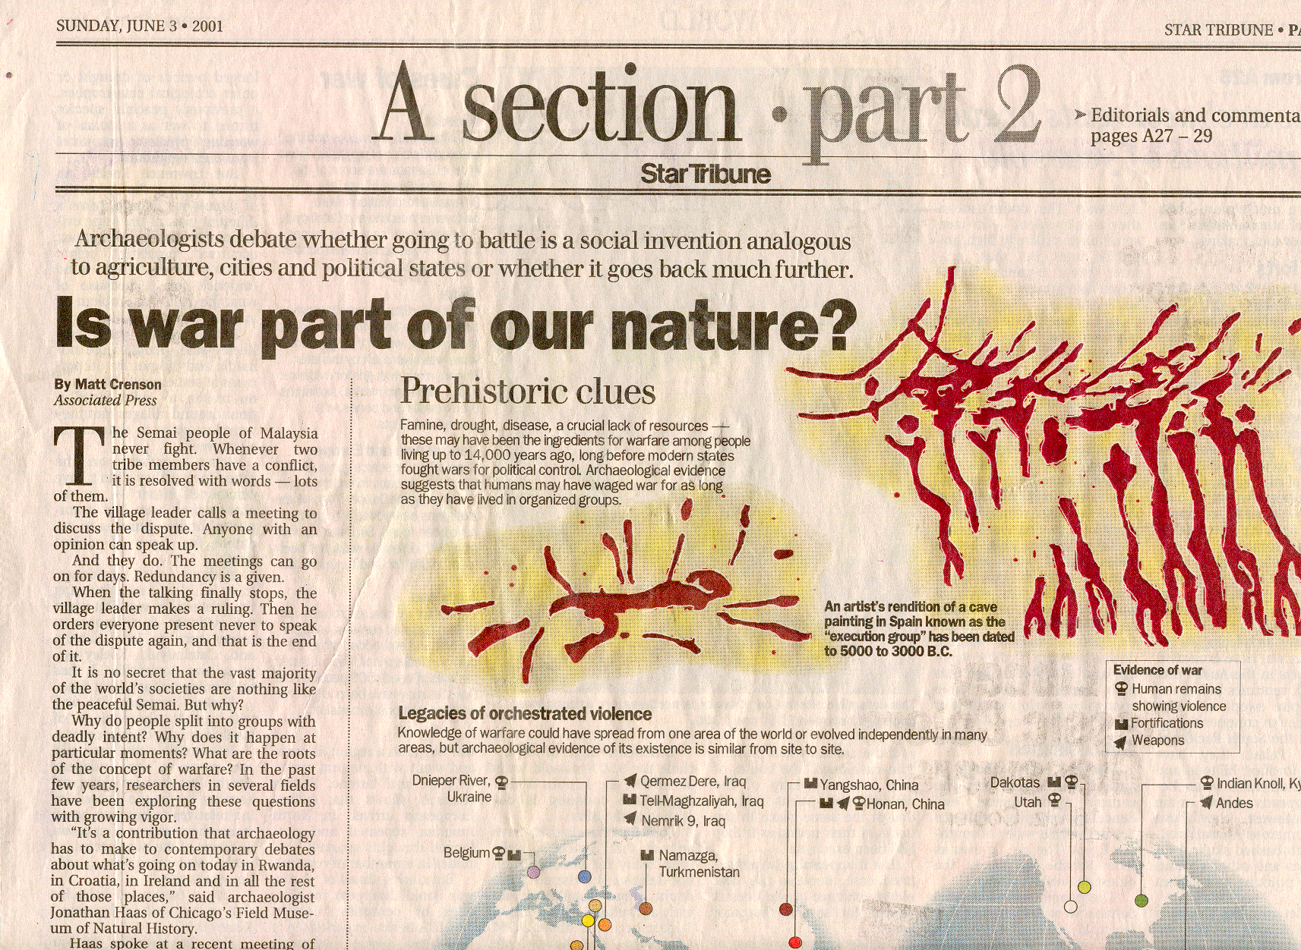

Slide 37
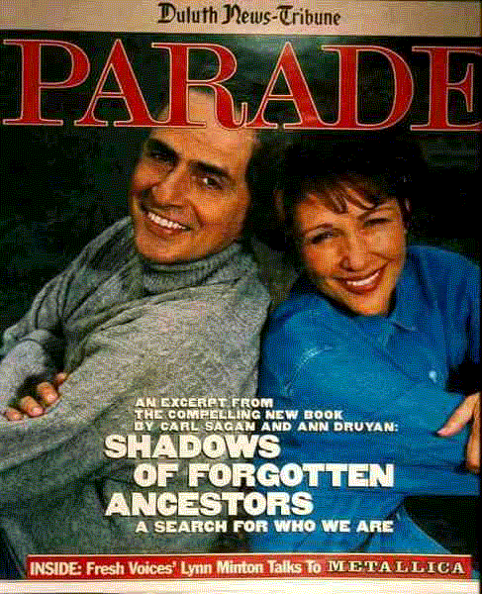

Slide 38
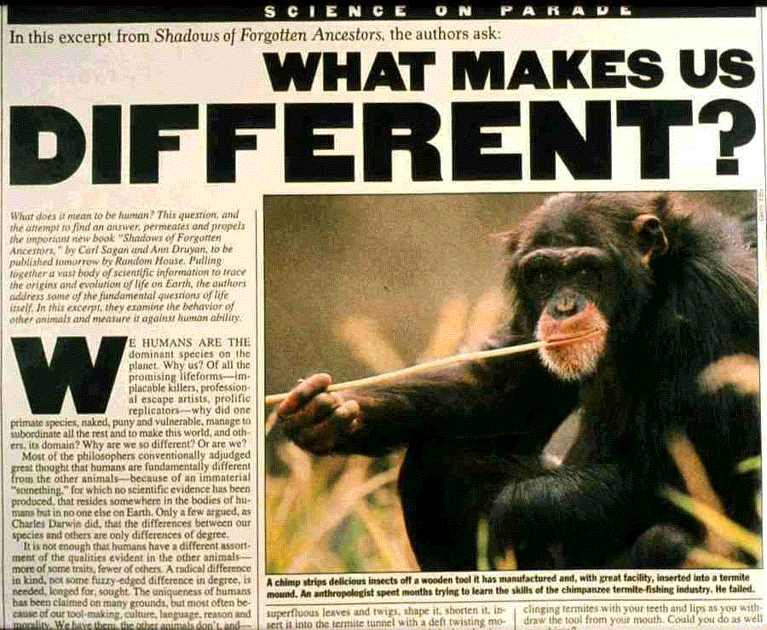

Slide 39


Slide 40
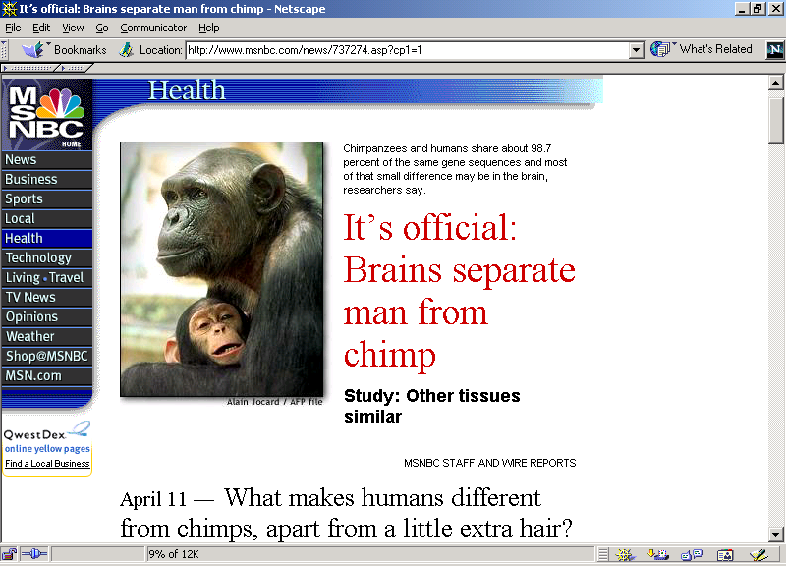

Slide 41
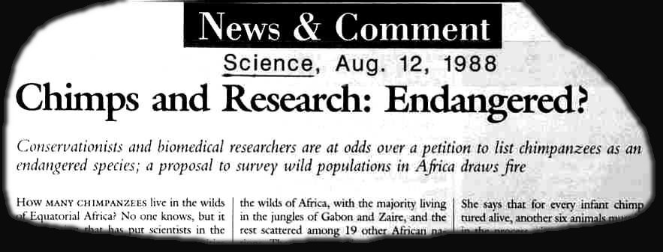

Slide 42
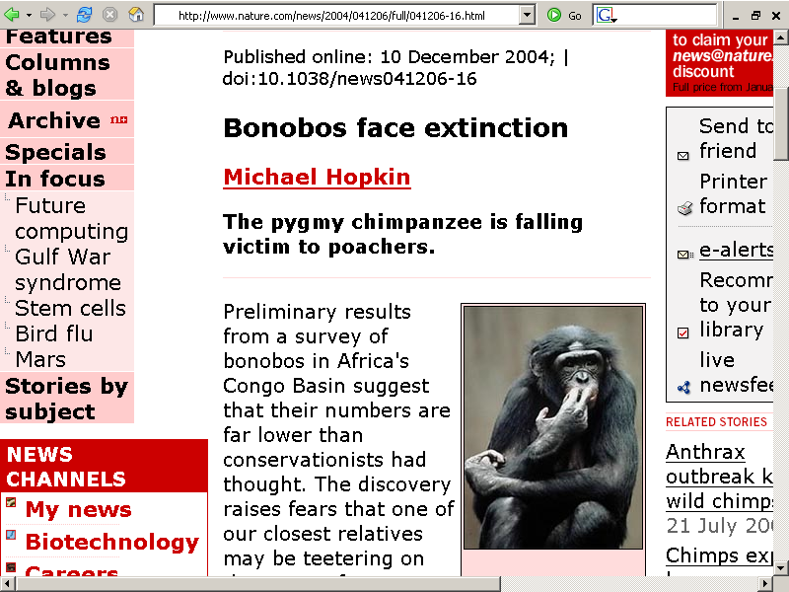
http://www.nature.com/news/2004/041206/full/041206-16.html

Slide 43
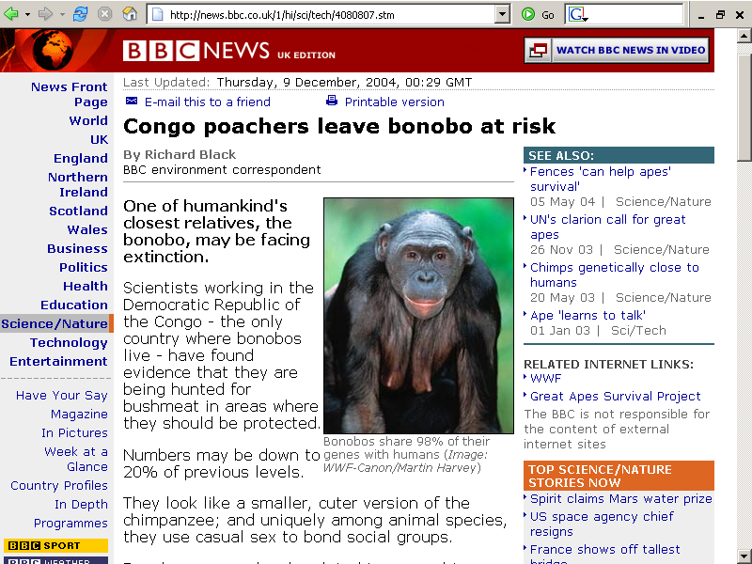
http://news.bbc.co.uk/1/hi/sci/tech/4080807.stm

Slide 44
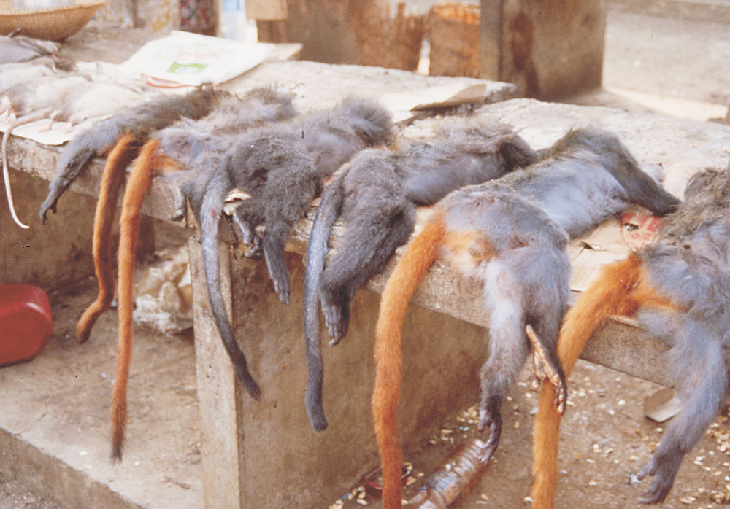
Guenons for sale in bushmeat market,
Malabo, Equatorial Guinea
Understanding Humans, 10th ed., p. 145

Slide 45
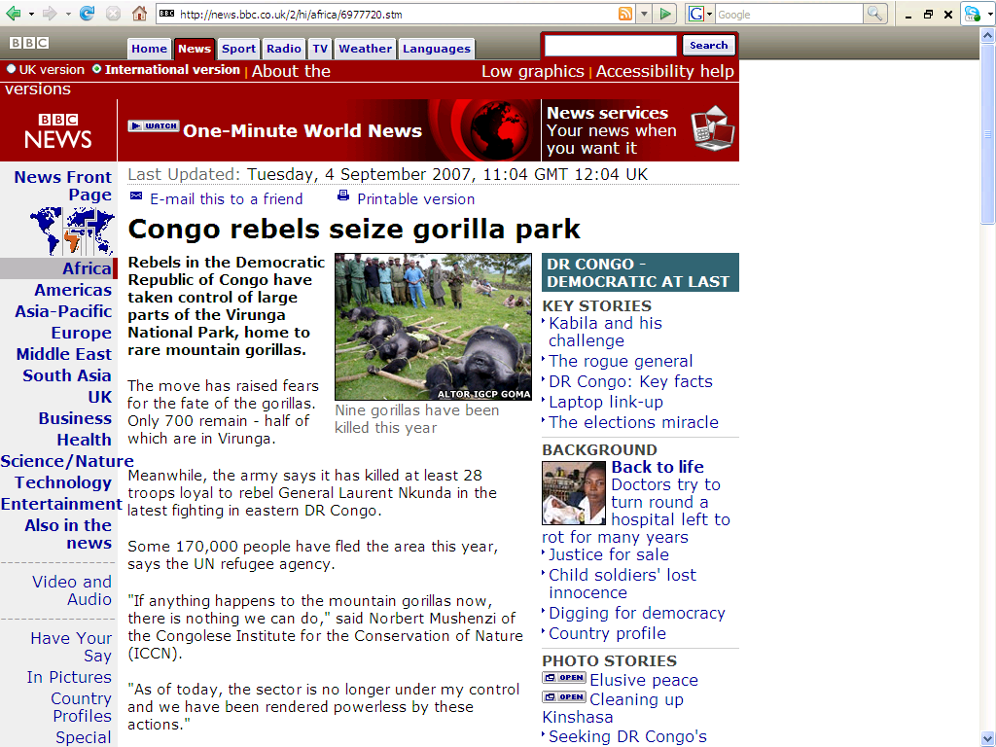
Spring
2003
news.bbc.co.uk/2/hi/africa/6977720.stm

Slide 46
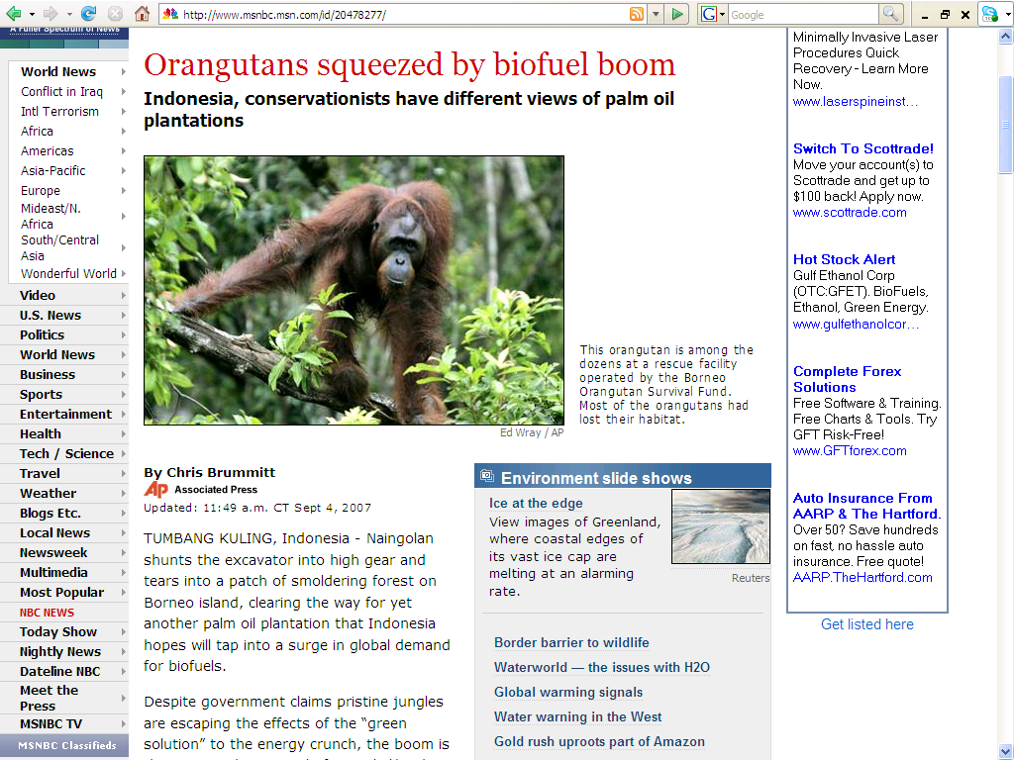
Spring
2003
www.msnbc.msn.com/id/20478277/

Slide 47
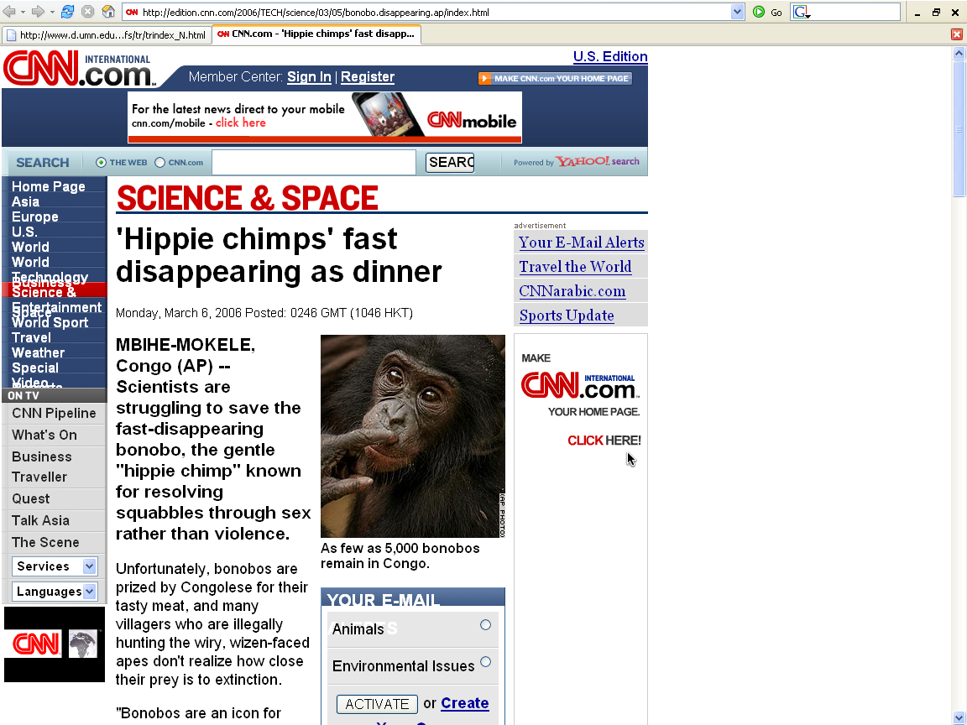
Spring
2003
http://edition.cnn.com/2006/TECH/science/03/05/bonobo.disappearing.ap/index.html

Slide 48
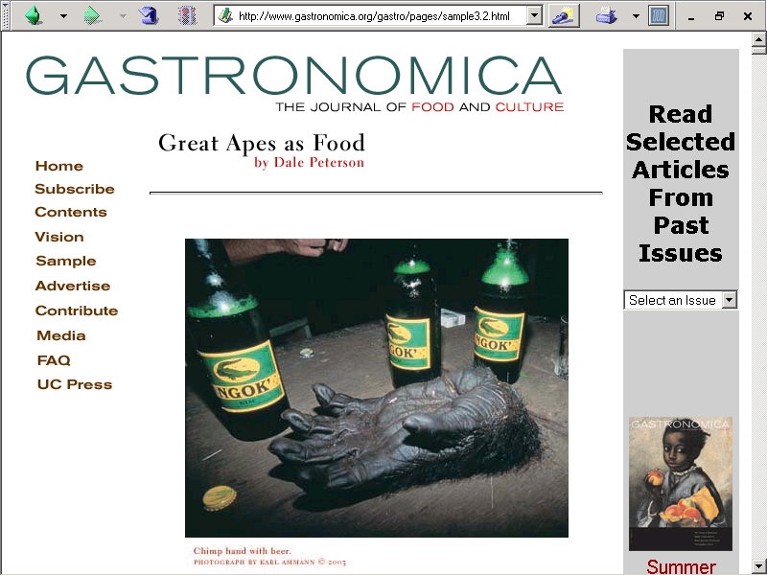
Spring
2003
http://www.gastronomica.org/gastro/pages/sample3.2.html

Slide 49
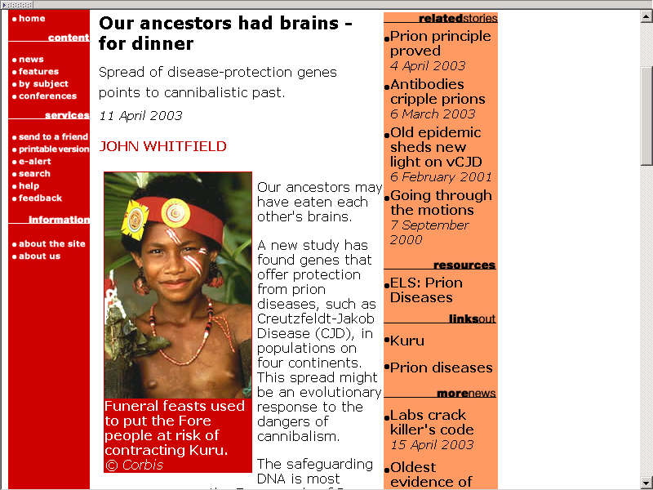

Slide 50
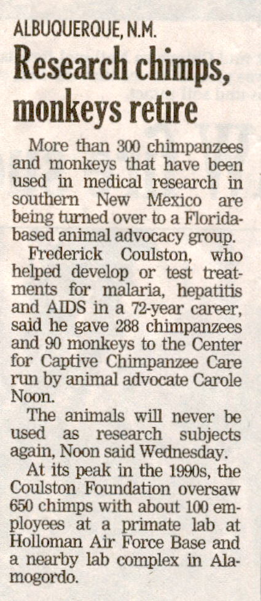
Duluth News Tribune, Thursday 19 September, 2002, 2A

Slide 51
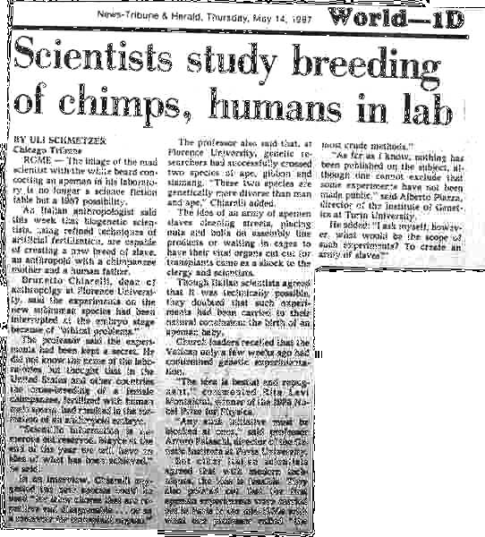

Slide 52

http://news.scotsman.com/international.cfm?id=2434192005

Slide 53
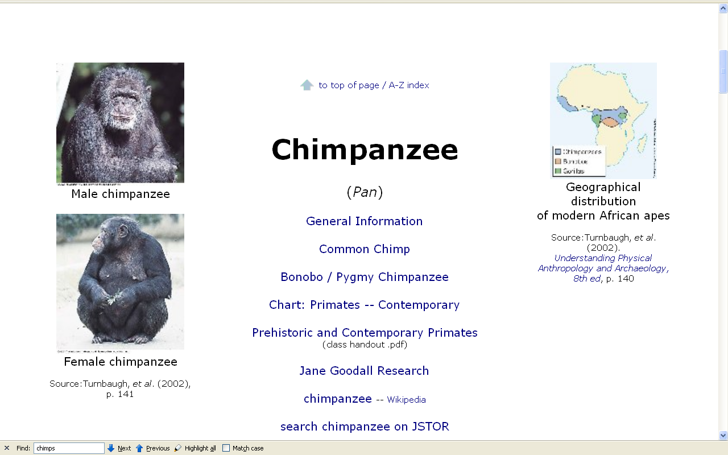

Slide 54
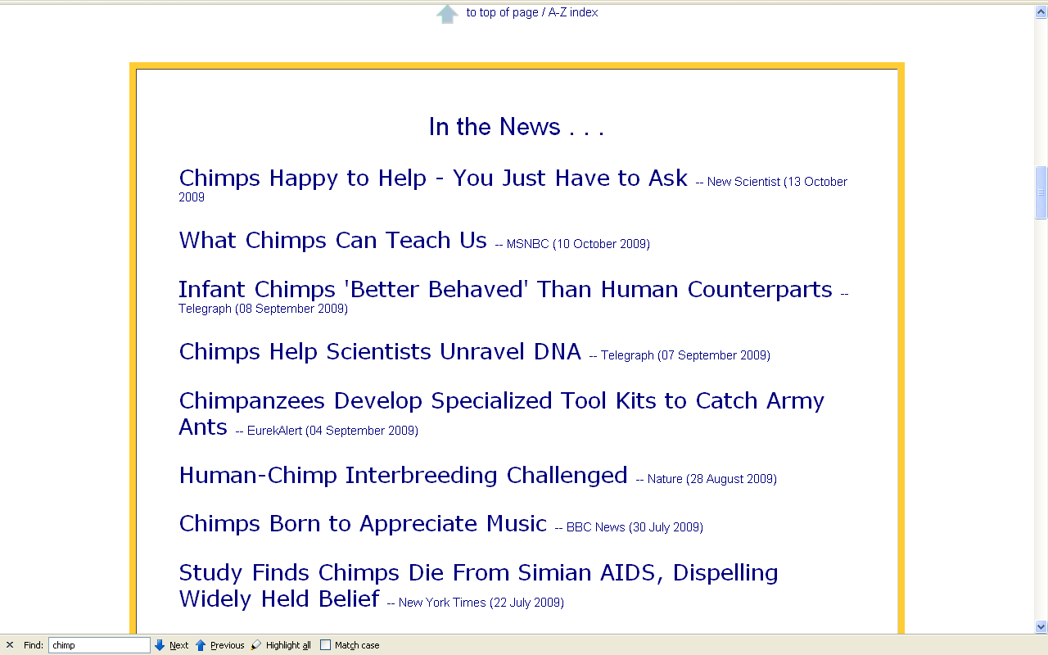

Slide 55

Monkeys
Understanding Humans 10th Ed., p. 136

Slide 56

http://news.nationalgeographic.com/news/2006/05/monkey-sentence.html

Slide 57


http://www.thenewstribune.com/news/nationworld/story/5679513p-5091981c.html

Slide 58


http://www.thenewstribune.com/news/nationworld/story/5679513p-5091981c.html

Slide 59


Slide 60
  “A Monkey Named Hellion”
  60 Minutes
  24 July 2002
  (12 min.)

Slide 61

abcnews.go.com/Technology/wireStory?id=5035837
Notes:
61

Slide 62

http://news.nationalgeographic.com/news/2005/01/0125_050125_chimeras.html

Slide 63


Slide 64


Slide 65

http://news.bbc.co.uk/2/hi/science/nature/4337435.stm

Slide 66

http://news.bbc.co.uk/2/hi/science/nature/4101001.stm

Slide 67


Slide 68

http://itsb.ucsf.edu/~vcr/Evil13.html

Slide 69

http://www.nature.com/news/2004/041206/full/041206-12.html

Slide 70


Slide 71


Slide 72

http://www.sciam.com/article.cfm?chanID=sa003&articleID=00005438-F938-13D7-9FCA83414B7FFE87

Slide 73


Slide 74


Slide 75

Other
Non-human
Primates
Understanding Humans 10th Ed., p. 139

Slide 76


Slide 77

http://news.nationalgeographic.com/news/2006/02/0201_060201_orangutan.html

Slide 78


Slide 79

http://dsc.discovery.com/news/briefs/20051031/animals_lemur.html

Slide 80

July 23, 2001
Ardipithecus
ramidus
kadabba

