Slide 1
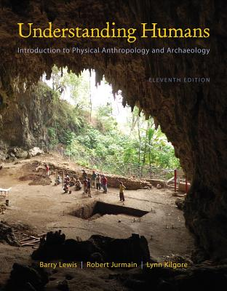
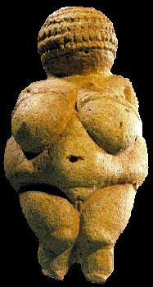
History of Though:
Darwin and Wallace
University of Minnesota Duluth
Tim Roufs
© 2010-2013
http://www.d.umn.edu/cla/faculty/troufs/anth1602/

Slide 2
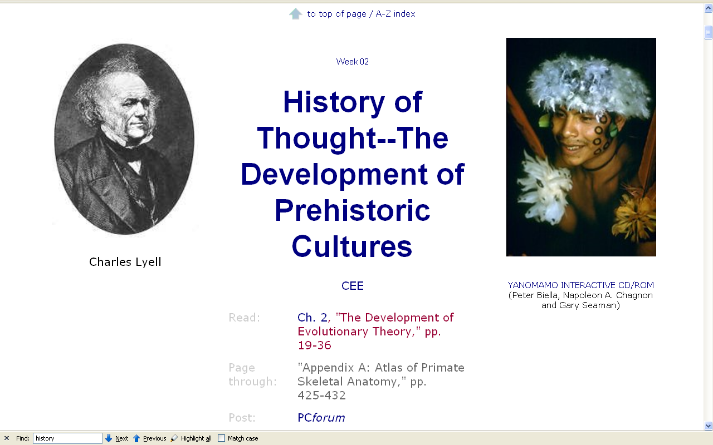
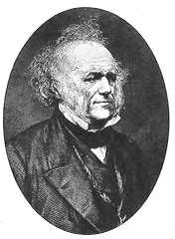
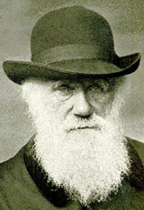
History
of Thought
to 1859
Charles Lyell
Charles Darwin

Slide 3
. . . or how to make sense out of Ch. 2 and Ch. 3 of the text . . .

Slide 4
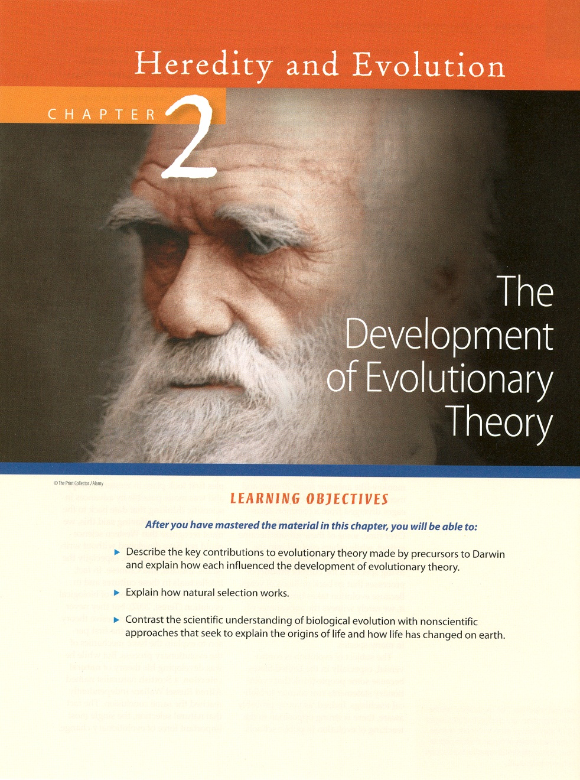
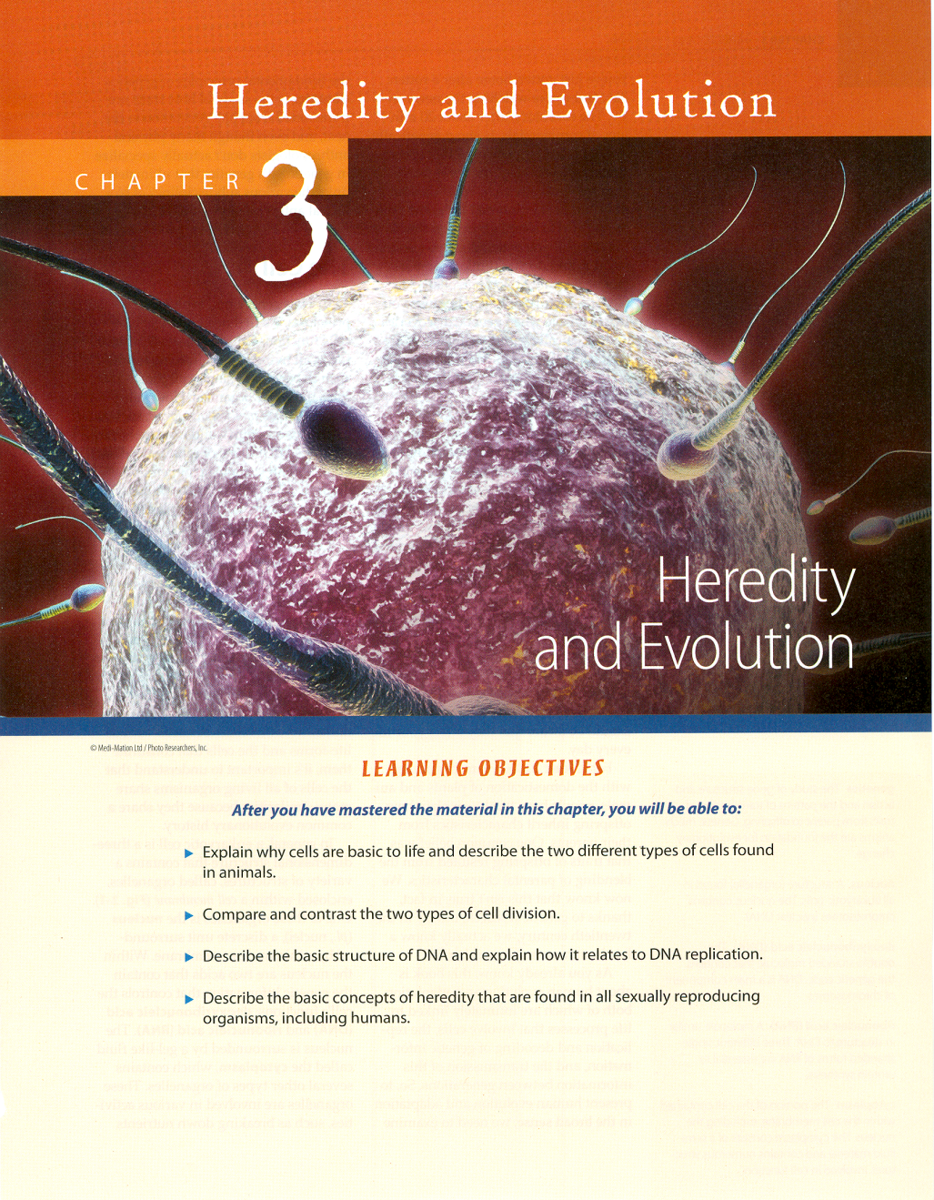

Slide 5
Major Periods in the History of Physical Anthropology
“Pre-Scientific Period” (to 1859)
Period of Evolutionism and Concern over Races (1860 - ca. 1940)
The Period Since WW II

Slide 6
Major Periods in the History of Physical Anthropology
“Pre-Scientific Period” (to 1859)
Period of Evolutionism and Concern over Races (1860 - ca. 1940)
The Period Since WW II

Slide 7
Major problems in “Pre – Scientific” Period
Humans were thought to have had ancient origins corresponding to the time of the creation of the earth
Earth was thought of as a Young Place

Slide 8
Glossary
creationism
The belief that humans and all life forms were specially created by God or some other divine force

Slide 9
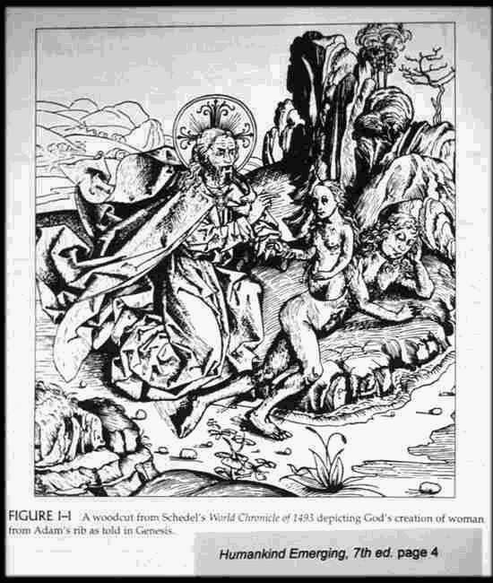

Slide 10
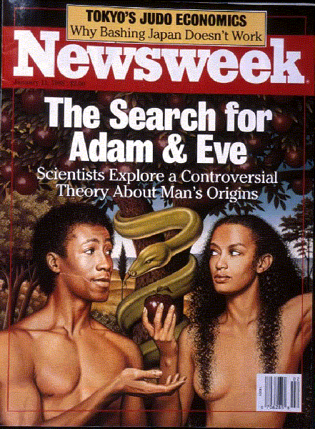

Slide 11
Glossary
catastrophism
George Cuvier’s theory that the earth’s geological landscape is the result of violent cataclysmic events
vast floods and other disasters wiped out ancient life forms again and again

Slide 12
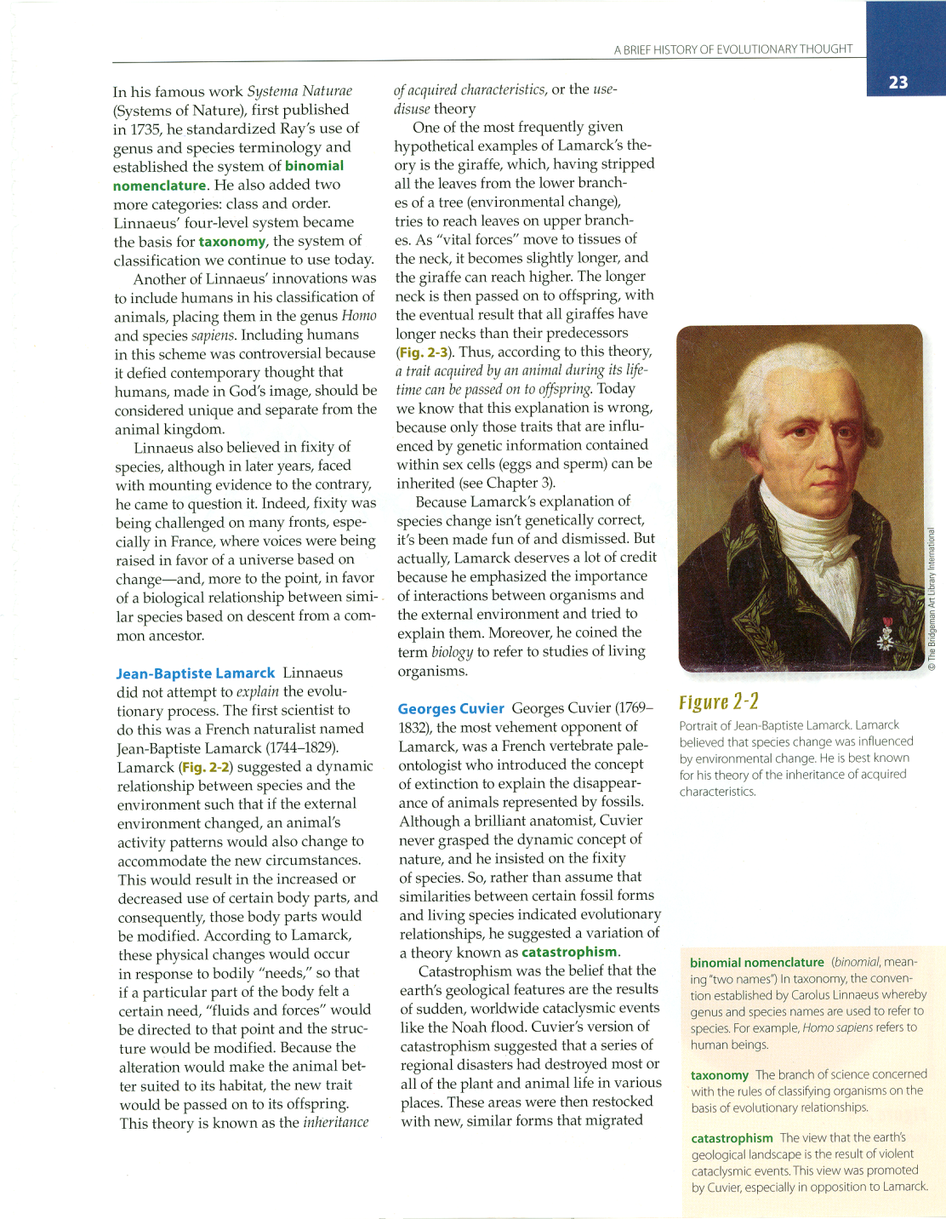
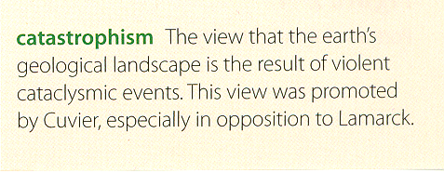
11th ed., p. 23
Understanding Humans, 11th ed., p. 23

Slide 13
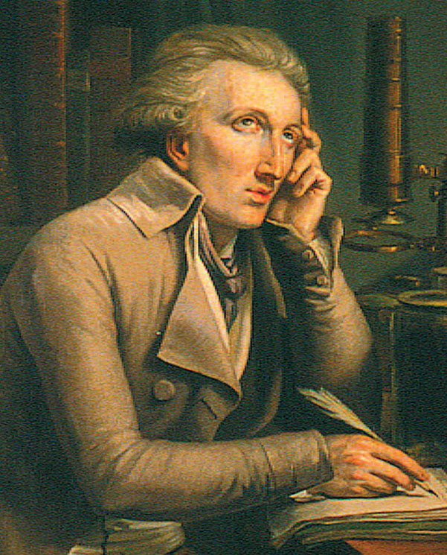
Cuvier explained the fossil record as the result of a
succession of catastrophes followed by new creation events
Understanding Humans, 10th ed., p. 25

Slide 14
Glossary
evolution
A change in the genetic structure of a population.
The term is also frequently used to refer to the appearance of a new species.

Slide 15
Glossary
evolution
Modern genetic definition:
A change in the frequency of alleles (i.e., “genes”) from one generation to the next.

Slide 16
creation and evolution are not mutually exclusive

Slide 17


Slide 18
Older Evolutionary Ideas
Example:
Titus Lucretius
(ca. 99 - 55 B.C.)
De Rerum Natura
(On the Nature of Things)

Slide 19
Older Evolutionary Ideas
Titus Lucretius
“. . . Gave us the classical version of the evolution of human culture and the concept of a lowly beginning for man [sic.], followed by the growth of material culture, social order, religion, and language.”
-- E. A. Hoebel

Slide 20
Older Evolutionary Ideas
Example: Titus Lucretius (ca. 99 - 55 B.C.)
Example: Genesis Account of Creation

Slide 21
Older Evolutionary Ideas
Example: Titus Lucretius (ca. 99 - 55 B.C.)
Example: Genesis Account of Creation

Slide 22
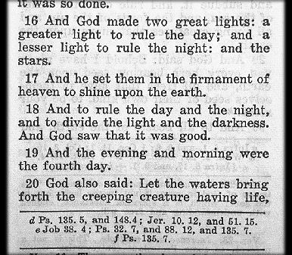

Slide 23
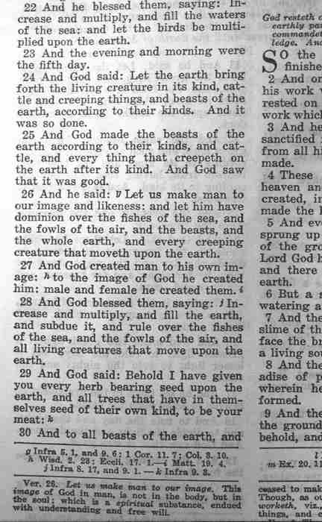

Slide 24
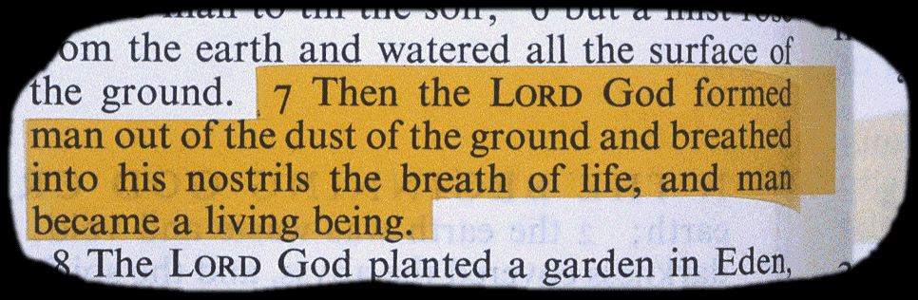

Slide 25
Major problems in “Pre – Scientific” Period
Humans were thought to have had ancient origins corresponding to the time of the creation of the earth
Earth was thought of as a Young Place

Slide 26
Important People / Works
Archbishop James Ussher
of Ireland
(1581 - 1656)
in 1650 proclaimed
“Earth was Created in 4004 B.C.”

Slide 27
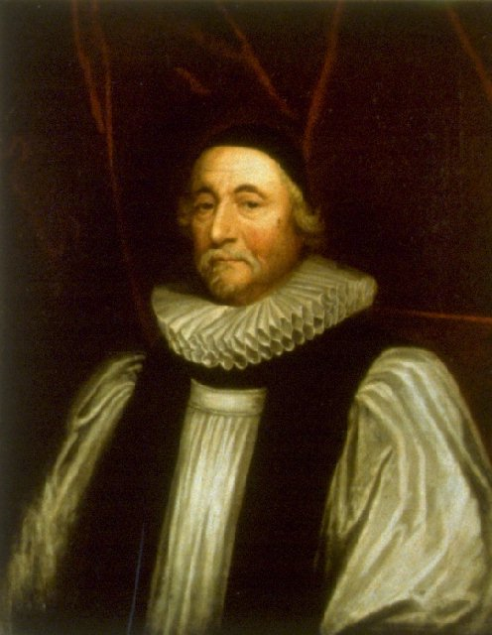
Archbishop James Ussher
1581 - 1656
http://en.wikipedia.org/wiki/James_Ussher

Slide 28
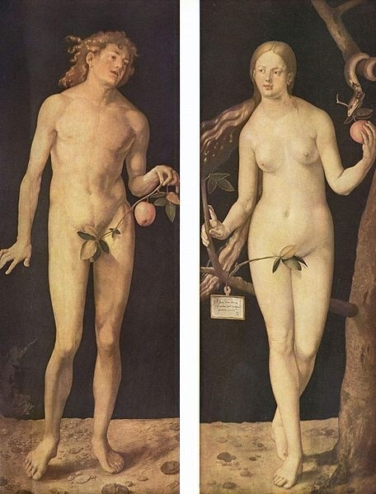
Adam and Eve
Albrecht Dürer
1507
http://en.wikipedia.org/wiki/File:Albrecht_D%C3%BCrer_002.jpg

Slide 29
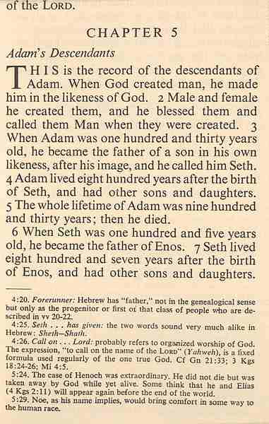

Slide 30
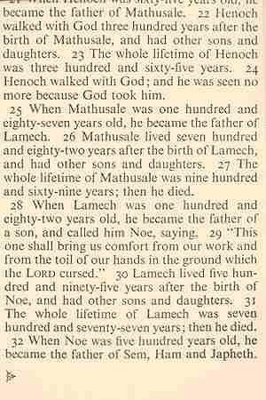

Slide 31
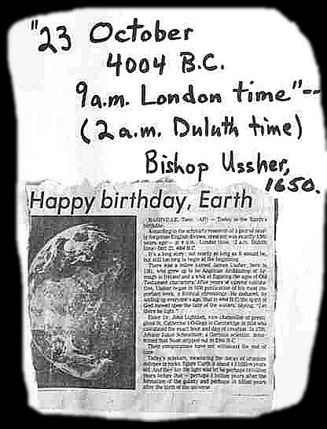

Slide 32
Widespread Idea of the 17th and 18th Centuries
“Ladder of Perfection”
aka “The Great Chain of Being”
aka “Scala Naturae”

Slide 33
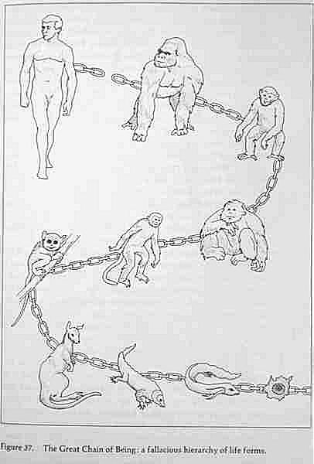

Slide 34
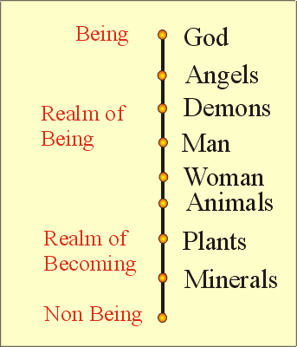
http://www.mlahanas.de/Greeks/Evolution.htm

Slide 35
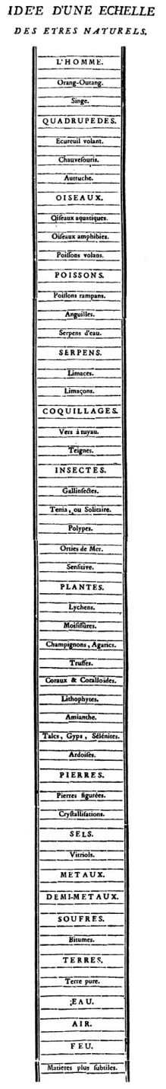
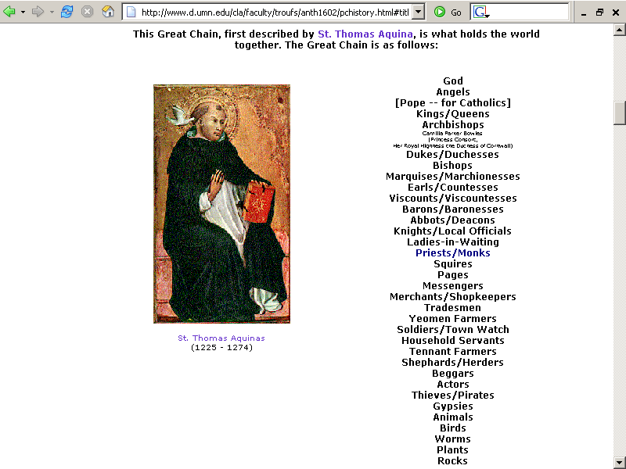
www.d.umn.edu/cla/faculty/troufs/anth1602/pchistory.html#title

Slide 36
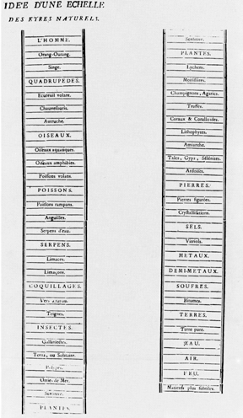
Scala naturae
The Great Chain of Being
http://en.wikipedia.org/wiki/Scala_naturae

Slide 37
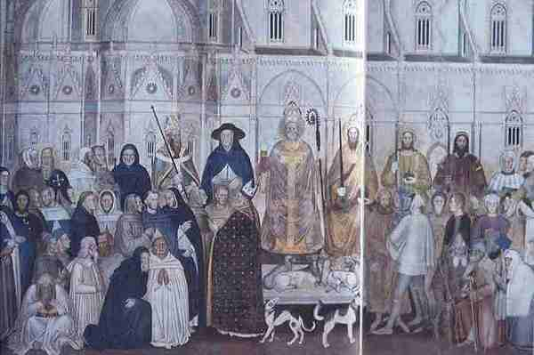

Slide 38
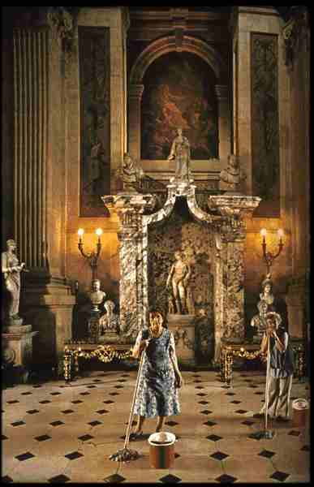

Slide 39
Important People / Works
Linnaeus aka Karl Von Linnae´å
(1707 - 1778)
Systema Naturae
1758

Slide 40

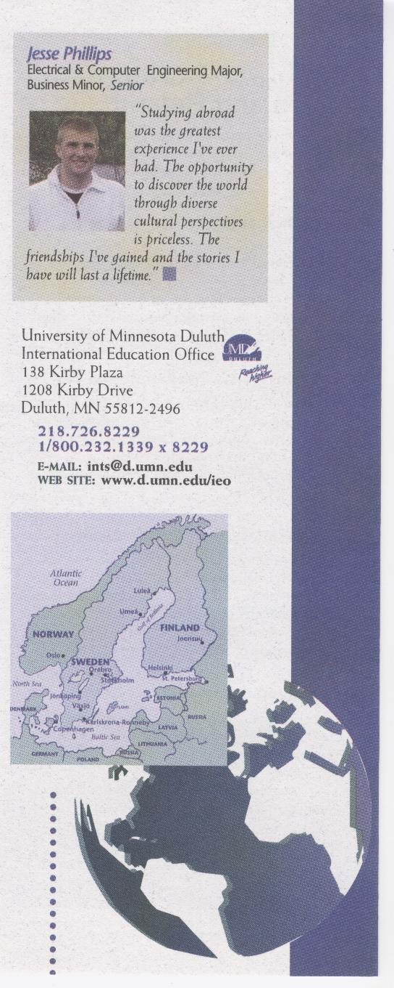

Slide 41
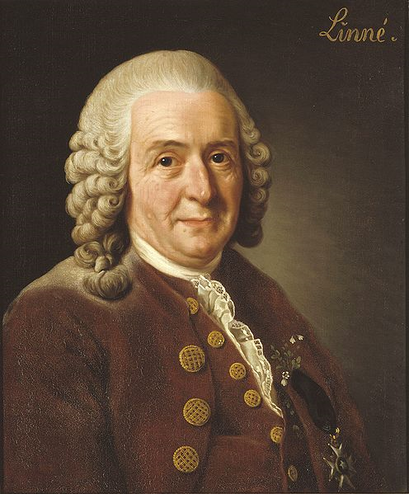
Carl von Linné
(Carl Linnaeus)
1707- 1778
http://en.wikipedia.org/wiki/Linnaeus

Slide 42
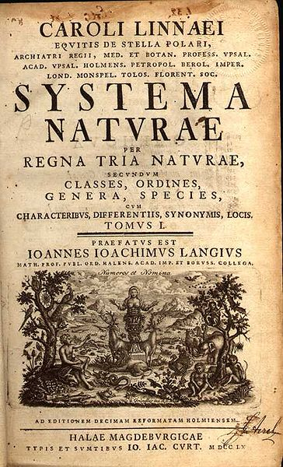
Carl von Linné
(Carl Linnaeus)
1758

Slide 43
Basic Concepts
. . . genus species variety:
Animalia . . . Homo sapiens sapiens
Animalia . . . Gorilla gorilla gorilla
~
“binomial nomenclature”

Slide 44
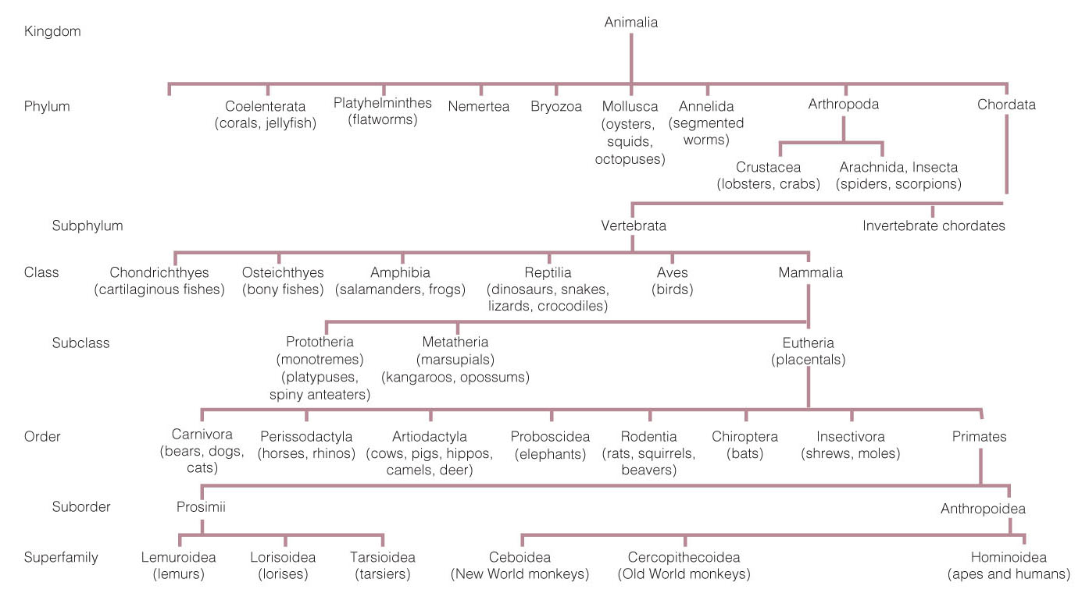
Classification chart, modified from Linnaeus.
Understanding Humans, 10th ed., p. 101

Slide 45
Glossary
taxonomy
the branch of science concerned with the rules of classifying organisms on the basis of evolutionary relationships

Slide 46
Glossary
taxon
a unit (group) in taxonomy

Slide 47
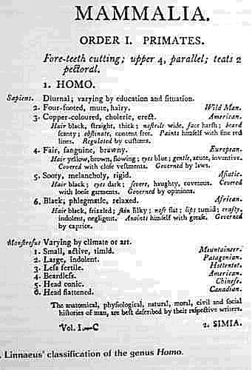
taxon

Slide 48
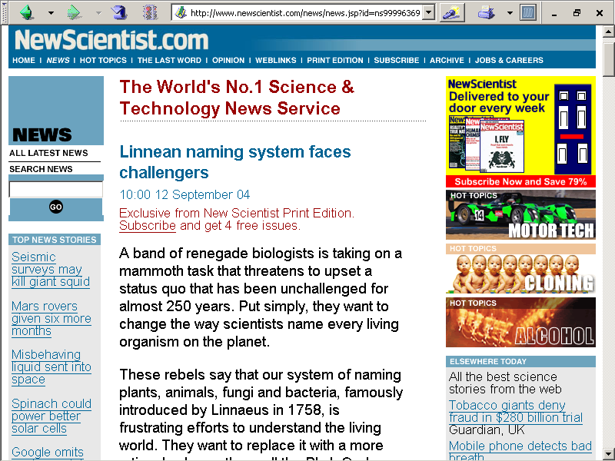
www.newscientist.com/news/news.jsp?id=ns99996369

Slide 49
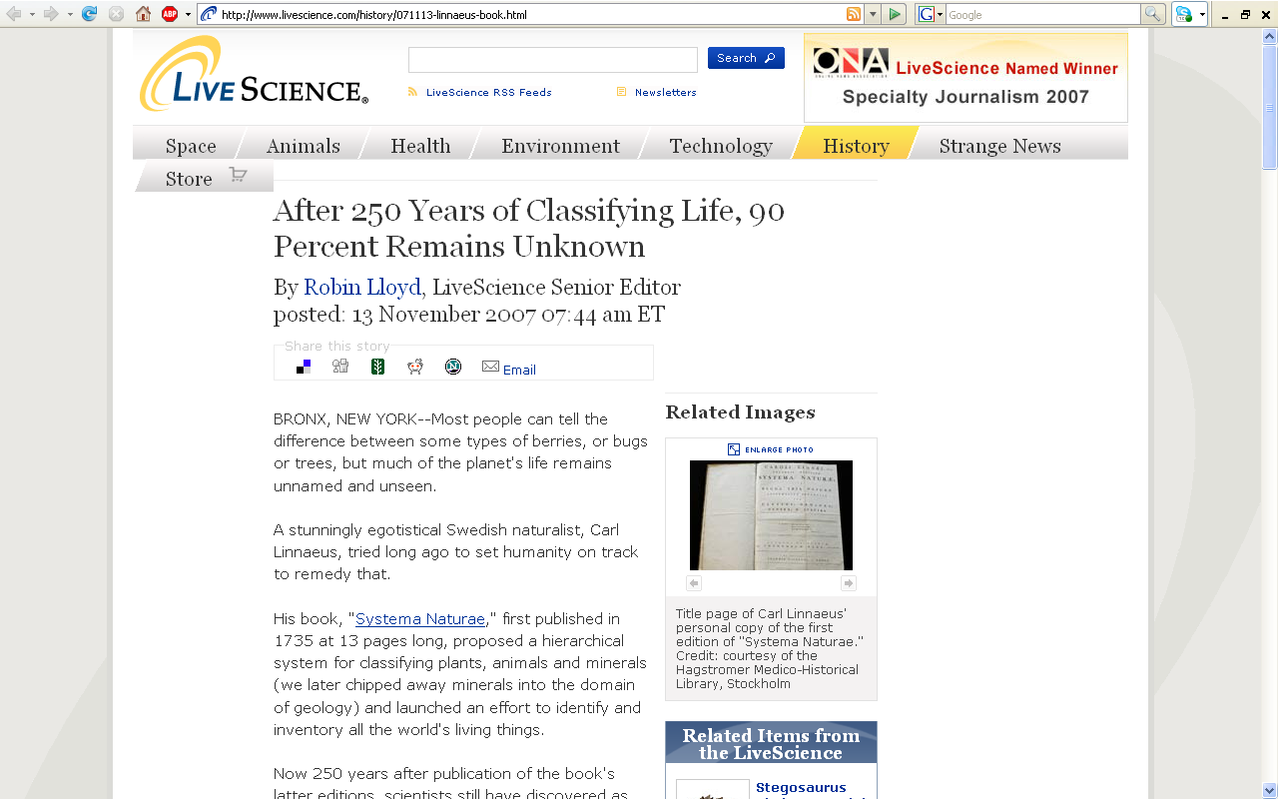
www.livescience.com/history/071113-linnaeus-book.html
Notes:
49

Slide 50
Important People / Works
Early Discoverers of Prehistoric Evidence . . .

Slide 51
Important People / Works
Isaac de la Peyrère, 1655
John Friedrich Esper, 1771
John Frere, 1790
Philippe-Charles Schmerling, 1830
Father John MacEnery, 1829
Kent’s Cavern, Devonshire

Slide 52
Important People / Works
Isaac de la Peyrère, 1655
John Friedrich Esper, 1771
John Frere, 1790
Philippe-Charles Schmerling, 1830
Father John MacEnery, 1829
Kent’s Cavern, Devonshire

Slide 53
Important People / Works
Isaac de la Peyrère, 1655
John Friedrich Esper, 1771
John Frere, 1790
Philippe-Charles Schmerling, 1830
Father John MacEnery, 1829
Kent’s Cavern, Devonshire

Slide 54
Important People / Works
Isaac de la Peyrère, 1655
John Friedrich Esper, 1771
John Frere, 1790
Philippe-Charles Schmerling, 1830
Father John MacEnery, 1829
Kent’s Cavern, Devonshire

Slide 55
Important People / Works
Isaac de la Peyrère, 1655
John Friedrich Esper, 1771
John Frere, 1790
Philippe-Charles Schmerling, 1830
Father John MacEnery, 1829
Kent’s Cavern, Devonshire

Slide 56
Important People / Works
Isaac de la Peyrère, 1655
John Friedrich Esper, 1771
John Frere, 1790
Philippe-Charles Schmerling, 1830
Father John MacEnery, 1829
Kent’s Cavern, Devonshire

Slide 57
Important People / Works
Isaac de la Peyrère, 1655
John Friedrich Esper, 1771
John Frere, 1790
Philippe-Charles Schmerling, 1830
Father John MacEnery, 1829
Kent’s Cavern, Devonshire

Slide 58
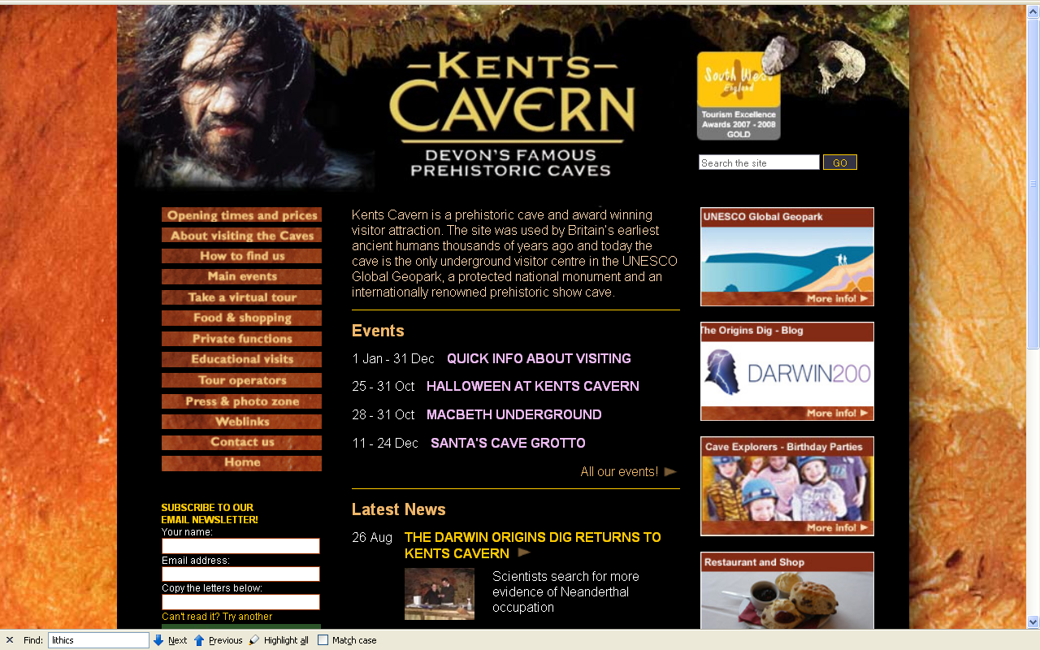
http://www.kents-cavern.co.uk/

Slide 59
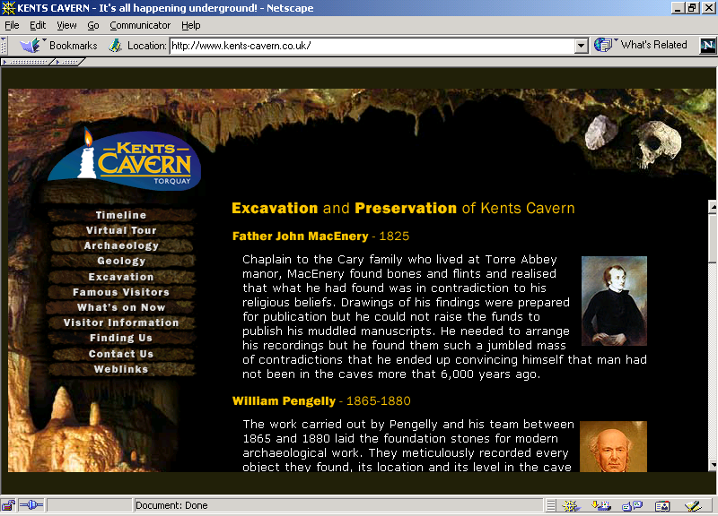
www.kents-cavern.co.uk/

Slide 60
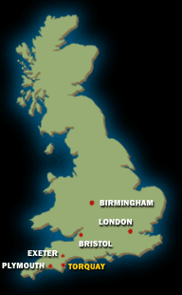
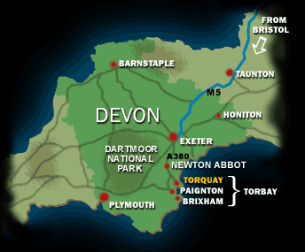
http://www.kents-cavern.co.uk/

Slide 61
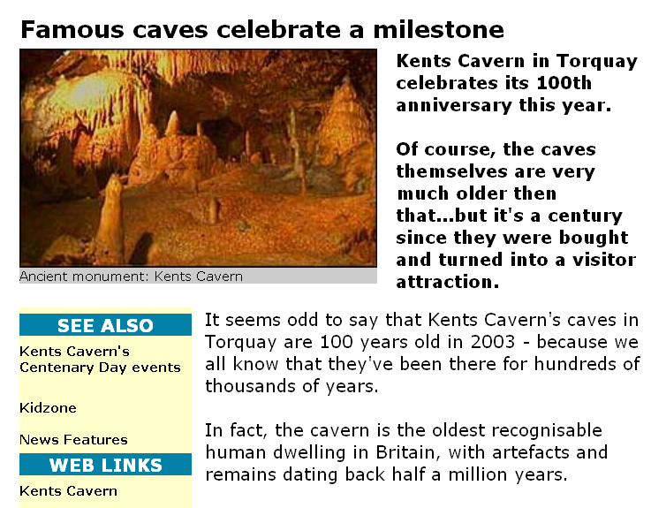
1903 – 2003
as a visitor attraction
These caves were first lived in 700,000 years ago
http://www.bbc.co.uk/devon/news_features/2003/kents_cavern.shtml

Slide 62
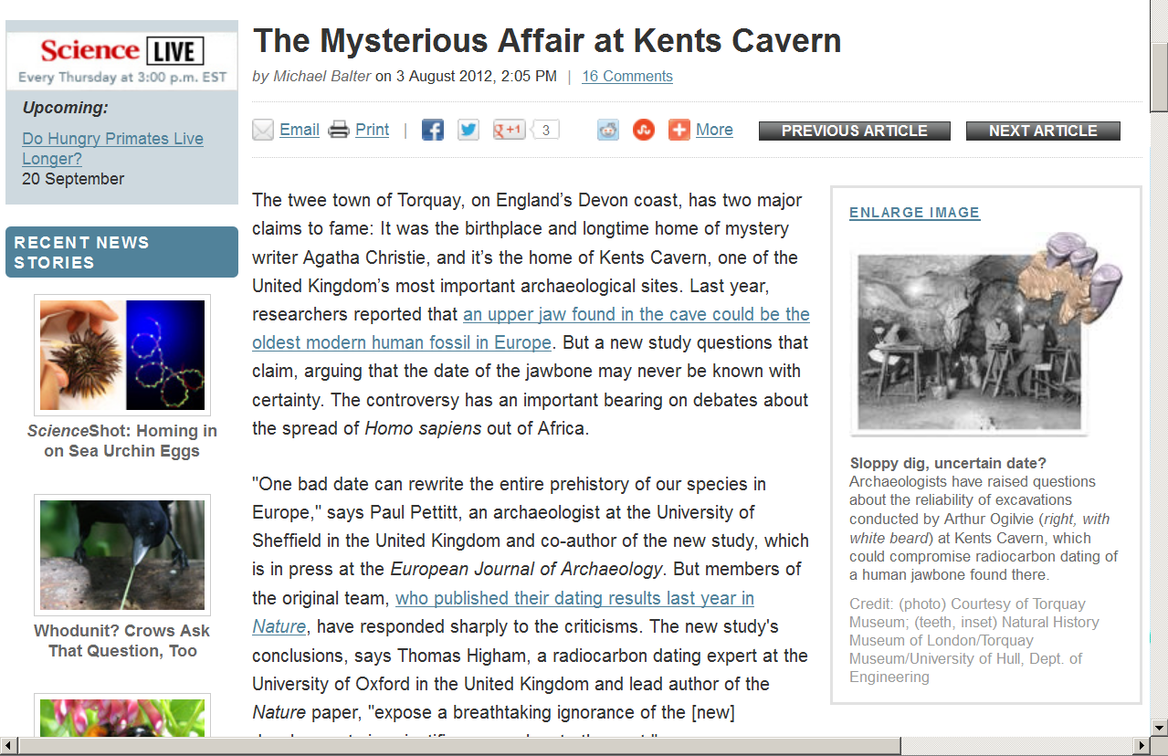
http://news.sciencemag.org/sciencenow/2012/08/the-mysterious-affair-at-kents.html

Slide 63
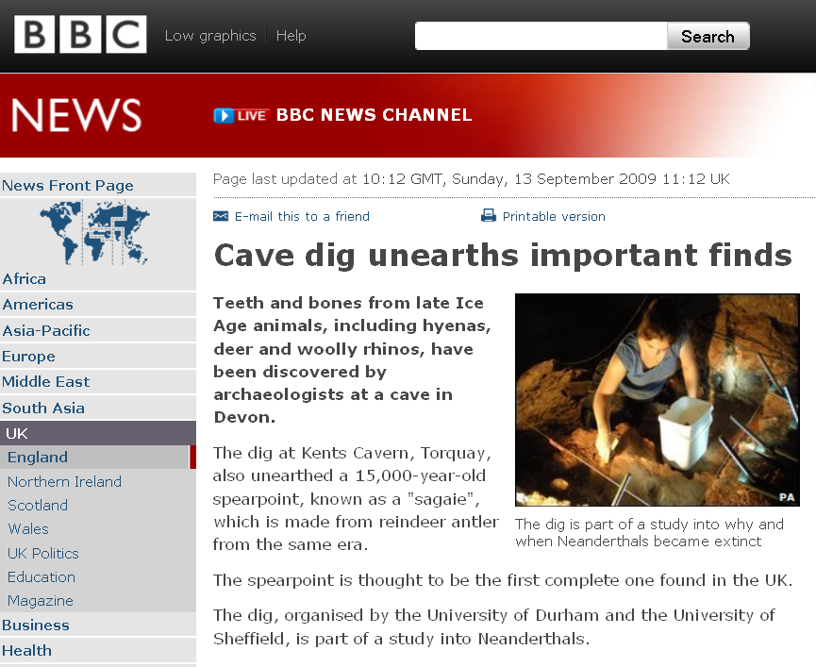
http://news.bbc.co.uk/2/hi/uk_news/england/devon/8253091.stm

Slide 64
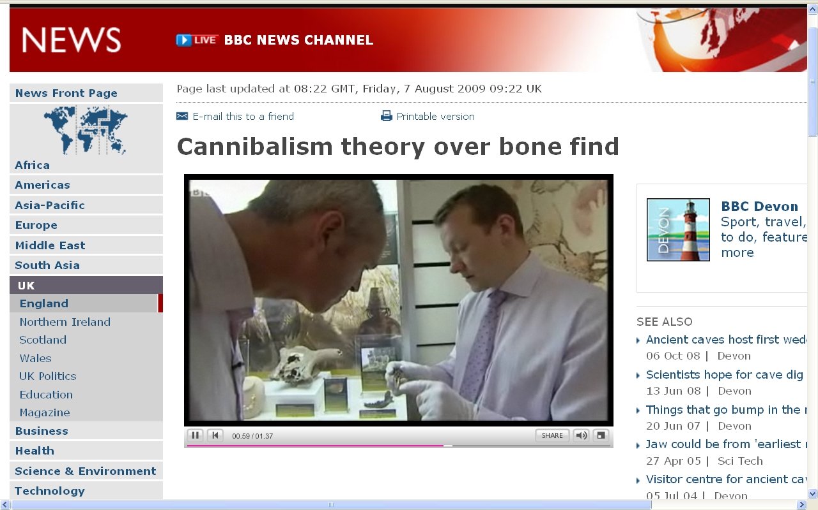
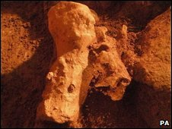
http://news.bbc.co.uk/2/hi/uk_news/england/devon/8188406.stm

Slide 65
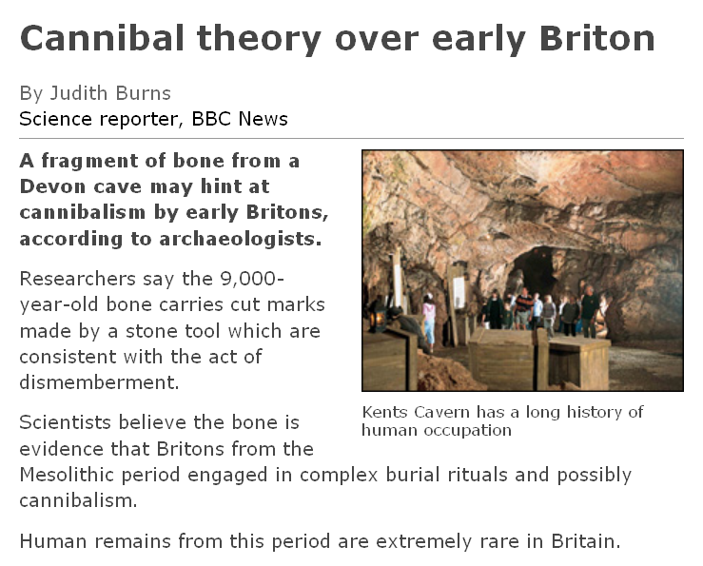
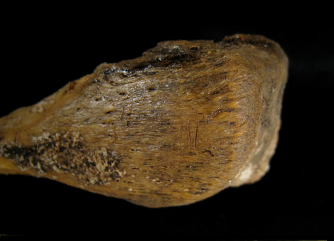
http://news.bbc.co.uk/2/hi/science/nature/8188601.stm

Slide 66
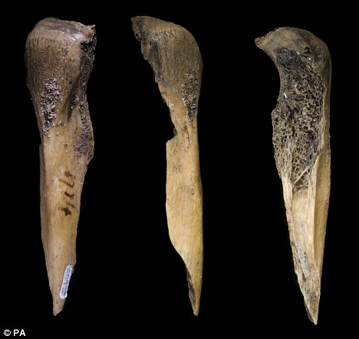
http://news.bbc.co.uk/2/hi/science/nature/8188601.stm

Slide 67
Important People / Works
Isaac de la Peyrère, 1655
John Friedrich Esper, 1771
John Frere, 1790
Philippe-Charles Schmerling, 1830
Father John MacEnery, 1829
Kent’s Cavern, Devonshire
Back to Father MacEnery . . .

Slide 68
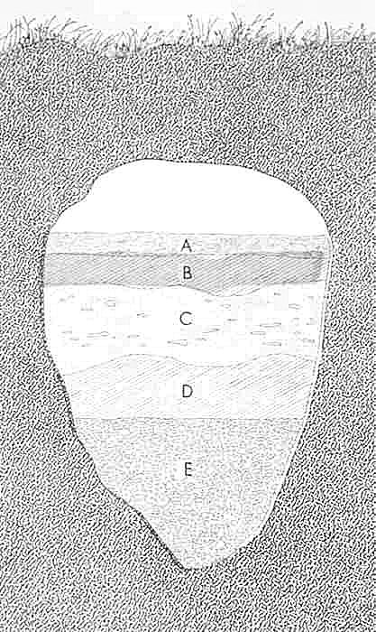
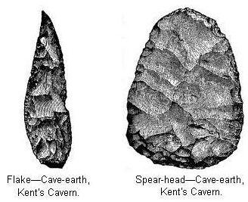
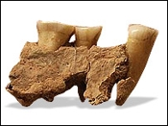
37,000 - 40,000 ybp
BBC News article
Kent’s Cavern (Kent’s Hole)
Torquay, Devonshire, SW England

Slide 69
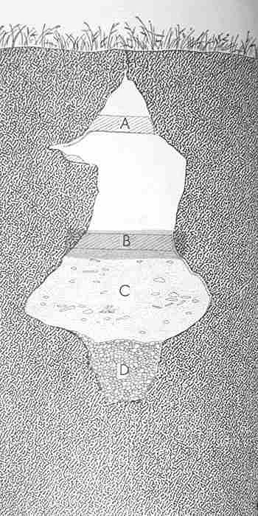
Kent’s Cavern (Kent’s Hole)
Torquay, Devonshire, SW England

Slide 70

Recreation of a human settlement at Kents Cavern, Devon
http://www.infobritain.co.uk/Ancient_Britain_History.htm

Slide 71

This handaxe was found in the lowest deposits in the cave. The damage to the edges suggests that it was moved by natural processes after it was discarded by humans. The same deposit contained remains of a bear, which has been extinct in Britain for 450,000 years.
Kent’s Cavern
Devon, England
500,000 B.C.
http://www.worldtimelines.org.uk/world/british_isles/england/south-west/500000-8500BC/kentscavern

Slide 72
This handaxe was found in the lowest deposits in the cave. The damage to the edges suggests that it was moved by natural processes after it was discarded by humans. The same deposit contained remains of a bear, which has been extinct in Britain for 450,000 years.
Kent’s Cavern
Devon, England
500,000 B.C.
http://www.worldtimelines.org.uk/world/british_isles/england/south-west/500000-8500BC/kentscavern

Slide 73
Important People / Works
Early Discovery of Prehistoric Evidence . . .
thunderstones
hand ax, 1715, Grayes Inn Lane, London
etc.

Slide 74


Slide 75

Hand Ax, 1715
Grayes Inn Lane, London, England

Slide 76

Examples of the Mousterian tool kit,
including (from left to right),
a Levallois point, a perforator, and a side scraper.
Understanding Humans, 10th ed., p. 275

Slide 77

^{Acheulian biface (“hand axe”).}
Understanding Physical Anthropology and Archaeology (9th ed), p. 239

Slide 78

side scraper
point
end scraper
burin
Small tools of the Acheulian Industry.
Understanding Humans, 10th ed., p. 252

Slide 79
Important People / Works
REM:
Early Discovery of Prehistoric Evidence . . .
and the bones associated with the “thunderstones” ???

Slide 80
Important People / Works
Isaac de la Peyrère, 1655
John Friedrich Esper, 1771
John Frere, 1790
Philippe-Charles Schmerling, 1830
Father John MacEnery, 1829
Kent’s Cavern, Devonshire

Slide 81
Important People / Works
Early Discovery of Prehistoric Evidence . . .
what about the stone tools?

Slide 82
Important People / Works
Early Discovery of Prehistoric Evidence . . .
what about the stone tools?

Slide 83
Important People / Works
Early Discovery of Prehistoric Evidence . . .
what about the stone tools?
. . . “thunderstones”

Slide 84

http://www.sciencedaily.com/releases/2010/06/100614101724.htm

Slide 85

cscs.umich.edu/~crshalizi/White/antiquity/thunder.html

Slide 86
Important People / Works
Early Discovery of Prehistoric Evidence . . .
thunderstones
hand ax, 1715, Grayes Inn Lane, London
etc.

Slide 87


Hail fell in many parts of the Northland on Monday afternoon [14 May 2007].
These hailstones, up to about 1 1/4 inch in diameter, fell in downtown Duluth. (Bob King / News Tribune)
www.duluthnewstribune.com/

Slide 88

http://allaboutfrogs.org/weird/general/raining.html
Notes:
88

Slide 89

http://scienceline.org/2006/09/17/physics-cosier-rainingfish/
Notes:
89

Slide 90
Important People / Works
Early Discovery of Prehistoric Evidence . . .
and what about
the bones associated
with the “thunderstones” ???

Slide 91
Important People / Works
Early Discovery of Prehistoric Evidence . . .
and what about
the bones associated
with the “thunderstones” ???
. . . “monsters”

Slide 92
Basic Concepts
. . . genus species variety:
Animalia . . . Homo sapiens sapiens
Animalia . . . Homo monstrosus
Animalia . . . Gorilla gorilla gorilla

Slide 94


Slide 95


Slide 96


Slide 97
Homo monstrosus
Source: De Waal Malefijt, Annemarie. (1968).
"Homo monstrosus," Scientific American, 219:4:112-118.

Slide 98


Slide 99


Slide 100


Slide 101


Slide 102


Slide 103


Slide 104

Cynocephale

Slide 105


Slide 106


Slide 107


Slide 108


Slide 109


Slide 110


Slide 111
Homo monstrosis
How can intelligent, even highly educated people believe in monsters ?

Slide 112
Homo monstrosis
Because everybody knew
they existed !

Slide 114



Slide 115

Sara-kaba woman near Lake Chad

Slide 116

Mursi woman with labret
Omo valley, Ethiopia
http://flickr.com/photos/41622708@N00/3791415577

Slide 117

Mursi woman with labret
Omo valley, Ethiopia
http://www.flickr.com/photos/41622708@N00/3025491072

Slide 118

Mursi woman
Omo valley, Ethiopia
http://www.flickr.com/photos/41622708@N00/3025491072

Slide 119

Mursi woman with labret
Omo valley, Ethiopia
http://flickr.com/photos/41622708@N00/3791415577

Slide 120

Sara-kaba woman near Lake Chad

Slide 122

Koskimo (Kwakiutl) woman

Slide 123

halfmoon.org

Slide 124

Painting by Paul Kane,
showing a Chinookan child in the process of having its head flattened,
and an adult after the process.
http://en.wikipedia.org/wiki/Head_flattening

Slide 125
Homo monstrosis
Because everybody knew
they existed !
And they even saw them at
the “freak shows”

Slide 126

P. T. Barnum
and
“Commodore Nutt”
“Range of Variation”

Slide 127

www.phreeque.com/

Slide 128

Ringling Brothers and Barnum and Bailey “Freak Show”

Slide 129

Saartjie Baartman
1789 - 1815

Slide 130

Saartjie Baartman
1789 - 1815

Slide 131

Saartjie Baartman
1789 - 1815

Slide 132

Saartjie Baartman
1789 - 1815

Slide 133

Saarjite Baartman,
“The Hottentot Venus,”
was brought to Europe from Cape Town, South Africa, in 1810, and was exhibited naked in a cage at Piccadilly, England.
www.emory.edu/ENGLISH/Bahri/Hott.html

Slide 134

http://en.wikipedia.org/wiki/Saartjie_Baartman

Slide 135
She died on 29 December 1815
Her skeleton, preserved genitals and brain were placed
on display in Paris' Musée de l'Homme until 1974.
Her remains were repatriated to her homeland, the Gamtoos Valley, on 6 May 2002 and she was
finally laid to rest on 9 August 2002
on Vergaderingskop, a hill in the town of Hankey
over 200 years after her birth.
Saartjie Baartman
1789 - 1815
http://en.wikipedia.org/wiki/Saartjie_Baartman

Slide 136
She died on 29 December 1815
Her skeleton, preserved genitals and brain were placed
on display in Paris' Musée de l'Homme until 1974.
Her remains were repatriated to her homeland, the Gamtoos Valley, on 6 May 2002 and she was
finally laid to rest on 9 August 2002
on Vergaderingskop, a hill in the town of Hankey
over 200 years after her birth.
Saartjie Baartman
1789 - 1815
http://en.wikipedia.org/wiki/Saartjie_Baartman

Slide 137

6 May 2002
Saartjie Baartman
1789 - 1815

Slide 138

6 May 2002
http://news.bbc.co.uk/1/hi/world/europe/1957240.stm

Slide 139
6 May 2002
http://www.judyshopsthemall.com/2009/08/bodies-the-exhibition-walks-into-controversial-debut-at-mall-of-america/

Slide 140
August 2009
http://www.judyshopsthemall.com/2009/08/bodies-the-exhibition-walks-into-controversial-debut-at-mall-of-america/

Slide 141

BODIES Exhibit
in Paris
an at
The Mall of America
August 2009
http://www.judyshopsthemall.com/2009/08/bodies-the-exhibition-walks-into-controversial-debut-at-mall-of-america/

Slide 142

http://news.bbc.co.uk/2/hi/uk_news/scotland/edinburgh_and_east/7492386.stm
Notes:
142

Slide 143

“It all amounts to a 21st Century version of a circus freak show; no one is supposed to watch junk like that but everyone does.”
www.duluthsuperior.com/mld/duluthsuperior/news/editorial/15397954.htmhttp://www.duluthsuperior.com/mld/duluthsuperior/news/editorial/15397954.htm

Slide 144
Important People / Works
Jonathan Swift
(1667 - 1745)
Gulliver’s Travels
1726

Slide 145

1726
http://en.wikipedia.org/wiki/Gulliver%27s_travels

Slide 146

http://en.wikipedia.org/wiki/Jonathan_swift

Slide 147


Slide 148









Slide 149
meanwhile images
of the colonial people
continue to set the
mental picture
of peoples from
around the world
http://www.andaman.org/BOOK/chapter52/5-Tasmania-traditional/traditional.htm

Slide 150
meanwhile images
of the colonial people
continue to set the
mental picture
of peoples from
around the world
For example,
The Baudin expedition
to Australia
1800 to 1803
http://www.andaman.org/BOOK/chapter52/5-Tasmania-traditional/traditional.htm

Slide 151

For example,
http://en.wikipedia.org/wiki/Baudin_expedition_to_Australia

Slide 152
meanwhile images
of the colonial people
continue to set the
mental picture
of peoples from
around the world
For example,
The Baudin expedition
to Australia
1800 to 1803
http://www.andaman.org/BOOK/chapter52/5-Tasmania-traditional/traditional.htm

Slide 153

The Baudin expedition
to Australia
1800 to 1803
Portrait of
Bara-Ourou
Artist: Nicolas-Martin Petit
http://www.andaman.org/BOOK/chapter52/5-Tasmania-traditional/traditional.htm

Slide 154

The Baudin expedition
to Australia
1800 to 1803
http://www.andaman.org/BOOK/chapter52/5-Tasmania-traditional/traditional.htm

Slide 155

The Baudin expedition
to Australia
1800 to 1803
Norou-Gal-Derri advancing for combat
François Péron
1802
http://nishi.slv.vic.gov.au/latrobejournal/issue/latrobe-41/fig-latrobe-41-021b.html

Slide 156

http://en.wikipedia.org/wiki/Trucanini

Slide 157
And there were many others. . . .

Slide 158
REM? Major problems in the “Pre – Scientific” Period
Humans were thought to have had ancient origins corresponding to the time of the creation of the earth
Earth was thought of as a Young Place

Slide 159
Important People / Works
James Hutton
(1726 - 1797)
Theory of the Earth
1775
first demonstrated the immense antiquity of the earth

Slide 160

James Hutton
(1726 - 1797)

Slide 161
Glossary
“deep time”
The theory that the earth is billions of years old and thus has a long history of development and change

Slide 162

Charles Lyell (1797 - 1875)

Slide 163
Important People / Works
Charles Lyell (1797 - 1875)
Principles of Geology
1830
~
“Uniformitarianism”

Slide 164
Important People / Works
Charles Lyell (1797 - 1875)
Principles of Geology
1830
~
“Uniformitarianism”

Slide 165

The explosion had the power of 500 atomic bombs and was the largest of its kind in recorded US history
Mount St Helens erupted at 0832 on 18 May 1980, sending a plume of ash 15 miles (24 km) into the sky . . .
http://news.bbc.co.uk/onthisday/hi/dates/stories/may/19/newsid_2511000/2511133.stm

Slide 166

River of fire: Lava streams from the Hawaiian volcano Kilauea in 1959
http://www.bbc.co.uk/sn/tvradio/programmes/supervolcano/article2.shtml

Slide 167


On Boxing Day 2004, a powerful earthquake off the Indonesian coast triggered a tsunami that reached the shores of three continents leading to the deaths of more than 200,000 people
http://news.bbc.co.uk/2/hi/in_depth/world/2004/asia_quake_disaster/default.stm
http://news.bbc.co.uk/2/hi/science/nature/4381395.stm

Slide 168

tsunamis
http://weir.vsb.bc.ca/library/disasters.html

Slide 169

http://news.bbc.co.uk/2/hi/in_pictures/4802458.stm

Slide 170

http://news.bbc.co.uk/2/hi/in_depth/2059330.stm

Slide 171

http://news.bbc.co.uk/2/hi/uk_news/wales/6356073.stm

Slide 172


http://news.bbc.co.uk/2/hi/uk_news/england/humber/6411975.stm

Slide 173


www.sinkholeinfo.com/

Slide 174

www.physorg.com/news109738331.html

Slide 175


Stanford University biologist Terry Root says that in a hundred years or so rising ocean waters from global warming may kill the last remaining wetlands in Palo Alto, Calif., behind her Sept. 6, 2007. (AP Photo/Paul Sakuma)
http://news.yahoo.com/s/ap/20070922/ap_on_sc/rising_seas

Slide 176

http://news.bbc.co.uk/2/hi/science/nature/5324984.stm

Slide 177

www.bbc.co.uk/weather/features/understanding/hurricane_season.shtml

Slide 178


http://news.bbc.co.uk/2/hi/in_pictures/6981388.stm

Slide 179


Slide 180


Slide 181
Glossary
uniformitarianism
The theory that the earth’s features are the result of long-term processes that continue to operate in the present as they did in the past
elaborated on by Lyell, this theory opposed catastrophism and provided for immense geological time

Slide 182


10th ed., p. 25
Understanding Humans, 10th ed., p. 25

Slide 183
Jacques Boucher de Perthes
Jacques Boucher de Crèvecœur de Perthes
http://en.wikipedia.org/wiki/Jacques_Boucher_de_Perthes

Slide 184
Jacques Boucher de Perthes
Jacques Boucher de Crèvecœur de Perthes
http://en.wikipedia.org/wiki/Jacques_Boucher_de_Perthes

Slide 185

Jacques Boucher de Perthes
http://en.wikipedia.org/wiki/Jacques_Boucher_de_Perthes

Slide 186
Important People / Works
Jacques Boucher de Crèvecœur de Perthes in 1838 - 1839:
“Chipped stone tools are human artifacts.”

Slide 187
Important People / Works
Jacques Boucher de Crèvecœur de Perthes in 1838 - 1839:
“And the tools may be as old as a million years.”

Slide 188
Prehistoric Cultures
Continue on to Set #05
History of Thought: Darwin and Wallace

Slide 189

Added to
pc5
f2008
www.cnn.com/2008/WORLD/europe/09/15/uk.church.darwin.apology.ap/index.html
Notes:
189

