Slide 1
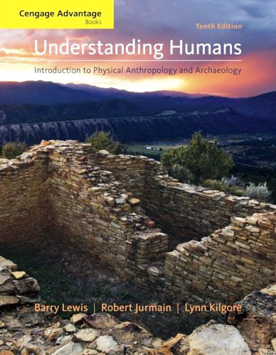
Major Characteristics of Modern Physical Anthropology
#7

Slide 2
Modern Physical Anthropology
Work on effects of culture as it influences human breeding patterns

Slide 3
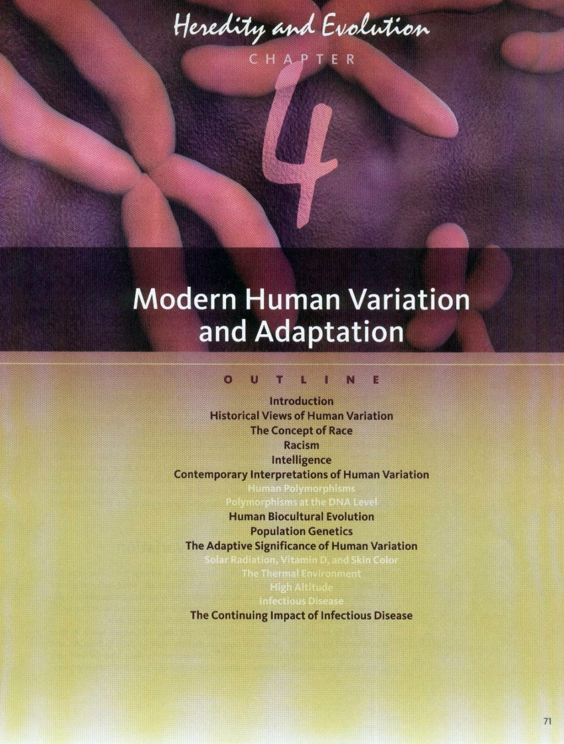

Slide 4
Modern Physical Anthropology
“nature” – biology
(inherited)
“nurture” – culture
(learned)

Slide 5
Modern Physical Anthropology
Culture and Biology
cross-cousin marriage

Slide 6
Culture and Biology
Marriage patterns
cross-cousin marriage

Slide 7
Culture and Biology
Marriage patterns
cross-cousin marriage
occurs in ca. 4/5 “cultures of the world”
(77.4%)
HRAF
Human Relations Area Files
World Ethnographic Atlas

Slide 8
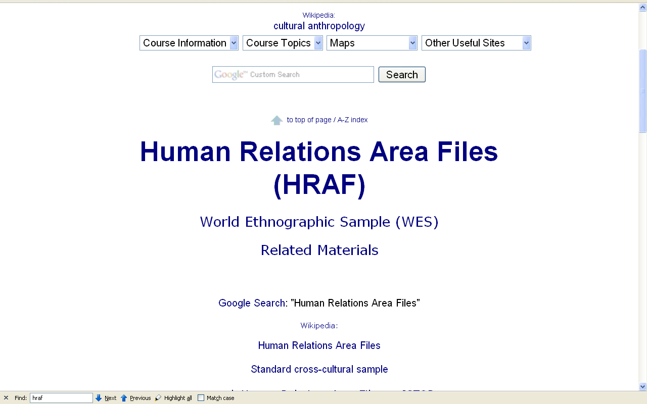

Slide 9
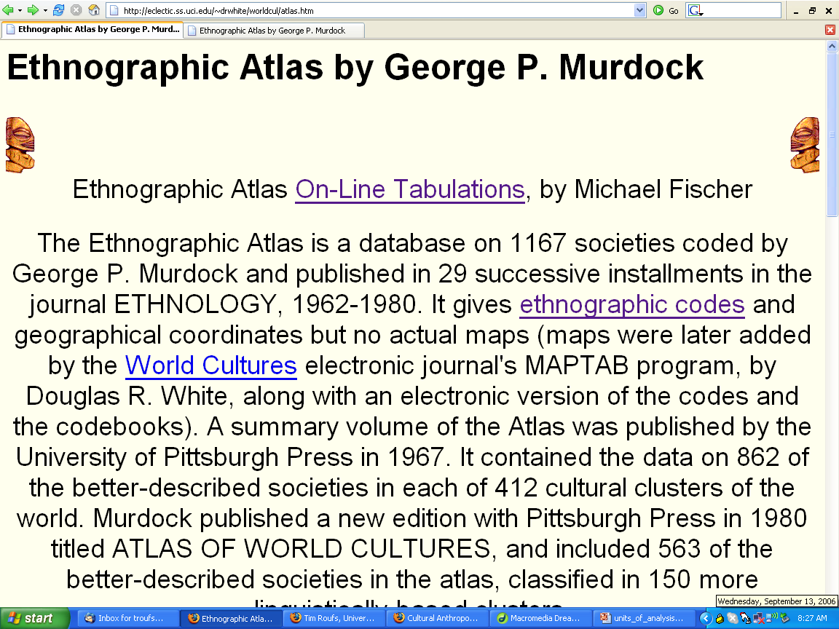
http://eclectic.ss.uci.edu/~drwhite/worldcul/atlas.htm

Slide 10
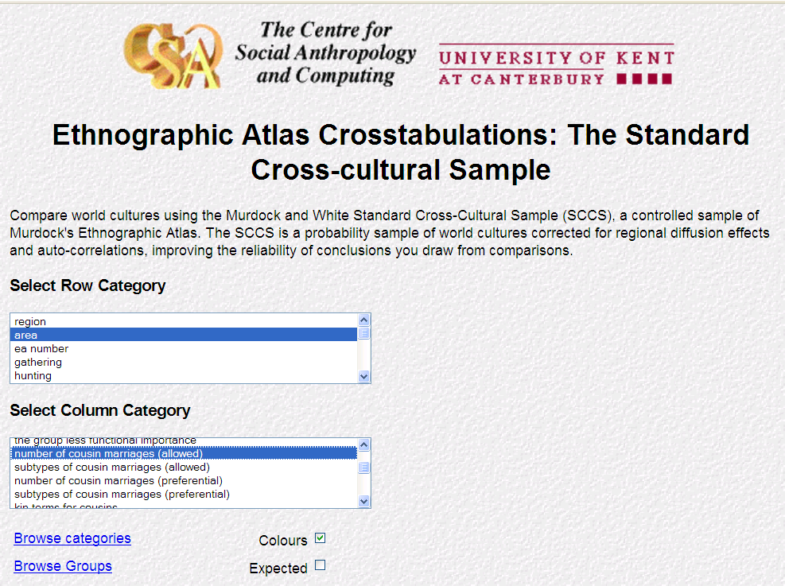
lucy.ukc.ac.uk/cgi-bin/uncgi/Ethnoatlas/atlas.vopts

Slide 11
lucy.ukc.ac.uk/cgi-bin/uncgi/Ethnoatlas/atlas.vopts

Slide 12
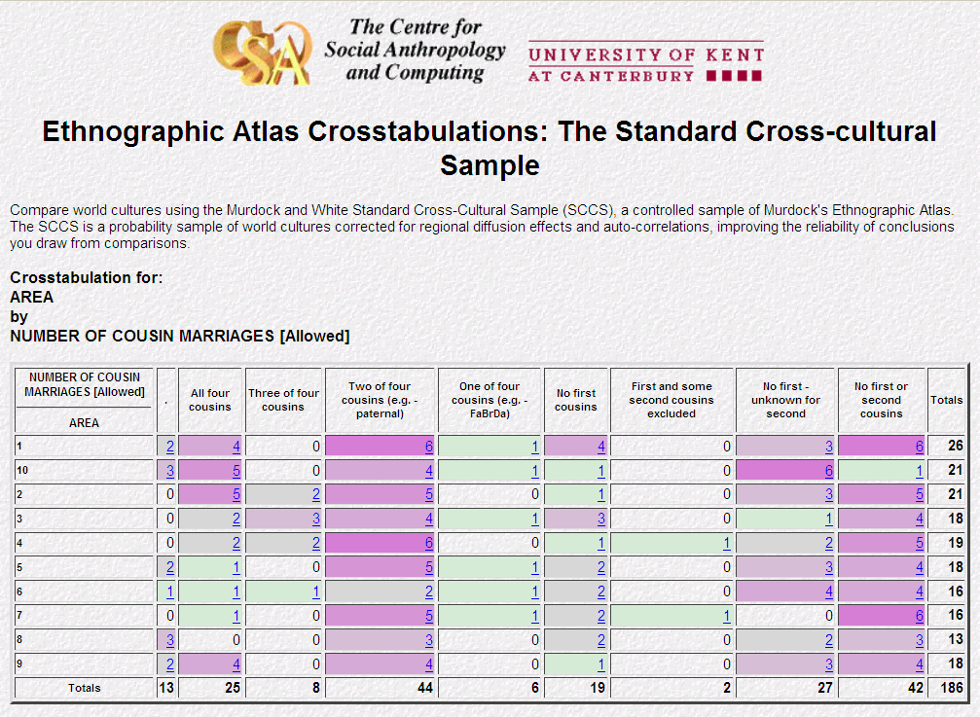
42/ 186 = 22.6%
do not allow 1st or 2nd cousin marriage
144/ 186 = 77.4%
do allow 1st or 2nd cousin marriage
lucy.ukc.ac.uk/cgi-bin/uncgi/Ethnoatlas/atlas.vopts

Slide 13
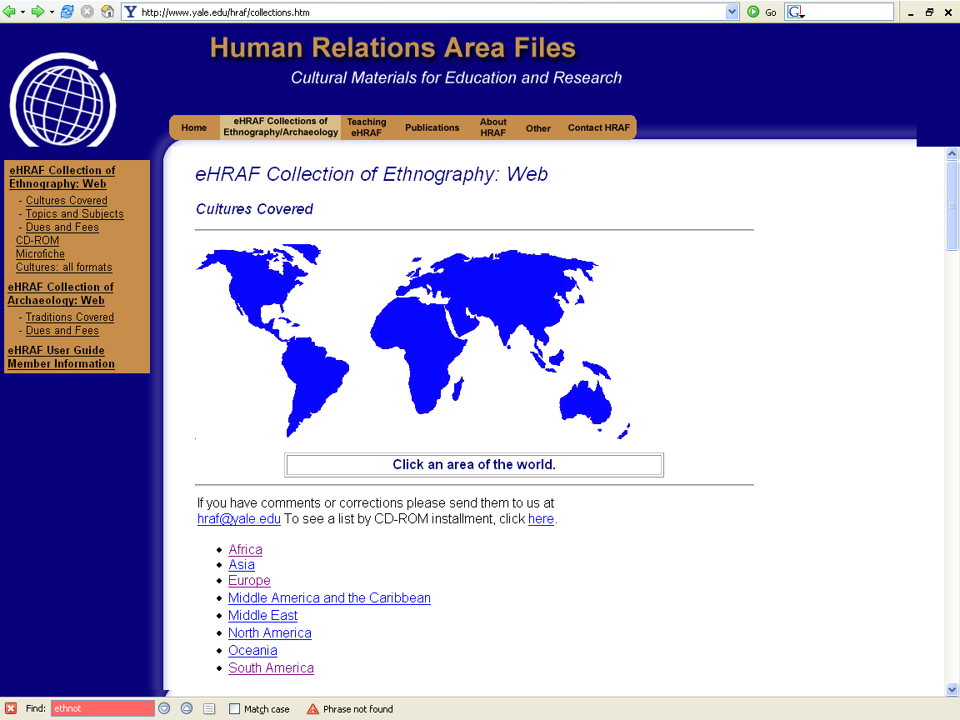
http://www.yale.edu/hraf/collections.htm

Slide 14
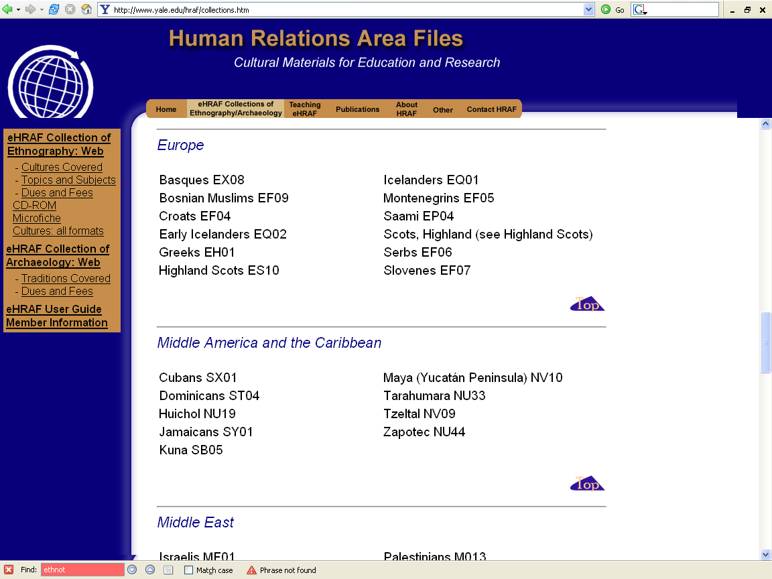
http://www.yale.edu/hraf/collections.htm

Slide 15
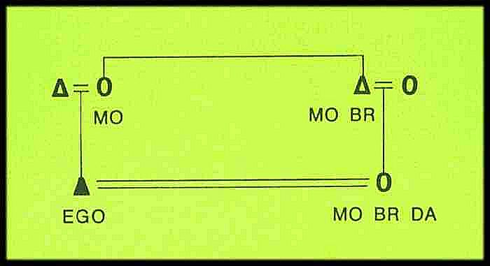

Slide 16
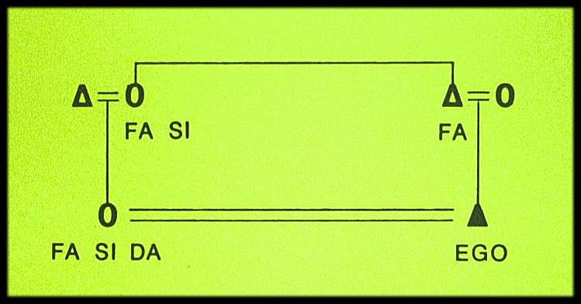

Slide 17
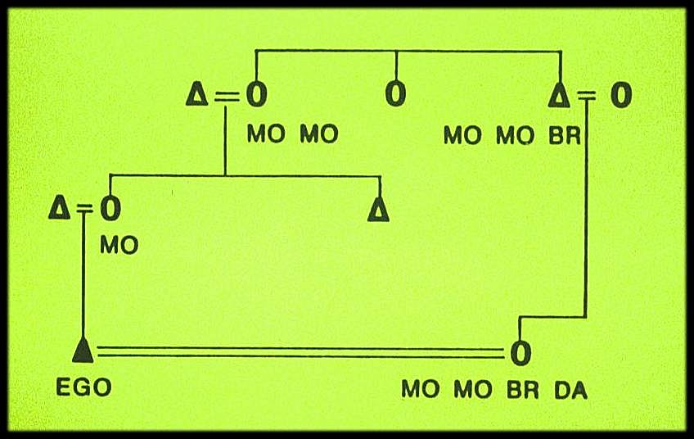

Slide 18
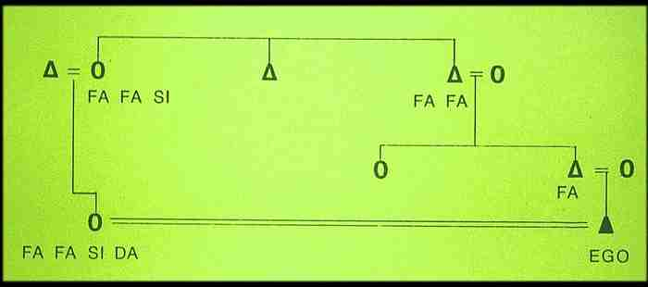

Slide 19
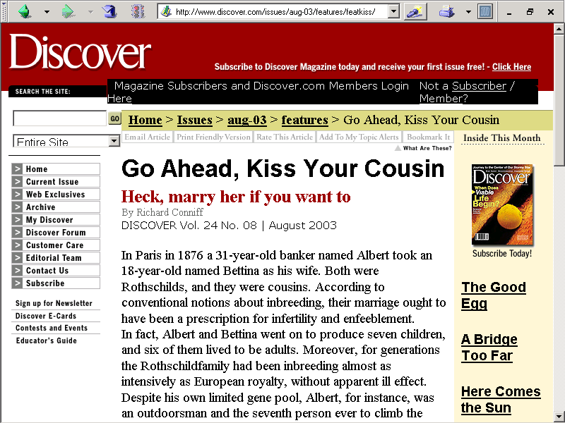
http://www.discover.com/issues/aug-03/features/featkiss/

Slide 20
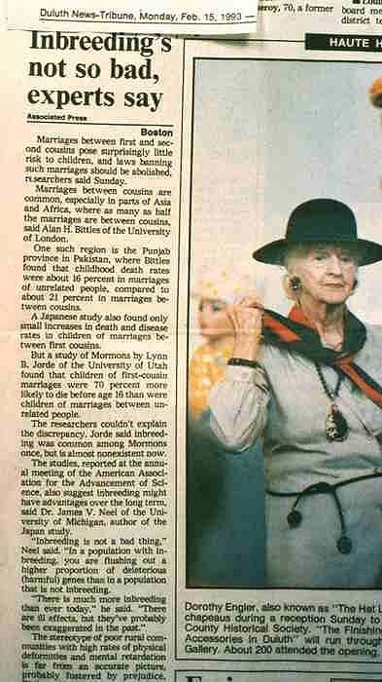

Slide 21
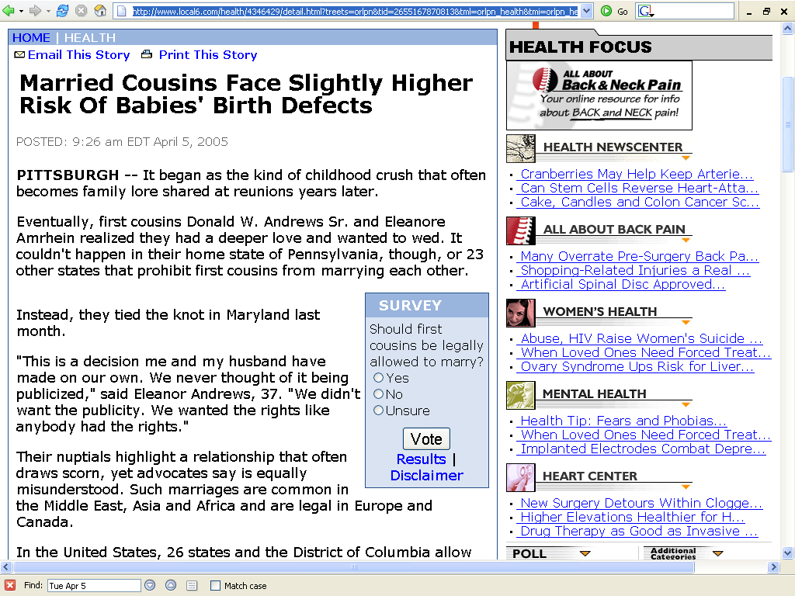
www.local6.com/health/4346429/detail.html?treets=orlpn&tid=2655167870813&tml=orlpn_health&tmi=orlpn_health_1_11150104052005&ts=H

Slide 22
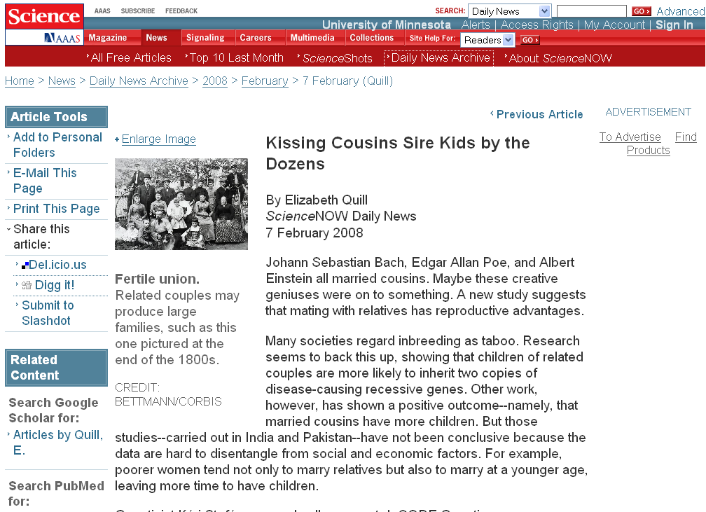
http://sciencenow.sciencemag.org/cgi/content/full/2008/207/2
Notes:
22

Slide 23
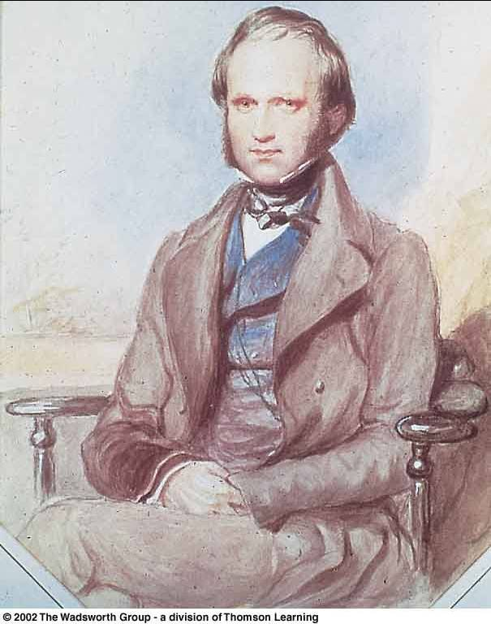
In 1839 Charles Darwin married his first cousin, Emma Wedgwood
Daughter of the younger Josiah Wedgwood, son of the Josiah Wedgwood who founded the pottery works
Darwin's mother Susannah was the sister of his wife’s father

Slide 24
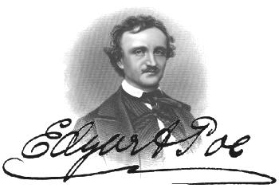
In 1835 Edgar Allan Poe married his widowed aunt’s daughter, Virginia Eliza Clemm
Virginia was 13 years old

Slide 25
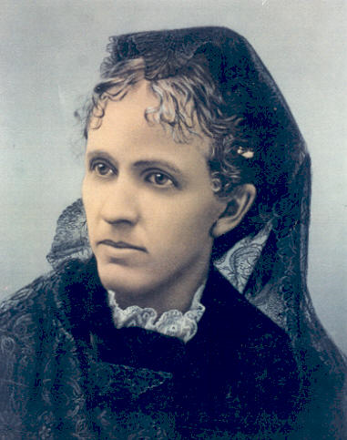
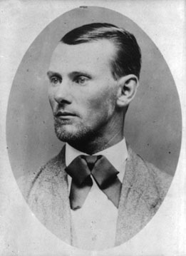
Jesse James married his first cousin
Zerelda "Zee" Mimms, named for his own mother
Zerelda "Zee" Mimms
“cousin of Jesse James and commonly accepted by historians as his wife”

Slide 26
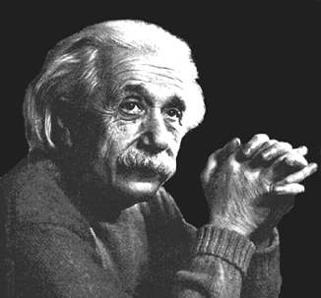
In 1919 Einstein married
his second cousin, his second wife,
Elsa Lowenthal

Slide 27
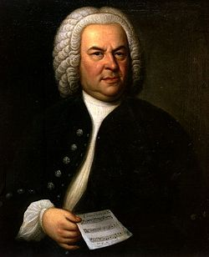
Johann Sebastian Bach
(1685-1750)
married his second cousin
Maria Barbara Bach
(1685-1750)
the daughter of Johann Michael Bach
http://news.bbc.co.uk/2/hi/americas/6057004.stm

Slide 28
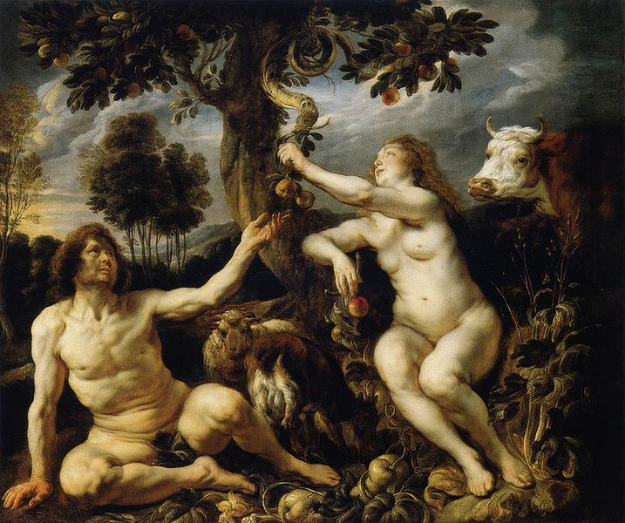
Adam and Eve’s Grandchildren
http://commons.wikimedia.org/wiki/File:Jordaens_Fall_of_man.jpg

Slide 29
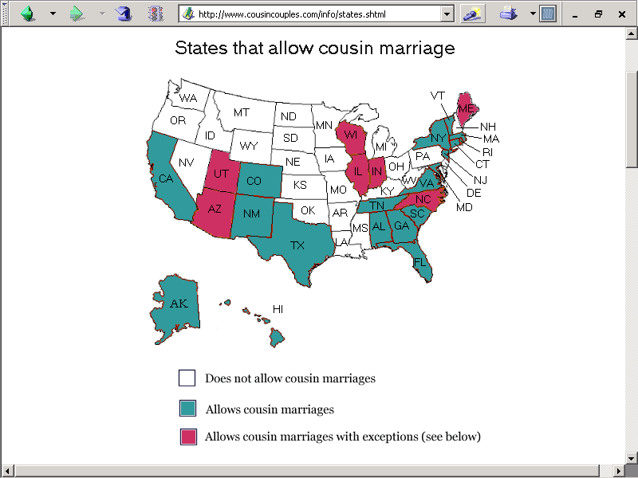
http://www.cousincouples.com/info/states.shtml

Slide 30
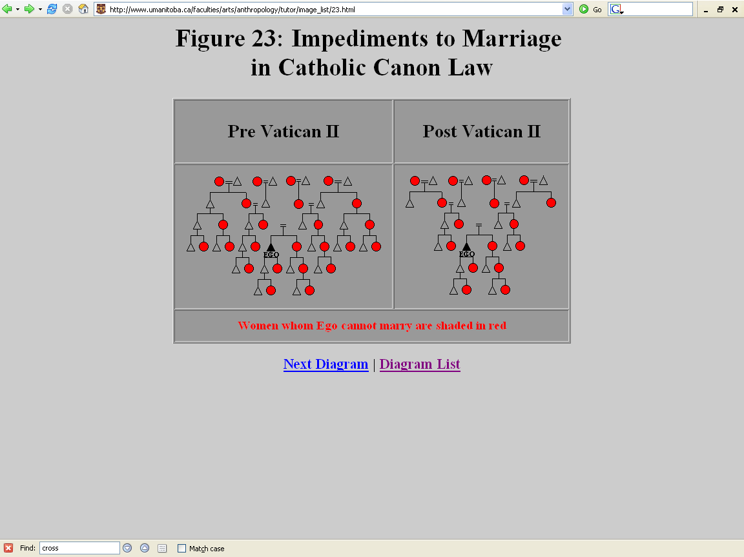
The Second Ecumenical Council of the Vatican, or Vatican II, was an Ecumenical Council of the Roman Catholic Church opened under Pope John XXIII in 1962 and closed under Pope Paul VI in 1965.
http://www.umanitoba.ca/faculties/arts/anthropology/tutor/image_list/23.html

Slide 31
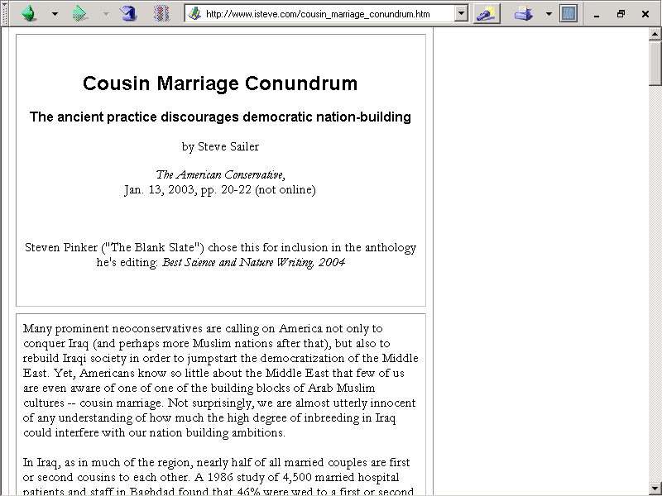
http://www.isteve.com/cousin_marriage_conundrum.htm

Slide 32
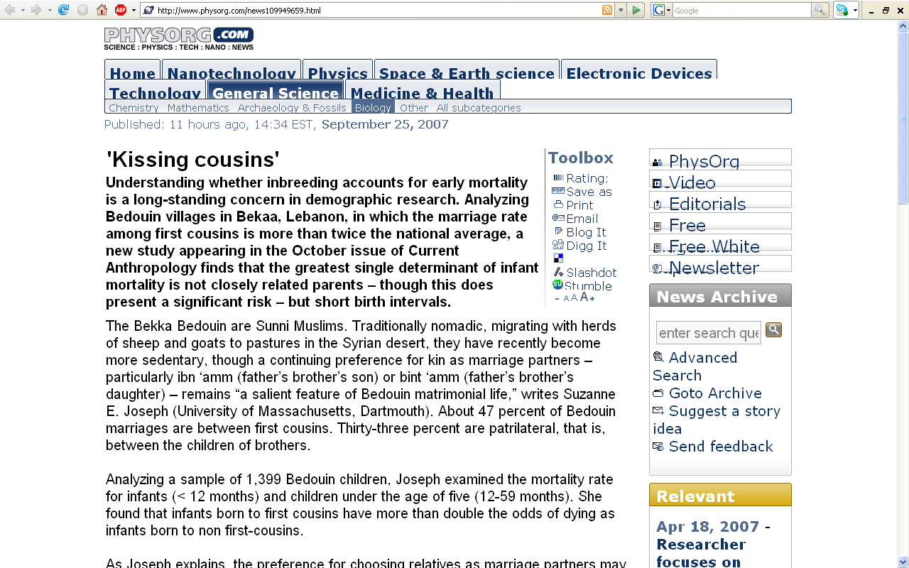
http://www.physorg.com/news109949659.html

Slide 33
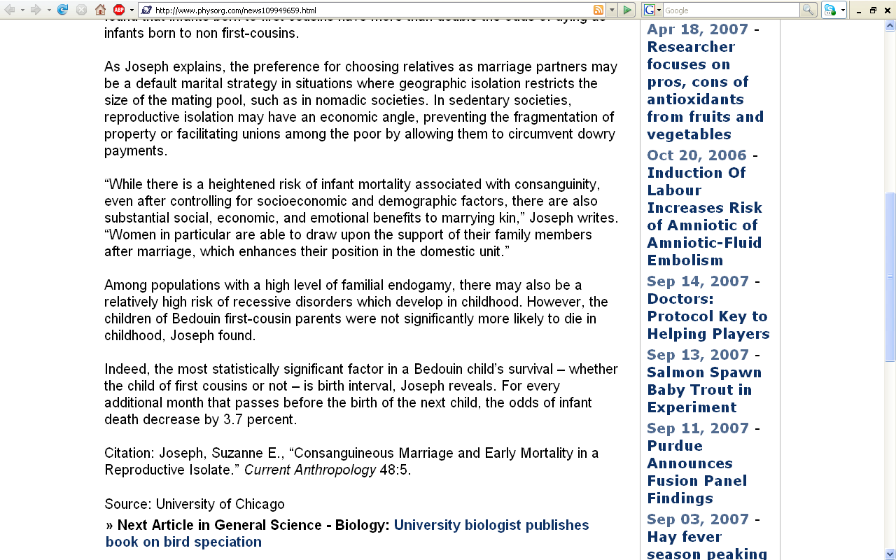
http://www.physorg.com/news109949659.html

Slide 34
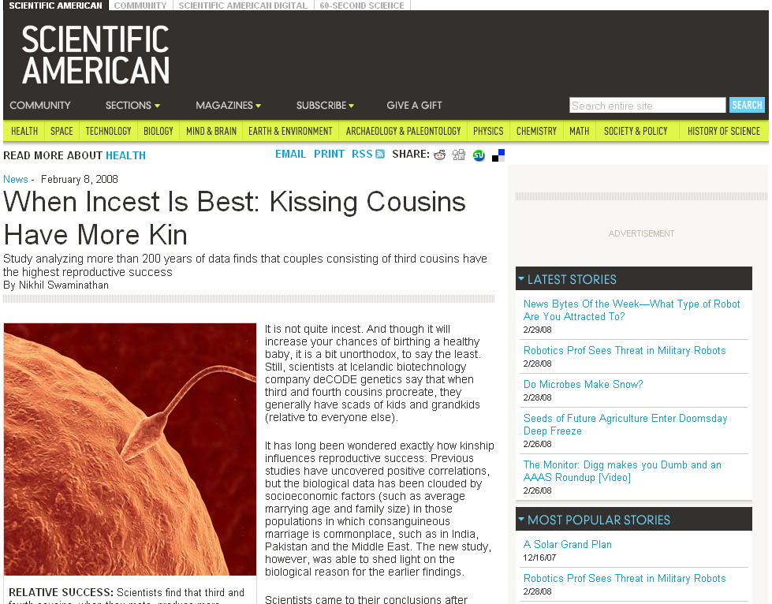
www.sciam.com/article.cfm?id=when-incest-is-best-kissi
Notes:
34

Slide 35
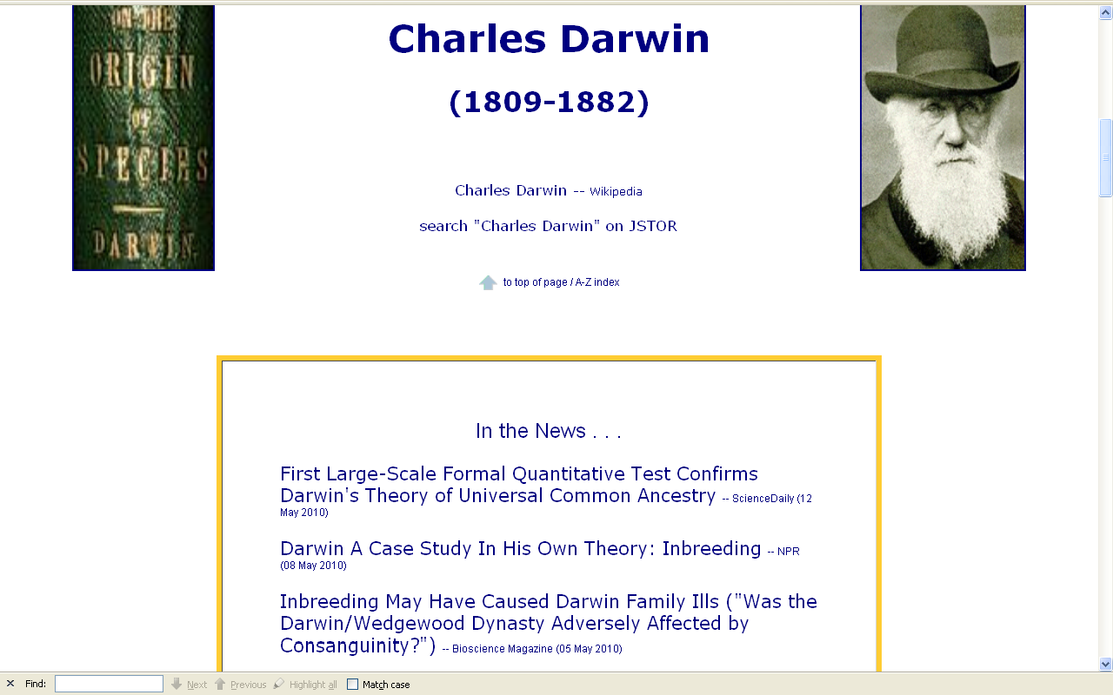
http://www.d.umn.edu/cla/faculty/troufs/anth1602/pcdarwin.html#title

Slide 36
In 1839 Charles Darwin married his first cousin, Emma Wedgwood
Daughter of the younger Josiah Wedgwood, son of the Josiah Wedgwood who founded the pottery works
Darwin's mother Susannah was the sister of his wife’s father

Slide 37
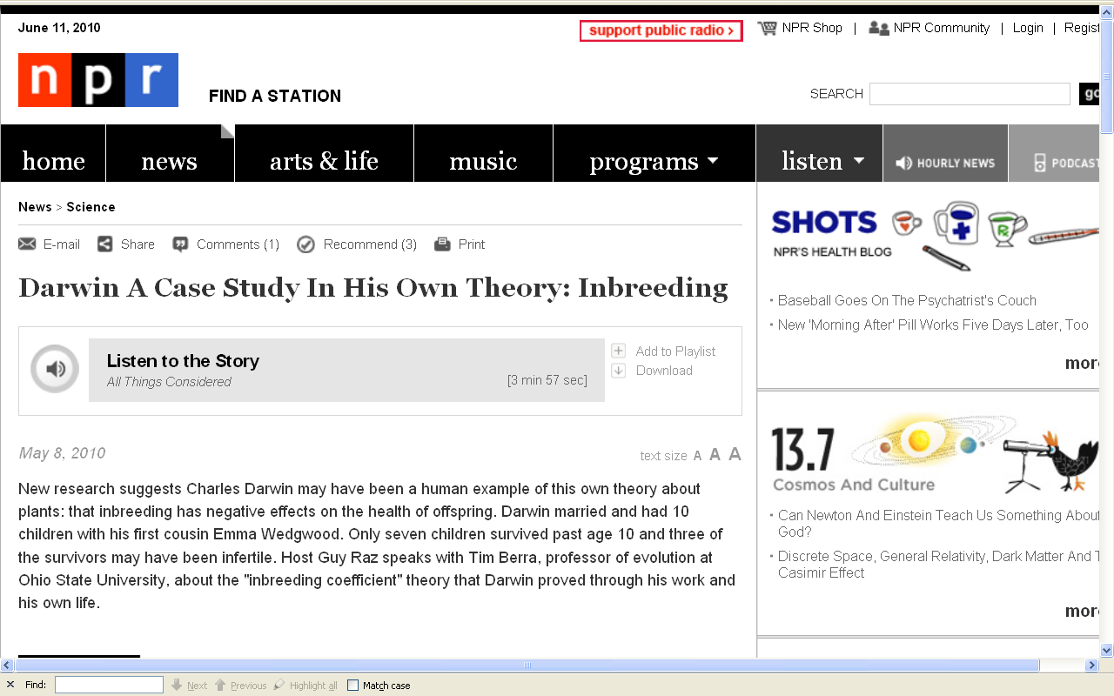
http://www.npr.org/templates/story/story.php?storyId=126637625

Slide 38
http://www.local6.com/health/4346429/detail.html?treets=orlpn&tid=2655167870813&tml=orlpn_health&tmi=orlpn_health_1_11150104052005&ts=H

Slide 39
http://www.isteve.com/cousin_marriage_conundrum.htm
Notes:
39

Slide 40
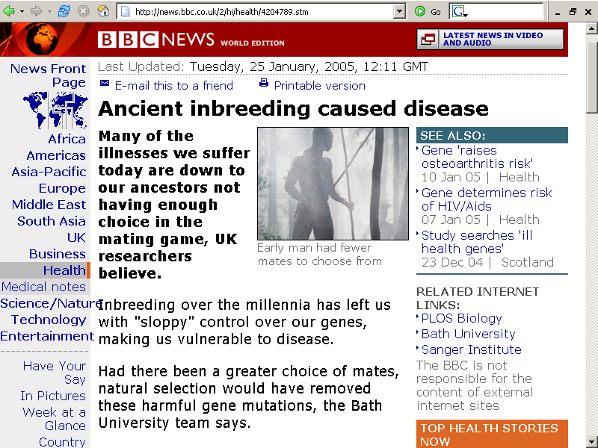
http://news.bbc.co.uk/2/hi/health/4204789.stm

Slide 41
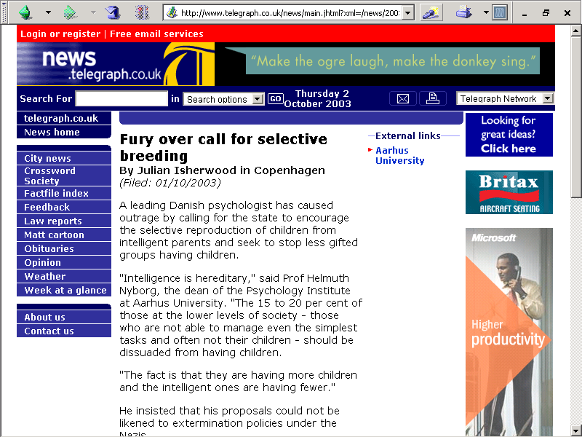

Slide 42
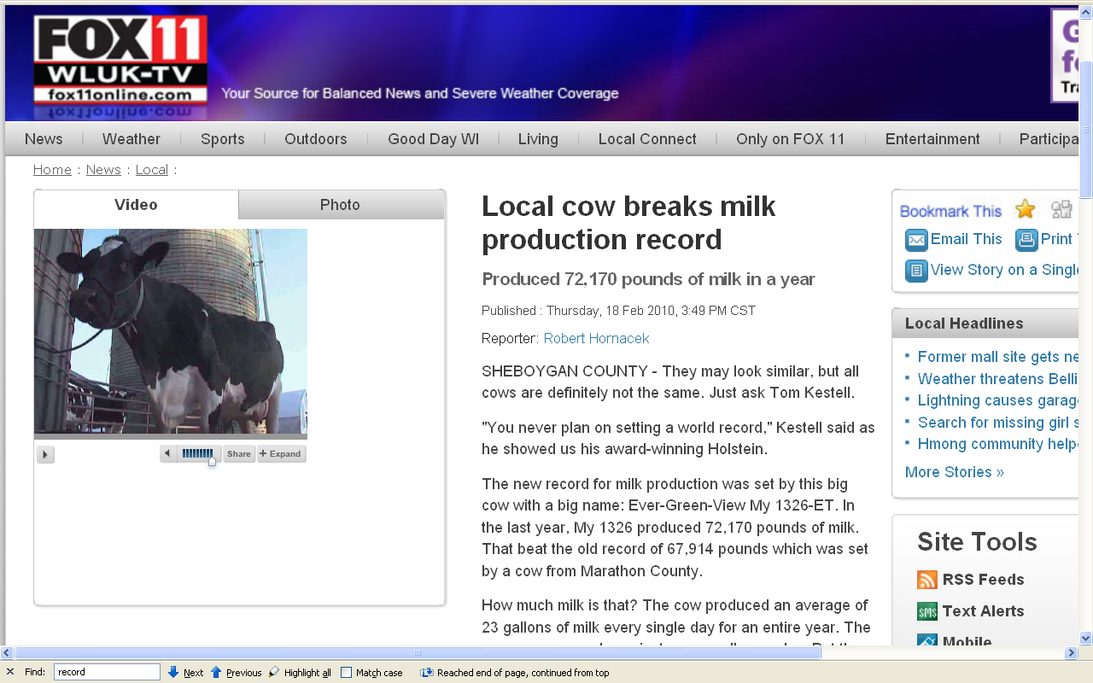
http://www.fox11online.com/dpp/news/local/thomas-kestell-cow-breaks-holstein-milk-production-record

Slide 43
Modern Physical Anthropology
Culture and Biology
marriage patterns
cross-cousin marriage
polygamy

Slide 44
Modern Physical Anthropology
Culture and Biology
marriage patterns
cross-cousin marriage
polygamy
polygyny
plural marriage in which several women share a husband
(i.e., “A man has more than one wife.”)

Slide 45

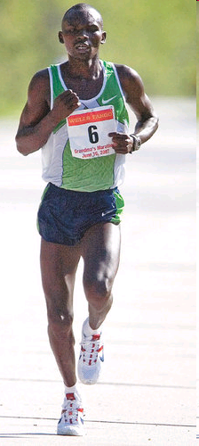
Grandma's Marathon: Remembering a fallen champion
Kevin Pates Duluth News Tribune Published Sunday, June 15, 2008
There will be a moment of silence before the start of Saturday’s 32nd Grandma’s Marathon.
Standing on North Shore Drive, just south of Two Harbors, Stephen Muturi will gather his thoughts and emotions before the day’s task of running 26.2 miles.
He’ll remember close friend and countryman Wesly Ngetich, last year’s champion, who was killed Jan. 21 at Emarti village in Kenya’s Trans Mara district. Ngetich was caught in the middle of an incident that turned violent. He was 31 and had two wives and three children, ages 8, 6 and 1. “Wesly was a peacemaker. . . .”
www.duluthnewstribune.com/articles/index.cfm?id=68557
Notes:
45

Slide 46
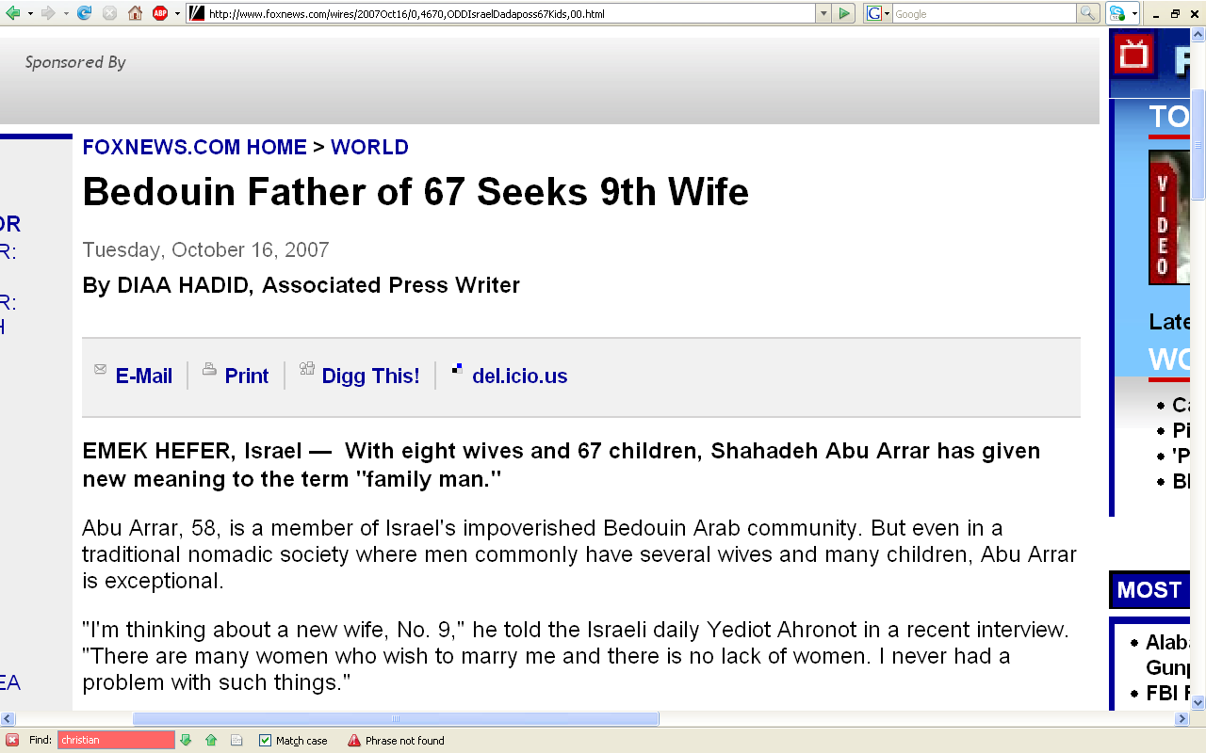
http://www.foxnews.com/wires/2007Oct16/0,4670,ODDIsraelDadaposs67Kids,00.html

Slide 47
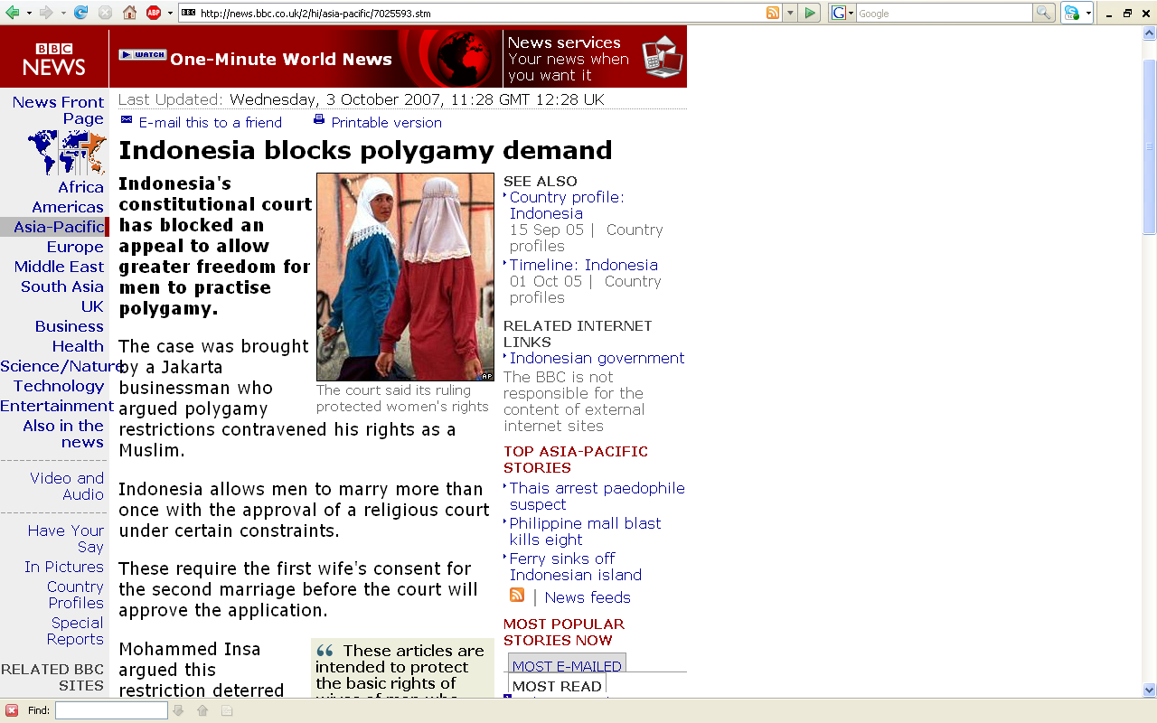
http://news.bbc.co.uk/2/hi/asia-pacific/7025593.stm

Slide 48
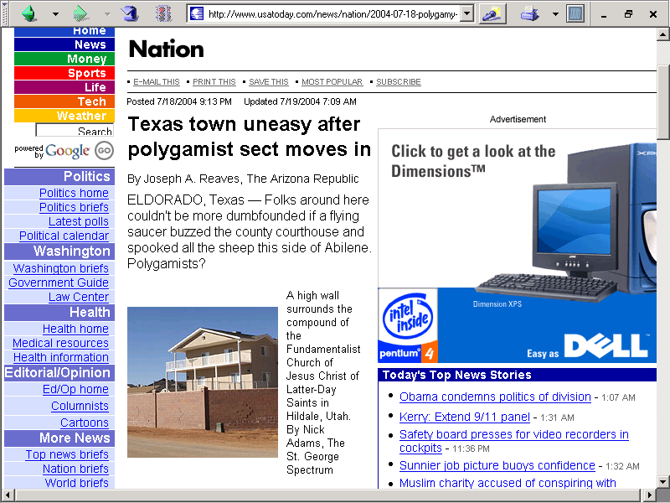
http://www.usatoday.com/news/nation/2004-07-18-polygamy-usat_x.htm

Slide 49
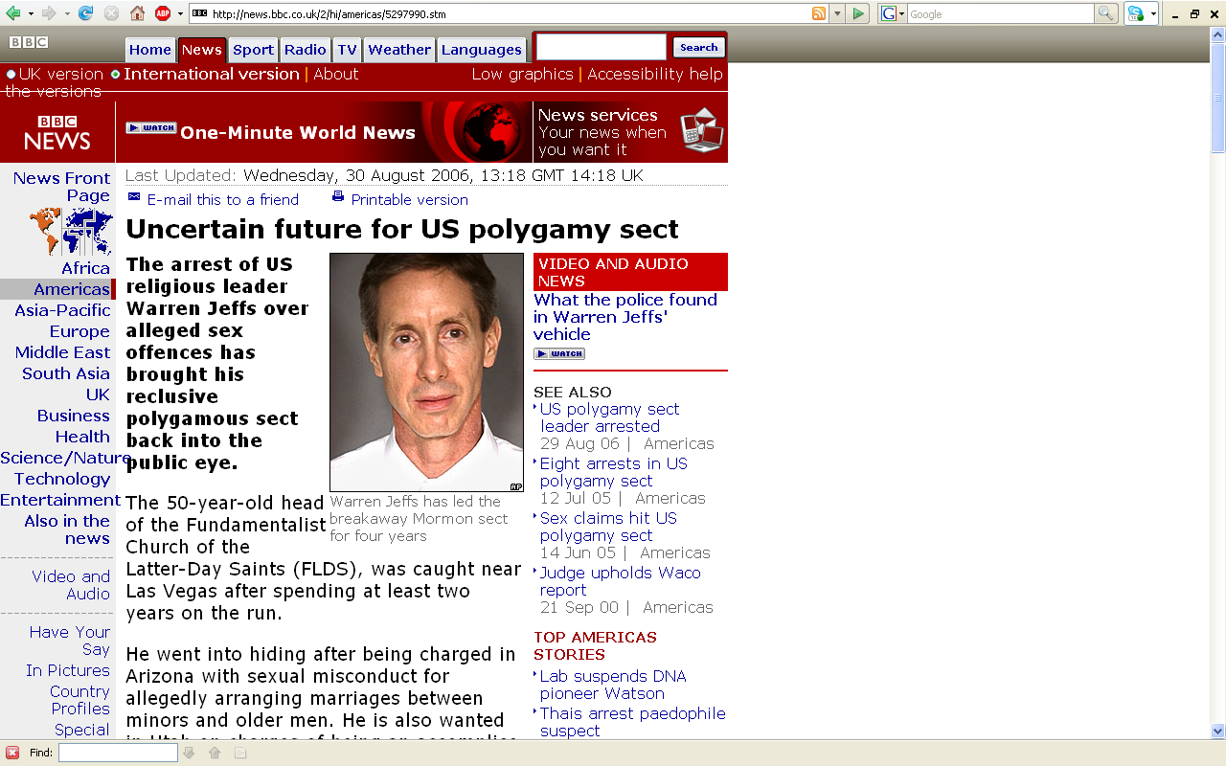
http://news.bbc.co.uk/2/hi/americas/5297990.stm

Slide 50
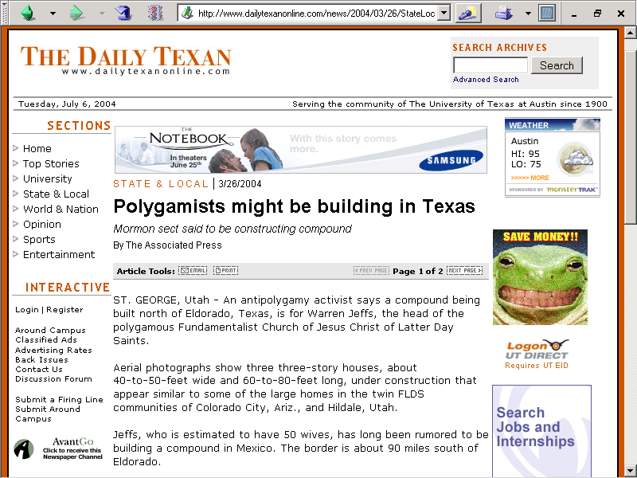
http://www.dailytexanonline.com/news/2004/03/26/StateLocal/Polygamists.Might.Be.Building.In.Texas-642621.shtml
Notes:
50

Slide 51
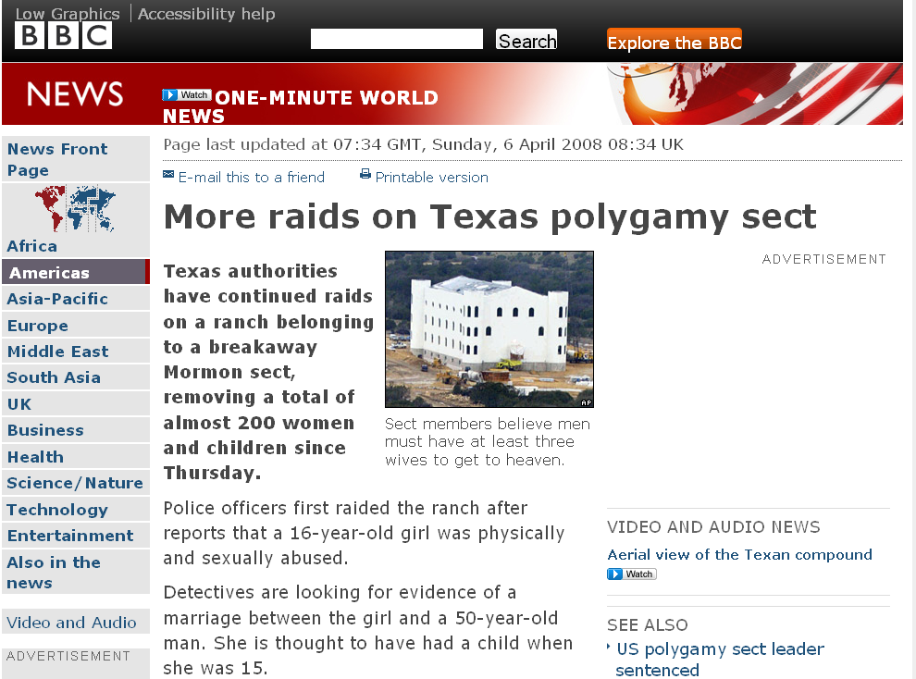
http://news.bbc.co.uk/2/hi/americas/7333004.stm
Notes:
51

Slide 52
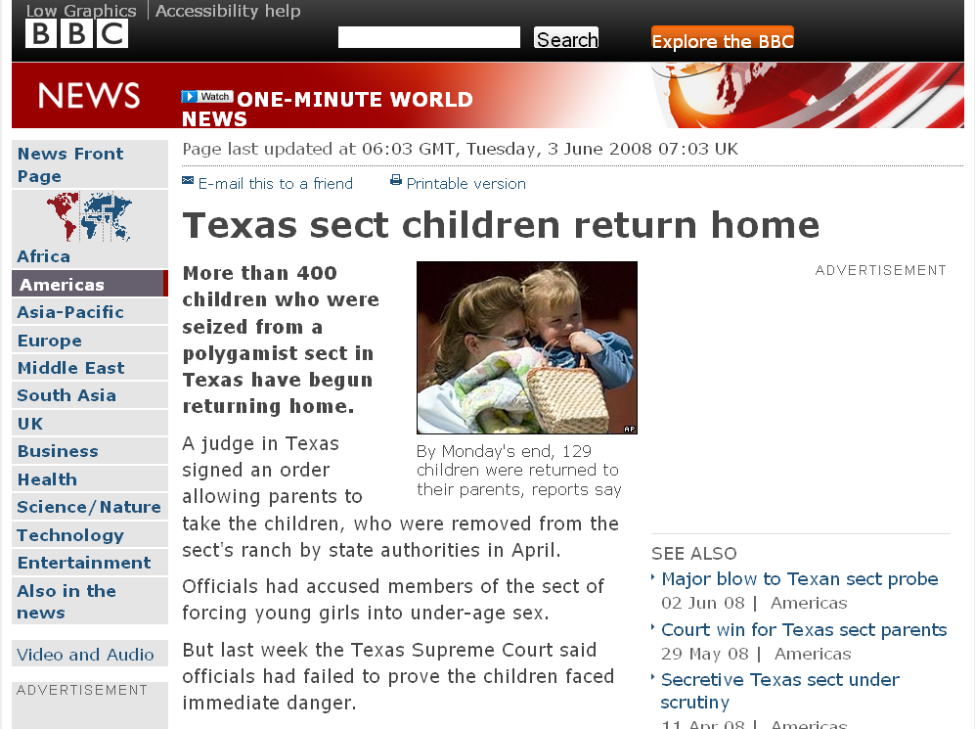
http://news.bbc.co.uk/2/hi/americas/7431848.stm
Notes:
52

Slide 53
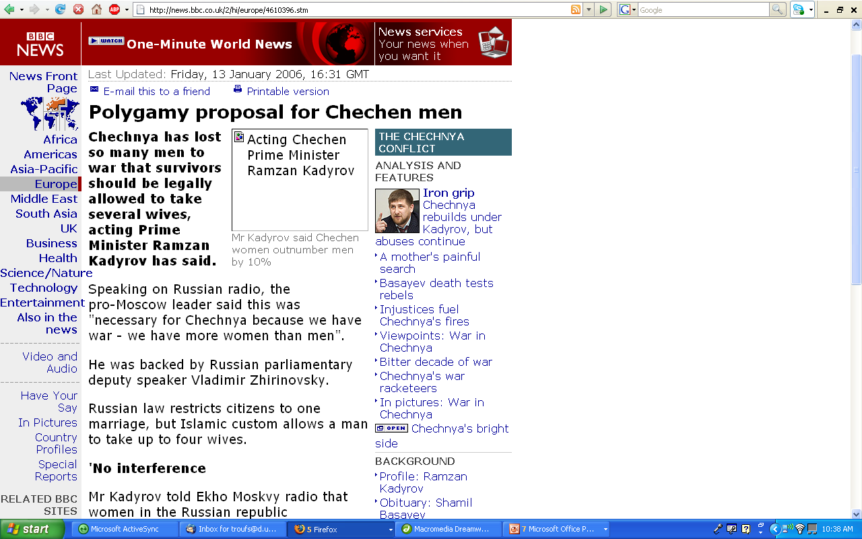
http://news.bbc.co.uk/2/hi/europe/4610396.stm

Slide 54
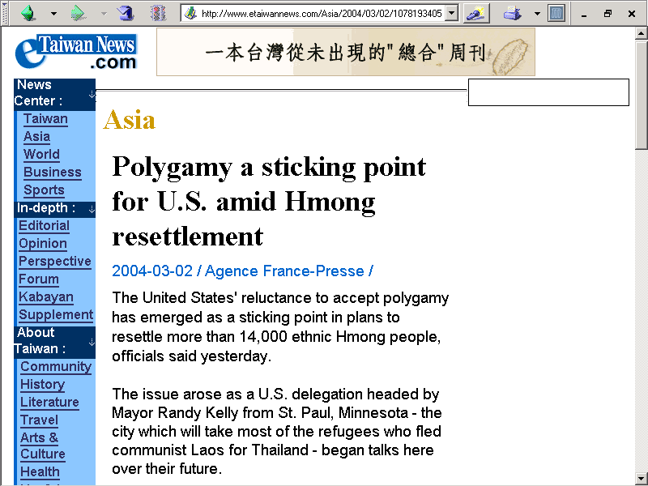
http://www.etaiwannews.com/Asia/2004/03/02/1078193405.htm

Slide 55
http://news.bbc.co.uk/2/hi/europe/4610396.stm

Slide 56
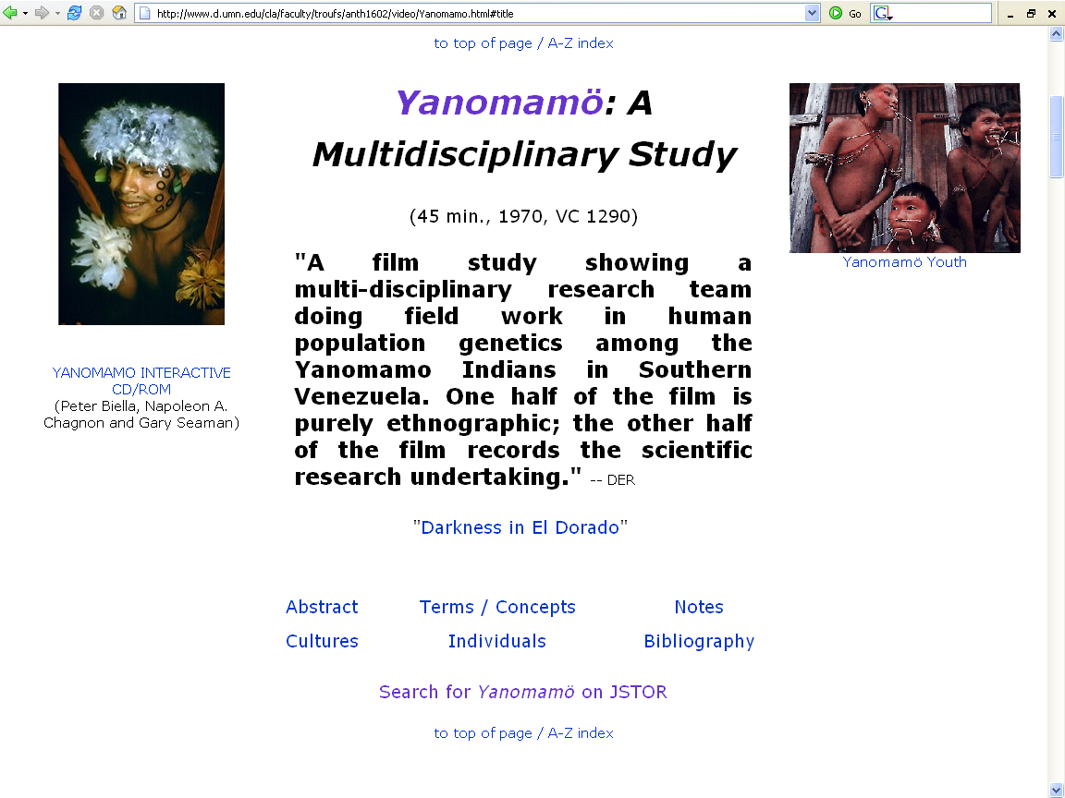
http://www.d.umn.edu/cla/faculty/troufs/anth1602/video/Yanomamo.html

Slide 57
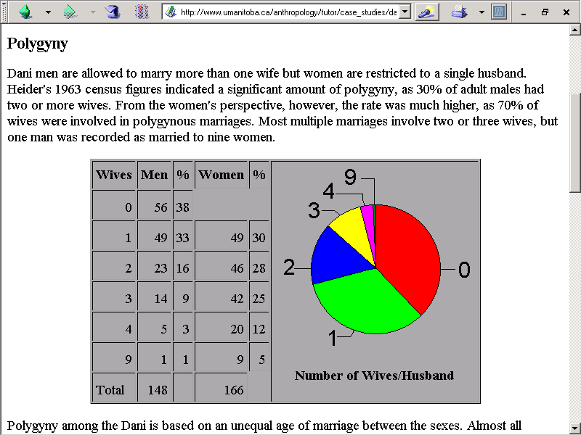
http://www.umanitoba.ca/anthropology/tutor/case_studies/dani/marriage.html

Slide 58
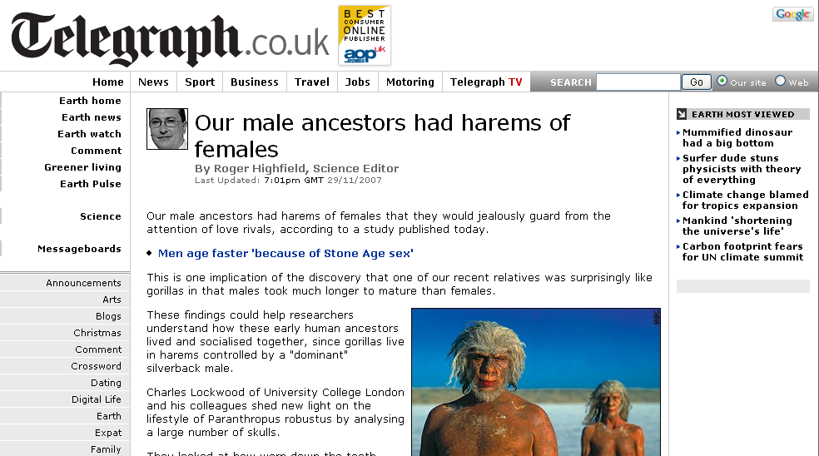
www.telegraph.co.uk/earth/main.jhtml?xml=/earth/2007/11/29/sciharem129.xml
Notes:
58

Slide 59
Modern Physical Anthropology
Culture and Biology
marriage patterns
cross-cousin marriage
polygamy
polyandry
plural marriage in which several men share a wife

Slide 60
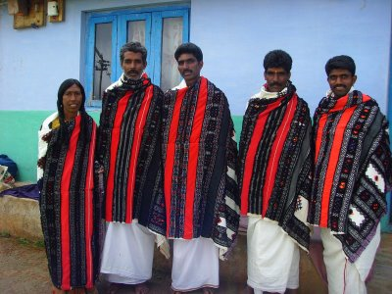
Toda, India
http://noctoc-noctoc.blogspot.com/2008/10/polyandry-among-toda-tribe-of-india.html

Slide 61
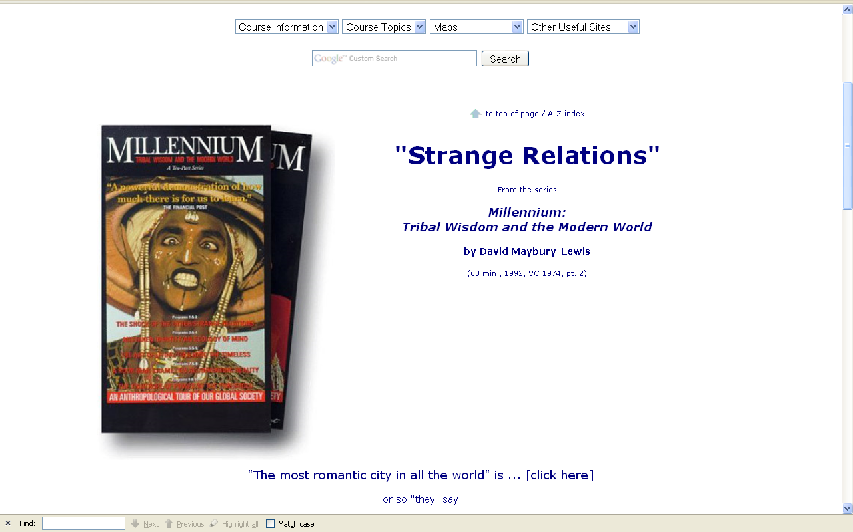
“Zumkhet comes to live in Sonam's household, consisting of his father and mother and his three brothers. Zumkhet has her first child, by Sonam's older brother, Ghoka. She is traditional, believing in the polyandrous system of her culture: the family and the family holdings are held together through the one wife.”
http://www.d.umn.edu/cla/faculty/troufs/anth1604/video/Strange_Relations.html#title

Slide 62
Modern Physical Anthropology
Culture and Biology
marriage patterns
cross-cousin marriage
polygamy
class endogamy
village exogamy

Slide 63
Modern Physical Anthropology
Culture and Biology
marriage patterns
cross-cousin marriage
polygamy
class endogamy
village exogamy
-ogamy refers to rules of marriage

Slide 64
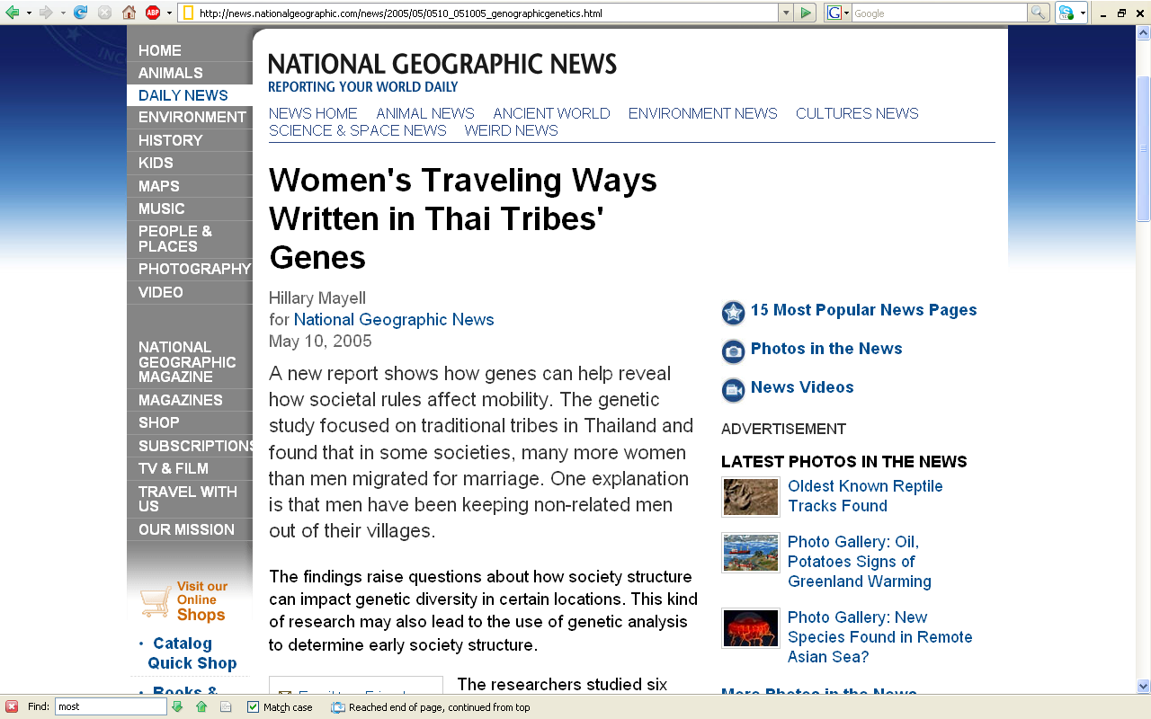
http://news.nationalgeographic.com/news/2005/05/0510_051005_genographicgenetics.html/

Slide 65
Modern Physical Anthropology
endogamy
mating with others from the same group

Slide 66
Modern Physical Anthropology
endogamy
mating with others from the same group
exogamy
mating with individuals from other groups

Slide 67
Modern Physical Anthropology
Culture and Biology
marriage patterns
cross-cousin marriage
polygamy
class endogamy
village exogamy
cultural standards of beauty

Slide 68


Slide 69

www.telegraph.co.uk/earth/main.jhtml?xml=/earth/2008/08/18/scisexy118.xml

Slide 70

www.telegraph.co.uk/earth/main.jhtml?xml=/earth/2008/06/05/scifashion205.xml
Notes:
70

Slide 71

http://news.bbc.co.uk/1/hi/health/2817795.stm

Slide 72



Slide 73
Modern Physical Anthropology
Culture and Biology
Marriage patterns
cross-cousin marriage
polygamy
class endogamy
village exogamy
cultural standards of beauty
age at marriage

Slide 74

http://news.bbc.co.uk/2/hi/middle_east/7711554.stm
Notes:
74

Slide 75


http://news.bbc.co.uk/2/hi/south_asia/4536579.stm

Slide 76

N!ai, one of the little girls in the film The Hunters,
was married to Gunda at the age of 8

Slide 77

2003

Slide 78


Slide 79


Slide 80
Modern Physical Anthropology
Culture and Biology
marriage patterns
cross-cousin marriage
polygamy
class endogamy
village exogamy
cultural standards of beauty
age at marriage
levirate / sororate

Slide 81

http://anthro.palomar.edu/marriage/marriage_4.htm

Slide 82

http://anthro.palomar.edu/marriage/marriage_4.htm

Slide 83
Modern Physical Anthropology
Culture and Biology
marriage patterns
cross-cousin marriage
polygamy
class endogamy
village exogamy
cultural standards of beauty
age at marriage
levirate / sororate
inheritance patterns

Slide 84
Modern Physical Anthropology
Culture and Biology
marriage patterns
cross-cousin marriage
polygamy
class endogamy
village exogamy
cultural standards of beauty
age at marriage
levirate / sororate
inheritance patterns
personal traits and status . . .

Slide 85

http://news.bbc.co.uk/2/hi/science/nature/7013136.stm

Slide 86

http://www.telegraph.co.uk/science/science-news/7603548/Men-with-monotonous-voices-are-irresistible-scientists-say.html

Slide 87
Modern Physical Anthropology
Culture and Biology
cultural values and beliefs
“machismo”
motherhood
ancestor worship
religious beliefs
magically induced sickness

Slide 88
Modern Physical Anthropology
Culture and Biology
other cultural practices
residence patterns
wife stealing
pre- and extra-marital mating
contraception / abortion
female infanticide
warfare

Slide 89
Modern Physical Anthropology
Culture and Biology
other factors
splitting / joining of villages
intervillage migration
different languages
breakdown of society due to illness
diffusion
technological inventions

Slide 90


Slide 91

Modern Physical Anthropology

Slide 92
Modern Physical Anthropology
Culture and Biology
other factors
splitting / joining of villages
intervillage migration
different languages
breakdown of society due to illness
diffusion
technological inventions
contact with western “civilization”

Slide 93


Slide 94
Glossary
“savage”
“civilized”

Slide 95
Glossary
“savage”
one in the state of nature
(in the woods)

Slide 96
Glossary
“civilization”
pertaining to a citizen of a city
(originally the citizenry of Rome,
not the town)

Slide 97
Modern Physical Anthropology
“Civilization Diseases”
obesity
gall bladder disease
diabetes
arteriosclerosis
hypertension

Slide 98
Modern Physical Anthropology
“Civilization Diseases”
obesity
gall bladder disease
diabetes
arteriosclerosis
hypertension
plagues . . .

Slide 99


Slide 100

Modern Physical Anthropology
“Spanish Flu”
epidemic of
1918 - 1919
In 1918 and 1919, the worldwide Spanish Influenza pandemic ("The Spanish Lady") killed at least 21 million humans -- well over twice the number of combat deaths in the whole of World War I

Slide 101

http://news.bbc.co.uk/1/hi/health/4308872.stm

Slide 102

http://news.bbc.co.uk/1/hi/world/asia-pacific/4292426.stm

Slide 103

http://www.usatoday.com/news/topstories/2008-08-18-2869138399_x.htm
Notes:
103

Slide 104


Slide 105

www.med.umich.edu/medschool/chm/influenza/index.htm
Notes:
105

Slide 106


Slide 107
The Backbone of History: Health and Nutrition in the Western Hemisphere, Richard H. Steckel and Dr. Jerome C. Rose (Cambridge University Press, 2002).
“The researchers attributed the widespread decline in health in large part to the rise of agriculture and urban living.”
“The more mobile, less densely settled populations were usually the healthiest pre-Columbians.”
“Even so, in the simplest hunter-gatherer societies, few people survived past age 50. In the healthiest cultures in the 1,000 years before Columbus, a life span of no more than 35 years might be usual.”

Slide 108
Modern Physical Anthropology
“nature” – biology
(inherited)
“nurture” – culture
(learned)

Slide 109
Modern Physical Anthropology
Next:
Work on population studies, including effect of population density on behavior

