Slide 1
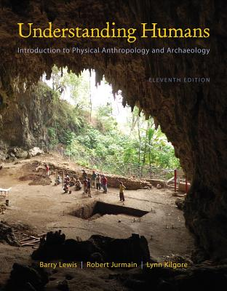
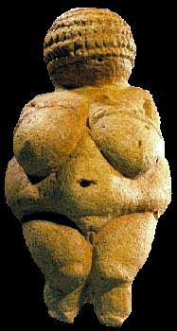
Class Slides Set 10A
Special Skills Used to Study Early Humans
. . . or how to make sense out of Ch. 8 of the text . . .
University of Minnesota Duluth
Tim Roufs
© 2010-2013
http://www.d.umn.edu/cla/faculty/troufs/anth1602/

Slide 2
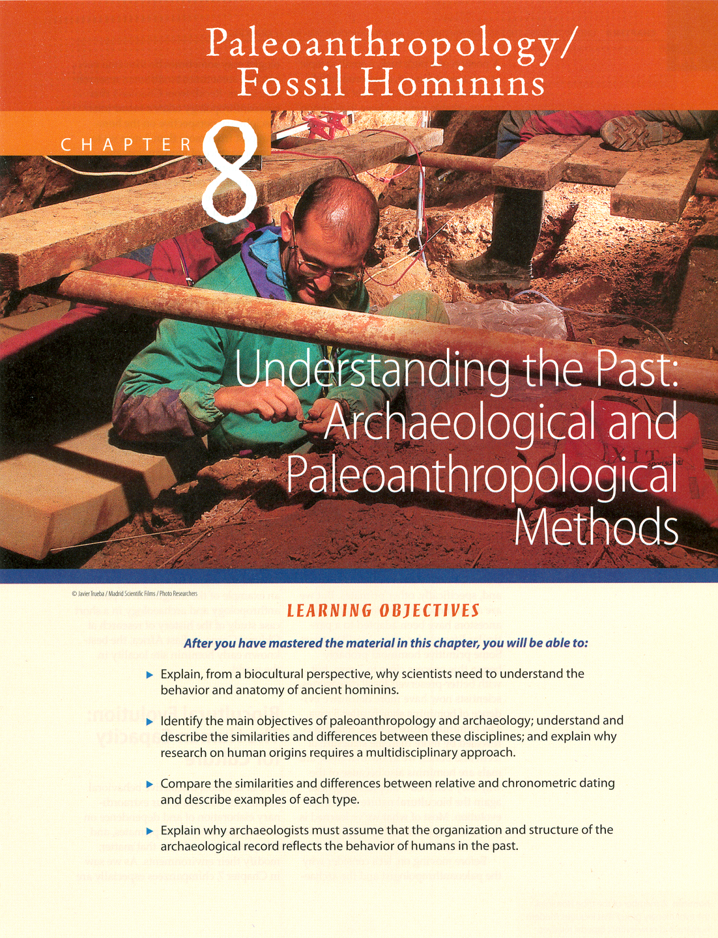
Archaeological Dating Methods

Slide 3
In the Field and Lab
methods =
basic overall approaches to a problem
techniques =
specific tools / procedures used

Slide 4
In the Field and Lab
archaeological
dating methods
relative dating
chronometric dating
(aka “absolute” dating)

Slide 5
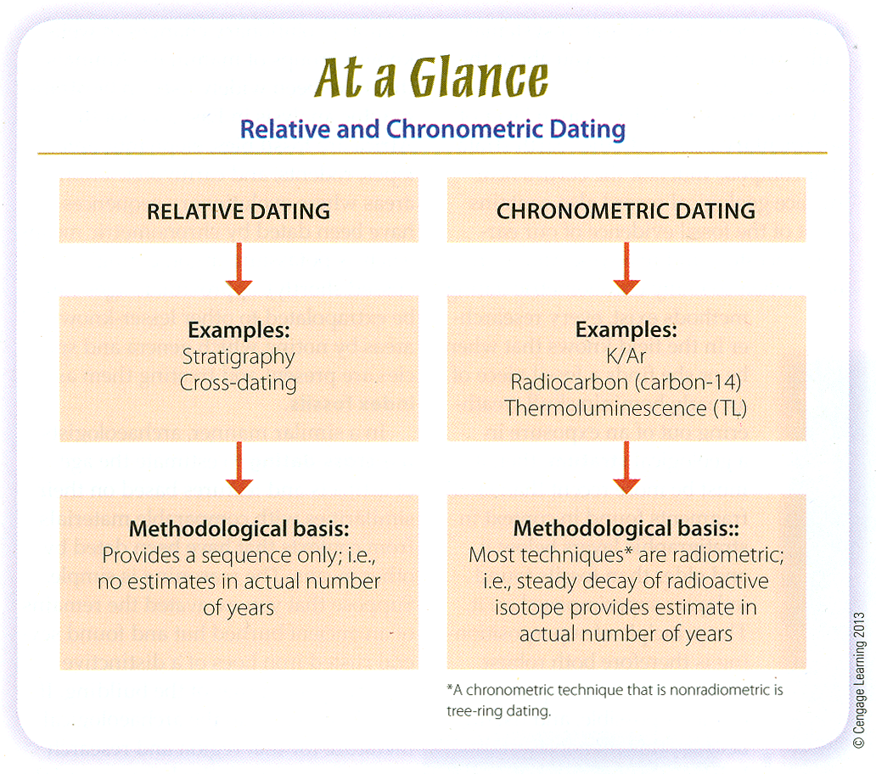
Relative and Chronometric Dating
Understanding Humans, 11th Ed., p. 185

Slide 6
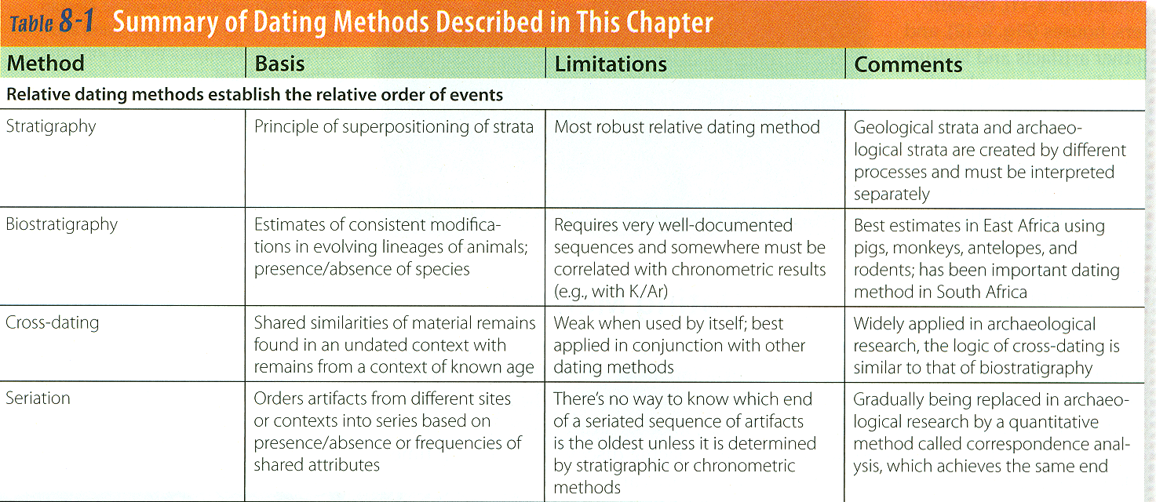
REM: relative
methods
tell you whether something is
older / younger / the same age
relative dating methods
Paleoanthropology is Heavily Interdisciplinary.
Understanding Humans, 11th Ed., p. 184

Slide 7
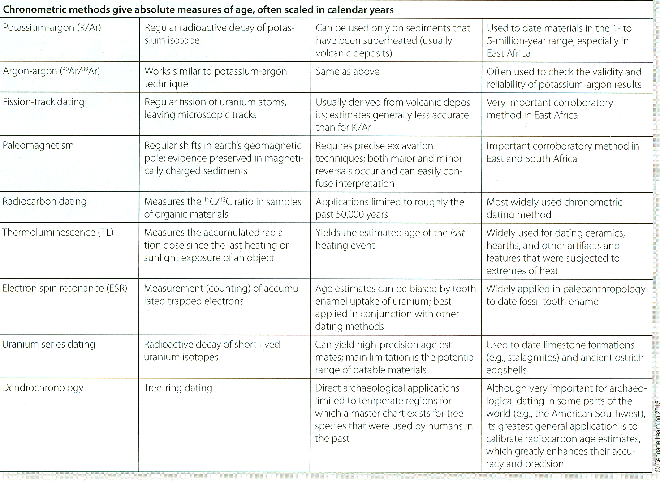
REM: chronometric
methods
yield yield a date
often scaled in calendar years
A Summary of Dating Methods.
Understanding Humans, 11th Ed., p. 184

Slide 8
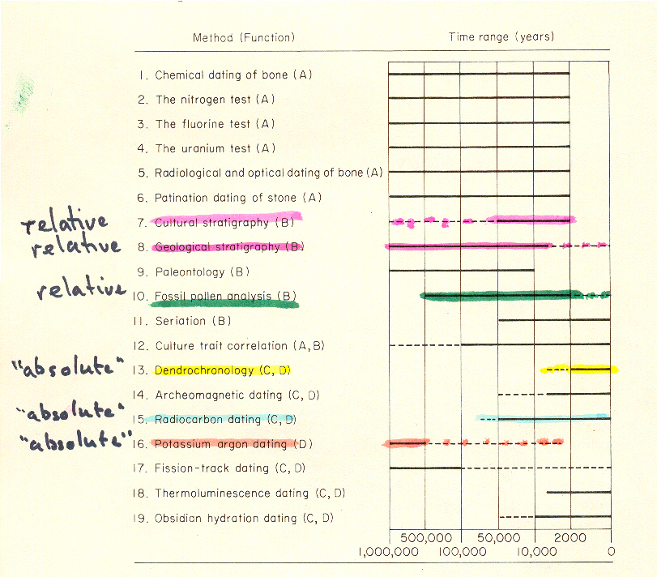
method
technique
Relative and “Absolute” (Chronometric) Dating Techniques.
Michels, Dating Methods in Archaeology, p. 4.

Slide 9
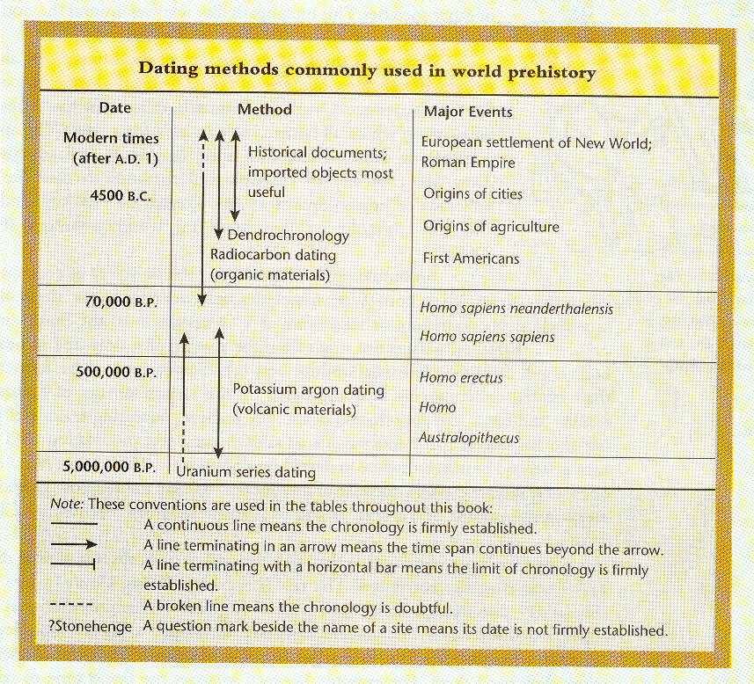
techniques
technique
People of the Earth, 10th Ed., p. 11.

Slide 10
In the Field and Lab
stratigraphy
the sequence of geological strata, or layers, formed by materials deposited by water or wind
also the study of this sequence

Slide 11
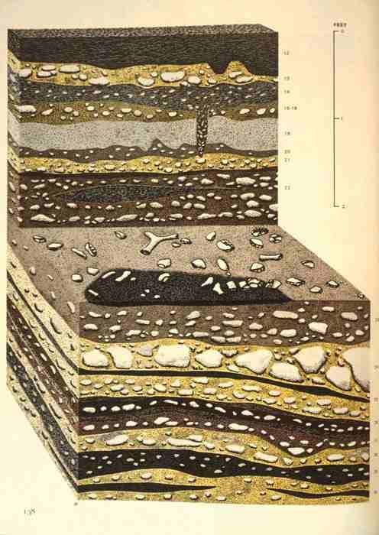
Notes:
11

Slide 12
relative dating methods
Paleoanthropology is Heavily Interdisciplinary.
Understanding Humans, 11th Ed., p. 184

Slide 13
REM: relative
methods
tell you whether something is
older / younger / the same age
relative dating methods
Paleoanthropology is Heavily Interdisciplinary.
Understanding Humans, 11th Ed., p. 184

Slide 14
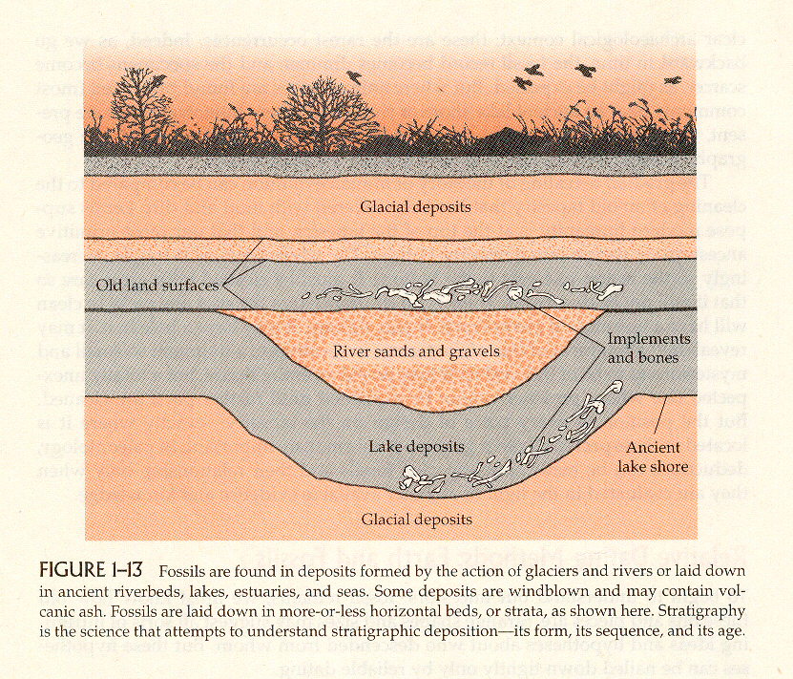
Humankind Emerging, 7th Ed., p. 24.

Slide 15
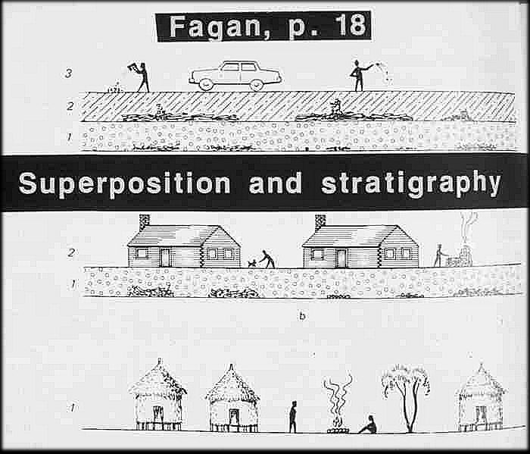
People of the Earth, p. 18.

Slide 16
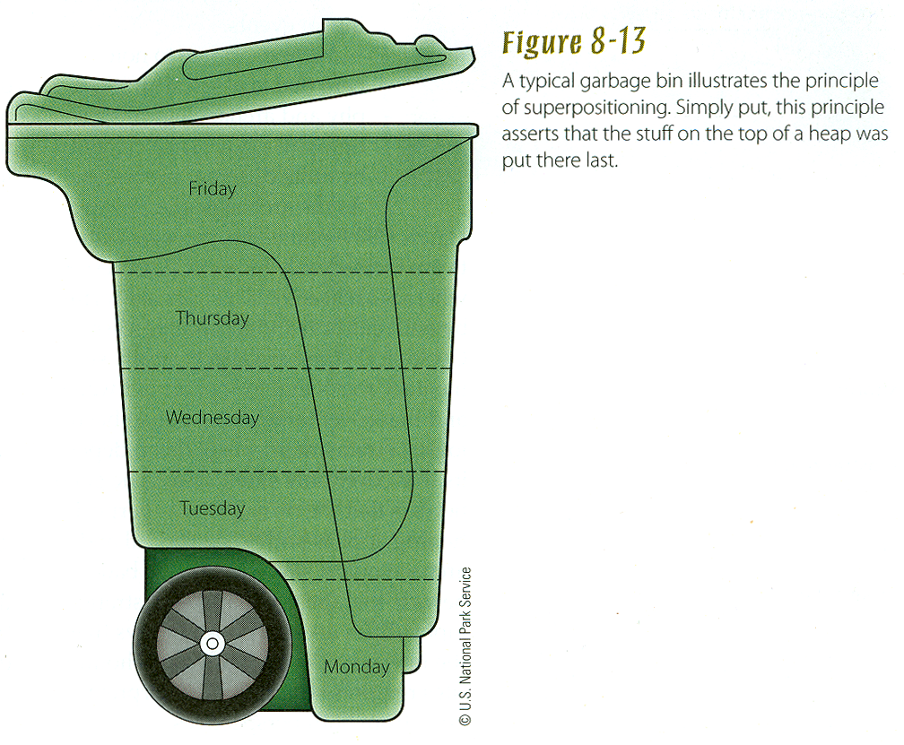
Principle of Superposition
Understanding Humans, 11th Ed., p. 185

Slide 17
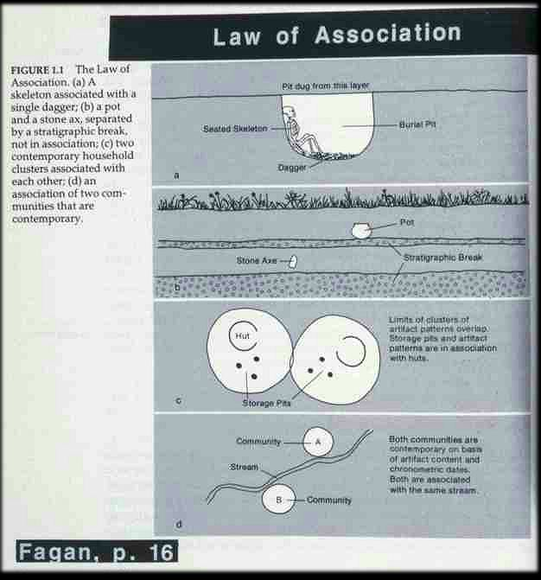
People of the Earth, p. 16.

Slide 18
In the Field and Lab
archaeological
dating methods
relative dating
chronometric dating
(aka “absolute” dating)

Slide 19
In the Field and Lab
archaeological dating methods
relative dating
places finds in a sequence but provides no actual estimates in numbers of years

Slide 20
In the Field and Lab
archaeological dating methods
relative dating
estimating the age of geologic deposits (and the fossils in them) by determining their stratigraphic level in relation to that of other deposits whose relative or absolute age is known

Slide 21
In the Field and Lab
R.1. or “First Order Relative Dating”
c = contemporaneous
i = intrusive
r = redeposited

Slide 22
R.1. c = contemporaneous
R.1. i = intrusive
R.1. r = redeposited

Slide 23
In the Field and Lab
R.2. or “Second Order Relative Dating”
stage referable to
local sequence
e.g., Olduvai Bed I

Slide 24
In the Field and Lab
R.2. or “Second Order Relative Dating”
stage referable to
local sequence
e.g., Olduvai Bed I

Slide 25
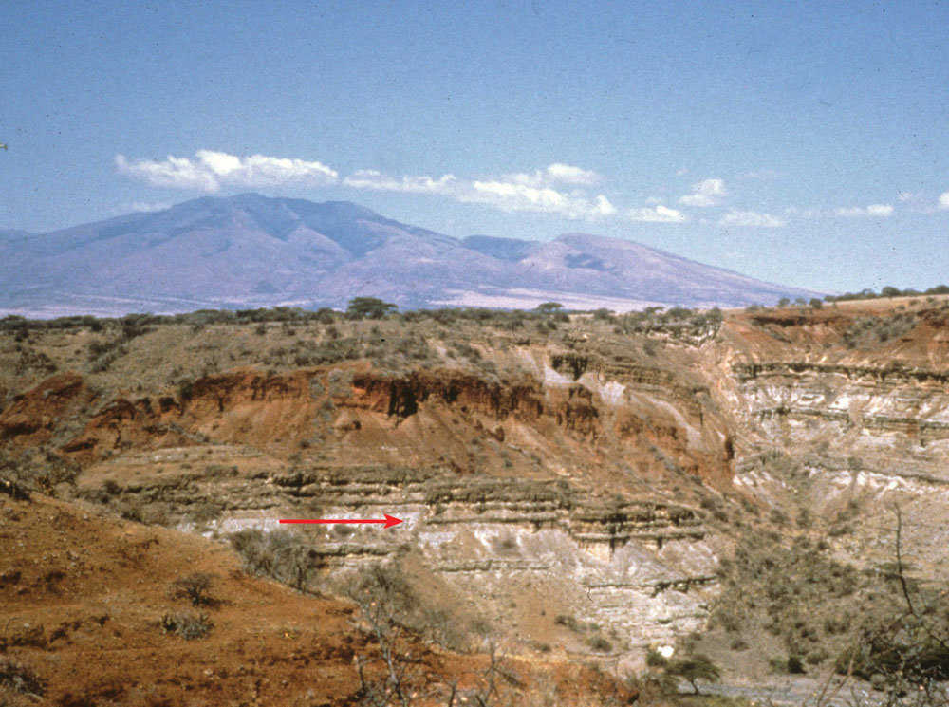
Geological sequence at Olduvai Gorge.
Note Geological beds.
Understanding Humans, 11th Ed., p. 193.

Slide 26
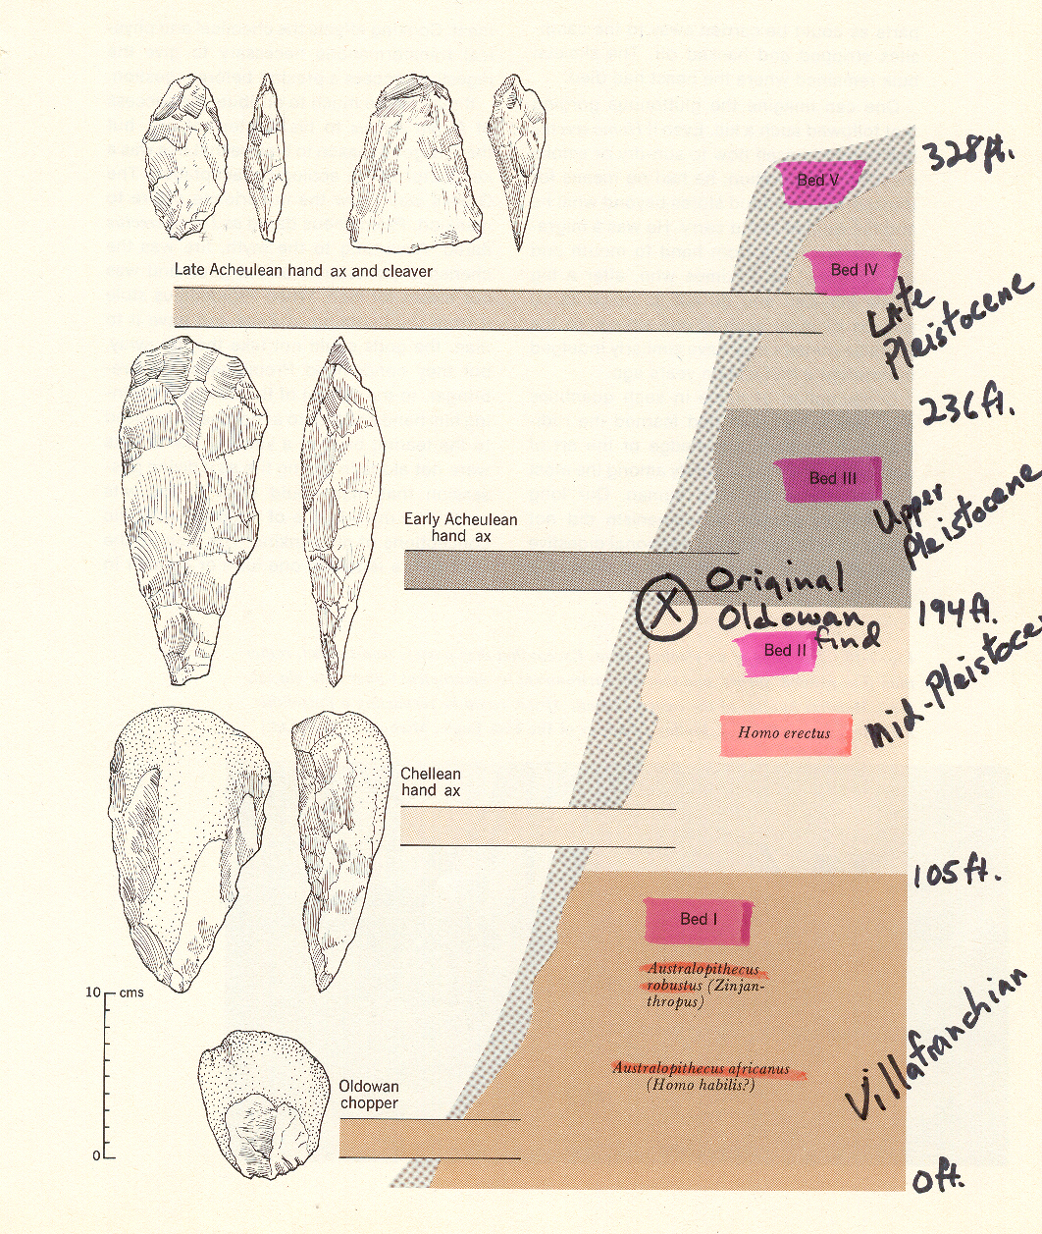
Bed I
Olduvai Gorge, Kenya.
Hoebel, Anthropology: The Study of Man and Archaeology, 4th Ed., p. 153.

Slide 27
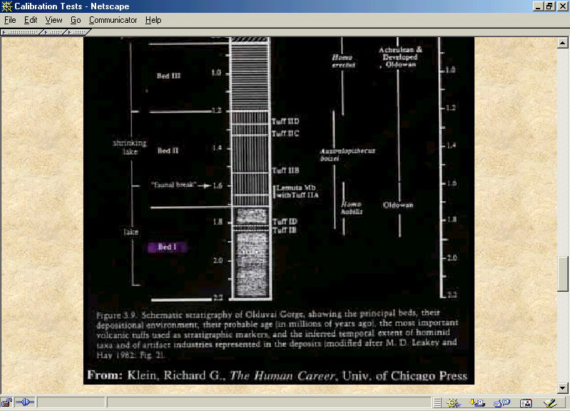

Slide 28
In the Field and Lab
R.2. or “Second Order Relative Dating”
stage referable to
local sequence
e.g., Olduvai Bed I

Slide 29
In the Field and Lab
R.3. or “Third Order Relative Dating”
inferred position in terms of wider-scale stratigraphy
or cultural sequence
e.g., Lower Villafrancian

Slide 30
In the Field and Lab
R.3. or “Third Order Relative Dating”
inferred position in terms of wider-scale stratigraphy
or cultural sequence
e.g., Lower Villafrancian

Slide 31
In the Field and Lab

Slide 32
In the Field and Lab
R.4. or “Morphological Dating”
estimate of age based on shape or style

Slide 33
In the Field and Lab
R.4. or “Morphological Dating”
estimate of age based on shape or style

Slide 34
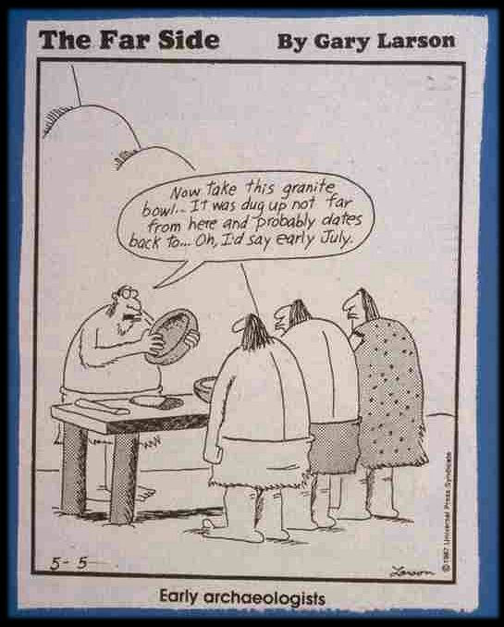

Slide 35
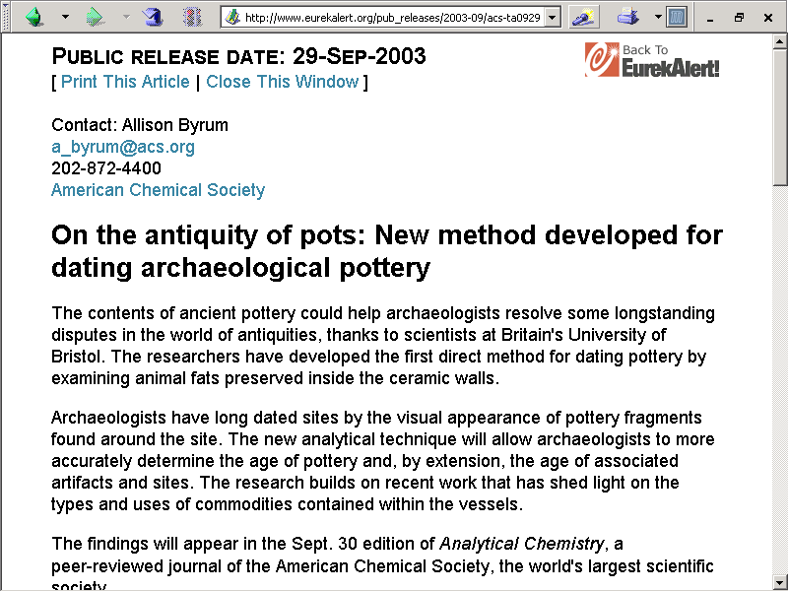

Slide 36
REM: relative methods
tell you whether something is
older / younger / the same age
relative dating methods
Paleoanthropology is Heavily Interdisciplinary.
Understanding Humans, 11th Ed., p. 184

Slide 37
Gradually being replaced in
archaeological research by a
quantitative method called
correspondence analysis,
which achieves the same end
relative dating methods
Paleoanthropology is Heavily Interdisciplinary.
Understanding Humans, 11th Ed., p. 184

Slide 38
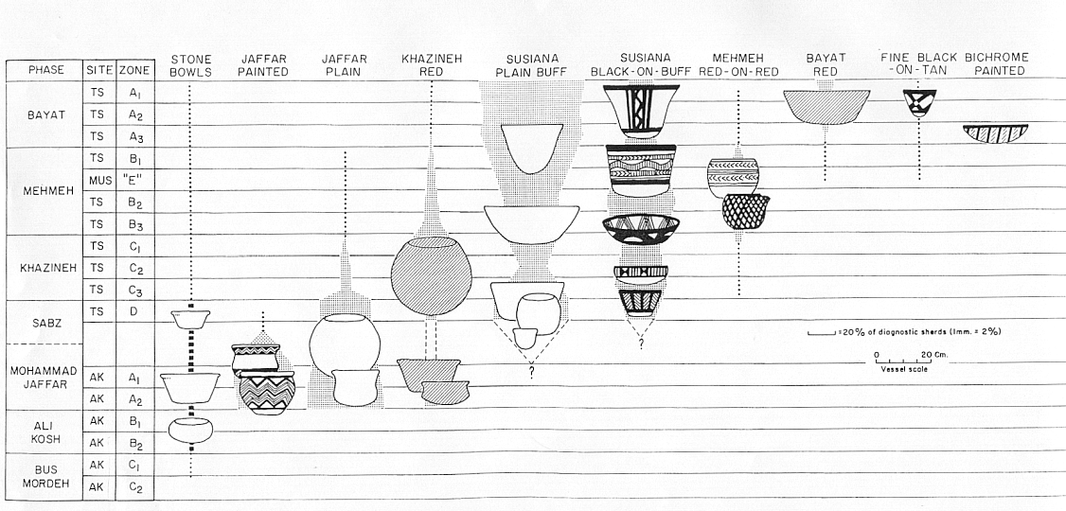
seriation
Relative dating method that orders artiacts into a temporal series based on their similar attributes or the frequency of these attributes
11th Ed. p. 184, 186-187
Pottery types from Deh Luran, Iran.
Source: Hole, Flannery and Neely, “Prehistory and Human Ecology
Of the Deh Luran Plain: An Early Village Sequence from
Khuzistan, Iran.” Ann Arbor: 1969, fig. 69.

Slide 39
Pottery types from Deh Luran, Iran.
Source: Hole, Flannery and Neely, “Prehistory and Human Ecology
Of the Deh Luran Plain: An Early Village Sequence from
Khuzistan, Iran.” Ann Arbor: 1969, fig. 69.

Slide 40
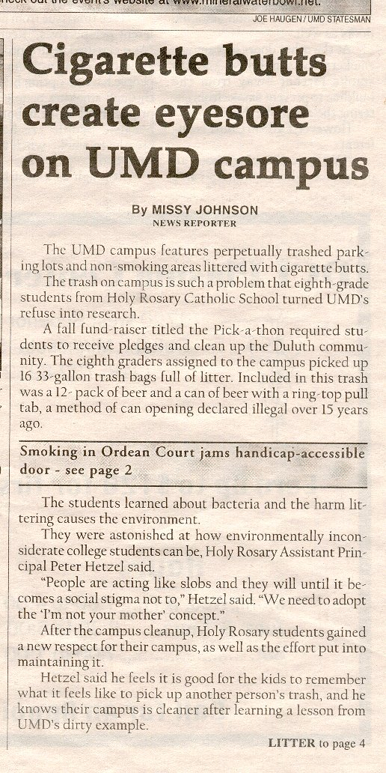
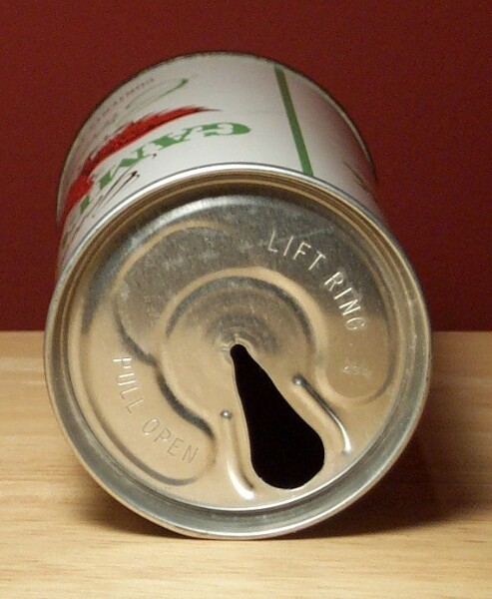
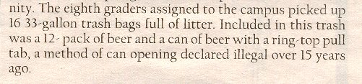
UMD Statesman, 15 November 2001.

Slide 41

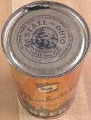

Slide 42
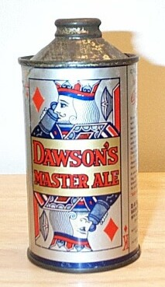


Slide 43
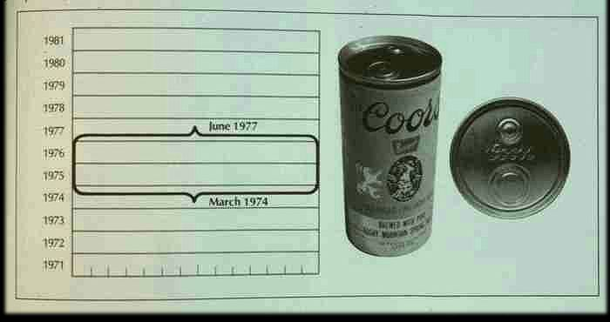

Slide 44
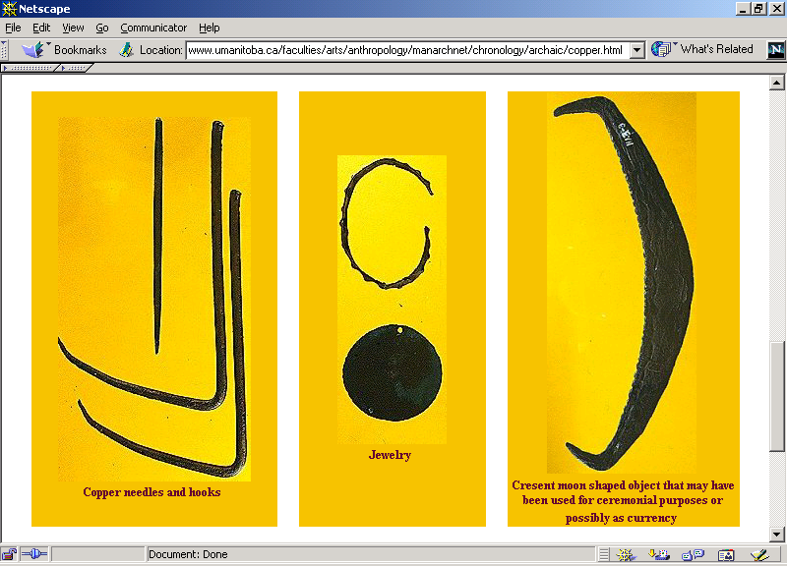
Lake Superior Old Copper Culture, 4,000 B.C. - 1,000 B.C.

Slide 45
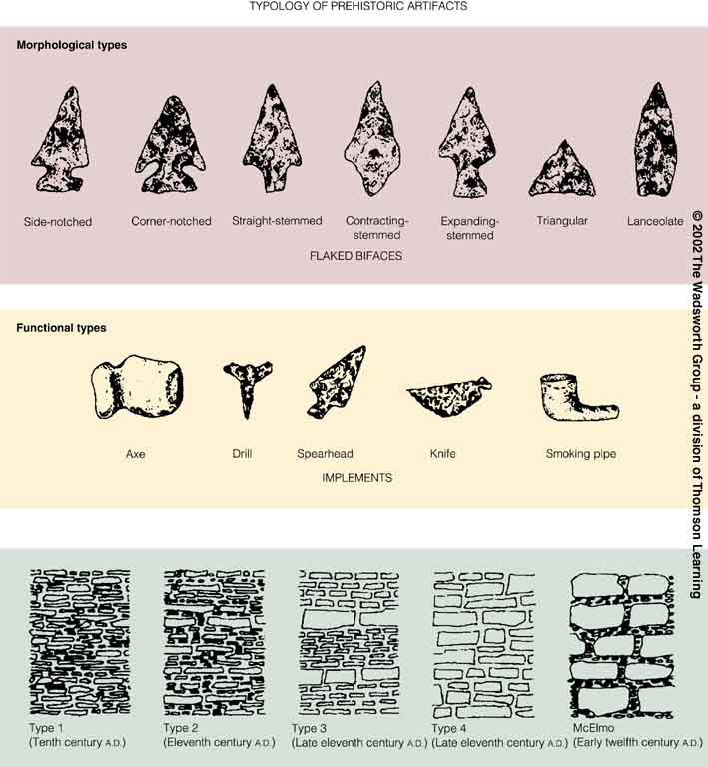
Typological dating, Chaco Canyon, New Mexico.
Understanding Physical Anthropology and Archaeology, 8th Ed., p. 354.

Slide 46
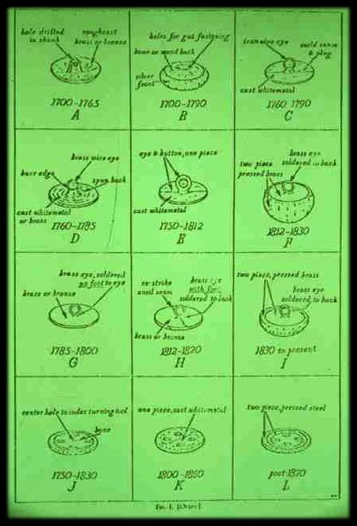
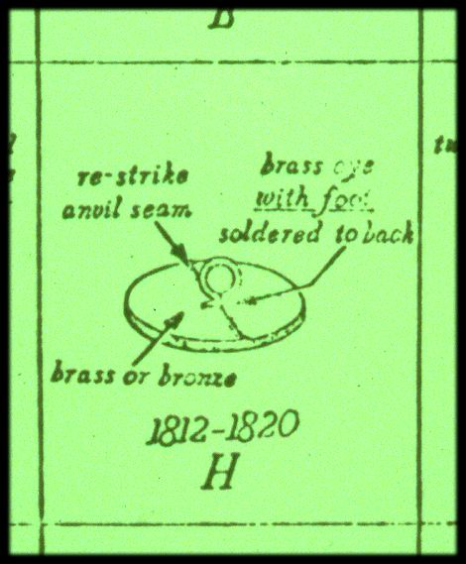

Slide 47
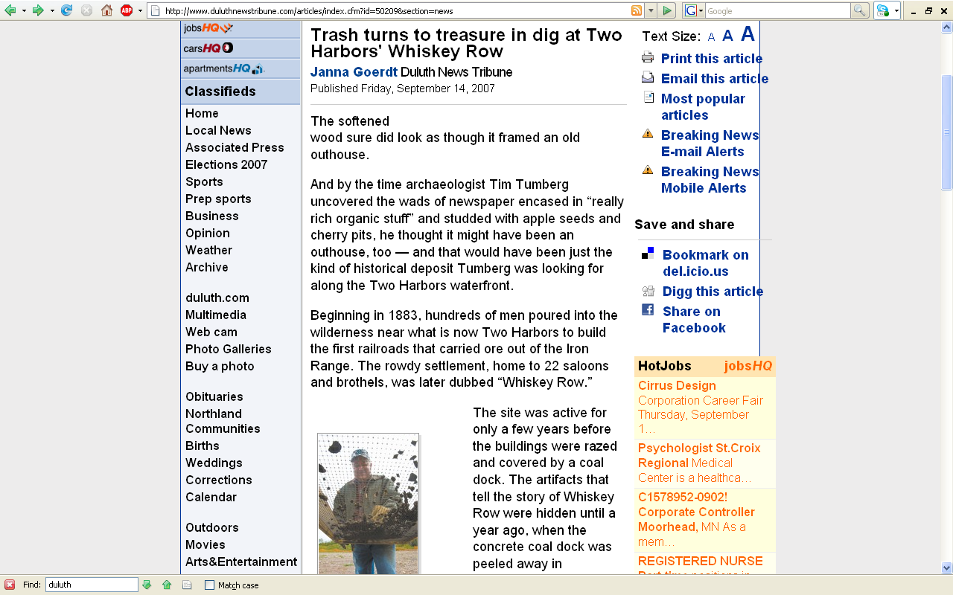
http://www.duluthnewstribune.com/articles/index.cfm?id=50209&section=news

Slide 48
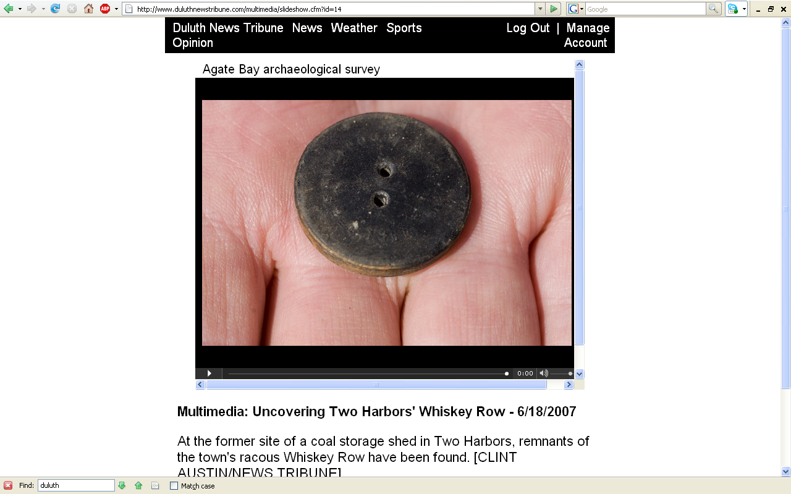
http://www.duluthnewstribune.com/articles/index.cfm?id=50209&section=news

Slide 49
In the Field and Lab
archaeological
dating methods
relative dating
chronometric dating
(aka “absolute” dating)

Slide 50
In the Field and Lab
archaeological dating methods
chronometric dating (aka “absolute” dating)
provides estimates in actual numbers of years
(sometimes +/-)

Slide 51
Relative and Chronometric Dating
Understanding Humans, 11th Ed., p. 185

Slide 52
In the Field and Lab
archaeological dating methods
chronometric dating (aka “absolute” dating)
determining the actual age of geological deposits (and the fossils in them) by examining the chemical composition of rock fragments and organic remains containing radioactive substances such as uranium 238, and carbon 14, which decay at a known rate

Slide 53
In the Field and Lab
A.1. or “First Order Absolute Dating”
direct determination of age based on internal evidence
e.g., 14C dating of bone sample
e.g., dendrochronology
e.g., molecular clocks

Slide 54
In the Field and Lab
A.1. or “First Order Absolute Dating”
direct determination of age based on internal evidence
e.g., 14C dating of bone sample
e.g., dendrochronology
e.g., molecular clocks

Slide 55
In the Field and Lab
A.1. or “First Order Absolute Dating”
direct determination of age based on internal evidence
e.g., 14C dating of bone sample
e.g., dendrochronology
e.g., molecular clocks

Slide 56
Relative and Chronometric Dating
Understanding Humans, 11th Ed., p. 185

Slide 57
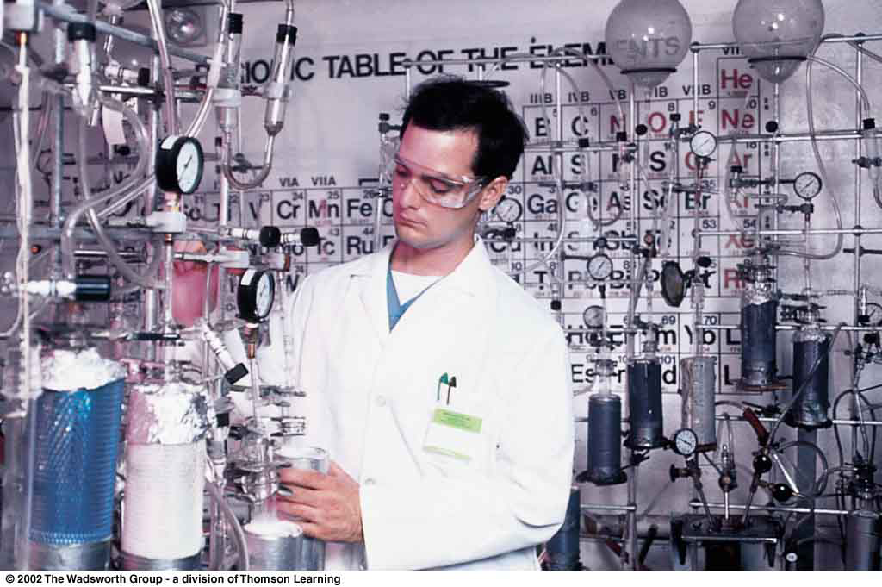
Technician in a radiocarbon dating laboratory.
Understanding Humans, 10th Ed., p. 194.

Slide 58
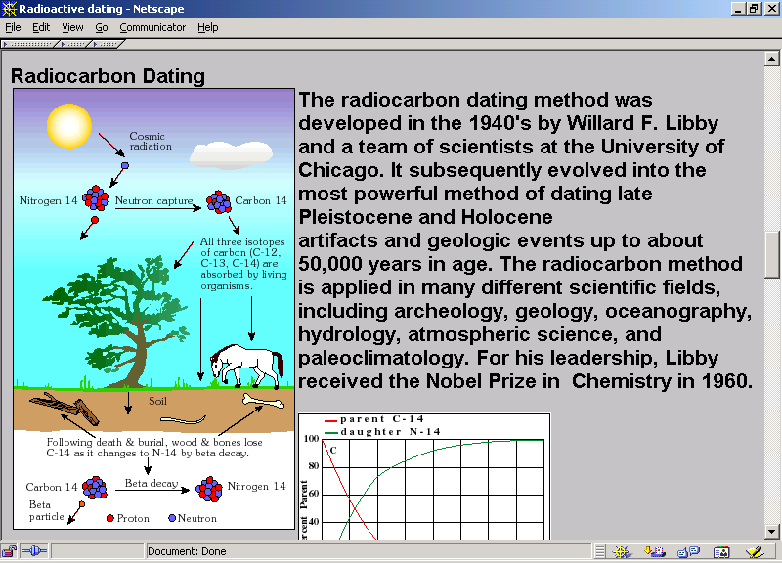

Slide 59
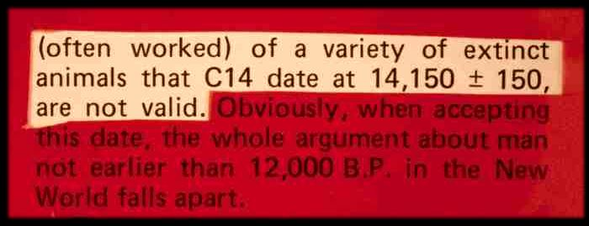

Slide 60
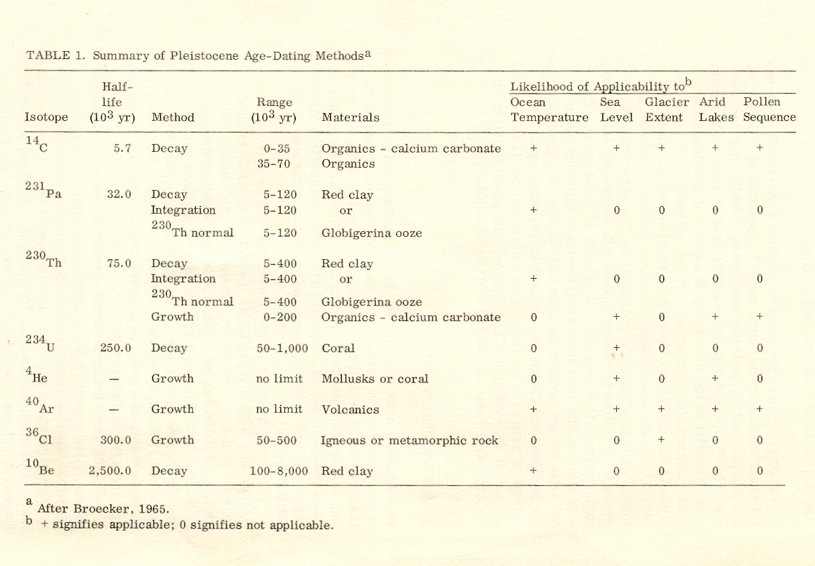
“half-life” of 14C = 5,730 years
Summary of Pleistocene Age-Dating Methods.
Time and Stratigraphy in the Evoluton of Man. (National Research Council, 1967), p. 46.

Slide 61
techniques
technique
People of the Earth, 10th Ed., p. 11.

Slide 62
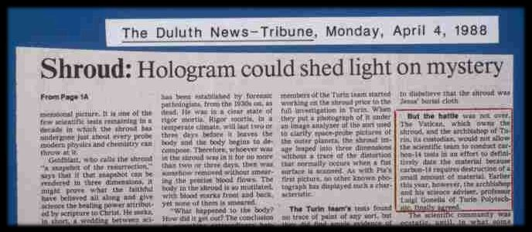
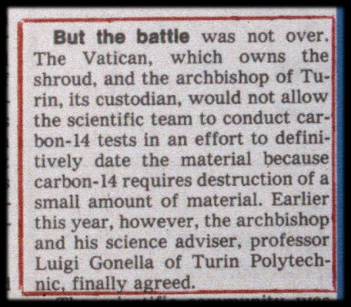
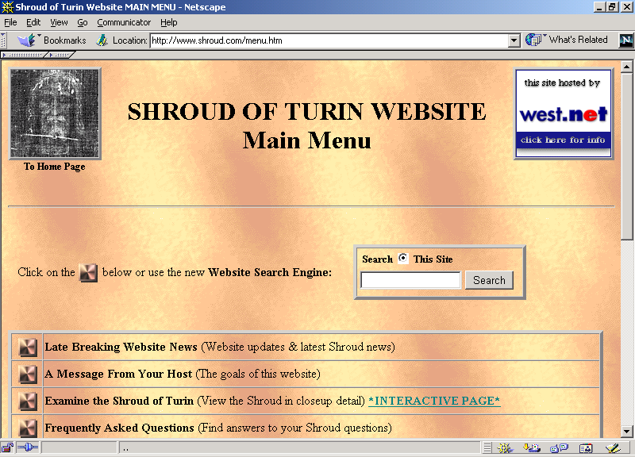
Problem#1: Part of the artifact must be destroyed in running the test(s)

Slide 63
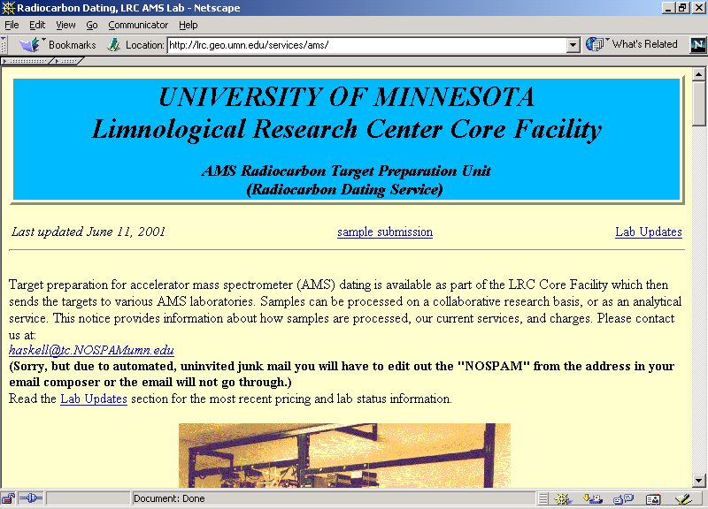
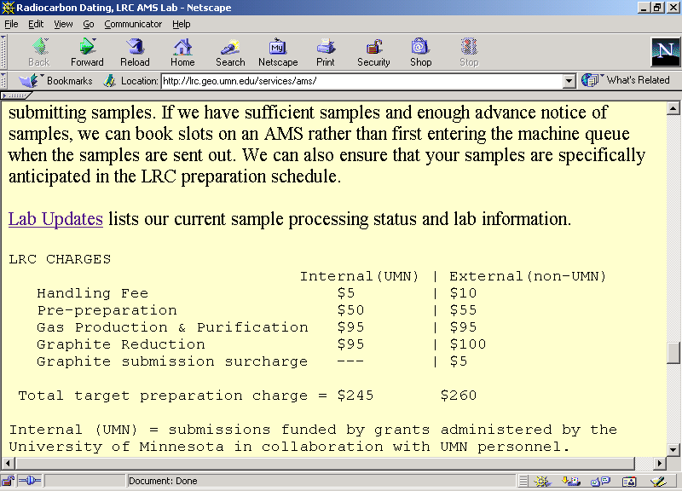
Problem #2: Tests are expensive

Slide 64
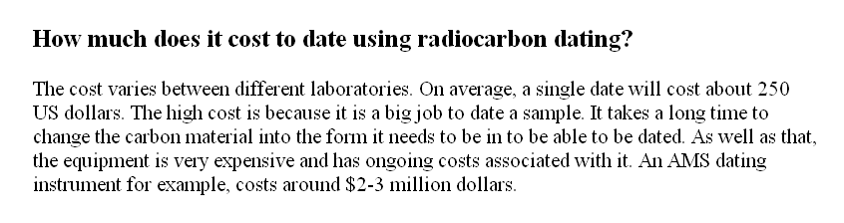
Problem #2: Tests are expensive

Slide 65
In the Field and Lab
A.1. or “First Order Absolute Dating”
direct determination of age based on internal evidence
e.g., 14C dating of bone sample
e.g., dendrochronology
e.g., molecular clocks

Slide 66
REM: chronometric
methods
yield yield a date
often scaled in calendar years
A Summary of Dating Methods.
Understanding Humans, 11th Ed., p. 184

Slide 67
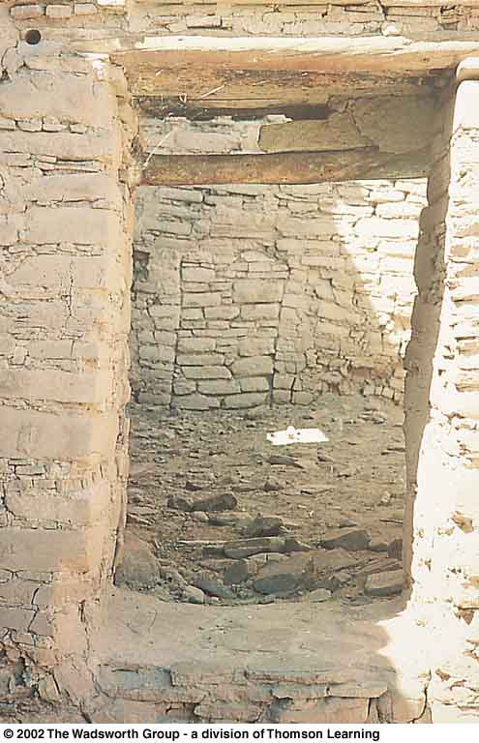
Doorway in White House Ruin, Canyon de Chelly, Arizona.
Understanding Humans, 10th Ed., p. 195.

Slide 68
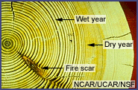
dendrochronology

Slide 69
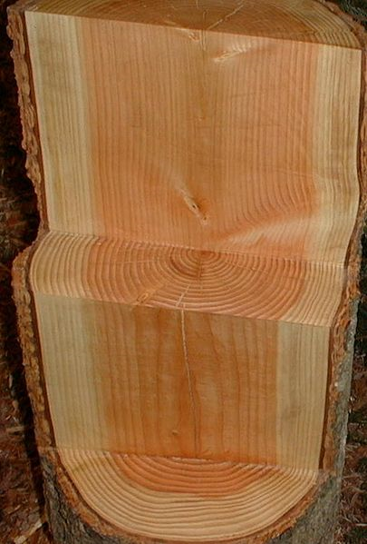
http://commons.wikimedia.org/wiki/File:Douglasie2.jpg

Slide 70
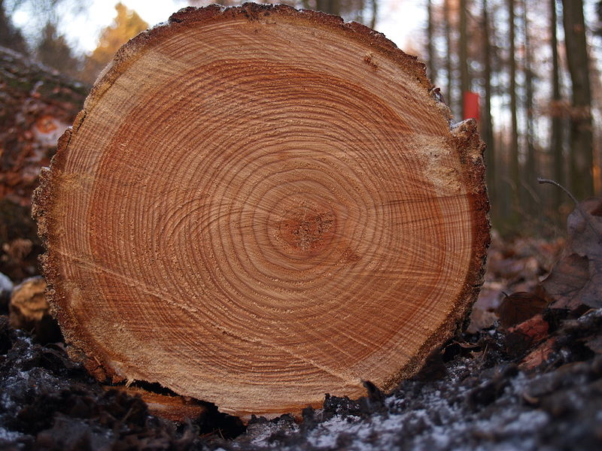
http://commons.wikimedia.org/wiki/File:Tree_rings.jpg

Slide 71
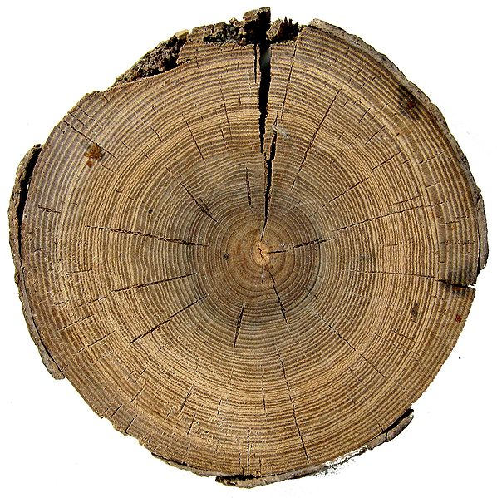
http://commons.wikimedia.org/wiki/File:Salzbergwerk_Hallstat_680_v_Chr.jpg

Slide 72
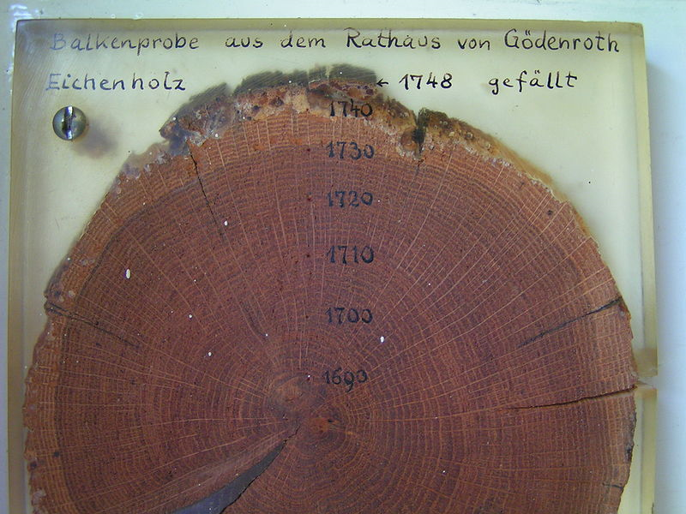
http://commons.wikimedia.org/wiki/File:Dendrochronologie.jpg

Slide 73
Prepared wood sample from Wild fire area, N Hörken, Ljusnarsberg, Sweden. Growth rings from 1910-summer 2006. The outermost ring shows that this spruce was killed by the fire sometime around midsummer 2006. While the core was taken at breast height and the pitch was not hit, the tree was at least 100 years old when died.
http://commons.wikimedia.org/wiki/File:WildFireAreaNHorken0709-PCAB-woodsample%28NHrkF01a%29.jpg

Slide 74
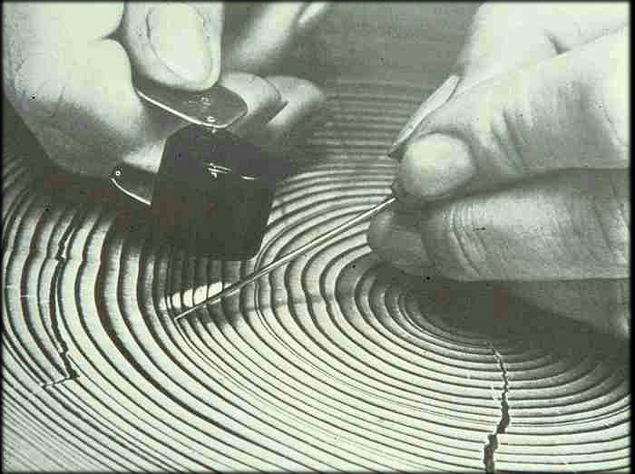

Slide 75
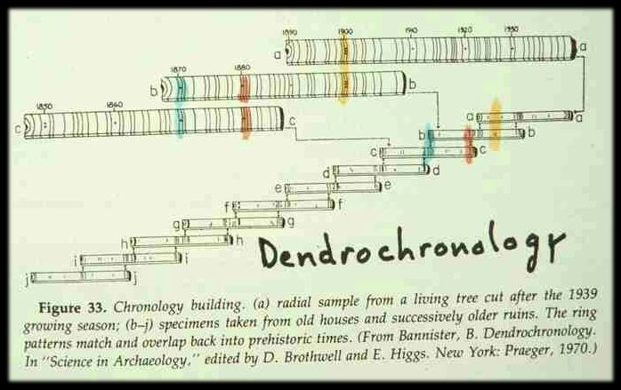
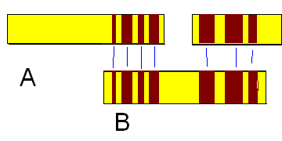
http://commons.wikimedia.org/wiki/File:Treering_sequence.PNG

Slide 76

http://en.wikipedia.org/wiki/Timeline_of_dendrochronology_timestamp_events

Slide 77

http://en.wikipedia.org/wiki/Timeline_of_dendrochronology_timestamp_events

Slide 78


Slide 79
techniques
technique
People of the Earth, 10th Ed., p. 11.

Slide 80
In the Field and Lab
A.1. or “First Order Absolute Dating”
direct determination of age based on internal evidence
e.g., 14C dating of bone sample
e.g., dendrochronology
e.g., molecular clocks

Slide 81

http://en.wikipedia.org/wiki/Molecular_clocks

Slide 82

Chronometric Dating – Molecular Clocks

Slide 83


Slide 84
In the Field and Lab
A.2. or “Second Order Absolute Dating”
direct determination of age of the source of the deposit
e.g., K / A dating of volcanic materials associated with Olduvai hominids

Slide 85
In the Field and Lab
A.2. or “Second Order Absolute Dating”
direct determination of age of the source of the deposit
e.g., K / A dating of volcanic materials associated with Olduvai hominids

Slide 86
REM: chronometric
methods
yield yield a date
often scaled in calendar years
A Summary of Dating Methods.
Understanding Humans, 11th Ed., p. 184

Slide 87

Reversals in world magnetic polarity.
Humankind Emerging (7th Ed). p. 28.

Slide 88
In the Field and Lab
R.1. or “First Order Relative Dating”
c = contemporaneous
i = intrusive
r = redeposited

Slide 89
In the Field and Lab
A.3. or “Third Order Absolute Dating”
age inferred by
correlating source bed
with a deposit whose actual age is known
e.g., Trinil gravel with Trinil gravel whose actual age has been determined

Slide 90
In the Field and Lab
A.3. or “Third Order Absolute Dating”
age inferred by
correlating source bed
with a deposit whose actual age is known
e.g., Trinil gravel with Trinil gravel whose actual age has been determined

Slide 91

Understanding Humans, 10th Ed., p. 245.

Slide 92

Java stratigraphy
Modern deposits and bones
Sampoeng stratum (Neolithic)
Ngandong stratum (Upper Pleistocene)
Trinil stratum (ca. 700,000 ybp)
Djetis stratum (Lower Pleistocene)
Three or more strata (Pliocene)

Slide 93
Java stratigraphy
Modern deposits and bones
Sampoeng stratum (Neolithic)
Ngandong stratum (Upper Pleistocene)
Trinil stratum (ca. 700,000 ybp)
Djetis stratum (Lower Pleistocene)
Three or more strata (Pliocene)

Slide 94
Java stratigraphy
Modern deposits and bones
Sampoeng stratum (Neolithic)
Ngandong stratum (Upper Pleistocene)
Trinil stratum (ca. 700,000 ybp)
Djetis stratum (Lower Pleistocene)
Three or more strata (Pliocene)

Slide 95
R.1. = c
= Trinil stratum (ca., 700,000 ybp)
Jakarta
Trinil
Modern deposits and bones
Sampoeng stratum (Neolithic)
Ngandong stratum (Upper Pleistocene)
Trinil stratum (Middle Pleistocene)
Djetis stratum (Lower Pleistocene)
Three or more strata (Pliocene)
R.1. = c
Trinil stratum (ca., 700,000 ybp)

Slide 96
R.1. = c
Trinil stratum (ca., 700,000 ybp)
Jakarta
Trinil
Modern deposits and bones
Sampoeng stratum (Neolithic)
Ngandong stratum (Upper Pleistocene)
Trinil stratum (Middle Pleistocene)
Djetis stratum (Lower Pleistocene)
Three or more strata (Pliocene)
R.1. = c
Trinil stratum (ca., 700,000 ybp)

Slide 97
In the Field and Lab
paleomagnetism
a form of relative dating that can be used for absolute dating because the historic pattern of the earth’s magnetic fluctuations and reversals is known and dated

Slide 98

http://news.nationalgeographic.com/news/2005/12/1215_051215_north_pole.html

Slide 99
REM: chronometric
methods
yield yield a date
often scaled in calendar years
A Summary of Dating Methods.
Understanding Humans, 11th Ed., p. 184

Slide 100
In the Field and Lab
paleomagnetism
magnetism is preserved in a rock originally generated by the earth’s magnetic field
past changes in the direction of this field allow correlation between strata

Slide 101

In the Field and Lab
Paleomagnetic sequences, Olduvai, East Turkana, and Omo.
Understanding Humans, 10th Ed., p. 193.

Slide 102
Reversals in world magnetic polarity.
Humankind Emerging (7th Ed). p. 28.

Slide 103
Lucy
Reversals in world magnetic polarity.
Humankind Emerging (7th Ed). p. 28.

Slide 104
Lucy
Reversals in world magnetic polarity.
Humankind Emerging (7th Ed). p. 28.

Slide 105

Lucy
Reversals in world magnetic polarity.
Stratigraphic column at Hadar.
Humankind Emerging (7th Ed). p. 28.

Slide 106
Lucy
Reversals in world magnetic polarity.
Stratigraphic column at Hadar.
Humankind Emerging (7th Ed). p. 28.

Slide 107
Lucy
Reversals in world magnetic polarity.
Stratigraphic column at Hadar.
Humankind Emerging (7th Ed). p. 28.

Slide 108
Relative and Absolute Methods
can be combined
e.g., Hadar pigs
Biostratigraphy (relative)
Paleomagnetism (chronometric)
Understanding Humans, 10th Ed., p. 188.

Slide 109
Lucy
First Family
Reversals in world magnetic polarity.
Stratigraphic column at Hadar.
Humankind Emerging (7th Ed). p. 28.

Slide 110

A Summary of Dating Methods.
Understanding Humans, 11th Ed., p. 184

Slide 111
REM: chronometric
methods
yield yield a date
often scaled in calendar years
A Summary of Dating Methods.
Understanding Humans, 11th Ed., p. 184

Slide 112
relative dating methods
Paleoanthropology is Heavily Interdisciplinary.
Understanding Humans, 11th Ed., p. 184

Slide 113
In the Field and Lab
Biostratigraphy
“faunal correlations”
dating a site by the similarity of its animal fossils to those of another site that may carry a reliable absolute date

Slide 114

Hadar Pigs.

Slide 115
Olduvai
Hadar
Humankind Emerging (7th ed). pp. 28, 244.

Slide 116
In the Field and Lab
A.4. or “Fourth Order Absolute Dating”
age inferred from some
theoretical consideration
e.g., ocean levels

Slide 117
In the Field and Lab
A.4. or “Fourth Order Absolute Dating”
age inferred from some
theoretical consideration
e.g., ocean levels

Slide 118
In the Field and Lab
A.4. or “Fourth Order Absolute Dating”
age inferred from some
theoretical consideration
e.g., ocean levels

Slide 119


Slide 121

Understanding Humans, 11th Ed., p. 253

Slide 122

http://commons.wikimedia.org/wiki/File:Northern_icesheet_hg.png

Slide 123

Continue on to Set # 10E
Special Skills Used to Study Early Humans
Other Methods of Analysis

