Slide 1
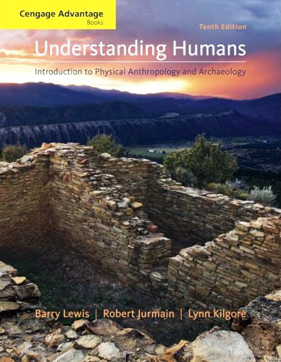
Class Slides Set 11A
Special Skills Used to Study Early Humans
. . . or how to make sense out of Ch. 8 of the text . . .
Prehistoric Cultures Tim Roufs’ section ©2009

Slide 2
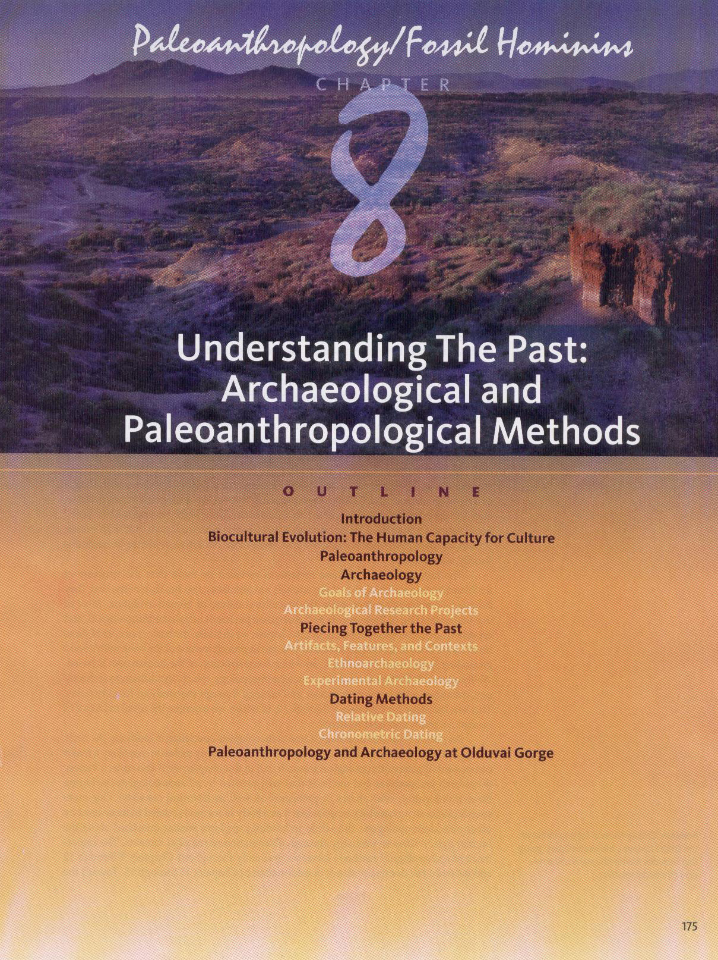

Slide 3
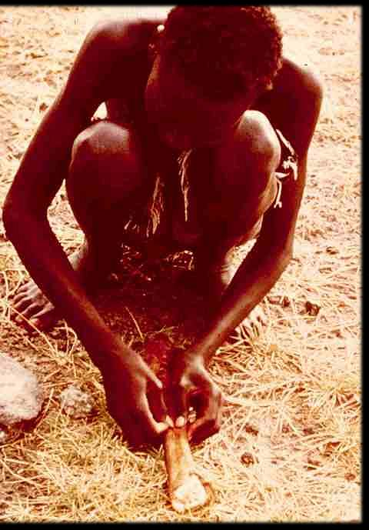
Class Slides Set 11A
Special Skills Used to Study Early Humans
Ethnoarchaeology and Ethnographic analogy

Slide 4
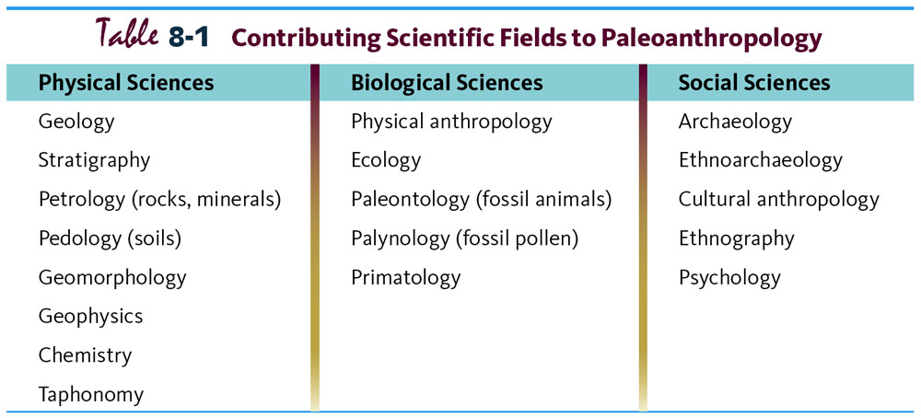
Multidisciplinary Study.
Understanding Humans, 10th Ed., p. 178.

Slide 5
Glossary
Ethnoarchaeology
the study of contemporary cultures to help understand the archaeological record

Slide 6
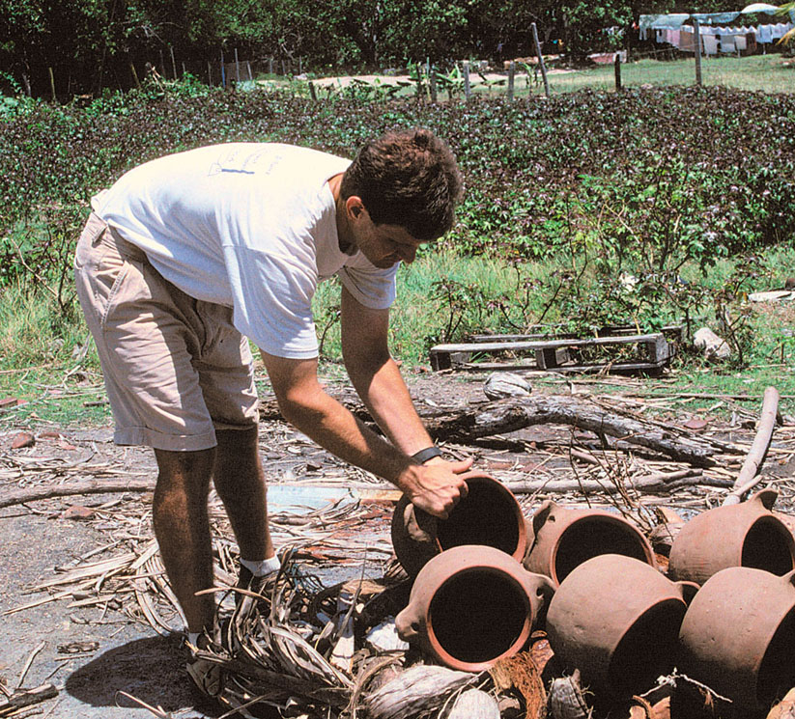
Colon Betts apprenticed himself to Afro-Caribbean potters . . .
to learn about regional pottery-making
Understanding Humans, 10th Ed., p. 186.

Slide 7
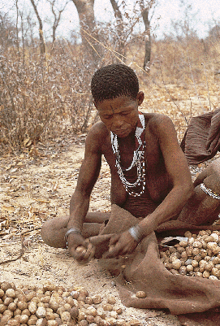
Hunting / Gathering

Slide 8
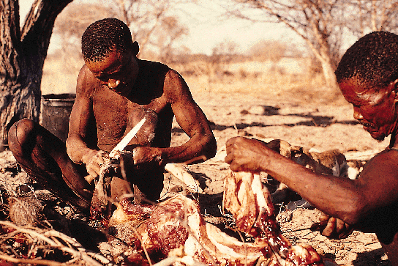
Hunting / Gathering

Slide 9
Ethnoarcheological Studies of !Kung Lifeways
Understanding Physical Anthropology and Archaeology, 8th Ed., p. 347.

Slide 10
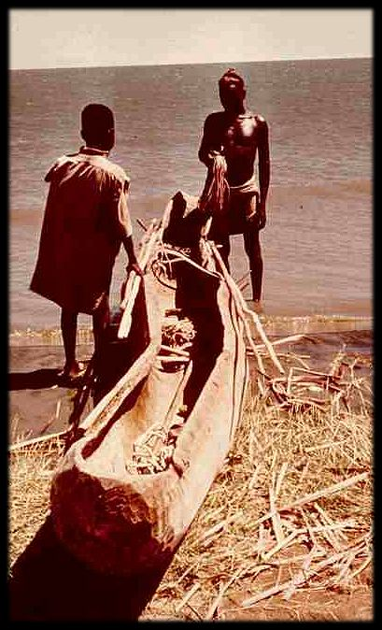

Slide 11
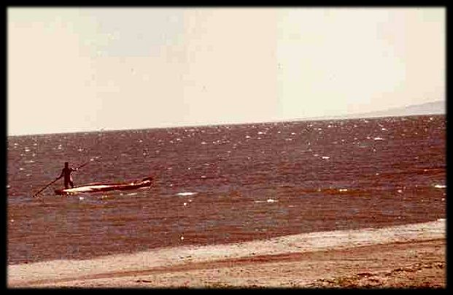

Slide 12
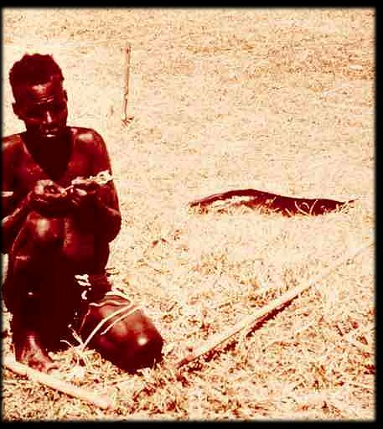

Slide 13
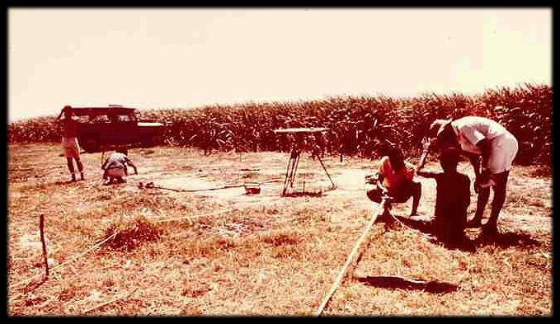

Slide 14
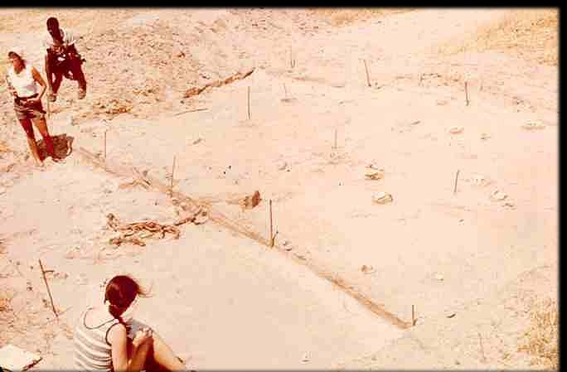

Slide 15
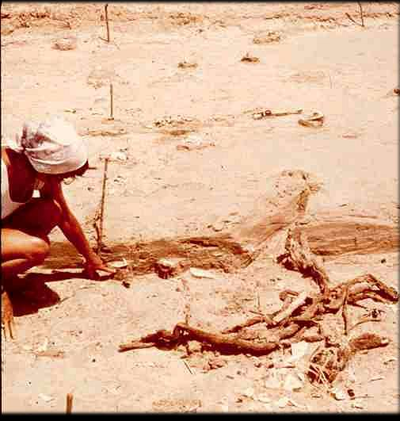

Slide 16
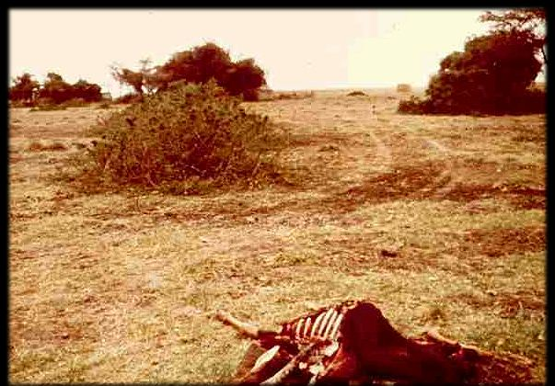

Slide 18
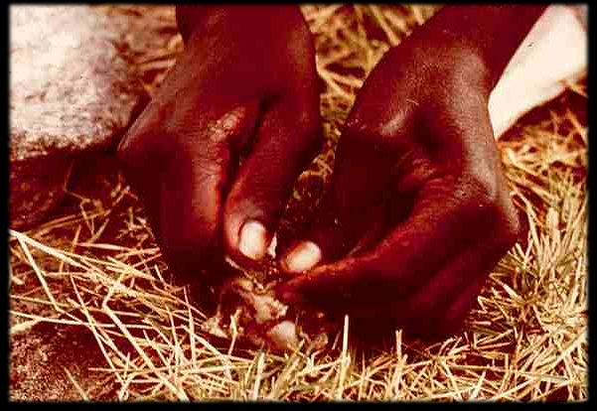

Slide 19
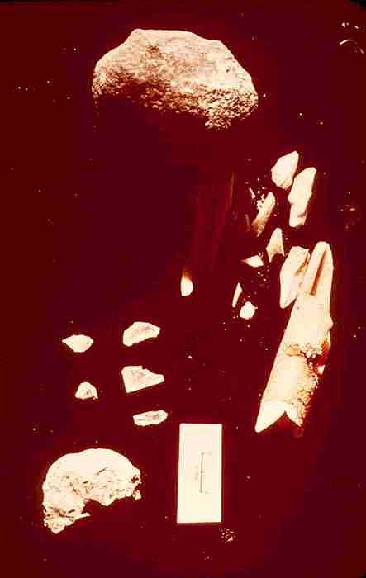

Slide 20
Glossary
Ethnographic analogy
the method of analysis which uses contemporary cultures as models to help understand the archaeological past

Slide 21
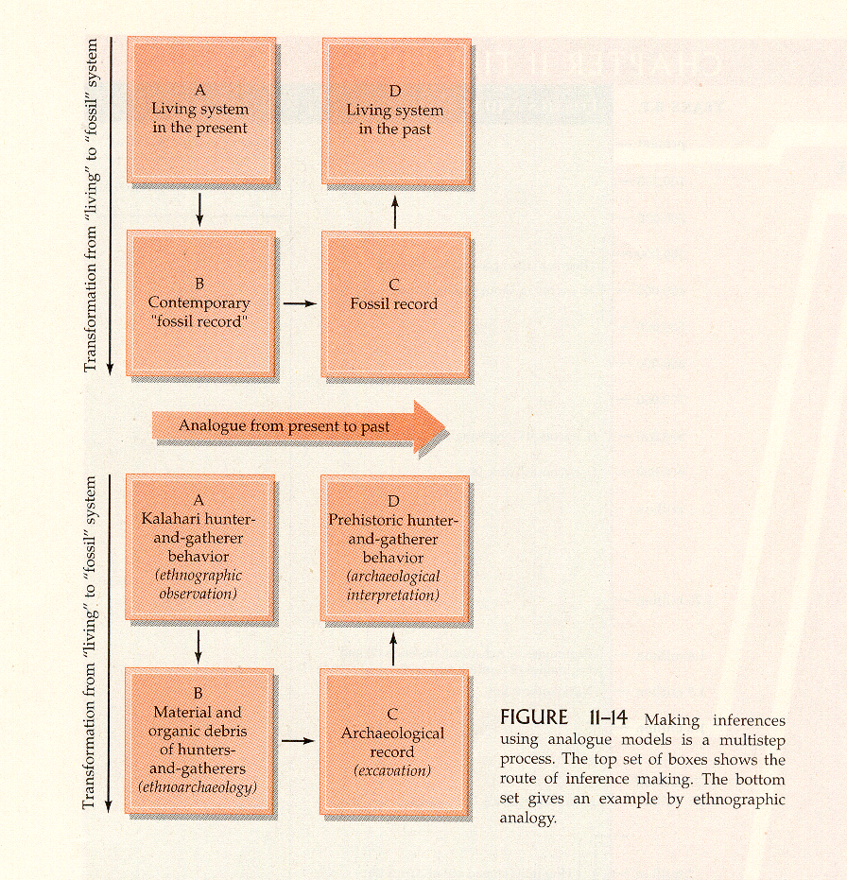
Humankind Emerging, 7th Ed., p. 345.

Slide 22
Some Important Concepts
^{Continue on to Slide Set 11B}

