Slide 1
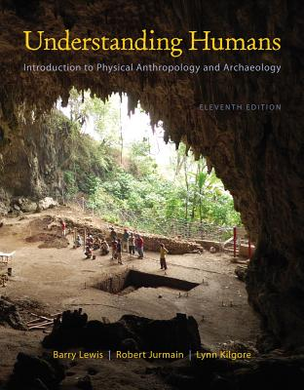
Class Slides Set 11A
Special Skills Used to Study Early Humans
. . . or how to make sense
out of
Ch. 8 of the text . . .
University of Minnesota Duluth
Tim Roufs
© 2010-2013
http://www.d.umn.edu/cla/faculty/troufs/anth1602/

Slide 2
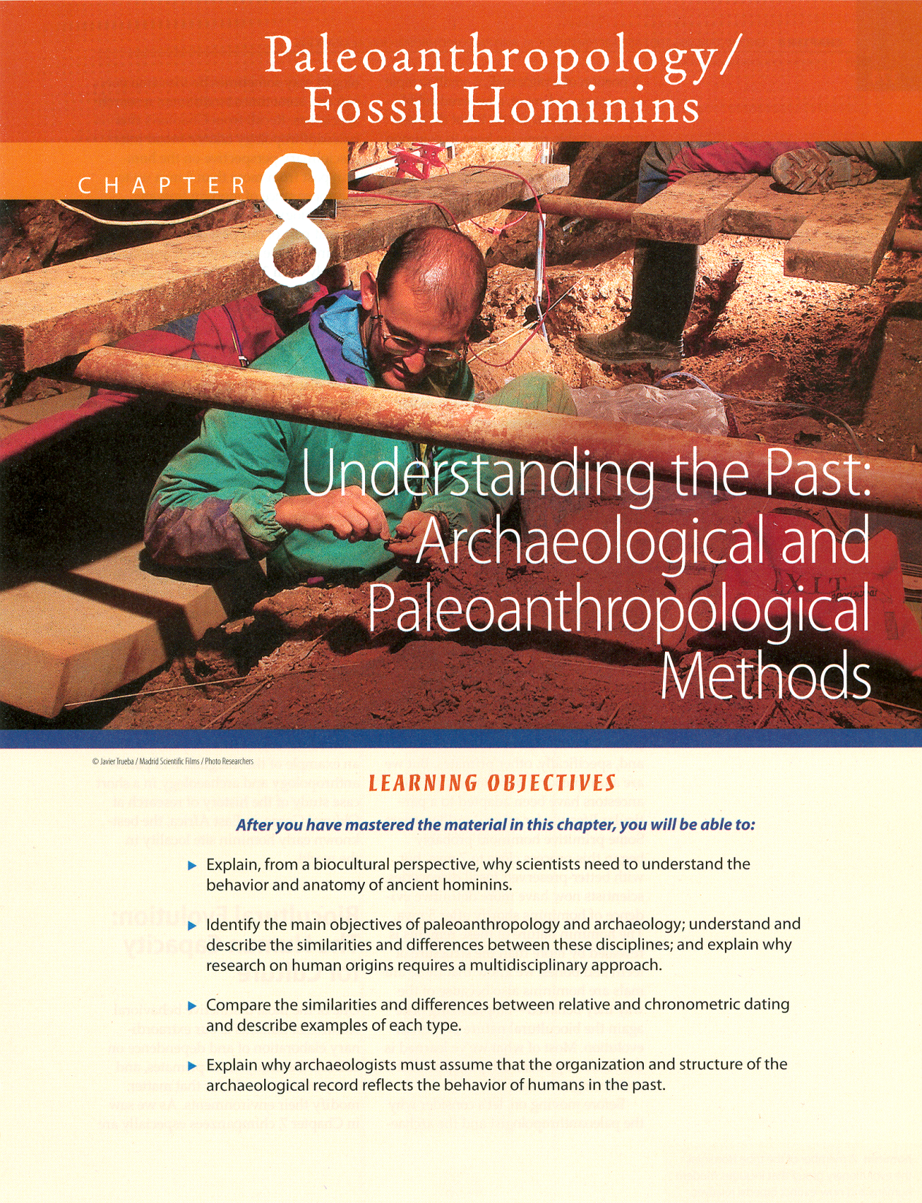

Slide 3
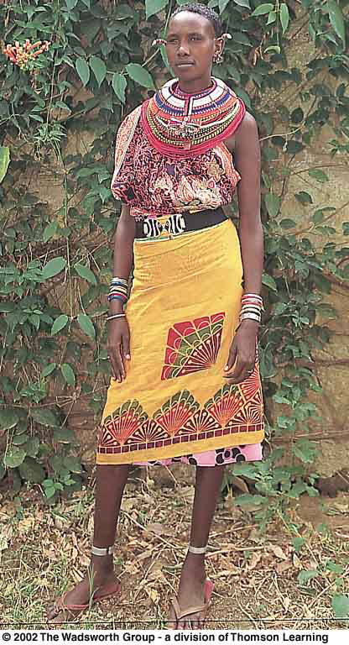
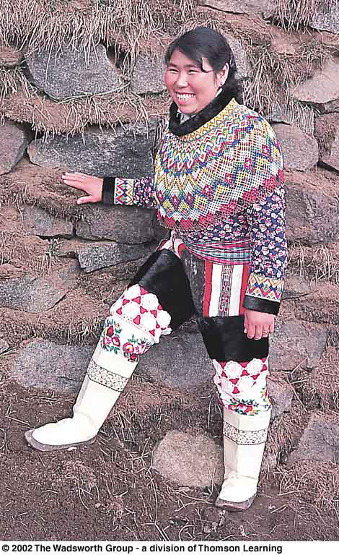
Class Slides Set 11B
Some Important Concepts
Misc.

Slide 4
Important Concepts
Some important
things you ought to know about . . .

Slide 5
Important Concepts
range of variation
statistical averages
“fossil”
“osteodontokeratic”
the “Three Great Ages of Prehistoric Times”

Slide 6
Important Concepts
range of variation
statistical averages
“fossil”
“osteodontokeratic”
the “Three Great Ages of Prehistoric Times”

Slide 7
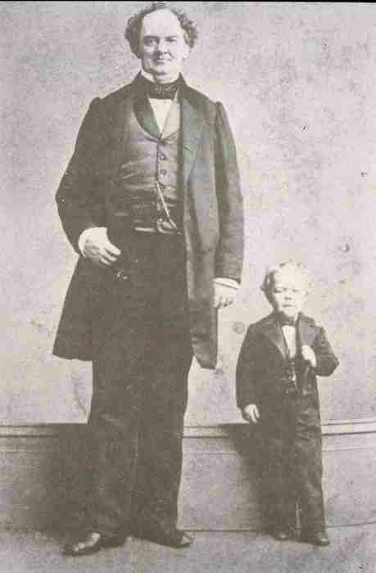
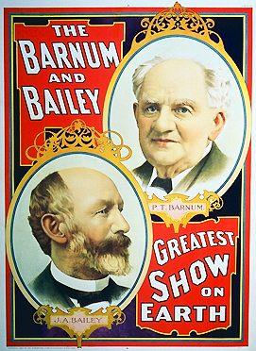
Phineas T. Barnum
1810 - 1891
George Washington Morrison
("Commodore") Nutt
29” tall
1844 - 1881

Slide 8
Range of Variation
Understanding Humans, 10th Ed., p. 89.

Slide 9
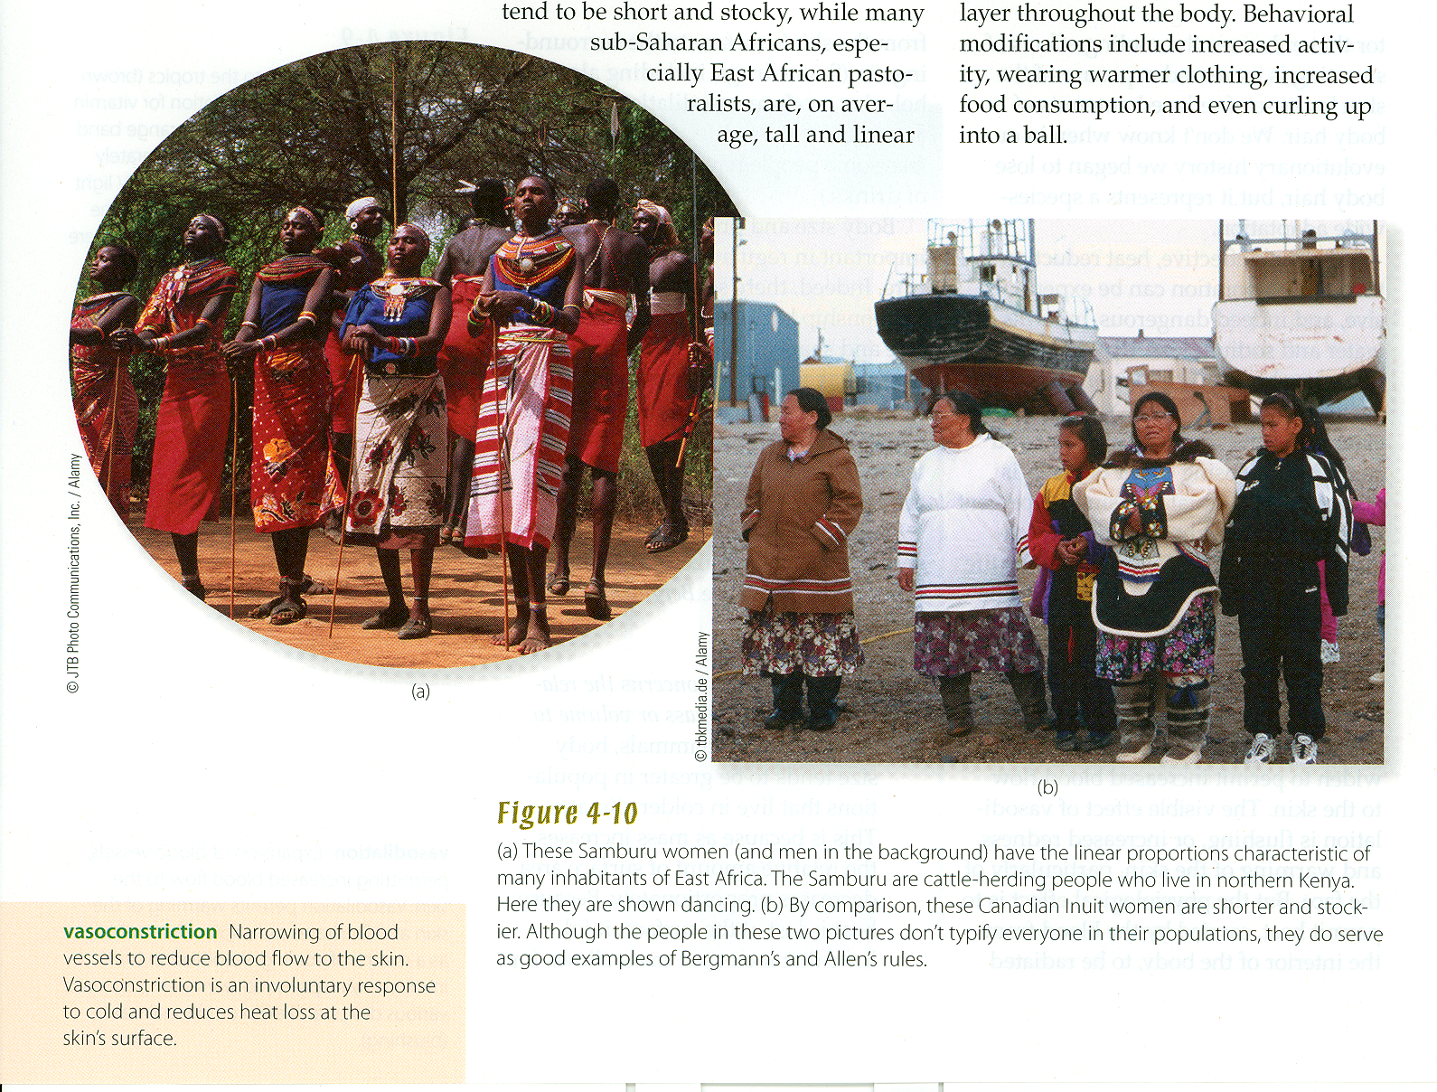
Range of Variation
Understanding Humans, 11th Ed., p. 86

Slide 10
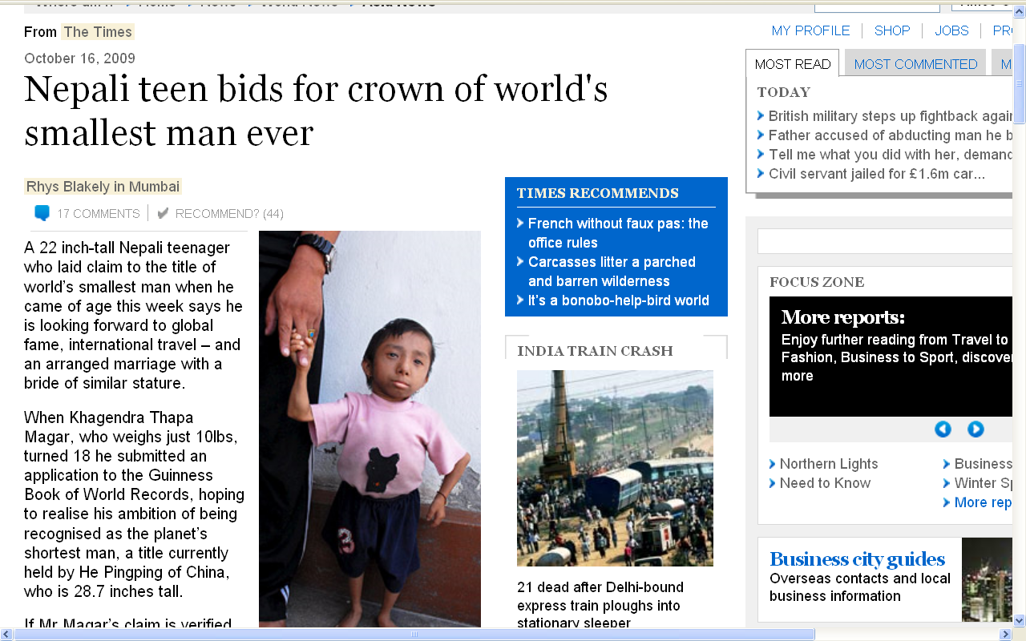
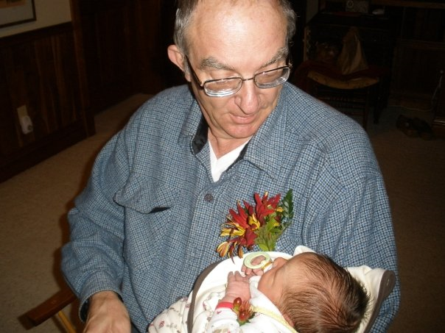
Eli Campbell Roufs
10 lb., 6 oz.
1 min. old
10 lb.,
28.7 in. tall
18 years old
http://www.timesonline.co.uk/tol/news/world/asia/article6876941.ece

Slide 11
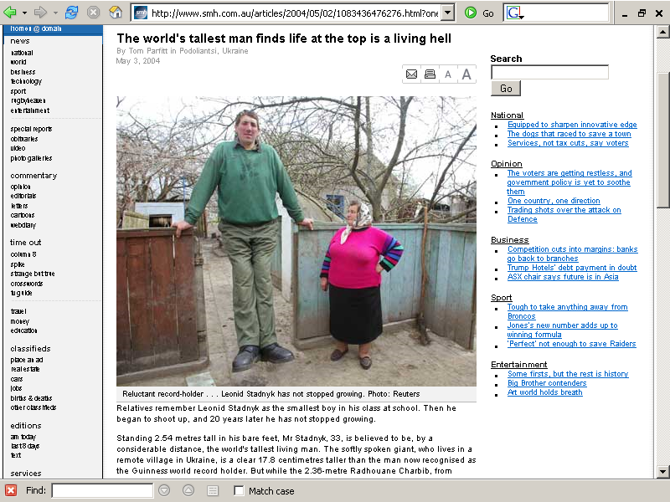
2.54 meters tall
(100 “ = 8’ 3-1/2”)
20 years old
www.sciam.com/article.cfm?chanID=sa003&articleID=000C1A68-BA52-11F6-BA5283414B7F0000

Slide 12
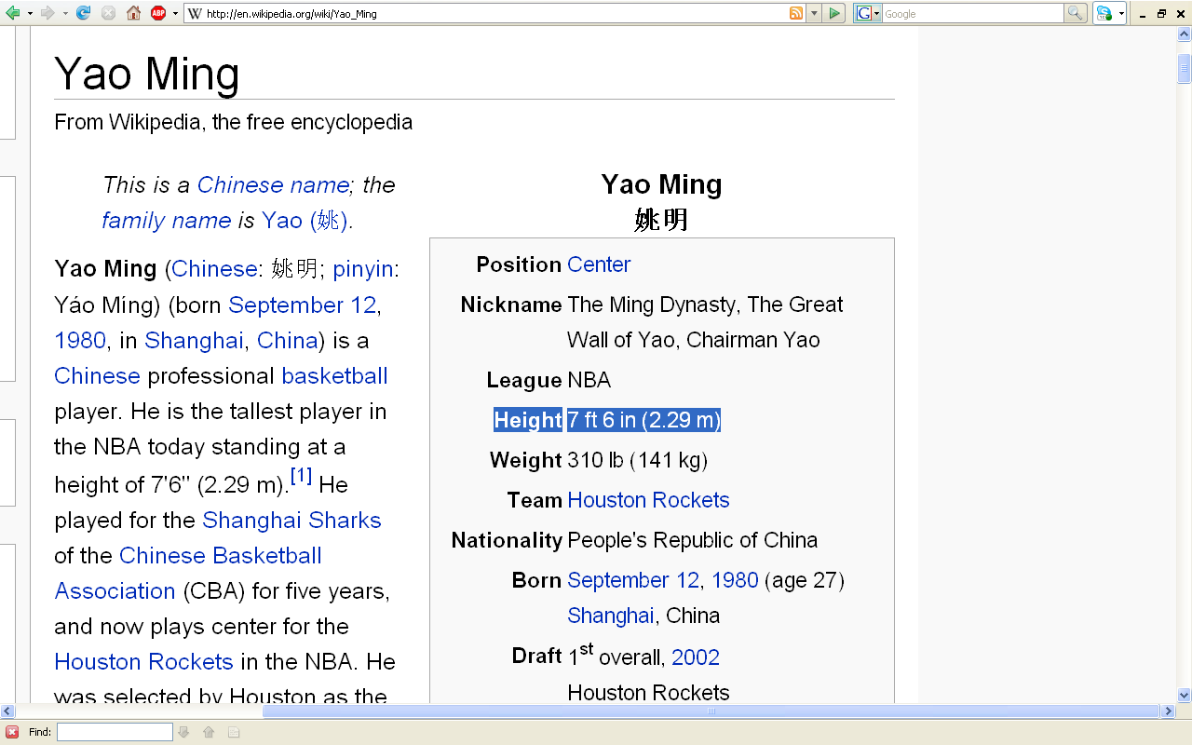
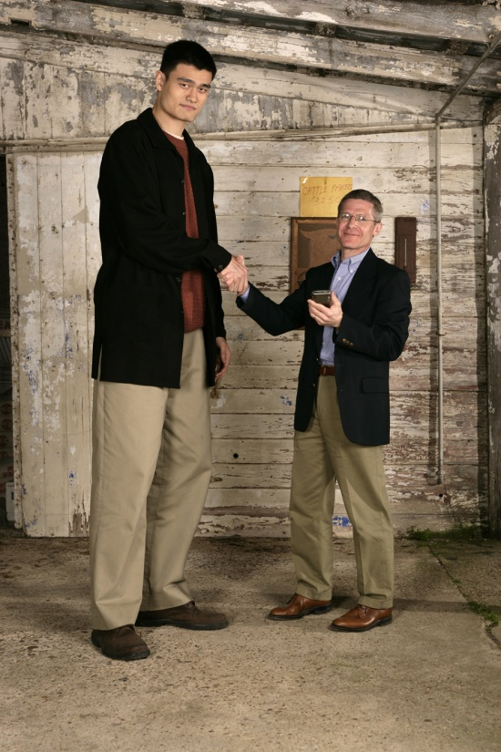
http://en.wikipedia.org/wiki/Yao_Ming
Notes:
12

Slide 13
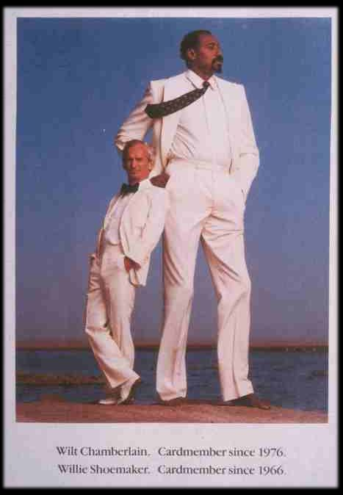

Slide 14
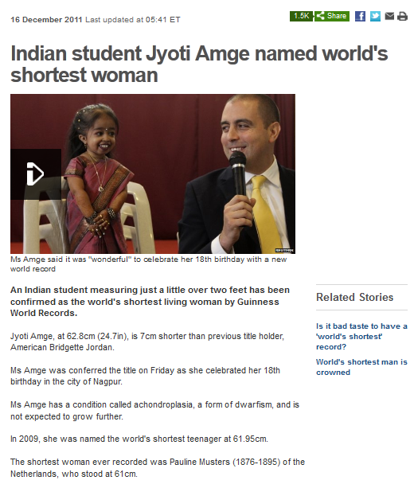
24.7 in. tall
18 years old
24.02 in. tall
http://www.bbc.co.uk/news/world-asia-india-16212541

Slide 15
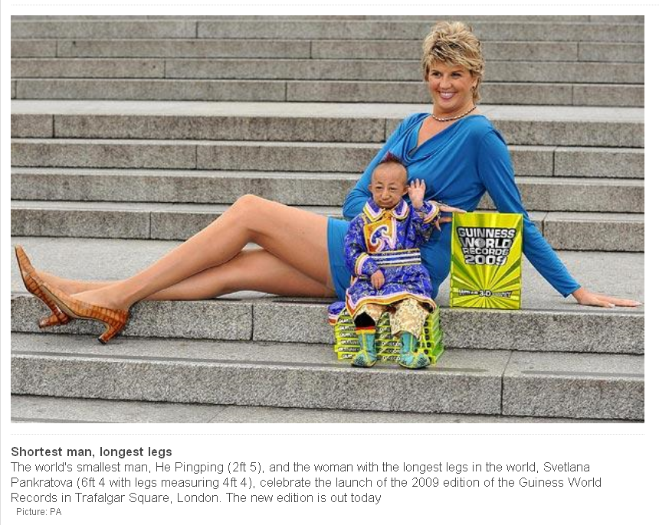
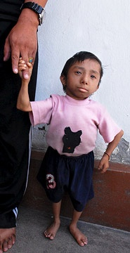
16 October 2009
http://www.telegraph.co.uk/news/newstopics/howaboutthat/2969038/Worlds-smallest-man-meets-woman-with-worlds-longest-legs.html
Notes:
15

Slide 16
http://www.telegraph.co.uk/news/newstopics/howaboutthat/2969038/Worlds-smallest-man-meets-woman-with-worlds-longest-legs.html
Notes:
16

Slide 17
Pygmies

Slide 18
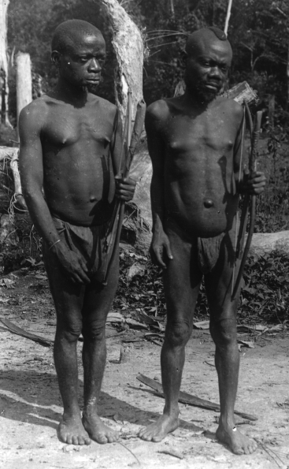
Efe
Eastern Congo
(formerly Zaire)
Average Height
male 4’ 8”
female 4’ 5”
Pygmies 1904
Source: Boaz and Almquist Biological Anthropology, 2nd ed.
(Prentice Hall, 2002), p. 426

Slide 19
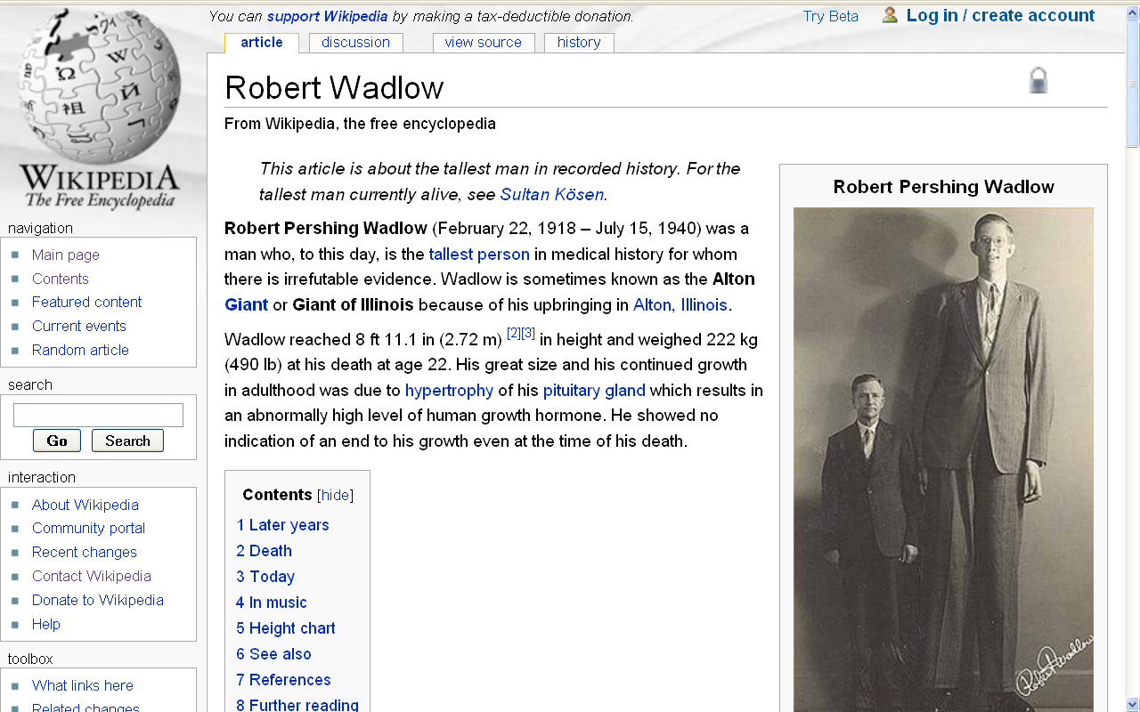
Tallest man in recorded history
8 ft. 11.1 in
(2.72 m)
http://en.wikipedia.org/wiki/Robert_Wadlow

Slide 20
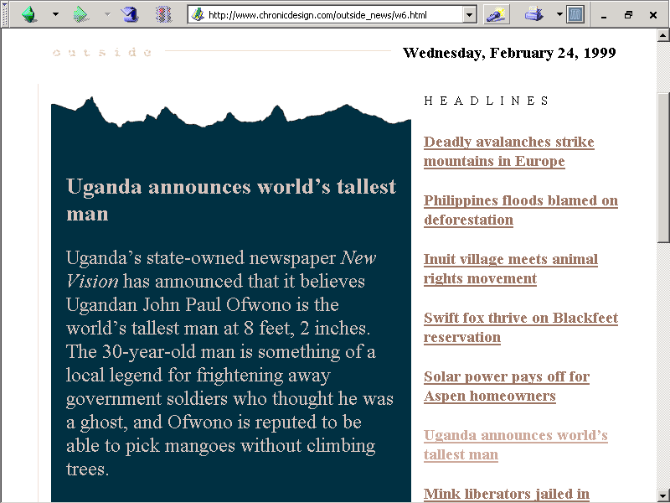
Tallest living man
8 ft. 2 in.
The world's tallest woman is Sandy Allen. She is 7 ft. 7 in.
Robert Pershing Wadlow (1918-1940), Alton, IL, was 8 ft. 11. in.

Slide 21
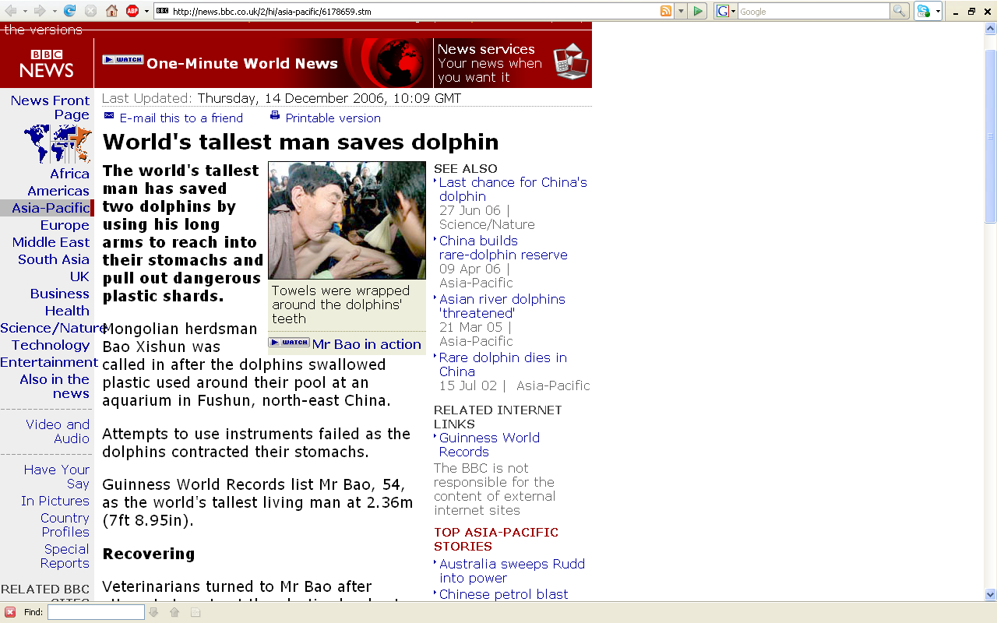
This tallest living man
7 ft. 8.95 in.
http://news.bbc.co.uk/2/hi/asia-pacific/6178659.stm
Notes:
21

Slide 22
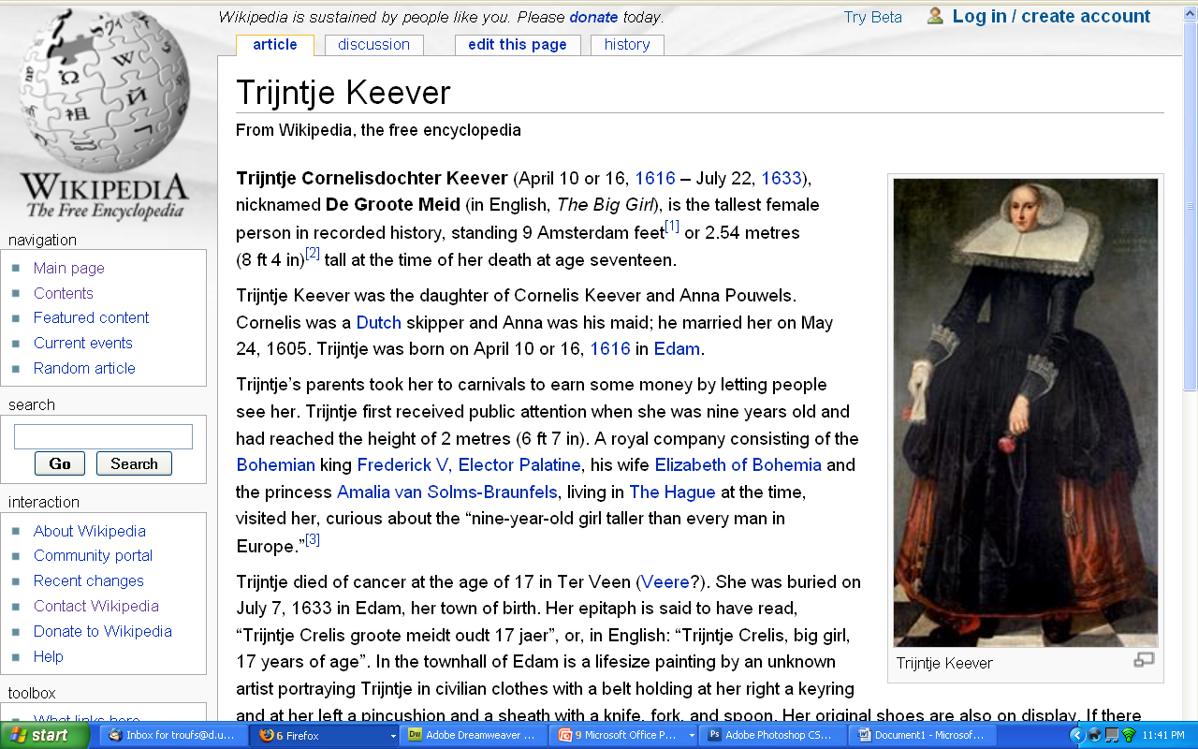
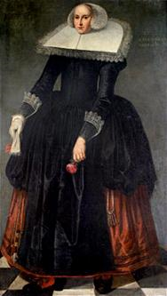
Tallest woman in recorded history
8 ft. 4 in
(2.54 m)
http://en.wikipedia.org/wiki/Trijntje_Keever

Slide 23
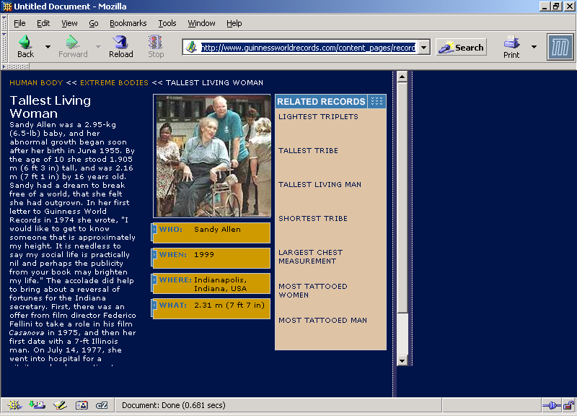
Tallest living woman
7 ft. 7 in.
Robert Pershing Wadlow (1918-1940), Alton, IL, was 8 ft. 11. in.

Slide 24
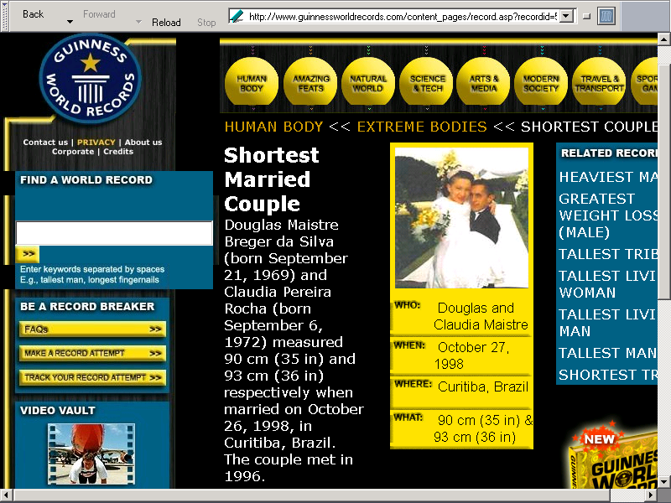
Shortest Married Couple
35 in. and 36 in.
www.guinnessworldrecords.com/content_pages/record.asp?recordid=53034

Slide 25
The Guiness Book of Records
”The Most Dissimilar
Couple in the World”
Wife: 2’ 11½”
Husband: 6’ 2”
They met on the internet
-- The Maury Show, 27 April 1999

Slide 26
Important Concepts
range of variation
statistical averages
“fossil”
“osteodontokeratic”
the “Three Great Ages of Prehistoric Times”

Slide 27
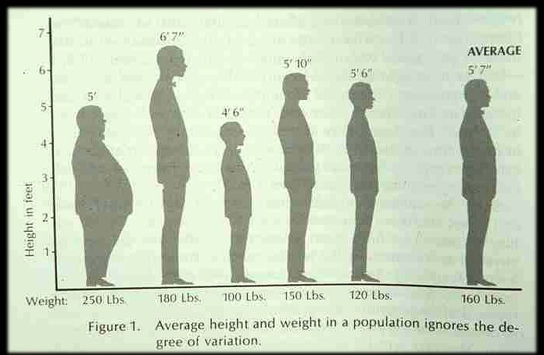

Slide 28
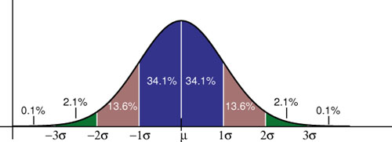
“normal distribution curve”
--- 2.2 % ---
--- 68.2 % ---
--- 2.2 % ---
------------------------- 99.8 % -------------------------
Notes:
28

Slide 29
“normal distribution curve”
---- 2.2 % ----
--- 68.2 % ---
---- 2.2 % ----
------------------------------- 99.8 % -------------------------------

Slide 30
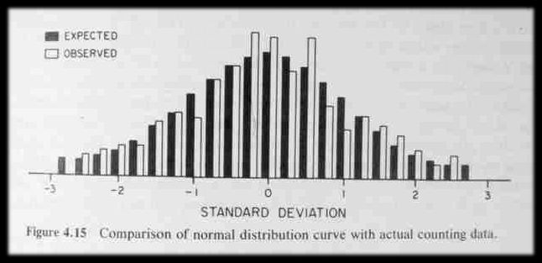
“normal distribution curve”
-- 2 ½ % --
------ 68 % ------
-- 2 ½ % --
------------------------------ 99 % -------------------------------

Slide 31
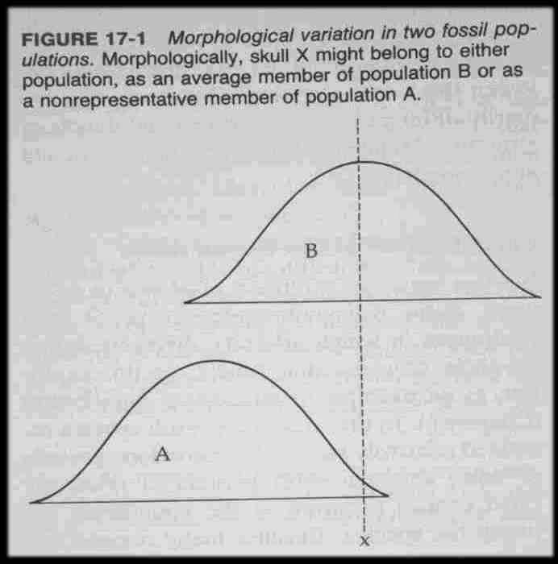

Slide 32
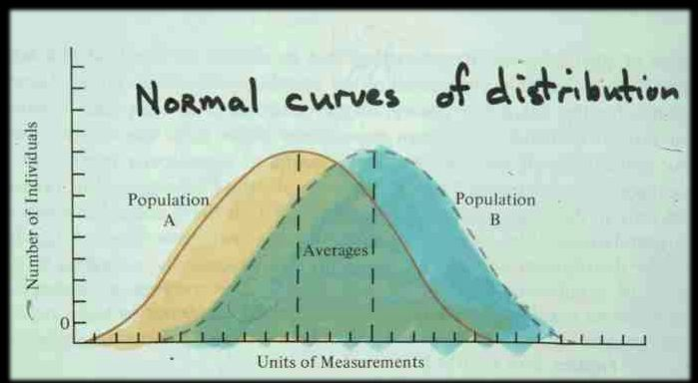

Slide 33
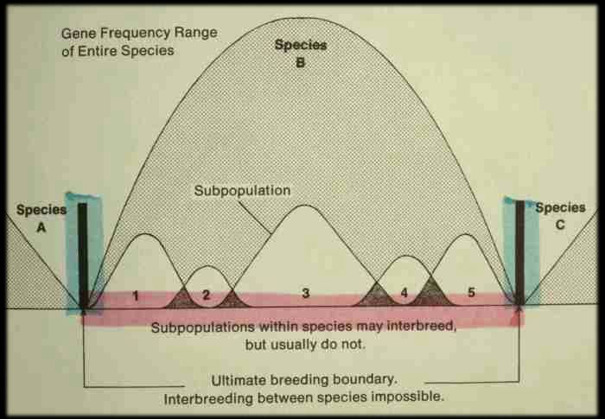

Slide 34
Important Concepts
range of variation
statistical averages
“fossil”
“osteodontokeratic”
the “Three Great Ages of Prehistoric Times”

Slide 35
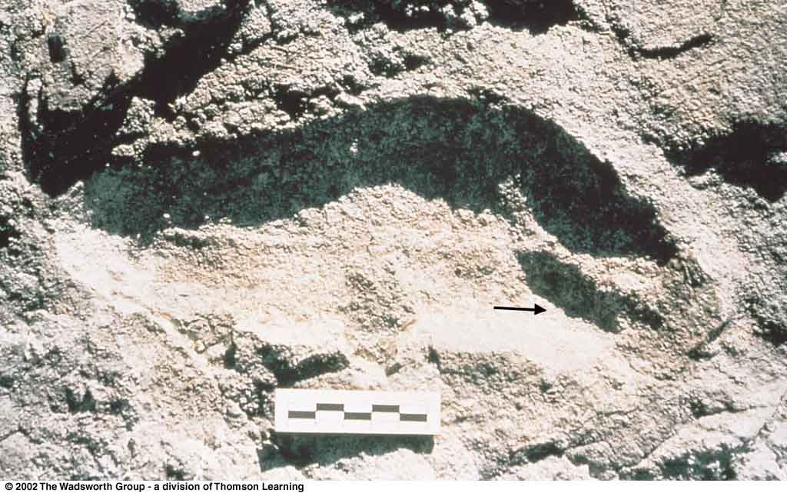
Important Concepts
fossil
any impression, or trace, of an animal or plant of past geological ages
-- including /
footprints
or tracks
Hominid footprint from Laetoli, Tanzania

Slide 36
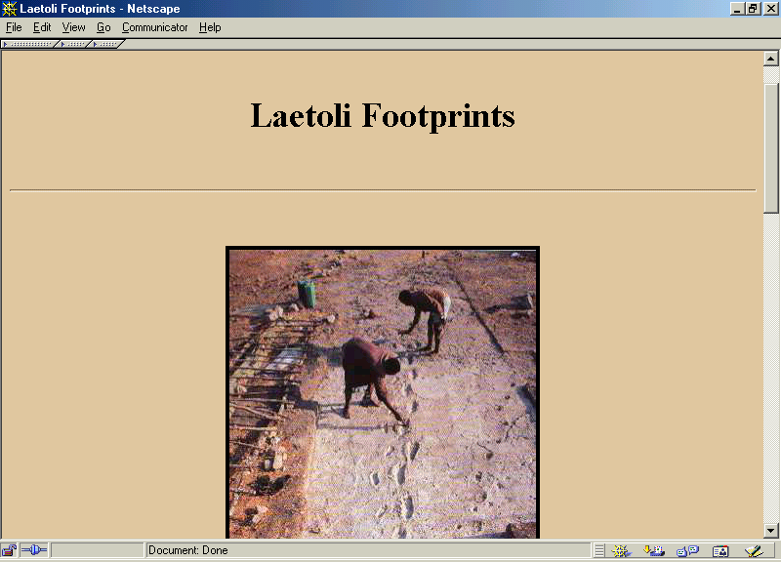
Mary
Leakey

Slide 37
Important Concepts
range of variation
statistical averages
“fossil”
“osteodontokeratic”
the “Three Great Ages of Prehistoric Times”

Slide 38
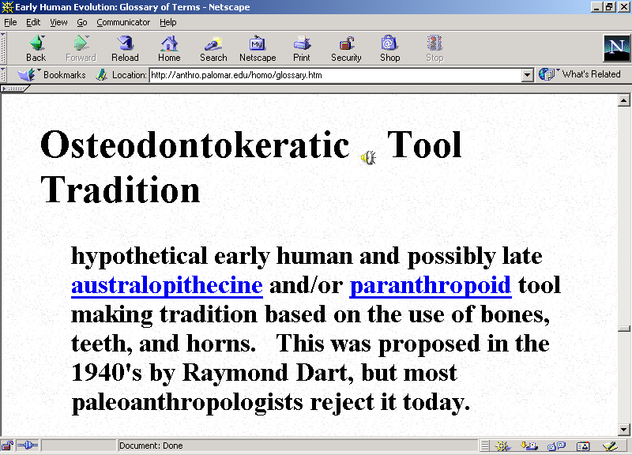

Slide 39
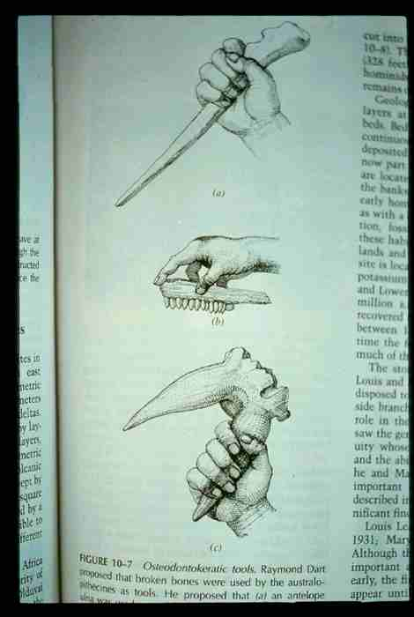
osteo =
"bone"
donto =
"tooth"
keratic =
"horn"

Slide 40
Tools and Technologies
bone, tooth, horn / antler
lithic (stone)
Notes:
40

Slide 41
Glossary
osteodontokeratic
osteo = "bone"
donto = "tooth"
keratic = "horn"

Slide 42
Glossary
osteodontokeratic
osteo = "bone"

Slide 43
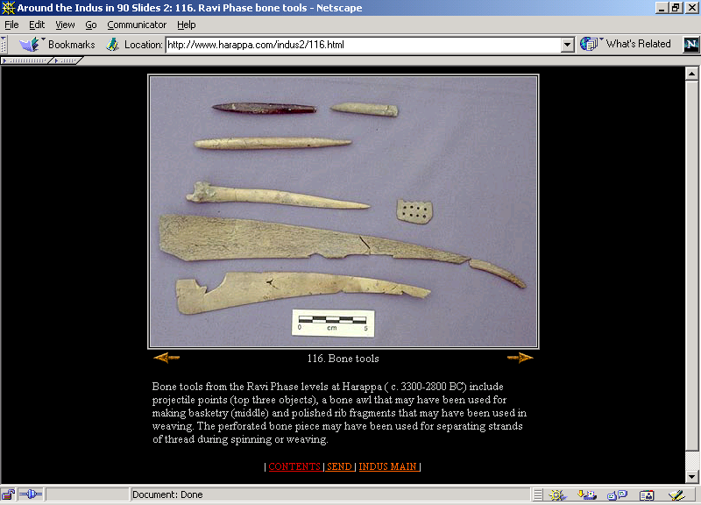
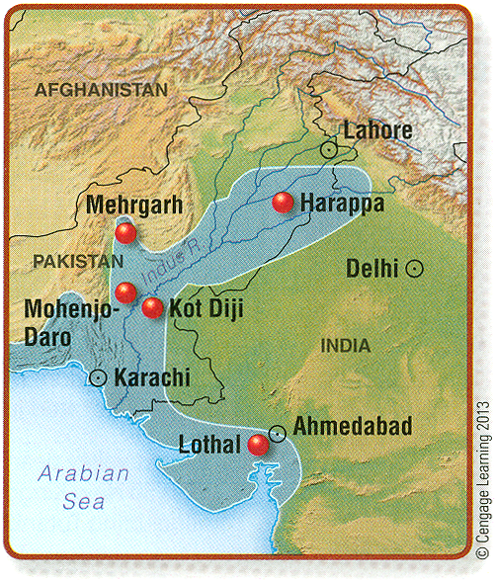
11th p. 388
Harappa (c. 3300-2800 B.C.)
Notes:
43

Slide 44
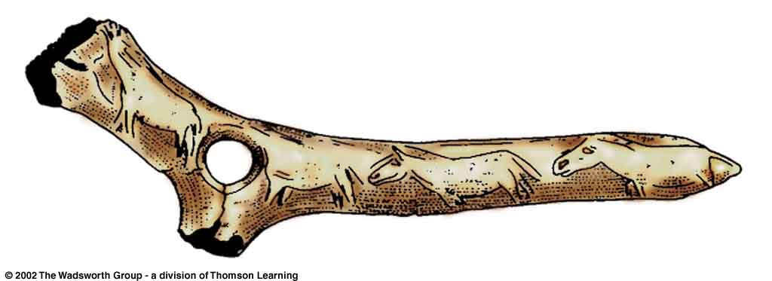
^{Magdalenian bone artifact.}
Understanding Physical Anthropology and Archaeology (9th ed), p. 292.
Notes:
44

Slide 45
Glossary
osteodontokeratic
osteo = "bone"
donto = "tooth"

Slide 46
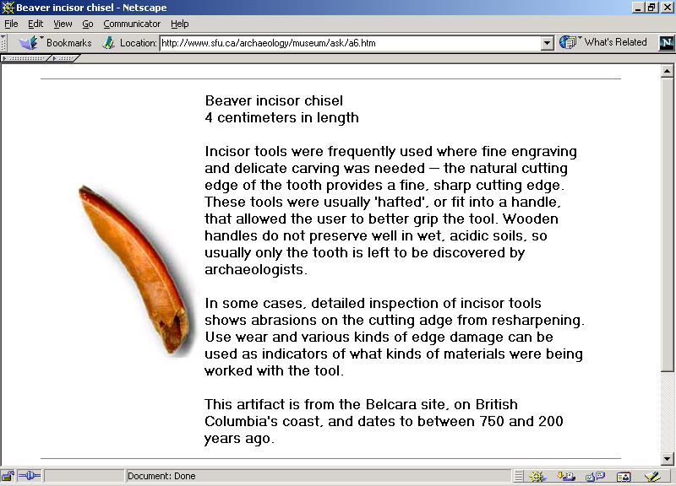
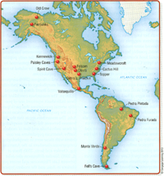
11th p. 315
http://www.sfu.ca/archaeology/museum/ask/a6.htm
Notes:
46

Slide 47
Glossary
osteodontokeratic
osteo = "bone"
donto = "tooth"
keratic = "horn"

Slide 48
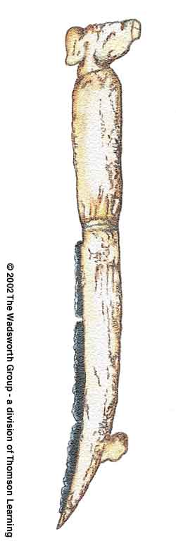
Reconstruction of a Natufian gazelle horn reaping knife,
^{with inset flint blades.}
Understanding Physical Anthropology and Archaeology (9th ed), p. 328.
Notes:
48

Slide 49
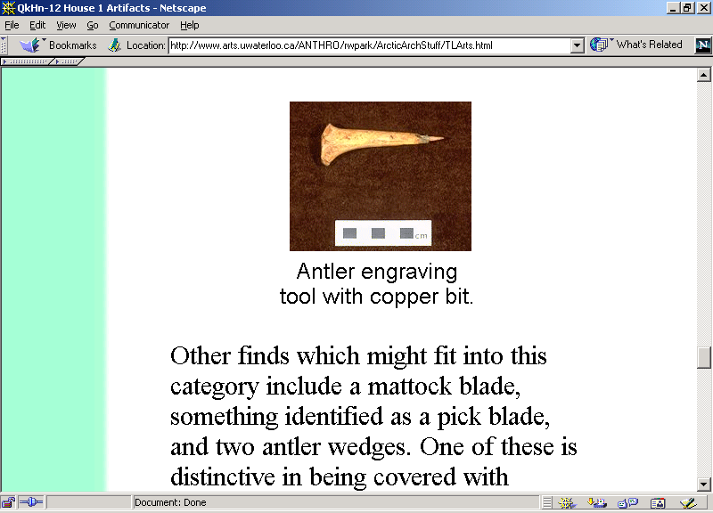
11th p. 315
Devon Island, High Arctic Canada.
www.arts.uwaterloo.ca/ANTHRO/rwpark/ArcticArchStuff/TLArts.html
Notes:
49

Slide 50
Tools and Technologies
bone, tooth, horn / antler
lithic (stone)
Notes:
50

Slide 51
Important Concepts
range of variation
statistical averages
“fossil”
“osteodontokeratic”
the “Three Great Ages of Prehistoric Times”

Slide 52
Time Periods
Three Great Ages of Prehistoric Time
(Jurgensen Thomsen, 1807)

Slide 53
Time Periods
Three Great Ages of Prehistoric Time
Iron Age
Bronze Age
Stone Age
(Jurgensen Thomsen, 1807)

Slide 54
Time Periods
Three Great Ages of Prehistoric Time
Iron Age
Bronze Age
Stone Age
(Jurgensen Thomsen, 1807)

Slide 55
Time Periods
“The Stone Age”

Slide 56
Time Periods
“The Stone Age”
Neolithic
“The New Stone Age”
Mesolithic
“The Middle Stone Age”
Paleolithic
“The Old Stone Age”

Slide 57
Important Concepts

