Slide 1
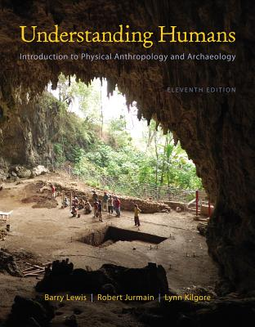
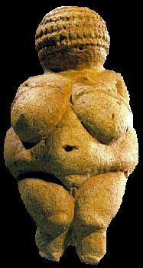
Class Slides Set 21
Tools and Technologies I
University of Minnesota Duluth
Tim Roufs
© 2010-2013
http://www.d.umn.edu/cla/faculty/troufs/anth1602/

Slide 2
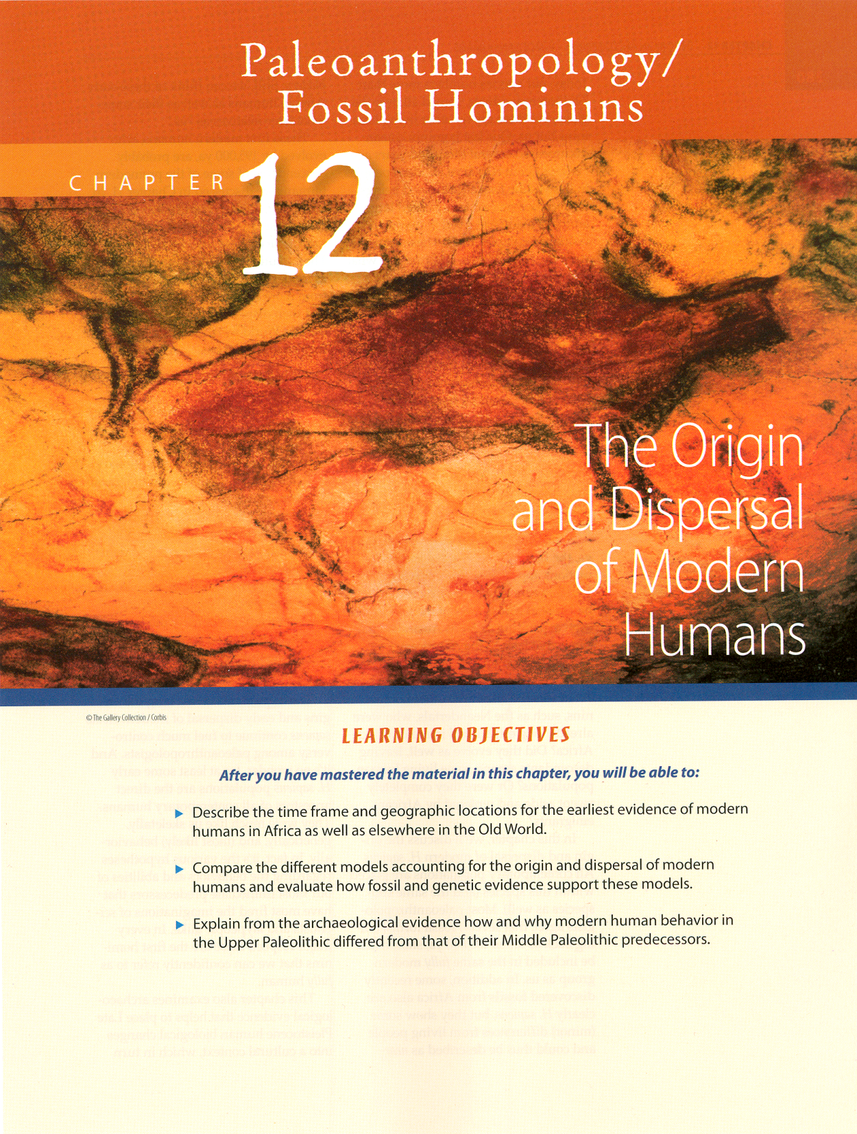
. . . or how to make sense
out of
Ch. 12 of the text . . .

Slide 3
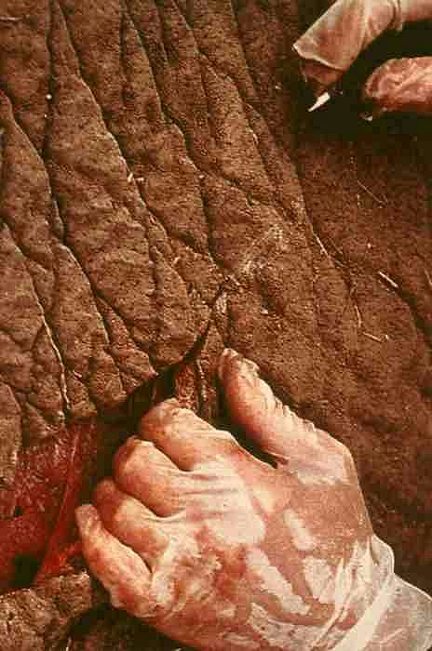
Tools and Technologies I
Introduction:
Basic Terms / Basic Types
University of Minnesota Duluth
Tim Roufs
© 2010-2013

Slide 4
Tools and Technologies
bone, tooth, horn / antler
lithic (stone)
Notes:
4

Slide 5
Tools and Technologies
bone, tooth, horn / antler
lithic (stone)
Notes:
5

Slide 6
Important Concepts
range of variation
statistical averages
“fossil”
“osteodontokeratic”
the “Three Great Ages of Prehistoric Times”

Slide 7
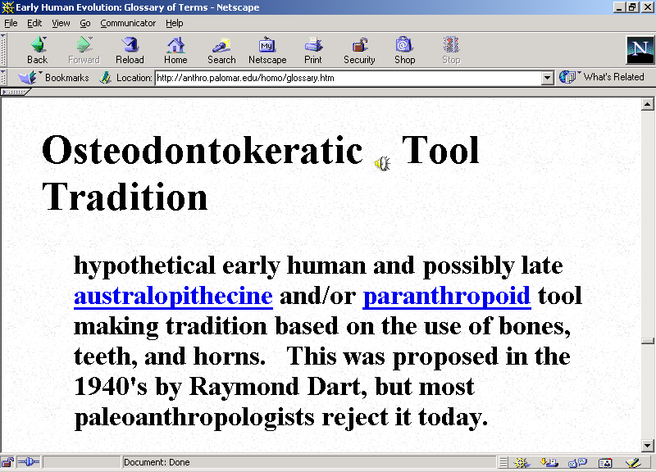

Slide 8
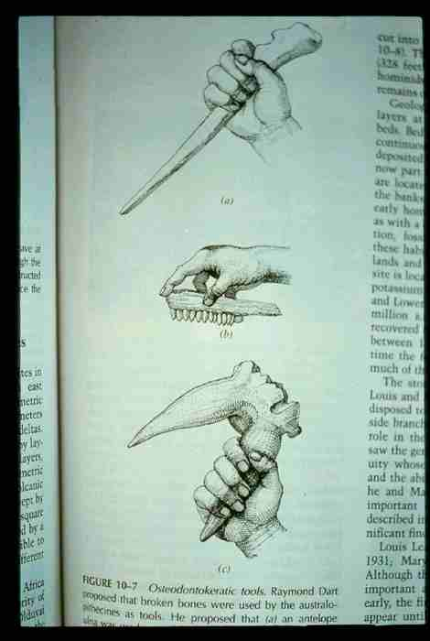
Glossary
osteodontokeratic
osteo = "bone"
donto = "tooth"
keratic = "horn"

Slide 9
Glossary
osteodontokeratic
osteo = "bone"

Slide 10
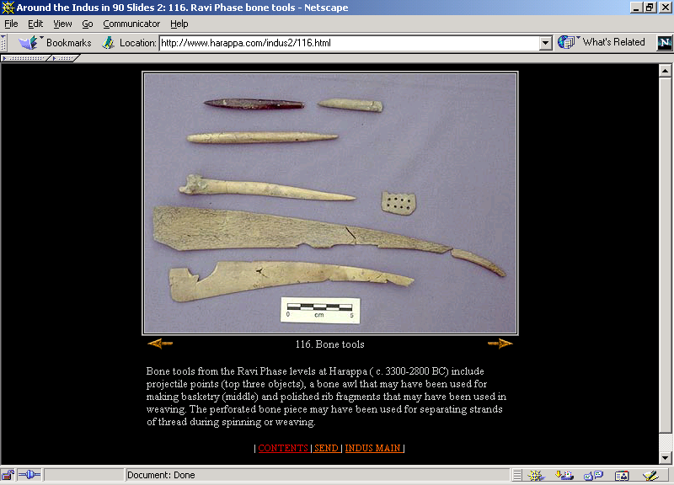
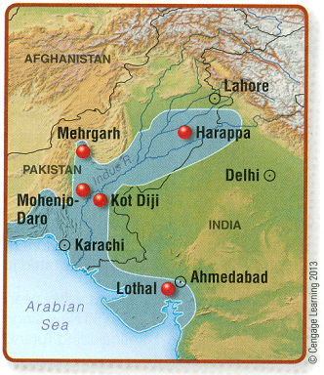
11th p. 388
Harappa (c. 3300-2800 B.C.)
Notes:
10

Slide 11
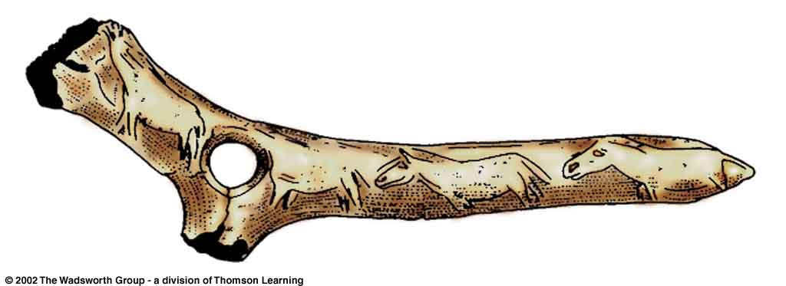
^{Magdalenian bone artifact.}
Understanding Physical Anthropology and Archaeology (9th Ed.), p. 292
Notes:
11

Slide 12
Glossary
osteodontokeratic
osteo = "bone"
donto = "tooth"

Slide 13
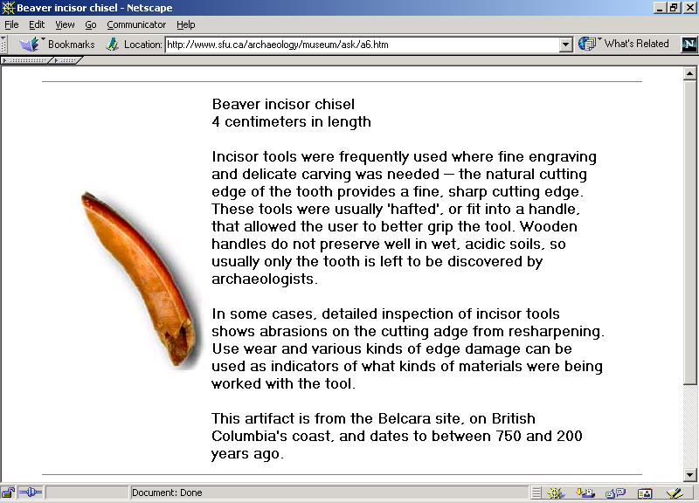
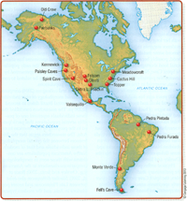
11th p. 315
http://www.sfu.ca/archaeology/museum/ask/a6.htm
Notes:
13

Slide 14
Glossary
osteodontokeratic
osteo = "bone"
donto = "tooth"
keratic = "horn"

Slide 15
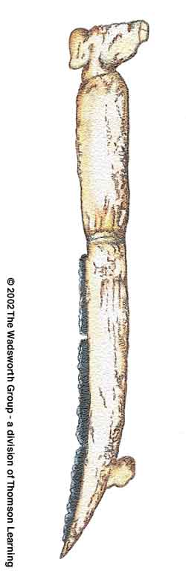
Reconstruction of a Natufian gazelle horn reaping knife,
^{with inset flint blades.}
Understanding Physical Anthropology and Archaeology (9th Ed.), p. 328
Notes:
15

Slide 16
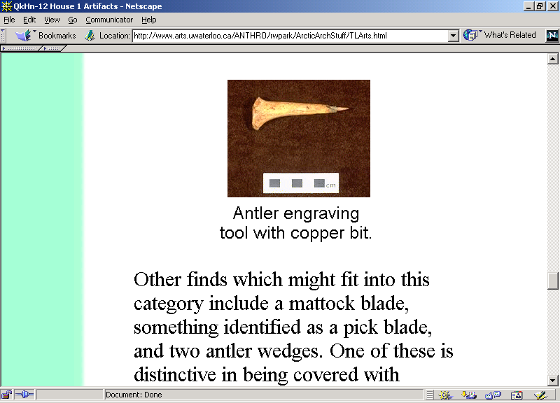
10th p. 321
Devon Island, High Arctic Canada.
www.arts.uwaterloo.ca/ANTHRO/rwpark/ArcticArchStuff/TLArts.html
Notes:
16

Slide 17
Tools and Technologies
bone, tooth, horn / antler
lithic (stone)
Notes:
17

Slide 18
Stone Tools and Technologies
lithic tools
basic types
basic techniques of manufacture
basic tool uses
Upper Paleolithic traditions

Slide 19
Glossary
tradition
horizon

Slide 20
Glossary
tradition
horizon

Slide 21
Glossary
tradition
similarity of elements over considerable time in a delimited area
  site, locality or region

Slide 22
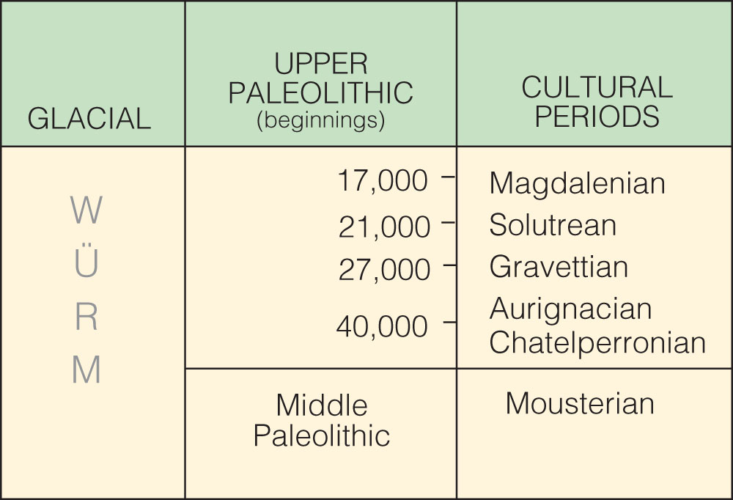
is the “culture”
the technique is called “Levallois”
Cultural periods of the European Upper Paleolithic.
Understanding Humans, 10th Ed., p. 257

Slide 23
Upper
Paleolithic
traditions
(SW France)
is the “culture”
the technique is called “Levallois”
Cultural periods of the European Upper Paleolithic.
Understanding Humans, 10th Ed., p. 257

Slide 24
Upper
Paleolithic
traditions
(SW France)
is the “culture”
the technique is called “Levallois”
Cultural periods of the European Upper Paleolithic.
Understanding Humans, 10th Ed., p. 257

Slide 25
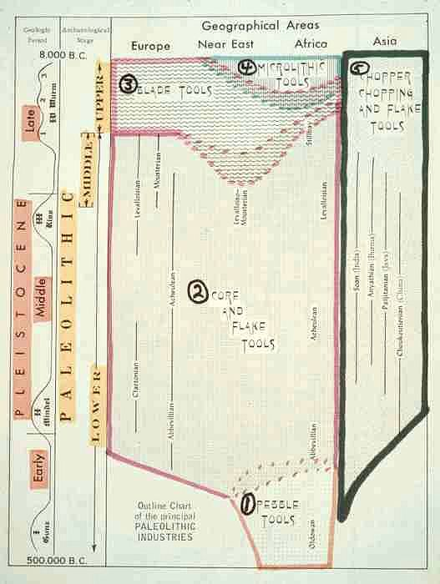
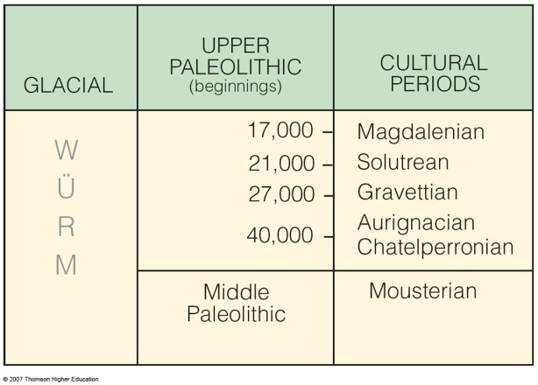
Upper
Paleolithic
traditions
(SW France)
10th p. 257

Slide 26
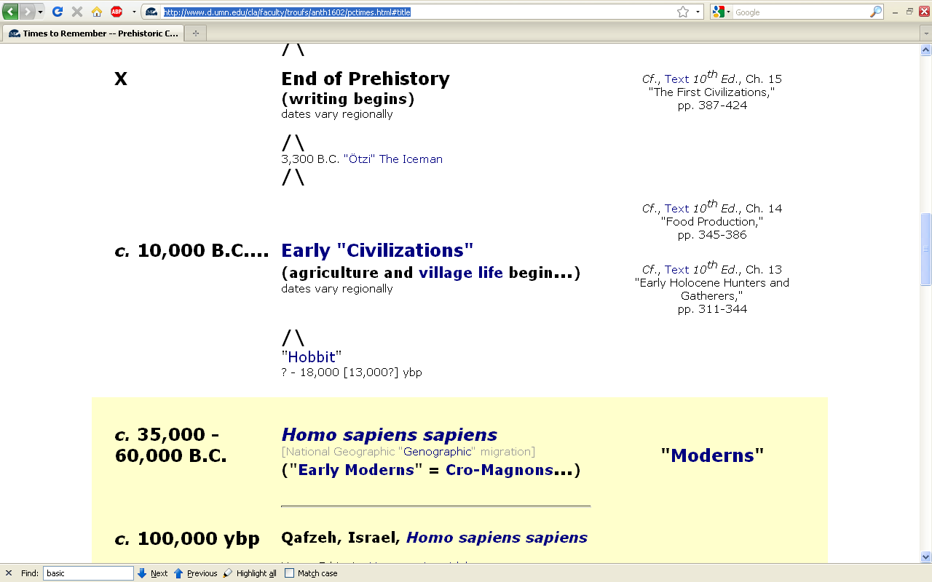
http://www.d.umn.edu/cla/faculty/troufs/anth1602/pctimes.html

Slide 27
is the “culture”
the technique is called “Levallois”
Cultural periods of the European Upper Paleolithic.
Understanding Humans, 10th Ed., p. 257

Slide 28
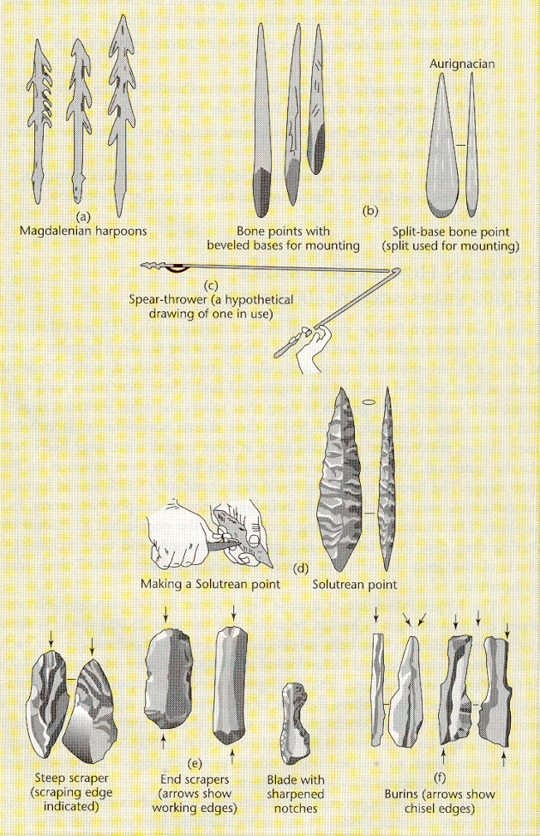
^{Solutrean}
Brian Fagan, People of the Earth, 10th Ed., p. 132

Slide 29
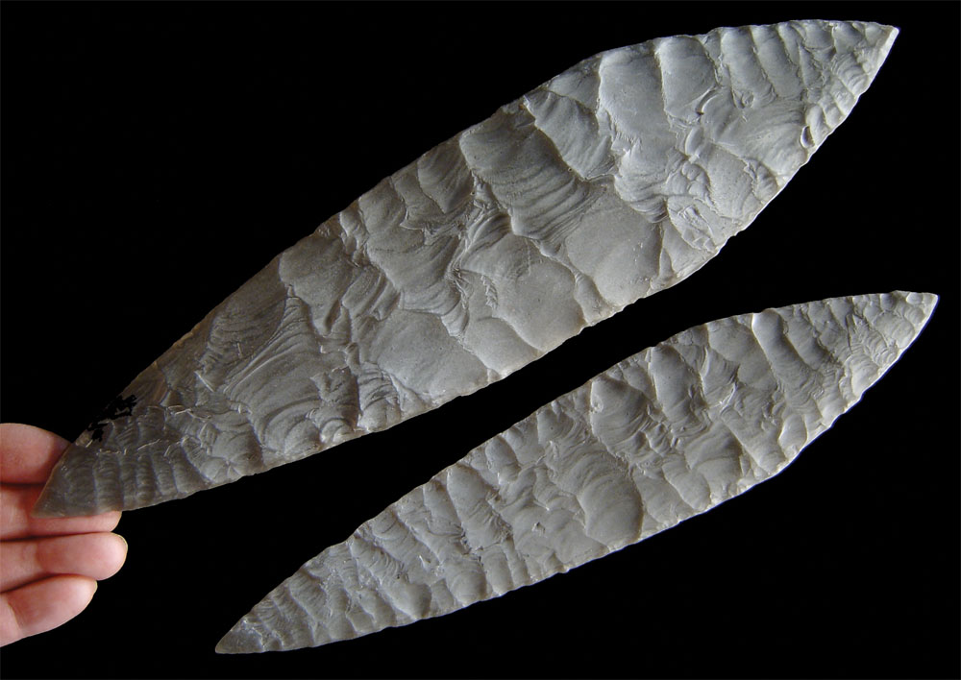
Solutrean blade
Understanding Humans, 10th Ed., p. 304

Slide 30
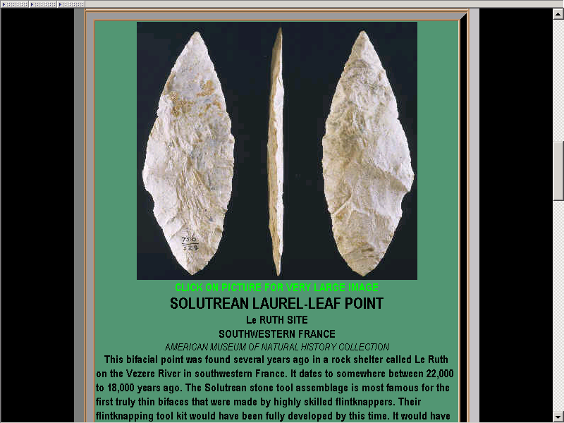
http://lithiccastinglab.com/gallery-pages/cloviswheredidcomefrompage2.htm

Slide 31
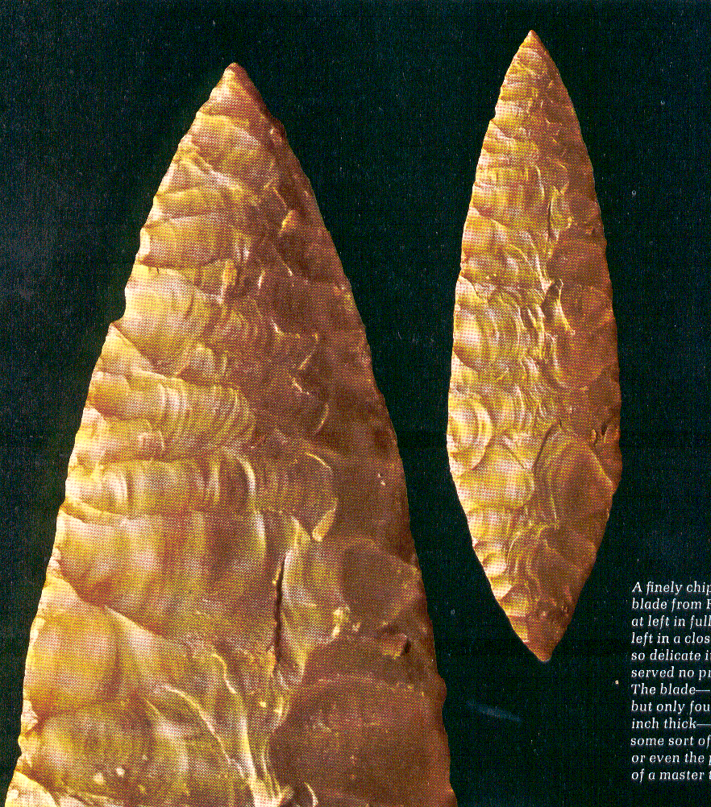
Solutrean
“laurel leaf” blade
France
Life Nature Library, Cro-Magnon, p. 60

Slide 32
is the “culture”
the technique is called “Levallois”
Cultural periods of the European Upper Paleolithic.
Understanding Humans, 10th Ed., p. 257

Slide 33
^{Magdalenian}
Brian Fagan, People of the Earth, 10th Ed., p. 132

Slide 34
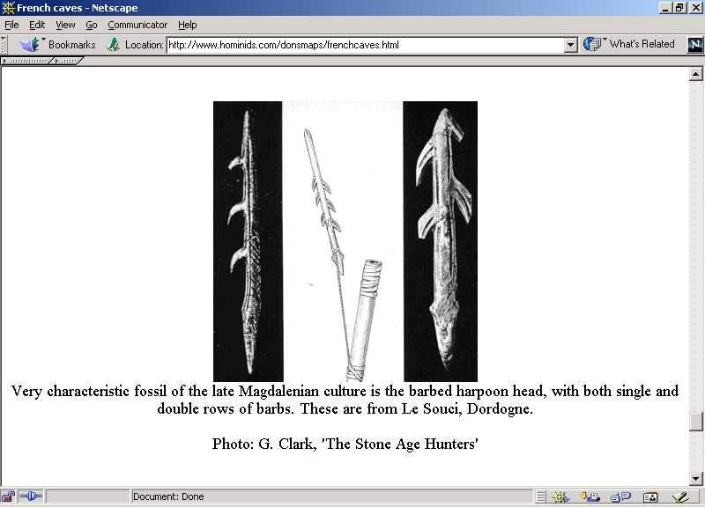
www.arts.uwaterloo.ca/ANTHRO/rwpark/ArcticArchStuff/TLArts.html

Slide 35
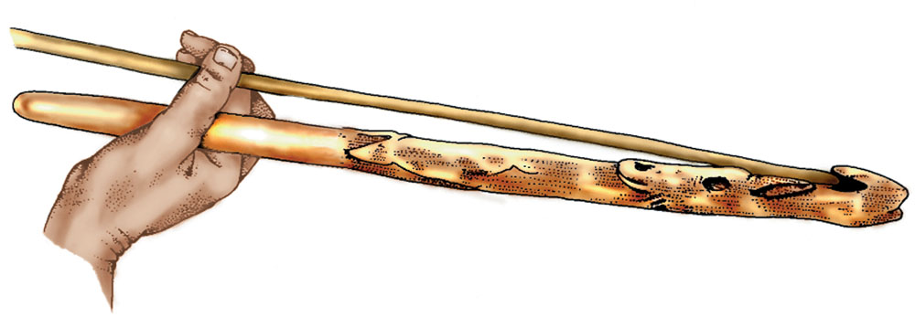
Magdalenian Spear-thrower (atlatl). Note the carving..
Understanding Humans, 11th Ed., p. 298

Slide 36

A modern example of an ancient idea..
Understanding Humans, 10th Ed., p. 302

Slide 37
Glossary
tradition
horizon

Slide 38
Glossary
horizon
similarity of elements over a large area during a “short” time span

Slide 39
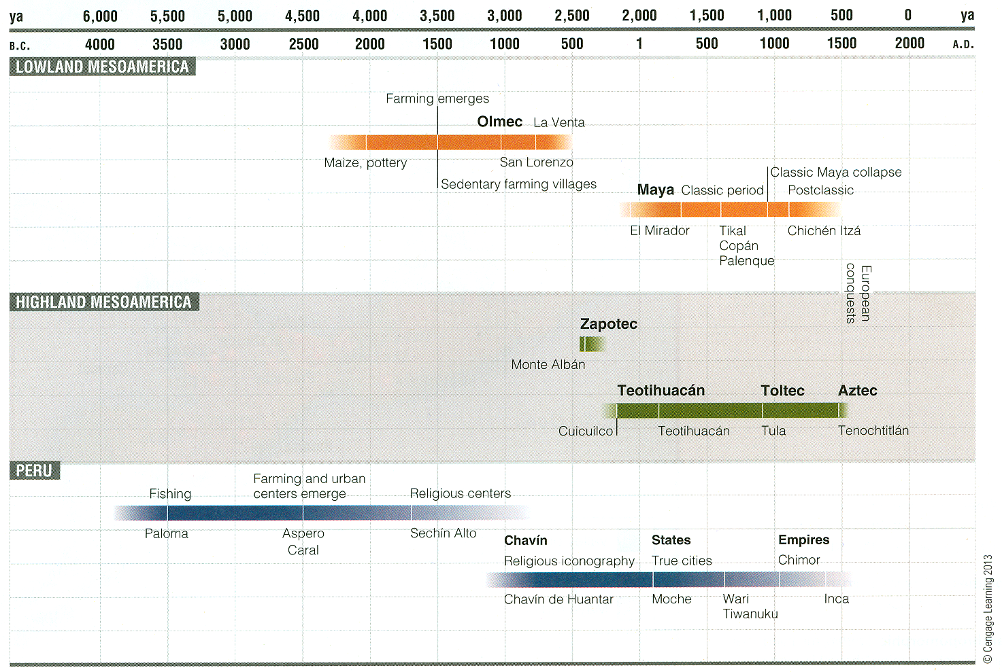
Understanding Physical Anthropology and Archaeology, 11th Ed., p. 393

Slide 40
Glossary
horizon marker
characteristic item that marks an identifiable horizon

Slide 41
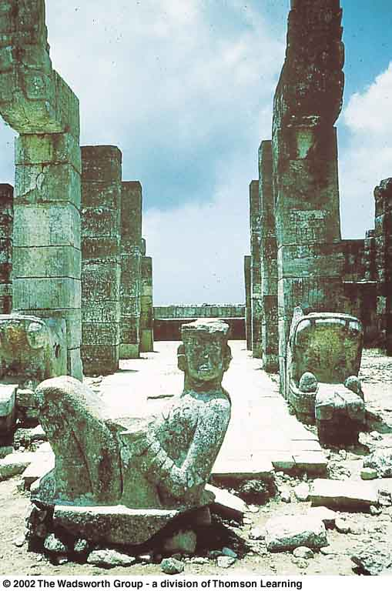
Toltec
serpentine
columns
Toltec
chacmool
Toltec-style serpentine columns and Chacmool.
Understanding Physical Anthropology and Archaeology (8th Ed.), p. 491

Slide 42
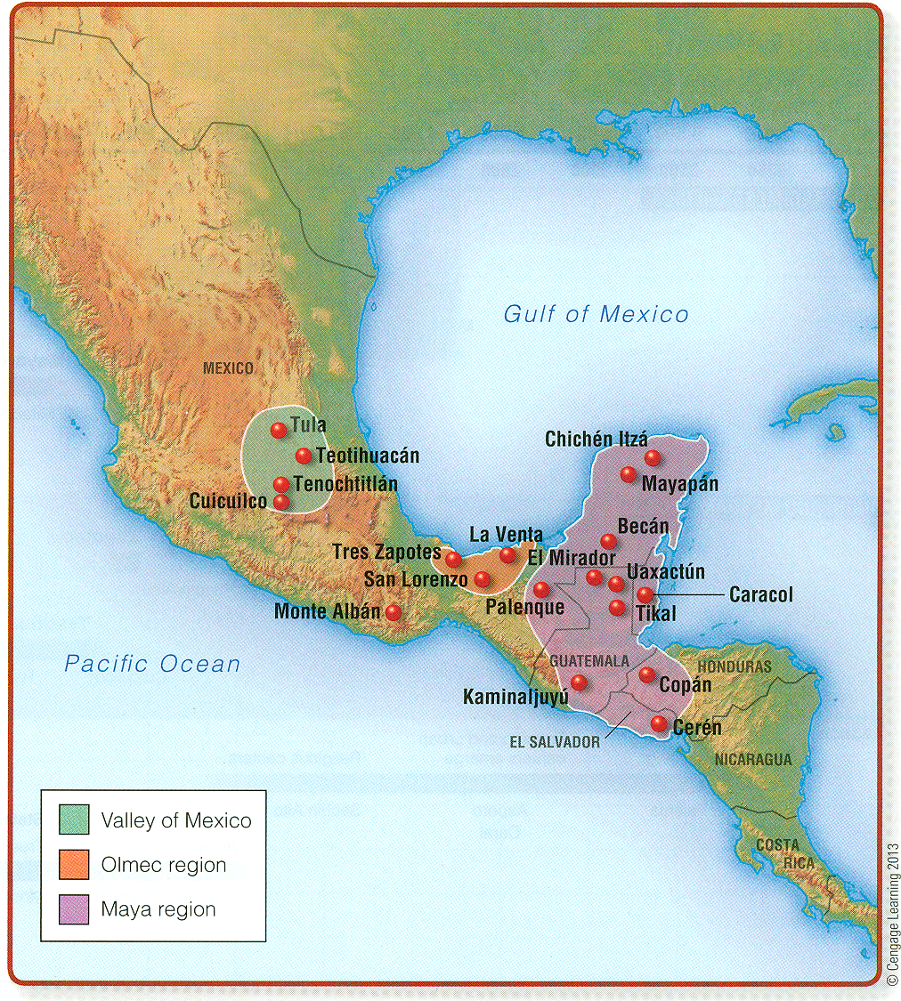
Toltec
“Toltecized” Maya
Mesoamerican archaeological sites mentioned in the text
Understanding Humans, 11th Ed., p. 394

Slide 43
Understanding Physical Anthropology and Archaeology, 11th Ed., p. 393

Slide 44
Glossary
flake tools
core tools

Slide 45
Glossary
flake tools
the smaller pieces struck off of a stone

Slide 46
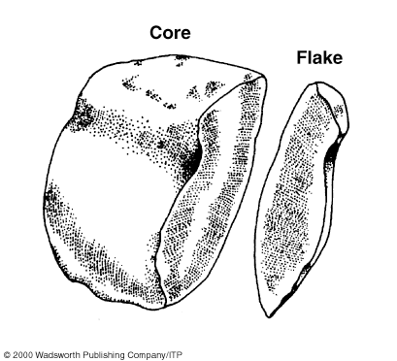
^{Core and flake.}
Understanding Physical Anthropology and Archaeology (8th Ed.), p. 351

Slide 47
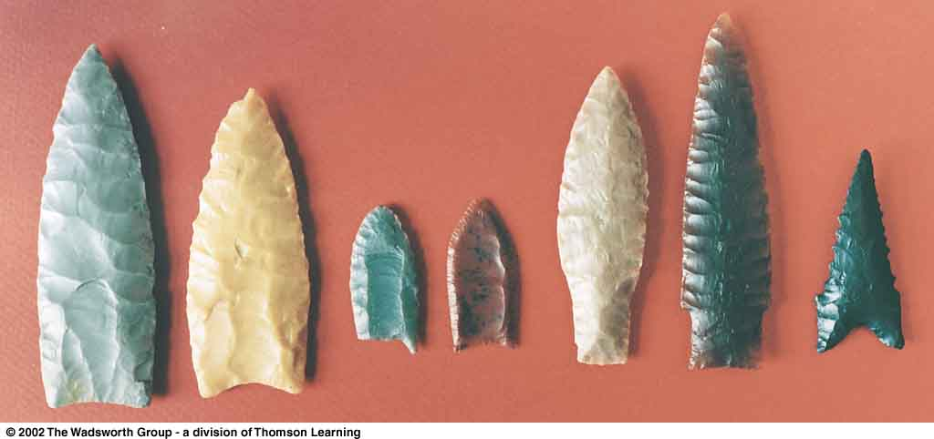
^{Clovis}
^{Folsom}
^{Plano}
^{Dalton}
Major types of North American Paleo-Indian projectile points.
Understanding Physical Anthropology and Archaeology (9th Ed.), p. 315

Slide 48
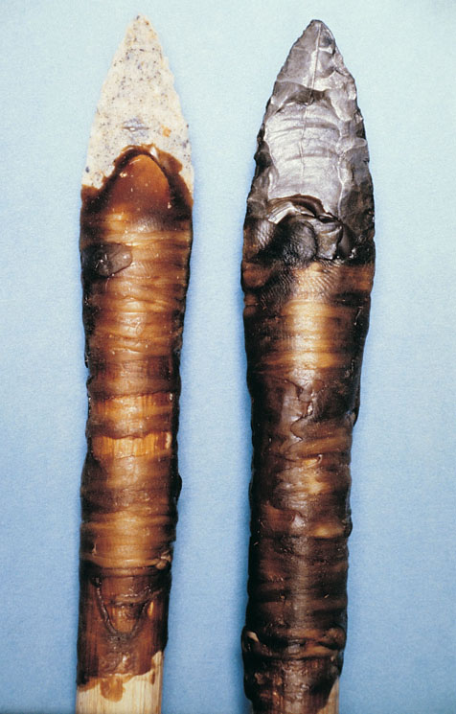
Clovis fluted points in simulated mountings.
Understanding Humans, 10th Ed., p. 327

Slide 49

North American Paleo-Indian and Archaic sites.
Understanding Humans, 11th Ed., p. 315

Slide 50
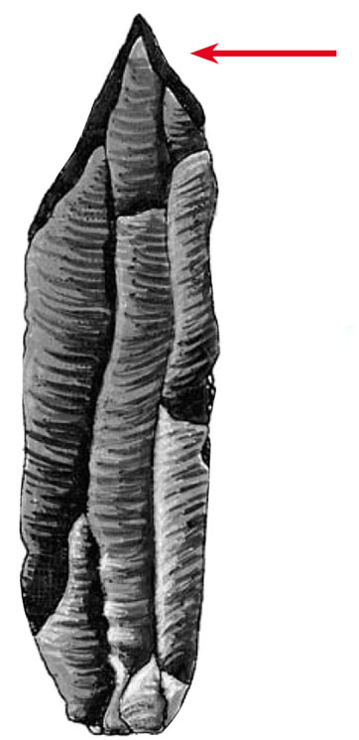
Burin.
Understanding Humans, 10th Ed., p. 303

Slide 51
http://lithiccastinglab.com/gallery-pages/cloviswheredidcomefrompage2.htm

Slide 52
Glossary
core
what is left over after a flake has been struck off of a stone

Slide 53
^{Core and flake.}
Understanding Physical Anthropology and Archaeology (8th Ed.), p. 351

Slide 54
Stone Tools and Technologies
lithic tools
basic types
basic techniques of manufacture
basic tool uses
Upper Paleolithic traditions

Slide 56
^{#1}
^{pebble}
^{tools}

Slide 57
Glossary
pebble tools
aka “choppers”
rounded stone (pebble) struck with a similar stone (hammerstone),
which creates a jagged edge,
that serves as a chopping edge

Slide 58
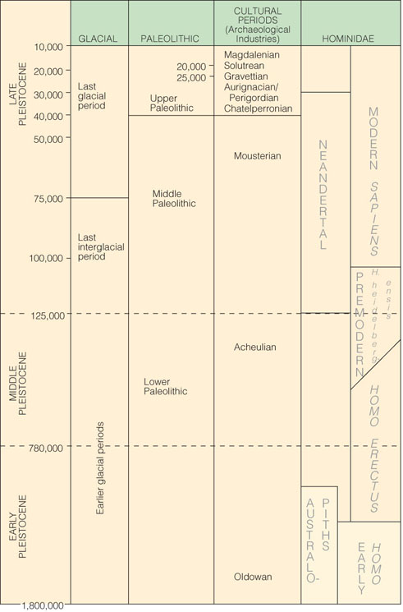
sometimes
pebble tools
are also
known
as
“Oldowan
choppers”
Pleistocene Subdivisions, Archaeological Industries and Hominins.
Understanding Humans, 10th Ed., p. 267

Slide 59
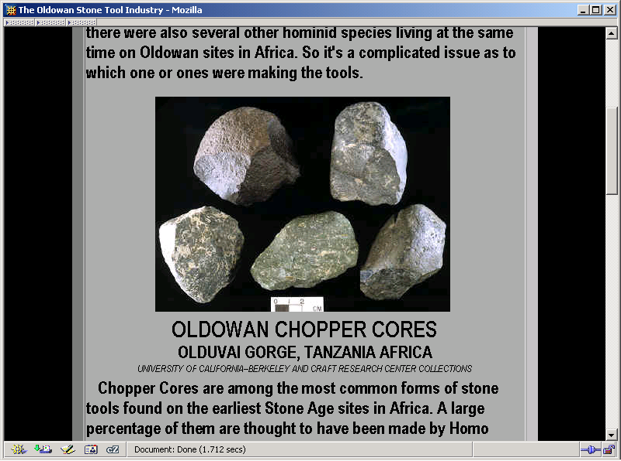
http://lithiccastinglab.com/gallery-pages/oldowanstonetools.htm

Slide 60
^{#2}
^{Core}
^{and} ^{flake}
^{tools}
^{are}
^{“bifacial}
^{handaxes”}

Slide 61
Glossary
Lower Paleolithic European and African bifacial hand axes
    Clactonian (flake)
    Acheulean (core)
    Abbevillian (core)

Slide 62
Glossary
Lower Paleolithic European and African bifacial hand axes
    Clactonian (flake)
    Acheulean (core)
    Abbevillian (core)

Slide 63
bifacial
handaxes
Abbevillian
aka
“primitive”
hand axes

Slide 64
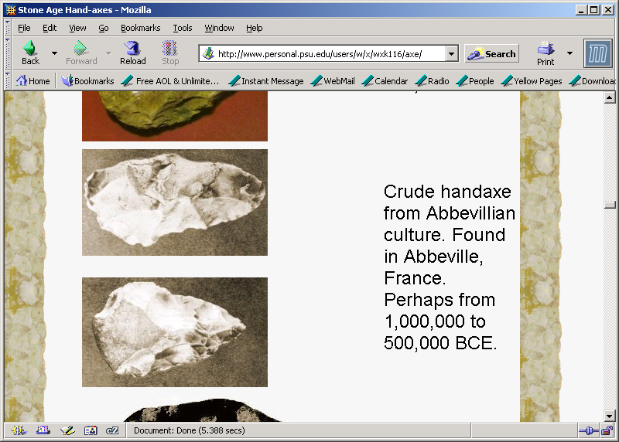
www.personal.psu.edu/users/w/x/wxk116/axe/

Slide 65
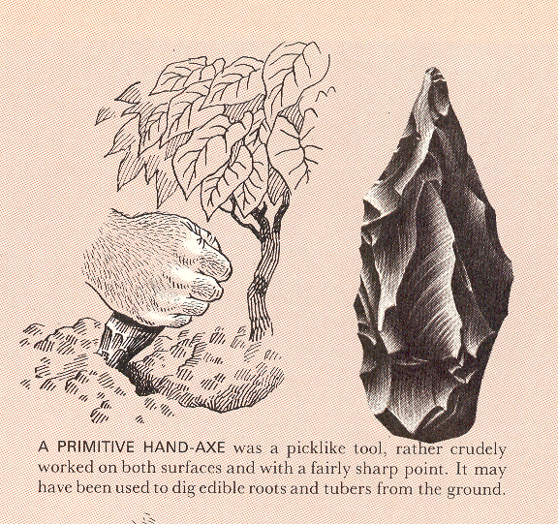
Life Nature Library, Early Man, p. 115

Slide 66
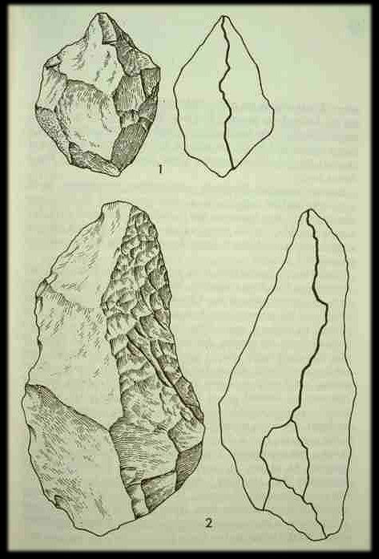

Slide 67
Glossary
Lower Paleolithic European and African bifacial hand axes
    Clactonian (flake)
    Acheulean (core)
    Abbevillian (core)

Slide 68
bifacial
handaxes
Acheulean

Slide 69
Pleistocene Subdivisions, Archaeological Industries and Hominins.
Understanding Humans, 10th Ed., p. 267

Slide 70
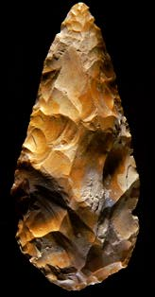
^{Acheulian biface (“hand axe”).}
Richard Effland, Maricopa College

Slide 71
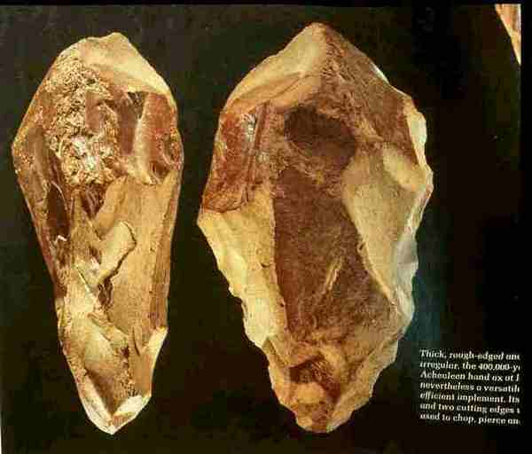

Slide 72
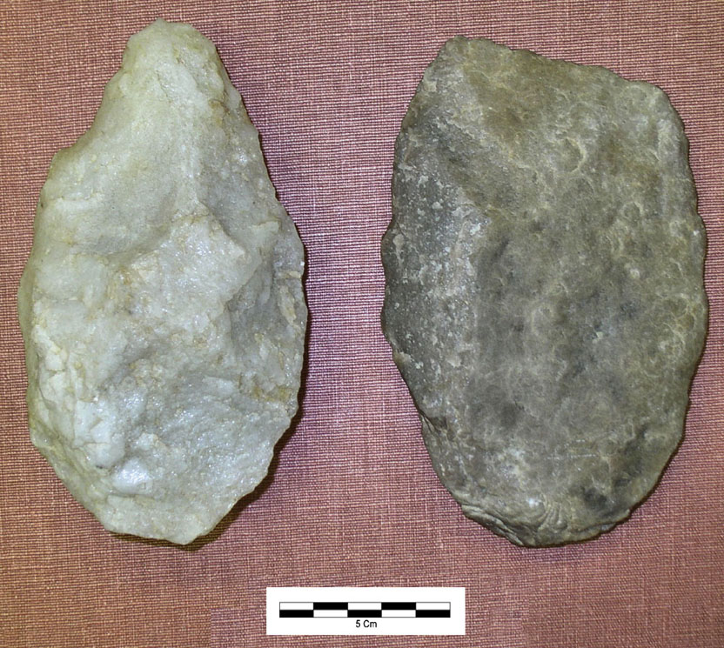
Hand axe (left) and cleaver (right),
both basic Acheulian tradition tools
Understanding Humans, 10th Ed., p. 251

Slide 73
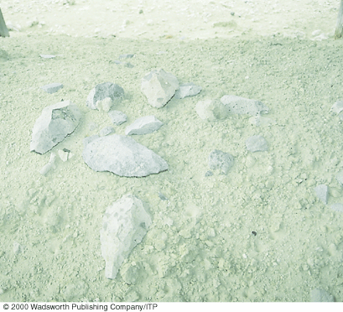
Acheulian tools, mainly hand axes, from Olorgesailie, Kenya.
Understanding Physical Anthropology and Archaeology (9th Ed.), p. 240

Slide 74
Glossary
Lower Paleolithic European and African bifacial hand axes
    Clactonian (flake)
    Acheulean (core)
    Abbevillian (core)

Slide 76
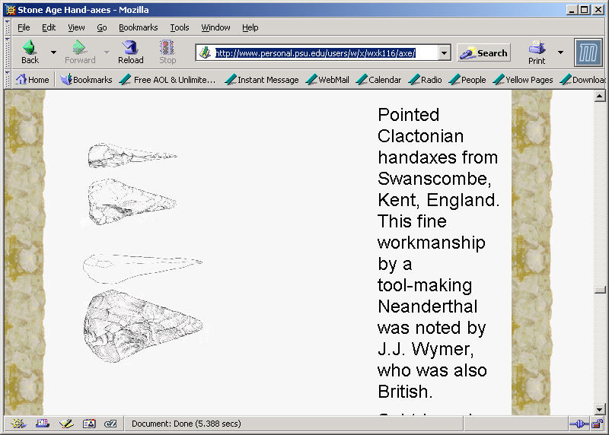
www.personal.psu.edu/users/w/x/wxk116/axe/

Slide 77
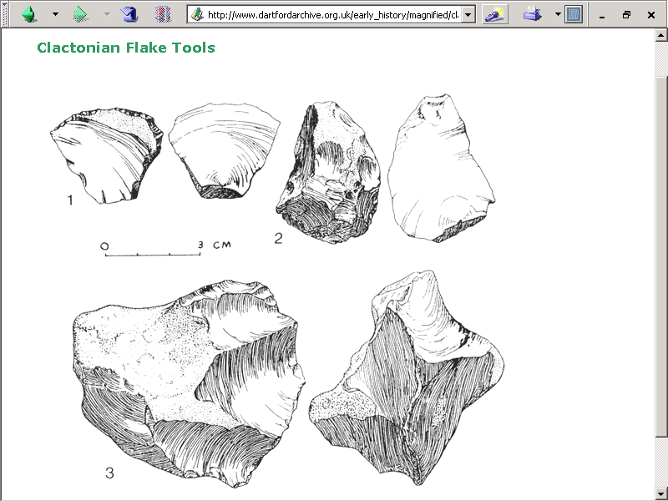
www.dartfordarchive.org.uk/early_history/magnified/clactonian_flake_tools.html

Slide 78
#3
blade
tools

Slide 79
Glossary
blade tool
a flake tool that is at least twice as long as it is wide
a thin-edged fragment removed from a core

Slide 80
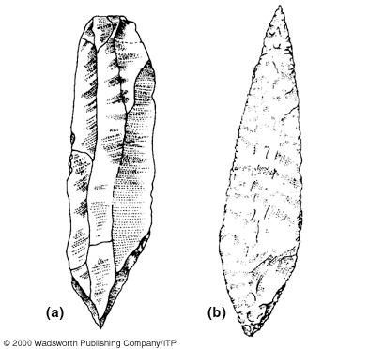
Burin. Solutrean blade.
Understanding Physical Anthropology and Archaeology (9th Ed.), p. 289

Slide 81
Solutrean blade
Understanding Humans, 10th Ed., p. 304

Slide 82
http://lithiccastinglab.com/gallery-pages/cloviswheredidcomefrompage2.htm

Slide 83
Glossary
serrated
having a notched edge or saw-like teeth

Slide 84
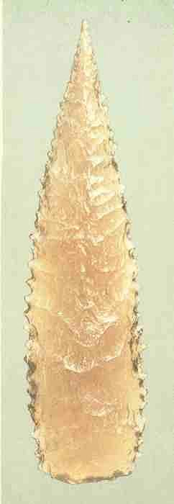

Slide 85
Glossary
fluted
with a furrow or groove

Slide 86
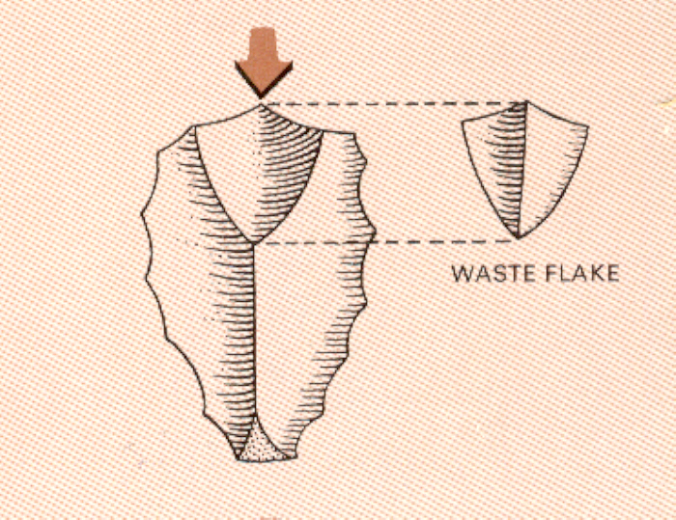
fluting
Life Nature Library, Early Man, p. 112

Slide 87
#4
microliths

Slide 88
Glossary
microliths
small stone tools usually produced from narrow blades punched from a core
  “micro” = “small”
  “lith” = “stone”

Slide 89
Glossary
microliths
small stone tools usually produced from narrow blades punched from a core
  “micro” = “small”
  “lith” = “stone”

Slide 90
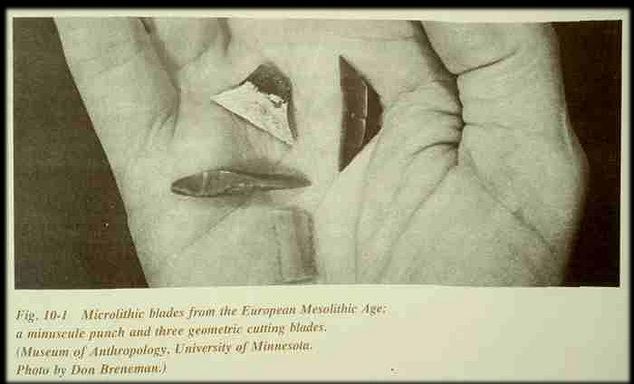

Slide 91
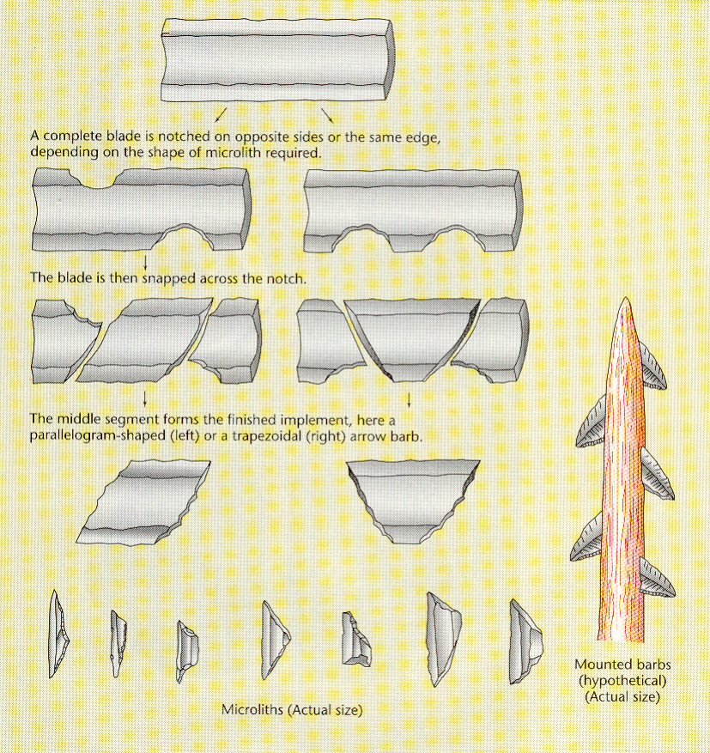
Brian Fagan, People of the Earth, 10th Ed., p. 213

Slide 92
Glossary
compound
(composite)
made of several parts
e.g., harpoon, sickle, hammer . . .

Slide 93
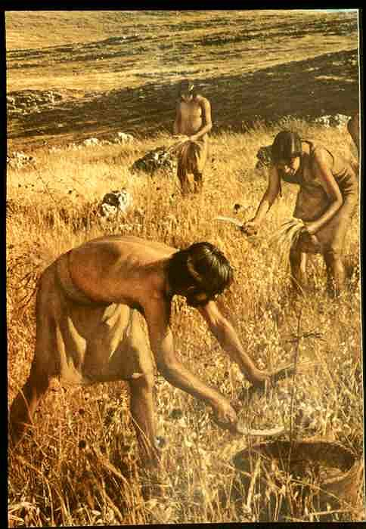

Slide 94
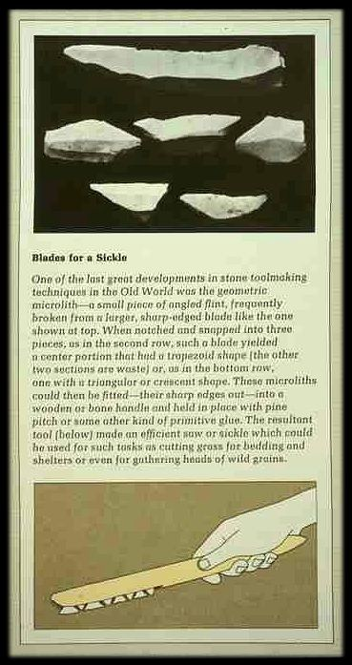
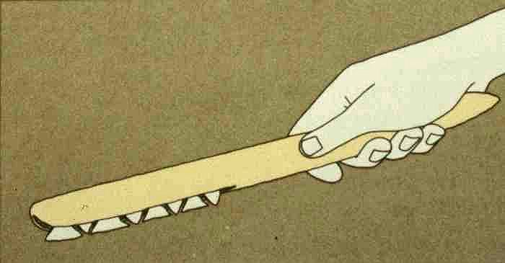

Slide 95
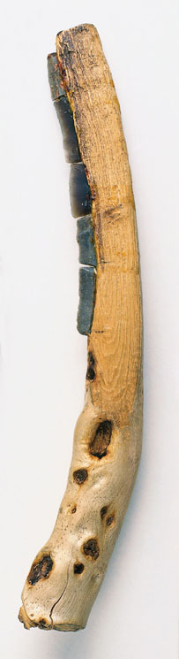
Sickle with embedded row of small flint blades.
Understanding Humans, 11th Ed., p. 337

Slide 96

European Mesolithic stone axe in its antler sleeve,
Shaped to fit into the socket of a missing wooden handle.
Understanding Physical Anthropology and Archaeology (9th Ed.), p. 319

Slide 97

Mesolithic stone axes.
Understanding Humans, 10th Ed., p. 333

Slide 98
Reconstruction of a Natufian gazelle horn reaping knife,
^{with inset flint blades.}
Understanding Physical Anthropology and Archaeology (9th Ed.), p. 328
Understanding Physical Anthropology and Archaeology, 8th ed., p. 393.

Slide 99
Glossary
hafted
with a “handle”

Slide 100
Clovis fluted points in simulated mountings.
Understanding Humans, 10th Ed., p. 327

Slide 101

http://news.bbc.co.uk/1/hi/sci/tech/1766683.stm

Slide 102

Brian Fagan, People of the Earth, 10th Ed., p. 106

Slide 103

Life Nature Library, Early Man, p. 114

Slide 104


Slide 105


Slide 106

Life Nature Library, Early Man, p. 114

Slide 107
Glossary
atlatl
“spear thrower”
(Nahuatl, Aztec)

Slide 108
Magdalenian Spear-thrower (atlatl). Note the carving..
Understanding Humans, 11th Ed., p. 298

Slide 109


Slide 110

www.worldatlatl.org/

Slide 111
^{Magdalenian bone artifact.}
Understanding Physical Anthropology and Archaeology (9th Ed.), p. 292
Notes:
111

Slide 112

Braidwood, Prehistoric Men 2nd Ed. (Chicago Natural History Museum, 1951), p. 74

Slide 113
#5
chopper
copping
and
flake
tools

Slide 114
Glossary
“chopper-chopping
[flake] tools” . . .

Slide 115


Slide 116


Slide 117


Slide 118
Movius Line

Slide 119

Movius Line
Campbell and Loy, Humankind Emerging, 7th Ed., p. 334

Slide 120
To Class Slides Set 22
Next: Tools and Technologies II
Making and Using Lithic Tools

