Slide 1
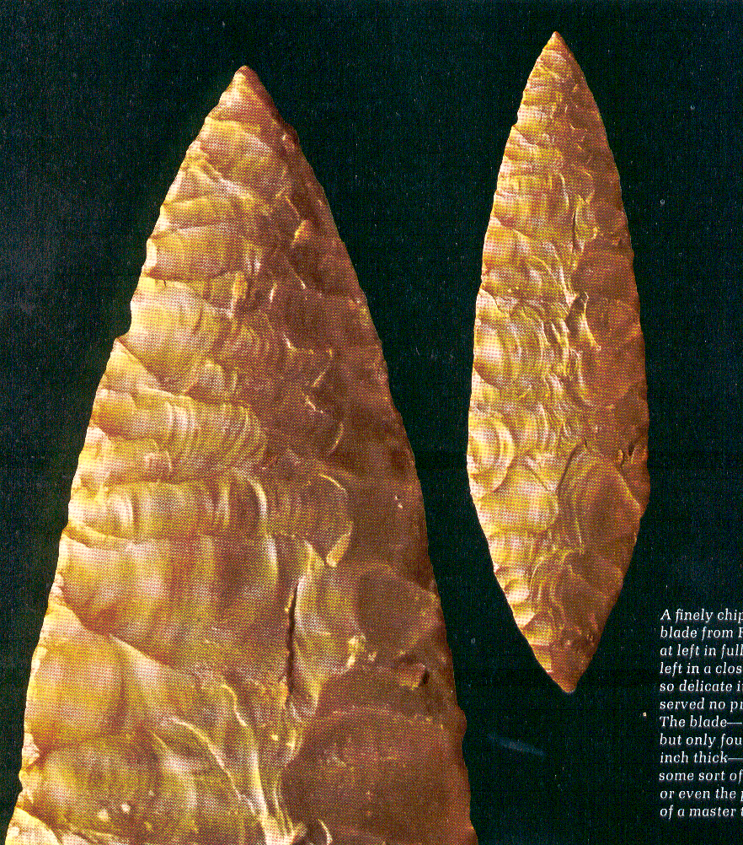
Tools and Technologies III
Upper Paleolithic Traditions
Solutrean
“laurel leaf” blade
France
Prehistoric Cultures
Tim Roufs’ section ©2009-2013
Life Nature Library, Cro-Magnon, p. 60.

Slide 2
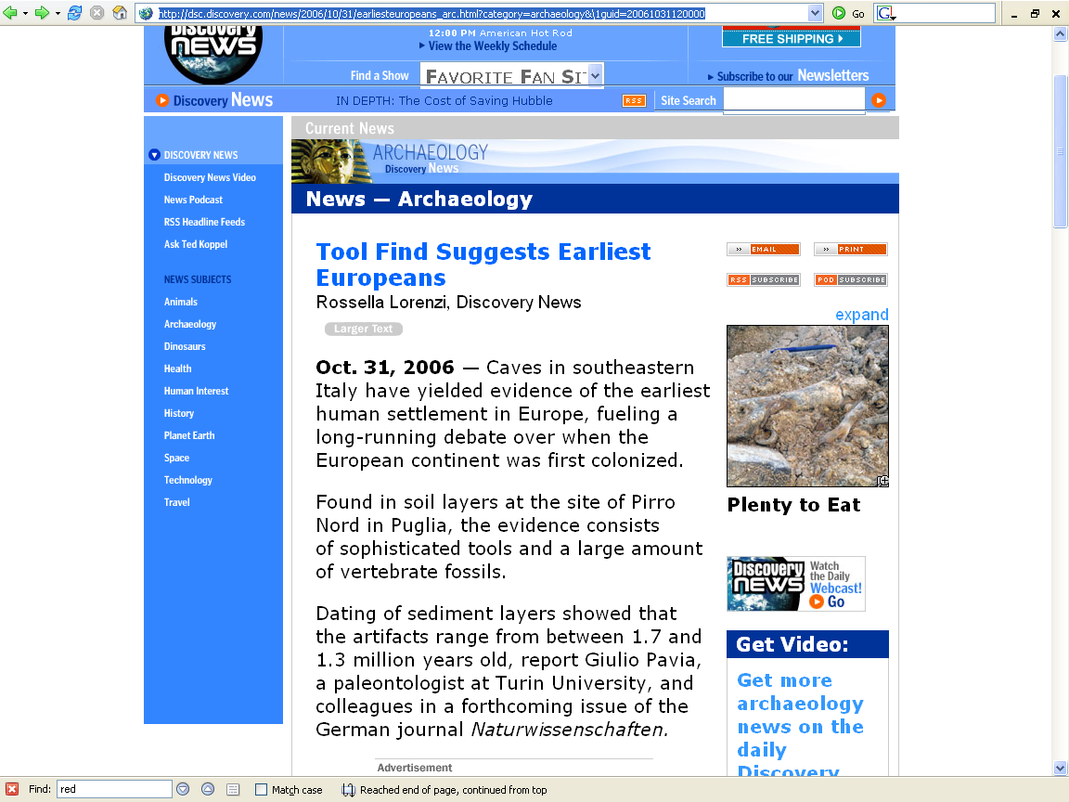
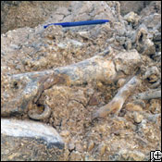
http://dsc.discovery.com/news/2006/10/31/earliesteuropeans_arc.html?category=archaeology&\1guid=20061031120000

Slide 3
Lithic Tools and Technologies
lithic tools
basic types
basic techniques of manufacture
basic too uses
Upper Paleolithic traditions

Slide 4
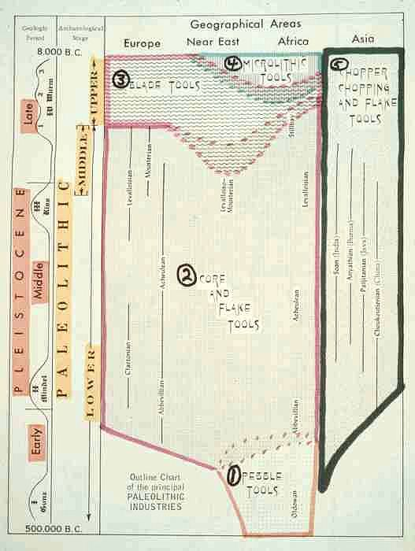
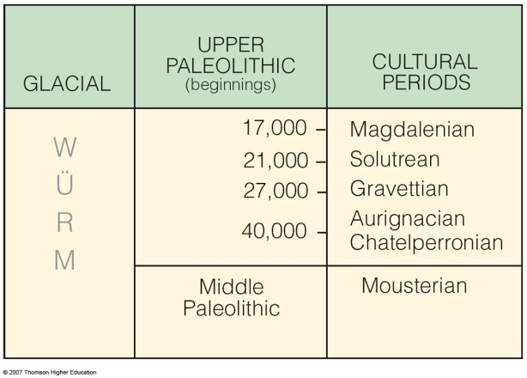
Upper
Paleolithic
traditions
(SW France)
10th p. 257

Slide 5
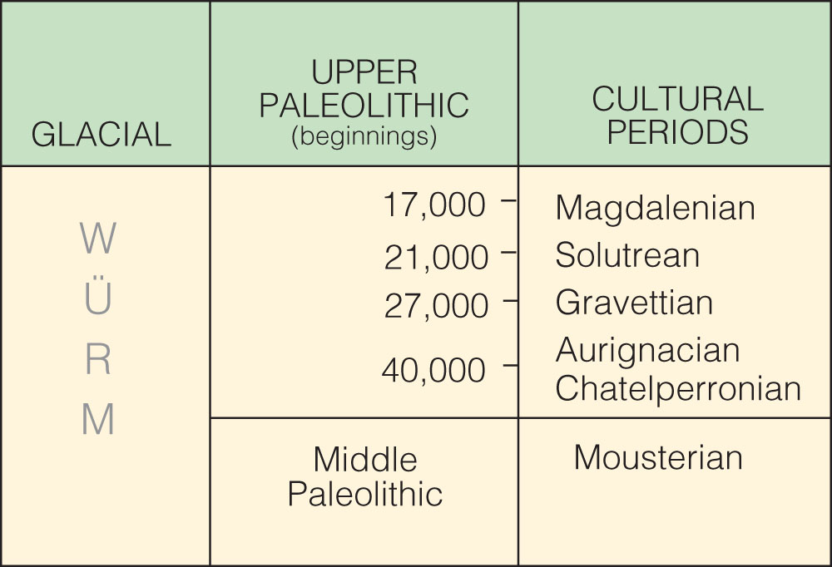
Upper Périgordian
Lower Périgordian
is the “culture”
the technique is called “Levallois”
Cultural periods of the European Upper Paleolithic.
Understanding Humans, 10th Ed., p. 257

Slide 6
Lower Périgordian
is the “culture”
the technique is called “Levallois”
Cultural periods of the European Upper Paleolithic.
Understanding Humans, 10th Ed., p. 257

Slide 7
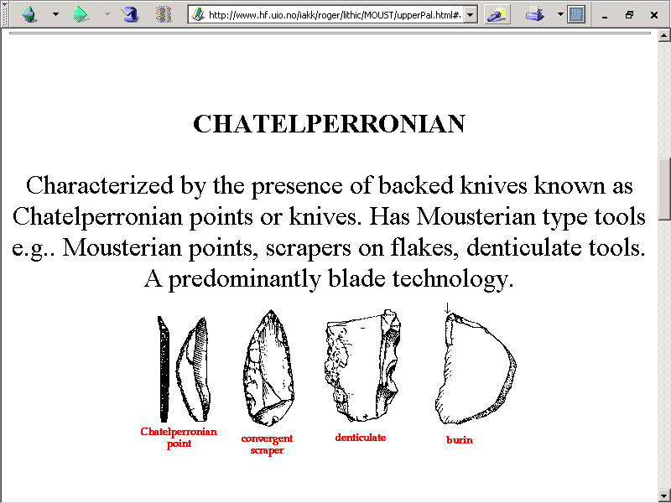

Slide 8
is the “culture”
the technique is called “Levallois”
Cultural periods of the European Upper Paleolithic.
Understanding Humans, 10th Ed., p. 257

Slide 9
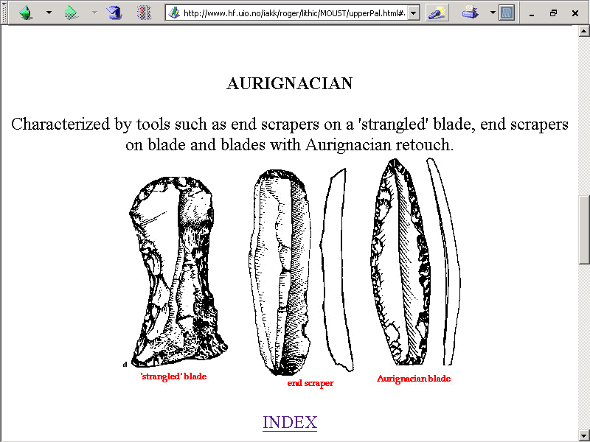
http://www.hf.uio.no/iakk/roger/lithic/MOUST/upperPal.html#anchor75523

Slide 10
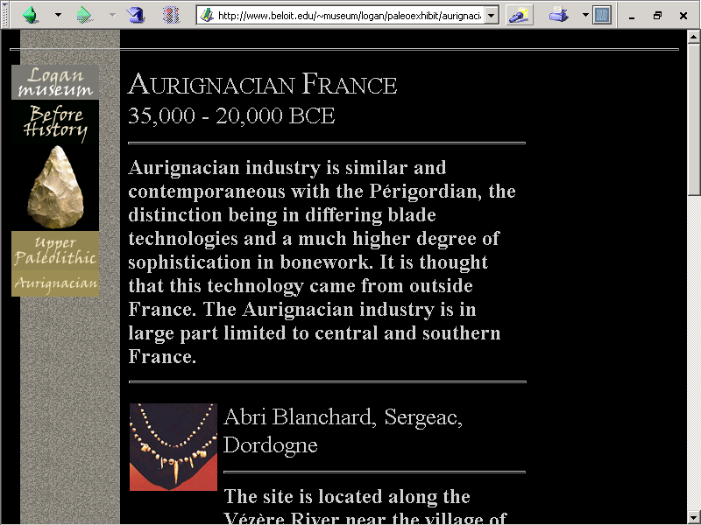
www.beloit.edu/~museum/logan/paleoexhibit/aurignacian.htm

Slide 11
Upper Périgordian
is the “culture”
the technique is called “Levallois”
Cultural periods of the European Upper Paleolithic.
Understanding Humans, 10th Ed., p. 257

Slide 12
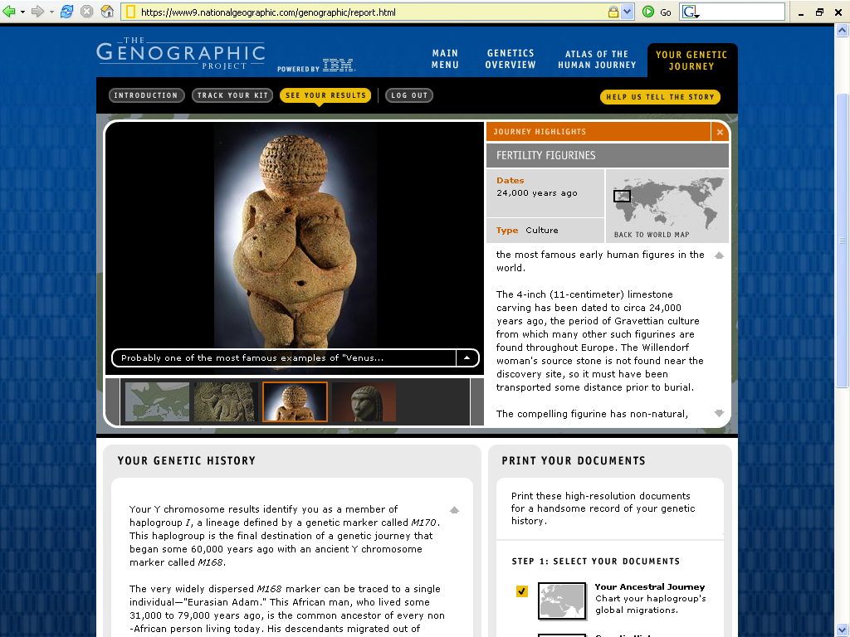

Slide 13
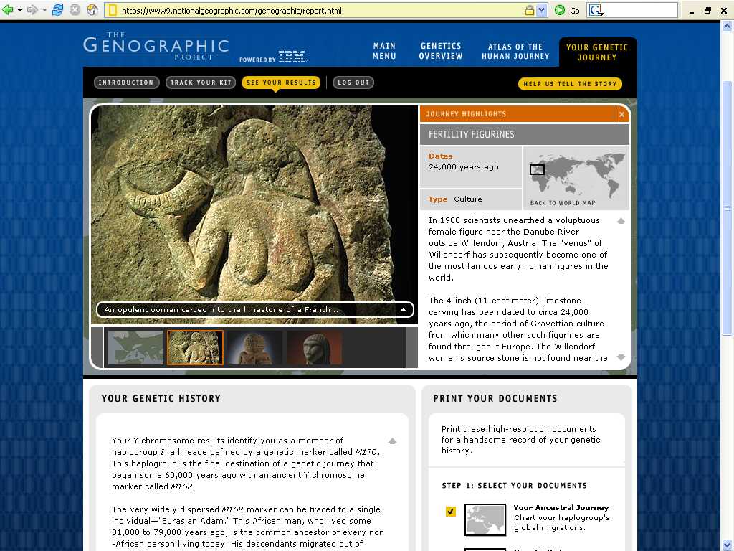
https://www9.nationalgeographic.com/genographic/report.html

Slide 14

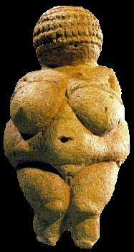
https://www5.nationalgeographic.com/genographic/

Slide 15
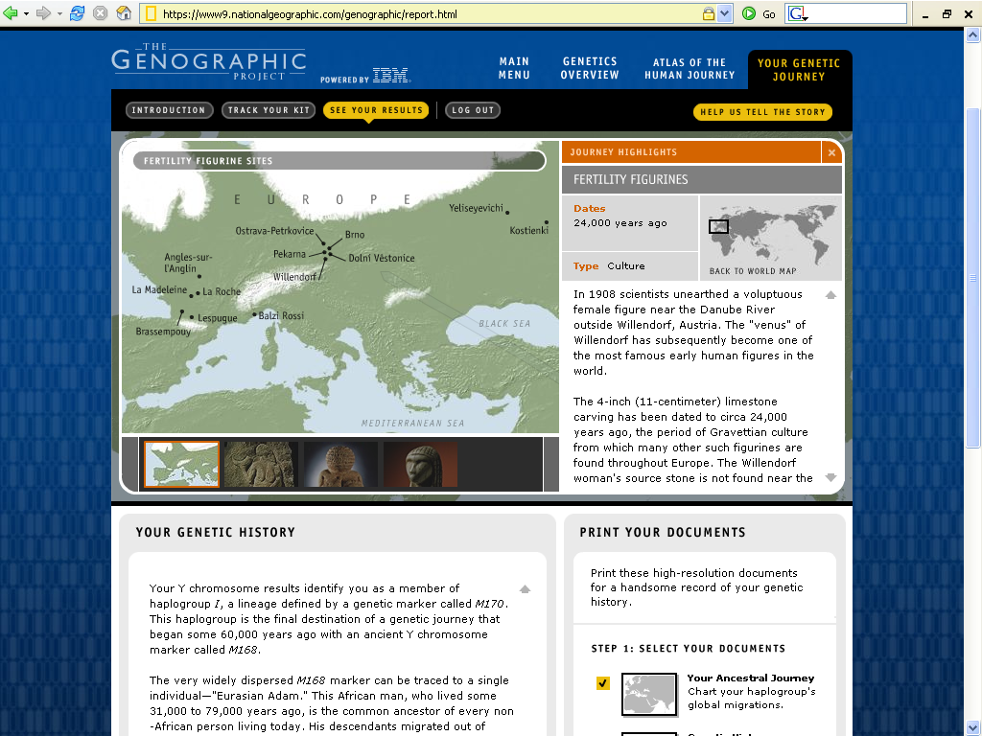
https://www9.nationalgeographic.com/genographic/report.html

Slide 16
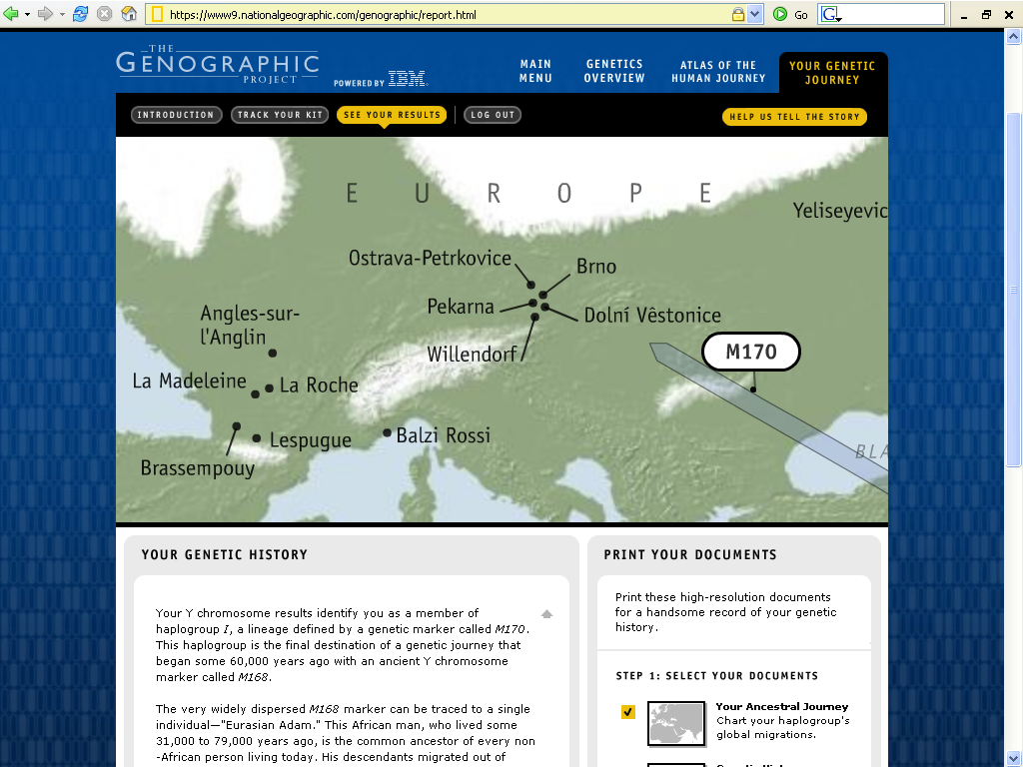
https://www9.nationalgeographic.com/genographic/report.html

Slide 17
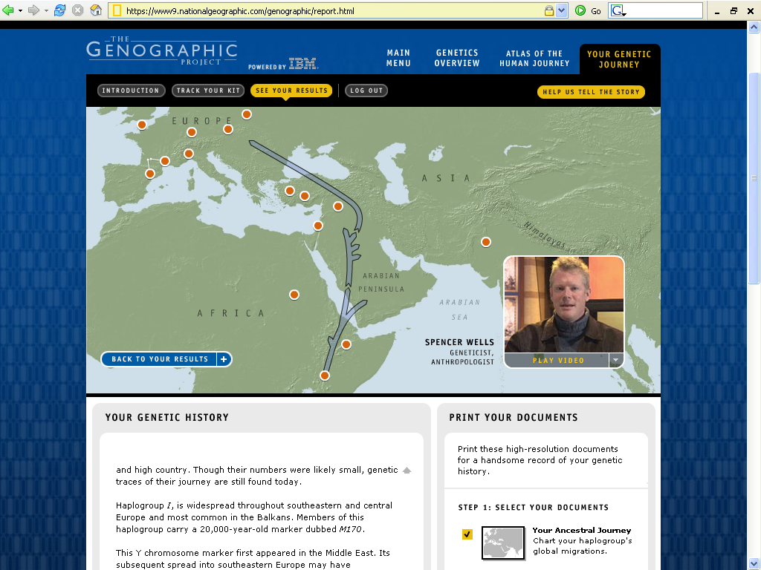

Venus of Willendorf
c. 24,000 ybp
https://www5.nationalgeographic.com/genographic/
Roufs DNA results ID # = FW35F6VQRR
https://www9.nationalgeographic.com/genographic/report.html
Notes:
17

Slide 18
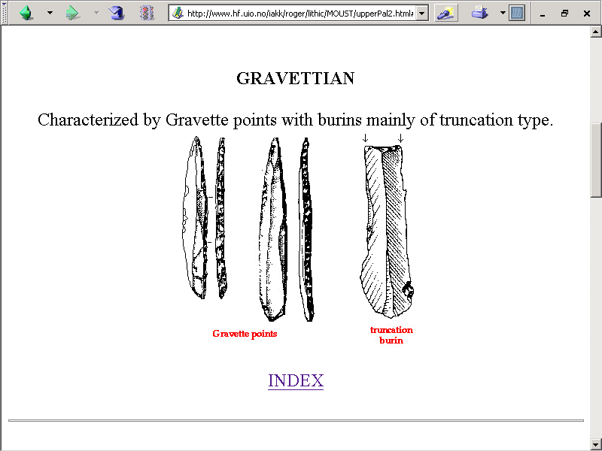
www.hf.uio.no/iakk/roger/lithic/MOUST/upperPal2.html

Slide 19
is the “culture”
the technique is called “Levallois”
Cultural periods of the European Upper Paleolithic.
Understanding Humans, 10th Ed., p. 257

Slide 20
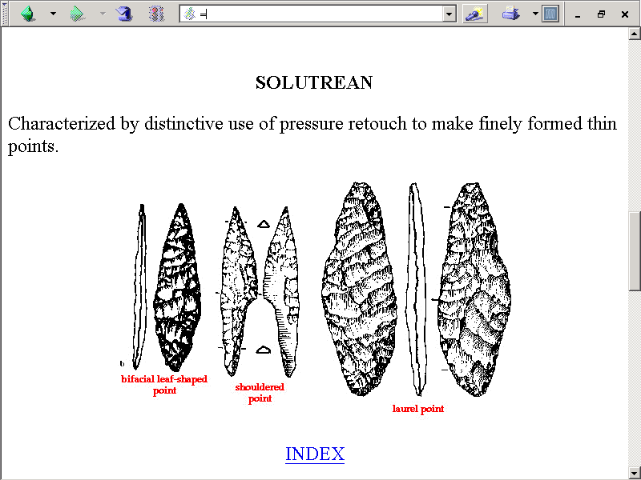
www.hf.uio.no/iakk/roger/lithic/MOUST/upperPal2.html

Slide 21
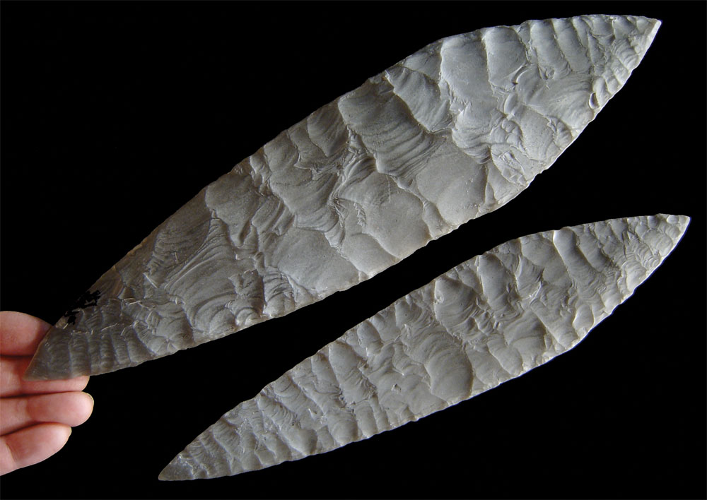
Solutrean blade
Understanding Humans, 10th Ed., p. 304

Slide 22
Solutrean
“laurel leaf” blade
France
Life Nature Library, Cro-Magnon, p. 60

Slide 23
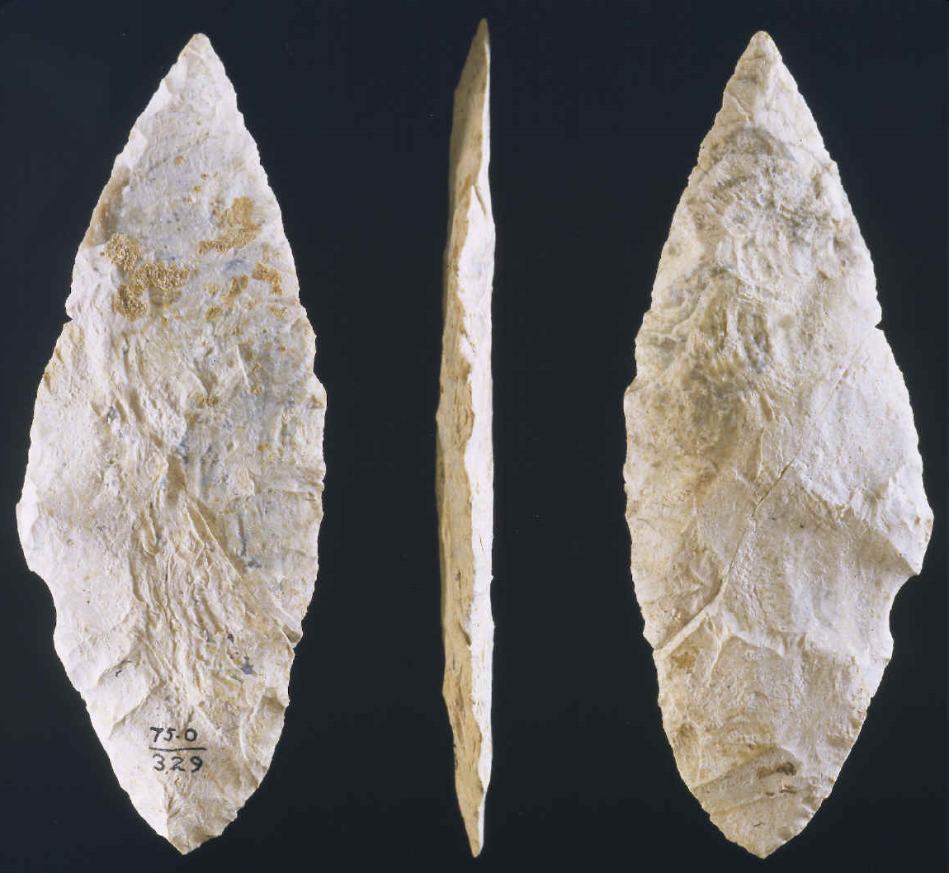
Solutrean blade
Understanding Humans, 10th Ed., p. 304
Notes:
23

Slide 24
is the “culture”
the technique is called “Levallois”
Cultural periods of the European Upper Paleolithic.
Understanding Humans, 10th Ed., p. 257

Slide 25
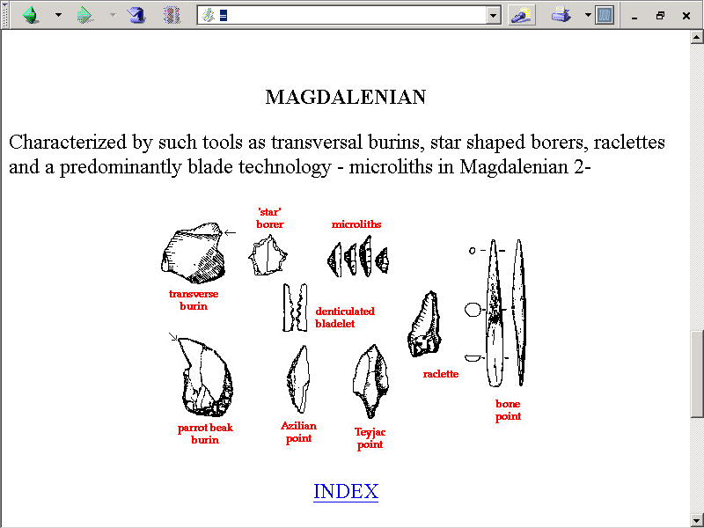
www.hf.uio.no/iakk/roger/lithic/MOUST/upperPal2.html

Slide 26
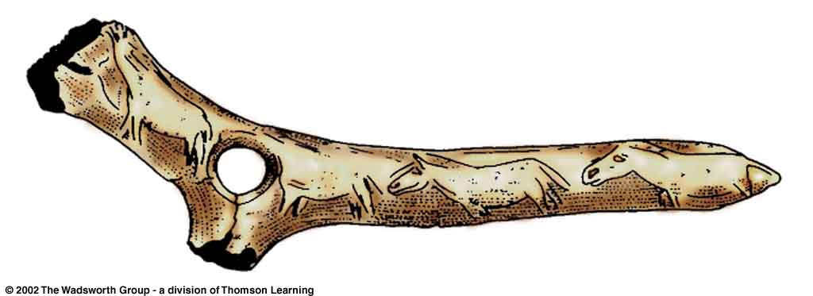
^{Magdalenian bone artifact.}
Understanding Physical Anthropology and Archaeology (9th Ed.), p. 292
Notes:
26

Slide 27
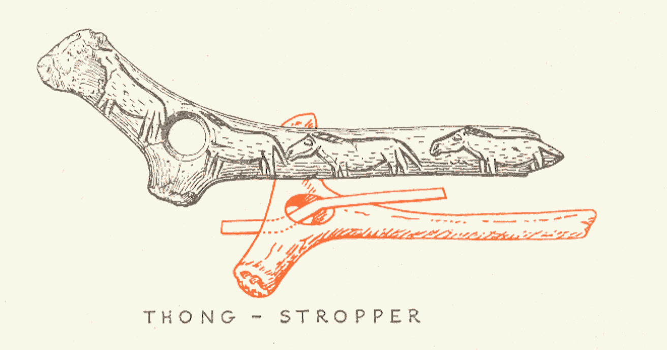
Braidwood, Prehistoric Men 2nd Ed. (Chicago Natural History Museum, 1951), p. 74

Slide 28
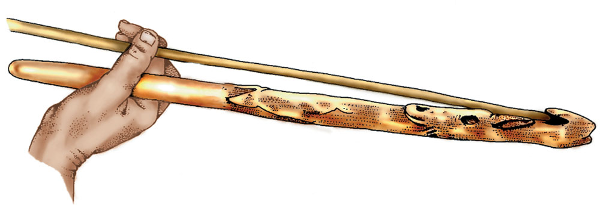
Magdalenian Spear-thrower (atlatl). Note the carving..
Understanding Humans, 11th Ed., p. 298

Slide 29
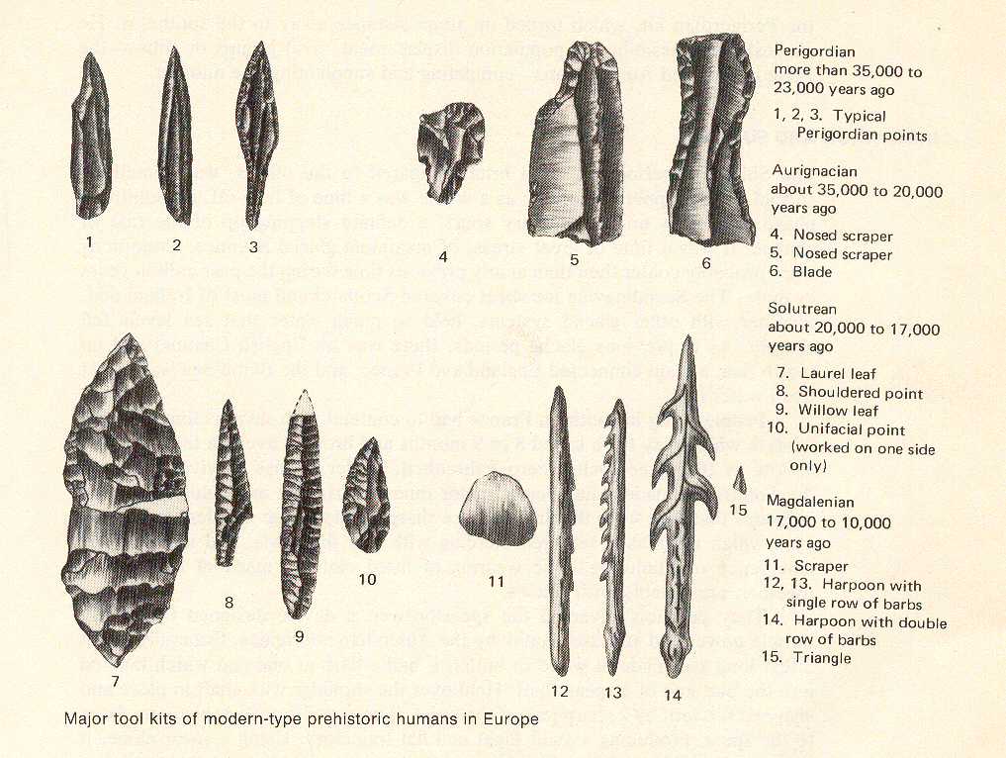
Pfeiffer, The Emergence of Humankind, 4th Ed. (NY: Harper & Row, 1985), p. 179

Slide 30
^{Azilian}
is the “culture”
the technique is called “Levallois”
Cultural periods of the European Upper Paleolithic.
Understanding Humans, 10th Ed., p. 257

Slide 31
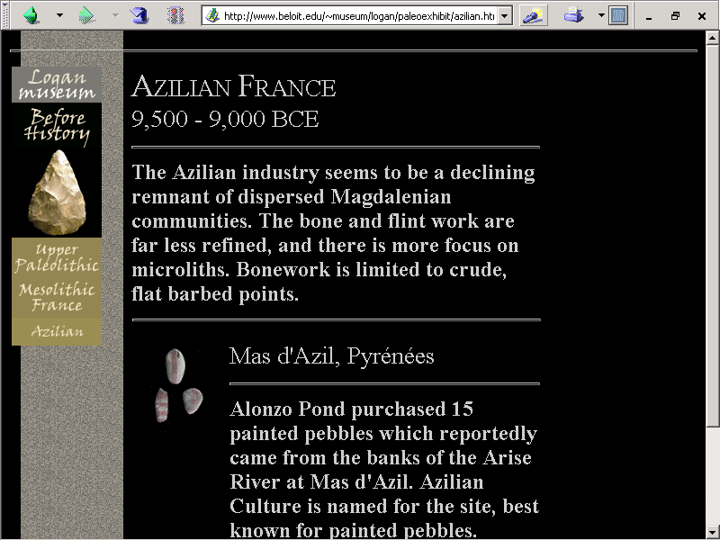
www.beloit.edu/~museum/logan/paleoexhibit/azilian.htm

Slide 32
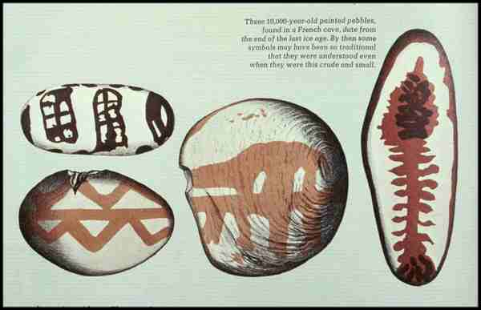
Life Nature Library, Cro-Magnon, p. 136

Slide 33
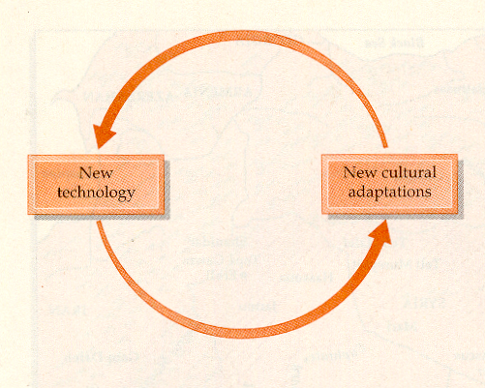
Campbell and Loy, Humankind Emerging, 7th ed., p. 522

Slide 34
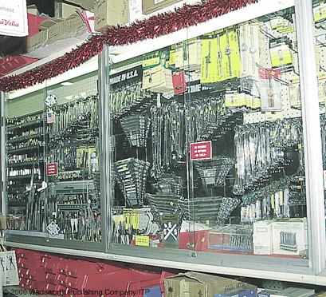
Assortment of implements available today in a modern hardware store.
Understanding Physical Anthropology and Archaeology (9th Ed), p. 3

Slide 35
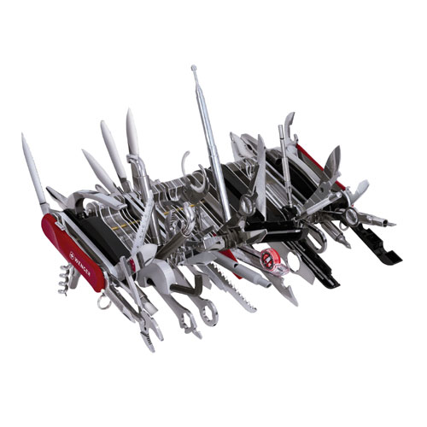
www.wengerna.com/browse/product.jsp?prod_id=1260&cat_id=1&sub_cat_id=23
Notes:
35

