Slide 1
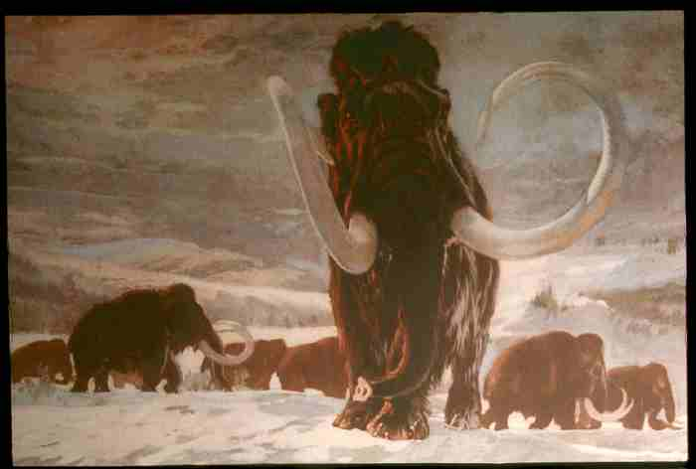
Hunting / Gathering /
Collecting
(foraging)
Prehistoric Cultures
Tim Roufs ©2009-2013

Slide 2
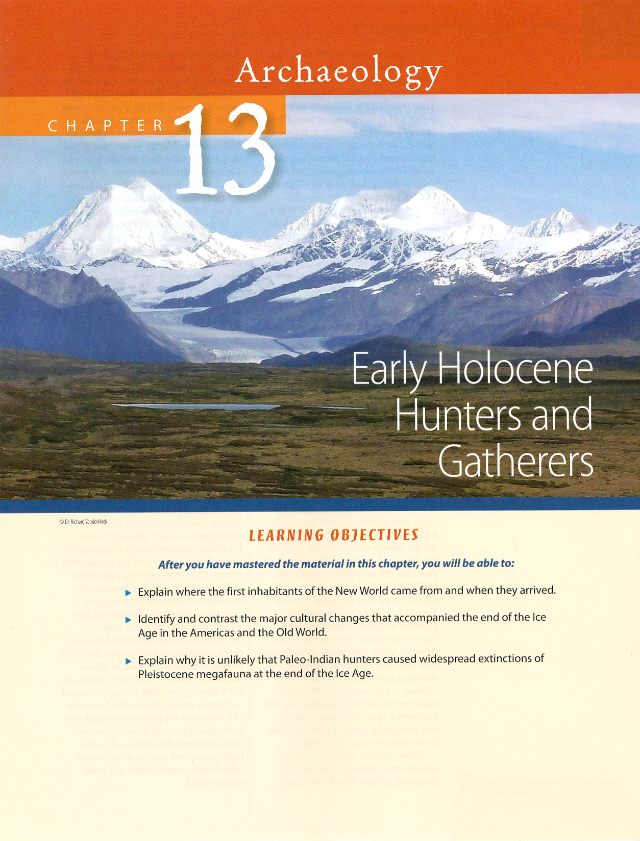

Slide 3
. . . controlled ethnographic
comparisons for
Ch. 13 of the text . . .

Slide 4
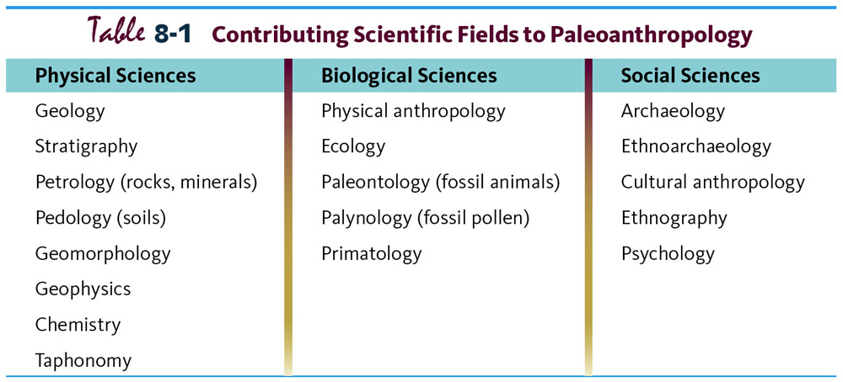
Multidisciplinary Study.
Understanding Humans, 10th Ed., p. 178.

Slide 5
Glossary
Ethnoarchaeology
the study of contemporary cultures to help understand the archaeological record

Slide 6
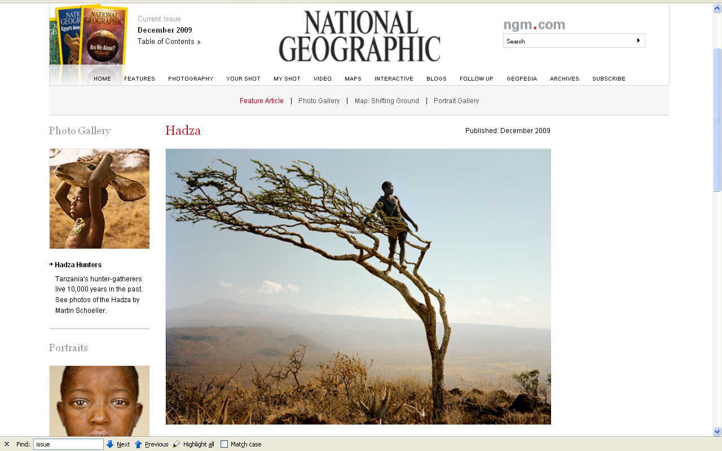
http://ngm.nationalgeographic.com/2009/12/hadza/finkel-text

Slide 7
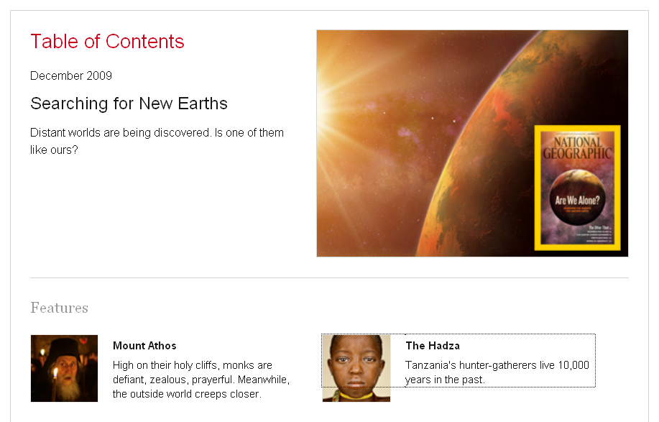
http://ngm.nationalgeographic.com/2009/12/hadza/finkel-text

Slide 8
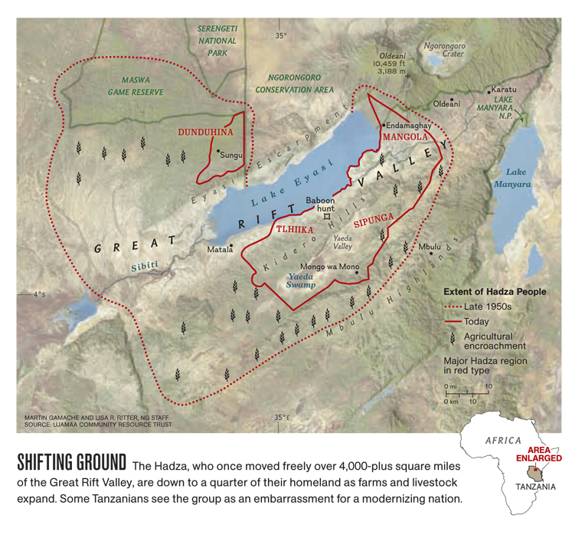
http://ngm.nationalgeographic.com/2009/12/hadza/finkel-text

Slide 9
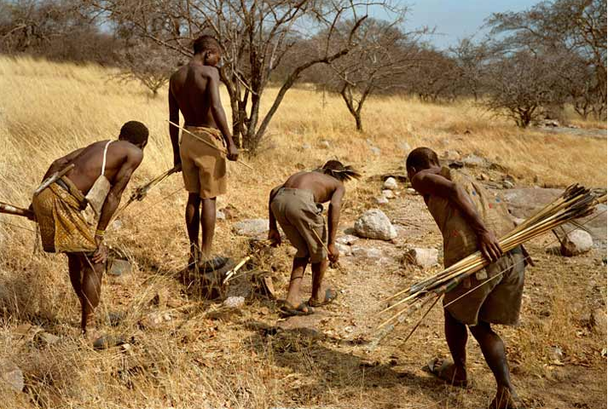
A hunting party tracks a warthog that's been shot . . .
http://ngm.nationalgeographic.com/2009/12/hadza/finkel-text

Slide 10
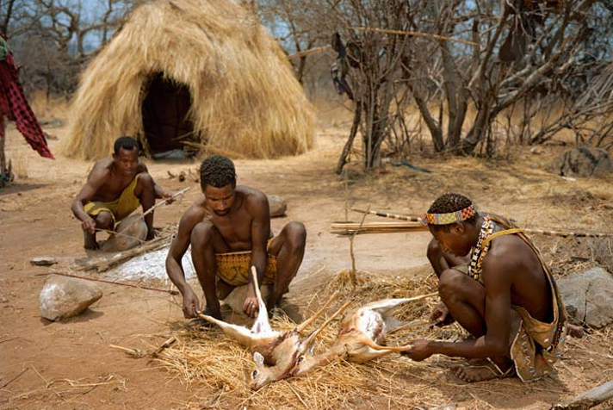
Men butcher small antelope called dik-diks near a hut in a traditional camp.
http://ngm.nationalgeographic.com/2009/12/hadza/finkel-text

Slide 11
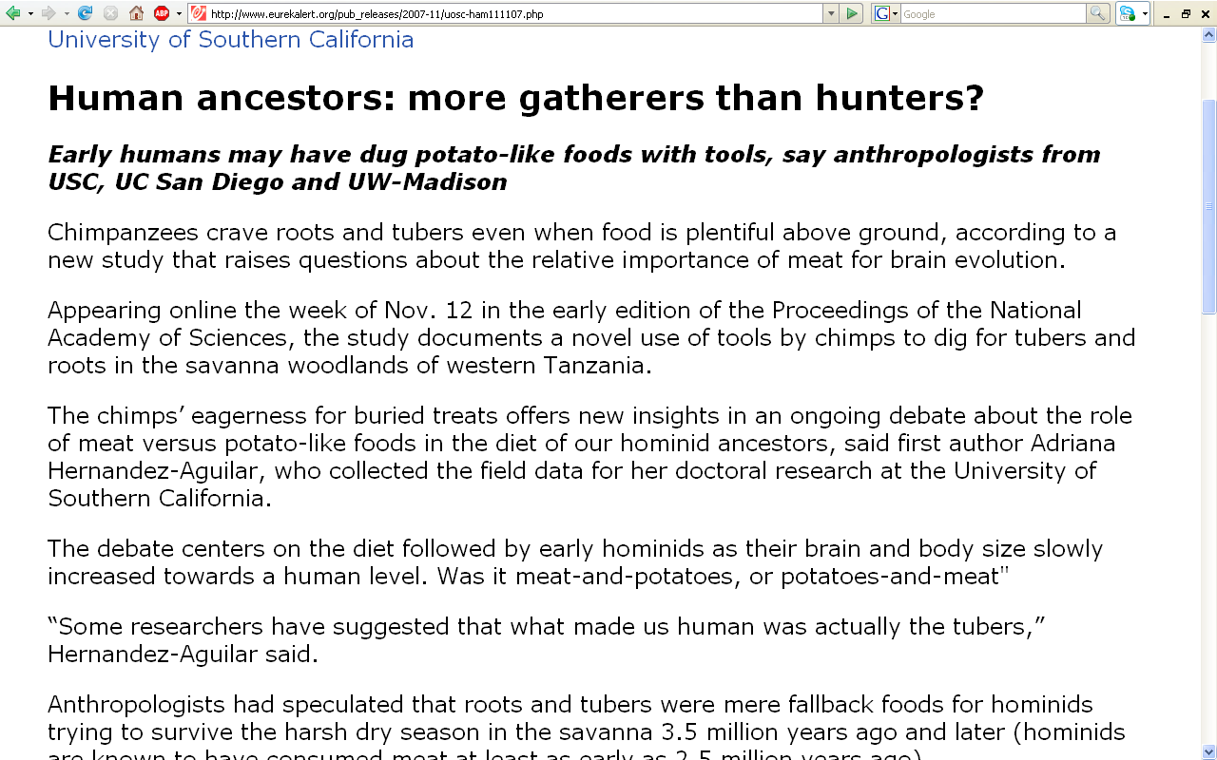
12-Nov-2007
www.eurekalert.org/pub_releases/2007-11/uosc-ham111107.php
Notes:
11

Slide 12
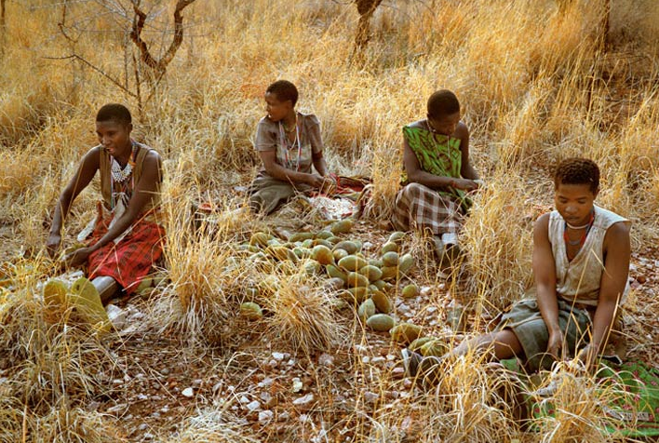
While men hunt, women crack baobab shells for the tart flesh within. Women's contributions of fruits and tubers are more vital than game in the Hadza diet . . .
http://ngm.nationalgeographic.com/2009/12/hadza/finkel-text

Slide 13
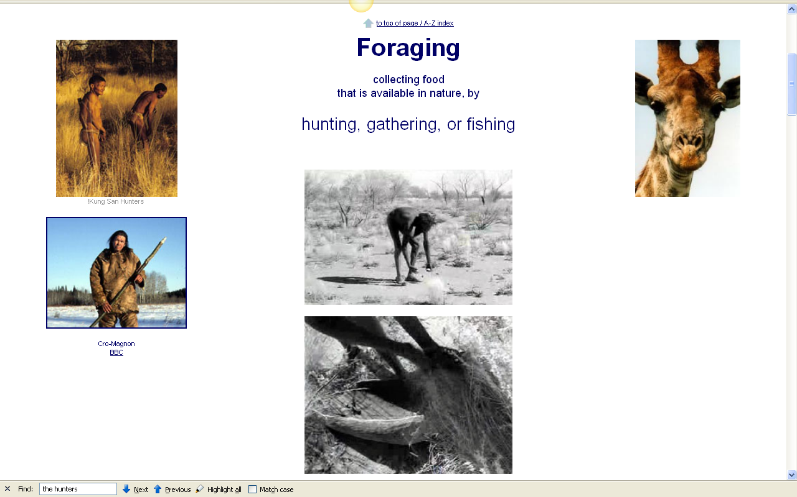
www.d.umn.edu/cla/faculty/troufs/anth1602/pcweek12.html#CEE12

Slide 14
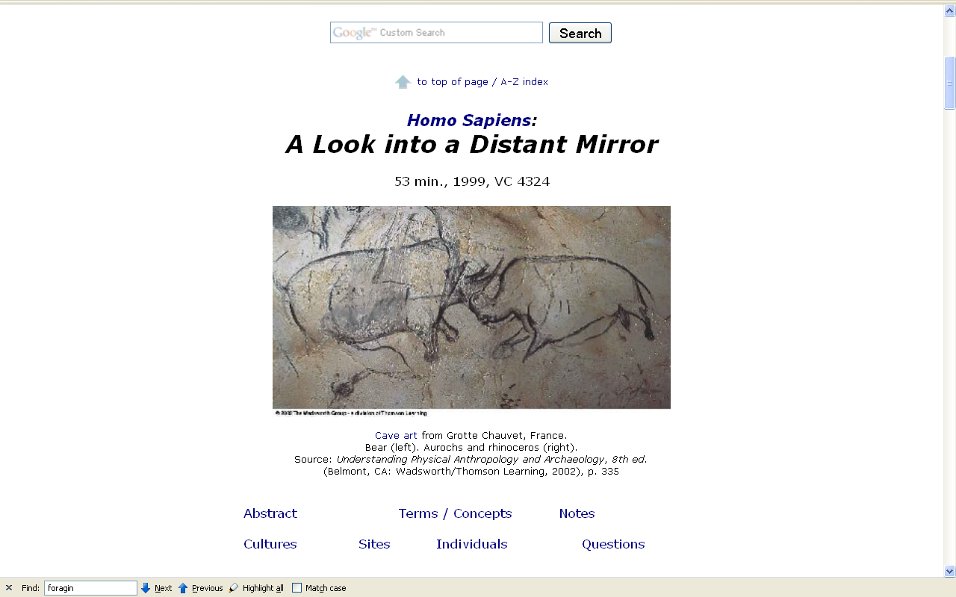
http://www.d.umn.edu/cla/faculty/troufs/anth1602/video/Distant_Mirror.html
Notes:
14

Slide 15
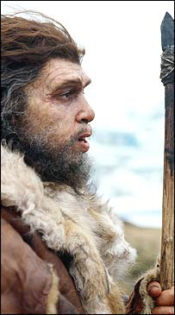
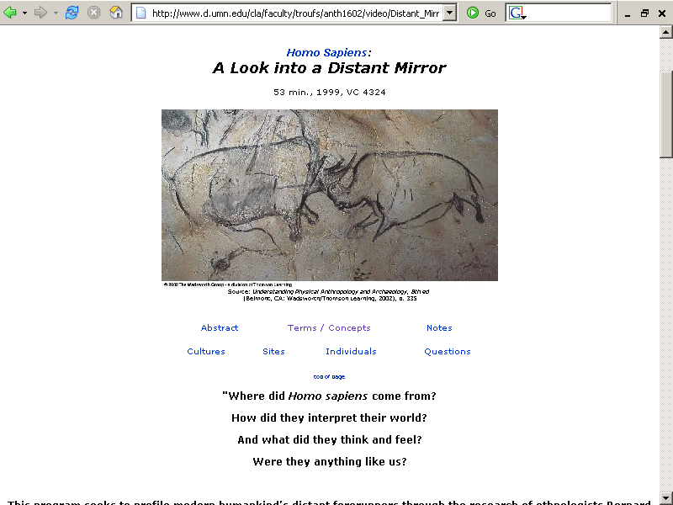
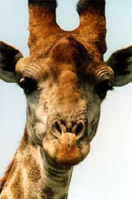
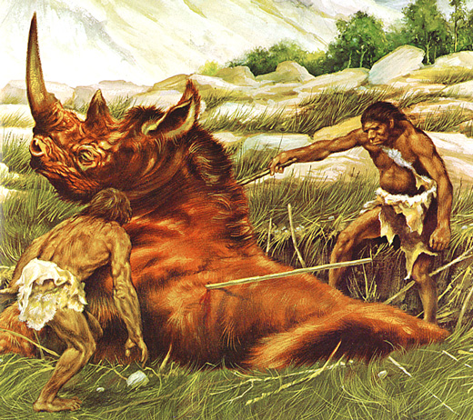
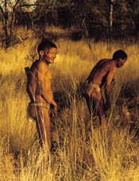
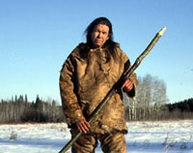
http://www.d.umn.edu/cla/faculty/troufs/anth1602/video/Distant_Mirror.html
Notes:
15

Slide 16

www.d.umn.edu/cla/faculty/troufs/anth1602/pchunt.html

Slide 17
Hunting / Gathering
Homo sapiens ca. 0.4 mya
Homo erectus ca. 1.8 mya
Homo habilis
Australopithecus
Ramapithecus – Kenyapithecus
Times to Remember Chart

Slide 18
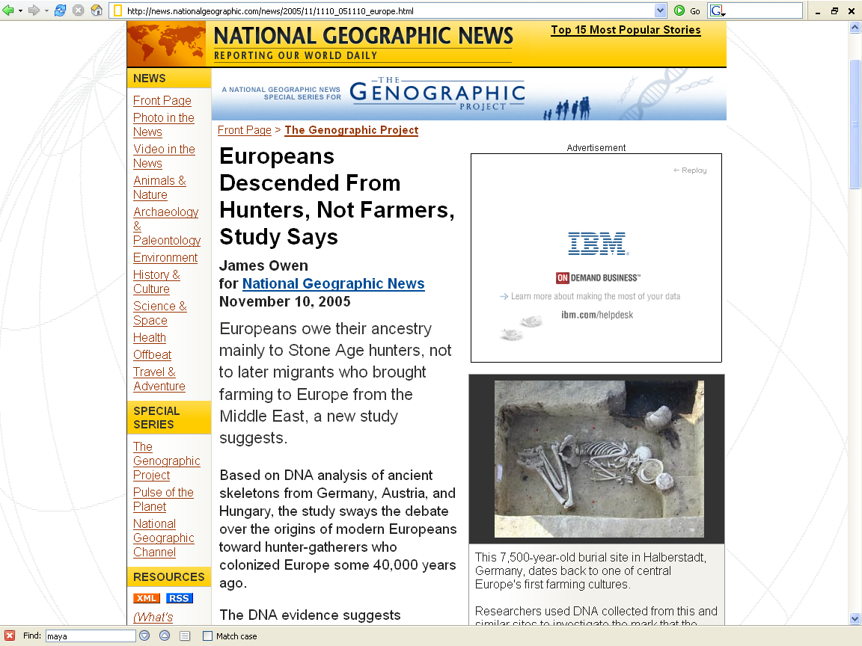
http://news.nationalgeographic.com/news/2005/11/1110_051110_europe.html

Slide 19
Glossary
controlled comparison
“a method in which hypotheses are tested by comparing two or more populations that are similar or identical in most respects other than that which has been defined as the independent variable”
-- Anthromorphemics
Franz Boas 1916

Slide 20
Glossary
controlled comparison
in this case
hunting
is the
independent variable

Slide 21
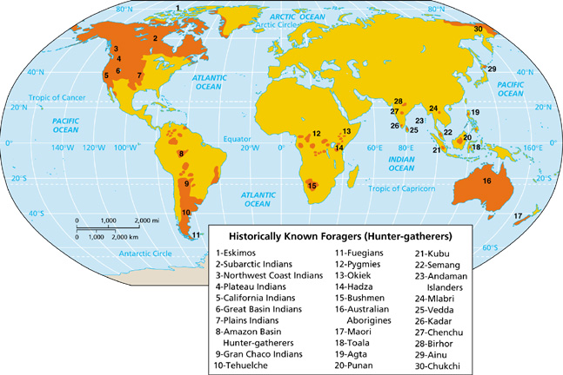
Notes:
21

Slide 22
Glossary
ethnoarchaeology
the archaeological study of contemporary cultures to help understand the archaeological record

Slide 23
Paleoanthropology is Heavily Interdisciplinary.
Understanding Humans, 10th Ed., p. 178

Slide 24
Glossary
ethnographic analogy
the method of analysis which uses contemporary cultures as models to help understand
the archaeological past

Slide 25
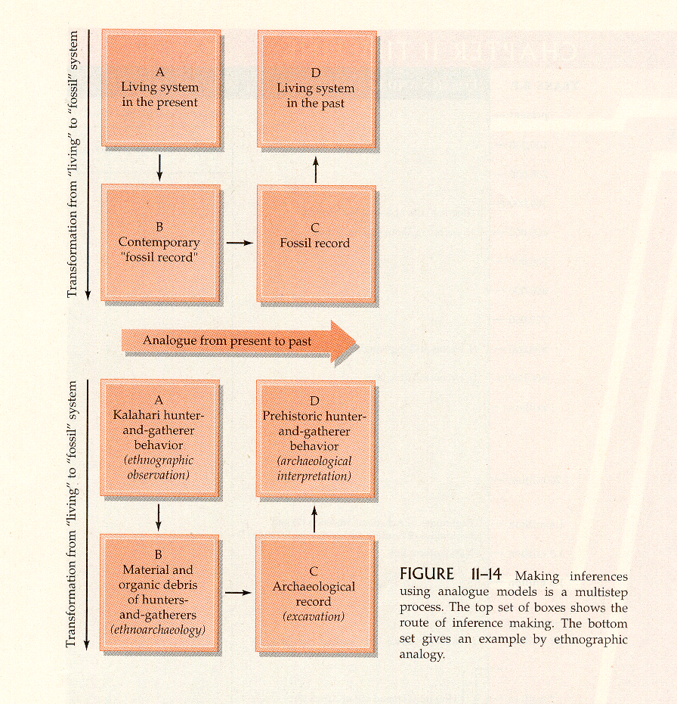
Humankind Emerging, 7th Ed., p. 345.

Slide 26
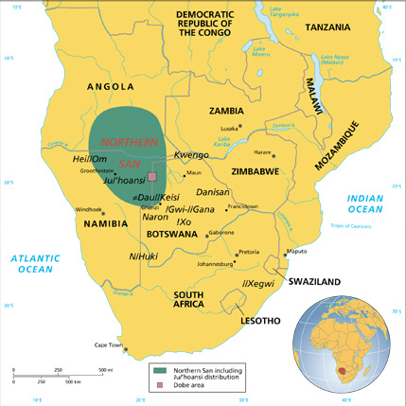
ethnographic analogy
!Kung San of the
Kalahari Desert

Slide 27
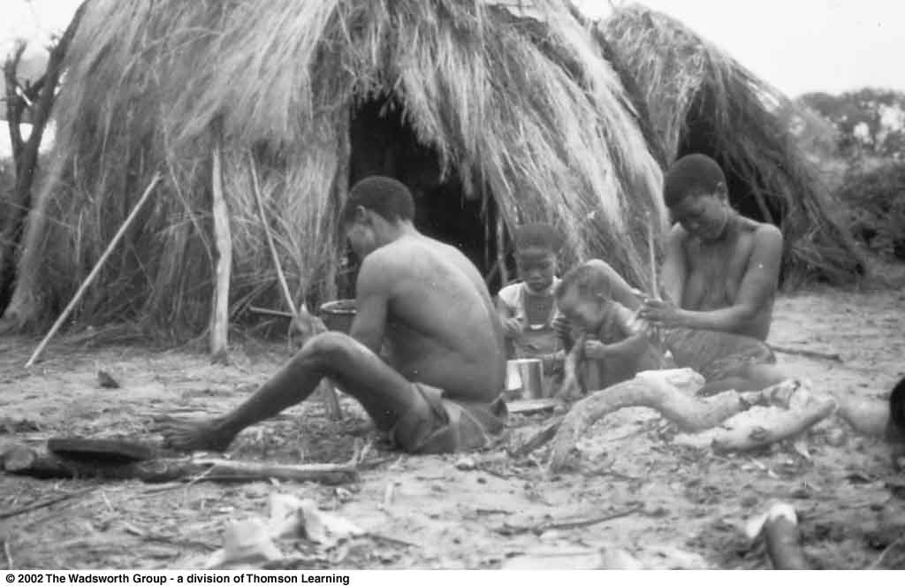
Ethnoarcheological Studies of !Kung Lifeways
Understanding Physical Anthropology and Archaeology, 8th Ed., p. 347

Slide 28
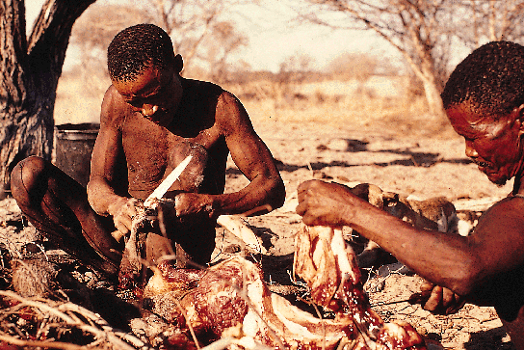

Slide 29
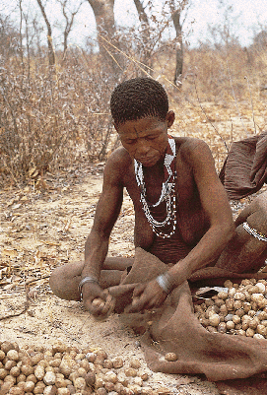

Slide 30
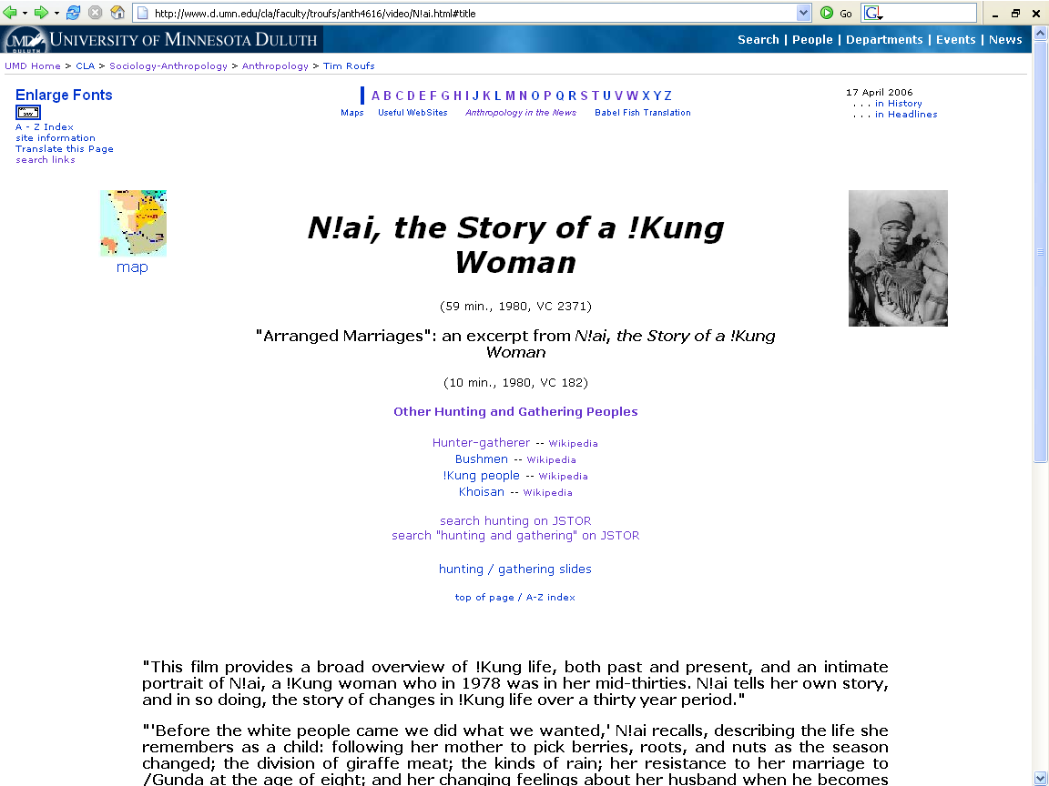
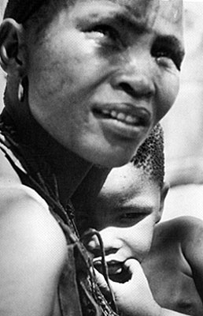
www.d.umn.edu/cla/faculty/troufs/anth4616/video/N!ai.html

Slide 31
Hunting / Gathering
“hunting” = big game hunting
megafauna = 100 lbs. or more

Slide 32
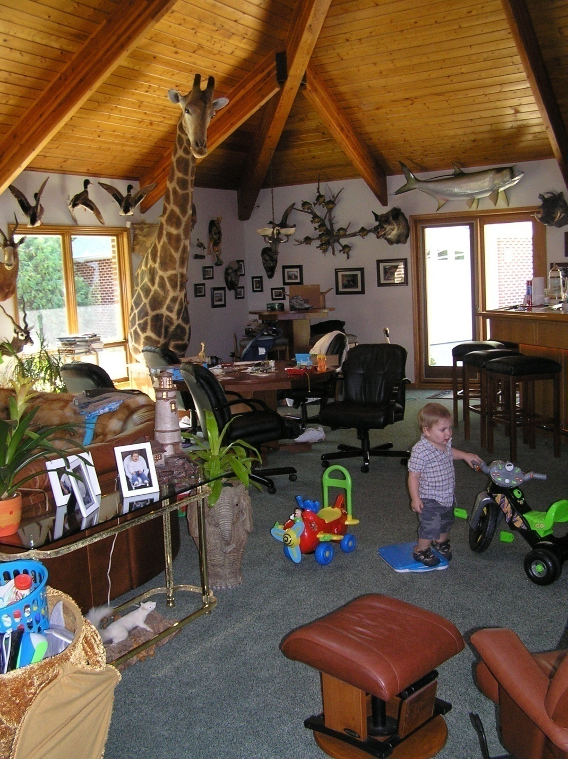
July 2008

Slide 33
July 2008

Slide 36
Hunting / Gathering
“vegetarian”
sometimes is used erroneously to mean not eating big game animals
“ground meats”
may be “collected” and eaten
and lots of people eat bugs, worms, insects, etc.
("Entomophagy“)

Slide 37
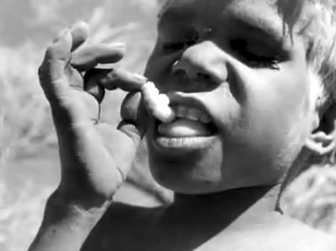
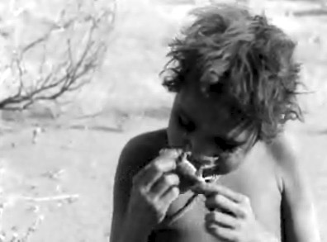
video:
The Desert People
www.d.umn.edu/cla/faculty/troufs/anth1602/pchunt.html#title

Slide 38
Hunting / Gathering
cold climate hunters
(e.g. Inuit, “Eskimo”)
have a different adaptive pattern than other hunters

Slide 39
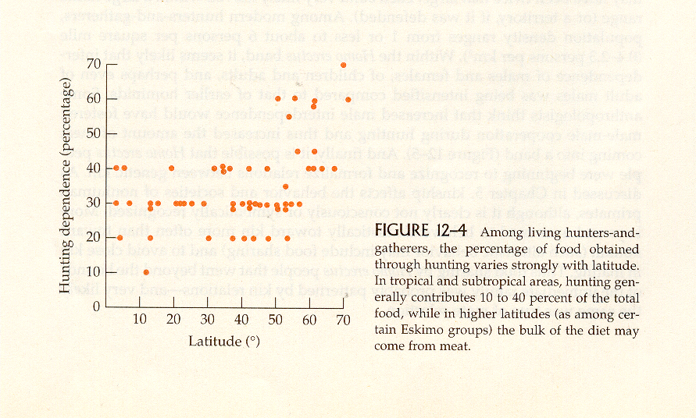
cold climate hunters
Humankind Emerging, 7th Ed., p. 357.

Slide 40
Hunting / Gathering
hunting = a leisurely life
it is not hand-to-mouth living
“The Original Affluent Society”
Marshall Sahlins

Slide 41
Hunting / Gathering
“meat-eating mystique”
psychological associations
  male ego
  sexism

Slide 42
Hunting / Gathering
meat eating → rapid development
brain size went from 700 cc to 1200 cc
hunting

Slide 43
Hunting / Gathering
99% of human’s time has been that of a hunter-gatherer

Slide 44
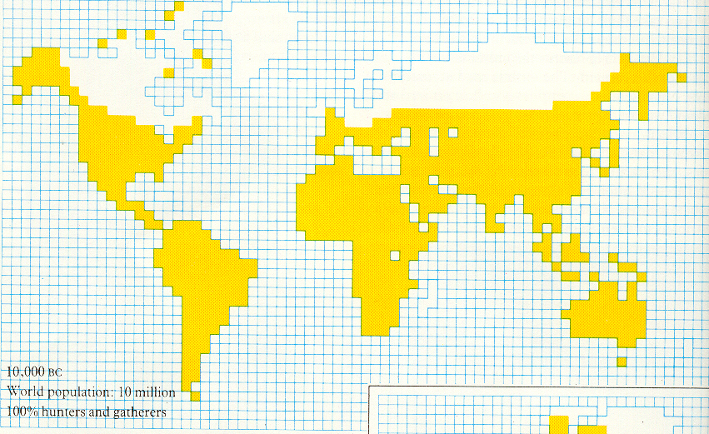
10, 000 B.C. – 100 % Foragers
Ascent to Civilization, p. 10

Slide 45
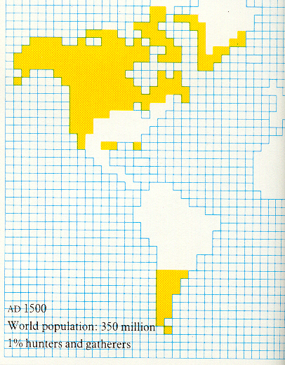
A.D. 1500 – 1 % Foragers
Ascent to Civilization, p. 10

Slide 46
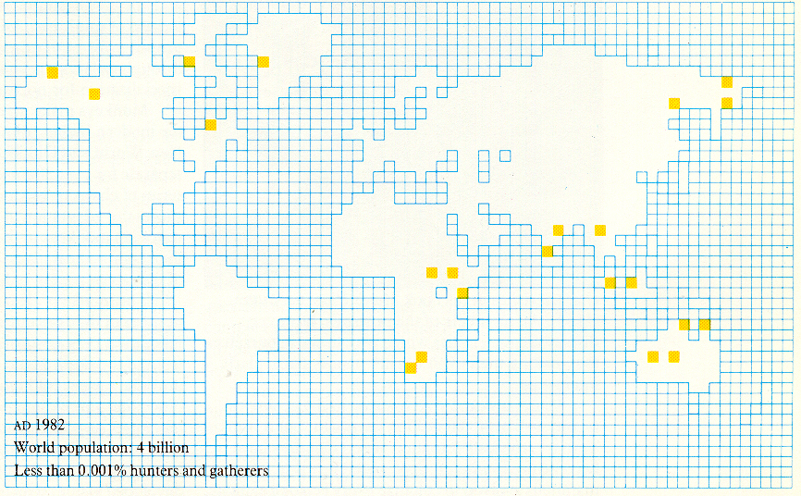
The Hunters
The Desert People
A.D. 1982 – < 0.001 % Foragers
Ascent to Civilization, p. 10

Slide 47
Hunting / Gathering
origins of hunting
?
scavenging
running down game
(esp. the sick, the old, and the young)

Slide 48
Hunting / Gathering
origins of hunting
?
scavenging
running down game
(esp. the sick, the old, and the young)

Slide 49
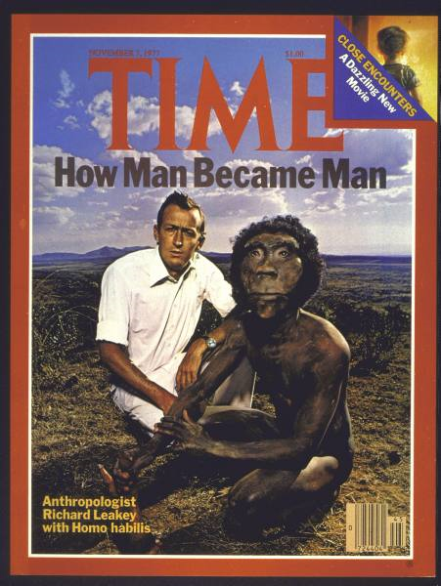
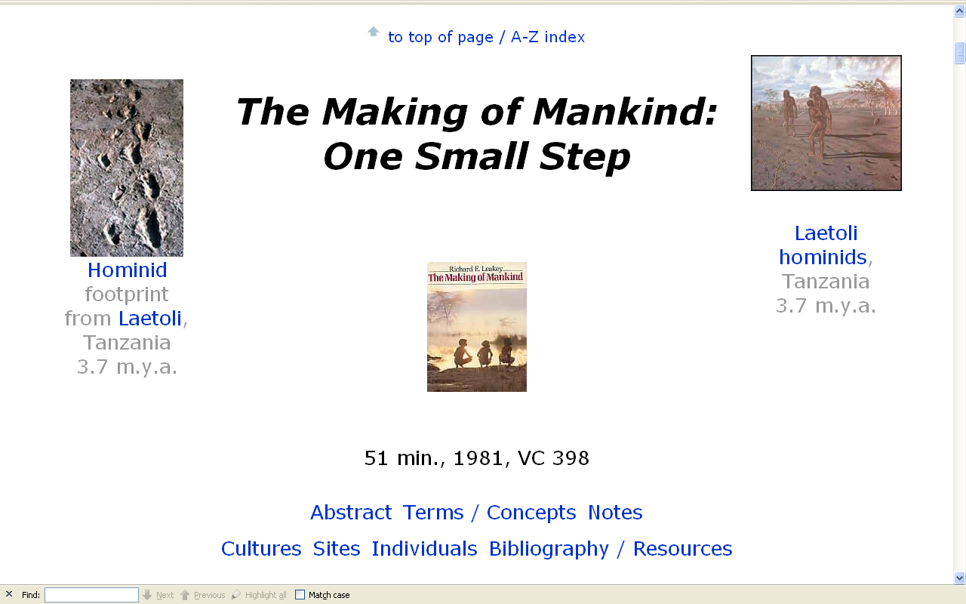
www.d.umn.edu/cla/faculty/troufs/anth1602/video/Making.html#title
Notes:
49

Slide 50
Hunting / Gathering
origins of hunting
?
scavenging
running down game
(esp. the sick, the old, and the young)

Slide 51
www.bolenhq.com/scubaandsnorkeling.htm
Notes:
51

Slide 52
Hunting / Gathering
origins of foraging
origins of hunting
simple collecting is very efficient . . .

Slide 53
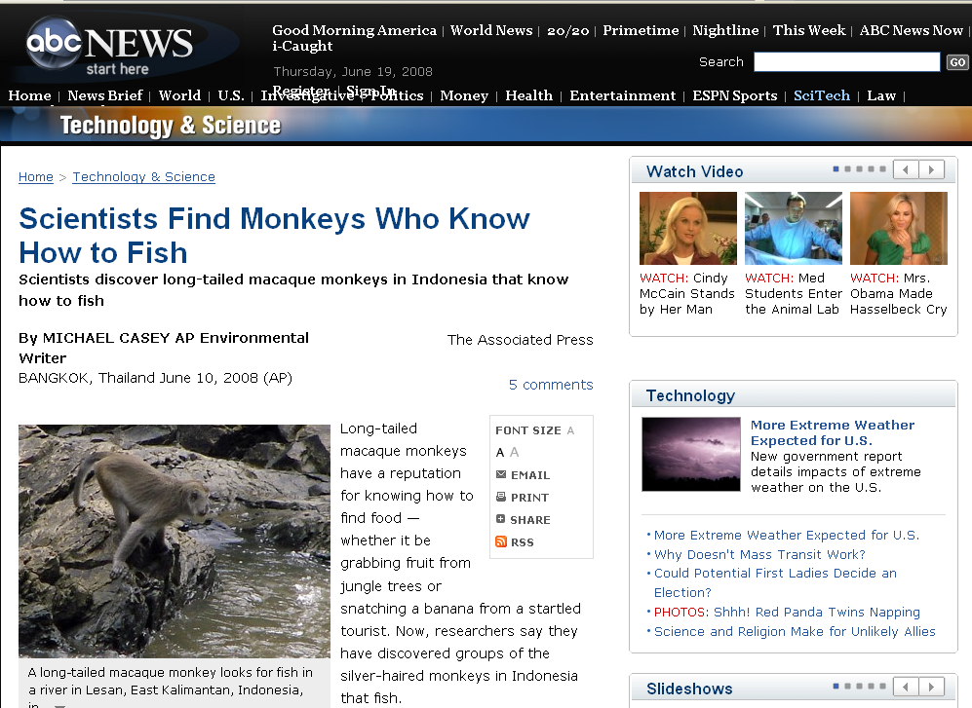
abcnews.go.com/Technology/wireStory?id=5035837
Notes:
53

Slide 54
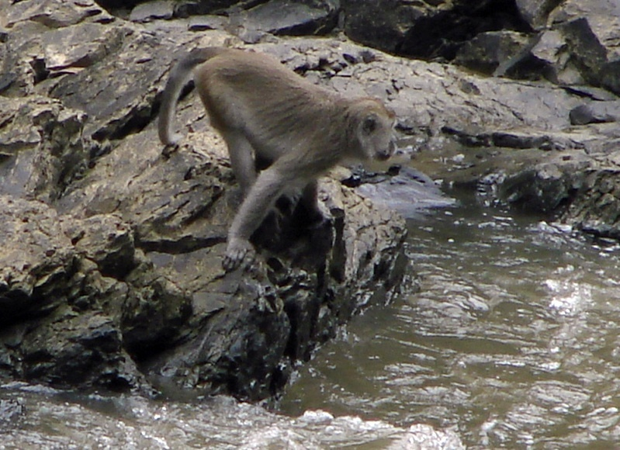
abcnews.go.com/Technology/wireStory?id=5035837
Notes:
54

Slide 55
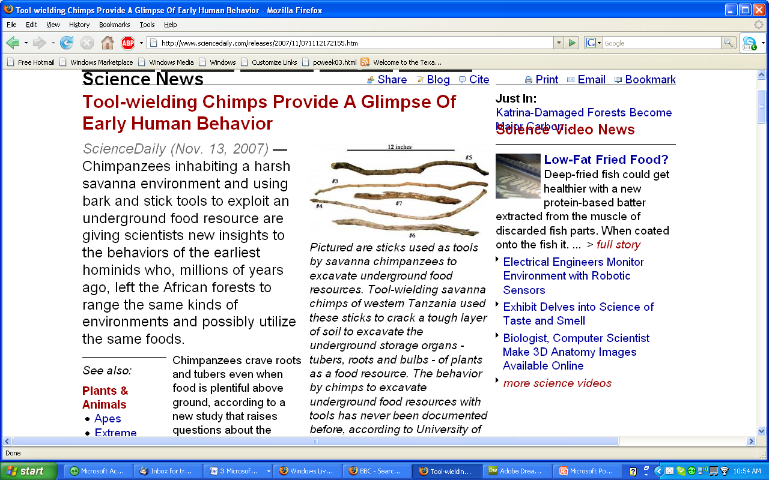
www.sciencedaily.com/releases/2007/11/071112172155.htm
Notes:
55

Slide 56
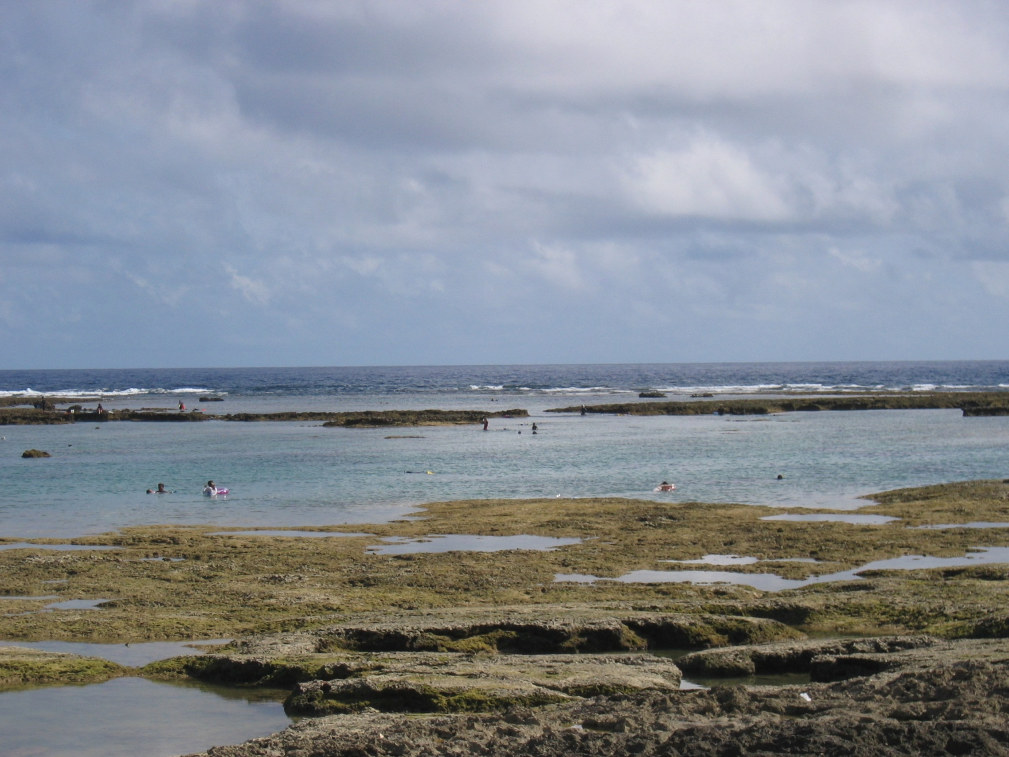
tidal pools
www.bolenhq.com/scubaandsnorkeling.htm
Notes:
56

Slide 57
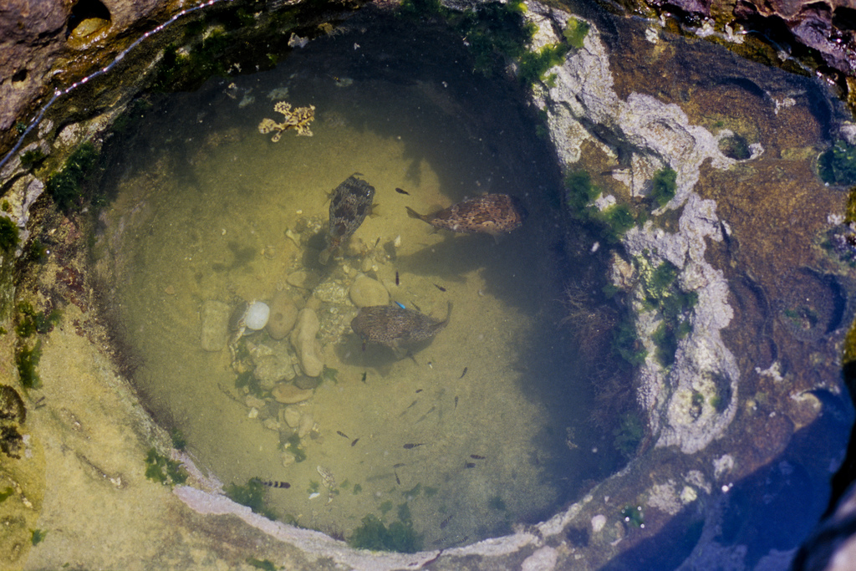
http://tirugondar.wordpress.com/2008/08/03/yehliu-and-the-yehliu-geopark/
Notes:
57

Slide 58
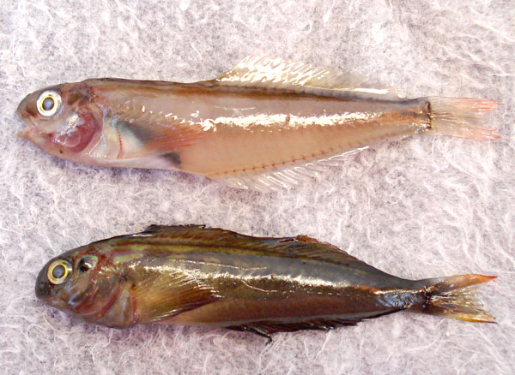
Panamic Fanged Blenny, Ophioblennius steindachneri: [Adults] are common and always found in tidal pools, even with extreme low tides, with plenty of water and a place to hide under a rock . . . . Collected in January 2008 in a dry El Tule Tidal pool, Km. 17, San Jose del Cabo, Mexico . . .
www.mexfish.com/fish/pfblen/pfblen.htm
Notes:
58

Slide 59
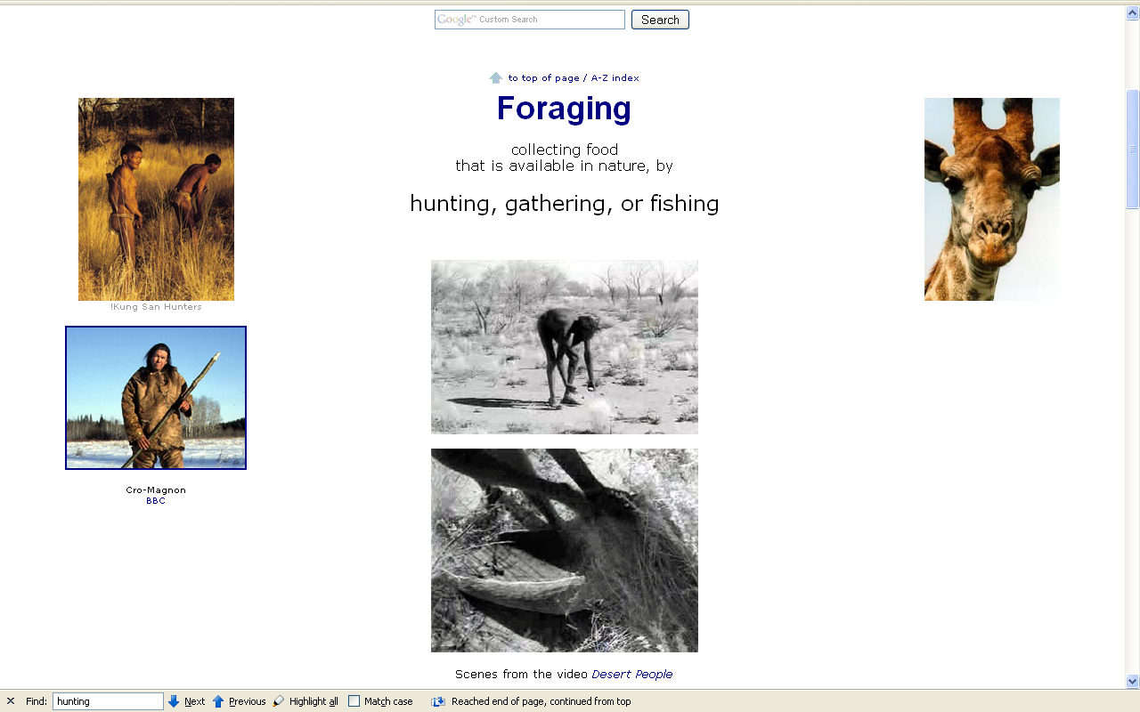
www.d.umn.edu/cla/faculty/troufs/anth1602/pcweek12.html#CEE12

Slide 60
Hunting / Gathering
Be that as it may . . .

Slide 61
Hunting / Gathering
meat eating becomes increasingly more important from 1.8 mya onwards
(with the beginning of the pleistocene,
and the advent of Homo erectus)

Slide 62
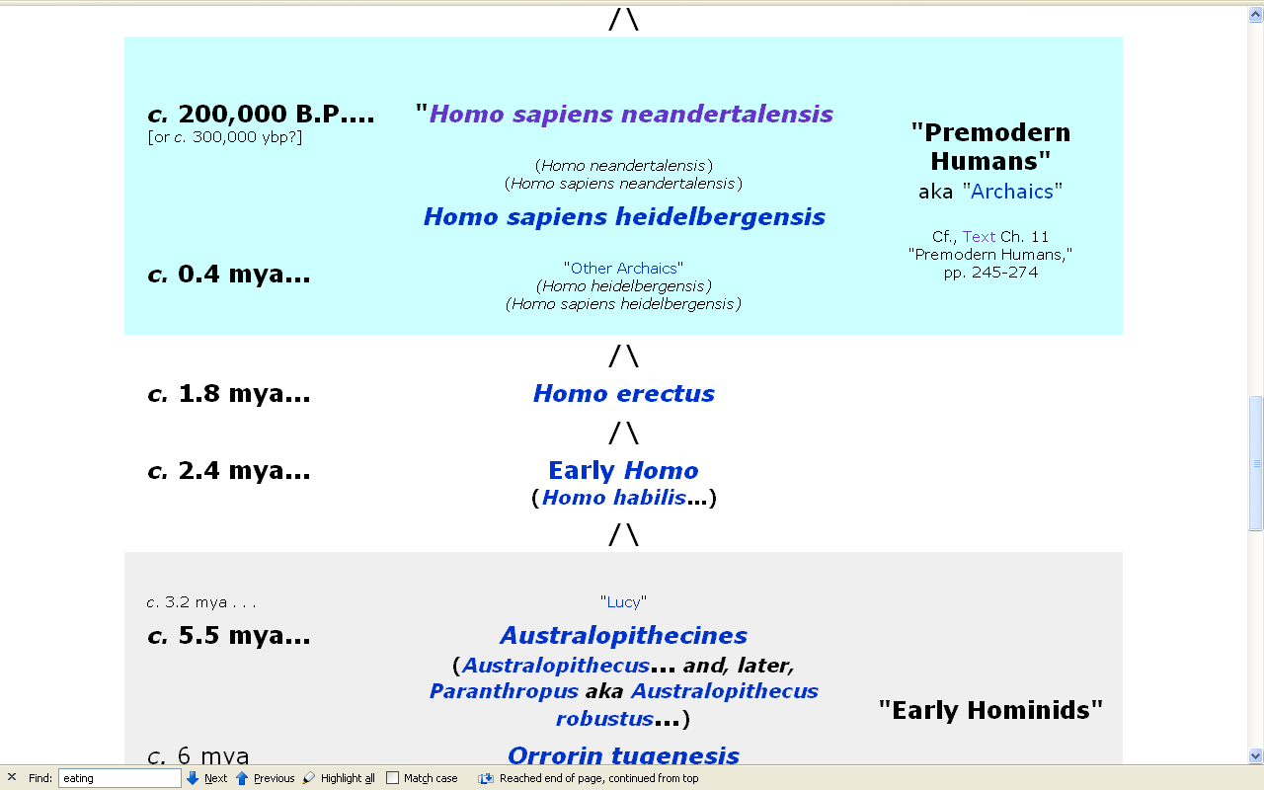
www.d.umn.edu/cla/faculty/troufs/anth1602/pctimes.html#title
Notes:
62

Slide 63
Hunting / Gathering
complex interrelated
and interacting changes occurred
biological
cultural / social

Slide 64
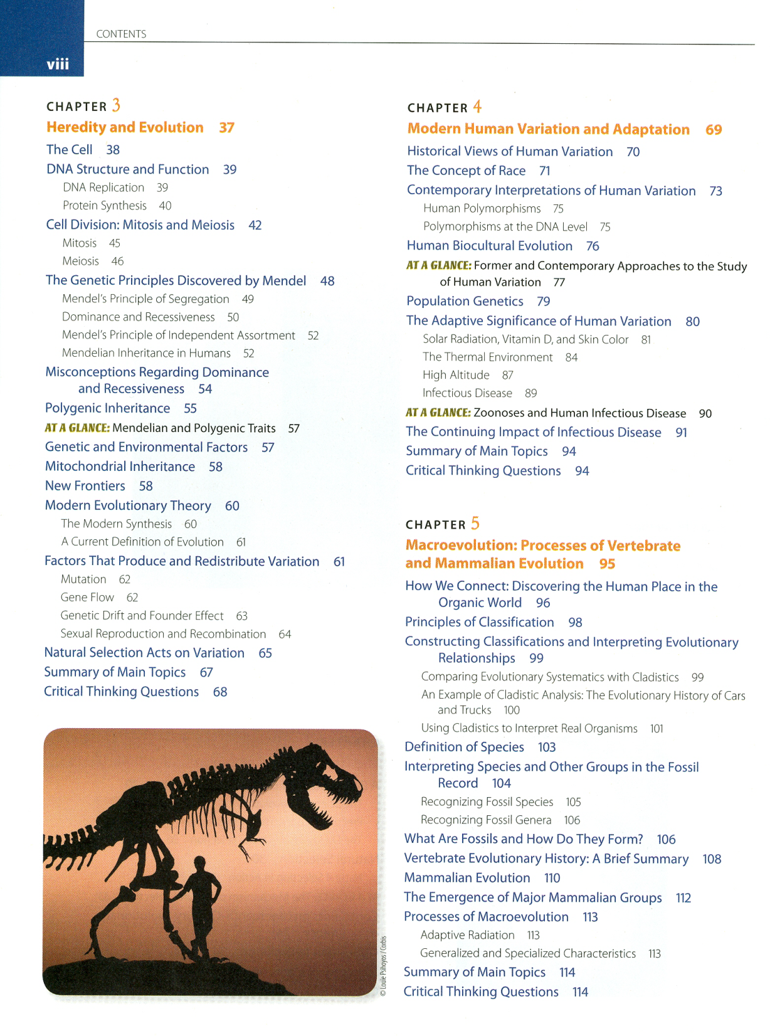

Slide 65
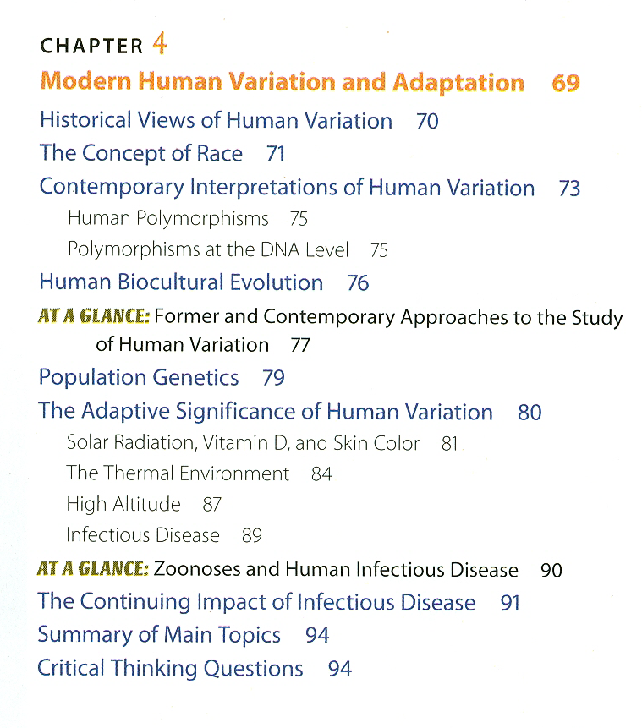

Slide 67
Hunting / Gathering
complex interrelated
and interacting changes occurred
biological
cultural / social

Slide 68
Hunting / Gathering
complex interrelated
and interacting changes occurred
biological
cultural / social

Slide 69
Hunting / Gathering
one of the best examples of
early sites . . .
Torralba / Ambrona
(Spain)
400,000 - 200,000 ? ybp
Acheulian

Slide 70
Hunting / Gathering
one of the best examples of
early sites . . .
Torralba / Ambrona
(Spain)
400,000 - 200,000 ? ybp
Acheulian

Slide 71
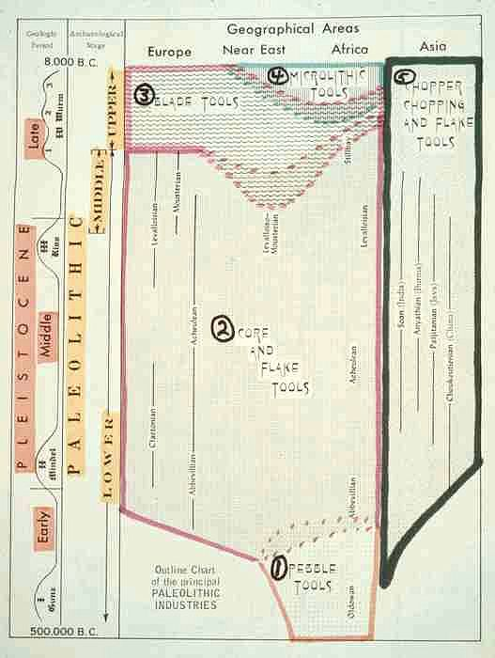

Slide 72
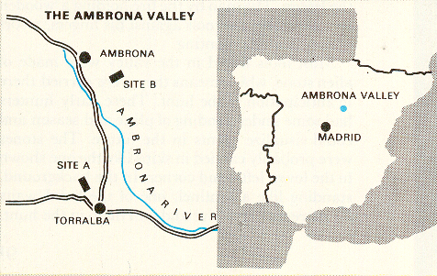
Time-Life, Early Man, p. 92.

Slide 73
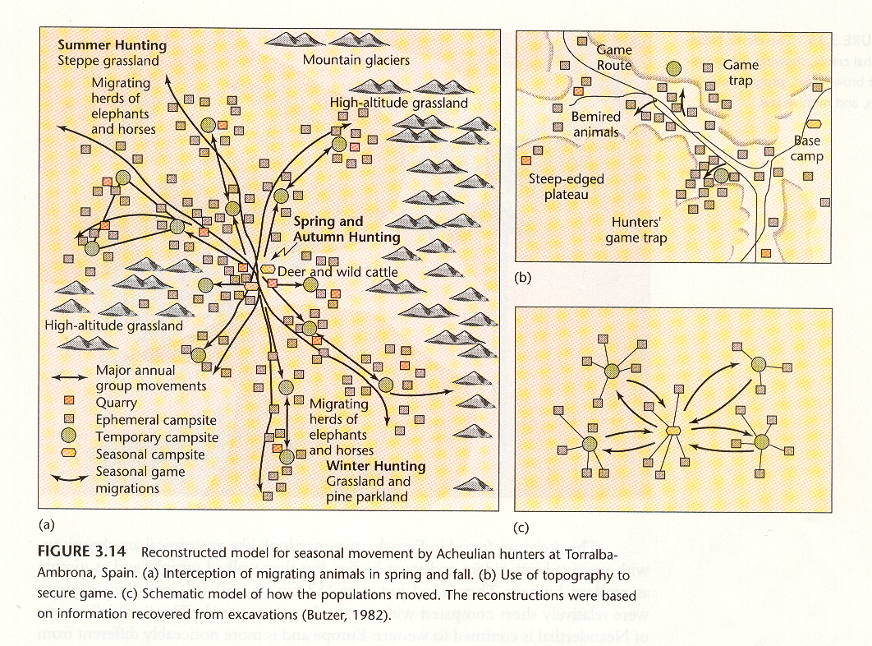
People of the Earth, 10th Ed., p. 97.

Slide 74
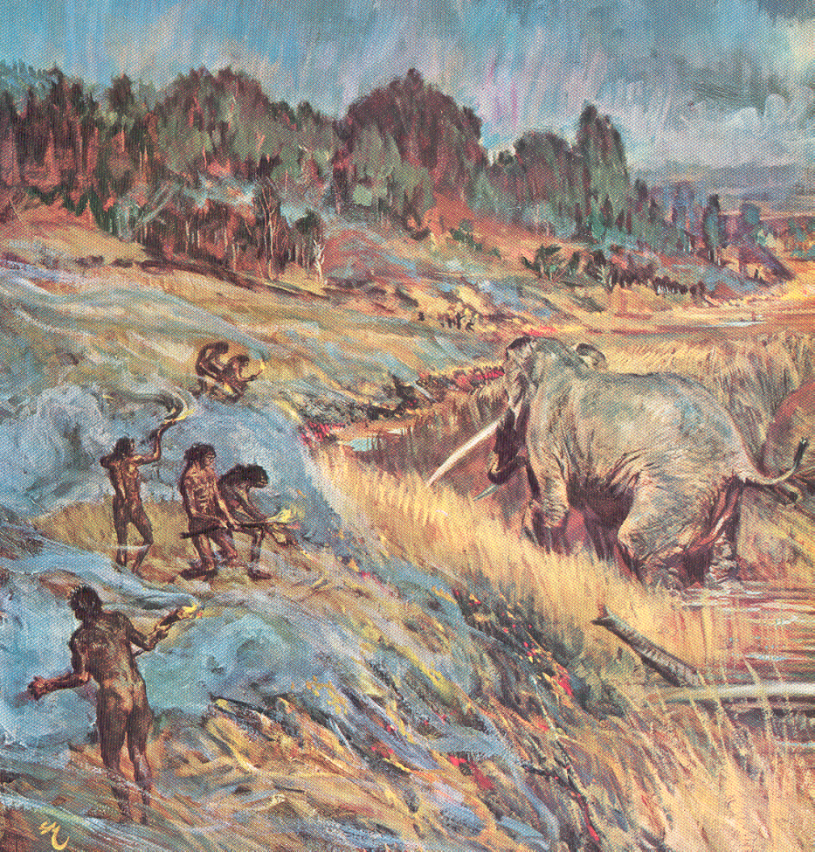
Homo erectus at Torralba-Ambrona, Spain
Time-Life, Early Man, p. 94

Slide 75
Hunting / Gathering
but the evolutionary ecology
of earlier hominids and modern Homo sapiens was quite divergent

Slide 76
Glossary
controlled comparison
“a method in which hypotheses are tested by comparing two or more populations that are similar or identical in most respects other than that which has been defined as the independent variable”
-- Anthromorphemics
Franz Boas 1916

Slide 77
Glossary
controlled comparison
in this case
hunting
is the
independent variable

Slide 78


Slide 79
Hunting / Gathering
The Desert People
Pfeiffer, Ch. 15
The Hunters
Pfeiffer, Ch. 16

Slide 80
Hunting / Gathering
The Desert People
Australian “aborigines”
The Hunters
“Bushmen”
!Kung San
Khoisan
zhun/twasi
  (“ourselves”)

Slide 81
Hunting / Gathering
The Desert People
The Hunters
both are desert dwellers

Slide 82

Major Deserts on Earth
http://members.ozemail.com.au/~slacey/deserts.htm

Slide 83

Not all deserts are like the Sahara
http://news.bbc.co.uk/cbbcnews/

Slide 84

Or like Egypt
http://www.cs.rice.edu/~kdiaa/

Slide 85
Hunting / Gathering
The Desert People
desert dwellers
  Great Western Austrailian
The Hunters
both are desert dwellers

Slide 86

Hunting / Gathering
Aborigines of the
Western Australian Desert
Map 12-3

Slide 87

Great Sandy Desert, Australia
http://www.confluence.org/photo.php?visitid=3398&pic=ALL

Slide 88

Great Sandy Desert, Australia
video: The Desert People
www.d.umn.edu/cla/faculty/troufs/anth1602/pchunt.html#title

Slide 89
Hunting / Gathering
The Desert People
desert dwellers
  Great Western Austrailian
The Hunters
desert dwellers
  Kalahari
both are desert dwellers

Slide 90
Hunting / Gathering
Aborigines of the
Western Australian Desert
!Kung San of the
Kalahari Desert
Map 12-3

Slide 91

Hunting / Gathering
Aborigines of the
Western Australian Desert
!Kung San of the
Kalahari Desert
Map 12-3

Slide 92

Kalahari Desert, Africa
video: The Hunters
www.d.umn.edu/cla/faculty/troufs/anth1602/pchunt.html#title

Slide 93
Hunting / Gathering
The Desert People
simple material culture
The Hunters
simple material culture

Slide 94
Hunting / Gathering
moving puts a premium
on multi-purpose tools
e.g., digging stick, blade tools . . .

Slide 95

Digging stick
New Hebrides (Vanuatu)
wood, Vanuatu, l. 158 cm, d. 3.5 cm
Museum of Australia, Canberra
www.nma.gov.au/cook/artefact.php?id=354

Slide 96

“Ngadadjara woman sharpening digging stick by rubbing away charred wood with scraper stone after having been used to dig up lerp scale from mulga, in the dish beside her.”
www.samuseum.sa.gov.au/orig/tindale/K4/k4.htm

Slide 97
moving puts a premium
on multi-purpose tools
e.g., digging stick, blade tools . . .
www.nma.gov.au/cook/artefact.php?id=354

Slide 98
Hunting / Gathering
The Desert People
“band” society
The Hunters
“band” society
most band societies are patrilineal

Slide 99

Hunting / Gathering
patrilineal kinship

Slide 100

Hunting / Gathering
patrilineal kinship

Slide 101

Hunting / Gathering
patrilineal societies are patrilocal
patrilineal societies are patrilocal
patrilocal residence

Slide 102
“band” societies
bands have the simplest level of social organization
with patrilineal families living in small groups
    ca. 25 – 50 / group

Slide 103

“band” societies
!Kung San in Camps

Slide 104
“band” societies
50 – 500 persons are integrated by a shared language and a sense of common identity
  exact numbers depend on the carrying capacity of their geographic area

Slide 105
“band” societies
“charismatic leadership”
leadership is based solely on personal traits
no official leaders
leader has no power and only limited authority
position carries no rewards of power or riches

Slide 106
“band” societies
age and sex
generally determine
who will exert influence
strongly male dominated
but the old people -- male and female
-- are respected and are influential

Slide 107
“band” societies
influence may dissolve or be created in an instant

Slide 108
“band” societies
status positions are fluid from generation to generation

Slide 109
“band” societies
band composition is fluid as people shift residence frequently

Slide 110
“band” societies
marriages are through alliances with members of other bands
Video: N!ai, The Story Of A !Kung Woman

Slide 111
“band” societies
group decisions are made by consensus

Slide 112
“band” societies
The Desert People
are not hunters
The Hunters
are hunters
hunting is the independent variable

Slide 113
“band” societies
The Desert People
are not hunters
The Hunters
are hunters
hunting is the independent variable

Slide 114
Hunting / Gathering
hunting-gathering bands
nomadic

Slide 115
Hunting / Gathering
full-scale hunting
-- expanded range and experiences

Slide 116
Hunting / Gathering
hunting places adaptive value
on knowledge of
  area
  animals / animal habits
  tools / technologies

Slide 117
Hunting / Gathering
hunting places emphasis on
patience
waiting (restraint)
persistence
    “persistence hunting”

Slide 118
Hunting / Gathering
hunting emphasizes planning, and a heightened sense of the future

Slide 119
Hunting / Gathering
cooperating hunters
are more successful
can prey on large animals
can eat most of the meat at one time (waste less)
have more fun

Slide 120
Hunting / Gathering
hominin hunting
probably followed the hunting of lions
or wild dogs in the African savannah

Slide 121
Hunting / Gathering
lions, heyenas, and wild dogs
hunt in groups
share their food
hunt cooperatively

Slide 122
Hunting / Gathering
hunting affects social relationships

Slide 123

North Alaskan Eskimos [sic.],
for e.g.,
hunt lifelong with cohorts
and refer to their hunting partners
by the term for the part of the animal they traditionally receive whenever the hunters are successful
www.d.umn.edu/cla/faculty/troufs/anth1602/pchunt.html#title
Notes:
123

Slide 124
Hunting / Gathering
hunting is for more than meat
ritual / taboos / religion
status
fun / comaraderie
?

Slide 125

www.duluthsuperior.com/mld/duluthtribune/11274391.htm

Slide 126

www.duluthsuperior.com/mld/duluthsuperior/news/editorial/12743924.htm

Slide 127
Hunting / Gathering
a good hunter often
is also a group’s shaman
Cf. video:
Homo Sapiens: A Look into a Distant Mirror
(53 min, 1999, VC 4324)

Slide 128
Hunting / Gathering
male – male relationships
dominate
associations / fraternities ?

Slide 129
Hunting / Gathering
difference between
young males and old males
is intensified in hunting societies

Slide 130
Hunting / Gathering
hunting allows young males to vent their frustrations

Slide 131
Hunting / Gathering
ability to hunt signifies change of status and may be required for adulthood

Slide 132
Hunting / Gathering
dietary changes →
social adaptations

Slide 133
Hunting / Gathering
hunting intensifies differences between sexes . . .

Slide 134
Hunting / Gathering
hunting creates a “male world”
and
a “world of the women and children”
. . . BUT, it seems like …

Slide 135
Hunting / Gathering
hunting creates a “male world”
and
a “world of the women and children”
. . . BUT, it seems like . . .

Slide 136

/www.nytimes.com/2006/12/05/science/05nean.html?_r=2&\1ref=science&\1oref=slogin&oref=slogin

Slide 137
Hunting / Gathering
hunting increases
the division of labor
between sexes
but hunting thus also creates more need for cooperation between sexes

Slide 138
Hunting / Gathering
hunting increases
the division of labor
between sexes
but hunting thus also creates more need for cooperation between sexes

Slide 139
Hunting / Gathering
sharing becomes important
for survival

Slide 140
Hunting / Gathering
females specialize in collecting

Slide 141


www.d.umn.edu/cla/faculty/troufs/anth1602/pchunt.html

Slide 142
Hunting / Gathering
75 % of “hunters” rely more heavily on collecting than on hunting
(Martin and Voorhies, 1975)

Slide 143
12-Nov-2007
www.eurekalert.org/pub_releases/2007-11/uosc-ham111107.php
Notes:
143

Slide 144
www.sciencedaily.com/releases/2007/11/071112172155.htm
Notes:
144

Slide 145

in the Gibson Desert, for e.g.,
90 % of the time
women furnish at least
80 % of the food

Slide 146
Hunting / Gathering
in hunting societies females stay in the home base more

Slide 147
Hunting / Gathering
there is
female division of labor
by age

Slide 148
Hunting / Gathering
home base
changes socialization patterns

Slide 149
Hunting / Gathering
delayed maturity is related to home base
  emphasis is placed on learning

Slide 150
Hunting / Gathering
trend
multiple births → single births
  with emphasis on infant as individual

Slide 151
Hunting / Gathering
from the child’s point of view
the home base
= a self-contained world

Slide 152

Hunting / Gathering
home base
allows sick to survive
  e.g., Shanidar I, or “Nandy”
  aka “Creeb” from Clan of the Cave Bear

Slide 153

Shanidar I, aka “Nandy” aka “Creeb”
http://en.wikipedia.org/wiki/Shanidar#Shanidar_1

Slide 154

Paleopathologists Wil Salo (left) and Art Aufderheide (right).
Understanding Physical Anthropology and Archaeology, 8th Ed., p. 117

Slide 155
Hunting / Gathering
home base
is away from water holes
to avoid scaring game
to avoid conflict with other hunters
for safety from carnivores
to avoid mother-in-law

Slide 156
Hunting / Gathering
home sites problem for archaeology
temporary use ?
seasonal use ?
other ?

Slide 157
Hunting / Gathering
“living floor analysis”

Slide 158
Homo erectus at Torralba-Ambrona, Spain
Time-Life, Early Man, p. 94

Slide 159
Homo erectus at Torralba-Ambrona, Spain
Time-Life, Early Man, p. 94

Slide 160

Homo erectus at Torralba-Ambrona, Spain
Time-Life, Early Man, p. 94

Slide 161
Hunting / Gathering
remember
cold climate hunters
(e.g. Iniut, “Eskimo”)
have a different adaptive pattern than other hunters

Slide 162
cold climate hunters
Humankind Emerging, 7th Ed., p. 357

Slide 163
cold climate hunters
Humankind Emerging, 7th Ed., p. 357.
Notes:
163

Slide 164
Hunting / Gathering
until the mid-1980s the !Kung model of the foraging lifeway dominated the Pleistocene paradigm
(Robert Foley, Science, May 1988)

Slide 165
Map 12-3

Slide 167
Hunting / Gathering
anthropologists no longer take the !Kung model
as the stereotype of
pre-agricultural societies

Slide 168
Hunting / Gathering
anthropologists now recognize a much greater variability among foraging groups
(Robert Foley, Science, May 1988)

Slide 169
Hunting / Gathering
some suggest that true hunting and gathering
(with division of labor, food sharing,
and central place foraging . . .)
is a recently emerged behavior
(Robert Foley, Science, May 1988)

Slide 170
Hunting / Gathering
agriculture and modern hunting-gathering are adaptations to
Late Pleistocene
resource depletion
(Robert Foley, Science, May 1988)

Slide 171
Hunting / Gathering
some argue that the !Kung must have been significantly influenced by other, non-foraging, groups in the historical past, thus limiting generalizations
(“historical particularism”)

Slide 172
Hunting / Gathering
Pleistocene male hunters seem to be responsible for much of the foraging, and are provisioning / sharing with females and young
(Robert Foley, Science, May 1988)

Slide 173
Hunting / Gathering
in the Late Pleistocene
males hunted more,
particularly very large animals

Slide 174


Hunting / Gathering
humans became more efficient
carnivores after 40,000 ybp
with projectiles
and fire

Slide 175

Hunting / Gathering
humans became more efficient
carnivores after 40,000 ybp
with projectiles
and fire

Slide 176

Hunting / Gathering
humans became more efficient
carnivores after 40,000 ybp
with projectiles
and fire

Slide 177

“Opportunistic hunting”
www.newscientist.com/news/news.jsp?id=ns99993085
Notes:
177

Slide 178
replaced by new technologies, inventions, strategies . . .
“Opportunistic hunting”
www.newscientist.com/news/news.jsp?id=ns99993085
Notes:
178

Slide 179

Magdalenian Spear-thrower (atlatl). Note the carving.
Understanding Physical Anthropology and Archaeology, 11th ed., p. 298
Notes:
179

Slide 180

Cro-Magnon hunters.
Time-Life, Cro-Magnon Man, p. 29

Slide 181
Hunting / Gathering
Late Pleistocene modern humans
are not the same as
Post-Pleistocene modern humans

Slide 182
Hunting / Gathering
modern hunting – gathering
is Post-Pleistocene

Slide 183
Hunting / Gathering
Post-Pleistocene change in body size and sexual dimorphism reflects a shift
in subsistence strategy

Slide 184
Hunting / Gathering
Post-Pleistocene moderns are smaller and have less sexual dimorphism than Pleistocene moderns

Slide 185
Hunting / Gathering
high levels of sexual dimorphism
and robust males reflect
considerable male - male competition for females
different male / female foraging strategies

Slide 186
Hunting / Gathering
Do hunters waste food ?
Yes

Slide 187


Slide 188
The audience was questioning the lecturer who had just spoken on big game hunting in Africa.
“Is it true,” asked a woman, “that wild beasts in the jungle won’t harm you if you carry a torch ?”
“That depends,” the lecturer said, “on how fast you carry it.”
Duluth Budgeter, Sunday, August 21, 1988

Slide 189
Hunting / Gathering /
Collecting
(foraging)
Most of the Woolly Mammoths came to an end ca. 12,000 years ago
We do now.

Slide 190


