Slide 1
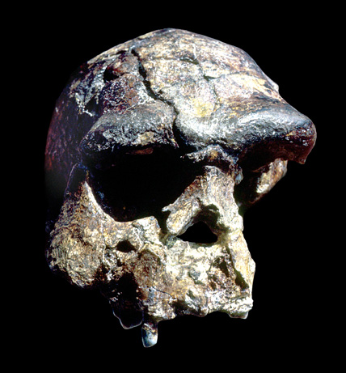
Homo erectus I
    Pithecanthropus erectus
      aka Homo erectus erectus
      aka “Java Man”
National Geographic
12 March 2009
Prehistoric Cultures
Tim Roufs’ section ©2009

Slide 2

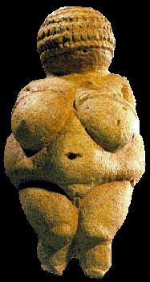
. . . or how to make sense
out of
Ch. 10 of the text . . .
University of Minnesota Duluth
Tim Roufs
© 2010-2013
http://www.d.umn.edu/cla/faculty/troufs/anth1602/

Slide 3
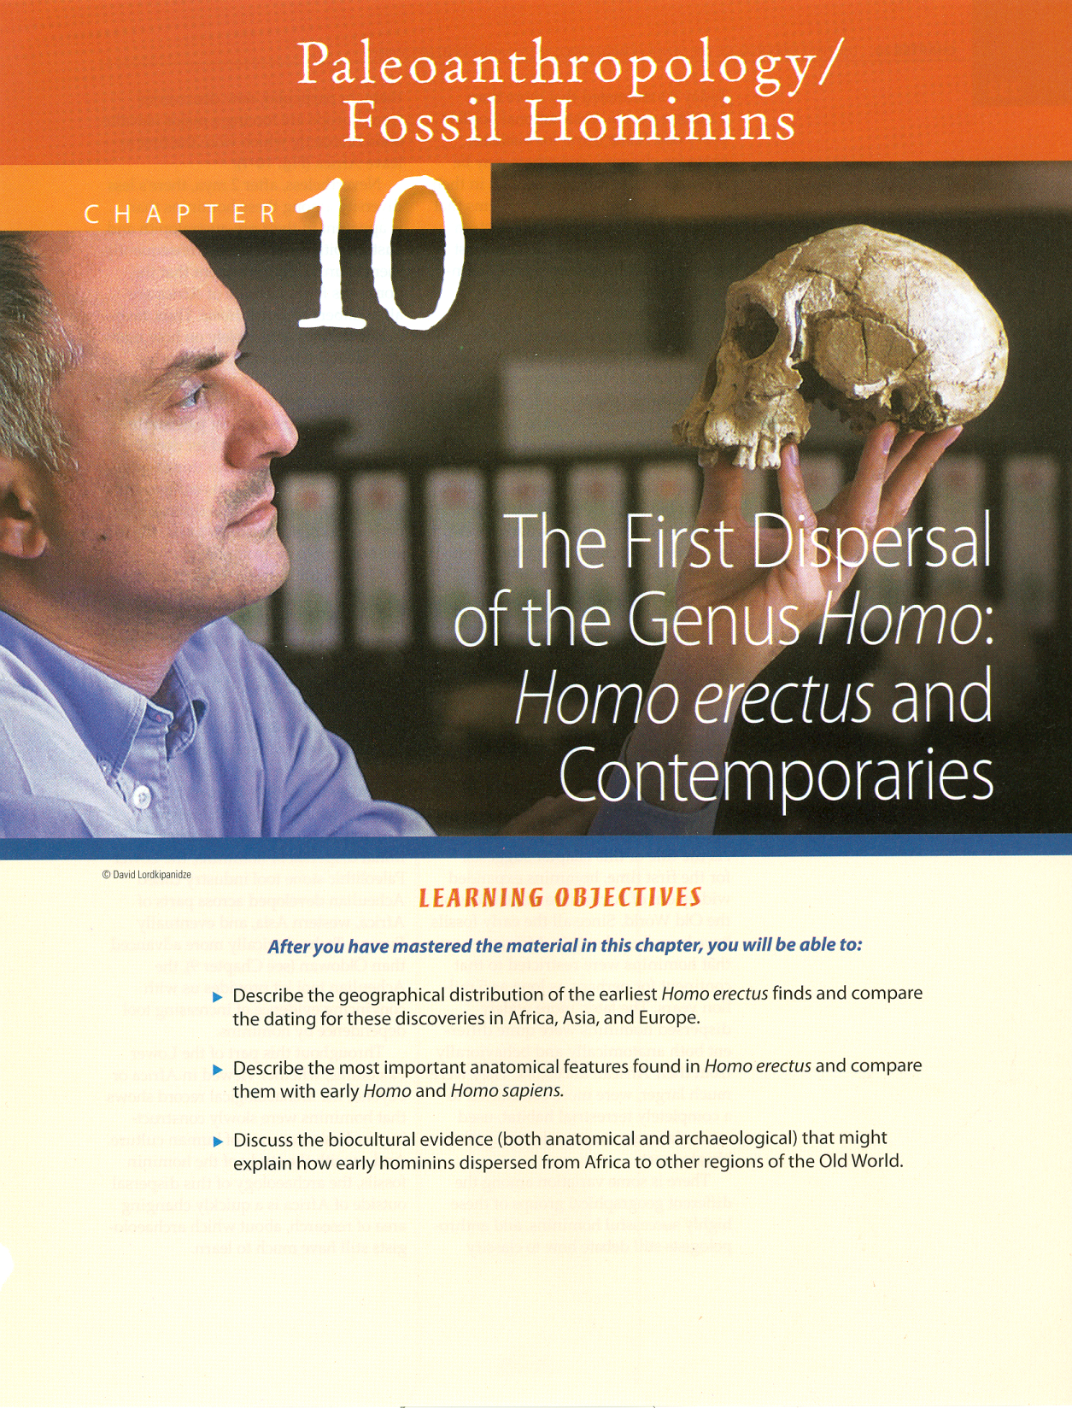
. . . or how to make sense out of
Ch. 10 of the text . . .

Slide 4
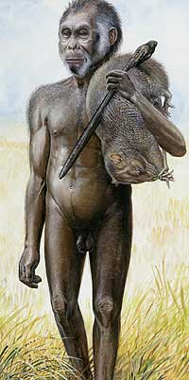
?
"The ‘hobbit’ as envisaged by National Geographic. "
(Image: National Geographic) -- BBC
www.smh.com.au/articles/2004/10/28/1098667862380.html?oneclick=true

Slide 5
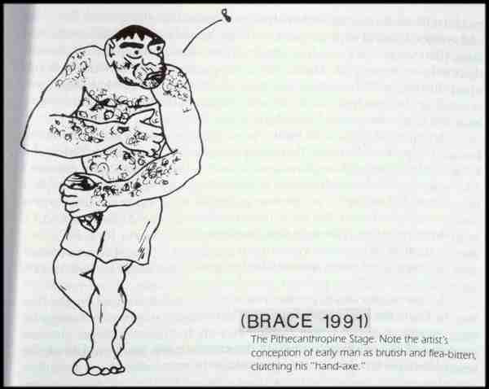

Slide 6
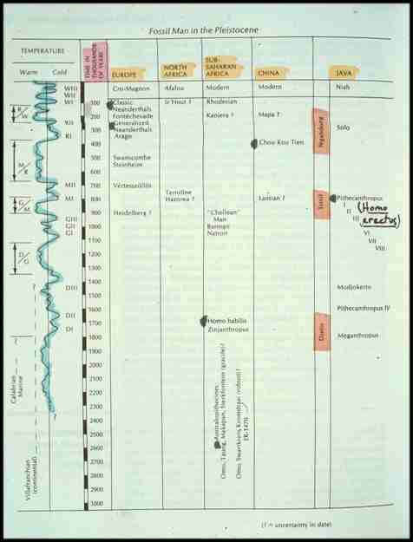
^{“Moderns”}
^{Neandertals}
^{Homo sapiens}
^{Homo erectus}
Pleistocene
^{Homo}
^{habilis}
^{Australopithecus}

Slide 7
Homo erectus
Orrorin
Ardipithecus
Australopithecus
Paranthropus
Homo
tugenensis
ramidus
anamensis
afarensis
africanus
garhi
aethiopicus
boisei
robustus
rudolfensis ( “early” )
habilis ( “early” )
erectus
sapiens

Slide 8
Homo
Genus
Homo
Species
rudolfensis ( “early” )
habilis ( “early” )
erectus
  Java (Trinil)
    Pithecanthropus erectus
  China (Beijing)
    Homo erectus pekinensis
  Africa . . .
  Europe . . .
sapiens

Slide 9
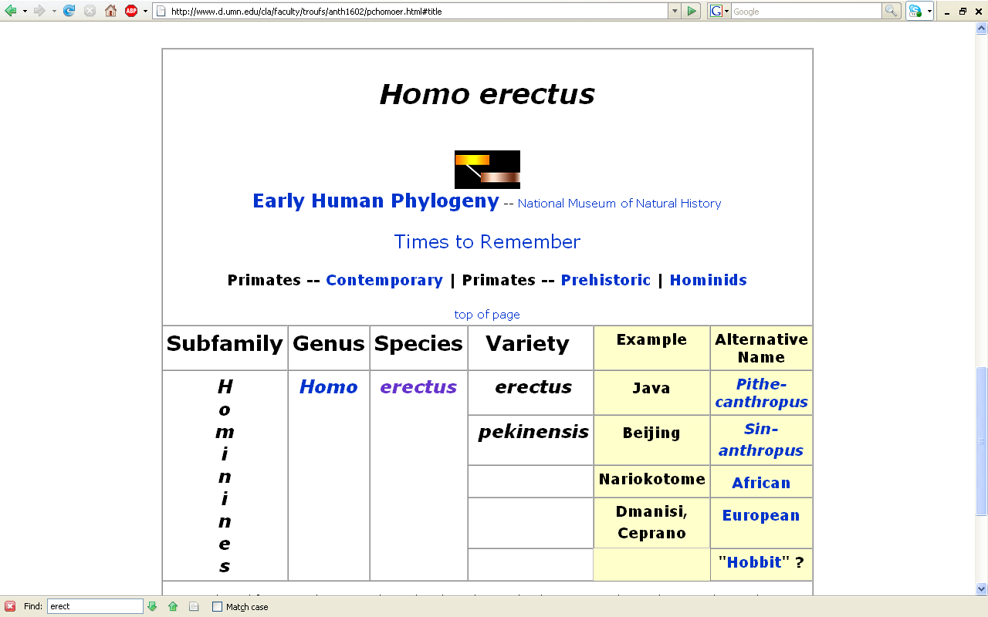
www.d.umn.edu/cla/faculty/troufs/anth1602/pchomoer.html#title

Slide 10
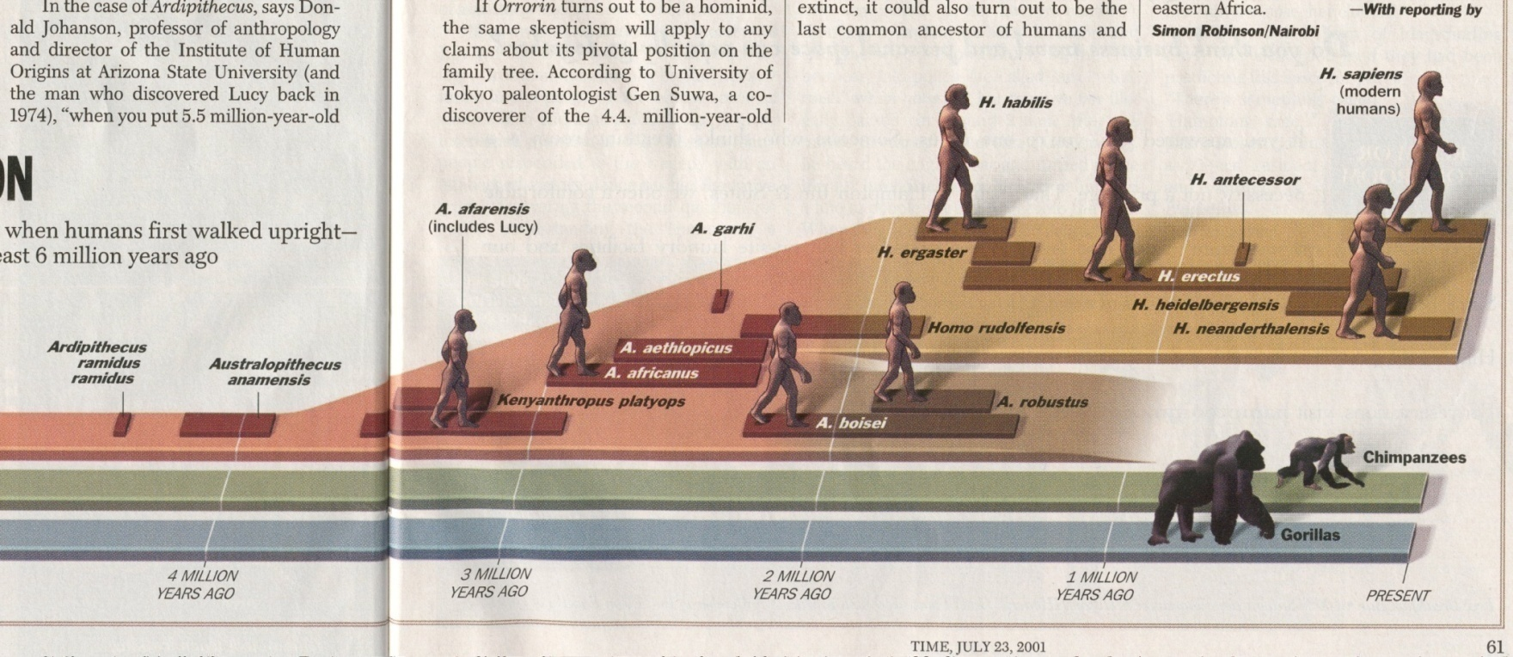
^{Time 23 July 2001}

Slide 11
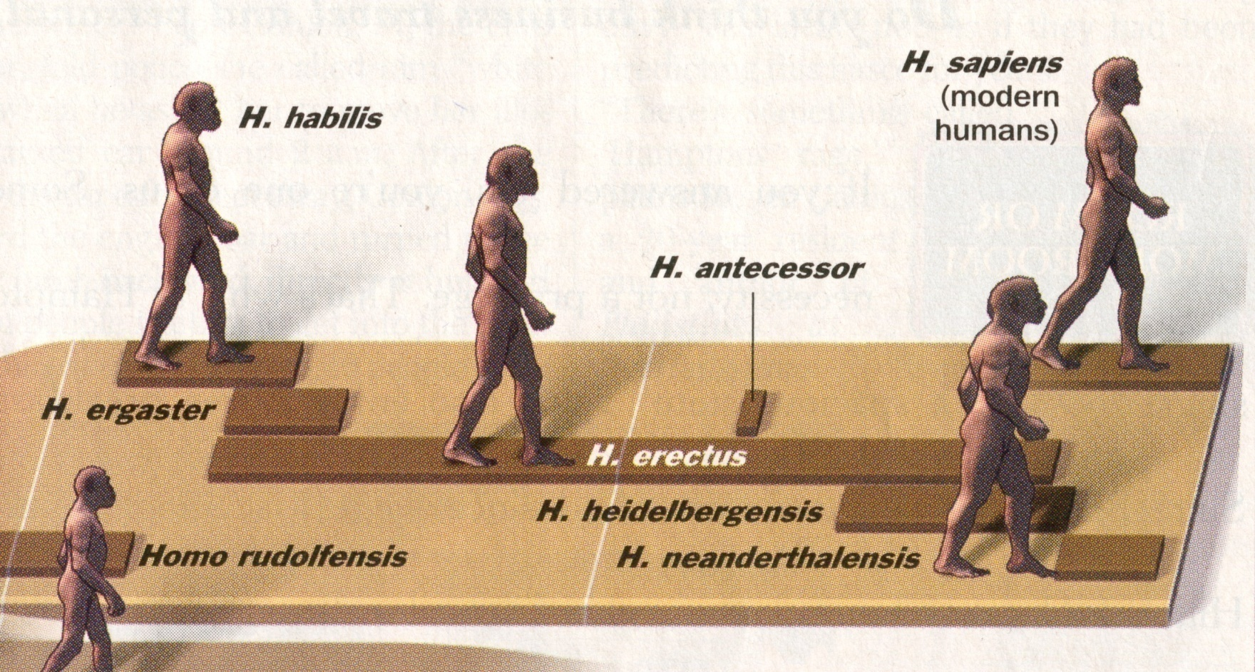
^{Time 23 July 2001}

Slide 12
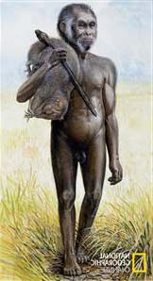
The “hobbit”
^{Time 23 July 2001}

Slide 13

^{Time 23 July 2001}

Slide 14
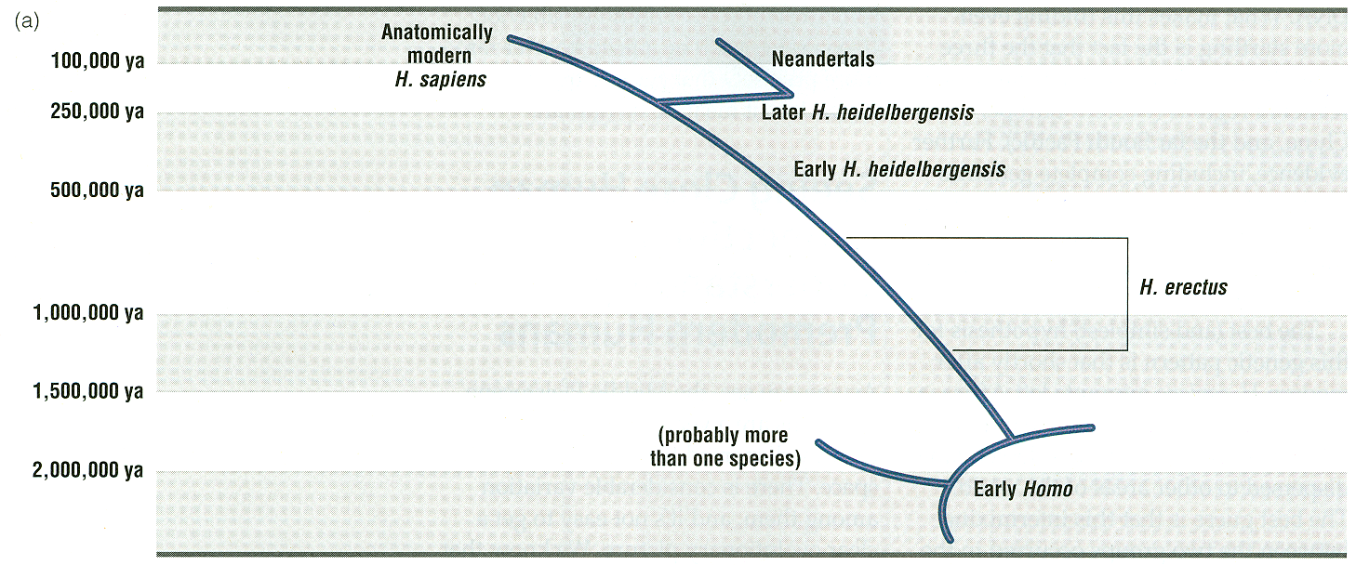
Understanding Physical Anthropology and Archaeology, 11th Ed., p. 276

Slide 15
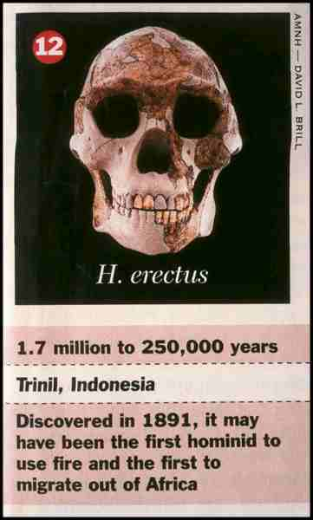

Slide 16
?
"The ‘hobbit’ as envisaged by National Geographic. "
(Image: National Geographic) -- BBC
www.smh.com.au/articles/2004/10/28/1098667862380.html?oneclick=true

Slide 17
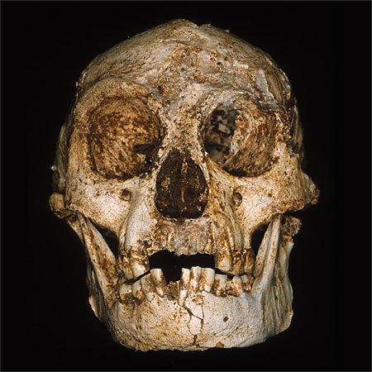
“Homo floresiensis”
The Homo floresiensis type specimen (LB1)
Liang Bua, Flores, Indonesia
http://news.bbc.co.uk/2/hi/science/nature/3948165.stm

Slide 18
Homo floresiensis
(LB1)
“The Hobbit”
http://news.bbc.co.uk/2/hi/science/nature/3948165.stm

Slide 19
Major Sites / Species
Java, 1891
Pithecanthropus erectus
  aka Homo erectus erectus
  aka “Java Man”
  aka “Java People”

Slide 20
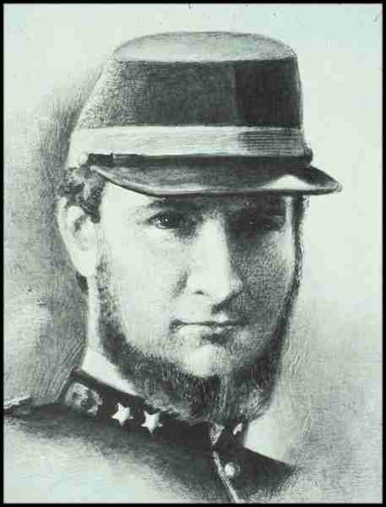
Eugene Dubois
1858-1940

Slide 21
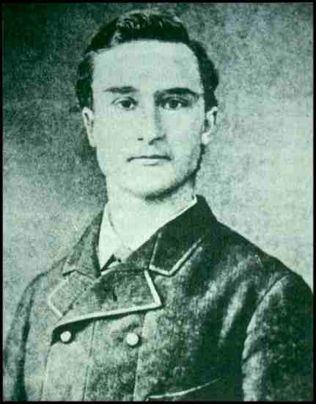
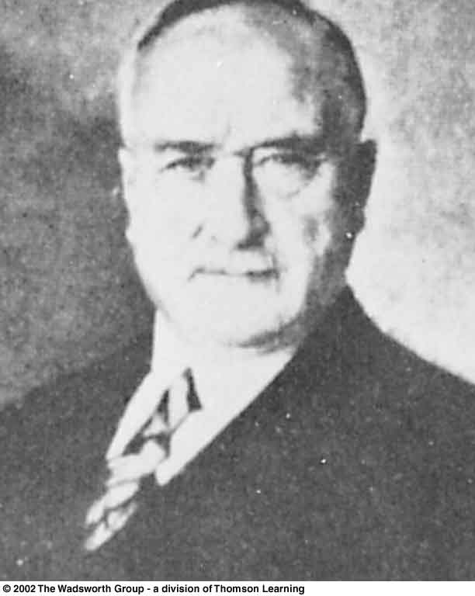
Lewis et al, 9th
p. 230
Eugene Dubois
1858-1940

Slide 22
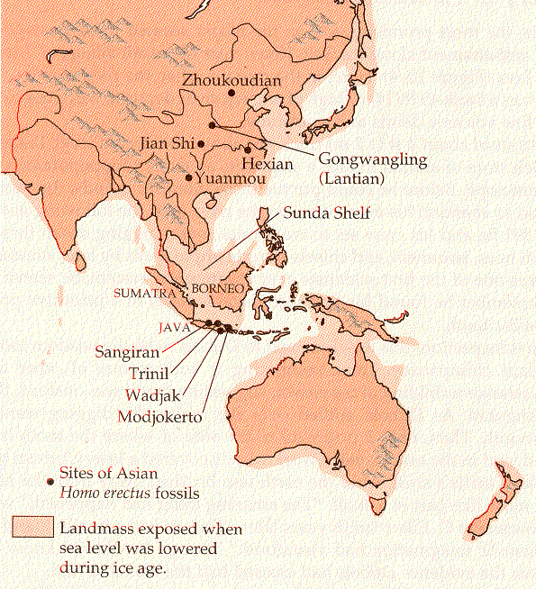
Campbell – Loy, Humankind Emerging, 7th ed., p. 295

Slide 23
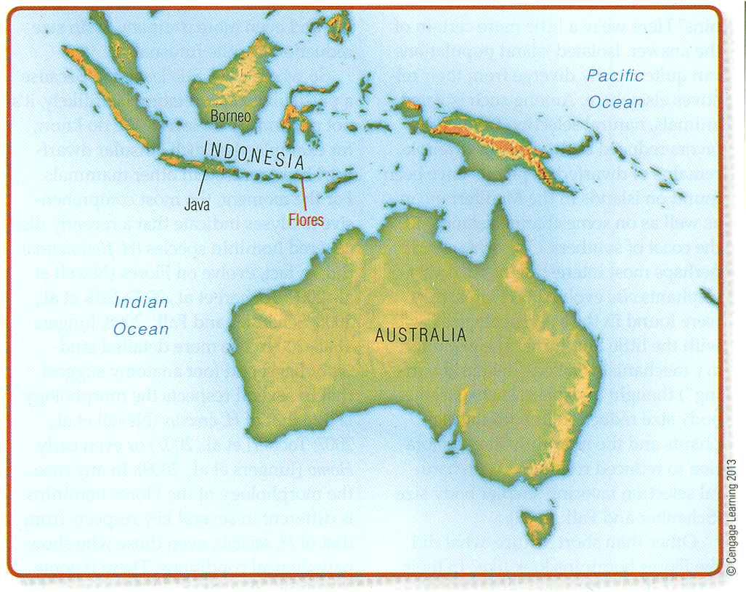
Understanding Physical Anthropology and Archaeology, 11th Ed., p. 295

Slide 24
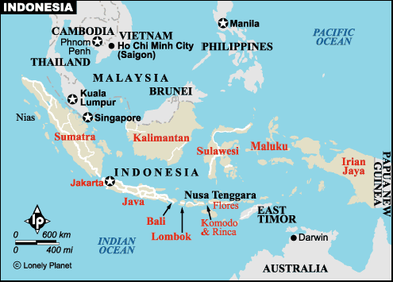
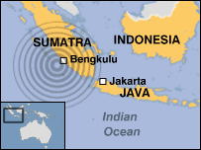
Tsunami Quake
Epicentre
20 Dec 2004
Earthquake
Epicentre
28 Mar 2005
Earthquake
Epicentre
12 Sept 2007
“Hobbit”
“Java Man”
Homo erectus
http://www.lonelyplanet.com/mapshells/south_east_asia/indonesia/indonesia.htm

Slide 25
Tsunami Quake
Epicentre
20 Dec 2004
Earthquake
Epicentre
28 Mar 2005
Earthquake
Epicentre
12 Sept 2007
“Hobbit”
“Java Man”
Homo erectus
http://www.lonelyplanet.com/mapshells/south_east_asia/indonesia/indonesia.htm

Slide 26
Understanding Physical Anthropology and Archaeology, 9th ed., p. 103

Slide 27
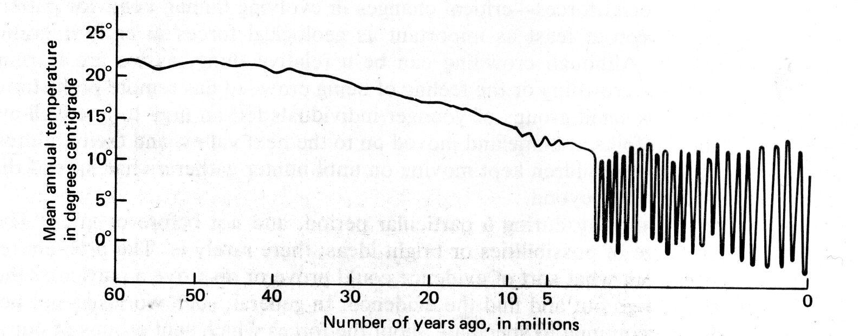
Miocene
Pleistocene
Plocene
John E. Pfeiffer, The Emergence of Man, 4th ed.
(NY: Harper and Row, 1985), p. 101.

Slide 28
^{Homo sapiens}
^{Homo erectus}
^{Homo}
^{habilis}
^{Australopithecus}

Slide 29
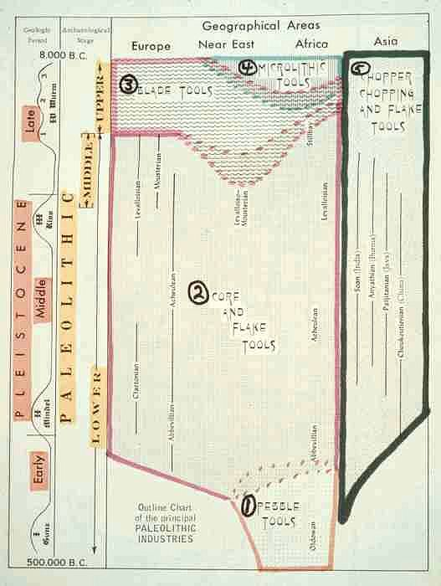

Slide 30
^{Homo sapiens}
^{Homo erectus}
^{Homo}
^{habilis}
^{Australopithecus}

Slide 31
Solo River
Campbell – Loy, Humankind Emerging, 7th ed., p. 295

Slide 32
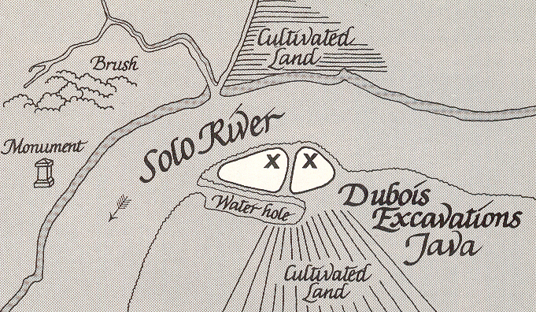
The First Men (NY: Little, Brown, 1973), p. 42

Slide 33
Homo erectus
Java stratigraphy
Modern deposits and bones
Sampoeng stratum (Neolithic)
Ngandong stratum (Upper Pleistocene)
Trinil stratum (Middle Pleistocene)
Djetis stratum (Lower Pleistocene)
Three or more strata (Pliocene)

Slide 34
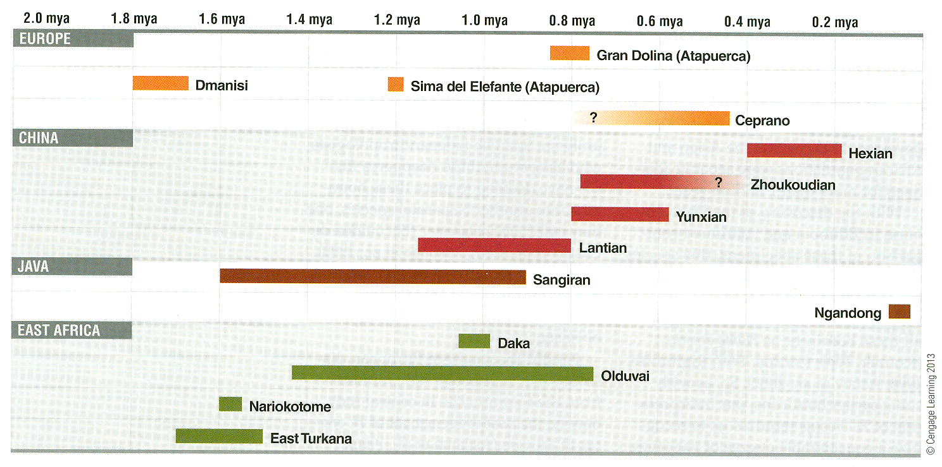
Understanding Physical Anthropology and Archaeology, 11th Ed., p. 246

Slide 35
Major Sites / Species
Java, 1891
Pithecanthropus erectus
  aka Homo erectus erectus
  aka “Java Man”
  aka “Java People”

Slide 36
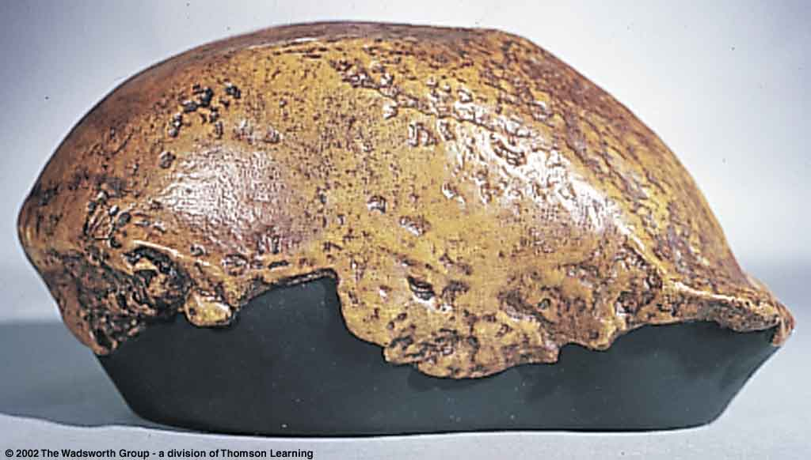
^{Trinil Homo erectus erectus}
Understanding Physical Anthropology and Archaeology, 9th ed., p. 225

Slide 37
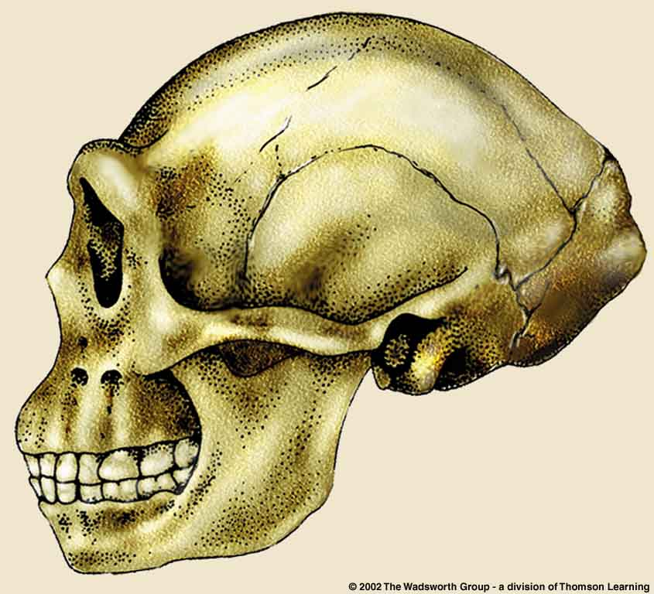
From Franz Weidenreich, “Morphology of Solo Man” 1951
Understanding Physical Anthropology and Archaeology, 9th ed., p. 227

Slide 38
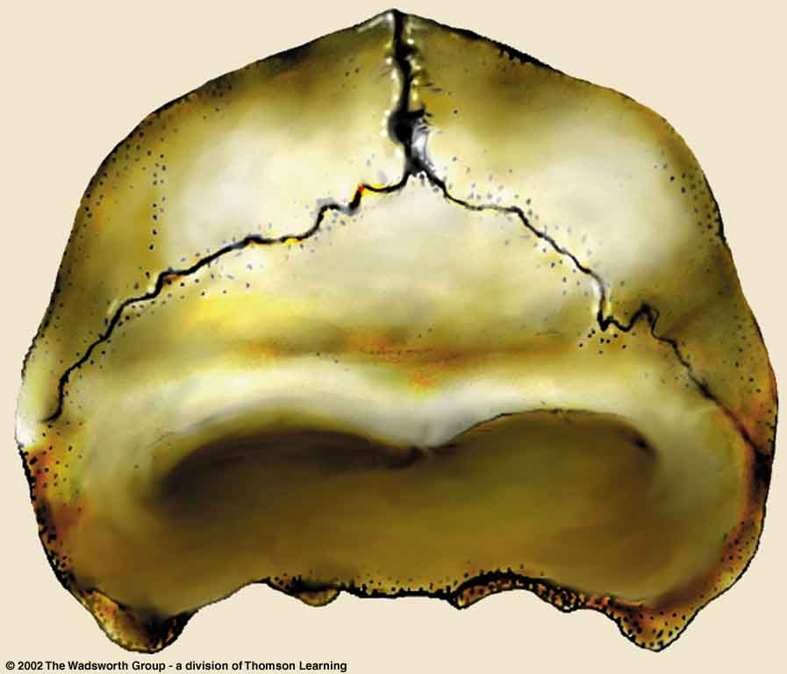
From Franz Weidenreich, “Morphology of Solo Man” 1951
Understanding Physical Anthropology and Archaeology, 9th ed., p. 227

Slide 39
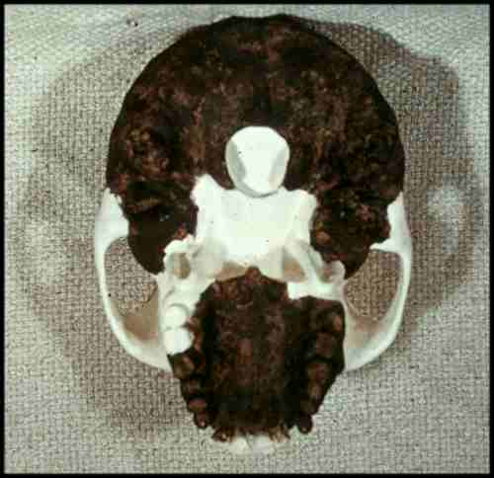

Slide 40
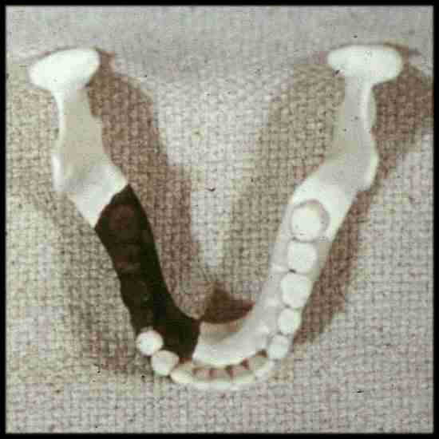

Slide 41
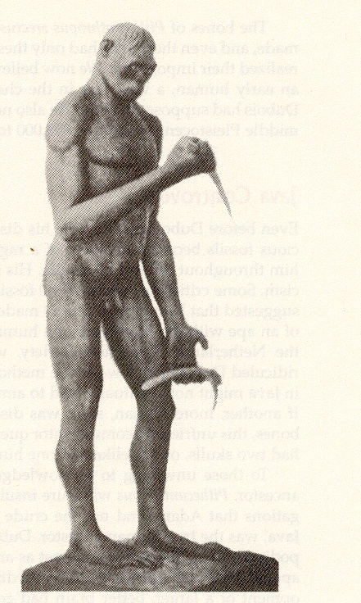
Dubois’s model
of
Pithecanthropus erectus
Humankind Emerging 7th Ed., p. 300

Slide 42
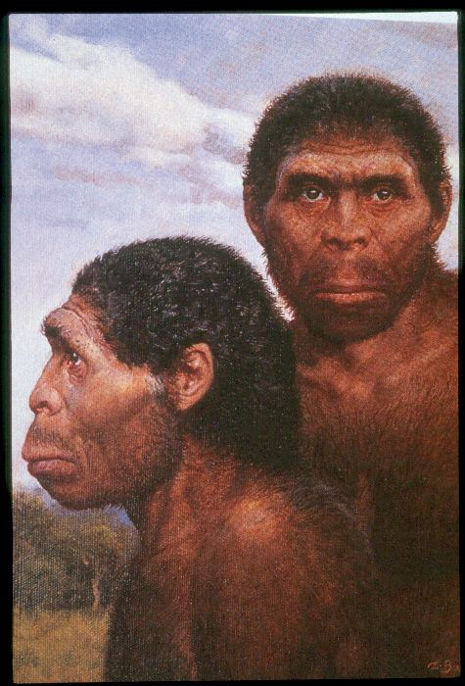

Slide 43
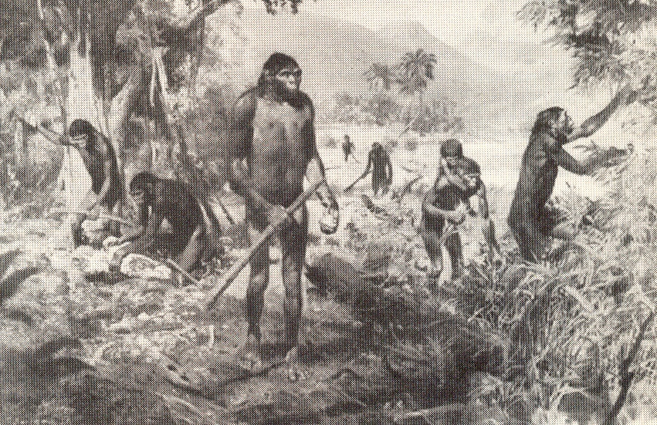
The Emergence of Humankind 4th Ed., p. 105

Slide 44
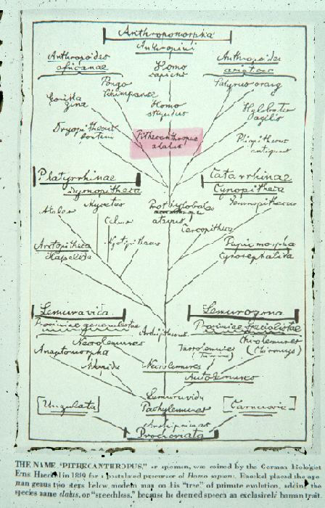

Slide 45
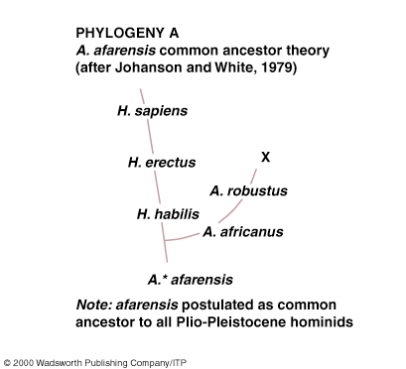
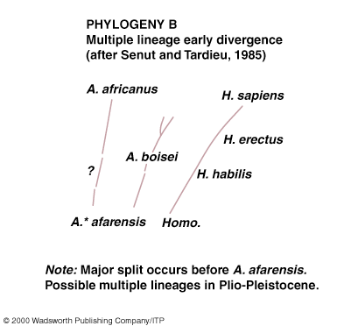
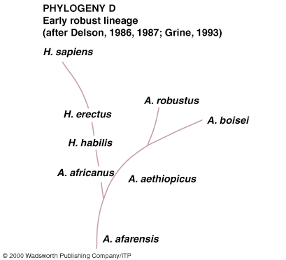
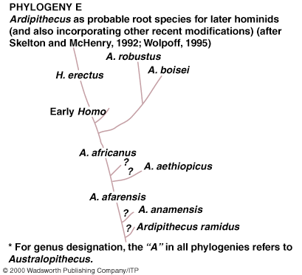
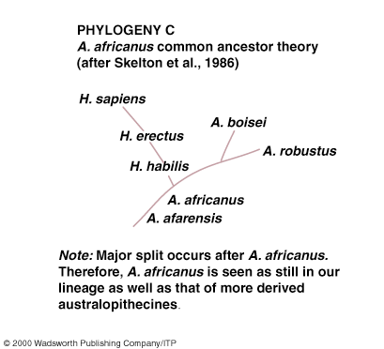
Understanding Physical Anthropology and Archaeology, 8th ed., p. 254

Slide 46
Pithecanthropus erectus
=
Homo erectus erectus
=
“Java Man”

Slide 47
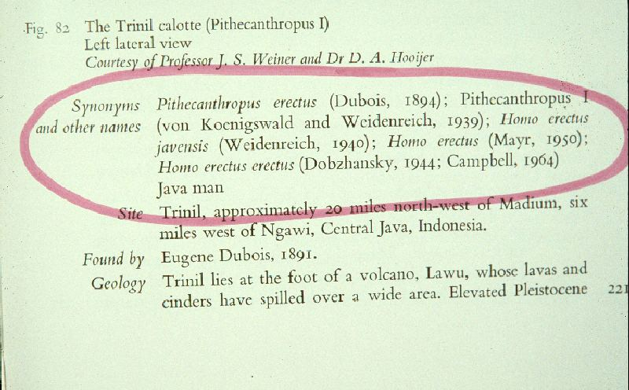

Slide 48
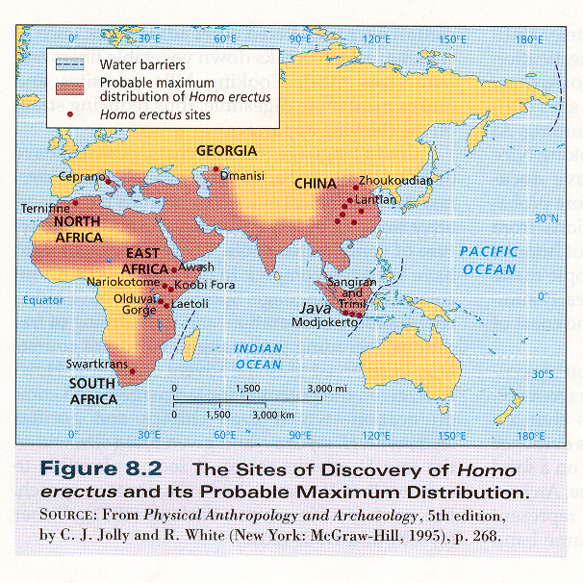
Kottak, Physical Anthropology & Archaeology (NY: McGraw-Hill, 2004), p. 202.

Slide 49
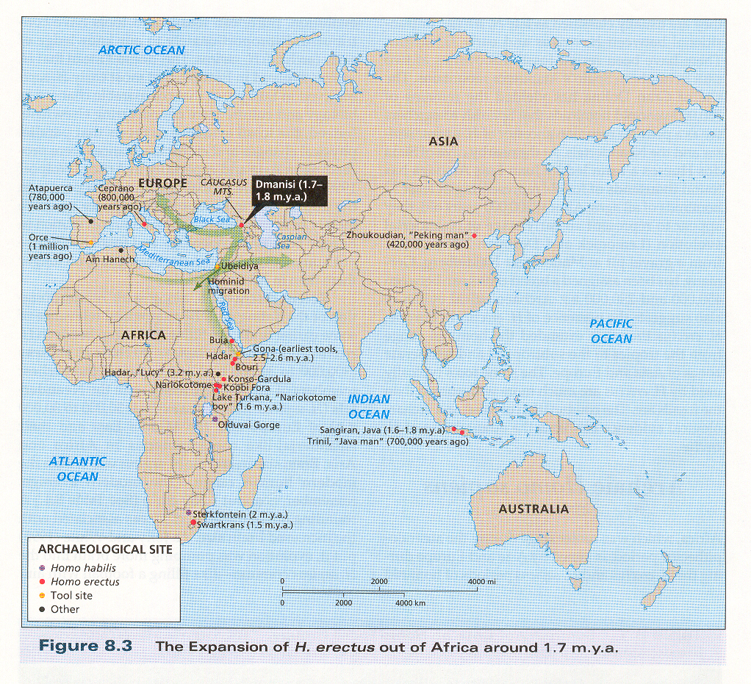
Kottak, Physical Anthropology & Archaeology (NY: McGraw-Hill, 2004), p. 203.

Slide 50
Homo erectus erectus
Java people
tool maker (Padjitan industry)

Slide 51
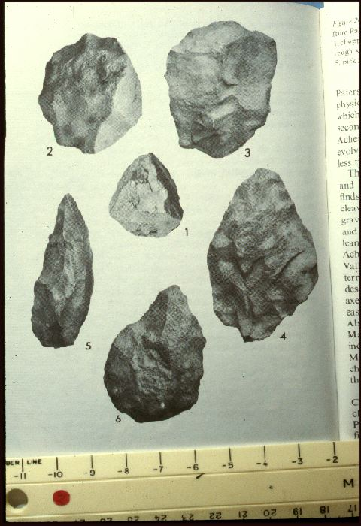

Slide 53
^{Homo sapiens}
^{Homo erectus}
^{Homo}
^{habilis}
^{Australopithecus}

Slide 54
Homo erectus
Homo erecti
are hand axe people

Slide 56
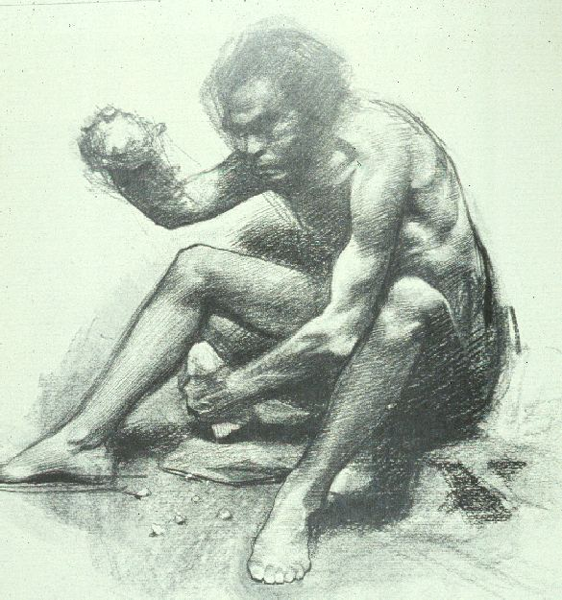

Slide 57
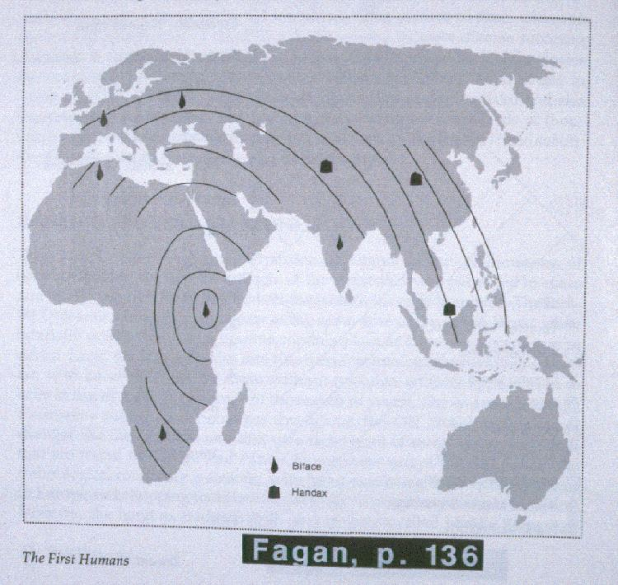

Slide 58
Glossary
The Movius Line
divided the world of Homo erectus and their immediate descendants into the Acheulean hand-ax cultures of the West and the “chopper-chopping” cultures to the east
?
-- Hallam Movius, 1948

Slide 60
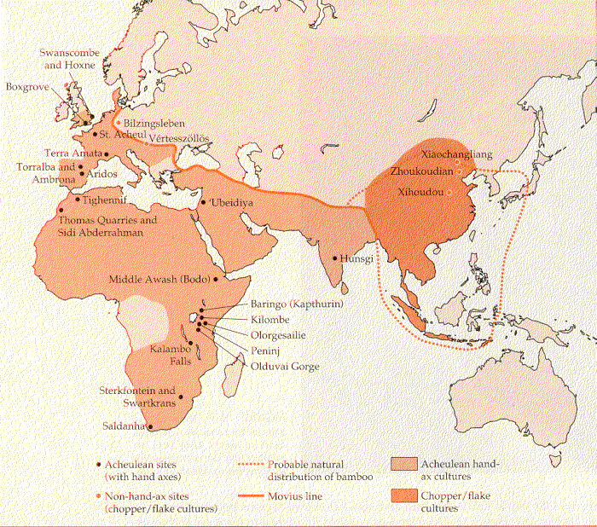
Source: Campbell and Loy, Humankind Emerging, 7th ed, p. 334

Slide 61
Homo erectus erectus
Java people
tool maker (Padjitan industry)
lived in the open
had not yet invented fire
no evidence of hunting prowess, but was a predator
later descendents = Solo people

Slide 62
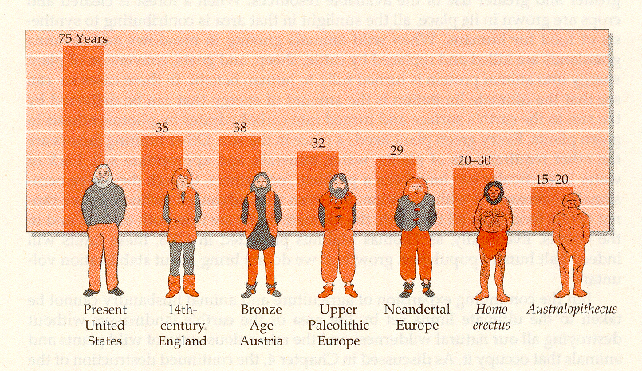
Campbell – Loy, Humankind Emerging, 7th ed., p. 544

Slide 63
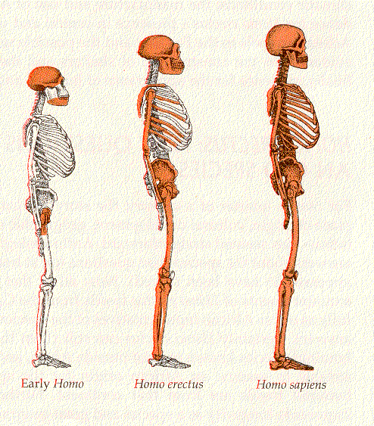
Campbell – Loy, Humankind Emerging, 7th ed., p. 326

Slide 64
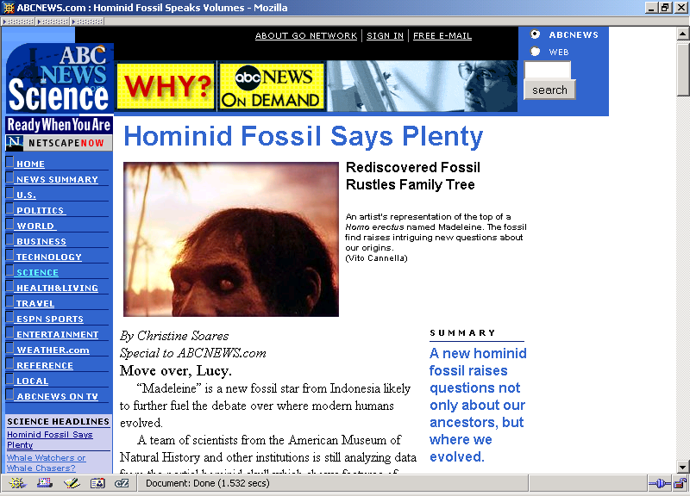
“Madeleine”
  Homo erectus - Homo sapiens
    (very late Homo erectus)
  probably had a capacity for
language close to that of modern human
  100,000 and 200,000 y.b.p.

Slide 65
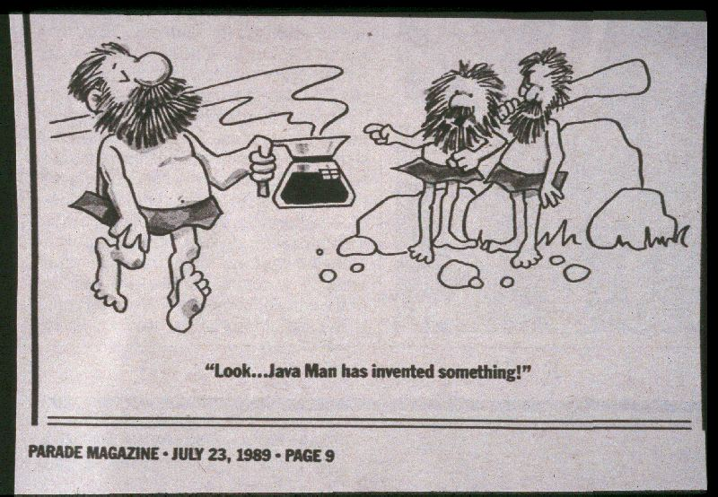

Slide 66
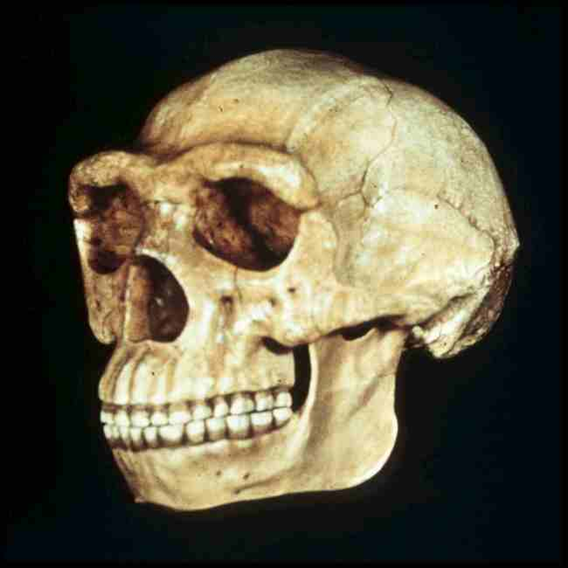
^{Next}
Class Slides Set # 26A
Tim Roufs’ section
“Peking Man”
  aka Homo erectus pekinensis
  aka Sinanthropus

