Slide 1


Welcome to
Cultural Anthropology
2009
2012
University of Minnesota Duluth
Tim Roufs
© 2010-2011
http://www.d.umn.edu/cla/faculty/troufs/anth1604/

Slide 2
How
to
Study for Exams
2009
2012
University of Minnesota Duluth
Tim Roufs
© 2010-2011
http://www.d.umn.edu/cla/faculty/troufs/anth1604/

Slide 3


Slide 4


Slide 6
2009
2012

Slide 7
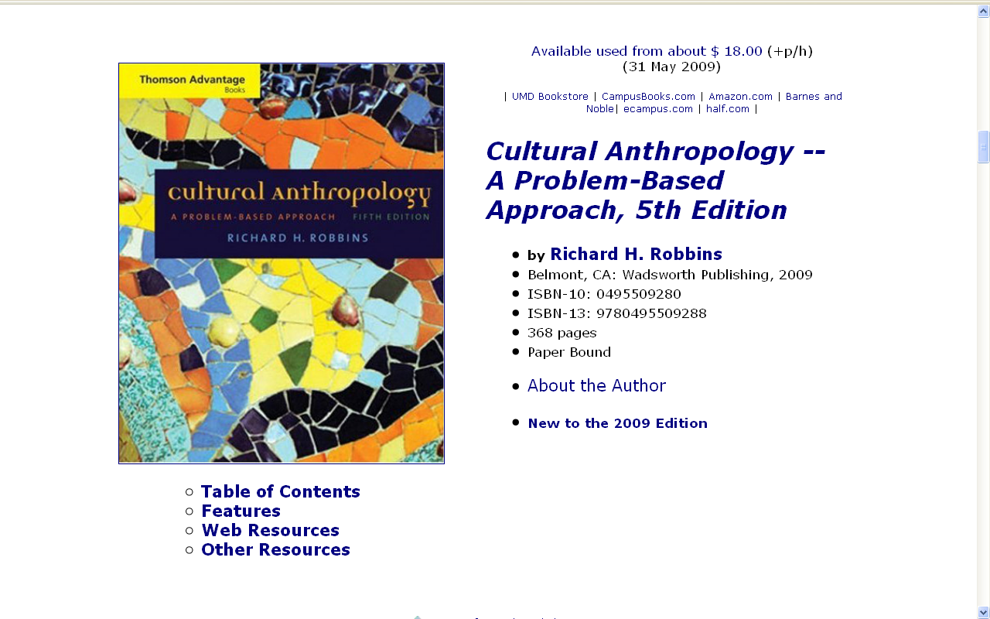

Slide 8
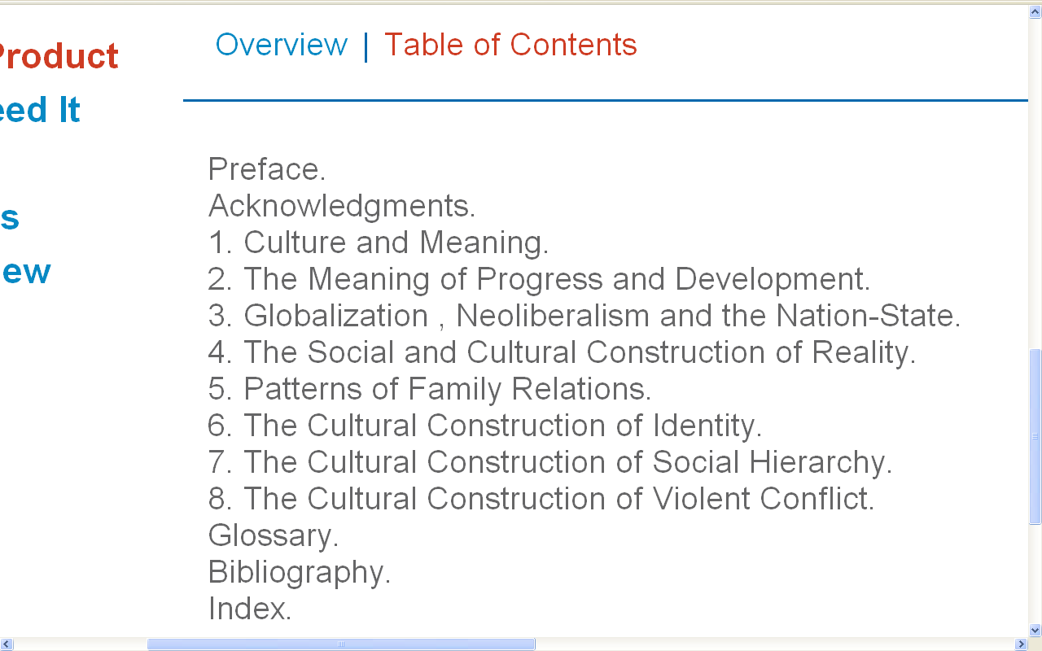

Slide 9

http://www.d.umn.edu/cla/faculty/troufs/anth1604/cacal-ss2010.html

Slide 10


Slide 11


Slide 12


Slide 14
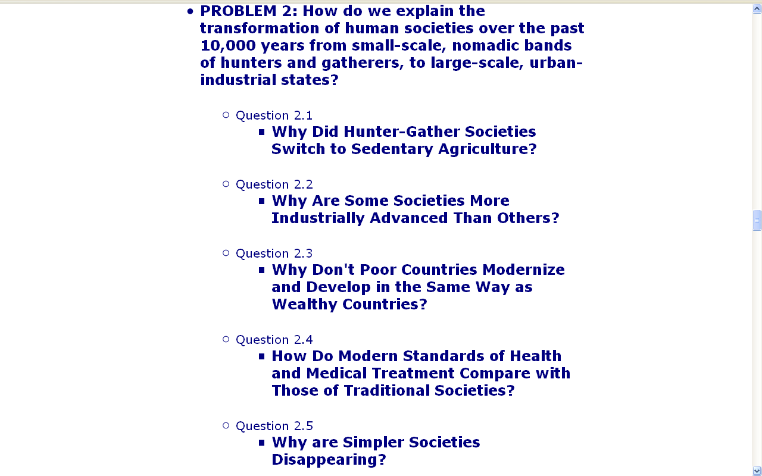

Slide 15


Slide 16


Slide 17
Optional Resources
for the Text
are Available On-line

Slide 18
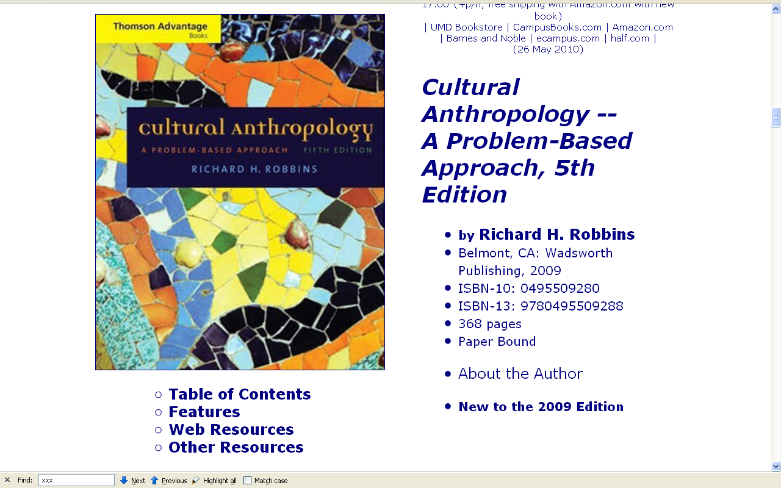

Slide 19
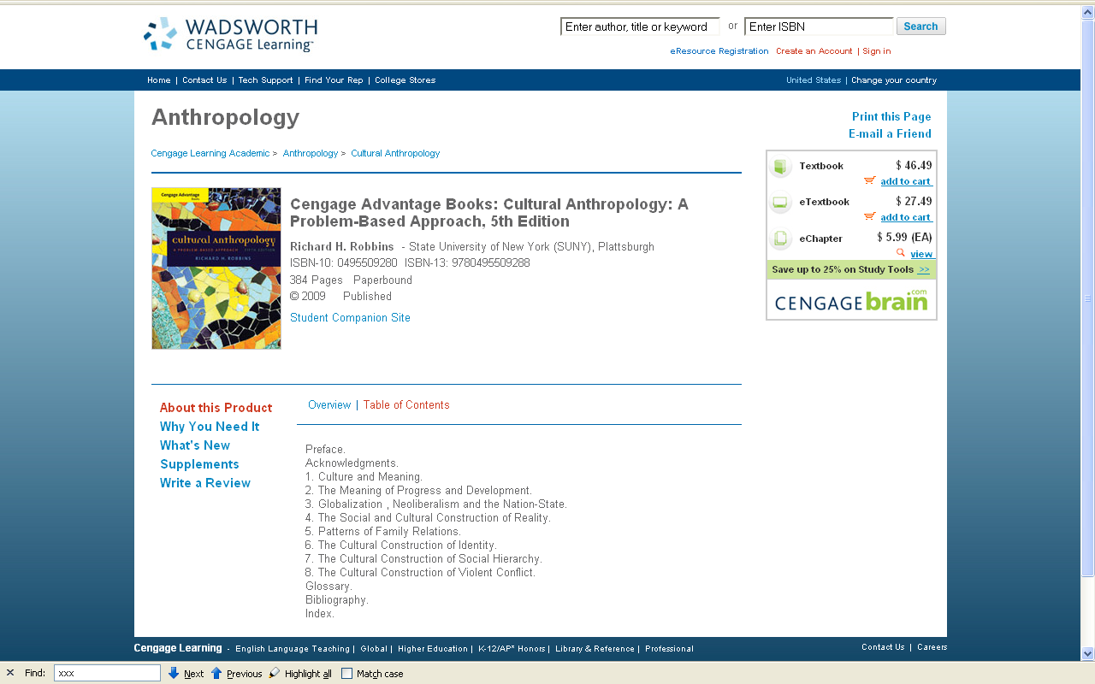

Slide 20
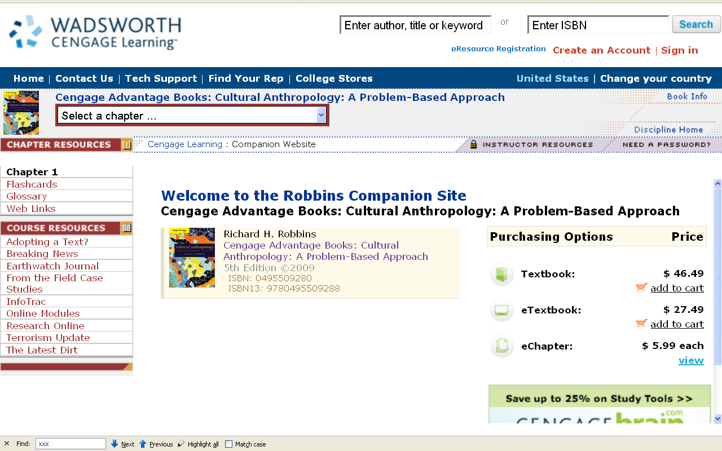

Slide 21
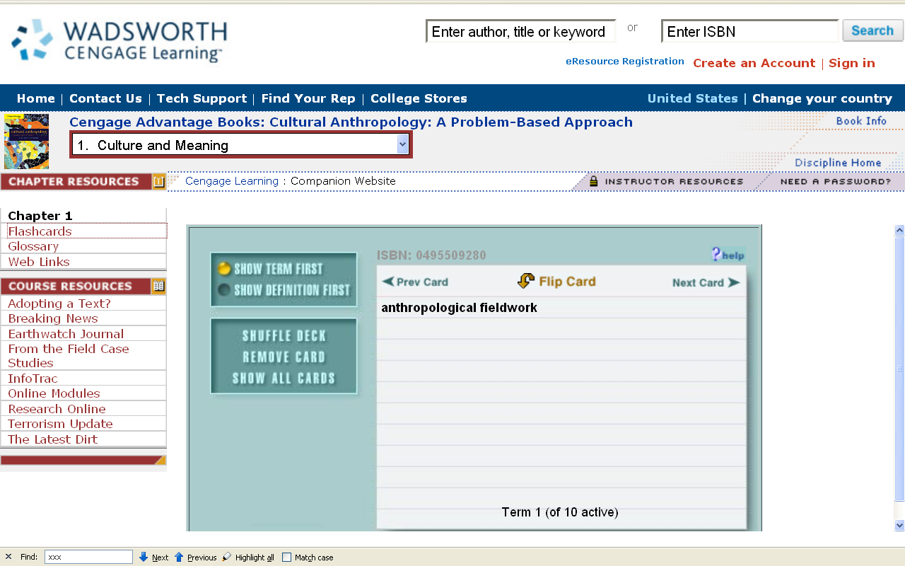

Slide 22
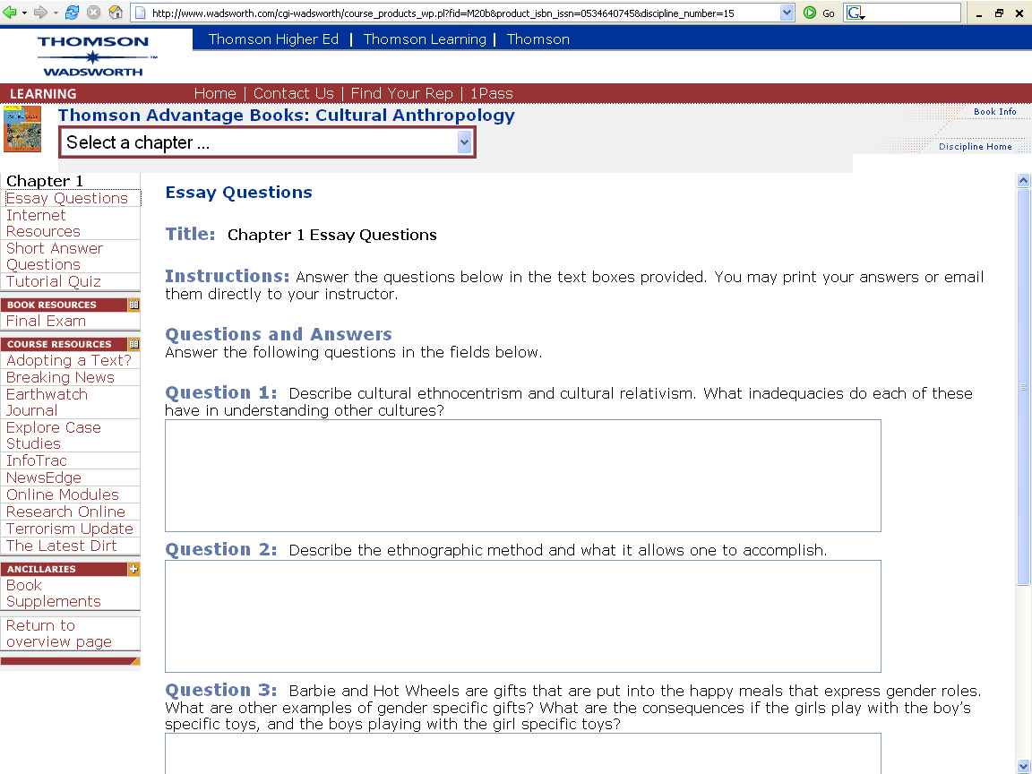

Slide 23
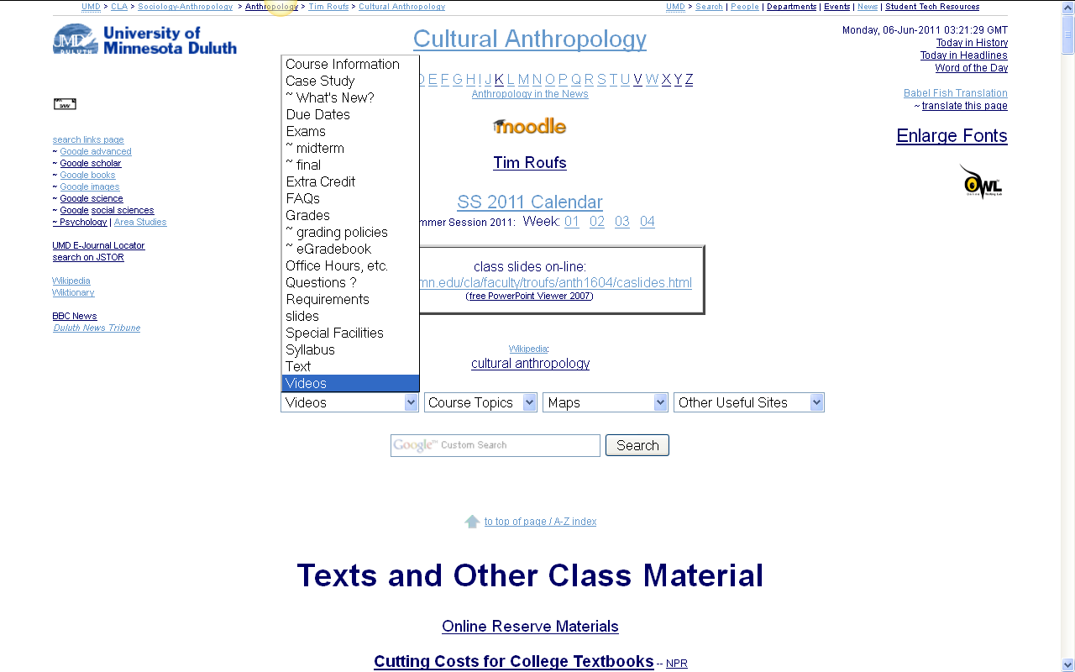
http://www.d.umn.edu/cla/faculty/troufs/anth1604/cacal-ss2010.html

Slide 24
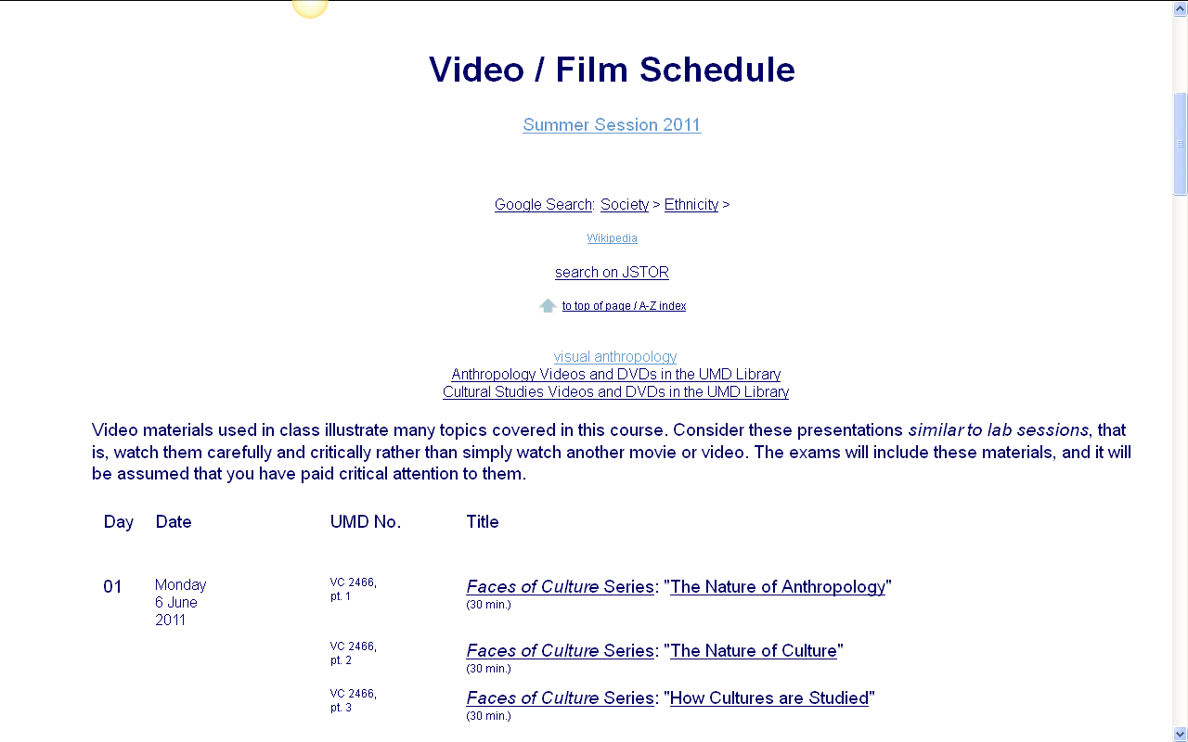

Slide 25
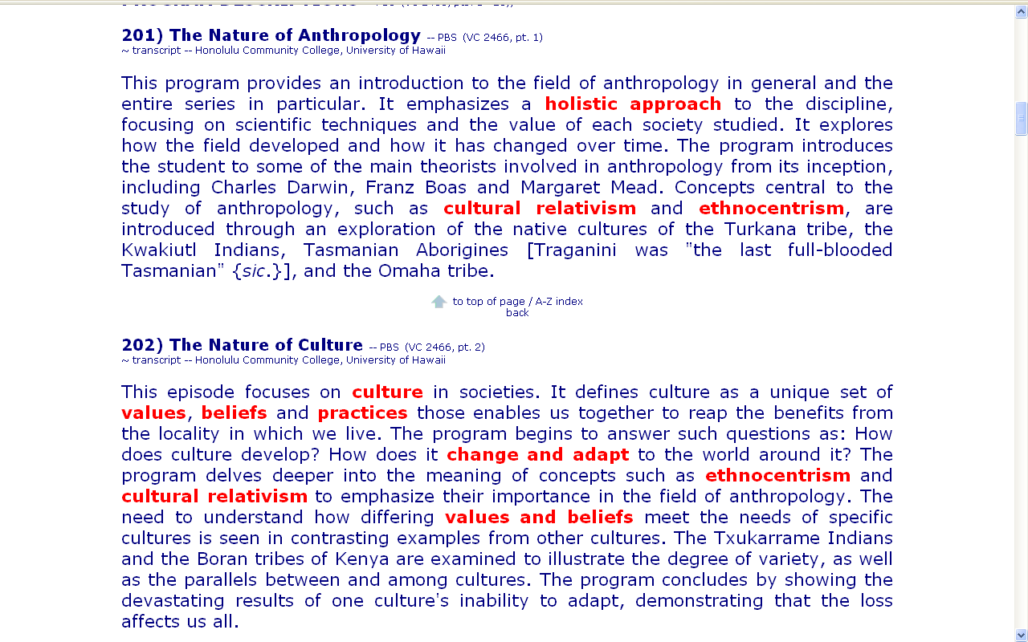

Slide 26
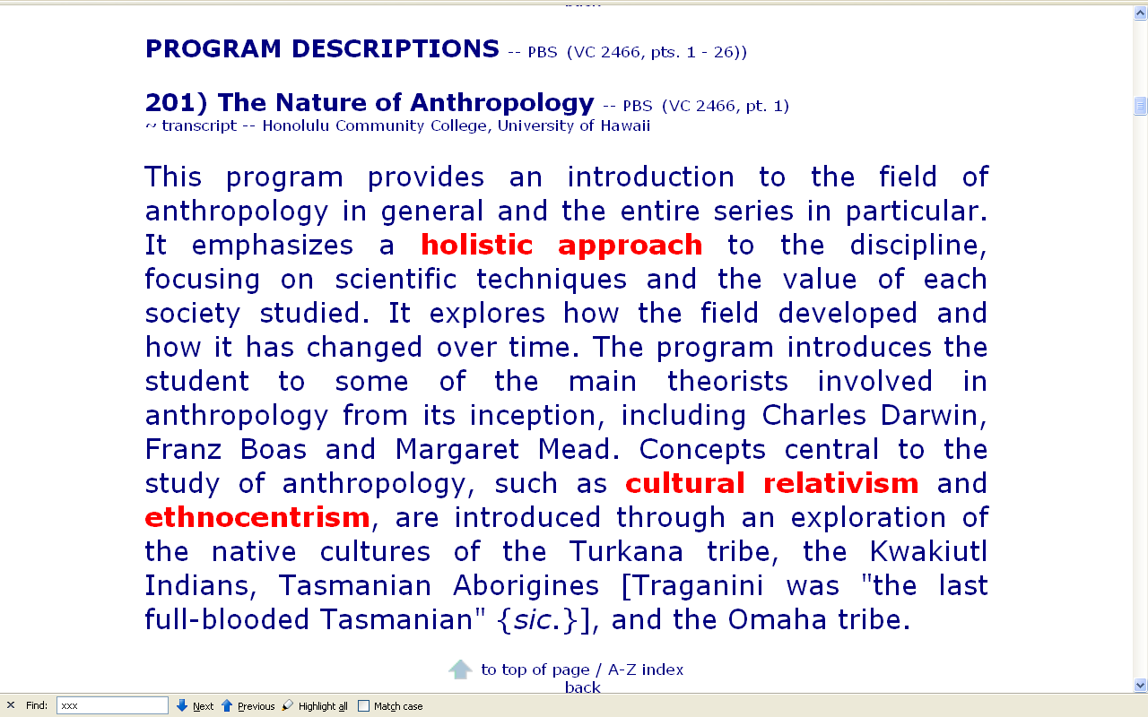

Slide 27
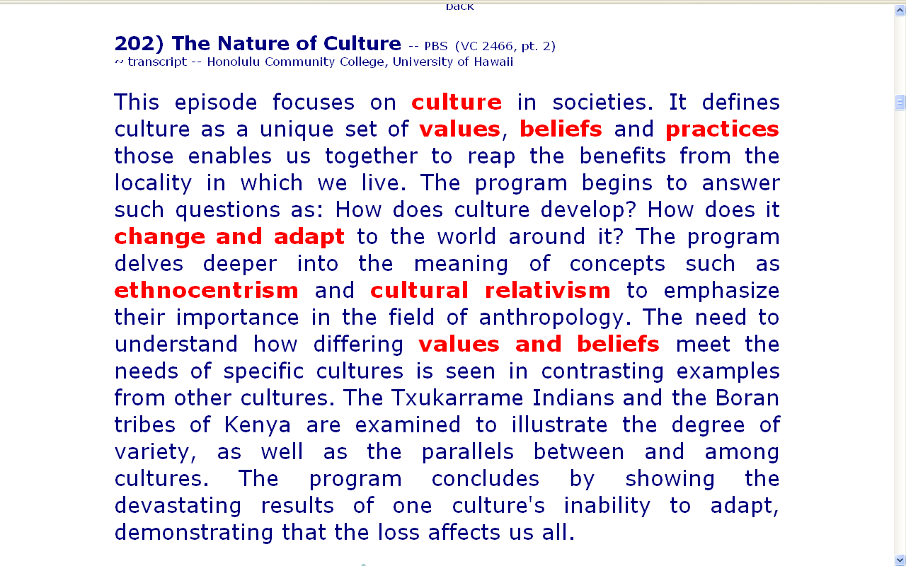

Slide 28
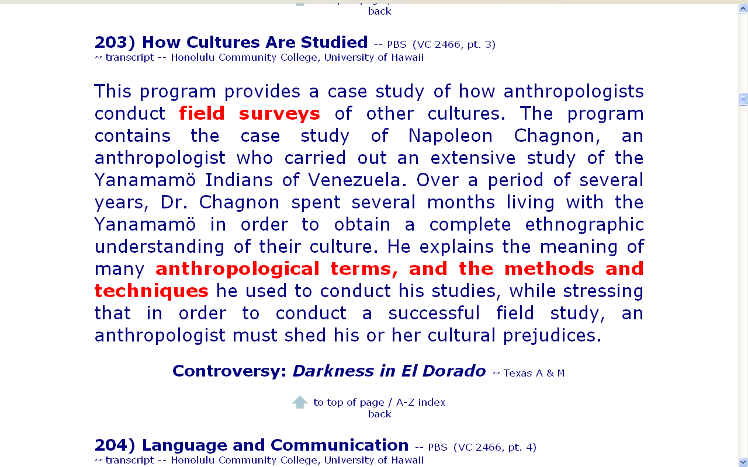

Slide 29
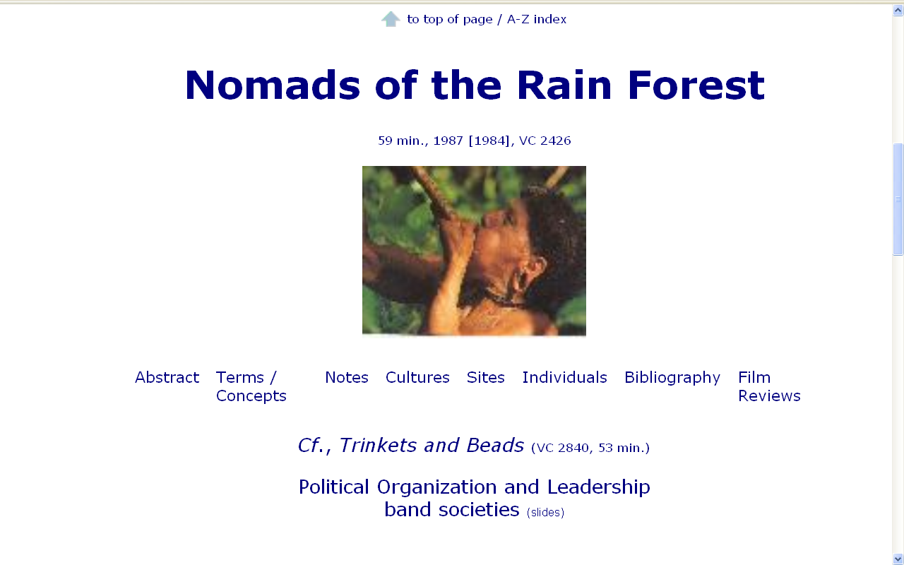

Slide 30
Know Major Figures

Slide 32


Margaret Mead
(1901 - 1978)
Coming of Age in Samoa 1928

Slide 33
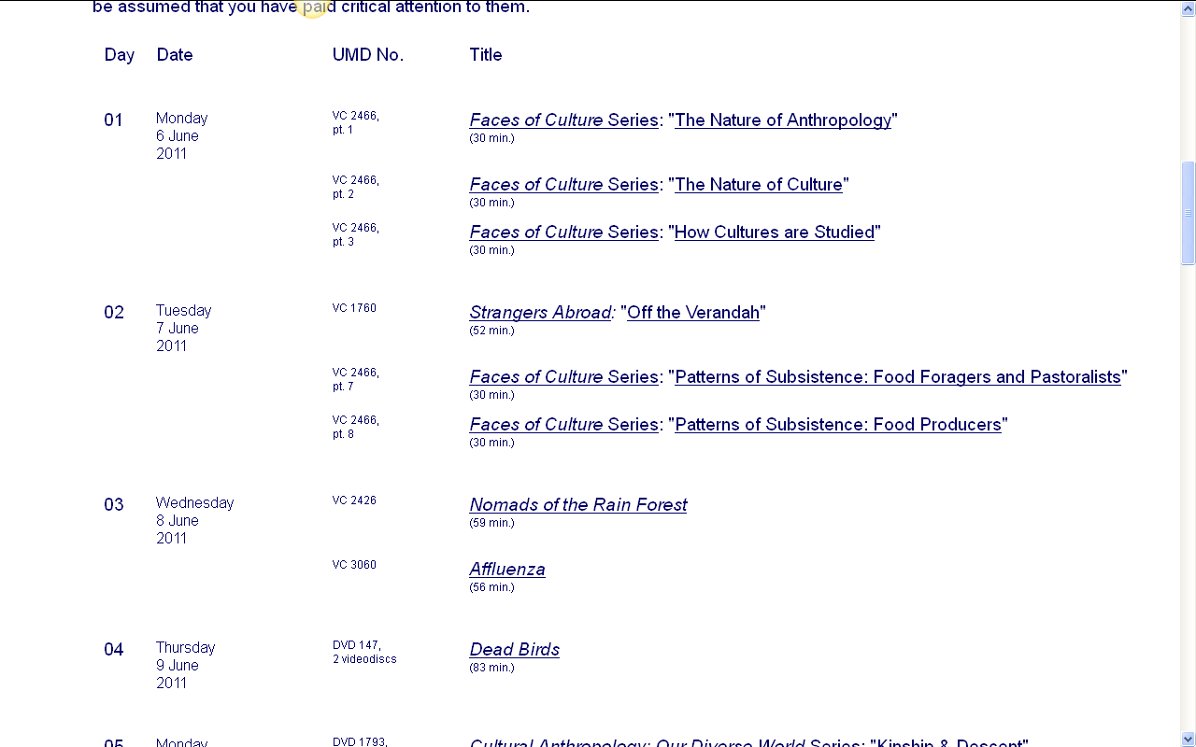
http://www.d.umn.edu/cla/faculty/troufs/anth1604/cacal-ss2010.html

Slide 34
