Slide 1
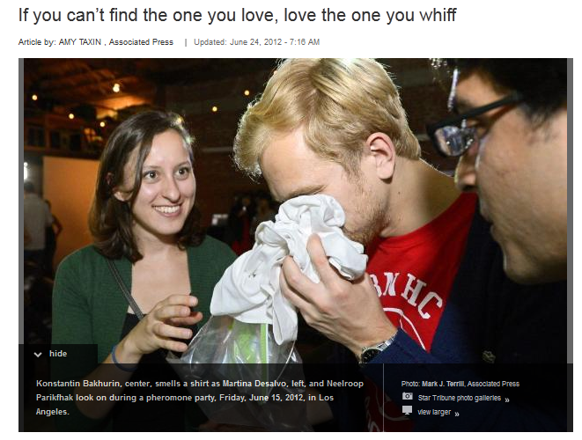
http://www.startribune.com/lifestyle/160114215.html

Slide 2
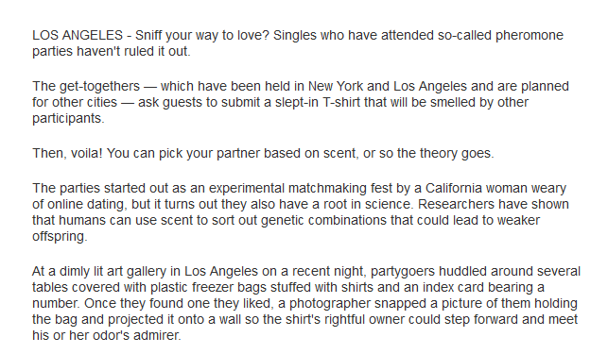
http://www.startribune.com/lifestyle/160114215.html

Slide 3
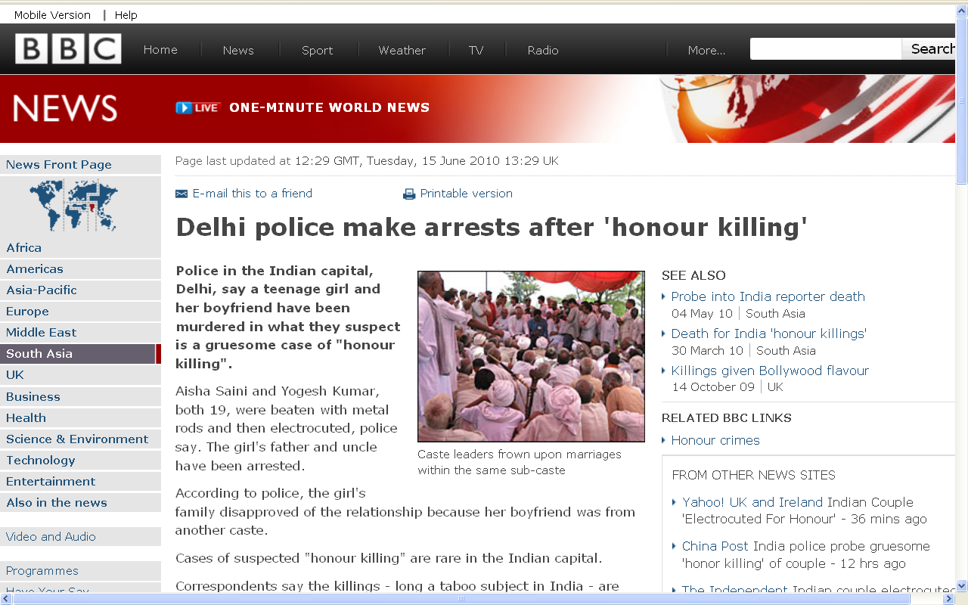
http://news.bbc.co.uk/2/hi/world/south_asia/10316249.stm

Slide 4
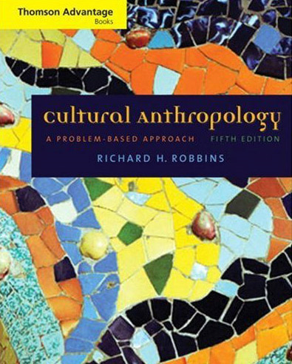
Marriage Patterns
including
Cross-Cousin Marriage
Tim Roufs
© 2010

Slide 5
What are the effects of culture as it influences human breeding patterns ?

Slide 6
“nature” – biology
(inherited)
“nurture” – culture
(learned)

Slide 7
Three Major
Parennial
Debtes
re Cultural Anthropology
Tim Roufs
© 2010

Slide 8
three major contemporary debates
Biological Determinism
vs. Cultural Constructionism
(“nature” vs. “nurture”)
Ideationism vs. Cultural Materialism
(ideas vs. things)
Individual Agency vs. Structuralism
(“free will” vs. “power structures”)

Slide 9
Culture and Biology

Slide 10
Culture and Biology
Marriage Patterns
  cross-cousin marriage
  arranged marriage
  polygamy
  class endogamy
  village exogamy
  cultural standards of beauty
  age at marriage
  levirate / sororate
  inheritance patterns
  personal traits and status . . .

Slide 11
Culture and Biology
Marriage Patterns
  cross-cousin marriage
  arranged marriage
  polygamy
  class endogamy
  village exogamy
  cultural standards of beauty
  age at marriage
  levirate / sororate
  inheritance patterns
  personal traits and status . . .

Slide 12
Culture and Biology
Marriage Patterns
  cross-cousin marriage
  arranged marriage
  polygamy
  class endogamy
  village exogamy
  cultural standards of beauty
  age at marriage
  levirate / sororate
  inheritance patterns
  personal traits and status . . .

Slide 13
Culture and Biology
Marriage Patterns
  cross-cousin marriage
  arranged marriage
  polygamy
  class endogamy
  village exogamy
  cultural standards of beauty
  age at marriage
  levirate / sororate
  inheritance patterns
  personal traits and status . . .

Slide 14
Culture and Biology
Marriage Patterns
  cross-cousin marriage
  arranged marriage
  polygamy
  class endogamy
  village exogamy
  cultural standards of beauty
  age at marriage
  levirate / sororate
  inheritance patterns
  personal traits and status . . .

Slide 15
Culture and Biology
Marriage Patterns
  cross-cousin marriage
  arranged marriage
  polygamy
  class endogamy
  village exogamy
  cultural standards of beauty
  age at marriage
  levirate / sororate
  inheritance patterns
  personal traits and status . . .
  occurs in ca.
  4/5 “cultures of the world”
  (77.4%)
  HRAF
  Human Relations Area Files
  World Ethnographic Atlas

Slide 16
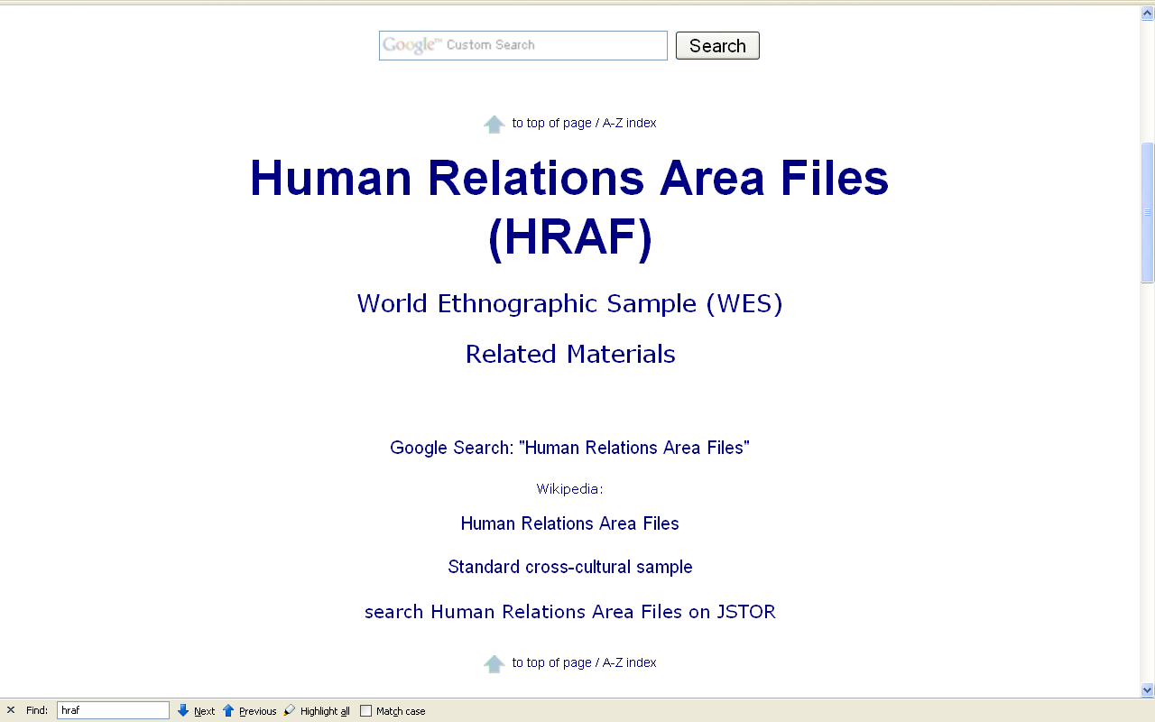

Slide 17
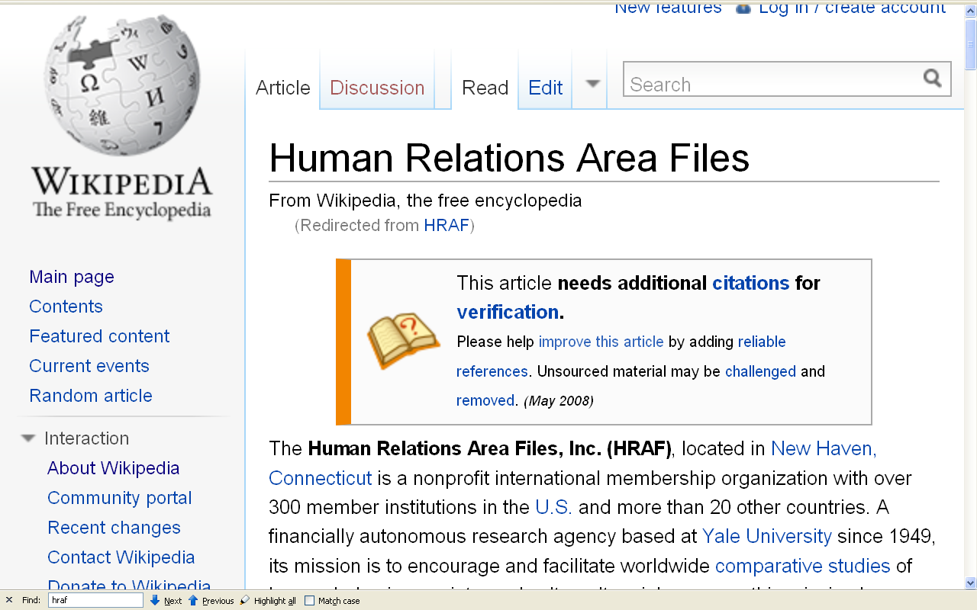

Slide 18
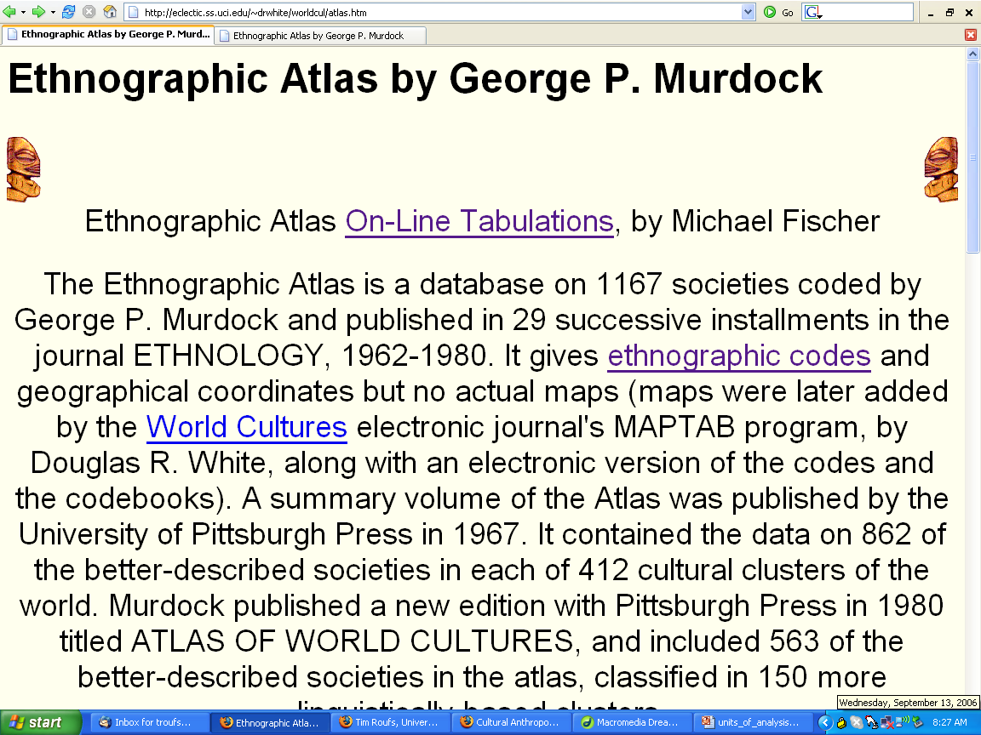
http://eclectic.ss.uci.edu/~drwhite/worldcul/atlas.htm

Slide 19
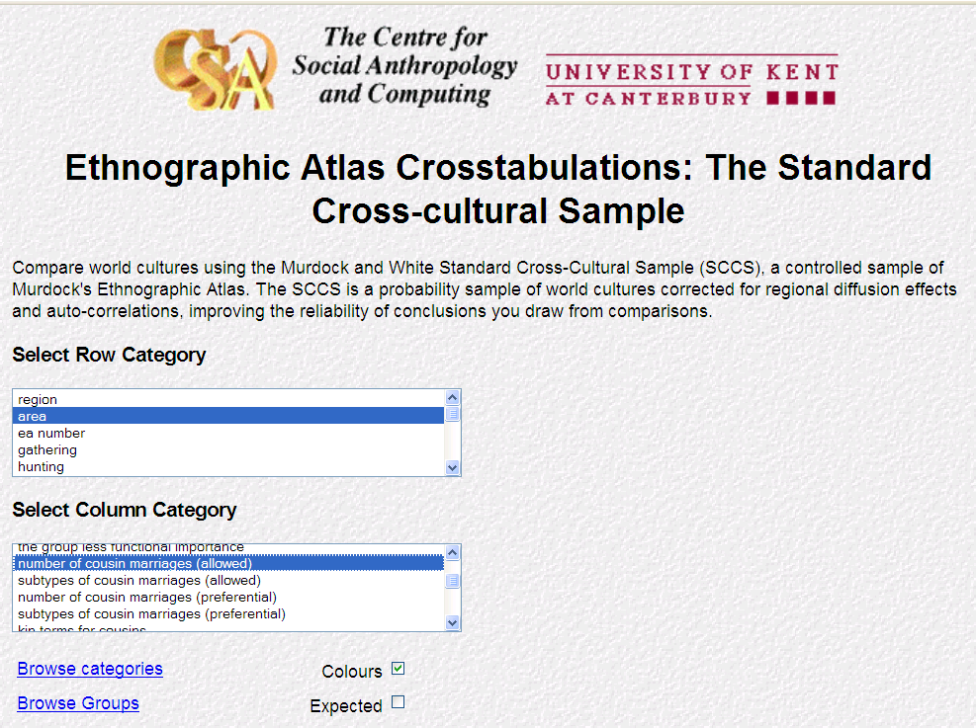
lucy.ukc.ac.uk/cgi-bin/uncgi/Ethnoatlas/atlas.vopts

Slide 20
lucy.ukc.ac.uk/cgi-bin/uncgi/Ethnoatlas/atlas.vopts

Slide 21
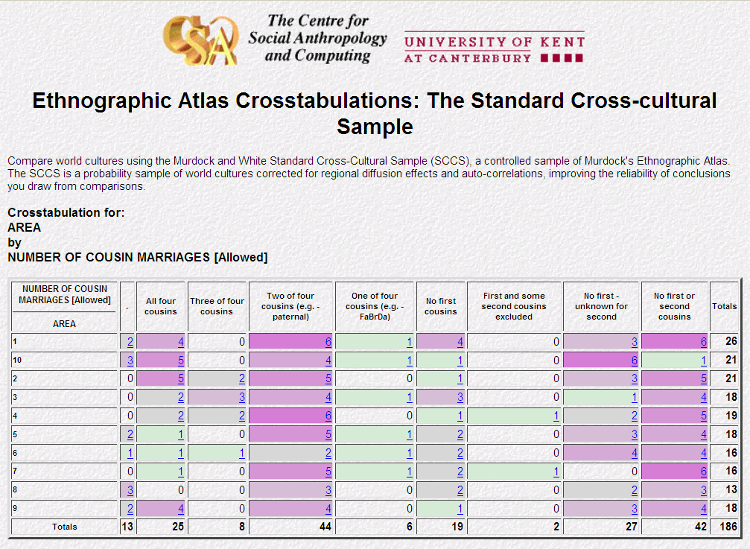
42/ 186 = 22.6%
do not allow 1st or 2nd cousin marriage
144/ 186 = 77.4%
do allow 1st or 2nd cousin marriage
lucy.ukc.ac.uk/cgi-bin/uncgi/Ethnoatlas/atlas.vopts

Slide 22
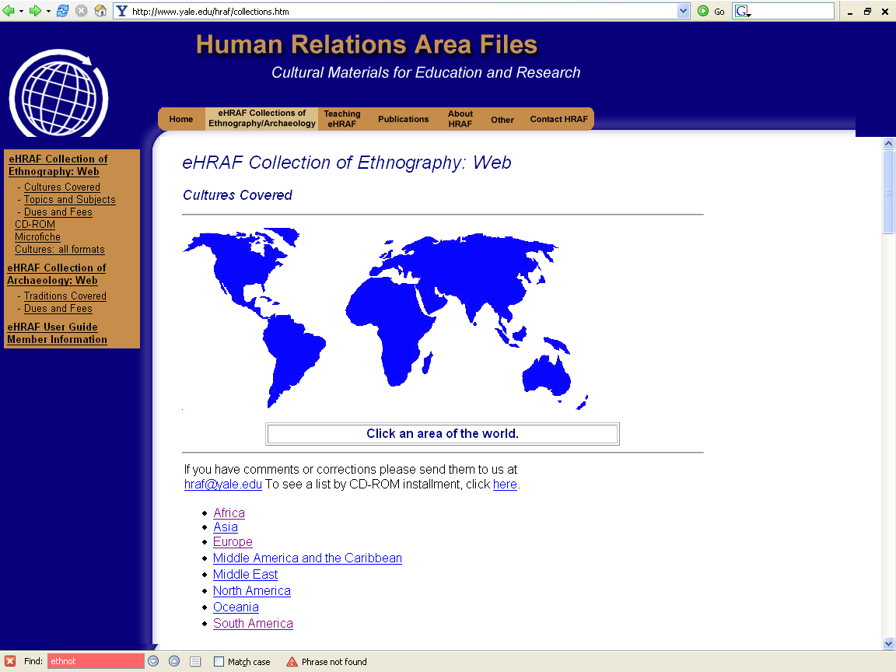
http://www.yale.edu/hraf/collections.htm

Slide 23
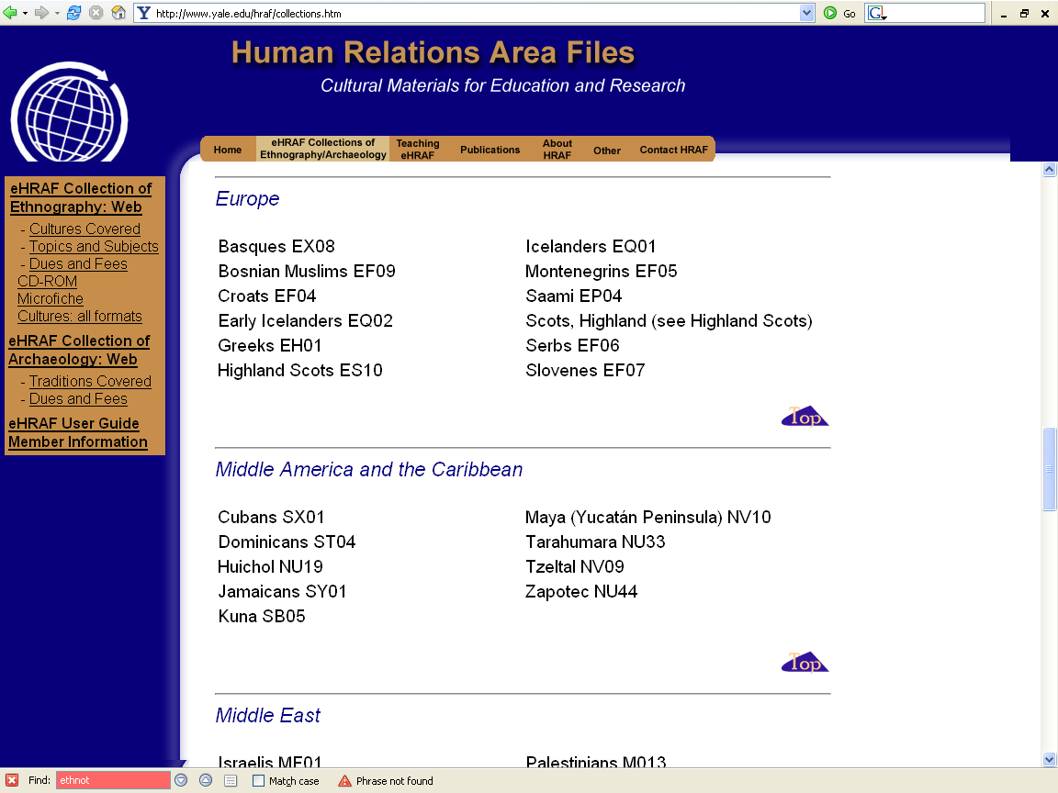
http://www.yale.edu/hraf/collections.htm

Slide 24
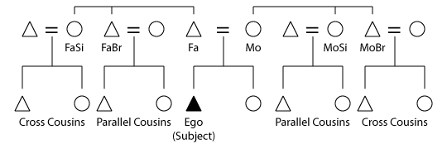
http://en.wikipedia.org/wiki/Cross_cousin

Slide 25
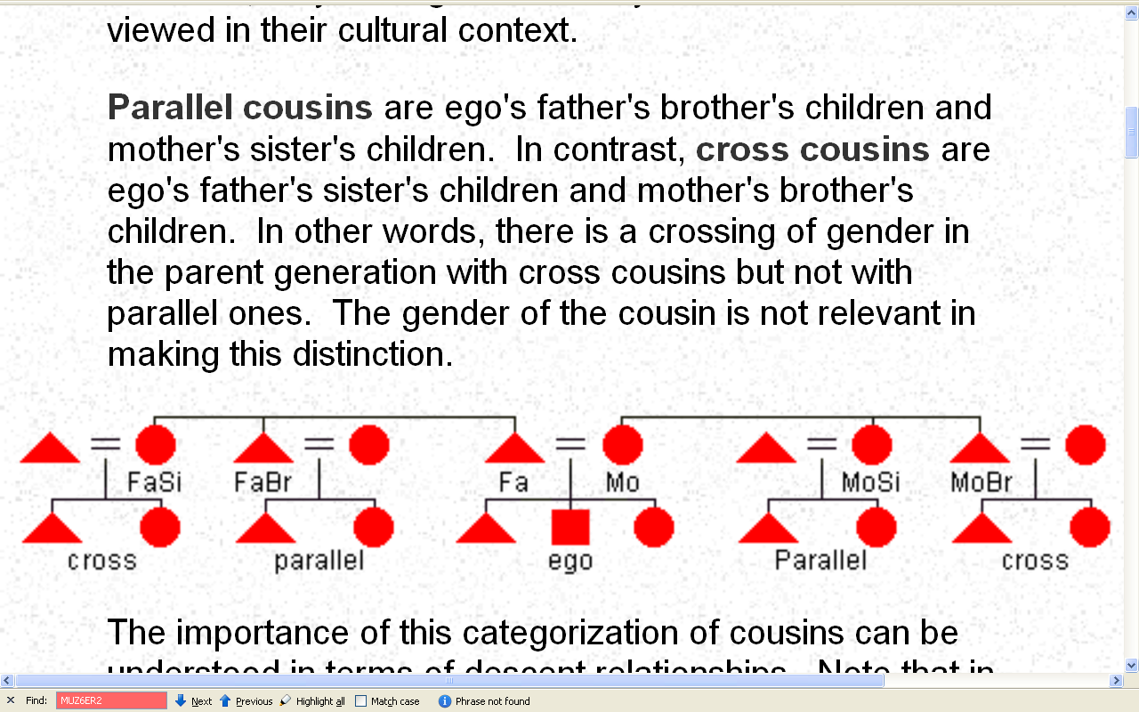
http://anthro.palomar.edu/kinship/kinship_6.htm

Slide 26
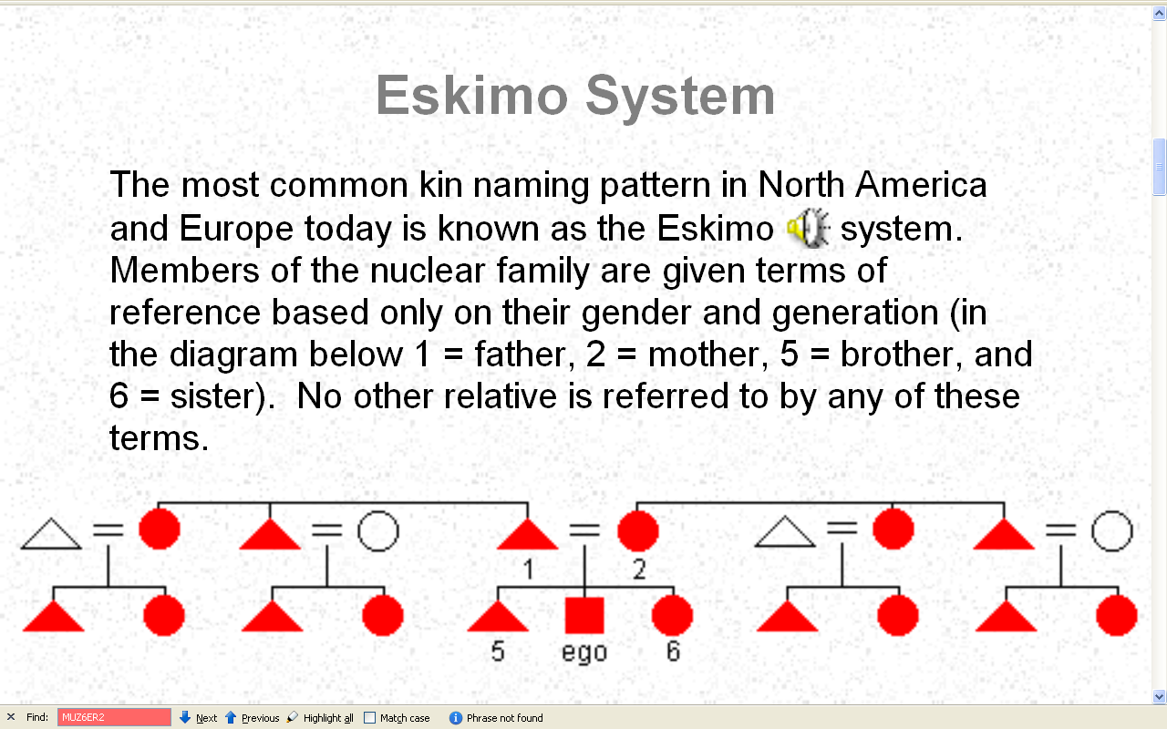
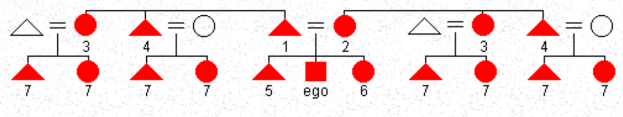
http://anthro.palomar.edu/kinship/kinship_6.htm

Slide 27
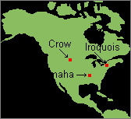
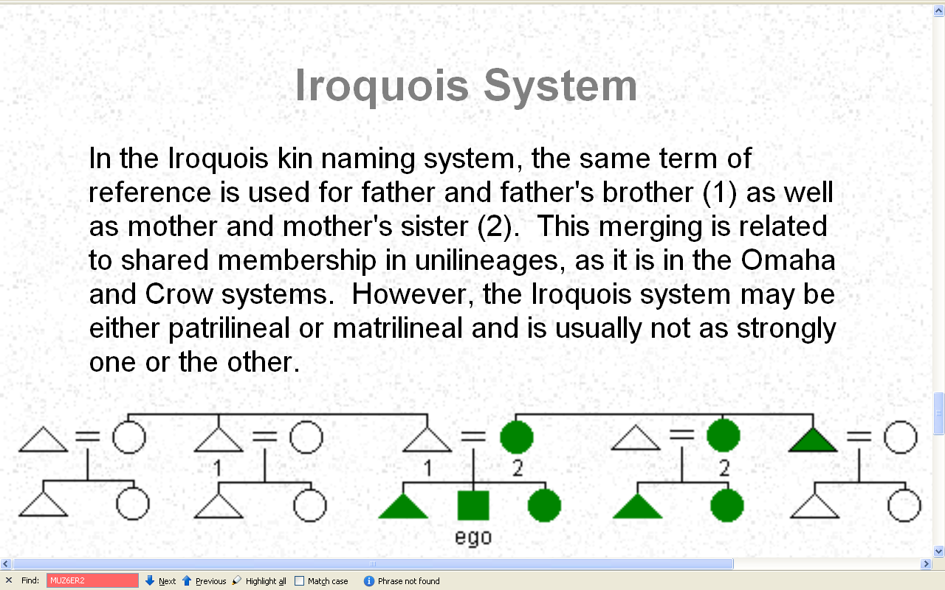
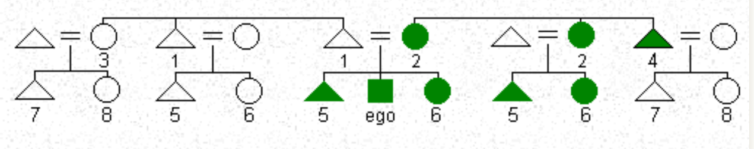
http://anthro.palomar.edu/kinship/kinship_6.htm

Slide 28
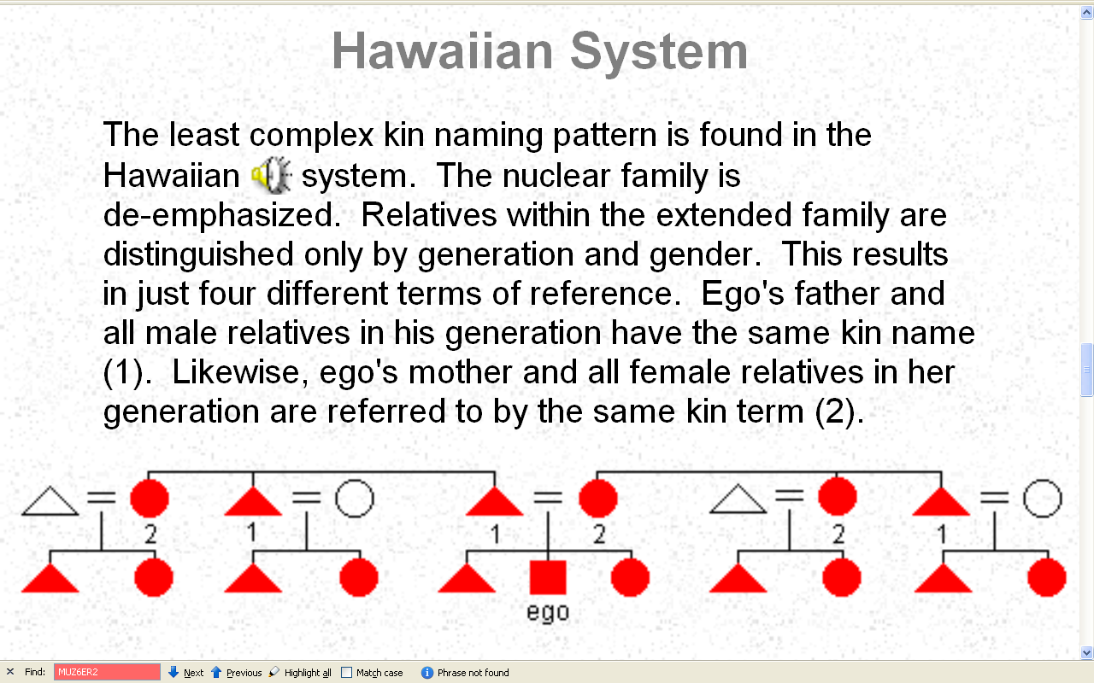
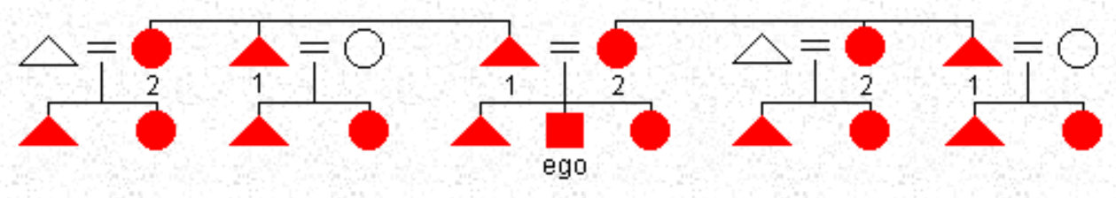
http://anthro.palomar.edu/kinship/kinship_6.htm

Slide 29
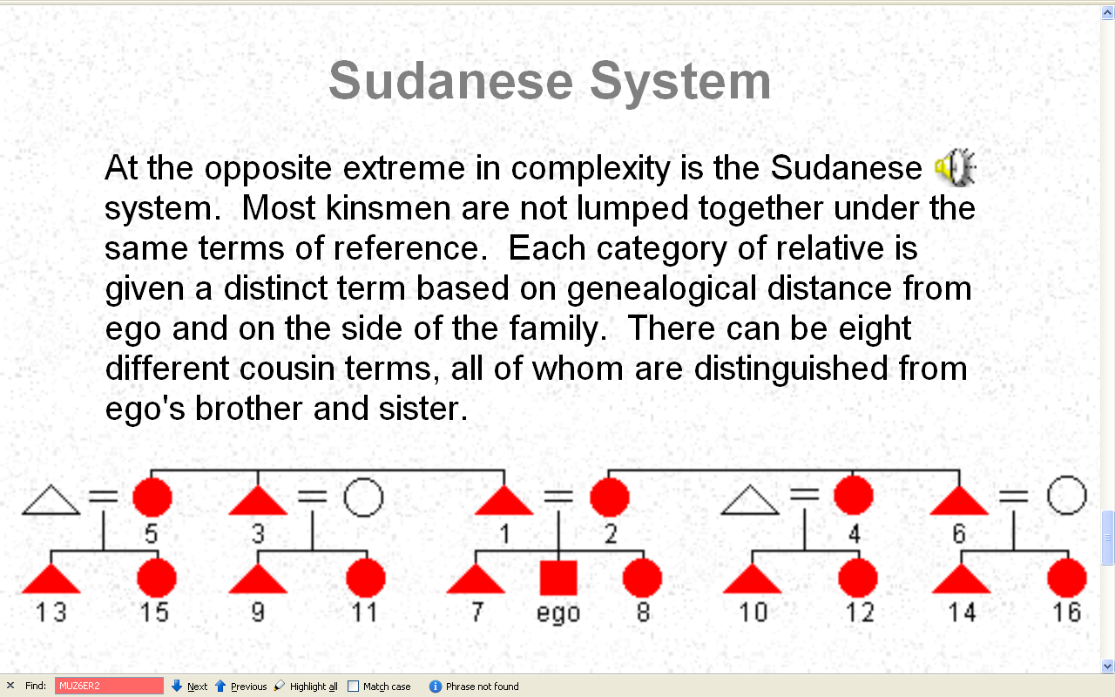
http://anthro.palomar.edu/kinship/kinship_6.htm

Slide 30
http://anthro.palomar.edu/kinship/kinship_6.htm

Slide 31
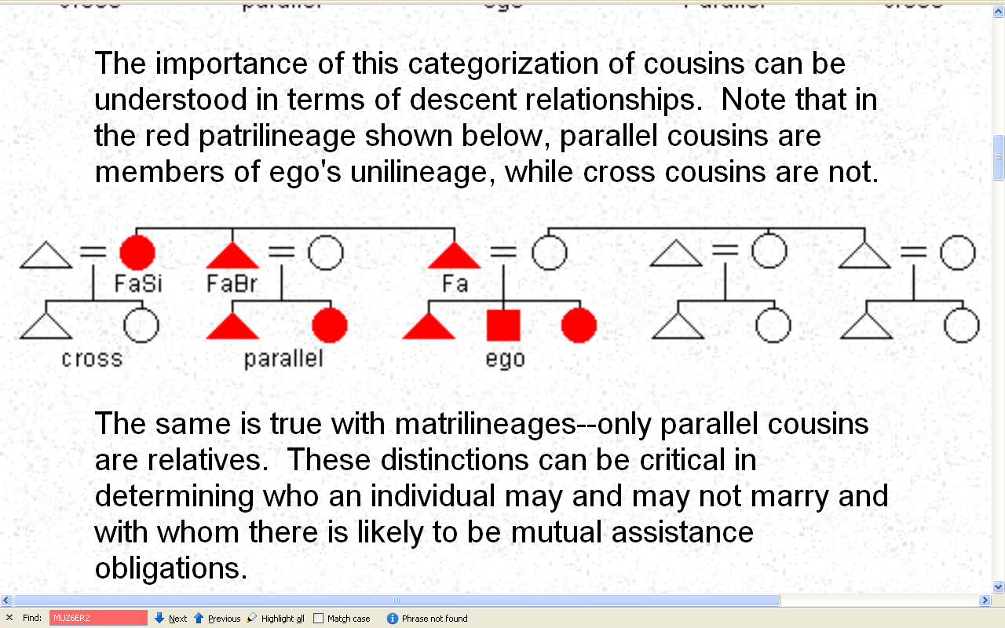
http://anthro.palomar.edu/kinship/kinship_6.htm

Slide 32
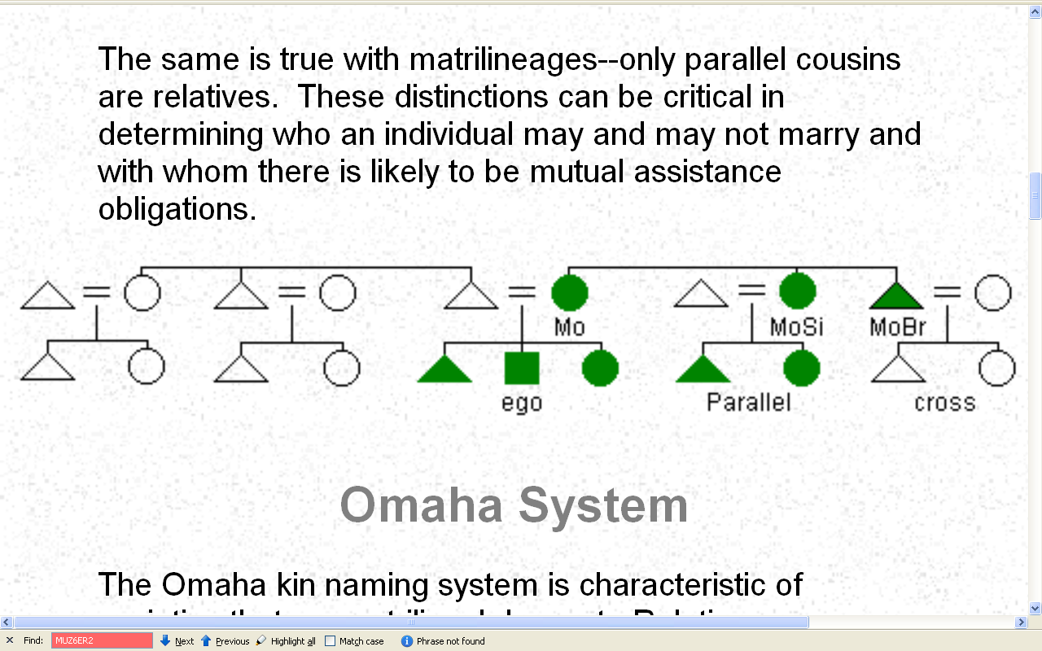
http://anthro.palomar.edu/kinship/kinship_6.htm

Slide 33
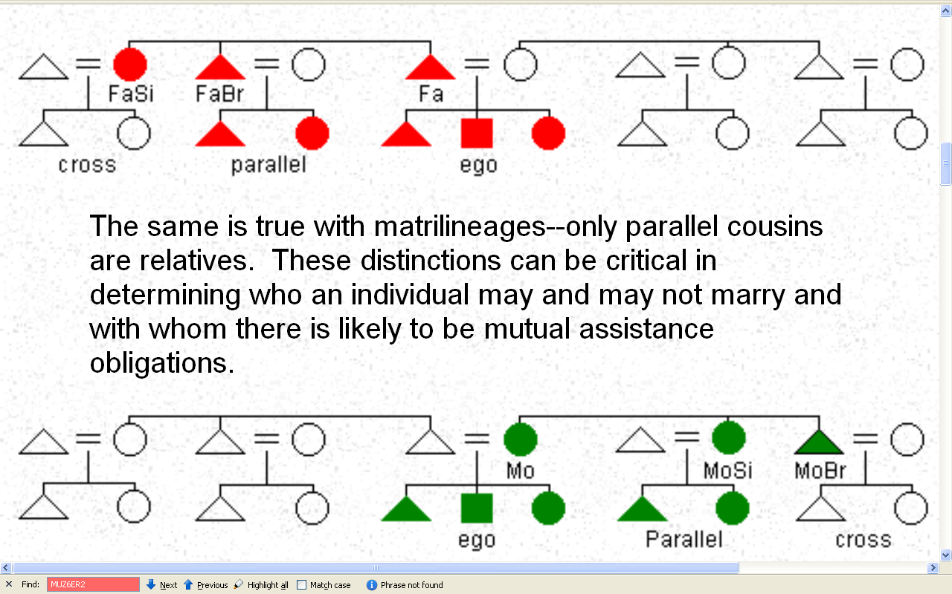
http://anthro.palomar.edu/kinship/kinship_6.htm

Slide 34
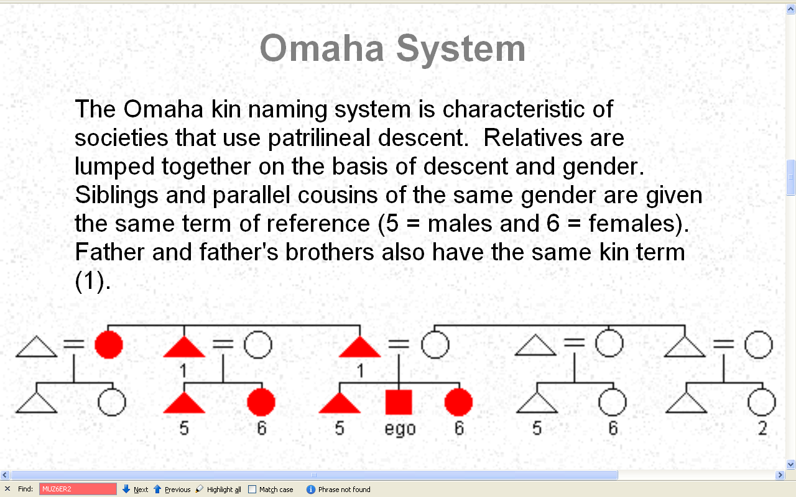
http://anthro.palomar.edu/kinship/kinship_6.htm

Slide 35
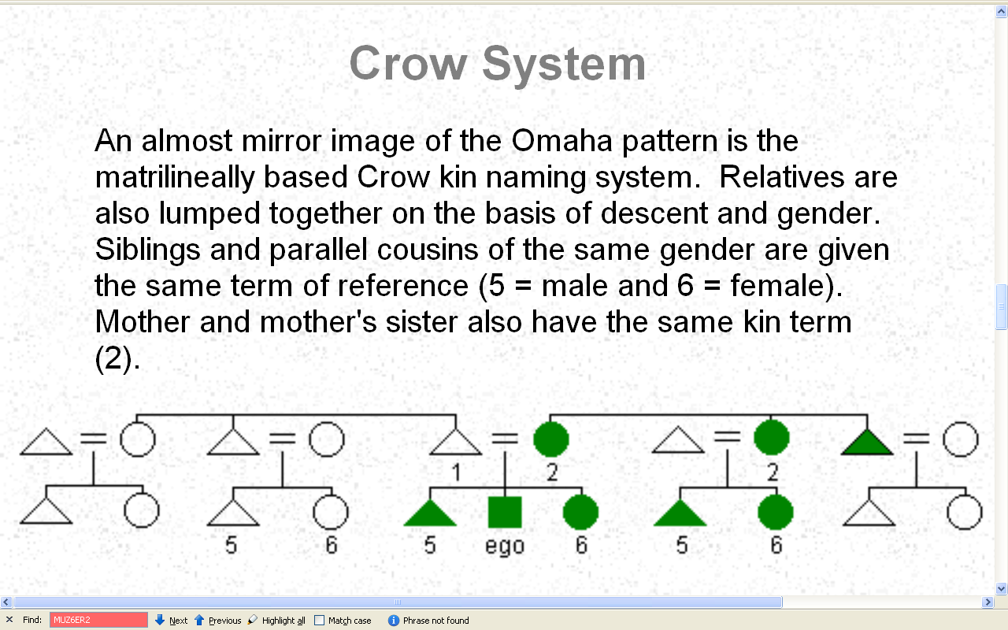
http://anthro.palomar.edu/kinship/kinship_6.htm

Slide 36
Culture and Biology
Marriage Patterns
  cross-cousin marriage
  arranged marriage
  polygamy
  class endogamy
  village exogamy
  cultural standards of beauty
  age at marriage
  levirate / sororate
  inheritance patterns
  personal traits and status . . .
  occurs in ca.
  4/5 “cultures of the world”
  (77.4%)
  HRAF
  Human Relations Area Files
  World Ethnographic Atlas

Slide 37
http://anthro.palomar.edu/kinship/kinship_6.htm

Slide 38
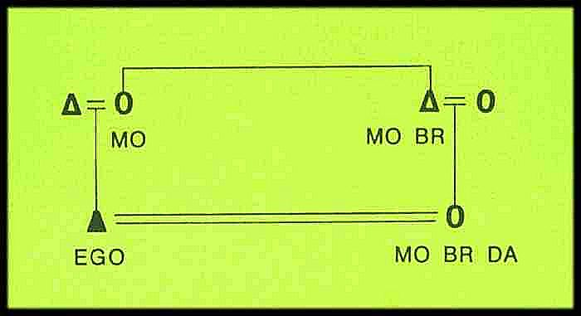

Slide 39
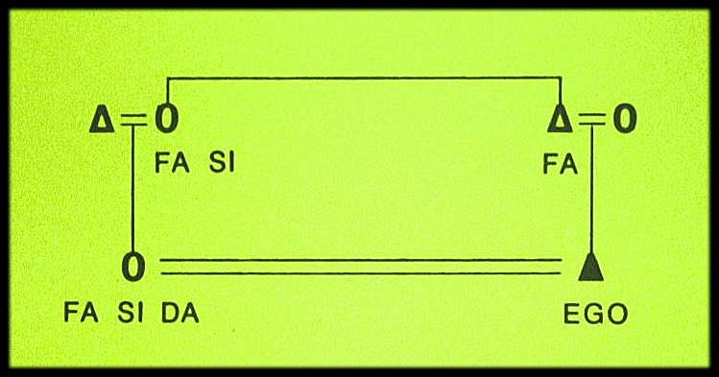

Slide 40
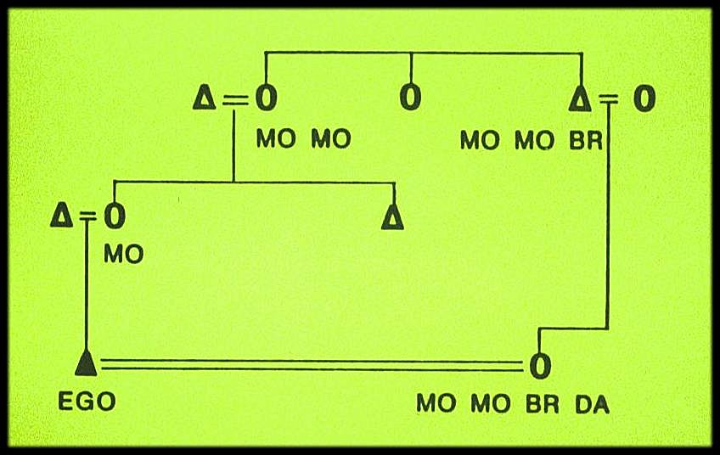

Slide 41
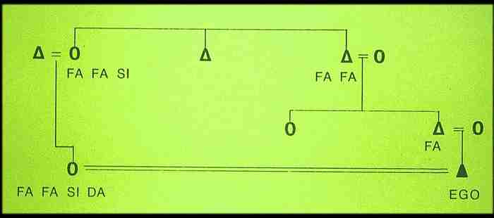

Slide 42
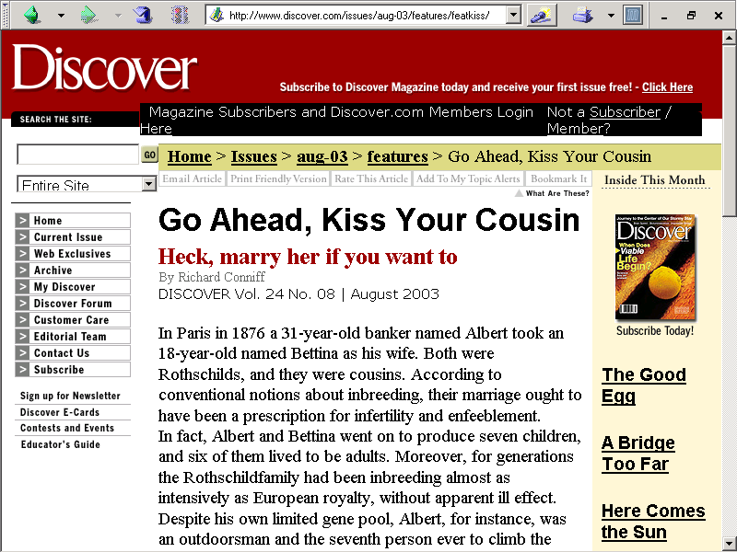
http://www.discover.com/issues/aug-03/features/featkiss/

Slide 43
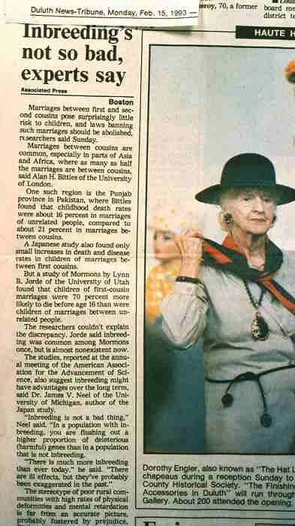

Slide 44
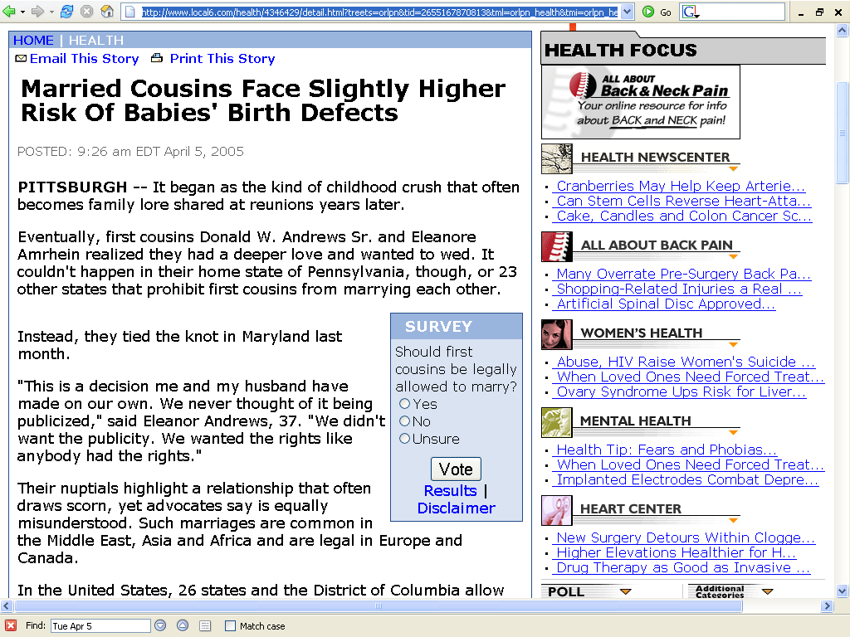
www.local6.com/health/4346429/detail.html?treets=orlpn&tid=2655167870813&tml=orlpn_health&tmi=orlpn_health_1_11150104052005&ts=H

Slide 45
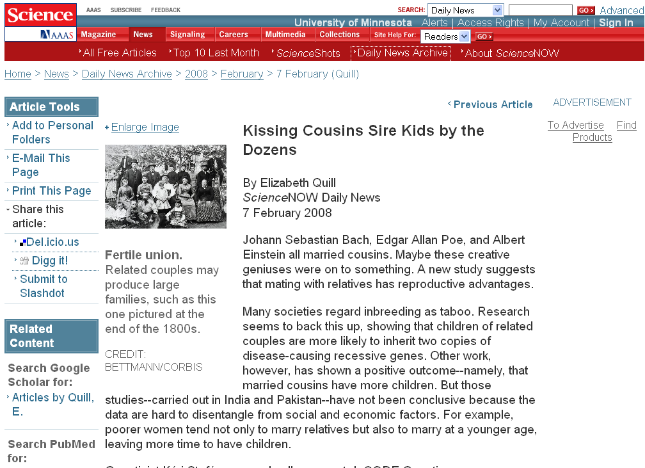
http://sciencenow.sciencemag.org/cgi/content/full/2008/207/2
Notes:
45

Slide 46
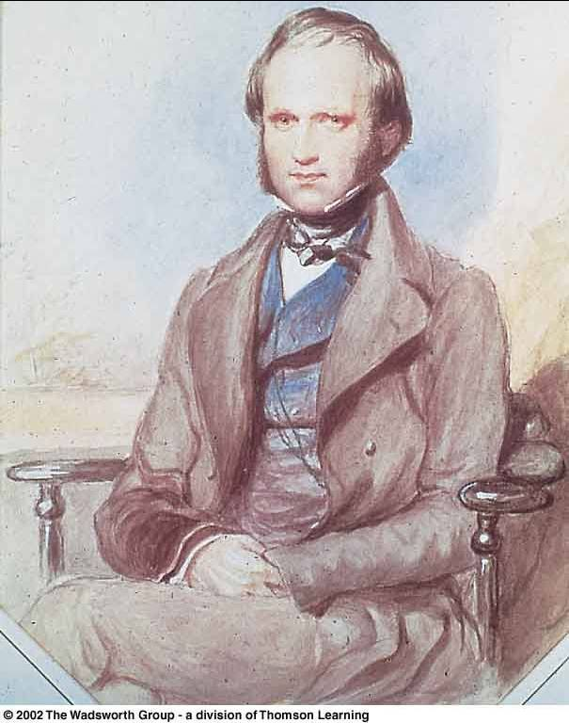
In 1839 Charles Darwin married his first cousin, Emma Wedgwood
Daughter of the younger Josiah Wedgwood, son of the Josiah Wedgwood who founded the pottery works
Darwin's mother Susannah was the sister of his wife’s father

Slide 47
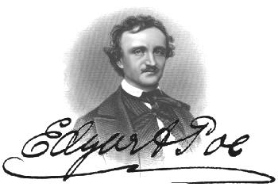
In 1835 Edgar Allan Poe married his widowed aunt’s daughter, Virginia Eliza Clemm
Virginia was 13 years old

Slide 48
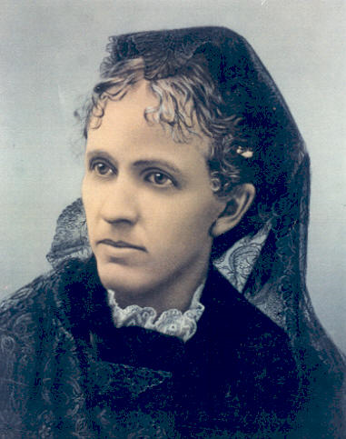
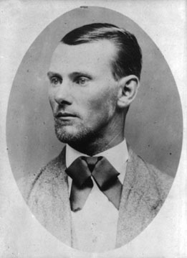
Jesse James married his first cousin
Zerelda "Zee" Mimms, named for his own mother
Zerelda "Zee" Mimms
“cousin of Jesse James and commonly accepted by historians as his wife”

Slide 49
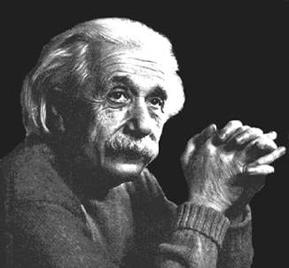
In 1919 Einstein married
his second cousin, his second wife,
Elsa Lowenthal

Slide 50
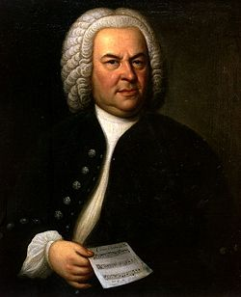
Johann Sebastian Bach
(1685-1750)
married his second cousin
Maria Barbara Bach
(1685-1750)
the daughter of Johann Michael Bach
http://news.bbc.co.uk/2/hi/americas/6057004.stm

Slide 51
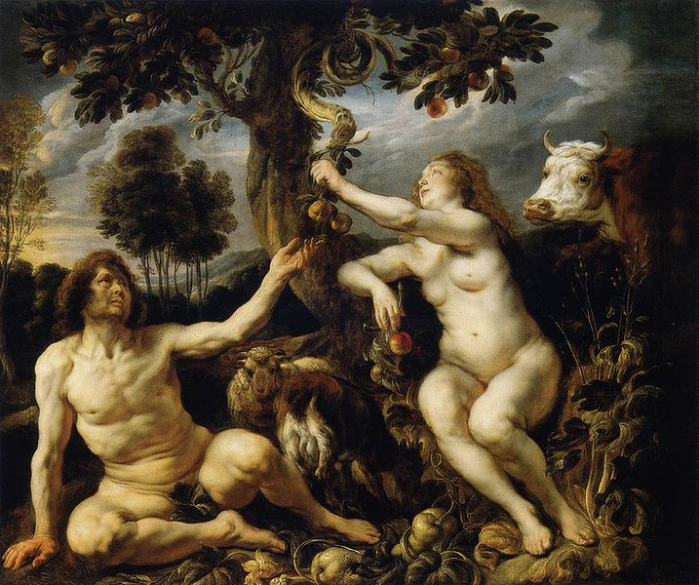
Adam and Eve’s Grandchildren
http://commons.wikimedia.org/wiki/File:Jordaens_Fall_of_man.jpg

Slide 52
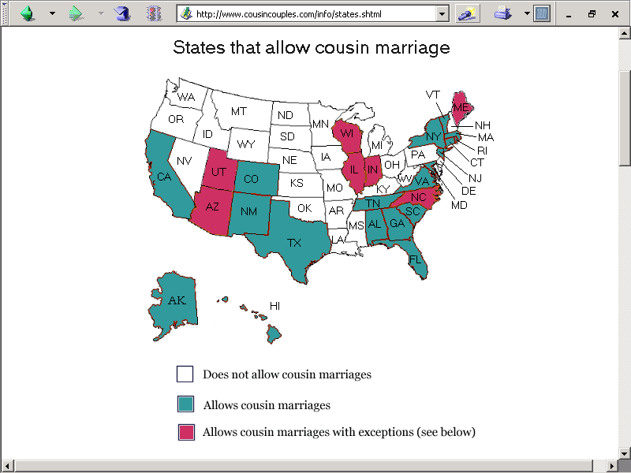
http://www.cousincouples.com/info/states.shtml

Slide 53
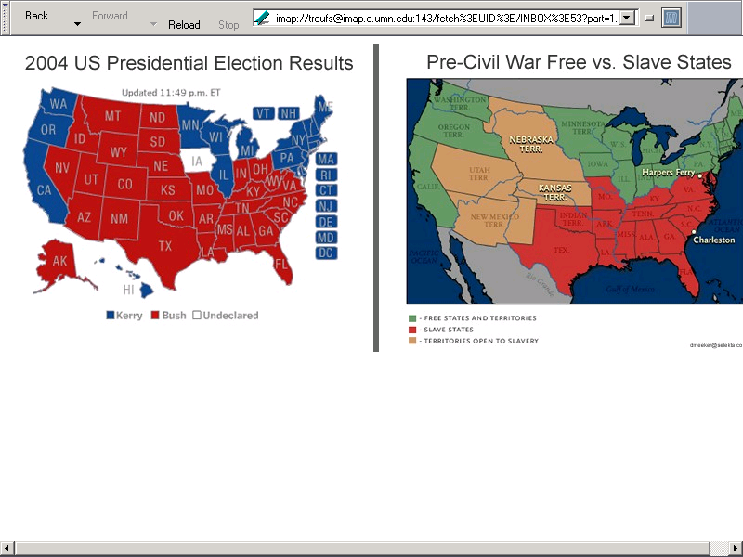
imap://troufs@imap.d.umn.edu:143/fetch%3EUID%3E/INBOX%3E53?part=1.2&type=image/jpeg&filename=map_nowvsthen.jpg

Slide 54
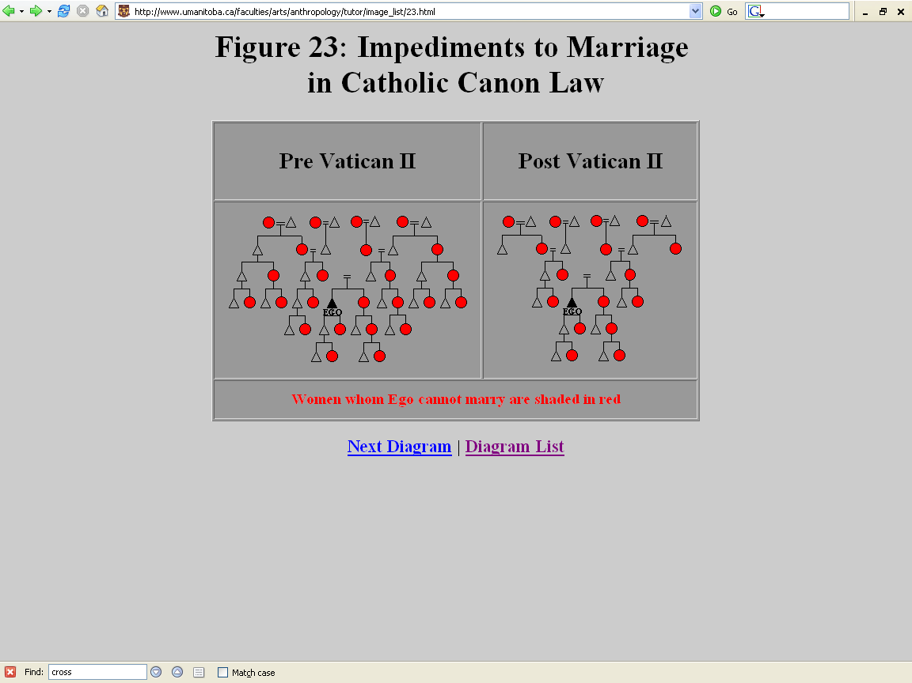
The Second Ecumenical Council of the Vatican, or Vatican II, was an Ecumenical Council of the Roman Catholic Church opened under Pope John XXIII in 1962 and closed under Pope Paul VI in 1965.
http://www.umanitoba.ca/faculties/arts/anthropology/tutor/image_list/23.html

Slide 55
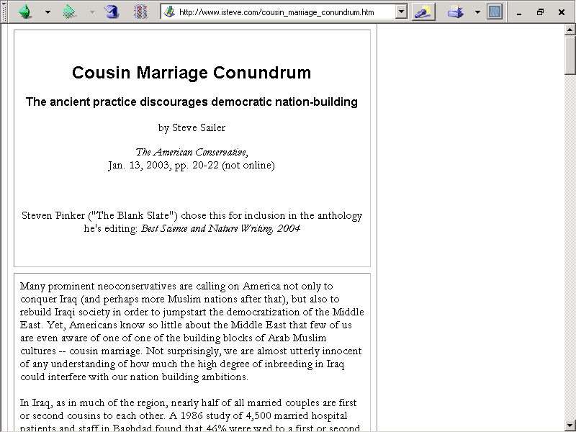
http://www.isteve.com/cousin_marriage_conundrum.htm

Slide 56
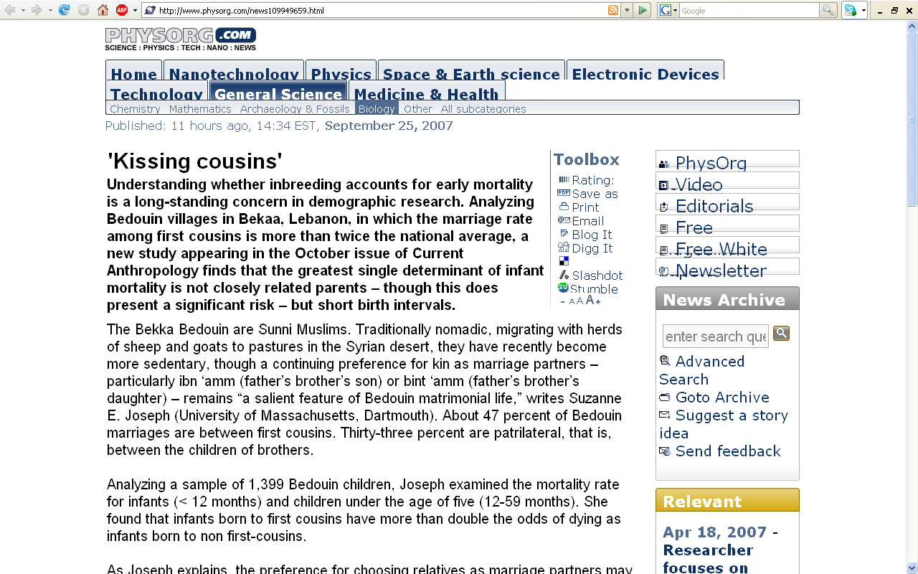
http://www.physorg.com/news109949659.html

Slide 57
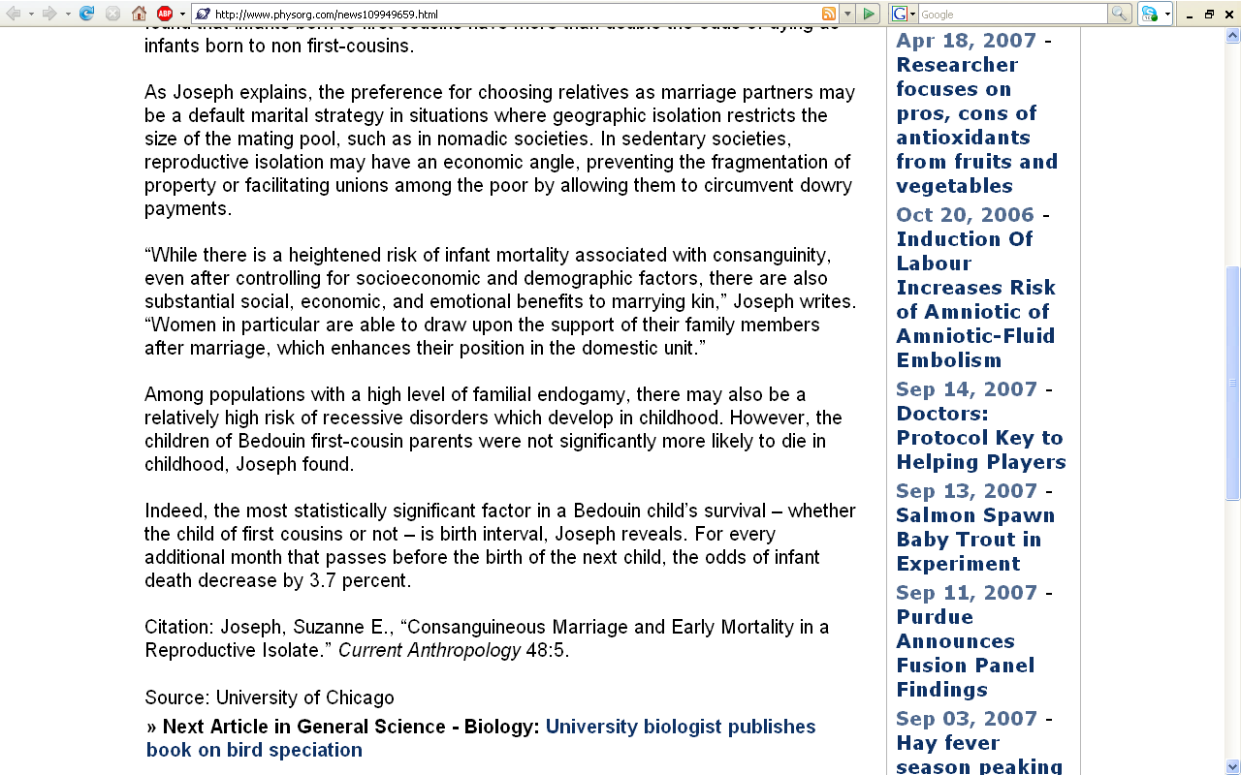
http://www.physorg.com/news109949659.html

Slide 58
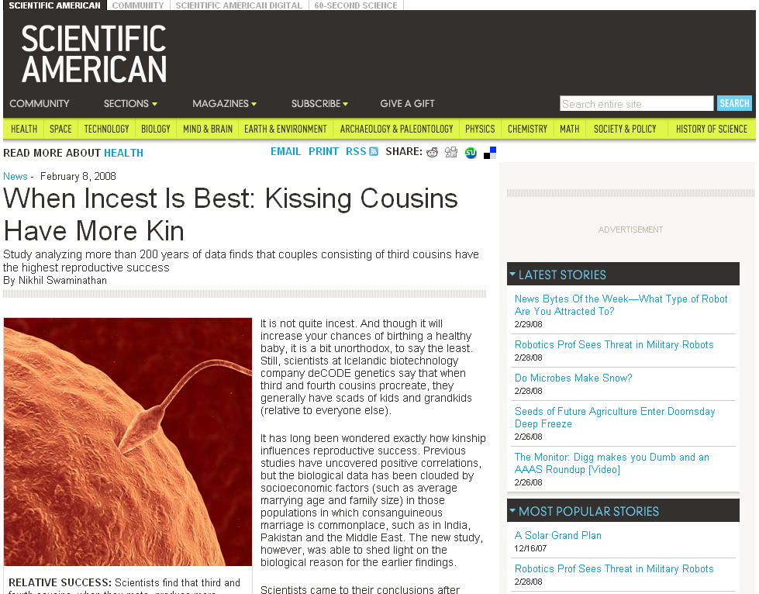
www.sciam.com/article.cfm?id=when-incest-is-best-kissi
Notes:
58

Slide 59
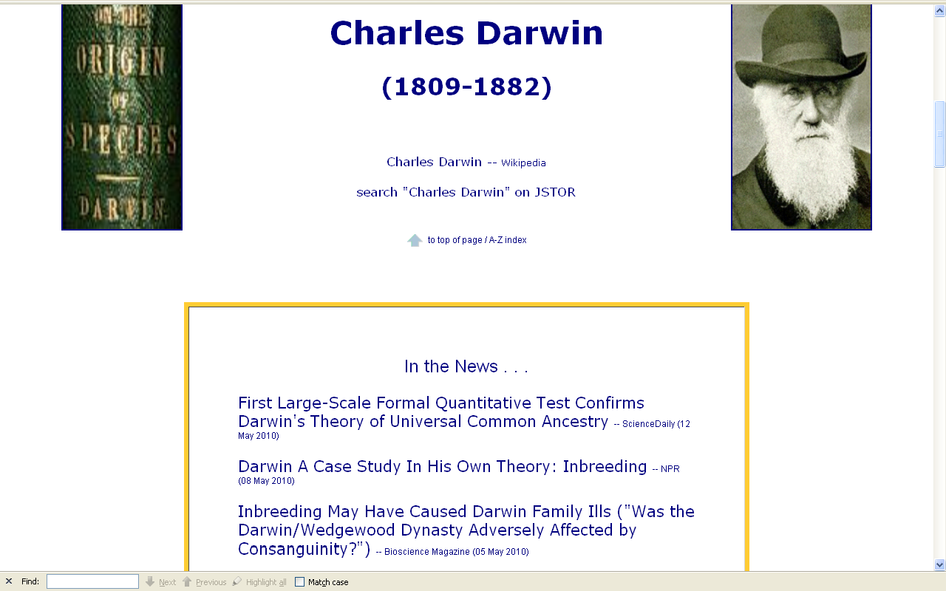
http://www.d.umn.edu/cla/faculty/troufs/anth1602/pcdarwin.html#title

Slide 60
In 1839 Charles Darwin married his first cousin, Emma Wedgwood
Daughter of the younger Josiah Wedgwood, son of the Josiah Wedgwood who founded the pottery works
Darwin's mother Susannah was the sister of his wife’s father

Slide 61
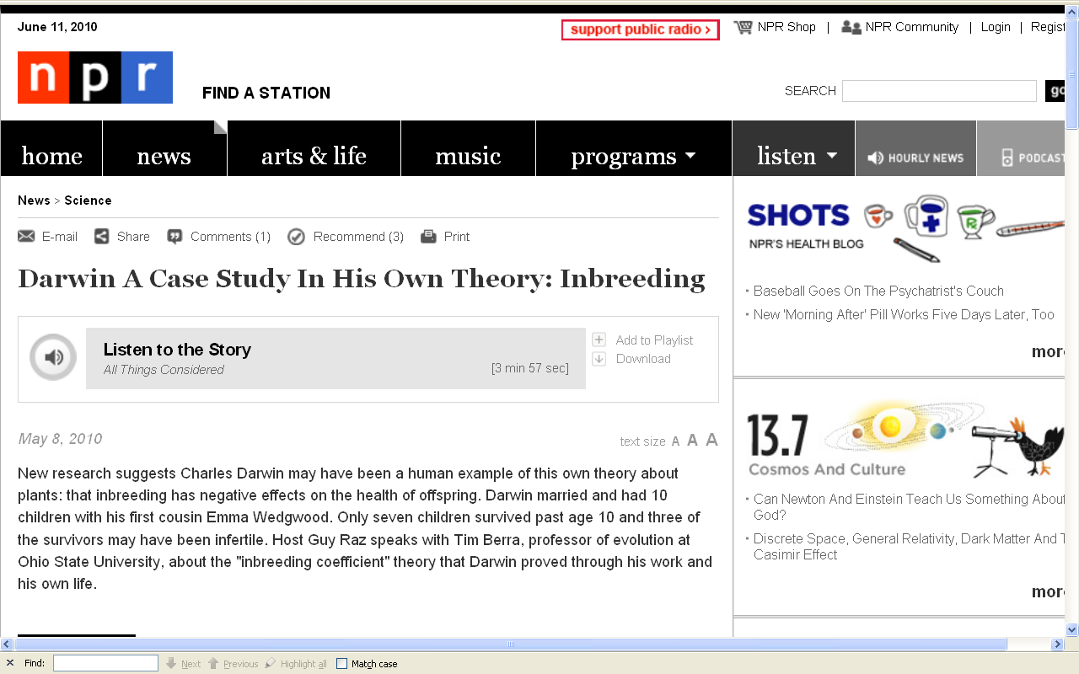
http://www.npr.org/templates/story/story.php?storyId=126637625

Slide 62

http://news.bbc.co.uk/2/hi/health/4204789.stm

Slide 63


Slide 64

http://www.fox11online.com/dpp/news/local/thomas-kestell-cow-breaks-holstein-milk-production-record

Slide 65
Culture and Biology
Marriage Patterns
  cross-cousin marriage
  arranged marriage
  polygamy
  class endogamy
  village exogamy
  cultural standards of beauty
  age at marriage
  levirate / sororate
  inheritance patterns
  personal traits and status . . .

Slide 66


Slide 67


Slide 68
Culture and Biology
Marriage Patterns
  cross-cousin marriage
  arranged marriage
  polygamy
  class endogamy
  village exogamy
  cultural standards of beauty
  age at marriage
  levirate / sororate
  inheritance patterns
  personal traits and status . . .

Slide 69


Grandma's Marathon: Remembering a fallen champion
Kevin Pates Duluth News Tribune
Published Sunday, June 15, 2008
There will be a moment of silence before the start of Saturday’s 32nd Grandma’s Marathon.
Standing on North Shore Drive, just south of Two Harbors, Stephen Muturi will gather his thoughts and emotions before the day’s task of running 26.2 miles.
He’ll remember close friend and countryman Wesly Ngetich, last year’s champion, who was killed Jan. 21 at Emarti village in Kenya’s Trans Mara district. Ngetich was caught in the middle of an incident that turned violent. He was 31 and had two wives and three children, ages 8, 6 and 1. “Wesly was a peacemaker. . . .”
www.duluthnewstribune.com/articles/index.cfm?id=68557
Notes:
69

Slide 70

http://www.foxnews.com/wires/2007Oct16/0,4670,ODDIsraelDadaposs67Kids,00.html

Slide 71

http://news.bbc.co.uk/2/hi/asia-pacific/7025593.stm

Slide 72

http://www.etaiwannews.com/Asia/2004/03/02/1078193405.htm

Slide 73

http://www.dailytexanonline.com/news/2004/03/26/StateLocal/Polygamists.Might.Be.Building.In.Texas-642621.shtml
Notes:
73

Slide 74

http://news.bbc.co.uk/2/hi/americas/7333004.stm
Notes:
74

Slide 75

http://news.bbc.co.uk/2/hi/americas/7431848.stm
Notes:
75

Slide 76

http://news.bbc.co.uk/2/hi/europe/4610396.stm

Slide 77

http://www.d.umn.edu/cla/faculty/troufs/anth1602/video/Yanomamo.html

Slide 78

http://www.umanitoba.ca/anthropology/tutor/case_studies/dani/marriage.html

Slide 79
Culture and Biology
Marriage Patterns
  cross-cousin marriage
  arranged marriage
  polygamy
  class endogamy
  village exogamy
  cultural standards of beauty
  age at marriage
  levirate / sororate
  inheritance patterns
  personal traits and status . . .

Slide 80
Culture and Biology
Marriage Patterns
  cross-cousin marriage
  arranged marriage
  polygamy
  class endogamy
  village exogamy
  cultural standards of beauty
  age at marriage
  levirate / sororate
  inheritance patterns
  personal traits and status . . .
  polygyny
  plural marriage in which several women share a husband
  (i.e., “A man has more than one wife.”)

Slide 81
Culture and Biology
Marriage Patterns
  cross-cousin marriage
  arranged marriage
  polygamy
  class endogamy
  village exogamy
  cultural standards of beauty
  age at marriage
  levirate / sororate
  inheritance patterns
  personal traits and status . . .
  polyandry
  plural marriage in which several men share a wife

Slide 82
Polygamy
  polygyny
  plural marriage in which several women share a husband
  (i.e., “A man has more than one wife.”)
Marriage Patterns
  cross-cousin marriage
  arranged marriage
  polygamy
  class endogamy
  village exogamy
  cultural standards of beauty
  age at marriage
  levirate / sororate
  inheritance patterns
  personal traits and status . . .
  polyandry
  plural marriage in which several men share a wife

Slide 83

http://www.d.umn.edu/cla/faculty/troufs/anth1604/video/Strange_Relations.html#title

Slide 84
“Zumkhet comes to live in Sonam's household, consisting of his father and mother and his three brothers. Zumkhet has her first child, by Sonam's older brother, Ghoka. She is traditional, believing in the polyandrous system of her culture: the family and the family holdings are held together through the one wife.”
http://www.d.umn.edu/cla/faculty/troufs/anth1604/video/Strange_Relations.html#title

Slide 85

Toda, India
http://noctoc-noctoc.blogspot.com/2008/10/polyandry-among-toda-tribe-of-india.html

Slide 86
Culture and Biology
Marriage Patterns
  cross-cousin marriage
  arranged marriage
  polygamy
  class endogamy
  village exogamy
  cultural standards of beauty
  age at marriage
  levirate / sororate
  inheritance patterns
  personal traits and status . . .

Slide 87
Culture and Biology
Marriage Patterns
  cross-cousin marriage
  arranged marriage
  polygamy
  class endogamy
  village exogamy
  cultural standards of beauty
  age at marriage
  levirate / sororate
  inheritance patterns
  personal traits and status . . .
  -ogamy refers to rules of marriage

Slide 88
Culture and Biology
Marriage Patterns
  cross-cousin marriage
  arranged marriage
  polygamy
  class endogamy
  village exogamy
  cultural standards of beauty
  age at marriage
  levirate / sororate
  inheritance patterns
  personal traits and status . . .
  mating with others from the same group

Slide 89
Culture and Biology
Marriage Patterns
  cross-cousin marriage
  arranged marriage
  polygamy
  class endogamy
  village exogamy
  cultural standards of beauty
  age at marriage
  levirate / sororate
  inheritance patterns
  personal traits and status . . .

Slide 90
Culture and Biology
Marriage Patterns
  cross-cousin marriage
  arranged marriage
  polygamy
  class endogamy
  village exogamy
  cultural standards of beauty
  age at marriage
  levirate / sororate
  inheritance patterns
  personal traits and status . . .
  mating with others from other groups

Slide 91
Culture and Biology
Marriage Patterns
  cross-cousin marriage
  arranged marriage
  polygamy
  class endogamy
  village exogamy
  cultural standards of beauty
  age at marriage
  levirate / sororate
  inheritance patterns
  personal traits and status . . .

Slide 92
Culture and Biology
Marriage Patterns
  cross-cousin marriage
  arranged marriage
  polygamy
  class endogamy
  village exogamy
  cultural standards of beauty
  age at marriage
  levirate / sororate
  inheritance patterns
  personal traits and status . . .

Slide 95

www.telegraph.co.uk/earth/main.jhtml?xml=/earth/2008/08/18/scisexy118.xml

Slide 96

www.telegraph.co.uk/earth/main.jhtml?xml=/earth/2008/06/05/scifashion205.xml
Notes:
96

Slide 97

http://news.bbc.co.uk/1/hi/health/2817795.stm

Slide 98


Slide 99


Slide 100
http://news.bbc.co.uk/1/hi/health/2817795.stm

Slide 101
Culture and Biology
Marriage Patterns
  cross-cousin marriage
  arranged marriage
  polygamy
  class endogamy
  village exogamy
  cultural standards of beauty
  age at marriage
  levirate / sororate
  inheritance patterns
  personal traits and status . . .

Slide 102

http://news.bbc.co.uk/2/hi/middle_east/7711554.stm
Notes:
102

Slide 103


http://news.bbc.co.uk/2/hi/south_asia/4536579.stm

Slide 104

N!ai, one of the little girls in the film The Hunters,
was married to Gunda at the age of 8

Slide 105

www.d.umn.edu/cla/faculty/troufs/anth1604/video/Two_Girls.html#title

Slide 106

2003

Slide 107


Slide 108


Slide 109


Slide 110

Campbell – Loy, Humankind Emerging, 7th ed., p. 544

Slide 111


Slide 112


Slide 113


Slide 114
Culture and Biology
Marriage Patterns
  cross-cousin marriage
  arranged marriage
  polygamy
  class endogamy
  village exogamy
  cultural standards of beauty
  age at marriage
  levirate / sororate
  inheritance patterns
  personal traits and status . . .

Slide 115

http://anthro.palomar.edu/marriage/marriage_4.htm

Slide 116

http://anthro.palomar.edu/marriage/marriage_4.htm

Slide 117
Culture and Biology
Marriage Patterns
  cross-cousin marriage
  arranged marriage
  polygamy
  class endogamy
  village exogamy
  cultural standards of beauty
  age at marriage
  levirate / sororate
  inheritance patterns
  personal traits and status . . .

Slide 118
Culture and Biology
Marriage Patterns
  cross-cousin marriage
  arranged marriage
  polygamy
  class endogamy
  village exogamy
  cultural standards of beauty
  age at marriage
  levirate / sororate
  inheritance patterns
  personal traits and status . . .

Slide 119

http://news.bbc.co.uk/2/hi/science/nature/7013136.stm

Slide 120

http://www.telegraph.co.uk/science/science-news/7603548/Men-with-monotonous-voices-are-irresistible-scientists-say.html

Slide 121
Culture and Biology
Cultural Values and Beliefs
  “machismo”
  motherhood
  ancestor worship
  religious beliefs
  magically induced sickness . . .

Slide 122
Culture and Biology
Cultural Values and Beliefs
  “machismo”
  motherhood
  ancestor worship
  religious beliefs
  magically induced sickness . . .

Slide 123
Culture and Biology
Cultural Values and Beliefs
  “machismo”
  motherhood
  ancestor worship
  religious beliefs
  magically induced sickness . . .

Slide 124
Culture and Biology
Cultural Values and Beliefs
  “machismo”
  motherhood
  ancestor worship
  religious beliefs
  magically induced sickness . . .

Slide 125
Culture and Biology
Cultural Values and Beliefs
  “machismo”
  motherhood
  ancestor worship
  religious beliefs
  magically induced sickness . . .

Slide 126
Culture and Biology
Cultural Values and Beliefs
  “machismo”
  motherhood
  ancestor worship
  religious beliefs
  magically induced sickness . . .

Slide 127
Culture and Biology
Other Cultural Practices
  residence patterns
  wife stealing
  pre- and extra-marital mating
  contraception / abortion
  female infanticide
  warfare.

Slide 128
Culture and Biology
Other Cultural Practices
  residence patterns
  wife stealing
  pre- and extra-marital mating
  contraception / abortion
  female infanticide
  warfare

Slide 129
Culture and Biology
Other Cultural Practices
  residence patterns
  wife stealing
  pre- and extra-marital mating
  contraception / abortion
  female infanticide
  warfare

Slide 130
Culture and Biology
Other Cultural Practices
  residence patterns
  wife stealing
  pre- and extra-marital mating
  contraception / abortion
  female infanticide
  warfare

Slide 131
Culture and Biology
Other Cultural Practices
  residence patterns
  wife stealing
  pre- and extra-marital mating
  contraception / abortion
  female infanticide
  warfare

Slide 132
Culture and Biology
Other Cultural Practices
  residence patterns
  wife stealing
  pre- and extra-marital mating
  contraception / abortion
  female infanticide
  warfare

Slide 133
Culture and Biology
Other Cultural Practices
  residence patterns
  wife stealing
  pre- and extra-marital mating
  contraception / abortion
  female infanticide
  warfare

Slide 134
Culture and Biology
Other Factors
  splitting / joining of villages
  intervillage migration
  different languages
  breakdown of society due to illness
  contact with western “civilization”
  technological inventions
  diffusion

Slide 135
Culture and Biology
Other Factors
  splitting / joining of villages
  intervillage migration
  different languages
  breakdown of society due to illness
  contact with western “civilization”
  technological inventions
  diffusion

Slide 136
Culture and Biology
Other Factors
  splitting / joining of villages
  intervillage migration
  different languages
  breakdown of society due to illness
  contact with western “civilization”
  technological inventions
  diffusion

Slide 137
Culture and Biology
Other Factors
  splitting / joining of villages
  intervillage migration
  different languages
  breakdown of society due to illness
  contact with western “civilization”
  technological inventions
  diffusion

Slide 138
Culture and Biology
Other Factors
  splitting / joining of villages
  intervillage migration
  different languages
  breakdown of society due to illness
  contact with western “civilization”
  technological inventions
  diffusion

Slide 139
Culture and Biology
Other Factors
  splitting / joining of villages
  intervillage migration
  different languages
  breakdown of society due to illness
  contact with western “civilization” . . .
  technological inventions
  diffusion

Slide 140
Culture and Biology
Other Factors
  splitting / joining of villages
  intervillage migration
  different languages
  breakdown of society due to illness
  contact with western “civilization”
  technological inventions
  diffusion
  and even civilization itself

Slide 141
Glossary
“savage”
“civilized”

Slide 142
Glossary
“savage”
one in the state of nature
(in the woods)

Slide 143
Glossary
“civilization”
pertaining to a citizen of a city
(originally the citizenry of Rome,
not the town)

Slide 144
Culture and Biology
“Civilization Diseases”
  obesity
  gall bladder disease
  diabetes
  arteriosclerosis
  hypertension
  plagues

Slide 145
Culture and Biology
“Civilization Diseases”
  obesity
  gall bladder disease
  diabetes
  arteriosclerosis
  hypertension
  plagues

Slide 146


Slide 147

“Spanish Flu”
epidemic of
1918 - 1919
In 1918 and 1919, the worldwide Spanish Influenza pandemic ("The Spanish Lady") killed at least 21 million humans -- well over twice the number of combat deaths in the whole of World War I

Slide 148

http://news.bbc.co.uk/1/hi/health/4308872.stm

Slide 149

http://news.bbc.co.uk/1/hi/world/asia-pacific/4292426.stm

Slide 150
Culture and Biology
Other Factors
  splitting / joining of villages
  intervillage migration
  different languages
  breakdown of society due to illness
  contact with western “civilization”
  technological inventions
  diffusion

Slide 151
Culture and Biology
Other Factors
  splitting / joining of villages
  intervillage migration
  different languages
  breakdown of society due to illness
  contact with western “civilization”
  technological inventions
  diffusion

Slide 152
Culture and Biology
Other Factors
  love
  . . .

Slide 153
Culture and Biology
Other Factors
  love
  . . .

Slide 154

www.d.umn.edu/cla/faculty/troufs/anth1604/video/Strange_Relations.html#title
Notes:
154

Slide 155

http://news.bbc.co.uk/1/hi/world/south_asia/3917425.stm

Slide 156
Culture and Biology
Other Factors
  love
  . . .

Slide 157

http://www.usatoday.com/news/world/iraq/2005-05-04-pleasure-marriage_x.htm

Slide 158

Elizabeth and David Weinlick
“On-sight wedding”
Mall of America, 1998
www.geocities.com/Athens/2383/wedding.html/

Slide 159

www.msnbc.msn.com/id/25121427/
Notes:
159

Slide 160

www.d.umn.edu/

Slide 161


Slide 162
The Guiness Book of Records
”The Most Dissimilar
Couple in the World”
wife: 2’ 11½”
husband: 6’ 2”
They met on the internet
-- The Maury Show, 27 April 1999
Notes:
162

Slide 163

Married With Children? You’re part of a minority
Institution Becoming The Choice of the Educated, Affluent
By Blaine Harden
Washington Post Staff Writer
Wednesday, March 7, 2007; A5
PORTLAND, Ore. -- Punctuating a fundamental change in American family life, married couples with children now occupy fewer than one in every four households -- a share that has been slashed in half since 1960 and is the lowest ever recorded by the census.
As marriage with children becomes an exception rather than the norm, social scientists say it is also becoming the self-selected province of the college-educated and the affluent. The working class and the poor, meanwhile, increasingly steer away from marriage, while living together and bearing children out of wedlock.
"The culture is shifting, and marriage has almost become a luxury item, one that only the well educated and well paid are interested in," said Isabel V. Sawhill, an expert on marriage and a senior fellow at the Brookings Institution.
xxx
Notes:
163

Slide 164

http://www.islam-online.net/English/News/2006-10/15/06.shtml
Notes:
164

Slide 165

http://news.bbc.co.uk/2/hi/africa/4748292.stm

Slide 166

Two dogs get married at farmyard
Two dogs get married at a farmyard near Stoke-on-Trent in what could be Britain's first canine coupling.
BBC News
1 Aug 2006
xxx
Notes:
166

Slide 167
“nature” – biology
(inherited)
“nurture” – culture
(learned)

Slide 168
Three Major
Parennial
Debtes
re Cultural Anthropology
Tim Roufs
© 2010

Slide 169
three major contemporary debates
Biological Determinism
vs. Cultural Constructionism
(“nature” vs. “nurture”)
Ideationism vs. Cultural Materialism
(ideas vs. things)
Individual Agency vs. Structuralism
(“free will” vs. “power structures”)

Slide 170
And also in 2006
The nuclear family in the USA is no longer the normal
Family unit
http://news.bbc.co.uk/2/hi/americas/6057004.stm

Slide 171
And more than half of the marriages in the USA fail
http://news.bbc.co.uk/2/hi/americas/6057004.stm

Slide 172

Added to
genographic Roufs
f2009
http://abcnews.go.com/Health/story?id=3991467&page=1
Notes:
172

Slide 173

Added to
pc5
f2008
http://abcnews.go.com/Technology/story?id=5791845&page=1

Slide 174

http://abcnews.go.com/Technology/story?id=5791845&page=1
Notes:
174

