Slide 1
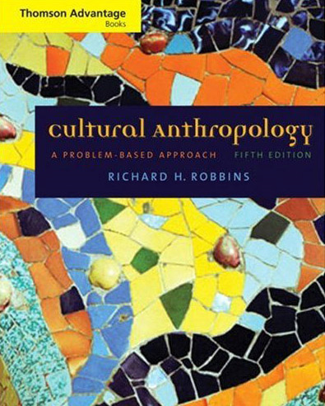
Three Major
Parennial
Debtes
re Cultural Anthropology
Tim Roufs
© 2010

Slide 2
three major contemporary debates
Biological Determinism vs. Cultural Constructionism (“nature” vs. “nurture”)
Ideationism vs. Cultural Materialism (ideas vs. things)
Individual Agency vs. Structuralism (“free will” vs. “power structures”)

Slide 3
three major contemporary debates
Biological Determinism vs. Cultural Constructionism (“nature” vs. “nurture”)
Ideationism vs. Cultural Materialism (ideas vs. things)
Individual Agency vs. Structuralism (“free will” vs. “power structures”)

Slide 4
three major contemporary debates
Biological Determinism vs. Cultural Constructionism (“nature vs. nurture”) (“inherited vs. learned”)
(“nativism” vs. “empiricism”)

Slide 5
three major contemporary debates
Biological Determinism vs. Cultural Constructionism (“nature vs. nurture”) (“inherited vs. learned”)
(“nativism” vs. “empiricism”)

Slide 6
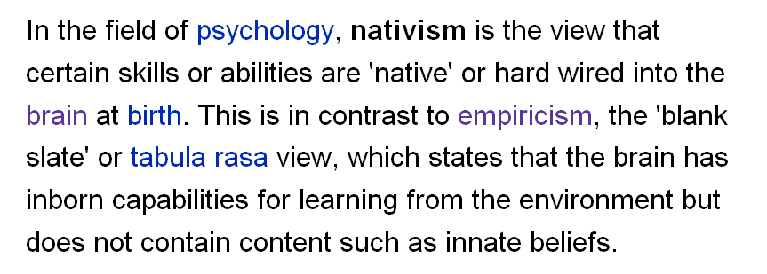
http://en.wikipedia.org/wiki/Psychological_nativism

Slide 7
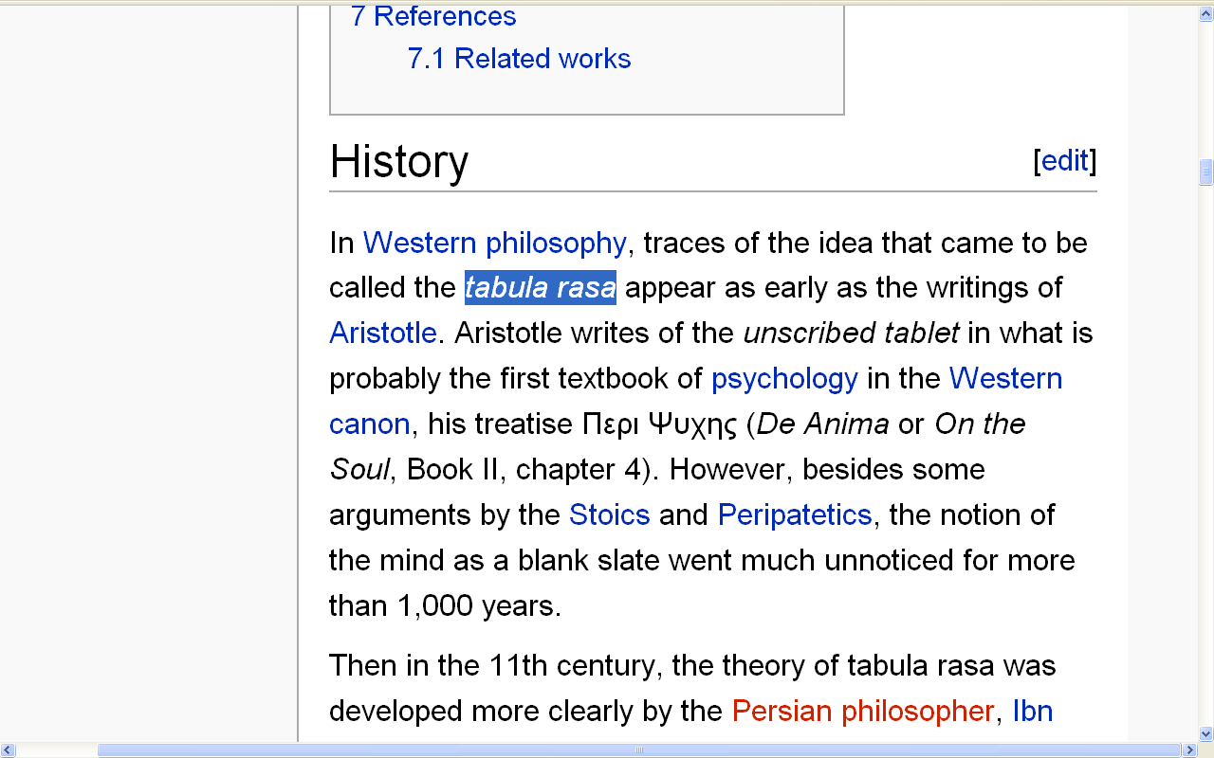
http://en.wikipedia.org/wiki/Tabula_rasa#History

Slide 8
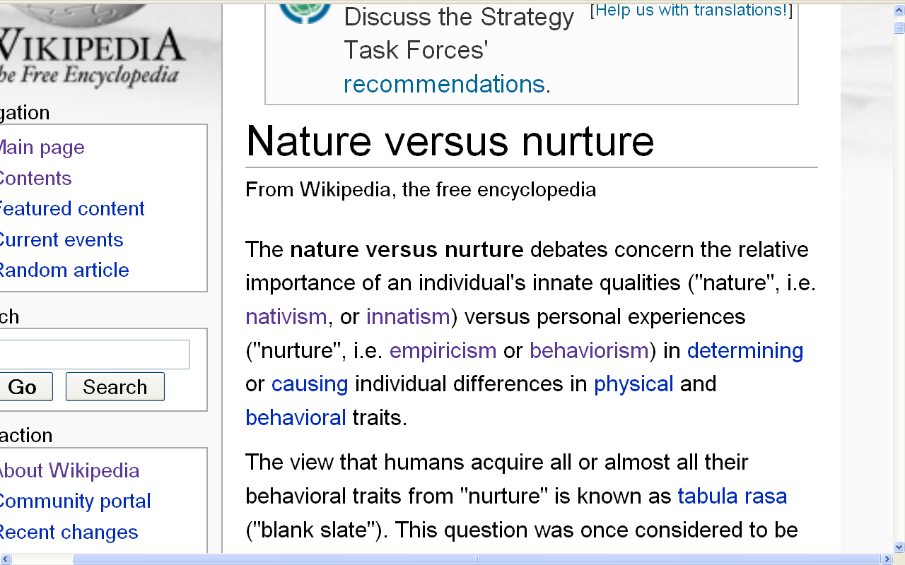
(“nature vs. nurture”)
(“inherited vs. learned”)
(“nativism” vs. “empiricism”)
http://en.wikipedia.org/wiki/Nature_versus_nurture

Slide 9
three major contemporary debates
Biological Determinism vs. Cultural Constructionism (“nature vs. nurture”) (“inherited vs. learned”)
(“nativism” vs. “empiricism”)

Slide 10
WORKING
Anth of Food

Slide 11
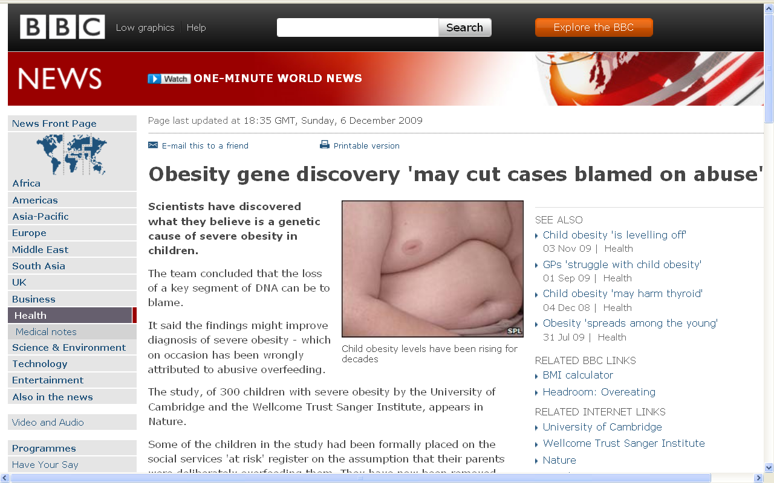
July 19, 2009
http://news.bbc.co.uk/2/hi/health/8394991.stm
Notes:
11

Slide 12
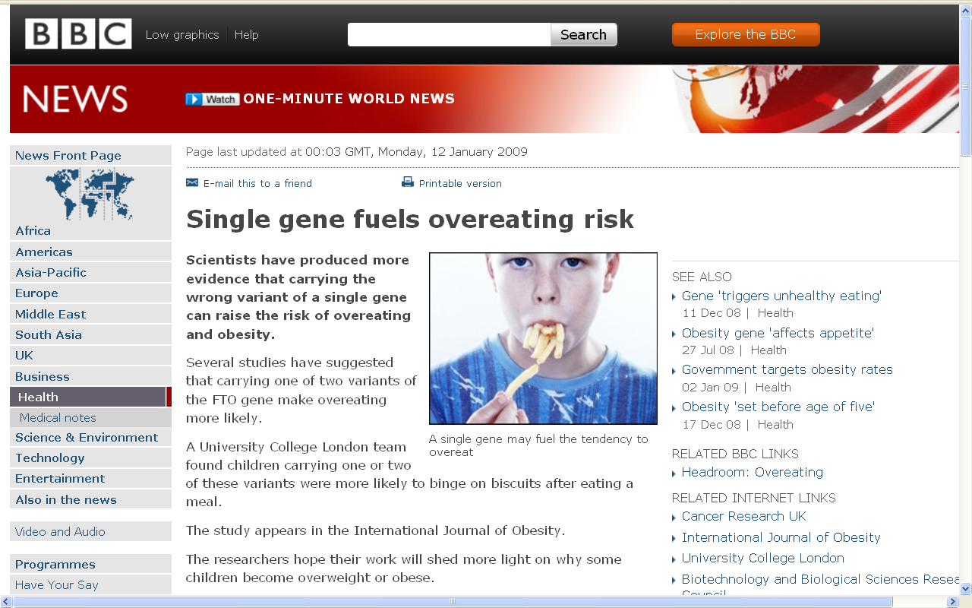
July 19, 2009
http://news.bbc.co.uk/2/hi/health/7820042.stm
Notes:
12

Slide 13
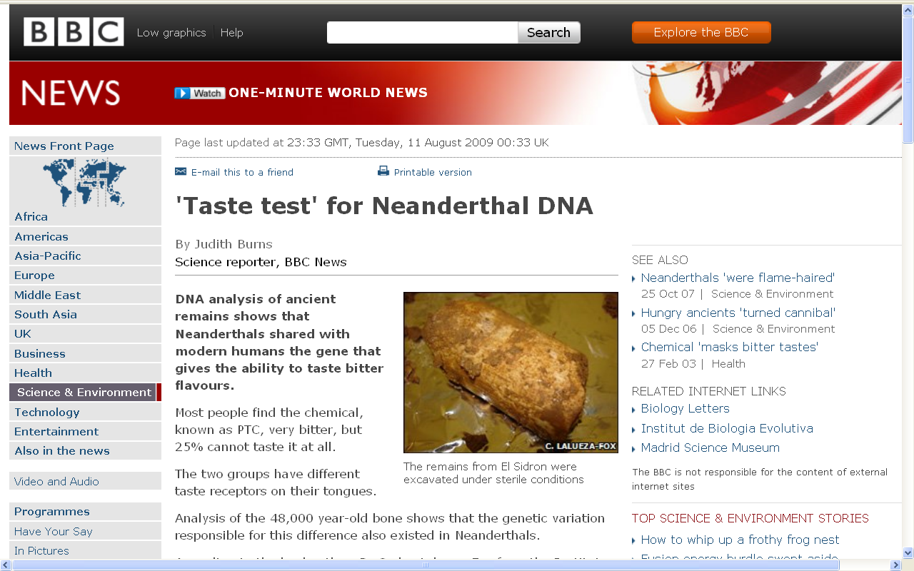
July 19, 2009
http://news.bbc.co.uk/2/hi/science/nature/8195762.stm
Notes:
13

Slide 14
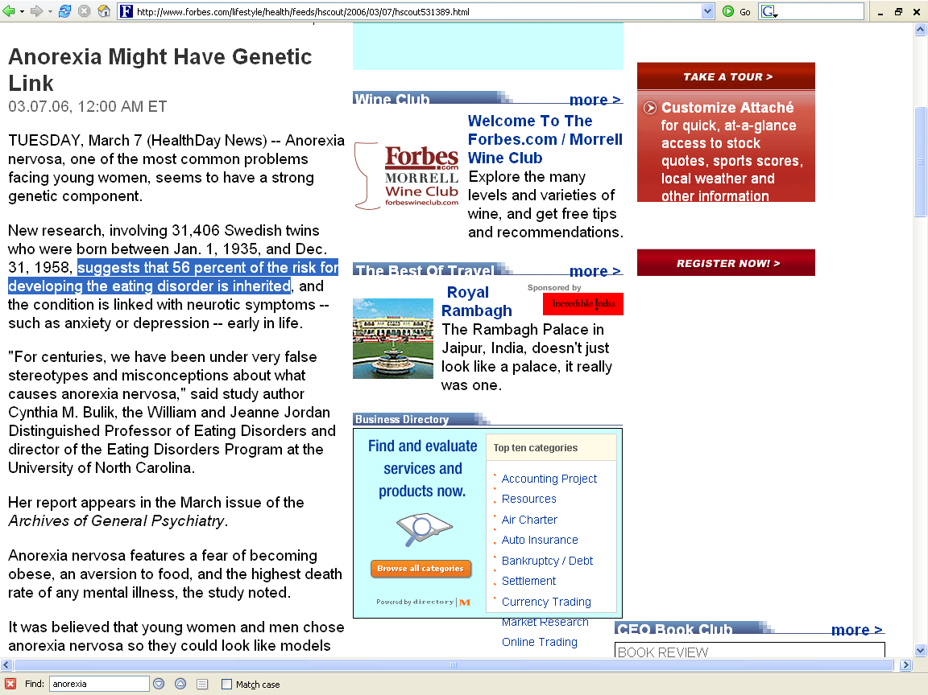
http://www.forbes.com/lifestyle/health/feeds/hscout/2006/03/07/hscout531389.html

Slide 15
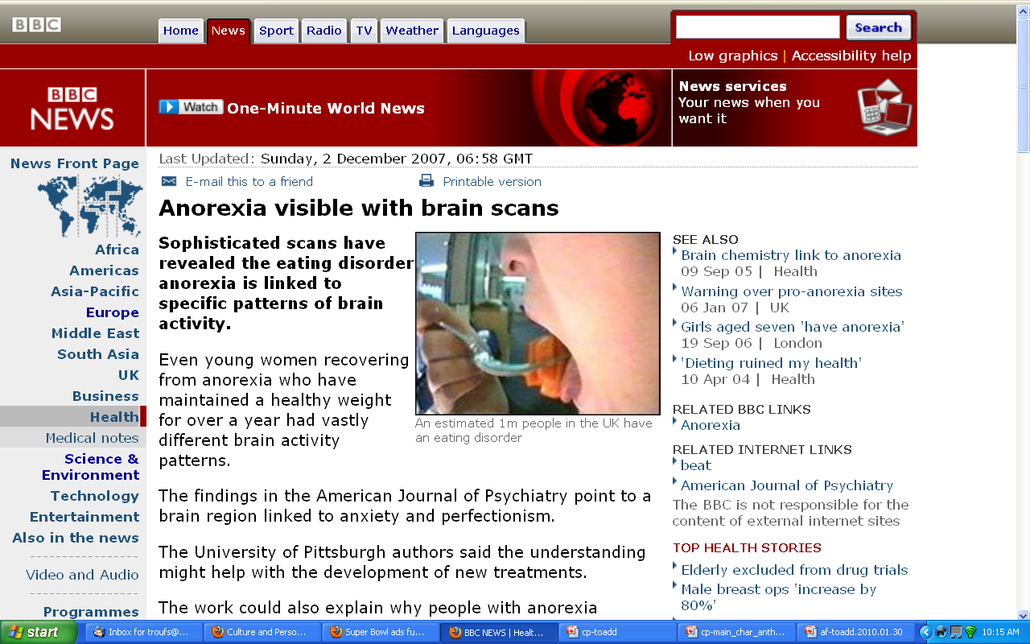
http://news.bbc.co.uk/2/hi/health/7120564.stm

Slide 16
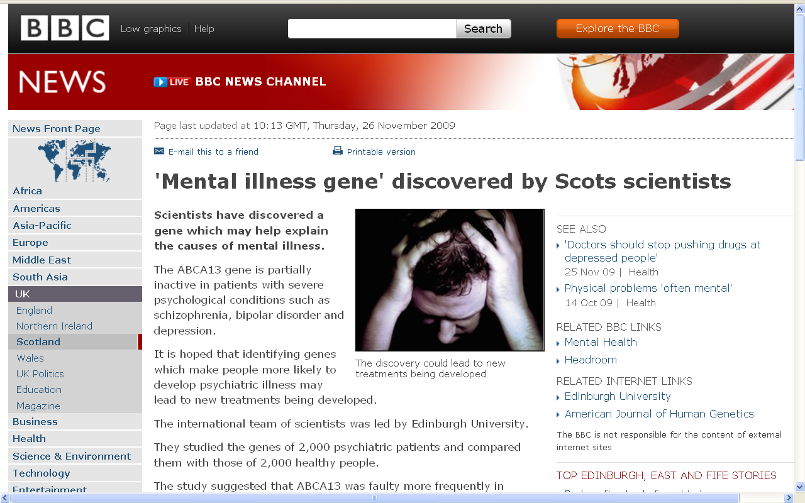
http://news.bbc.co.uk/2/hi/uk_news/scotland/edinburgh_and_east/8380341.stm

Slide 17
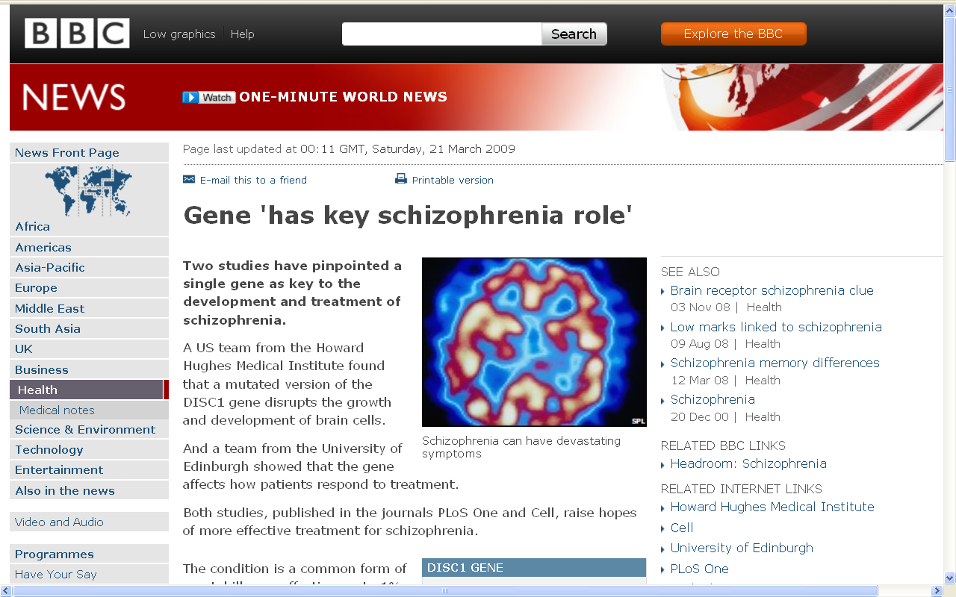
http://news.bbc.co.uk/2/hi/health/7954451.stm

Slide 18
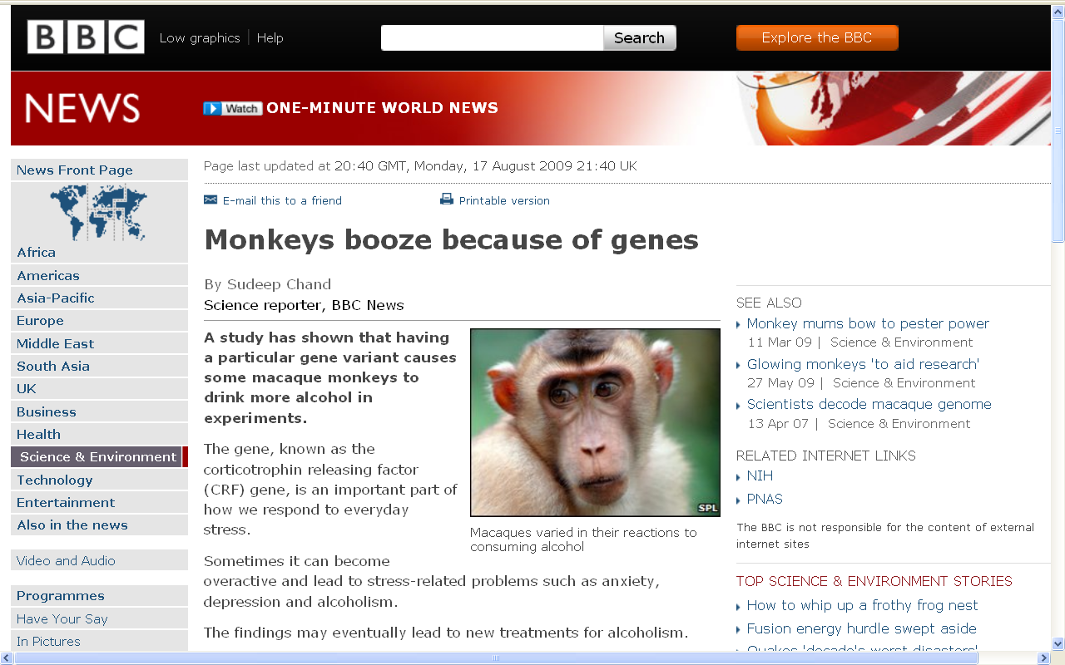
http://news.bbc.co.uk/2/hi/science/nature/8206151.stm

Slide 19
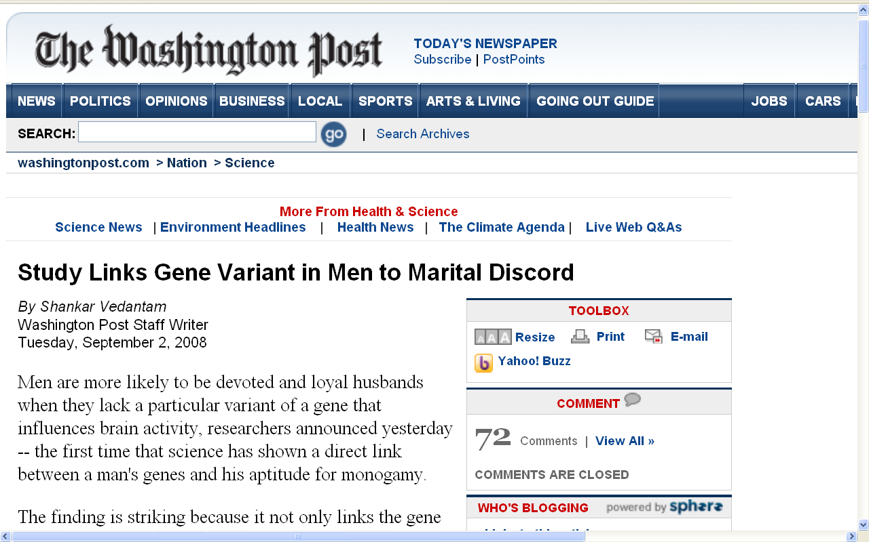
www.washingtonpost.com/wp-dyn/content/article/2008/09/01/AR2008090102087.html

Slide 20
three major contemporary debates
Biological Determinism vs. Cultural Constructionism (“nature vs. nurture”) (“inherited vs. learned”)
(“nativism” vs. “empiricism”)

Slide 21
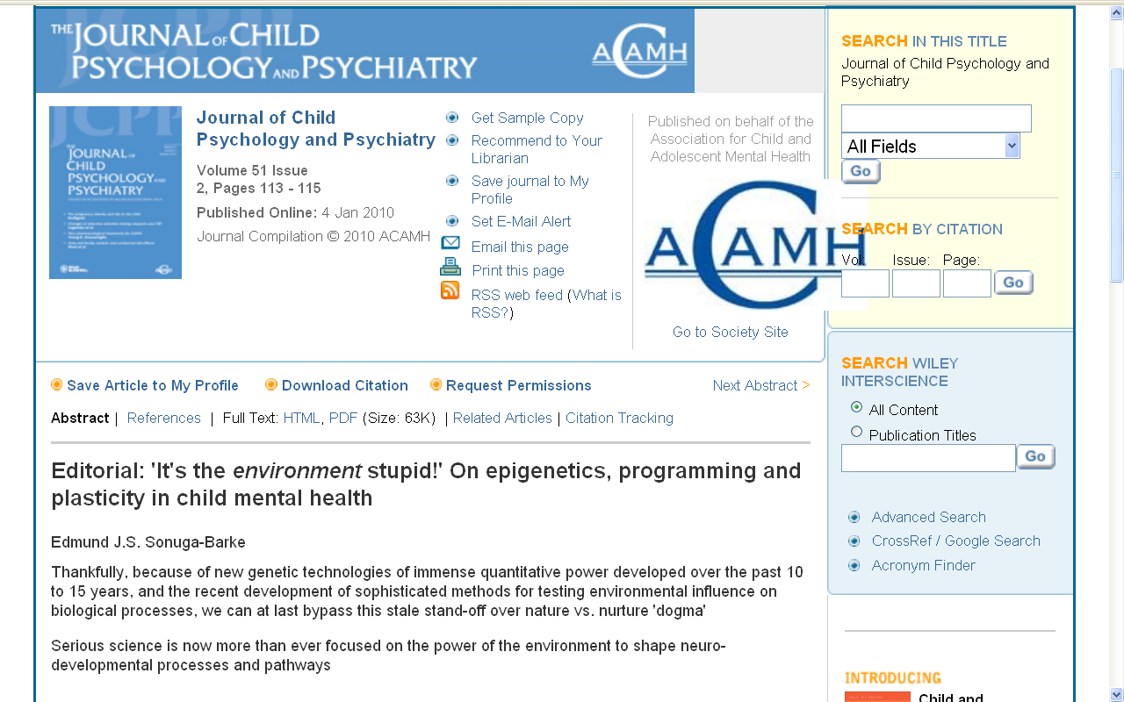
http://www3.interscience.wiley.com/journal/123232350/abstract

Slide 22
three major contemporary debates
Biological Determinism and Cultural Constructionism (“nature and nurture”) (“inherited and learned”)
(“nativism” and “empiricism”)

Slide 23
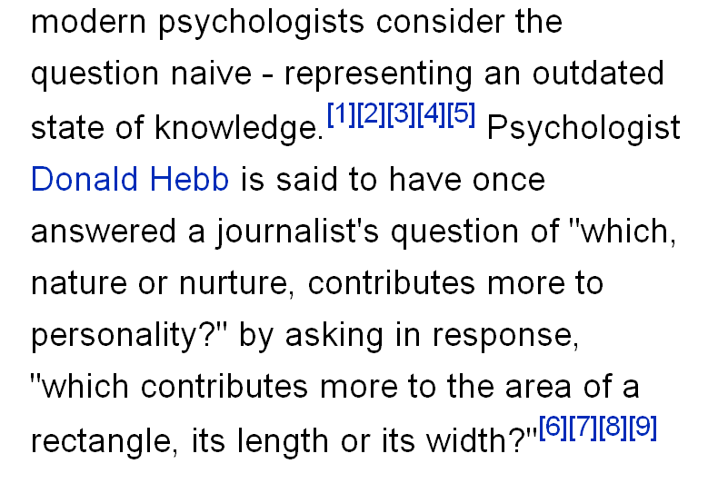
http://en.wikipedia.org/wiki/Nature_versus_nurture

Slide 24
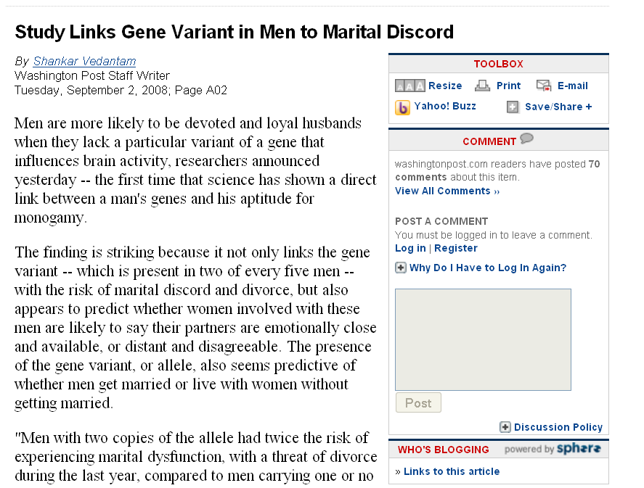
www.washingtonpost.com/wp-dyn/content/article/2008/09/01/AR2008090102087.html

Slide 25
three major contemporary debates
Biological Determinism vs. Cultural Constructionism
Ideationism vs. Cultural Materialism
Individual Agency vs. Structuralism (“free will” vs. “power structures”)

Slide 26
three major contemporary debates
Biological Determinism vs. Cultural Constructionism
Ideationism vs. Cultural Materialism
Individual Agency vs. Structuralism (“free will” vs. “power structures”)

Slide 27
three major contemporary debates
Biological Determinism vs. Cultural Constructionism
Ideationism vs. Cultural Materialism
Individual Agency vs. Structuralism (“free will” vs. “power structures”)
Ideationism vs. Cultural Materialism
e.g., Aztecs must sacrifice and eat humans
in order to please the gods
in order that the gods allow
the sun to rise each day,
so that the world doesn’t end

Slide 28
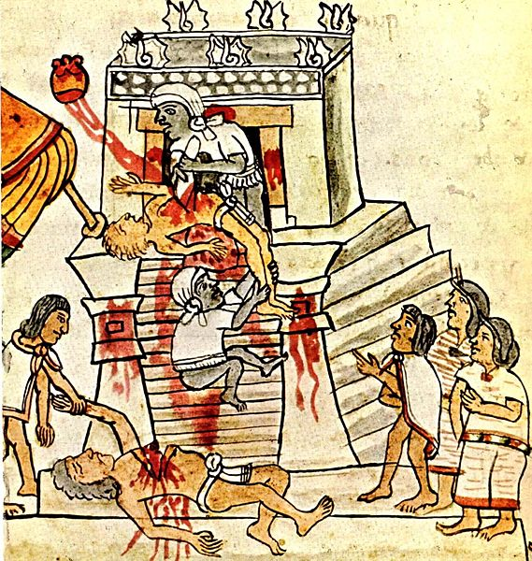
Aztec human sacrifice as shown in the Codex Magliabechiano
http://en.wikipedia.org/wiki/Image:Mendoza_HumanSacrifice.jpg

Slide 29
three major contemporary debates
Ideationism vs. Cultural Materialism
Biological Determinism vs. Cultural Constructionism
Ideationism vs. Cultural Materialism
Individual Agency vs. Structuralism (“free will” vs. “power structures”)
e.g., Aztecs sacrificed and ate humans
in order to control population size
in order to preserve their property,
to terrorize their neighbors
so they will continue to provide
goods and services as tribute,
and because they tasted good

Slide 30
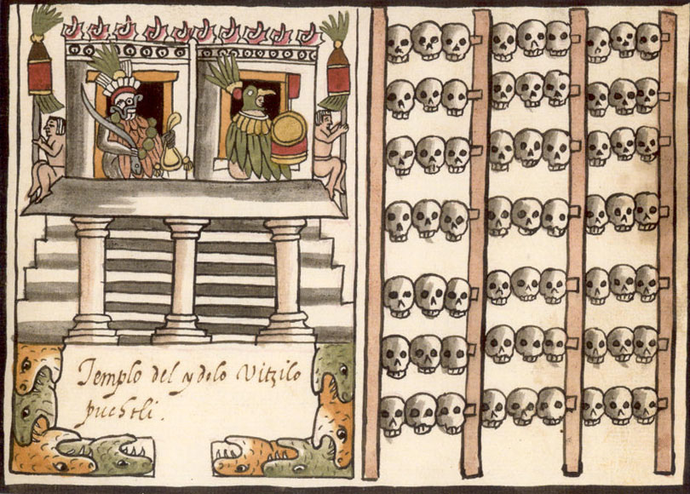
A tzompantli, or skull rack, as shown in the post-Conquest Ramirez Codex.
http://en.wikipedia.org/wiki/Image:Mendoza_HumanSacrifice.jpg

Slide 31
Example:
Some Neandertals were cannibals,
as were the Aztecs and others . . .
Did they eat people because of something like a religious belief ?
Because they tasted good ?
Ideationism
or
Cultural Materialism
Notes:
31

Slide 32
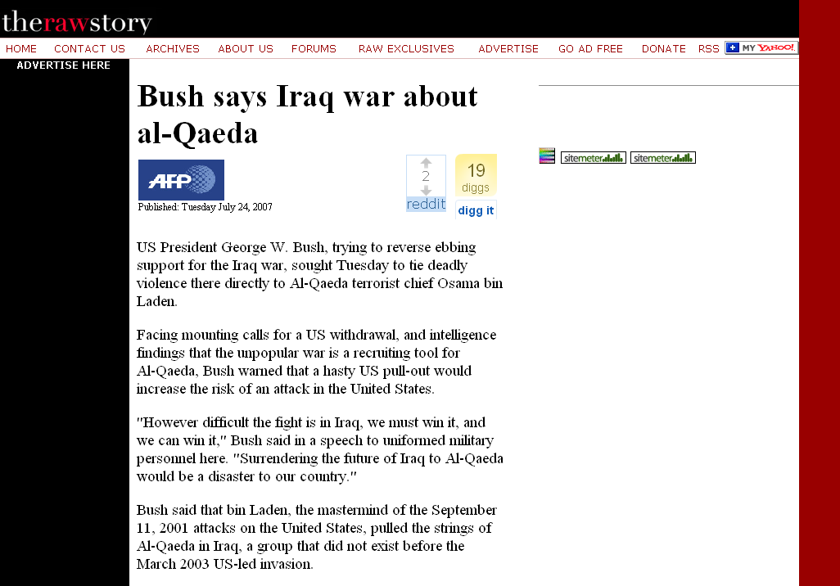
Peace
Justice
Security
Freedom
Honor
[God’s will / Allah’s will . . .]
Ideationism vs. Cultural Materialism
http://rawstory.com/news/afp/Bush_says_Iraq_war_about_al_Qaeda_07242007.html
Notes:
32

Slide 33
three major contemporary debates
Biological Determinism vs. Cultural Constructionism
Ideationism vs. Cultural Materialism
Individual Agency vs. Structuralism (“free will” vs. “power structures”)
Peace
Justice
Security
Freedom
Honor
God’s will / Allah’s will . . .

Slide 34

Ideationism vs. Cultural Materialism
http://news.aol.com/political-machine/2008/09/02/sarah-palin-iraq-war-gods-plan/
Notes:
34

Slide 35
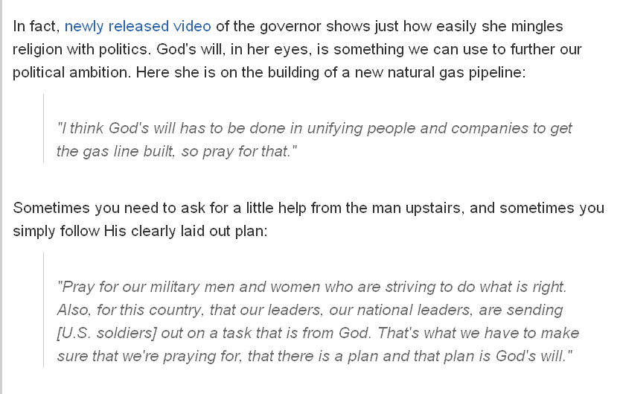
on building a new natural gas pipeline in Alaska . . .
Ideationism vs. Cultural Materialism
http://news.aol.com/political-machine/2008/09/02/sarah-palin-iraq-war-gods-plan/
Notes:
35

Slide 36

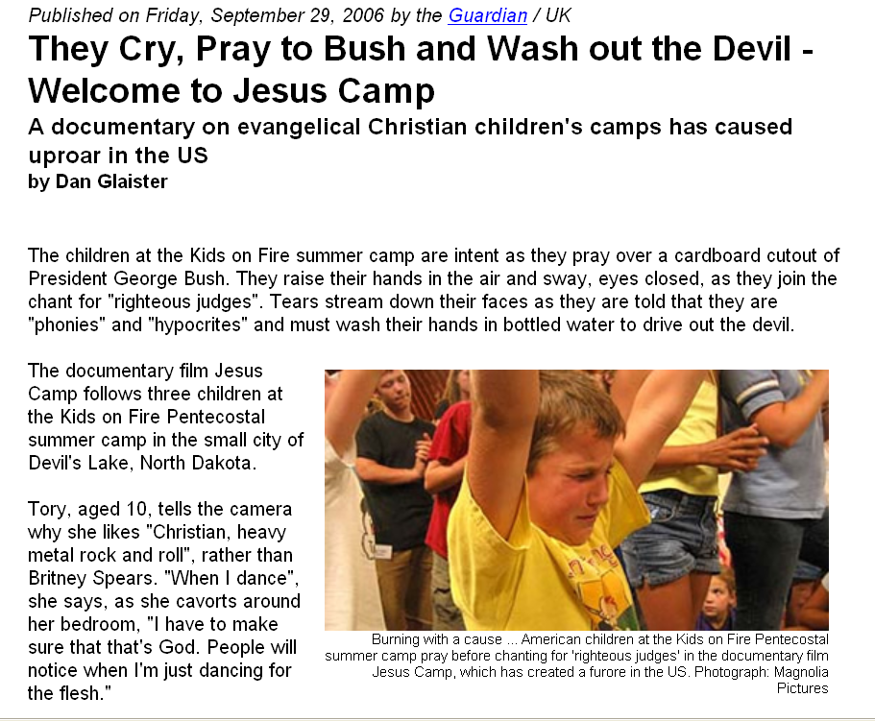
“At one point Pastor Fischer equates the preparation she is giving children with the training of terrorists in the Middle East. ‘I want to see young people who are as committed to the cause of Jesus Christ as the young people are to the cause of Islam," she tells the camera. "I want to see them radically laying down their lives for the gospel, as they are over in Pakistan and Israel and Palestine.’"
http://news.aol.com/political-machine/2008/09/02/sarah-palin-iraq-war-gods-plan/
Notes:
36

Slide 37
Ideationism vs. Cultural Materialism
http://news.aol.com/political-machine/2008/09/02/sarah-palin-iraq-war-gods-plan/
Notes:
37

Slide 38
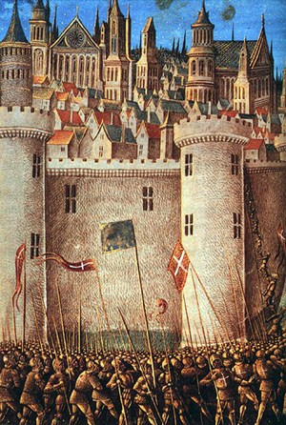
Ideationism vs. Cultural Materialism
The Siege of Antioch, from a medieval miniature painting, during the First Crusade.
http://en.wikipedia.org/wiki/Crusade
Notes:
38

Slide 39
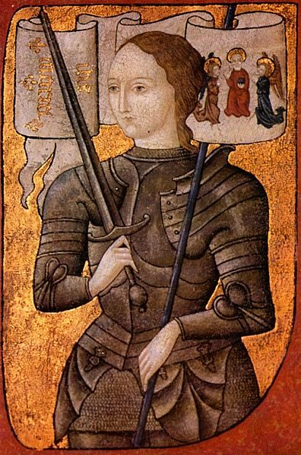
Ideationism vs. Cultural Materialism
Saint Joan of Arc Burned at the stake by an ecclesiastical court
For leading the French Armey by divine guidance
During the Hundred Years’ War (1337 to 1453)
http://en.wikipedia.org/wiki/Joan_of_arc
Notes:
39

Slide 40
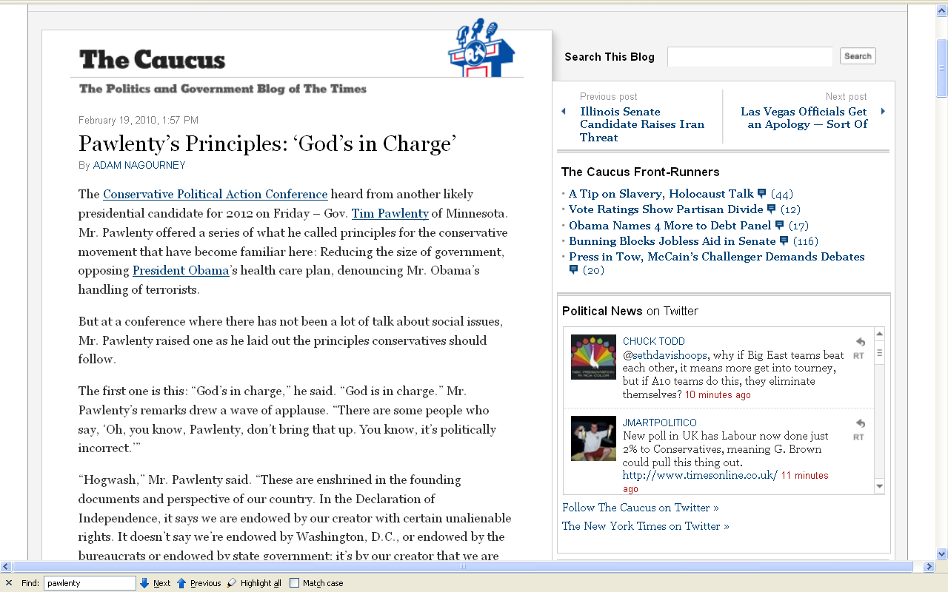
19 February 2010
http://thecaucus.blogs.nytimes.com/2010/02/19/pawlentys-principles-gods-in-charge/
Notes:
40

Slide 41
More to the point:
when considering the “whole of history”
and the cannons of
critical cultural relativism
actions such as Aztec
human sacrifice and cannibalism,
Yanomamó female infanticide,
and the like
may not make sense to everyone,
but they are more understandable
http://en.wikipedia.org/wiki/Crusade
Notes:
41

Slide 42
three major contemporary debates
Biological Determinism vs. Cultural Constructionism
Ideationism vs. Cultural Materialism
Individual Agency vs. Structuralism (“free will” vs. “power structures”)

Slide 43
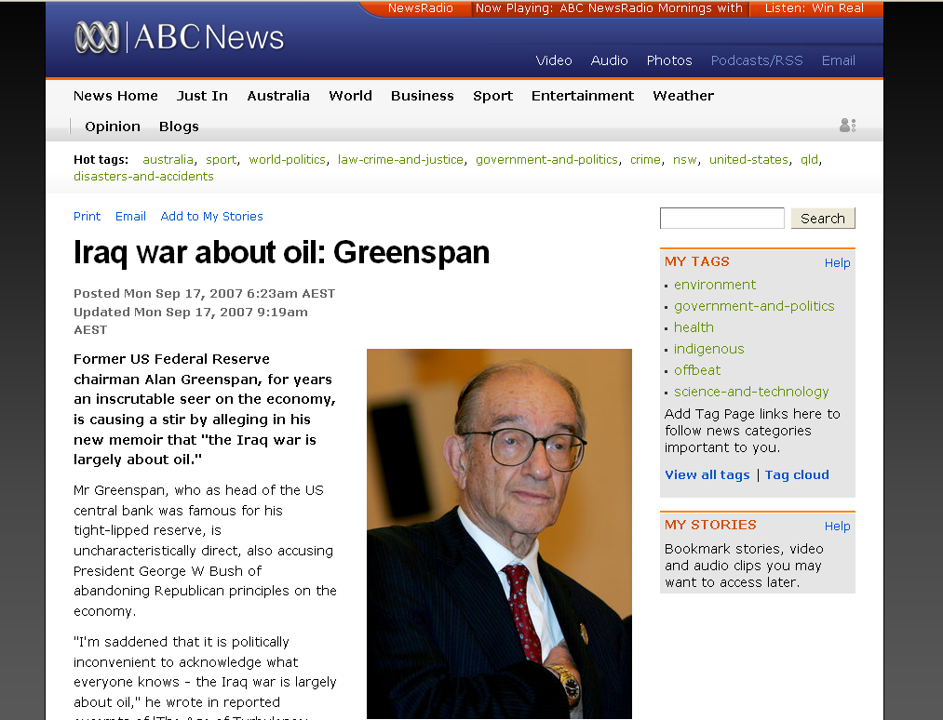
Ideationism vs. Cultural Materialism
www.abc.net.au/news/stories/2007/09/17/2034283.htm
Notes:
43

Slide 44
three major contemporary debates
Biological Determinism vs. Cultural Constructionism
Ideationism vs. Cultural Materialism
Individual Agency vs. Structuralism (“free will” vs. “power structures”)
this debate is related in part to
“THE ‘TWO-CULTURE’ PROBLEM”
— C.P. Snow

Slide 45
Marion Nestle
Food Politics, Revsed Ed.
Ch. 10 “Science versus Supplements: ‘A Gulf of Mutual Incomprehension’”
“THE ‘TWO-CULTURE’ PROBLEM”
“belief-based” attitudes
vs.
“science-based” attitudes

Slide 46
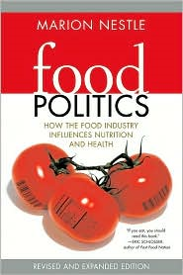
Marion Nestle
Food Politics, Revsed Ed.
Ch. 10 “Science versus Supplements: ‘A Gulf of Mutual Incomprehension’”
“THE ‘TWO-CULTURE’ PROBLEM”
“belief-based” attitudes
vs.
“science-based” attitudes
University of California Press
2007

Slide 47
Marion Nestle
Food Politics, Revised Ed.
Ch. 10 “Science versus Supplements: ‘A Gulf of Mutual Incomprehension’”
“THE ‘TWO-CULTURE’ PROBLEM”
“belief-based” attitudes
vs.
“science-based” attitudes
Marion Nestle, Food Politics, Rev. Ed., 2007, pp. 230-233

Slide 48
C.P. Snow
“Two Cultures and the Scientific Revolution: The Rede Lecture.”
London, Cambridge University Press
1959

Slide 49
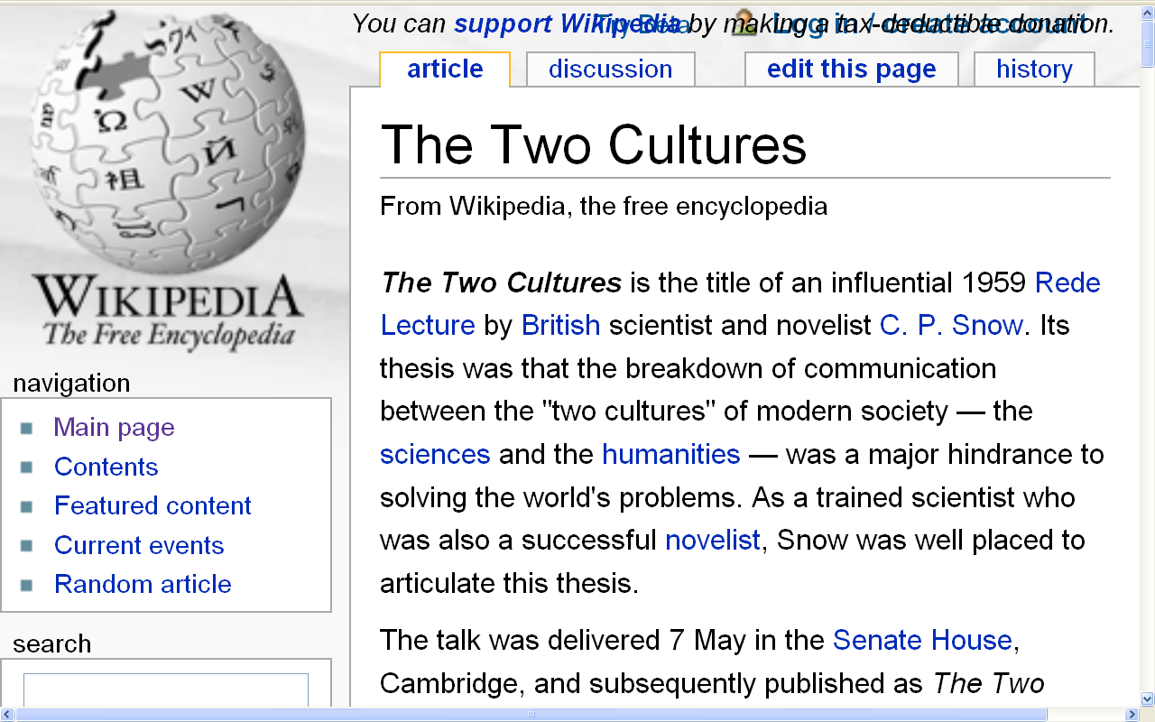
http://en.wikipedia.org/wiki/The_Two_Cultures
Notes:
49

Slide 50
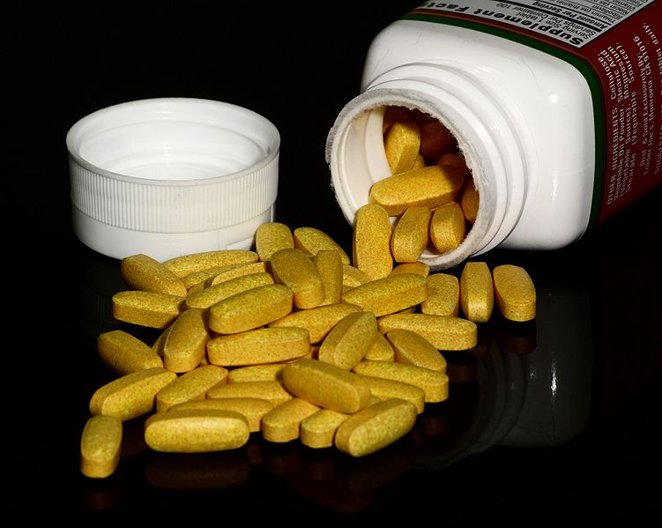
Are dietary supplements needed ?
http://en.wikipedia.org/wiki/Multivitamin

Slide 51
Are dietary supplements needed ?

Slide 52
Are dietary supplements needed ?
“belief-based” attitudes
vs.
“science-based” attitudes
Safety
Need
Efficacy
after Marion Nestle, Food Politics, Rev. Ed., 2007, pp. 232

Slide 53
Are dietary supplements needed ?
“science-based” attitudes
Safety
Excessive doses of many nutrients are demonstrably toxic
High levels of single nutrients interfere with the functions of other nutrients
The safety of many herbal products is untested and, therefore, unknown
Herbal supplements vary in composition, potency, and quality
after Marion Nestle, Food Politics, Rev. Ed., 2007, pp. 232

Slide 54
Are dietary supplements needed ?
“belief-based” attitudes
Safety
Supplements are safe within a broad range of intake; safety problems are rare
Herbal products have been used for thousands of years
Supplements cause less harm than many prescription drugs
after Marion Nestle, Food Politics, Rev. Ed., 2007, pp. 232

Slide 55
Are dietary supplements needed ?
“science-based” attitudes
Need
Food is sufficient to meet nutritional needs
Foods provide nutrients and other valuable substances not present in supplements
People who take supplements are better educated and wealthier
they are healthier whether or not they take supplements
after Marion Nestle, Food Politics, Rev. Ed., 2007, pp. 232

Slide 56
Are dietary supplements needed ?
“belief-based” attitudes
Need
Diets do not always follow dietary recommendations
Foods grown on depleted soils lack essential nutrients
Pollution and stressful living conditions increase nutrient requirements
Cooking destroys essential nutrients
after Marion Nestle, Food Politics, Rev. Ed., 2007, pp. 232

Slide 57
Are dietary supplements needed ?
“science-based” attitudes
Efficacy
Research demonstrates health benefits of diets and foods, not of single nutrients
Higher-than-recommended doses of few single nutrients improve health
Health claims for many supplements often address issues (such as “stress”) that are difficult to evaluate scientifically
The health benefits of most supplements are unproven
Many “benefits” of supplements can be explained as placebo or other self-healing effects
after Marion Nestle, Food Politics, Rev. Ed., 2007, pp. 232

Slide 58
Are dietary supplements needed ?
“belief-based” attitudes
Efficacy
People who take supplements are healthier
People feel better when they take supplements
Studies demonstrate the health benefits of supplements
Benefits are sometimes greater at amounts higher than can be obtained from food
after Marion Nestle, Food Politics, Rev. Ed., 2007, pp. 232

Slide 59
DIETARY SUPPLEMENTS
“science-
based”
“faith-
based”
Safe No/ Yes
Unknown
Need No Yes
Efficacy No/ Yes
Unknown
Take No Yes
after Marion Nestle, Food Politics, Rev. Ed., 2007, pp. 232

Slide 60
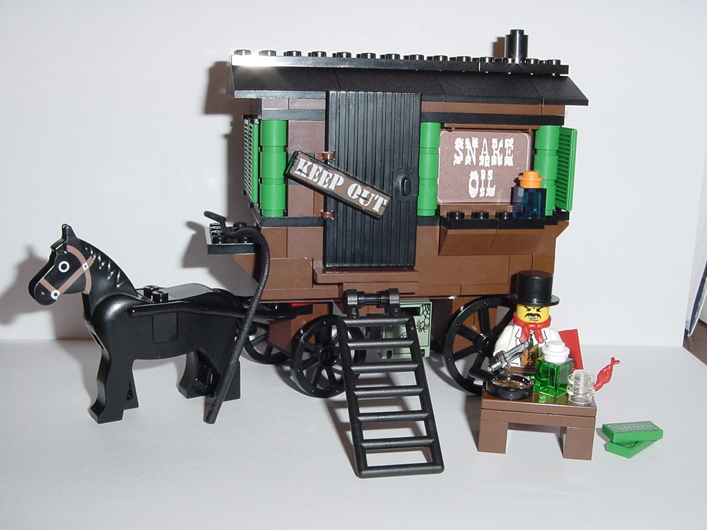
http://www.mocpages.com/moc.php/30406
Notes:
⁶⁰

Slide 61
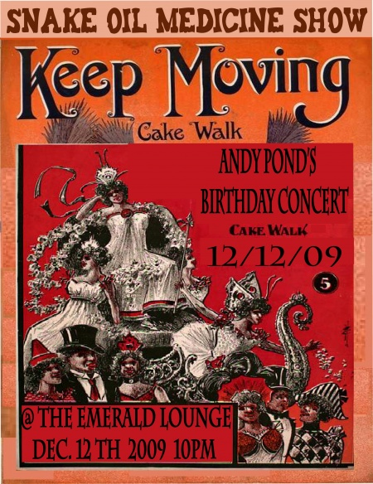
http://georgespond.wordpress.com/
Notes:
⁶¹

Slide 62
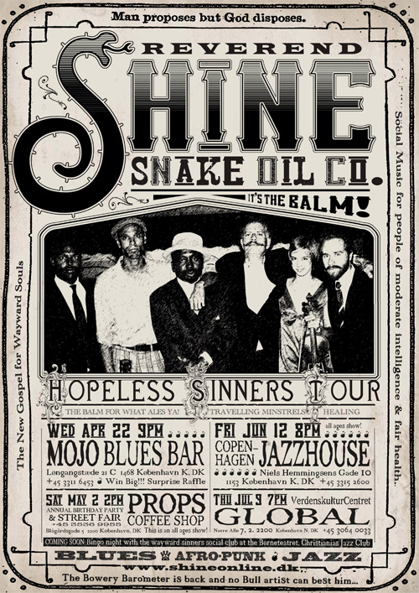
http://www.reverbnation.com/data_public/artist/userfiles/97034/shine04.09.jpg
Notes:
⁶²

Slide 63
DIETARY SUPPLEMENTS
Question:
What percentage of Americans
regularly take
dietary supplements ?
after Marion Nestle, Food Politics, Rev. Ed., 2007, pp. 232

Slide 64
DIETARY SUPPLEMENTS
Question:
Why do the science-based “people” take them ?
after Marion Nestle, Food Politics, Rev. Ed., 2007, pp. 232

Slide 65
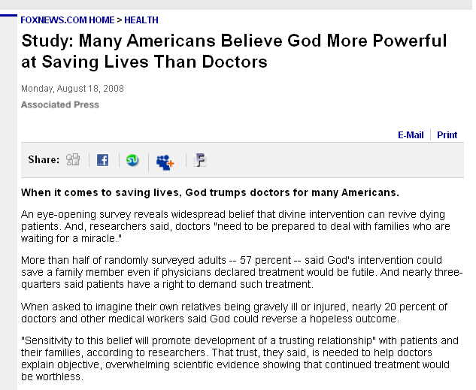
www.foxnews.com/story/0,2933,405765,00.html
Notes:
⁶⁵

Slide 66
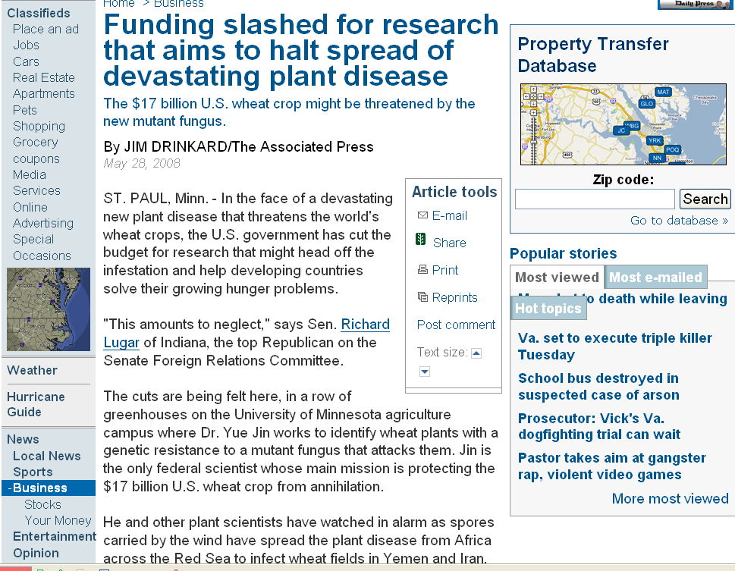
www.dailypress.com/business/dp-biz_endangered_wheat_0528may28,0,3094328.story
Notes:
66

Slide 67
C.P. Snow
“Two Cultures and the Scientific Revolution: The Rede Lecture”
London, Cambridge University Press
1959

Slide 68
Marion Nestle
Food Politics, Revised Ed.
Ch. 10 “Science versus Supplements: ‘A Gulf of Mutual Incomprehension’”
“THE ‘TWO-CULTURE’ PROBLEM”
“belief-based” attitudes
vs.
“science-based” attitudes

Slide 69
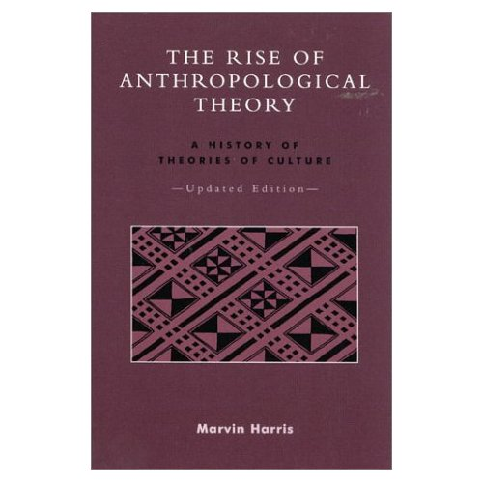
Cultural Materialism
Marvin Harris.
The Rise of Anthropological Theory:
A History of Theories of Culture,
Updated Edition.
Lanham, MD: Altamira Press, 2000.
Notes:
69

Slide 70
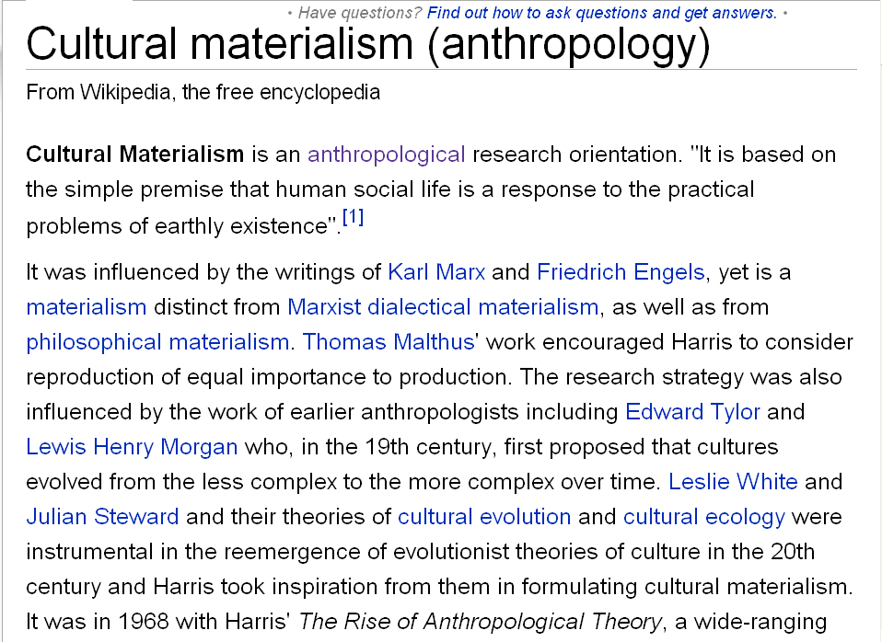
http://en.wikipedia.org/wiki/Cultural_materialism_%28anthropology%29
Notes:
70

Slide 71
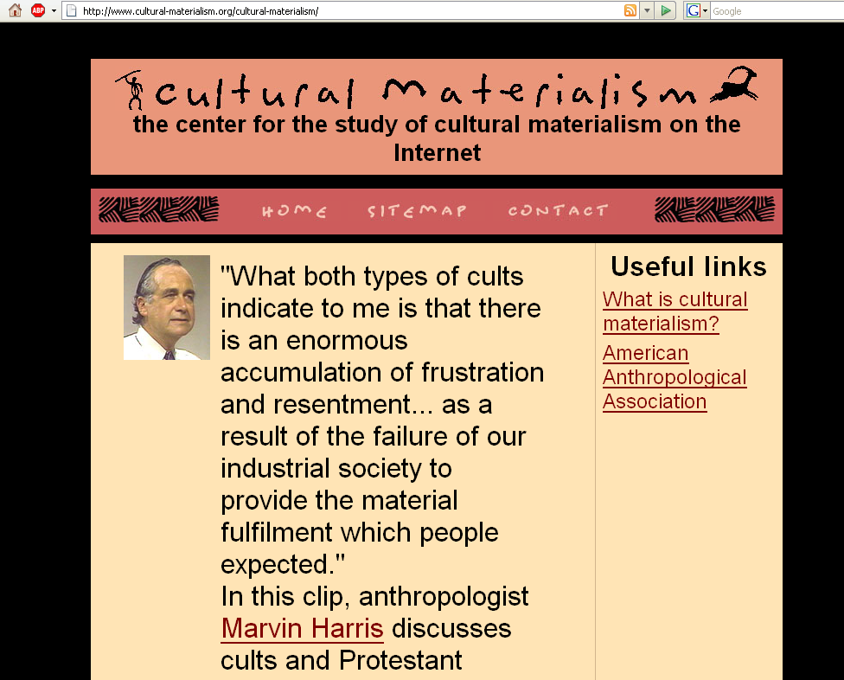
www.cultural-materialism.org/cultural-materialism/
Notes:
71

Slide 73
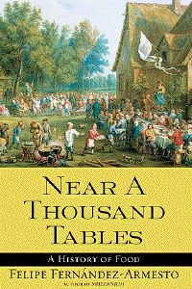
Simon & Schuster 2003

Slide 74
Eight Food “Revolutions”
Invention of Cooking
Discovery that Food is More Than Sustenance
The “Herding Revolution”
Snail Farming
Use of Food as a Means and Index of Social Differentiation
Long-Range Exchange of Culture
Ecological Revolution of last 500 years
Industrial Revolution of the 19th and 20th Centuries
Simon & Schuster 2003

Slide 75
Eight Food “Revolutions”
Invention of Cooking
Discovery that Food is More Than Sustenance
The “Herding Revolution”
Snail Farming
Use of Food as a Means and Index of Social Differentiation
Long-Range Exchange of Culture
Ecological Revolution of last 500 years
Industrial Revolution of the 19th and 20th Centuries
Ideationism vs. Cultural Materialism
Simon & Schuster 2003

Slide 76
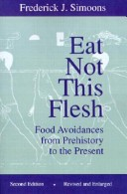
The University of Wisconsin Press 1961

Slide 77
three major contemporary debates
Biological Determinism vs. Cultural Constructionism
Ideationism vs. Cultural Materialism
Individual Agency vs. Structuralism (“free will” vs. “power structures”)

Slide 78
three major contemporary debates
Biological Determinism vs. Cultural Constructionism
Ideationism vs. Cultural Materialism
Individual Agency vs. Structuralism (“free will” vs. “power structures”)

Slide 79
three major contemporary debates
Biological Determinism vs. Cultural Constructionism
Ideationism vs. Cultural Materialism
Individual Agency vs. Structuralism (“free will” vs. “power structures”)

Slide 80
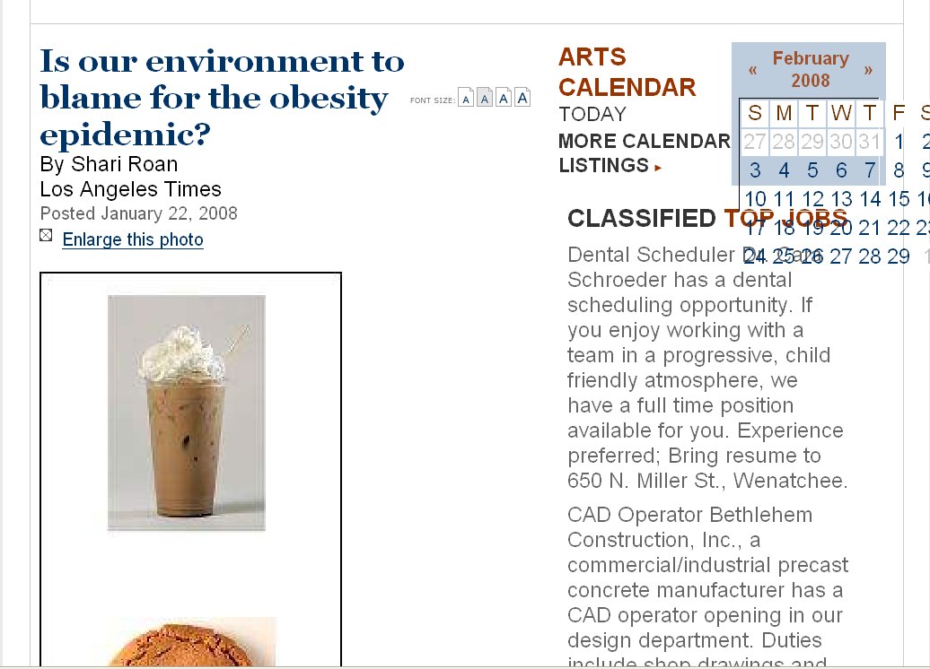
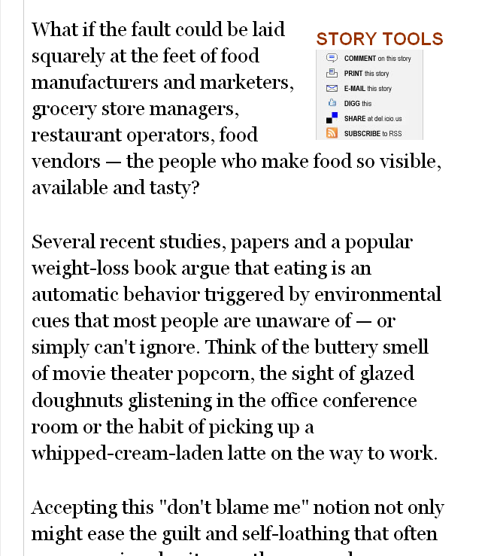
(“free will” vs. “power structures”)
www.wenatcheeworld.com/apps/pbcs.dll/article?AID=/20080122/FOOD/373497927/1030/rss1030
Notes:
80

Slide 81
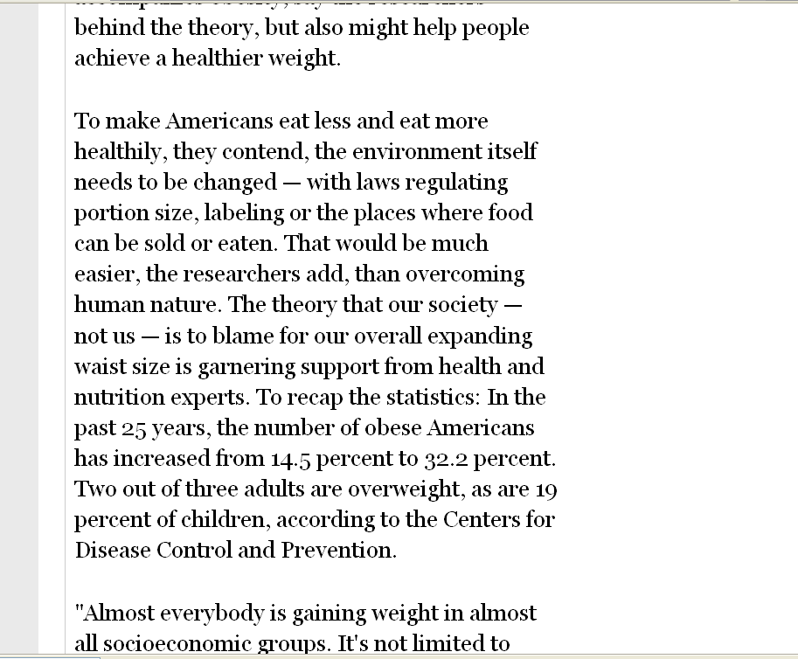
(“free will” vs. “power structures”)
www.wenatcheeworld.com/apps/pbcs.dll/article?AID=/20080122/FOOD/373497927/1030/rss1030
Notes:
81

Slide 82
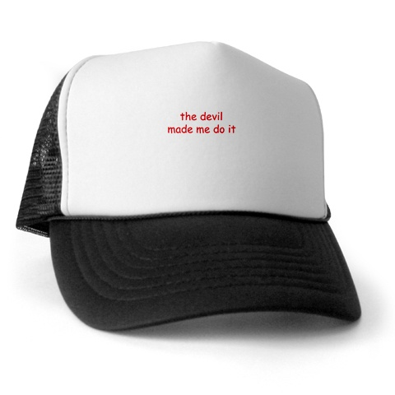
(“free will” vs. “power structures”)
www.cafepress.com/metalstar.71120928
Notes:
82

Slide 83
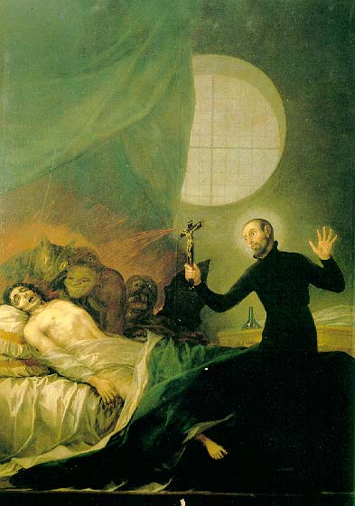
Saint Francis Borgia performing an exorcism.
Francisco Goya
http://en.wikipedia.org/wiki/Exorcism
Notes:
83

Slide 84
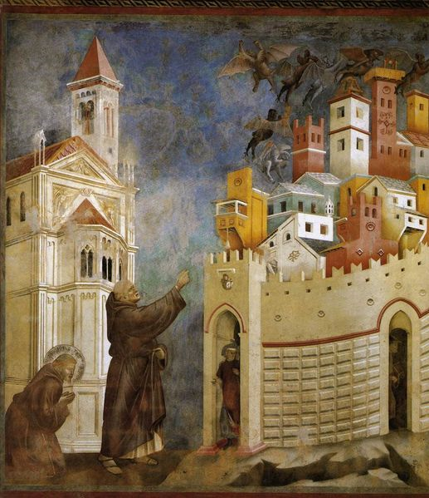
Saint Francis exorcised demons in Arezzo Giotto
http://en.wikipedia.org/wiki/Exorcism
Notes:
84

Slide 85
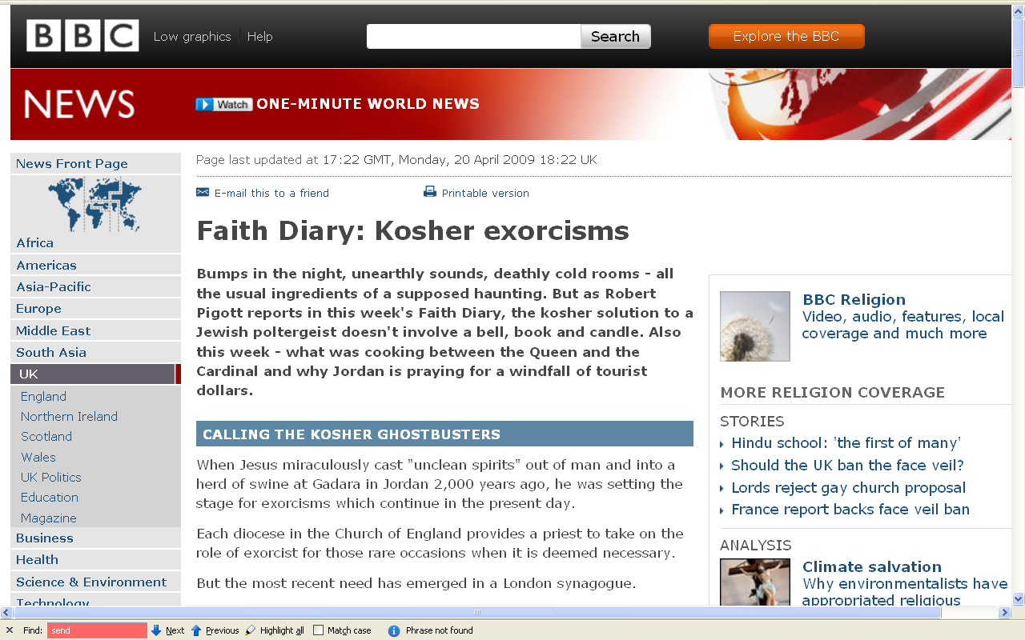
http://news.bbc.co.uk/2/hi/uk_news/7999000.stm

Slide 86
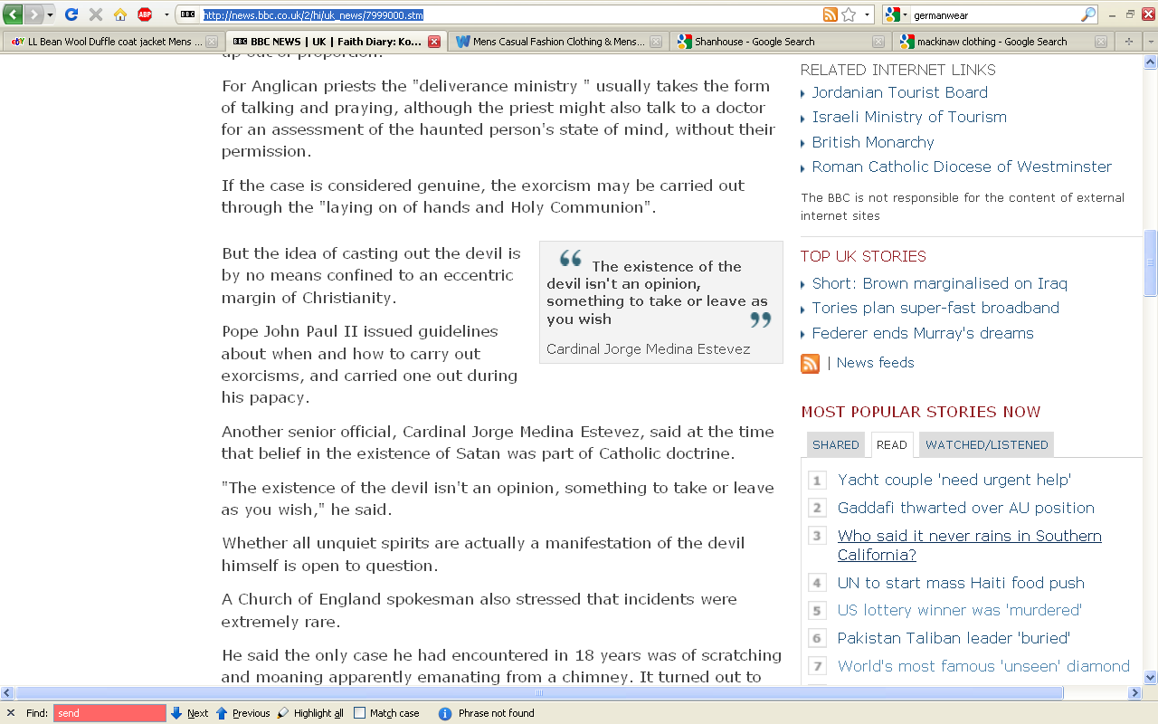
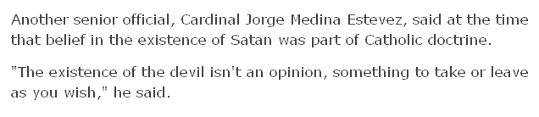
http://news.bbc.co.uk/2/hi/uk_news/7999000.stm

Slide 87
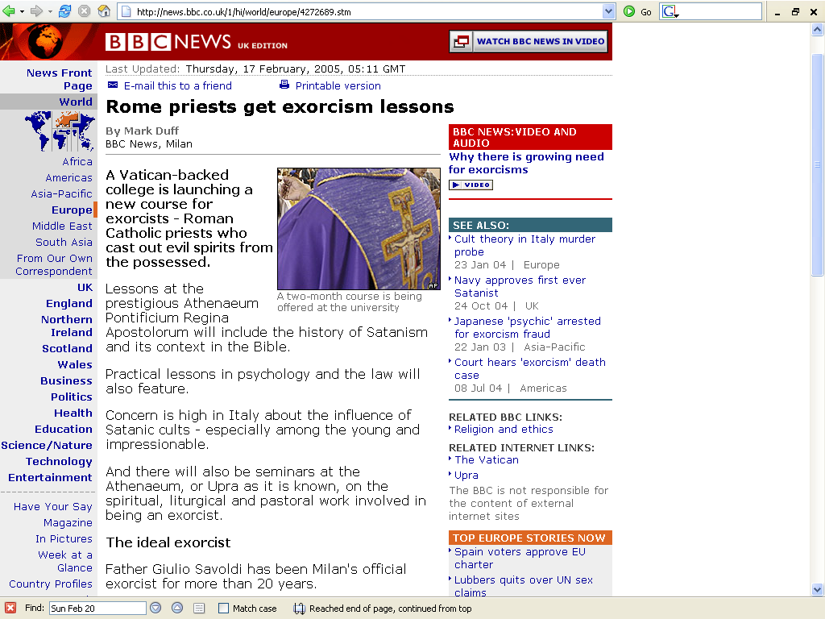
http://news.bbc.co.uk/1/hi/world/europe/4272689.stm

Slide 88
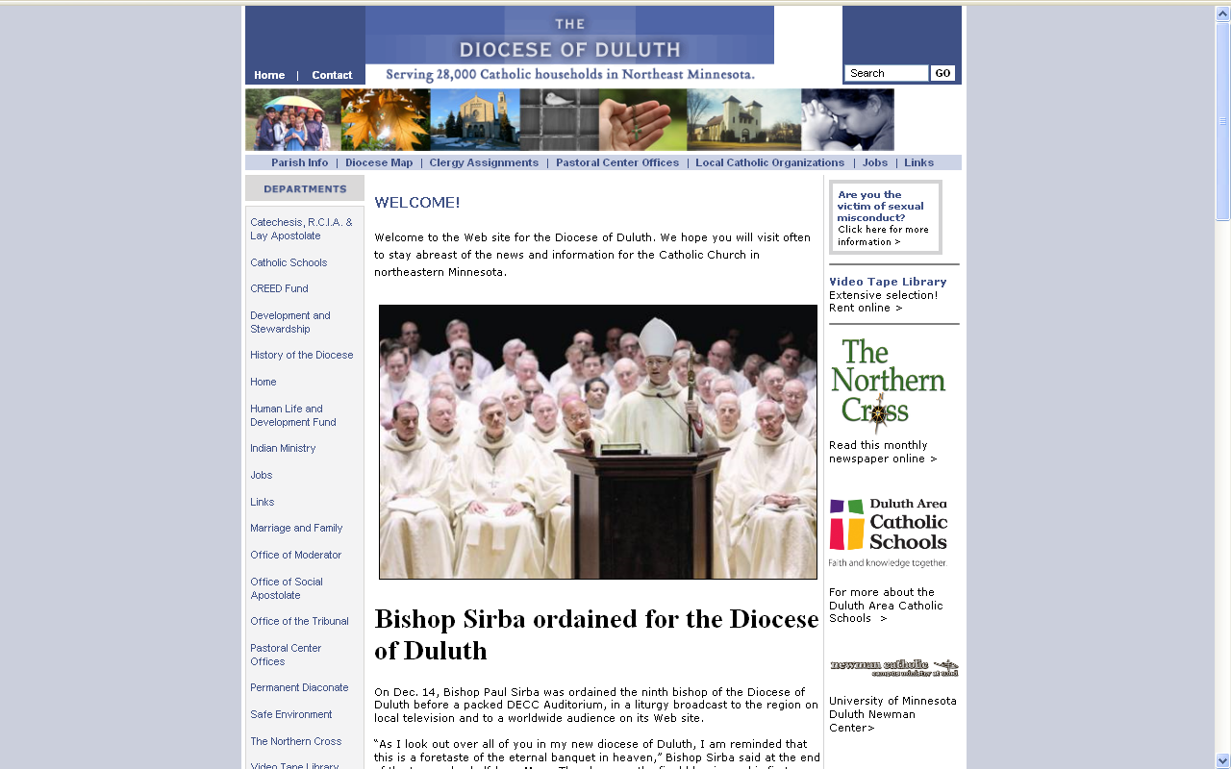
http://www.dioceseduluth.org/index.php

