Slide 1

Religion
with a
Regional Focus
Tim Roufs
© 2010

Slide 2

Religion
Wisconsin
Minnesota
Misc.
University of Minnesota Duluth
Tim Roufs’ Section

Slide 3
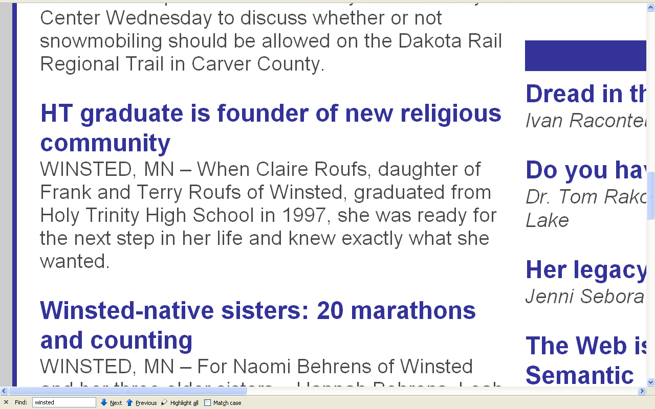
June 28, 2010
http://www.herald-journal.com/archives/2010/stories/winsted-mothermaryclare.html

Slide 4
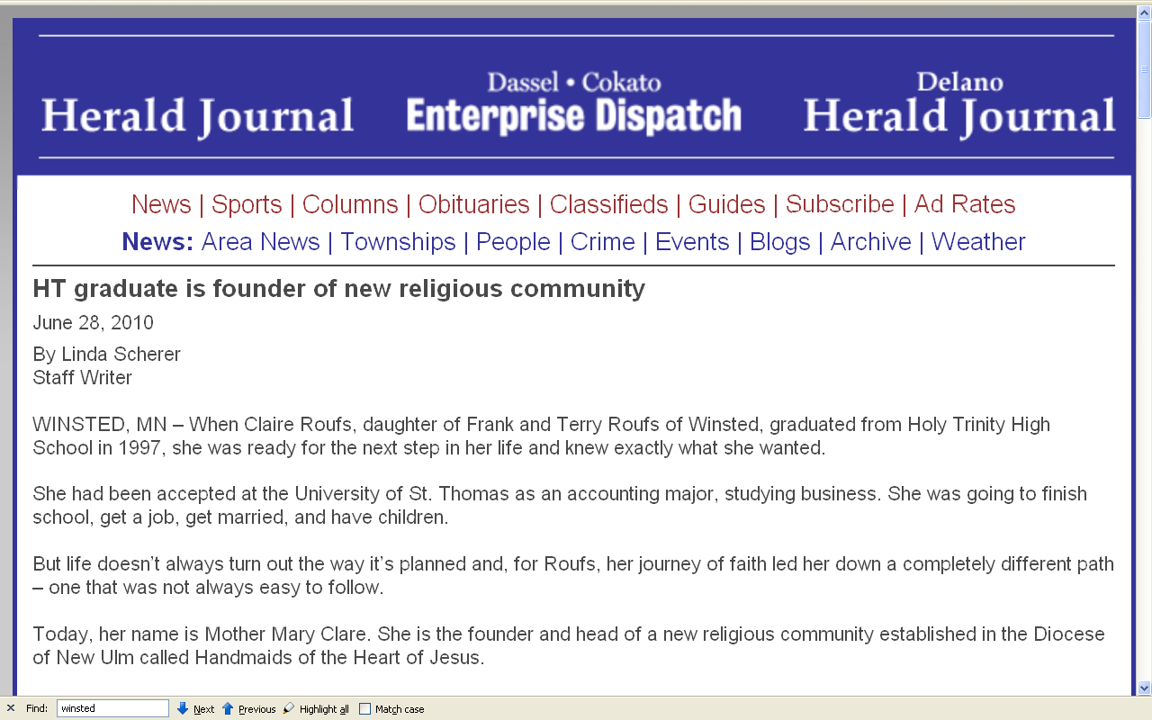
http://www.herald-journal.com/archives/2010/stories/winsted-mothermaryclare.html

Slide 5
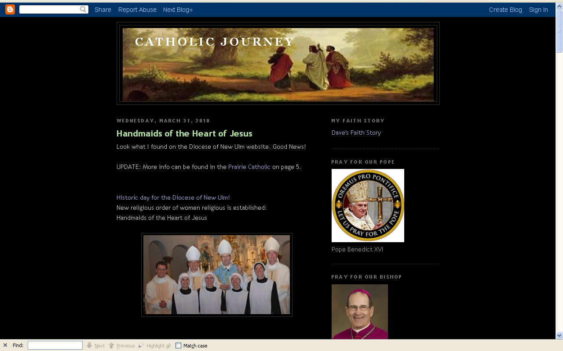
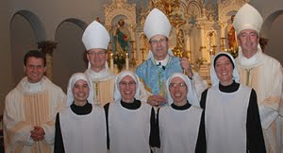
Mother Mary Clare
of the Heart of the Father
http://happy-catholic.blogspot.com/2010/03/andmaids-of-heart-of-jesus.html

Slide 6
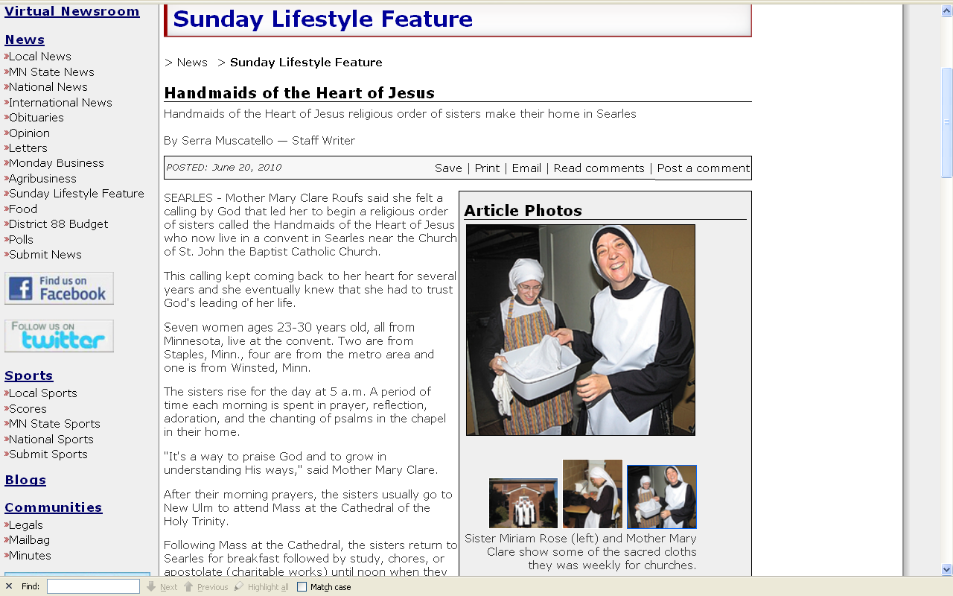
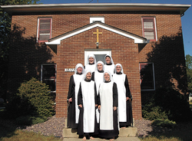
http://www.nujournal.com/page/content.detail/id/514037.html?nav=5005

Slide 7
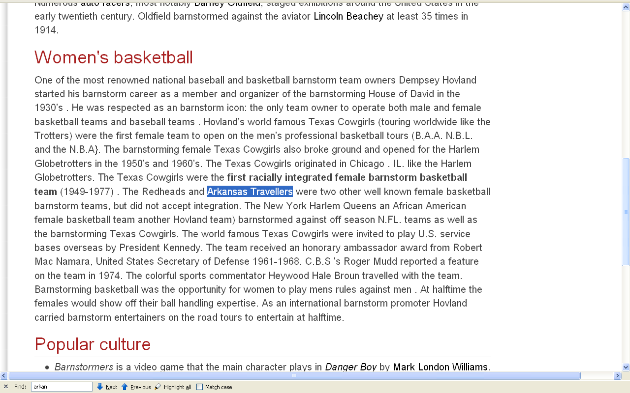
Mother Mary Clare’s
older sister was a professional female basketball player
http://www.ireference.ca/search/Barnstorm%20%28sports%29/

Slide 8
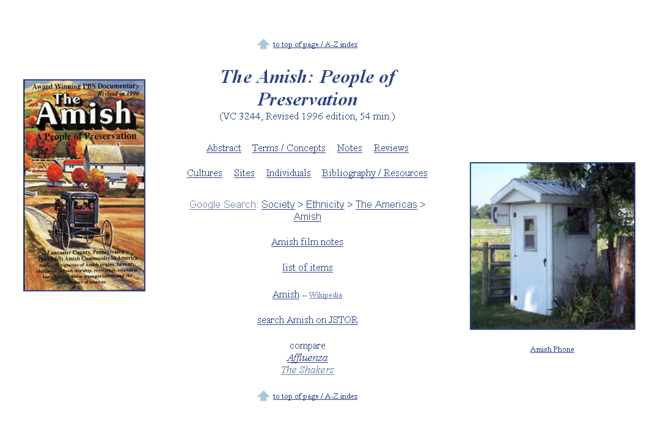
www.d.umn.edu/cla/faculty/troufs/anth4616/video/Amish.html#title

Slide 9
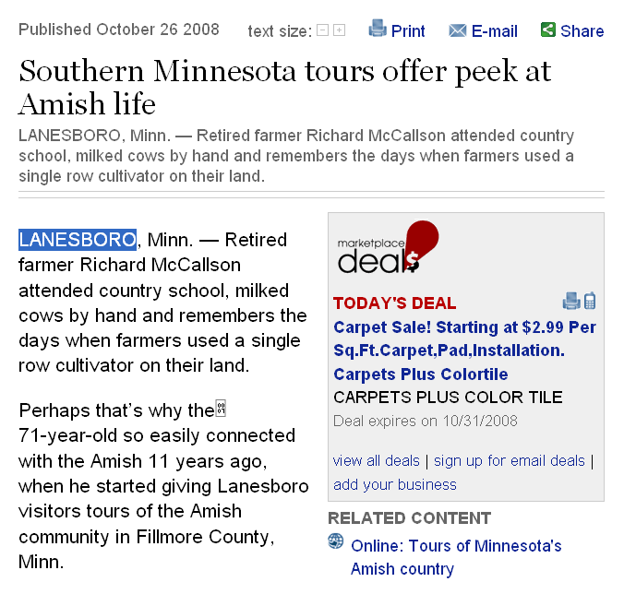
www.duluthnewstribune.com/event/article/id/76678/

Slide 10
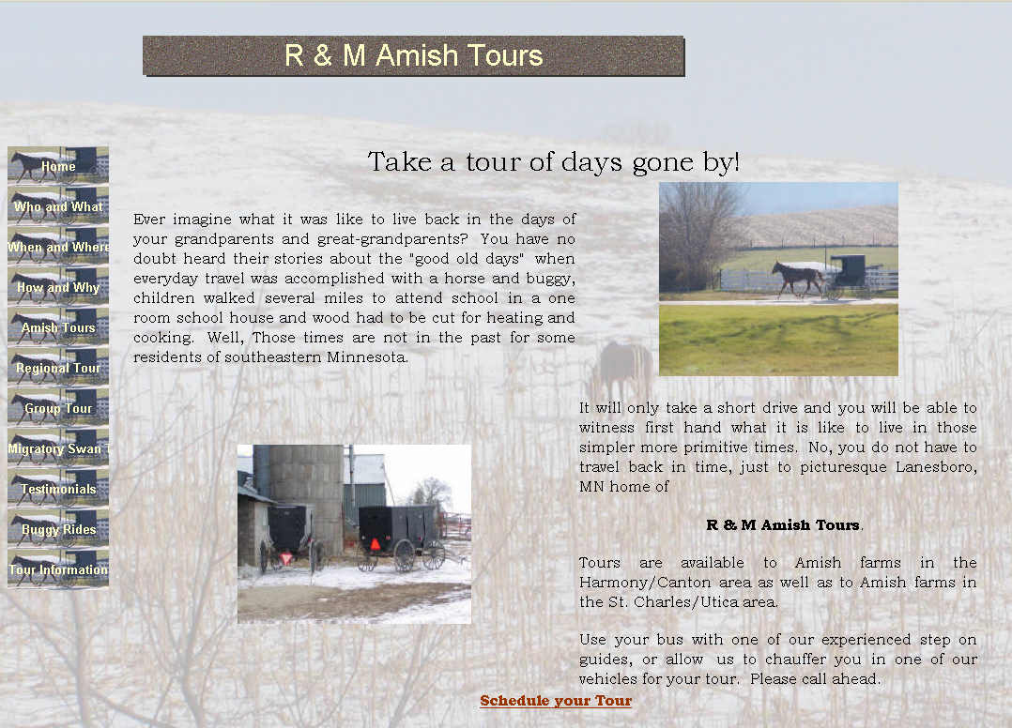
www.rmamish.com/

Slide 11
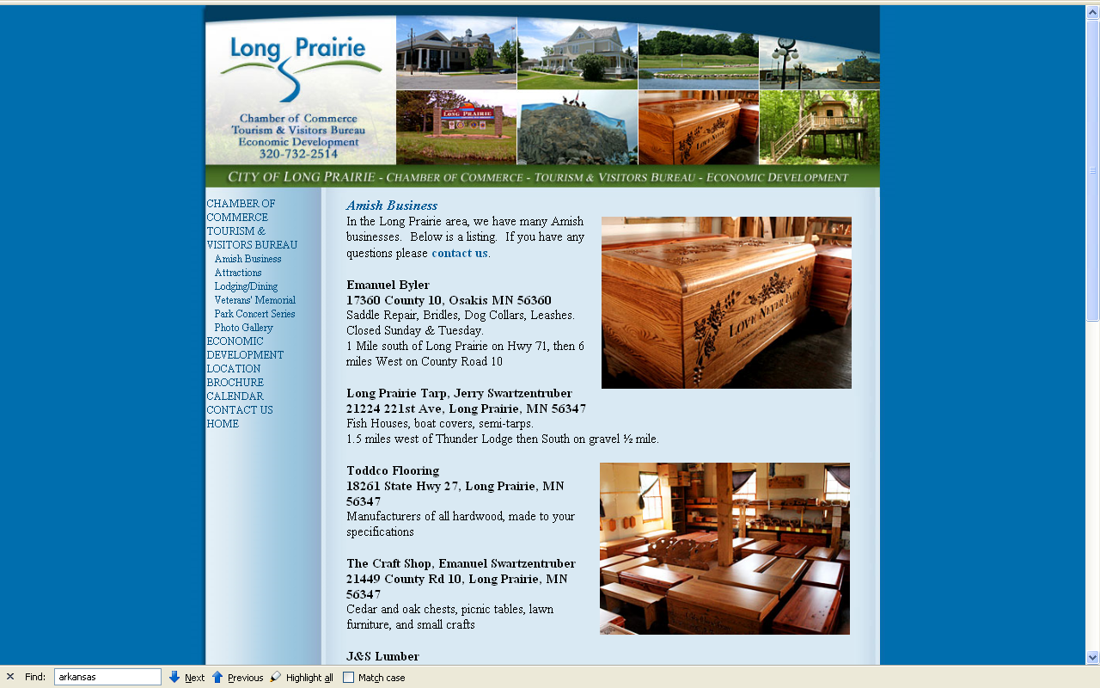
http://www.longprairie.org/tourism/amish_business.html

Slide 12
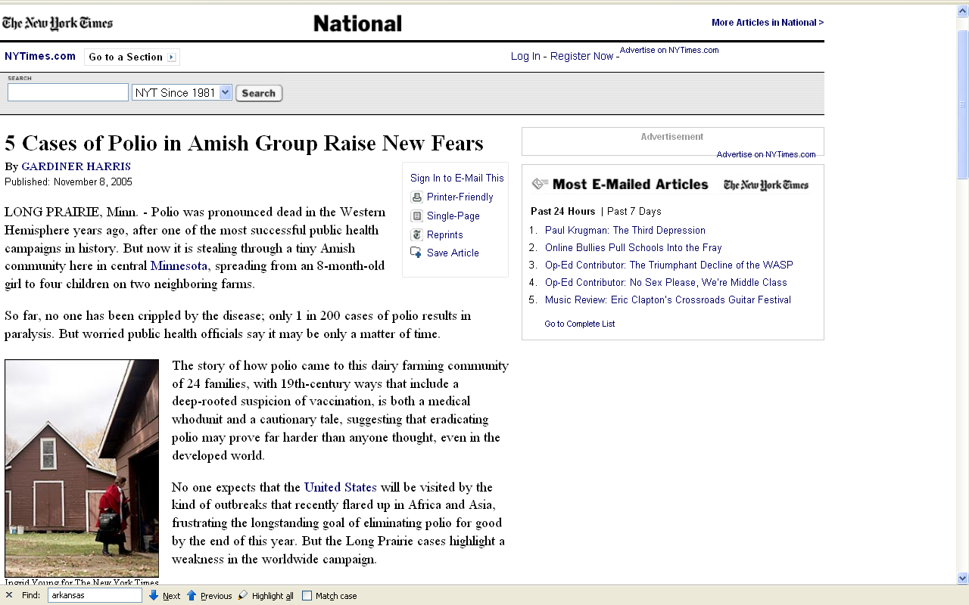
http://www.nytimes.com/2005/11/08/national/08polio.html

Slide 13
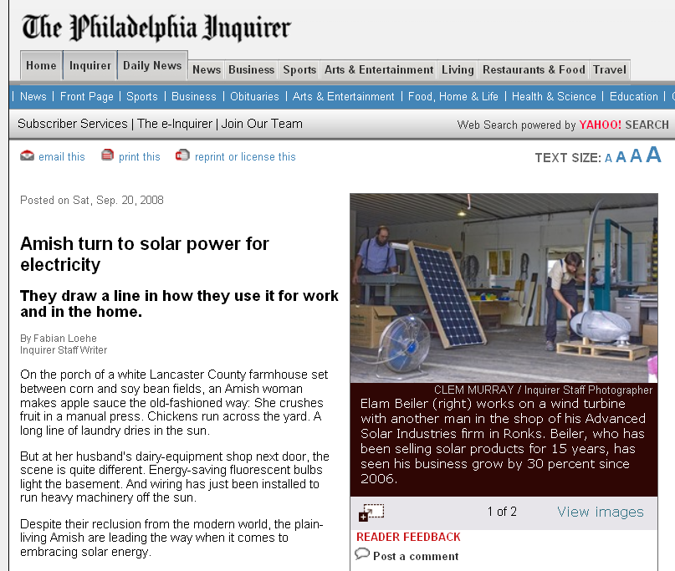
www.philly.com/inquirer/home_top_left_story/20080920_Amish_turn_to_solar_power_for_electricity.html

Slide 14
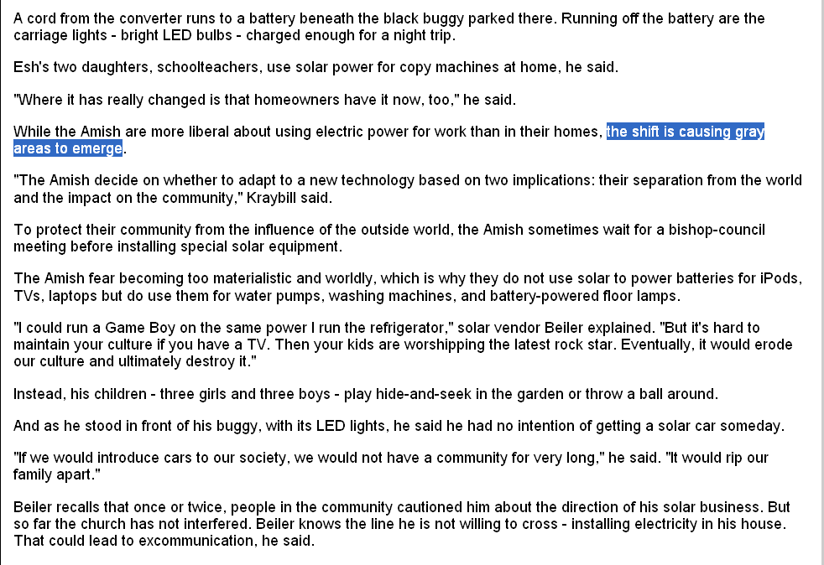
www.philly.com/inquirer/home_top_left_story/20080920_Amish_turn_to_solar_power_for_electricity.html

Slide 15
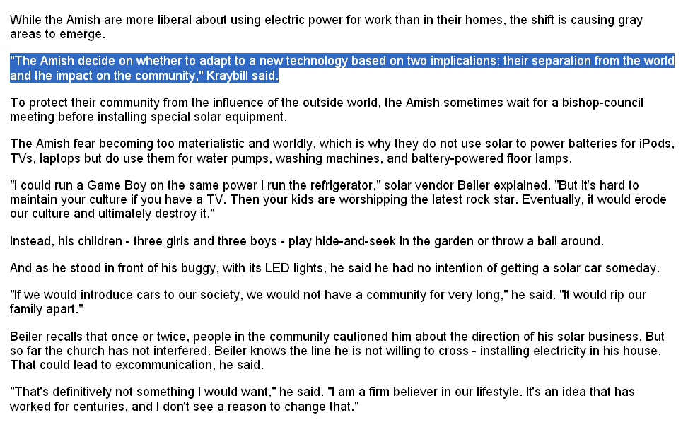
www.philly.com/inquirer/home_top_left_story/20080920_Amish_turn_to_solar_power_for_electricity.html

Slide 16
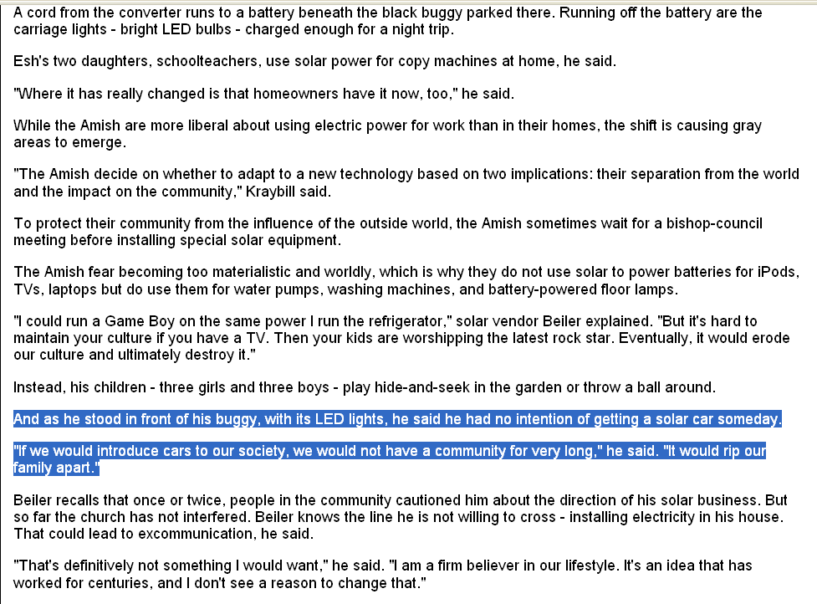
www.philly.com/inquirer/home_top_left_story/20080920_Amish_turn_to_solar_power_for_electricity.html

Slide 17
Wisconsin . . ..

Slide 18
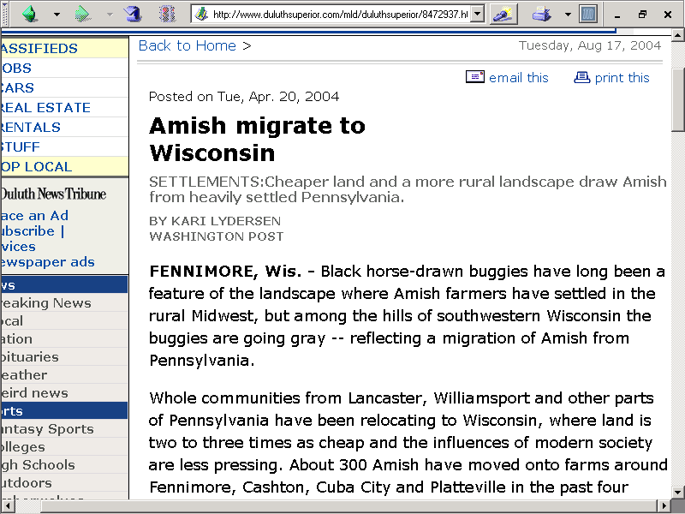
www.duluthsuperior.com/mld/duluthsuperior/8472937.htm

Slide 19
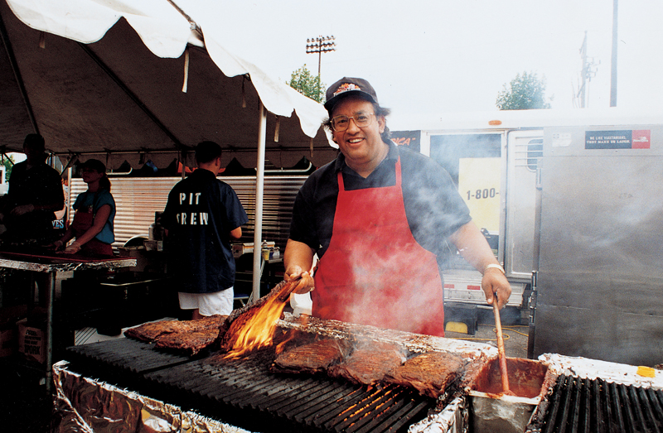

www.famousbbq.com/photogallery.html

Slide 20
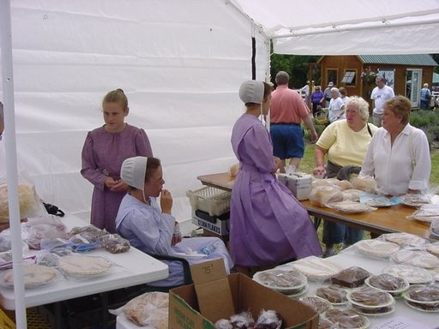
http://picasaweb.google.com/hollis.humphries/LavenderFestivalNearHillsboroAndDardHunterHouseInChillicothe/photo#5113181503919899922

Slide 21
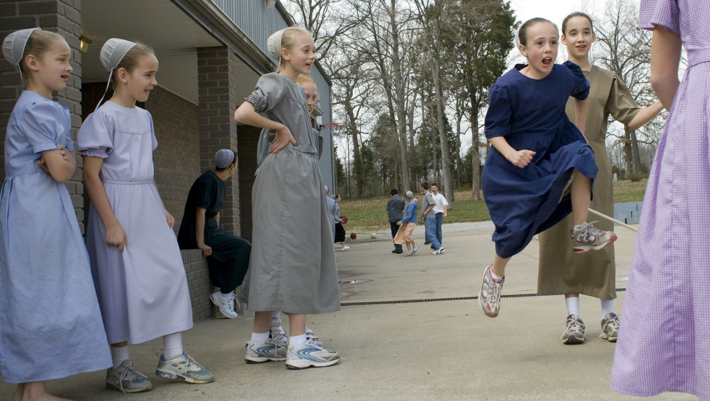
http://brianascroggins.blogspot.com/2008/03/opening-eyes.html

Slide 22
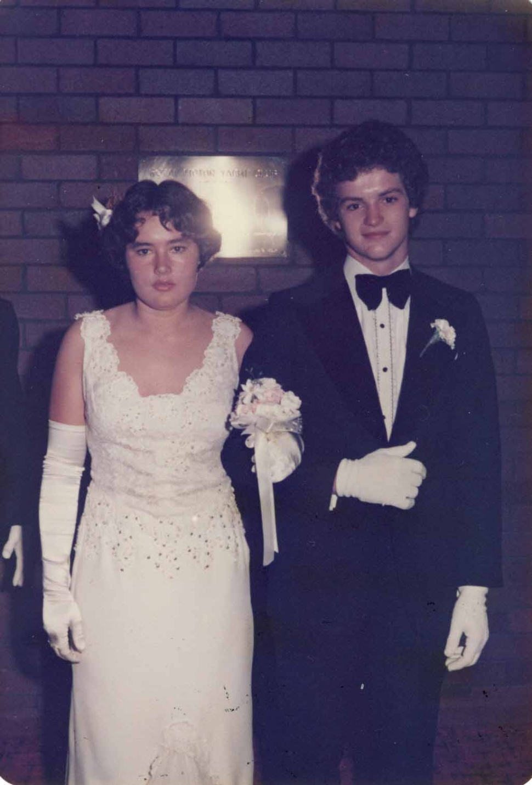
http://pittwaterhigh.wordpress.com/

Slide 23
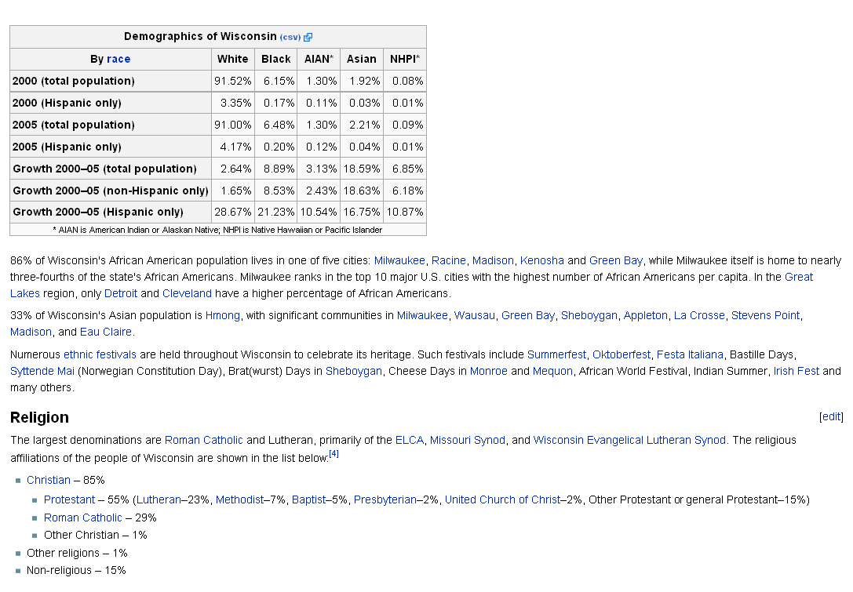
http://en.wikipedia.org/wiki/Wisconsin#Religion

Slide 24
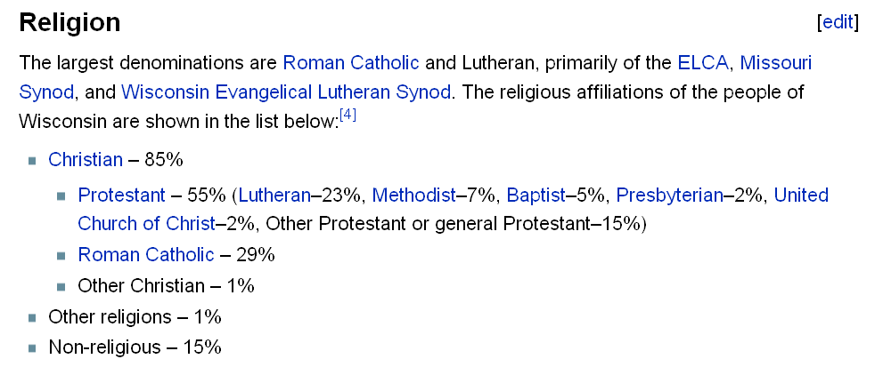
http://en.wikipedia.org/wiki/Wisconsin#Religion

Slide 25
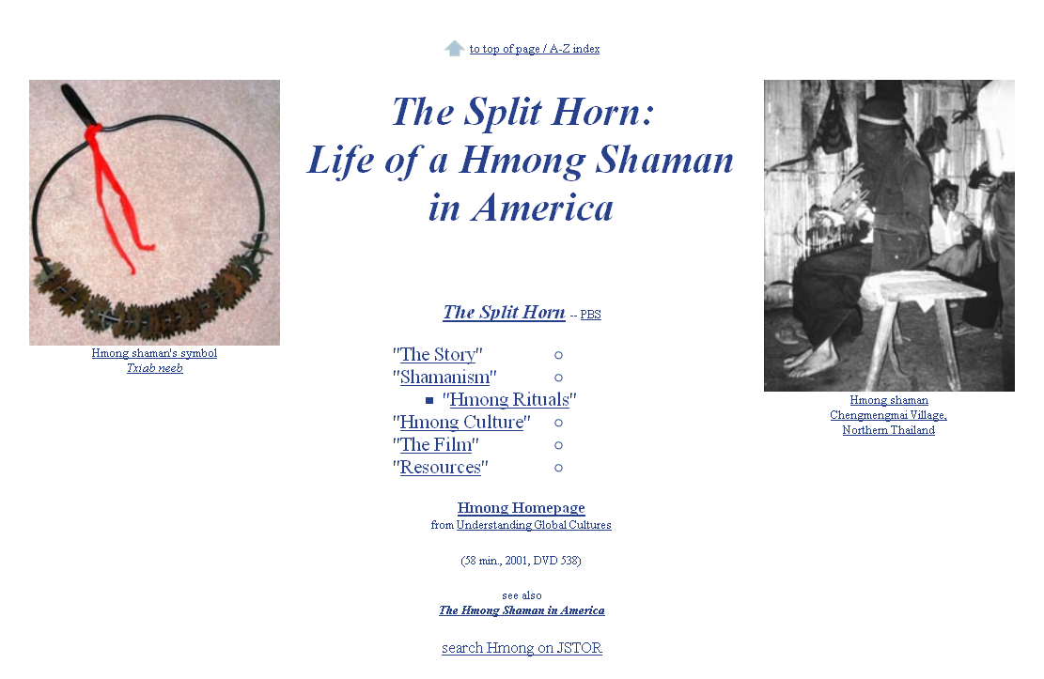
www.d.umn.edu/cla/faculty/troufs/anth4616/video/Split_Horn.html#title

Slide 26
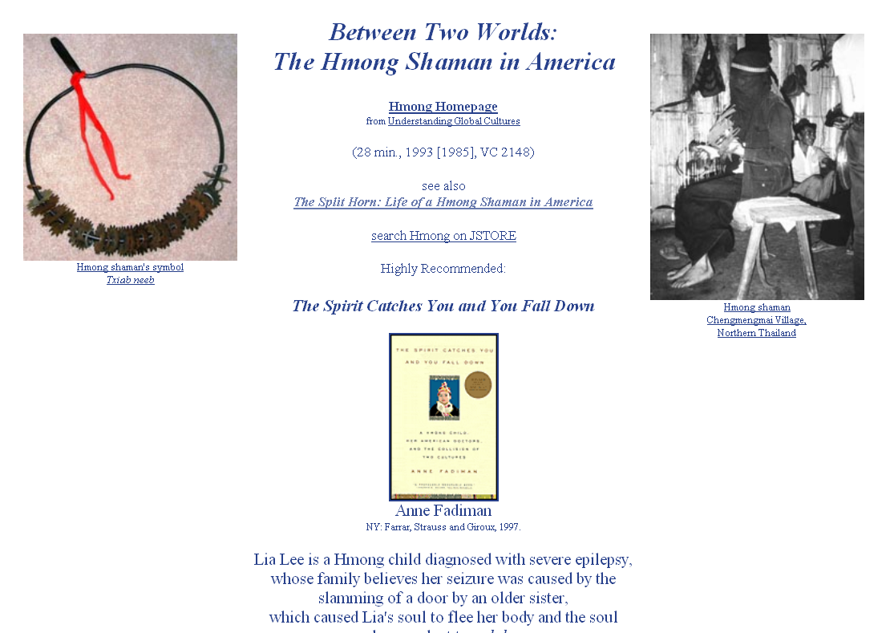
www.d.umn.edu/cla/faculty/troufs/anth4616/video/Hmong_Shaman.html#title

Slide 27
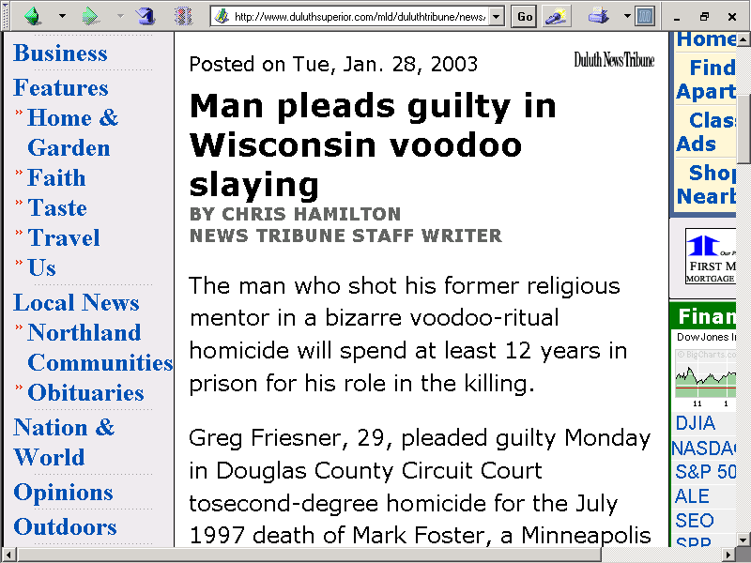

Slide 28
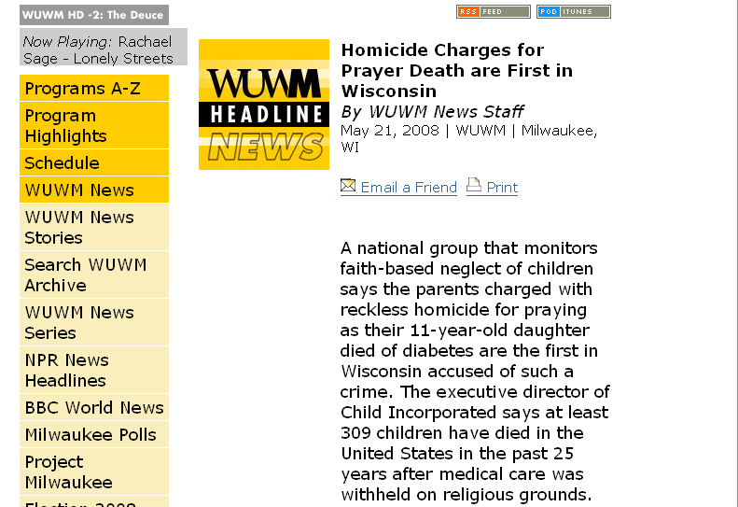
www.wuwm.com/programs/news/view_news.php?articleid=2242

Slide 29
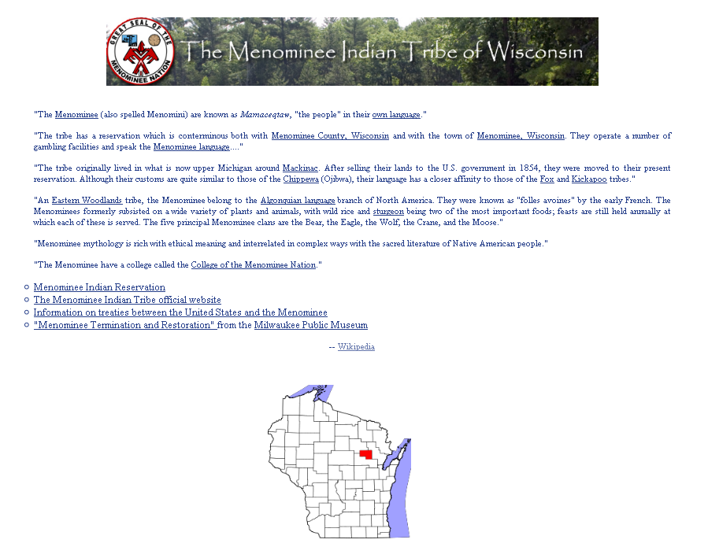
www.d.umn.edu/cla/faculty/troufs/anth4616/cpweek13.html#title

Slide 30
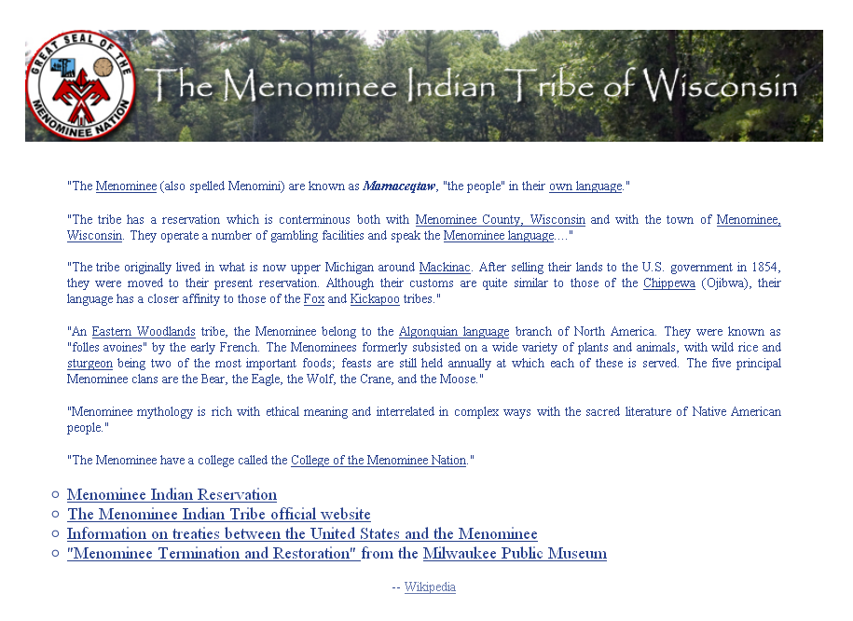
www.d.umn.edu/cla/faculty/troufs/anth4616/cpweek13.html#title

Slide 31
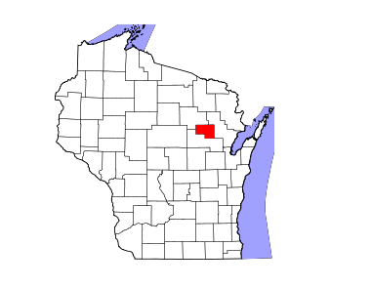
www.d.umn.edu/cla/faculty/troufs/anth4616/cpweek13.html#title

Slide 32
People live in
Multiple Cultural Worlds

Slide 33
Multiple Cultural Worlds
class
race
ethnicity
sex/gender
age
institutions

Slide 34
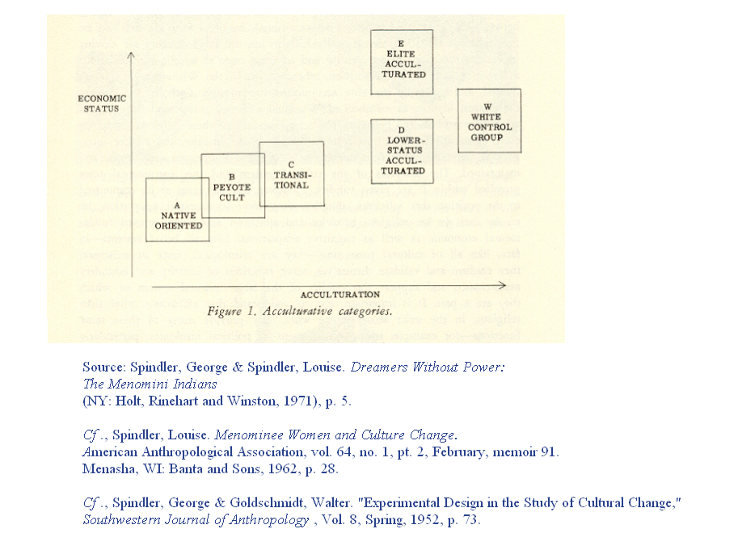
www.d.umn.edu/cla/faculty/troufs/anth4616/cpweek13.html#title

Slide 35
Minnesota . . .

Slide 36
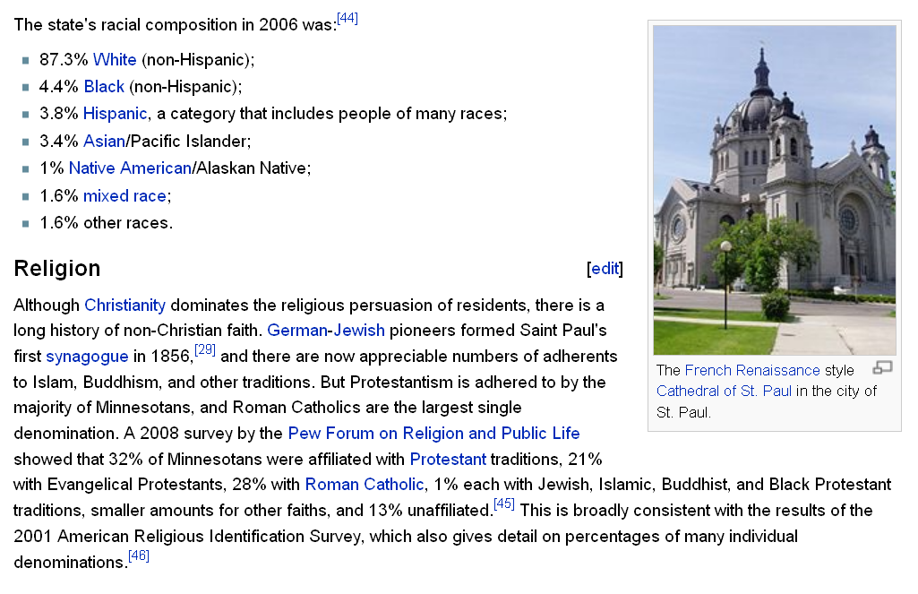
http://en.wikipedia.org/wiki/Minnesota#Religion

Slide 37
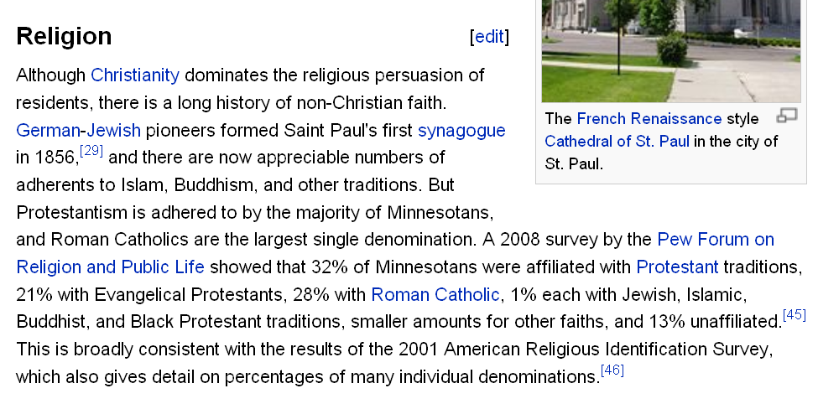
http://en.wikipedia.org/wiki/Minnesota#Religion

Slide 38
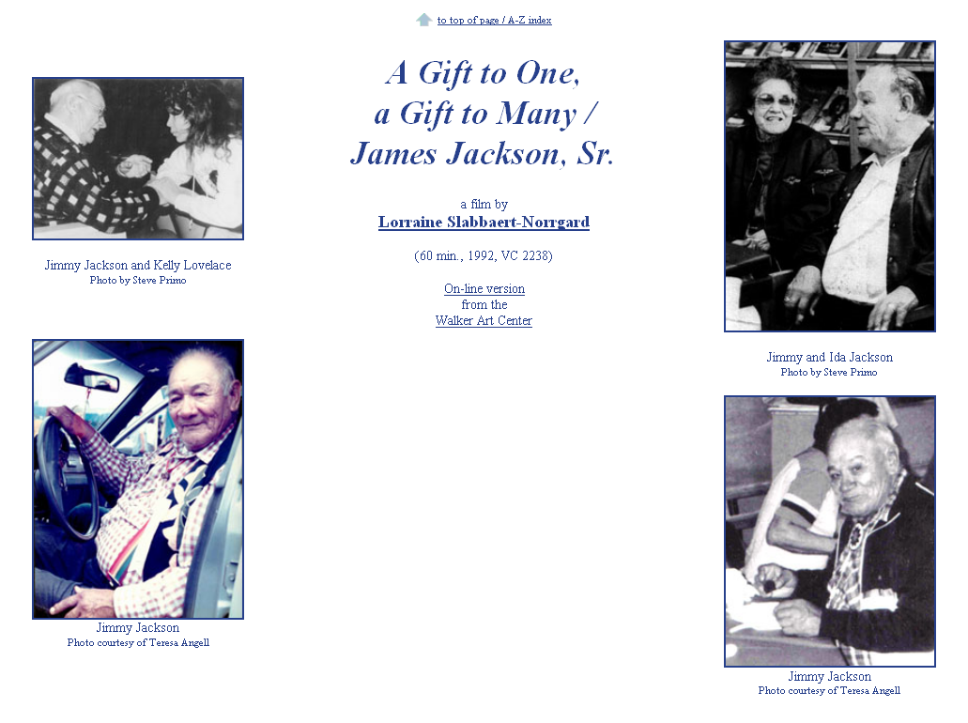
www.d.umn.edu/cla/faculty/troufs/anth4616/video/Jimmy_Jackson.html#title

Slide 39
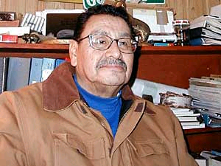
Larry Aitken is a Native healer on the White Earth Reservation. He says there are hundreds of plants found in the forest that can be used for medicine.
(MPR Photo/Tom Robertson)
http://news.minnesota.publicradio.org/features/2003/08/18_gundersond_spiritualityeigh/
Notes:
³⁹

Slide 40
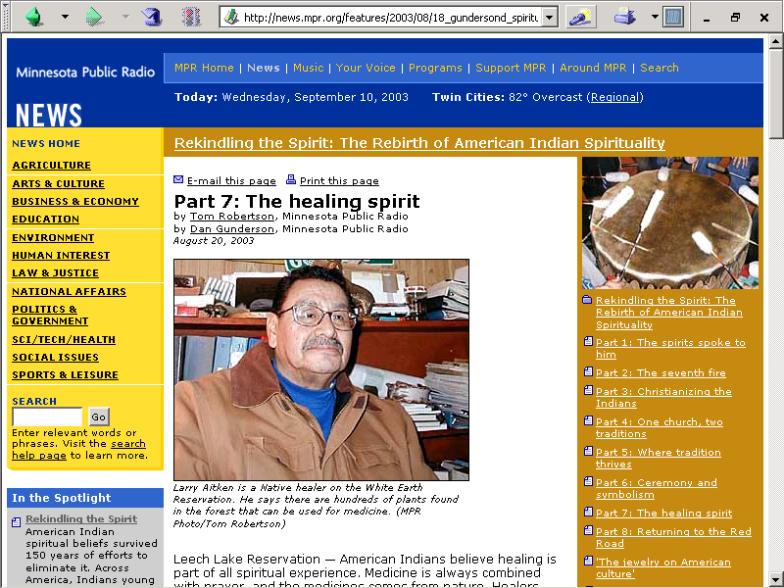

Slide 41
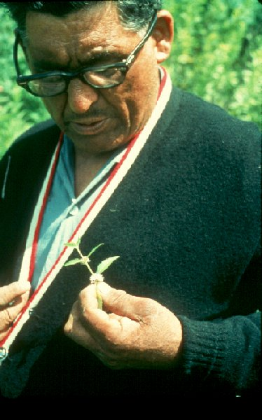
Paul Buffalo Meditating Medicine

Slide 42
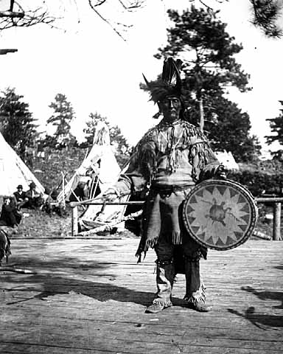
Chippewa medicine man singer with ceremonial turtle clan drum.
Photograph Collection ca. 1900
Minnesota Historical Society, Negative No. 21120

Slide 43
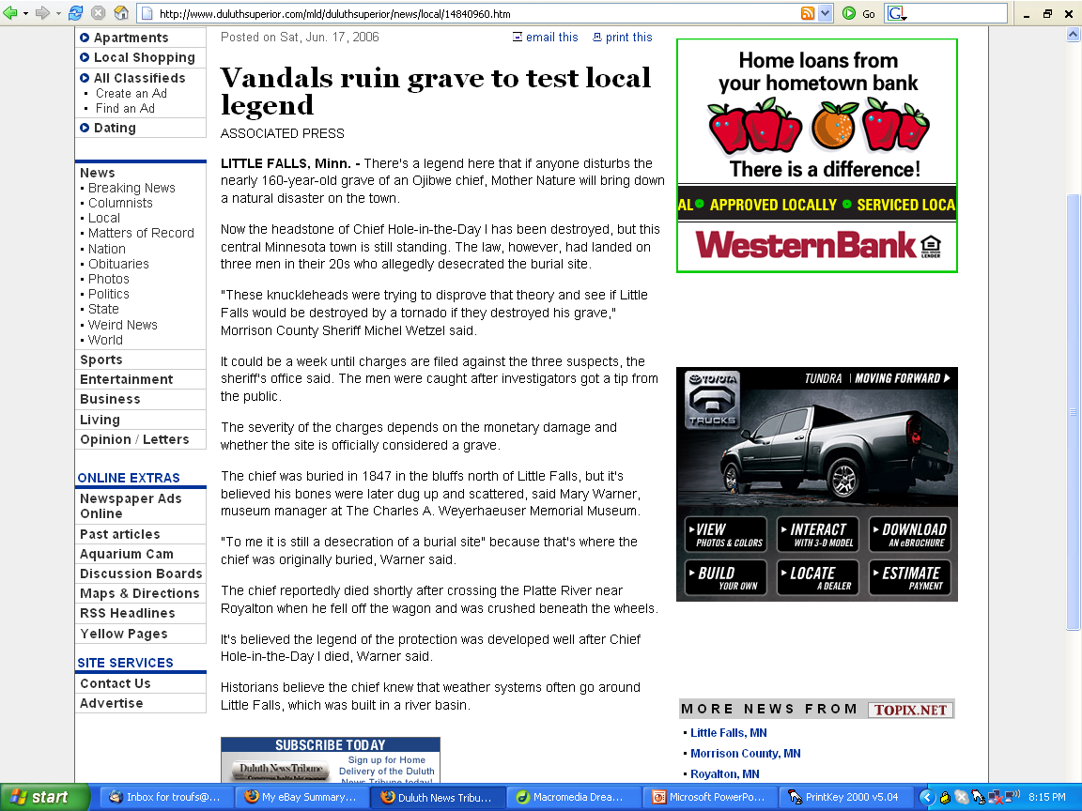
http://www.duluthsuperior.com/mld/duluthsuperior/news/local/14840960.htm

Slide 44
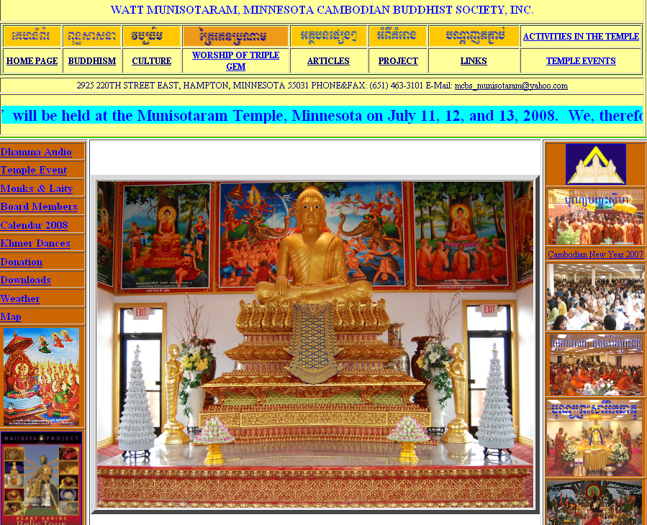
http://wattmunisota.org/

Slide 45
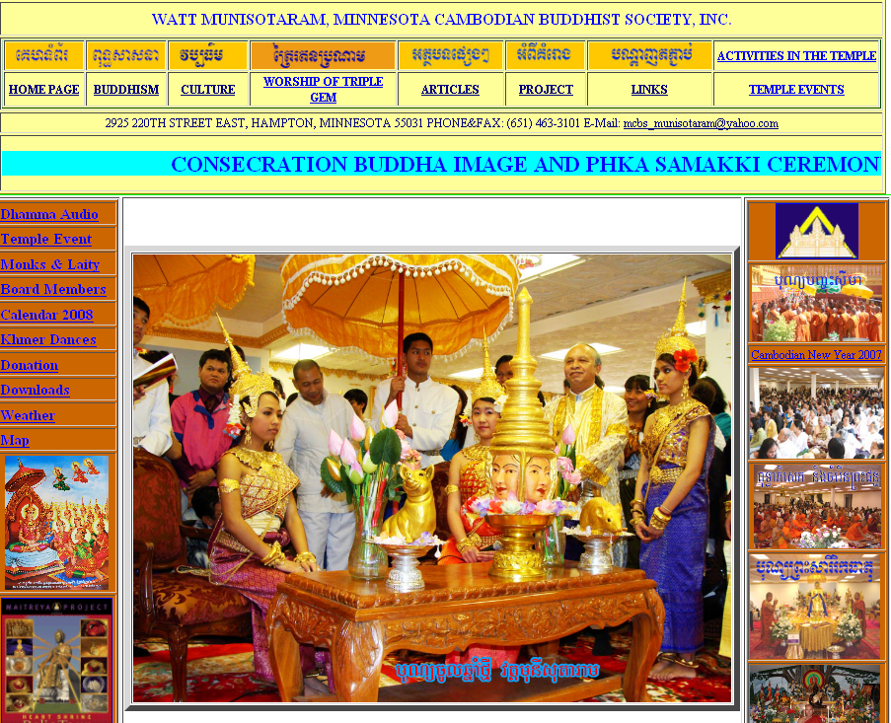
http://wattmunisota.org/

Slide 46
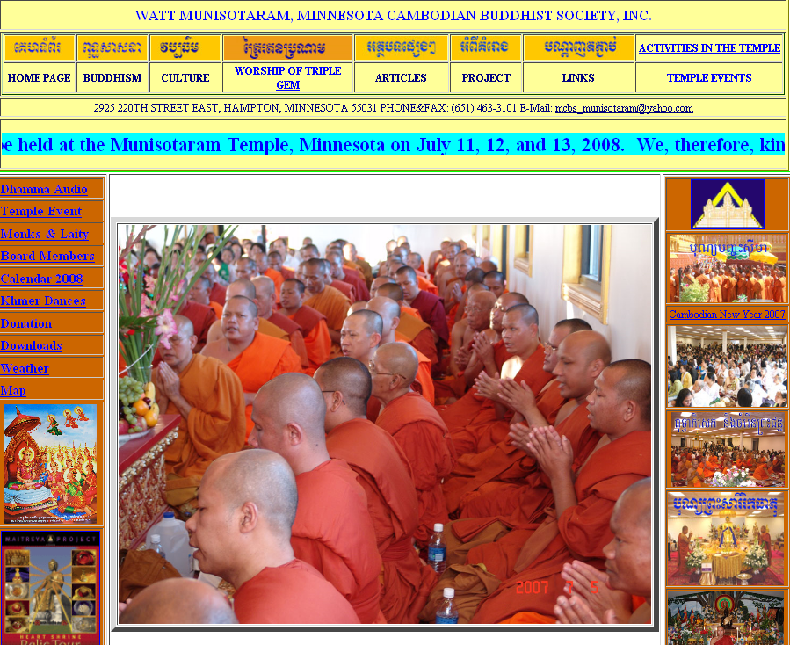
http://wattmunisota.org/

Slide 47
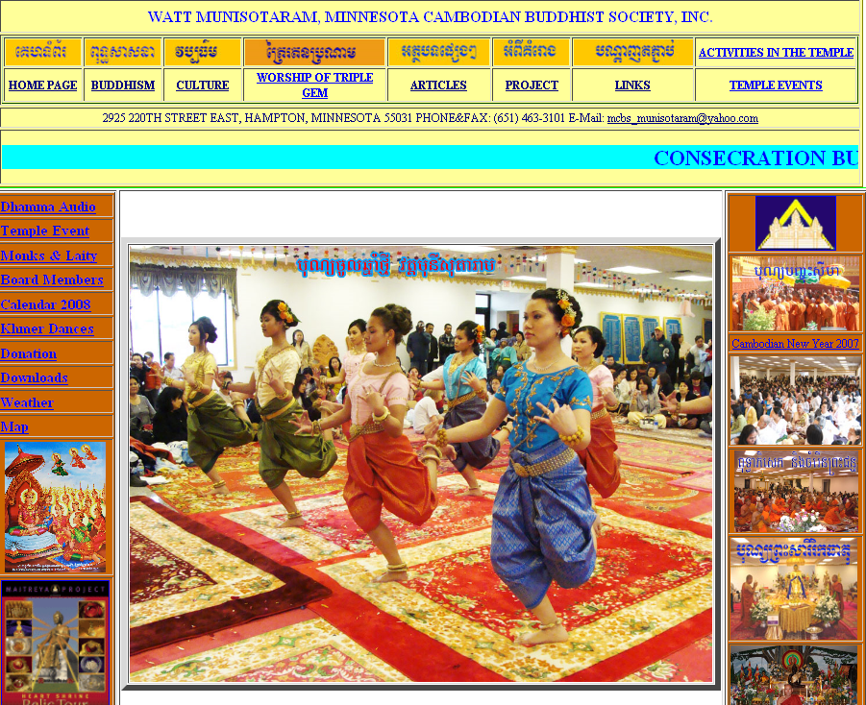
http://wattmunisota.org/

Slide 48
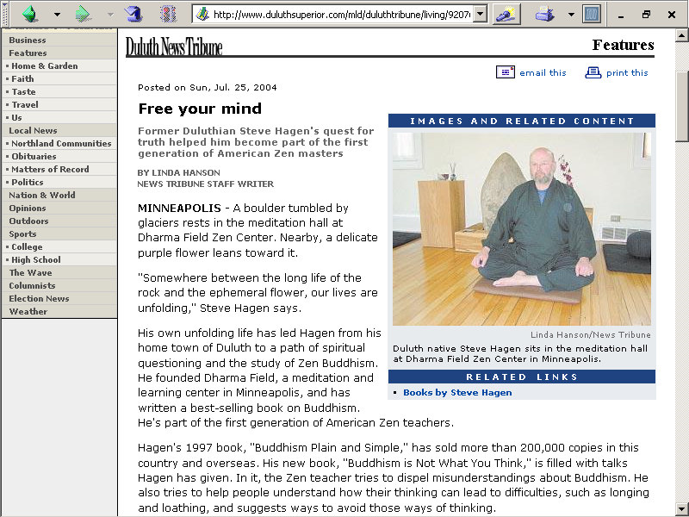
www.duluthsuperior.com/mld/duluthtribune/

Slide 49
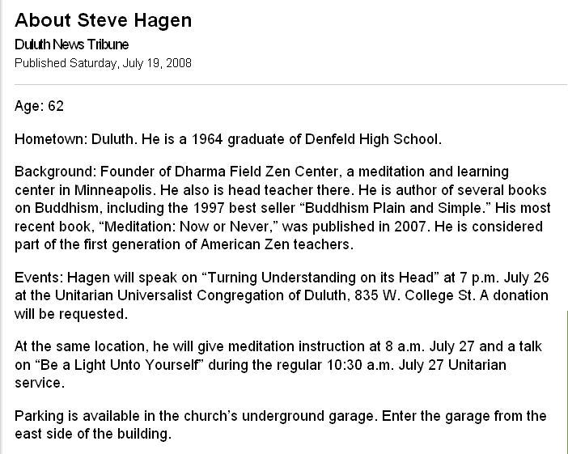
www.duluthnewstribune.com/articles/index.cfm?id=70617&section=Faith

Slide 50
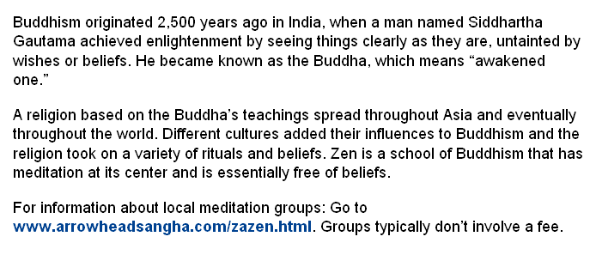
www.duluthnewstribune.com/articles/index.cfm?id=70617&section=Faith

Slide 51
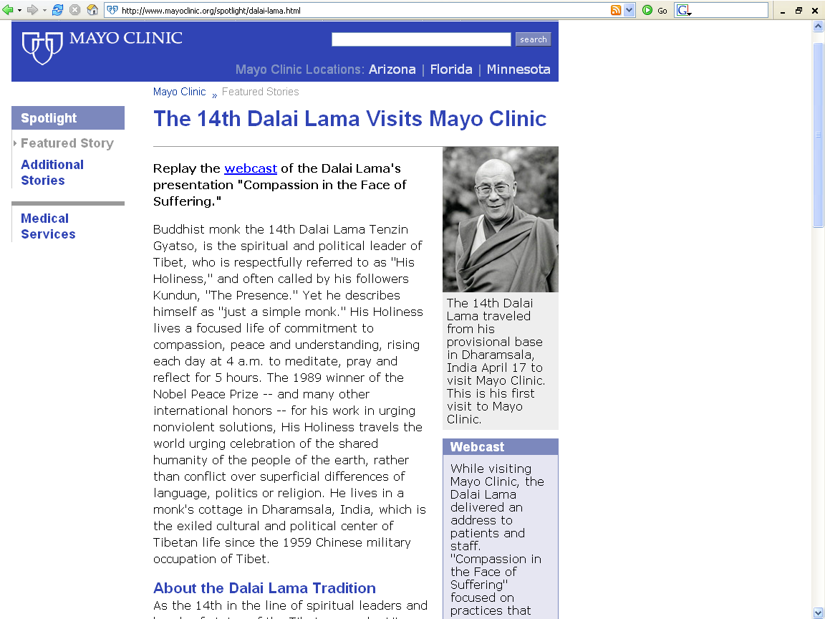
http://www.mayoclinic.org/spotlight/dalai-lama.html

Slide 52
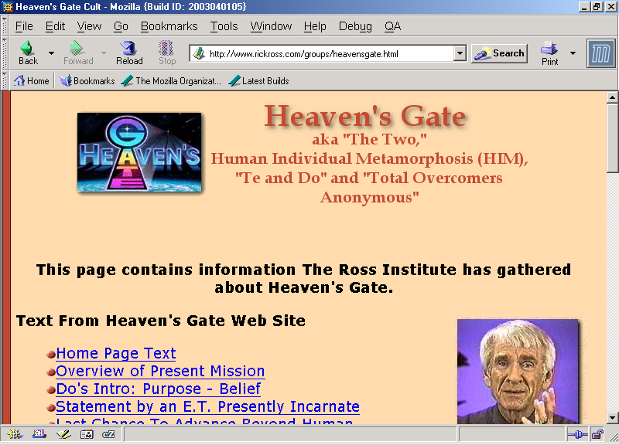
Believed a flying saucer was traveling behind the Hale-Bopp comet.

Slide 53
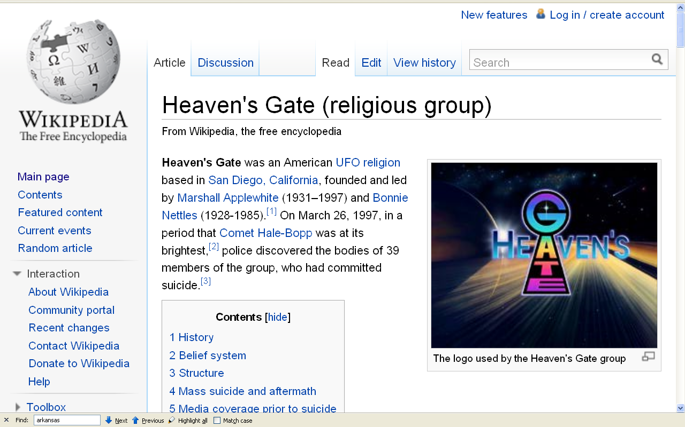
http://en.wikipedia.org/wiki/Heaven%27s_Gate_%28religious_group%29

Slide 54
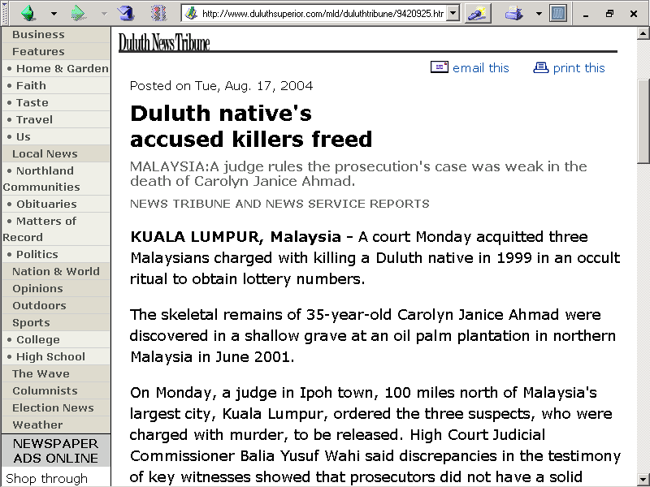
www.duluthsuperior.com/mld/duluthtribune/9420925.htm

Slide 55

www.duluthsuperior.com/mld/duluthsuperior/news/local/13669300.htm

Slide 56

www.bethel.edu/alumni/HeartMind/06spring/triumph-from-tragedy.html

Slide 57

Huaorani
(Ecuador)
Paul Buffalo
Meditating
Medicine
www.d.umn.edu/cla/faculty/troufs/anth1604/video/Trinkets_and_Beads.html#title

Slide 58
Duluth . . .
blessing of the motorcycles

Slide 59

http://www.duluthnewstribune.com/event/photogallery/id/1205/

Slide 60

http://www.duluthnewstribune.com/event/photogallery/id/1205/

Slide 61

http://www.duluthnewstribune.com/event/photogallery/id/1205/

Slide 62
Misc. . . ..

Slide 63

http://news.bbc.co.uk/1/hi/uk/728180.stm

Slide 64

www.duluthsuperior.com/mld/duluthtribune/news/nation/10948054.htm

Slide 65

http://news.bbc.co.uk/1/hi/world/europe/4272689.stm

Slide 66

http://news.nationalgeographic.com/news/2008/03/080331-AP-islam-largest.html

Slide 67

www.foxnews.com/story/0,2933,343336,00.html

Slide 68

www.foxnews.com/story/0,2933,343336,00.html

Slide 69

www.sptimes.com/2005/11/18/Worldandnation/The_word_of_God_is_ou.shtml

Slide 70

http://news.bbc.co.uk/2/hi/south_asia/4822750.stm

Slide 71

http://speakingoffaith.publicradio.org/programs/pagans/index.shtml

Slide 72
Jani Ferrill Roberts
http://speakingoffaith.publicradio.org/programs/pagans/index.shtml
Notes:
72

Slide 73

Kim Smyth Roufs, Jani Farrell-Roberts, Marjorie Blagburn
Bristol Harbour, England
http://www.d.umn.edu/cla/faculty/troufs/anth4616/images/Farrell-Roberts_KSR_MB.jpg
Notes:
73

Slide 74

http://speakingoffaith.publicradio.org/programs/pagans/index.shtml
Notes:
74

Slide 75

www.usatoday.com/news/nation/2004-07-18-polygamy-usat_x.htm

Slide 76

http://www.dailytexanonline.com/news/2004/03/26/StateLocal/Polygamists.Might.Be.Building.In.Texas-642621.shtml

Slide 77

http://news.bbc.co.uk/2/hi/americas/7333004.stm

Slide 78

http://news.bbc.co.uk/2/hi/americas/7431848.stm

Slide 79

www.presstelegram.com/Stories/0,1413,204%257E23187%257E2235392,00.html

