Slide 1
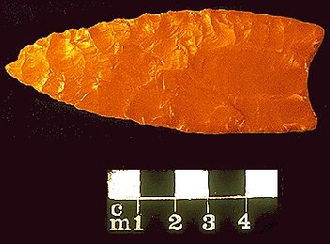
Welcome to the
The American Lithic
University of Minnesota Duluth
Ancient Middle America
Tim Roufs ©2009-2019

Slide 2
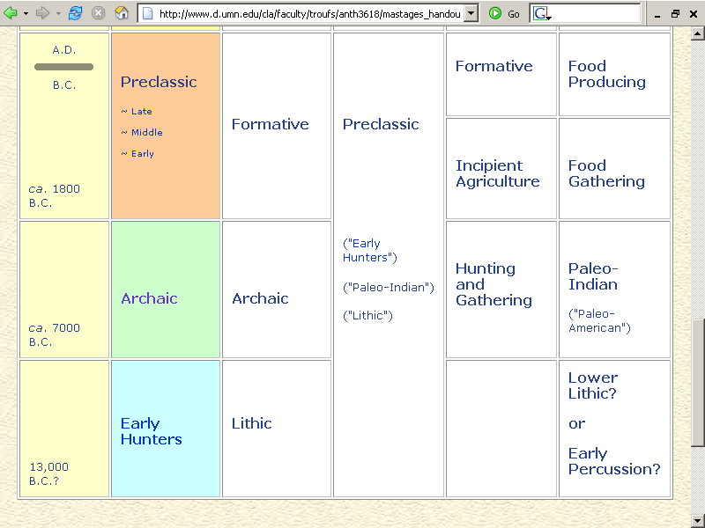
www.d.umn.edu/cla/faculty/troufs/anth3618/mastages_handout.html

Slide 3
www.d.umn.edu/cla/faculty/troufs/anth3618/mastages_handout.html

Slide 4
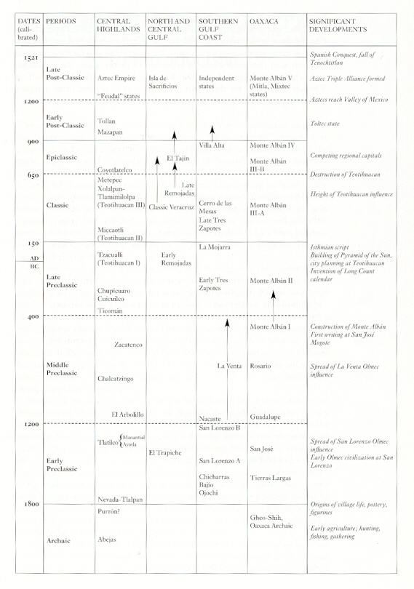
Mexico
(7th ed)
Page 244
Mexico (5th ed.). Michael D. Coe and Rex Koontz. NY: Thames and Hudson, 2008, p. 244.

Slide 5
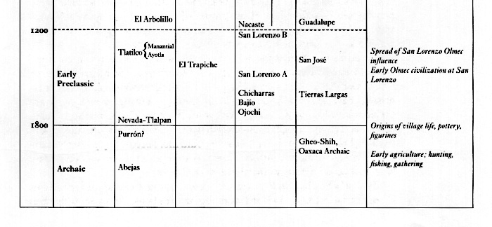
Mexico
(7th ed)
Page 244
Mexico (5th ed.). Michael D. Coe and Rex Koontz. NY: Thames and Hudson, 2008, p. 244.

Slide 6
Text: Mexico, page 244
www.d.umn.edu/cla/faculty/troufs/anth3618/mastages_handout.html

Slide 7
Mexico, Ch. 4, “The Preclassic Period:
Early Villagers”
Mexico, Ch. 3, “The Archaic Period”
Mexico, Ch. 2, “Early Hunters”
www.d.umn.edu/cla/faculty/troufs/anth3618/mastages_handout.html

Slide 8
The Maya, Ch. 2, “The Earliest Maya”
www.d.umn.edu/cla/faculty/troufs/anth3618/mastages_handout.html

Slide 9
Mexico, Ch. 2, “Early Hunters”
www.d.umn.edu/cla/faculty/troufs/anth3618/mastages_handout.html

Slide 10
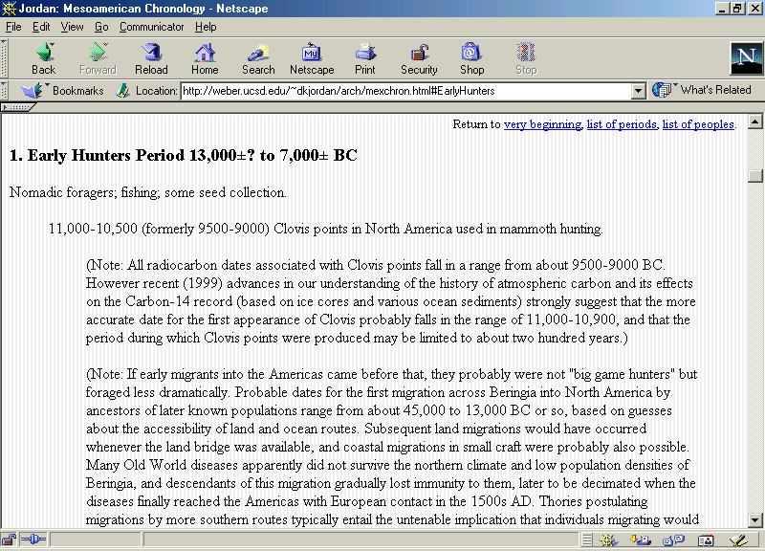
http://weber.ucsd.edu/~dkjordan/arch/mexchron.html#EarlyHunters

Slide 11
Nine Important Points
for the Lithic Stage
After Willey and Phillips,
Method and Theory in American Archaeology. Chicago: University of Chicago Press, 1970

Slide 12
Mexico, Ch. 2, “Early Hunters”
www.d.umn.edu/cla/faculty/troufs/anth3618/mastages_handout.html

Slide 13
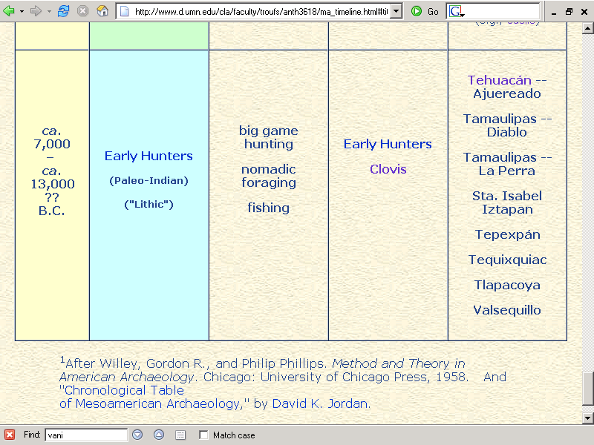
www.d.umn.edu/cla/faculty/troufs/anth3618/mastages_handout.html

Slide 14
Lithic Stage
1. Principle stage criteria:
  rough and chipped
  stone artifacts

Slide 15
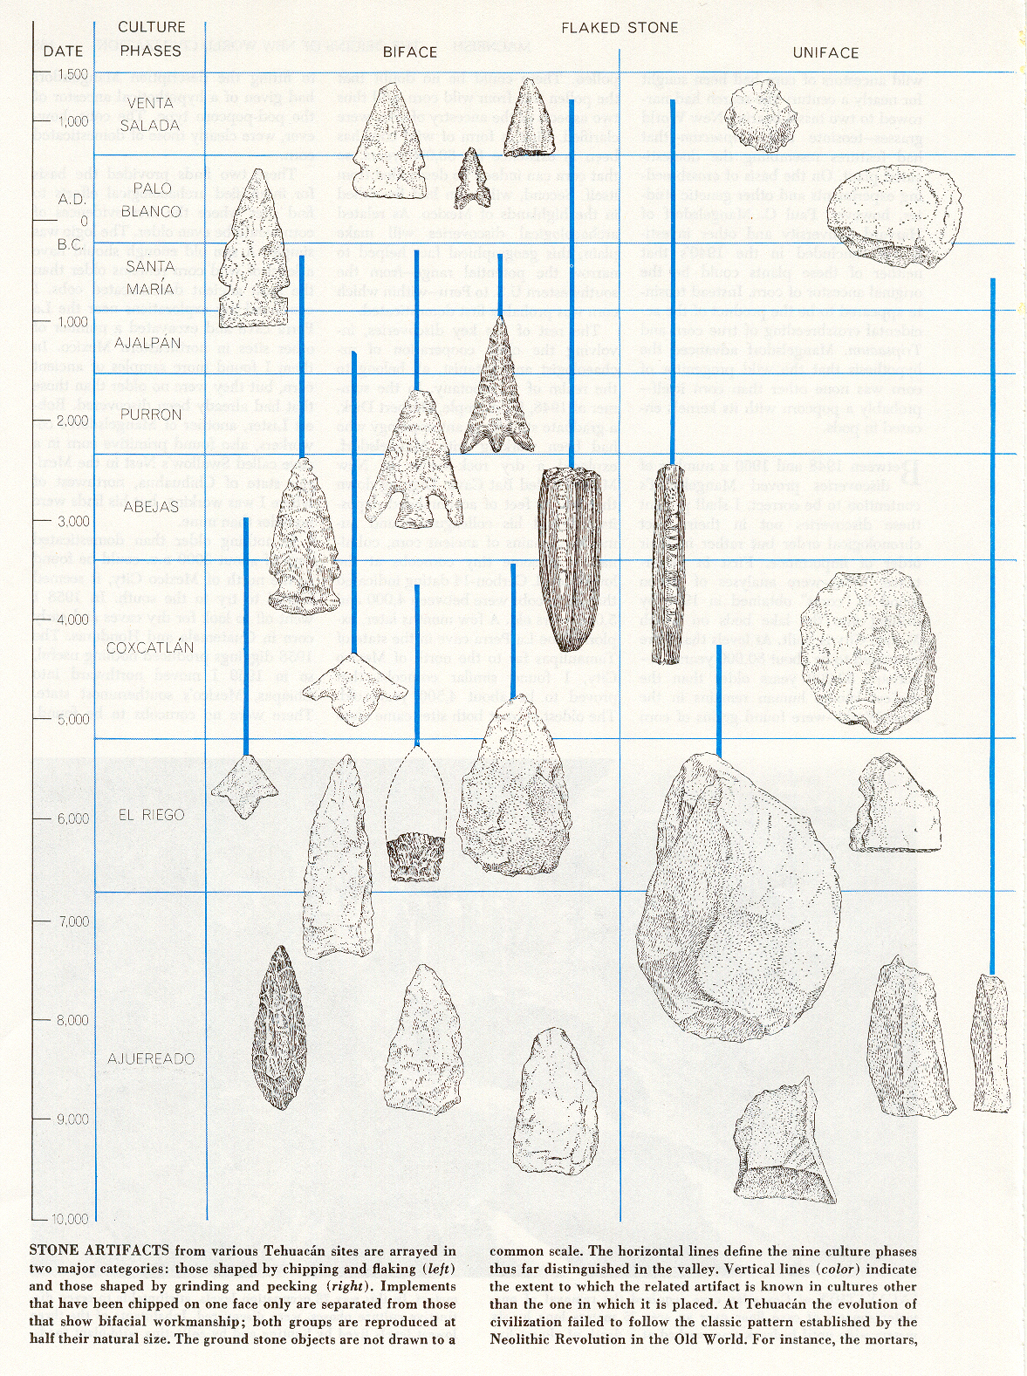
Tehuacán,
Puebla

Slide 16
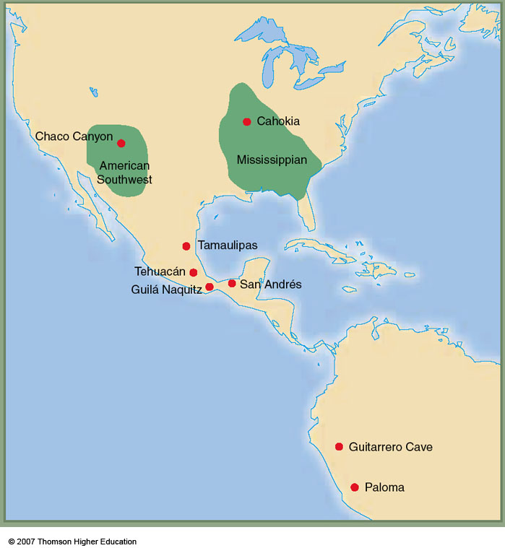
this will later become famous for the origin of maize . . .
4,200 ybp
Tehuacán Valley,
Puebla, Mexico
Early farming in the Americas
Understanding Physical Anthropology and Archaeology, 9th Ed., p. 358

Slide 17
Lithic Stage
2. Natural Context:
  late glacial and early postglacial environments
  of the New World

Slide 18
Lithic Stage
the environmental contexts
of the Late Pleistocene
indicate a climate quite different from that of the present

Slide 19
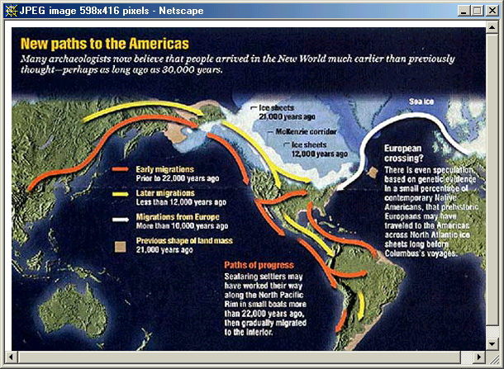

Slide 20
Lithic Stage
this stage may have ranged from as early as 38,000 ? B.C. down to about 5000 B.C., although the later limit varies considerably
  some suggest 7000 B.C.

Slide 21
www.d.umn.edu/cla/faculty/troufs/anth3618/mastages_handout.html

Slide 22
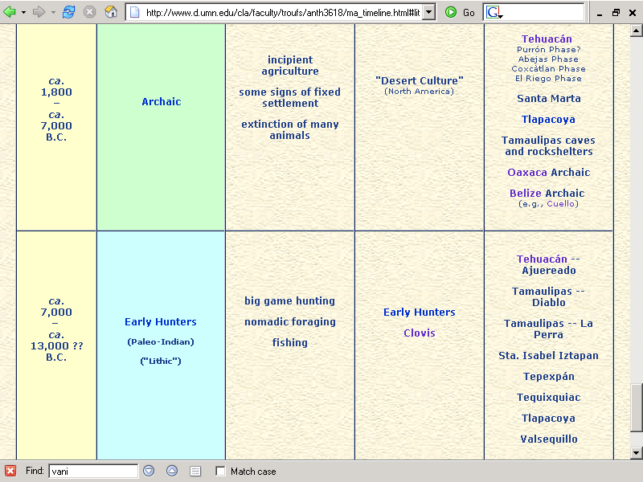
www.d.umn.edu/cla/faculty/troufs/anth3618/mastages_handout.html

Slide 23
Lithic Stage
Evidences are most complete in Western North America
  particularly in the High Plains

Slide 24
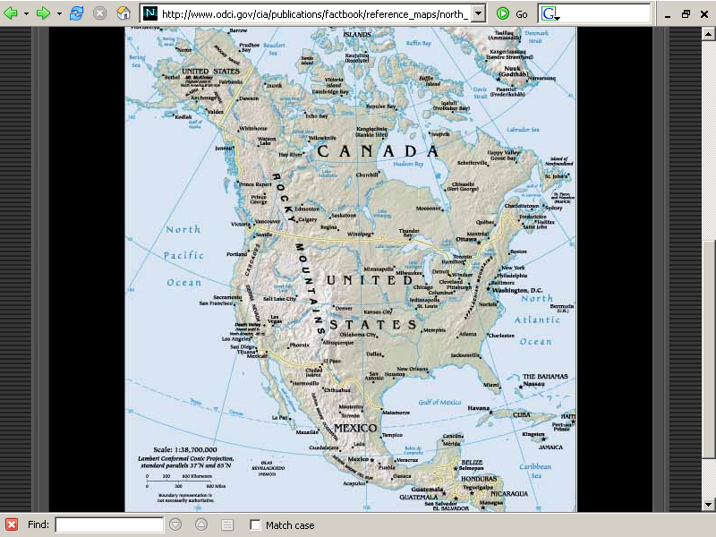
http://www.odci.gov/cia/publications/factbook/reference_maps/north_america.html

Slide 25
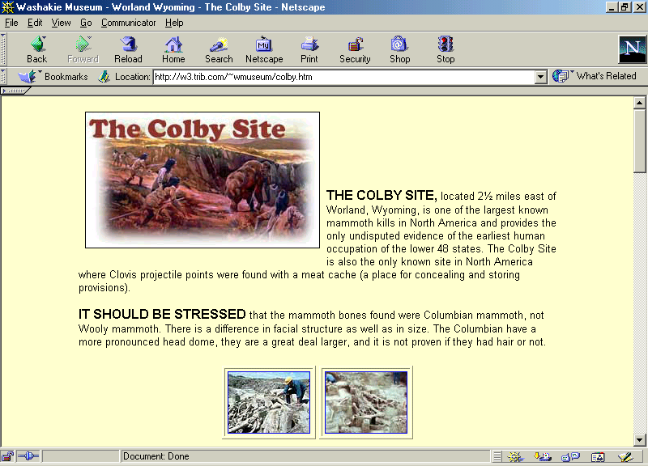
http://w3.trib.com/~wmuseum/colby.htm

Slide 26
Lithic Stage
Evidences are most complete in Western North America
  particularly in the High Plains
  but also included is the Central Mexican Area and Taumalipas

Slide 27
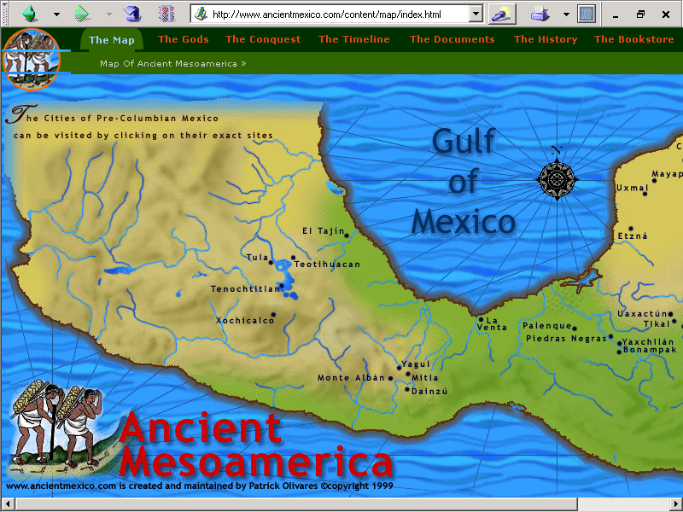

Slide 28
Lithic Stage
4. Two major technological traditions, or groups of traditions are postulated in the Lithic Stage . . .

Slide 29
Lithic Stage
4.A. One is characterized by
pressure flaking and
lanceolate blades . . .

Slide 30
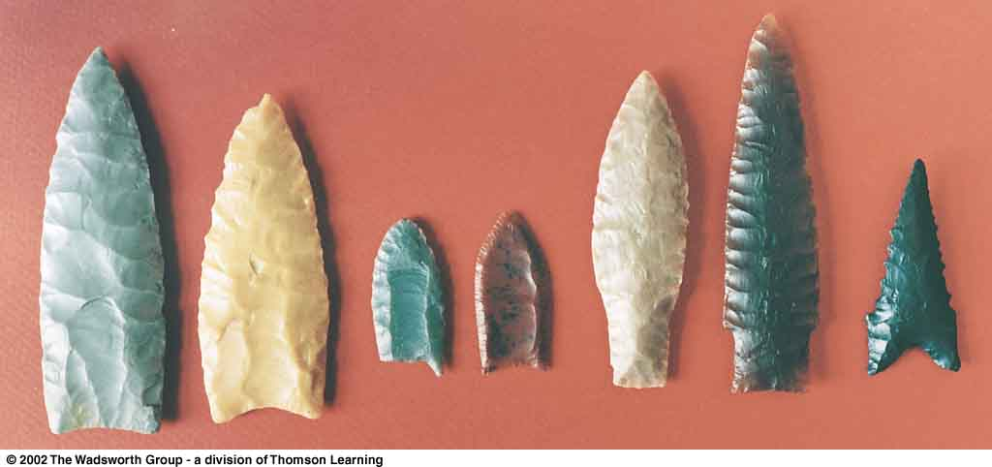
^{Clovis}
^{Folsom}
^{Plano}
^{Dalton}
Major types of North American Paleo-Indian projectile points.
Understanding Physical Anthropology and Archaeology (8th ed), p. 386

Slide 31
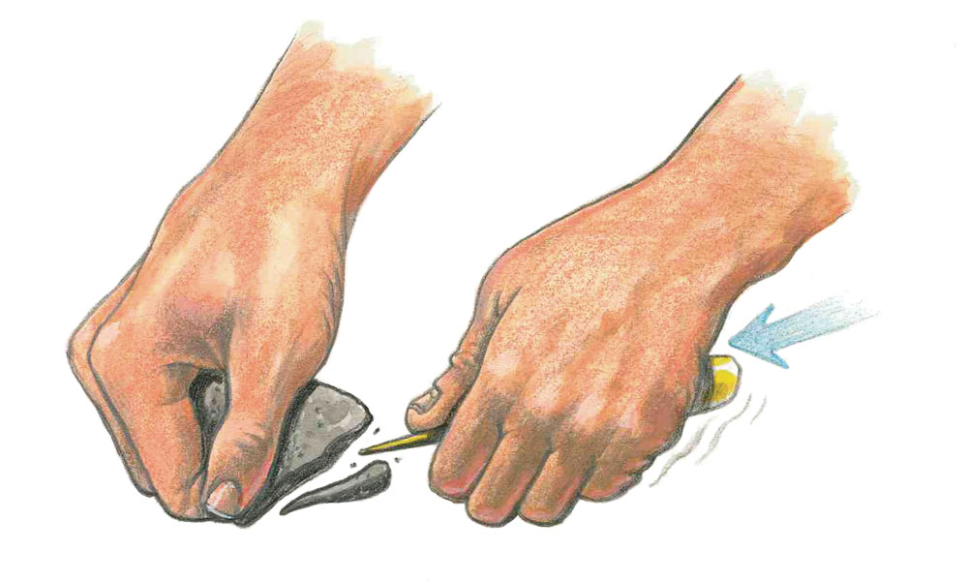
Pressure flaking.
Understanding Humans, 10th Ed., p. 303.

Slide 32
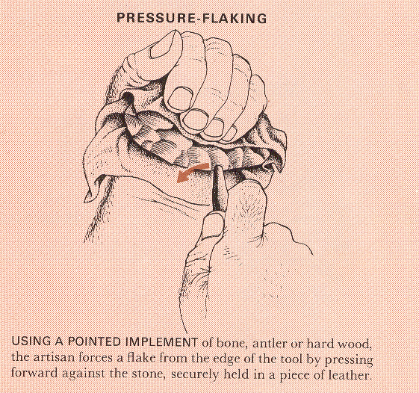
Life Nature Library, Early Man, p. 111

Slide 33
Lithic Stage
e.g., Clovis points

Slide 34
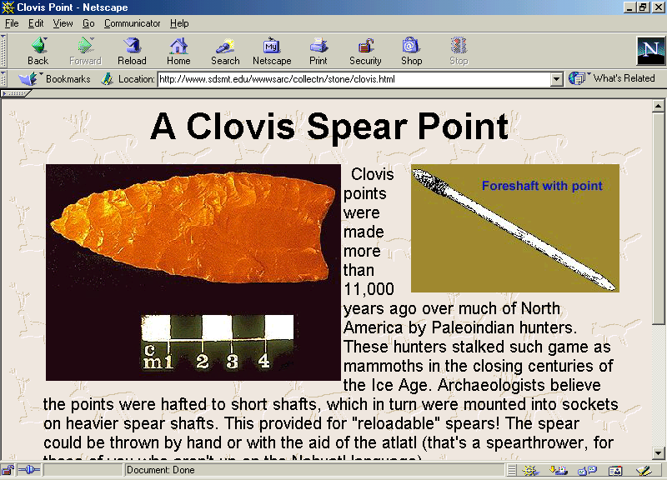
http://www.sdsmt.edu/wwwsarc/collectn/stone/clovis.html

Slide 35
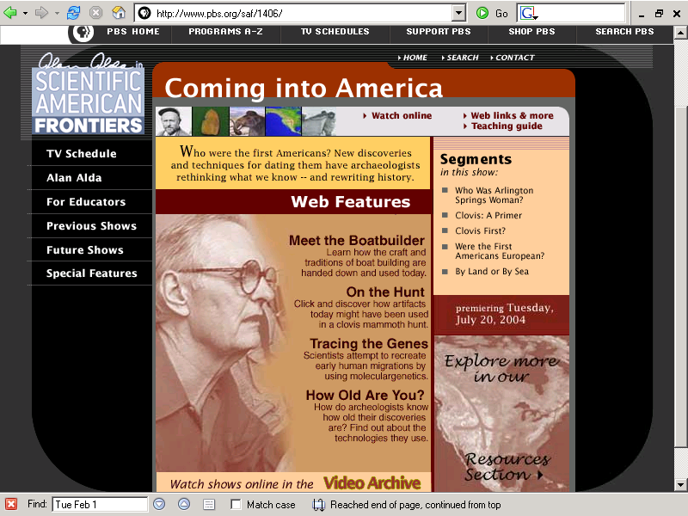
http://www.pbs.org/saf/1406/

Slide 36
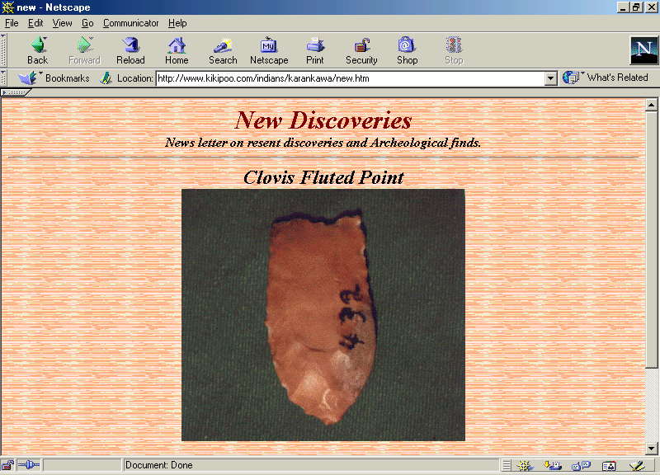
http://www.kikipoo.com/indians/karankawa/new.htm

Slide 37
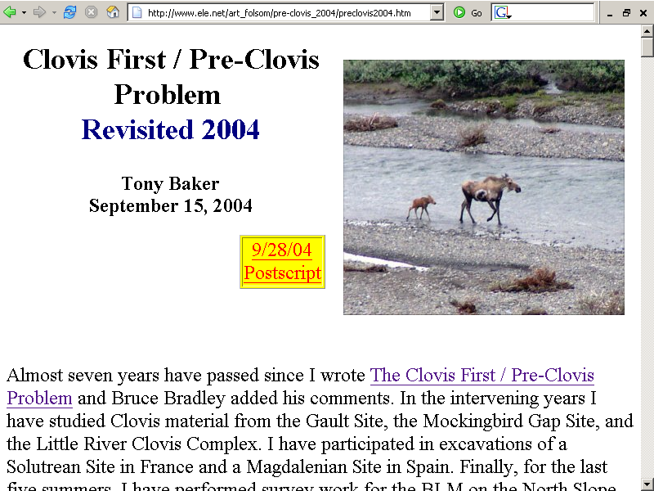
http://www.ele.net/art_folsom/pre-clovis_2004/preclovis2004.htm

Slide 38
Lithic Stage
e.g., Angostura points

Slide 39
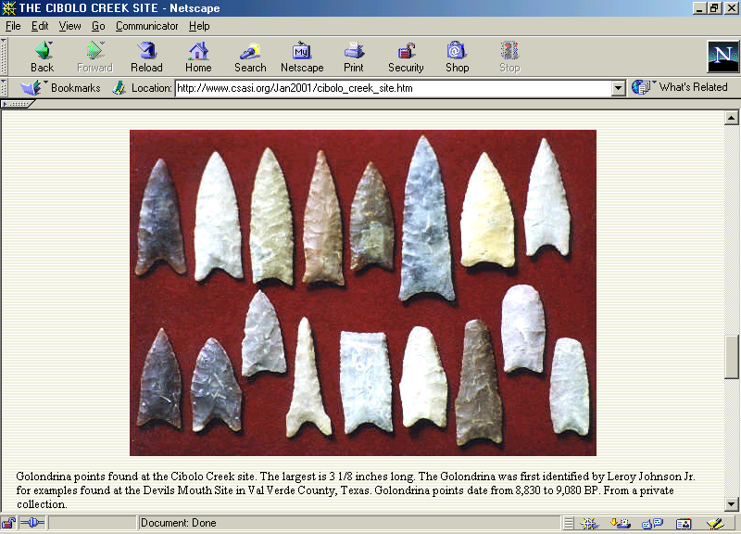
http://www.csasi.org/2001_january_journal/cibolo_creek_site.htm

Slide 40
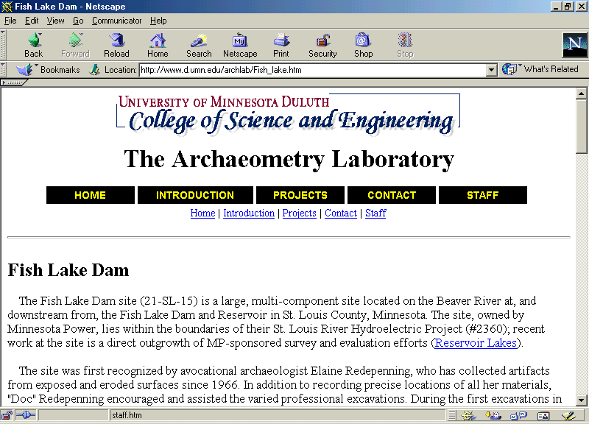
http://www.d.umn.edu/archlab/Fish_lake.htm

Slide 41
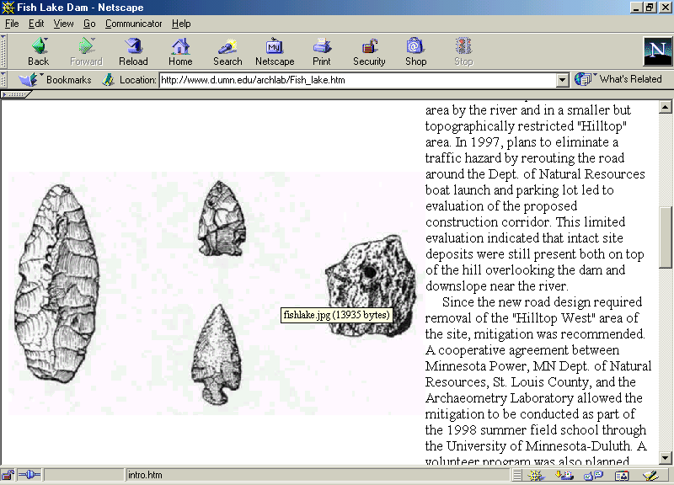

Slide 42
Lithic Stage
4.B. The other is characterized by percussion chipping and crude choppers and scrapers . . .

Slide 43
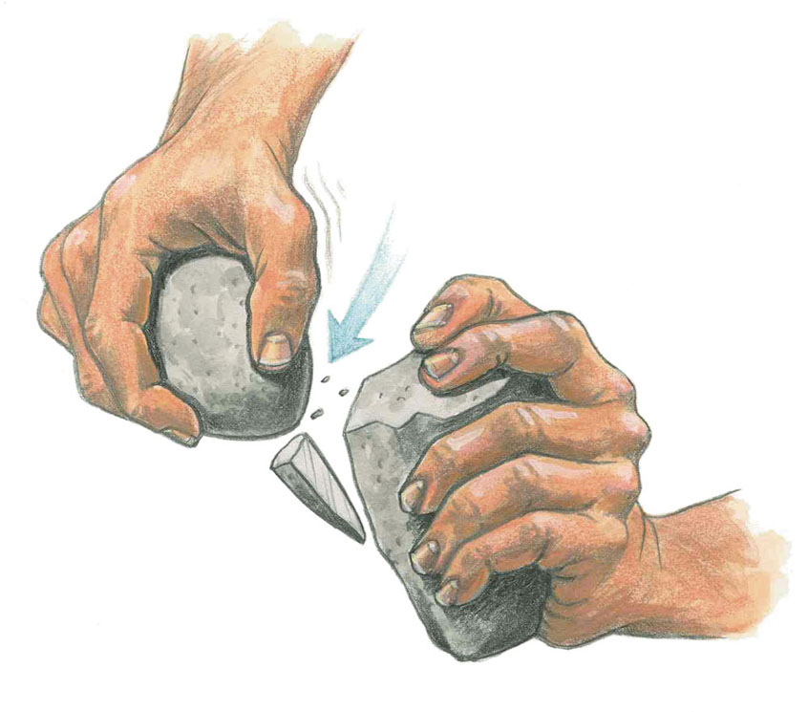
Hard hammer percussion.
Understanding Humans, 10th Ed., p. 229.

Slide 44
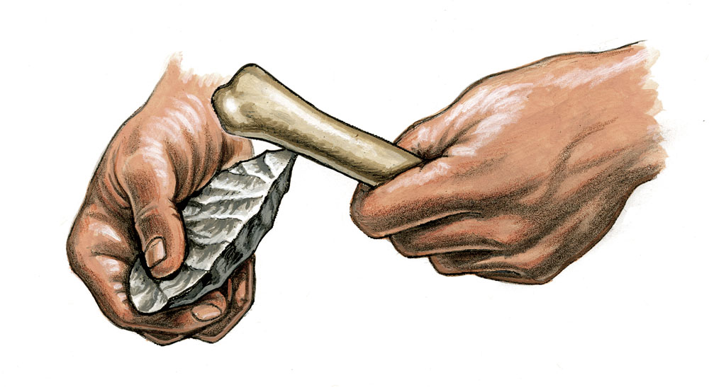
“Soft hammer” percussion.
(“Baton” technique)
Understanding Humans, 10th Ed., p. 229.

Slide 45
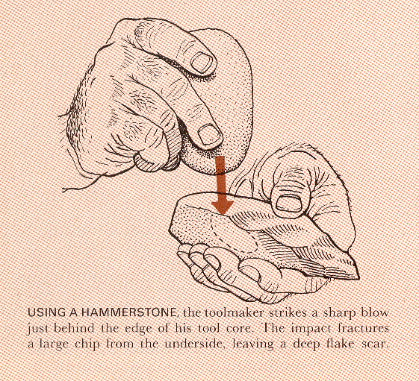
Life Nature Library, Early Man, p. 110

Slide 46
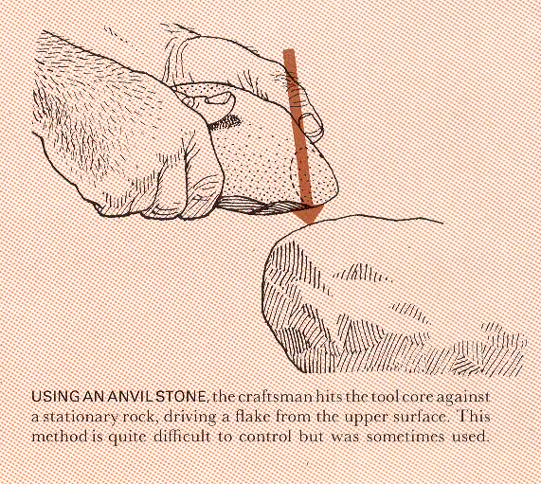
Life Nature Library, Early Man, p. 110

Slide 47
Lithic Stage
e.g., stone tools from the Tamaulipas Archaic are similar to this

Slide 49
Lithic Stage
5. The percussion chipper-scraper tradition may have earlier beginnings than the pressure-flaked-blade traditions . . .

Slide 50
Lithic Stage
Whether or not the percussion chipper-scraper tradition is older remains to be demonstrated as fact, but . . .
there is good evidence that the two existed contemporaneously for a long time

Slide 51
Lithic Stage
Major Proponent for an “Early Lithic”:
Alex Krieger

Slide 52
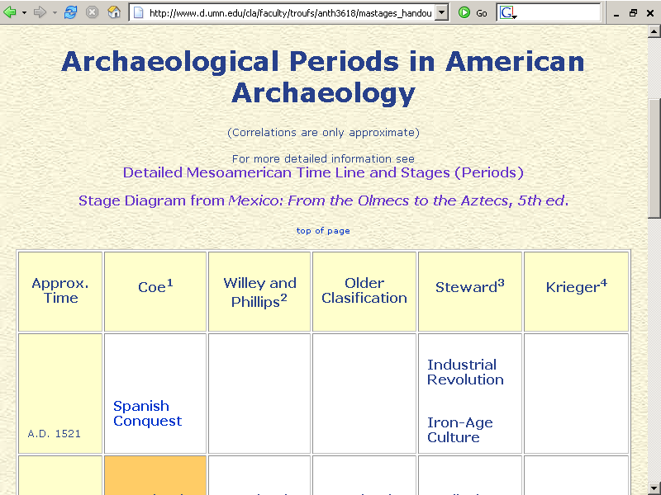
Alex Krieger
www.d.umn.edu/cla/faculty/troufs/anth3618/mastages_handout.html

Slide 53
Alex Krieger
www.d.umn.edu/cla/faculty/troufs/anth3618/mastages_handout.html

Slide 54
Lithic Stage
6. The pressure-flaked-blade traditions are clearly best adapted to the ancient grassland environment of the Plains and the East . . .

Slide 55
http://www.odci.gov/cia/publications/factbook/reference_maps/north_america.html

Slide 56
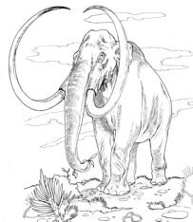
Lithic Stage
and (with the pressure-flaked-blade) to the hunting of large animals now extinct

Slide 57
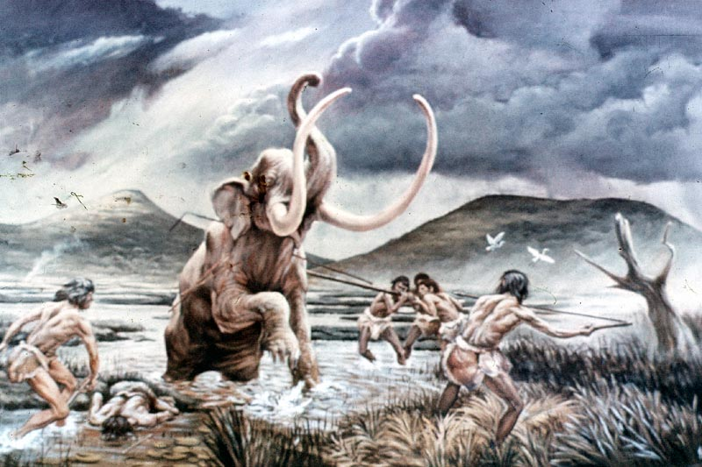

Slide 58
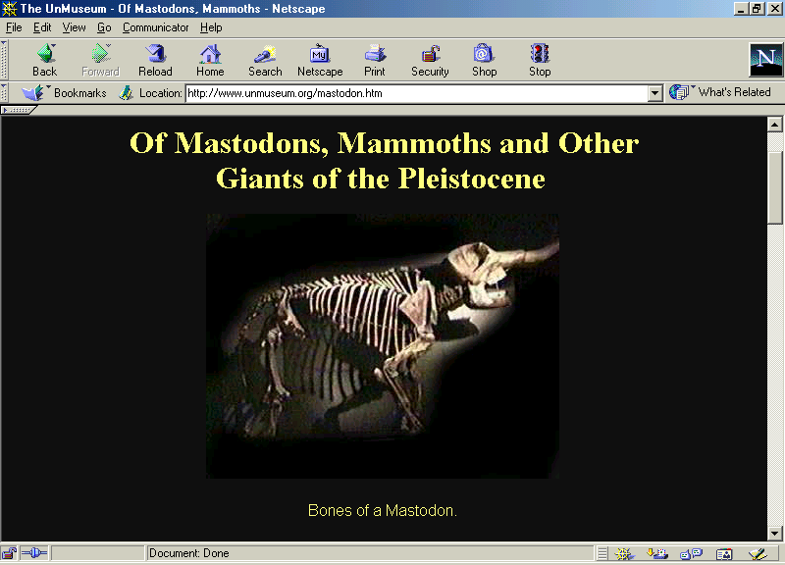
http://www.unmuseum.org/mastodon.htm

Slide 59
Lithic Stage
the percussion chipper-scraper traditions seem more at home in the semiarid environments of the Greater Southwest . . .

Slide 60
http://www.odci.gov/cia/publications/factbook/reference_maps/north_america.html

Slide 61
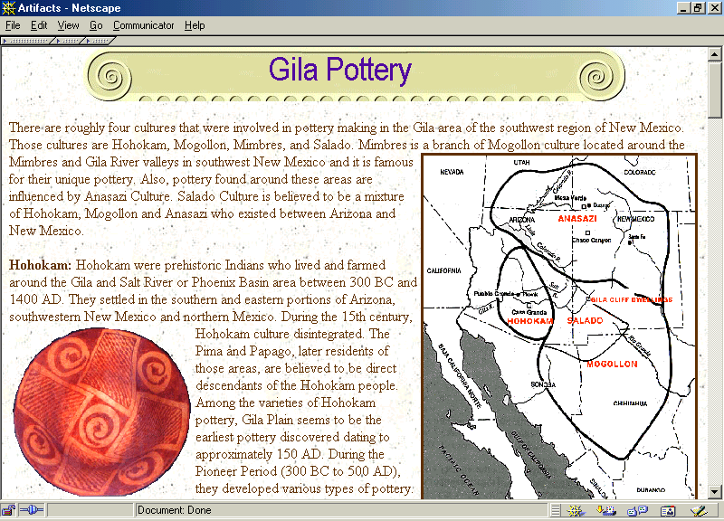
http://www.mnsu.edu/emuseum/archaeology/artifacts/gilapottery.html

Slide 62
Lithic Stage
. . . associated (with the percussion chipper-scraper) in the Greater Southwest with the economic pursuits of gathering

Slide 63
Lithic Stage
in some instances both the pressure-flaked-blade traditions and the percussion chipper-scraper traditions may appear in the archaeological assemblage of a single culture

Slide 64
Lithic Stage
e.g., Sta. Isabel Iztapán

Slide 65
Sta. Isabel Ixtapán

Slide 66
Lithic Stage
7. Both the pressure-flaked-blade and the percussion chipper-scraper traditions show continuity into later cultures of the succeeding Archaic Stage . . .

Slide 67
www.d.umn.edu/cla/faculty/troufs/anth3618/mastages_handout.html

Slide 68
Lithic Stage
. . . this is especially true of the percussion chopper-scraper traditions which carry on into the later Archaic Desert cultures of the Greater Southwest

Slide 69
http://www.mnsu.edu/emuseum/archaeology/artifacts/gilapottery.html

Slide 70
Lithic Stage
The origins of the Lithic culture in North America – unlike the Old World – are still fairly obscure
  and it is not clear whether there was a “Pre-Clovis culture”
    one which was here before stone tool making

Slide 71
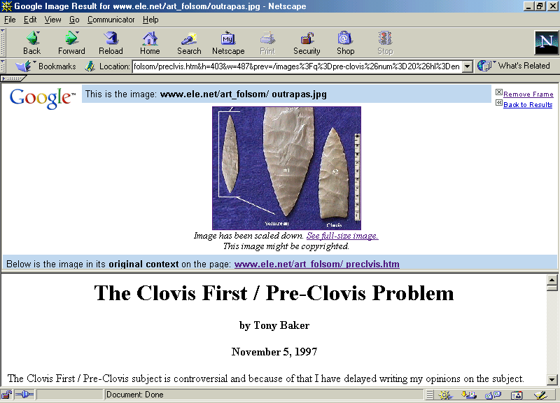
http://www.ele.net/art_folsom/preclvis.htm

Slide 72
http://www.ele.net/art_folsom/pre-clovis_2004/preclovis2004.htm

Slide 73
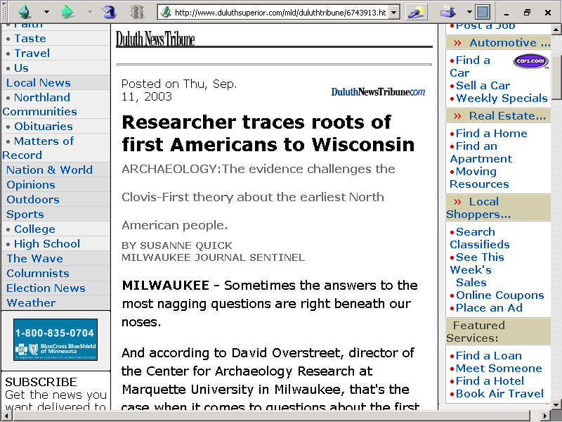
“pre-Clovis”
    11,500 - 14,000 ybp

Slide 74
Lithic Stage
9. Populations in the Lithic Stage were small and scattered, but by 5000 B.C. or before, humans had found their way over most of the New World

Slide 75
http://www.odci.gov/cia/publications/factbook/reference_maps/north_america.html

Slide 76
Lithic Stage
Discussion

Slide 77
Lithic Stage
“Lithic” is not entirely satisfactory as a name, but evidence on this stage is predominantly of stone technology
  there are, however, an increasing number of bone finds

Slide 78
Lithic Stage
the Lithic is the stage of adaptation by immigrant societies to the late glacial and early postglacial climatic and physiographic conditions of the New World

Slide 80
Lithic Stage
the effective working criteria are, therefore, associations of artifacts and other evidences of human activity in geological deposits
  or with plant and animal remains which reflect these times and conditions

Slide 81
Lithic Stage
the nature of the finds indicates that the predominant economic activity of this stage, at least in certain areas, was hunting

Slide 82
Lithic Stage
  main emphasis was on large herbivores, including extinct Pleistocene forms
  the Lithic is pre-eminently a hunting stage, although other economic patterns were certainly present

Slide 83
Lithic Stage
the general pattern of life was migratory in the full sense of the word

Slide 84
Lithic Stage
knowledge of the culture in the Lithic stage are few
  lithic technology covers an immense range of rough and chipped stone traditions
  but it does not include the practice of grinding and polishing

Slide 85
Lithic Stage
work in bone and horn is assumed to have been important, but the evidence has largely disappeared

Slide 86
Tools and Technologies
  lithic (stone)
  bone, tooth, horn / antler

Slide 87
Glossary
osteodontokeratic
osteo = "bone"
donto = "tooth"
keratic = "horn"

Slide 88
Glossary
osteodontokeratic
osteo = "bone"
donto = "tooth"
keratic = "horn"

Slide 89
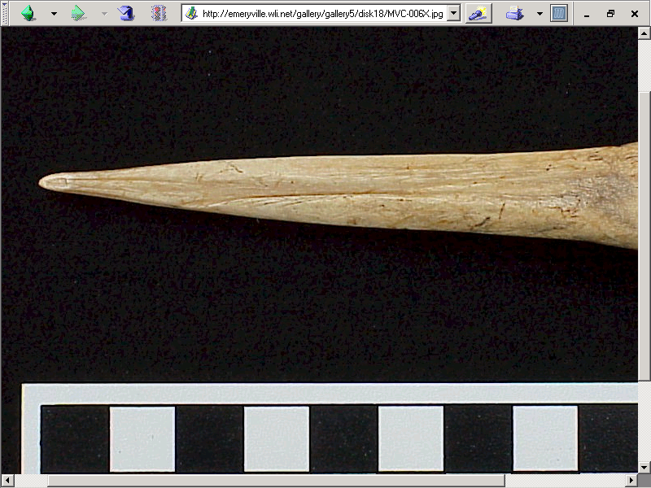
Bone awl, Emeryville, CA.
http://emeryville.wli.net/gallery/gallery2/bone_top_10_list.htm

Slide 90
Glossary
osteodontokeratic
osteo = "bone"
donto = "tooth"
keratic = "horn"

Slide 91
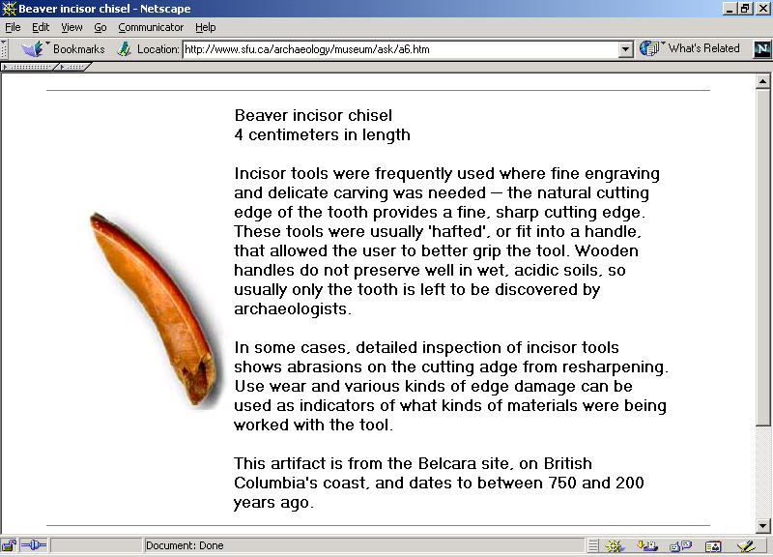
http://www2.sfu.ca/archaeology/museum/ask/a6.htm

Slide 92
Glossary
osteodontokeratic
osteo = "bone"
donto = "tooth"
keratic = "horn"

Slide 93
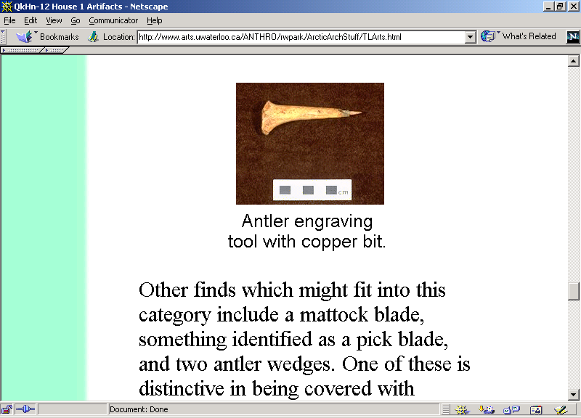
http://www.arts.uwaterloo.ca/ANTHRO/rwpark/ArcticArchStuff/TLArts.html

Slide 94
Lithic Stage
settlement and habitation patterns were such as to leave few traces in the ground

Slide 95
Lithic Stage
sociopolitical inferences for this stage are hazardous
  a small-scale kinship type of organization is postulated, but within this generalization there is room for a high degree of variability

Slide 96
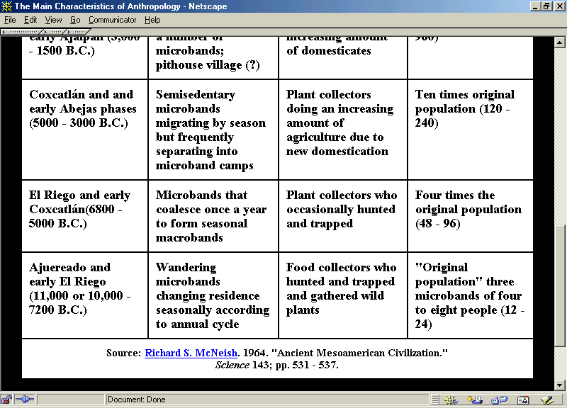
Tehuacán

Slide 97
Lithic Stage
data do not support the view that because Lithic cultures are relatively simple they are also uniform
  all parts of the continent were settled
  in these days, but trait lists suggest
  they were different

Slide 98
Lithic Stage
Lithic Sites include:
    Tehuacán
    Tamaulipas (Diablo and La Perra Phases)
    Tepexpan
    Sta. Isabel Ixtapán
    Tlapacoya
    Valsequillo
    Tequixquiac

Slide 99
Tehuacán

Slide 100
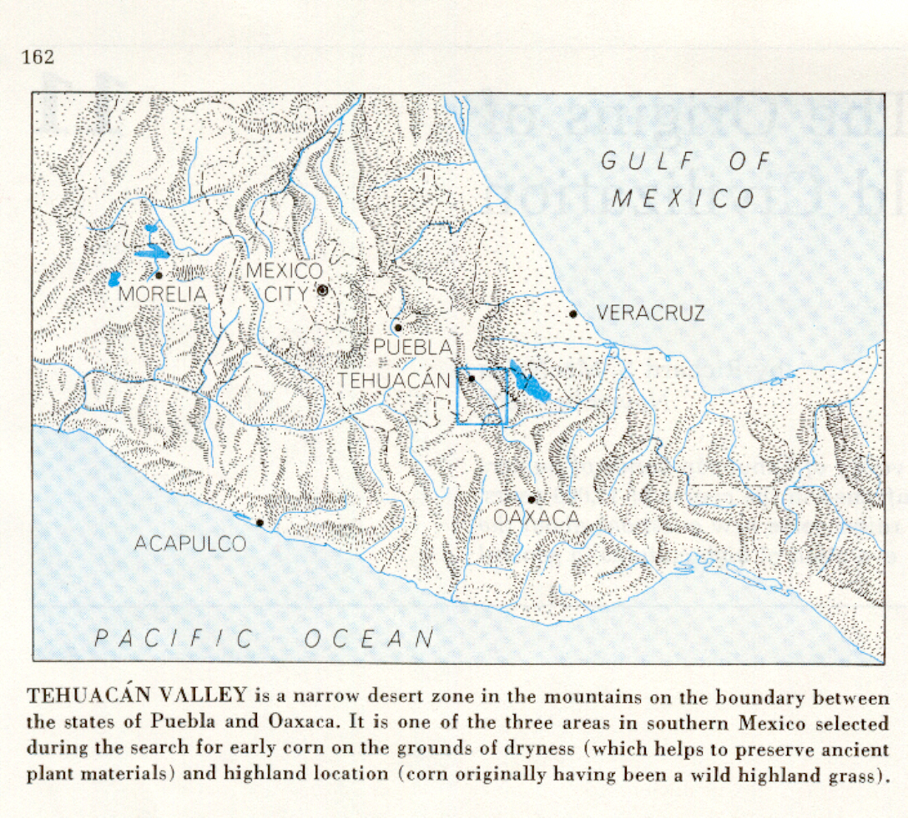

Slide 101
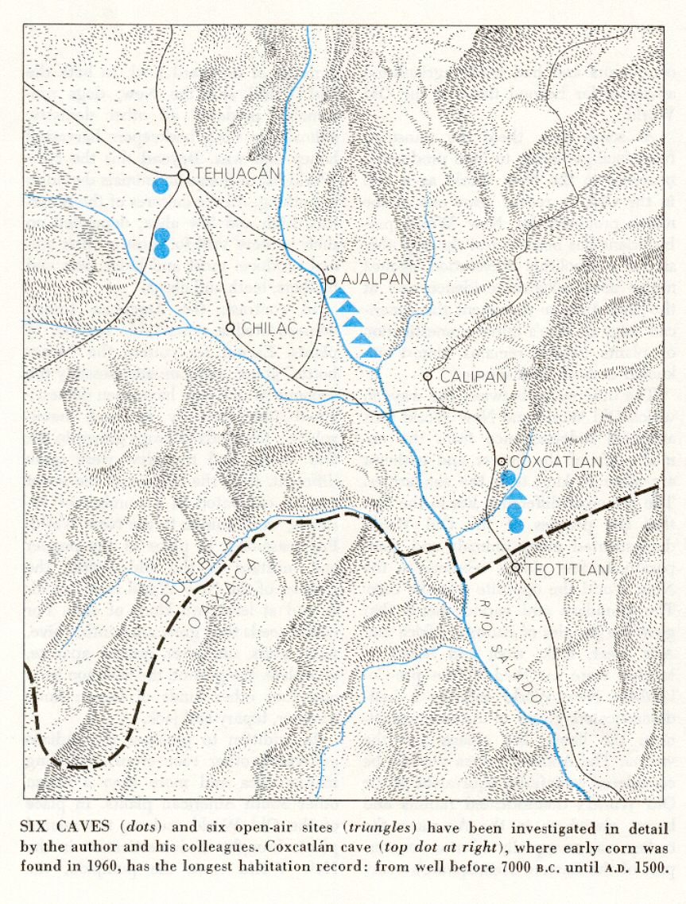

Slide 102
http://www.d.umn.edu/cla/faculty/troufs/anth3618/ma_timeline.html#lithic

Slide 103
Lithic Stage
Lithic Sites include:
    Tehuacán
    Tamaulipas (Diablo and La Perra Phases)
    Tepexpan
    Sta. Isabel Ixtapán
    Tlapacoya
    Valsequillo
    Tequixquiac

Slide 104
Tamaulipas

Slide 105
http://www.d.umn.edu/cla/faculty/troufs/anth3618/ma_timeline.html#lithic

Slide 106
Lithic Stage
Lithic Sites include:
    Tehuacán
    Tamaulipas (Diablo and La Perra Phases)
    Tepexpan
    Sta. Isabel Ixtapán
    Tlapacoya
    Valsequillo
    Tequixquiac

Slide 107
Tepexpán

Slide 108
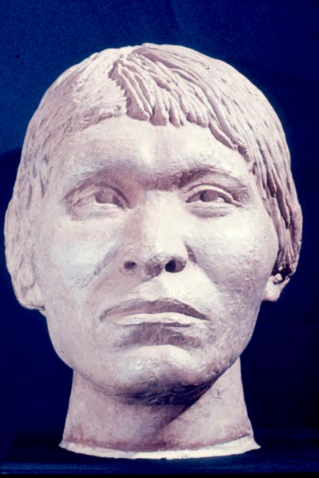
Tepexpán

Slide 109
http://www.d.umn.edu/cla/faculty/troufs/anth3618/ma_timeline.html#lithic

Slide 110
Lithic Stage
Lithic Sites include:
    Tehuacán
    Tamaulipas (Diablo and La Perra Phases)
    Tepexpan
    Sta. Isabel Ixtapán
    Tlapacoya
    Valsequillo
    Tequixquiac

Slide 111
Sta. Isabel Ixtapán

Slide 112
http://www.d.umn.edu/cla/faculty/troufs/anth3618/ma_timeline.html#lithic

Slide 113
Lithic Stage
Lithic Sites include:
    Tehuacán
    Tamaulipas (Diablo and La Perra Phases)
    Tepexpan
    Sta. Isabel Ixtapán
    Tlapacoya
    Valsequillo
    Tequixquiac

Slide 114
Tlapacoya

Slide 115
http://www.d.umn.edu/cla/faculty/troufs/anth3618/ma_timeline.html#lithic

Slide 116
Lithic Stage
Lithic Sites include:
    Tehuacán
    Tamaulipas (Diablo and La Perra Phases)
    Tepexpan
    Sta. Isabel Ixtapán
    Tlapacoya
    Valsequillo
    Tequixquiac

Slide 117
Valsequillo

Slide 118
http://www.d.umn.edu/cla/faculty/troufs/anth3618/ma_timeline.html#lithic

Slide 119
Lithic Stage
    Tehuacán
    Tamaulipas (Diablo and La Perra Phases)
    Tepexpan
    Sta. Isabel Ixtapán
    Tlapacoya
    Valsequillo
    Tequixquiac

Slide 120
Tequixquiac

Slide 121
http://www.d.umn.edu/cla/faculty/troufs/anth3618/ma_timeline.html#lithic

Slide 122
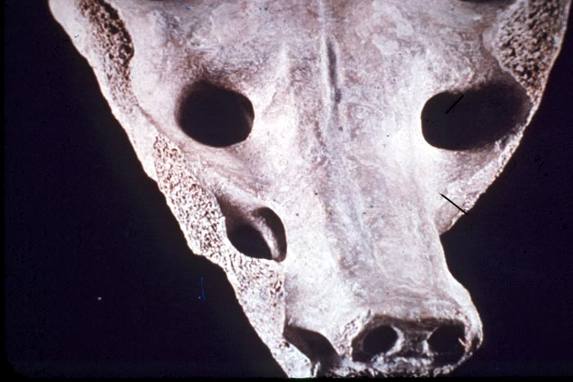
Tequixquiac

Slide 123
Lithic Stage
Lithic Sites include:
    Tehuacán
    Tamaulipas (Diablo and La Perra Phases)
    Tepexpan
    Sta. Isabel Ixtapán
    Tlapacoya
    Valsequillo
    Tequixquiac

Slide 124
What happens next?

Slide 125
www.d.umn.edu/cla/faculty/troufs/anth3618/mastages_handout.html

Slide 126
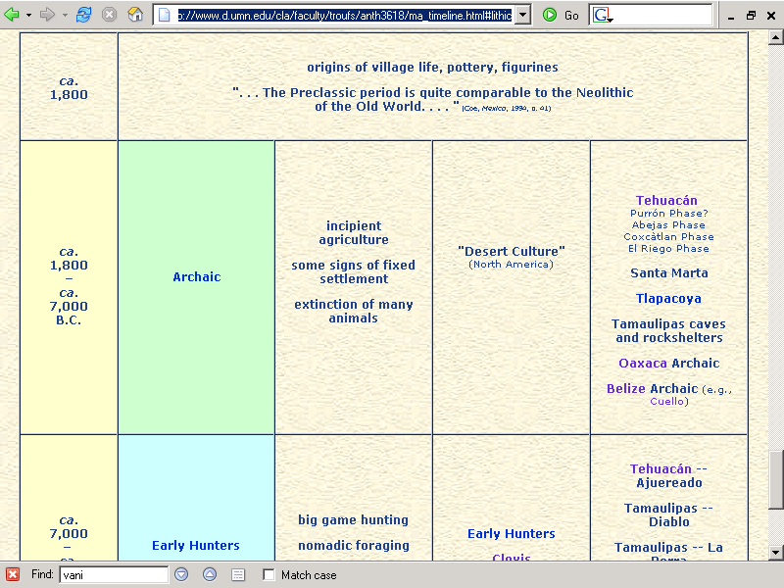
http://www.d.umn.edu/cla/faculty/troufs/anth3618/ma_timeline.html#lithic

Slide 127
And after that?

Slide 128
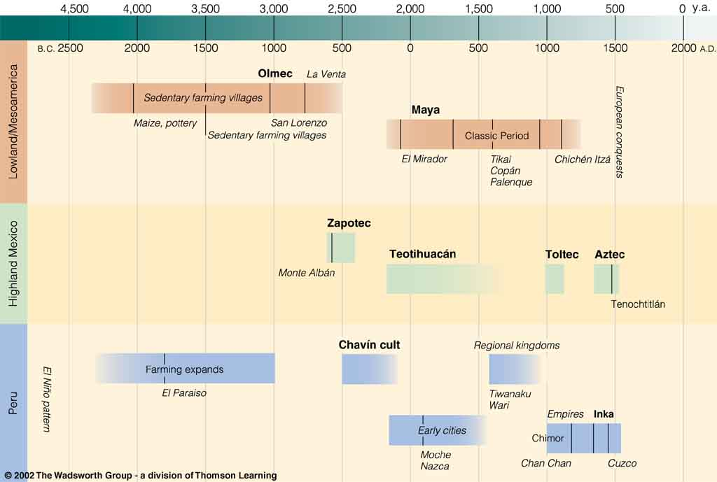
Time line of “New World Civilizations.”
Understanding Physical Anthropology and Archaeology, 8th ed., p. 479.

Slide 129
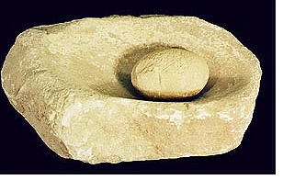
End of The Lithic
Continue on to
Welcome to the
The American Archaic
University of Minnesota Duluth
Tim Roufs

