Slide 1
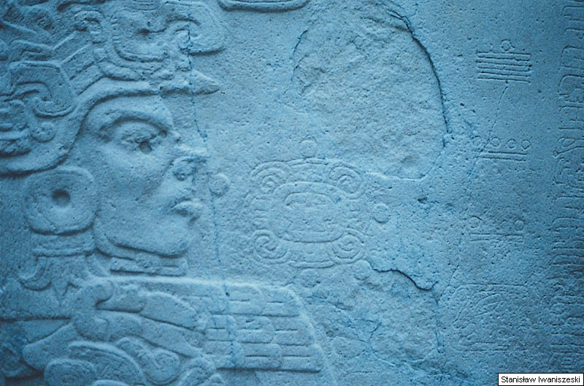
Ancient Middle America
The Late Preclassic
“Late Formative”
“Epi-Olmec”
University of Minnesota Duluth
Stela I from La Moharra
Ancient Middle America
Tim Roufs ©2009-2019
photo by

Slide 2
Late Preclassic Stage
Late Preclassic
Middle Preclassic
Early Preclassic

Slide 3
Late Preclassic Stage
300 B.C. - A.D. 250 (The Maya)
400 B.C. – A.D. 150 (Mexico)
300 B.C. – A.D. 1 / 150

Slide 4
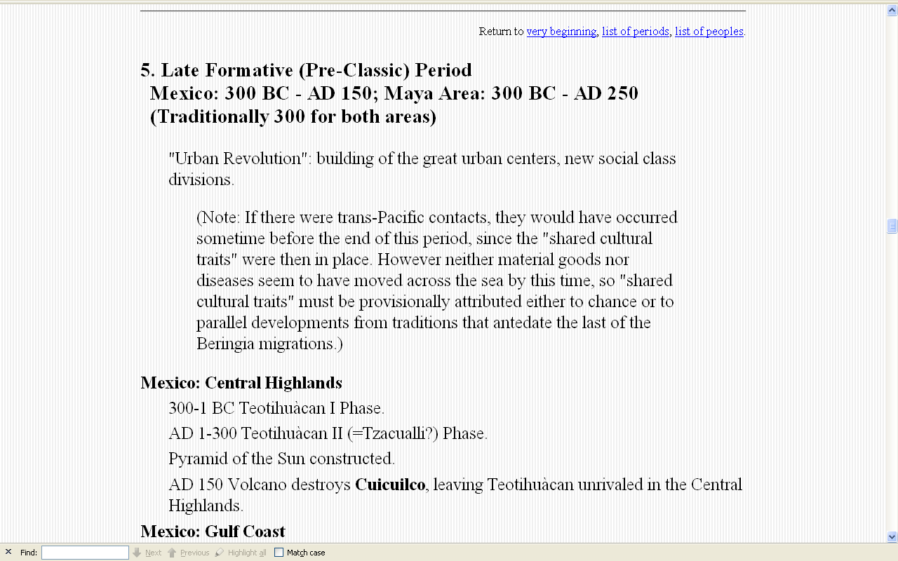
http://weber.ucsd.edu/~dkjordan/arch/mexchron.html#LPC

Slide 5
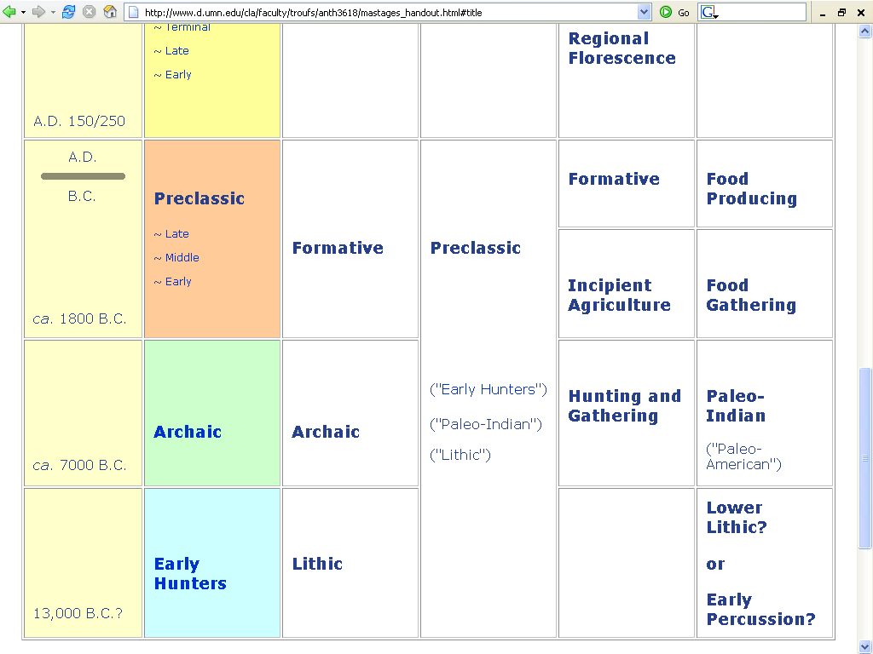

Slide 6
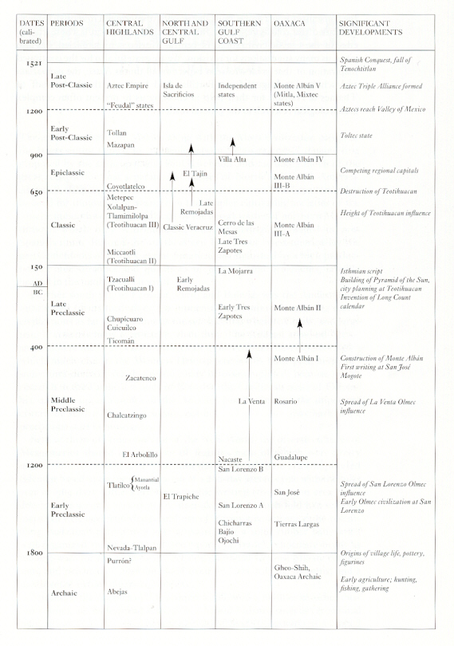
Mexico
(6th ed.)
Page 236

Slide 7
Mexico
(6th ed.)
Page 236

Slide 8
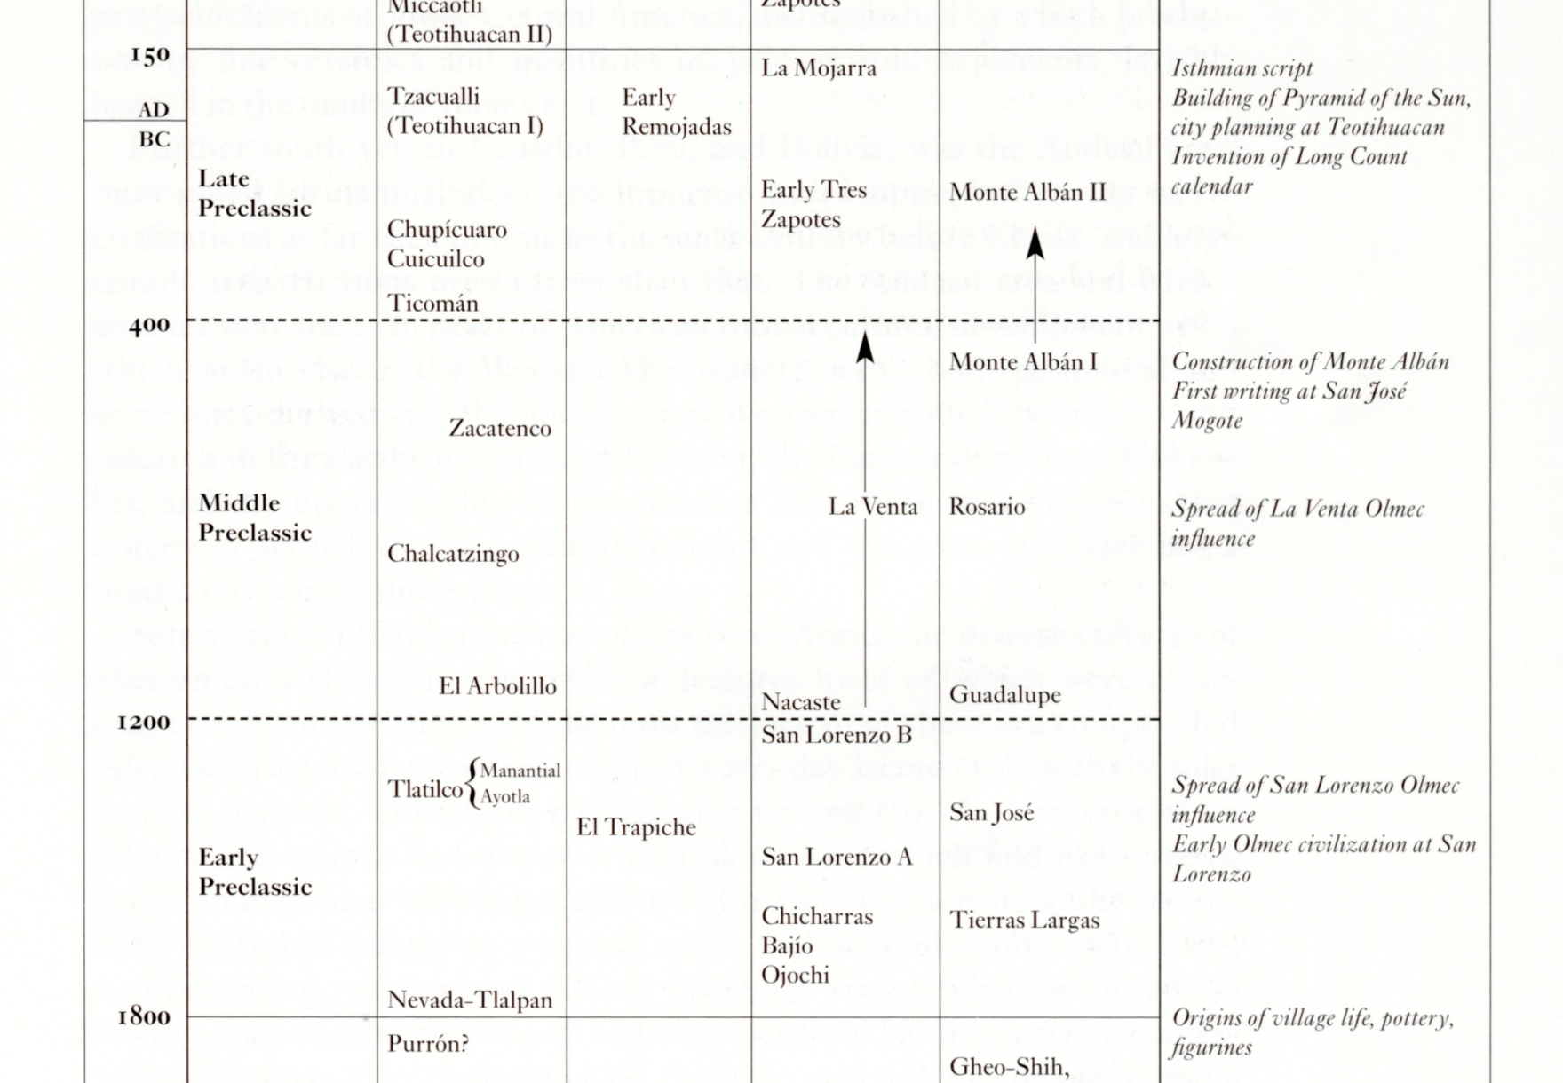
Mexico (6th ed.) Page 236

Slide 9
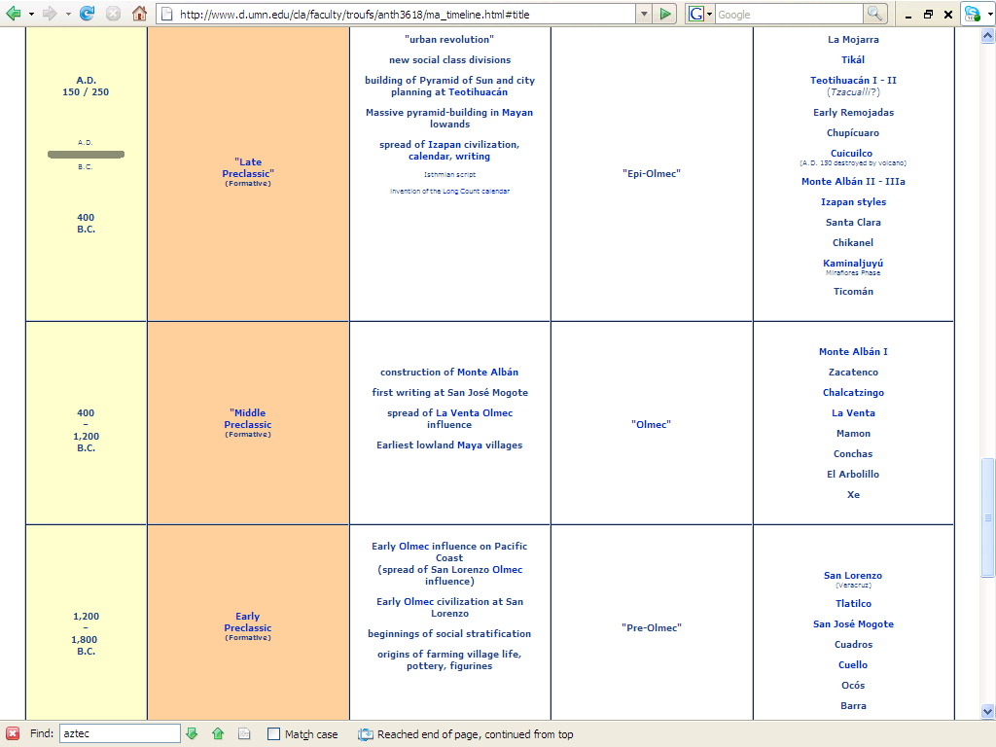
http://www.d.umn.edu/cla/faculty/troufs/anth3618/ma_timeline.html#Late_Preclassic

Slide 10
Late Preclassic Stage
300 B.C. - A.D. 250 (The Maya)
400 B.C. – A.D. 150 (Mexico)
300 B.C. – A.D. 1 / 150
characterized by. . .

Slide 11
Late Preclassic Stage
the high point of village groups
  small ceremonial centers characterized by temple bases appear in areas other than the Olmec heartland
  some contain tombs

Slide 12
Late Preclassic Stage
the high point of village groups
  small ceremonial centers characterized by temple bases appear in areas other than the Olmec heartland
  some contain tombs

Slide 13
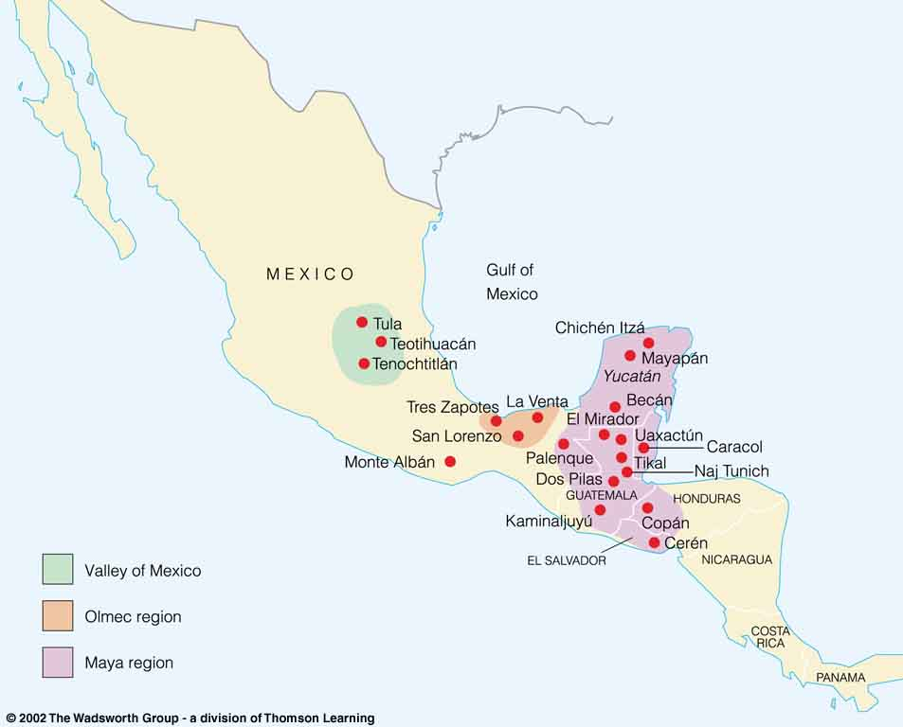
Toltec
Aztec
Tarascan
Maya
Mixtec
Zapotec
Mesoamerican archaeological sites
Understanding Physical Anthropology and Archaeology, 8th ed., p. 481

Slide 14
Late Preclassic Stage
the priesthood and a formalized religion also took shape in areas other than the Olmec heartland

Slide 15
Late Preclassic Stage
the priesthood and a formalized religion also took shape in areas other than the Olmec heartland

Slide 16
Late Preclassic Stage
there were marked advances in scientific knowledge and in technology
  principally of astronomical and mathematical character

Slide 17
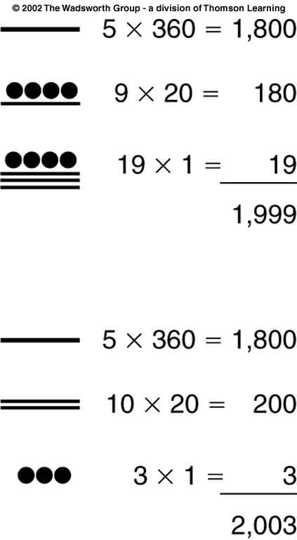
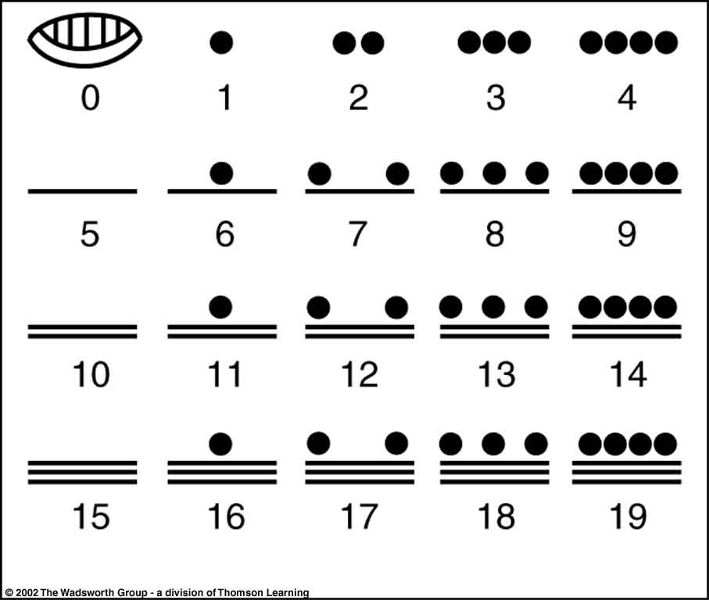
Maya Mathematics
Understanding Physical Anthropology and Archaeology, 8th ed., p. 487.

Slide 18
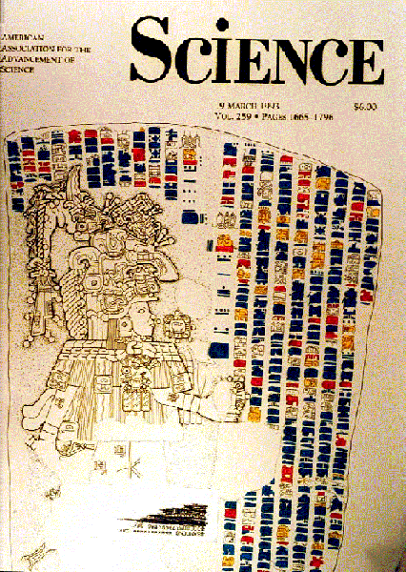
Stela I from La Moharra

Slide 19
Stela I from La Moharra
photo by

Slide 20
Late Preclassic Stage
considerable progress had been made in technology, which enabled more elaborate platforms and temple bases to be built . . .

Slide 21
Late Preclassic Stage
considerable progress had been made in technology, which enabled more elaborate platforms and temple bases to be built . . .

Slide 22
Late Preclassic Stage
new tools appear which suggest the existence of stonecutters, masons, and others involved in architecture
    planes for leveling floors and walls
    plumbs
    hammers
    chisels for cutting stone
    stone polishers

Slide 23
Late Preclassic Stage
pottery is predominantly of
  polychrome and negative decorations
  with fresco-style painting
  ornamental supports
  painting outlined by incisions
  ring bases

Slide 24
Late Preclassic Stage
The pottery of Chupícuaro, Guanajuato, is outstanding for this period and influenced the ceramic ware of other groups

Slide 25
http://www.d.umn.edu/cla/faculty/troufs/anth3618/ma_timeline.html#Late_Preclassic

Slide 26
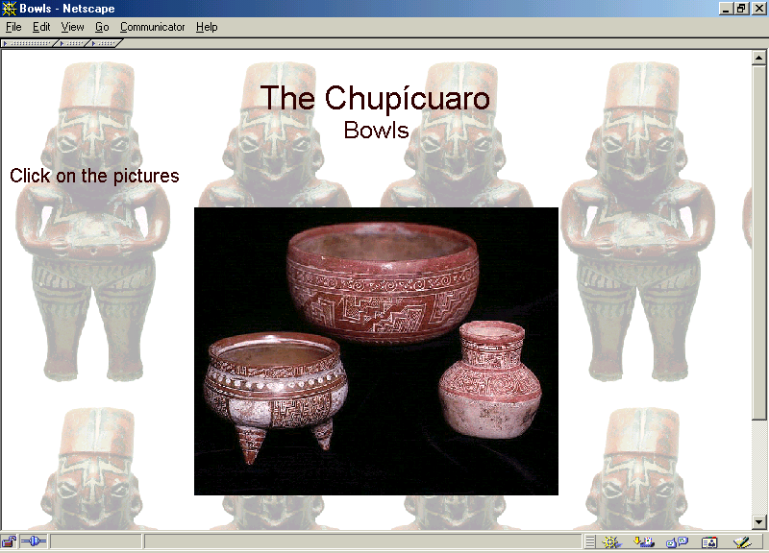

Slide 27
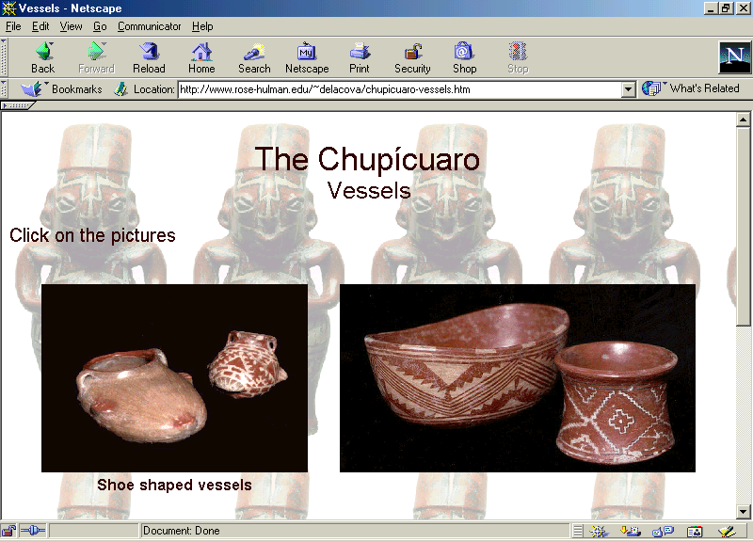

Slide 28
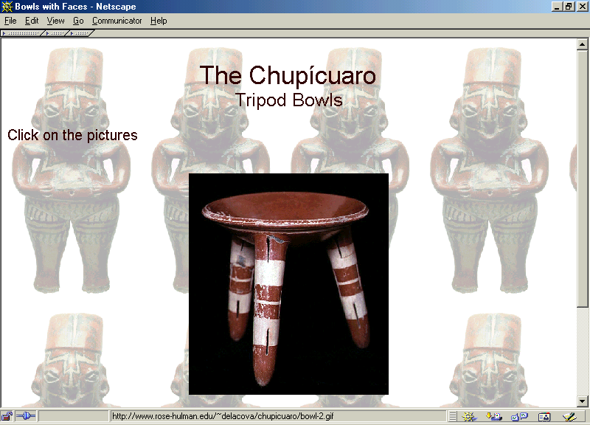

Slide 29
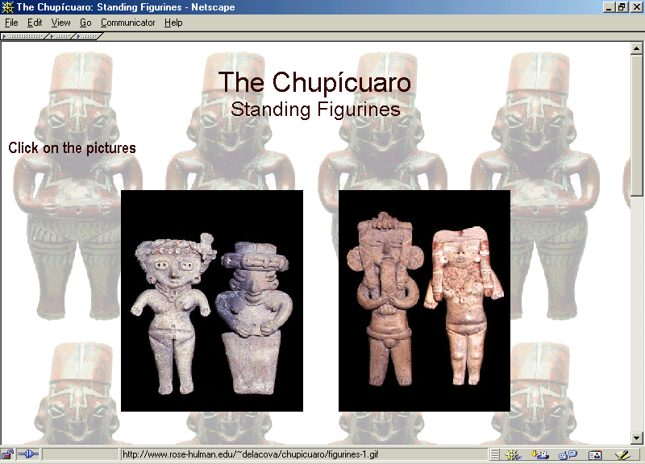

Slide 30
Late Preclassic Stage
with the appearance of small ceremonial centers and temple bases the worship of certain deities begins and a priestly caste emerges
  including the belief in Huehueteotl
    god of fire
    hunchback who carried a brazier on his back

Slide 31
Late Preclassic Stage
with the appearance of small ceremonial centers and temple bases the worship of certain deities begins and a priestly caste emerges
  including the belief in Huehueteotl
    god of fire
    hunchback who carried a brazier on his back

Slide 32
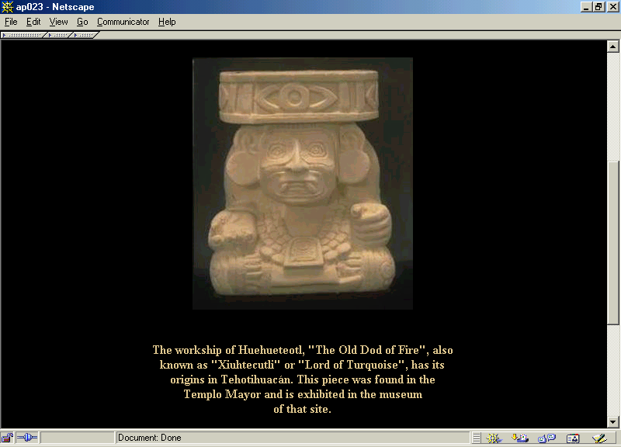

Slide 33
Late Preclassic Stage
architecture evolved fairly rapidly
  began with platforms and huts
  (Cerro de Tepalcate)

Slide 34
Late Preclassic Stage
architecture evolved fairly rapidly
  followed by superposing of platforms
    e.g., 1st steps of Cuicuilco
    first build on a circular plan, first in clay in later in stone

Slide 35
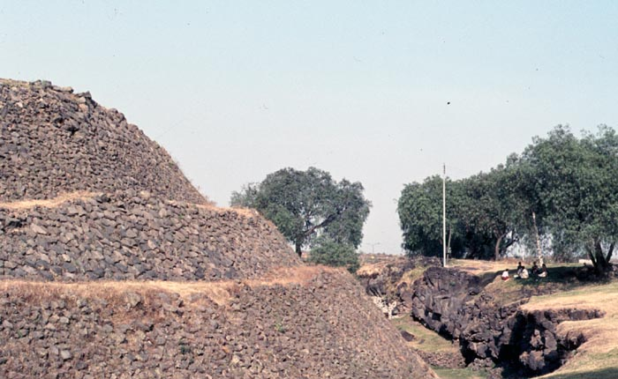
Cuicuilco

Slide 36
http://www.d.umn.edu/cla/faculty/troufs/anth3618/ma_timeline.html#Late_Preclassic

Slide 37
Late Preclassic Stage
  3. followed by pyramidal bases
  e.g., Tlapacoya
  (influenced Teotihuacán’s builders of the
  Pyramid of the Sun and the Pyramid of the Moon)

Slide 38
Late Preclassic Stage
small circular structure at Cuicuilco
  built by superposing great basalt slabs, forming a sort of cupola or vaulted enclosure
  has an entrance passage
  inner walls are painted with spiral or serpentine designs in red
  probably used for religious ceremonies

Slide 39
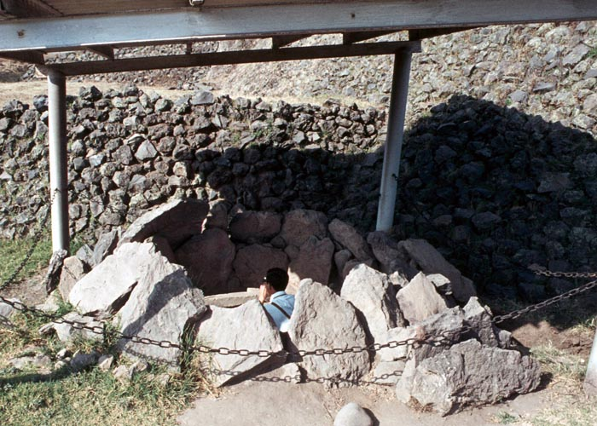
Cuicuilco

Slide 40
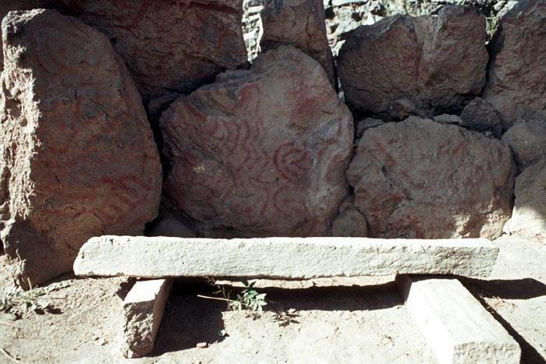
Cuicuilco

Slide 41
Late Preclassic Stage
Late Preclassic Sites begin to multiply rapidly and include
    Teotihuacán I (Tzacualli phase)
    Monte Albán II
    Chupicuaro
    Cuicuilco
    Early Tres Zapotes
    Tikál
    Dzibilchaltún

Slide 42
Late Preclassic Stage
Late Preclassic Sites include:
    La Mojarra
    Tlapacoya
    Izapan styles
    Edzná
    Early Remojadas
    Ticomán
    Miraflores

Slide 43
Late Preclassic Stage
Late Preclassic Sites include:
    Miraflores
    Chikanel
    Santa Clara

Slide 44
Late Preclassic Stage
Protoclassic ?
Late Preclassic
Middle Preclassic
Early Preclassic

Slide 45
Protoclassic Stage
200 B.C. – A.D. 200
In the stage which some call the “Protoclassic” a number of features which will later distinguish the major Mexoamerican civilizations can already be recognized . . .

Slide 46
Protoclassic Stage
200 B.C. – A.D. 200
These civilizations include . . .
      Maya
      Zapotec
      Central Veracruz cultures (Totonac)
      and perhaps the Huastec
      and Teotihuacán

Slide 47
Protoclassic Stage
. . . among the features are:
  a precise technique of working stone
  the erection of stelae and altars associated with them
  the calendar and a system of numbering using dots and bars
  the god of rain with recognizable attributes

Slide 48
Protoclassic Stage
. . . also included are:
  fresco-type painting on vessels and tombs
  tetrapod vessels with mammiform legs
  labial and basal moldings on pottery

Slide 49
Ancient Middle America
The Late Preclassic
“Late Formative”
“Epi-Olmec”
End of the
University of Minnesota Duluth
Stela I from La Moharra
Ancient Middle America
Tim Roufs ©2009-2019
photo by

Slide 50
Continue on to
The Classic
University of Minnesota Duluth
Stela I from La Moharra
Tim Roufs
photo by

Slide 51
End of The Late Preclassic
Continue on to The Classic

