Slide 1
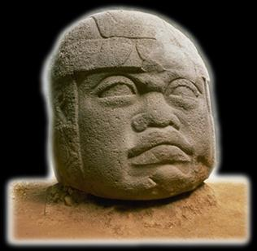
Ancient Middle America
The Middle Preclassic
“Middle Formative”
“Olmec”
University of Minnesota Duluth
Ancient Middle America
Tim Roufs ©2009-2019

Slide 2
Middle Preclassic Stage
Late Preclassic
Middle Preclassic
Early Preclassic

Slide 3
Middle Preclassic Stage
1000 - 300 B.C. (The Maya)
1200 - 400 B.C. (Mexico)

Slide 4
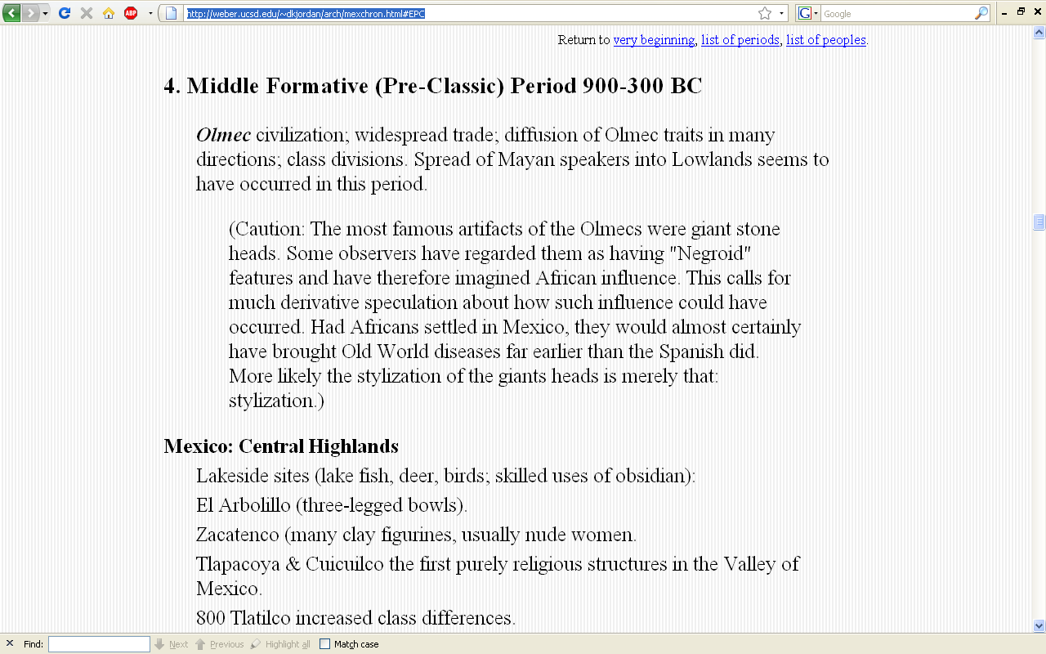
http://weber.ucsd.edu/~dkjordan/arch/mexchron.html#MPC

Slide 5
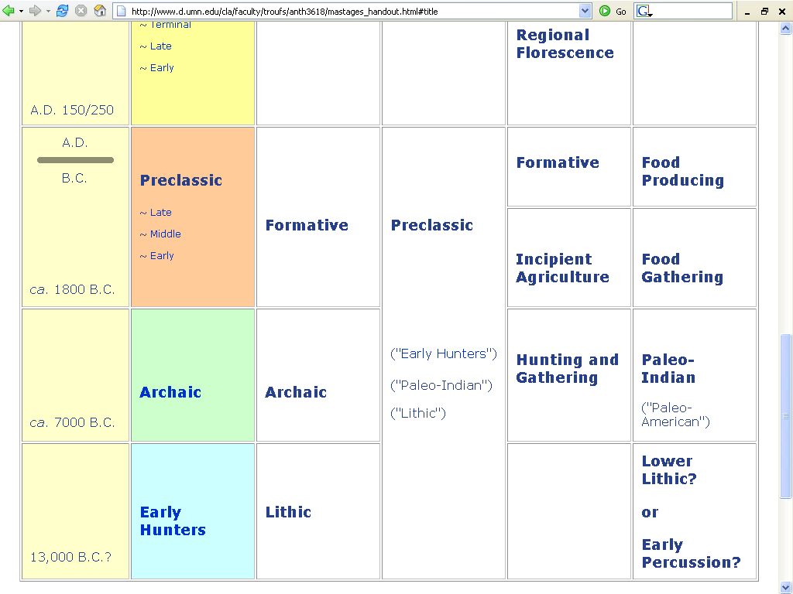

Slide 6
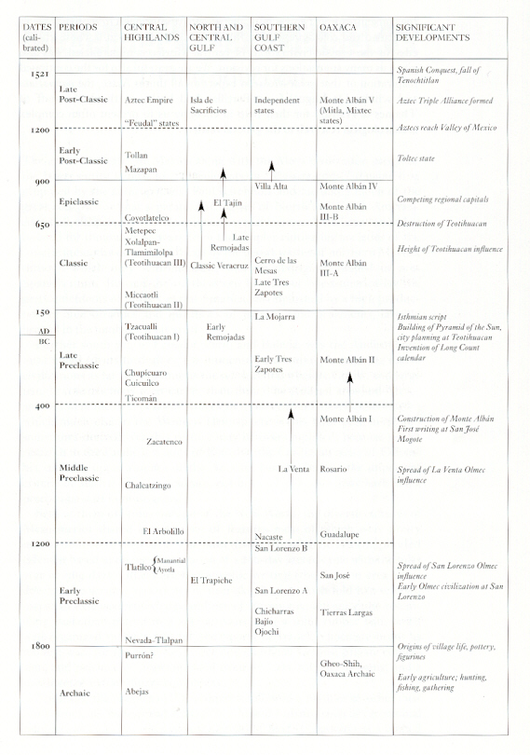
Mexico
(6th ed.)
Page 236

Slide 7
Mexico
(6th ed.)
Page 236

Slide 8
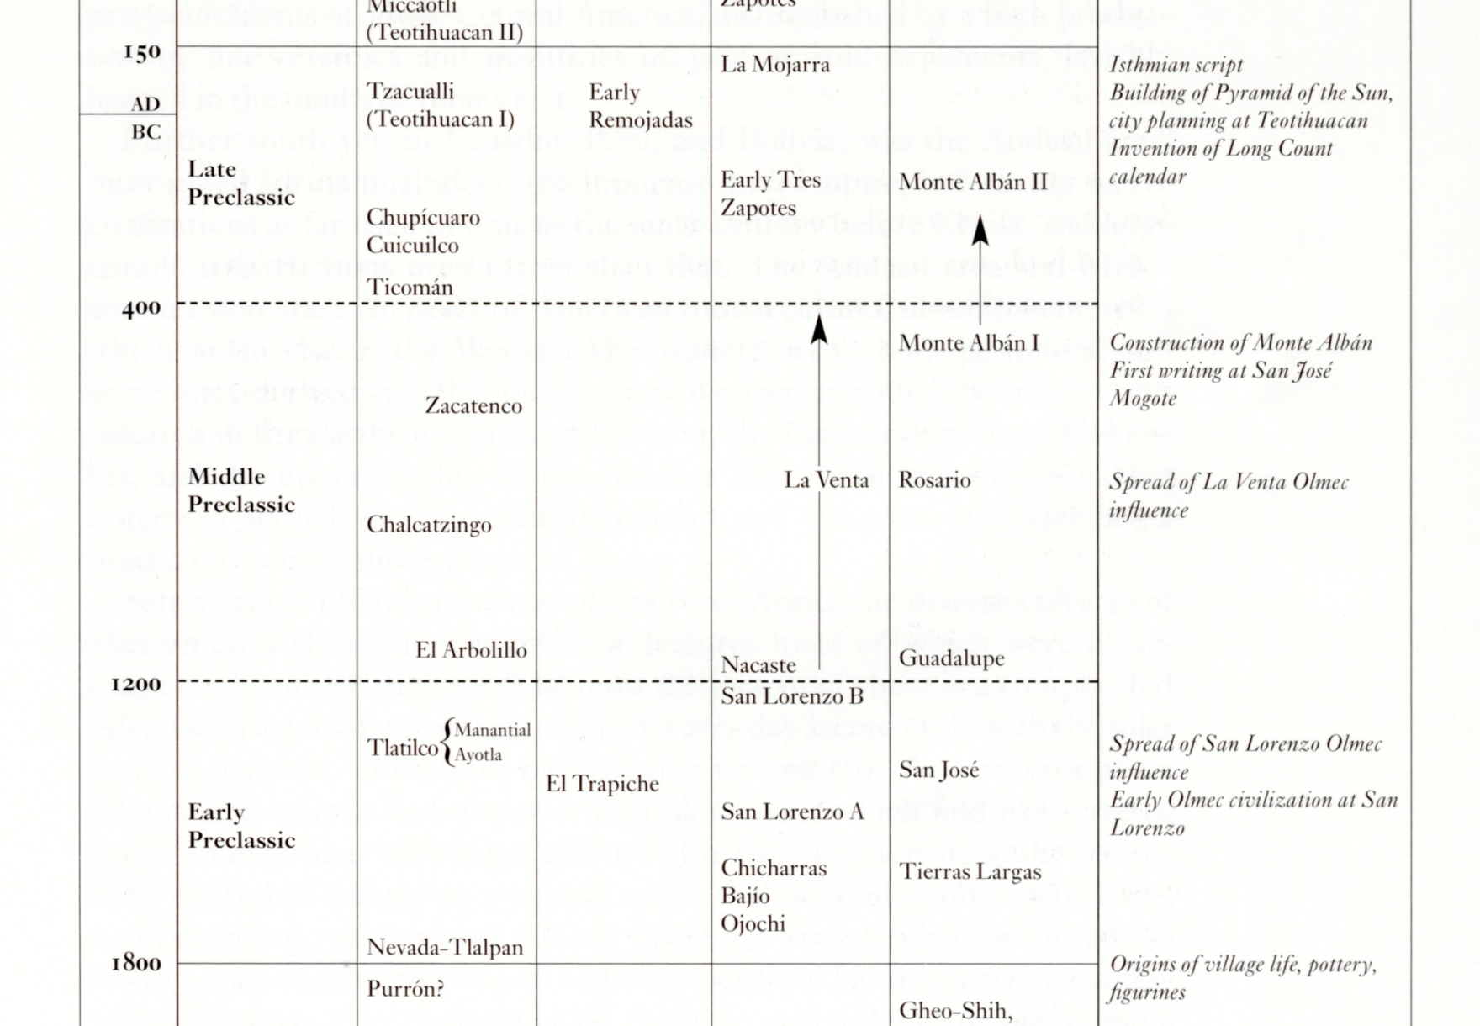
Mexico (6th ed.) Page 236

Slide 9
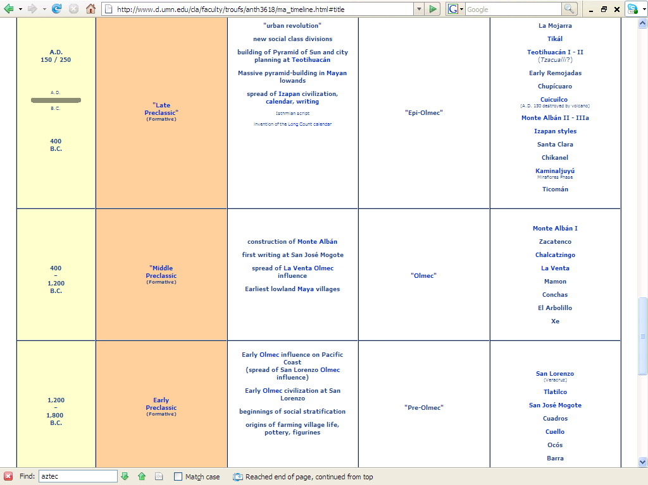
http://www.d.umn.edu/cla/faculty/troufs/anth3618/ma_timeline.html#Late_Preclassic

Slide 10
Middle Preclassic Stage
1000 - 300 B.C. (The Maya)
1200 - 400 B.C. (Mexico)
Characterized by. . .

Slide 11
Middle Preclassic Stage
agricultural communities moved in the direction of a more densely populated type of village or town
  they were made up of huts built over house-mound platforms of earth covered with stone
  with had tamped earth or slab floors

Slide 12
Middle Preclassic Stage
agricultural communities moved in the direction of a more densely populated type of village or town
  they were made up of huts built over house-mound platforms of earth covered with stone
  with had tamped earth or slab floors

Slide 13
Middle Preclassic Stage
local variations of pottery were being developed in both the round and flat-bottomed traditions of pottery
      tecomate / tecomatl
      flat-bottomed dish

Slide 14
Middle Preclassic Stage
on the Gulf coast the Olmec culture was now well integrated and had acquired considerable strength
  and had widespread influence over groups in the Central Highlands

Slide 15
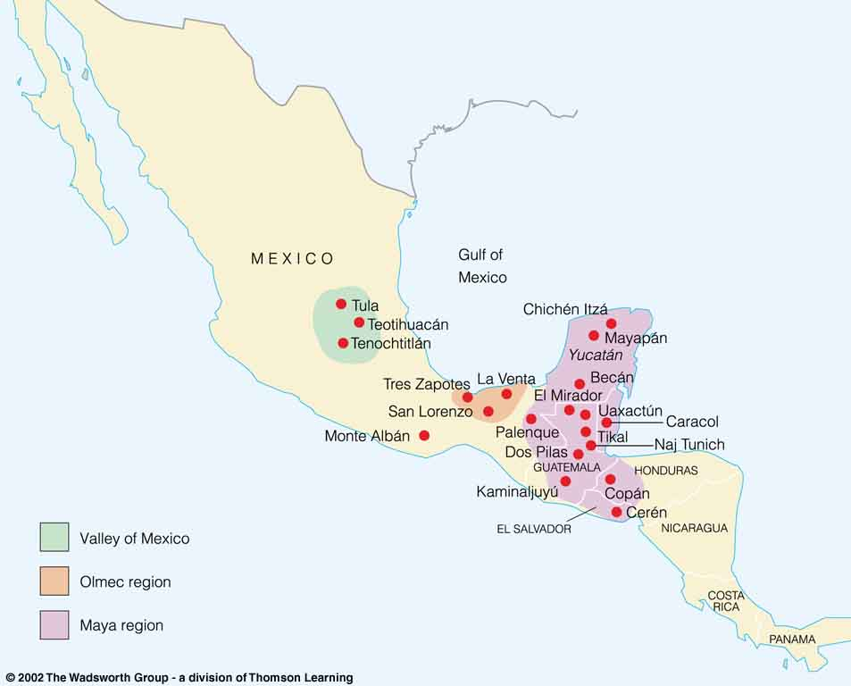
Olmec
Understanding Physical Anthropology and Archaeology, 8th ed., p. 481.

Slide 16
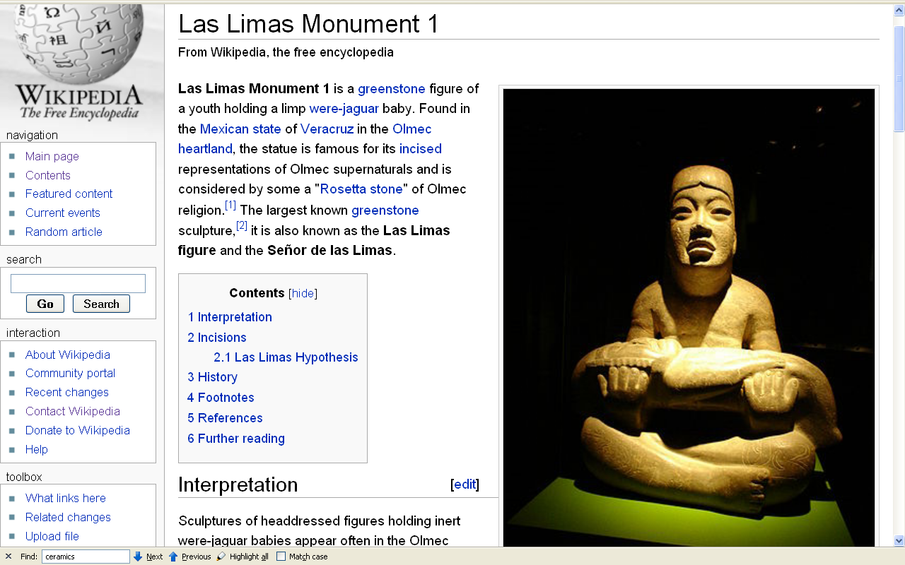
Probably carved during the Middle Formative Period, some time between 1000 to 600 BCE.
http://en.wikipedia.org/wiki/Las_Limas_Monument_1

Slide 17
Middle Preclassic Stage
the pottery of the Middle Preclassic period became more improved
  for e.g., they had vessels with a polished surface or red, or white on red

Slide 18
Middle Preclassic Stage
pottery of the Olmec style was introduced into the Highlands from the Gulf Coast
  characterized by vases, plates, gourd-shaped bowls and bottles
  had flat bottoms, adorned with feline or geometric motifs
  used decorative techniques of finger-nail marking, rocker stamping, textile impressions, excisions, etc.

Slide 19
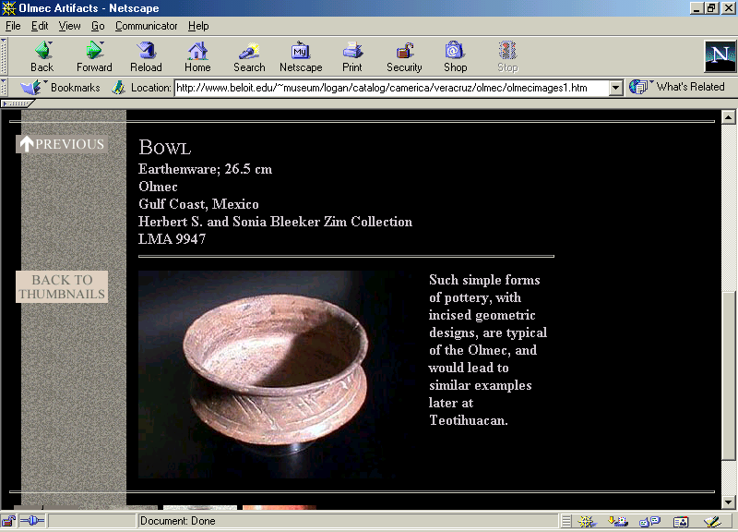

Slide 20
Middle Preclassic Stage
at this stage phytomorphic
(plant-like forms) and zoomorphic bottles, dishes with spouts, stirrup-spout vessels, anthropmorphic receptacles, and other pottery forms appear

Slide 21
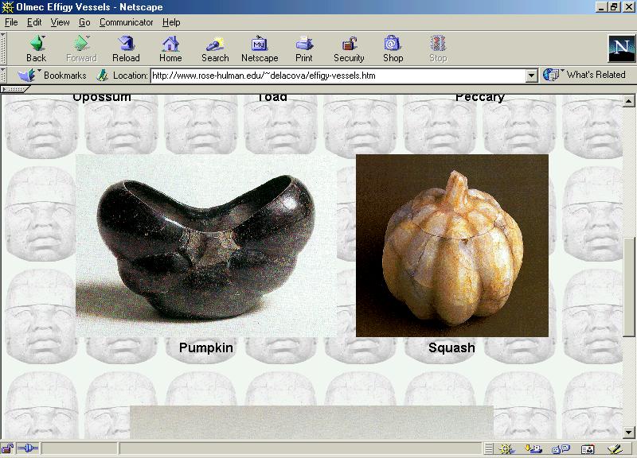

Slide 22
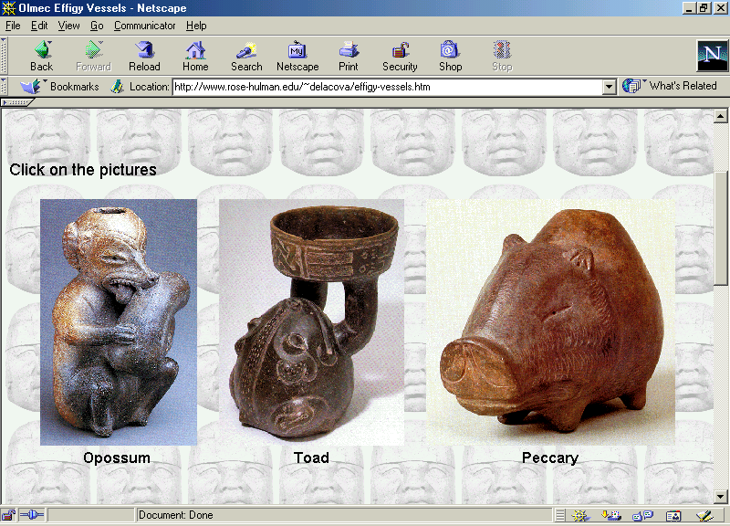

Slide 23
Middle Preclassic Stage
colors and techniques used:
  red on white, red on brown, orange and yellowish lacquer, white with negative painting, and painting on dry stucco

Slide 24
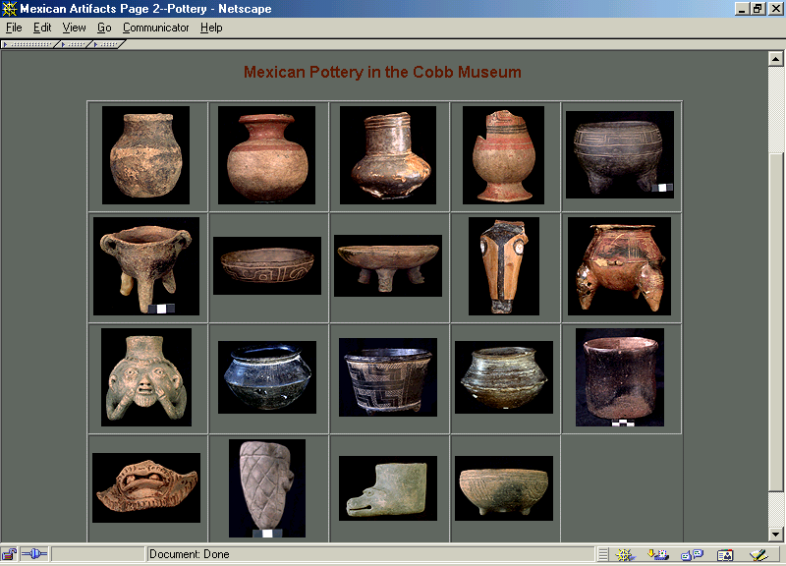

Slide 25
Middle Preclassic Stage
with the arrival of the Olmec a new type of figurine is also introduced into Central Mexico, characterized by a trapezoidal and enlarged mouth
  representing that of a child or a jaguar
  facial features formed by incising and punctuation

Slide 26
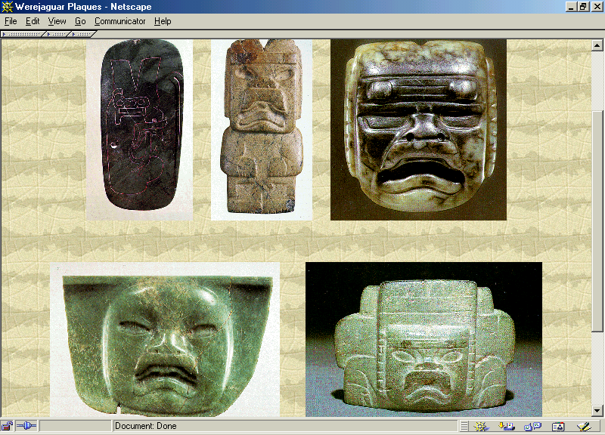

Slide 27
Middle Preclassic Stage
other types of figures continue to develop in the Highlands and become intermixed, resulting in may new types of figurines in the Middle Preclassic

Slide 28
Middle Preclassic Stage
Middle Preclassic Sites include:
      La Venta
      Chalcatzingo
      Monte Alban I
      Copilco
      Kaminaljuyú
      Uaxactún

Slide 29
Middle Preclassic Stage
Middle Preclassic Sites include:
      Gualupita
      Mamon
      Xe
      El Arbolillo
      Conchas
      Mazatán

Slide 30
Middle Preclassic Stage
Middle Preclassic Sites include:
      El Opeño
      Zacatenco

Slide 31
Late Preclassic Stage
Late Preclassic
Middle Preclassic
Early Preclassic

Slide 32
Late Preclassic Stage
300 B.C. - A.D. 250 (The Maya)
400 B.C. – A.D. 150 (Mexico)
300 B.C. – A.D. 1 / 150
characterized by. . .

Slide 33
End of The Middle Preclassic
Continue on to The Late Classic

