Slide 1


Use your up/down arrow keys and/or
your space bar to advance the slides
University of Minnesota Duluth
Tim Roufs
© 2010-2014
http://www.d.umn.edu/cla/faculty/troufs/anth3618/

Slide 2
Welcome to
Ancient Middle America
University of Minnesota Duluth
Tim Roufs
© 2010-2013
http://www.d.umn.edu/cla/faculty/troufs/anth3618/

Slide 3
Welcome to
Ancient Middle America
This will be a great course . . .
you will see . . .
University of Minnesota Duluth
Tim Roufs
© 2010-2013
http://www.d.umn.edu/cla/faculty/troufs/anth3618/

Slide 4

First thing . . .
(if you are not already in Moodle)
go to your
course management site
and check it out . . .

Slide 5
How do you find
in the first place?

Slide 6
Further instructions follow,
but if you want,
and your browser permits,
clicking on the URL that follows
in the next slide
will take you to your Moodle home . . .
(your browser may require that you double-click)
There is another link at the end of this program

Slide 7
https://moodle2.umn.edu/
(your browser may require that you double-click)
If your browser does not allow you to click on the above URL just enter it in your browser window . . .
Continue on here for further instructions . . .
There is another link at the end of this program

Slide 8
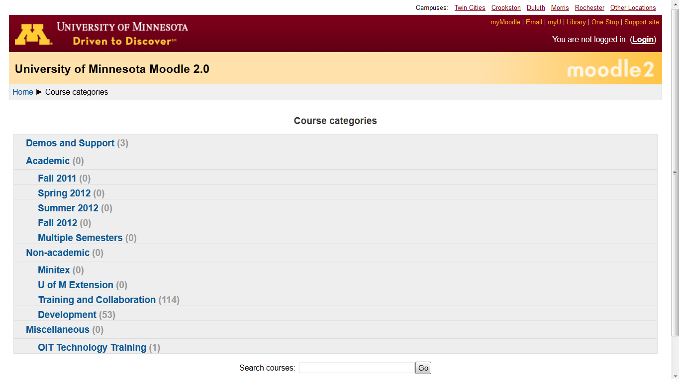
Your Moodle screen will look something like this . . .
Be sure to log in

Slide 9
Your Moodle screen will look something like this . . .
Be sure to log in

Slide 10
Your log-in page will look something like the following . . .
Log in using your “x.500” information . . .
(that’s the log-in information you use for your e-mail)
https://moodle.umn.edu/

Slide 11
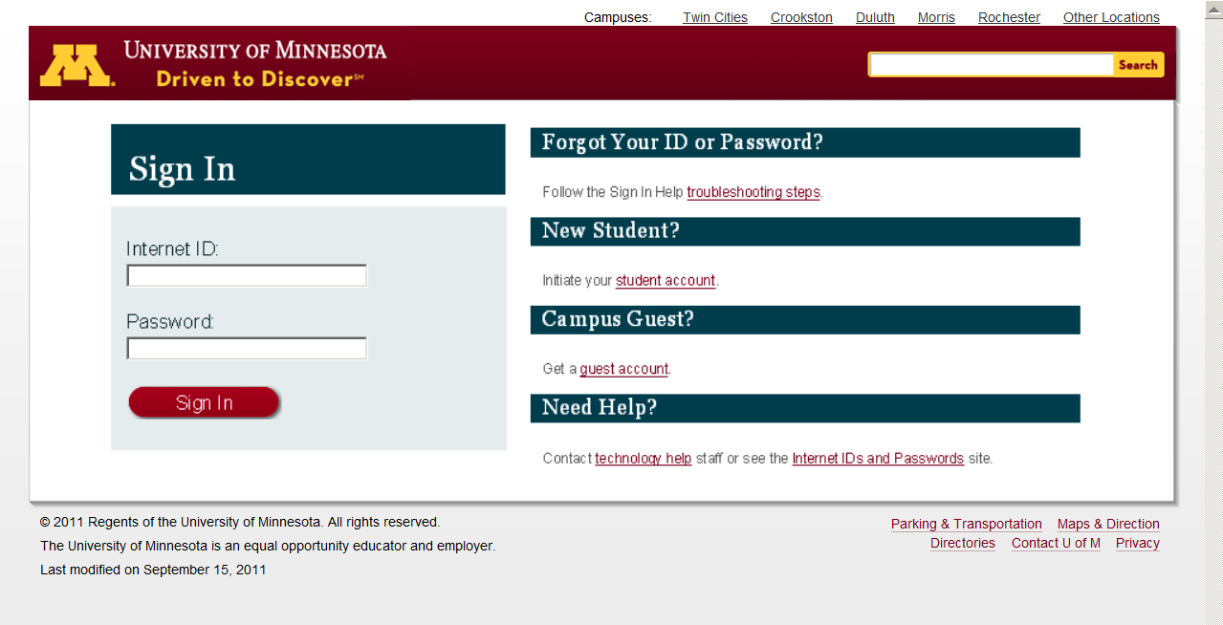
Log in using your “x.500” information . . .

Slide 12
Your Moodle screen
will look
something like the following . . .

Slide 13
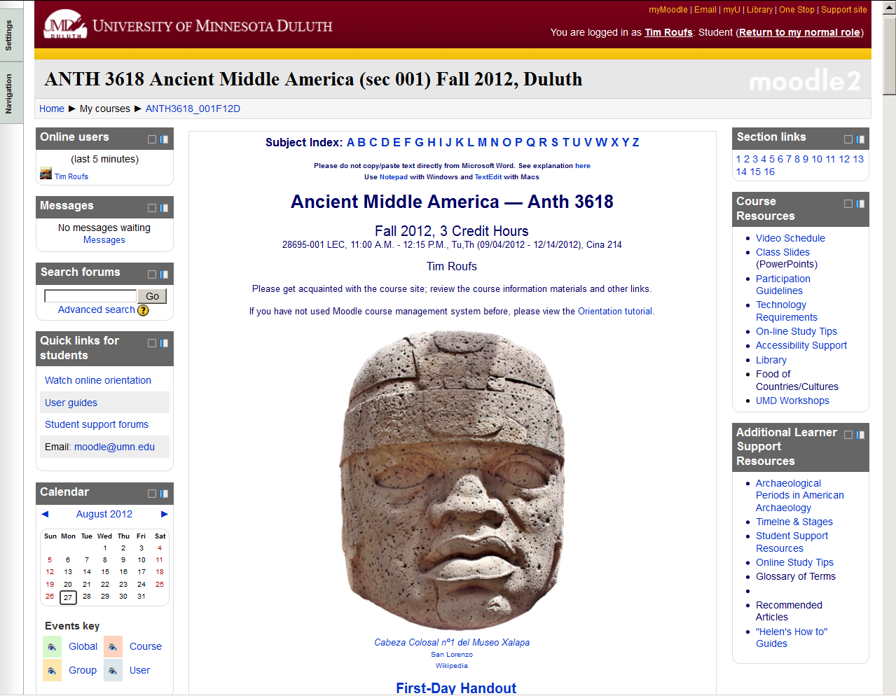
Your Moodle screen will look something like this . . .

Slide 15
And the listing for Week 1
will look something like this . . .

Slide 16
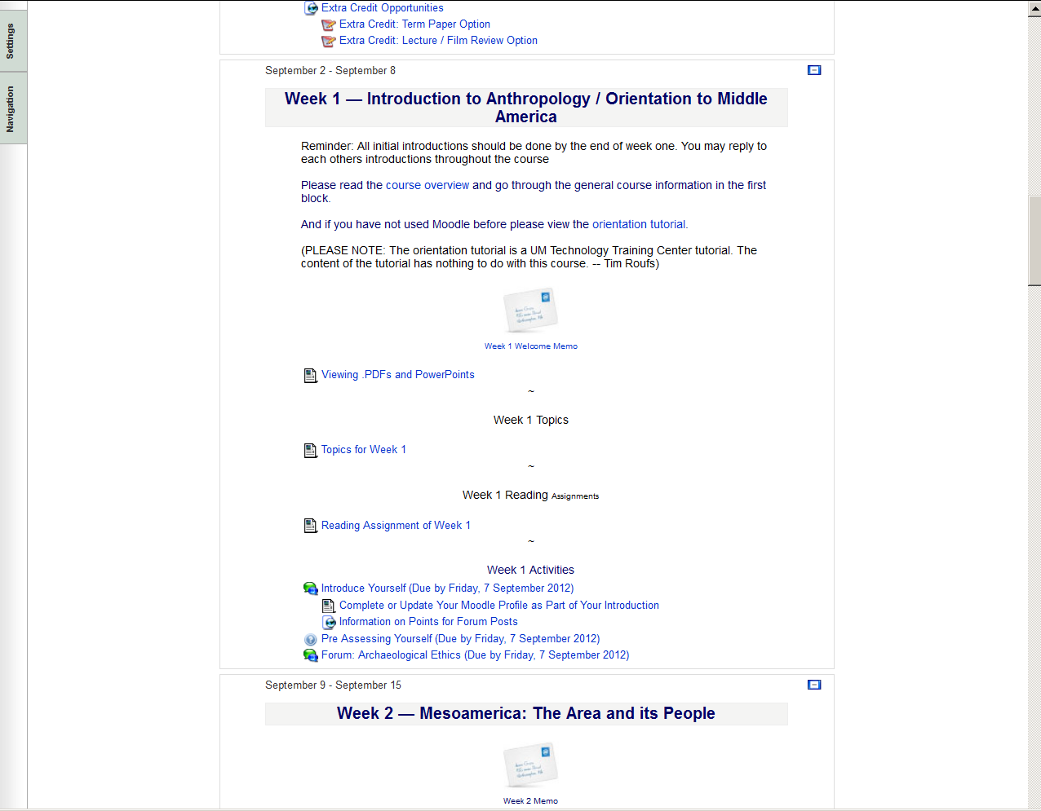

Slide 18
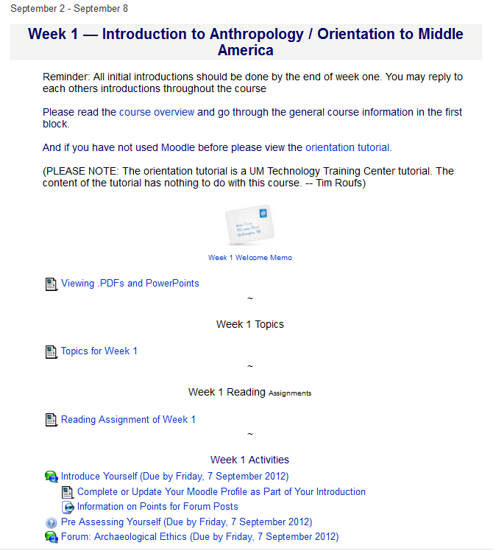

Slide 19
There are usually three main parts to the listing of a week . . .

Slide 20
1. Topics for the Week . . .

Slide 21
2. Readings for the Week . . .

Slide 22
and 3. Activities for the week . . .

Slide 23

The first week . . .
    introduce yourself
    and, just for the fun of it, have a look around at the rest of the materials

Slide 24
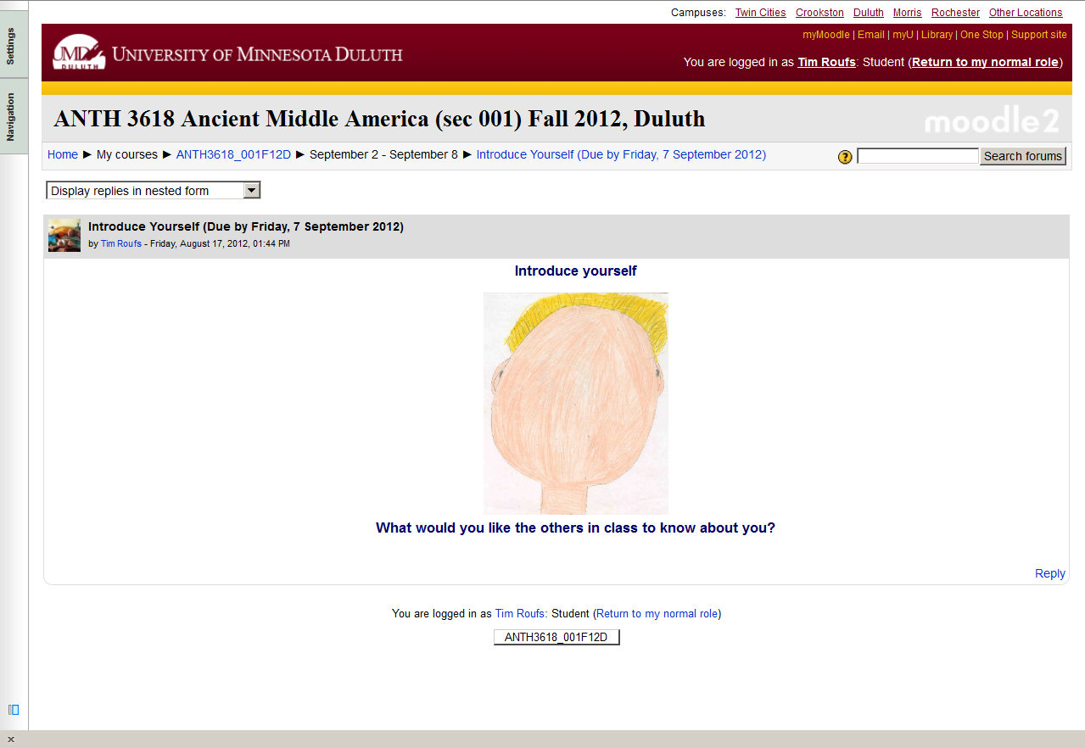
And the Introduction Page will look something like this . . .

Slide 25
The first week . . .
    introduce yourself
    and, just for the fun of it, have a look around at the rest of the materials
    be sure to Update Your Moodle Profile
    as part of your introduction

Slide 26
The first week . . .
    introduce yourself
    and, just for the fun of it, have a look around at the rest of the materials

Slide 27

Week 2 . . .
    do the Pre-Assessment
    join in on the Forum Discussion
    and, just for the fun of it, have a look around at the rest of the materials

Slide 28
And the “Pre Assessment” Materials
will look something like the following . . .

Slide 29
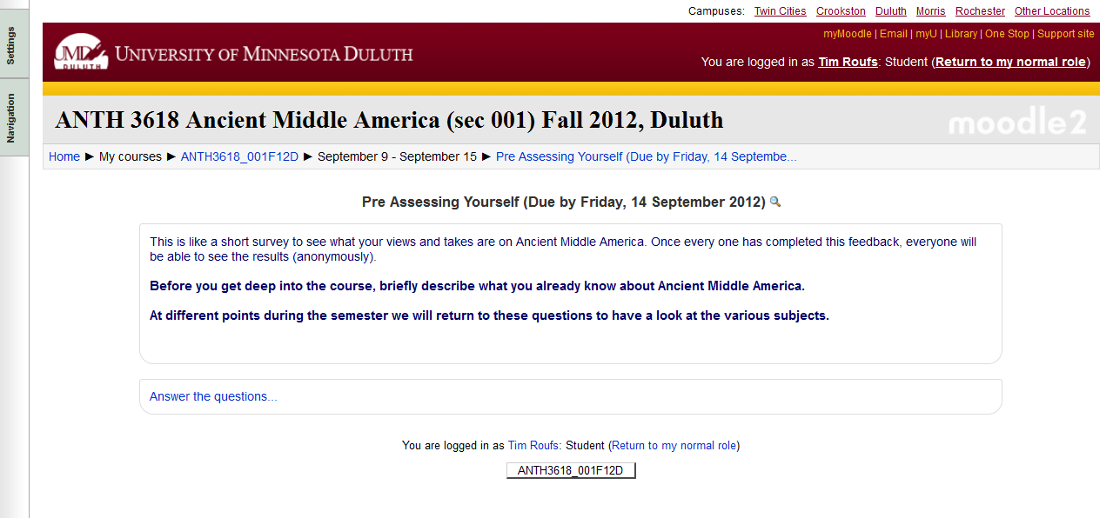
And the “Pre Assessment” Materials will look something like this . . .

Slide 30
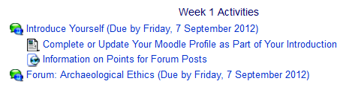
Week 1 . . .
    do the Pre-Assessment
    join in on the Forum
    and, just for the fun of it, have a look around at the rest of the materials

Slide 31
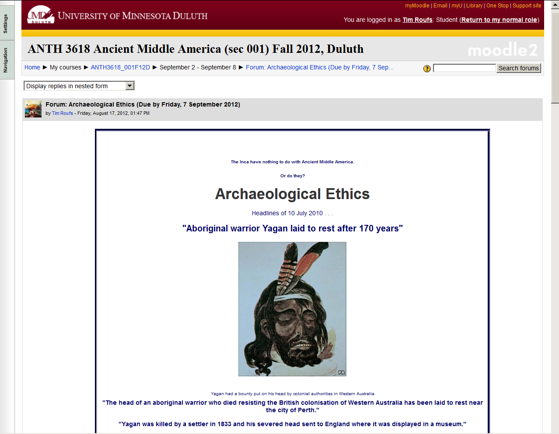

Slide 32
Week 2 . . .
    do the Pre-Assessment
    join in on the Forum
    and, just for the fun of it, have a look around at the rest of the materials

Slide 33
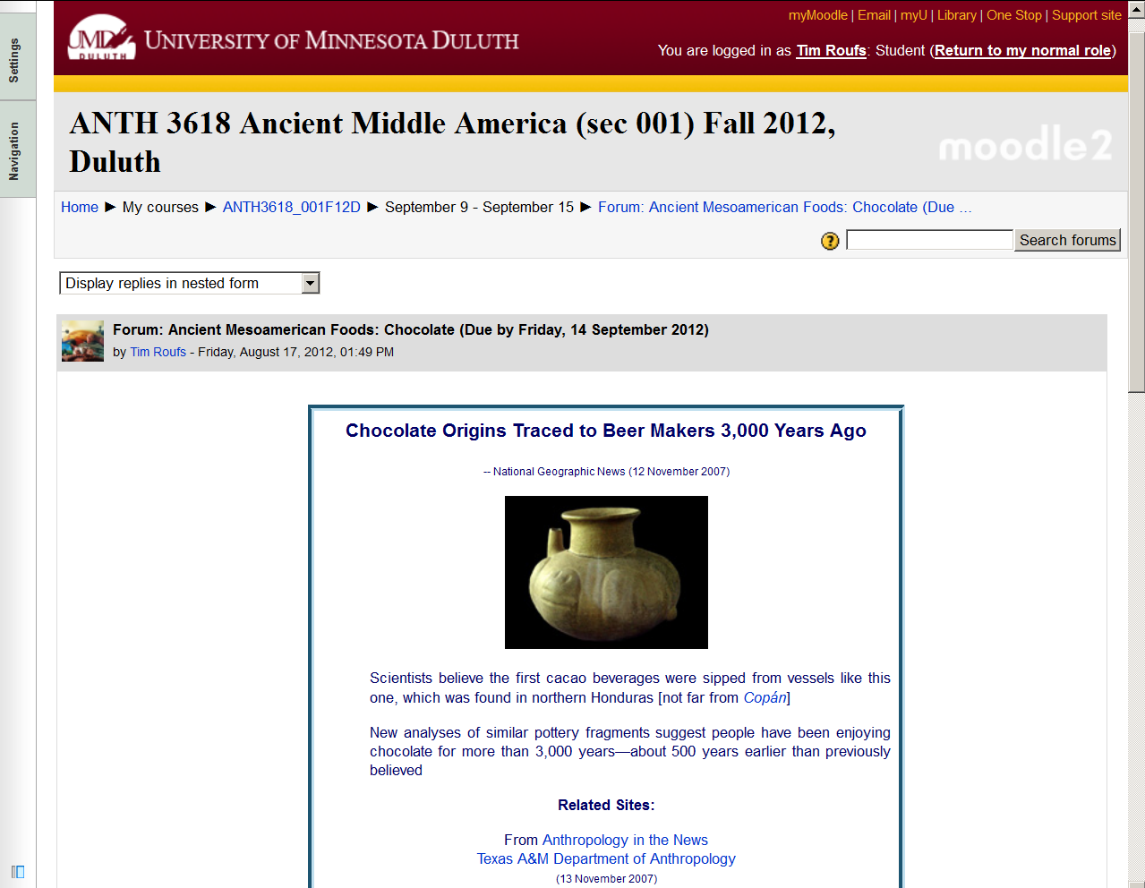

Slide 34
Weeks 1 and 2 . . .
    do the Pre-Assessment
    join in on the Forum Discussion
    and, look around some more, just for the fun of it

Slide 35
Week 2 . . .
    do the Pre-Assessment
    join in on the Forum Discussion
    then look around still more,
    just for the fun of it

Slide 36
You may also access your Moodle folder via the Main UMD WebPage . . .
www.d.umn.edu

Slide 37
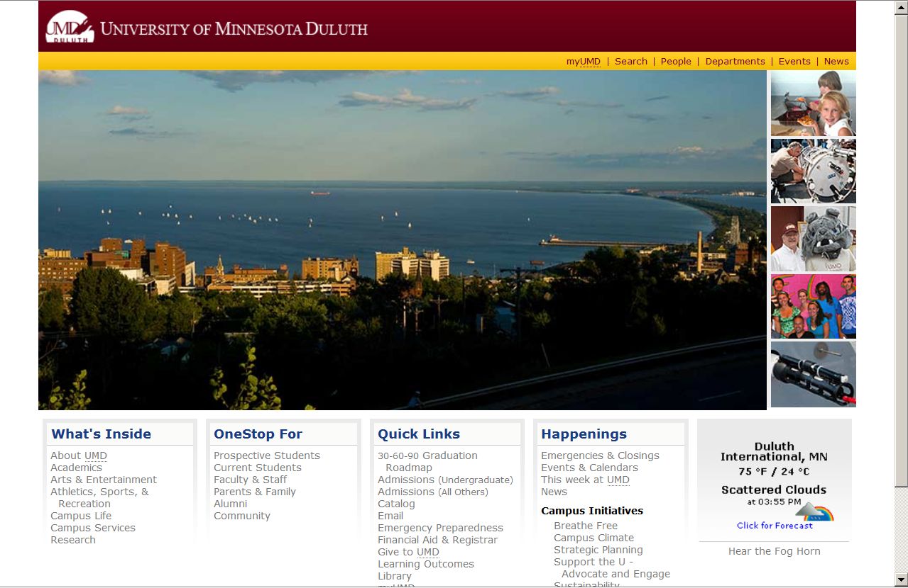
Main UMD WebPage . . .
(this image changes)
www.d.umn.edu

Slide 38
click on “OneStop For Current Students” . . .
(not the image that will appear)
www.d.umn.edu

Slide 39
Main UMD WebPage . . .
(this image changes)
www.d.umn.edu

Slide 40
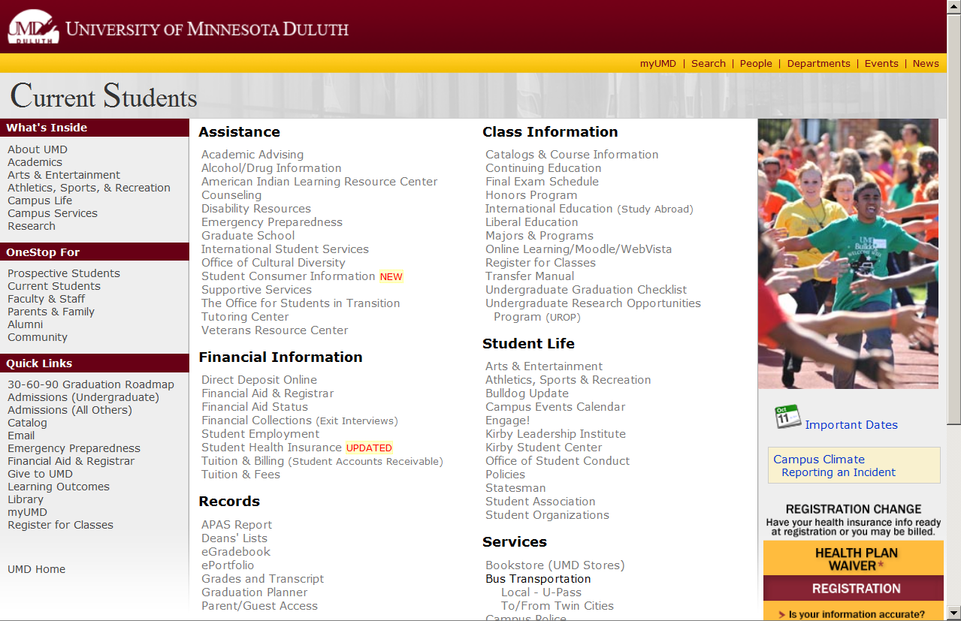
scroll down
http://www.d.umn.edu/students/

Slide 41
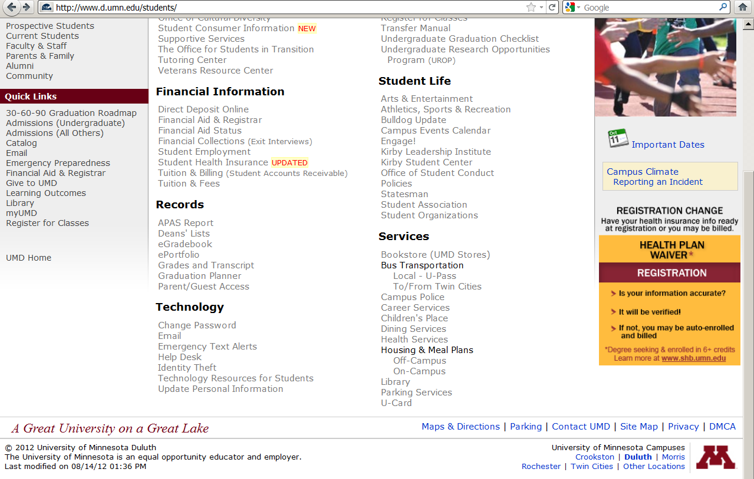
click on “Technology Resources for Students” . . .

Slide 42
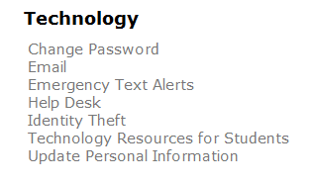
click on “Technology Resources for Students” . . .
http://www.d.umn.edu/itss/students/

Slide 43
then click on “Moodle Support” . . .
http://www.d.umn.edu/itss/students/

Slide 44
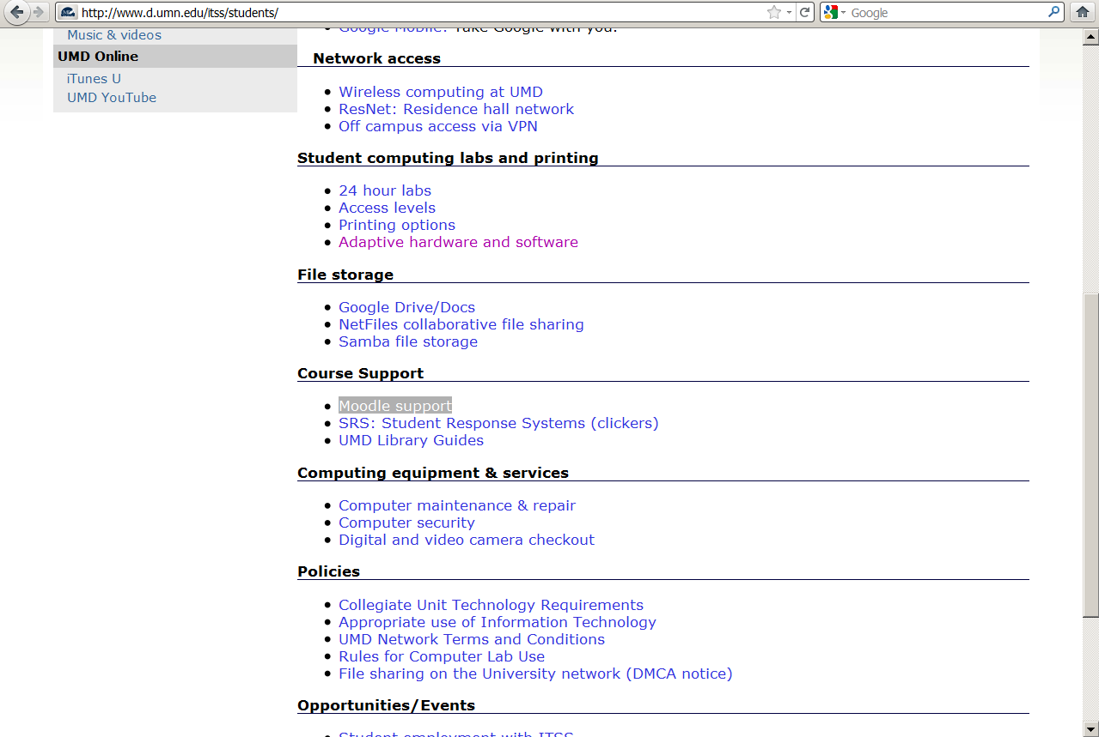
click on “Moodle Support” . . .
http://www.d.umn.edu/itss/students/

Slide 45
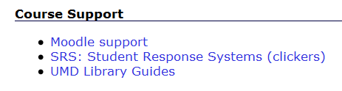
click on “Moodle Support” . . .
http://www.d.umn.edu/itss/students/

Slide 46
Your log-in page will look something like the following . . .
Log in using your “x.500” information . . .
(that’s the log-in information you use for your e-mail)
https://moodle.umn.edu/

Slide 47
Log in using your “x.500” information . . .

Slide 48
Your Moodle “home” will look something like the following . . .
https://moodle.umn.edu/

Slide 49
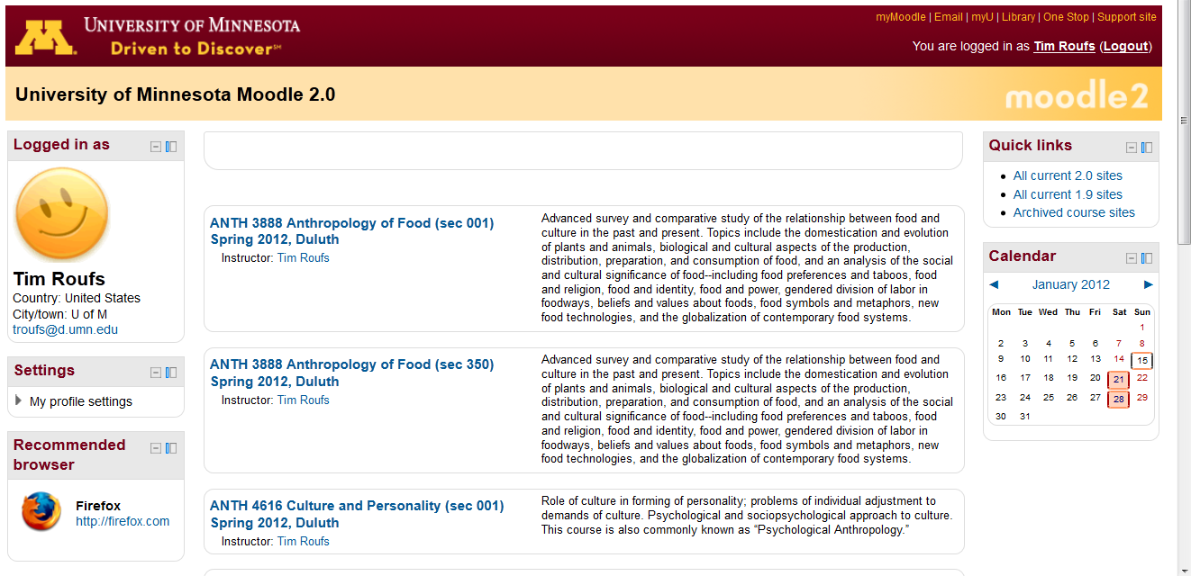
Your Moodle “home” will look something like this . . .
https://moodle.umn.edu/

Slide 50
Select Ancient Middle America . . .

Slide 51
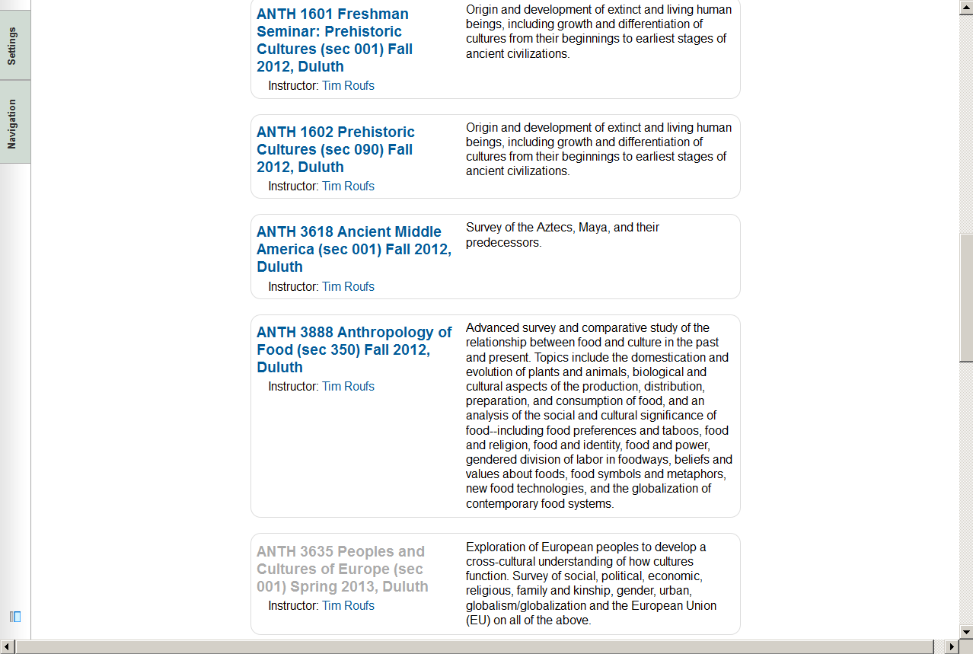
Your Moodle “home” will look something like this . . .

Slide 53
The “First-Day” Handout information contains the basic information . . .
It look something like the following . . .

Slide 54
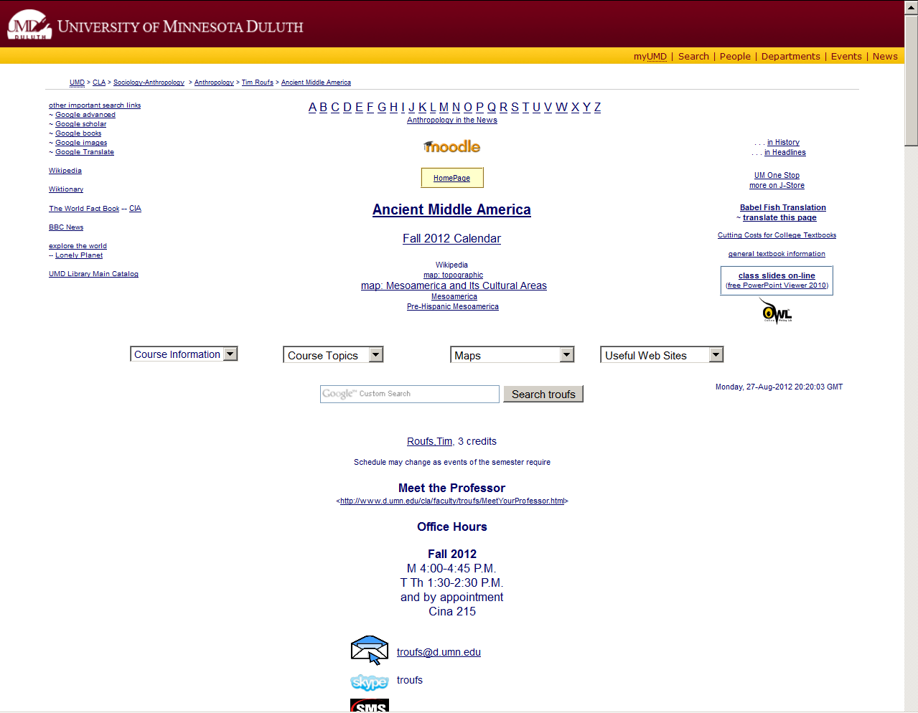
“First-Day” Handout information . . .
http://www.d.umn.edu/cla/faculty/troufs/anthfood/afhandout_first-day_online.html

Slide 55
“First-Day” Handout information . . .
scroll down
http://www.d.umn.edu/cla/faculty/troufs/anthfood/afhandout_first-day_online.html

Slide 56
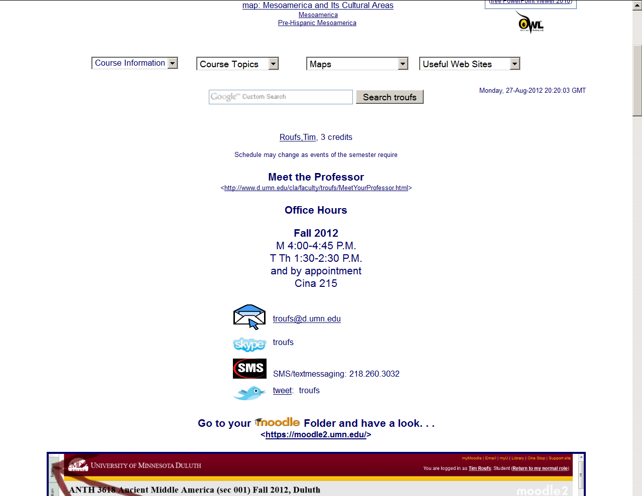
Basic Contact information . . .
http://www.d.umn.edu/cla/faculty/troufs/anthfood/afhandout_first-day_online.html

Slide 57
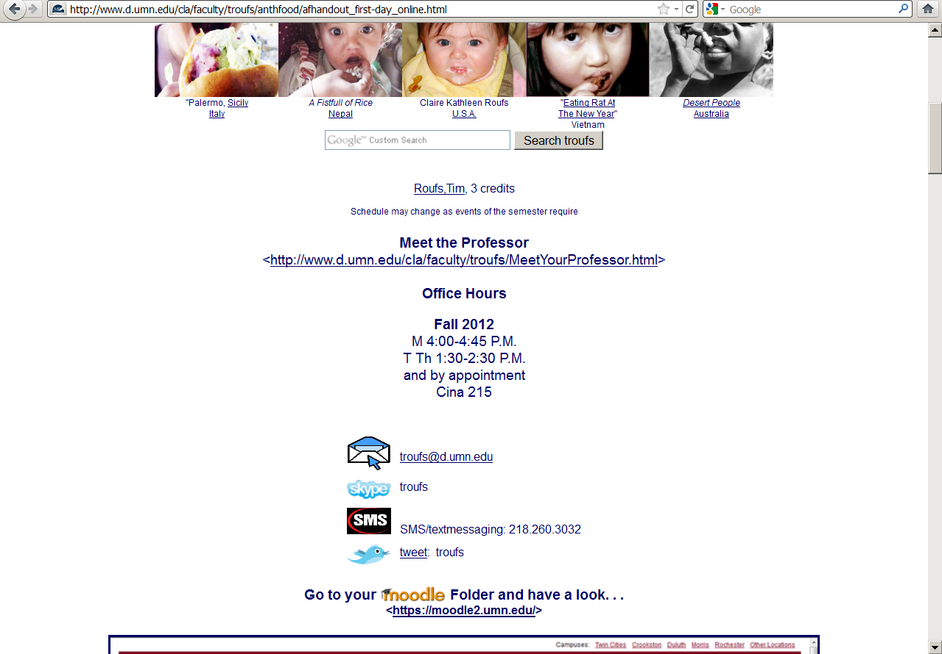
Basic Contact information . . .
scroll down

Slide 58
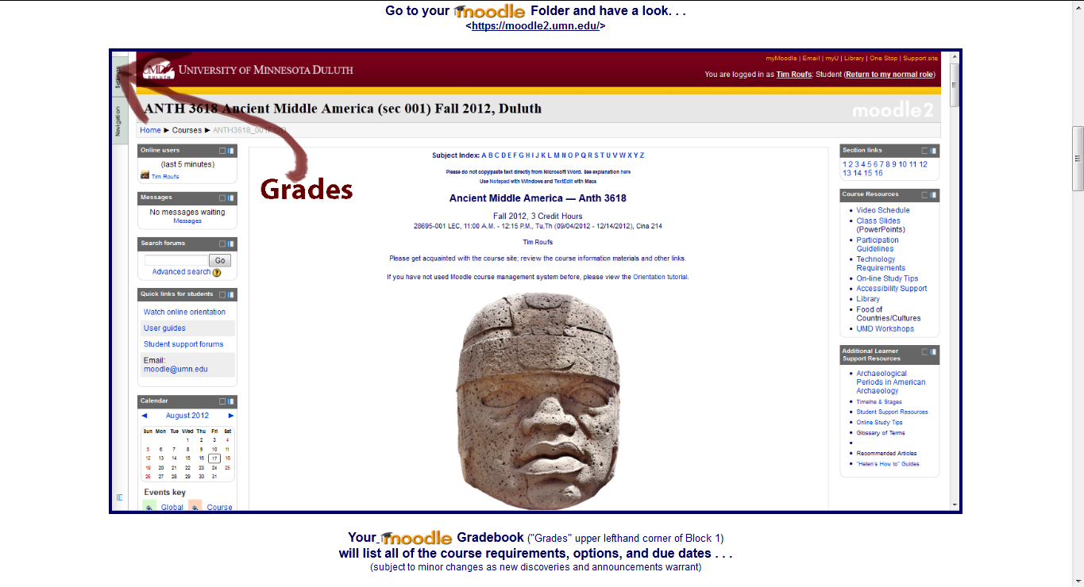
Moodle “Block 1”

Slide 59
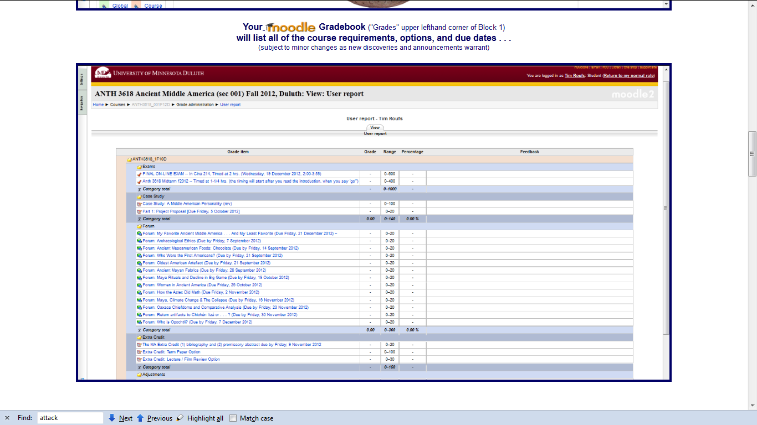
Moodle Grader

Slide 60
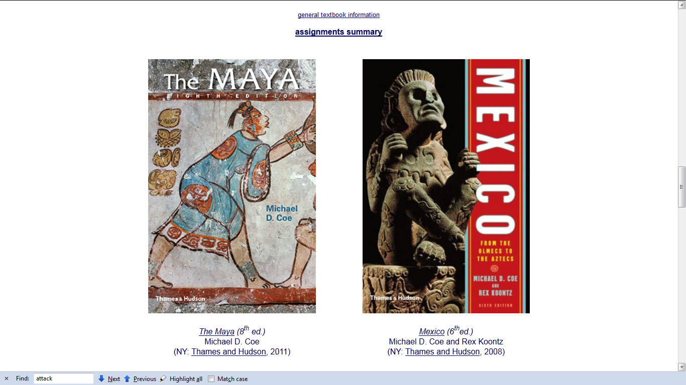
Basic Text Information

Slide 61
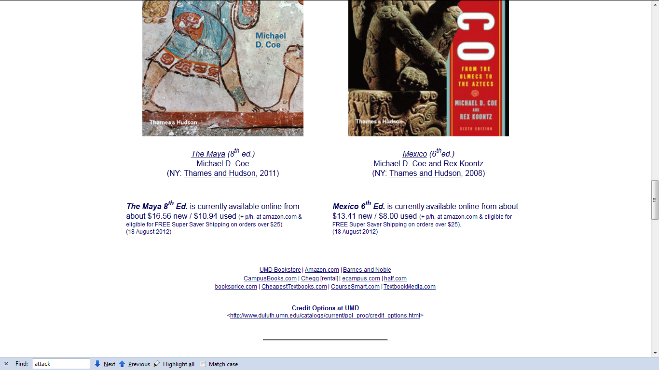
Basic Text Information
including information on purchasing texts . . .

Slide 62
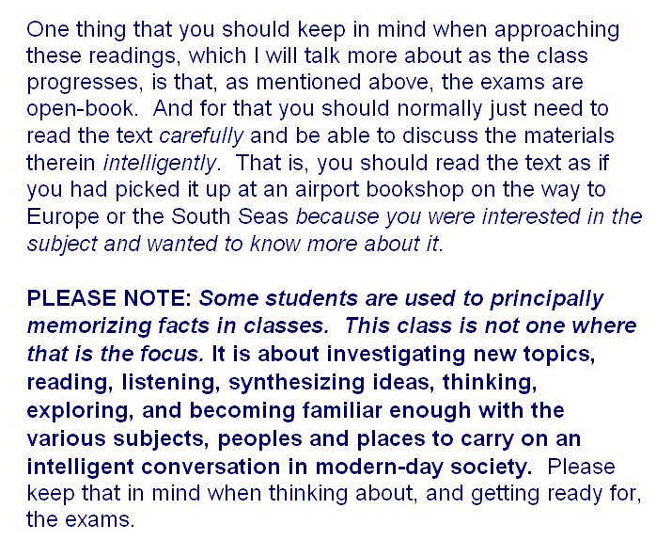

Slide 63
Governing Procedures
pay attention . . .

Slide 64
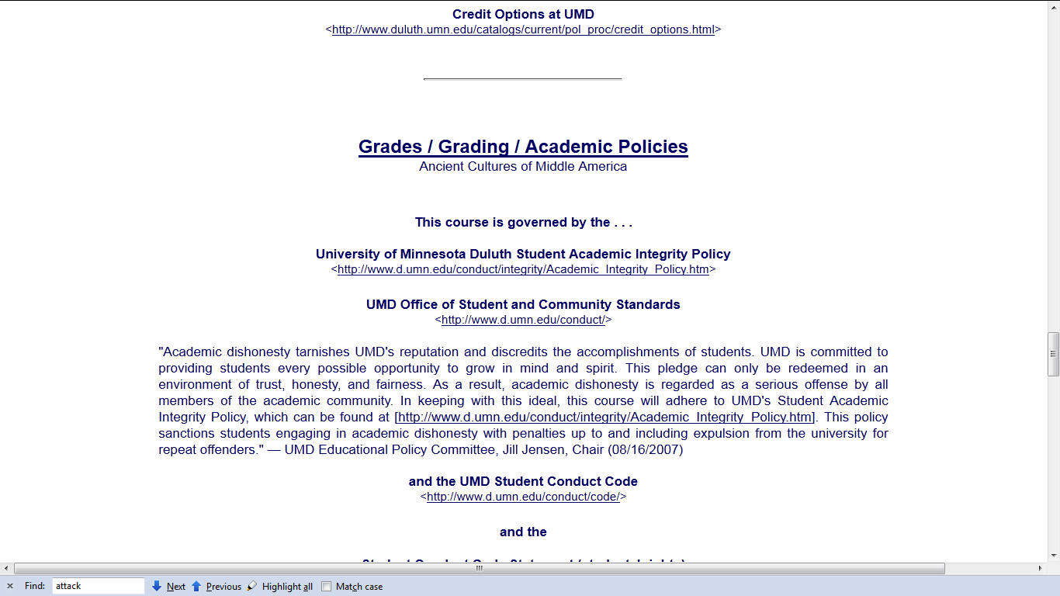
Governing Procedures

Slide 65
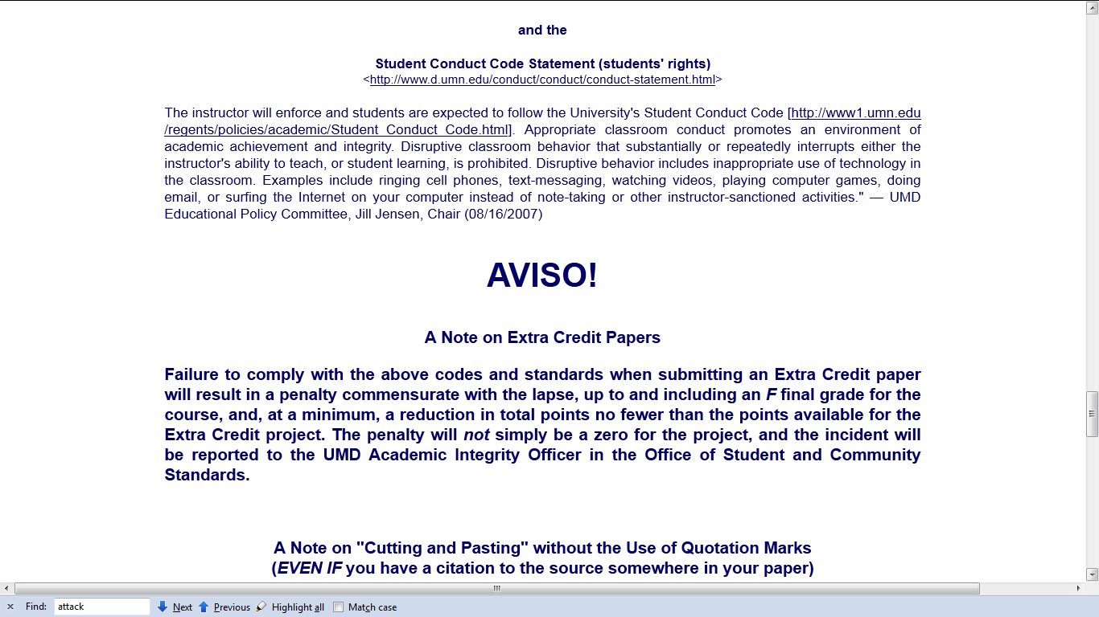
Governing Procedures

Slide 66
Governing Procedures
Governing Procedures
note on Extra Credit Papers

Slide 67
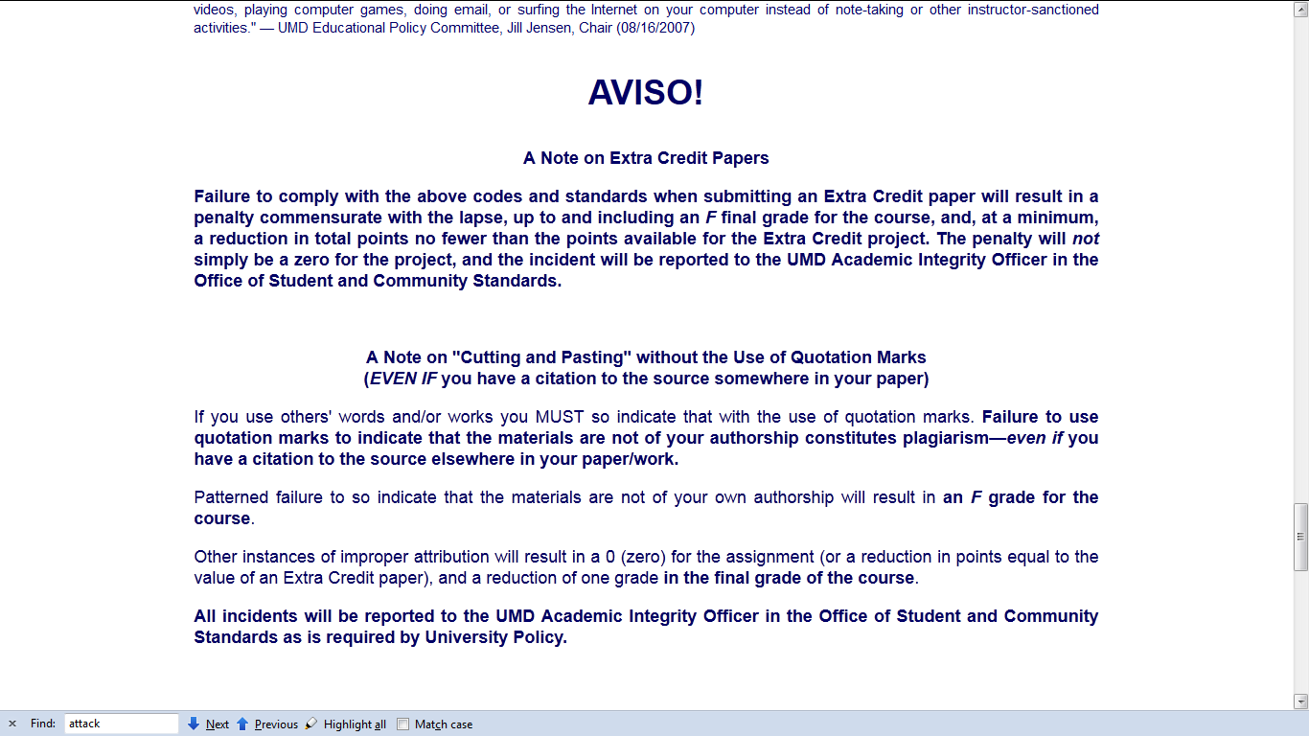
Governing Procedures

Slide 68
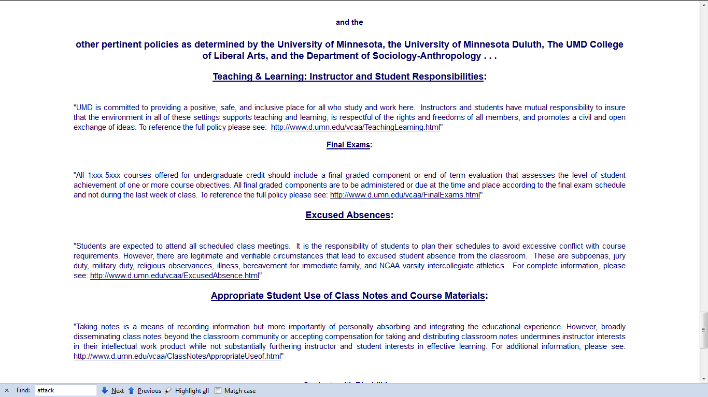
Governing Procedures

Slide 69
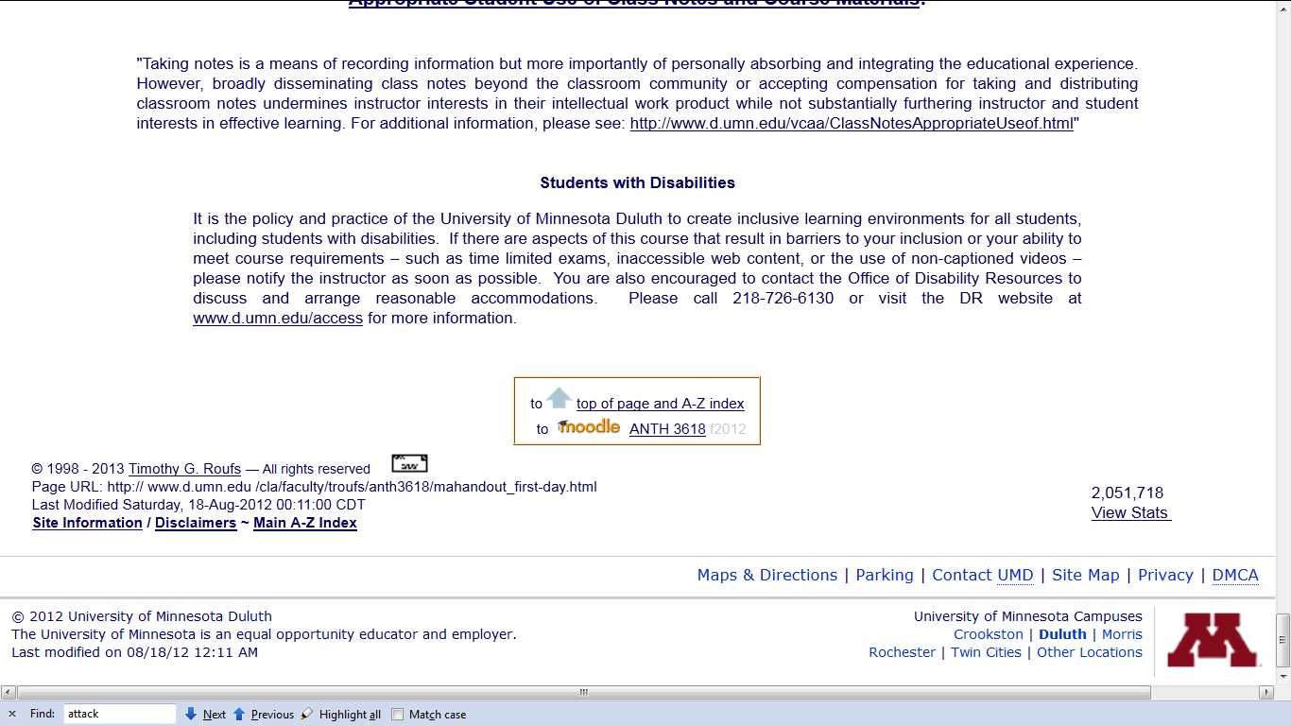
Special Facilities Information

Slide 71
Back to the
Moodle main page
“Block 1”

Slide 72
Moodle main page
“Block 1”

Slide 73
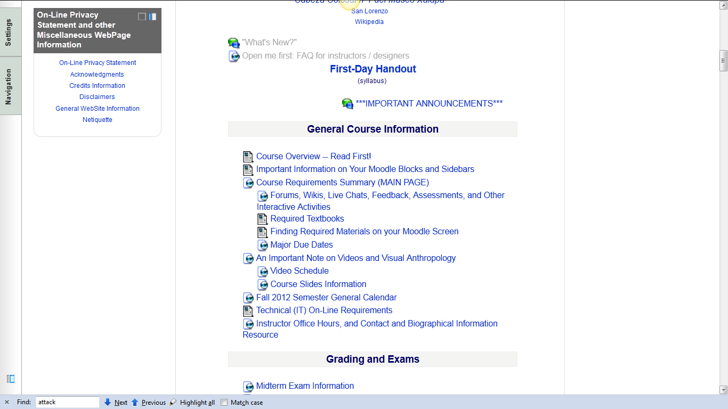

Slide 74
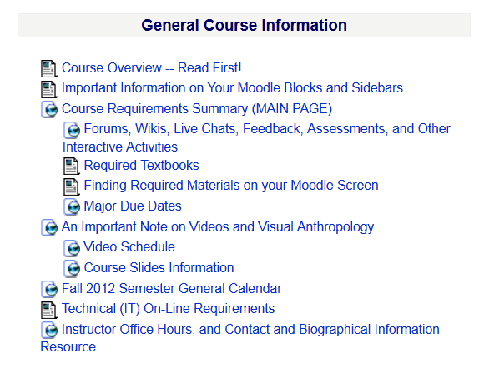

Slide 76
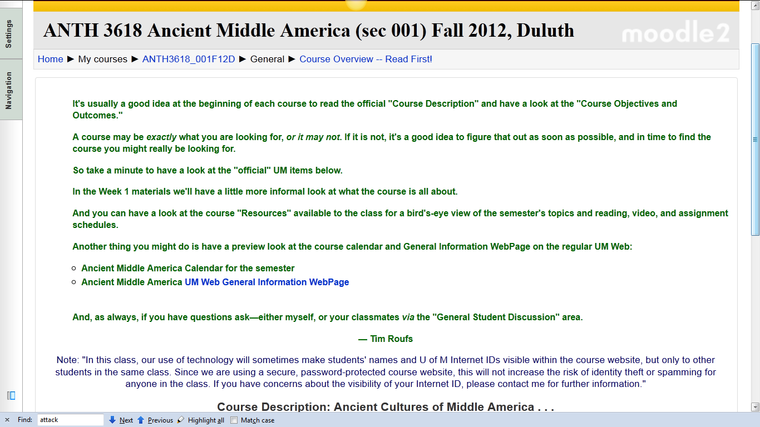

Slide 77
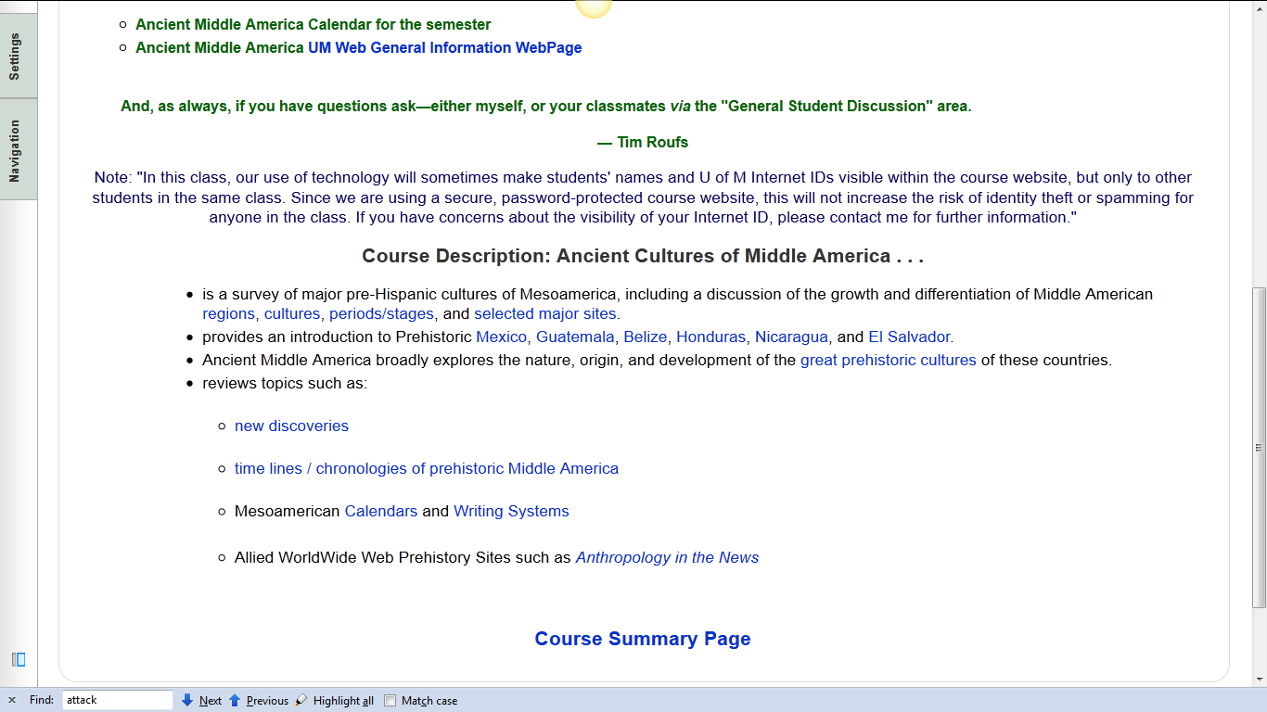

Slide 78
requirements, due dates, options, and grades

Slide 79
click here for grades link
requirements, due dates, options, and grades

Slide 80
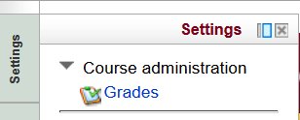
requirements, due dates, options, and grades

Slide 81
requirements, due dates, options, and grades

Slide 82
Your Gradebook
will look something like this

Slide 83
Your Gradebook
will look something like this
this is the best place to check requirements, due dates, options, and grades . . .

Slide 84
Back to the
Moodle main page
“Block 1”

Slide 85
“Major Due Dates” is a handy site

Slide 86
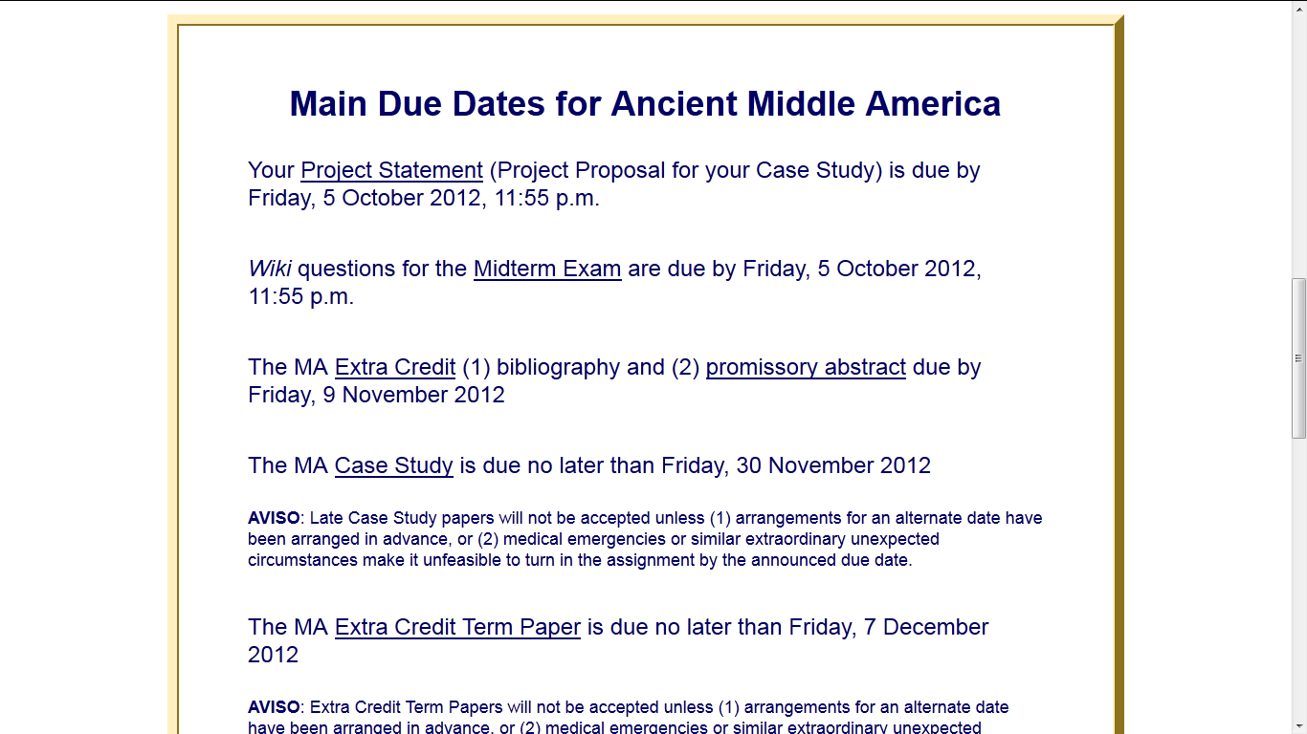

Slide 88
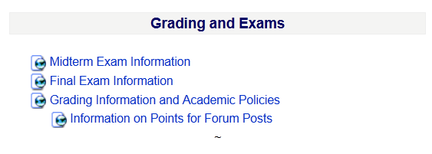

Slide 89
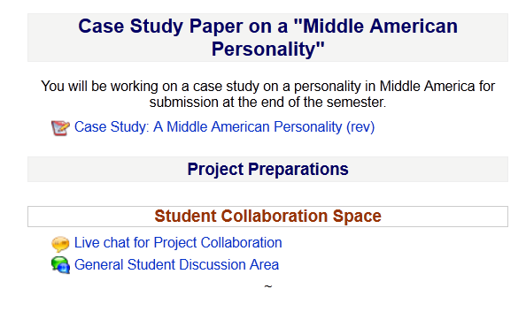

Slide 90
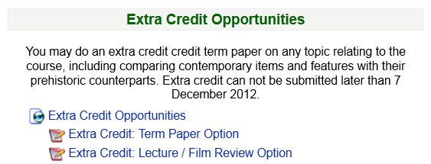

Slide 91
Back to the
Moodle main page
“Block 1”
REM

Slide 92
Reading Assignments . . .

Slide 94
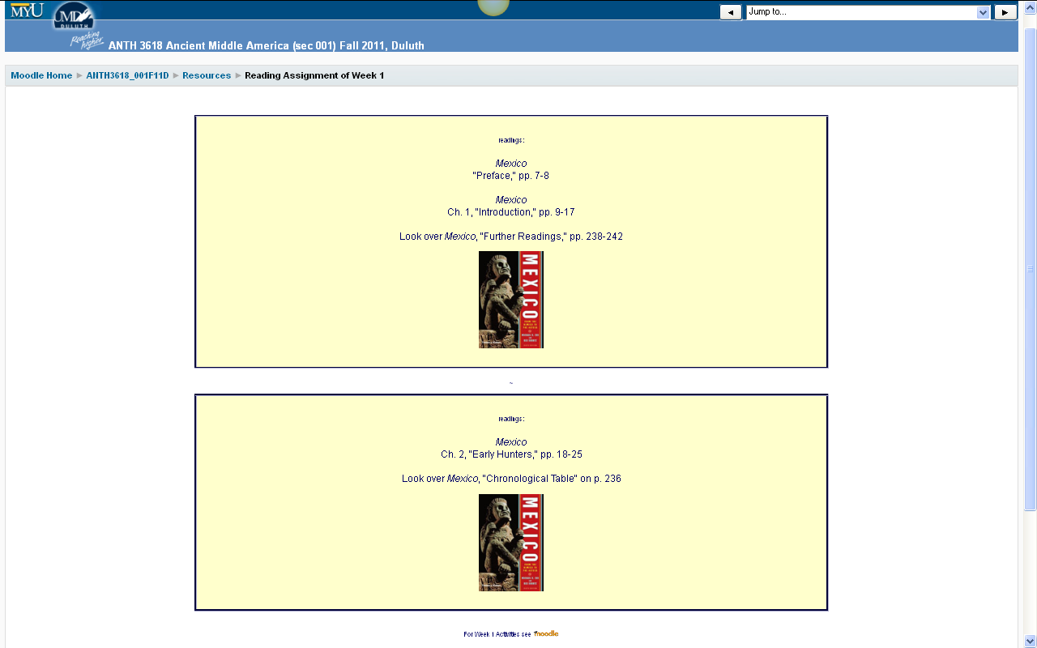
Reading Assignments for Week 1

Slide 95
and Activities for the week . . .

Slide 96
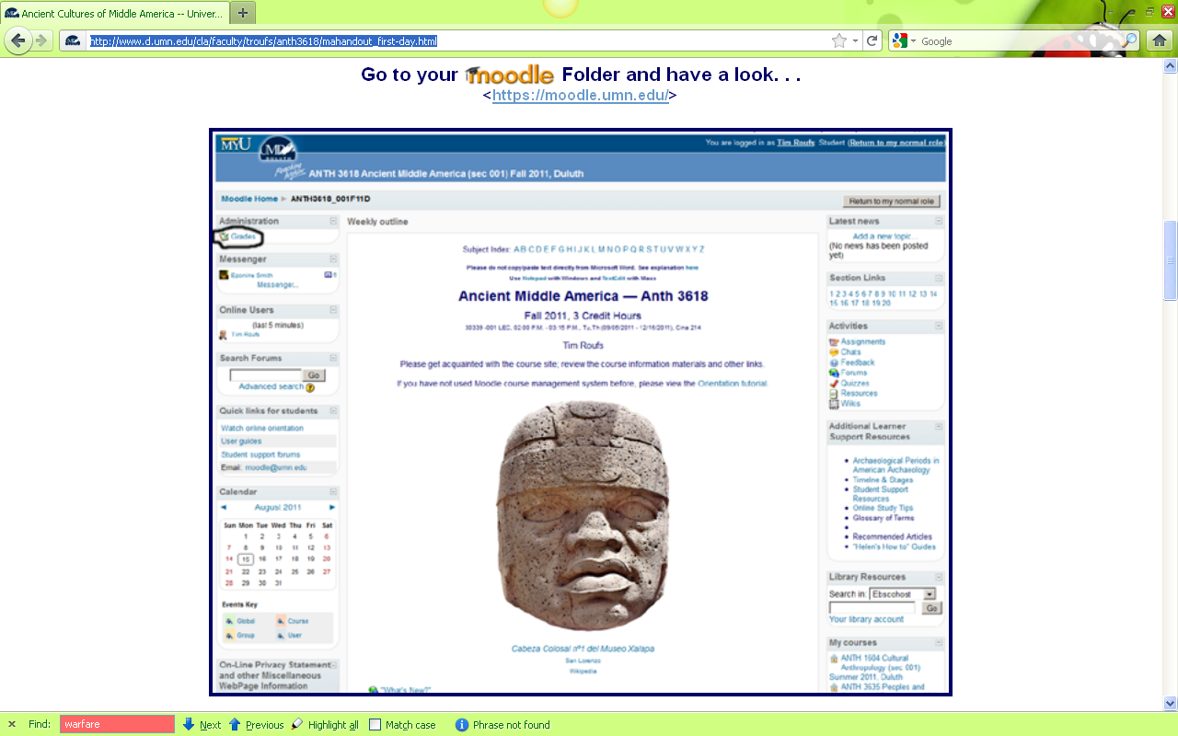
And, if you haven’t already done so,
have a look at the
Orientation Materials

Slide 97


Slide 98
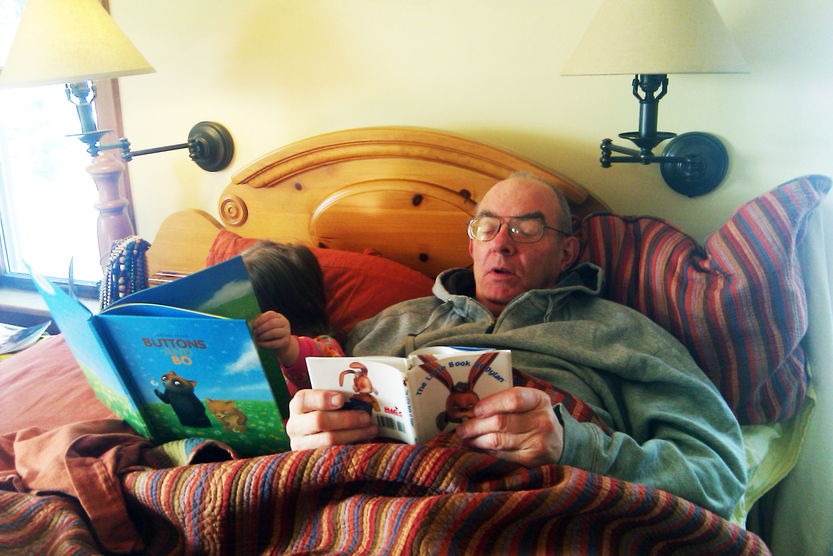
And, for the fun of it,
have a look at the
“Meet Your Professor” Materials

Slide 99
Why?

Slide 100
Research shows that people who know a little about their teachers . . .

Slide 101
Research shows that people who know a little about their teachers . . .
Learn more . . .

Slide 102
Research shows that people who know a little about their teachers . . .
Learn more . . .
Remember it better . . .

Slide 103
Research shows that people who know a little about their teachers . . .
Learn more . . .
Remember it better . . .
Have more fun learning . . .

Slide 105
one more piece
of useful information . . .

Slide 106
At the very top of “Block 1” you will see an alphabet.
Clicking on a letter will bring you to a page that indexes course WebPages for virtually all of the scheduled topics and items in the course.

Slide 107
At the very top of “Block 1” you will see an alphabet.
Clicking on a letter will bring you to a page that indexes course WebPages for virtually all of the scheduled topics and items in the course.

Slide 108
This information is very useful

Slide 109
How useful?

Slide 110
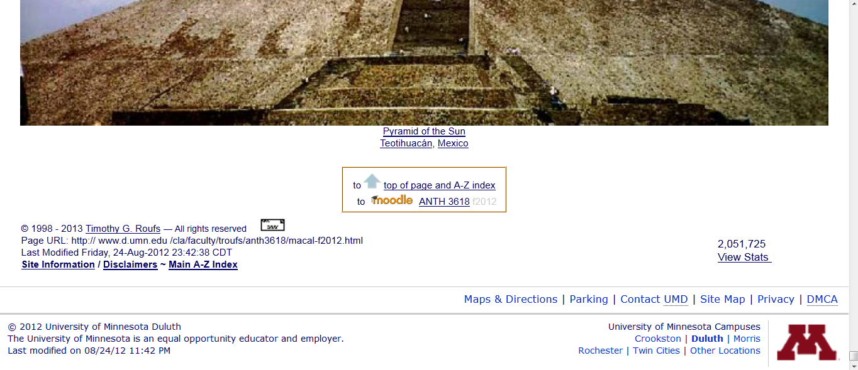
in the last few years there has been over
two million page visits to the
Ancient Middle America course page . . .

Slide 111
to access a topic simply click on a letter to go to an index page . . .

Slide 112
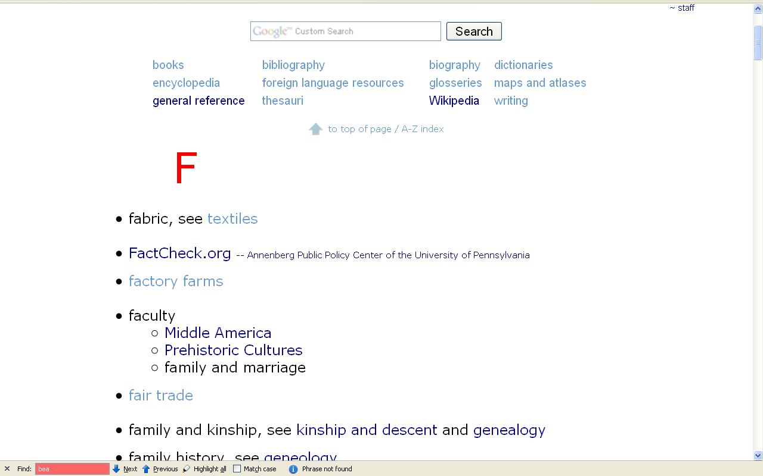
and from the index page click on the item you want . . .

Slide 113
and from the index page click on the item you want . . .
scroll down for more items

Slide 114
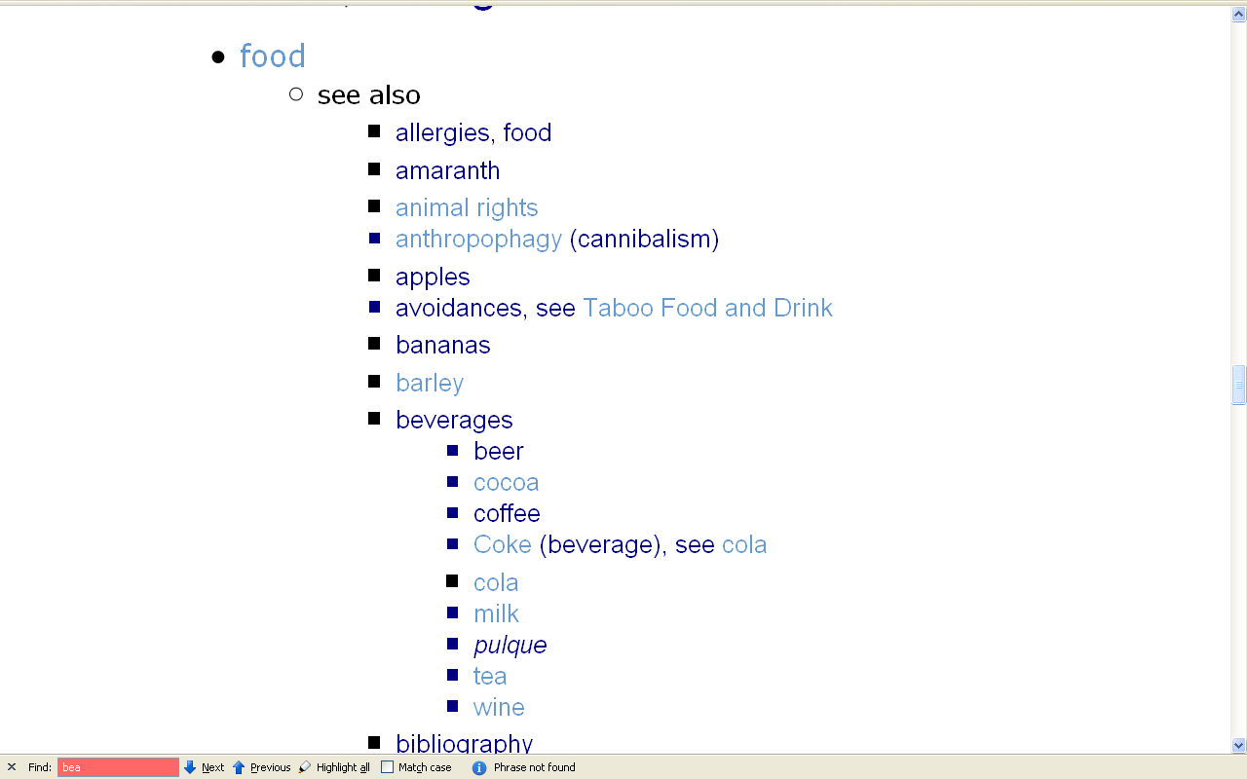
scroll down for more items

Slide 115
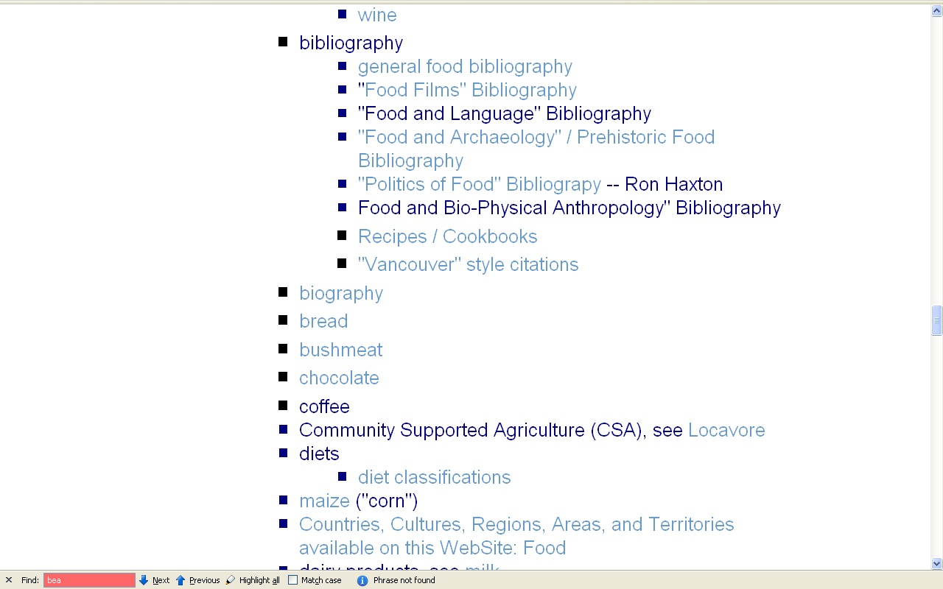
click on item . . . and . . .

Slide 116
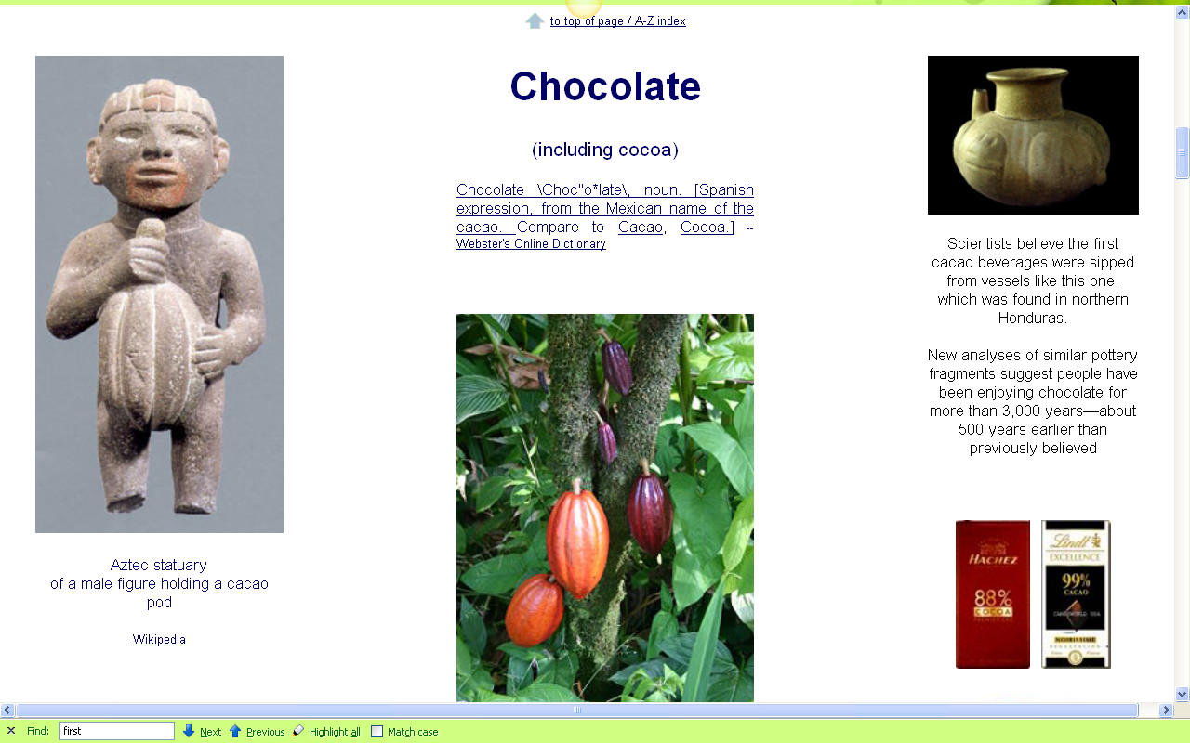
voilá

Slide 117

Laptops
Welcome
(in fact, they’re encouraged)

Slide 118
Next . . .

Slide 119
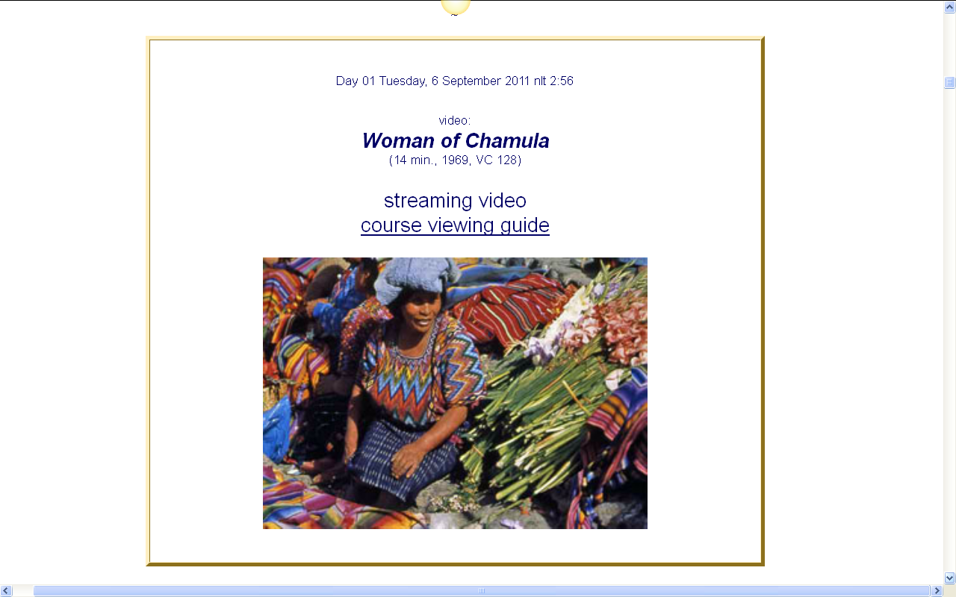
Next . . .

Slide 120

Our first “field trip” . . .
(Day 01 . . . to see . . .)
Woman of Chamula

Slide 121
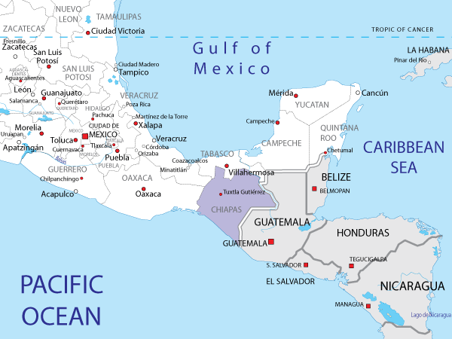
Tenejapa,
Chiapas
Mexico
http://www.map-of-mexico.co.uk/map-of-chiapas.htm

Slide 122

Our second “field trip” . . .
(Day 02 . . . to visit . . .)
Tikál and Seven Other Ancient Mesoamerican Sites

Slide 123
Next Time . . .

Slide 124


Slide 125
If your browser allows,
clicking on this URL
should take you to your Moodle home . . .
https://moodle2.umn.edu/
(your browser may require that you double-click)
If your browser does not allow you to click on the above URL just enter it in your browser window . . .

Slide 126
Once again . . .
Welcome to
Ancient Middle America
Enjoy your stay!
University of Minnesota Duluth
Tim Roufs
© 2010-2014
http://www.d.umn.edu/cla/faculty/troufs/anth3618/

