Slide 1
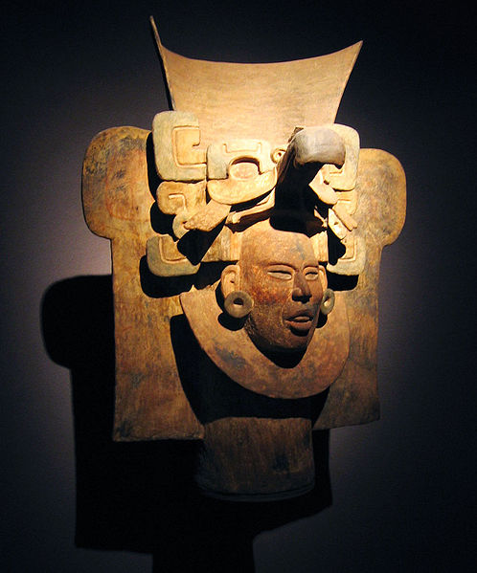
Main
Characteristics of
Anthropology
Ancient Middle America
University of Minnesota Duluth
Tim Roufs
© 2010-2019

Slide 2
Anthropology graduates, reflecting back on their time with us at UMD, suggested in our surveys that it would be a good idea to tie the individual courses in the Anthropology curriculum together a little more.
So that’s what we’re going to do . . .

Slide 3
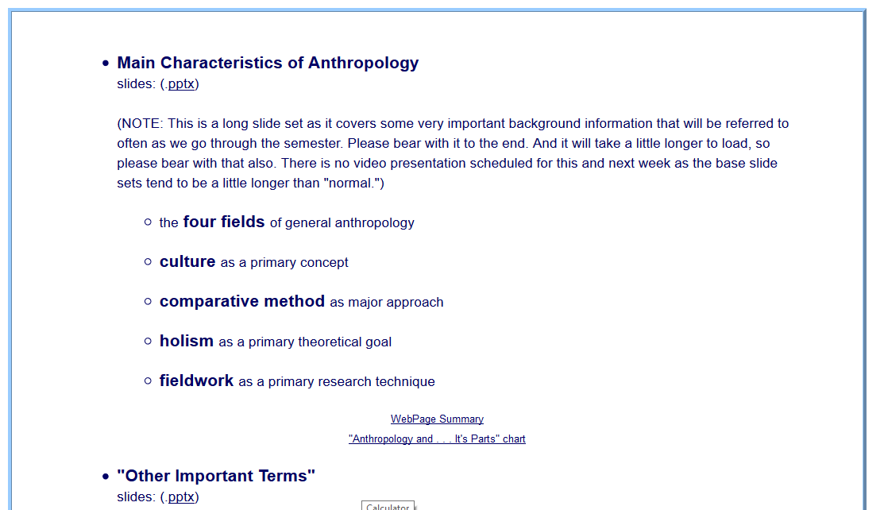
You’ve seen these listed in the
Week 1 “Topics” . . .

Slide 4
You’ve seen these listed in the
Week 1 “Topics” . . .
Let’s have a closer look . . .

Slide 5
Main Characteristics of Anthropology
1. the four fields of general anthropology
culture as a primary concept
comparative method as major approach
holism as a primary theoretical goal
fieldwork as a primary research technique

Slide 6
Main Characteristics of Anthropology
1. the four fields
of general anthropology
culture as a primary concept
comparative method as major approach
holism as a primary theoretical goal
fieldwork as a primary research technique

Slide 7
The Four Fields of American Anthropology
cultural / social
physical
archaeology
linguistics

Slide 8
we’re going to have a closer look at . . .
Middle America
and its . . .
cultural / social
physical
archaeology
linguistics
aspects

Slide 9
These are also commonly known as . . .

Slide 10
sociocultural
biophysical
archaeological
linguistical
cultural / social
physical / biological
archaeological
linguistical
aspects

Slide 11
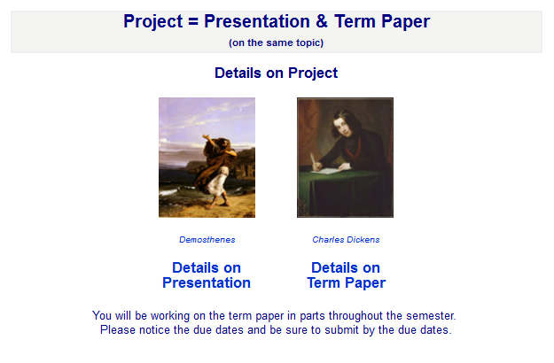
And you’ve seen these fields with your term project . . .

Slide 12
Main Characteristics of Anthropology
1. the four fields of general anthropology
culture as a primary concept
comparative method as major approach
holism as a primary theoretical goal
fieldwork as a primary research technique

Slide 13
Main Characteristics
“culture” is
  learned
  shared
  transmitted from generation to generation
  based on symbols
  integrated

Slide 14
Main Characteristics
“culture”
  learned
  shared
  transmitted from generation to generation
  based on symbols
  integrated
some focus on the idea that it involves
“shared understanding”

Slide 15
Main Characteristics
“culture”
    is not inherited
  (i.e., is not biological)
    is not “instinct”

Slide 16
Main Characteristics
“cultures”
    are groups of people sharing a common heritage
    (and usually a common language)

Slide 17

for e.g.,
Aztec
Maya
Inca
Sophie D. Coe
America's First Cuisines
Austin: University of Texax Press, 1994.
www.d.umn.edu/cla/faculty/troufs/anthfood/aftexts.html#title

Slide 18
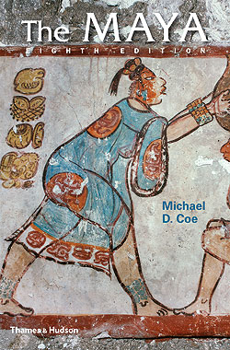
for e.g.,
www.d.umn.edu/cla/faculty/troufs/anth3618/matext.html#title

Slide 19
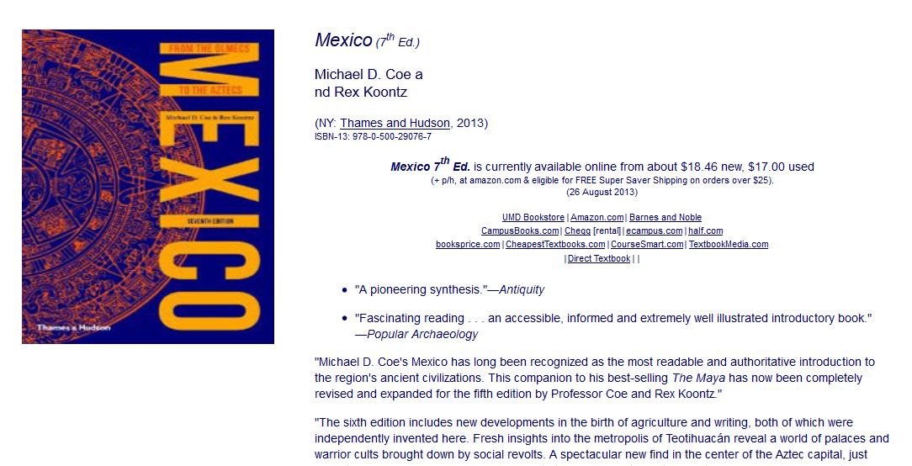
for e.g.,
www.d.umn.edu/cla/faculty/troufs/anth3618/matext.html#title

Slide 20
for e.g.,
but “Mexico”
includes many cultures . . .
Aztec
Toltec
Mixtec
Totonac
Tarascan
Zapotec
Olmec
Yaqui
and others
www.d.umn.edu/cla/faculty/troufs/anth3618/matext.html#title

Slide 21
for e.g.,
more about this
with
“local cultures”
(“microcultures”)
below
www.d.umn.edu/cla/faculty/troufs/anth3618/matext.html#title

Slide 22
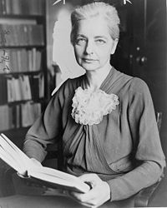
Main Characteristics
“cultures”
    are “integrated”
    -- an idea that was pioneered and emphasized by the “pioneer” anthropologist Ruth Benedict
Ruth Fulton Benedict
1887-1948
Patterns of Culture
1934

Slide 23
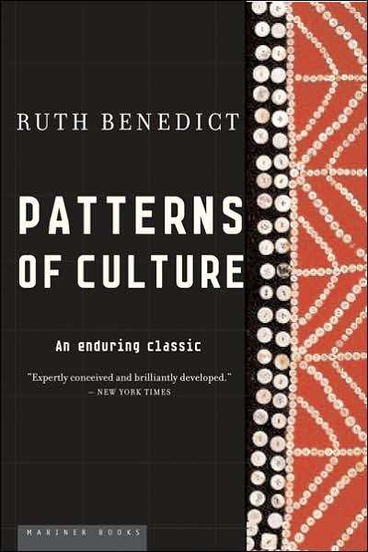
Ruth Fulton Benedict
1887-1948
Patterns of Culture
1934

Slide 24
Main Characteristics
“cultures”
    are integrated
    Interact and change
      the idea that some cultures
      (like “hunting and gathering” cultures, or the Amish)
      do not change is not correct

Slide 25
The Concept of Culture
microculture
  are smaller groups with distinct pattern of learned and shared behavior and thinking found within larger cultures such as ethnic groups in localized regions
  some people like to think of these as
  “local cultures”

Slide 26
The Concept of Culture
microculture
  are smaller groups with distinct pattern of learned and shared behavior and thinking found within larger cultures such as ethnic groups in localized regions
  some people like to think of these as
  “local cultures”

Slide 27
The Concept of Culture
microcultures can include ethnic groups within nations
  e.g., Greek-Americans
  e.g., Anishinabe (Chippewa; Ojibwa)
  e.g., Irish “Travellers”
    sometimes incorrectly called “Gypsies”
  e.g., Australian Aboriginals
  e.g., Cajun
  e.g., Rom (Gypsies)
  e.g., Basques
  e.g., Kurds

Slide 28
The Concept of Culture
microcultures can include ethnic groups within nations
  e.g., Greek-Americans
  e.g., Anishinabe (Chippewa; Ojibwa)
  e.g., Irish “Travellers”
    sometimes incorrectly called “Gypsies”
  e.g., Australian Aboriginals
  e.g., Cajun
  e.g., Rom (Gypsies)
  e.g., Basques
  e.g., Kurds
local groups generally strive to preserve their cultural identity

Slide 29
The Concept of Culture
local groups (microcultures)
generally strive to preserve their cultural identity with . . .
food
clothing
religion
ritual
music, dance, and other arts
language
cultural symbols . . .

Slide 30
The Concept of Culture
microcultures can include ethnic groups within nations
  e.g., Greek-Americans
  e.g., Anishinabe (Chippewa; Ojibwa)
  e.g., Irish “Travellers”
    sometimes incorrectly called “Gypsies”
  e.g., Australian Aboriginals
  e.g., Cajun
  e.g., Rom (Gypsies)
  e.g., Basques
  e.g., Kurds

Slide 31

The Concept of Culture
microculture
  are smaller groups with distinct pattern of learned and shared behavior and thinking found within larger cultures such as ethnic groups in localized regions
  some people like to think of these as
  “local cultures”

Slide 32
The Concept of Culture
microculture
  are smaller groups with distinct pattern of learned and shared behavior and thinking found within larger cultures such as ethnic groups in localized regions
  some people like to think of these as
  “local cultures”
local groups generally strive to preserve their cultural identity . . .

Slide 33
The Concept of Culture
local groups (microcultures)
generally strive to preserve their cultural identity with . . .
food
clothing
religion
ritual
music, dance, and other arts
language
cultural symbols . . .

Slide 34
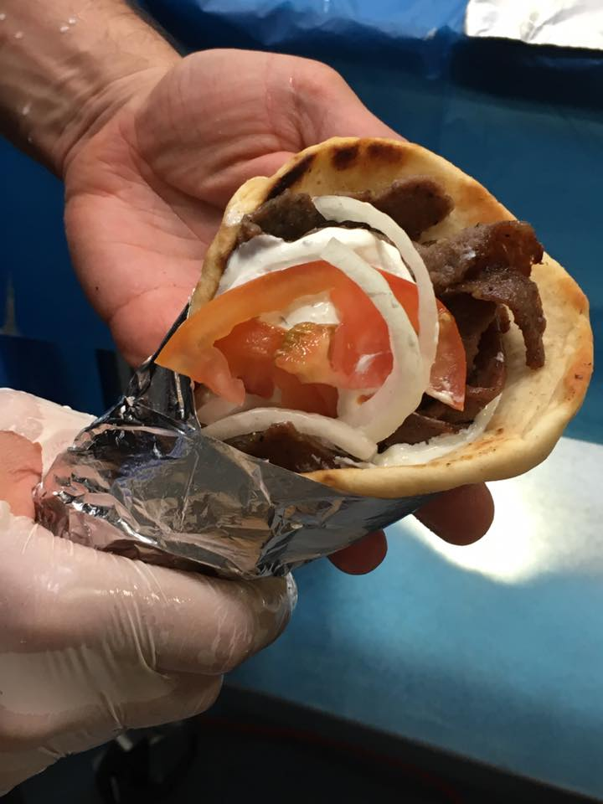
gyro
A Tate of Greece
25th Annual Food Festival 2017

Slide 35
The Concept of Culture
local groups (microcultures)
generally strive to preserve their cultural identity with . . .
food
clothing
religion
ritual
music, dance, and other arts
language
cultural symbols . . .

Slide 36
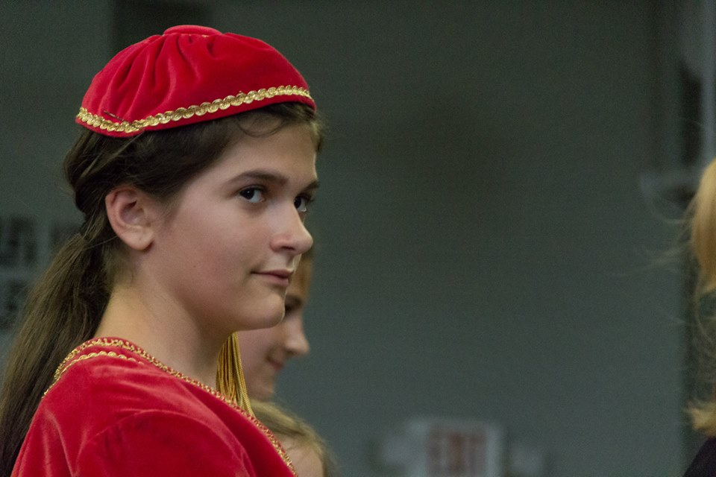
www.facebook.com/alexganeevphotography/photos/

Slide 37
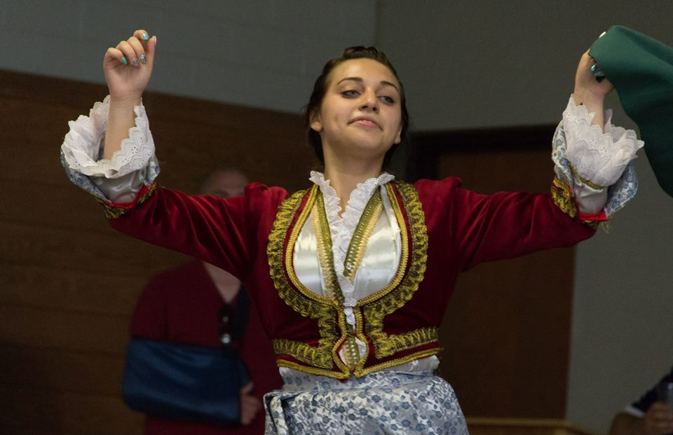
www.facebook.com/alexganeevphotography/photos/

Slide 38
The Concept of Culture
local groups (microcultures)
generally strive to preserve their cultural identity with . . .
food
clothing
religion
ritual
music, dance, and other arts
language
cultural symbols . . .

Slide 39
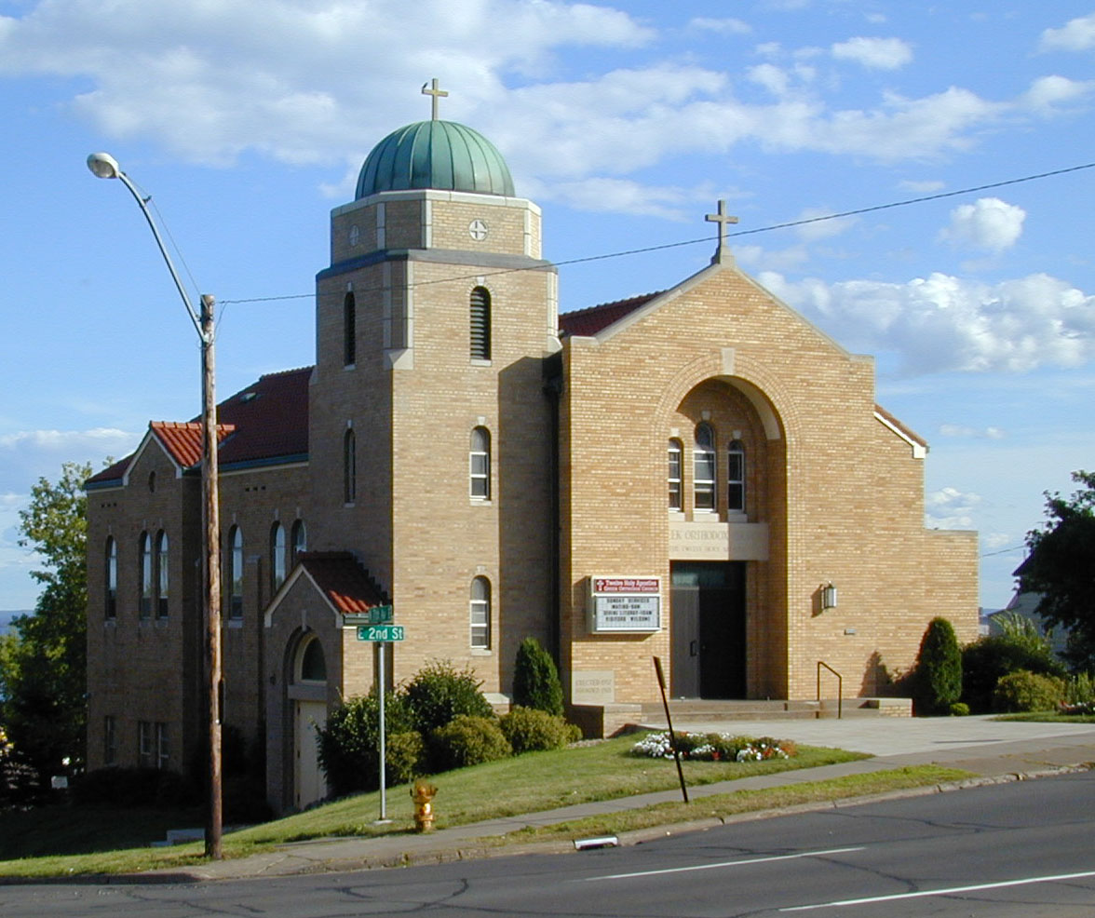
https://www.facebook.com/pages/Taste-of-Greece-Festival-Duluth-Minnesota/199921043362252

Slide 40
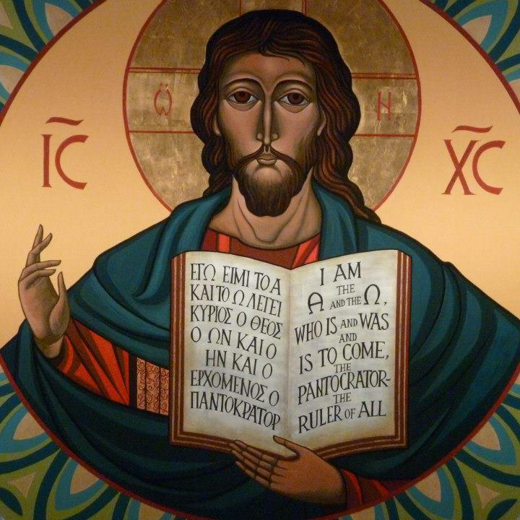
https://www.facebook.com/12HolyApostlesChurch/photos/

Slide 41
The Concept of Culture
local groups (microcultures)
generally strive to preserve their cultural identity with . . .
food
clothing
religion
ritual
music, dance, and other arts
language
cultural symbols . . .

Slide 42
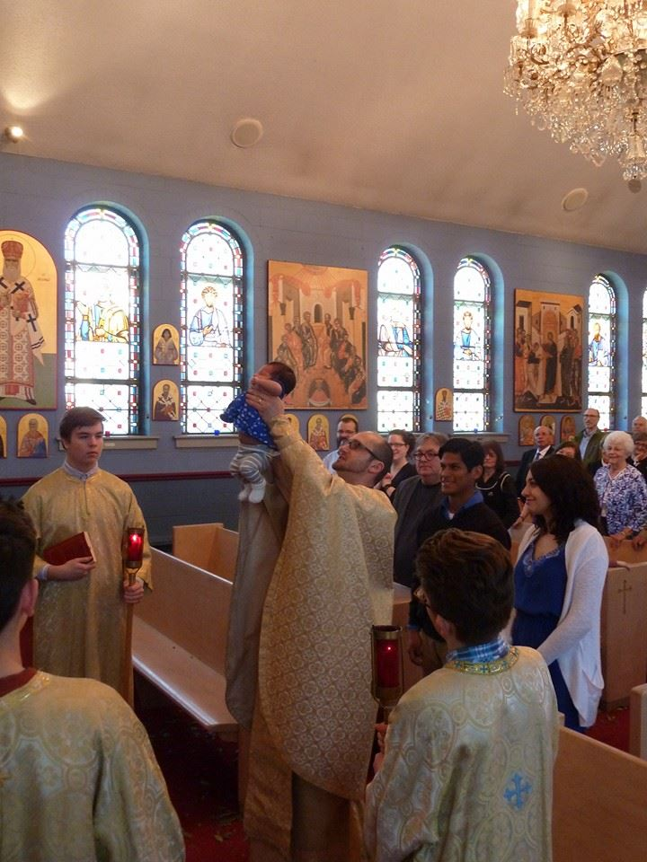
www.facebook.com/alexganeevphotography/photos/

Slide 43
The Concept of Culture
local groups (microcultures)
generally strive to preserve their cultural identity with . . .
food
clothing
religion
ritual
music, dance, and other arts
language
cultural symbols . . .

Slide 44
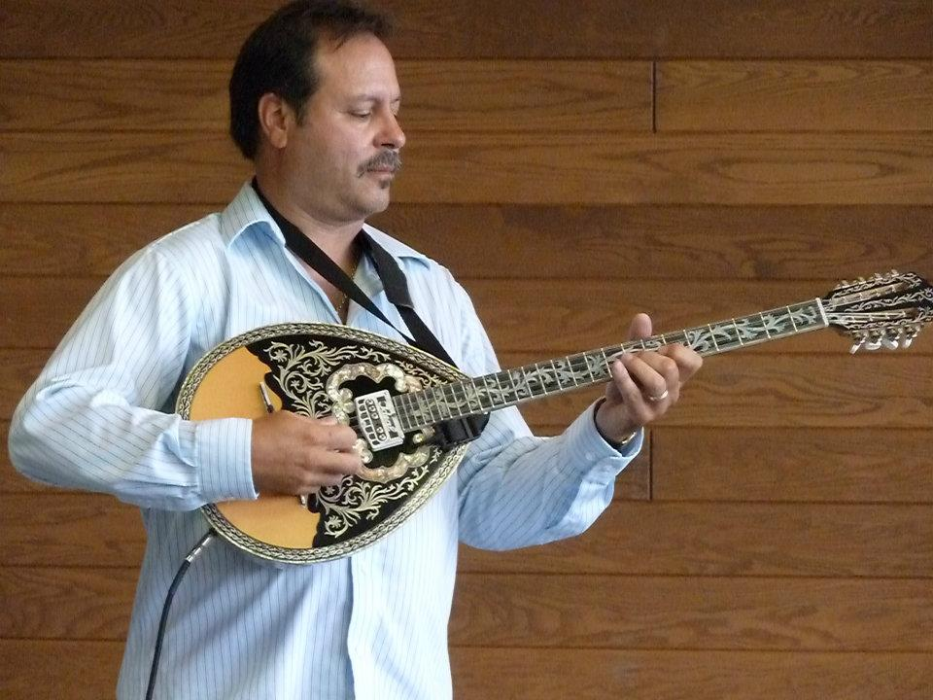
A Taste of Greece
22nd Annual Food Festival 2014
https://www.facebook.com/pages/Taste-of-Greece-Festival-Duluth-Minnesota/199921043362252

Slide 45
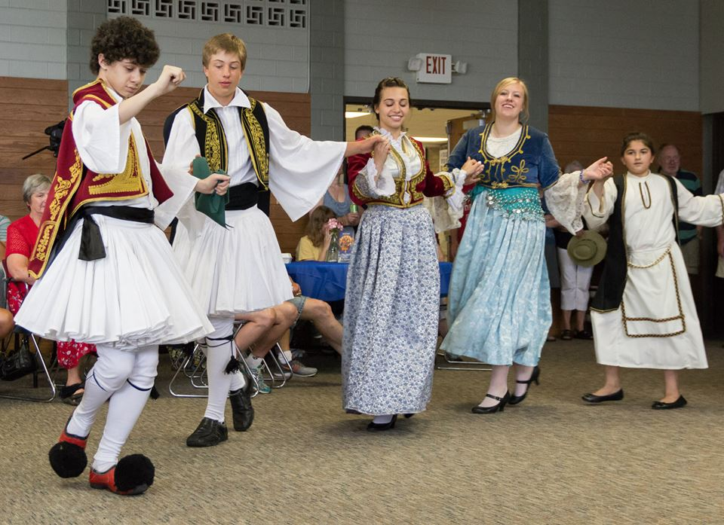
www.facebook.com/alexganeevphotography/photos/

Slide 46
The Concept of Culture
local groups (microcultures)
generally strive to preserve their cultural identity with . . .
food
clothing
religion
ritual
music, dance, and other arts
language
cultural symbols . . .

Slide 47
https://www.facebook.com/12HolyApostlesChurch/photos/

Slide 48
The Concept of Culture
local groups (microcultures)
generally strive to preserve their cultural identity with . . .
food
clothing
religion
ritual
music, dance, and other arts
language
cultural symbols . . .

Slide 49


Slide 50
including colors

Slide 51
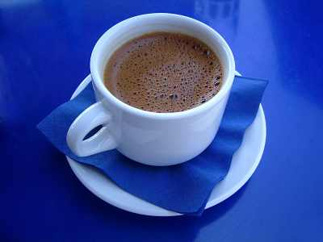
“Greek Coffee”

Slide 52
The Concept of Culture
local groups (microcultures)
generally strive to preserve their cultural identity with . . .
food
clothing
religion
ritual
music, dance, and other arts
language
cultural symbols . . .
and these can be combined . . .

Slide 53
Main Characteristics
“cultures”
    are groups of people sharing a common heritage
    (and usually a common language)

Slide 54
Middle American cultures include . . .
  Aztec
  Maya
  Zapotec
  Mixtec
  Otomi
  Tarascan
  Yaqui
  Tarahumara . . .

Slide 55
The Concept of Culture
microcultures can include ethnic groups within nations
  e.g., Anishinabe (Chippewa; Ojibwa)
  e.g., Irish “Travellers”
    sometimes incorrectly called “Gypsies”
  e.g., Rom (Gypsies)
  e.g., Basques
  e.g., Kurds
  e.g., Australian Aboriginals

Slide 56
The Concept of Culture
Microculture
  a distinct pattern of learned and shared behavior and thinking found within larger cultures such as ethnic groups in localized regions
  local cultures
Macroculture
  a distinct pattern of learned and shared behavior and thinking that crosses local boundaries, such as transnational culture and global culture

Slide 57
every region has its own
local cultures,
or microcultures . . .
Notes:
57

Slide 58
“units of analysis” may include:
  one person
  the family
  the community
  a region
  “culture area”
  a culture / “subculture”
    Ancient Middle America
      Chamula
      Lancandon
      Tzotzil
      Tzeltal
      Zoque
for e.g.,
Prehistoric Middle America
has all of these cultures . . .
and more . . .
    Yaqui
    Otomi
    Tarascan
    Mixtec
    Zapotec
    Olmec
    Toltec
    Aztec
    Teotihuacanos
    Tarahumara

Slide 59
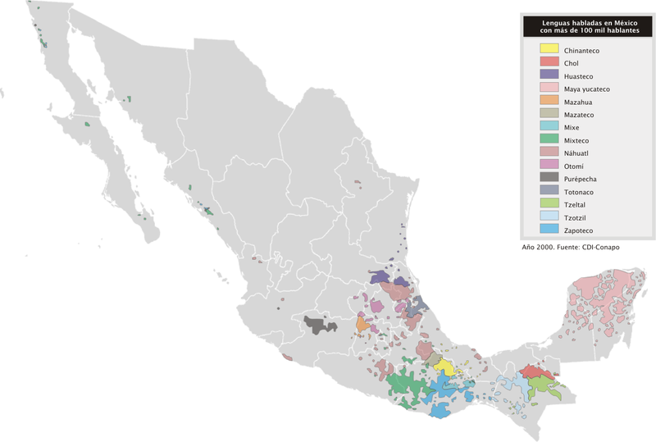
indigenous groups
with a population
of more than 100,000
http://en.wikipedia.org/wiki/Indigenous_peoples_of_Mexico#Indigenous_groups_with_a_population_of_more_than_100.2C000
Notes:
59

Slide 60
indigenous groups
with a population
of more than 100,000
http://en.wikipedia.org/wiki/Indigenous_peoples_of_Mexico#Indigenous_groups_with_a_population_of_more_than_100.2C000
Notes:
60

Slide 61
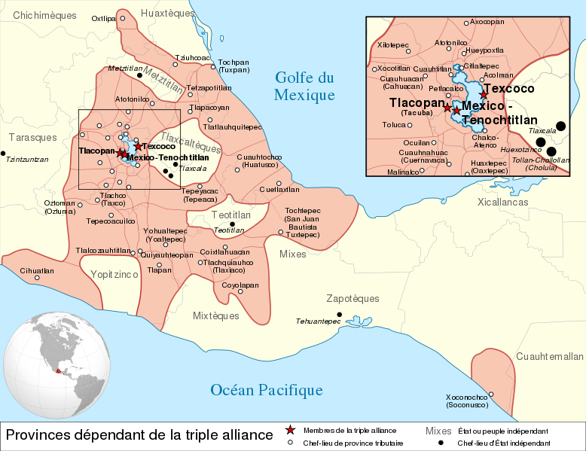
Aztec “Triple Alliance” . . .
http://en.wikipedia.org/wiki/Aztec
Notes:
61

Slide 62
“units of analysis” may include:
  one person
  the family
  the community
  a region
  “culture area”
  a culture / “subculture”
    Maya
      Chamula
      Lancandon
      Tzotzil
      Tzeltal
      Zoque
and
just the Maya
include all of these subcultures . . .
and more . . .

Slide 63
every region has its own
local cultures,
or microcultures . . .
Notes:
63

Slide 64
The Concept of Culture
microcultures can include ethnic groups within nations
  e.g., Anishinabe (Chippewa; Ojibwa)
  e.g., Irish “Travellers”
    sometimes incorrectly called “Gypsies”
  e.g., Rom (Gypsies)
  e.g., Basques
  e.g., Kurds
  e.g., Australian Aboriginals
local groups generally strive to preserve their cultural identity . . .
and you can often see that in the artifacts that they produce

Slide 65
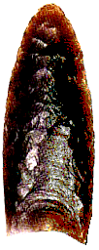
Clovis Point

Slide 66
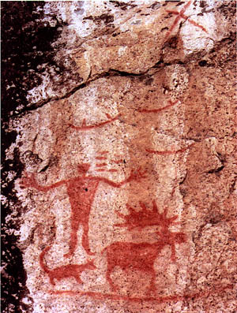
Pictograph from Hegman Lake, Minnesota

Slide 67
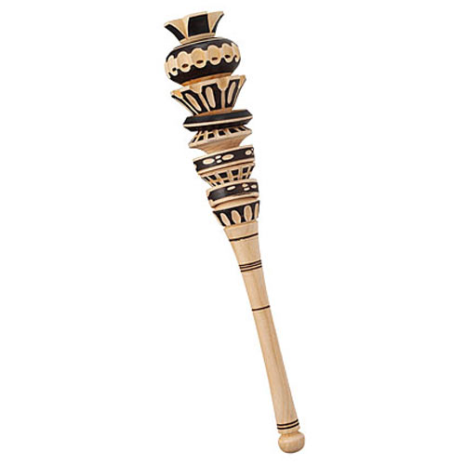
and prehistoric items sometimes have modern counterparts
Molinillo
Ancient Mexican Hot Chocolate Frother
http://www.thegreenhead.com/2009/01/molinillo-traditional-mexican-hot-chocolate-frother.php

Slide 68

but context is always important
What is this,
for e.g.?

Slide 69
but context is always important
What is this,
for e.g.?

Slide 70
it’s a “spurtle”
for stirring oatmeal
and soups
(in Scotland)
http://en.wikipedia.org/wiki/Spurtle

Slide 71
The Concept of Culture
microcultures can include ethnic groups within nations
  e.g., Anishinabe (Chippewa; Ojibwa)
  e.g., Irish “Travellers”
    sometimes incorrectly called “Gypsies”
  e.g., Rom (Gypsies)
  e.g., Basques
  e.g., Kurds
  e.g., Australian Aboriginals
. . . some areas of human activity tell us more than others . . .

Slide 72
The Concept of Culture
microcultures can include ethnic groups within nations
  e.g., Anishinabe (Chippewa; Ojibwa)
  e.g., Irish “Travellers”
    sometimes incorrectly called “Gypsies”
  e.g., Rom (Gypsies)
  e.g., Basques
  e.g., Kurds
  e.g., Australian Aboriginals
. . . food, for e.g., is almost always a key part of peoples’ cultural identity,
often dating back to their prehistoric past, and defining their history . . .

Slide 73
The Concept of Culture
microcultures can include ethnic groups within nations
  e.g., Anishinabe (Chippewa; Ojibwa)
  e.g., Irish “Travellers”
    sometimes incorrectly called “Gypsies”
  e.g., Rom (Gypsies)
  e.g., Basques
  e.g., Kurds
  e.g., Australian Aboriginals
and this often shows up in the archeological record . . .

Slide 74
The Concept of Culture
and, as usual, local groups (microcultures)
generally strive to preserve their cultural identity with . . .
food
clothing
religion
ritual
music, dance, and other arts
language
cultural symbols . . .

Slide 75
The Concept of Culture
and, as usual, local groups (microcultures)
generally strive to preserve their cultural identity with . . .
food
clothing
religion
ritual
music, dance, and other arts
language
cultural symbols . . .

Slide 76
The Concept of Culture
and, as usual, local groups (microcultures)
generally strive to preserve their cultural identity with . . .
food
clothing
religion
ritual
music, dance, and other arts
language
cultural symbols . . .

Slide 77
The Concept of Culture
and, as usual, local groups (microcultures)
generally strive to preserve their cultural identity with . . .
food
clothing
religion
ritual
music, dance, and other arts
language
cultural symbols . . .

Slide 78
The Concept of Culture
and, as usual, local groups (microcultures)
generally strive to preserve their cultural identity with . . .
food
clothing
religion
ritual
music, dance, and other arts
language
cultural symbols . . .

Slide 79
The Concept of Culture
and, as usual, local groups (microcultures)
generally strive to preserve their cultural identity with . . .
food
clothing
religion
ritual
music, dance, and other arts
language
cultural symbols . . .

Slide 80
The Concept of Culture
and, as usual, local groups (microcultures)
generally strive to preserve their cultural identity with . . .
food
clothing
religion
ritual
music, dance, and other arts
language
cultural symbols . . .

Slide 81
The Concept of Culture
local groups (microcultures)
generally strive to preserve their cultural identity with . . .
food
clothing
religion
ritual
music, dance, and other arts
language
cultural symbols . . .
and these can be combined . . .

Slide 82
The Concept of Culture
. . . these elements are often
key factors in one’s individual
and in collective,
even national, cultural identities . . .

Slide 83
The Concept of Culture
And when we’re looking at ancient cultures, in Middle America or anywhere else, these are items we look for . . .

Slide 84
The Concept of Culture
microcultures can include ethnic groups within nations
  Aztec
  Maya
  Zapotec
  Mixtec
  Otomi
  Tarascan
  Yaqui
  Tarahumara . . .
  Inca

Slide 85
Aztec
Maya
Inca
Sophie D. Coe
America's First Cuisines
Austin: University of Texax Press, 1994.
www.d.umn.edu/cla/faculty/troufs/anthfood/aftexts.html#title

Slide 86
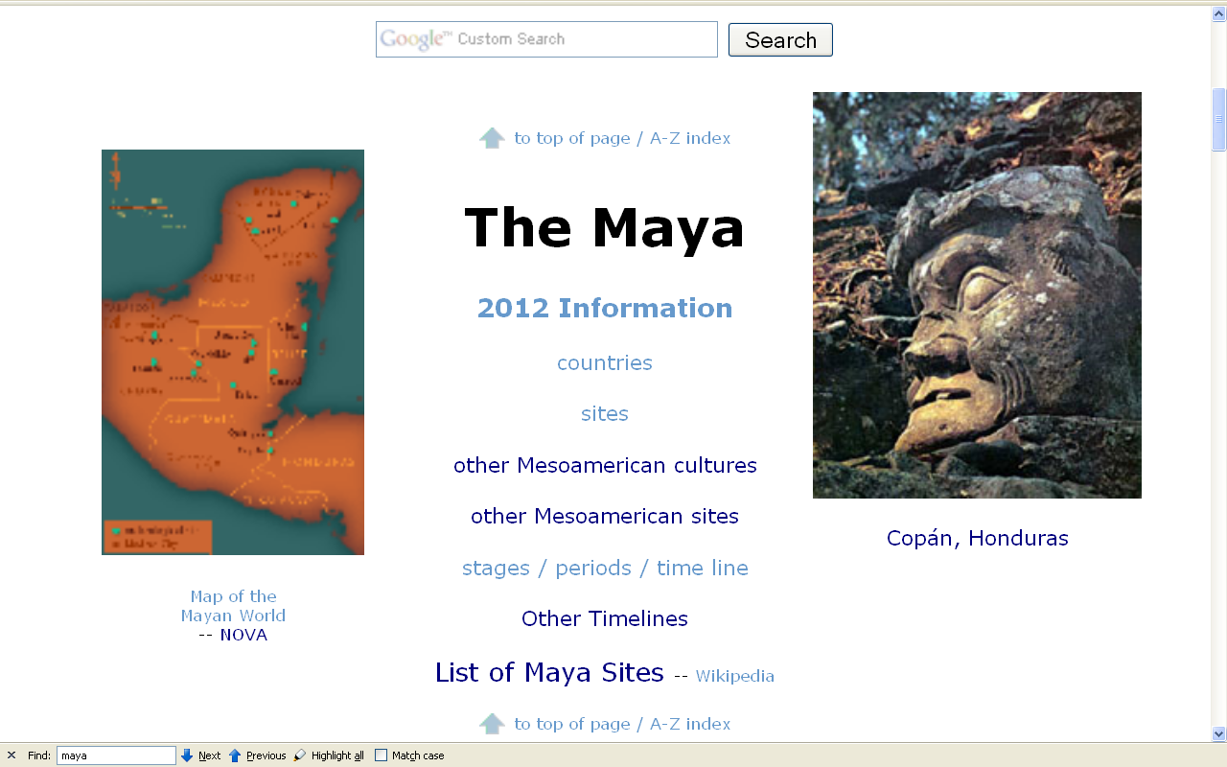
Compare . . .
http://www.d.umn.edu/cla/faculty/troufs/anth3618/mamaya.html#title

Slide 87
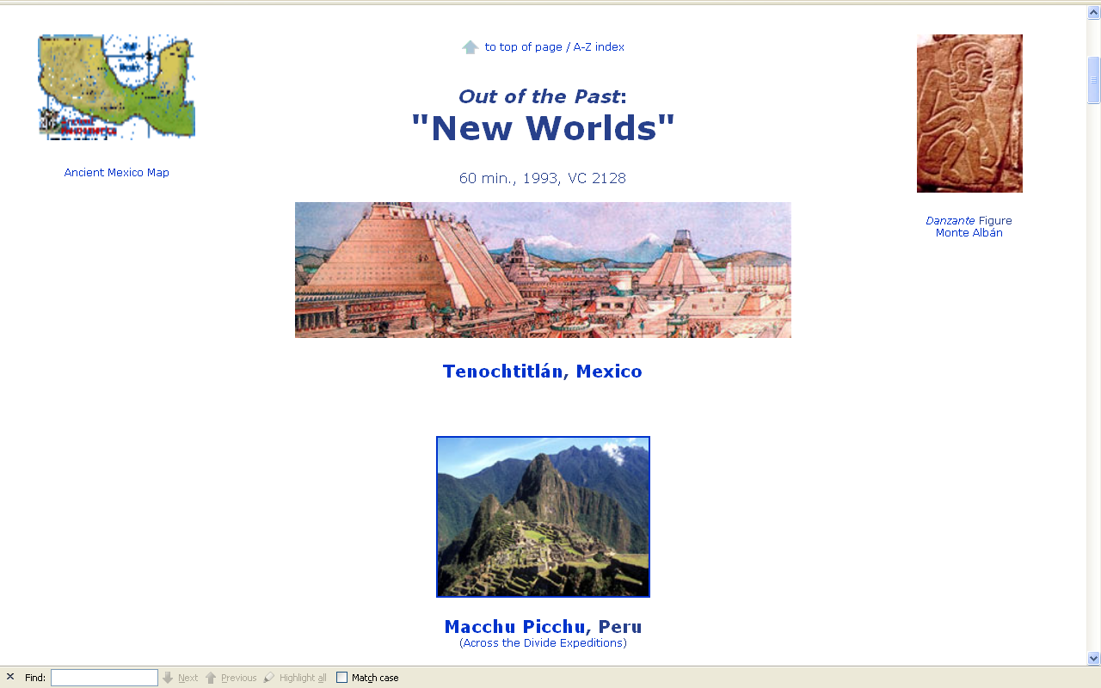
Compare . . .
www.d.umn.edu/cla/faculty/troufs/anth3618/video/Out_of_Past.html#title

Slide 88
back to our
main characteristics of anthropology . . .

Slide 89
Main Characteristics of Anthropology
1. the four fields of general anthropology
culture as a primary concept
comparative method as major approach
holism as a primary theoretical goal
fieldwork as a primary research technique

Slide 90
Main Characteristics of Anthropology
1. the four fields of general anthropology
culture as a primary concept
comparative method
as major approach
development and structure
holism as a primary theoretical goal
fieldwork as a primary research technique

Slide 91
Compare . . .
Main Characteristics
comparative method
  as a major approach to the study of human behavior
  the comparative method compares things (what else would a “comparative” method do?)

Slide 92
Compare . . .
Main Characteristics
comparative method
  One form of comparative method was pioneered by Fred Eggan
  (University of Chicago)
“Social anthropology and the method of controlled comparison”
  American Anthropologist, 56:743-61 (1954)

Slide 93
Compare . . .
Main Characteristics
comparative method
  One form of comparative method was pioneered by Fred Eggan
  (University of Chicago)
“Social anthropology and the method of controlled comparison”
  American Anthropologist, 56:743-61 (1954)

Slide 94
Compare . . .
Main Characteristics
comparative method
  Other methods . . .
compare things regionally
in an attempt to understand process

Slide 95
Compare . . .
Main Characteristics
comparative method
  Other methods . . .
process
essentially refers to
how things change
or
how things came to be
the way they are now
compare things regionally
in an attempt to understand process

Slide 96
Compare . . .
Main Characteristics
the comparative method compares things
for e.g. . . .

Slide 97
Aztec
Maya
Inca
Sophie D. Coe
America's First Cuisines
Austin: University of Texax Press, 1994.
comparing cultures and cuisines
www.d.umn.edu/cla/faculty/troufs/anthfood/aftexts.html#title

Slide 98
Compare . . .
Main Characteristics
comparative method
  Other methods . . .
compare things regionally
in an attempt to understand process

Slide 99
Compare . . .
Main Characteristics
the comparative method compares things, for e.g., process of domestication / civilization
    maize – Mexico
    wheat – Turkey
    rice – China
    manioc – Brazil
    millet – Africa

Slide 100
Compare . . .
Main Characteristics
the comparative method compares things, for e.g., process of domestication / civilization
    maize – Mexico
    wheat – Turkey
    rice – China
    manioc – Brazil
    millet – Africa

Slide 101
Compare . . .
Main Characteristics
the comparative method compares things, for e.g., process of domestication / civilization
    maize – Mexico
    wheat – Turkey
    rice – China
    manioc – Brazil
    millet – Africa

Slide 102
Compare . . .
Main Characteristics
the comparative method compares things, for e.g., process of domestication / civilization
    maize – Mexico
    wheat – Turkey
    rice – China
    manioc – Brazil
    millet – Africa

Slide 103
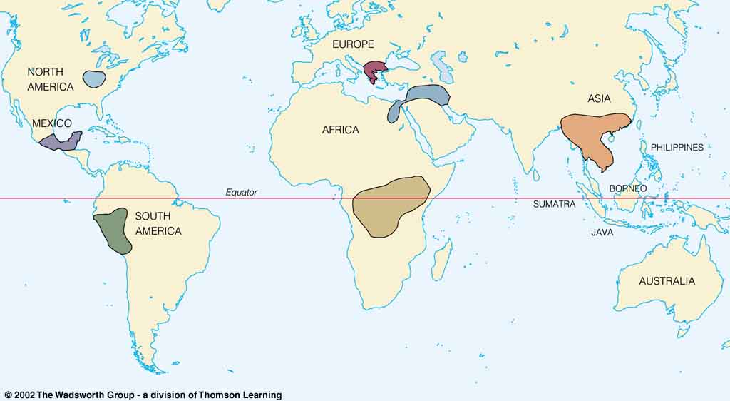
Origin of Domestication for Selected Plants
Compare . . .
wheat
10,500 ybp
maize
4,200 ybp
rice
7,000 ybp
manioc
4,200 ybp
millet
4,000 ybp
Understanding Physical Anthropology and Archaeology, 9th Ed., p. 342.

Slide 104
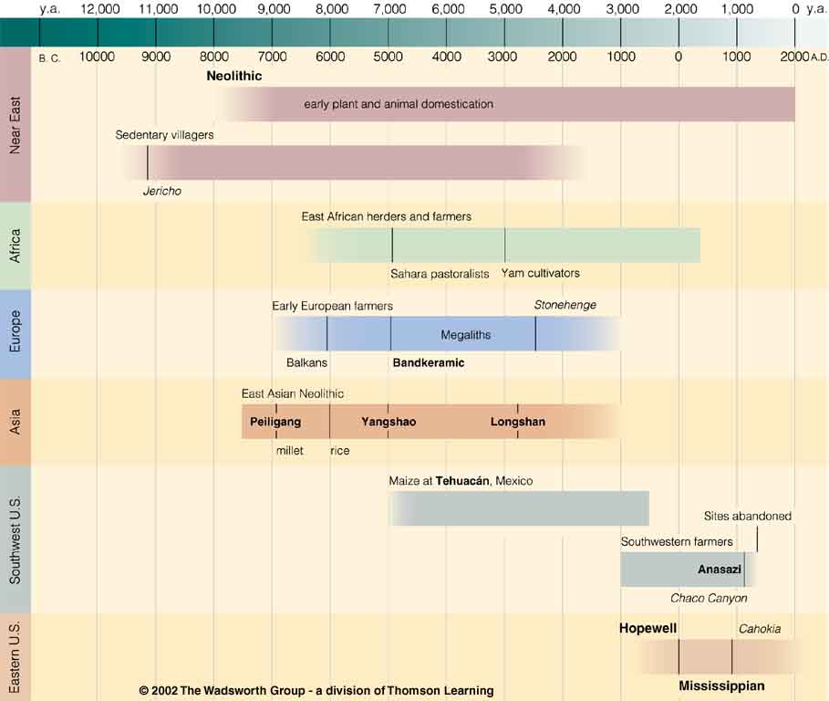

Chapter 14
Understanding Physical Anthropology and Archaeology, 9th Ed.
“Food Production”
A Biocultural Revolution
Neolithic
Time line for Ch. 14 Food Production
Understanding Physical Anthropology and Archaeology, 9th Ed., p. 333

Slide 105
Neolithic
one of the best places
in the world to look at
the process
of plant domestication
Tehuacán
Time line for Ch. 14 Food Production
Understanding Physical Anthropology and Archaeology, 9th Ed., p. 333

Slide 106
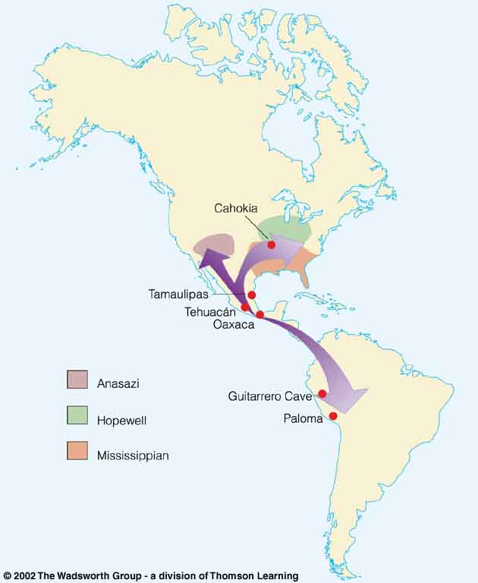
Compare . . .
Tehuacán Valley, Puebla, Mexico
maize
4,200 ybp
Understanding Physical Anthropology and Archaeology, 8th Ed., p. 432.

Slide 107
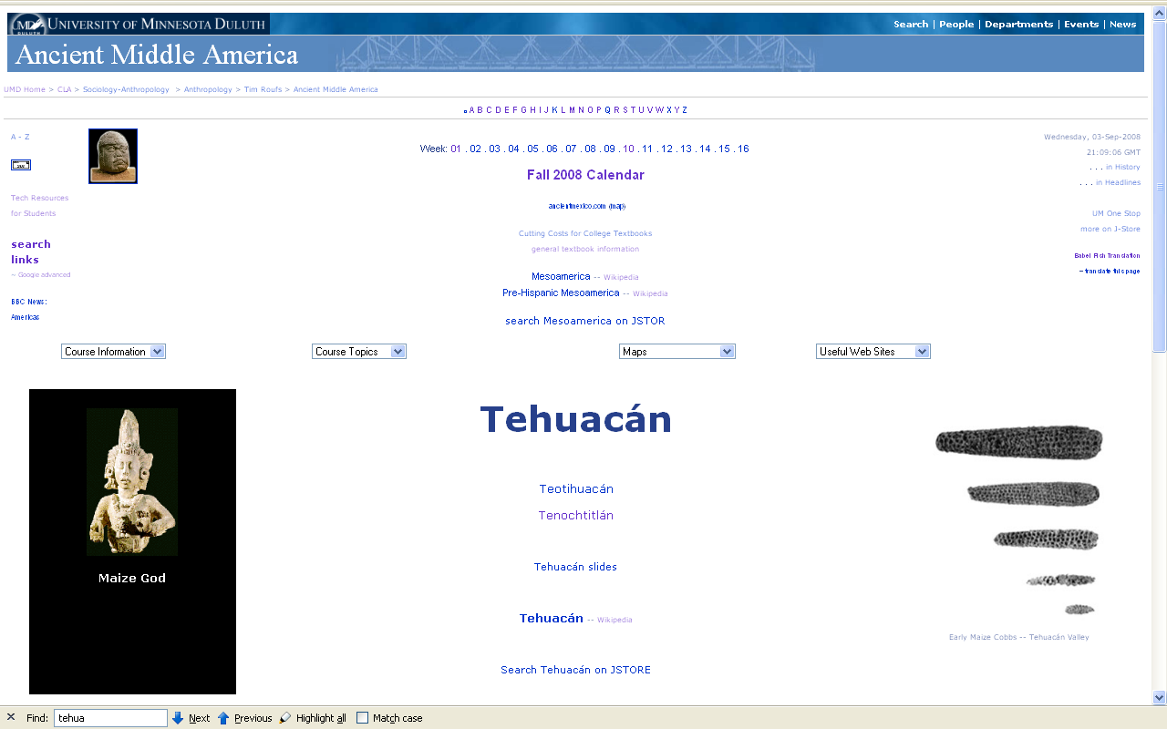
www.d.umn.edu/cla/faculty/troufs/anth3618/matehuac.html#title

Slide 108
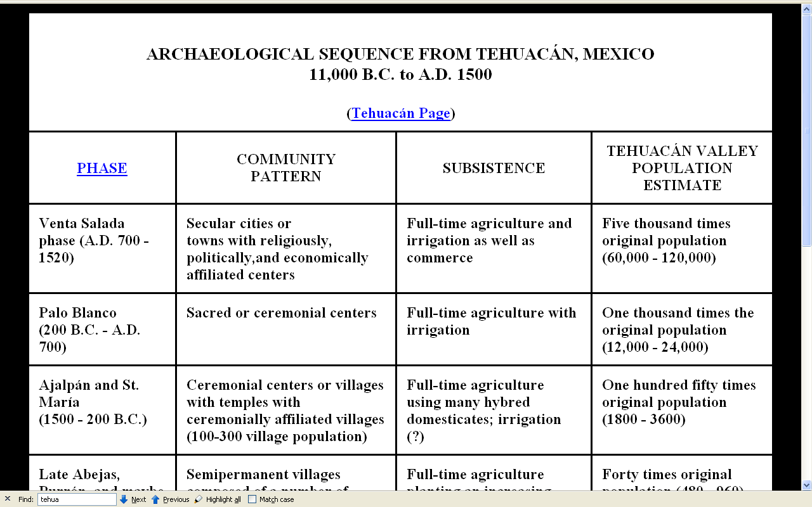
www.d.umn.edu/cla/faculty/troufs/anth3618/matehuac.html#title

Slide 109
Neolithic
Time line for Ch. 14 Food Production
Understanding Physical Anthropology and Archaeology, 9th Ed., p. 333

Slide 110
Neolithic
“The Neolithic Revolution”
“The New Stone Age”
in Middle America this is known as
The “Archaic”
and sometimes they’re all referred to as
“The Agriculture Revolution”
Time line for Ch. 14 Food Production.
Understanding Physical Anthropology and Archaeology, 9th Ed., p. 333

Slide 111
REM:
“The Neolithic Revolution”
“The New Stone Age”
in Middle America this is known as
The “Archaic”
and sometimes they’re all referred to as
“The Agriculture Revolution”

Slide 112
Neolithic
Time line for Ch. 14 Food Production
Understanding Physical Anthropology and Archaeology, 9th Ed., p. 333

Slide 113
Main Characteristics of Anthropology
1. the four fields of general anthropology
culture as a primary concept
comparative method
as major approach
development and structure
holism as a primary theoretical goal
fieldwork as a primary research technique
another e.g. . . .

Slide 114
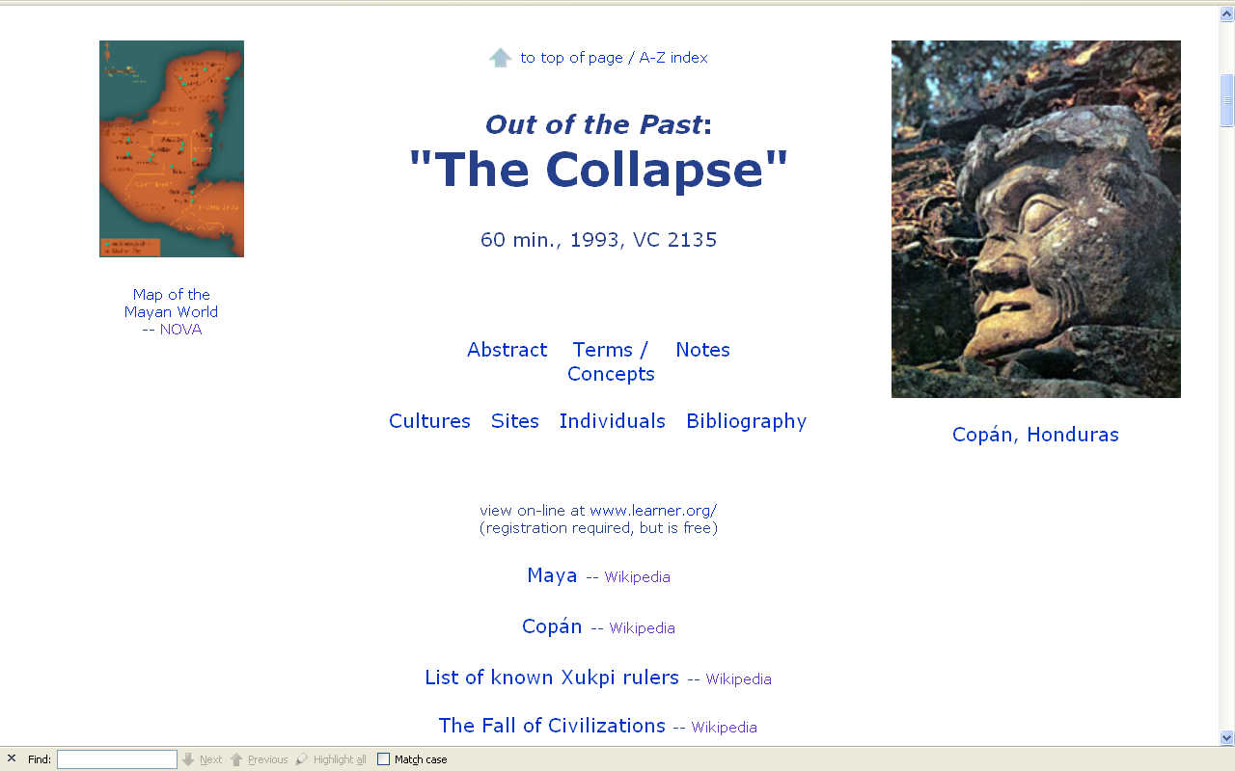
Compare . . .
comparing
the “fall of civilization”
around the world
www.d.umn.edu/cla/faculty/troufs/anth3618/video/Collapse.html#title

Slide 115
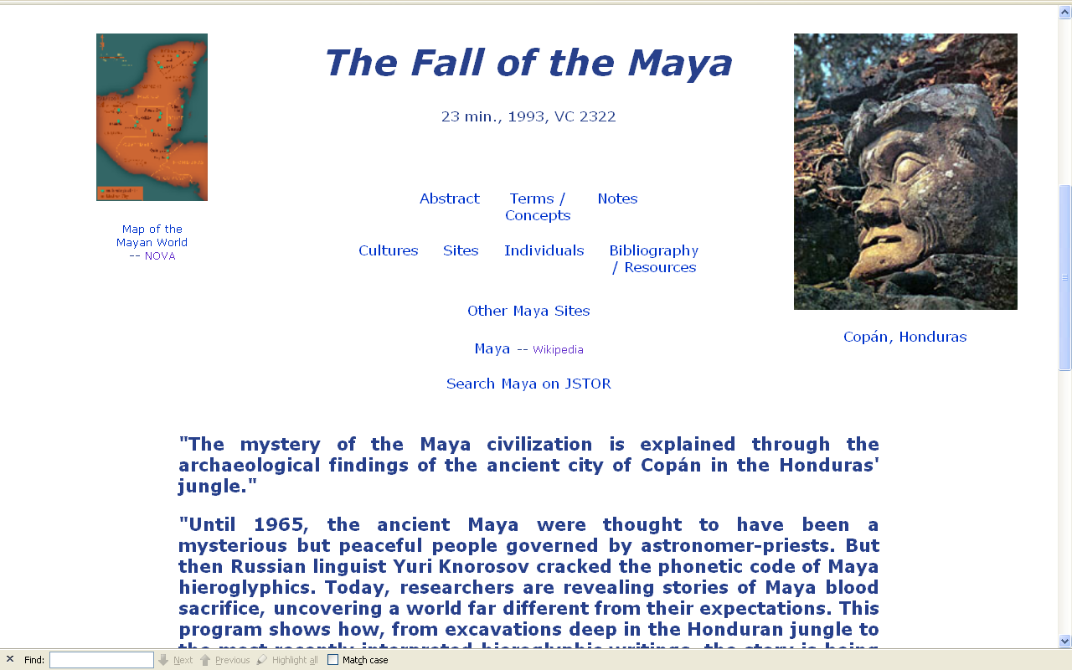
www.d.umn.edu/cla/faculty/troufs/anth3618/video/Fall_Maya.html#title

Slide 116
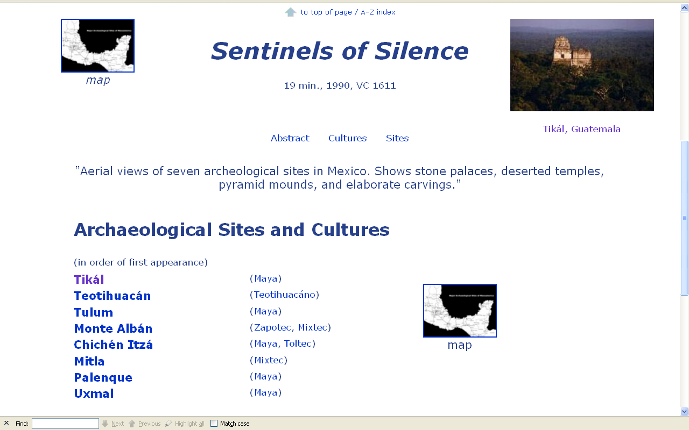
Compare . . .
comparing sites and cultures
www.d.umn.edu/cla/faculty/troufs/anth3618/video/Sentinels.html#title

Slide 117
Compare . . .
www.d.umn.edu/cla/faculty/troufs/anth3618/video/Out_of_Past.html#title

Slide 118
Main Characteristics of Anthropology
1. the four fields of general anthropology
culture as a primary concept
comparative method as major approach
holism
or the study of "humankind" as a whole, as a primary theoretical goal
fieldwork as a primary research technique

Slide 119
Main Characteristics of Anthropology
1. the four fields of general anthropology
culture as a primary concept
comparative method as major approach
holism as a primary theoretical goal
fieldwork as a primary research technique

Slide 120
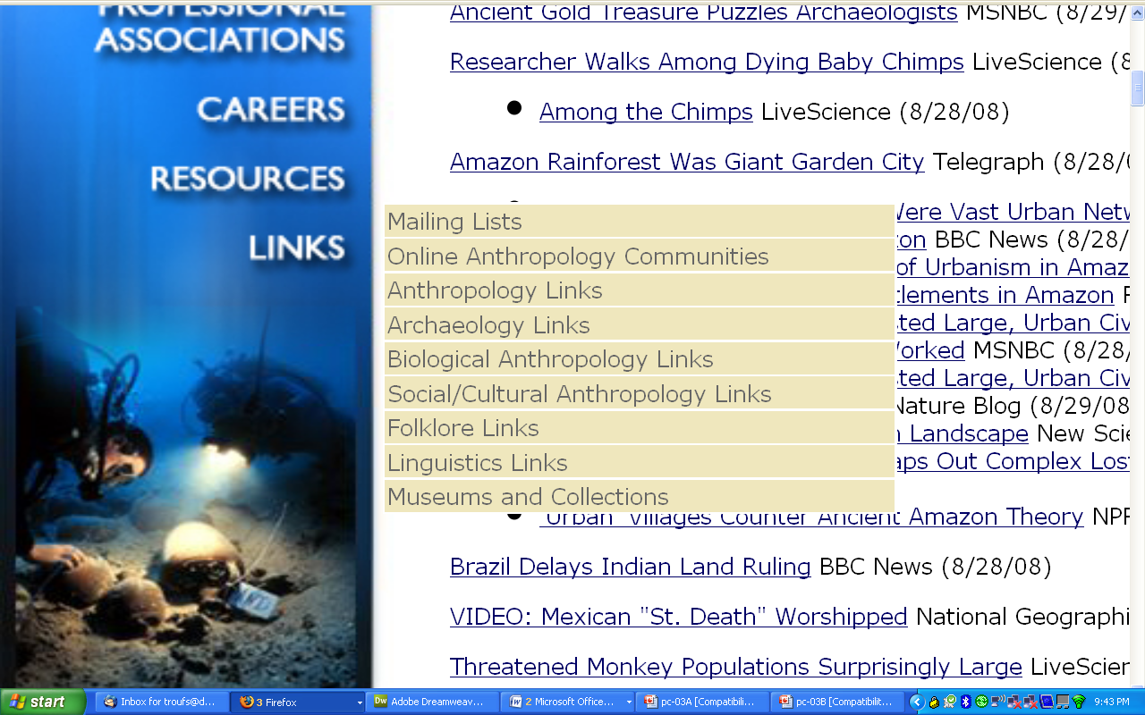
The main fields
of general anthropology
1
2
3
4
http://www.tamu.edu/anthropology/news.html

Slide 121
Holism is fundamental to understanding the cultures of Ancient Middle America . . .

Slide 122
holism tries to put all of the pieces together . . .
American Anthropology
cultural / social
physical (bio-physical)
archaeology
linguistics

Slide 123
. . . so let’s have a look at that on the
“Anthropology and . . . Its Parts” chart to try to understand HOLISM . . .

Slide 124
NOTE:
usually anthropologists read charts from the bottom up
that has to do with the fact that in archaeology the oldest layers are at the bottom of a site and the newer ones are on top

Slide 125
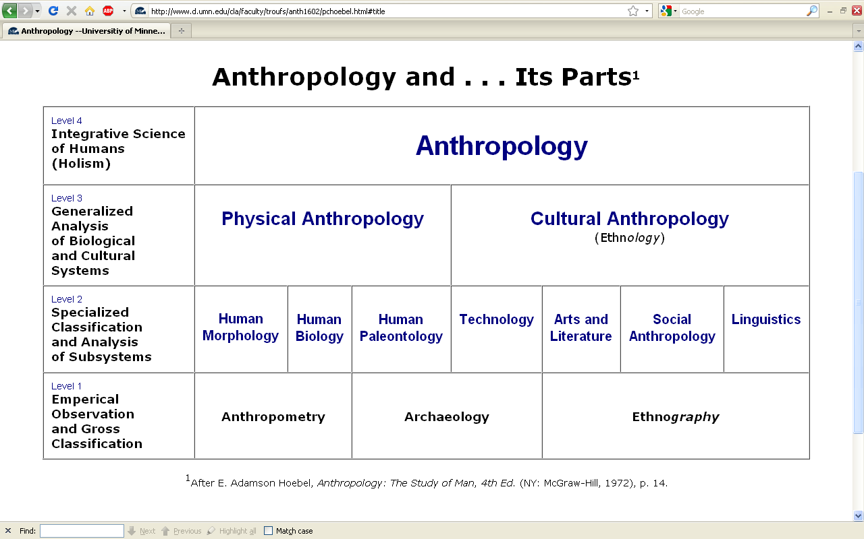

Slide 126
Having a look at . . .
Ancient Middle America
cultural / social
physical
archaeology
linguistics
would appear on the chart as . . .

Slide 128
NOTE:
There are four levels . . .
(REM: read from the bottom up)

Slide 133
HOLISM
Involves all four levels
and all
of the physical and cultural
components combined

Slide 134
holism

Slide 135
holism
holism

Slide 136

Finland is switching their
entire school curriculum to
holistic studies . . .
https://brightside.me/wonder-curiosities/finland-will-become-the-first-country-in-the-world-to-get-rid-of-all-school-subjects-259910/

Slide 137
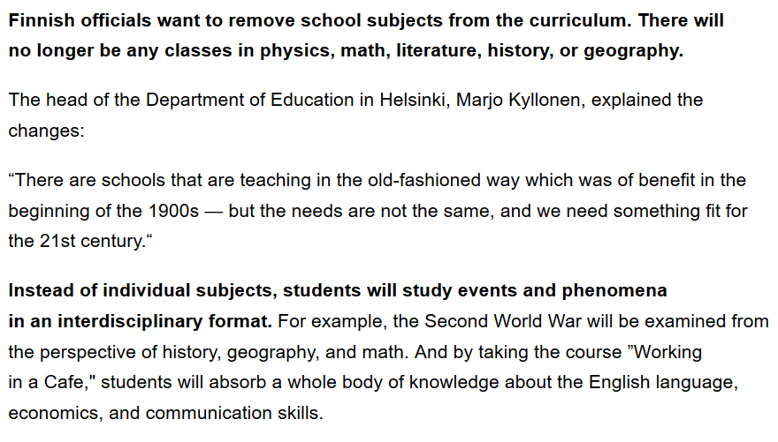
https://brightside.me/wonder-curiosities/finland-will-become-the-first-country-in-the-world-to-get-rid-of-all-school-subjects-259910/

Slide 138
A simple example of the importance of
holistic thinking . . .

Slide 139
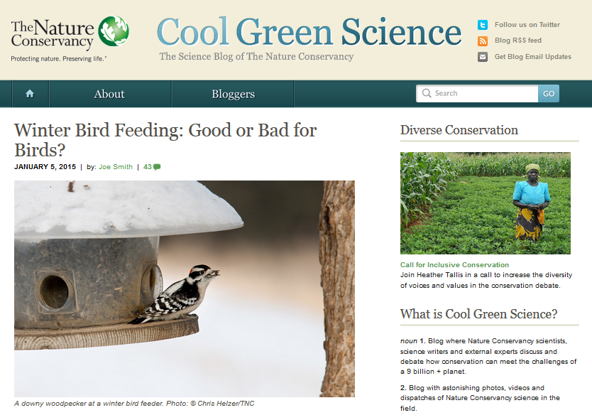
http://blog.nature.org/science/2015/01/05/winter-bird-feeding-good-or-bad-for-birds/

Slide 140
Is it good to feed the winter birds?
Yes . . .
for the reasons one might suspect . . .
http://blog.nature.org/science/2015/01/05/winter-bird-feeding-good-or-bad-for-birds/

Slide 141
Is it good to feed the winter birds?
Yes . . .
for the reasons one might suspect . . .
A simple answer . . .
http://blog.nature.org/science/2015/01/05/winter-bird-feeding-good-or-bad-for-birds/

Slide 142
Is it good to feed the winter birds?
Yes . . .
for the reasons one might suspect . . .
http://blog.nature.org/science/2015/01/05/winter-bird-feeding-good-or-bad-for-birds/

Slide 143
Is it good to feed the winter birds?
More than 40 percent of U.S. households feed their backyard birds, and in the United Kingdom, the rate is as high as 75 percent.
A study conducted during winter in Wisconsin showed that black-capped chickadees with access to bird seed had a much higher overwinter survival rate (69 percent) as compared to those without access to human-provided seed (37 percent survival
Furthermore, some studies have shown that birds making it through the winter in better physical condition see those benefits carry over into the nesting season
Bird feeding produces significantly earlier egg laying dates, larger clutches of eggs, higher chick weights and higher overall breeding success across a wide range of bird species
http://blog.nature.org/science/2015/01/05/winter-bird-feeding-good-or-bad-for-birds/

Slide 144
Is it good to feed the winter birds?
Yes . . .
for the reasons one might suspect . . .
BUT . . .
http://blog.nature.org/science/2015/01/05/winter-bird-feeding-good-or-bad-for-birds/

Slide 145
Is it good to feed the winter birds?
Yes . . .
for the one might suspect . . .
A holistic view would also consider . . .
http://blog.nature.org/science/2015/01/05/winter-bird-feeding-good-or-bad-for-birds/

Slide 146
Is it good to feed the winter birds?
feeding can promote the survival and reproduction of the not-quite-fittest
one research group found that birds fed during winter subsequently laid a smaller number of eggs that had lower hatching success and ultimately fledged fewer young than birds that weren’t fed at all
the offspring that did fledge weighed less and had a lower survival rate than the young of unfed birds
http://blog.nature.org/science/2015/01/05/winter-bird-feeding-good-or-bad-for-birds/

Slide 147
Is it good to feed the winter birds?
both species [in two U.K. studies], when they had access to bird food, laid fewer eggs, had lower hatching success, and ultimately had fewer chicks fledged
feeding an irresistible diet that was unbalanced – too high in fat to produce high-quality eggs
http://blog.nature.org/science/2015/01/05/winter-bird-feeding-good-or-bad-for-birds/

Slide 148
Is it good to feed the winter birds?
bird feeding allowed individuals with a lower reproductive capacity which ordinarily would not survive the winter the chance to nest
the feeders may be in poor quality nesting habitat – leading the birds to choose these suboptimal sites as nesting areas in the spring
http://blog.nature.org/science/2015/01/05/winter-bird-feeding-good-or-bad-for-birds/

Slide 149
Is it good to feed the winter birds?
So from the holistic view, one must look at things like the impacts of bird feeding not only on the survival
of the birds fed,
but also on things like . . .
http://blog.nature.org/science/2015/01/05/winter-bird-feeding-good-or-bad-for-birds/

Slide 150
Is it good to feed the winter birds?
  overall reproductive success
  other factors such as disease transmission
  species range expansion
  population trajectories
  and the long-range evolutionary effects on the species
http://blog.nature.org/science/2015/01/05/winter-bird-feeding-good-or-bad-for-birds/

Slide 151
another simple example . . .
http://www.bbc.com/news/health-40118539

Slide 152
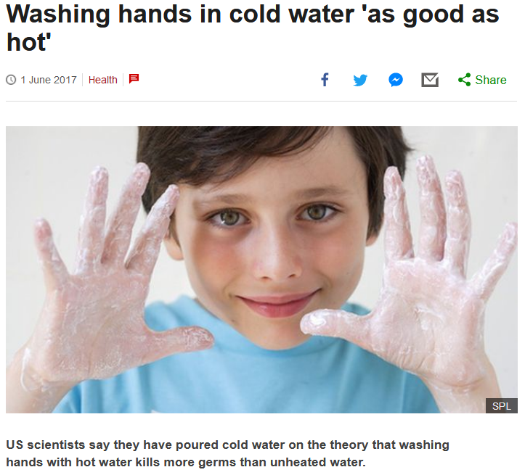


http://www.bbc.com/news/health-40118539

Slide 153
US scientists say they have poured cold water on the theory that washing hands with hot water kills more germs than unheated water.
http://www.bbc.com/news/health-40118539

Slide 154
Article:
“Quantifying the Effects of Water Temperature, Soap Volume, Lather Time, and Antimicrobial Soap as Variables in the Removal of Escherichia coli ATCC 11229 from Hands”
Dane A. Jensen, David R. Macinga, David J. Shumaker, Roberto Bellino, James W. Arbogast and Donald W. Schaffner
Journal of Food Protection, Volume 80, Issue 6 (June 2017), pp. 1022-1031.
http://jfoodprotection.org/doi/pdf/10.4315/0362-028X.JFP-16-370http://jfoodprotection.org/doi/pdf/10.4315/0362-028X.JFP-16-370

Slide 155
an anthropologist would look at the problem of water temperature holistically, and conclude that the water temperature DOES make a difference . . .
http://www.bbc.com/news/health-40118539

Slide 156
because length of time of washing hands
(like length of time
brushing one’s teeth)
is a key variable to overall effectiveness
. . .
http://www.bbc.com/news/health-40118539

Slide 157
. . . in other words, HUMAN BEHAVIOR
is a most-important
key variable
http://www.bbc.com/news/health-40118539

Slide 158
. . . and people tend to wash their hands longer if the water temperature is comfortably warm
http://www.bbc.com/news/health-40118539

Slide 159
even the scientists focusing on water temperature in the experiments note more or less in passing that human behavior is an important issue . . .
http://www.bbc.com/news/health-40118539

Slide 160
“A large part of the variability in the data was associated with the behaviors of the volunteers. Understanding what behaviors and human factors most influence hand washing may help researchers find techniques to optimize the effectiveness of hand washing.”
http://www.bbc.com/news/health-40118539

Slide 161
“A large part of the variability in the data was associated with the behaviors of the volunteers. Understanding what behaviors and human factors most influence hand washing may help researchers find techniques to optimize the effectiveness of hand washing.”
Dane A. Jensen, David R. Macinga, David J. Shumaker, Roberto Bellino, James W. Arbogast and Donald W. Schaffner
Journal of Food Protection, Volume 80, Issue 6 (June 2017), pp. 1022-1031.
http://jfoodprotection.org/doi/abs/10.4315/0362-028X.JFP-16-370http://jfoodprotection.org/doi/abs/10.4315/0362-028X.JFP-16-370

Slide 162
with humans,
in anthropology,
holism looks at an item including the many subdisciplines in the areas of . . .

Slide 163
Holism tries to put all of the pieces together . . .
cultural / social
physical
archaeology
linguistics
(bio-physical)

Slide 164
Anthropology

Slide 165
theory
holism

Slide 166
theory
holism
and the theory ultimately also includes the
results of interdisciplinary study . . .

Slide 167
and finally,
we have the last
main characteristic of anthropology . . .

Slide 168
so back to finishing off our
main characteristics of anthropology . . .

Slide 169
Main Characteristics of Anthropology
1. the four fields of general anthropology
culture as a primary concept
comparative method as major approach
holism as a primary theoretical goal
fieldwork as a primary research technique

Slide 170
Main Characteristics of Anthropology
1. the four fields of general anthropology
culture as a primary concept
comparative method as major approach
holism as a primary theoretical goal
fieldwork
as a primary research technique—
involving “participant observation”

Slide 171
Main Characteristics of Anthropology
1. the four fields of general anthropology
culture as a primary concept
comparative method as major approach
holism as a primary theoretical goal
fieldwork
as a primary research technique—
involving “participant observation”

Slide 172
Note two terms in the listing . . .

Slide 173
Main Characteristics
1. culture as a primary concept
2. comparative method as major approach to the study of human behavior
3. holism or the study of "humankind" as a whole, as a primary theoretical goal
4. fieldwork as a primary research
technique, involving “participant observation”

Slide 174
Main Characteristics
1. culture as a primary concept
2. comparative method as major approach to the study of human behavior
3. holism or the study of "humankind" as a whole, as a primary theoretical goal
4. fieldwork as a primary research
technique, involving “participant observation”
what’s the difference?

Slide 175
Main Characteristics
1. culture as a primary concept
2. comparative method as major approach to the study of human behavior
3. holism or the study of "humankind" as a whole, as a primary theoretical goal
4. fieldwork as a primary research
technique, involving “participant observation” = how you get information
= tool

Slide 176
Main Characteristics
1. culture as a primary concept
2. comparative method as major approach to the study of human behavior
3. holism or the study of "humankind" as a whole, as a primary theoretical goal
4. fieldwork as a primary research
technique, involving “participant observation” = how you get information
data gathering technique —
participant observation
(fieldwork)
= tool

Slide 177
Main Characteristics
Anthropologists use other tools . . . like questionnaires, interview schedules, psychological tests, documentary filming . . . but “participant observation” is a characteristic technique use by anthropologists, especially cultural anthropologists (ethnologists)
1. culture as a primary concept
2. comparative method as major approach to the study of human behavior
3. holism or the study of "humankind" as a whole, as a primary theoretical goal
4. fieldwork as a primary research
technique, involving “participant observation” = how you get information
= tool

Slide 178
Main Characteristics
Anthropologists use other tools . . . like questionnaires, interview schedules, psychological tests, documentary filming . . . but “participant observation” is a characteristic technique use by anthropologists, especially cultural anthropologists (ethnologists)
1. culture as a primary concept
2. comparative method as major approach to the study of human behavior
3. holism or the study of "humankind" as a whole, as a primary theoretical goal
4. fieldwork as a primary research
technique, involving “participant observation” = how you get information
NOTE:
= tool

Slide 179
Main Characteristics
1. culture as a primary concept
2. comparative method as major approach to the study of human behavior
3. holism or the study of "humankind" as a whole, as a primary theoretical goal
4. fieldwork as a primary research
technique, involving “participant observation” = how you get information
= tool

Slide 180
Main Characteristics
1. culture as a primary concept
2. comparative method as major approach to the study of human behavior
3. holism or the study of "humankind" as a whole, as a primary theoretical goal
4. fieldwork as a primary research
technique, involving “participant observation” = how you get information
= approach
= how you use information
= tool

Slide 181
Main Characteristics
1. culture as a primary concept
2. comparative method as major approach to the study of human behavior
3. holism or the study of "humankind" as a whole, as a primary theoretical goal
4. fieldwork as a primary research
technique, involving “participant observation” = how you get information
= tool

Slide 182
Main Characteristics
1. culture as a primary concept
2. comparative method as major approach to the study of human behavior
3. holism or the study of "humankind" as a whole, as a primary theoretical goal
4. fieldwork as a primary research
technique, involving “participant observation” = how you get information
other tools include
things like . . .
= tool

Slide 183
Main Characteristics
surveys and questionnaires
various laboratory analyses of a variety of artifacts
ethological research techniques
(animal studies in the field)
1. culture as a primary concept
2. comparative method as major approach to the study of human behavior
3. holism or the study of "humankind" as a whole, as a primary theoretical goal
4. fieldwork as a primary research
technique, involving “participant observation” = how you get information
= tool
  after Marion Nestle, Food Politics, Rev. Ed., 2007, pp. 401-405

Slide 184
  various studies of laboratory animals
biochemical research
(“test tube”)
epidemiological research (populations)
clinical studies
(medical)
and others

Slide 185
Anthropologists also often like to use a research “technique” based on “unobtrusive measures” . . .
(either in the field or elsewhere)

Slide 186
  “unobtrusive measures”
  analysis of available data
  analysis of artifacts
  simply observing
  still and video photography
  and analysis of films and images
  and others
  after Marion Nestle, Food Politics, Rev. Ed., 2007, pp. 401-405

Slide 187
But most of all (generally)
Anthropologists
LOVE . . .

Slide 188
Main Characteristics of Anthropology
1. the four fields of general anthropology
culture as a primary concept
comparative method as major approach
holism as a primary theoretical goal
fieldwork
as a primary research technique --
involving “participant observation”

Slide 189
Main Characteristics of Anthropology
1. the four fields of general anthropology
culture as a primary concept
comparative method as major approach
holism as a primary theoretical goal
fieldwork
as a primary research technique --
involving site excavation for archaeology

Slide 190
And as I mentioned in the
“An Important Note on Videos and Visual Anthropology” note
we would LOVE to take you along with us around the world, but the next best thing we can do is bring the world to you in the form of films and videos. And we’ll do a lot of that
(starting Week 2)

Slide 191
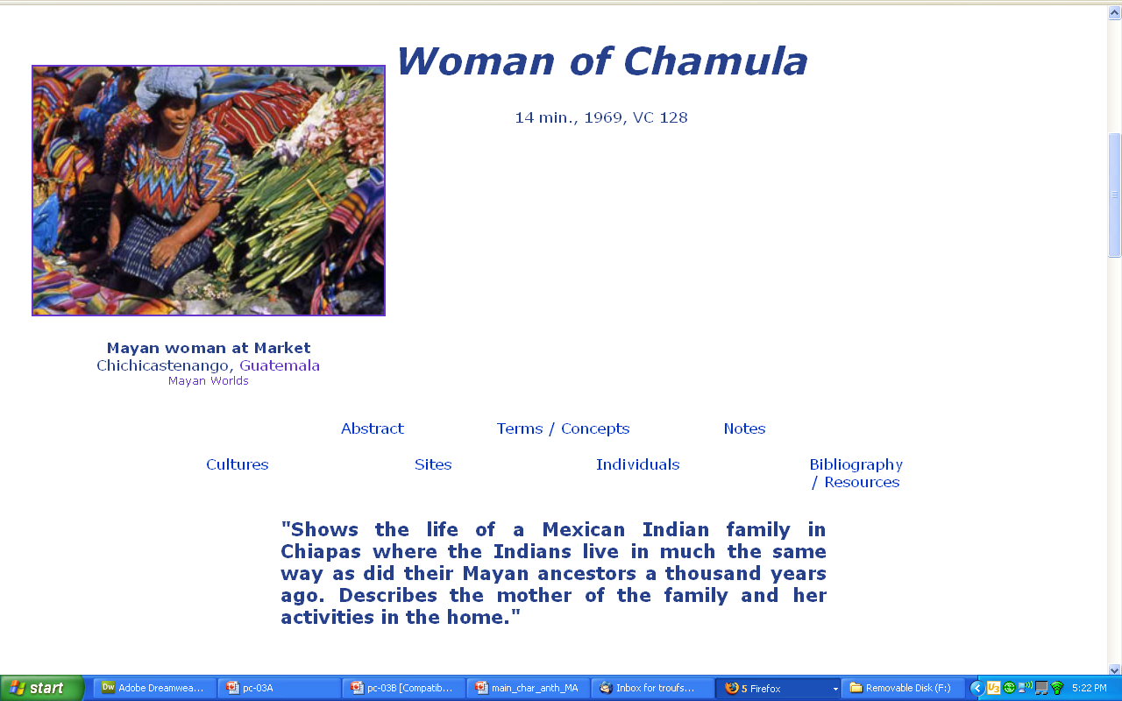
our first “field trip” it to visit the . . .

Slide 192
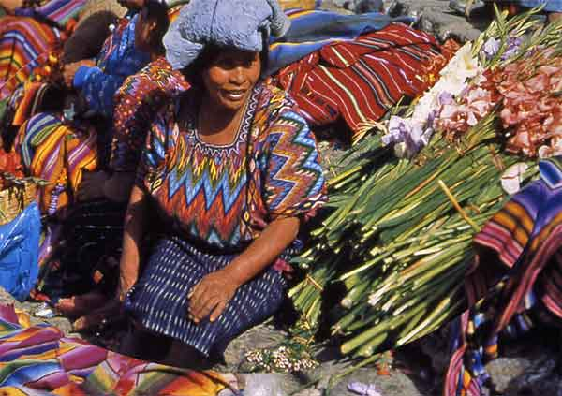
our first “field trip” . . .
Woman of Chamula

Slide 193
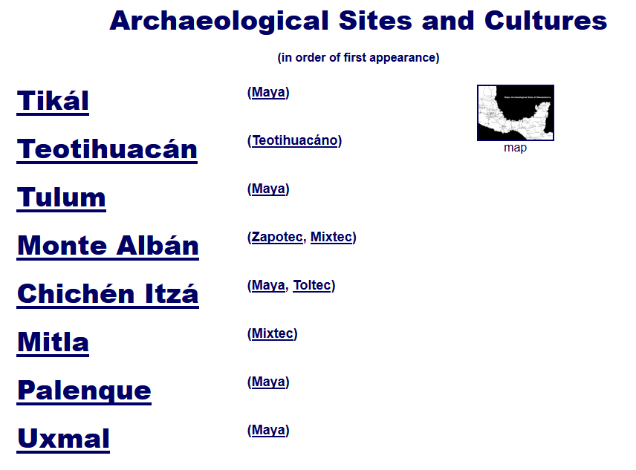
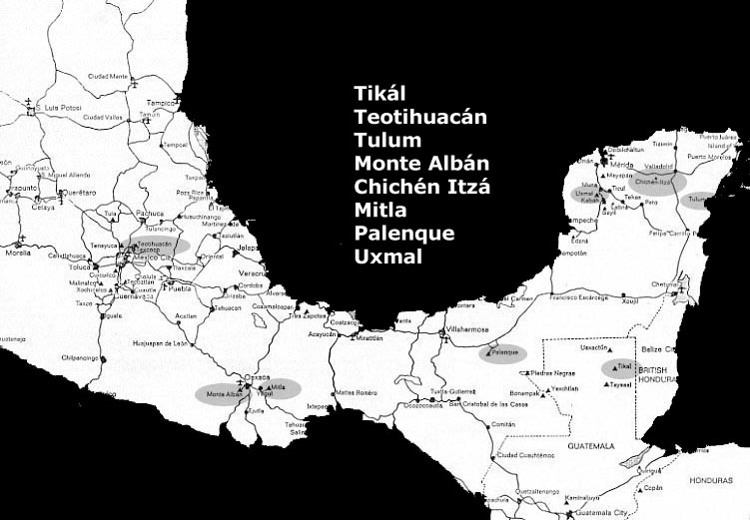
then we move on to . . .

Slide 194

on our second “field trip” . . .
to visit . . .
Tikál and Seven Other Ancient Mesoamerican Sites

Slide 195
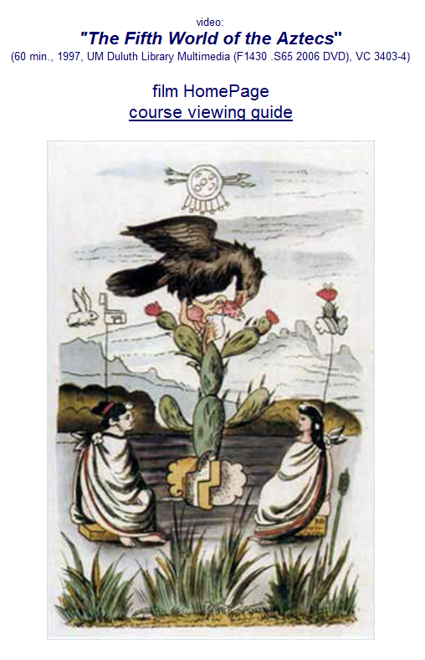
our third “field trip” . . .
Aztecs

Slide 196
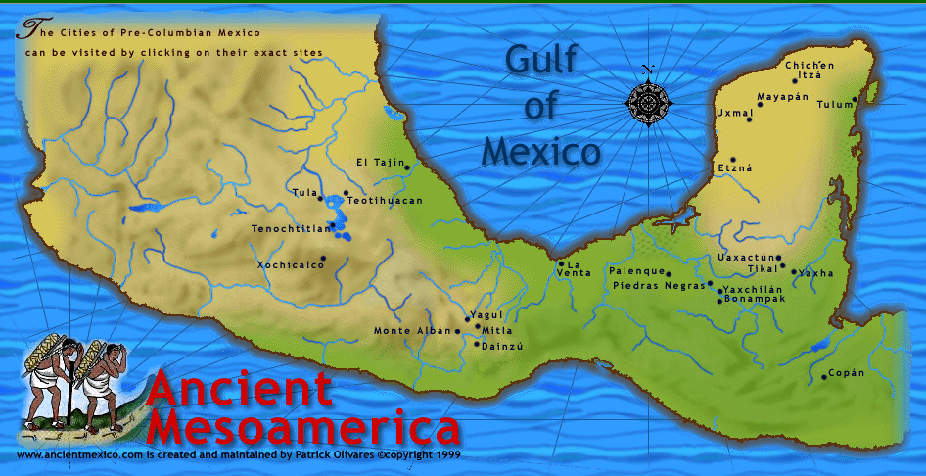
and from there
we’ll explore most of . . .
www.d.umn.edu/cla/faculty/troufs/anth3618/video/Copan.html#title

