Slide 1
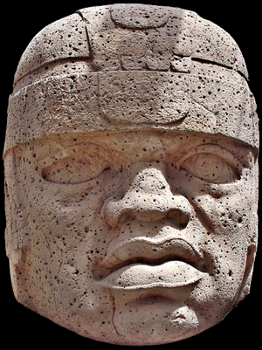
use your up/down arrow keys and/or
your space bar to advance the slides
Other
Important
Terms
Ancient Middle America
University of Minnesota Duluth
Tim Roufs © 2010-2019
http://www.d.umn.edu/cla/faculty/troufs/anth3618/

Slide 2
Other
Important
Terms
Ancient Middle America
University of Minnesota Duluth
Tim Roufs © 2010-2019
http://www.d.umn.edu/cla/faculty/troufs/anth3618/

Slide 3
. . . and one or more of these term clarifications
might prove interesting, and even helpful with your class project

Slide 4
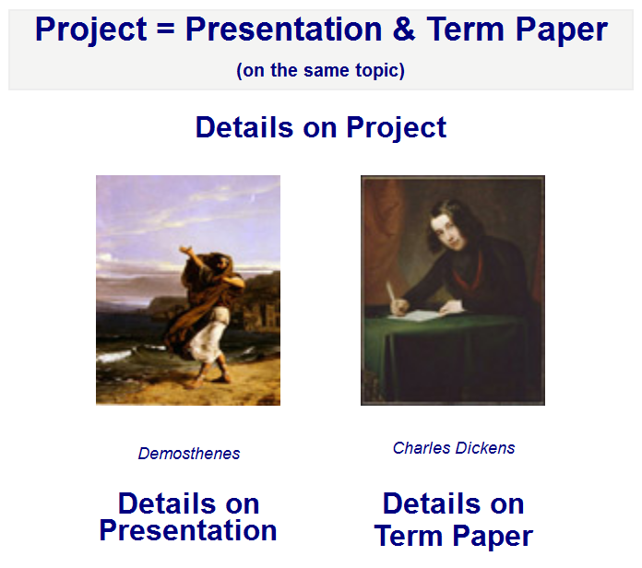

Slide 5
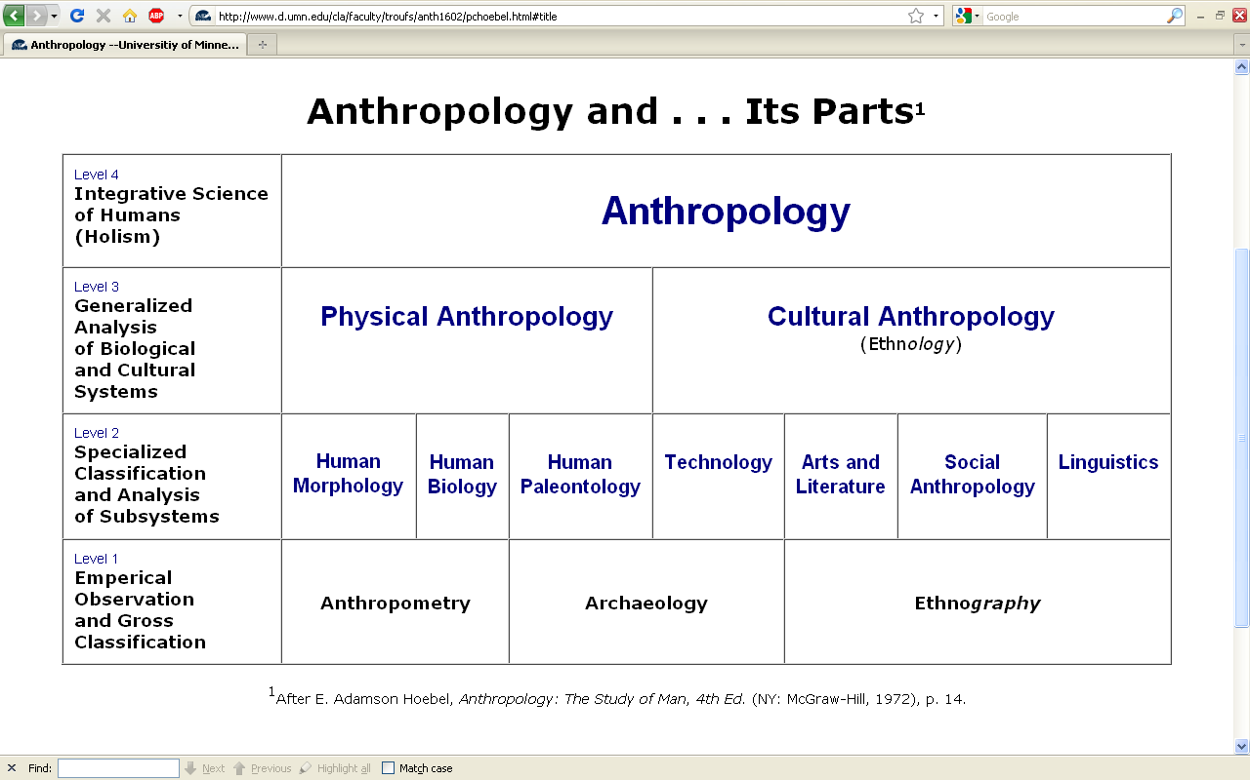
this is the same chart as in the
“Main Characteristics of Anthropology”
material

Slide 6
difficult terms

Slide 7
ethnography
  scientific description of cultures
  (“a portrait of a people”)

Slide 8
ethno – graphy
  graph from the Greek, meaning something “written” or “drawn”

Slide 9
ethno – graphy
  ethnography looks at “who,” “what,” “where” and “when”

Slide 10
ethnology
  comparative study of cultures

Slide 11
ethn – ology
  comparative study of cultures

Slide 12
ethn – ology
  ethnology looks at “why” and “how”

Slide 13
ethnology
  comparative study of cultures

Slide 14
ethnology
  comparative study of cultures
Take out the n and that yields an entirely different word . . .

Slide 15
ethology
  comparative study of cultures
  scientific study of the social behavior of animals, especially in their natural environments

Slide 16
primatology
  scientific study of the social behavior of primates, especially (non-human primates) apes and monkeys

Slide 17
“primatologist”
  usually refers to one who studies the behavior and social lives of chimpanzees, gorillas, orangutans, monkeys, etc.
      e.g., Jane Goodall, Diane Fossy
      Birute Galdikas-Brindamour

Slide 18
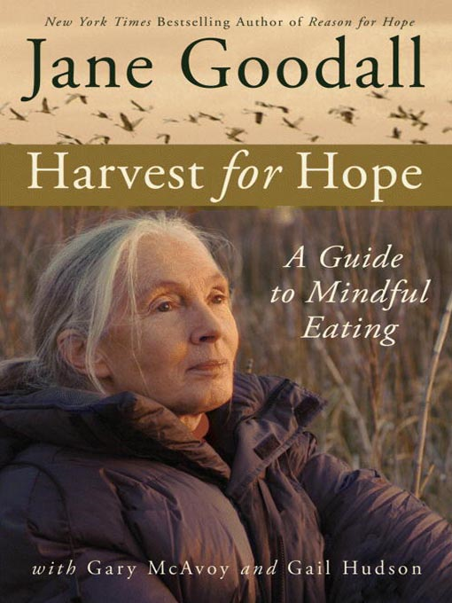
Jane Goodall is the most famous primatologist of all time, and she has some excellent advice on food consumption by primates – including human primates
Grand Central Publishing, 2006

Slide 19
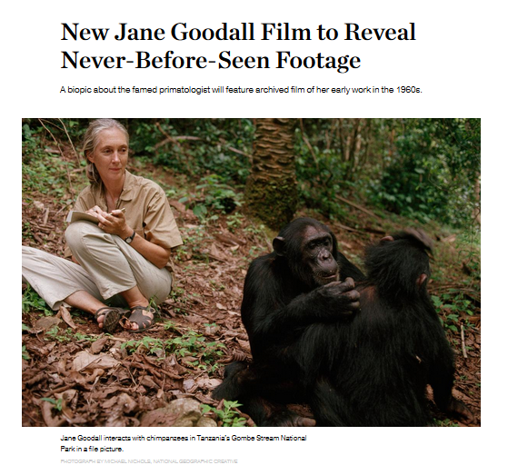
The 2016 film premiered
on the National Geographic Channel
in 171 countries and 44 languages.
(21 January 2016)
Jane Goodall is the most famous primatologist of all time – including human primates

Slide 20
“primates” include
    prosimians (“pre-monkeys”)
    monkeys
    apes
    and also humans

Slide 21
include
“primates”
    prosimians (“pre-monkeys”)
    monkeys
    apes
    and also humans

Slide 22
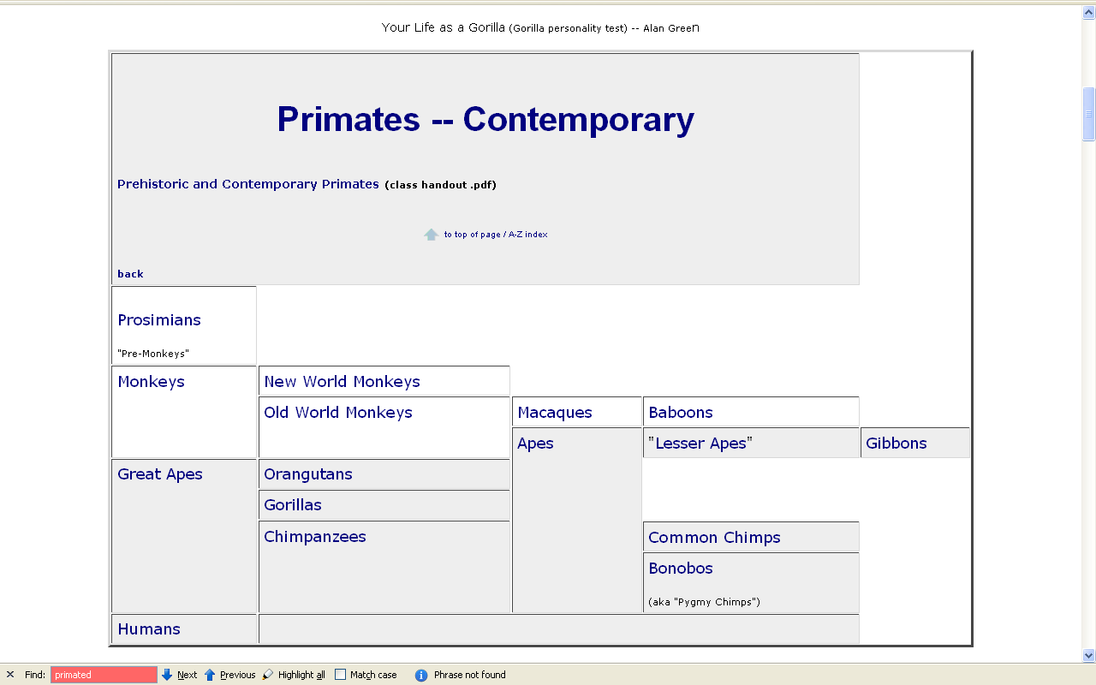
www.d.umn.edu/cla/faculty/troufs/anth1602/pcprim.html

Slide 23
“non-human primates” are
  prosimians (“pre-monkeys”)
  monkeys
  apes

Slide 24
“non-human primates”
www.d.umn.edu/cla/faculty/troufs/anth1602/pcprim.html

Slide 25
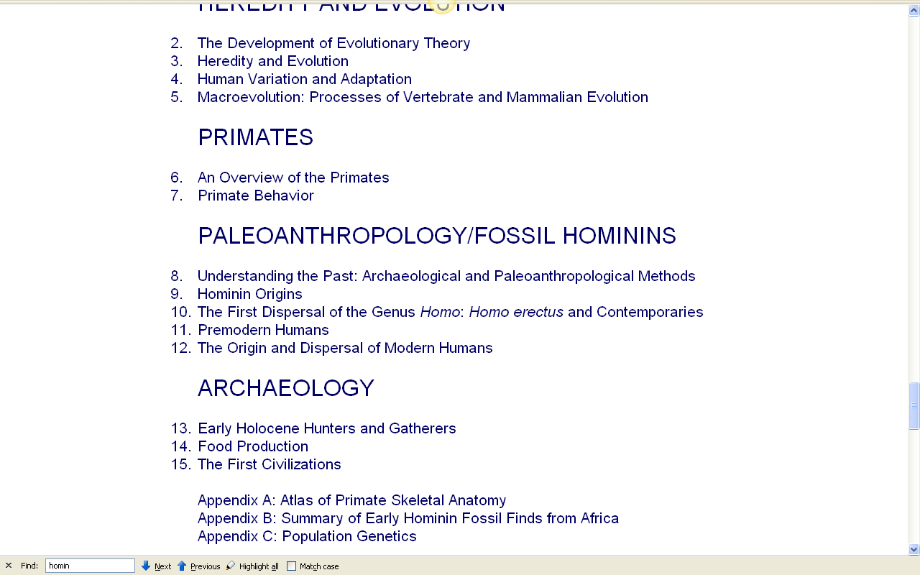
with regard to primates, note one major recent change . . .

Slide 26
with regard to primates, note one major recent change . . .
“hominins” is now generally used rather than “hominids”

Slide 27
this reflects a relatively recent change in the classification of the Great Apes and prehistoric forms like “Lucy”
“hominins” is now generally used rather than “hominids”

Slide 28
other important terms include . . .

Slide 29
ethnocentrism
  judging other cultures by the standards of one’s own culture rather than by the standards of that particular culture

Slide 30
two fundamental concepts in anthropology are . . .
ethnocentrism
  judging other cultures by the standards of one’s own culture rather than by the standards of that particular culture
cultural relativism

Slide 31
ethnocentrism
  is the mindset of judging other cultures by the standards of one’s own culture rather than by the standards of that particular culture

Slide 32
cultural relativism
  refers to the perspective that each culture must be understood in terms of the values and ideas of that culture and should not be judged by the standards of another

Slide 33
in recent times two types of cultural relativism have emerged . . .
cultural relativism
  absolute cultural relativism
  critical cultural relativism

Slide 34
the term as originally proposed came to be referred to as . . .
in recent times two types of cultural relativism have emerged . . .
cultural relativism
  absolute cultural relativism
  critical cultural relativism

Slide 35
absolute cultural relativism
  the perspective that says a person from one culture should not question the rightness or wrongness of behavior or ideas in other cultures because that would be ethnocentric

Slide 36
absolute cultural relativism
  was quickly criticized as unacceptable as, taken literally, [absolute] cultural relativism suggested we should accept anything and everything that was thought to be OK by the people under consideration

Slide 37
absolute cultural relativism
  critics quickly pointed to Hitler and the World War II Holocaust and (rightfully) said that no one should accept behaviors that resulted in The [WW II] Holocaust; that such behavior was unacceptable under any circumstances

Slide 38
absolute cultural relativism
  and the critics added enough other examples so that the original concept of cultural relativism was modified and resulted in today’s concept of
  critical cultural relativism

Slide 39
critical cultural relativism
  offers an alternative view that poses questions about cultural practices and ideas in terms of who accepts them and why, and who they might be harming or helping

Slide 40
critical cultural relativism . . .
answered many of the early critics
but—even accepting the modified concept—it is oftentimes not easy to figure out what “. . . in terms of who accepts them and why, and who they might be harming or helping” means

Slide 41
critical cultural relativism . . .
let’s look at a few examples of where
“it is oftentimes not easy to figure out what ‘. . . in terms of who accepts them and why, and who they might be harming or helping’ means” . . .

Slide 42
absolute cultural relativism
  how about?
  doctor assisted suicide
  arranged “underage” marriage
  female genital mutilations
  withholding of medical treatment of children for religious reasons
  polygyny
  marriage of first cousins . . .

Slide 43
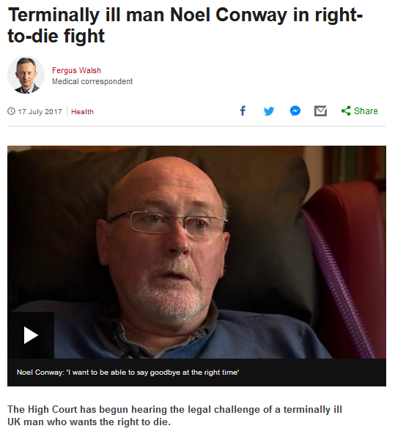

14 APRIL2016
Source

Slide 44
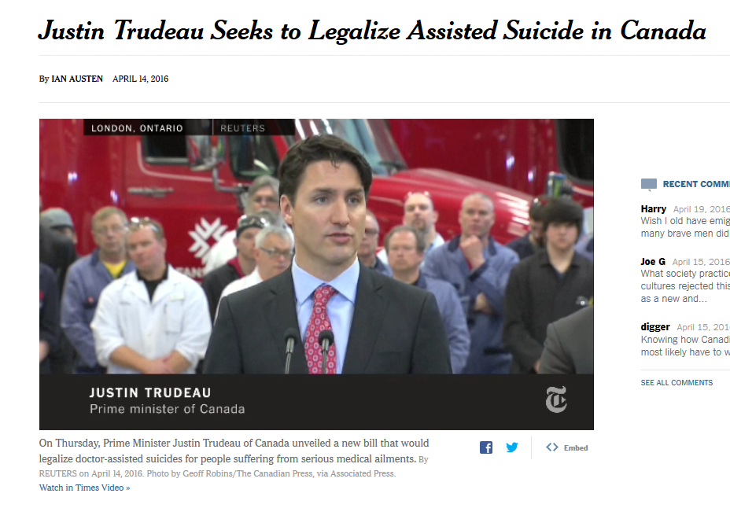
14 APRIL2016
https://www.nytimes.com/2016/04/15/world/americas/canadian-prime-minister-seeks-to-legalize-physician-assistedsuicide.html?emc=edit_na_20160414&nlid=60046204&ref=cta

Slide 45
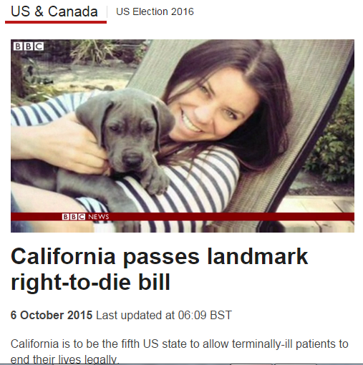
http://www.bbc.com/news/world-us-canada-34451379

Slide 46
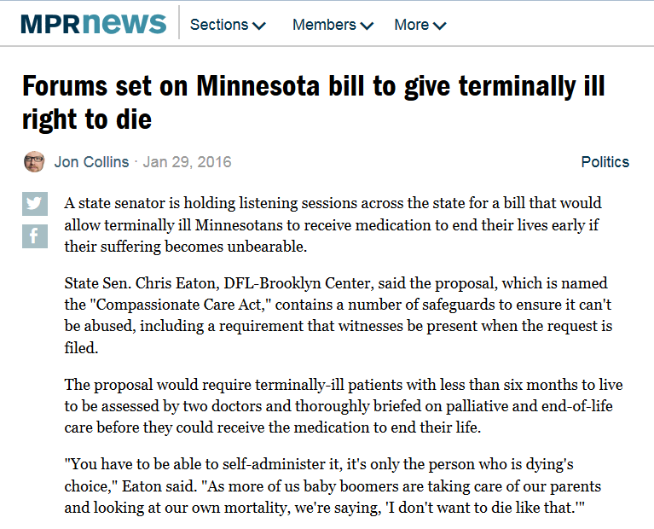
http://www.mprnews.org/story/2016/01/29/minnesota-right-to-die-bill-forums-set

Slide 47
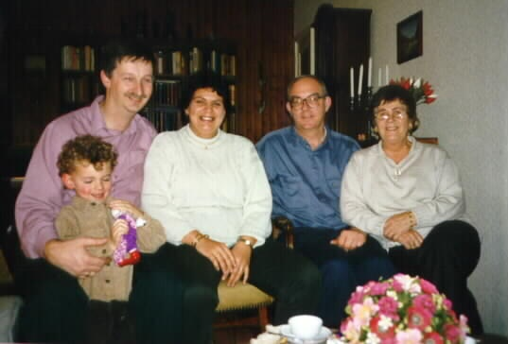
in many places doctor assisted suicide is legal, perfectly acceptable to many if not most, of the members of a culture

Slide 48
is that OK?

Slide 49
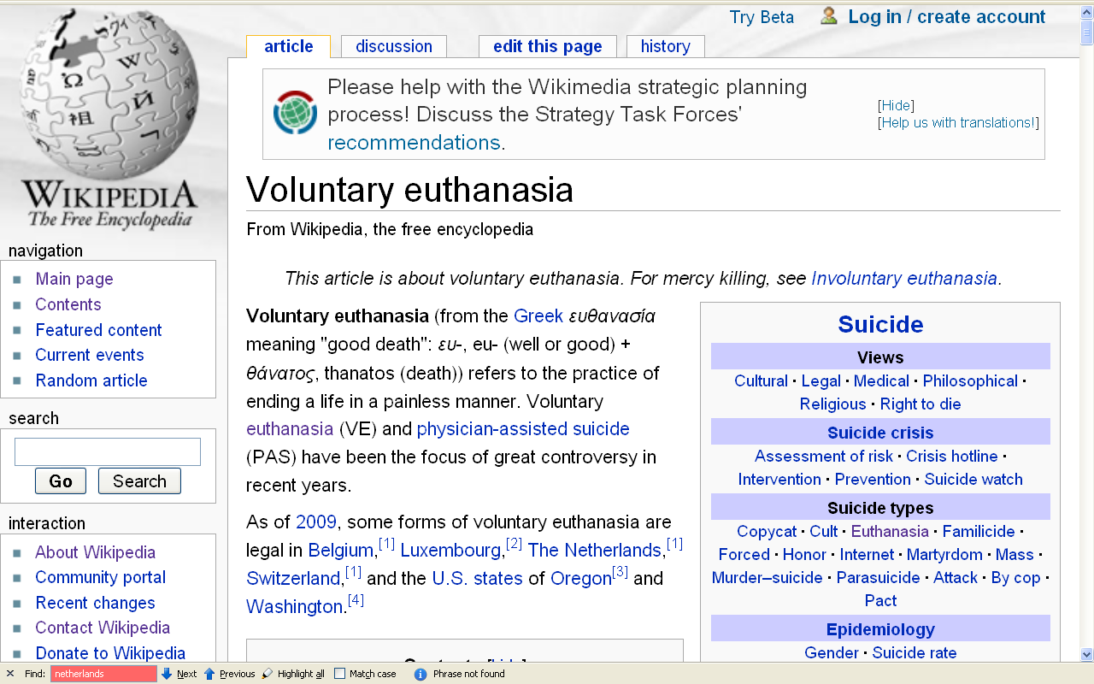
people living in the states of Oregon and Washington, and the countries of Belgium, Luxembourg, The Netherlands and Switzerland think so (for e.g.)
\ http://en.wikipedia.org/wiki/Voluntary_euthanasia

Slide 50
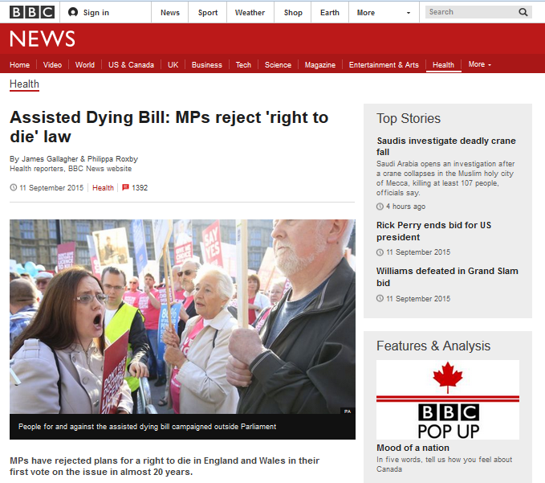
http://www.bbc.com/news/health-34208624

Slide 51

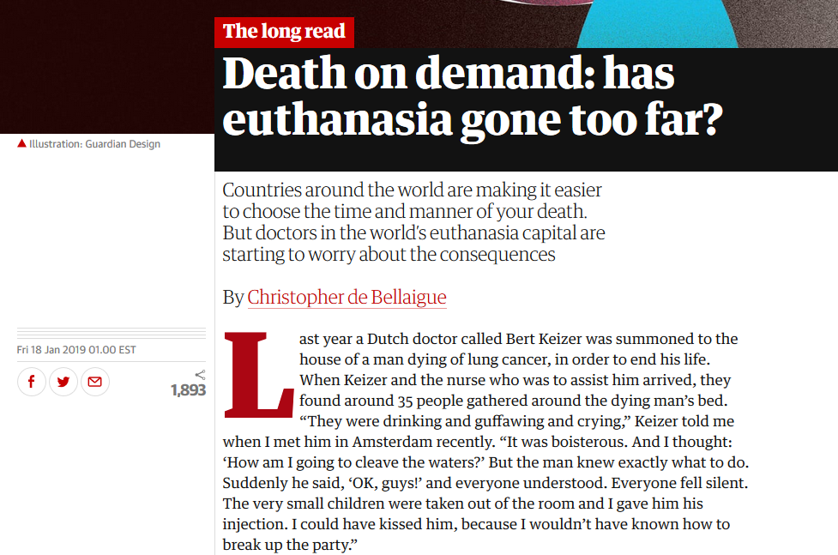
18 January 2019

Slide 52
absolute cultural relativism
  how about?
  Doctor Assisted Suicide
  arranged “underage” forced marriage
  female genital mutilations
  withholding of medical treatment of children for religious reasons
  polygyny
  marriage of first cousins . . .

Slide 53
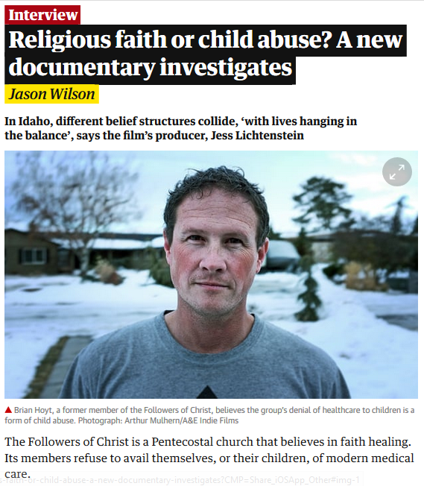
Sat 22 Sep 2018

Slide 54
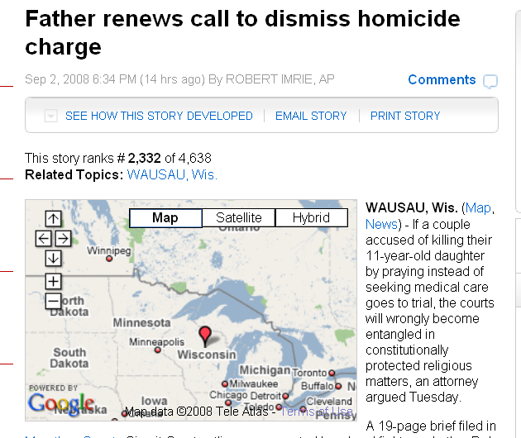
this is in Wisconsin, not Minnesota
www.examiner.com/a-1567034~Father_renews_call_to_dismiss_homicide_charge.html

Slide 55
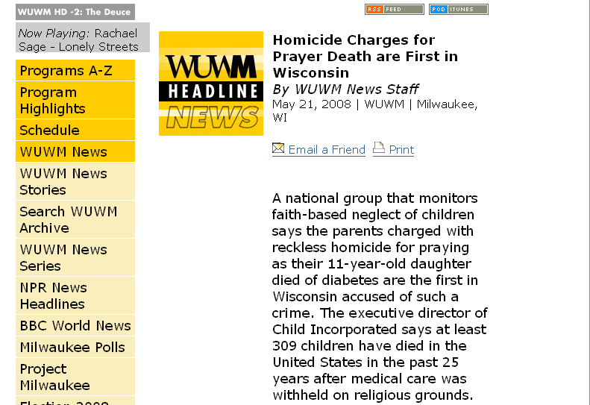
www.wuwm.com/programs/news/view_news.php?articleid=2242

Slide 56
absolute cultural relativism
  How about?
  Doctor Assisted Suicide
  arranged “underage” marriage
  female genital mutilations
  withholding of medical treatment of children for religious reasons
  polygyny . . .

Slide 57
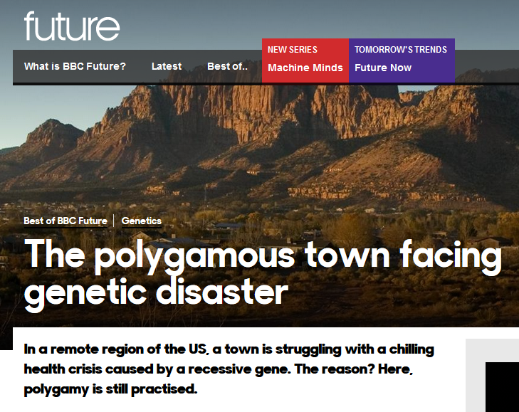
  26 July 2017

Slide 58
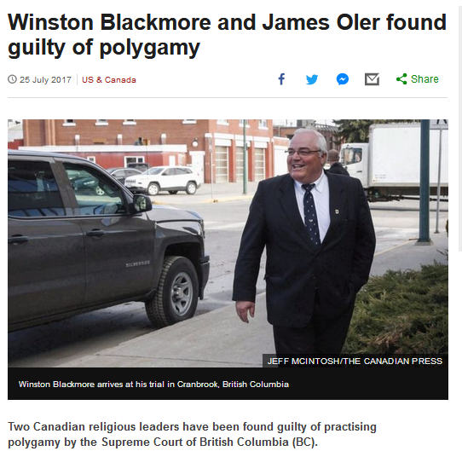
  25 July 2017
http://www.bbc.com/news/world-us-canada-40709250?ocid=global_bbccom_email_25072017_top+news+stories

Slide 59

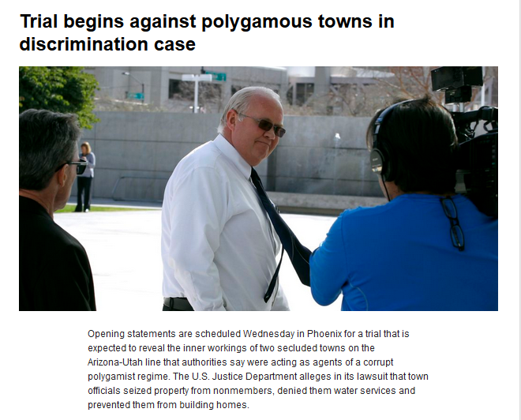
  20 January 2016
https://www.yahoo.com/digest/20160120/trial-begins-polygamous-towns-discrimination-case-01399592

Slide 60

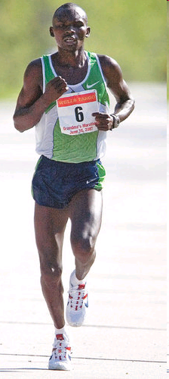
Grandma's Marathon: Remembering a fallen champion
Kevin Pates Duluth News Tribune
Published Sunday, June 15, 2008
There will be a moment of silence before the start of Saturday’s 32nd Grandma’s Marathon.
Standing on North Shore Drive, just south of Two Harbors, Stephen Muturi will gather his thoughts and emotions before the day’s task of running 26.2 miles.
He’ll remember close friend and countryman Wesly Ngetich, last year’s champion, who was killed Jan. 21 at Emarti village in Kenya’s Trans Mara district. Ngetich was caught in the middle of an incident that turned violent. He was 31 and had two wives and three children, ages 8, 6 and 1. “Wesly was a peacemaker. . . .”
www.duluthnewstribune.com/articles/index.cfm?id=68557
Notes:
60

Slide 61
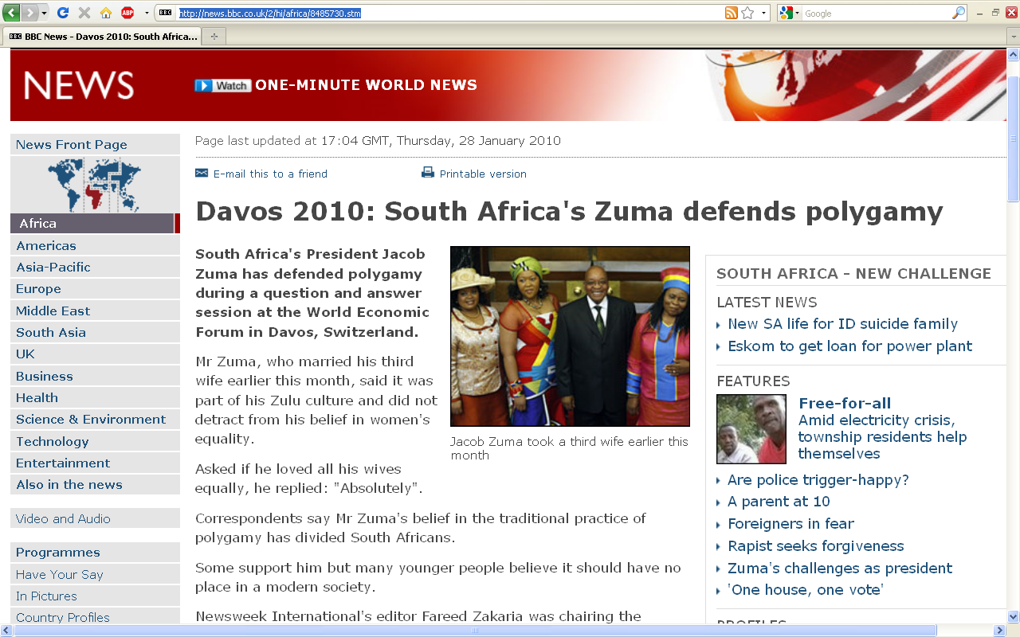
http://news.bbc.co.uk/2/hi/africa/8485730.stm
Notes:
61

Slide 62
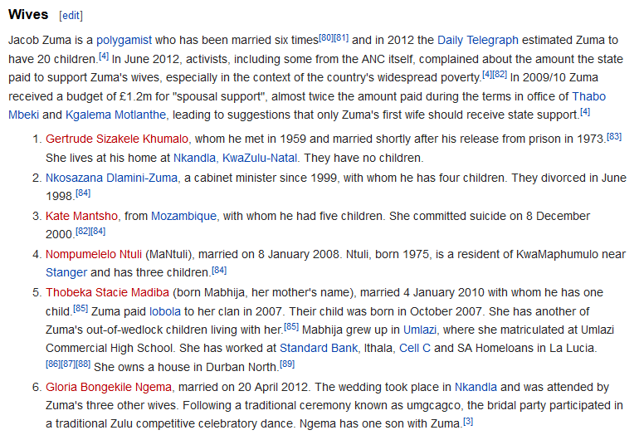
  How does the White House hadle official protocol at a state dinner when the President / Prime Minister of the other country has three or more wives?

Slide 63
  How does the White House handle official protocol at a state dinner when the President / Prime Minister of the other country has three or more wives?
  (at the same time, not successively with the President of the U.S.A.)

Slide 64
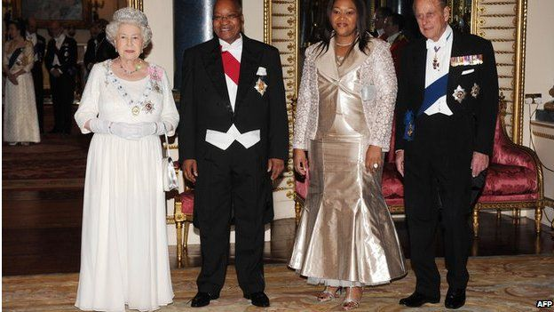
President Zuma attended a banquet at Buckingham Palace in 2010 with one of his wives, Tobeka Madiba Zuma
BBCNews

Slide 65
absolute cultural relativism
  how about?
  Doctor Assisted Suicide
  arranged “underage” forced marriage
  female genital mutilations
  withholding of medical treatment of children for religious reasons
  polygyny
  marriage of first cousins . . .

Slide 66
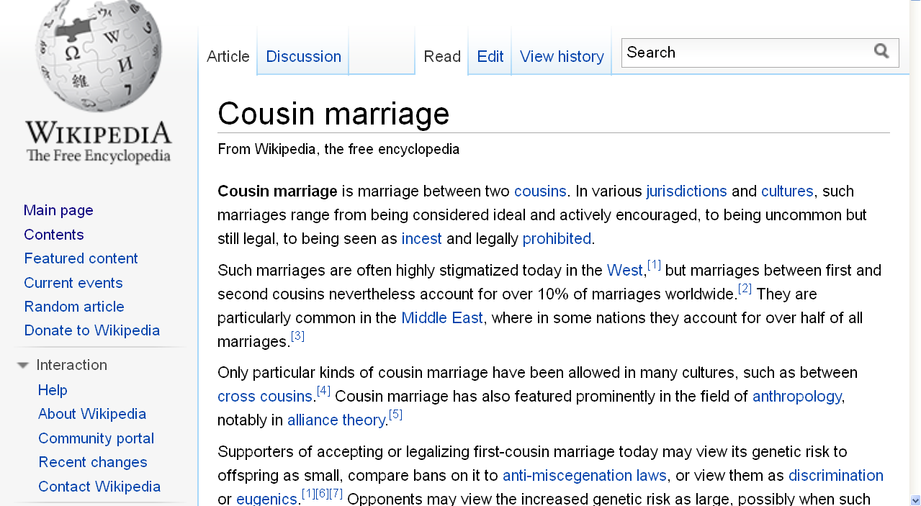
http://en.wikipedia.org/wiki/Cousin_marriage
Notes:
66

Slide 67
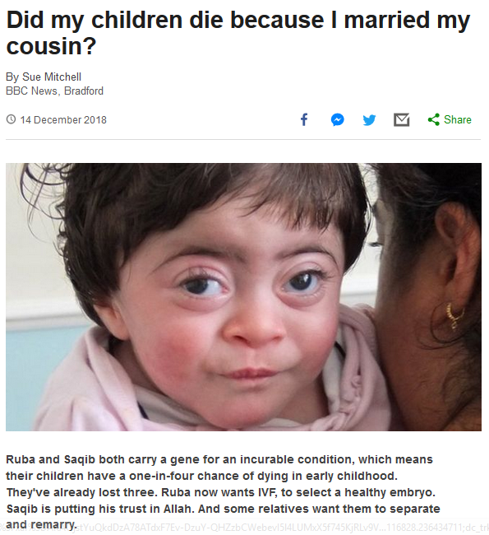

14 December 2018
Notes:
67

Slide 68
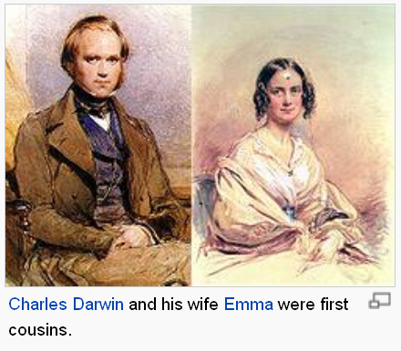
http://en.wikipedia.org/wiki/Cousin_marriage
Notes:
68

Slide 69
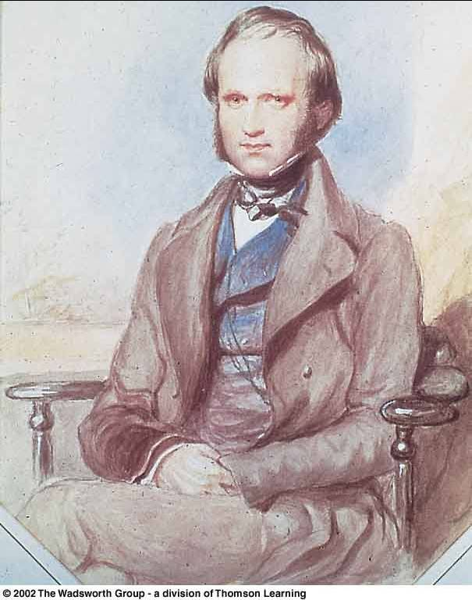
In 1839 Charles Darwin married his first cousin, Emma Wedgwood
Daughter of the younger Josiah Wedgwood, son of the Josiah Wedgwood who founded the pottery works
Darwin's mother Susannah was the sister of his wife’s father

Slide 70
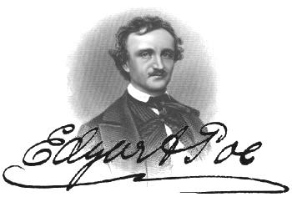
In 1835 Edgar Allan Poe married his widowed aunt’s daughter, Virginia Eliza Clemm
Virginia was 13 years old

Slide 71
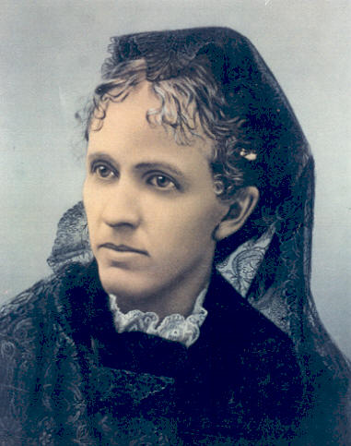
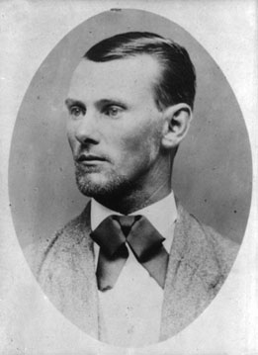
Jesse James married his first cousin
Zerelda "Zee" Mimms, named for his own mother
Zerelda "Zee" Mimms
“cousin of Jesse James and commonly accepted by historians as his wife”

Slide 72
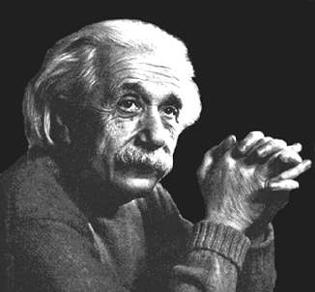
In 1919 Einstein married
his second cousin, his second wife,
Elsa Lowenthal

Slide 73
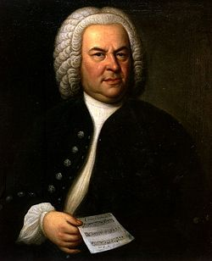
Johann Sebastian Bach
(1685-1750)
married his second cousin
Maria Barbara Bach
(1685-1750)
the daughter of Johann Michael Bach
http://news.bbc.co.uk/2/hi/americas/6057004.stm

Slide 74
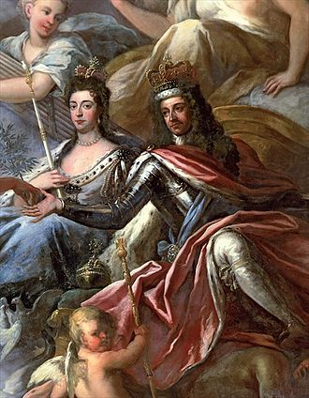
William and Mary
(English Monarchs William III and Mary II)
(Reigned 1689-1702/1694)
were first cousins
Mary was 15 when they married,
William was 26
https://en.wikipedia.org/wiki/William_and_Mary

Slide 75

College of
William and Mary in Williamsburg, Virginia
https://en.wikipedia.org/wiki/William_and_Mary

Slide 76
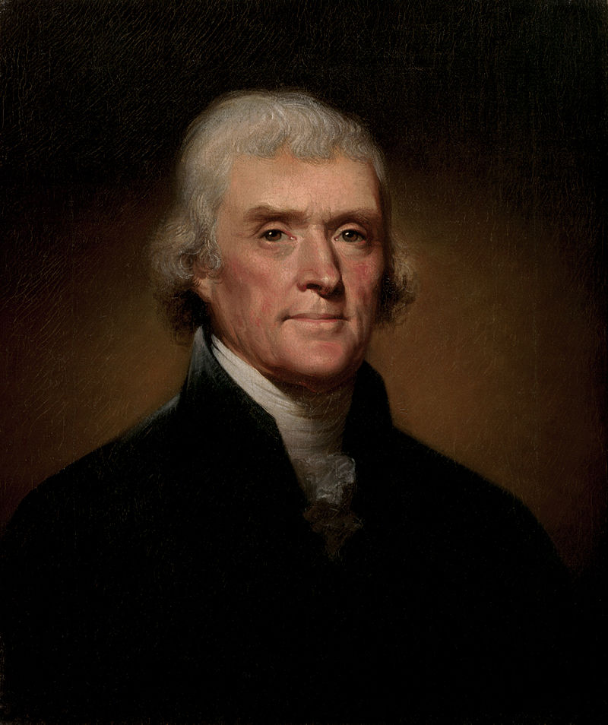
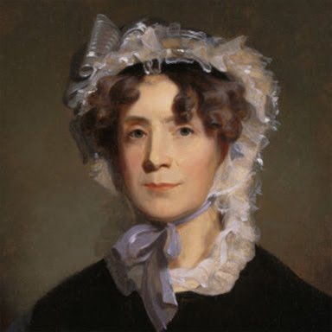
Thomas Jefferson
(1743 -1826)
married his third cousin
Martha Wayles Skelton
(1748-1782)
https://en.wikipedia.org/wiki/Thomas_Jefferson

Slide 77
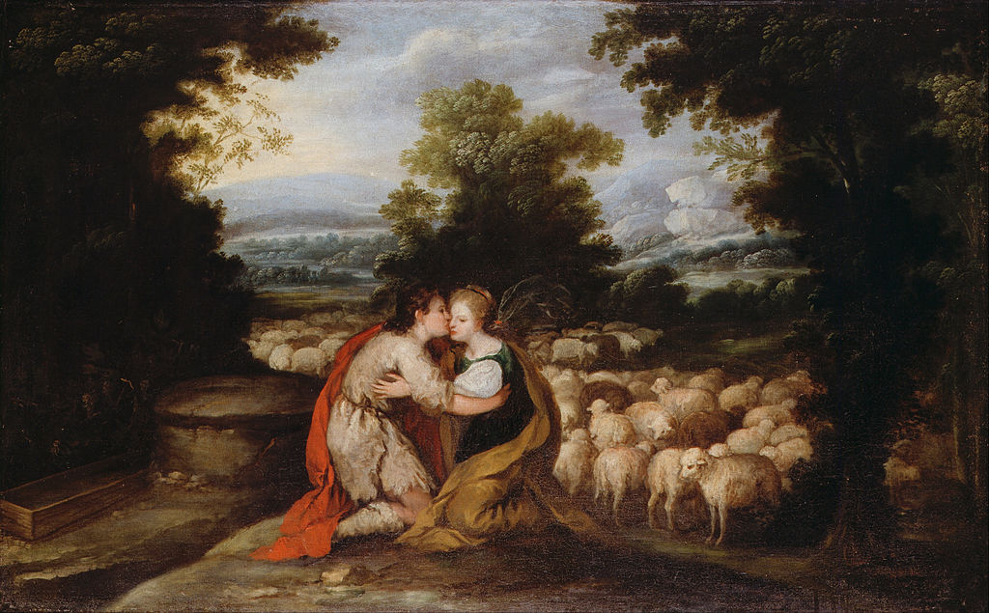
Jacob married two first cousins, Rachel and Leah
https://commons.wikimedia.org/wiki/Category:Paintings_of_Jacob_and_Rachel#/media/File:Spanish_-_Jacob_and_Rachel_at_the_Well_-_Google_Art_Project.jpg

Slide 78
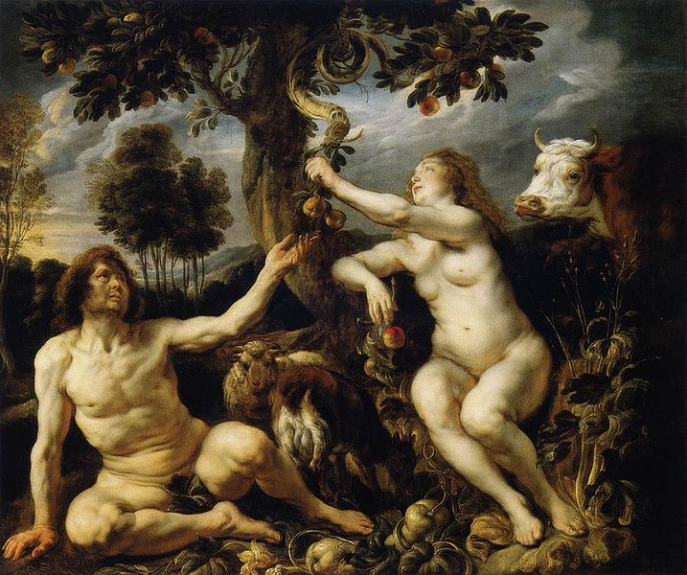
Adam and Eve’s Grandchildren
http://commons.wikimedia.org/wiki/File:Jordaens_Fall_of_man.jpg

Slide 79
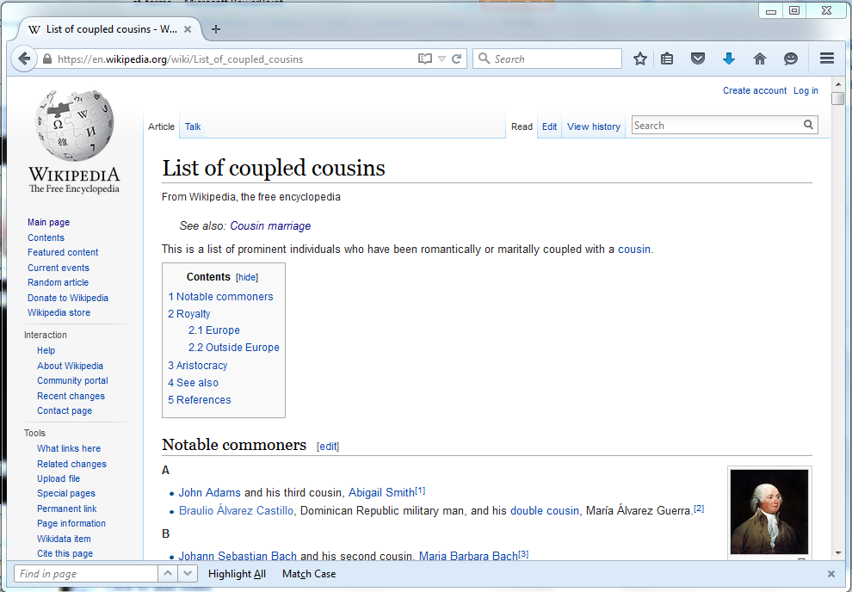
https://en.wikipedia.org/wiki/List_of_coupled_cousins
Notes:
79

Slide 80
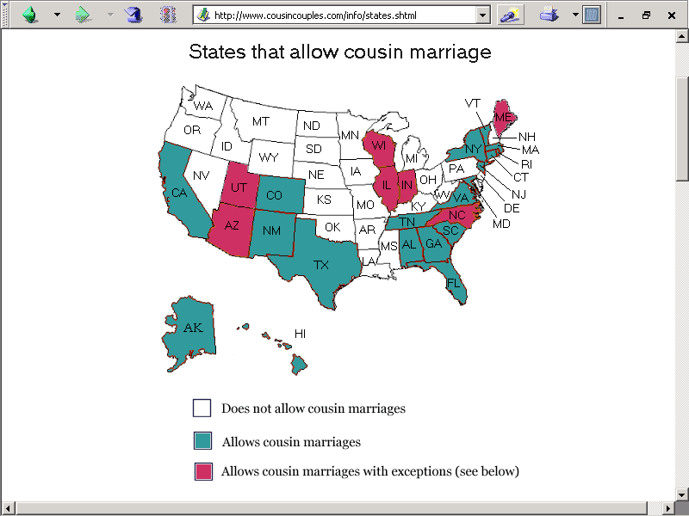
http://www.cousincouples.com/info/states.shtml

Slide 81
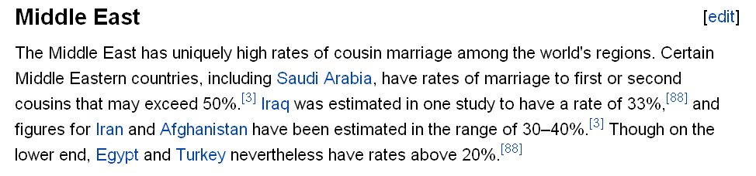
http://en.wikipedia.org/wiki/Cousin_marriage
Notes:
81

Slide 82
usually children of brothers marry
FA-BR-DA
http://en.wikipedia.org/wiki/Cousin_marriage
Notes:
82

Slide 83

Harvard University Press , 2011
Notes:
83

Slide 84
absolute cultural relativism
  How about?
  Doctor Assisted Suicide
  arranged “underage” and arranged/forced marriage
  female genital mutilations
  withholding of medical treatment of children for religious reasons
  polygyny . . .

Slide 85
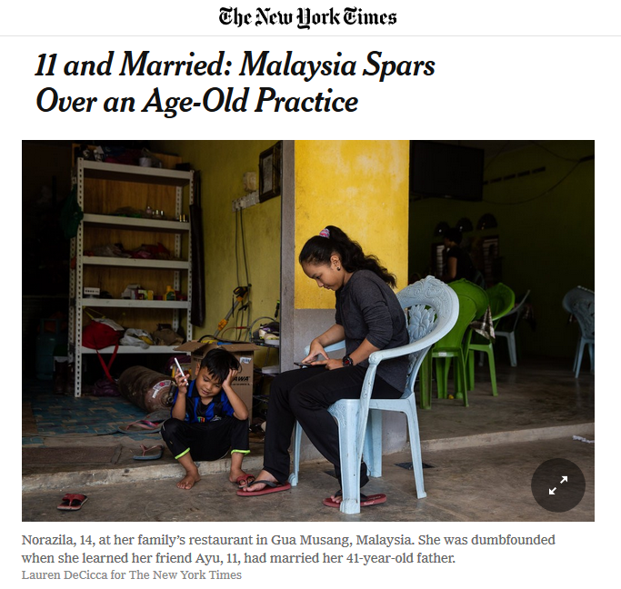
July 29, 2018
http://news.bbc.co.uk/2/hi/middle_east/7711554.stm
Notes:
85

Slide 86
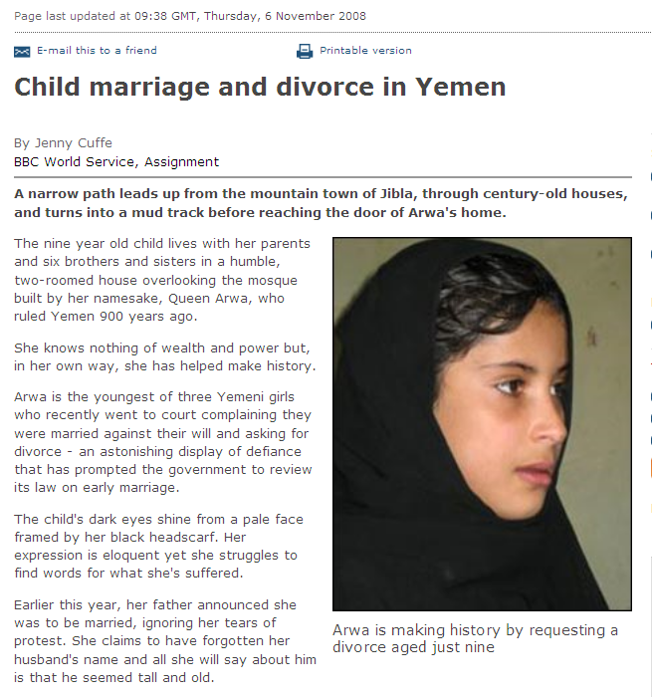
a 9-year-old requests a divorce in Yemen
http://news.bbc.co.uk/2/hi/middle_east/7711554.stm
Notes:
86

Slide 87
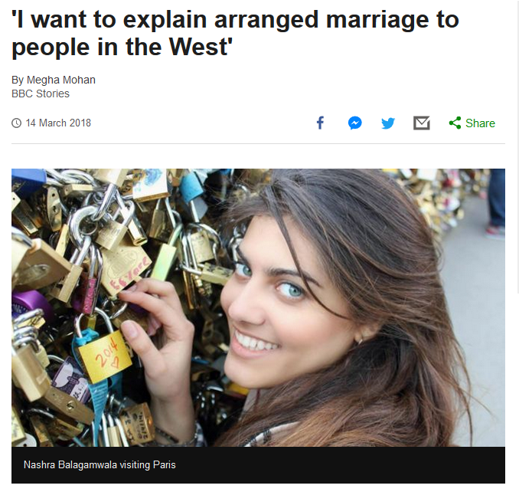
http://news.bbc.co.uk/2/hi/middle_east/7711554.stm
Notes:
87

Slide 88
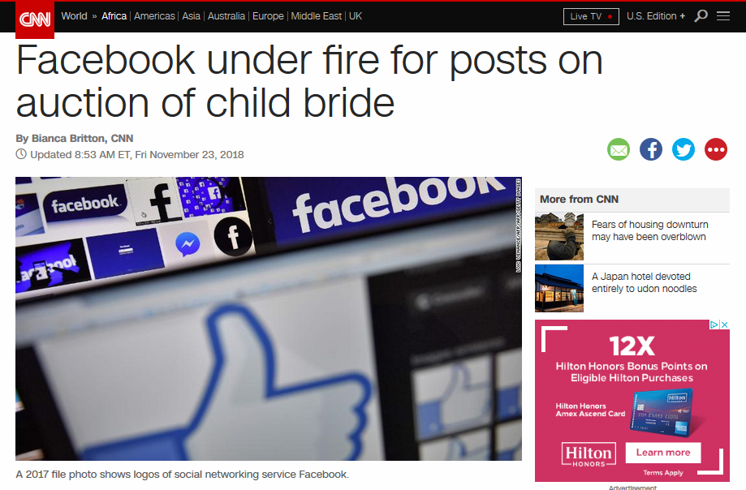
Notes:
88

Slide 89
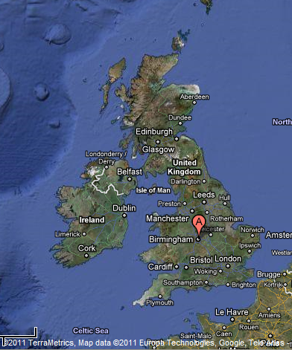
Birmingham, England
1985 Asian Teen HelpLine
received 1,400 calls / month

Slide 90
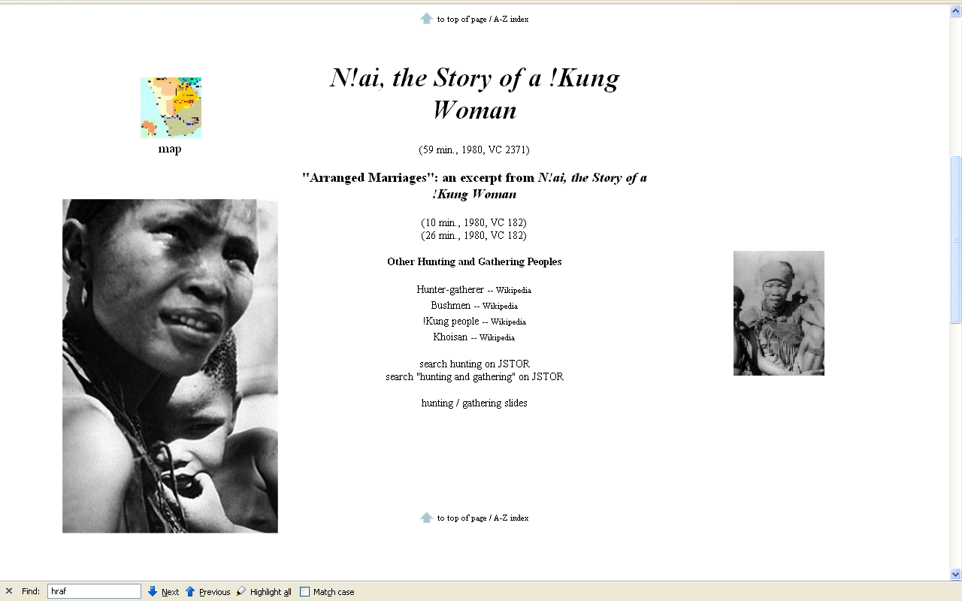
N!ai, one of the little girls in the film The Hunters,
was married to Gunda at the age of 8

Slide 91
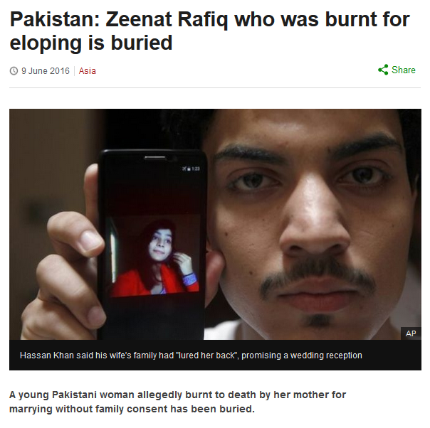
http://www.bbc.com/news/world-asia-36486974
Notes:
91

Slide 92
Glossary
  ?
absolute cultural relativism
  World War II Holocaust
  arranged “underage” marriage
  female genital mutilations
  withholding of medical treatment of children for religious reasons
  polygyny. . . .

Slide 93
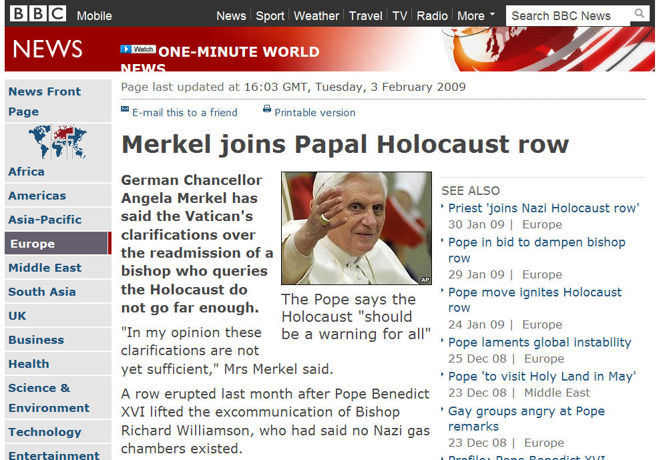

Slide 94


Slide 95
Glossary
  ?
absolute cultural relativism
  World War II Holocaust
  arranged “underage” marriage
  female infanticide
  collateral infanticide

Slide 96


Slide 97
absolute cultural relativism
  How about . . .

Slide 98
absolute cultural relativism
  “freak shows” ?

Slide 99

https://www.mprnews.org/story/2017/08/22/history-state-fair-sideshow

Slide 100

Saartjie Baartman
1789 - 1815

Slide 101

Saartjie Baartman
1789 - 1815

Slide 102

Saartjie Baartman
1789 - 1815

Slide 103

Saartjie Baartman
1789 - 1815

Slide 104

http://en.wikipedia.org/wiki/Saartjie_Baartman

Slide 105
She died on 29 December 1815
Her skeleton, preserved genitals and brain were placed
on display in Paris' Musée de l'Homme until 1974.
Her remains were repatriated to her homeland, the Gamtoos Valley, on 6 May 2002 and she was
finally laid to rest on 9 August 2002
on Vergaderingskop, a hill in the town of Hankey
over 200 years after her birth.
Saartjie Baartman
1789 - 1815
http://en.wikipedia.org/wiki/Saartjie_Baartman

Slide 106
She died on 29 December 1815
Her skeleton, preserved genitals and brain were placed
on display in Paris' Musée de l'Homme until 1974.
Her remains were repatriated to her homeland, the Gamtoos Valley, on 6 May 2002 and she was
finally laid to rest on 9 August 2002
on Vergaderingskop, a hill in the town of Hankey
over 200 years after her birth.
Saartjie Baartman
1789 - 1815
http://en.wikipedia.org/wiki/Saartjie_Baartman

Slide 107

6 May 2002
Saartjie Baartman
1789 - 1815

Slide 108

6 May 2002
http://news.bbc.co.uk/1/hi/world/europe/1957240.stm

Slide 109
6 May 2002
http://www.judyshopsthemall.com/2009/08/bodies-the-exhibition-walks-into-controversial-debut-at-mall-of-america/

Slide 110

Saartjie Baartman
1789 - 1815

Slide 111
August 2009
http://www.judyshopsthemall.com/2009/08/bodies-the-exhibition-walks-into-controversial-debut-at-mall-of-america/

Slide 112

BODIES Exhibit
in Paris
an at
The Mall of America
August 2009
http://www.judyshopsthemall.com/2009/08/bodies-the-exhibition-walks-into-controversial-debut-at-mall-of-america/

Slide 113

http://news.bbc.co.uk/2/hi/uk_news/scotland/edinburgh_and_east/7492386.stm
Notes:
113

Slide 114

“It all amounts to a 21st Century version of a circus freak show; no one is supposed to watch junk like that but everyone does.”
www.duluthsuperior.com/mld/duluthsuperior/news/editorial/15397954.htmhttp://www.duluthsuperior.com/mld/duluthsuperior/news/editorial/15397954.htm

Slide 115

1862 - 1890
https://www.theguardian.com/uk-news/2016/jun/09/elephant-man-skeleton-should-be-given-christian-burial-say-campaigners

Slide 116

http://www.bbc.com/news/magazine-37344210

Slide 117

http://www.bbc.com/news/magazine-37344210

Slide 118

http://www.bbc.com/news/magazine-37344210

Slide 119

23 August 2016
http://news.nationalgeographic.com/2016/08/human-skulls-sale-legal-ebay-forensics-science/

Slide 120

23 August 2016
http://news.nationalgeographic.com/2016/08/human-skulls-sale-legal-ebay-forensics-science/

Slide 121
absolute cultural relativism
  How about ? . . .
  cannibalism

Slide 122


Slide 123

Cambridge University Press, 1986

Slide 124

  “gustatory
  cannibalism”

Slide 125

  Marvin Harris
  (of “cultural materialism” fame)
  writes about cannibalism
  from an anthropological view
Knopf 1991

Slide 126


Slide 127


  How about
  “survival
  cannibalism”

Slide 128


10 June 2015
http://www.theguardian.com/science/2015/jun/10/brains-helped-papua-new-guinea-tribe

Slide 129
  “ritual cannibalism”

Slide 130

cultural relativism?
  stealing peoples’ land and property
  infant cranial deformation
  Aztec human heart sacrifice
  cannibalism
  selling and eating children
  eating insects
  eating dogs
  . . .
  “ritual cannibalism”
e.g., Aztecs must sacrifice and eat humans
in order to please the gods
in order that the gods allow
the sun to rise each day,
so that the world doesn’t end

Slide 131
absolute cultural relativism
  How about ? . . .

Slide 132

or eating gorilla?
Spring
2003
http://www.gastronomica.org/gastro/pages/sample3.2.html

Slide 133

Spring
2003
How about baiting, then killing Cecil the Lion to hang his stuffed head on your wall?
http://www.bbc.com/news/uk-england-oxfordshire-33782249

Slide 134
Spring
2003
Cecil was a well-known tourist attraction in Zimbabwe and was shot by dentist Walter Palmer from Minnesota, USA.
http://www.bbc.com/news/uk-england-oxfordshire-33782249

Slide 135

http://www.bbc.com/news/world-europe-37034619

Slide 136

https://www.theguardian.com/film/2016/jul/06/jesus-camp-christian-documentary-kids-10-years-later?CMP=oth_b-aplnews_d-1

Slide 137
absolute cultural relativism
  How about ? . . .

Slide 138

http://www.bbc.com/news/world-us-canada-35117311

Slide 139
rich kids who kill people not held responsible because they are rich kids suffering from “affluenza” ?
http://www.bbc.com/news/world-us-canada-35117311

Slide 140

How about the rich kid’s mother harboring a fugitive, and aiding and abetting (and even celebrating) his criminal behavior ?
http://www.bbc.com/news/world-us-canada-35192267

Slide 141

http://www.bbc.com/news/world-us-canada-36040878

Slide 142


or maybe his genes made him do it . . .
source

Slide 143
source

Slide 144
absolute cultural relativism
  More directly related to
  Peoples and Cultures of Europe . . .

Slide 145
absolute cultural relativism
  How about ? . . .
  the way girls and women are treated in Kypseli

Slide 146

  or requiring women to bare their faces in Italy?

Slide 147

  or Belgium?

Slide 148
absolute cultural relativism
  how about ? . . .
bullfighting
corrida de toros

Slide 149

http://www.bbc.com/news/world-europe-38063778

Slide 150
absolute cultural relativism
  how about ? . . .

Slide 151

21 October 2016
http://www.bbc.com/capital/story/20161020-where-its-common-to-get-nude-with-your-colleagues?ocid=ww.social.link.email

Slide 152

21 October 2016
http://www.bbc.com/capital/story/20161020-where-its-common-to-get-nude-with-your-colleagues?ocid=ww.social.link.email

Slide 153
absolute cultural relativism
  how about ? . . .

Slide 154

http://www.telegraph.co.uk/news/2016/09/02/obese-patients-and-smokers-banned-from-all-routine-operations-by/

Slide 155

http://www.telegraph.co.uk/news/2016/08/25/university-of-chicago-rejects-safe-spaces-and-trigger-warnings-i/

Slide 156

https://www.theguardian.com/us-news/2016/aug/27/new-york-yellow-taxi-cab-drivers-english-test?CMP=Share_iOSApp_Other

Slide 157

https://www.theguardian.com/world/2016/aug/25/burkini-ban-sarkozy-calls-swimsuits-a-provocation-that-support-radical-islam?CMP=Share_iOSApp_Other

Slide 158

https://www.theguardian.com/world/2016/aug/24/the-burkini-ban-what-it-really-means-when-we-criminalise-clothes?CMP=Share_iOSApp_Other

Slide 159

https://www.theguardian.com/world/2016/aug/11/cannes-mayor-bans-burqinis-beachwear-must-respect-secularism?CMP=Share_iOSApp_Other

Slide 160

http://www.telegraph.co.uk/news/2016/07/07/burka-ban-for-muslims-enforced-in-switzerland-with-fines-of-up-t/

Slide 161

http://www.bbc.com/news/world-europe-37033286

Slide 162

http://www.telegraph.co.uk/news/2016/08/09/german-judges-could-be-banned-from-wearing-islamic-headscarves-o/

Slide 163

http://www.bbc.com/news/world-europe-37373324

Slide 164


http://www.telegraph.co.uk/women/work/the-prejudice-against-brown-shoes-is-a-classic-case-of-class-sno/

Slide 165
switching to
a much more pleasant subject . . .

Slide 166
Glossary
critical cultural relativism
  What is “normal” / “abnormal” ?

Slide 167
always remember
that
people live in
multiple cultural worlds

Slide 168
multiple cultural worlds include
class
race
ethnicity
gender
age
institutions

Slide 169
more
Other
Important
Terms
to come later . . .
University of Minnesota Duluth
Tim Roufs © 2010-2019
http://www.d.umn.edu/cla/faculty/troufs/anth3618/

