Slide 1
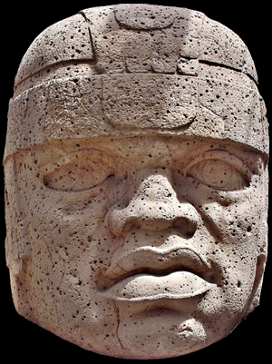
use your up/down arrow keys and/or
your space bar to advance the slides
Units
of
Analysis
Ancient Middle America
University of Minnesota Duluth
Tim Roufs © 2010-2019
http://www.d.umn.edu/cla/faculty/troufs/anth3618/

Slide 2
Units
of
Analysis
Ancient Middle America
University of Minnesota Duluth
Tim Roufs © 2010-2019
http://www.d.umn.edu/cla/faculty/troufs/anth3618/

Slide 3
When you pick a topic for your Project
the most important thing to consider is picking a topic that you are interested in . . . .

Slide 4
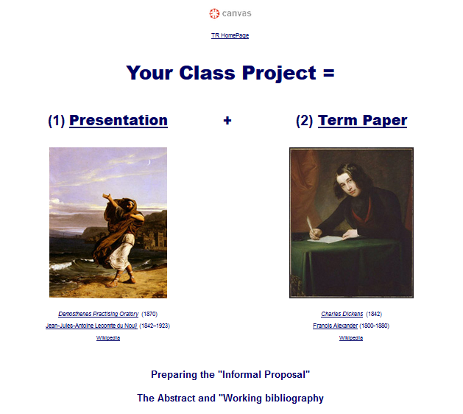

Slide 5
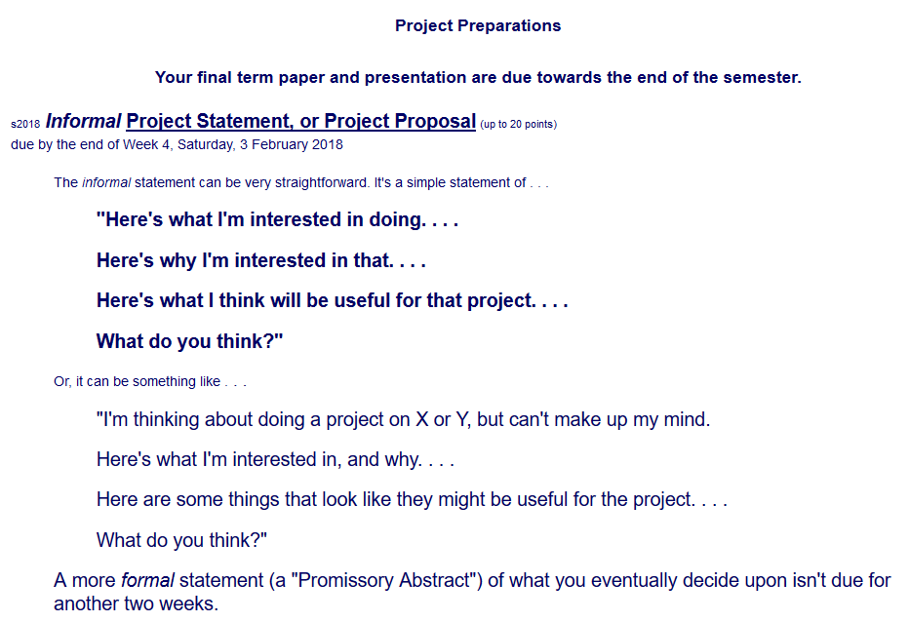

Slide 6
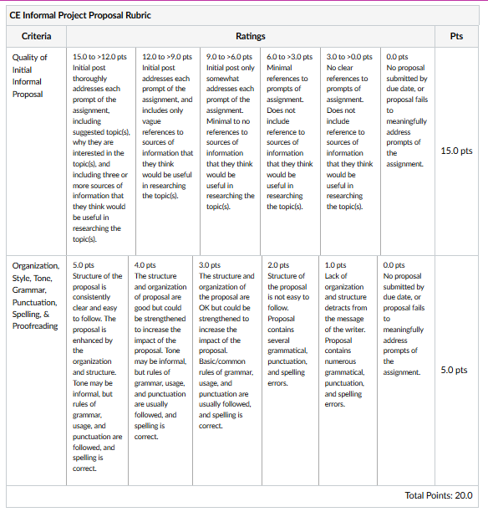
See larger version of the
Informal Project Proposal Rubric
in your Canvas file

Slide 7
The next most important thing to consider is what “unit(s) of analysis” are best for you to use . . . .

Slide 8
Units
of
Analysis
Ancient Middle America
University of Minnesota Duluth
Tim Roufs © 2010-2019
http://www.d.umn.edu/cla/faculty/troufs/anth3618/

Slide 9
when you are looking at anthropological works
— or social science works in general —
it is important to pay attention to what “units of analysis” are being considered
. . .

Slide 10
in the “Main Characteristics of Anthropology” review it is noted that one of the defining characteristics of Anthropology is that it tends to be comparative
. . .

Slide 11
Main Characteristics of Anthropology
1. the four fields of general anthropology
2. culture as a primary concept
3. comparative method as major approach to the study of human behavior
4. holism or the study of "humankind" as a whole, as a primary theoretical goal
5. fieldwork as a primary research technique, involving “participant observation”

Slide 12
in comparative works it is especially important to check to see that the units of analysis are comparable
. . .

Slide 13
and if you utilize a comparative approach in your project,
or in extra credit reports
— or in your exam questions —you need to be especially careful to compare like units
. . .

Slide 14
so lets have a look at
Units of Analysis

Slide 15
as mentioned in the “Orientation”
units of analysis may include:
one person
the family
the community
a region
a “culture area”
a culture / “subculture”
a nation
an item or action itself
a “cultural metaphor”

Slide 16
the individual
as a
Unit of Analysis

Slide 17
as mentioned in the “Orientation”
units of analysis may include:
one person
the family
the community
a region
a “culture area”
a culture / “subculture”
a nation
an item or action itself
a “cultural metaphor”

Slide 18
“units of analysis” may include:
one person
the family
the community
a region
a “culture area”
a culture / “subculture”
a nation
an item or action itself
a “cultural metaphor”
for e.g. . . .

Slide 19
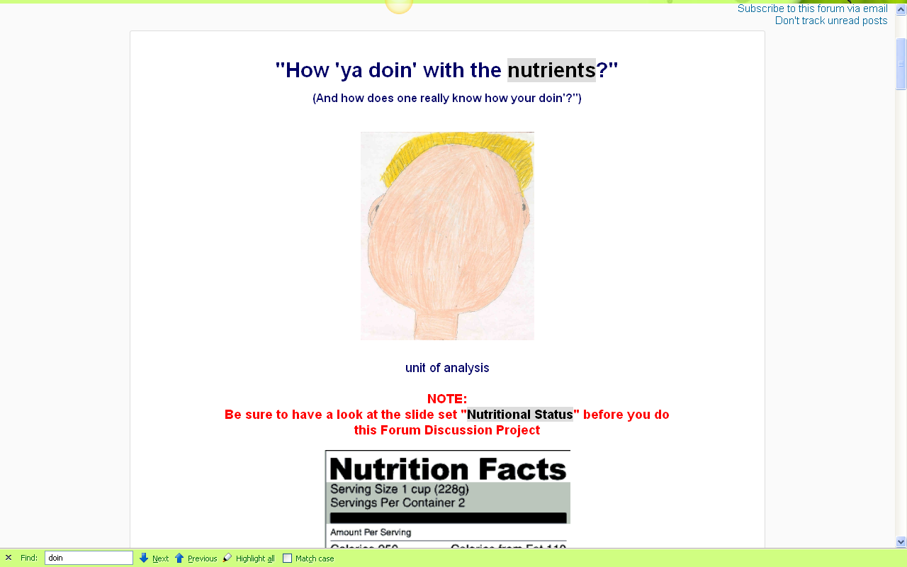
you

Slide 20
“units of analysis” may include:
one person (e.g., Nan)
the family
the community
a region (“culture area”)
a culture
“Irish”
“Chinese”
“Mexicans”
“Bedouins”
“life histories”

Slide 21
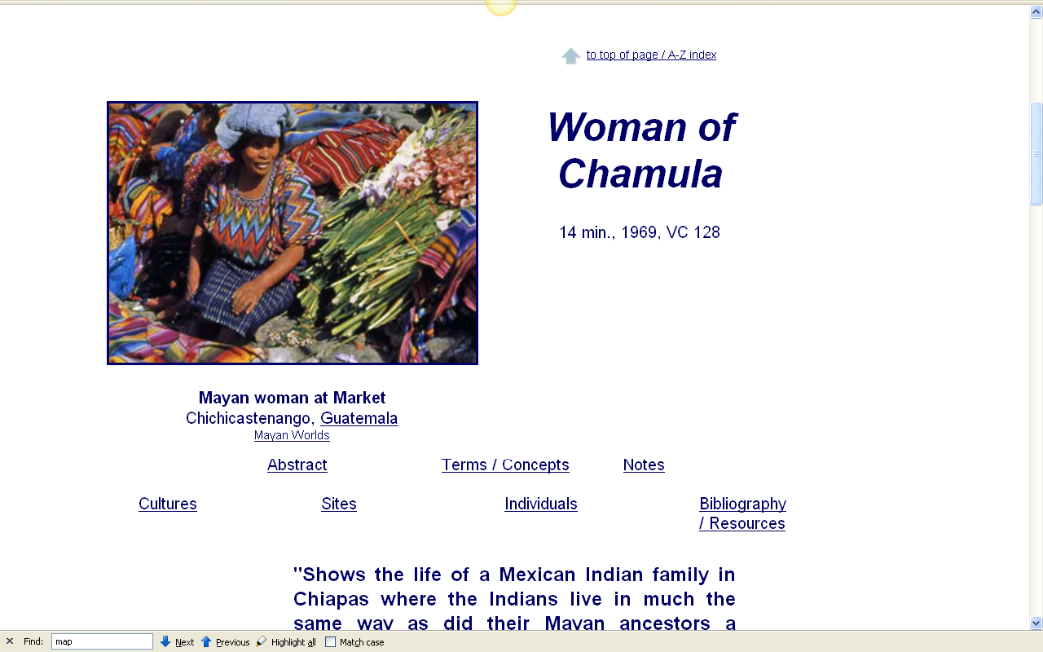
http://www.d.umn.edu/cla/faculty/troufs/anth3618/video/Chamula.html#title

Slide 22
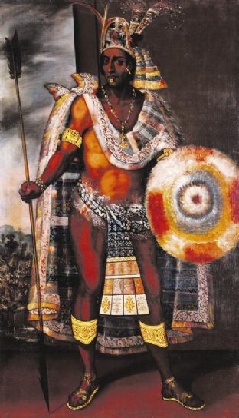
Motecuhzoma Xocoyotzin
(Motecuhzoma II)
(c. 1466 – June 1520)
Through Spanish eyes: a portrait of Montezuma (Moctezuma) by Antonio Rodriguez, 1680-97, from the Museo degli Argenti, Florence © SU CONCESSIONE DEL MINISTERO PER I BENI E LET ATTIVITÀ CULTURALI

Slide 23
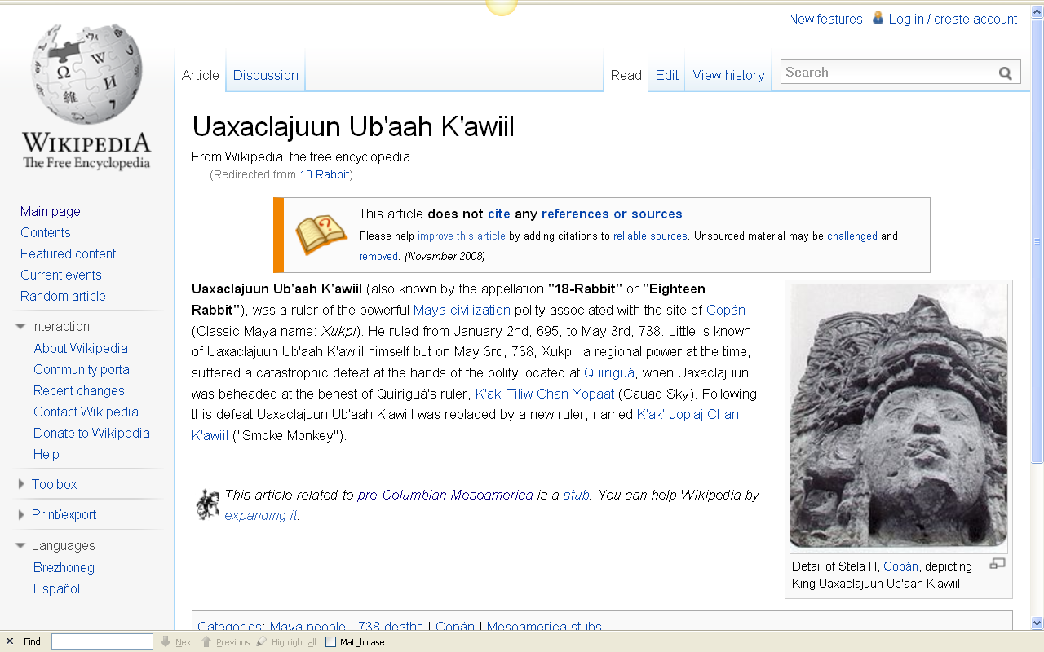
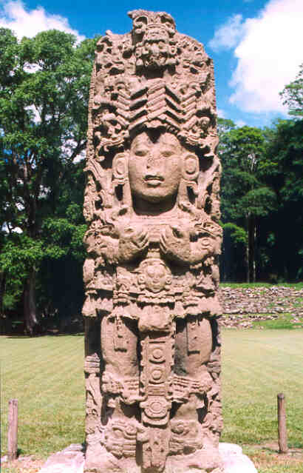
18-Rabbit
Copán, Honduras
http://en.wikipedia.org/wiki/18_Rabbit

Slide 24
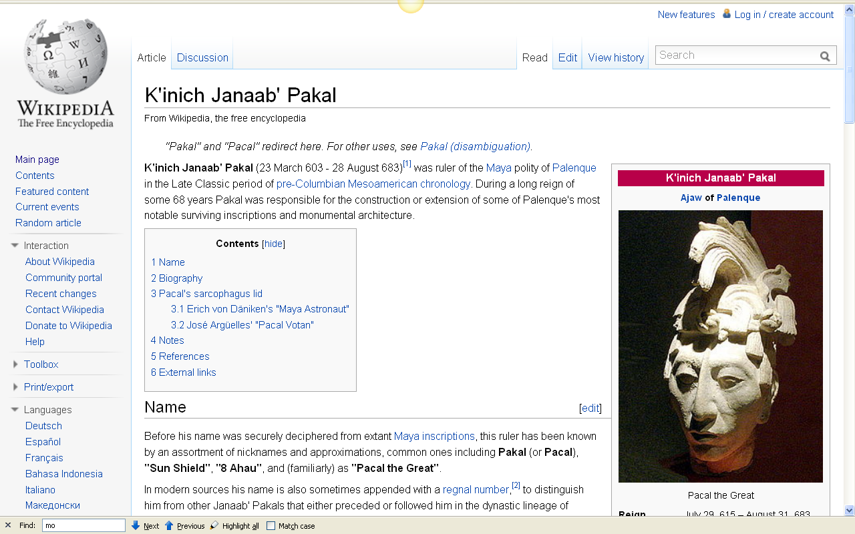
Lord “Shield” Pacal
Palenque, Chiapas, Mexico

Slide 25
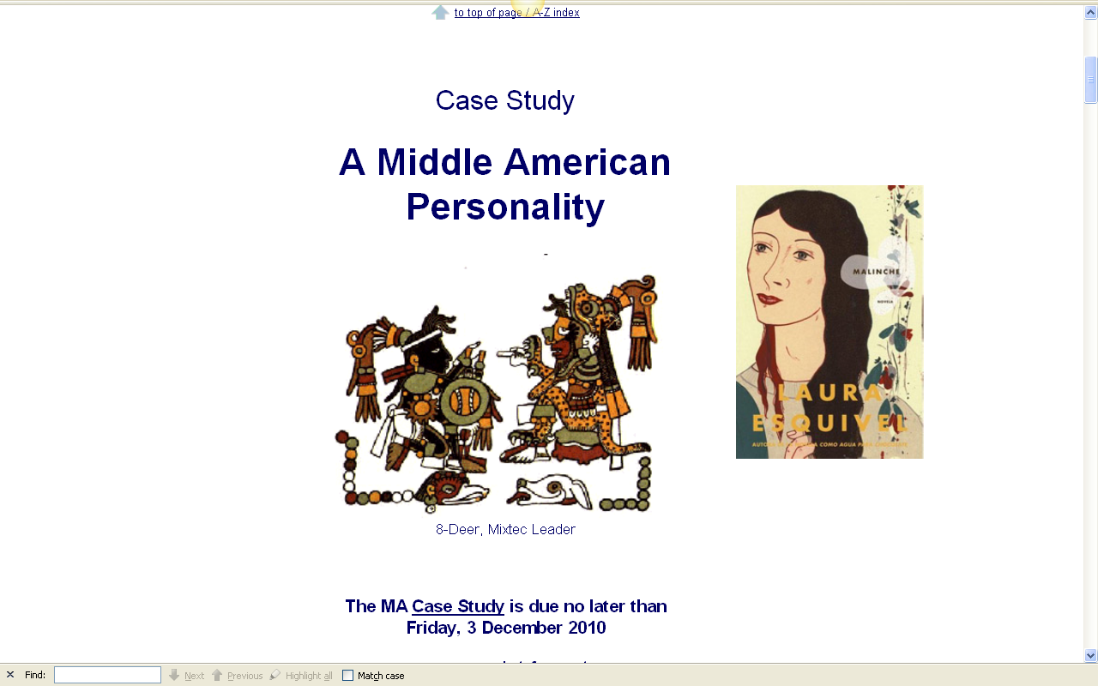
the unit of analysis for your case study
is one person

Slide 26
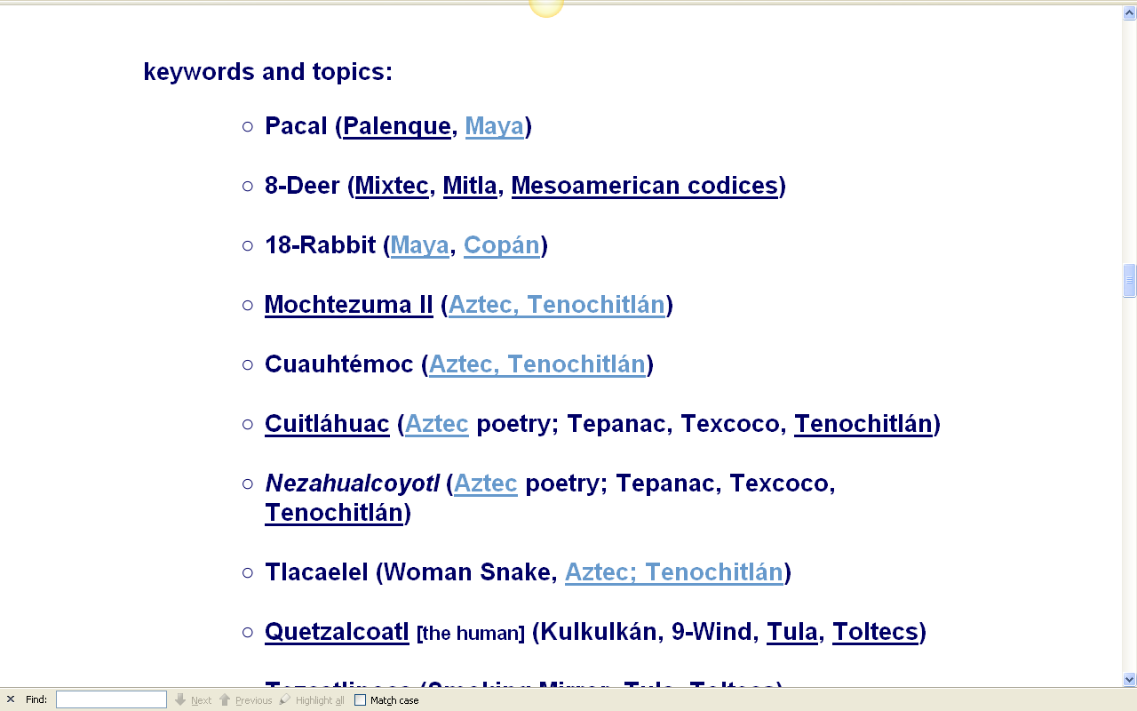
other examples from Middle America

Slide 27
focusing on the individual as a unit of analysis was advocated in anthropology by early pioneers such as . . .
Oscar Lewis
Bronislow Malinowski
Edward Sapir (of “Sapir-Whorf” hypothesis fame)
Margaret Mead

Slide 28
the family
as a
Unit of Analysis

Slide 29
as mentioned in the “Orientation”
units of analysis may include:
one person
the family
the community
a region
a “culture area”
a culture / “subculture”
a nation
an item or action itself
a “cultural metaphor”

Slide 30
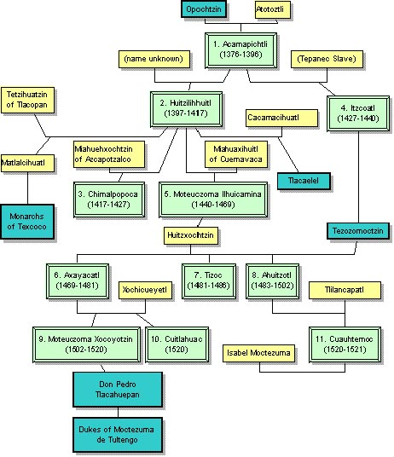
Aztec Genealogy
Family of Moteuczoma
://www.unexplainable.net/artman/publish/article_2274.shtml

Slide 31
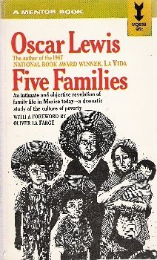

Oscar Lewis
is one of the best known anthropologists pioneering
studies of the family

Slide 32
peasant studies and community studies by and large perpetuated the island model of anthropological units of study with its concomitant notions of . . .
Susan Parman, Europe in the Anthropological Imagination, pp. 11 - 14

Slide 33
the community
as a
Unit of Analysis

Slide 34
As mentioned in the “Orientation”
units of analysis may include:
one person
the family
the community
a region
a “culture area”
a culture / “subculture”
a nation
an item or action itself
a “cultural metaphor”

Slide 35
As mentioned in the “Orientation”
units of analysis may include:
one person
the family
the community
a region
a “culture area”
a culture / “subculture”
a nation
an item or action itself
a “cultural metaphor”
in archaeology
the comparable unit
to the “community”
is the
“site”

Slide 36
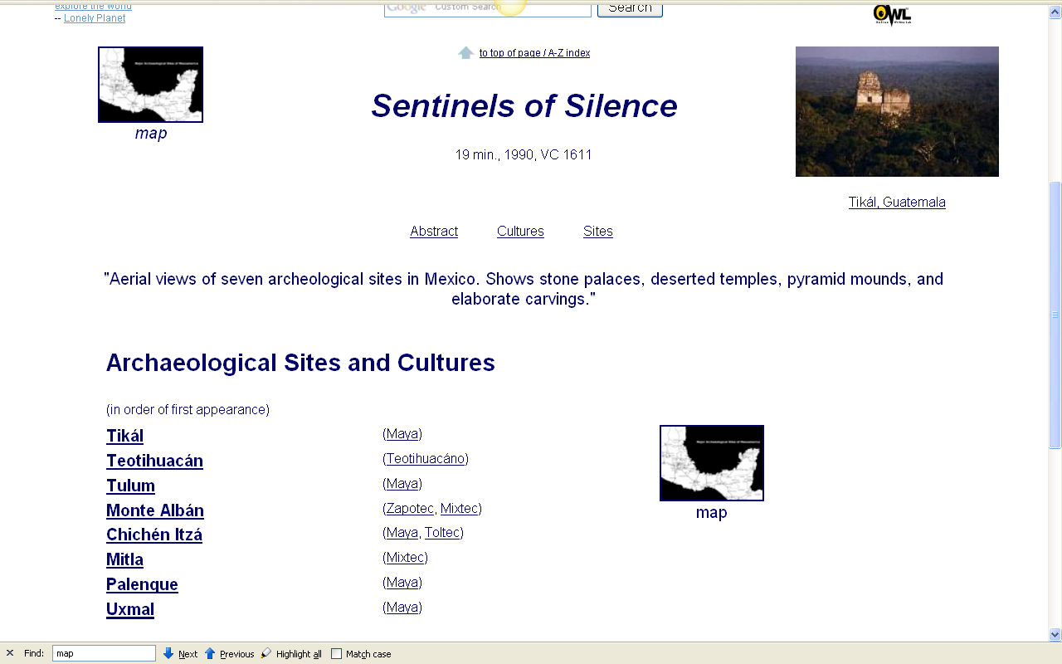
this film introduces eight sites
http://www.d.umn.edu/cla/faculty/troufs/anth3618/video/Sentinels.html#title

Slide 37
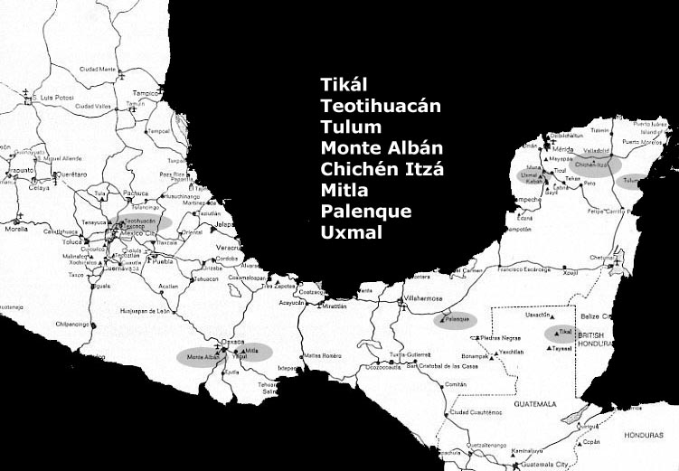
this film introduces eight sites
http://www.d.umn.edu/cla/faculty/troufs/anth3618/video/Sentinels.html#title

Slide 38
in some regions there are a lot of sites
there are more than
12,000
archaeological sites
in modern-day Mexico
alone
for e.g.

Slide 39
in some regions there are a lot of sites
there are more than
12,000
archaeological sites
in modern-day Mexico
alone
for e.g.

Slide 40
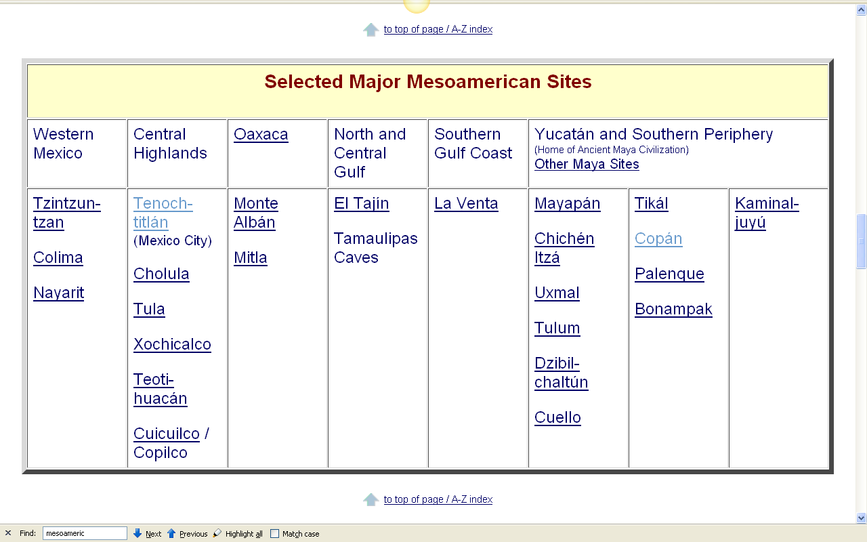
in Ancient Middle America
we will focus on these sites
http://www.d.umn.edu/cla/faculty/troufs/anth3618/masummary.html#major_sites

Slide 41
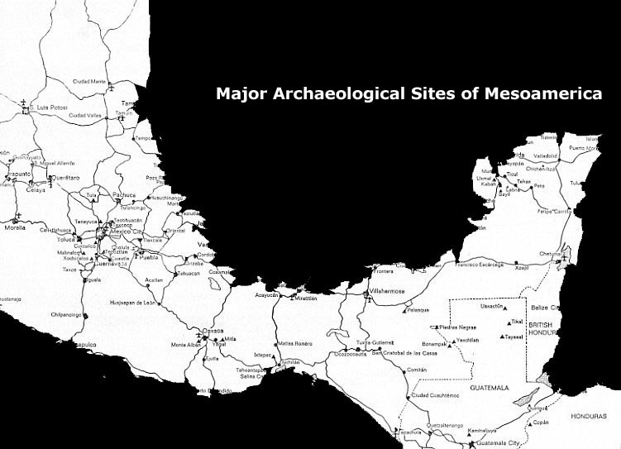

Slide 42
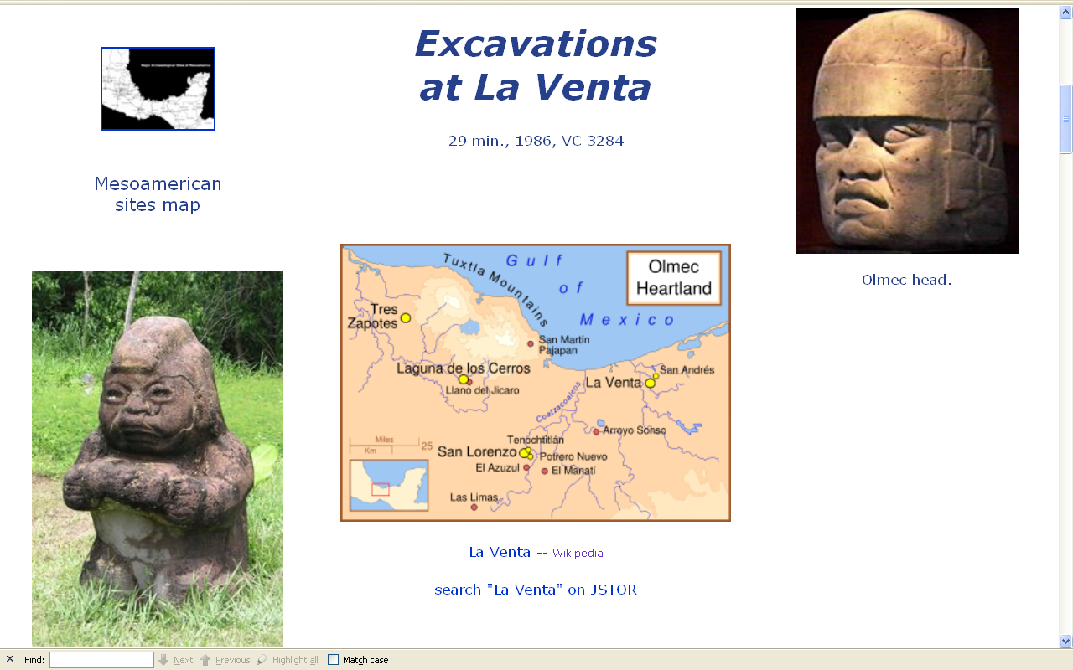
www.d.umn.edu/cla/faculty/troufs/anth3618/video/Excavations.html#title

Slide 43
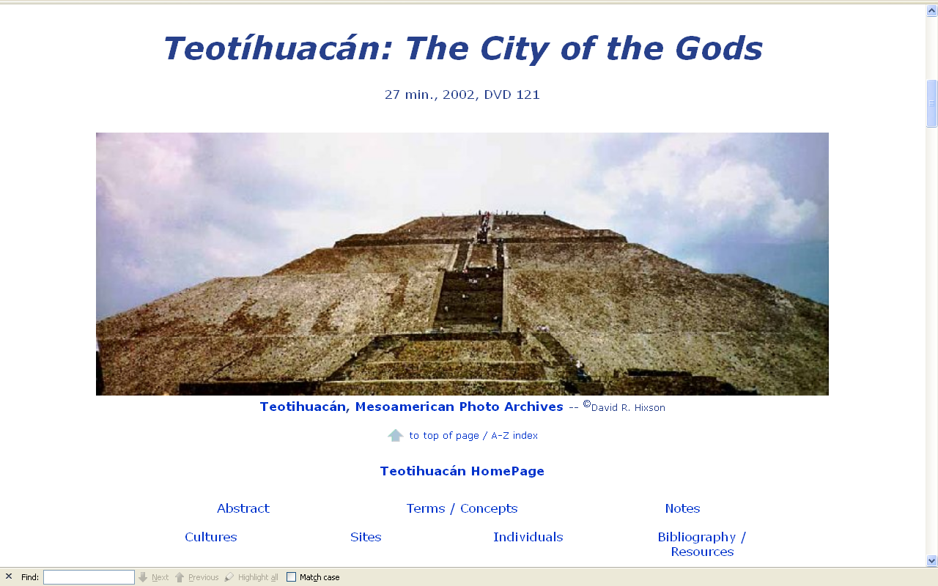
www.d.umn.edu/cla/faculty/troufs/anth3618/video/Teotihuacan.html#title

Slide 44
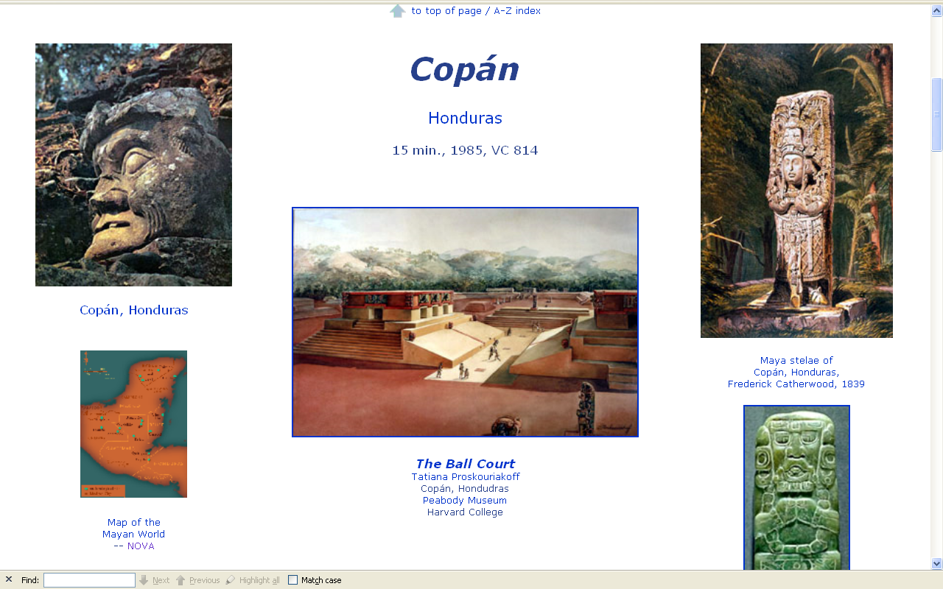
www.d.umn.edu/cla/faculty/troufs/anth3618/video/Copan.html#title

Slide 45
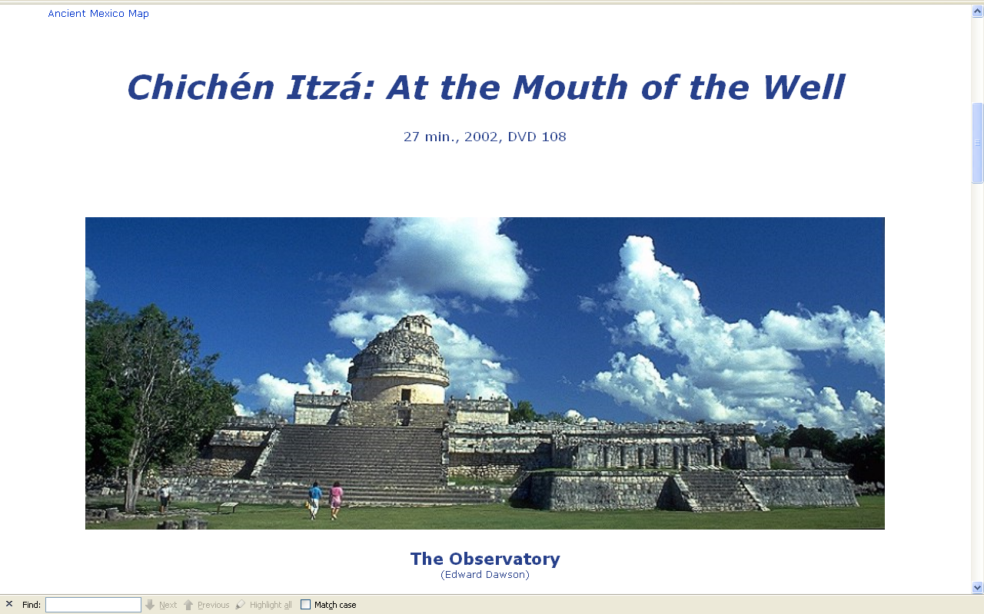
www.d.umn.edu/cla/faculty/troufs/anth3618/video/Copan.html#title

Slide 46
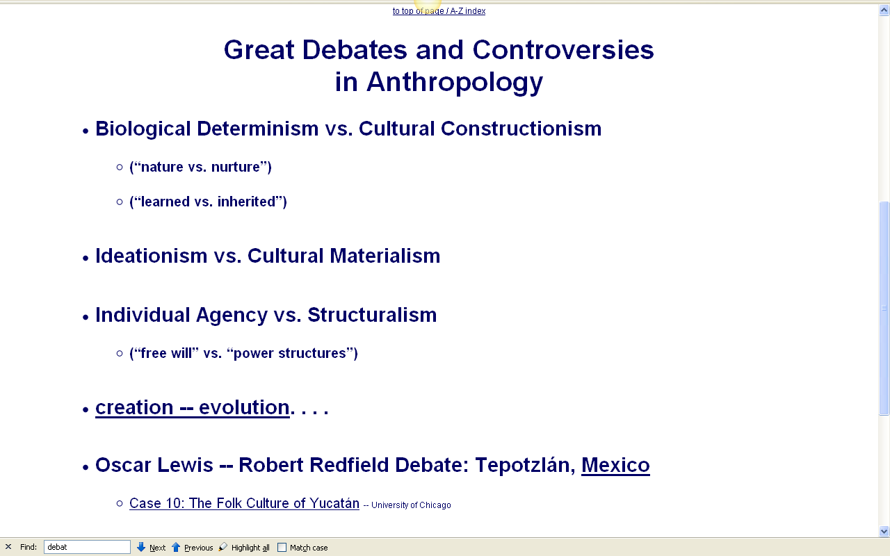
you have seen the big three debates in
“Three Major Perennial Debates”

Slide 47
a fourth debate in anthropology became one of the most famous in all of the history of the social sciences . . .

Slide 48
one of the greatest debates (and most important) in the history of the philosophy of science as well was the Lewis-Redfield debate over their interpretations of the Mexican community
of Tepotzlán

Slide 49
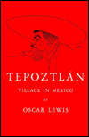
Lewis - Refield debate
Robert Redfield
Tepoztlan, a Mexican Village: A Study of Folk Life
Oscar Lewis
Life in a Mexican Village: Tepoztlan Restudied

Slide 50
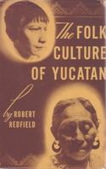
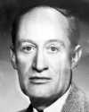
Compare . . .
1930 Tepoztlan, a Mexican Village: A Study of Folk Life
Chicago: University of Chicago Press
1941 Folk Culture of Yucatan
Chicago: University of Chicago Press
Robert Redfield

Slide 51
the region
as a
Unit of Analysis

Slide 52
as mentioned in the “Orientation”
units of analysis may include:
one person
the family
the community
a region
a “culture area”
a culture / “subculture”
a nation
an item or action itself
a “cultural metaphor”

Slide 53
as mentioned in the “Orientation”
units of analysis may include:
one person
the family
the community
a region
a “culture area”
a culture / “subculture”
a nation
an item or action itself
a “cultural metaphor”
Valley of Mexico
Soconusco
(Xoconusco)
El Bajío
Huasteca
Yucatán . . .

Slide 54
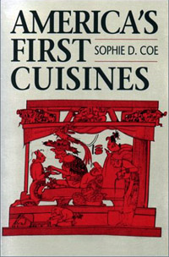
as mentioned in the “Orientation”
units of analysis may include:
one person
the family
the community
a region
a “culture area”
a culture / “subculture”
a nation
an item or action itself
a “cultural metaphor”
Valley of Mexico
Soconusco
(Xoconusco)
El Bajío
Huasteca
Yucatán . . .

Slide 55
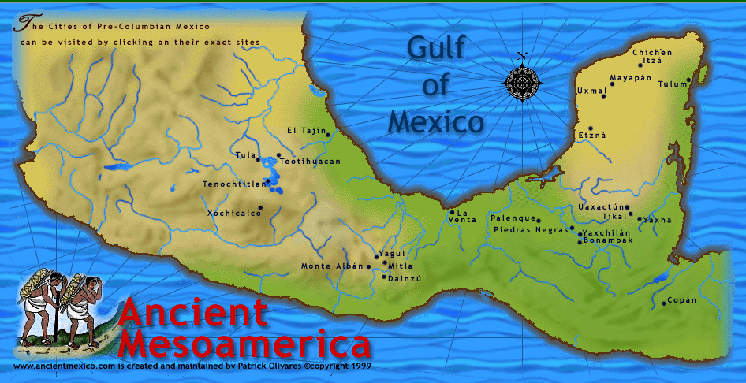
the Xoconusco region played a central role in chocolate, which played a key role in prehistoric and post-contact Mesoamerica
www.d.umn.edu/cla/faculty/troufs/anth3618/video/Copan.html#title

Slide 56
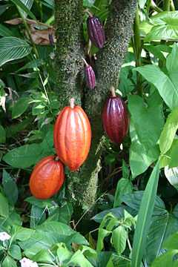
the Xoconusco region played a central role in chocolate, which played a key role in prehistoric and post-contact Mesoamerica
www.d.umn.edu/cla/faculty/troufs/anth3618/video/Copan.html#title

Slide 57
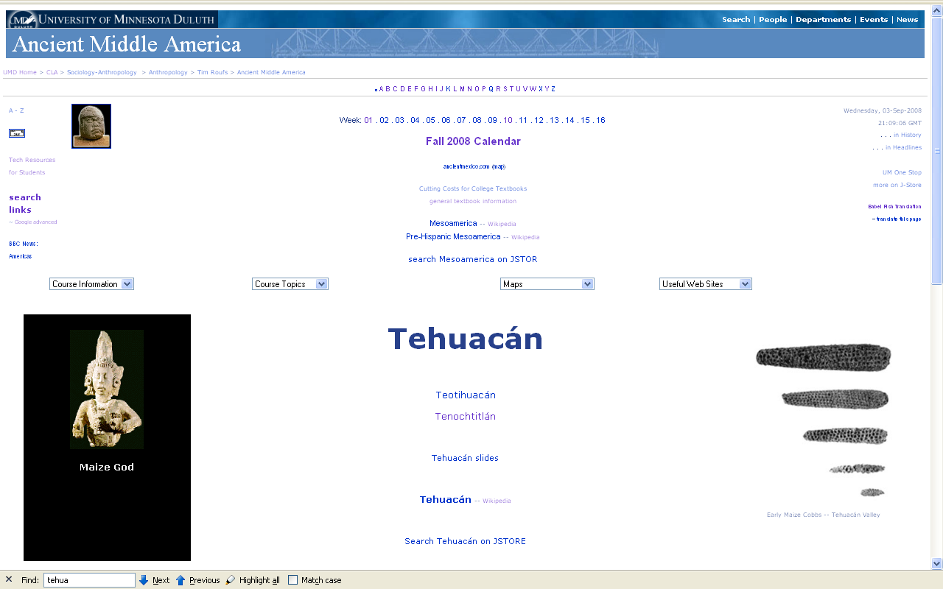
the Tehuacán region was one of the greatest centers of plant domestication in the world
www.d.umn.edu/cla/faculty/troufs/anth3618/matehuac.html#title

Slide 58
NOTE:
Tehuacán is different from Teotihuacán
the Tehuacán region was one of the greatest centers of plant domestication in the world
www.d.umn.edu/cla/faculty/troufs/anth3618/matehuac.html#title

Slide 59
and Tehuacán is one of the best places in the world to look at to understand
the “agricultural revolution”
www.d.umn.edu/cla/faculty/troufs/anth3618/video/Copan.html#title

Slide 60
and it’s likely where your bottled water came from if you purchased bottled water in Mexico
www.d.umn.edu/cla/faculty/troufs/anth3618/video/Copan.html#title

Slide 61
as mentioned, Tehuacán is it one of the best places in the world to look at to understand the “agricultural revolution”
www.d.umn.edu/cla/faculty/troufs/anth3618/video/Copan.html#title

Slide 62
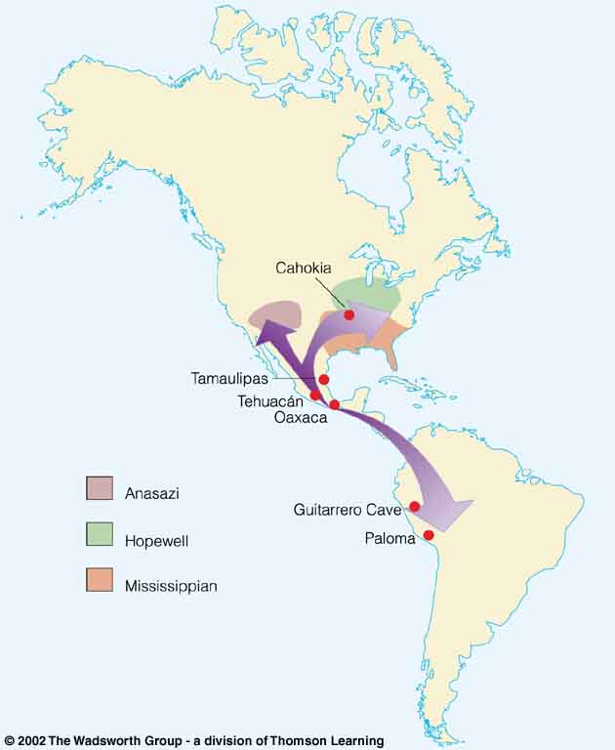
Tehuacán Valley, Puebla, Mexico
maize was domesticated here by at least
4,200 ybp
Understanding Physical Anthropology and Archaeology, 8th Ed., p. 432.

Slide 63
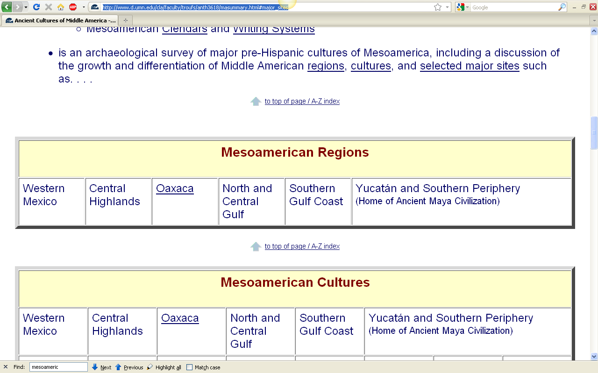
in Ancient Middle America
we will focus on these regions
http://www.d.umn.edu/cla/faculty/troufs/anth3618/masummary.html#major_sites

Slide 64
“cultural area”
as a
Unit of Analysis

Slide 65
some areas are
“officially”
anthropological
“cultural areas” . . .

Slide 66
as mentioned in the “Orientation”
units of analysis may include:
one person
the family
the community
a region
a “culture area”
a culture / “subculture”
a nation
an item or action itself
a “cultural metaphor”

Slide 67
those “culture areas” were initially established by George P. Murdock and associates
and are commonly associated with
HRAF
(the Human Relations Area Files)
and its
World Ethnographic Atlas
http://eclectic.ss.uci.edu/~drwhite/worldcul/atlas.htm

Slide 68
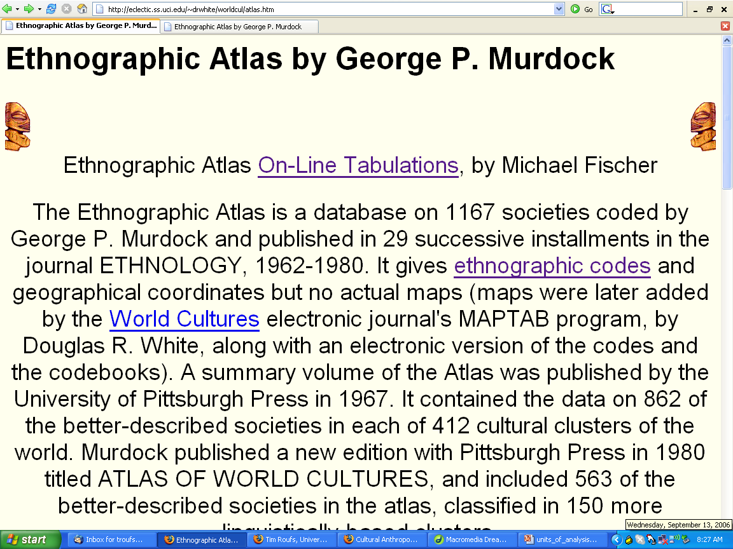
http://eclectic.ss.uci.edu/~drwhite/worldcul/atlas.htm

Slide 69
some culture areas were very carefully and precisely defined, such as “Mesoamerica” as defined in 1952 by Paul Kirchoff ...
Kirchhoff, Paul. "Meso-America," in Heritage of Conquest, Sol Tax, ed., pp. 17-30. Glencoe, Illinois, 1952.

Slide 70
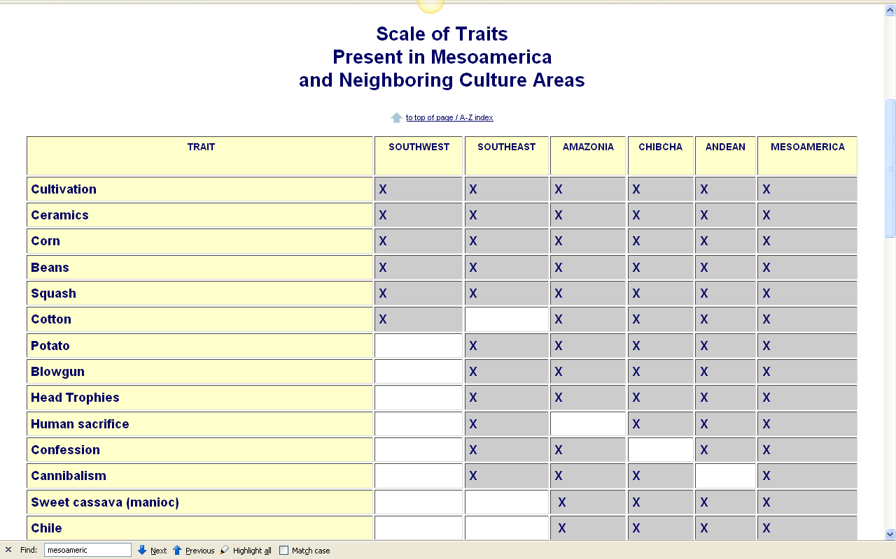
Paul Kirchhoff
defined
"Meso-America"
as a culture area in 1952
in Heritage of Conquest, Sol Tax, ed., pp. 17-30. Glencoe, Illinois
http://www.d.umn.edu/cla/faculty/troufs/anth3618/maKirchhof_handout.html

Slide 71
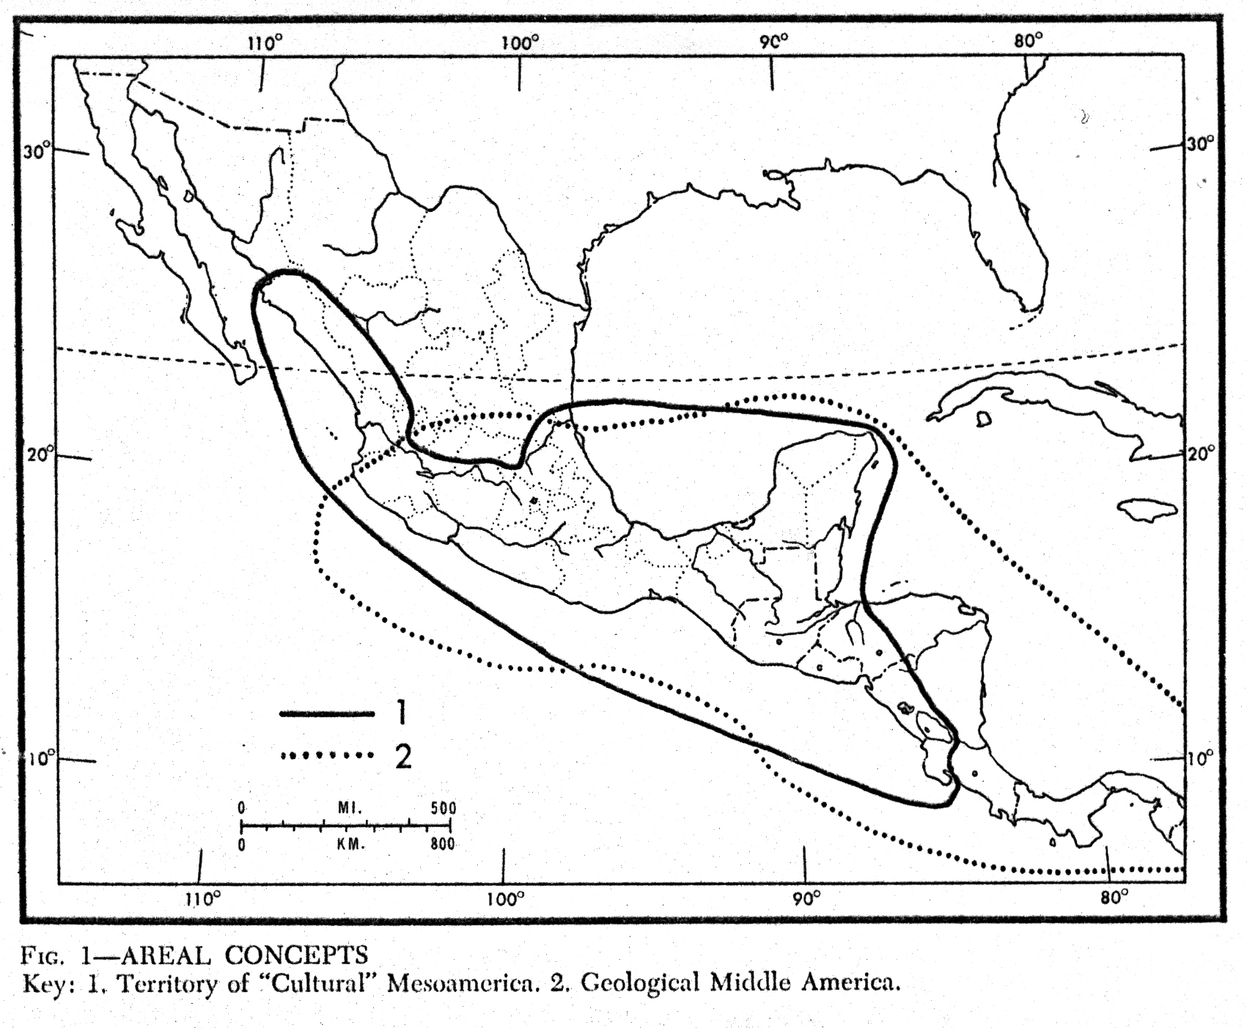
“Mesoamerica”
(“culture area)
after Kirchhoff
“Middle America”
(geological area)

Slide 72
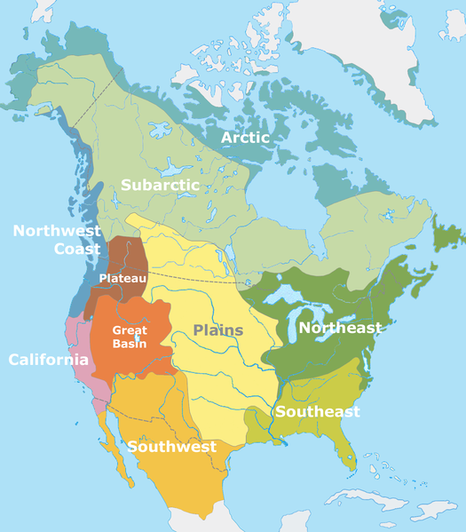
other North American “culture areas”
http://en.wikipedia.org/wiki/Culture_areas_of_North_America

Slide 73
some “areas” are not “officially”
anthropological
“cultural areas” . . .

Slide 74
some areas that have been defined (by others) around cultural items / traits
are not the same as the anthropologists’
“cultural areas” . . .

Slide 75
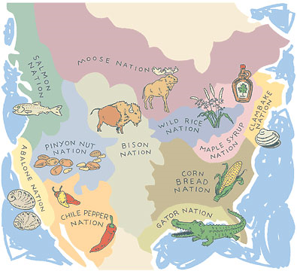
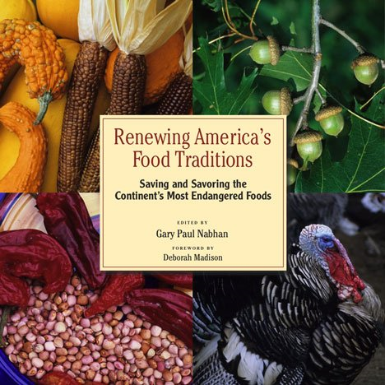
culture “areas” that are not “culture areas”
http://en.wikipedia.org/wiki/Culture_areas_of_North_America

Slide 76
it can get confusing
because, among other things,
some regions we consider cultural areas in daily life are also officially designated as “cultural areas” in modern Anthropology

Slide 77
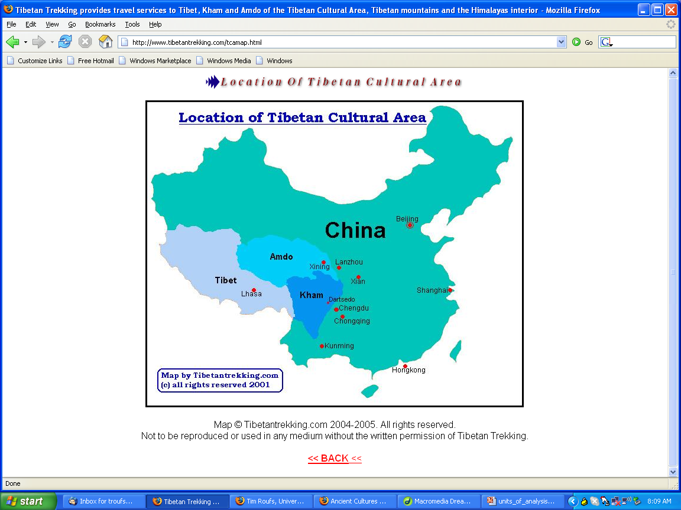
http://www.tibetantrekking.com/tcamap.html

Slide 78
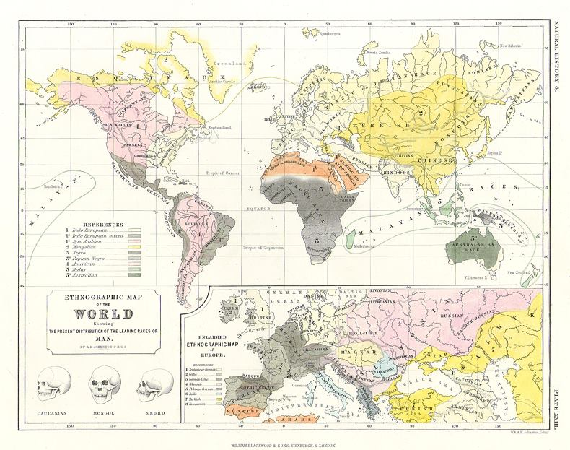
http://www.antiqueprints.com/images/af1/f1533.jpg

Slide 79
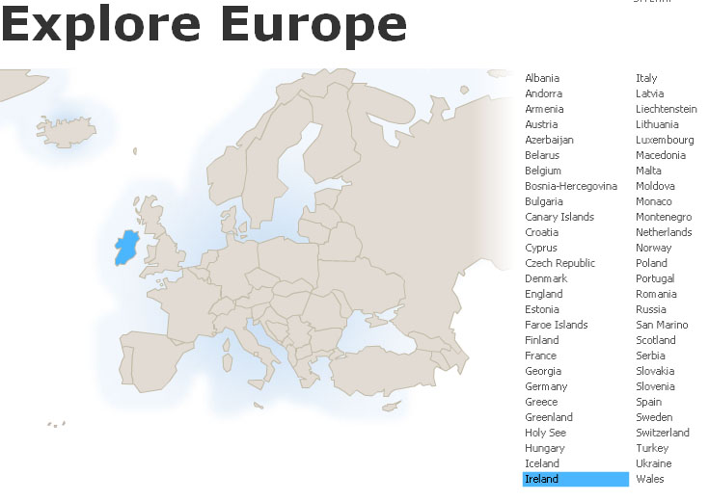
Europe, for e.g., is now officially an anthropological
“culture area”

Slide 80
a culture
as a
Unit of Analysis

Slide 81
as mentioned in the “Orientation”
units of analysis may include:
one person
the family
the community
a region
a “culture area”
a culture / “subculture”
a nation
an item or action itself
a “cultural metaphor”

Slide 82
as mentioned in the “Orientation”
units of analysis may include:
one person
the family
the community
a region
a “culture area”
a culture / “subculture”
a nation
an item or action itself
a “cultural metaphor”
cultures are major groups of individuals with common customs, traditions, history, and origin,
sharing a common language

Slide 83
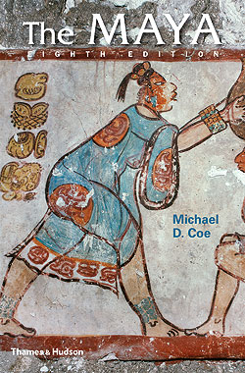
for e.g.,
www.d.umn.edu/cla/faculty/troufs/anth3618/matext.html#title

Slide 84
Aztec
Maya
Inca
Sophie D. Coe America's First Cuisines Austin: University of Texax Press, 1994.
www.d.umn.edu/cla/faculty/troufs/anthfood/aftexts.html#title

Slide 85
as mentioned in the “Orientation”
units of analysis may include:
one person
the family
the community
a region
a “culture area”
a culture / “subculture”
a nation
an item or action itself
a “cultural metaphor”
there are dozens in Mesoamerica
for e.g.
cultures are major groups of individuals with common customs, traditions, history, and origin,
sharing a common language

Slide 86
as mentioned in the “Orientation”
units of analysis may include:
one person
the family
the community
a region
a “culture area”
a culture / “subculture”
a nation
an item or action itself
a “cultural metaphor”
there are dozens in Mesoamerica
for e.g.
Maya
Chamula
Lancandon
Tzotzil
Tzeltal
Zoque
Yaqui
Otomi
Tarascan
Mixtec
Zapotec
Olmec
Toltec
Aztec
Teotihuacanos
Tarahumara . . .

Slide 87
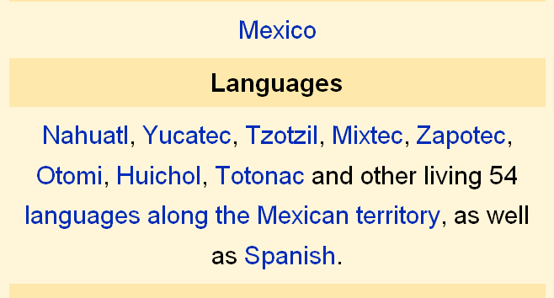
just in Mexico, for e.g., there are 63 languages spoken
—9 “major” languages,
and 54 languages of “microcultures”
http://en.wikipedia.org/wiki/Indigenous_peoples_of_Mexico#History_of_the_indigenous_peoples

Slide 88
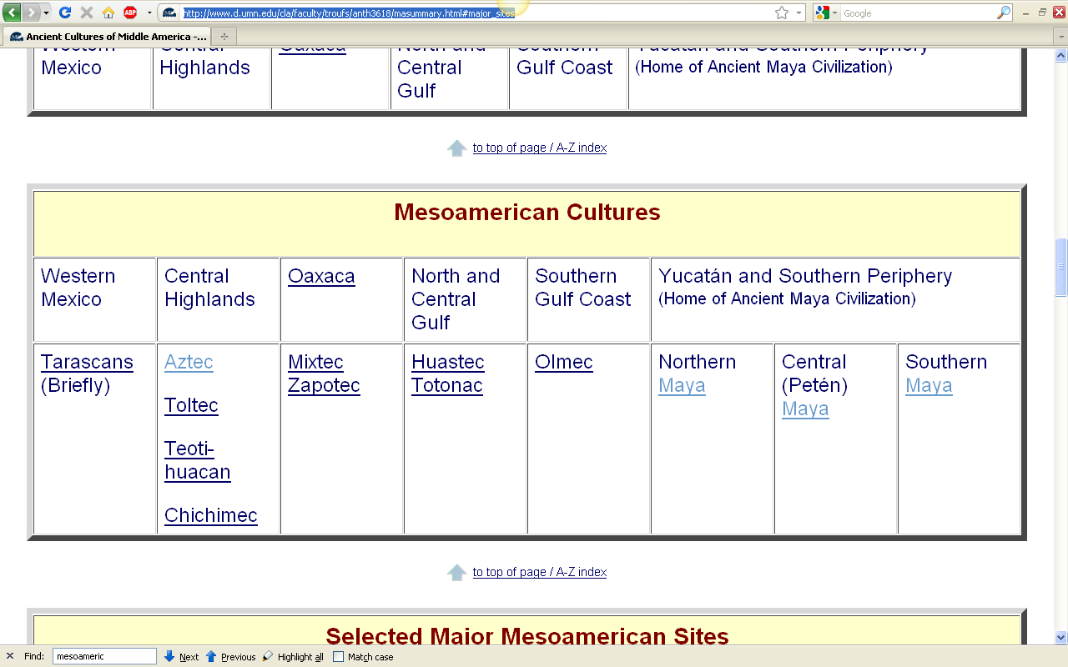
in Ancient Middle America
we will focus on these cultures,
plus the Conquistadores
http://www.d.umn.edu/cla/faculty/troufs/anth3618/masummary.html#major_sites

Slide 89
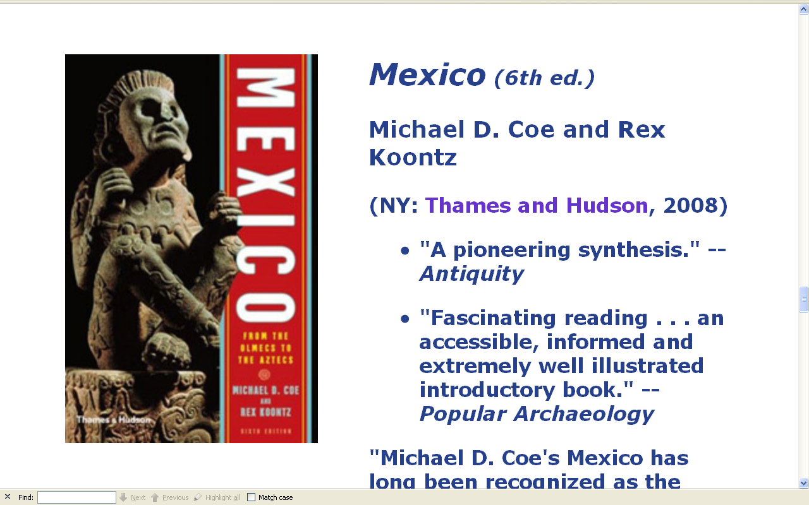
www.d.umn.edu/cla/faculty/troufs/anth3618/matext.html#title

Slide 90
but Mexico, for e.g., is not a “culture”
it is a “nation”
www.d.umn.edu/cla/faculty/troufs/anth3618/matext.html#title

Slide 91
a “subculture” (“local culture”) (“microculture”) as a
Unit of Analysis

Slide 92
as mentioned in the “Orientation”
units of analysis may include:
one person
the family
the community
a region
a “culture area”
a culture / “subculture”
a nation
an item or action itself
a “cultural metaphor”

Slide 93
within “culture areas” there are most often
“subcultures”
these are also known as
“microcultures”
and occasionally as
“local cultures”

Slide 94
within “culture areas” there are most often
“subcultures”
these are also known as
“microcultures”
and occasionally as
“local cultures”

Slide 95
within “culture areas” there are most often
“subcultures”
these are also known as
“microcultures”
and occasionally as
“local cultures”

Slide 96
within “culture areas” there are most often
“subcultures”
these are also known as
“microcultures”
and occasionally as
“local cultures”

Slide 97
within “culture areas” there are most often
“subcultures”
these are also known as
“microcultures”
and occasionally as
“local cultures”
and there are lots of them

Slide 99
The Concept of Culture
microcultures can include ethnic groups within nations
e.g., Greek-Americans
e.g., Anishinabe (Chippewa; Ojibwa)
e.g., Irish “Travellers”
sometimes incorrectly called “Gypsies”
e.g., Australian Aboriginals
e.g., Cajun
e.g., Rom (Gypsies)
e.g., Basques
e.g., Kurds
local groups generally strive to preserve their cultural identity

Slide 100
The Concept of Culture
local groups (microcultures)
generally strive to preserve their cultural identity with . . .
food clothing
religion
ritual
music, dance, and other arts
language
cultural symbols . . .

Slide 101
The Concept of Culture
microcultures can include ethnic groups within nations
e.g., Greek-Americans
e.g., Anishinabe (Chippewa; Ojibwa)
e.g., Irish “Travellers”
sometimes incorrectly called “Gypsies”
e.g., Australian Aboriginals
e.g., Cajun
e.g., Rom (Gypsies)
e.g., Basques
e.g., Kurds

Slide 102
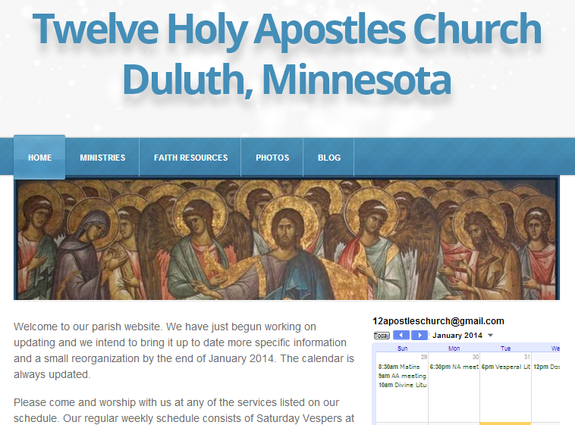
The Concept of Culture
microculture
are smaller groups with distinct pattern of learned and shared behavior and thinking found within larger cultures such as ethnic groups in localized regions
some people like to think of these as “local cultures”

Slide 103
A Taste of Greece
27nd Annual Food Festival 2019

Slide 104
The Concept of Culture
microculture
are smaller groups with distinct pattern of learned and shared behavior and thinking found within larger cultures such as ethnic groups in localized regions
some people like to think of these as “local cultures”
local groups generally strive to preserve their cultural identity . . .

Slide 105
The Concept of Culture
local groups (microcultures)
generally strive to preserve their cultural identity with . . .
food clothing
religion
ritual
music, dance, and other arts
language
cultural symbols . . .

Slide 106
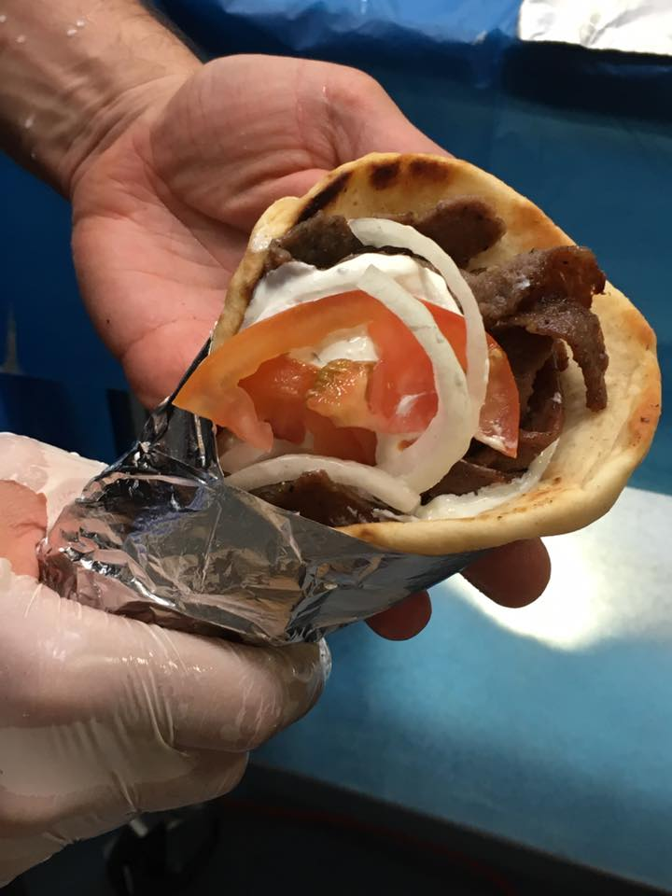
gyro
A Tate of Greece
25th Annual Food Festival 2017

Slide 107
The Concept of Culture
local groups (microcultures)
generally strive to preserve their cultural identity with . . .
food clothing
religion
ritual
music, dance, and other arts
language
cultural symbols . . .

Slide 108
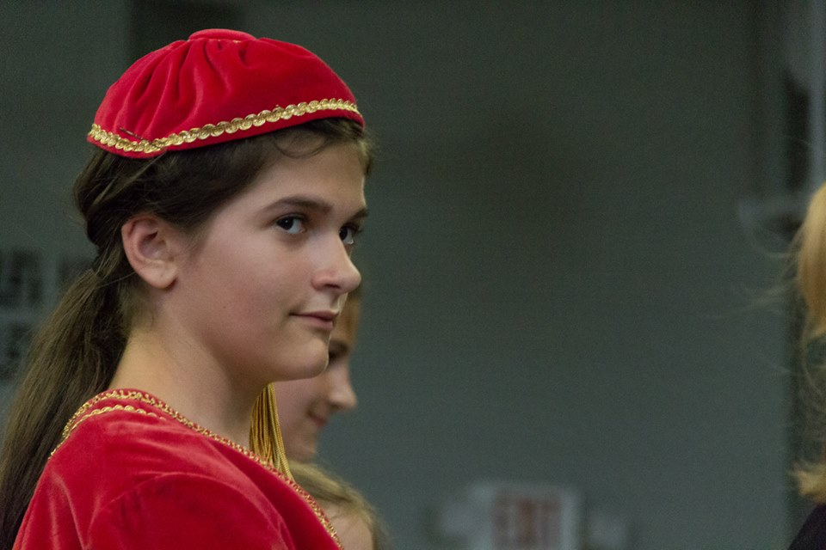
www.facebook.com/alexganeevphotography/photos/

Slide 109
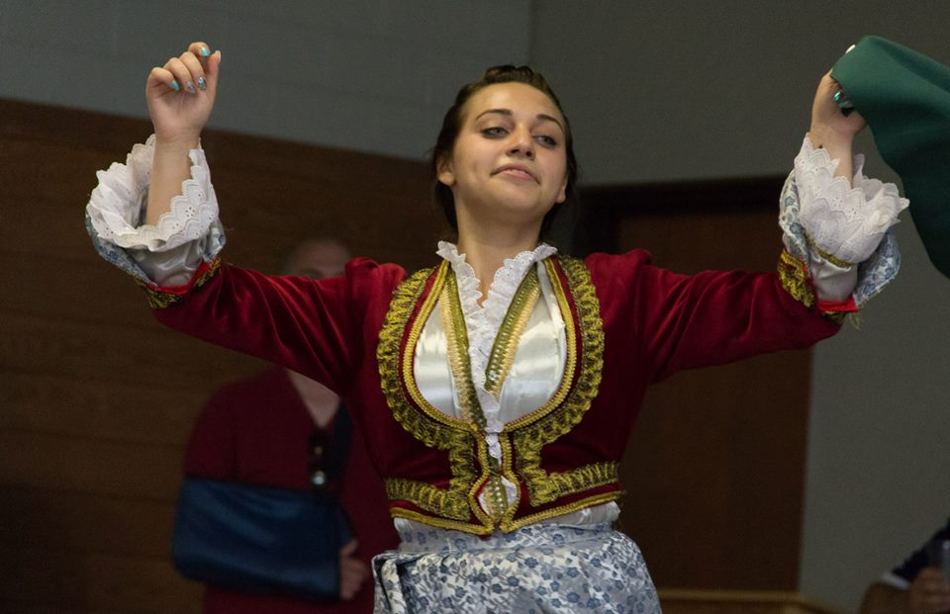
www.facebook.com/alexganeevphotography/photos/

Slide 110
The Concept of Culture
local groups (microcultures)
generally strive to preserve their cultural identity with . . .
food clothing
religion
ritual
music, dance, and other arts
language
cultural symbols . . .

Slide 111
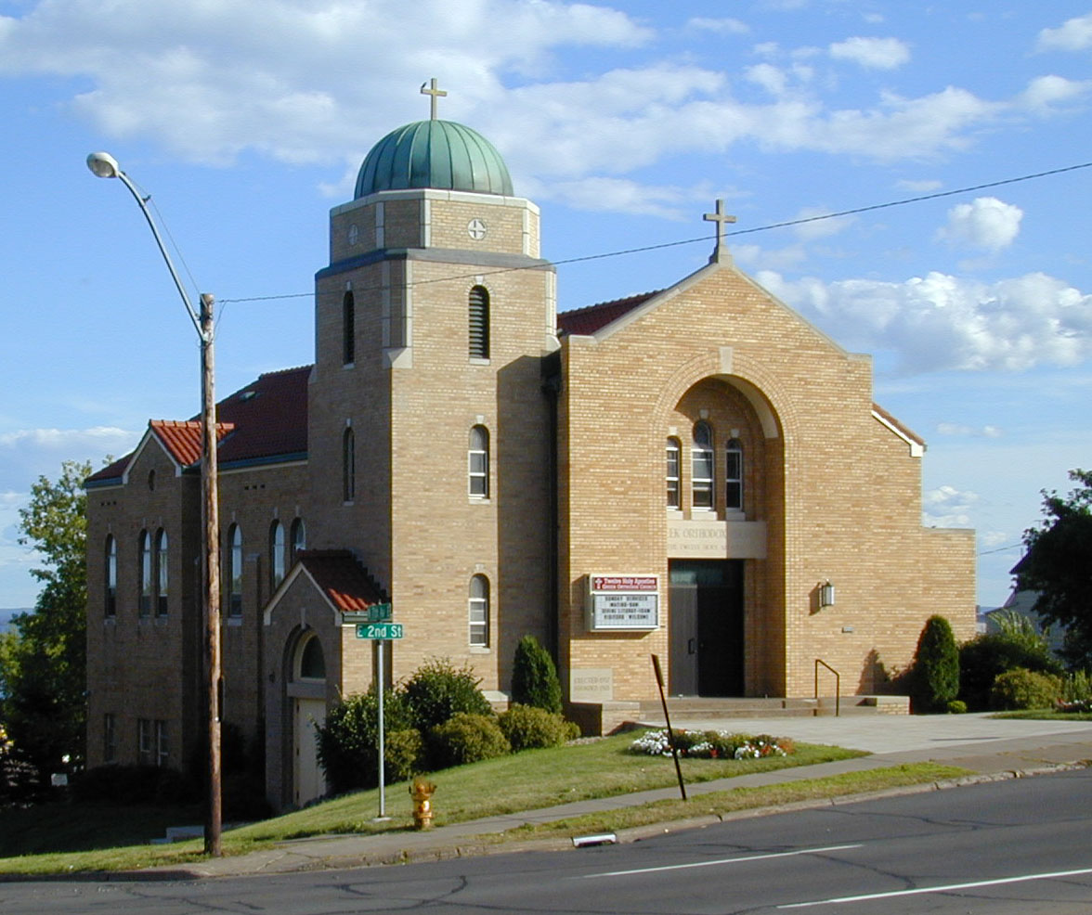
https://www.facebook.com/pages/Taste-of-Greece-Festival-Duluth-Minnesota/199921043362252

Slide 112

https://www.facebook.com/12HolyApostlesChurch/photos/

Slide 113
The Concept of Culture
local groups (microcultures)
generally strive to preserve their cultural identity with . . .
food clothing
religion
ritual
music, dance, and other arts
language
cultural symbols . . .

Slide 114

www.facebook.com/alexganeevphotography/photos/

Slide 115
The Concept of Culture
local groups (microcultures)
generally strive to preserve their cultural identity with . . .
food clothing
religion
ritual
music, dance, and other arts
language
cultural symbols . . .

Slide 116

A Taste of Greece
22nd Annual Food Festival 2014
https://www.facebook.com/pages/Taste-of-Greece-Festival-Duluth-Minnesota/199921043362252

Slide 117

www.facebook.com/alexganeevphotography/photos/

Slide 118
The Concept of Culture
local groups (microcultures)
generally strive to preserve their cultural identity with . . .
food clothing
religion
ritual
music, dance, and other arts
language
cultural symbols . . .

Slide 119
https://www.facebook.com/12HolyApostlesChurch/photos/

Slide 120
The Concept of Culture
local groups (microcultures)
generally strive to preserve their cultural identity with . . .
food clothing
religion
ritual
music, dance, and other arts
language
cultural symbols . . .

Slide 121


Slide 122
including colors

Slide 123

“Greek Coffee”

Slide 124
The Concept of Culture
local groups (microcultures)
generally strive to preserve their cultural identity with . . .
food clothing
religion
ritual
music, dance, and other arts
language
cultural symbols . . .
and these can be combined . . .

Slide 126
within “culture areas” there are most often
“subcultures”
these are also known as
“microcultures”
and occasionally as
“local cultures”
and in Middle America
there are lots of them

Slide 127
as mentioned in the “Orientation”
units of analysis may include:
one person
the family
the community
a region
a “culture area”
a culture / “subculture”
a nation
an item or action itself
a “cultural metaphor”
there are several “subcultures” in the Maya area alone
Maya
Chamula
Lancandon
Tzotzil
Tzeltal
Zoque
Olmec
Toltec
Aztec
Teotihuacanos
Tarahumara . . .
Yaqui
Otomi
Tarascan
Mixtec
Zapotec

Slide 128

Maya
Chamula
Lancandon
Tzotzil
Tzeltal
Zoque
www.d.umn.edu/cla/faculty/troufs/anth3618/video/Maya_Lords.html#title

Slide 129

www.d.umn.edu/cla/faculty/troufs/anth3618/video/Maya_Lords.html#title

Slide 130
units of analysis may include:
one person
the family
the community
a region
a “culture area”
a culture / “subculture”
a nation
the world
an item or action itself
a “cultural metaphor”

Slide 131
units of analysis may include:
one person
the family
the community
a region
a “culture area”
a culture / “subculture”
a nation
the world
an item or action itself
a “cultural metaphor”
~ “tribe” ?

Slide 132

Fox, Robin. The Tribal Imagination: Civilization and the Savage Mind. Harvard University Press, 2011.

Slide 133
units of analysis may include:
one person
the family
the community
a region
a “culture area”
a culture / “subculture”
a nation
the world
an item or action itself
a “cultural metaphor”
~ “tribe” ?
Sometimes the “tribe” is also a “nation”

Slide 134

Sometimes the “tribe” is also a “nation”

Slide 135

Sometimes the “tribe” is also a “nation”

Slide 136
“units of analysis” may include:
one person (e.g., Paul Buffalo)
the family (e.g., Strodtbeck, see later)
the community
a region
“culture area”
a culture
“Irish”
“Irish Travellers” (“Gypsies”)
“Rom” (“Gypsies”)
“Basques”
Catalans
in summary
(so far)

Slide 137
“units of analysis” may include:
one person (e.g., Nan)
the family
the community
a region
“culture area”
a culture / subculture
“Irish”
“Irish Travellers” (“Gypsies”)
“Rom” (“Gypsies”)
“Basques”
Catalans
and there’s more …

Slide 138
“units of analysis” may include:
one person (e.g., Nan)
the family
the community
a region
“culture area”
a culture / subculture
“Irish”
“Irish Travellers” (“Gypsies”)
“Rom” (“Gypsies”)
“Basques”
Catalans
and there’s more …

Slide 139
“units of analysis” may also include:
a nation
(“national character studies”)
the item or action itself
(including “processes”)
a “cultural metaphor”

Slide 140
a nation
(Nation-State)
as a
Unit of Analysis

Slide 141
as mentioned in the “Orientation”
units of analysis may include:
one person
the family
the community
a region
a “culture area”
a culture / “subculture”
a nation
an item or action itself
a “cultural metaphor”

Slide 142

Mesoamerica
includes 7 countries
http://www.d.umn.edu/cla/faculty/troufs/anth3618/mamaya.html#countries

Slide 143
REM: Mexico, for e.g., is not a “culture”
it is a “nation”
www.d.umn.edu/cla/faculty/troufs/anth3618/matext.html#title

Slide 144
as mentioned in the “Orientation”
units of analysis may include:
one person
the family
the community
a region
a “culture area”
a culture / “subculture”
a nation
an item or action itself
a “cultural metaphor”
contemporary studies of nations in anthropology are often known as “national character studies”

Slide 145
the world
as a
Unit of Analysis

Slide 146


Slide 147
Roufs, Timothy G. and Kathleen Smyth Roufs. 2014. Sweet Treats around the World, Santa Barbara, CA: ABC-CLIO.

Slide 148

Martha Elena Félix Brasdefer and Teódulo Espinosa Victoria enjoying Martha’s flan (Mexico)

Slide 149
the item or action
or idea
itself
as a
Unit of Analysis

Slide 150
as mentioned in the “Orientation”
units of analysis may include:
one person
the family
the community
a region
a “culture area”
a culture / “subculture”
a nation
an item or action itself
a “cultural metaphor”

Slide 151
as mentioned in the “Orientation”
units of analysis may include:
one person
the family
the community
a region
a “culture area”
a culture / “subculture”
a nation
an item or action itself
a “cultural metaphor”
including “processes”

Slide 152
as mentioned in the “Orientation”
units of analysis may include:
one person
the family
the community
a region
a “culture area”
a culture / “subculture”
a nation
an item or action itself
a “cultural metaphor”
and there’s almost no end
to these . . .

Slide 153

Who Were the First Americans?
http://www.pbs.org/saf/1406/index.html

Slide 154

http://www.d.umn.edu/cla/faculty/troufs/anth3618/video/Fallacy_of_Diffusionism.html#title

Slide 155

www.d.umn.edu/cla/faculty/troufs/anth3618/video/Fifth_World.html#title

Slide 156

http://www.d.umn.edu/cla/faculty/troufs/anth3618/video/Forests.html#title

Slide 157

http://www.d.umn.edu/cla/faculty/troufs/anth3618/video/Culture_and_Math.html#title

Slide 158

http://www.d.umn.edu/cla/faculty/troufs/anth3618/video/Cracking_Maya_Code.html#title

Slide 159


Slide 160

Sidney W. Mintz Sweetness and Power:
The Place of Sugar in Modern History NY: Penguin Books, 1986.
www.d.umn.edu/cla/faculty/troufs/anthfood/aftexts.html#title

Slide 161

gold
http://www.d.umn.edu/cla/faculty/troufs/anth3618/video/Sweat.html#title

Slide 162

. . . the rise and fall of civilizations
http://www.d.umn.edu/cla/faculty/troufs/anth3618/video/Collapse.html#title

Slide 163

Compare . . .
www.d.umn.edu/cla/faculty/troufs/anth3618/video/Conquistadors.html#title

Slide 164

www.pbs.org/wnet/secrets/aztec_massacre/aztec_massacre

Slide 165
a cultural metaphor
(analogy, by means of cultural metaphors)
as a
Unit of Analysis

Slide 166
as mentioned in the “Orientation”
units of analysis may include:
one person
the family
the community
a region
a “culture area”
a culture / “subculture”
a nation
an item or action itself
a “cultural metaphor”

Slide 167
as mentioned in the “Orientation”
units of analysis may include:
one person
the family
the community
a region
a “culture area”
a culture / “subculture”
a nation
an item or action itself
a “cultural metaphor”
cultural metaphors use an item or event representative of a culture and analyze the culture with reference to that item or event

Slide 168
a cultural metaphor is a specialized use of an item or action or idea itself
as a Unit of Analysis . . .

Slide 169
a cultural metaphor is a specialized use of an item or action or idea itself
as a Unit of Analysis . . .
through analogy

Slide 170


Slide 171
Carlos Fuentes
for e.g.,
looks at prehistoric and modern
Mexico and Spain
in terms of the imagery of
“The Virgin”
and
“The Bull”

Slide 172

Martin J. Gannon uses cultural metaphors as the basis
for his book on Global Cultures
http://www.d.umn.edu/cla/faculty/troufs/anth1095/fstext.html#text

Slide 173
Compare . . .
European Cultural Metaphors include
Ch. 6 Kimchi and Korea
Ch. 9 The Danish Christmas Luncheon
Ch. 14 French Wine
Ch. 21 The Mexican Fiesta
Ch. 22 The Turkish Coffehouse
Ch. 25 The Singapore Hawker Centers
6 / 37 cultures have food and food events as their metaphor

Slide 174

http://www.d.umn.edu/cla/faculty/troufs/anth3618/video/Appeals.html

Slide 175
and, of course, the
Units of Analysis
can be combined
(and quite often are)

Slide 176

genes
cultural diversity
food
Island Press (2004)

Slide 177
in summary . . .

Slide 178
“units of analysis” may include:
one person
the family
the community
a region
a “culture area”
a culture / “subculture”
a nation
an item or action itself
a “cultural metaphor”

Slide 179
as mentioned in the “Orientation”
units of analysis may include:
one person
the family
the community
a region
a “culture area”
a culture / “subculture”
a nation
the world
an item or action itself
a “cultural metaphor”
more on
everything
later in the semester

Slide 180
end of unit on
Units
of
Analysis
Ancient Middle America
University of Minnesota Duluth
Tim Roufs © 2010-2014
http://www.d.umn.edu/cla/faculty/troufs/anth3618/

