Slide 1
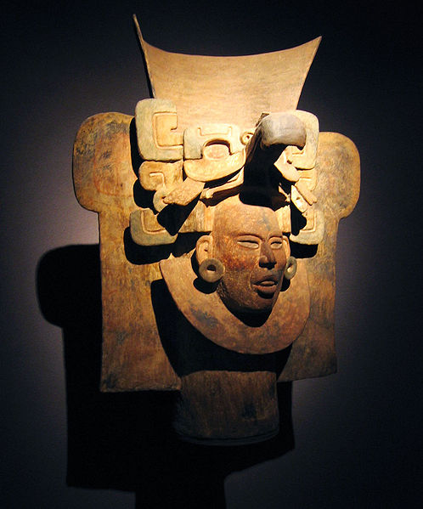
Main
Characteristics of
Anthropology
Ancient Middle America
University of Minnesota Duluth
Tim Roufs
© 2010-2019

Slide 2
Anthropology graduates, reflecting back on their time with us at UMD, suggested in our surveys that it would be a good idea to tie the individual courses in the Anthropology curriculum together a little more.
So that’s what we’re going to do . . .

Slide 3
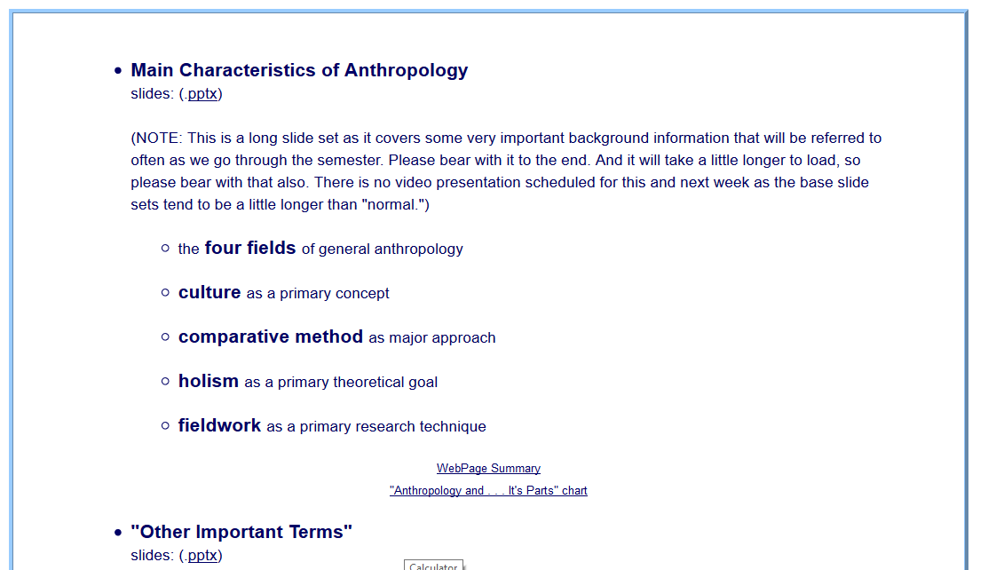
You’ve seen these listed in the
Week 1 “Topics” . . .

Slide 4
You’ve seen these listed in the
Week 1 “Topics” . . .
Let’s have a closer look . . .

Slide 5
Main Characteristics of Anthropology
1. the four fields of general anthropology
culture as a primary concept
comparative method as major approach
holism as a primary theoretical goal
fieldwork as a primary research technique

Slide 6
Main Characteristics of Anthropology
1. the four fields
of general anthropology
culture as a primary concept
comparative method as major approach
holism as a primary theoretical goal
fieldwork as a primary research technique

Slide 7
The Four Fields of American Anthropology
cultural / social
physical
archaeology
linguistics

Slide 8
These are also commonly known as . . .

Slide 9
sociocultural
biophysical
archaeological
linguistical
aspects

Slide 10
sociocultural
biophysical
archaeological
linguistical
cultural / social
physical / biological
archaeological
linguistical
aspects

Slide 11
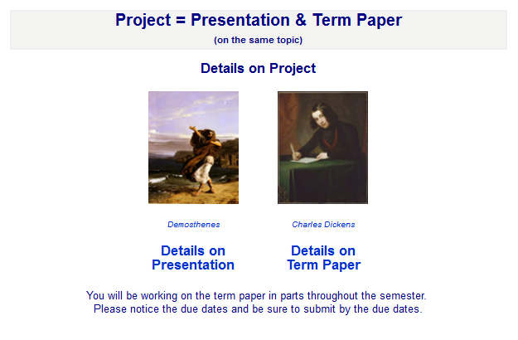
And you’ve seen these fields with your term project . . .

Slide 12
Main Characteristics of Anthropology
1. the four fields of general anthropology
culture as a primary concept
comparative method as major approach
holism as a primary theoretical goal
fieldwork as a primary research technique

Slide 13
Main Characteristics
“culture” is
  learned
  shared
  transmitted from generation to generation
  based on symbols
  integrated

Slide 14
Main Characteristics
“culture”
  learned
  shared
  transmitted from generation to generation
  based on symbols
  integrated
some focus on the idea that it involves
“shared understanding”

Slide 15
Main Characteristics
“culture”
    is not inherited
  (i.e., is not biological)
    is not “instinct”

Slide 16
Main Characteristics
“cultures”
    are groups of people sharing a common heritage
    (and usually a common language)

Slide 17
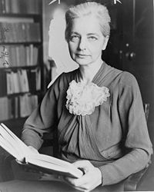
Main Characteristics
“cultures”
    are “integrated”
    -- an idea that was pioneered and emphasized by the “pioneer” anthropologist Ruth Benedict
Ruth Fulton Benedict
1887-1948
Patterns of Culture
1934

Slide 18
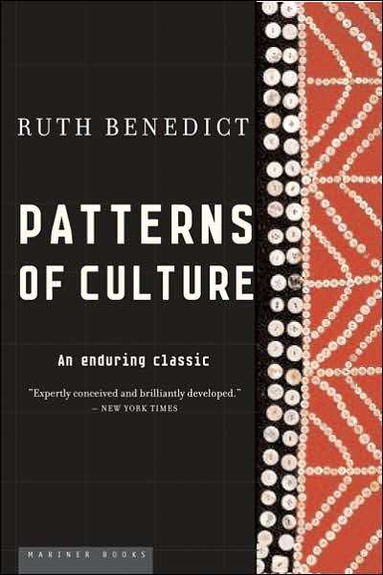
Ruth Fulton Benedict
1887-1948
Patterns of Culture
1934

Slide 19
Main Characteristics
“cultures”
    are integrated
    Interact and change
      the idea that some cultures
      (like “hunting and gathering” cultures, or the Amish)
      do not change is not correct

Slide 20
The Concept of Culture
microculture
  are smaller groups with distinct pattern of learned and shared behavior and thinking found within larger cultures such as ethnic groups in localized regions
  some people like to think of these as
  “local cultures”

Slide 21
The Concept of Culture
microculture
  are smaller groups with distinct pattern of learned and shared behavior and thinking found within larger cultures such as ethnic groups in localized regions
  some people like to think of these as
  “local cultures”

Slide 22
The Concept of Culture
microcultures can include ethnic groups within nations
  e.g., Greek-Americans
  e.g., Anishinabe (Chippewa; Ojibwa)
  e.g., Irish “Travellers”
    sometimes incorrectly called “Gypsies”
  e.g., Australian Aboriginals
  e.g., Cajun
  e.g., Rom (Gypsies)
  e.g., Basques
  e.g., Kurds

Slide 23
The Concept of Culture
microcultures can include ethnic groups within nations
  e.g., Greek-Americans
  e.g., Anishinabe (Chippewa; Ojibwa)
  e.g., Irish “Travellers”
    sometimes incorrectly called “Gypsies”
  e.g., Australian Aboriginals
  e.g., Cajun
  e.g., Rom (Gypsies)
  e.g., Basques
  e.g., Kurds
local groups generally strive to preserve their cultural identity

Slide 24
The Concept of Culture
local groups (microcultures)
generally strive to preserve their cultural identity with . . .
food
clothing
religion
ritual
music, dance, and other arts
language
cultural symbols . . .

Slide 25
The Concept of Culture
microcultures can include ethnic groups within nations
  e.g., Greek-Americans
  e.g., Anishinabe (Chippewa; Ojibwa)
  e.g., Irish “Travellers”
    sometimes incorrectly called “Gypsies”
  e.g., Australian Aboriginals
  e.g., Cajun
  e.g., Rom (Gypsies)
  e.g., Basques
  e.g., Kurds

Slide 26

The Concept of Culture
microculture
  are smaller groups with distinct pattern of learned and shared behavior and thinking found within larger cultures such as ethnic groups in localized regions
  some people like to think of these as
  “local cultures”

Slide 27
The Concept of Culture
microculture
  are smaller groups with distinct pattern of learned and shared behavior and thinking found within larger cultures such as ethnic groups in localized regions
  some people like to think of these as
  “local cultures”
local groups generally strive to preserve their cultural identity . . .

Slide 28
The Concept of Culture
local groups (microcultures)
generally strive to preserve their cultural identity with . . .
food
clothing
religion
ritual
music, dance, and other arts
language
cultural symbols . . .

Slide 29
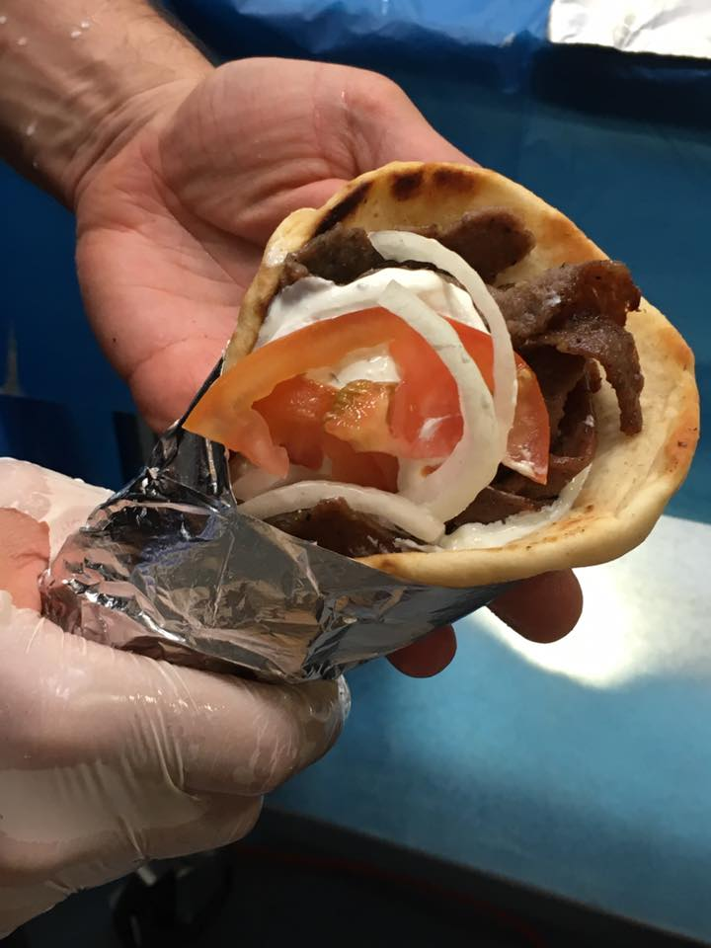
gyro
A Tate of Greece
25th Annual Food Festival 2017

Slide 30
The Concept of Culture
local groups (microcultures)
generally strive to preserve their cultural identity with . . .
food
clothing
religion
ritual
music, dance, and other arts
language
cultural symbols . . .

Slide 31
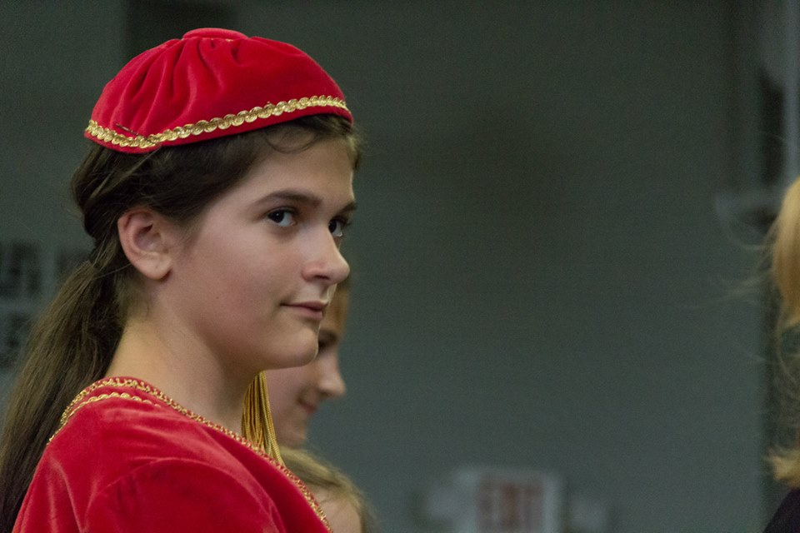
www.facebook.com/alexganeevphotography/photos/

Slide 32
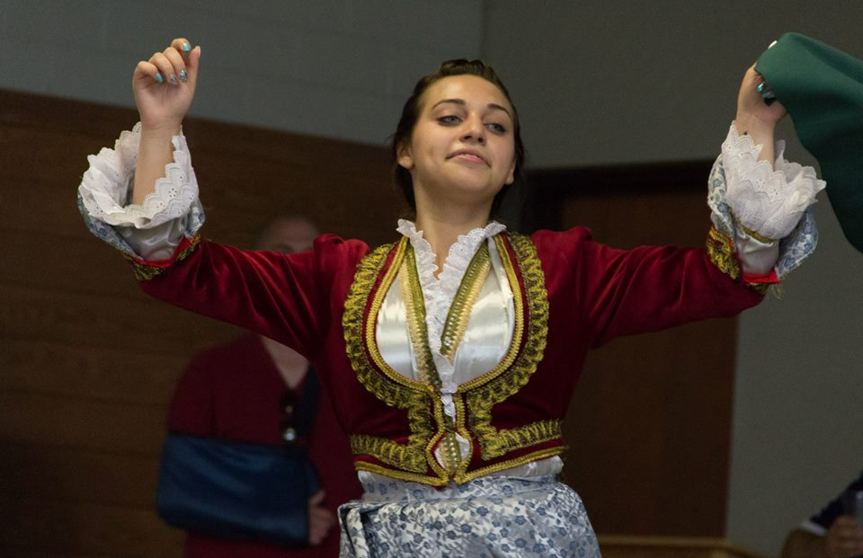
www.facebook.com/alexganeevphotography/photos/

Slide 33
The Concept of Culture
local groups (microcultures)
generally strive to preserve their cultural identity with . . .
food
clothing
religion
ritual
music, dance, and other arts
language
cultural symbols . . .

Slide 34
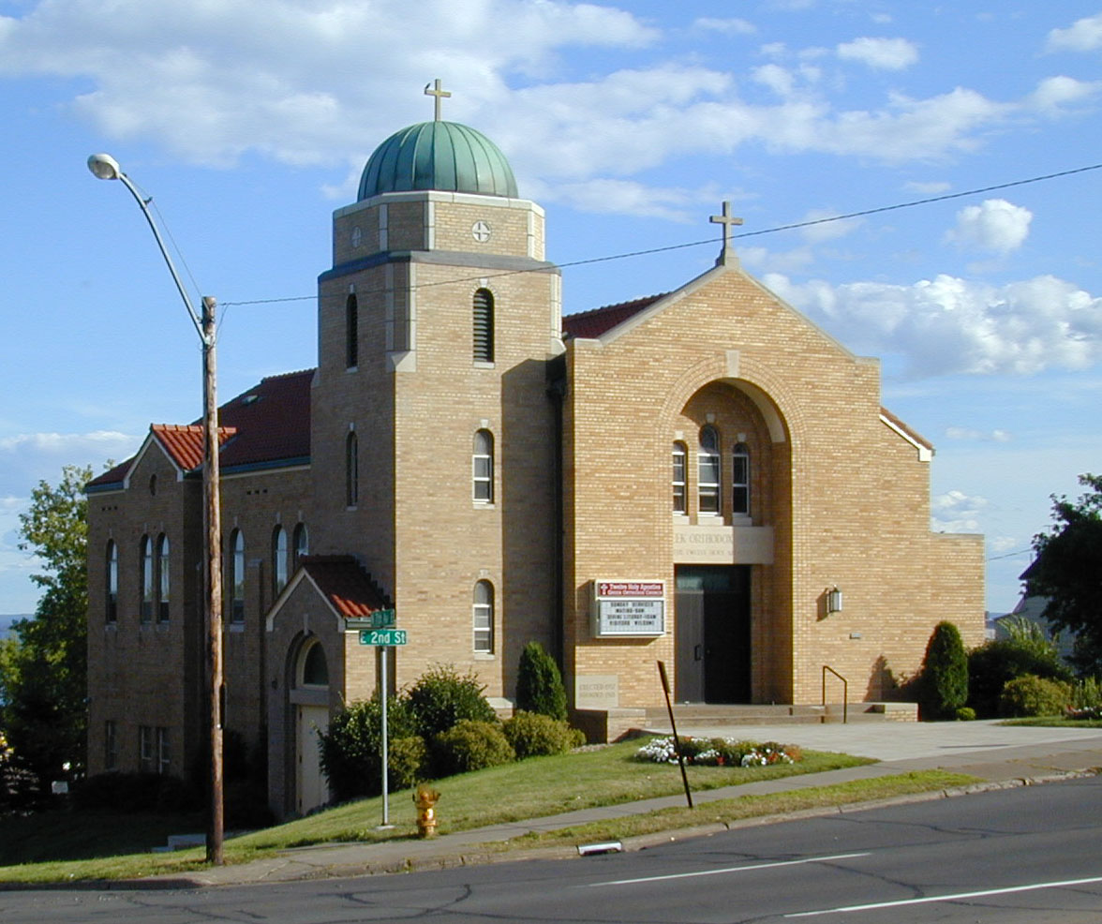
https://www.facebook.com/pages/Taste-of-Greece-Festival-Duluth-Minnesota/199921043362252

Slide 35

https://www.facebook.com/12HolyApostlesChurch/photos/

Slide 36
The Concept of Culture
local groups (microcultures)
generally strive to preserve their cultural identity with . . .
food
clothing
religion
ritual
music, dance, and other arts
language
cultural symbols . . .

Slide 37
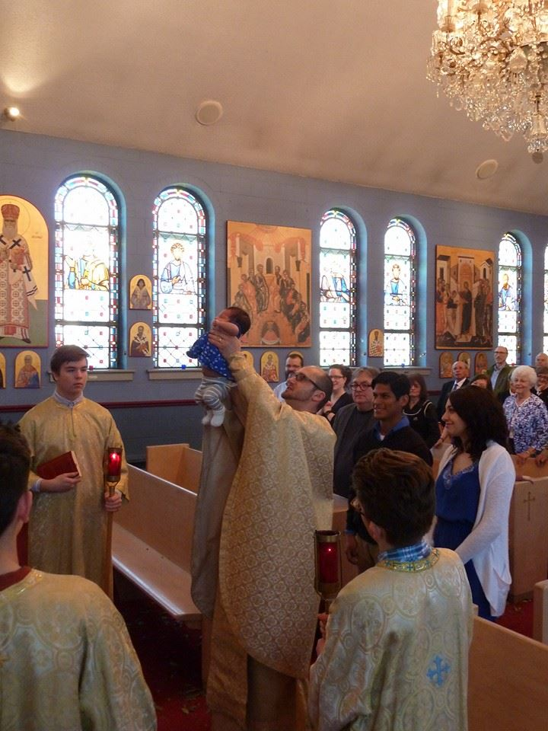
www.facebook.com/alexganeevphotography/photos/

Slide 38
The Concept of Culture
local groups (microcultures)
generally strive to preserve their cultural identity with . . .
food
clothing
religion
ritual
music, dance, and other arts
language
cultural symbols . . .

Slide 39
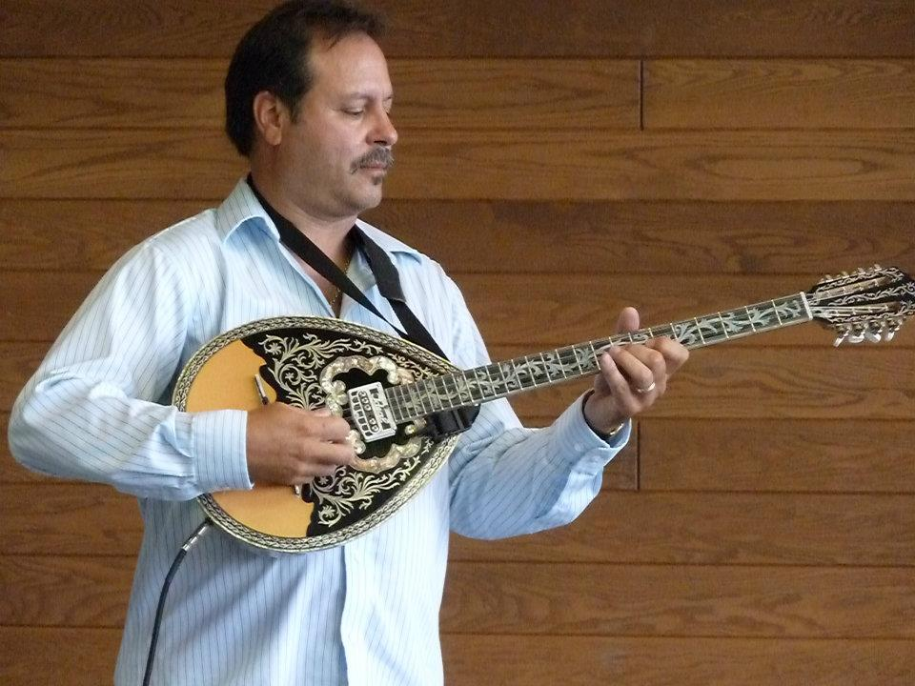
A Taste of Greece
22nd Annual Food Festival 2014
https://www.facebook.com/pages/Taste-of-Greece-Festival-Duluth-Minnesota/199921043362252

Slide 40
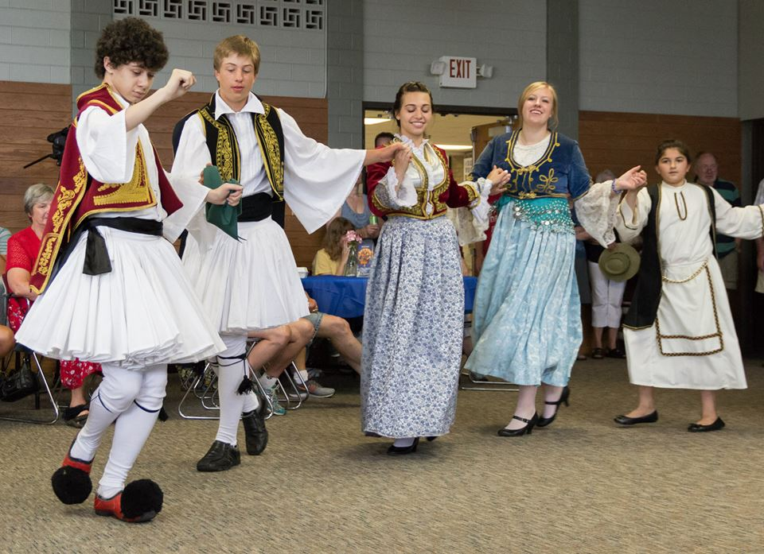
www.facebook.com/alexganeevphotography/photos/

Slide 41
The Concept of Culture
local groups (microcultures)
generally strive to preserve their cultural identity with . . .
food
clothing
religion
ritual
music, dance, and other arts
language
cultural symbols . . .

Slide 42
https://www.facebook.com/12HolyApostlesChurch/photos/

Slide 43
The Concept of Culture
local groups (microcultures)
generally strive to preserve their cultural identity with . . .
food
clothing
religion
ritual
music, dance, and other arts
language
cultural symbols . . .

Slide 44


Slide 45
including colors

Slide 46
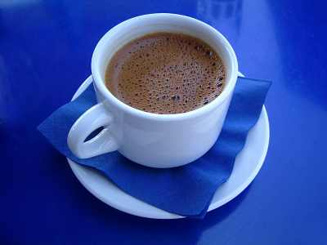
“Greek Coffee”

Slide 47
The Concept of Culture
local groups (microcultures)
generally strive to preserve their cultural identity with . . .
food
clothing
religion
ritual
music, dance, and other arts
language
cultural symbols . . .
and these can be combined . . .

Slide 48
Main Characteristics
“cultures”
    are groups of people sharing a common heritage
    (and usually a common language)

Slide 49
Middle American cultures include . . .
  Aztec
  Maya
  Zapotec
  Mixtec
  Otomi
  Tarascan
  Yaqui
  Tarahumara . . .

Slide 50
The Concept of Culture
microcultures can include ethnic groups within nations
  e.g., Anishinabe (Chippewa; Ojibwa)
  e.g., Irish “Travellers”
    sometimes incorrectly called “Gypsies”
  e.g., Rom (Gypsies)
  e.g., Basques
  e.g., Kurds
  e.g., Australian Aboriginals

Slide 51
The Concept of Culture
Microculture
  a distinct pattern of learned and shared behavior and thinking found within larger cultures such as ethnic groups in localized regions
  local cultures
Macroculture
  a distinct pattern of learned and shared behavior and thinking that crosses local boundaries, such as transnational culture and global culture

Slide 52
The Concept of Culture
and, as usual, local groups (microcultures)
generally strive to preserve their cultural identity with . . .
food
clothing
religion
ritual
music, dance, and other arts
language
cultural symbols . . .

Slide 53
The Concept of Culture
and, as usual, local groups (microcultures)
generally strive to preserve their cultural identity with . . .
food
clothing
religion
ritual
music, dance, and other arts
language
cultural symbols . . .

Slide 54
The Concept of Culture
and, as usual, local groups (microcultures)
generally strive to preserve their cultural identity with . . .
food
clothing
religion
ritual
music, dance, and other arts
language
cultural symbols . . .

Slide 55
The Concept of Culture
and, as usual, local groups (microcultures)
generally strive to preserve their cultural identity with . . .
food
clothing
religion
ritual
music, dance, and other arts
language
cultural symbols . . .

Slide 56
The Concept of Culture
and, as usual, local groups (microcultures)
generally strive to preserve their cultural identity with . . .
food
clothing
religion
ritual
music, dance, and other arts
language
cultural symbols . . .

Slide 57
The Concept of Culture
and, as usual, local groups (microcultures)
generally strive to preserve their cultural identity with . . .
food
clothing
religion
ritual
music, dance, and other arts
language
cultural symbols . . .

Slide 58
The Concept of Culture
and, as usual, local groups (microcultures)
generally strive to preserve their cultural identity with . . .
food
clothing
religion
ritual
music, dance, and other arts
language
cultural symbols . . .

Slide 59
The Concept of Culture
local groups (microcultures)
generally strive to preserve their cultural identity with . . .
food
clothing
religion
ritual
music, dance, and other arts
language
cultural symbols . . .
and these can be combined . . .

Slide 60
The Concept of Culture
. . . these elements are often
key factors in one’s individual
and in collective,
even national, cultural identities . . .

Slide 61
The Concept of Culture
And when we’re looking at ancient cultures, in Middle America or anywhere else, these are items we look for . . .

Slide 62
The Concept of Culture
microcultures can include ethnic groups within nations
  Aztec
  Maya
  Zapotec
  Mixtec
  Otomi
  Tarascan
  Yaqui
  Tarahumara . . .
  Inca

Slide 63

Aztec
Maya
Inca
Sophie D. Coe
America's First Cuisines
Austin: University of Texax Press, 1994.
www.d.umn.edu/cla/faculty/troufs/anthfood/aftexts.html#title

Slide 64
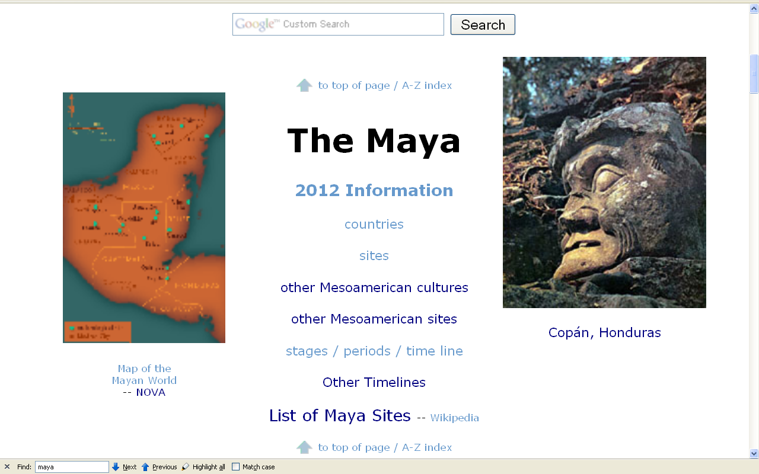
Compare . . .
http://www.d.umn.edu/cla/faculty/troufs/anth3618/mamaya.html#title

Slide 65
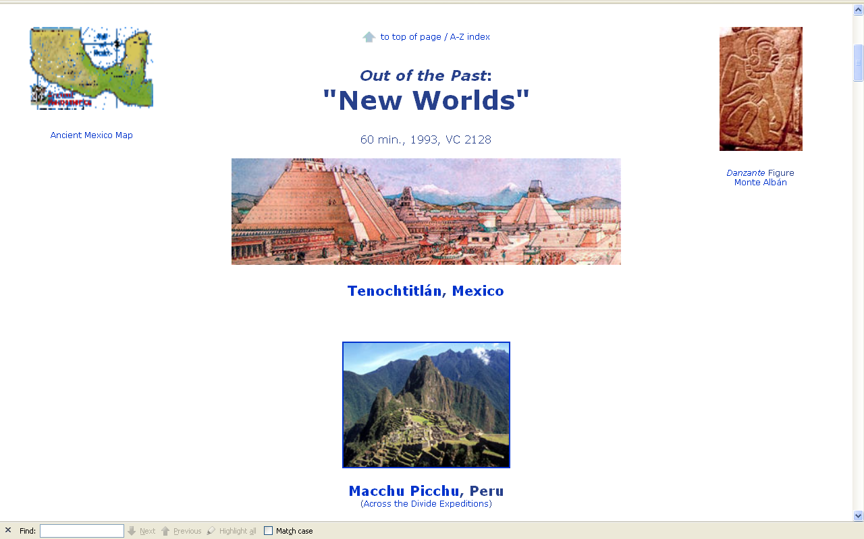
Compare . . .
www.d.umn.edu/cla/faculty/troufs/anth3618/video/Out_of_Past.html#title

Slide 66
back to our
main characteristics of anthropology . . .

Slide 67
Main Characteristics of Anthropology
1. the four fields of general anthropology
culture as a primary concept
comparative method as major approach
holism as a primary theoretical goal
fieldwork as a primary research technique

Slide 68
Main Characteristics of Anthropology
1. the four fields of general anthropology
culture as a primary concept
comparative method
as major approach
development and structure
holism as a primary theoretical goal
fieldwork as a primary research technique

Slide 69
Compare . . .
Main Characteristics
comparative method
  as a major approach to the study of human behavior
  the comparative method compares things (what else would a “comparative” method do?)

Slide 70
Compare . . .
Main Characteristics
comparative method
  One form of comparative method was pioneered by Fred Eggan
  (University of Chicago)
“Social anthropology and the method of controlled comparison”
  American Anthropologist, 56:743-61 (1954)

Slide 71
Compare . . .
Main Characteristics
comparative method
  One form of comparative method was pioneered by Fred Eggan
  (University of Chicago)
“Social anthropology and the method of controlled comparison”
  American Anthropologist, 56:743-61 (1954)

Slide 72
Compare . . .
Main Characteristics
comparative method
  Other methods . . .
compare things regionally
in an attempt to understand process

Slide 73
Compare . . .
Main Characteristics
comparative method
  Other methods . . .
process
essentially refers to
how things change
or
how things came to be
the way they are now
compare things regionally
in an attempt to understand process

Slide 74
Compare . . .
Main Characteristics
the comparative method compares things
for e.g. . . .

Slide 75
Aztec
Maya
Inca
Sophie D. Coe
America's First Cuisines
Austin: University of Texax Press, 1994.
comparing cultures and cuisines
www.d.umn.edu/cla/faculty/troufs/anthfood/aftexts.html#title

Slide 76
Compare . . .
Main Characteristics
comparative method
  Other methods . . .
compare things regionally
in an attempt to understand process

Slide 77
Compare . . .
Main Characteristics
the comparative method compares things, for e.g., process of domestication / civilization
    maize – Mexico
    wheat – Turkey
    rice – China
    manioc – Brazil
    millet – Africa

Slide 78
Compare . . .
Main Characteristics
the comparative method compares things, for e.g., process of domestication / civilization
    maize – Mexico
    wheat – Turkey
    rice – China
    manioc – Brazil
    millet – Africa

Slide 79
Compare . . .
Main Characteristics
the comparative method compares things, for e.g., process of domestication / civilization
    maize – Mexico
    wheat – Turkey
    rice – China
    manioc – Brazil
    millet – Africa

Slide 80
Compare . . .
Main Characteristics
the comparative method compares things, for e.g., process of domestication / civilization
    maize – Mexico
    wheat – Turkey
    rice – China
    manioc – Brazil
    millet – Africa

Slide 81
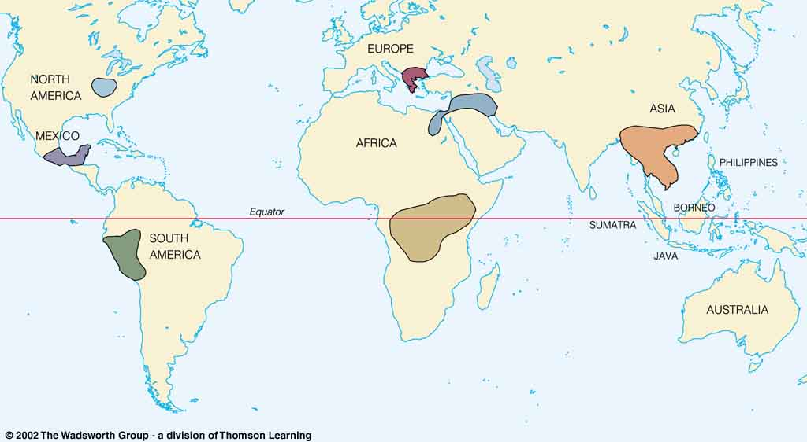
Origin of Domestication for Selected Plants
Compare . . .
wheat
10,500 ybp
maize
4,200 ybp
rice
7,000 ybp
manioc
4,200 ybp
millet
4,000 ybp
Understanding Physical Anthropology and Archaeology, 9th Ed., p. 342.

Slide 82
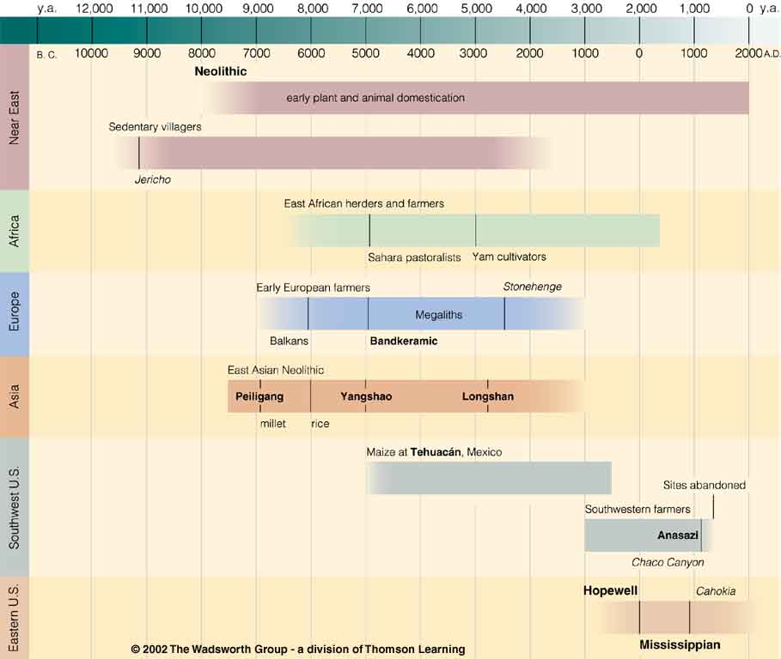
Neolithic
Tehuacán
Time line for Ch. 14 Food Production
Understanding Physical Anthropology and Archaeology, 9th Ed., p. 333.

Slide 83
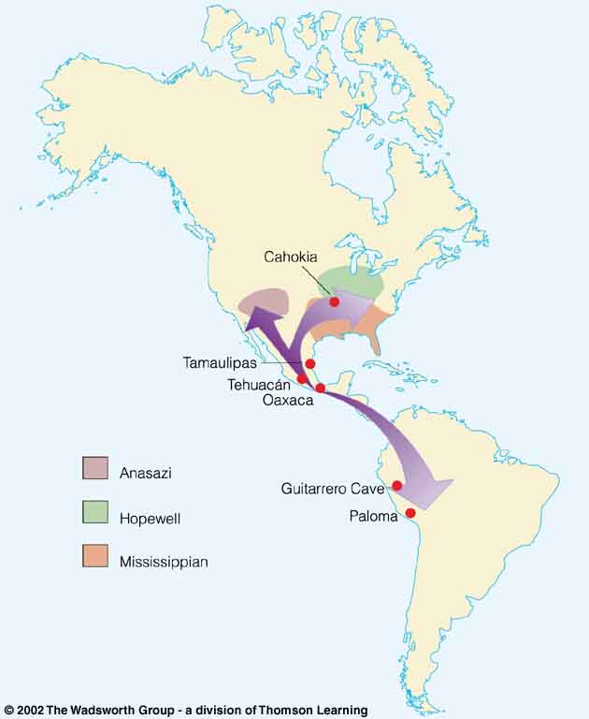
Compare . . .
Tehuacán Valley, Puebla, Mexico
maize
4,200 ybp
Understanding Physical Anthropology and Archaeology, 8th Ed., p. 432.

Slide 84
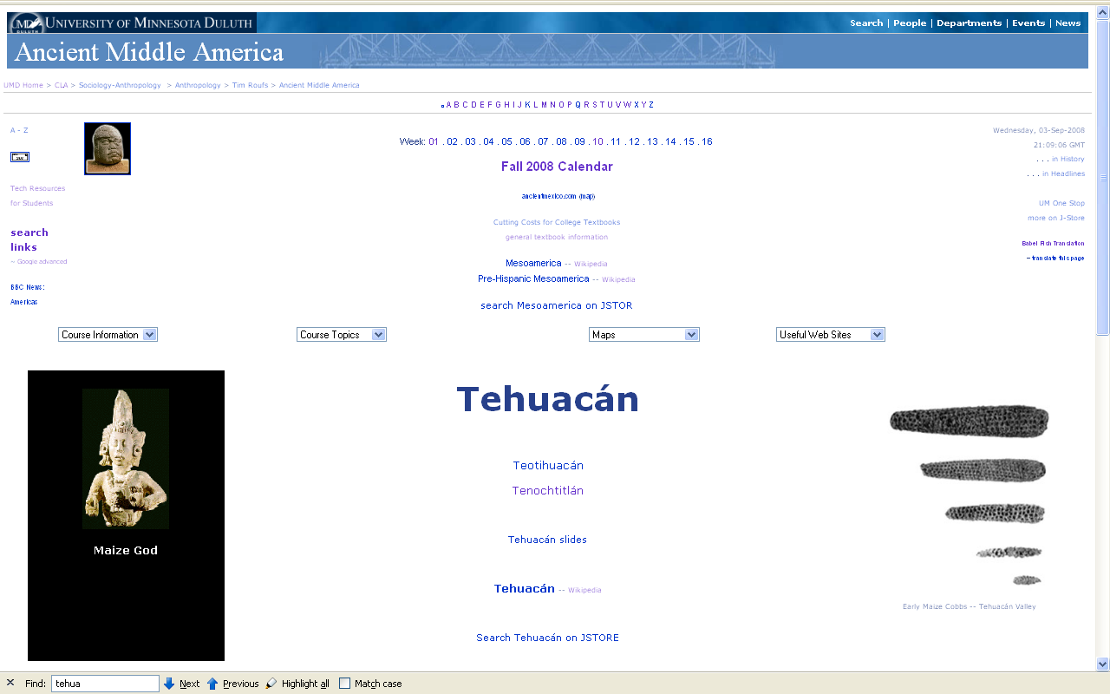
www.d.umn.edu/cla/faculty/troufs/anth3618/matehuac.html#title

Slide 85
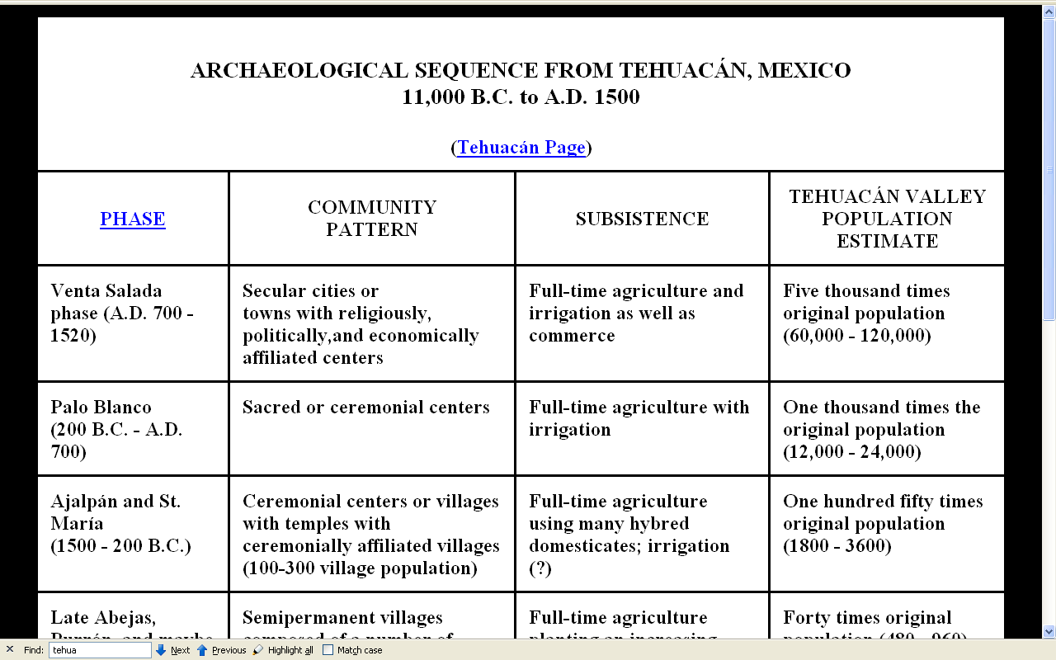
www.d.umn.edu/cla/faculty/troufs/anth3618/matehuac.html#title

Slide 86
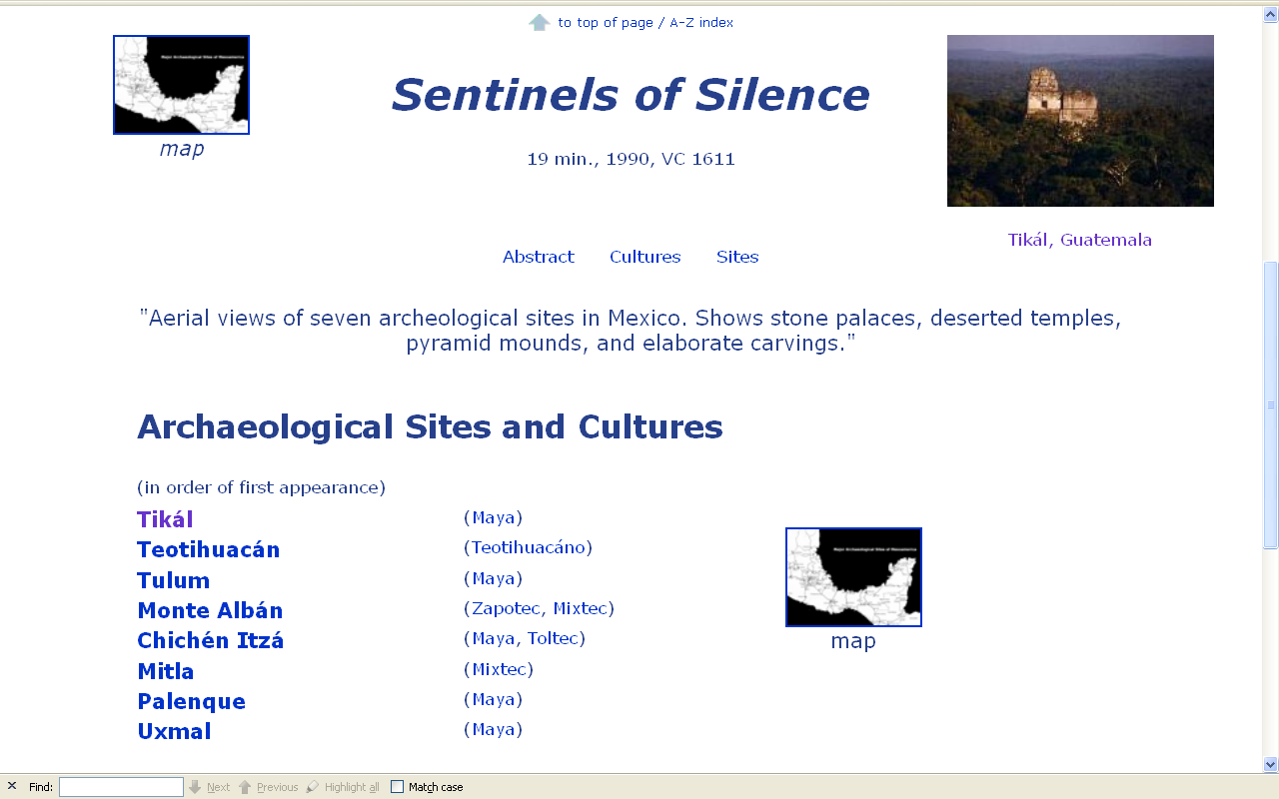
Compare . . .
www.d.umn.edu/cla/faculty/troufs/anth3618/video/Sentinels.html#title

Slide 87
Compare . . .
www.d.umn.edu/cla/faculty/troufs/anth3618/video/Out_of_Past.html#title

Slide 88
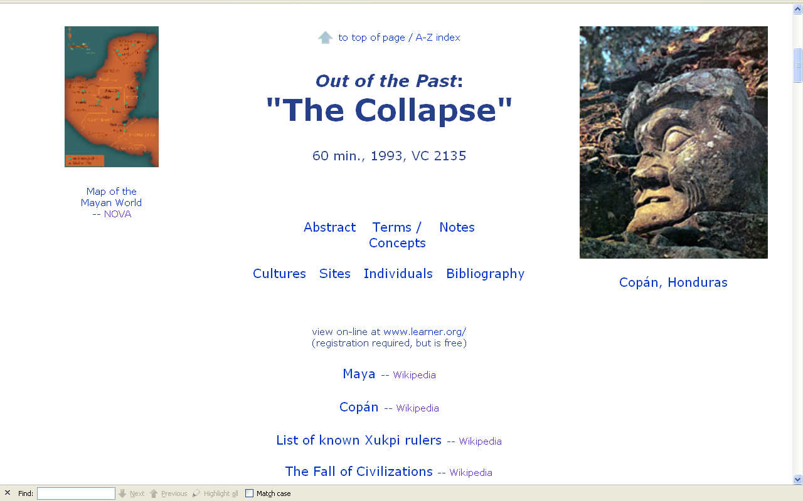
Compare . . .
www.d.umn.edu/cla/faculty/troufs/anth3618/video/Collapse.html#title

Slide 89
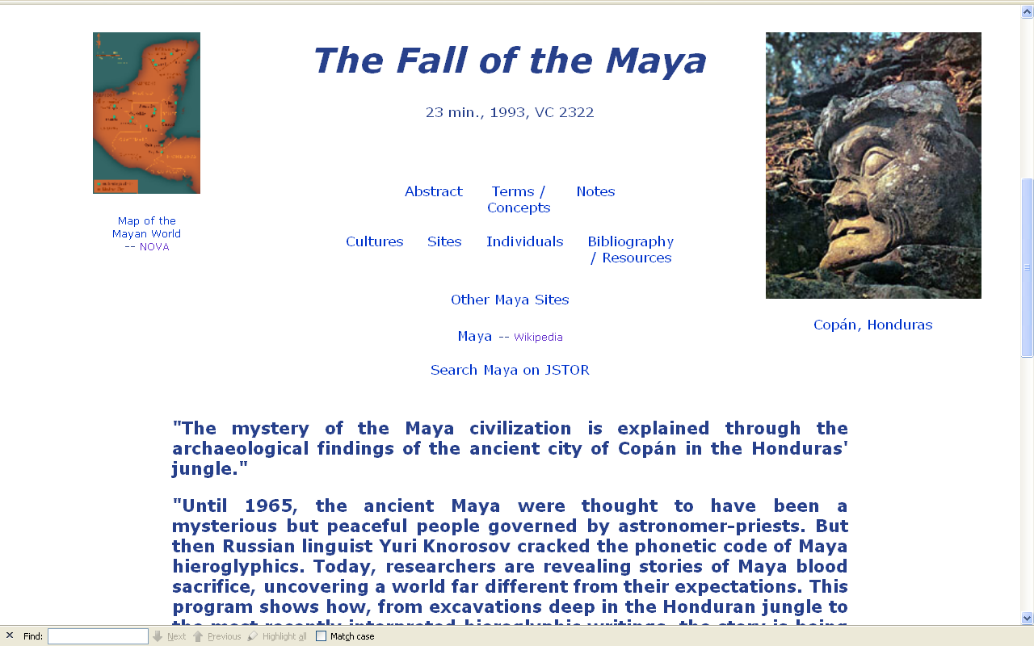
www.d.umn.edu/cla/faculty/troufs/anth3618/video/Fall_Maya.html#title

Slide 90
Main Characteristics of Anthropology
1. the four fields of general anthropology
culture as a primary concept
comparative method as major approach
holism as a primary theoretical goal
fieldwork as a primary research technique

Slide 91
Main Characteristics of Anthropology
1. the four fields of general anthropology
culture as a primary concept
comparative method as major approach
holism
or the study of "humankind" as a whole, as a primary theoretical goal
fieldwork as a primary research technique

Slide 92
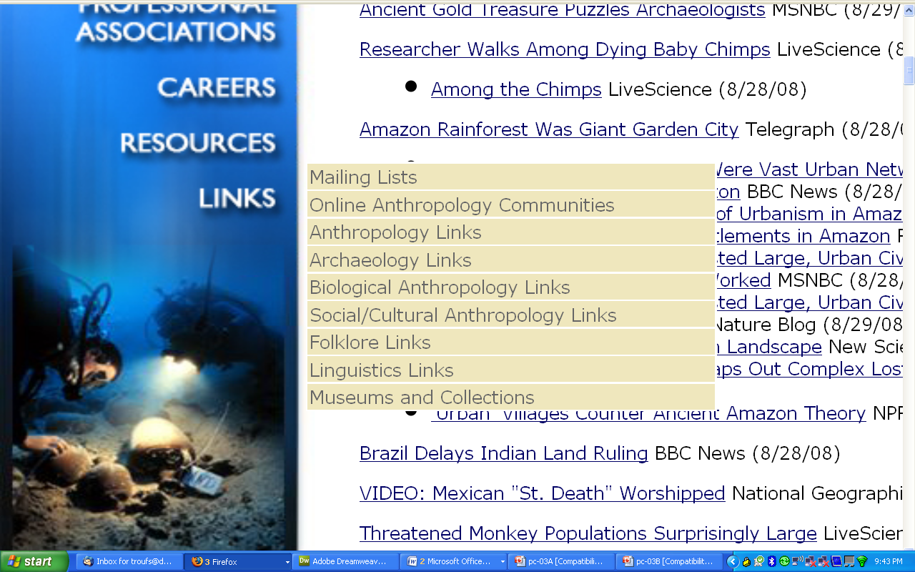
The main fields
of general anthropology
1
2
3
4
http://www.tamu.edu/anthropology/news.html

Slide 93
Holism is fundamental to understanding the cultures of Ancient Middle America . . .

Slide 94
holism tries to put all of the pieces together . . .
American Anthropology
cultural / social
physical (bio-physical)
archaeology
linguistics

Slide 95
. . . so let’s have a look at that on the
“Anthropology and . . . Its Parts” chart to try to understand HOLISM . . .

Slide 96
NOTE:
usually anthropologists read charts from the bottom up
that has to do with the fact that in archaeology the oldest layers are at the bottom of a site and the newer ones are on top

Slide 97
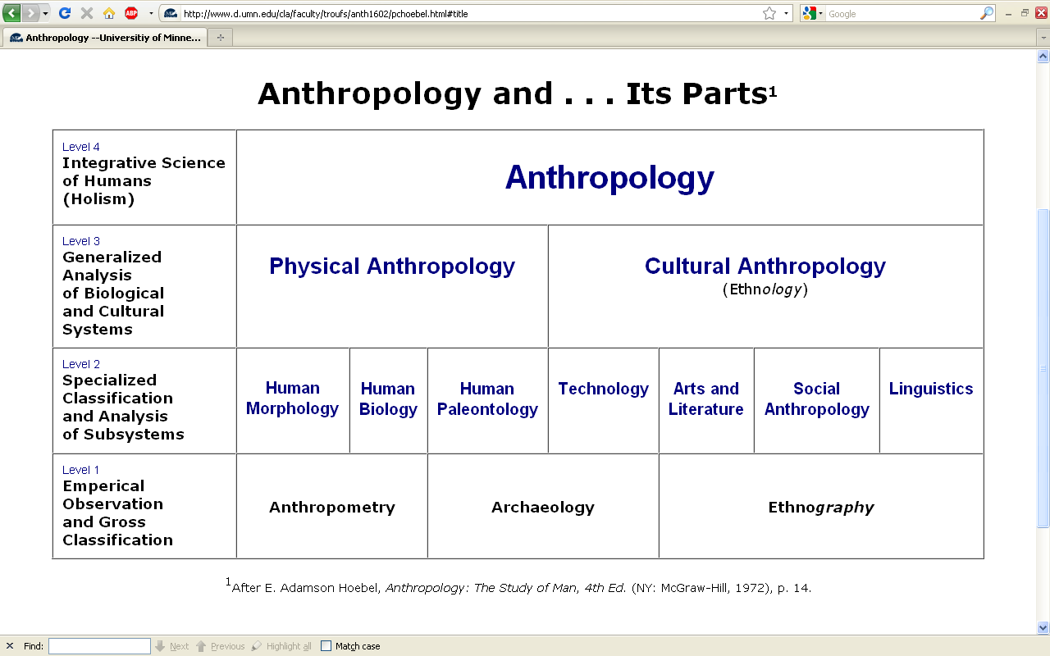

Slide 98
Having a look at . . .
Ancient Middle America
cultural / social
physical
archaeology
linguistics
would appear on the chart as . . .

Slide 100
NOTE:
There are four levels . . .
(REM: read from the bottom up)

Slide 105
HOLISM
Involves all four levels
and all
of the physical and cultural
components combined

Slide 106
holism

Slide 107
holism
holism

Slide 108

Finland is switching their
entire school curriculum to
holistic studies . . .
https://brightside.me/wonder-curiosities/finland-will-become-the-first-country-in-the-world-to-get-rid-of-all-school-subjects-259910/

Slide 109
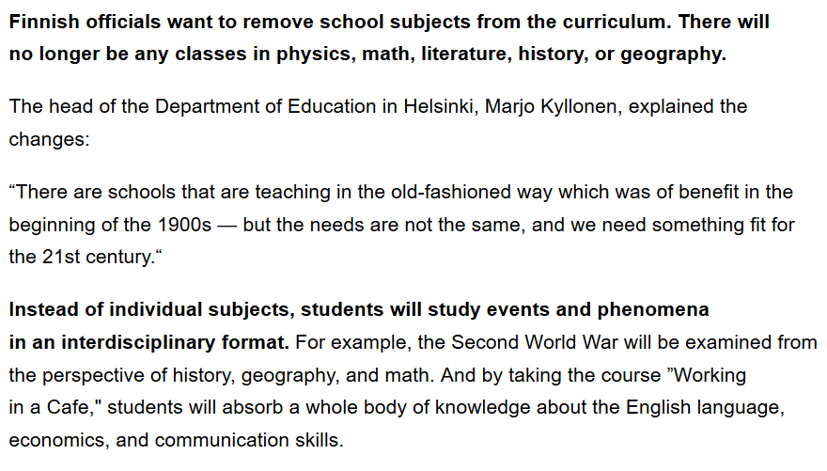
https://brightside.me/wonder-curiosities/finland-will-become-the-first-country-in-the-world-to-get-rid-of-all-school-subjects-259910/

Slide 110
A simple example of the importance of
holistic thinking . . .

Slide 111
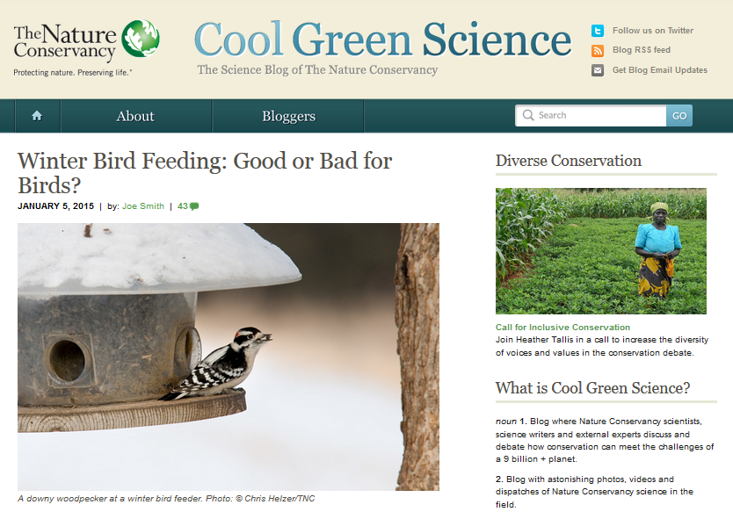
http://blog.nature.org/science/2015/01/05/winter-bird-feeding-good-or-bad-for-birds/

Slide 112
Is it good to feed the winter birds?
Yes . . .
for the reasons one might suspect . . .
http://blog.nature.org/science/2015/01/05/winter-bird-feeding-good-or-bad-for-birds/

Slide 113
Is it good to feed the winter birds?
Yes . . .
for the reasons one might suspect . . .
A simple answer . . .
http://blog.nature.org/science/2015/01/05/winter-bird-feeding-good-or-bad-for-birds/

Slide 114
Is it good to feed the winter birds?
Yes . . .
for the reasons one might suspect . . .
http://blog.nature.org/science/2015/01/05/winter-bird-feeding-good-or-bad-for-birds/

Slide 115
Is it good to feed the winter birds?
More than 40 percent of U.S. households feed their backyard birds, and in the United Kingdom, the rate is as high as 75 percent.
A study conducted during winter in Wisconsin showed that black-capped chickadees with access to bird seed had a much higher overwinter survival rate (69 percent) as compared to those without access to human-provided seed (37 percent survival
Furthermore, some studies have shown that birds making it through the winter in better physical condition see those benefits carry over into the nesting season
Bird feeding produces significantly earlier egg laying dates, larger clutches of eggs, higher chick weights and higher overall breeding success across a wide range of bird species
http://blog.nature.org/science/2015/01/05/winter-bird-feeding-good-or-bad-for-birds/

Slide 116
Is it good to feed the winter birds?
Yes . . .
for the reasons one might suspect . . .
BUT . . .
http://blog.nature.org/science/2015/01/05/winter-bird-feeding-good-or-bad-for-birds/

Slide 117
Is it good to feed the winter birds?
Yes . . .
for the one might suspect . . .
A holistic view would also consider . . .
http://blog.nature.org/science/2015/01/05/winter-bird-feeding-good-or-bad-for-birds/

Slide 118
Is it good to feed the winter birds?
feeding can promote the survival and reproduction of the not-quite-fittest
one research group found that birds fed during winter subsequently laid a smaller number of eggs that had lower hatching success and ultimately fledged fewer young than birds that weren’t fed at all
the offspring that did fledge weighed less and had a lower survival rate than the young of unfed birds
http://blog.nature.org/science/2015/01/05/winter-bird-feeding-good-or-bad-for-birds/

Slide 119
Is it good to feed the winter birds?
both species [in two U.K. studies], when they had access to bird food, laid fewer eggs, had lower hatching success, and ultimately had fewer chicks fledged
feeding an irresistible diet that was unbalanced – too high in fat to produce high-quality eggs
http://blog.nature.org/science/2015/01/05/winter-bird-feeding-good-or-bad-for-birds/

Slide 120
Is it good to feed the winter birds?
bird feeding allowed individuals with a lower reproductive capacity which ordinarily would not survive the winter the chance to nest
the feeders may be in poor quality nesting habitat – leading the birds to choose these suboptimal sites as nesting areas in the spring
http://blog.nature.org/science/2015/01/05/winter-bird-feeding-good-or-bad-for-birds/

Slide 121
Is it good to feed the winter birds?
So from the holistic view, one must look at things like the impacts of bird feeding not only on the survival
of the birds fed,
but also on things like . . .
http://blog.nature.org/science/2015/01/05/winter-bird-feeding-good-or-bad-for-birds/

Slide 122
Is it good to feed the winter birds?
  overall reproductive success
  other factors such as disease transmission
  species range expansion
  population trajectories
  and the long-range evolutionary effects on the species
http://blog.nature.org/science/2015/01/05/winter-bird-feeding-good-or-bad-for-birds/

Slide 123
another simple example . . .
http://www.bbc.com/news/health-40118539

Slide 124
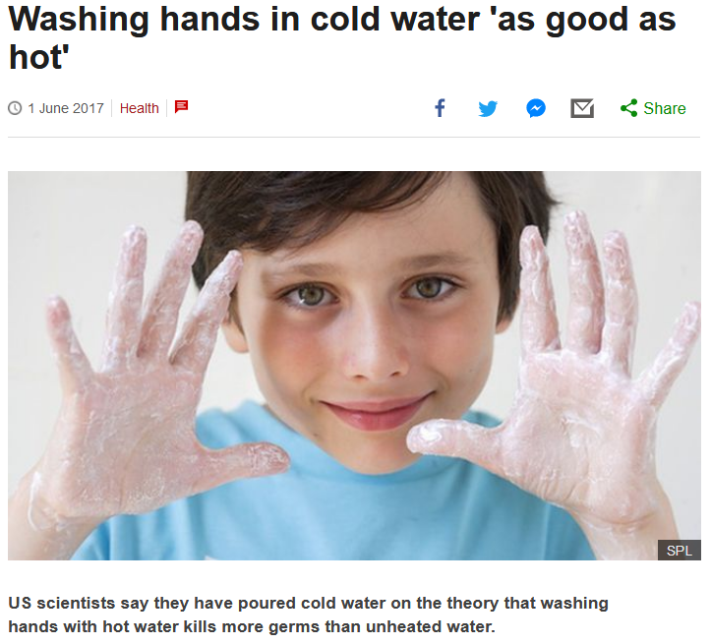


http://www.bbc.com/news/health-40118539

Slide 125
US scientists say they have poured cold water on the theory that washing hands with hot water kills more germs than unheated water.
http://www.bbc.com/news/health-40118539

Slide 126
Article:
“Quantifying the Effects of Water Temperature, Soap Volume, Lather Time, and Antimicrobial Soap as Variables in the Removal of Escherichia coli ATCC 11229 from Hands”
Dane A. Jensen, David R. Macinga, David J. Shumaker, Roberto Bellino, James W. Arbogast and Donald W. Schaffner
Journal of Food Protection, Volume 80, Issue 6 (June 2017), pp. 1022-1031.
http://jfoodprotection.org/doi/pdf/10.4315/0362-028X.JFP-16-370http://jfoodprotection.org/doi/pdf/10.4315/0362-028X.JFP-16-370

Slide 127
an anthropologist would look at the problem of water temperature holistically, and conclude that the water temperature DOES make a difference . . .
http://www.bbc.com/news/health-40118539

Slide 128
because length of time of washing hands
(like length of time
brushing one’s teeth)
is a key variable to overall effectiveness
. . .
http://www.bbc.com/news/health-40118539

Slide 129
. . . in other words, HUMAN BEHAVIOR
is a most-important
key variable
http://www.bbc.com/news/health-40118539

Slide 130
. . . and people tend to wash their hands longer if the water temperature is comfortably warm
http://www.bbc.com/news/health-40118539

Slide 131
even the scientists focusing on water temperature in the experiments note more or less in passing that human behavior is an important issue . . .
http://www.bbc.com/news/health-40118539

Slide 132
“A large part of the variability in the data was associated with the behaviors of the volunteers. Understanding what behaviors and human factors most influence hand washing may help researchers find techniques to optimize the effectiveness of hand washing.”
http://www.bbc.com/news/health-40118539

Slide 133
“A large part of the variability in the data was associated with the behaviors of the volunteers. Understanding what behaviors and human factors most influence hand washing may help researchers find techniques to optimize the effectiveness of hand washing.”
Dane A. Jensen, David R. Macinga, David J. Shumaker, Roberto Bellino, James W. Arbogast and Donald W. Schaffner
Journal of Food Protection, Volume 80, Issue 6 (June 2017), pp. 1022-1031.
http://jfoodprotection.org/doi/abs/10.4315/0362-028X.JFP-16-370http://jfoodprotection.org/doi/abs/10.4315/0362-028X.JFP-16-370

Slide 134
with humans,
in anthropology,
holism looks at an item including the many subdisciplines in the areas of . . .

Slide 135
Holism tries to put all of the pieces together . . .
cultural / social
physical
archaeology
linguistics
(bio-physical)

Slide 136
Anthropology

Slide 137
theory
holism

Slide 138
theory
holism
and the theory ultimately also includes the
results of interdisciplinary study . . .

Slide 139
and finally,
we have the last
main characteristic of anthropology . . .

Slide 140
so back to finishing off our
main characteristics of anthropology . . .

Slide 141
Main Characteristics of Anthropology
1. the four fields of general anthropology
culture as a primary concept
comparative method as major approach
holism as a primary theoretical goal
fieldwork as a primary research technique

Slide 142
Main Characteristics of Anthropology
1. the four fields of general anthropology
culture as a primary concept
comparative method as major approach
holism as a primary theoretical goal
fieldwork
as a primary research technique—
involving “participant observation”

Slide 143
Main Characteristics of Anthropology
1. the four fields of general anthropology
culture as a primary concept
comparative method as major approach
holism as a primary theoretical goal
fieldwork
as a primary research technique—
involving “participant observation”

Slide 144
Note two terms in the listing . . .

Slide 145
Main Characteristics
1. culture as a primary concept
2. comparative method as major approach to the study of human behavior
3. holism or the study of "humankind" as a whole, as a primary theoretical goal
4. fieldwork as a primary research
technique, involving “participant observation”

Slide 146
Main Characteristics
1. culture as a primary concept
2. comparative method as major approach to the study of human behavior
3. holism or the study of "humankind" as a whole, as a primary theoretical goal
4. fieldwork as a primary research
technique, involving “participant observation”
what’s the difference?

Slide 147
Main Characteristics
1. culture as a primary concept
2. comparative method as major approach to the study of human behavior
3. holism or the study of "humankind" as a whole, as a primary theoretical goal
4. fieldwork as a primary research
technique, involving “participant observation” = how you get information
= tool

Slide 148
Main Characteristics
1. culture as a primary concept
2. comparative method as major approach to the study of human behavior
3. holism or the study of "humankind" as a whole, as a primary theoretical goal
4. fieldwork as a primary research
technique, involving “participant observation” = how you get information
data gathering technique —
participant observation
(fieldwork)
= tool

Slide 149
Main Characteristics
Anthropologists use other tools . . . like questionnaires, interview schedules, psychological tests, documentary filming . . . but “participant observation” is a characteristic technique use by anthropologists, especially cultural anthropologists (ethnologists)
1. culture as a primary concept
2. comparative method as major approach to the study of human behavior
3. holism or the study of "humankind" as a whole, as a primary theoretical goal
4. fieldwork as a primary research
technique, involving “participant observation” = how you get information
= tool

Slide 150
Main Characteristics
Anthropologists use other tools . . . like questionnaires, interview schedules, psychological tests, documentary filming . . . but “participant observation” is a characteristic technique use by anthropologists, especially cultural anthropologists (ethnologists)
1. culture as a primary concept
2. comparative method as major approach to the study of human behavior
3. holism or the study of "humankind" as a whole, as a primary theoretical goal
4. fieldwork as a primary research
technique, involving “participant observation” = how you get information
NOTE:
= tool

Slide 151
Main Characteristics
1. culture as a primary concept
2. comparative method as major approach to the study of human behavior
3. holism or the study of "humankind" as a whole, as a primary theoretical goal
4. fieldwork as a primary research
technique, involving “participant observation” = how you get information
= tool

Slide 152
Main Characteristics
1. culture as a primary concept
2. comparative method as major approach to the study of human behavior
3. holism or the study of "humankind" as a whole, as a primary theoretical goal
4. fieldwork as a primary research
technique, involving “participant observation” = how you get information
= approach
= how you use information
= tool

Slide 153
Main Characteristics
1. culture as a primary concept
2. comparative method as major approach to the study of human behavior
3. holism or the study of "humankind" as a whole, as a primary theoretical goal
4. fieldwork as a primary research
technique, involving “participant observation” = how you get information
= tool

Slide 154
Main Characteristics
1. culture as a primary concept
2. comparative method as major approach to the study of human behavior
3. holism or the study of "humankind" as a whole, as a primary theoretical goal
4. fieldwork as a primary research
technique, involving “participant observation” = how you get information
other tools include
things like . . .
= tool

Slide 155
Main Characteristics
“24-hour activity surveys”
self-reported recordings
(diary)
“activity frequency questionnaires”
(recorded retrospectively)
1. culture as a primary concept
2. comparative method as major approach to the study of human behavior
3. holism or the study of "humankind" as a whole, as a primary theoretical goal
4. fieldwork as a primary research
technique, involving “participant observation” = how you get information
= tool
  after Marion Nestle, Food Politics, Rev. Ed., 2007, pp. 401-405

Slide 156
Anthropologists also often like to use a research “technique” based on “unobtrusive measures” . . .
(either in the field or elsewhere)

Slide 157
  “unobtrusive measures”
  analysis of data on availability of items
  supply data analysis
  laboratory analysis
  video recording . . .
  after Marion Nestle, Food Politics, Rev. Ed., 2007, pp. 401-405

Slide 158
But most of all (generally)
Anthropologists
LOVE . . .

Slide 159
Main Characteristics of Anthropology
1. the four fields of general anthropology
culture as a primary concept
comparative method as major approach
holism as a primary theoretical goal
fieldwork
as a primary research technique --
involving “participant observation”

Slide 160
Main Characteristics of Anthropology
1. the four fields of general anthropology
culture as a primary concept
comparative method as major approach
holism as a primary theoretical goal
fieldwork
as a primary research technique --
involving site excavation for archaeology

Slide 161
And as I mentioned in the
“An Important Note on Videos and Visual Anthropology” note
we would LOVE to take you along with us around the world, but the next best thing we can do is bring the world to you in the form of films and videos. And we’ll do a lot of that
(starting Week 2)

Slide 162
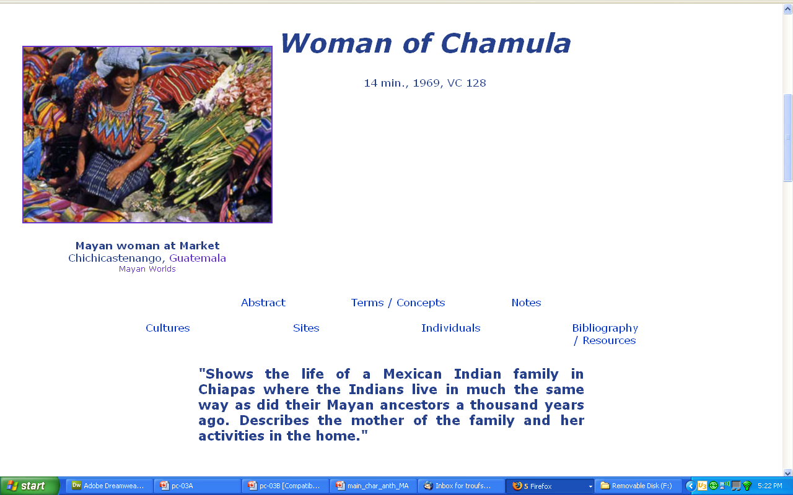
our first “field trip” it to visit the . . .

Slide 163
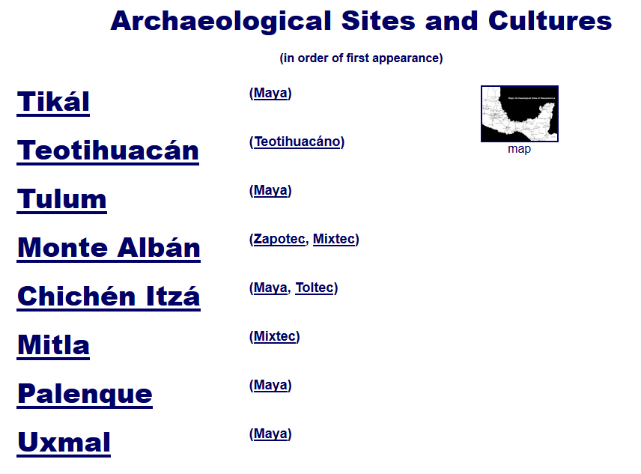
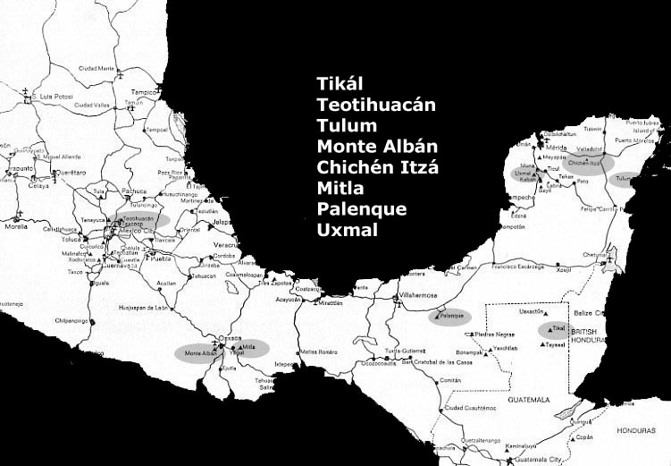
then we move on to . . .

Slide 164
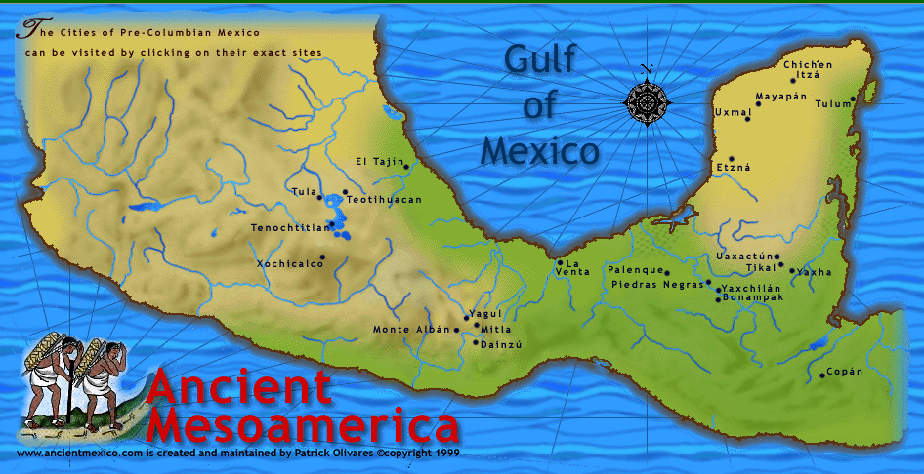
and from there
we’ll explore most of . . .
www.d.umn.edu/cla/faculty/troufs/anth3618/video/Copan.html#title

