Slide 1

Start deck in “Slide Show” mode,
and use your up/down arrow keys and/or
your space bar to advance the slides
© 2010-2024 Timothy G. Roufs, University of Minnesota Duluth

Slide 2
REM
indicates that the materials
are a REMinder
and are thus being repeated . . .
REMinder

Slide 3
ANTH 3635
Anthropology
of
Europe
© 2010-2024 Timothy G. Roufs, University of Minnesota Duluth

Slide 4
A Very Brief Outline
of the Course Structure
© 2010-2024 Timothy G. Roufs, University of Minnesota Duluth

Slide 5
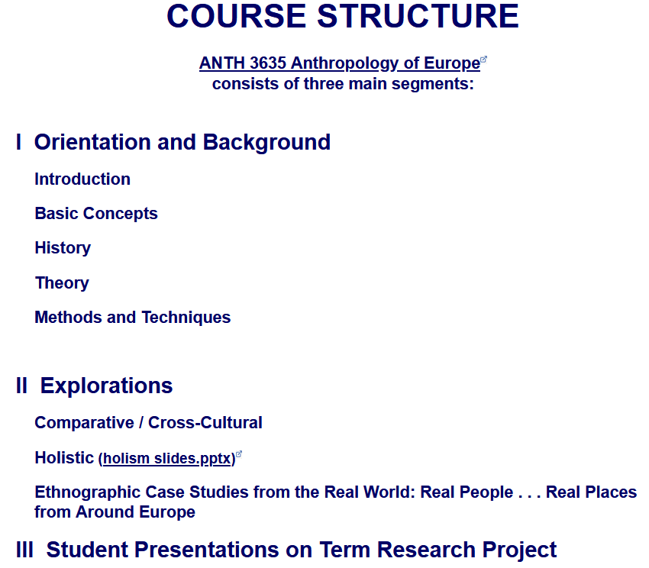
The Course Outline in a Nutshell
Course Structure
Course Structure

Slide 6
The Course Outline in a Nutshell
Course Structure . . .
Course Content

Slide 8
In a nutshell, ANTH 3635 Anthropology of Europe
consists of three main segments:
I Orientation and Background
  Introduction
  Basic Concepts
  History
  Theory
  Methods and Techniques
II Explorations
Comparative / Cross-Cultural
Holistic
Ethnographic Case Studies from the Real World: Real People . . . Real Places from Around the Globe
III Student Presentations on Term Research Project
https://www.d.umn.edu/cla/faculty/troufs/anth3635/ceproject.html#title

Slide 9
In a nutshell, ANTH 3635 Anthropology of Europe
consists of three main segments:
I Orientation and Background
  Introduction
  Basic Concepts
  History
  Theory
  Methods and Techniques
II Explorations
Comparative / Cross-Cultural
Holistic
Ethnographic Case Studies from the Real World: Real People . . . Real Places from Around the Globe
III Student Presentations on Term Research Project
https://www.d.umn.edu/cla/faculty/troufs/anth3635/ceproject.html#title

Slide 10
In a nutshell, ANTH 3635 Anthropology of Europe
consists of three main segments:
I Orientation and Background
  Introduction
  Basic Concepts
  History
  Theory
  Methods and Techniques
II Explorations
Comparative / Cross-Cultural
Holistic
Ethnographic Case Studies from the Real World: Real People . . . Real Places from Around the Globe
III Student Presentations on Term Research Project
https://www.d.umn.edu/cla/faculty/troufs/anth3635/ceproject.html#title

Slide 11
In a nutshell, ANTH 3635 Anthropology of Europe
consists of three main segments:
I Orientation and Background
  Introduction
  Basic Concepts
  History
  Theory
  Methods and Techniques
II Explorations
Comparative / Cross-Cultural
Holistic
Ethnographic Case Studies from the Real World: Real People . . . Real Places from Around the Globe
III Student Presentations on Term Research Project
https://www.d.umn.edu/cla/faculty/troufs/anth3635/ceproject.html#title

Slide 12


Slide 13
The Course Outline in a Nutshell
Course Structure . . .
Course Content . . .

Slide 14
This is the way your
Canvas Modules
are organized . . .

Slide 16
The End
A Very Brief Outline
of the Course Structure
© 2010-2024 Timothy G. Roufs, University of Minnesota Duluth

