Slide 1
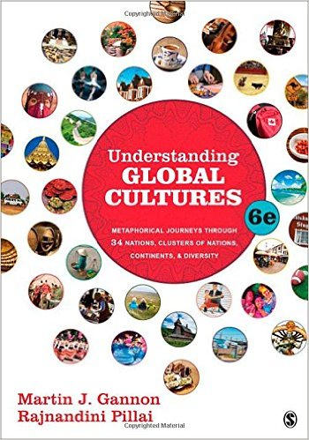
Start deck in “Slide Show” mode,
and use your up/down arrow keys and/or
your space bar to advance the slides
© 2010-2024 Timothy G. Roufs, University of Minnesota Duluth

Slide 2
REM
indicates that the materials
are a REMinder
and are thus being repeated . . .
REMinder

Slide 3
ANTH 3635
Anthropology of Europe
© 2010-2024 Timothy G. Roufs, University of Minnesota Duluth

Slide 4
ANTH 3635
Anthropology of Europe
Main
Characteristics of
Anthropology
© 2010-2024 Timothy G. Roufs, University of Minnesota Duluth

Slide 5
ANTH 3635
Anthropology of Europe
Comparative Method
as a
Major Approach
© 2010-2024 Timothy G. Roufs, University of Minnesota Duluth

Slide 6
American
Main Characteristics of˄Anthropology
1. the four fields of general anthropology
culture as a primary concept
comparative method as major approach
holism as a primary theoretical goal
fieldwork as a primary research technique

Slide 7
American
Main Characteristics of˄Anthropology
1. the four fields of general anthropology
culture as a primary concept
comparative method as major approach
holism as a primary theoretical goal
fieldwork as a primary research technique

Slide 8
Compare . . .
Main Characteristics
comparative method
  as a major approach to the study of human behavior
  the comparative method compares things (what else would a “comparative” method do?)

Slide 9
Compare . . .
Main Characteristics
comparative method
  One form of comparative method was pioneered by Fred Eggan
  (University of Chicago)
“Social anthropology and
the method of controlled comparison”
  American Anthropologist, 56:743-61 (1954)

Slide 10
Compare . . .
Main Characteristics
comparative method
  One form of comparative method was pioneered by Fred Eggan
  (University of Chicago)
“Social anthropology and
the method of controlled comparison”
  American Anthropologist, 56:743-61 (1954)

Slide 11
Compare . . .
Main Characteristics
the comparative method compares things
for e.g. . . .
David Montgomery compares what happens when great civilizations around the world ignore problems they are having with top soil . . .
Spoiler: All failed

Slide 12
Main Characteristics
comparative method
For e.g., we compare the basic ways people look at the world itself . . .

Slide 13
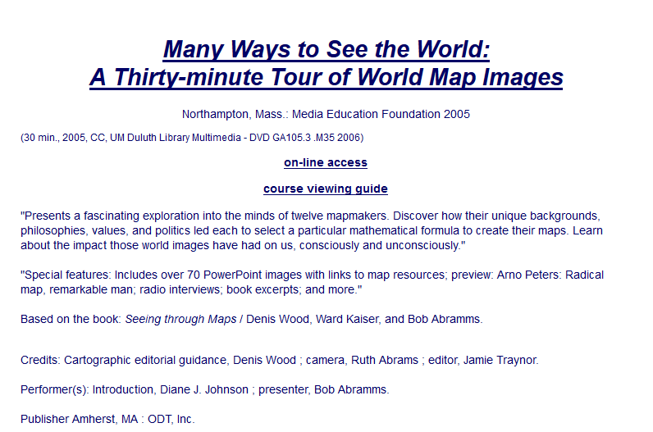
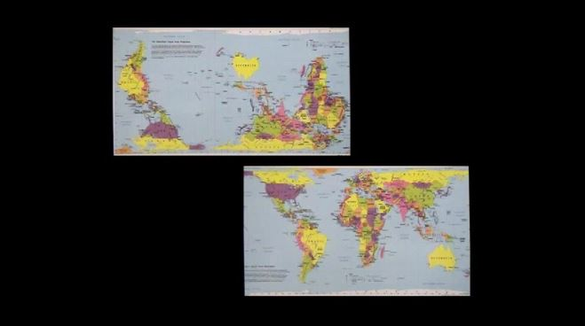

Slide 14
Main Characteristics
comparative method
For e.g.,
the textbook compares a number of cultures/countries in terms of their cultural metaphors . . .

Slide 15
Main Characteristics
comparative method
The textbook compares “bullfighting”
in Spain and Portugal
in terms of their cultural metaphors . . .

Slide 16
Cultural
Metaphors
PART XII: SAME METAPHOR, DIFFERENT MEANINGS
Chapter 34: The Spanish Bullfight
Chapter 35: The Portuguese Bullfight

Slide 17
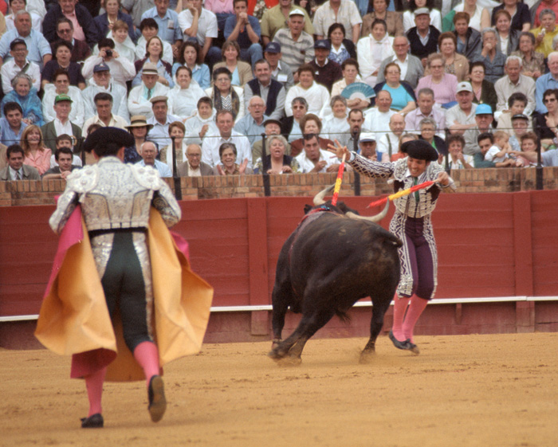
. . . Spain and Portugal . . .

Slide 18
Main Characteristics
comparative method
In class and in the textbook,
we compare regions of the Caribbean . . .

Slide 19
Cultural
Metaphors
PART XIV. OVERLAPPING CULTURAL METAPHORS FOR GEOGRAPHICALLY RELATED NATIONS
Chapter 38. Cultural Metaphors for the Caribbean

Slide 20

. . . we visit
BBC Caribbean with Simon Reeve

Slide 21
Main Characteristics
comparative method
And throughout the semester
the textbook compares . . .

Slide 22
Cultural
Metaphors

Slide 23
Cultural
Metaphors
Chapter 10: The German Symphony
Chapter 19: The Italian Opera

Slide 24
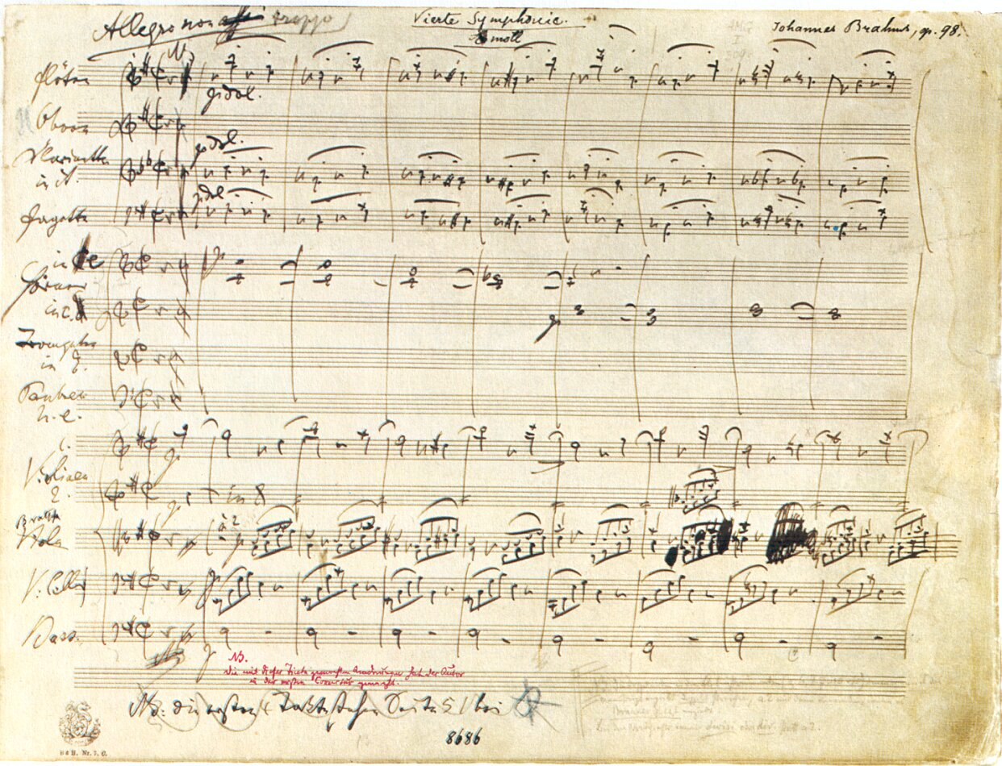
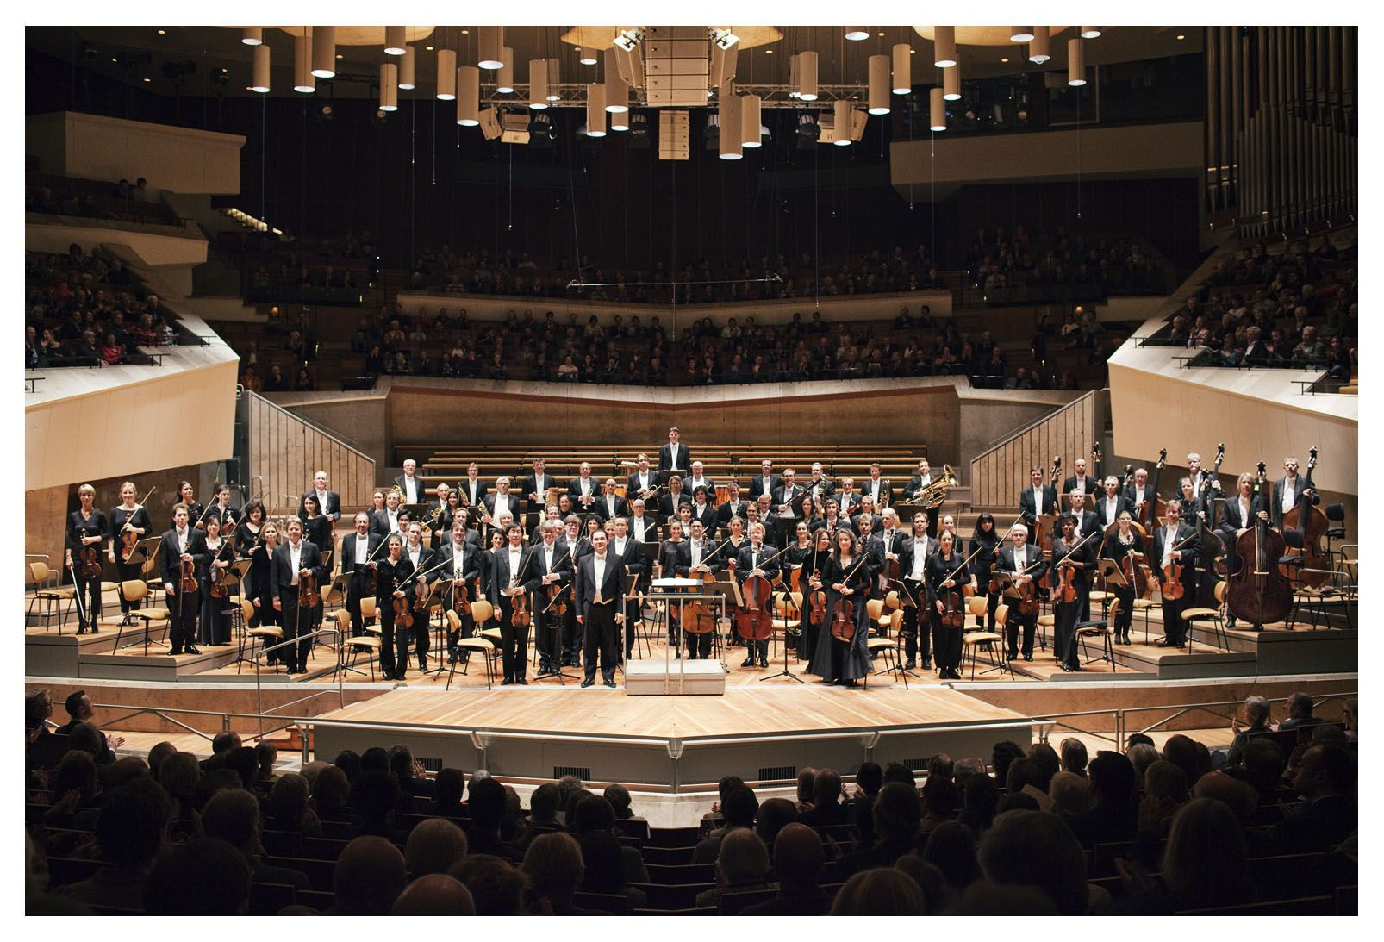
Compare that with the starkness of the
German Symphony Orchestra Berlin
http://www.mfiles.co.uk/manuscripts-pens-and-composers.htm

Slide 25
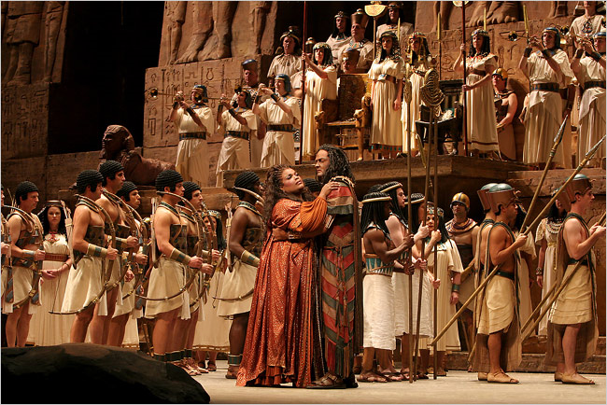
Italian Opera: Aida
http://www.nedgallagher.com/journal/images/aida.jpg

Slide 26
Cultural
Metaphors
PART III: SCANDINAVIAN EGALITARIAN CULTURES
Chapter 7: The Swedish Stuga
Chapter 8: The Finnish Sauna

Slide 27
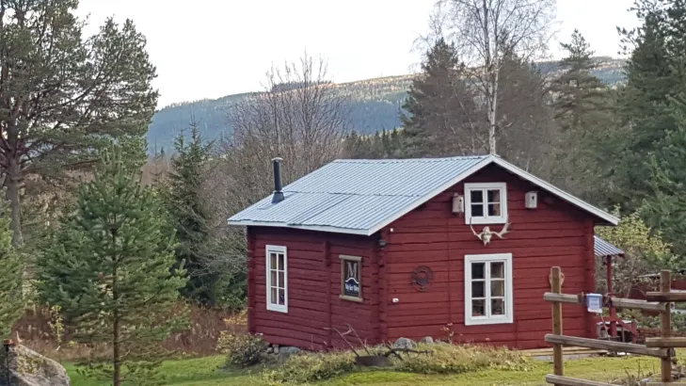
Swedish Stuga
https://wildernessadventuressweden.com/en/accommodations/cabin-bedroom/

Slide 28
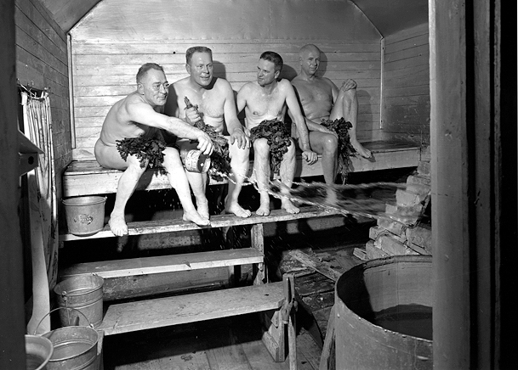
Finnish Sauna
Minnesota Historical Society

Slide 29
Cultural
Metaphors
PART XI: THE STRUGGLE FOR CULTURAL IDENTITY AND THE SPLINTERING OF NATIONS: THE CASE OF THE RUSSIAN EMPIRE
Chapter 31: The Russian Ballet
Chapter 32: Estonian Singing

Slide 30
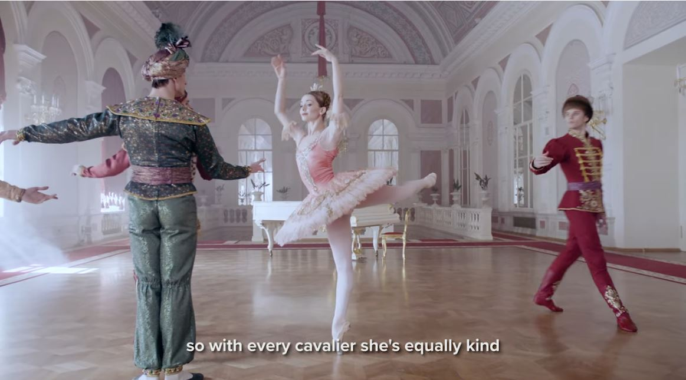
The Russian Ballet
Wikipedia

Slide 31
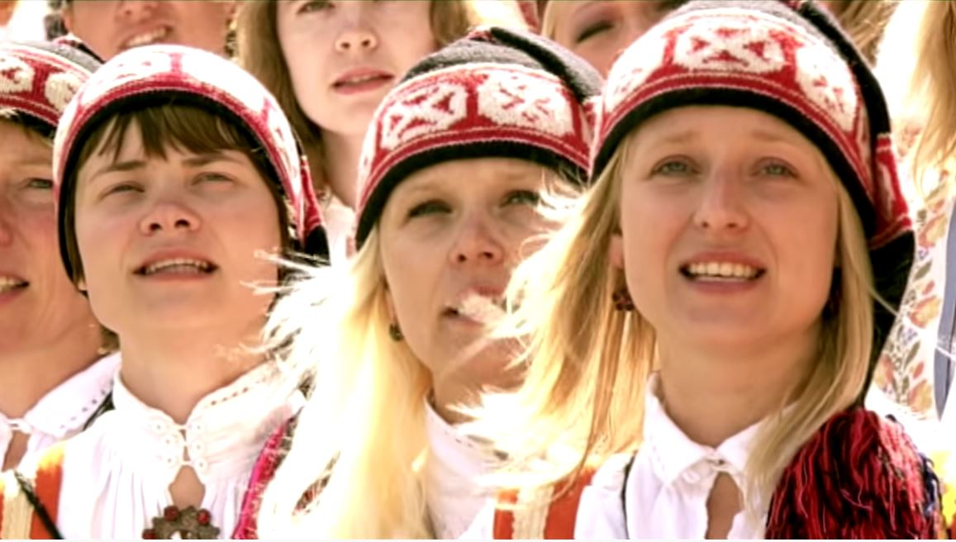
Estonian Singing
Wikipedia

Slide 32
Cultural
Metaphors
Chapter 11: Irish Conversations
Chapter 22: The Turkish Coffeehouse

Slide 33
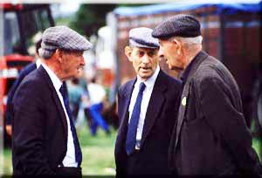
Irish Conversations
Wikipedia

Slide 34
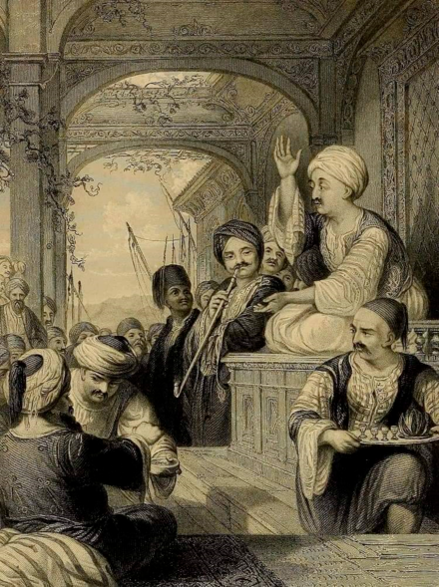
The Turkish Coffeehouse
Wikipedia

Slide 35
Cultural
Metaphors
Chapter 9: The Danish Christmas Luncheon
Chapter 14: French Wine

Slide 36
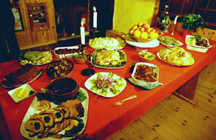
The Danish Christmas Luncheon
Wikipedia

Slide 37
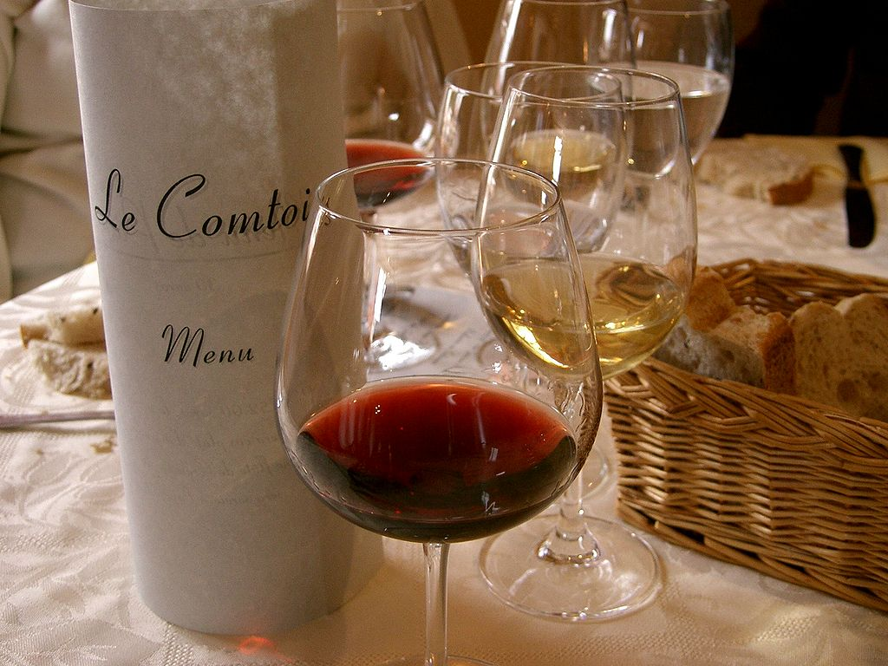
French Wine
Wikipedia

Slide 38
Cultural
Metaphors
PART VIII: THE BASE CULTURE AND ITS DIFFUSION ACROSS BORDERS (CLUSTERS OF NATIONS): THE EXAMPLE OF CHINA
Chapter 24: The Chinese Family Altar: The Expatriate Chinese Outside of China
Chapter 25: The Singapore Hawker Centers

Slide 39
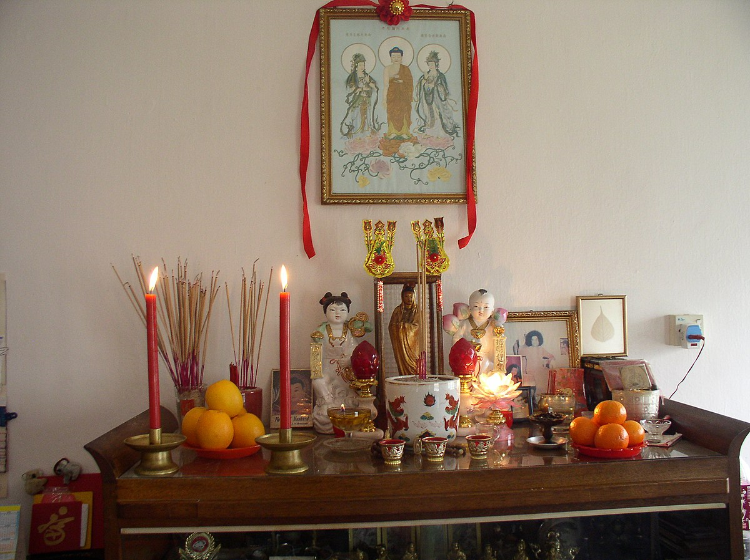
The Chinese Family Altar
Wikimedia Commond

Slide 40
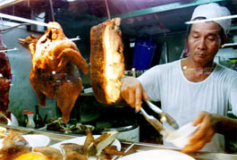
The Singapore Hawker Centers
Wikipedia

Slide 41
Main Characteristics
comparative method
We also compare
GREAT GATHERINGS . . .
In Sienna, Italy rival districts battle for supremacy in a 700 year-old horse race.

Slide 42
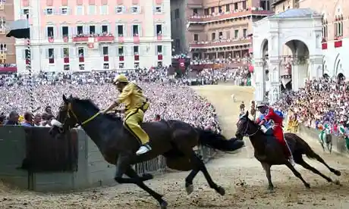

Great Gatherings: Palio di Siena

Slide 43
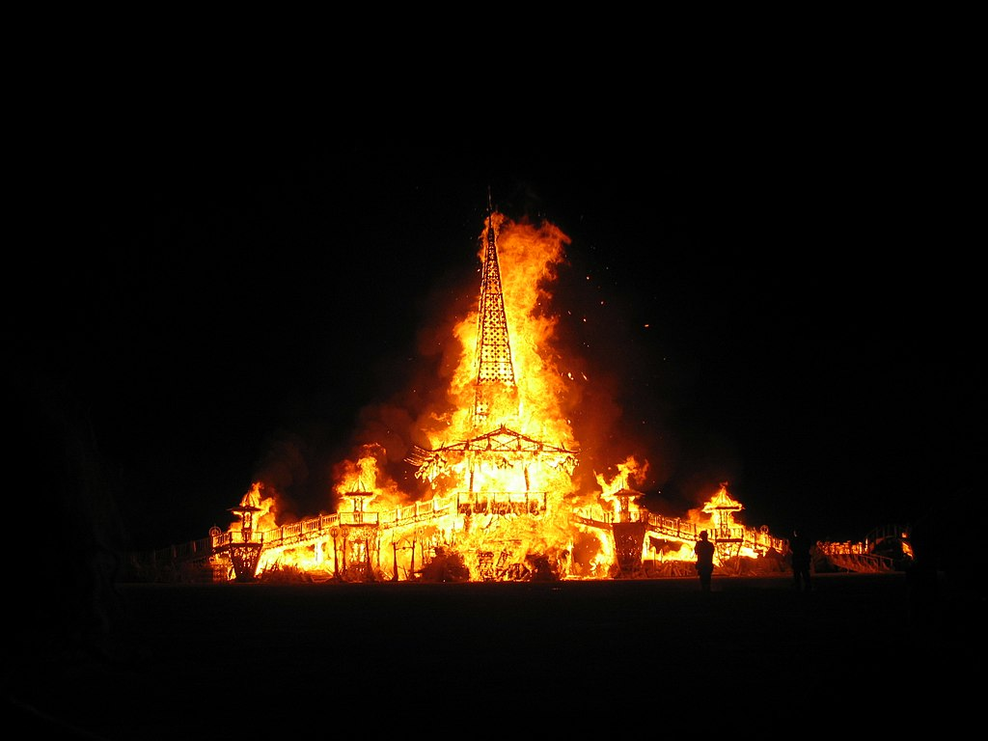
Wikipedia
Great Gatherings: Burning Man, U.S.A.

Slide 44
Main Characteristics
comparative method
We also compare
Villages and Village life . . .

Slide 45
Villages and Village life . . .
Kypseli, Greece
Argaki, Cyprus
Rural France
Aran Islands, Ireland
Faroe Islands (Denmark)
Gyönk, Hungary

Slide 46
Main Characteristics
comparative method
We compare
Religious Dances . . .

Slide 47
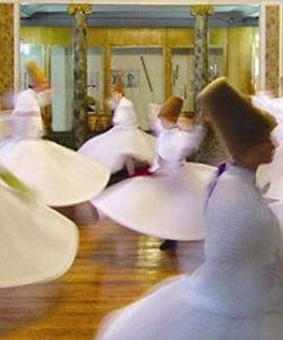
Turkey: Sema Ceremony
I Named Her Angel

Slide 48
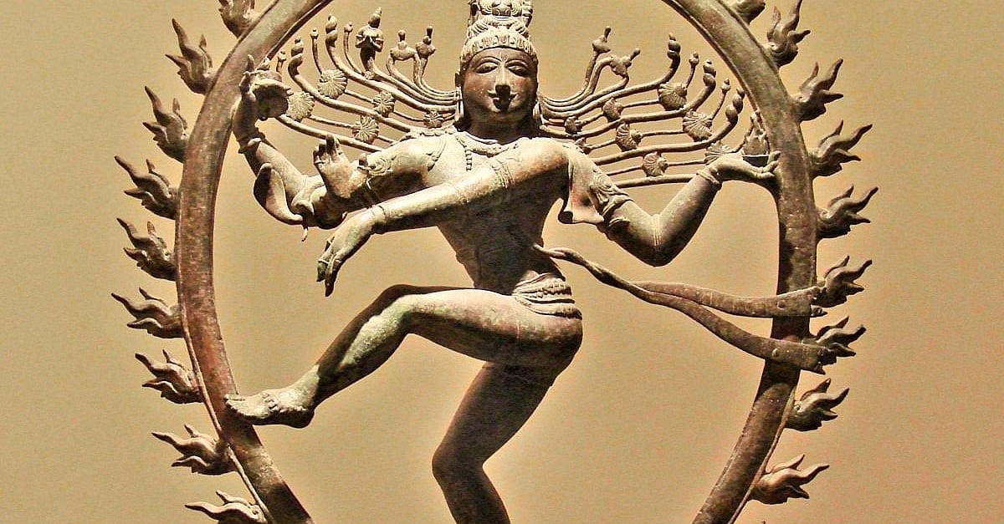
India: The Dance of Shiva
https://www.worldhistory.org/article/831/shiva-nataraja---lord-of-the-dance/

Slide 49
Main Characteristics
comparative method
We compare
“Romantic Love”
and marriage practices
in several cultures . . .

Slide 50

. . . to
Niger
(West Africa)
Nepal
France / England
Canada . . .

Slide 51
Main Characteristics
comparative method
We’ll have a look at
a few Commonwealth Nations
(fka the British Commonwealth)
of the former British Empire . . .

Slide 52
Main Characteristics
comparative method
We compare the significance of burial practices. . .

Slide 53
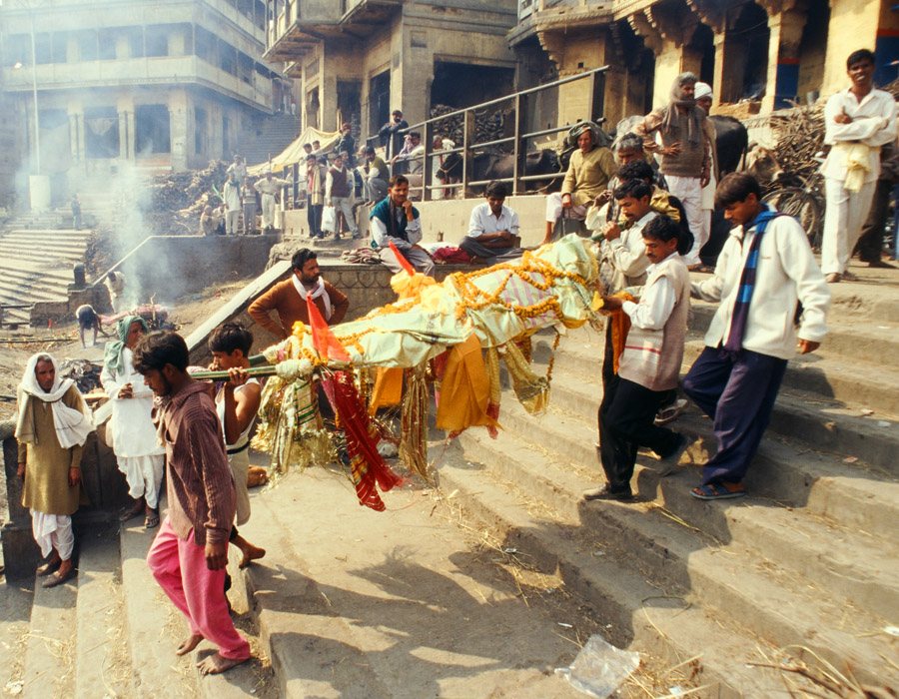
. . . India . . .

Slide 54
Main Characteristics
comparative method
We compare the significance of religious beliefs and behaviors of Chinese in China and Malaysia . . .

Slide 55
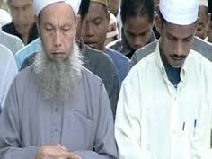
. . . we visit China and Malaysia . . .

Slide 56
Compare . . .
Main Characteristics
and items like “culture bound syndromes” are compared with similar phenomena that are thought to be “universal” . . . .

Slide 57
Main Characteristics
comparative method
often, for e.g.,
folks compare things regionally in an attempt
to understand process

Slide 58
Compare . . .
Main Characteristics
comparative method
  Other methods . . .
process
essentially refers to
how things change
or
how things came to be
the way they are now
compare things regionally
in an attempt to understand process

Slide 59
Compare . . .
Main Characteristics
the comparative method compares things
for e.g. . . .
David Montgomery compares what happens when great civilizations around the world ignore problems they are having with top soil . . .
Spoiler: All failed

Slide 60
Compare . . .
Main Characteristics
the comparative method compares things, for e.g., process of domestication / civilization
    maize – Mexico
    wheat – Turkey
    rice – China
    manioc – Brazil
    millet – Africa

Slide 61
Compare . . .
Main Characteristics
the comparative method compares things, for e.g., process of domestication / civilization
    maize – Mexico
    wheat – Turkey
    rice – China
    manioc – Brazil
    millet – Africa

Slide 62
Compare . . .
Main Characteristics
In this context Europe was/is primarily a “wheat’ area . . .aize – Mexico
    wheat – Turkey
    rice – China
    manioc – Brazil
    millet – Africa

Slide 63
Compare . . .
Main Characteristics
the comparative method compares things, for e.g., process of domestication / civilization
    maize – Mexico
    wheat – Turkey
    rice – China
    manioc – Brazil
    millet – Africa

Slide 64
Compare . . .
Main Characteristics
the comparative method compares things, for e.g., process of domestication / civilization
    maize – Mexico
    wheat – Turkey
    rice – China
    manioc – Brazil
    millet – Africa

Slide 65
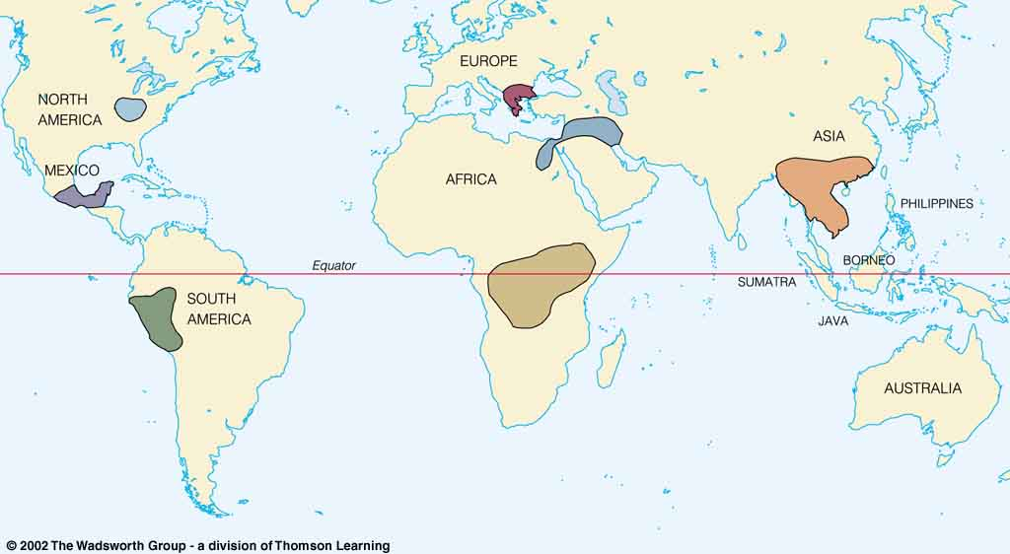
Origin of Domestication for Selected Plants
Compare . . .
wheat
10,500 ybp
maize
4,200 ybp
rice
7,000 ybp
manioc
4,200 ybp
millet
4,000 ybp
Understanding Physical Anthropology and Archaeology, 9th Ed., p. 342.

Slide 66
The Neolithic Revolution
=
The Agriculture Revolution

Slide 67
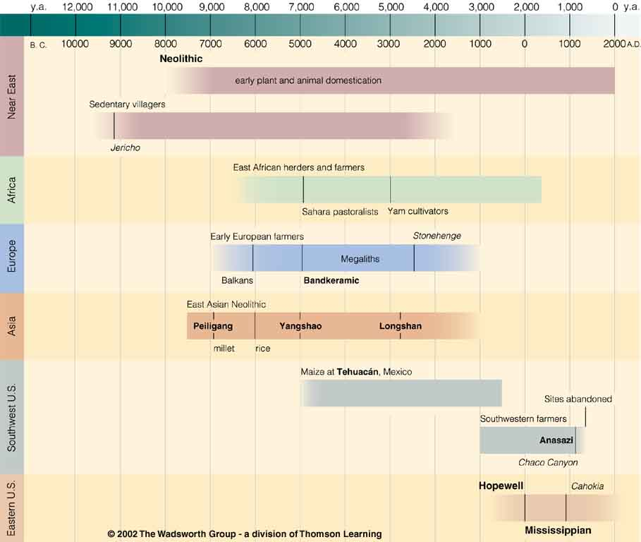
Neolithic
Time line for Ch. 14 Food Production
Understanding Physical Anthropology and Archaeology, 9th Ed., p. 333.

Slide 68
Main Characteristics in a Nutshell

Slide 69
American
Main Characteristics of˄Anthropology
1. the four fields of general anthropology
culture as a primary concept
comparative method as major approach
holism as a primary theoretical goal
fieldwork as a primary research technique

Slide 70
ANTH 3635
Anthropology of Europe
The End
Comparative Method
as a
Major Approach
© 2010-2024 Timothy G. Roufs, University of Minnesota Duluth

