Slide 1

Start deck in “Slide Show” mode,
and use your up/down arrow keys and/or
your space bar to advance the slides
© 2010-2024 Timothy G. Roufs, University of Minnesota Duluth

Slide 2
REM
indicates that the materials
are a REMinder
and are thus being repeated . . .
REMinder

Slide 3
ANTH 3635
Anthropology
Of
Europe
© 2010-2024 Timothy G. Roufs, University of Minnesota Duluth

Slide 4
ANTH 3635
Anthropology of Europe
Main
Characteristics of
Anthropology
© 2010-2024 Timothy G. Roufs, University of Minnesota Duluth

Slide 5
American
Main Characteristics of˄Anthropology
1. the four fields of general anthropology
culture as a primary concept
comparative method as major approach
holism as a primary theoretical goal
fieldwork as a primary research technique

Slide 6
American
Main Characteristics of˄Anthropology
1. the four fields of general anthropology
culture as a primary concept
comparative method as major approach
holism as a primary theoretical goal
fieldwork as a primary research technique

Slide 7
Main Characteristics of Anthropology
1. the four fields of general anthropology
culture as a primary concept
comparative method as major approach
holism
or the study of "humankind" as a whole, as a primary theoretical goal
fieldwork as a primary research technique

Slide 8
with humans,
in anthropology,
holism looks at an item including the many subdisciplines in the areas of . . .

Slide 9
Holism tries to put all of the pieces together . . .
Anthropology of Europe
and its . . .
cultural / social
physical
archaeology
linguistics
(Bio-physical)

Slide 10
let’s have a look at that on the
“Anthropology and . . . Its Parts” chart . . .

Slide 11
Main Characteristics of Anthropology
1. the four fields of general anthropology
culture as a primary concept
comparative method as major approach
holism as a primary theoretical goal
  Anthropology and its Parts chart
fieldwork as a primary research technique

Slide 12
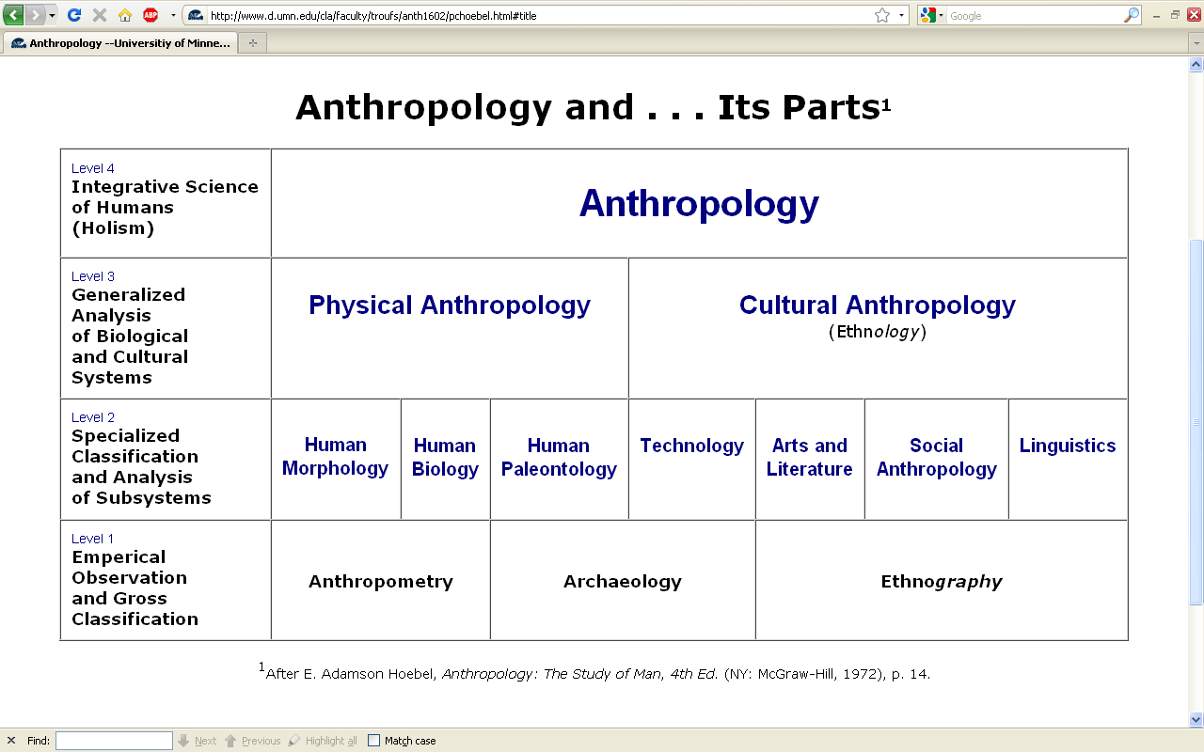

Slide 13
REM: We’re having a look at . . .
Anthropology of Europe
and their . . .
cultural / social
physical
archaeology
linguistics
and that would appear on the chart as . . .

Slide 14
NOTE:
usually anthropologists read charts from the bottom up
that has to do with the fact that in archaeology the oldest layers are at the bottom of a site and the newer ones are on top

Slide 15
. . . but first note that the two main divisions
of Anthropology are
Bio-physical and Cultural . . .

Slide 16
Anthropology of Europe
Anthropology

Slide 17
Anthropology of Europe
Anthropology

Slide 18
Anthropology of Europe
Anthropology
Bio-physical

Slide 19
. . . Bio-physical involves
things like . . .

Slide 20
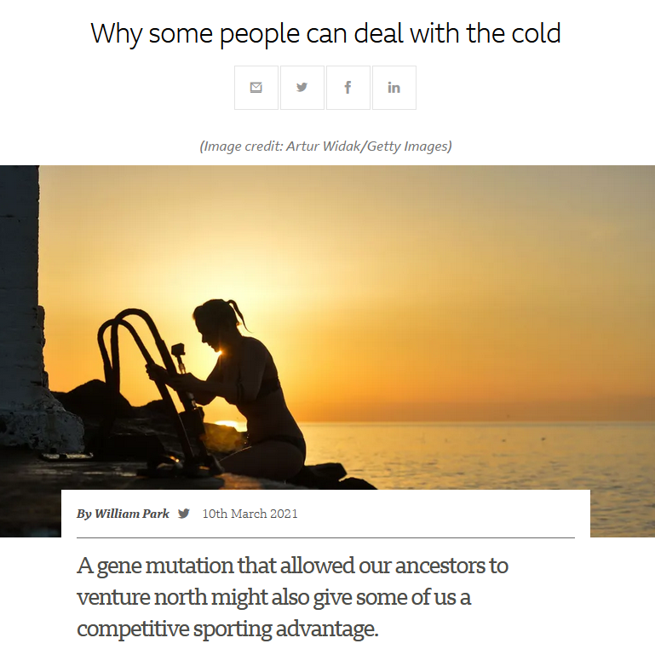

March 10, 2021

Slide 21
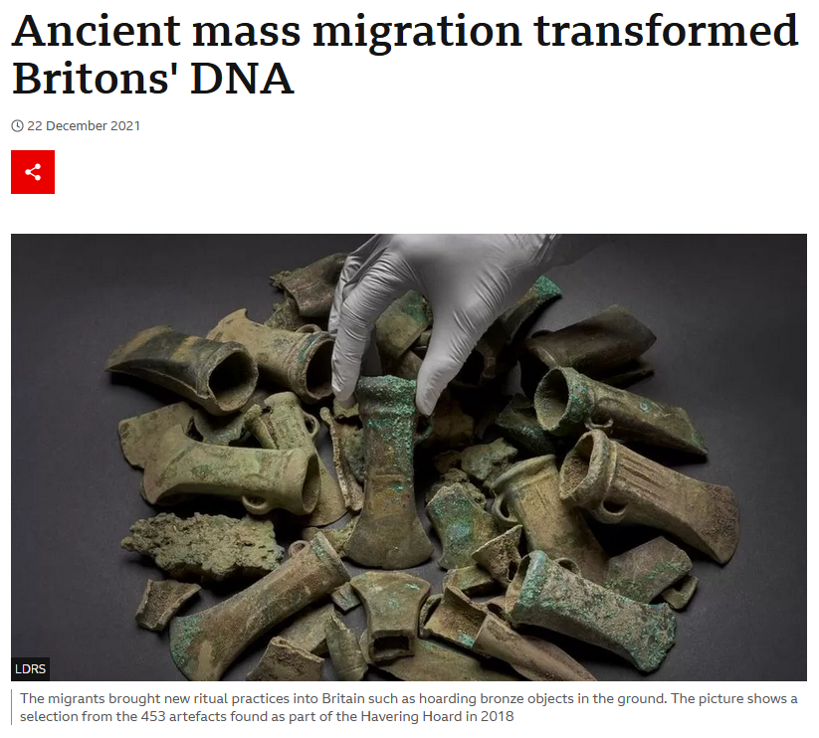
Source

Slide 22
. . . but ultimately anthropologists seek to study phenomena in terms of both physical and cultural aspects
. . .

Slide 23
Anthropology of Europe
Anthropology
Bio-physical
Cultural

Slide 24
  for example, numerous studies have shown that exposure to images [cultural] of ultrathin models can lead to body dissatisfaction and eventually to unhealthy eating behaviors and physical illness [physical] . . .
The Cultural Feast, 2nd ed., p. 115

Slide 25
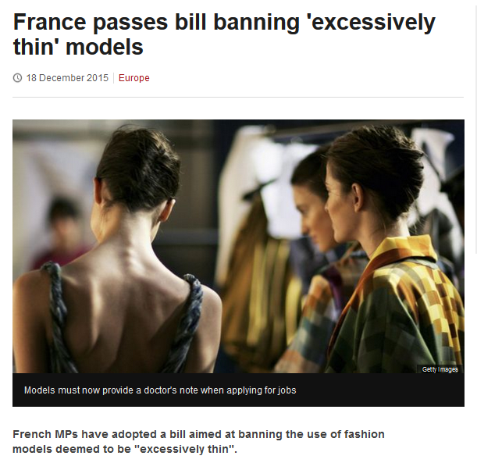
http://www.bbc.com/news/world-europe-35130792

Slide 26
Anthropology of Europe
. . . and to understand a phenomena in terms of both physical and cultural aspects
. . .
. . . ultimately involves lots of subdisciplines . . .

Slide 27
ANTH 3635
ANTHROPOLOGY OF EUROPE

Slide 28
NOTE:
There are four levels . . .
(REM: read from the bottom up)

Slide 33
HOLISM
Involves all four levels
and all
of the physical and cultural
components combined

Slide 34
holism
URL link to print: https://www.d.umn.edu/cla/faculty/troufs/anth1602/pchoebel.html#title

Slide 35
holism
holism

Slide 36
Anthropology

Slide 37
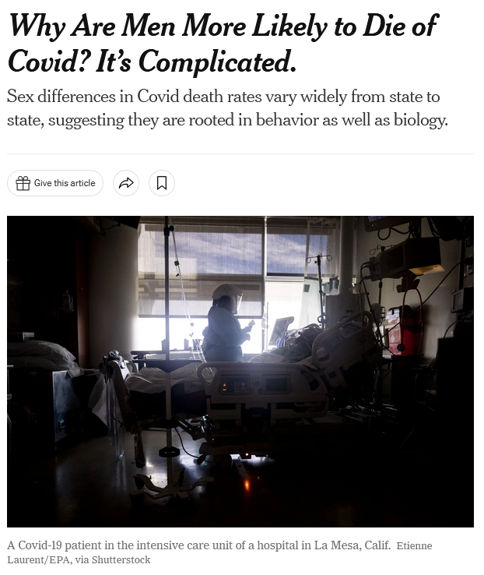
January 19, 2022
https://www.nytimes.com/2022/01/19/health/covid-gender-deaths-men-women.html?referringSource=articleShare

Slide 38
REM
. . . the two main divisions
of Anthropology are
Bio-physical and Cultural . . .

Slide 39
Anthropology of Europe
Anthropology
URL link to print: https://www.d.umn.edu/cla/faculty/troufs/anth1602/pchoebel.html#title

Slide 40
Anthropology
Bio-physical
URL link to print: https://www.d.umn.edu/cla/faculty/troufs/anth1602/pchoebel.html#title

Slide 41
Anthropology of Europe
Anthropology
Bio-physical
Cultural

Slide 42
. . . but, as mentioned above, ultimately anthropologists seek to study phenomena in terms of both physical and cultural aspects
. . .

Slide 43
Anthropology of Europe
Anthropology
Bio-physical
Cultural

Slide 44
  as in the example mentioned above, numerous studies have shown that exposure to images [cultural] of ultrathin models can lead to body dissatisfaction and eventually to unhealthy eating behaviors and physical illness [physical] . . .
The Cultural Feast, 2nd ed., p. 115

Slide 45
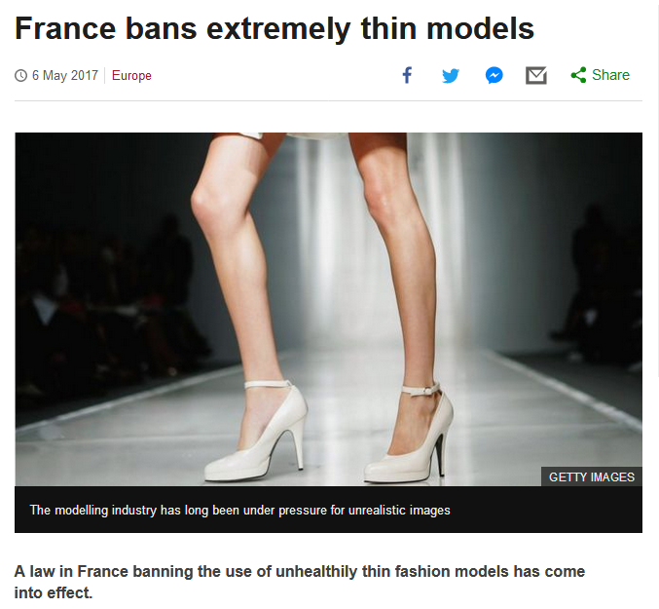
http://www.bbc.com/news/world-europe-39821036http://www.bbc.com/news/world-europe-39821036

Slide 46

http://www.bbc.co.uk/newsround/35979565

Slide 47
Anthropology of Europe
. . . and to understand a phenomena in terms of both physical and cultural aspects
. . .
. . . ultimately involves lots of disciplines and subdisciplines . . .

Slide 48
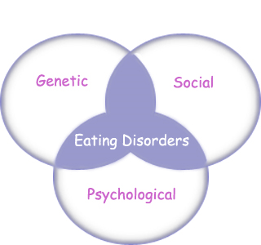
“Eating Disorders are about feelings, not food.”
The Eating Disorder Foundation
www.eatingdisorderfoundation.org/EatingDisorders.htm

Slide 49
. . . and that ultimately involves lots of subdisciplines . . .

Slide 50
Anthropology of Europe
Anthropology
Bio-physical
Cultural

Slide 51
Anthropology of Europe
Anthropology
Bio-physical
Cultural
measuring

Slide 52
Anthropology of Europe
Anthropology
Bio-physical
Cultural
measuring
excavating

Slide 53
Anthropology of Europe
Anthropology
Bio-physical
Cultural
measuring
excavating
participant /
observation

Slide 54
Anthropology of Europe
Anthropology
Bio-physical
Cultural
body
size/shape,
etc.
measuring
excavating
participant /
observation

Slide 55
Anthropology of Europe
Anthropology
Bio-physical
Cultural
body
size/shape,
etc.
nutrition,
etc.
measuring
excavating
participant /
observation

Slide 56
Anthropology of Europe
Anthropology
Bio-physical
Cultural
body
size/shape,
etc.
nutrition,
etc.
hunting /
meat eating
measuring
excavating
participant /
observation

Slide 57
Anthropology of Europe
Anthropology
Bio-physical
Cultural
body
size/shape,
etc.
nutrition,
etc.
hunting /
meat eating
the
“Agricultural
Revolution”
measuring
excavating
participant /
observation

Slide 58
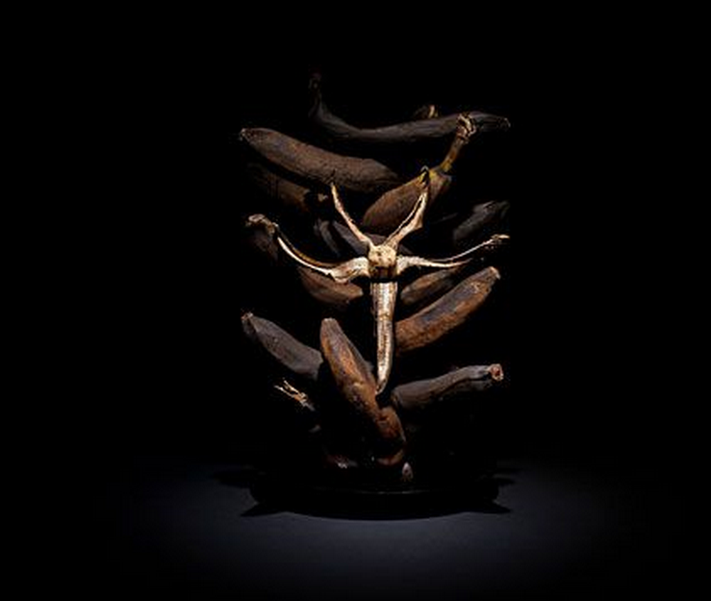

Slide 59
Anthropology of Europe
Anthropology
Bio-physical
Cultural
body
size/shape,
etc.
nutrition,
etc.
hunting /
meat eating
the
“Agricultural
Revolution”
art
literature,
etc.
measuring
excavating
participant /
observation

Slide 60
Anthropology of Europe
Anthropology
Bio-physical
Cultural
body
size/shape,
etc.
nutrition,
etc.
hunting /
meat eating
the
“Agricultural
Revolution”
art
literature,
etc.
kinship,
beliefs, etc.
measuring
excavating
participant /
observation

Slide 61
Anthropology of Europe
Anthropology
Bio-physical
Cultural
body
size/shape,
etc.
nutrition,
etc.
hunting /
meat eating
the
“Agricultural
Revolution”
art
literature,
etc.
kinship,
beliefs, etc.
language,
history,
structure,
world view,
etc.
measuring
excavating
participant /
observation

Slide 62
some examples of holistic comparative work include . . .

Slide 63

Penguin Avery, 2009

Slide 64
“I’m one of the few experts—if not the only expert—to have conducted large-scale, longitudinal surveys following obesity on a global scale.” (p. 2)
Penguin Avery, 2009

Slide 65
Barry Popkin’s work looks at . . .
(Trivia: Barry is from Superior, WI, and includes Superior in his comparisons in this book)

Slide 66
Anthropology of Europe
Anthropology
Bio-physical
Cultural
body
size/shape,
etc.
nutrition,
etc.
hunting /
meat eating
the
“Agricultural
Revolution”
art
literature,
etc.
kinship,
beliefs, etc.
language,
history,
structure,
world view,
etc.
measuring
excavating
participant /
observation

Slide 67
holism
holism

Slide 68
In some ways this chart business is all about
Theory
but key theory that is important to understanding
the Anthropology of Europe

Slide 69
Anthropology of Europe
theory
holism

Slide 70
Anthropology of Europe
theory
holism
and the theory ultimately also includes the
results of interdisciplinary study,
esp. with history, biological studies, economics, marketing . . .

Slide 71
theory
One excellent example of holism in action is
Nassim Nicholas Taleb’s
INCERTO. . .

Slide 72
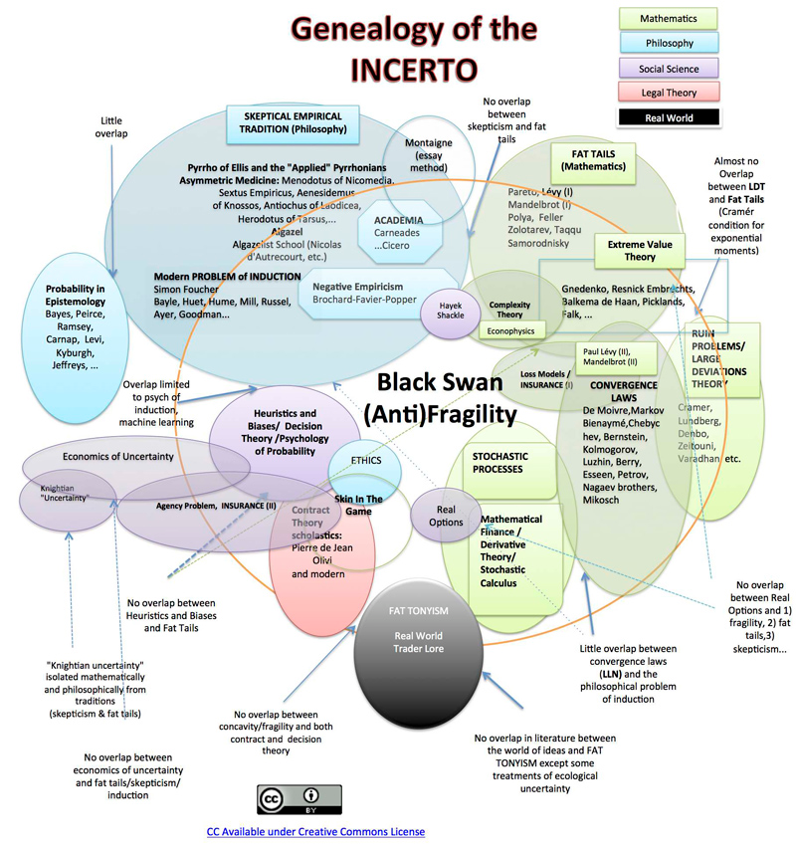

Slide 73
Main Characteristics
in a Nutshell

Slide 74
Main Characteristics of Anthropology
1. the four fields of general anthropology
culture as a primary concept
comparative method as major approach
holism as a primary theoretical goal
  Anthropology and its Parts chart
fieldwork as a primary research technique

Slide 75
ANTH 3635
Anthropology of Europe
The End
Main
Characteristics of
Anthropology
© 2010-2024 Timothy G. Roufs, University of Minnesota Duluth

