Slide 1

“Master Ethnographic Texts”
“Classics” in the
Anthropology of Europe
and related studies
Tim Roufs
© 2010-2024

Slide 2
. . . and trends . . .
“Master Ethnographic Texts”
“Classics” in the
Anthropology of Europe
and related studies
Tim Roufs

Slide 3
along with
. . . a little history
and theory . . .
“Master Ethnographic Texts”
“Classics” in the
Anthropology of Europe
and related studies
Tim Roufs

Slide 4
“Master Ethnographic Texts” are
“. . . ethnographies considered so important that they influence future research and affect how an audience of present and future anthropologists perceive a people”
Susan Parman, Europe in the Anthropological Imagination, pp. 11 - 14

Slide 5
“Master Ethnographic Texts” are
“. . . ethnographies considered so important that they influence future research and affect how an audience of present and future anthropologists perceive a people”
Susan Parman, Europe in the Anthropological Imagination, pp. 11 - 14

Slide 6
“[Jose E.] Limón defines ‘master ethnographic texts’ as texts that have or will ‘deeply influence the structure of later ethnographies’ and that often affect the way the world views the people they represent”
(Limón 1991, 116)
Susan Parman, Europe in the Anthropological Imagination, p. 92

Slide 7
From the “Introduction” of
Europe in the Anthropological Imagination
Susan Parman
pp. 11 – 14
MASTER TEXTS AND “CLASSICS”:
LURCHING TOWARD AN ANTHROPOLOGY OF EUROPE
Susan Parman, Europe in the Anthropological Imagination, pp. 11 - 14

Slide 8
“What is ‘classic,’ of course, depends on definition:
"Classic" by virtue of having been around a long time
    but now superseded and of interest only as an historical note? “
Susan Parman, Europe in the Anthropological Imagination, pp. 11 - 14

Slide 9
“What is ‘classic,’ of course, depends on definition:
"Classic" by virtue of having been around a long time
    but now superseded and of interest only as an historical note? “
Susan Parman, Europe in the Anthropological Imagination, pp. 11 - 14

Slide 10
"Classic" because it is inclusive, integrative, and generalizing in defining . . .
  a "culture area“
    e.g., the articles by . . .
      Arensberg
      Burns
      Kenny
      Halpern
      Kideckel
  REM "culture area“ and other units of analysis from earlier on
Parman's classic picks -- Tony Galt

Slide 11
"Classic" because it is inclusive, integrative, and generalizing in defining . . .
  a "culture area“
    e.g., the articles by . . .
      Arensberg
      Burns
      Kenny
      Halpern
      Kideckel
  More on "culture area“ and other units of analysis another day
Parman's classic picks -- Tony Galt

Slide 12
some areas are
“officially”
anthropological
“cultural areas” . . .

Slide 13
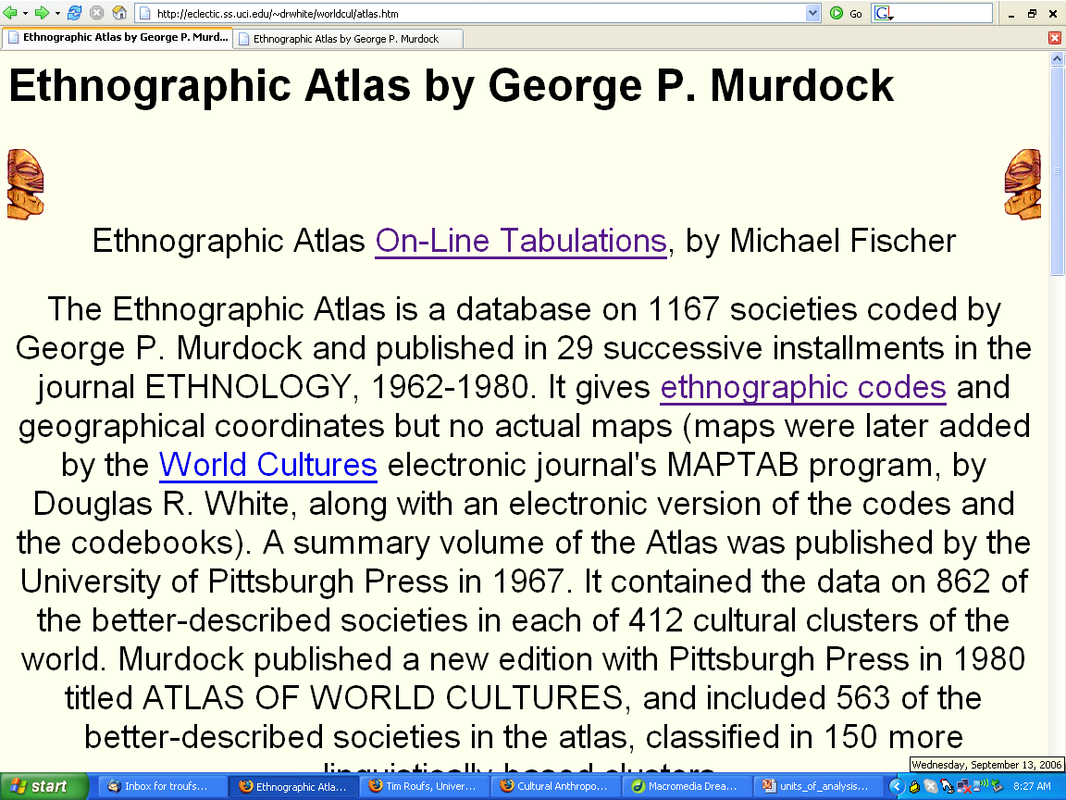
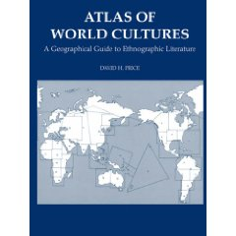
http://eclectic.ss.uci.edu/~drwhite/worldcul/atlas.htm

Slide 14
And Europe is no officially a “culture area”
in anthropology
Ch. 12 “The Place of Europe in
George P. Murdock's Anthropological Theory”
Mark T. Shutes, pp. 157-168

Slide 15
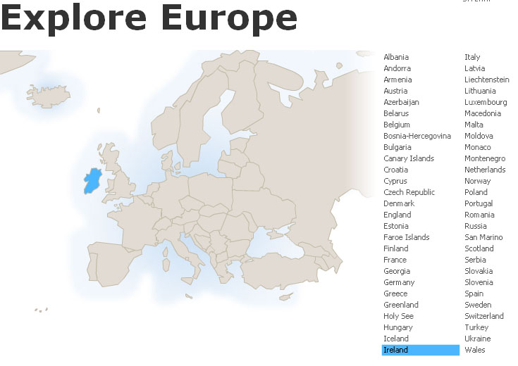

Slide 16
"Classic" because it is inclusive, integrative, and generalizing in defining . . .
  research topic
    gender
    ethnicity
    nationalism
Parman's classic picks -- Tony Galt

Slide 17
"Classic" because it is inclusive, integrative, and generalizing in defining . . .
  the subdiscipline itself
    what is "the anthropology of Europe"?
    or "the anthropology of the Mediterranean“?
Parman's classic picks -- Tony Galt

Slide 18
"Classic" because . . .
  it raises important issues, arguments, and controversies about doing the anthropology of Europe
    e.g. Herzfeld / Galt / Pina-Cabral's discussion of doing "Mediterranean" ethnography / ethnology?
Parman's classic picks -- Tony Galt

Slide 19
"Classic" because . . .
  it provided an influential model for subsequent research?
Parman's classic picks -- Tony Galt

Slide 20
the definition of what is “classic” probably also reflects
  the influence of personalities on the discipline
  the prestige of schools of thought
Susan Parman, Europe in the Anthropological Imagination, pp. 11 - 14

Slide 21
the definition of what is “classic” probably also reflects
  networks
  and whatever else defines the politics of inclusion and exclusion
Susan Parman, Europe in the Anthropological Imagination, pp. 11 - 14

Slide 22
the definition of what is “classic” may be
  controversial
  lyrically written
  topical
    peasants
    gender
    urbanization
    self
  or promoted for personal and / or political reasons
Susan Parman, Europe in the Anthropological Imagination, pp. 11 - 14

Slide 23
“above all,” the definition of what is “classic” must, says Parman, meet Roy Wagner’s definition of ethnogrification of theory
Susan Parman, Europe in the Anthropological Imagination, p. 02

Slide 24
“above all,” the definition of what is “classic” must, says Parman, meet Roy Wagner’s definition of ethnogrification of theory. . .
basically means putting people
and specific places into theory
Susan Parman, Europe in the Anthropological Imagination, p. 02

Slide 25
anthropology is “the study of man
‘as if’ there were culture” . . .
Roy Wagner (1975)
Susan Parman, Europe in the Anthropological Imagination, pp. 11 - 14

Slide 26
“. . . and the work of anthropologists is not only to invent, explore, and make useful the general concept of ‘culture’ but also to invent particular cultures”
Roy Wagner (1975)
Susan Parman, Europe in the Anthropological Imagination, p. 02

Slide 27
“. . . and the work of anthropologists is not only to invent, explore, and make useful the general concept of ‘culture’ but also to invent particular cultures”
Roy Wagner (1975)
Susan Parman, Europe in the Anthropological Imagination, p. 02

Slide 28
“. . . and the work of anthropologists is not only to invent, explore, and make useful the general concept of ‘culture’ but also to invent particular cultures”
Roy Wagner (1975)
A rather peculiar idea
when you think about it – Tim Roufs
Susan Parman, Europe in the Anthropological Imagination, p. 02

Slide 29
ethnography and particular peoples play key roles in the anthropological enterprise of helping anthropologists develop and define particular anthropological concepts
Susan Parman, Europe in the Anthropological Imagination, p. 02

Slide 30
“By forcing his [sic.] imagination, through analogy, to follow the detailed conformations of some external and unpredictable subject, the scientist’s or artist’s invention gains a sureness it would not otherwise command.”
“Invention is ‘controlled’ by the image of reality and the creator’s lack of awareness that he [sic.] is creating.”
Susan Parman, Europe in the Anthropological Imagination, p. 02

Slide 31
“By forcing his [sic.] imagination, through analogy, to follow the detailed conformations of some external and unpredictable subject, the scientist’s or artist’s invention gains a sureness it would not otherwise command.”
“Invention is ‘controlled’ by the image of reality and the creator’s lack of awareness that he [sic.] is creating.”
Roy Wagner (1975)
Susan Parman, Europe in the Anthropological Imagination, p. 02

Slide 32
“By forcing his [sic.] imagination, through analogy, to follow the detailed conformations of some external and unpredictable subject, the scientist’s or artist’s invention gains a sureness it would not otherwise command.”
“Invention is ‘controlled’ by the image of reality and the creator’s lack of awareness that he [sic.] is creating.”
Roy Wagner (1975)
REM
analogy
by means of cultural metaphors
Susan Parman, Europe in the Anthropological Imagination, p. 02

Slide 33
in classic texts, the imagination of the writer (and the reader) engages the specifics of ethnographic detail
and orchestrates this detail to produce insight
Susan Parman, Europe in the Anthropological Imagination, pp. 11 - 14

Slide 34
a
the master ethnographic text must be engageable — Hoffman’s conjuring of structuralism from the use of public and private space in Kypseli, Conrad Arensberg’s rendering of family and kinship in the West room — no matter how controversial
Susan Parman, Europe in the Anthropological Imagination, pp. 11 - 14

Slide 35
a
the master ethnographic text must be engageable — Hoffman’s conjuring of structuralism from the use of public and private space in Kypseli, Conrad Arensberg’s rendering of family and kinship in the West room — no matter how controversial
Susan Parman, Europe in the Anthropological Imagination, pp. 11 - 14

Slide 36
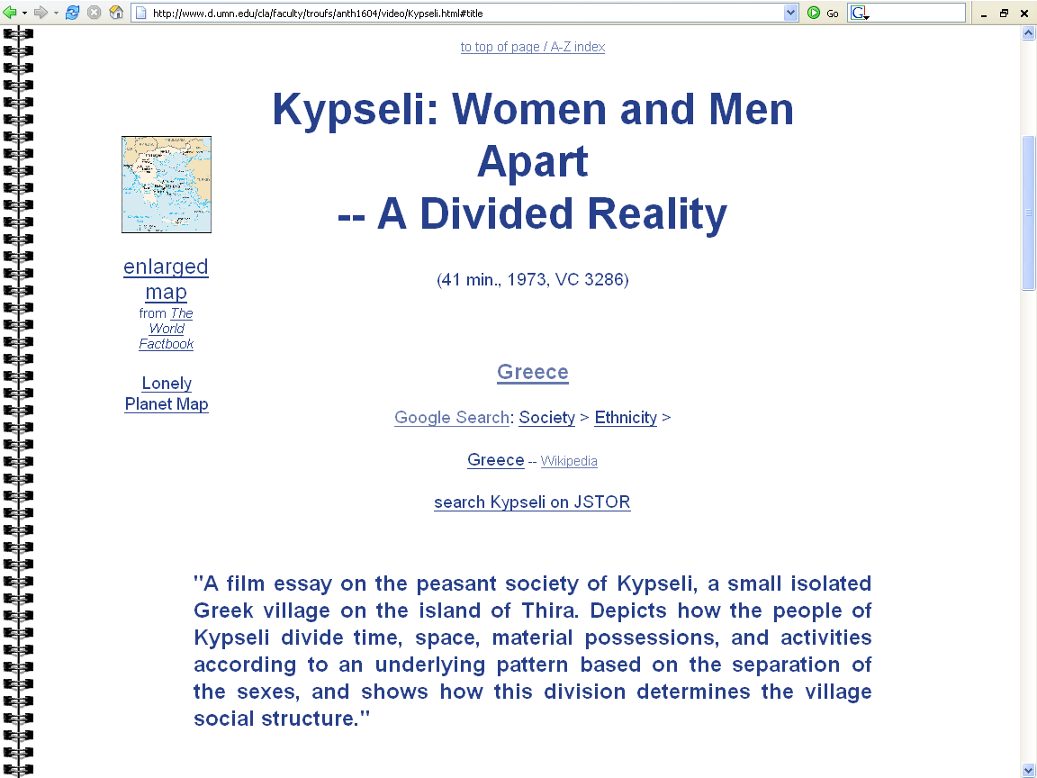

Slide 37
a
the master ethnographic text must be engageable — Hoffman’s conjuring of structuralism from the use of public and private space in Kypseli, Conrad Arensberg’s rendering of family and kinship in the West room — no matter how controversial
Susan Parman, Europe in the Anthropological Imagination, pp. 11 - 14

Slide 38

Conrad Arensberg
1937 The Irish Countryman.
  New York: Macmillan.
  ”the earliest example of anglophone Europeanist anthropology”

Slide 39
”Parman's Picks”
Susan Parman's list of classic articles
(more on this later)
Parman's classic picks -- Tony Galt

Slide 40
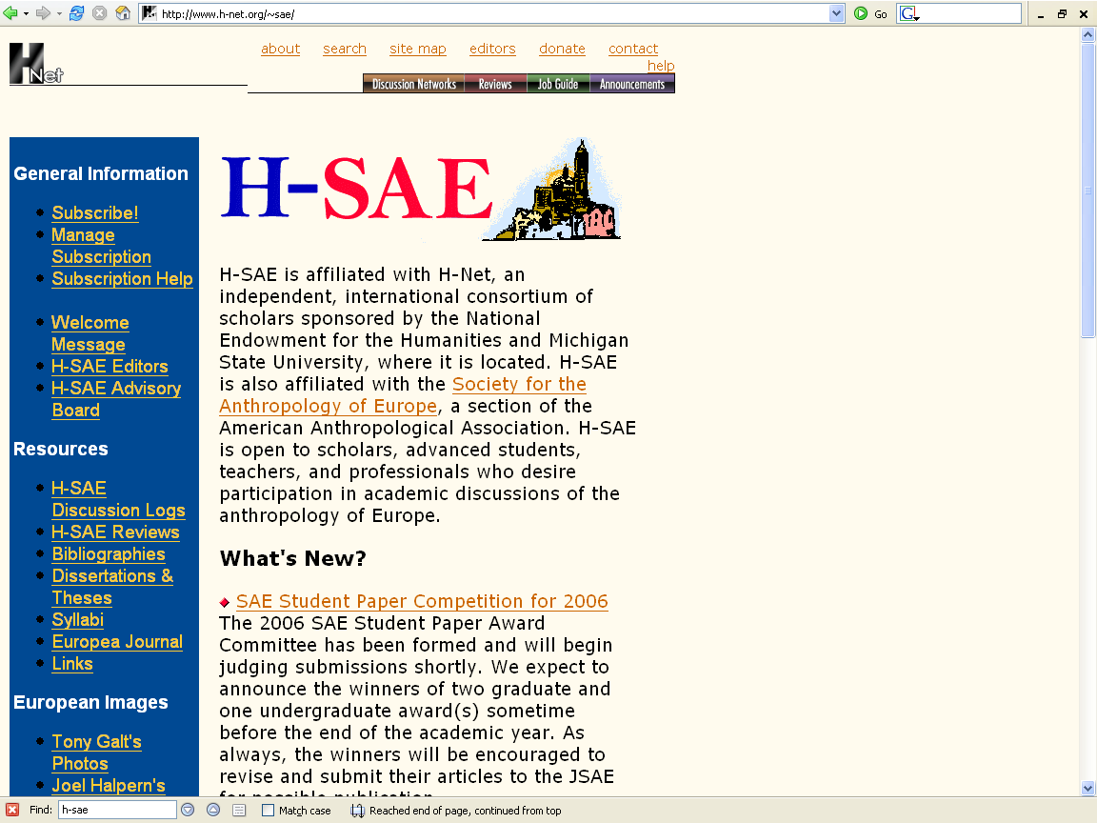
Some of the Resources
of the
American Anthropological Association
Which includes defining “classics” and master texts in the discipline
http://www.h-net.org/~sae/

Slide 41
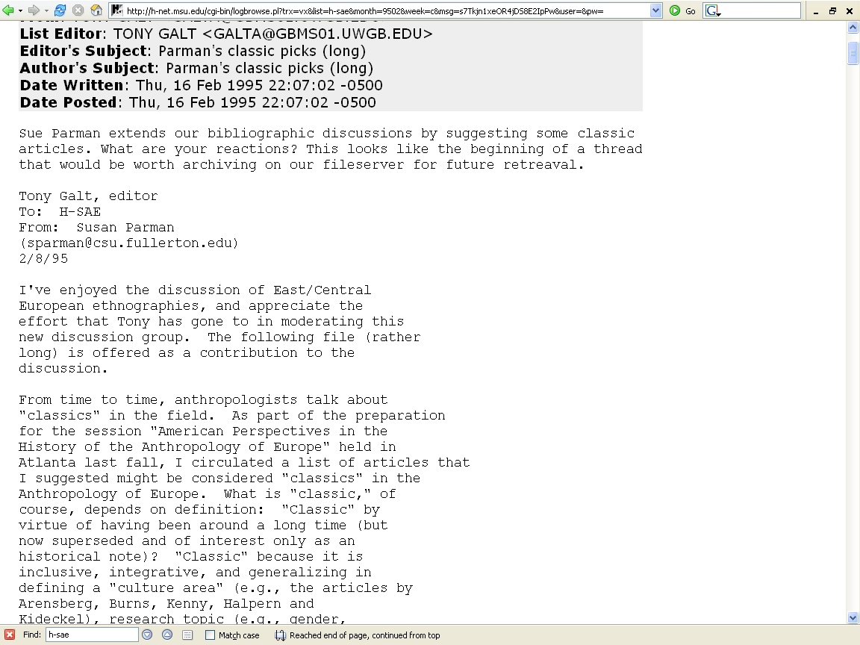
Some of the Resources
of the
American Anthropological Association
Which includes defining “classics” and master texts in the discipline
Parman's classic picks -- Tony Galt

Slide 42
whatever the conditions that produce master texts and classics, the fact remains that we are seeing a pattern of geographical areas and research preferences
Susan Parman, Europe in the Anthropological Imagination, pp. 11 - 14

Slide 43
research preferences are evident across disciplines*. . .
  historians prefer to study France, Germany, and Britain
*see Rogers in Parman for a discussion of disciplinary preferences in grant applications
Susan Parman, Europe in the Anthropological Imagination, pp. 11 - 14

Slide 44
art historians prefer France and Italy
    The Louvre Museum (Musée du Louvre) in Paris, France, is the largest museum in the world
    Florence, the “birthplace” of the Renaissance
Susan Parman, Europe in the Anthropological Imagination, pp. 11 - 14

Slide 45
political scientists like to study the European Union
etc.
Susan Parman, Europe in the Anthropological Imagination, pp. 11 - 14

Slide 46
in Anthropology one goes to . . .
  Ireland to study peasants
  Norway and England to study networks
  The Mediterranean to study gender roles, honor / shame values, and patron-client relationships
Susan Parman, Europe in the Anthropological Imagination, pp. 11 - 14

Slide 47
in Anthropology one goes to . . .
  Ireland to study peasants
  Norway and England to study networks
  The Mediterranean to study gender roles, honor / shame values, and patron-client relationships
Susan Parman, Europe in the Anthropological Imagination, pp. 11 - 14

Slide 48
in Anthropology one goes to . . .
  Ireland to study peasants
  Norway and England to study networks
  The Mediterranean to study gender roles, honor / shame values, and patron-client relationships
Susan Parman, Europe in the Anthropological Imagination, pp. 11 - 14

Slide 49
certain regions have become affiliated with certain research problems
Susan Parman, Europe in the Anthropological Imagination, pp. 11 - 14

Slide 50
“We work out certain aspects of our anthropological agenda in Europe, and other aspects of the anthropological agenda elsewhere”
Susan Parman, Europe in the Anthropological Imagination, pp. 11 - 14

Slide 51
“Classics" in the Anthropology of Europe
As a result of these thoughts, Parman selected articles for the list of ‘classics’ that seemed to her to illustrate . . .
  the history
  *paradigmatic shifts
  cultural context
  and future
  . . . of the anthropology of Europe
*Cf., Thomas Kuhn, The Structure of Scientific Revolutions
Parman's classic picks -- Tony Galt

Slide 52
“Classics" in the Anthropology of Europe
As a result of these thoughts, Parman selected articles for the list of ‘classics’ that seemed to her to illustrate . . .
  the history
  *paradigmatic shifts
  cultural context
  and future
  . . . of the anthropology of Europe
*Cf., Thomas Kuhn, The Structure of Scientific Revolutions
Parman's classic picks -- Tony Galt

Slide 53
“Classics" in the Anthropology of Europe
As a result of these thoughts, Parman selected articles for the list of ‘classics’ that seemed to her to illustrate . . .
  the history
  *paradigmatic shifts
  cultural context
  and future
  . . . of the anthropology of Europe
*Cf., Thomas Kuhn, The Structure of Scientific Revolutions
Parman's classic picks -- Tony Galt

Slide 54
“Classics" in the Anthropology of Europe
As a result of these thoughts, Parman selected articles for the list of ‘classics’ that seemed to her to illustrate . . .
  the history
  *paradigmatic shifts
  cultural context
  and future
  . . . of the anthropology of Europe
*Cf., Thomas Kuhn, The Structure of Scientific Revolutions
Parman's classic picks -- Tony Galt

Slide 55
or we include Europe specifically because we want to test the universality of anthropological models
    Hoffman
    Shutes
Susan Parman, Europe in the Anthropological Imagination, pp. 11 - 14

Slide 56
Arjun Appadurai (1986) used the term
“gatekeeping”
to refer to this tendency to link a particular place with a particular area of research
Susan Parman, Europe in the Anthropological Imagination, pp. 11 - 14

Slide 57
the chapters in Parman suggest that there has been a tendency in the history of the anthropology of Europe to . . .
  exoticize the familiar
  create syndromes of difference
    such as “honor and shame
  and to stress the study of the rural, the semiliterate folk, the small scale, preferably on islands
Susan Parman, Europe in the Anthropological Imagination, pp. 11 - 14

Slide 58
the chapters in Parman suggest that there has been a tendency in the history of the anthropology of Europe to . . .
  exoticize the familiar
  create syndromes of difference
    such as “honor and shame
  and to stress the study of the rural, the semiliterate folk, the small scale, preferably on islands
Susan Parman, Europe in the Anthropological Imagination, pp. 11 - 14

Slide 59
the chapters in Parman suggest that there has been a tendency in the history of the anthropology of Europe to . . .
  exoticize the familiar
  create syndromes of difference
    such as “honor and shame
  and to stress the study of the rural, the semiliterate folk, the small scale, preferably on islands
Susan Parman, Europe in the Anthropological Imagination, pp. 11 - 14

Slide 60
examples of “Classics
. . .

Slide 61
the classic ethnography of Ireland is
  Conrad Arensburg’s The Irish Countryman
  backed up in image by the film Man of Aran
Susan Parman, Europe in the Anthropological Imagination, pp. 11 - 14

Slide 62
Conrad Arensberg
1937 The Irish Countryman.
  New York: Macmillan.
  ”the earliest example of anglophone Europeanist anthropology”

Slide 63
the classic ethnography of Ireland is
  Conrad Arensburg’s The Irish Countryman
  backed up in image by the film Man of Aran
Susan Parman, Europe in the Anthropological Imagination, pp. 11 - 14

Slide 64

. . . backed up in image by the film
Man of Aran
(77 min, 1934, B&W)
  Robert J. Flaherty,
  Colman “Tiger” King,
  Maggie Dirrane, and
  Michael Dirrane

Slide 65
. . . backed up in image by the film
Man of Aran
(77 min, 1934, B&W)
  Robert J. Flaherty,
  Colman “Tiger” King,
  Maggie Dirrane, and
  Michael Dirrane
Including
the villagers’ views of
Man of Aran:
How the Myth was Made

Slide 66
the classic ethnography of Italy is Charlotte Gower Chapman’s study of a small Sicilian community of Milocca . . .
Susan Parman, Europe in the Anthropological Imagination, pp. 11 - 14

Slide 67
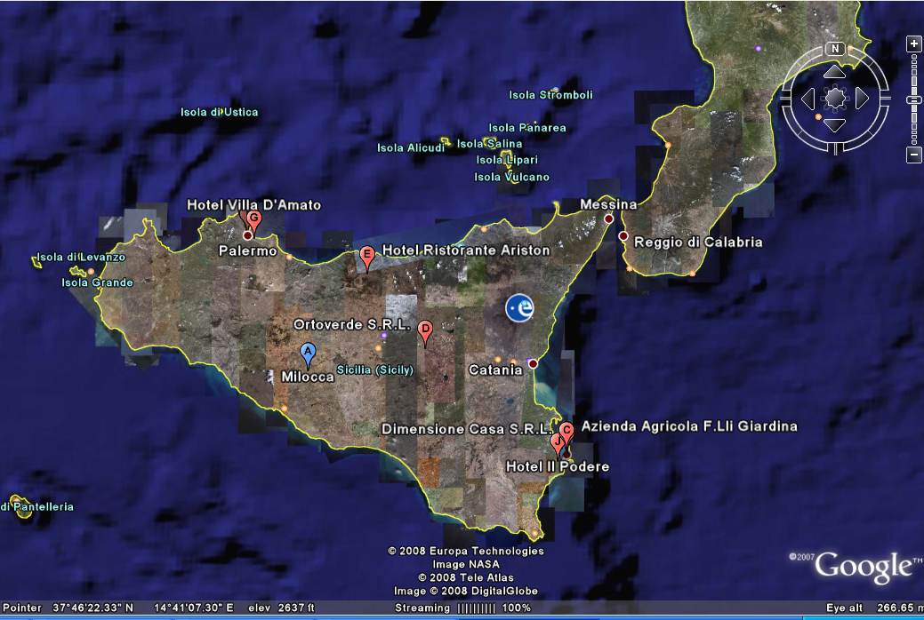
Milocca: A Sicilian Village
Charlotte Gower Chapman

Slide 68
two influential ethnographies of Greece are . . .
    Ernestine Friedl’s village study of Greece
      Vasilika
      (1962)
Susan Parman, Europe in the Anthropological Imagination, pp. 11 - 14

Slide 69
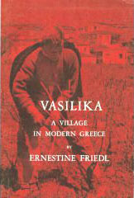
“Classics" in the Anthropology of Europe
Ernestine Friedl
1962 Vasilika: A Village in Modern Greece.
Belmont, CA: Thompson Wadsworth, 2002.
(ISBN: 0030115450)
Parman's classic picks -- Tony Galt

Slide 70
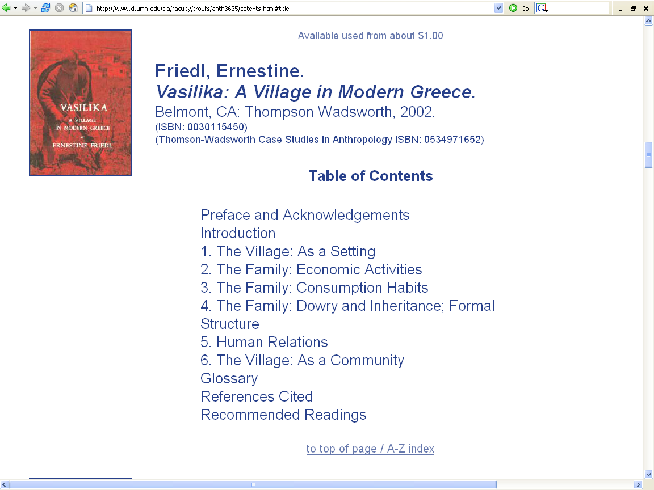

Slide 71
two influential ethnographies of Greece are . . .
    Ernestine Friedl’s village study of Greece
      Vasilika
      (1962)
    and John K. Campbell’s
      Honour, Family, and Patronage: A Study of Institutions and Moral Values in a Greek Mountain Community
      (1964)
Susan Parman, Europe in the Anthropological Imagination, pp. 11 - 14

Slide 72
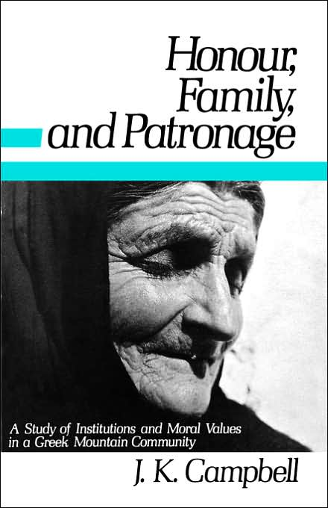
John K. Campbell
Honour, Family, and Patronage: A Study of Institutions and Moral Values in a Greek Mountain Community
(1964)

Slide 73
and Hoffman’s “classic” film, Kypseli, was self-consciously located in an isolated peasant community
on a Greek Island
Susan Parman, Europe in the Anthropological Imagination, pp. 11 - 14

Slide 75
in choosing to go to Europe, Susanna Hoffman, producer of the film Kypseli, was testing the question of universality of anthropological models
Susan Parman, Europe in the Anthropological Imagination, pp. 14 - 16

Slide 76
for many years
the island model
of peasant / community studies dominated Europeanist anthropology, and to some extent continues to do so
  whether or not the peasant community was on an island, the community itself was treated as a self-contained unit
  see Kertzer’s discussion of the anthropological yearning for “the simplicity of a manageable field setting . . . Where . . . The scale is human, and the cow dung wafts through the air”
Susan Parman, Europe in the Anthropological Imagination, pp. 11 - 14

Slide 77
for many years the island model of peasant / community studies dominated Europeanist anthropology, and to some extent continues to do so
  whether or not the peasant community was on an island, the community itself was treated as a self-contained unit
  see Kertzer’s discussion of the anthropological yearning for “the simplicity of a manageable field setting … Where … The scale is human, and the cow dung wafts through the air”
Susan Parman, Europe in the Anthropological Imagination, pp. 11 - 14

Slide 78
William A. Douglass, on the other hand, challenges the idea that anglophone [native English speaking] Europeanists anthropology has been “obsessed” with the study of isolated little communities, giving ample contrary evidence
(in Parman)
Susan Parman, Europe in the Anthropological Imagination, pp. 11 - 14

Slide 79
Douglass points out that migration has been a continuing feature of European and “Euro-settler” societies since the expansion of Europe outside of Europe in the fifteenth century
Susan Parman, Europe in the Anthropological Imagination, pp. 11 - 14

Slide 80
Douglass provides ample evidence of anthropology’s
long-term concern with
internal and transnational migration
Susan Parman, Europe in the Anthropological Imagination, p. 10

Slide 81
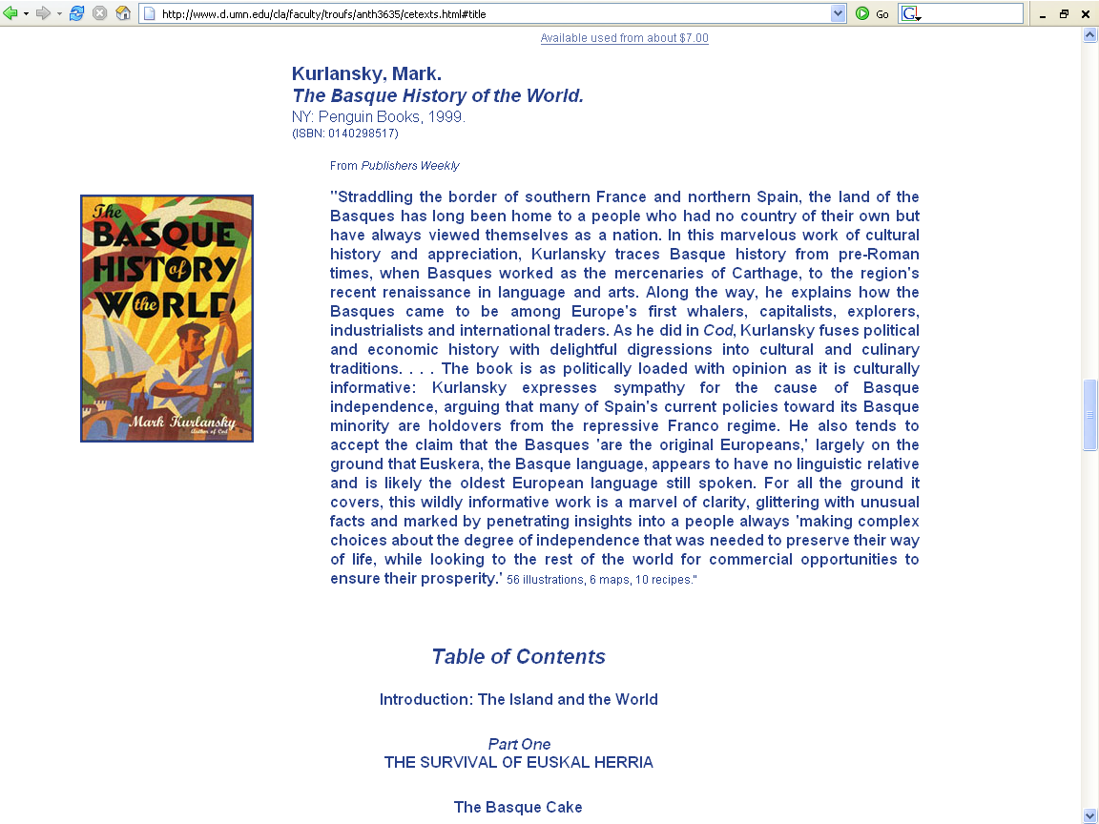

Slide 82
while Douglass points out
  the long history of anthropological awareness of internal and transnational migration
  and the importance of looking at networks of relationship that extend beyond the little community
Susan Parman, Europe in the Anthropological Imagination, pp. 11 - 14

Slide 83
on the other hand, Douglass admits that the model of community studies dominated
the anthropology of Europe from about 1950 to 1975
Susan Parman, Europe in the Anthropological Imagination, pp. 11 - 14

Slide 84
and Douglass suggests that the preference for peasant communities is due in part to the influence of
Radcliffe-Brown and
Robert Redfield
at the University of Chicago
Susan Parman, Europe in the Anthropological Imagination, pp. 11 - 14

Slide 85

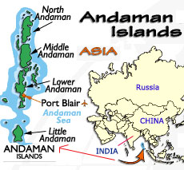

1952 Structure and Function in Primitive Society
Glencoe, IL.: The Free Press
1964 Andaman Islanders
Glencoe, IL.: The Free Press
Alfred Reginald Radcliffe-Brown

Slide 86
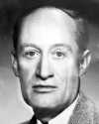

“Classics" in the Anthropology of Europe
Robert Redfield
  1930 Tepoztlan, a Mexican Village: A Study of Folk Life
      Chicago: University of Chicago Press
  1941 Folk Culture of Yucatan
      Chicago: University of Chicago Press

Slide 87
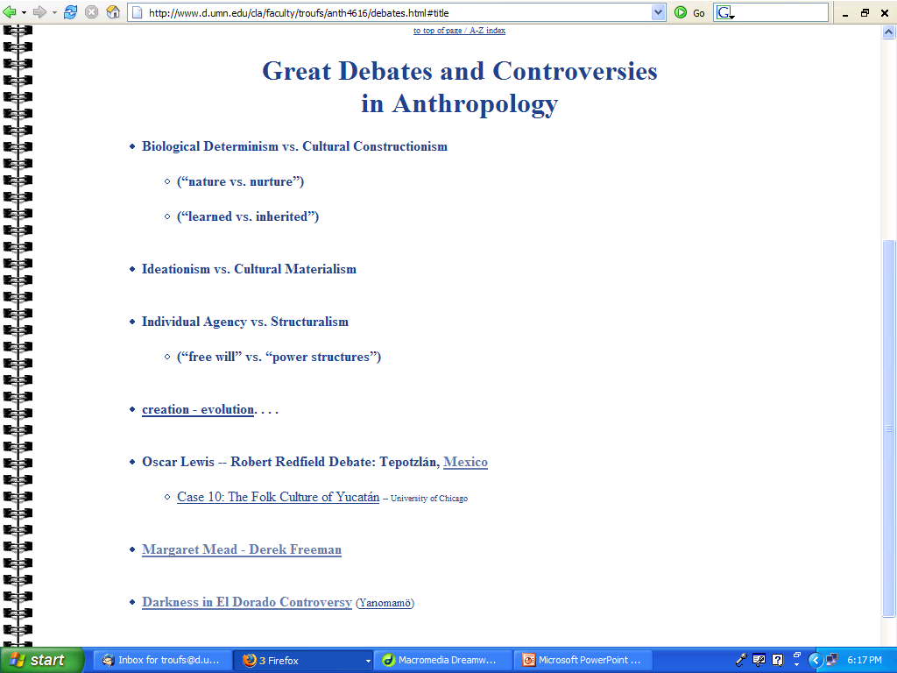
www.d.umn.edu/cla/faculty/troufs/anth4616/debates.html#title

Slide 88
an important influence on American interest in European Spanish studies was an attempt to trace Latin American influences back to Spain
Susan Parman, Europe in the Anthropological Imagination, pp. 11 - 14

Slide 89
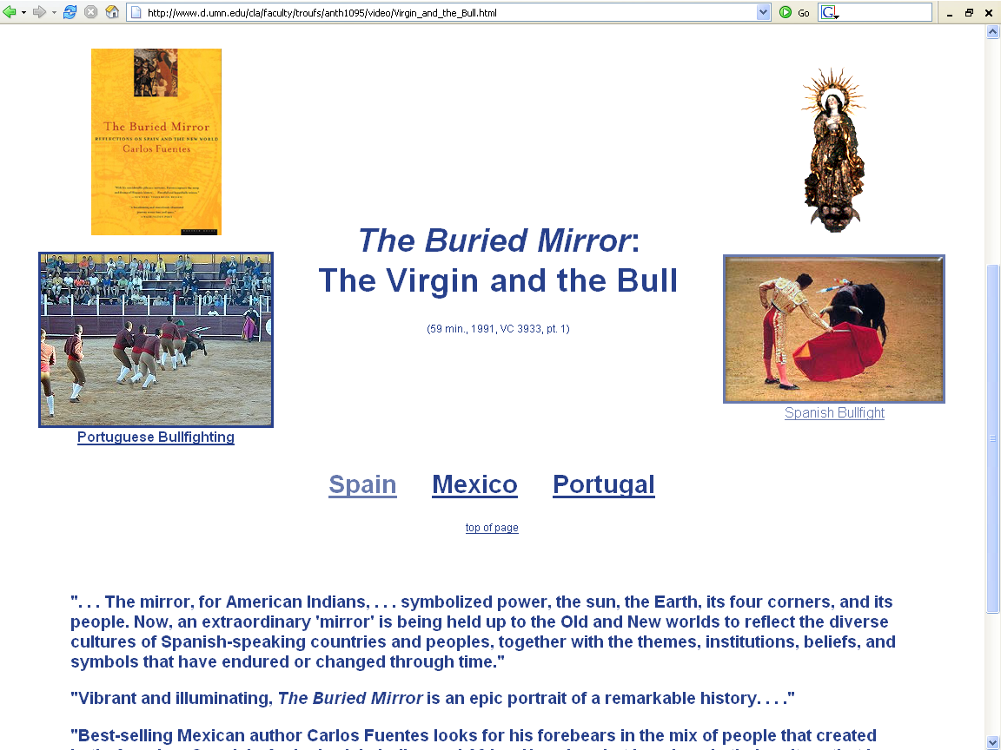
we will saw this video in class

Slide 90
One can see the Mexican Virgin of Guadalupe almost everywhere . . .

Slide 91

¡Raúl R. Salinas, Presente!
March 17, 1934 -- February 13, 2008
raúlrsalinas and the Jail Machine: My Weapon is My Pen: Selected Writings

Slide 92
American anthropologists, studying peasants
in Mesoamerica using a
rural-urban continuum,
went to Spain and studied peasant communities there
Susan Parman, Europe in the Anthropological Imagination, pp. 11 - 14

Slide 93
American anthropologists, studying peasants
in Mesoamerica using a
rural-urban continuum,
was a popular way to compare locations . . .
using locations along a
Susan Parman, Europe in the Anthropological Imagination, pp. 11 - 14

Slide 94
American anthropologists, studying peasants
in Mesoamerica using a
rural-urban continuum,
Quite often following Robert Redfield’s work in the Yucatan
Susan Parman, Europe in the Anthropological Imagination, pp. 11 - 14

Slide 95
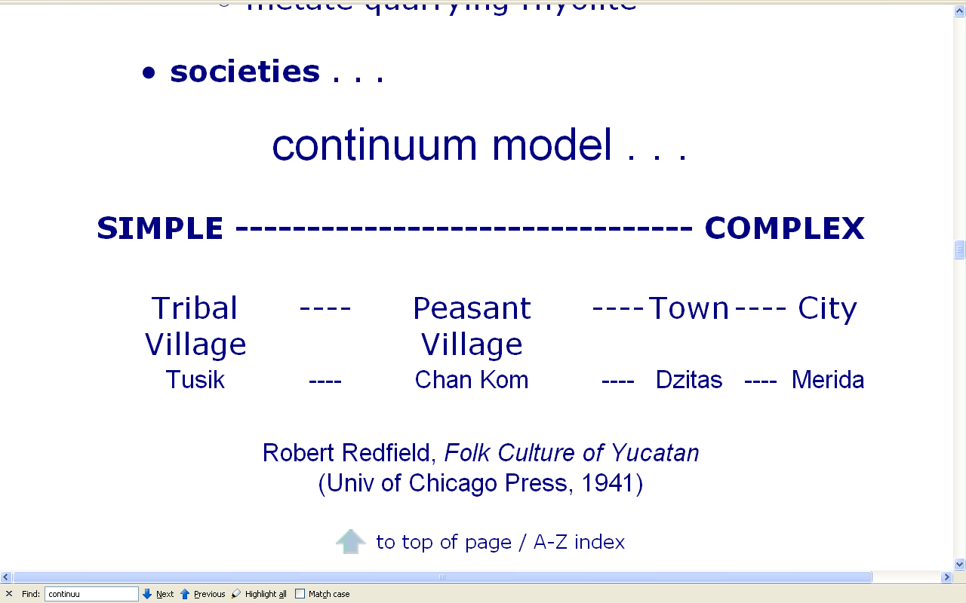
http://www.d.umn.edu/cla/faculty/troufs/anth3618/video/Artisans.html

Slide 96
NB: This rural-urban continuum model by Redfield is very famous in the social sciences . . .
http://www.d.umn.edu/cla/faculty/troufs/anth3618/video/Artisans.html

Slide 97
http://www.d.umn.edu/cla/faculty/troufs/anth3618/video/Artisans.html

Slide 98
In the 1960s there was a plethora of review articles about peasants
    Clifford Geertz 1962
    Ernestine Friedl 1963
    Robert T. Anderson 1965
Susan Parman, Europe in the Anthropological Imagination, pp. 11 - 14

Slide 99
In the 1960s there was a plethora of review articles about peasants
    Clifford Geertz 1962
    Ernestine Friedl 1963
    Robert T. Anderson 1965
Susan Parman, Europe in the Anthropological Imagination, pp. 11 - 14

Slide 100
In the 1960s there was a plethora of review articles about peasants
    Clifford Geertz 1962
    Ernestine Friedl 1963
    Robert T. Anderson 1965
are basically self-sufficient subsistence farmers that also grow a few crops or make a few things to sell at a local market to get some cash
Susan Parman, Europe in the Anthropological Imagination, pp. 11 - 14

Slide 101
and Susan Freeman went from the University of Chicago
  to do research in Spain
  she was influenced not only by the British social anthropology presence at Chicago
  but also by British social anthropologists producing seminal studies of Spanish communities
  (Pitt-Rivers)
Susan Parman, Europe in the Anthropological Imagination, pp. 11 - 14

Slide 102

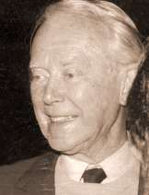
one of the master texts and classics
1954 People of the Sierra
Chicago: University of Chicago Press
1963 Mediterranean Countrymen: Essays in the Social Anthropology of the Mediterranean
Julian Alfred Pitt-Rivers, et al
Paris: Mouton
Julian Alfred Pitt-Rivers

Slide 103
one of the master texts and classics
Douglass extracts comments from . . .
  Arensberg’s Irish Countryman
    the earliest example of anglophone Europeanist anthropology
  Pitt-Rivers’s
  People of the Sierra
    “anglophone Europeanist anthropology’s quintessential and most influential little community study”
Susan Parman, Europe in the Anthropological Imagination, pp. 14 - 16

Slide 104
one of the master texts and classics
1954 People of the Sierra
Chicago: University of Chicago Press
Julian Alfred Pitt-Rivers

Slide 105
the research that came out of this school of thought emphasized
    self-sufficiency
    and isolation
rather than . . .
Susan Parman, Europe in the Anthropological Imagination, pp. 11 - 14

Slide 106
. . . rather than
    regional / national linkages
    migration
    tourism
    urbanization
Susan Parman, Europe in the Anthropological Imagination, pp. 11 - 14

Slide 107
peasant studies and community studies
by and large perpetuated the island model of anthropological units of study with its concomitant notions of . . .
Susan Parman, Europe in the Anthropological Imagination, pp. 11 - 14

Slide 108
  tradition
  conservatism
  homogeneity
    in ideology if not in fact, as Brettell points out in Parman
  egalitarianism
  mechanical solidarity
  cultural essences
  as opposed to . . . the notion of culture as . . .
Susan Parman, Europe in the Anthropological Imagination, pp. 11 - 14

Slide 109
  tradition
  conservatism
  homogeneity
    in ideology if not in fact, as Brettell points out in Parman
  egalitarianism
  mechanical solidarity
  cultural essences
  as opposed to . . . the notion of culture as . . .
Susan Parman, Europe in the Anthropological Imagination, pp. 11 - 14

Slide 110
  tradition
  conservatism
  homogeneity
    in ideology if not in fact, as Brettell points out in Parman
  egalitarianism
  mechanical solidarity
  cultural essences
  as opposed to . . . the notion of culture as . . .
Susan Parman, Europe in the Anthropological Imagination, pp. 11 - 14

Slide 111
  tradition
  conservatism
  homogeneity
    in ideology if not in fact, as Brettell points out in Parman
  egalitarianism
  mechanical solidarity
  cultural essences
  as opposed to . . . the notion of culture as . . .
Susan Parman, Europe in the Anthropological Imagination, pp. 11 - 14

Slide 112
  tradition
  conservatism
  homogeneity
    in ideology if not in fact, as Brettell points out in Parman
  egalitarianism
  mechanical solidarity
  cultural essences
  as opposed to . . . the notion of culture as . . .
Susan Parman, Europe in the Anthropological Imagination, pp. 11 - 14

Slide 113
  tradition
  conservatism
  homogeneity
    in ideology if not in fact, as Brettell points out in Parman
  egalitarianism
  mechanical solidarity
  cultural essences
  as opposed to . . . the notion of culture as . . .
Susan Parman, Europe in the Anthropological Imagination, pp. 11 - 14

Slide 114
  tradition
  conservatism
  homogeneity
    in ideology if not in fact, as Brettell points out in Parman
  egalitarianism
  mechanical solidarity
  cultural essences
  as opposed to . . . the notion of culture as . . .
Susan Parman, Europe in the Anthropological Imagination, pp. 11 - 14

Slide 115
  tradition
  conservatism
  homogeneity
    in ideology if not in fact, as Brettell points out in Parman
  egalitarianism
  mechanical solidarity
  cultural essences
  as opposed to . . . the notion of culture as . . .
Susan Parman, Europe in the Anthropological Imagination, pp. 11 - 14

Slide 116
  tradition
  conservatism
  homogeneity
    in ideology if not in fact, as Brettell points out in Parman
  egalitarianism
  mechanical solidarity
  cultural essences
  as opposed to . . . the notion of culture as . . .
Susan Parman, Europe in the Anthropological Imagination, pp. 11 - 14

Slide 117
  tradition
  conservatism
  homogeneity
    in ideology if not in fact, as Brettell points out in Parman
  egalitarianism
  mechanical solidarity
  cultural essences
  as opposed to . . . the notion of culture as . . .
Émile Durkheim
The Division of Labor in Society
(1893)
Susan Parman, Europe in the Anthropological Imagination, pp. 11 - 14

Slide 118
  tradition
  conservatism
  homogeneity
    in ideology if not in fact, as Brettell points out in Parman
  egalitarianism
  cultural essences
  mechanical solidarity
  as opposed to . . . the notion of culture as . . .
Émile Durkheim
The Division of Labor in Society
(1893)
Susan Parman, Europe in the Anthropological Imagination, pp. 11 - 14

Slide 119
mechanical solidarity
  comes from homogeneity
  when people feel connected through similar
    work
    educational and religious training
    lifestyle
  typically operates in “traditional” and small-scale societies
Émile Durkheim

Slide 120
organic solidarity
  based on division of labor
  comes from the interdependence that arises from specialization of work
  occurs in "modern" and "industrial" societies
Émile Durkheim

Slide 121
  tradition
  conservatism
  homogeneity
    in ideology if not in fact, as Brettell points out in Parman
  egalitarianism
  mechanical solidarity
  cultural essences
  as opposed to . . . the notion of culture as . . .
Susan Parman, Europe in the Anthropological Imagination, pp. 11 - 14

Slide 122
  . . . as opposed to . . . the alternative notion of culture as
      contested
      negotiated
      invented
      and relational
    . . . in a society characterized by
      stratification
      class differences
      and organic solidarity
      Gesellschaft
Susan Parman, Europe in the Anthropological Imagination, pp. 11 - 14

Slide 123
  . . . as opposed to . . . the alternative notion of culture as
      contested
      negotiated
      invented
      and relational
    . . . in a society characterized by
      stratification
      class differences
      and organic solidarity
      Gesellschaft
Susan Parman, Europe in the Anthropological Imagination, pp. 11 - 14

Slide 124
  . . . as opposed to . . . the alternative notion of culture as
      contested
      negotiated
      invented
      and relational
    . . . in a society characterized by
      stratification
      class differences
      and organic solidarity
      Gesellschaft
Susan Parman, Europe in the Anthropological Imagination, pp. 11 - 14

Slide 125
  . . . as opposed to . . . the alternative notion of culture as
      contested
      negotiated
      invented
      and relational
    . . . in a society characterized by
      stratification
      class differences
      and organic solidarity
      Gesellschaft
Susan Parman, Europe in the Anthropological Imagination, pp. 11 - 14

Slide 126
  . . . as opposed to . . . the alternative notion of culture as
      contested
      negotiated
      invented
      and relational
    . . . in a society characterized by
      stratification
      class differences
      and organic solidarity
      Gesellschaft
Susan Parman, Europe in the Anthropological Imagination, pp. 11 - 14

Slide 127
  . . . as opposed to . . . the alternative notion of culture as
      contested
      negotiated
      invented
      and relational
    . . . in a society characterized by
      stratification
      class differences
      and organic solidarity
      Gesellschaft
Susan Parman, Europe in the Anthropological Imagination, pp. 11 - 14

Slide 128
  . . . as opposed to . . . the alternative notion of culture as
      contested
      negotiated
      invented
      and relational
    . . . in a society characterized by
      stratification
      class differences
      and organic solidarity
      Gesellschaft
Susan Parman, Europe in the Anthropological Imagination, pp. 11 - 14

Slide 129
  . . . as opposed to . . . the alternative notion of culture as
      contested
      negotiated
      invented
      and relational
    . . . in a society characterized by
      stratification
      class differences
      and organic solidarity
      Gesellschaft
Susan Parman, Europe in the Anthropological Imagination, pp. 11 - 14

Slide 130
  . . . as opposed to . . . the alternative notion of culture as
      contested
      negotiated
      invented
      and relational
    . . . in a society characterized by
      stratification
      class differences
      and organic solidarity
      Gesellschaft
Susan Parman, Europe in the Anthropological Imagination, pp. 11 - 14

Slide 131
  . . . as opposed to . . . the alternative notion of culture as
      contested
      negotiated
      invented
      and relational
    . . . in a society characterized by
      stratification
      class differences
      and organic solidarity
      Gesellschaft
Susan Parman, Europe in the Anthropological Imagination, pp. 11 - 14

Slide 132
  . . . as opposed to . . . the alternative notion of culture as
      contested
      negotiated
      invented
      and relational
    . . . in a society characterized by
      stratification
      class differences
      and organic solidarity
      Gesellschaft
Susan Parman, Europe in the Anthropological Imagination, pp. 11 - 14

Slide 133
  …as opposed to . . . the alternative notion of culture as
      contested
      negotiated
      invented
      and relational
    in a society characterized by
      stratification
      class differences
      and organic solidarity
      Gesellschaft vs. Gemeinschaft
Susan Parman, Europe in the Anthropological Imagination, pp. 11 - 14

Slide 134
  …as opposed to . . . the alternative notion of culture as
      contested
      negotiated
      invented
      and relational
    in a society characterized by
      stratification
      class differences
      and organic solidarity
      Gesellschaft vs. Gemeinschaft
Susan Parman, Europe in the Anthropological Imagination, pp. 11 - 14

Slide 135
Gesellschaft
  for the individual, the larger association never takes on more importance than individual self interest
  lack the same level of shared common cultural beliefs
  maintained through individuals acting in their own self interest
  emphasize secondary relationships rather than familial or community ties
  generally less individual loyalty to society
  social cohesion typically derives from a more elaborate division of labor
  more susceptible to class conflict, as well as racial and ethnic conflicts
  e.g., a modern business
Ferdinand Tönnies

Slide 136
Gesellschaft
  for the individual, the larger association never takes on more importance than individual self interest
  lack the same level of shared common cultural beliefs
  maintained through individuals acting in their own self interest
  emphasize secondary relationships rather than familial or community ties
  generally less individual loyalty to society
  social cohesion typically derives from a more elaborate division of labor
  more susceptible to class conflict, as well as racial and ethnic conflicts
  e.g., a modern business

Slide 137
Gemeinschaft
Ferdinand Tönnies

Slide 138
  …as opposed to . . . the alternative notion of culture as
      contested
      negotiated
      invented
      and relational
    in a society characterized by
      stratification
      class differences
      and organic solidarity
      Gesellschaft vs. Gemeinschaft
Susan Parman, Europe in the Anthropological Imagination, pp. 11 - 14

Slide 139
Gemeinschaft
  an association in which individuals are oriented to the large association as much, if not more, than to their own self interest
  individuals in Gemeinschaft are regulated by common cultural beliefs
  characterized by
    a moderate division of labor
    strong personal relationships
    strong families
    relatively simple social institutions
  there is seldom a need to enforce social control externally
  e.g., the family
Ferdinand Tönnies

Slide 140
Gemeinschaft
  an association in which individuals are oriented to the large association as much, if not more, than to their own self interest
  individuals in Gemeinschaft are regulated by common cultural beliefs
  characterized by
    a moderate division of labor
    strong personal relationships
    strong families
    relatively simple social institutions
  there is seldom a need to enforce social control externally
  e.g., the family
Ferdinand Tönnies

Slide 141
while Douglass points out
  the long history of anthropological awareness of internal and transnational migration
  and the importance of looking at networks of relationship that extend beyond the little community
he also argues . . .
Susan Parman, Europe in the Anthropological Imagination, pp. 11 - 14

Slide 142
. . . he [Douglass] argues that small communities are an important part of the European experience
and
should not be dismissed
as an intellectual interlude in theoretical trends within American anthropology
Susan Parman, Europe in the Anthropological Imagination, pp. 11 - 14

Slide 143
others authors have justified the use of small communities in a variety of ways:
  they are condensed, manageable samples of a larger whole (Hoffman)
  they are primordial (Dubisch referring to Campbell)
  they are dynamic arenas within which national self-images are formed (Dubisch referring to Herzfeld)
  they provide the holistic and ethnographic vehicle for integrating micro and macro levels of analysis (Bennett; Wilson)
Susan Parman, Europe in the Anthropological Imagination, pp. 11 - 14

Slide 144
Others authors have justified the use of small communities in a variety of ways:
  they are condensed, manageable samples of a larger whole
      Hoffman
Susan Parman, Europe in the Anthropological Imagination, pp. 11 - 14

Slide 145
Others authors have justified the use of small communities in a variety of ways:
  they are primordial
      Dubisch referring to Campbell
Susan Parman, Europe in the Anthropological Imagination, pp. 11 - 14

Slide 146
Others authors have justified the use of small communities in a variety of ways:
  they are dynamic arenas within which national
  self-images are formed
      Dubisch referring to Herzfeld
Susan Parman, Europe in the Anthropological Imagination, pp. 11 - 14

Slide 147
Others authors have justified the use of small communities in a variety of ways:
  they provide the holistic and ethnographic vehicle for integrating micro and macro levels of analysis
      Bennett
      Wilson
Susan Parman, Europe in the Anthropological Imagination, pp. 11 - 14

Slide 148
gradually, however, changes within the field of anthropology itself led to changes in the way that Europe could be studied
Susan Parman, Europe in the Anthropological Imagination, pp. 11 - 14

Slide 149
David L. Kertzer argues that leftist political currents supported a shift away from the view of peasants not as
folk-loristically interesting but as victims of exploitation
Susan Parman, Europe in the Anthropological Imagination, pp. 11 - 14

Slide 150
  such currents stimulated criticism of Oscar Lewis’s “culture of poverty” thesis . . .
  and prompted an interest in the functioning of communism
(Kertzer 1980)
Susan Parman, Europe in the Anthropological Imagination, pp. 11 - 14

Slide 151
researchers began to look more closely at the romantic myth of egalitarian communities, and to describe stratification systems
Susan Parman, Europe in the Anthropological Imagination, pp. 11 - 14

Slide 152
researchers began to look more closely at the romantic myth of egalitarian communities, and to describe stratification systems
Susan Parman, Europe in the Anthropological Imagination, pp. 11 - 14

Slide 153
the island model of Gemeinschaft / peasant community
  allowed for some role differentiation
    primarily based on gender and kinship
  but not the extreme differentiation that comes under the heading of stratification
Susan Parman, Europe in the Anthropological Imagination, pp. 11 - 14

Slide 154
the island model of Gemeinschaft / peasant community
  allowed for some role differentiation
    primarily based on gender and kinship
  but not the extreme differentiation that comes under the heading of stratification
Susan Parman, Europe in the Anthropological Imagination, pp. 11 - 14

Slide 155
stratification is a symptom of large complex societies
    not the Gemeinschaft of small-scale societies
Susan Parman, Europe in the Anthropological Imagination, pp. 11 - 14

Slide 156
however, as David I. Kertzer notes in his review of American anthropologists working in Italy, most work [in Italy] continues to be done on islands and in the rural south
Susan Parman, Europe in the Anthropological Imagination, pp. 11 - 14

Slide 157
in addition, anthropologists often are drawn to border regions
Susan Parman, Europe in the Anthropological Imagination, pp. 11 - 14

Slide 158
in East Europe, as described by David A. Kideckel, a striking set of differences appear between how Western anthropologists
(mostly American)
study Eastern Europe, and how they study Western Europe
Susan Parman, Europe in the Anthropological Imagination, pp. 11 - 14

Slide 159
Western anthropologists studying Western Europe distinguish between
    the urban
    stratified
    literate
    large-scale “us”
  and . . .
Susan Parman, Europe in the Anthropological Imagination, pp. 11 - 14

Slide 160
Western anthropologists studying Western Europe distinguish between
    the urban
    stratified
    literate
    large-scale “us”
  and . . .
Susan Parman, Europe in the Anthropological Imagination, pp. 11 - 14

Slide 161
. . . the “other” of
    rural
    egalitarian
    folk
    small-scale communities
  and are asking questions
  about . . .
Susan Parman, Europe in the Anthropological Imagination, pp. 11 - 14

Slide 162
. . . the “other” of
    rural
    egalitarian
    folk
    small-scale communities
  and are asking questions
  about . . .
Susan Parman, Europe in the Anthropological Imagination, pp. 11 - 14

Slide 163
. . . the Western anthropologists are asking questions about
who “we” are
    what is the “home” toward which we are heading?
    what do we look like in the looking glass?
Susan Parman, Europe in the Anthropological Imagination, pp. 11 - 14

Slide 164
for Western anthropologists studying Eastern Europe, the whole of Eastern Europe becomes “other” . . .
Susan Parman, Europe in the Anthropological Imagination, pp. 11 - 14

Slide 165
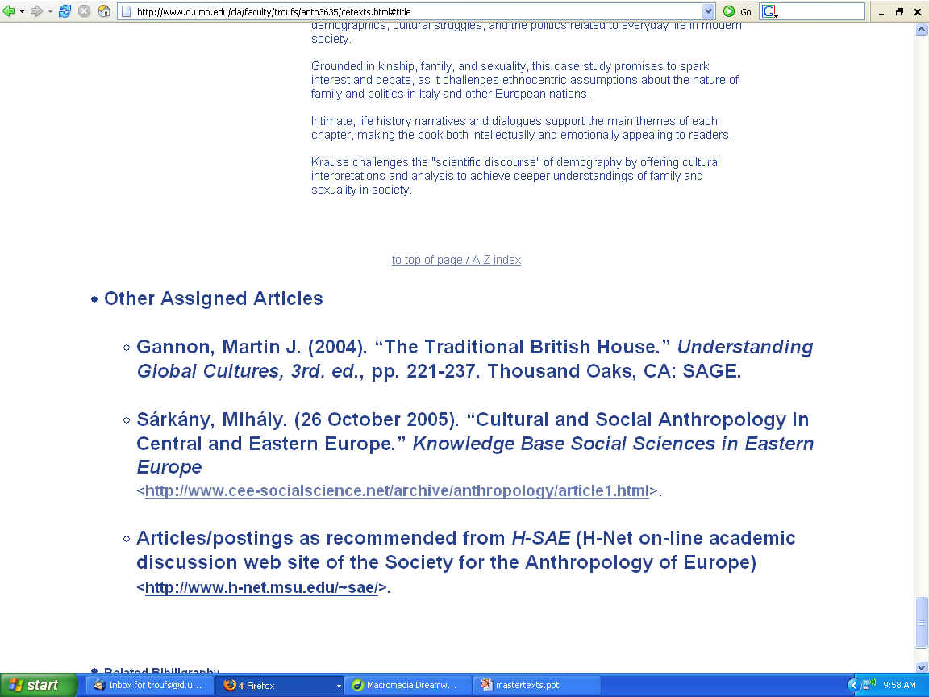
one of the may excellent Hungarian anthropologists

Slide 166
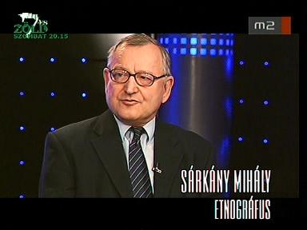

Slide 167
. . . and Western anthropologists explore the otherness of unfamiliar customs
  emphasizing the differences
    the “utter other”
  rather than exploring
  the similarities
Susan Parman, Europe in the Anthropological Imagination, pp. 11 - 14

Slide 168
. . . and Western anthropologists explore the otherness of unfamiliar customs
  emphasizing the differences
    the “utter other”
  rather than exploring
  the similarities
Susan Parman, Europe in the Anthropological Imagination, pp. 11 - 14

Slide 169
. . . and Western anthropologists explore the otherness of unfamiliar customs
  emphasizing the differences
    the “utter other”
  rather than exploring
  the similarities
Susan Parman, Europe in the Anthropological Imagination, pp. 11 - 14

Slide 170
Kideckel also provides an additional contrast:
  how Eastern European anthropologists
  studied Eastern Europe
Susan Parman, Europe in the Anthropological Imagination, pp. 11 - 14

Slide 171
Kideckel refers to Tomas Hofer’s classic article (1968) that compares how Americans and Europeans studied European villages
  the Americans characterized as slash-and-burn theoreticians with few ties to the community they studied
  the Europeans are characterized as theoretically limited but ethnographically invested, long-term visitors
Susan Parman, Europe in the Anthropological Imagination, pp. 11 - 14

Slide 172
Kideckel refers to Tomas Hofer’s classic article (1968) that compares how Americans and Europeans studied European villages
  the Americans characterized as slash-and-burn theoreticians with few ties to the community they studied
  the Europeans are characterized as theoretically limited but ethnographically invested, long-term visitors
Susan Parman, Europe in the Anthropological Imagination, pp. 11 - 14

Slide 173
Kideckel refers to Tomas Hofer’s classic article (1968) that compares how Americans and Europeans studied European villages
  the Americans characterized as slash-and-burn theoreticians with few ties to the community they studied
  the Europeans are characterized as theoretically limited but ethnographically invested, long-term visitors
Susan Parman, Europe in the Anthropological Imagination, pp. 11 - 14

Slide 174
Kideckel refers to Tomas Hofer’s classic article (1968) that compares how Americans and Europeans studied European villages
  the Americans characterized as slash-and-burn theoreticians with few ties to the community they studied
  the Europeans are characterized as theoretically limited but ethnographically invested, long-term visitors
Susan Parman, Europe in the Anthropological Imagination, pp. 11 - 14

Slide 175
Kideckel notes that the conditions of doing fieldwork in Eastern Europe (the mutual demonization of East and West) forced Americans to develop closer ties with their communities of study
  in an effort to serve as cultural mediators between adverse politico-economic systems
  for a detailed description of these ties concerning research in the former Yugoslavia, see Bennett’s chapter in Parman
Susan Parman, Europe in the Anthropological Imagination, pp. 11 - 14

Slide 176
what resulted was a stronger ethnographic component that continued to be linked with theoretical inquiry into
    nationalism
    social change
    political economy
      e.g., in the work of the Halperns
Susan Parman, Europe in the Anthropological Imagination, pp. 11 - 14

Slide 177
Western anthropologists were giving a human face to socialism and deflating many cold war myths about socialist life
Susan Parman, Europe in the Anthropological Imagination, pp. 11 - 14

Slide 178
the breakdown of socialist East Europe in 1989 provides an interesting opportunity to examine changing theoretical perspectives and ethnographic practice
Susan Parman, Europe in the Anthropological Imagination, pp. 11 - 14

Slide 179
David A. Kideckel notes
a trend away from the ethnographic detail of everyday life toward explanations of how sociopolitical systems are transformed
  and a focus on how to solve practical economic and political problems
Susan Parman, Europe in the Anthropological Imagination, pp. 11 - 14

Slide 180
David A. Kideckel notes
a trend away from the ethnographic detail of everyday life toward explanations of how sociopolitical systems are transformed
  and a focus on how to solve practical economic and political problems
Susan Parman, Europe in the Anthropological Imagination, pp. 11 - 14

Slide 181
David A. Kideckel notes
a trend away from the ethnographic detail of everyday life toward explanations of how sociopolitical systems are transformed
  and a focus on how to solve practical economic and political problems
Susan Parman, Europe in the Anthropological Imagination, pp. 11 - 14

Slide 182
David A. Kideckel notes
a trend away from the ethnographic detail of everyday life toward explanations of how sociopolitical systems are transformed
  and a focus on how to solve practical economic and political problems
Susan Parman, Europe in the Anthropological Imagination, pp. 11 - 14

Slide 183
East Europe has become not so much a place to be studied as
a problem to be mastered
for Western anthropologists, it is also a cultural zone waiting to be theoretically defined
Susan Parman, Europe in the Anthropological Imagination, pp. 11 - 14

Slide 184
East Europe has become not so much a place to be studied as a problem to be mastered
for Western anthropologists, it is also a cultural zone waiting to be theoretically defined
Susan Parman, Europe in the Anthropological Imagination, pp. 11 - 14

Slide 186
”Parman's Picks”
Susan Parman's list of classic articles
Parman's classic picks -- Tony Galt

Slide 187
one of Susan Parman's “classics” picks
Nancy F. Breuner
1992 Cult of the Virgin Mary in Southern Italy and Spain. Ethos 20:66-95.
Parman's classic picks -- Tony Galt

Slide 188
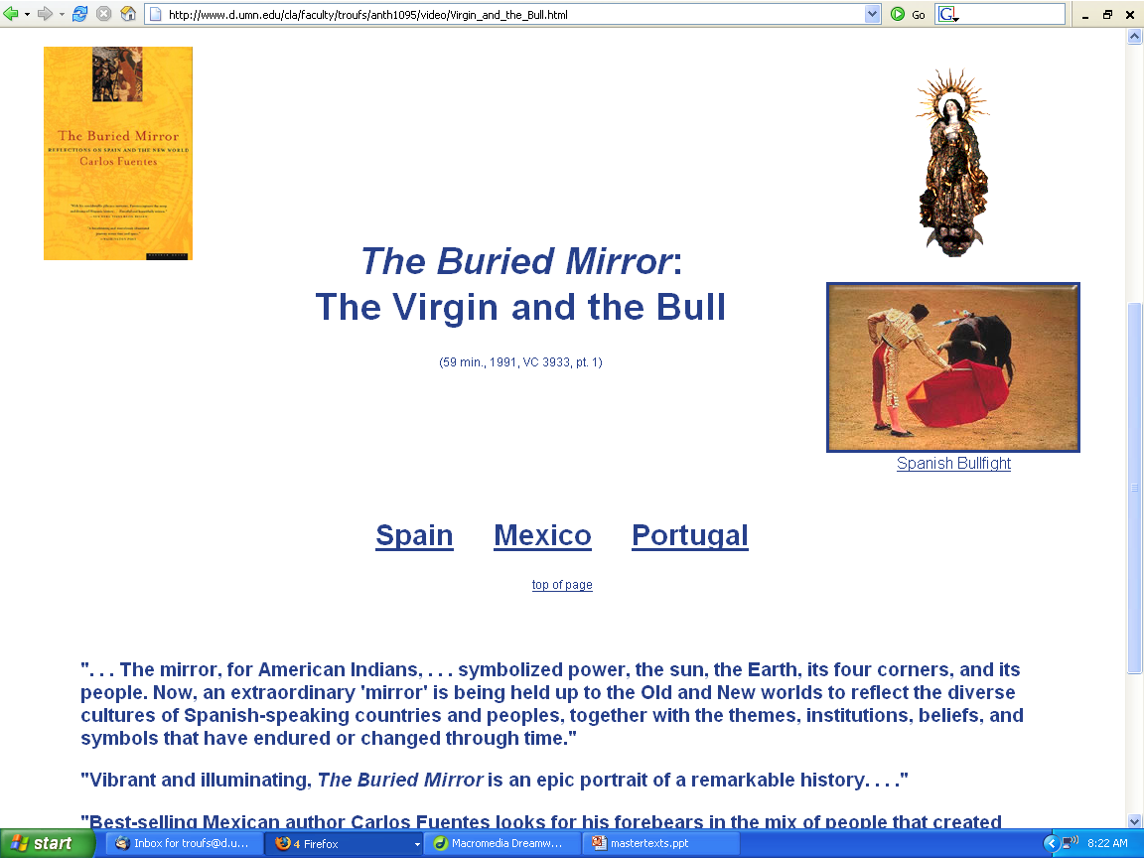

Slide 189

“Classics" in the Anthropology of Europe
George Foster
“Peasant Society and the Image of Limited Good.” American Anthropologist
  67:293-315.
Parman's classic picks -- Tony Galt

Slide 190
“Classics" in the Anthropology of Europe
Ernestine Friedl
1962 Vasilika: A Village in Modern Greece.
Belmont, CA: Thompson Wadsworth, 2002.
(ISBN: 0030115450)
Parman's classic picks -- Tony Galt

Slide 191
“Classics" in the Anthropology of Europe
Ernestine Friedl
1964 Lagging Emulation in Post-Peasant Society. American Anthropologist 66:569-586.
The Position of Women: Appearance and Reality. Anthropological Quarterly. 40:970108.
1988 Review of David D. Gilmore, ed. Honor and Shame and the Unity of the Mediterranean. American Ethnologist. 15:813-814.
Parman's classic picks -- Tony Galt

Slide 192
“Classics" in the Anthropology of Europe
Sharon B. Gmelch
1986 Groups that Don't Want in: Gypsies and other Artisan, Trader, and Entertainer Minorities. Annual Review of Anthropology 15:307-330.
Parman's classic picks -- Tony Galt

Slide 193

Sharon Gmelch
Nan: The Life of an Irish Traveling Woman, Revised Edition.
Long Grove: IL: Waveland Press, 1991.
(ISBN: 0881336025)
http://www.d.umn.edu/cla/faculty/troufs/anth3635/cetexts.html#Nan

Slide 194
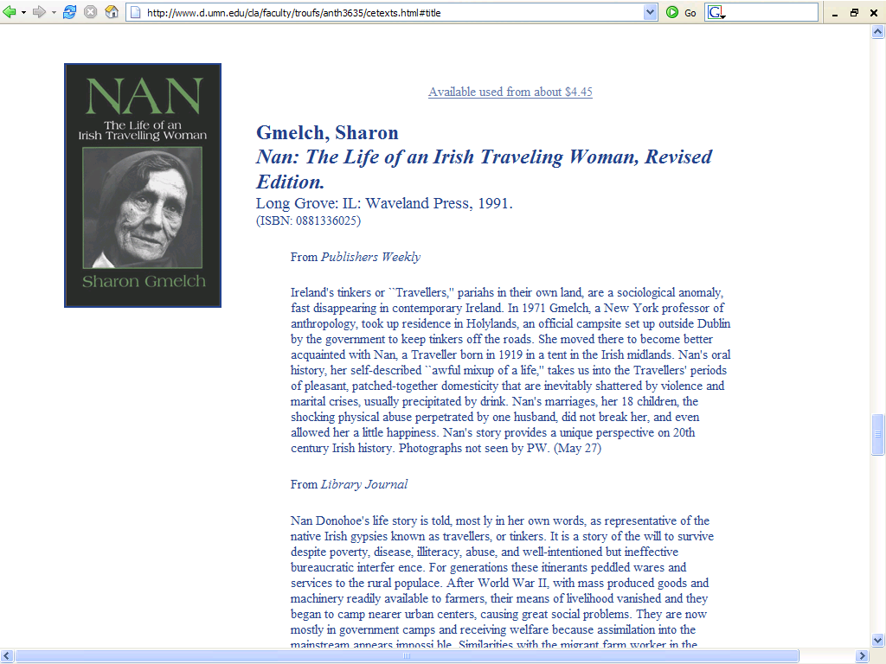

Slide 195


The Irish Tinkers: The Urbanization of an Itinerant People
by George Gmelch
1985

Slide 196
“Classics" in the Anthropology of Europe
Tomas Hofer
1972? Research Styles of American and Central European Ethnographers. Current Anthropology.
Parman's classic picks -- Tony Galt

Slide 197
“Classics" in the Anthropology of Europe
Tamaś Hofer
1968 Anthropologists and Native Ethnographers in Central European Villages: Comparative Notes on the Professional Personality of Two Disciplines. Current Anthropology, Vol. 9, No. 4 (Oct., 1968), pp. 311-315.
Parman's classic picks -- Tony Galt

Slide 198
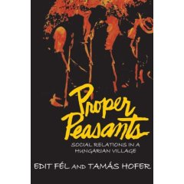
“Classics" in the Anthropology of Europe
Tamaś Hofer
1969 Proper peasants: Traditional life in a Hungarian village
Viking Fund Publications in
Anthropology
[Reprinted 31 March 2008]
Parman's classic picks -- Tony Galt

Slide 199
“Classics" in the Anthropology of Europe
John C. Messenger
1971 Sex and Repression in an Irish Folk Community. In Human Sexual Behavior: Variations in the Ethnographic Spectrum, by Donald S. Marshall and Robert C. Suggs. Englewood Cliffs, New Jersey: Prentice-Hall.
1978 The Golden Chain: A Study of the Structure, Function, and Patterning of Comparatico in a South Italian village. American Ethnologist 5:116- 136.
Parman's classic picks -- Tony Galt

Slide 200
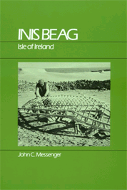
Inis Beag
Gaelic: "Little Island"
John C. Messenger
Inis Beag: Isle of Ireland.
Long Grove: IL: Waveland Press, 1983.
(ISBN: 0881330515)
http://www.d.umn.edu/cla/faculty/troufs/anth3635/cetexts.html#InisBeag

Slide 201
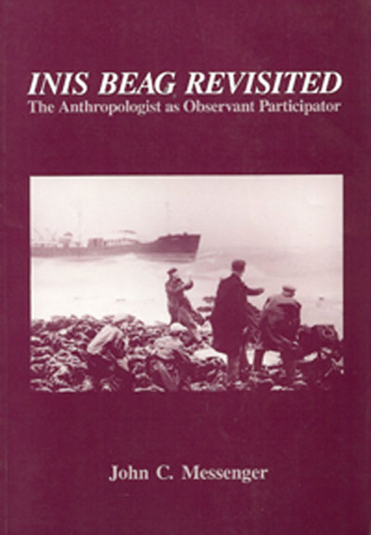
INIS Beag Revisited:
The Anthropologist as Observant Participator
Salem, WI: Sheffield. (Reprint edition August 1989).
The 1983 version was entitled An Anthropologist At Play:
Ballad-mongering in Ireland and its Consequences for Research

Slide 202
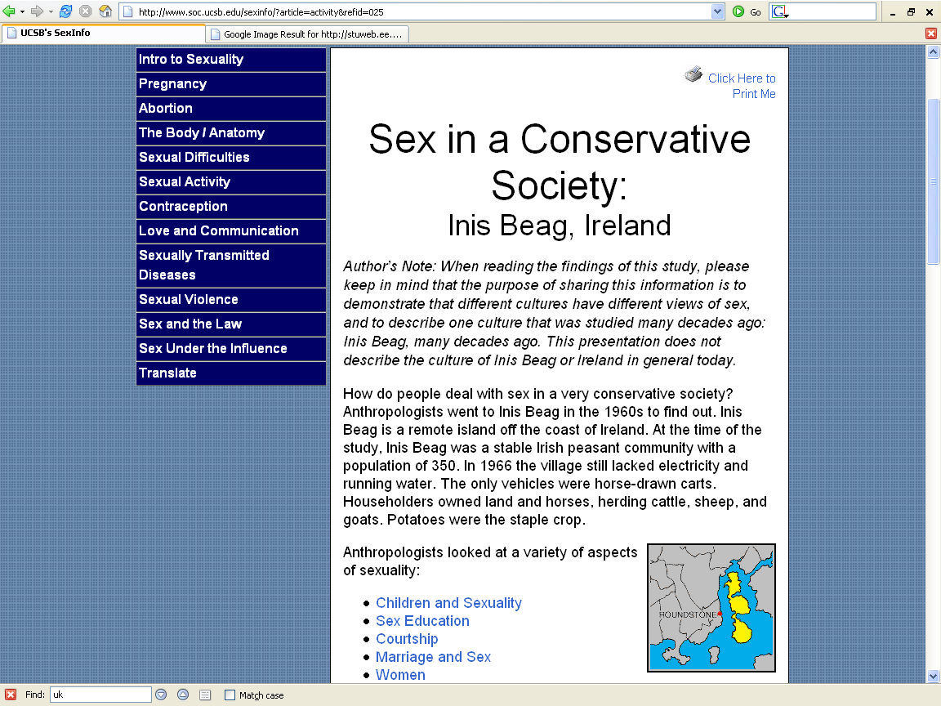
Anthropology majors should look at Messenger’s work, focusing on the ethics of fieldwork and publishing information about native peoples
http://www.soc.ucsb.edu/sexinfo/?article=activity&refid=025

Slide 203
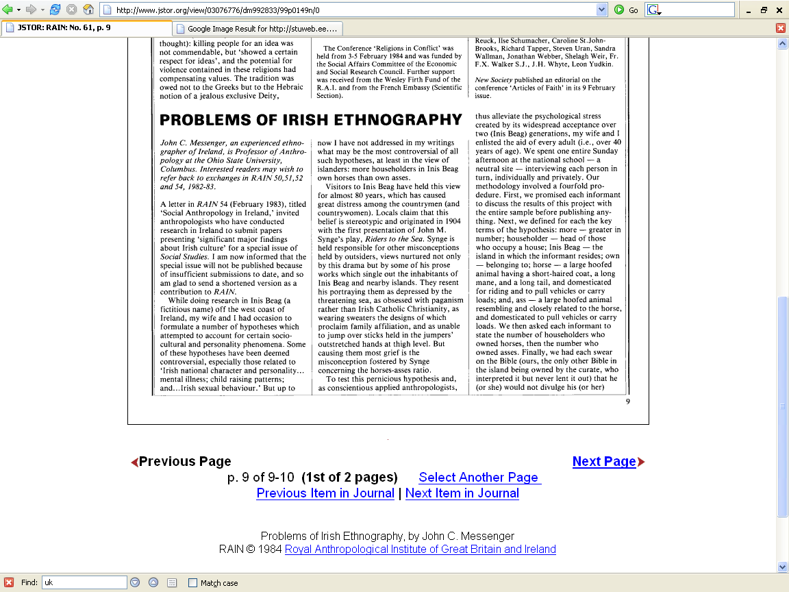
Anthropology majors should look at Messenger’s work, focusing on the ethics of fieldwork and publishing information about native peoples

Slide 204
“Classics" in the Anthropology of Europe
John C. Messenger
1971 Sex and Repression in an Irish Folk Community. In Human Sexual Behavior: Variations in the Ethnographic Spectrum, by Donald S. Marshall and Robert C. Suggs. Englewood Cliffs, New Jersey: Prentice- Hall.
1978 The Golden Chain: A Study of the Structure, Function, and Patterning of Comparatico in a South Italian village. American Ethnologist 5:116-136.
Parman's classic picks -- Tony Galt

Slide 205
“Classics" in the Anthropology of Europe
Andrei Simić
1974 Urbanization and Cultural Process in Yugoslavia. Anthropological Quarterly 47:211- 227
1991 Obstacles to the Development of a Yugoslav National Consciousness: Ethnic Identity and Folk Culture in the Balkans. Journal of Mediterranean Studies 1:18-36

Slide 206

“Classics" in the Anthropology of Europe
Eric Wolf
1966 Peasants. Englewood Cliffs: Prentice-Hall.
1969 Peasant Wars of the Twentieth Century.
NY: Harper and Row.

Slide 207

“Classics" in the Anthropology of Europe
Eric Wolf
1959 Chicago: University of Chicago Press.

Slide 208
“Classics" in the Anthropology of Europe
Eric Wolf
1969 Society and symbols in Latin Europe and in the Islamic Near East. Anthropological Quarterly 42:287-301.
1987 The Peasant War in Germany: Friedrich Engels as Social Historian. Science and Society 51:82-92.
1994 Perilous Ideas: Race, Culture, People. Current Anthropology 35:1-7.

Slide 209

“Classics" in the Anthropology of Europe addendum
Ronald Frankenberg
1957 Village on the Border: A Social Study of Religion, Politics, and Football in a North Wales Community
Cohen and West

Slide 210

“Classics" in the Anthropology of Europe addendum
Lewis - Refield debate
Robert Redfield
  Tepoztlan, a Mexican Village: A Study of Folk Life
  1930 University of Chicago Press.
Oscar Lewis
  Life in a Mexican Village: Tepoztlan Restudied
  1951 Urbana,IL: University of Illinois Press.

Slide 211


“Classics" in the Anthropology of Europe addendum
Oscar Lewis

Slide 212
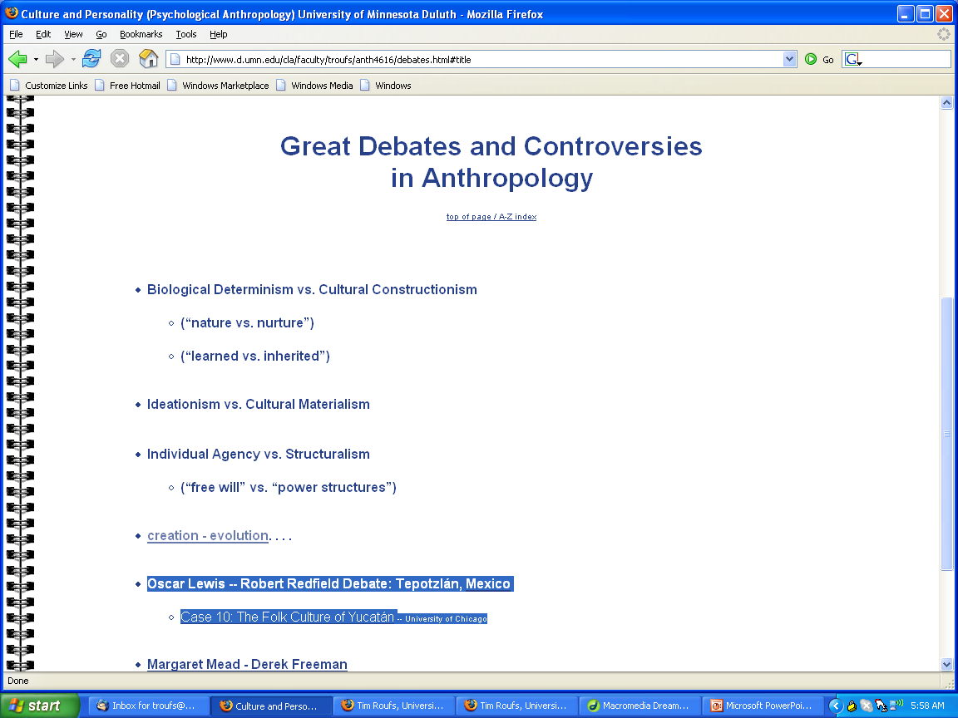
We’ll have a look at the Great Debates and Controversies separately
http://www.d.umn.edu/cla/faculty/troufs/anth4616/debates.html#title

Slide 213
Douglass extracts comments from . . .
  Arensberg’s Irish Countryman
      the earliest example of anglophone Europeanist anthropology
  Pitt-Rivers’s People of the Sierra
      “anglophone Europeanist anthropology’s quintessential and most influential little community study”
Susan Parman, Europe in the Anthropological Imagination, pp. 14 - 16

Slide 214
Since the fall
of the Berlin Wall, 1989 . . .

Slide 215
the Anthropology of Europe has changed
Since the fall
of the Berlin Wall, 1989 . . .

Slide 216
Since the fall
of the Berlin Wall, 1989 . . .
Since the exodus from
Lake Balaton,
Hungary, 1989 . . .

Slide 217
which was the forerunner of the fall of the Wall
Since the fall
of the Berlin Wall, 1989 . . .
Since the exodus from
Lake Balaton,
Hungary, 1989 . . .

Slide 218
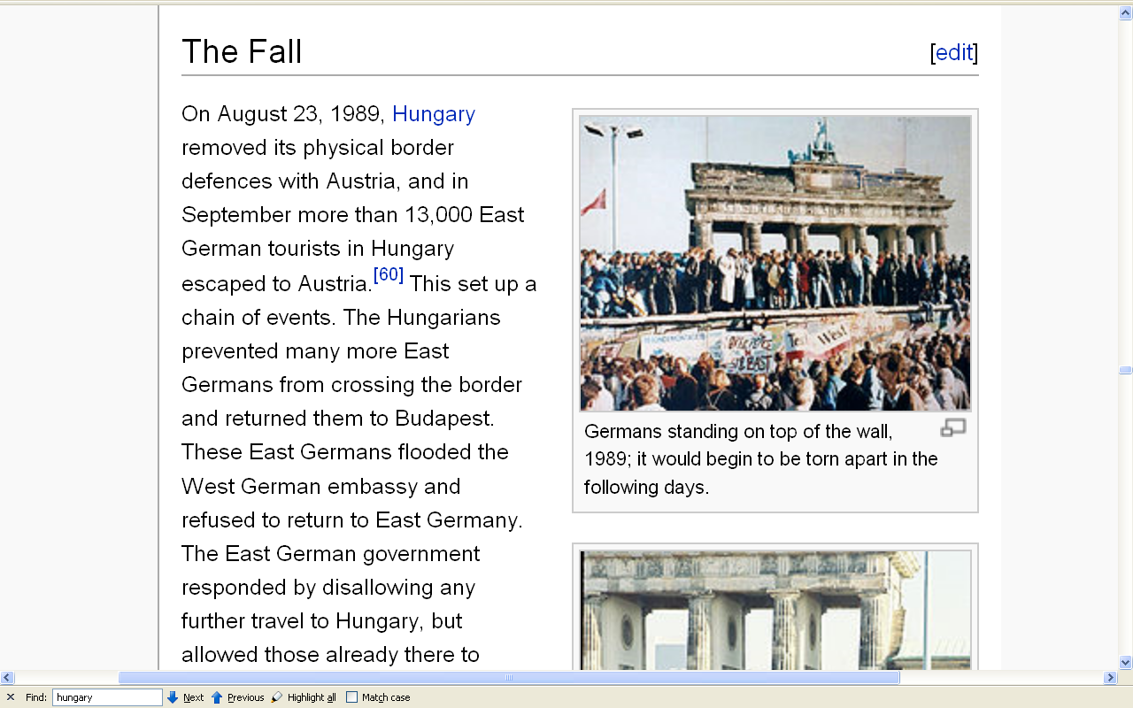
http://en.wikipedia.org/wiki/Fall_of_the_Berlin_Wall#The_Fall

Slide 219
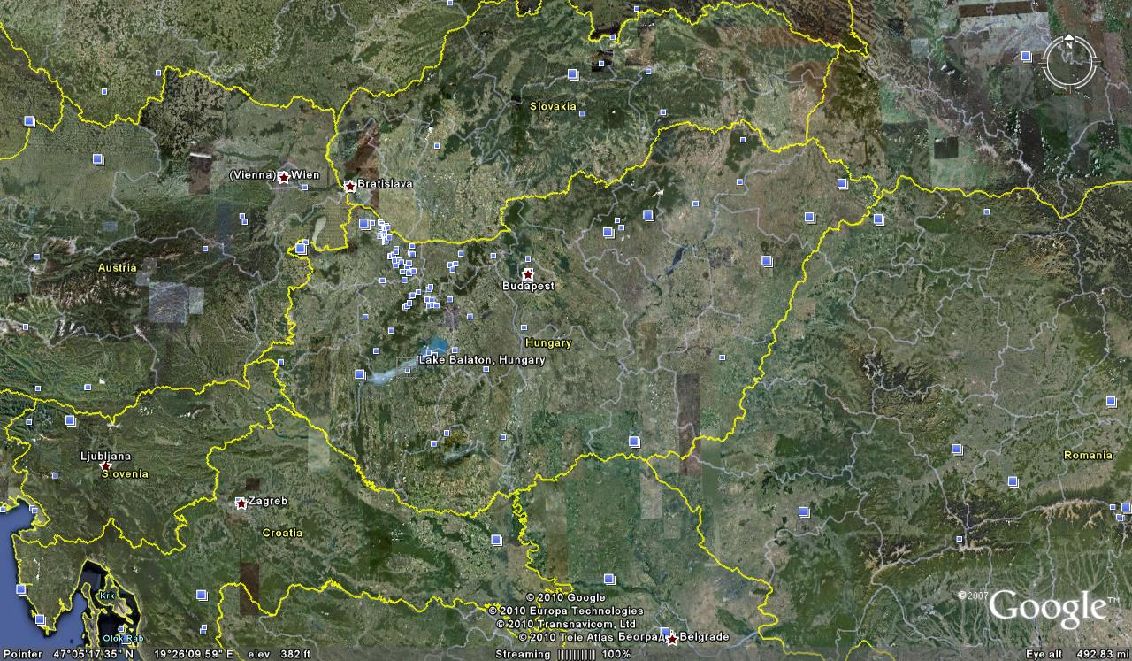
http://en.wikipedia.org/wiki/Fall_of_the_Berlin_Wall#The_Fall

Slide 220

more recent works include . . .
Oxford, UK: Berg Publishers, 1996

Slide 221
“This is the first study of Europe post-1989 from an anthropological perspective.”
“Thirteen distinguished authors examine the social, cultural and political implications of European integration with particular emphasis on changing European identities, concepts of citizenship and levels of participation.”
“Their aim is to suggest an agenda for future research capable of addressing developing trends in contemporary Europe.”
Oxford, UK: Berg Publishers, 1996

Slide 222
“The book is divided into two parts.”
“The first deals with major theoretical issues that have characterized the anthropological study of Europe and includes a detailed introductory chapter which charts the history of anthropology in Europe and considers the prospects for an anthropology of Europe.”
Oxford, UK: Berg Publishers, 1996

Slide 223
“This is followed by key themes in the study of European society and culture including kinship, gender, nationalism, immigration and changing patterns of production.”
Oxford, UK: Berg Publishers, 1996

Slide 224
“The second section develops these themes further using different theoretical perspectives to explain complex issues such as nationalism, ethnic identities, and sectarian conflicts.”
“Nine case studies cover . . . European integration and Irish nationalism, the transmission of ethnic identity, and identity and conflict in the former Yugoslavia and post-colonial Gibraltar.”
Oxford, UK: Berg Publishers, 1996

Slide 225
“This book fills a gap in the literature on European integration and will be of interest to anthropologists and sociologists as well as students of Political Science, Communications and European Studies.”
Oxford, UK: Berg Publishers, 1996

Slide 226
Themes . . .
European Communities?
From the Mediterranean to Europe
Nationalism in Europe
Foreigners Within: Germany’s Turks
Nationalism and EU Integration: Ireland
Xenophobia: Ethnic Violence in Yugoslavia
Identity: Gibraltar and its Migrants
Ethnic Identity, Gender, Life cycle: Catalonia
Gender Relations and Social Change
Commercial Realization and Community Boundary
Citizen’s Europe: Spain
Citizen’s Europe: EU
The Anthropology of Europe: Identities and Boundaries in Conflict
Oxford, UK: Berg Publishers, 1996

Slide 227
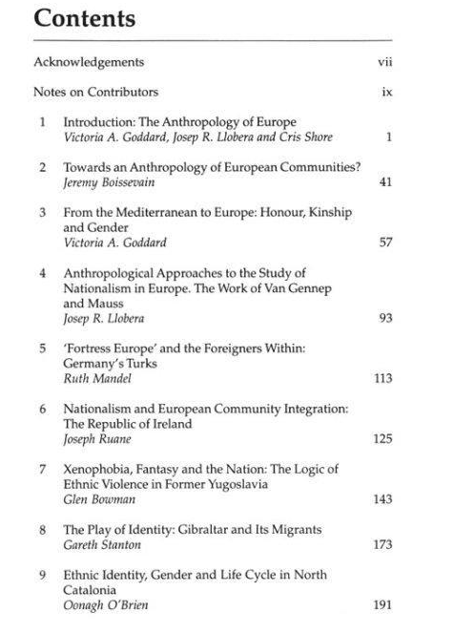
The Anthropology of Europe: Identities and Boundaries in Conflict
Oxford, UK: Berg Publishers, 1996

Slide 228
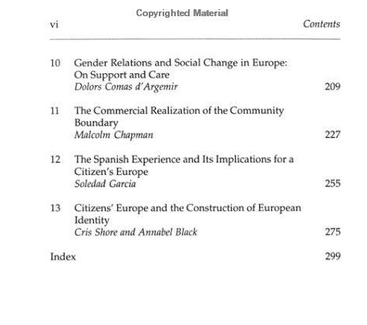
The Anthropology of Europe: Identities and Boundaries in Conflict
Oxford, UK: Berg Publishers, 1996

Slide 229
“Master Ethnographic Texts”
“Classics” in the
Anthropology of Europe
and related studies
Tim Roufs
© 2010-2024

