Slide 1


Welcome to
Culture and Personality
University of Minnesota Duluth
Tim Roufs’ © 2009-2013
Great Pyrenean
Mountain Dog
Venus of Willendorf
www.d.umn.edu/cla/faculty/troufs/anth4616/

Slide 2
Welcome to
Culture and Personality
This will be a great course . . .
you will see . . .
University of Minnesota Duluth
Tim Roufs’ © 2009-2013
Great Pyrenean
Mountain Dog
Venus of Willendorf
www.d.umn.edu/cla/faculty/troufs/anth4616/

Slide 3

First thing . . .
(if you are not already in Moodle)
go to your
2
course management site
and check it out . . .

Slide 4
How do you find
2
in the first place?

Slide 5
Further instructions follow,
but if you want,
and your browser permits,
clicking on the URL that follows
in the next slide
will take you to your Moodle home . . .
(your browser may require that you double-click)
There is another link at the end of this program

Slide 6
https://moodle2.umn.edu/
(your browser may require that you double-click)
If your browser does not allow you to click on the above URL just enter it in your browser window . . .
Continue on here for further instructions . . .
There is another link at the end of this program

Slide 7
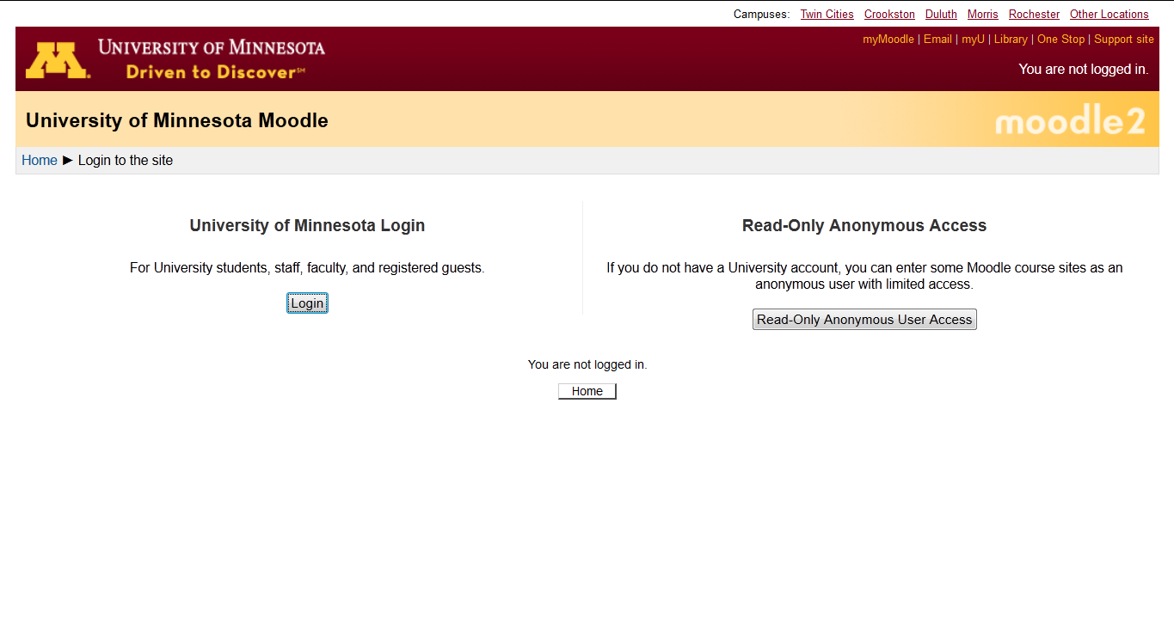
Your Moodle screen may look something like this . . .

Slide 8
Your Moodle screen may look something like this . . .

Slide 9
If you get this screen, go to “University of Minnesota Login” . . .
Be sure to log in

Slide 10
Your log-in page will then look something like the following . . .
Log in using your “x.500” information . . .
(that’s the log-in information you use for your e-mail)
https://moodle.umn.edu/

Slide 11
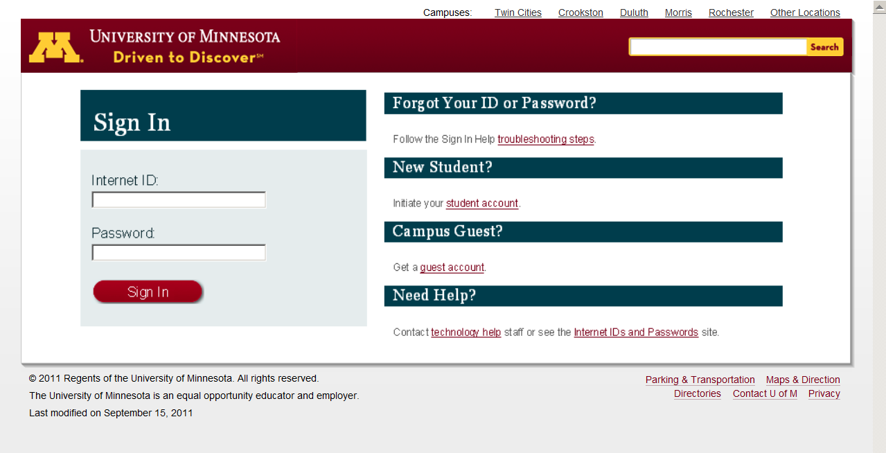
Log in using your “x.500” information . . .

Slide 12
You may also access your Moodle folder from any of the many
course index and content
web pages . . .

Slide 13
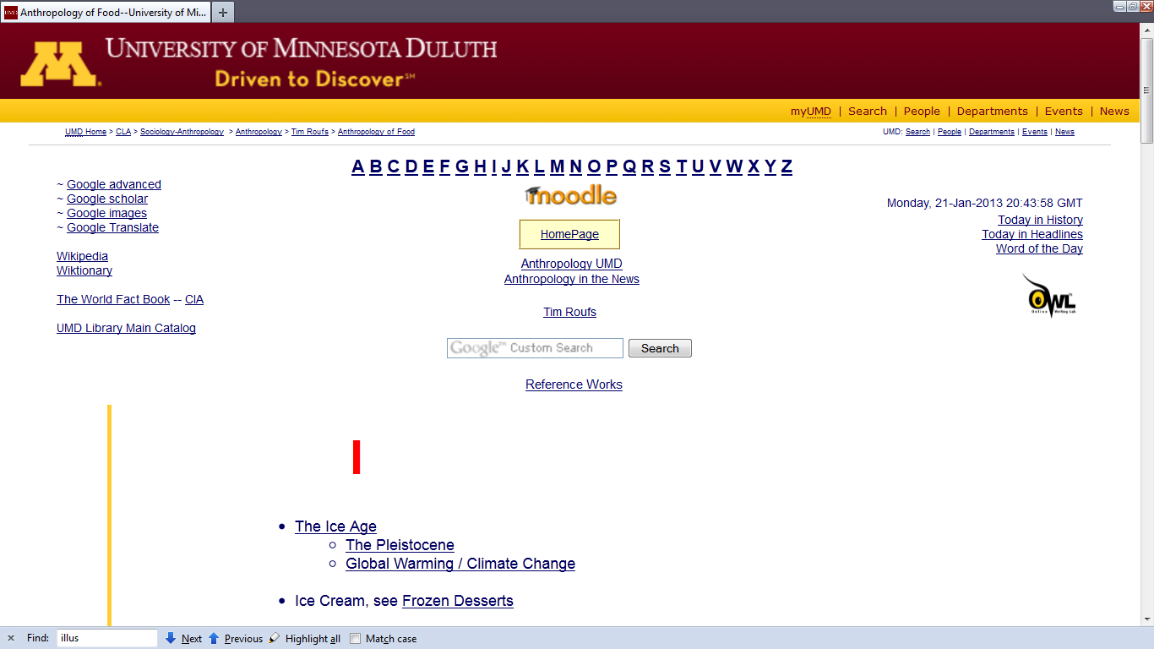

Slide 14
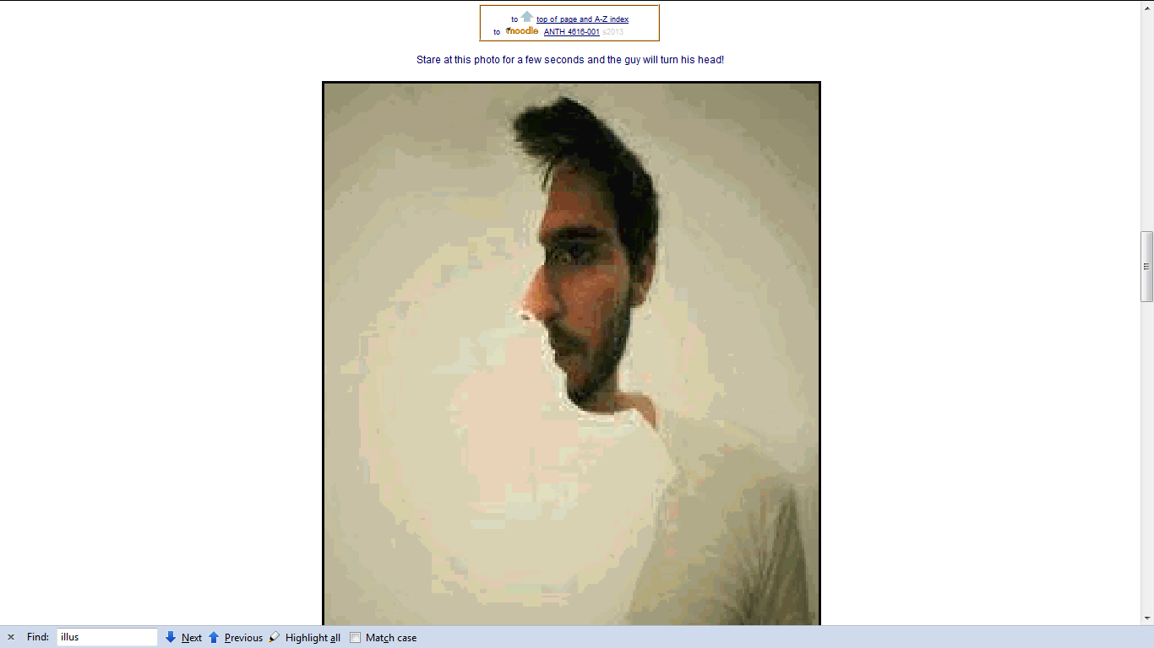

Slide 15
Or you may also access your Moodle folder via the Main UMD WebPage . . .

Slide 16
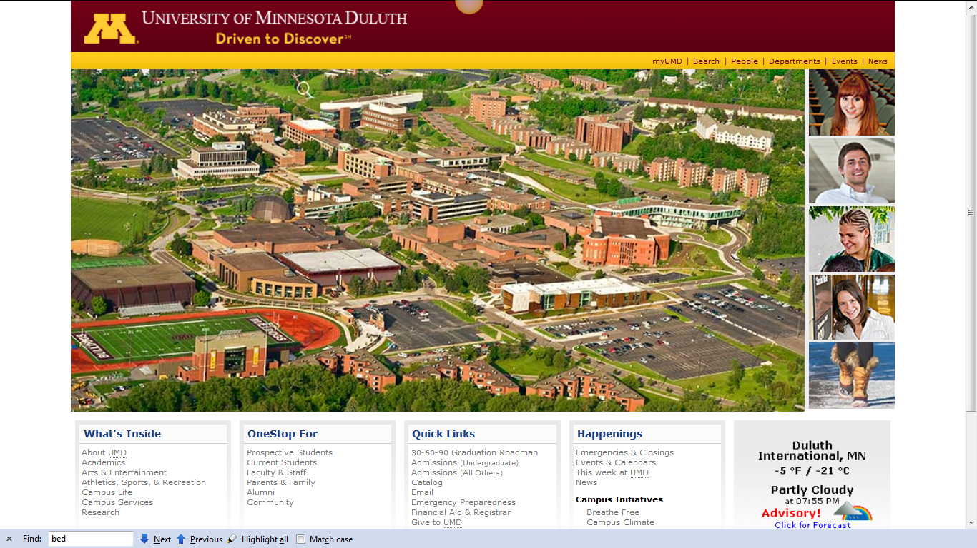
Main UMD WebPage . . .
(this image changes)
www.d.umn.edu

Slide 17
click on “OneStop For Current Students” . . .
(not the image that will appear)
www.d.umn.edu

Slide 18
Main UMD WebPage . . .
(this image changes)
www.d.umn.edu

Slide 19
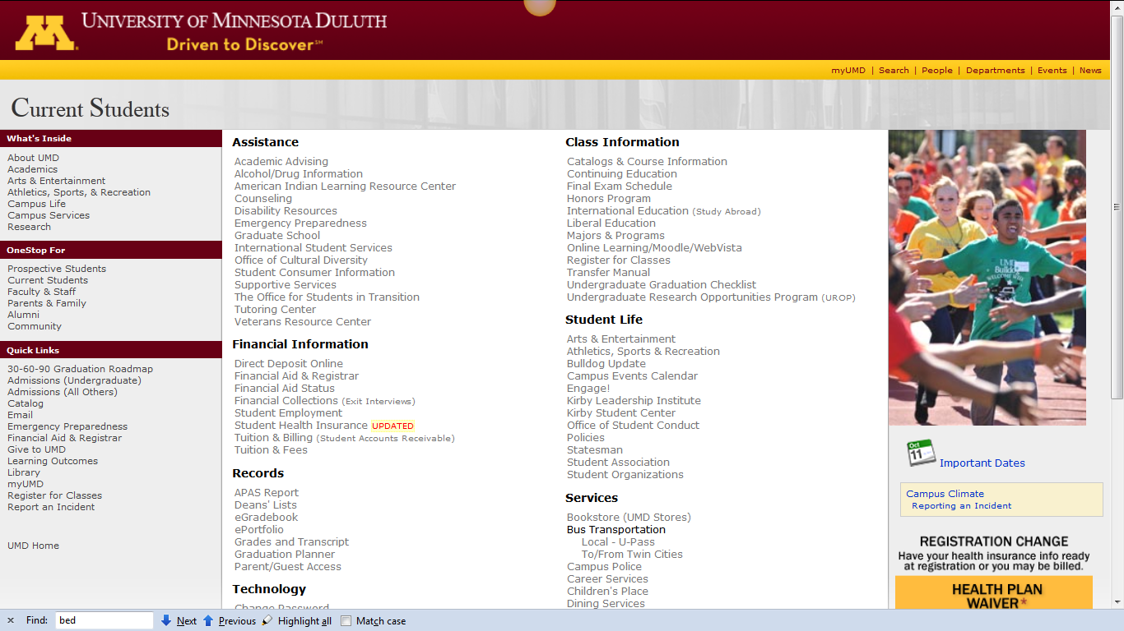
scroll down
http://www.d.umn.edu/students/

Slide 20
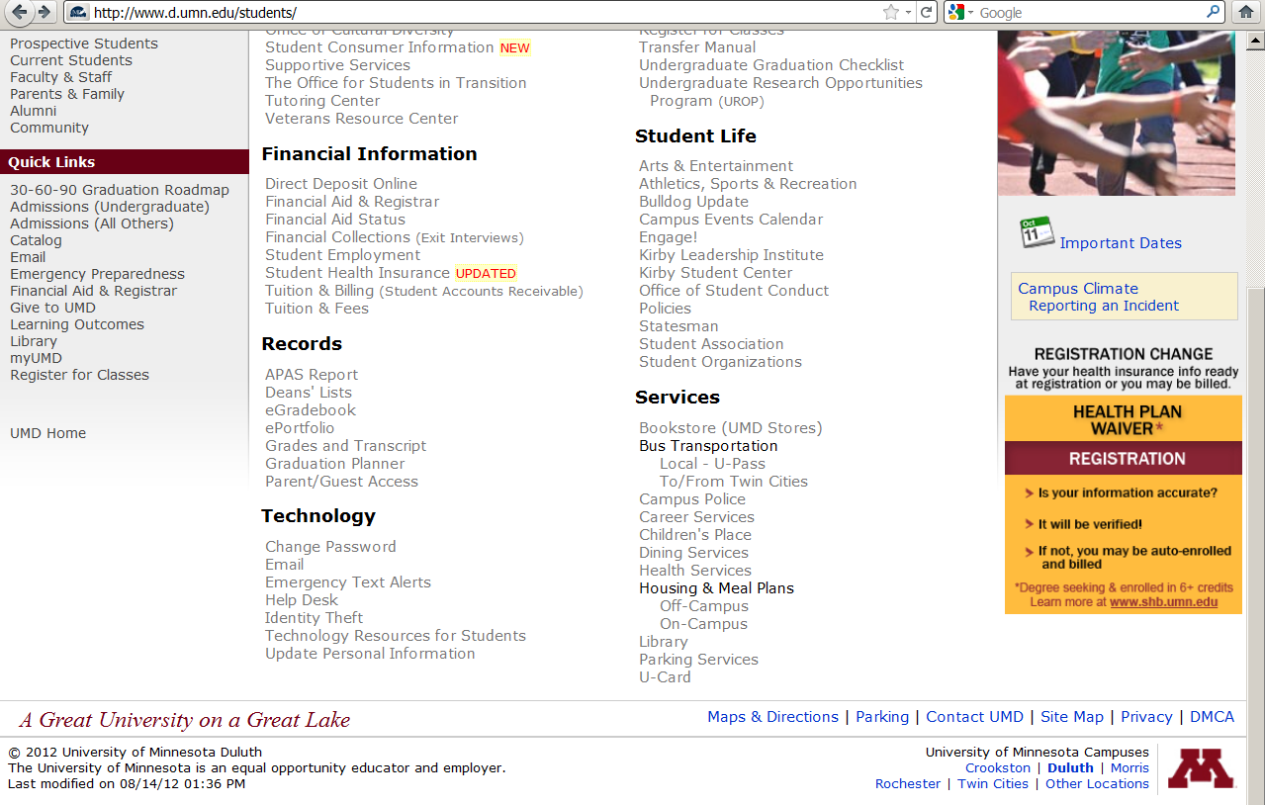
click on “Technology Resources for Students” . . .

Slide 21
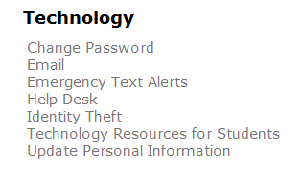
click on “Technology Resources for Students” . . .
http://www.d.umn.edu/itss/students/

Slide 22
then click on “Moodle Support” . . .
http://www.d.umn.edu/itss/students/

Slide 23
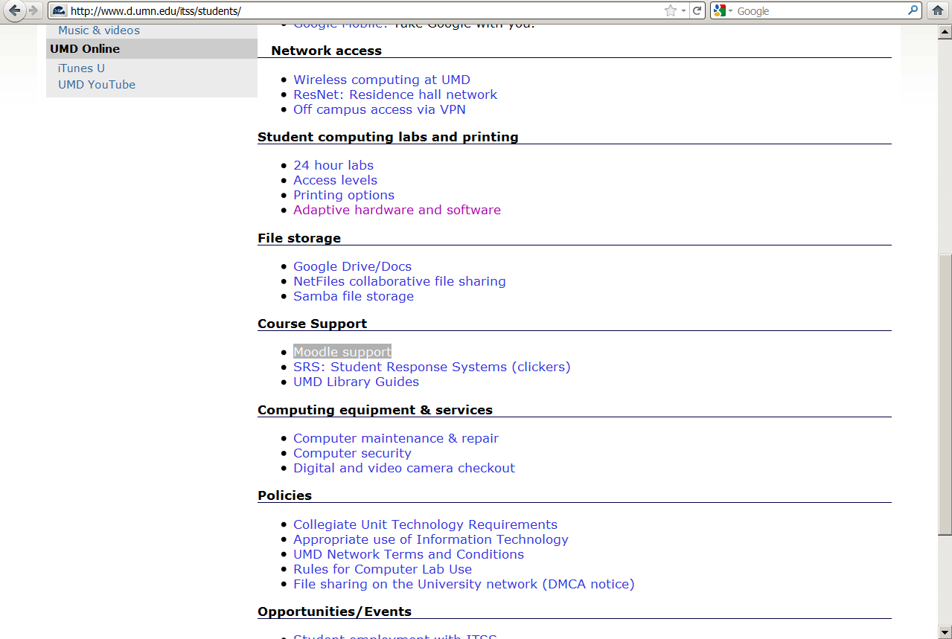
click on “Moodle Support” . . .
http://www.d.umn.edu/itss/students/

Slide 24
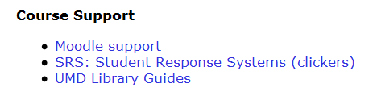
click on “Moodle Support” . . .
http://www.d.umn.edu/itss/students/

Slide 25
Your log-in page will then look something like the following . . .
Log in using your “x.500” information . . .
(that’s the log-in information you use for your e-mail)
https://moodle.umn.edu/

Slide 26
Log in using your “x.500” information . . .

Slide 27
Your Moodle “home” will look something like the following . . .
https://moodle.umn.edu/

Slide 28
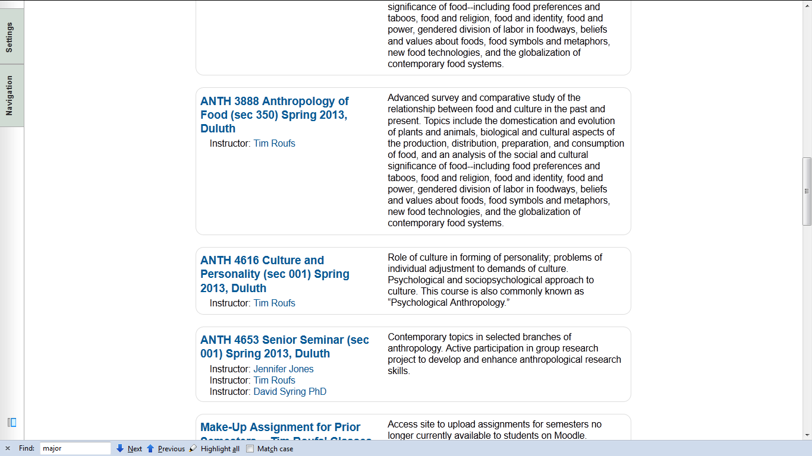
Your Moodle “home” will look something like this . . .

Slide 29
Select Culture and Personality . . .
https://moodle.umn.edu/

Slide 30
Your Moodle “home” will look something like this . . .

Slide 31
Your Moodle screen
will look
something like the following . . .

Slide 32
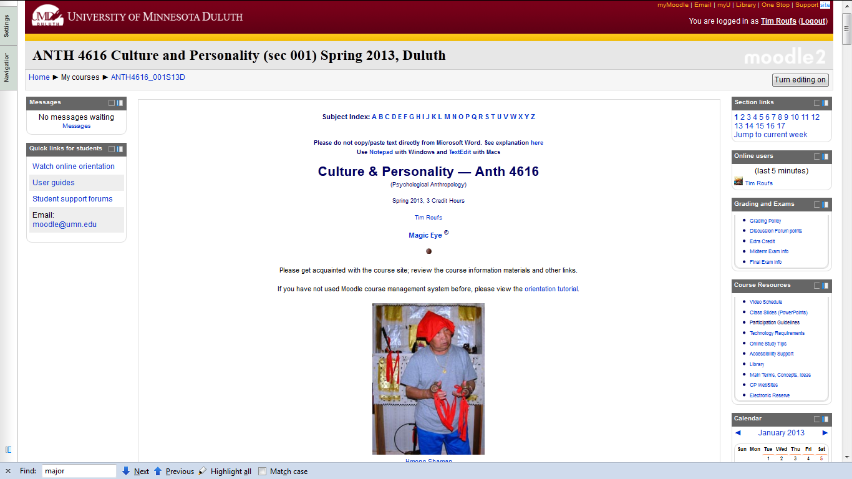
Your Moodle screen will look something like this . . .

Slide 33
Your Moodle screen will look something like this . . .
scroll down

Slide 34
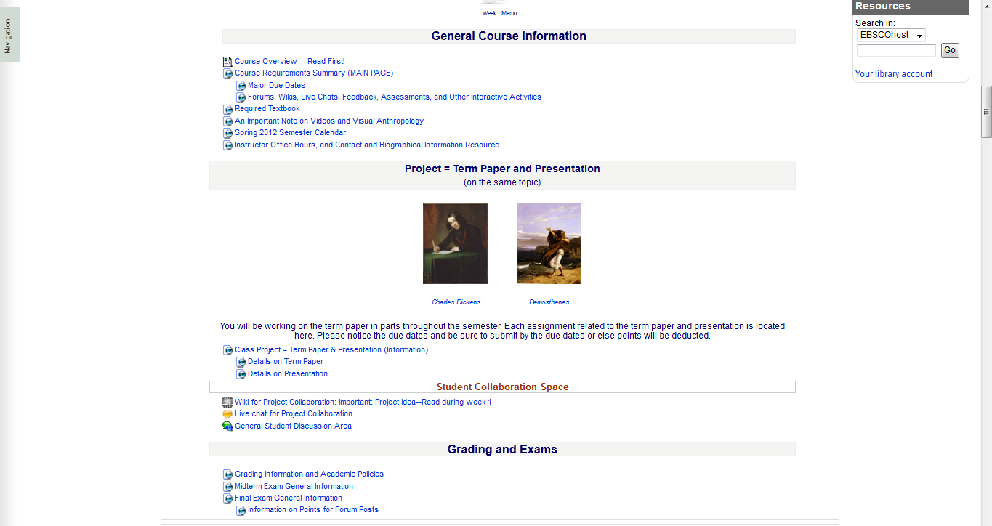
“Block 1” contains the basic information on the course . . .
“Block 1”

Slide 35
“Block 1” contains the basic information on the course . . .
“Block 1”
contains the basic information for the course

Slide 36
“Block 1” contains the basic information on the course . . .
scroll down

Slide 37
And the listing for Week 1
will look something like this . . .

Slide 38
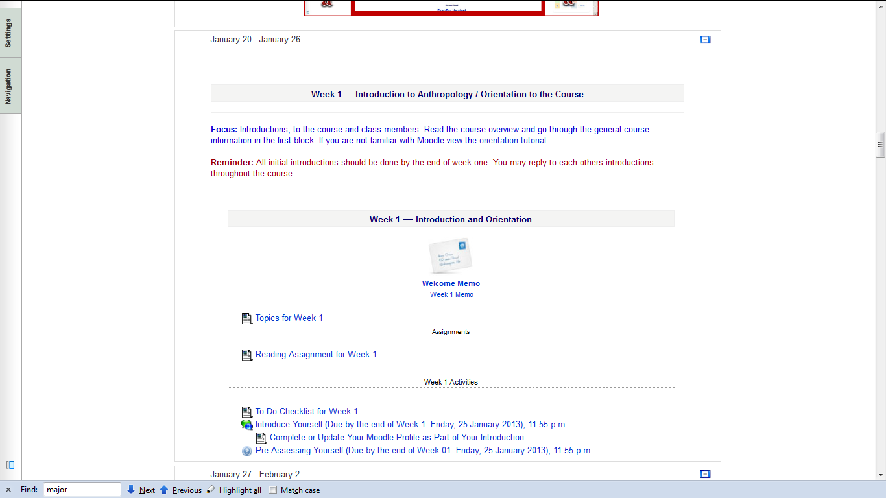
And the listing for Week 1 will look something like this . . .

Slide 39
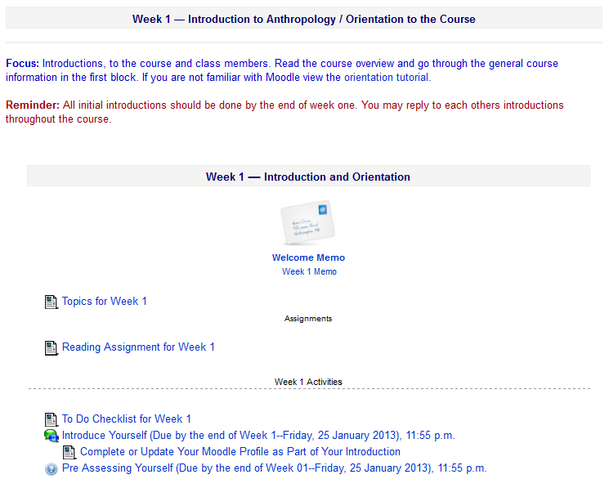

Slide 40
There are usually three main parts to the listing of a week . . .

Slide 41
1. Topics for the Week . . .

Slide 42
2. Readings for the Week . . .

Slide 43
and 3. Activities for the week . . .

Slide 44
The first week . . .
    introduce yourself
    and, just for the fun of it, have a look around at the rest of the materials

Slide 45
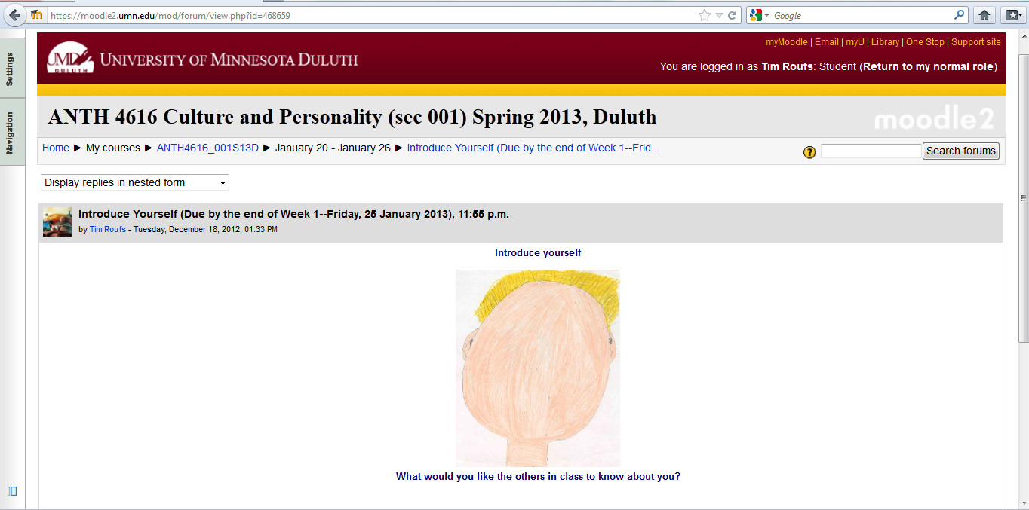
And the Introduction Page will look something like this . . .

Slide 46
The first week . . .
    introduce yourself
    and, just for the fun of it, have a look around at the rest of the materials
    be sure to Update Your Moodle Profile
    as part of your introduction

Slide 47
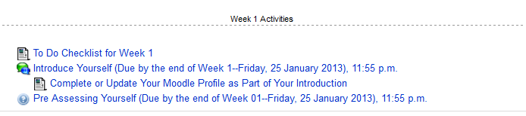
The first week . . .
    introduce yourself
    do the Pre-Assessment
    join in on the Forum Discussion
    and, just for the fun of it, have a look around at the rest of the materials

Slide 48
And the “Pre Assessment” Materials
will look something like the following . . .

Slide 49
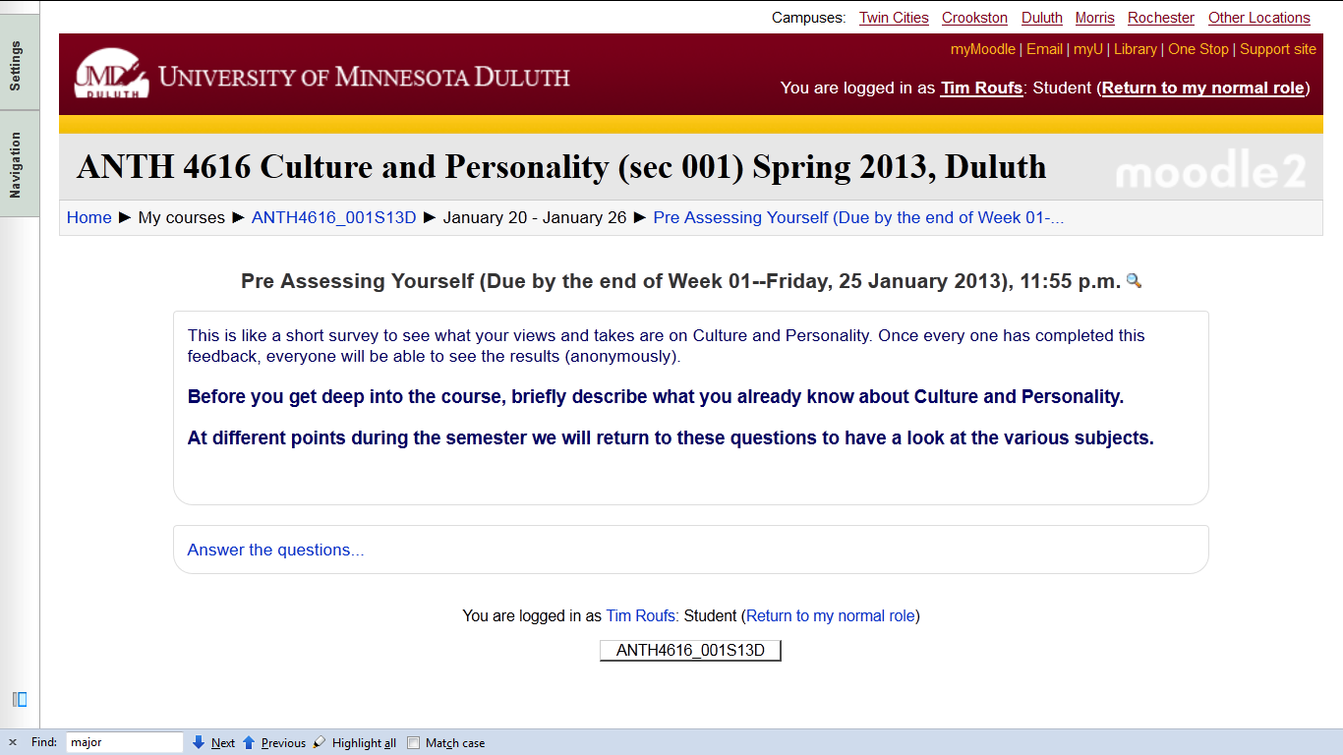
And the “Pre Assessment” Materials will look something like this . . .

Slide 50
The first week . . .
    introduce yourself
    and, just for the fun of it, have a look around at the rest of the materials

Slide 51
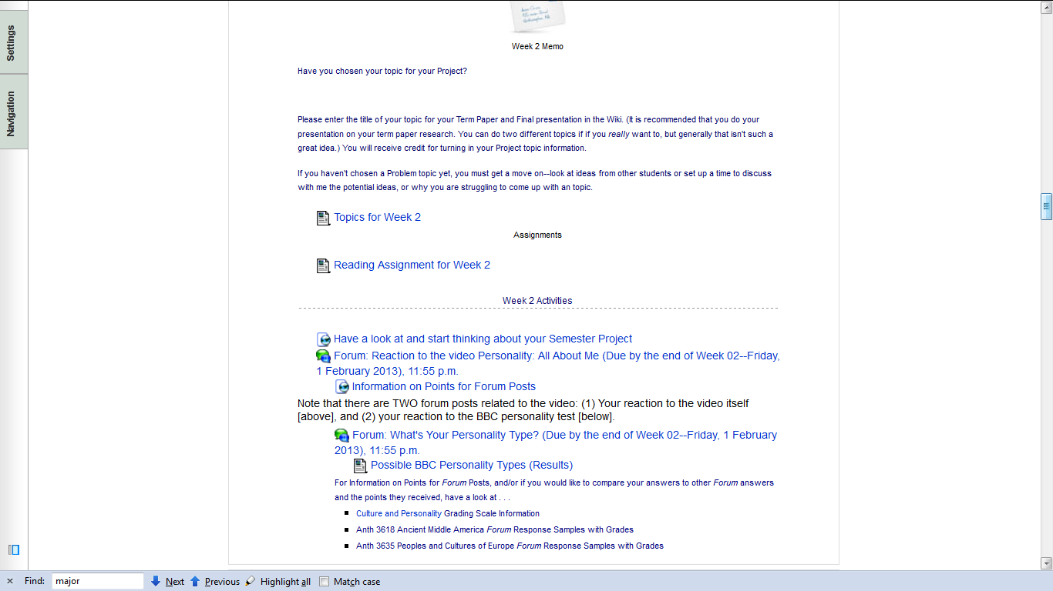
Week 2
Join in on the Forum Discussion

Slide 52
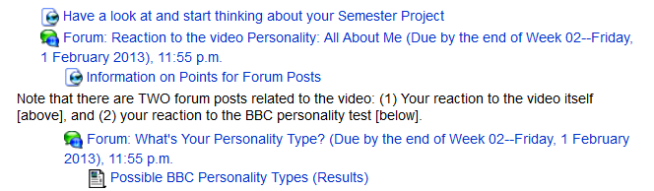
Week 2
Join in on the Forum Discussion

Slide 53
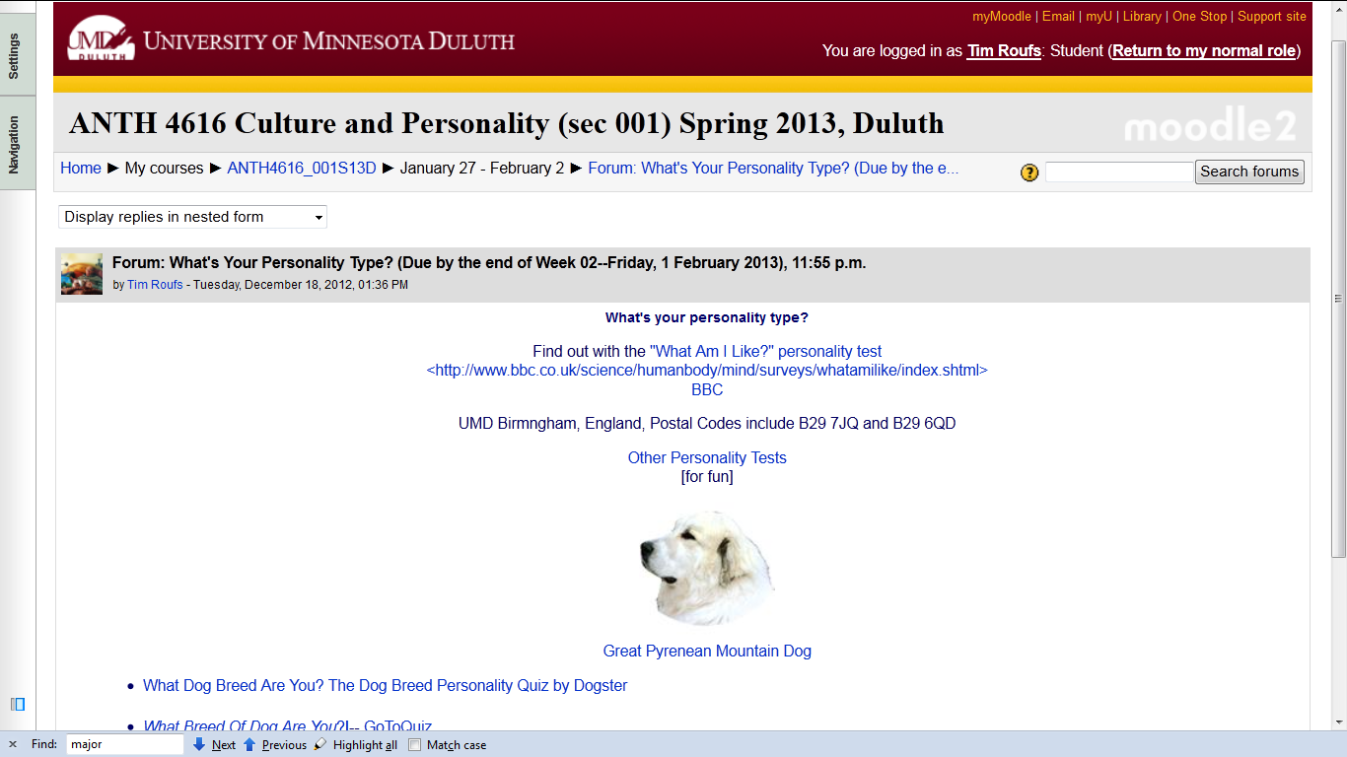

Slide 54
Your Moodle screen will look something like this . . .

Slide 55
Your Moodle screen will look something like this . . .
scroll down

Slide 56
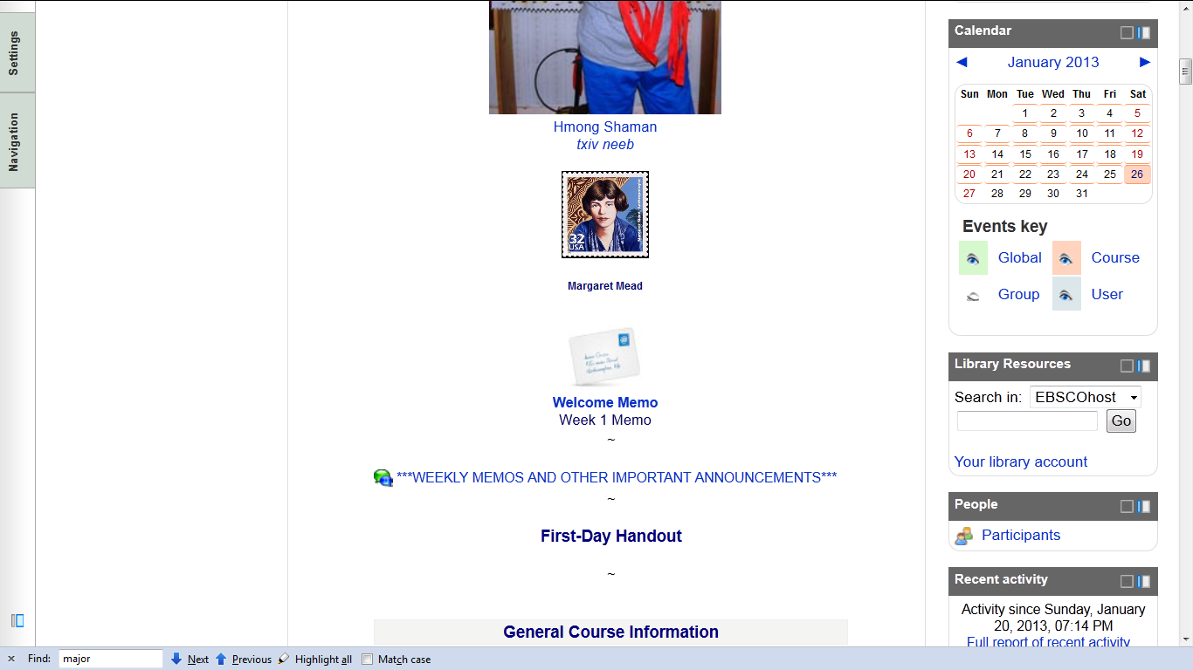
The “First-Day” Handout information below Margaret Mead . . .

Slide 57
The “First-Day” Handout information contains the basic information . . .
It look something like the following . . .
https://moodle.umn.edu/

Slide 58
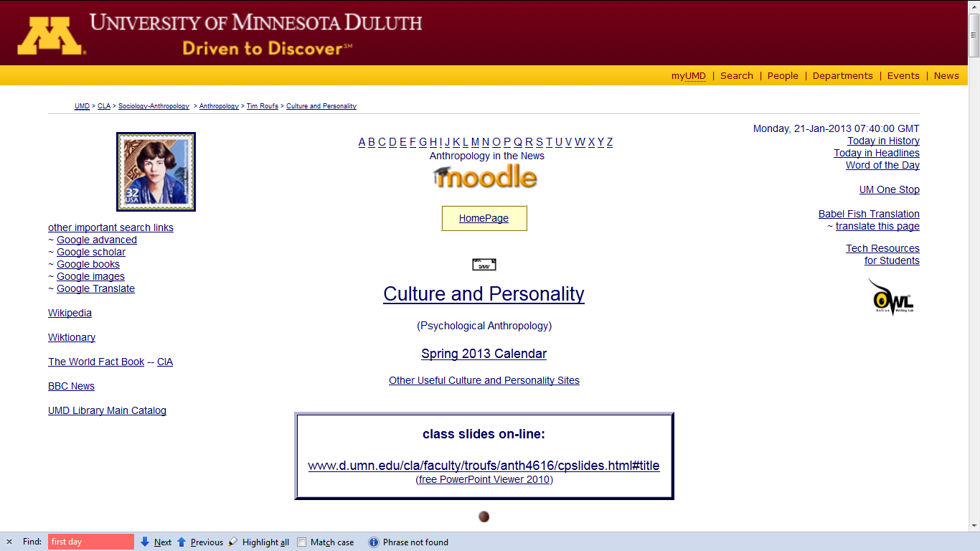
“First-Day” Handout information . . .
http://www.d.umn.edu/cla/faculty/troufs/anth3635/cehandout_first-day.html

Slide 59
“First-Day” Handout information . . .
scroll down
http://www.d.umn.edu/cla/faculty/troufs/anth3635/cehandout_first-day.html

Slide 60
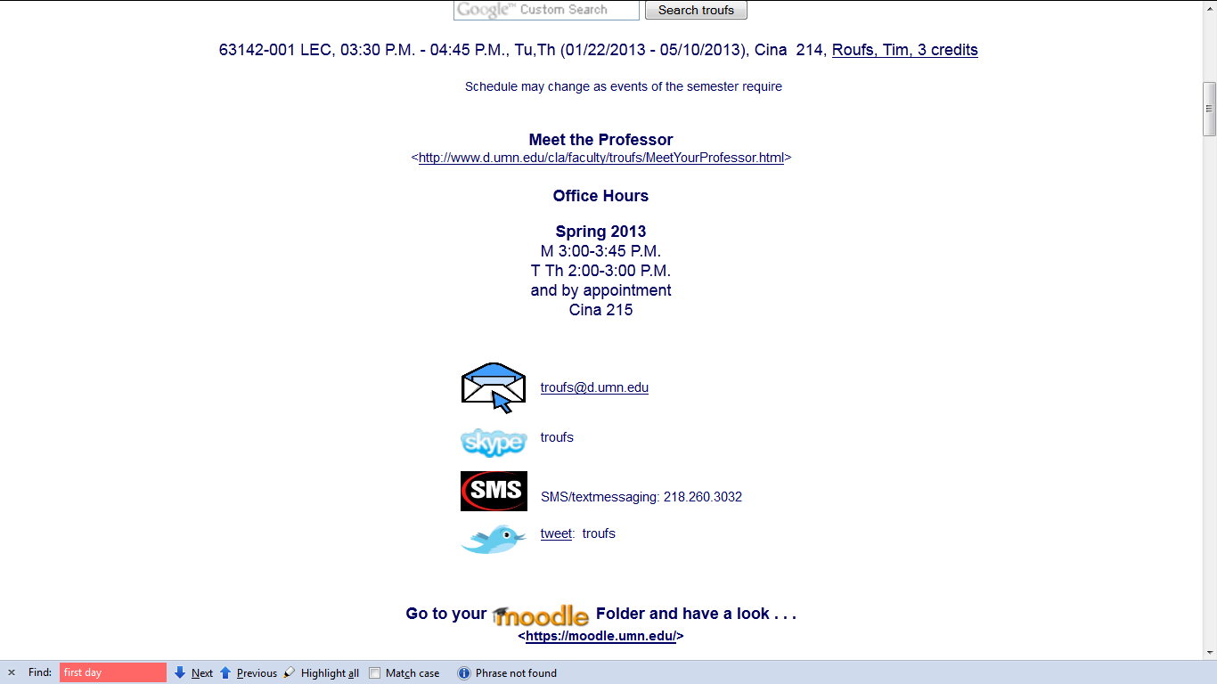
“First-Day” Handout information . . .
Basic Contact information . . .
http://www.d.umn.edu/cla/faculty/troufs/anth3635/cehandout_first-day.html

Slide 61
“First-Day” Handout information . . .
scroll down
http://www.d.umn.edu/cla/faculty/troufs/anth3635/cehandout_first-day.html

Slide 62
“First-Day” Handout information . . .
Moodle Home and
“Block 1”

Slide 63
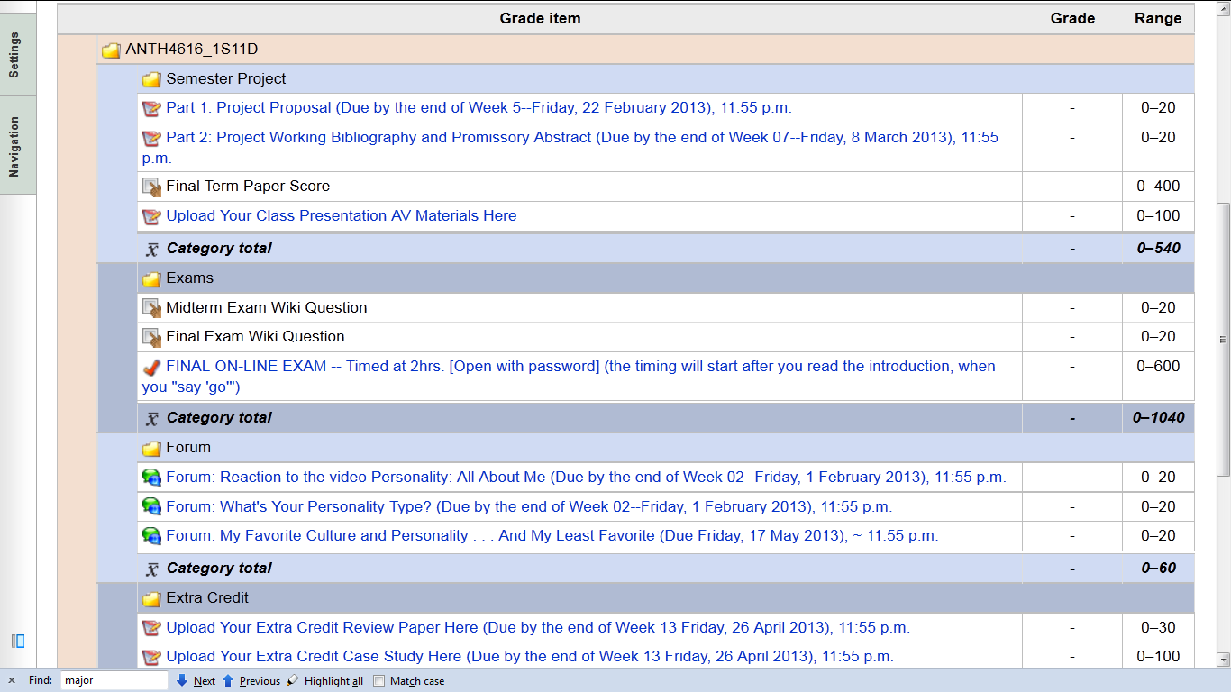
“First-Day” Handout information . . .
Moodle Grader
http://www.d.umn.edu/cla/faculty/troufs/anth3635/cehandout_first-day.html

Slide 64

“First-Day” Handout information . . .
Basic Text Information
http://www.d.umn.edu/cla/faculty/troufs/anth3635/cehandout_first-day.html

Slide 65
“First-Day” Handout information . . .
including information on purchasing texts . . .
http://www.d.umn.edu/cla/faculty/troufs/anth3635/cehandout_first-day.html

Slide 66
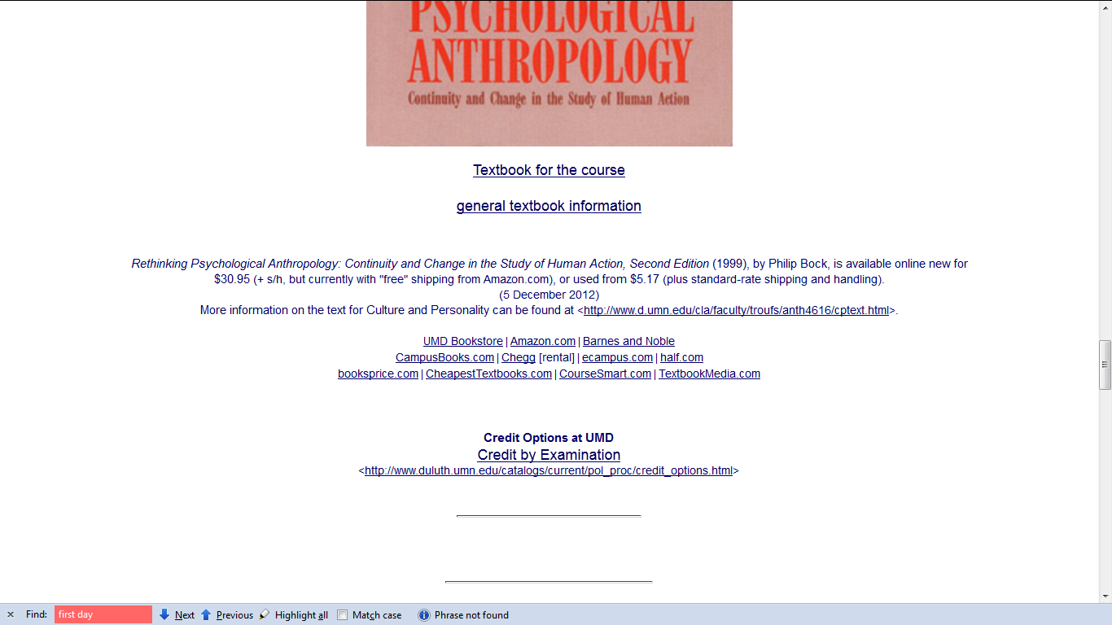
“First-Day” Handout information . . .
information on purchasing texts . . .
http://www.d.umn.edu/cla/faculty/troufs/anth3635/cehandout_first-day.html

Slide 67
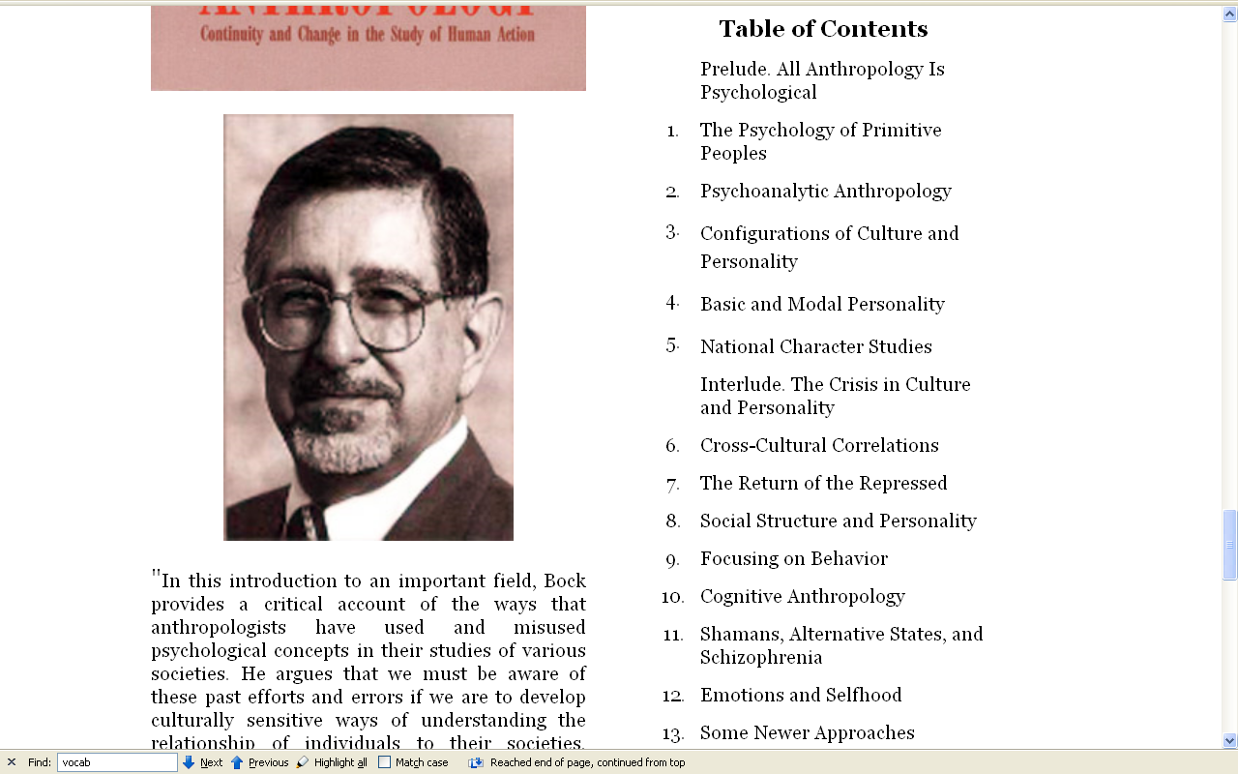
Author information . . .
www.d.umn.edu/cla/faculty/troufs/anth4616/cptext.html#title

Slide 68
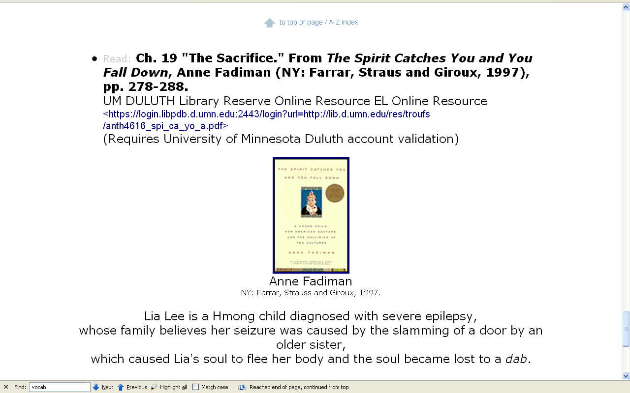
Supplementary Reading information . . .

Slide 69
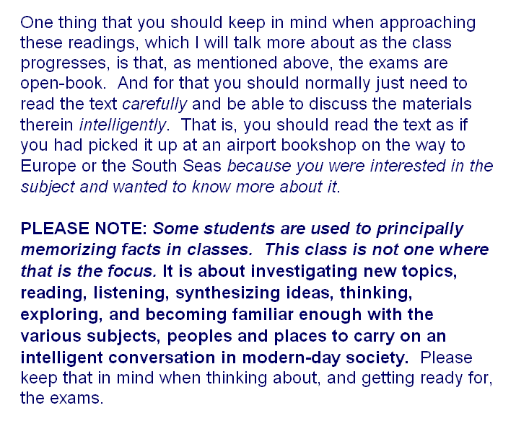
Text:

Slide 70
Your Moodle screen will look something like this . . .
Back to the main
Moodle page

Slide 71
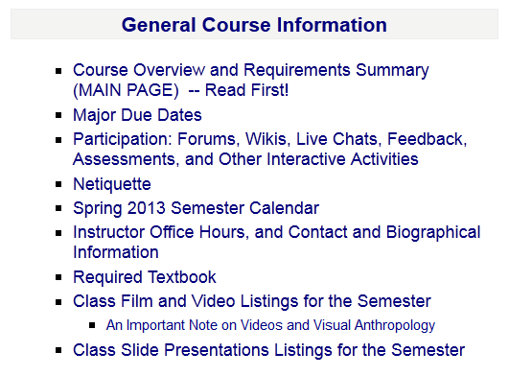
Your Moodle screen will look something like this . . .
“Block 1”

Slide 72
Your Moodle screen will look something like this . . .

Slide 73
Your Moodle screen will look something like this . . .

Slide 74
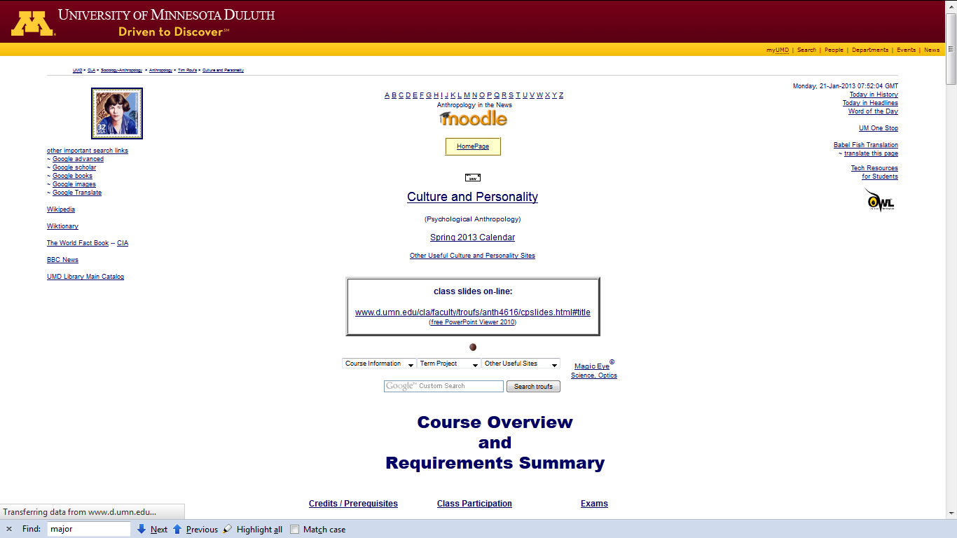

Slide 75
Governing Procedures
http://www.d.umn.edu/cla/faculty/troufs/anth3635/cehandout_first-day.html

Slide 76
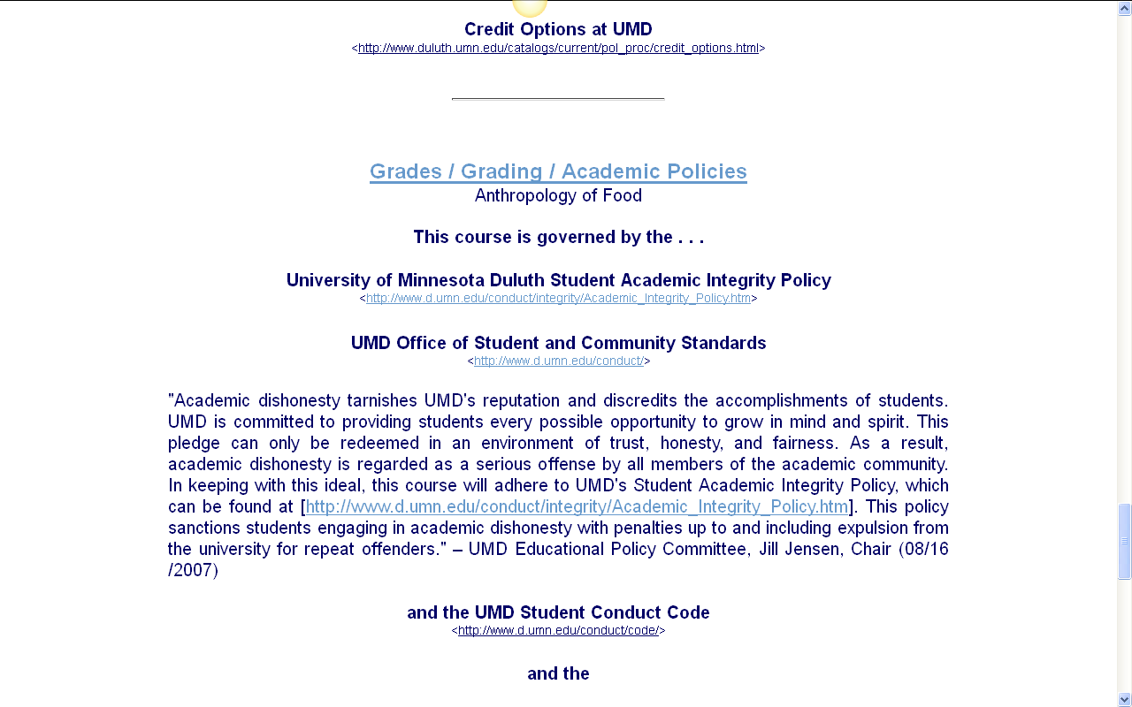
Governing Procedures
http://www.d.umn.edu/cla/faculty/troufs/anth3635/cehandout_first-day.html

Slide 77
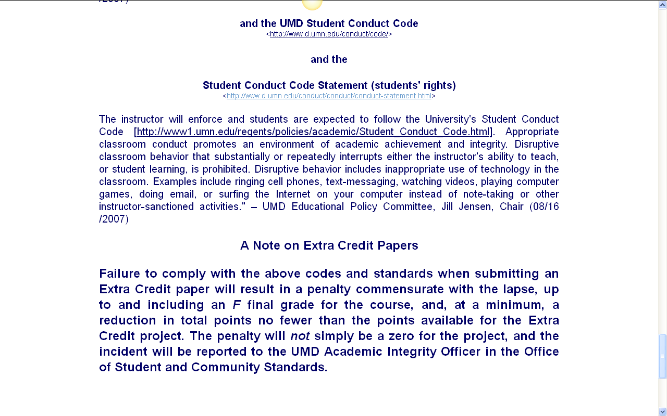
Governing Procedures
http://www.d.umn.edu/cla/faculty/troufs/anth3635/cehandout_first-day.html

Slide 78
Governing Procedures
Governing Procedures
note on Extra Credit Papers
http://www.d.umn.edu/cla/faculty/troufs/anth3635/cehandout_first-day.html

Slide 79
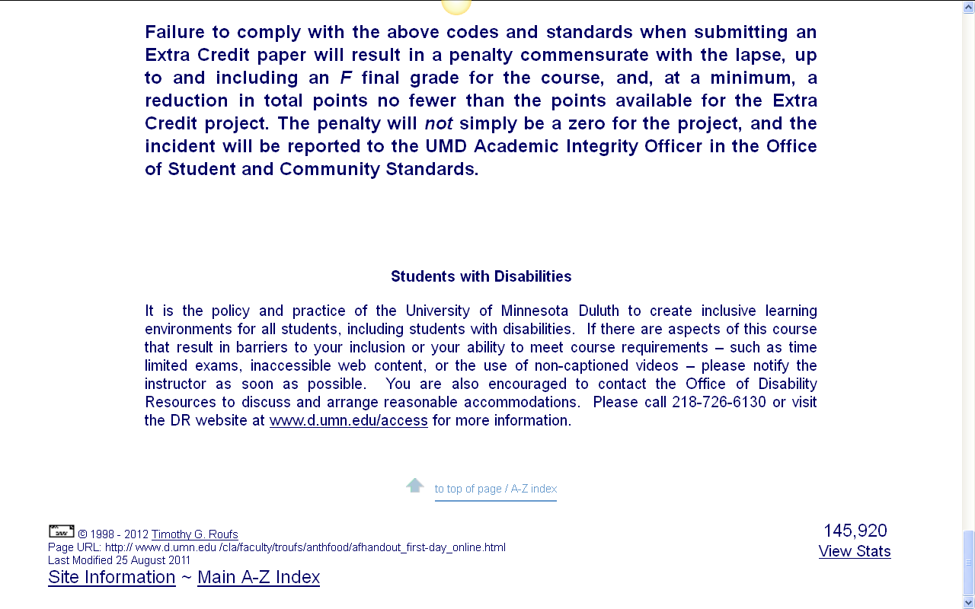
Special Facilities
Information
http://www.d.umn.edu/cla/faculty/troufs/anth3635/cehandout_first-day.html

Slide 80
Your Moodle screen will look something like this . . .
Back to the main
Moodle page
“Block 1”

Slide 81
Your Moodle screen will look something like this . . .
requirements, due dates, options, and grades

Slide 82
Your Moodle screen will look something like this . . .
click here for grades link
requirements, due dates, options, and grades

Slide 83
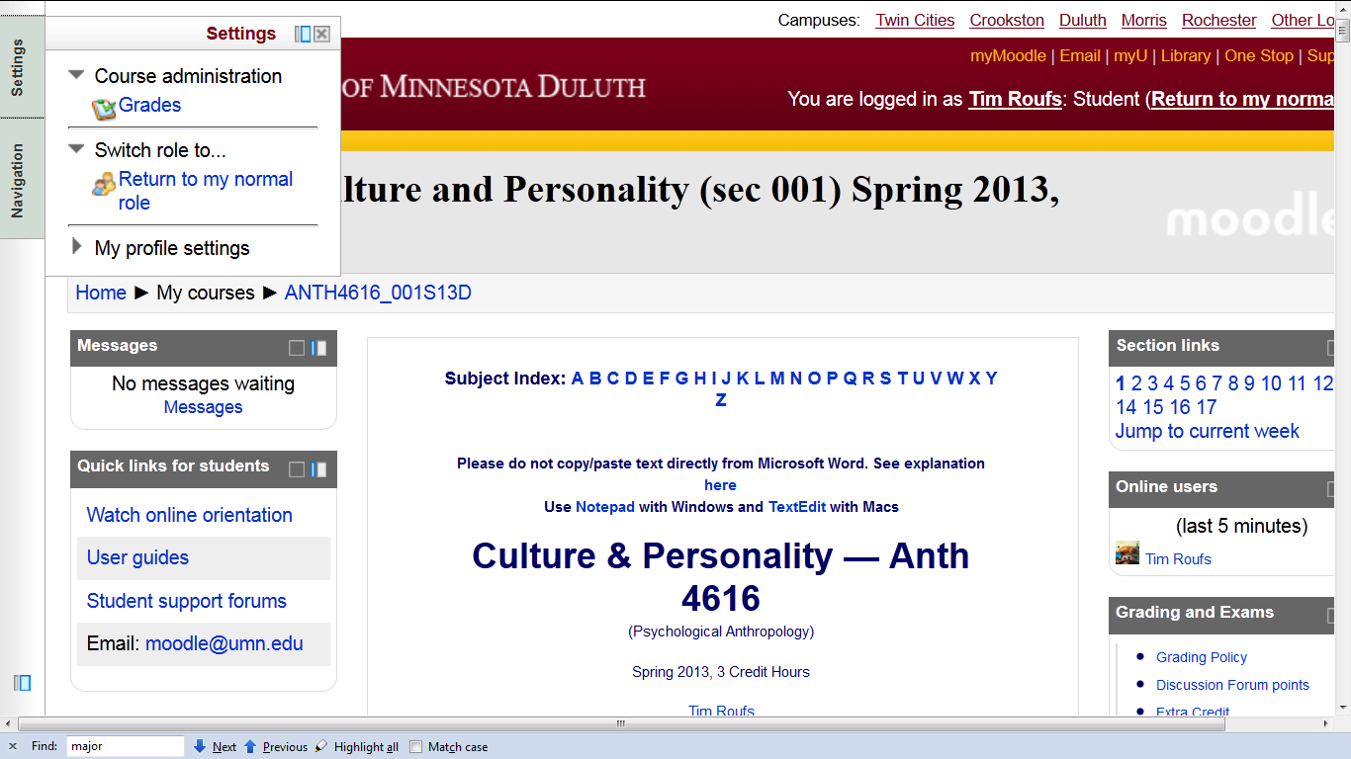
Your Moodle screen will look something like this . . .

Slide 84
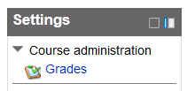
Your Moodle screen will look something like this . . .

Slide 85
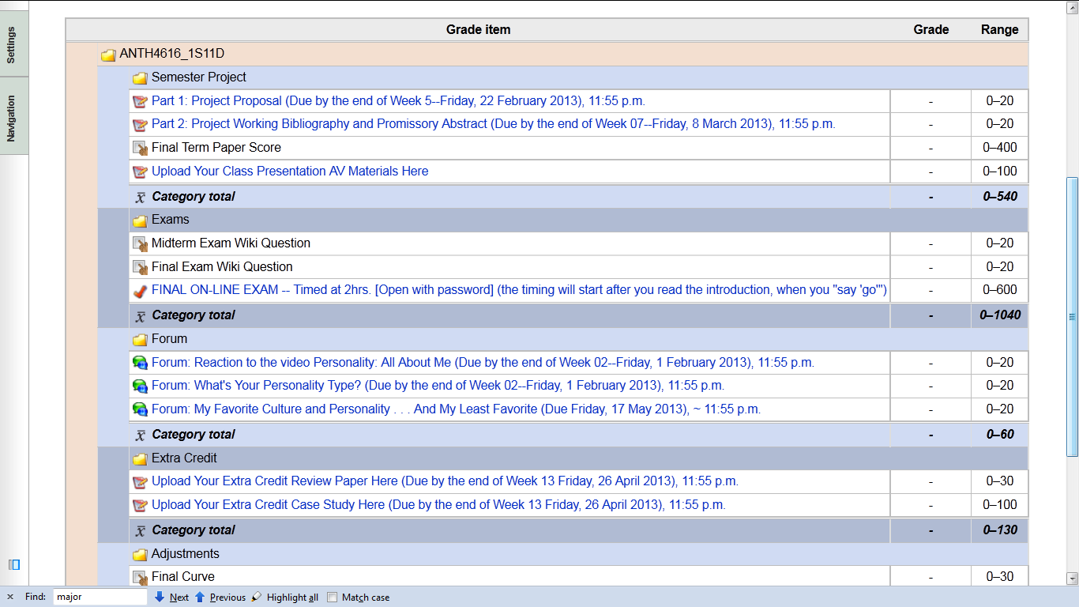
Your Gradebook
will look something like this

Slide 86
Your Gradebook
will look something like this
it lists course requirements, due dates, options, and grades . . .

Slide 87
Your Moodle screen will look something like this . . .
Back to the main
Moodle page
“Block 1”

Slide 88
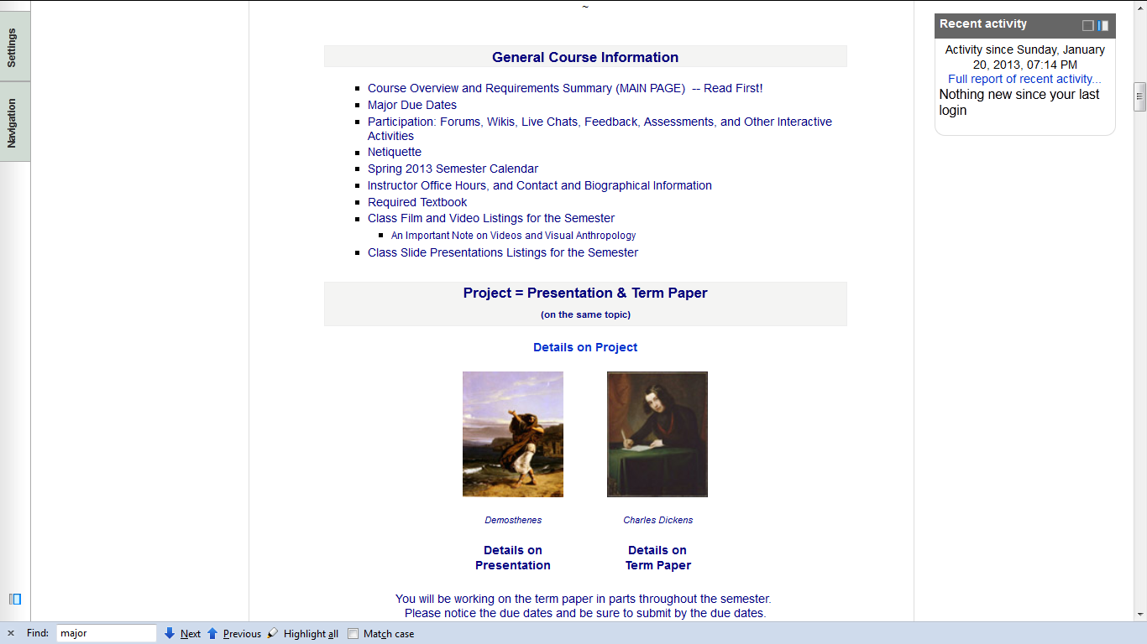
“Block 1” contains the basic information on the course . . .

Slide 89
“Block 1” contains the basic information on the course . . .

Slide 90
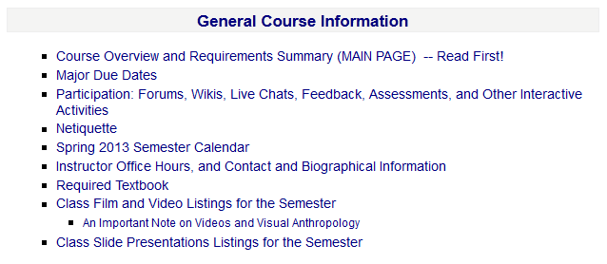
“Block 1” contains the basic information on the course . . .
The “Major Due Dates” web page is a handy site

Slide 91
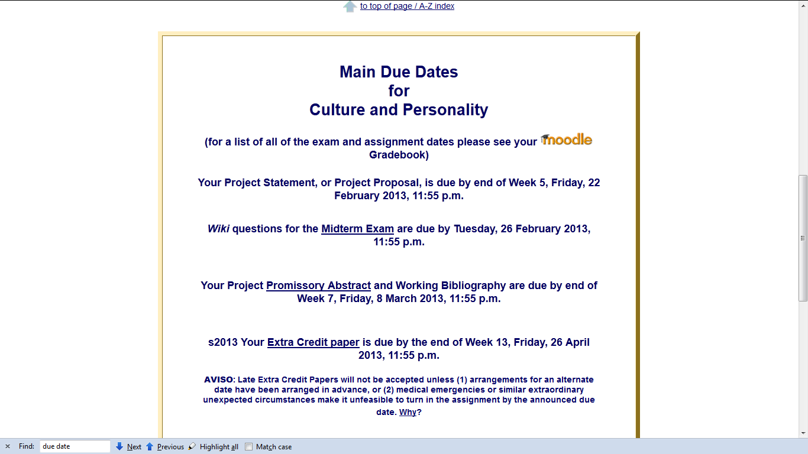

Slide 92
“Block 1” contains the basic information on the course . . .

Slide 93
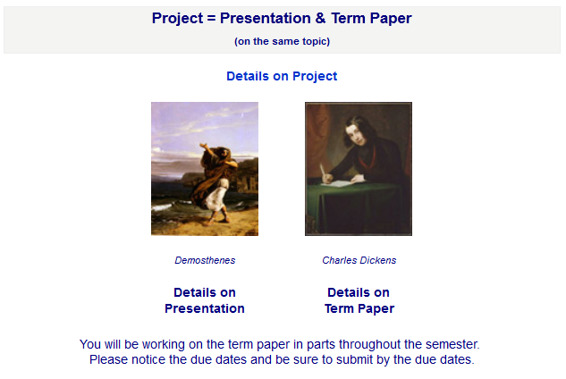
“Block 1” contains the basic information on the course . . .

Slide 94
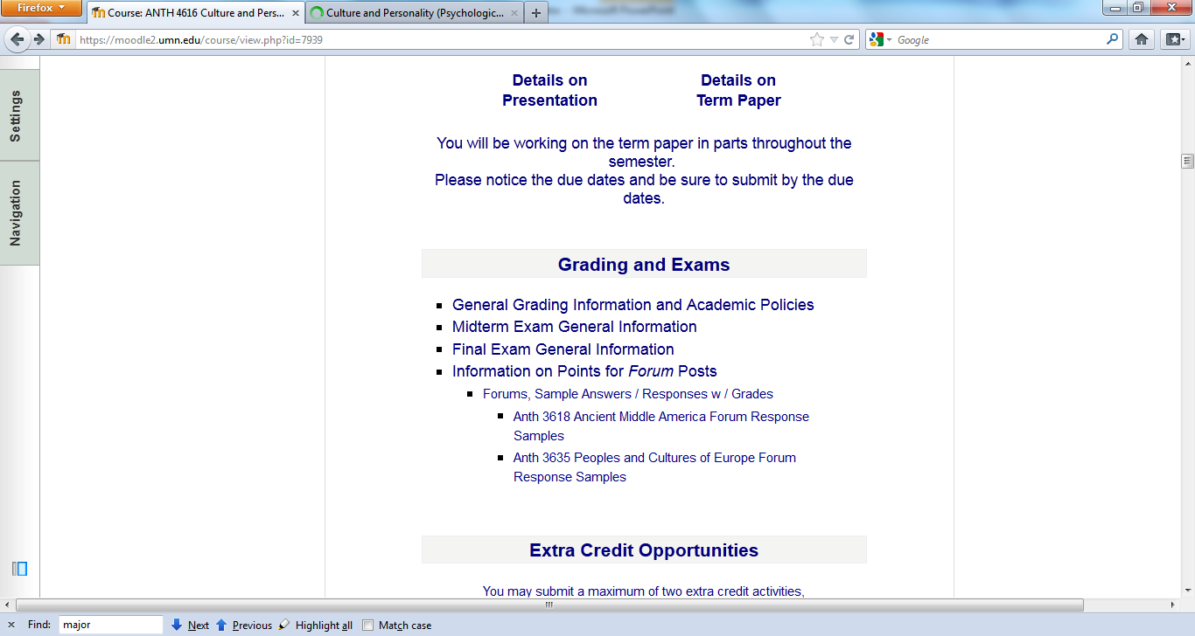
“Block 1” contains the basic information on the course . . .

Slide 95
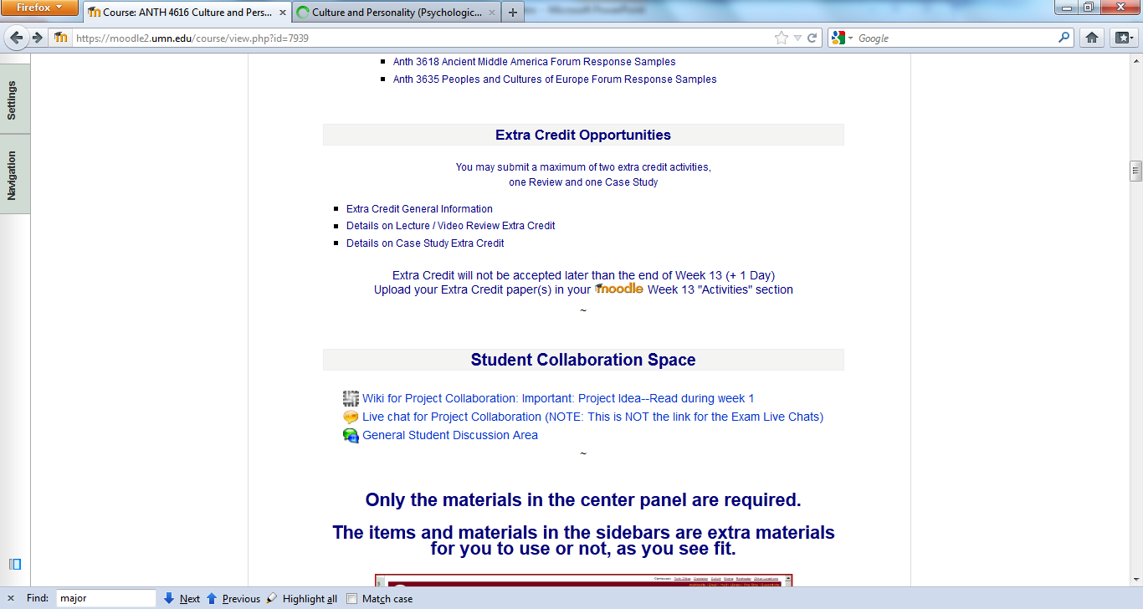
“Block 1” contains the basic information on the course . . .

Slide 96
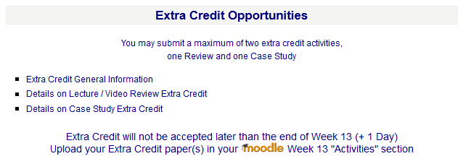
“Block 1” contains the basic information on the course . . .

Slide 97
“Block 1” contains the basic information on the course . . .

Slide 98
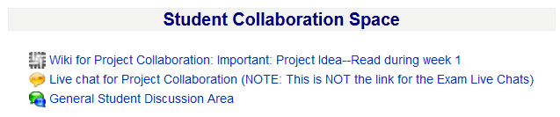
“Block 1” contains the basic information on the course . . .

Slide 99
Your Moodle screen will look something like this . . .

Slide 100
Your Moodle screen will look something like this . . .
REM

Slide 101
Reading Assignments

Slide 102
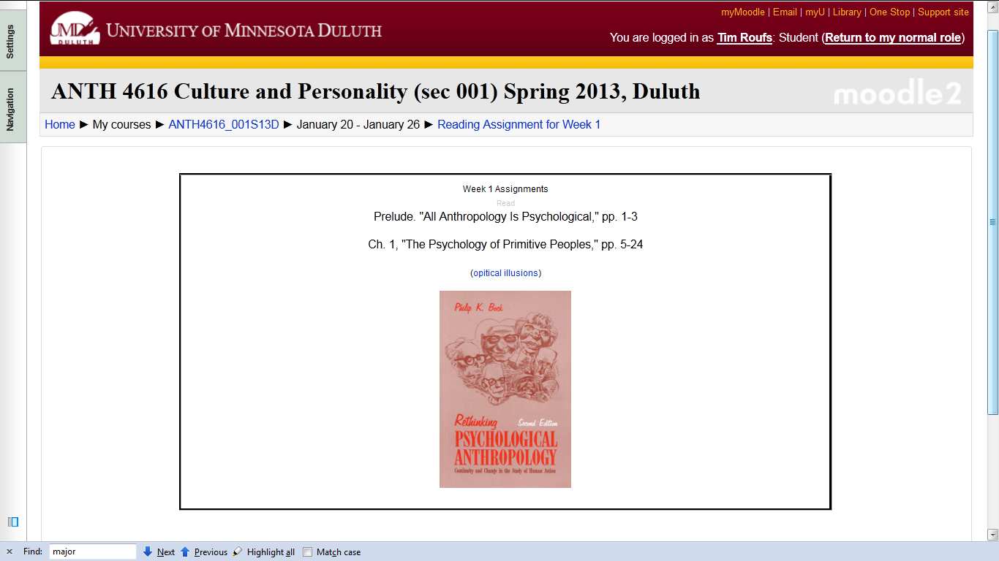
Reading Assignments for Week 1

Slide 103
REM: Don’t‘ forget the Activities . . .

Slide 104
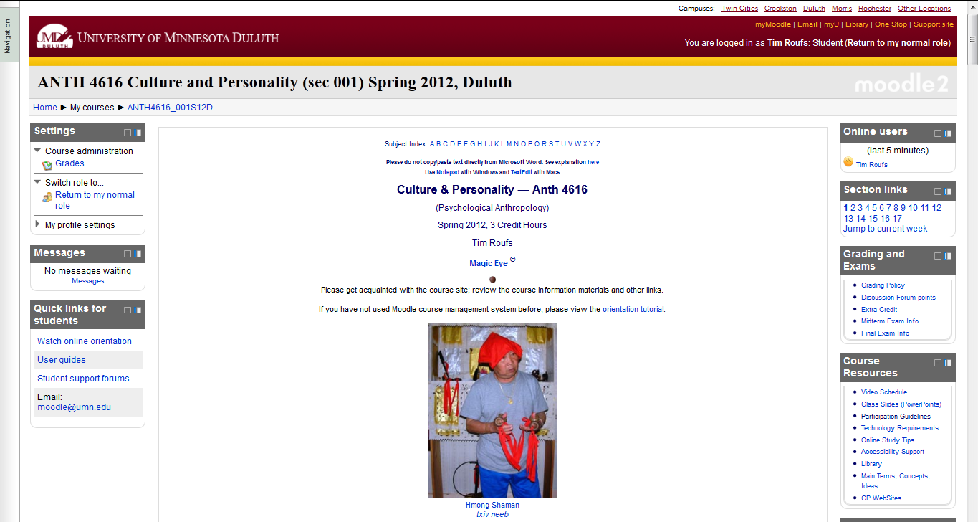
And, if you haven’t already done so,
have a look at the
Orientation Materials

Slide 105
Your Moodle screen will look something like this . . .

Slide 106

Your Moodle screen will look something like this . . .

Slide 107
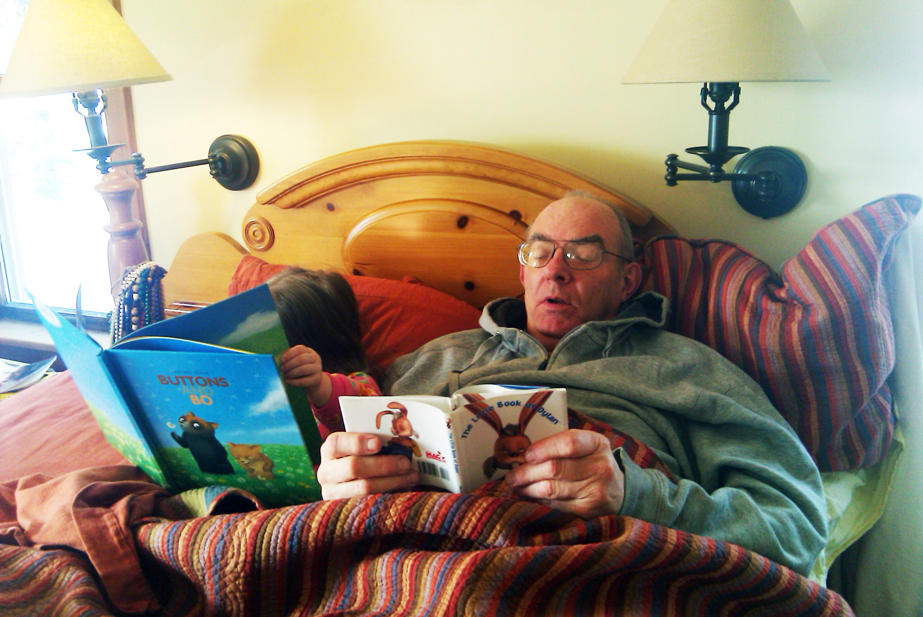
And, for the fun of it,
have a look at the
“Meet Your Professor” Materials

Slide 108
Why?

Slide 109
Research shows that people who know a little about their teachers . . .

Slide 110
Research shows that people who know a little about their teachers . . .
Learn more . . .

Slide 111
Research shows that people who know a little about their teachers . . .
Learn more . . .
Remember it better . . .

Slide 112
Research shows that people who know a little about their teachers . . .
Learn more . . .
Remember it better . . .
Have more fun learning . . .

Slide 113
one more piece
of useful information . . .

Slide 114
Back to the main
Moodle page
“Block 1”

Slide 115
At the very top of “Block 1” you will see an alphabet.
Clicking on a letter will bring you to a page that indexes course WebPages for virtually all of the scheduled topics and items in the course.

Slide 116
At the very top of “Block 1” you will see an alphabet.
Clicking on a letter will bring you to a page that indexes course WebPages for virtually all of the scheduled topics and items in the course.

Slide 117
This information is very useful

Slide 118
How useful?

Slide 119
in recent years there have been
1,068,000
page visits to the
Culture and Personality course page . . .

Slide 120
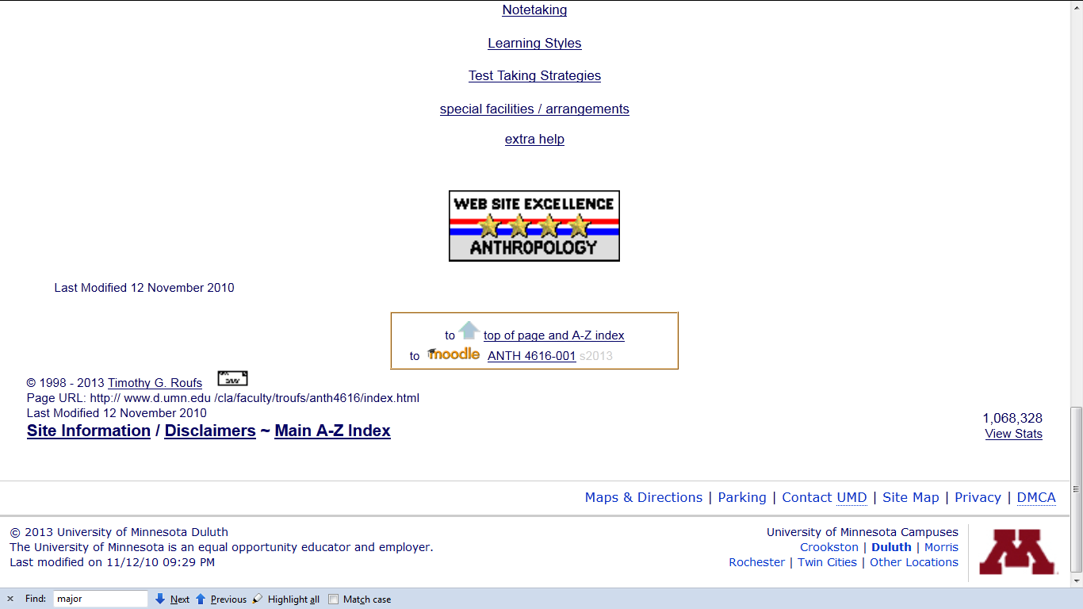

Slide 121
to access a topic simply click on a letter to go to an index page . . .

Slide 122
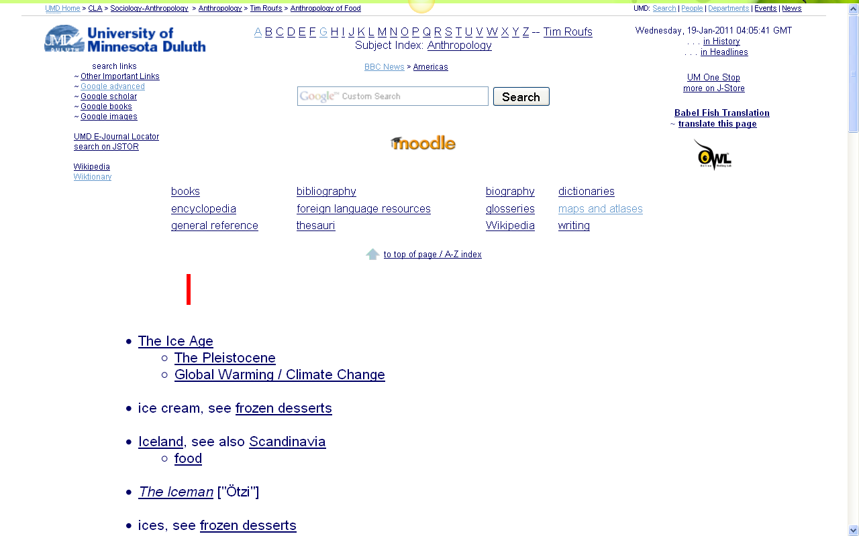
and from the index page click on the item you want . . .

Slide 123
and from the index page click on the item you want . . .
scroll down for more items

Slide 124

click on item . . . and . . .

Slide 125

voilà

Slide 126


Slide 127
Next Time . . .

Slide 128


Slide 129


Slide 130
B29 7JQ or B29 6QD

Slide 131
Then post your response to the Forum

Slide 132


Slide 133

Next Week

Slide 134

Laptops
Welcome
(in fact, they’re encouraged)

Slide 135
Welcome to
Culture and Personality
Enjoy your stay . . .
University of Minnesota Duluth
Tim Roufs’ © 2009-2013
Great Pyrenean
Mountain Dog
Venus of Willendorf
www.d.umn.edu/cla/faculty/troufs/anth4616/

