Slide 1
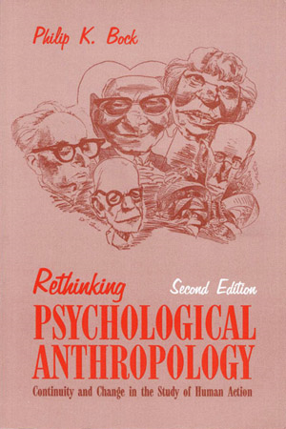
Units
of
Analysis re Psychological Anthropology
University of Minnesota Duluth
University of Minnesota Duluth
Tim Roufs
© 2010-2014

Slide 2

Units
of
Analysis re Psychological Anthropology
University of Minnesota Duluth
Tim Roufs
© 2010-2018

Slide 3
“units of analysis”
one person
the family
the community
a region
a “culture area”
a culture / “subculture”
a nation
an item or action itself
a “cultural metaphor”

Slide 4
as mentioned in the “Orientation”
units of analysis may include:
one person
the family
the community
a region
a “culture area”
a culture / “subculture”
a nation
the world
an item or action itself
a “cultural metaphor”

Slide 5
as mentioned in the “Orientation”
units of analysis may include:
one person
the family
the community
a region
a “culture area”
a culture / “subculture”
a nation
the world
an item or action itself
a “cultural metaphor”

Slide 6
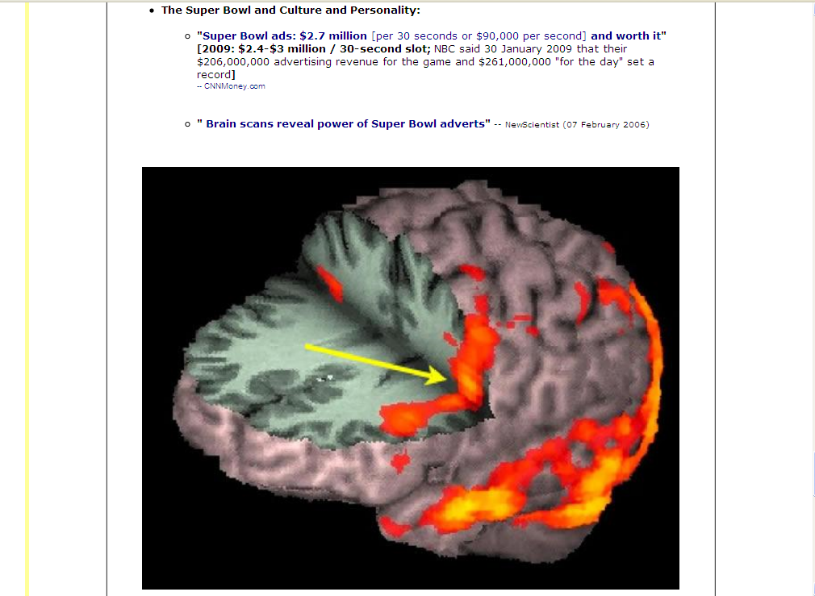
Notes:
6

Slide 7
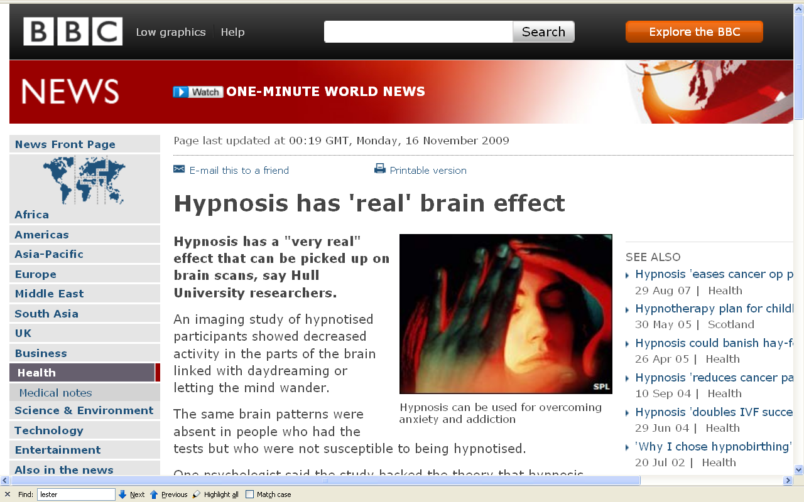
http://news.bbc.co.uk/2/hi/health/8359170.stm
Notes:
⁷

Slide 8
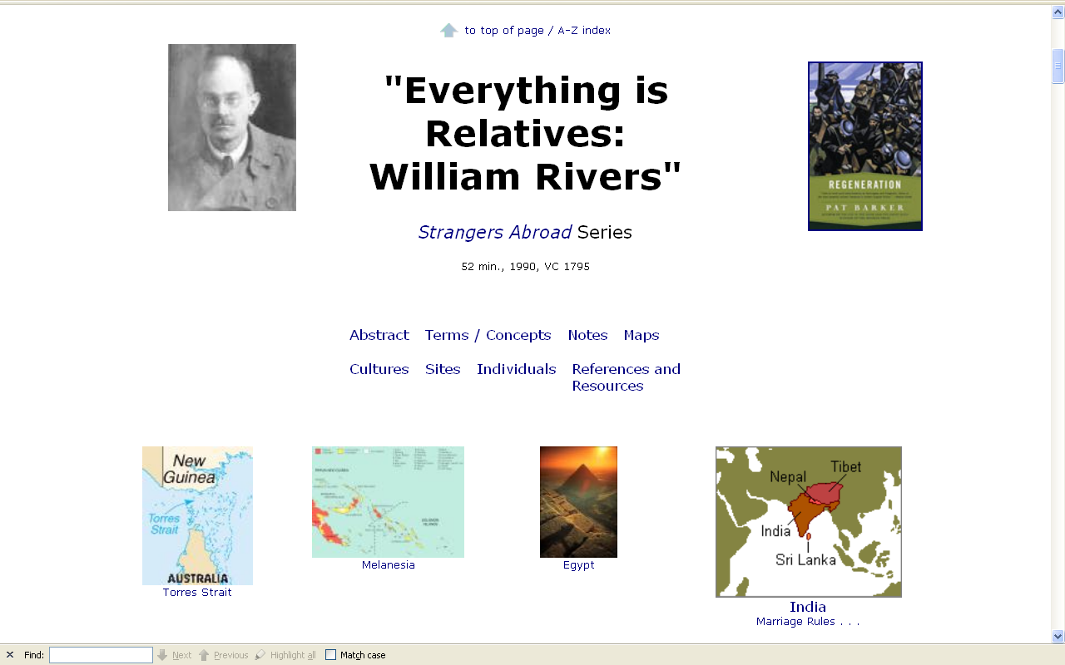
Notes:
8

Slide 9
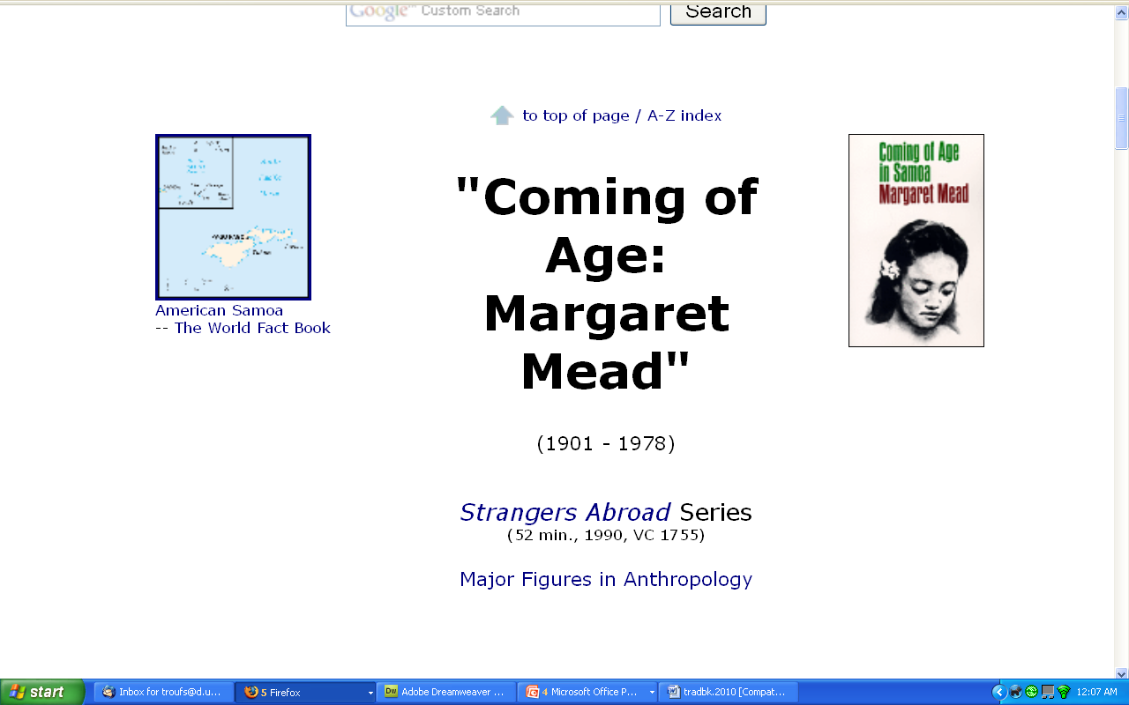
Notes:
9

Slide 10
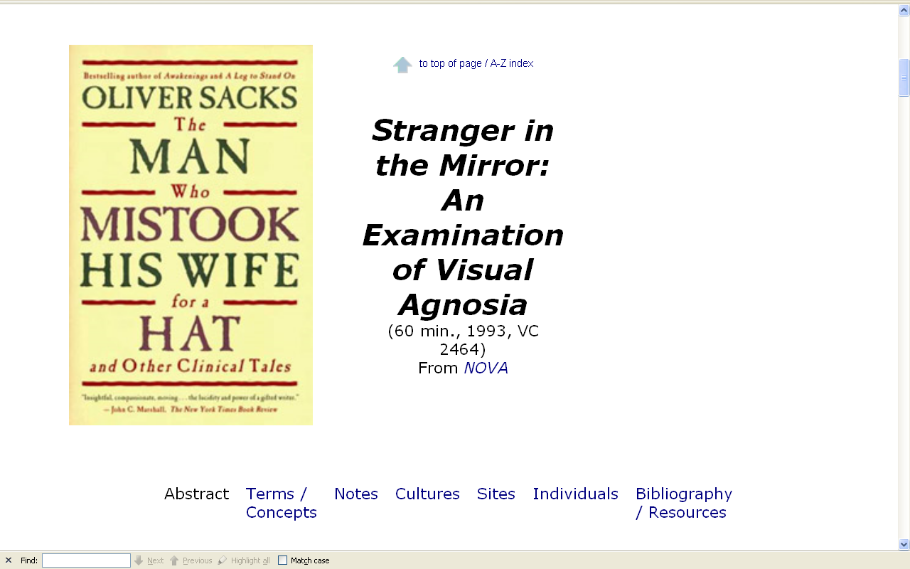
Notes:
10

Slide 11
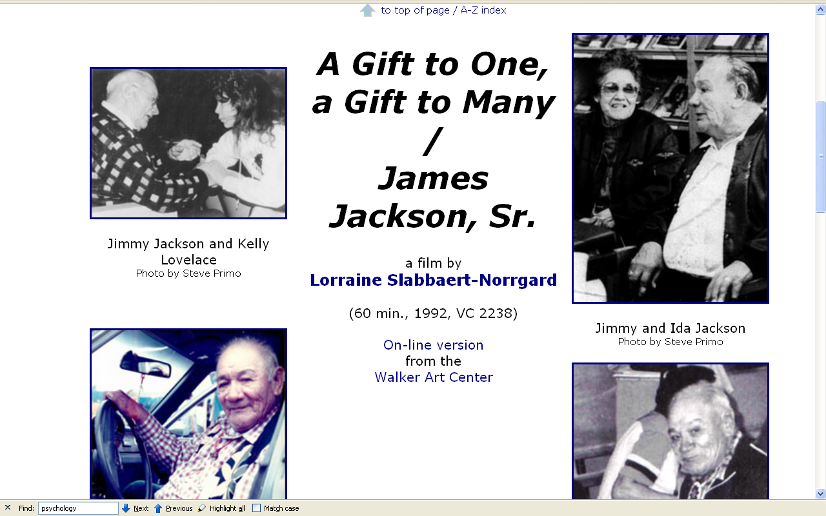
Notes:
11

Slide 12
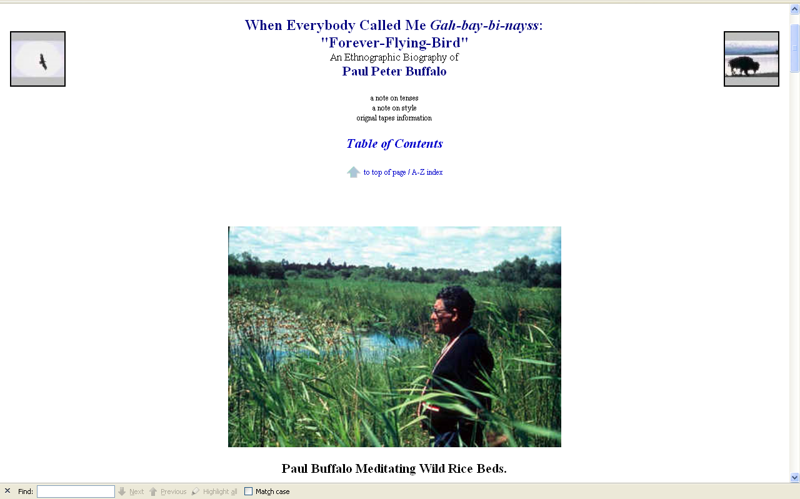
Notes:
12

Slide 13
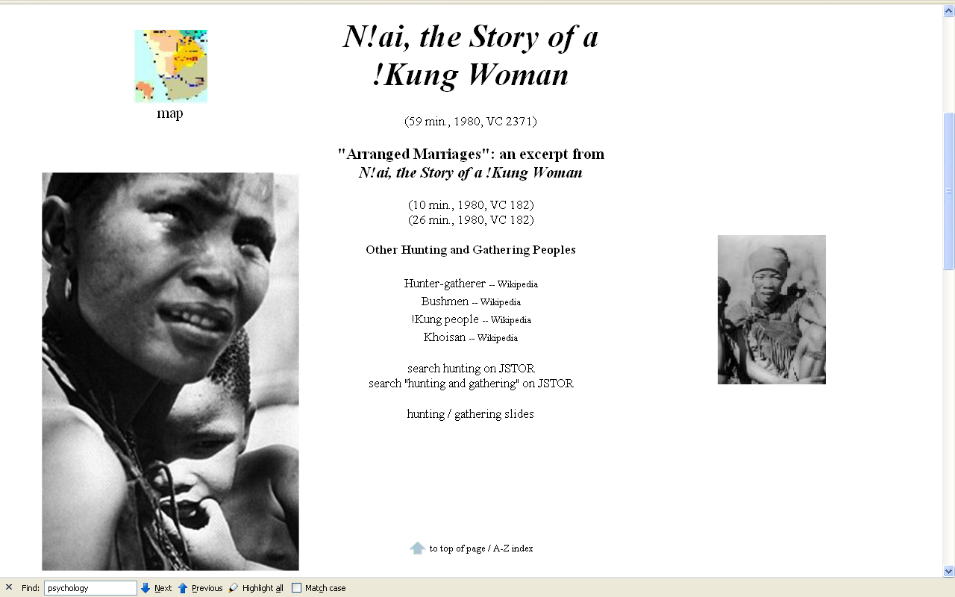
Notes:
13

Slide 14
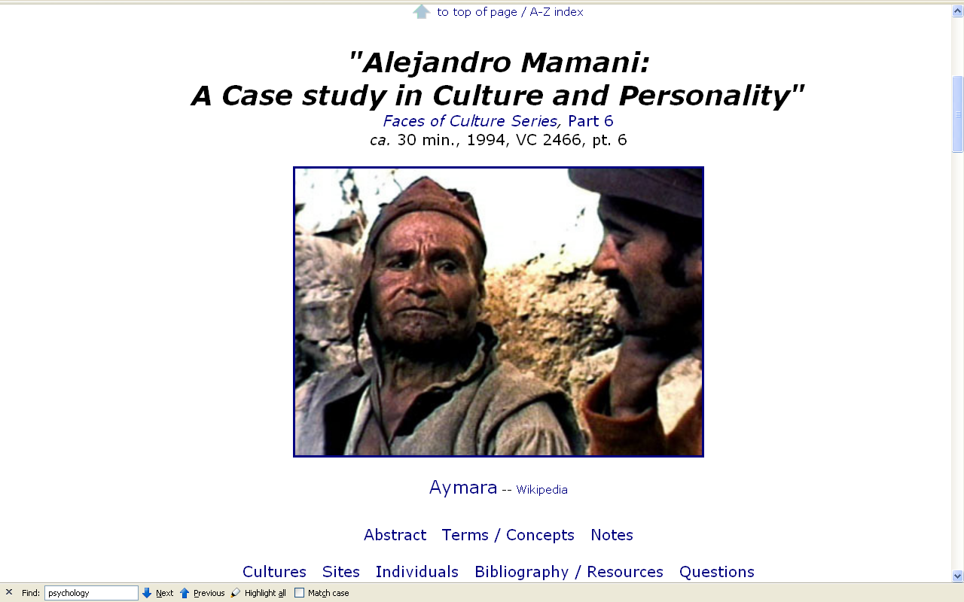
Notes:
14

Slide 15
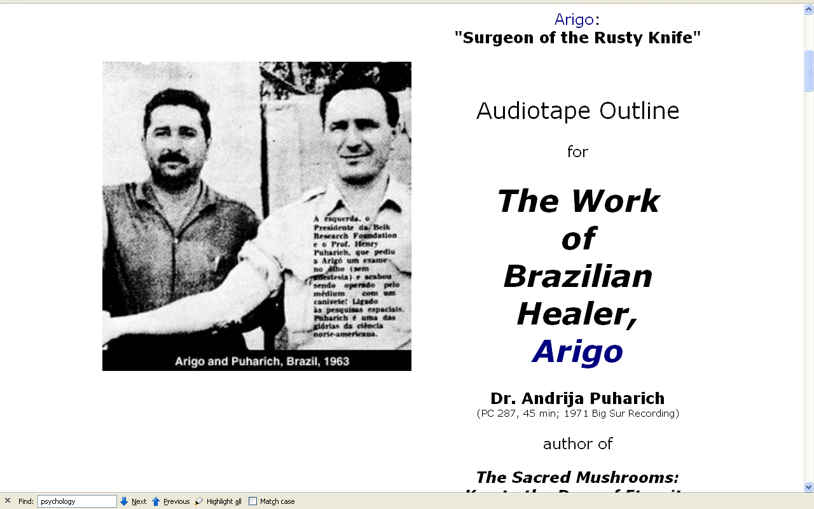
Notes:
15

Slide 16
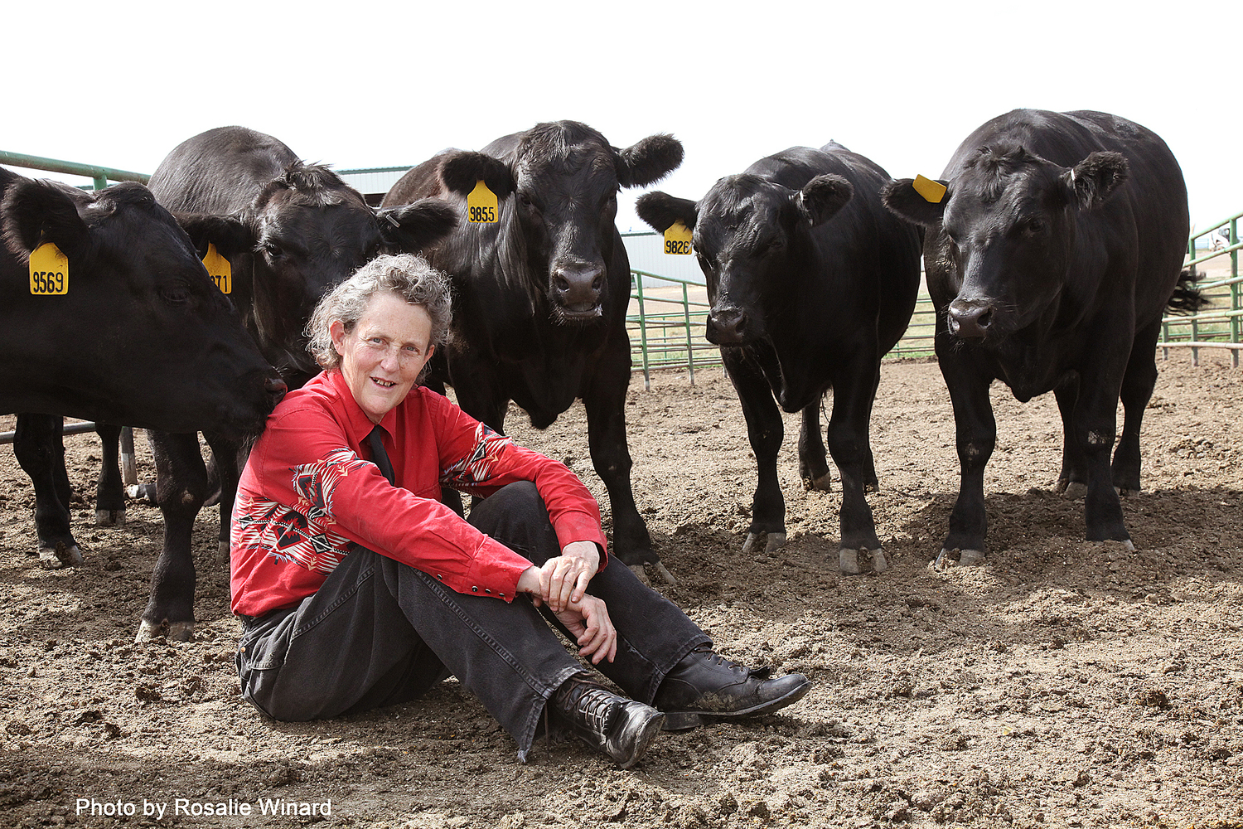
Temple Grandin
http://www.sassna.org/news/2015/3/21/temple-grandin-coming-to-sacramento-on-april-3rd

Slide 17




Slide 18
This was earlier advocated by:
Oscar Lewis
Bronislow Malinowski
Edward Sapir (“Sapir-Whorf” hypothesis)
Margaret Mead

Slide 19
as mentioned in the “Orientation”
units of analysis may include:
one person
the family
the community
a region
a “culture area”
a culture / “subculture”
a nation
the world
an item or action itself
a “cultural metaphor”

Slide 20
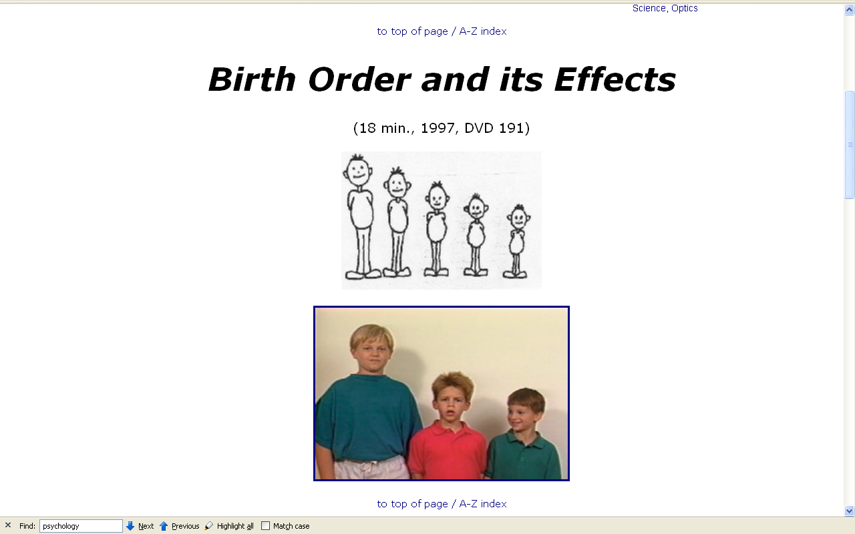
Notes:
20

Slide 21
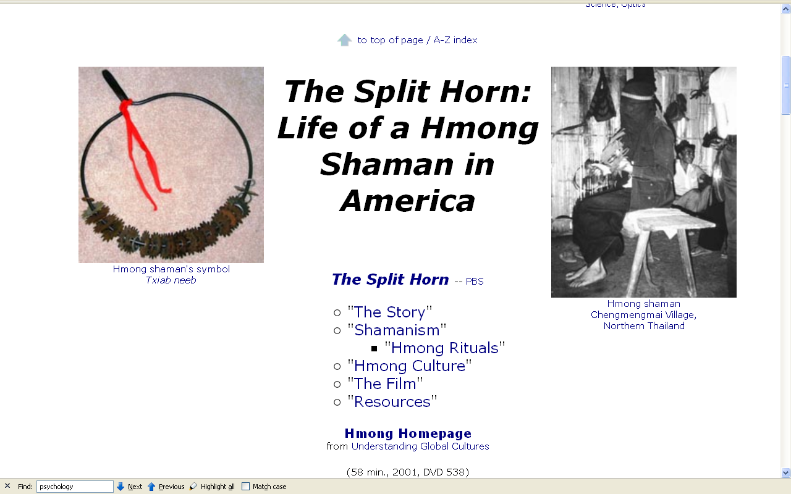
Notes:
21

Slide 22

5 families
Penguin Avery, 2009

Slide 23
The Popkins, 1950s
“typical multigenerational American family”
and 3 children
Superior, WI, U.S.A.
The “Jones, ” 2006
and 2 children
Suburban Cleveland, U.S.A.
Cesar and Ana Garcia
and 4 children
Immigrant Mexicans from Chiapas Mexico
Suburban Los Angeles
Rahul Desai and His Wife
and 4 children
Uttar Pradesh, Northern India
Gopal and Noopur Patel
and 3 children
Uttar Pradesh, Northern India
Penguin Avery, 2009

Slide 24
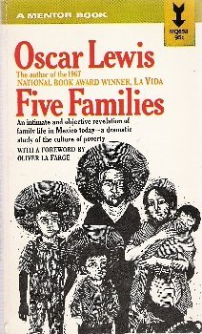

Compare . . .
Oscar Lewis

Slide 25
as mentioned in the “Orientation”
units of analysis may include:
one person
the family
the community
a region
a “culture area”
a culture / “subculture”
a nation
the world
an item or action itself
a “cultural metaphor”

Slide 26
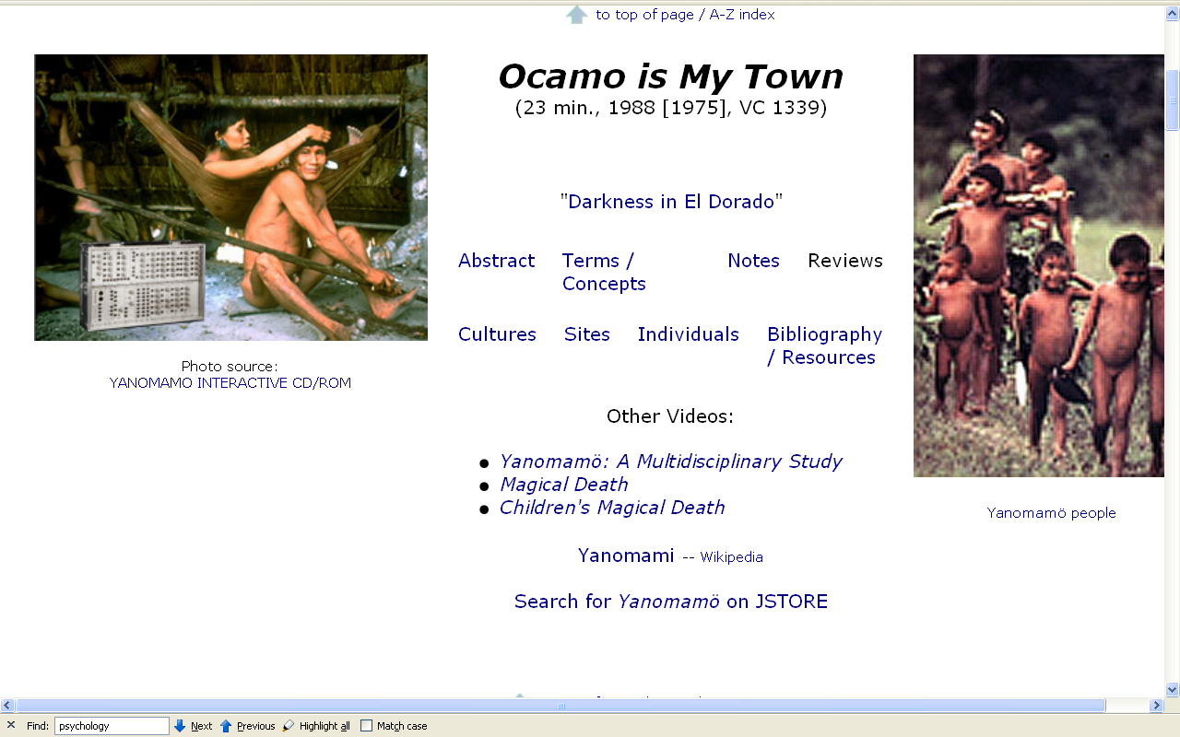
Notes:
26

Slide 27
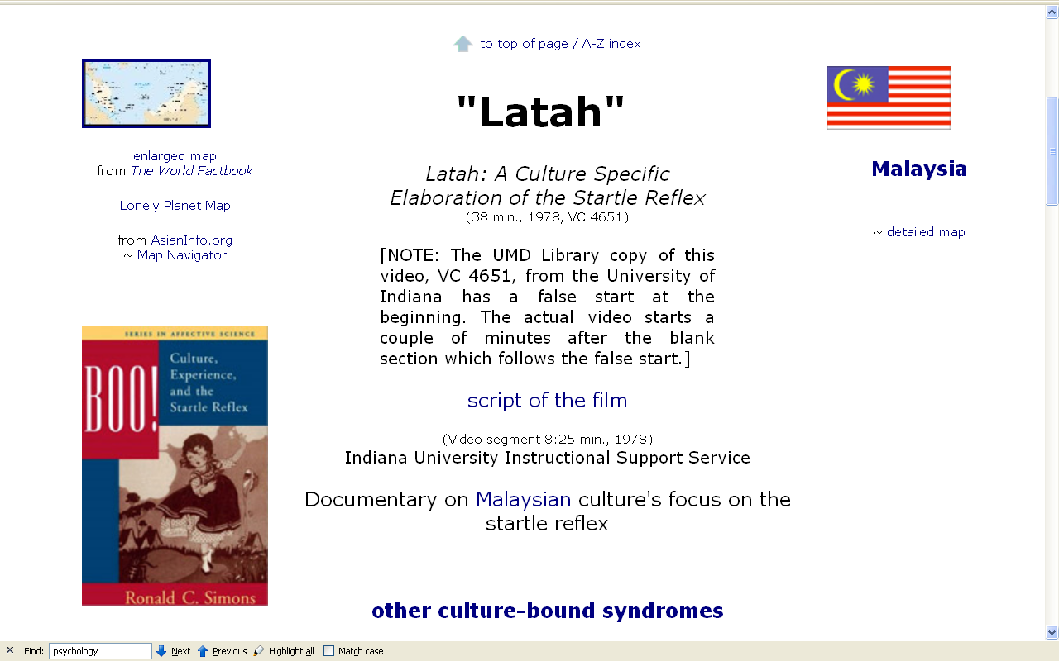
Notes:
27

Slide 28
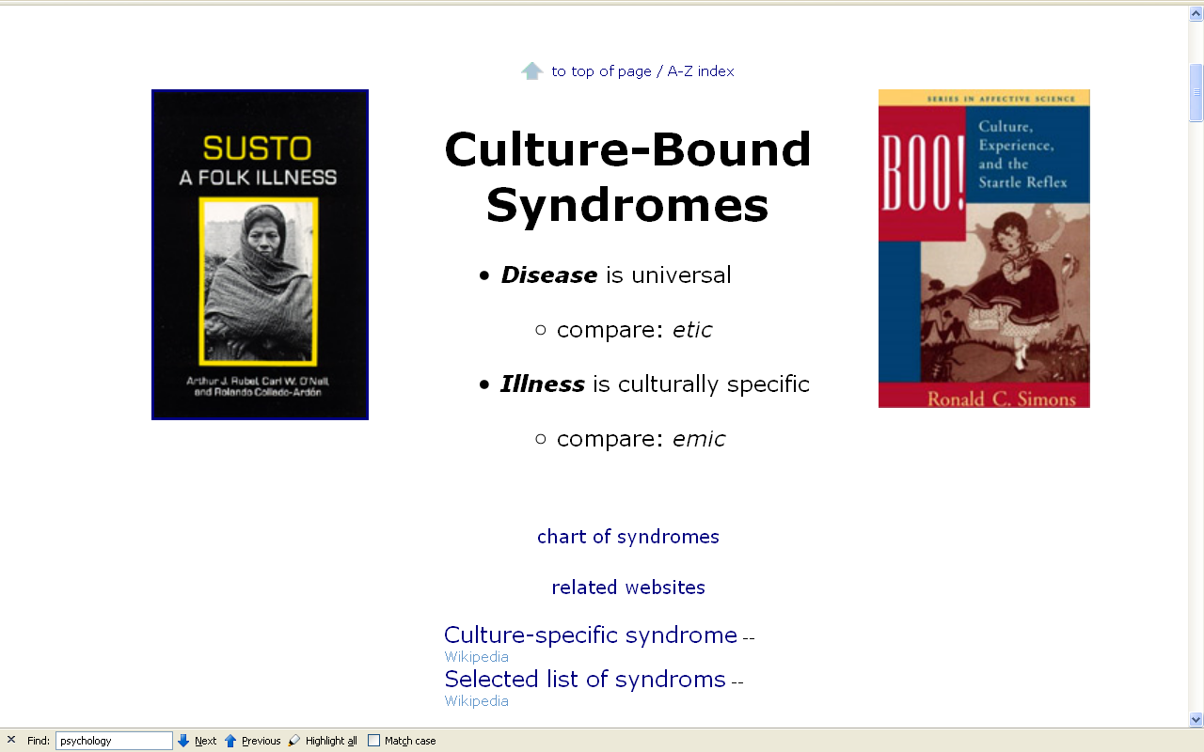
Notes:
28

Slide 29
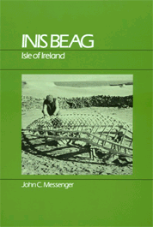
Inis Beag
Gaelic: "Little Island"
John C. Messenger
Inis Beag: Isle of Ireland.
Long Grove: IL: Waveland Press, 1983.
(ISBN: 0881330515)
http://www.d.umn.edu/cla/faculty/troufs/anth3635/cetexts.html#InisBeag

Slide 30
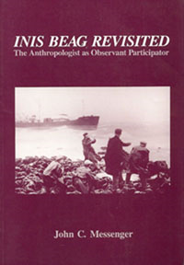
Inis Beag Revisited: The Anthropologist As Observant Participator
Sheffield Publishing Company, 1989.
http://www.d.umn.edu/cla/faculty/troufs/anth3635/cetexts.html#InisBeag

Slide 31
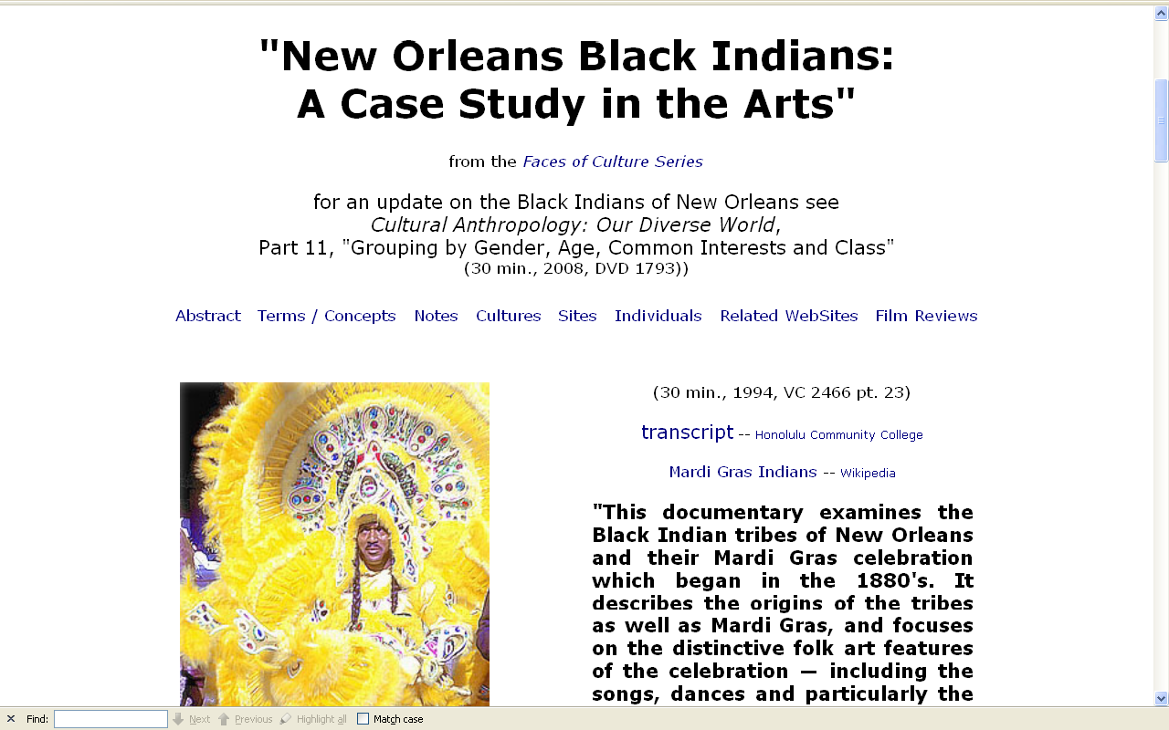
Notes:
31

Slide 32
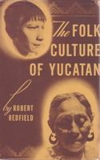
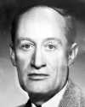
Compare . . .
1930 Tepoztlan, a Mexican Village: A Study of Folk Life
Chicago: University of Chicago Press
1941 Folk Culture of Yucatan
Chicago: University of Chicago Press
Robert Redfield

Slide 33
as mentioned in the “Orientation”
units of analysis may include:
one person
the family
the community
a region
a “culture area”
a culture / “subculture”
a nation
the world
an item or action itself
a “cultural metaphor”

Slide 34
as mentioned in the “Orientation”
units of analysis may include:
one person
the family
the community
a region
a “culture area”
a culture / “subculture”
a nation
the world
an item or action itself
a “cultural metaphor”
Samoan Islands

Slide 35
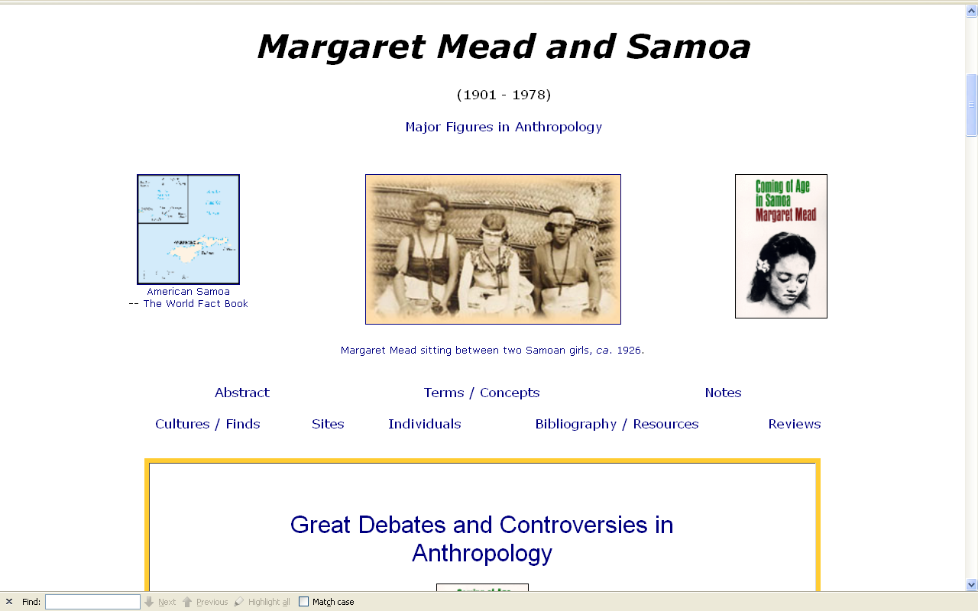
Notes:
35

Slide 36
as mentioned in the “Orientation”
units of analysis may include:
one person
the family
the community
a region
a “culture area”
a culture / “subculture”
a nation
the world
an item or action itself
a “cultural metaphor”
Malaysia

Slide 37
Notes:
37

Slide 38
as mentioned in the “Orientation”
units of analysis may include:
one person
the family
the community
a region
a “culture area”
a culture / “subculture”
a nation
the world
an item or action itself
a “cultural metaphor”
the Aran Islands

Slide 39

Compare . . .
. . Man of Aran
(77 min, 1934, B&W)
Robert J. Flaherty,
Colman “Tiger” King,
Maggie Dirrane, and
Michael Dirrane

Slide 40
as mentioned in the “Orientation”
units of analysis may include:
one person
the family
the community
a region
a “culture area”
a culture / “subculture”
a nation
the world
an item or action itself
a “cultural metaphor”
(not as a “culture area”)

Slide 41
as mentioned in the “Orientation”
units of analysis may include:
one person
the family
the community
a region
a “culture area”
a culture / “subculture”
a nation
the world
an item or action itself
a “cultural metaphor”

Slide 42
some areas are “officially”
anthropological
“cultural areas” . . .

Slide 43
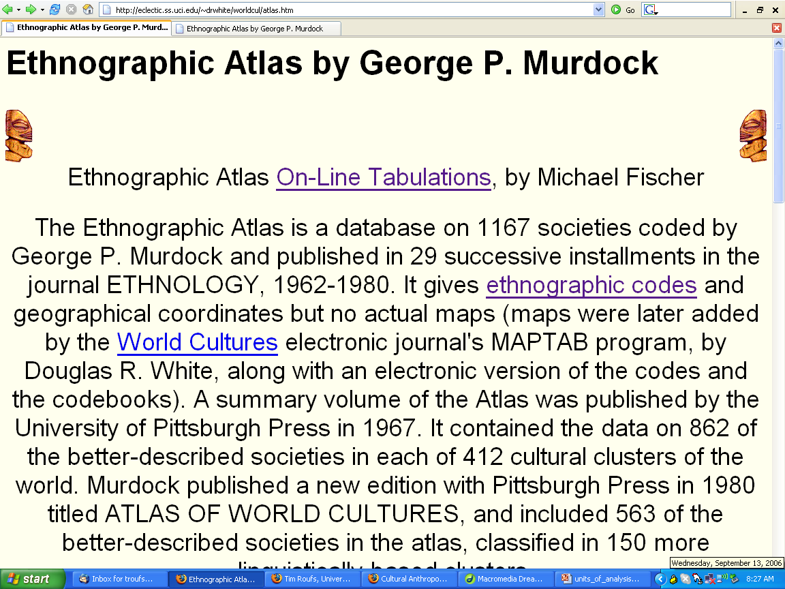
Compare . . .
http://eclectic.ss.uci.edu/~drwhite/worldcul/atlas.htm

Slide 44
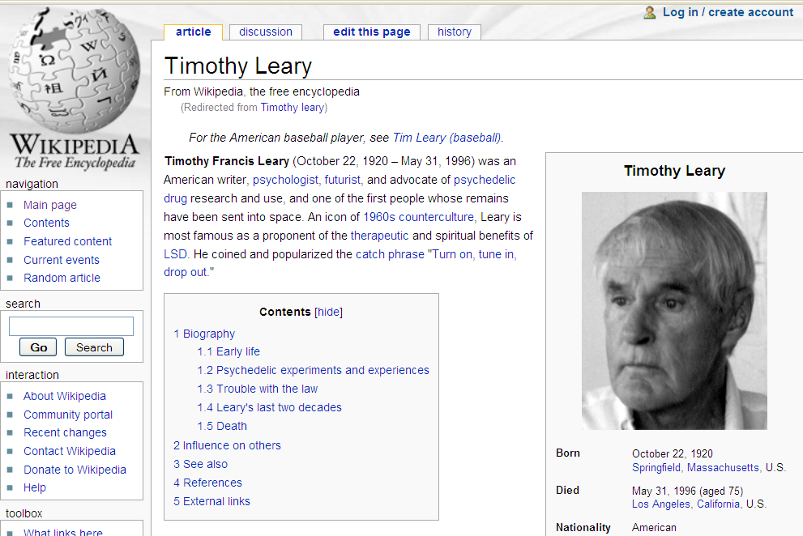

Slide 45



Slide 46
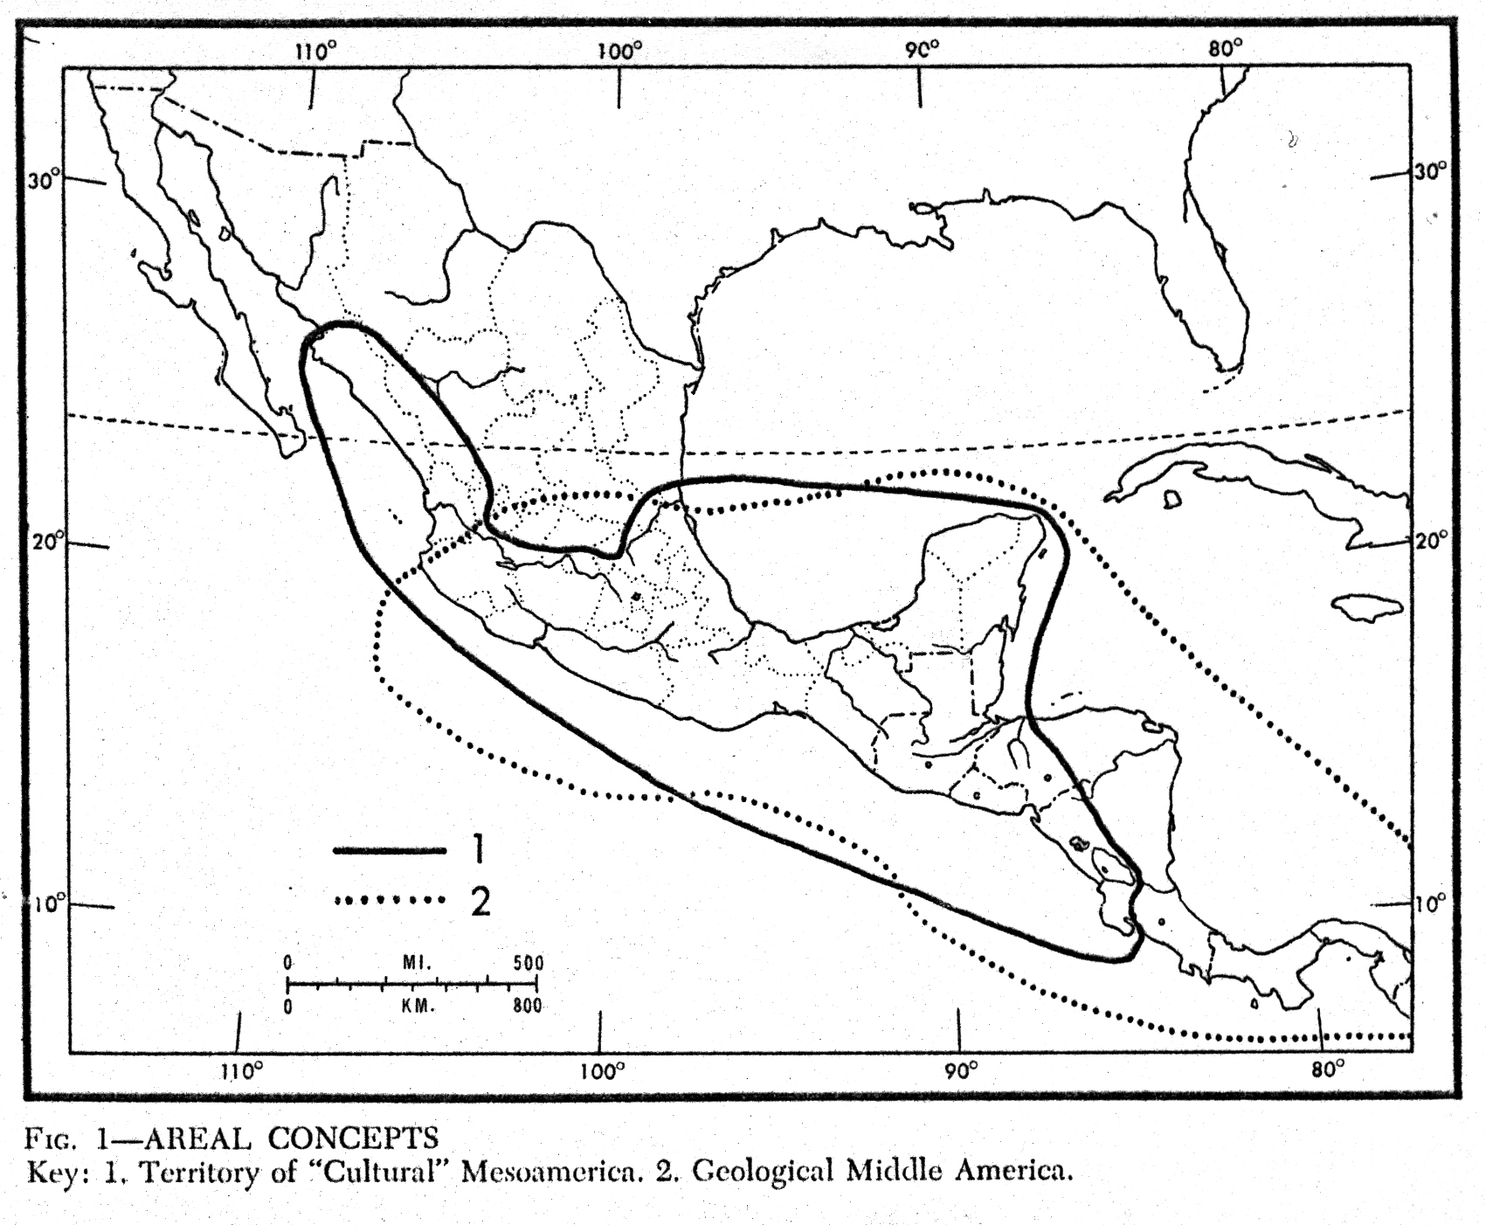
“Mesoamerica”
(cultural)
“Middle America”
(geological)

Slide 47
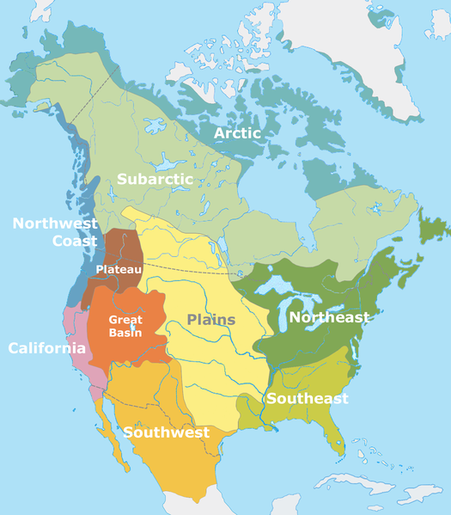
http://en.wikipedia.org/wiki/Culture_areas_of_North_America

Slide 48
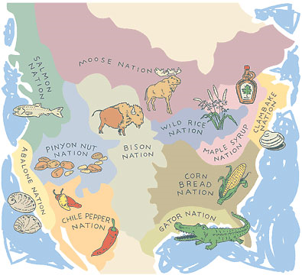

not “culture areas”
http://en.wikipedia.org/wiki/Culture_areas_of_North_America

Slide 49
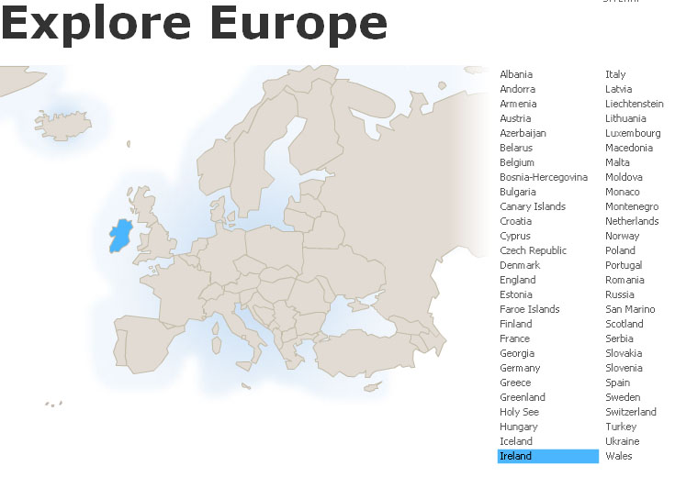

Slide 50
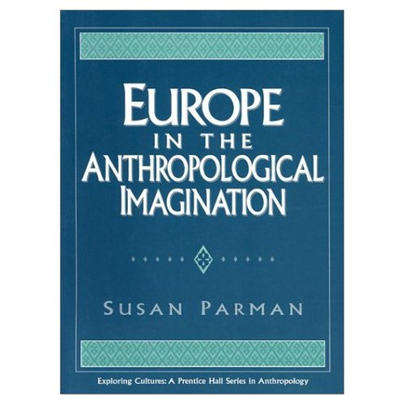
Compare . . .
Parman, Susan.
Europe in the Anthropological
Imagination.
Upper Saddle River, NJ: Prentice Hall,
1998.
http://www.d.umn.edu/cla/faculty/troufs/anth3635/cetexts.html#title

Slide 51
as mentioned in the “Orientation”
units of analysis may include:
one person
the family
the community
a region
a “culture area”
a culture / “subculture”
a nation
the world
an item or action itself
a “cultural metaphor”

Slide 52
Notes:
52

Slide 53
as mentioned in the “Orientation”
units of analysis may include:
one person
the family
the community
a region
a “culture area”
a culture / “subculture”
a nation
the world
an item or action itself
a “cultural metaphor”

Slide 54
as mentioned in the “Orientation”
units of analysis may include:
one person
the family
the community
a region
a “culture area”
a culture / “subculture”
a nation
the world
an item or action itself
a “cultural metaphor”
aka a “microculture”
aka a “local culture”

Slide 55
as mentioned in the “Orientation”
units of analysis may include:
one person
the family
the community
a region
a “culture area”
a culture / “subculture”
a nation
the world
an item or action itself
a “cultural metaphor”
Chicanos
“Irish”
“Irish Travellers” (“Gypsies”)
“Rom” (“Gypsies”)
“Basques”
Catalans
sometimes incorrectly called “Gypsies”

Slide 56
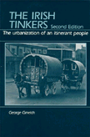

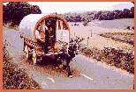
Compare . . .
The Irish Tinkers: The Urbanization of an Itinerant People
by George Gmelch
1985

Slide 57
as mentioned in the “Orientation”
units of analysis may include:
one person
the family
the community
a region
a “culture area”
a culture / “subculture”
a nation
the world
an item or action itself
a “cultural metaphor”
(“Gypsies”)om” (“Gypsies”)
“Basques”
Catalans

Slide 58

Compare . . .
Mark Kurlansky
The Basque History of the World.
NY: Penguin Books, 1999.
(ISBN: 0140298517)
http://www.d.umn.edu/cla/faculty/troufs/anth3635/cetexts.html#BasqueHistory

Slide 59
as mentioned in the “Orientation”
units of analysis may include:
one person
the family
the community
a region
a “culture area”
a culture / “subculture”
a nation
the world
an item or action itself
a “cultural metaphor”
Chicanos
“Rom” (“Gypsies”)
Hmong
Catalans

Slide 60
Notes:
60

Slide 61
as mentioned in the “Orientation”
units of analysis may include:
one person
the family
the community
a region
a “culture area”
a culture / “subculture”
a nation
the world
an item or action itself
a “cultural metaphor”
“Rom” (“Gypsies”)
Amish
Catalans

Slide 62
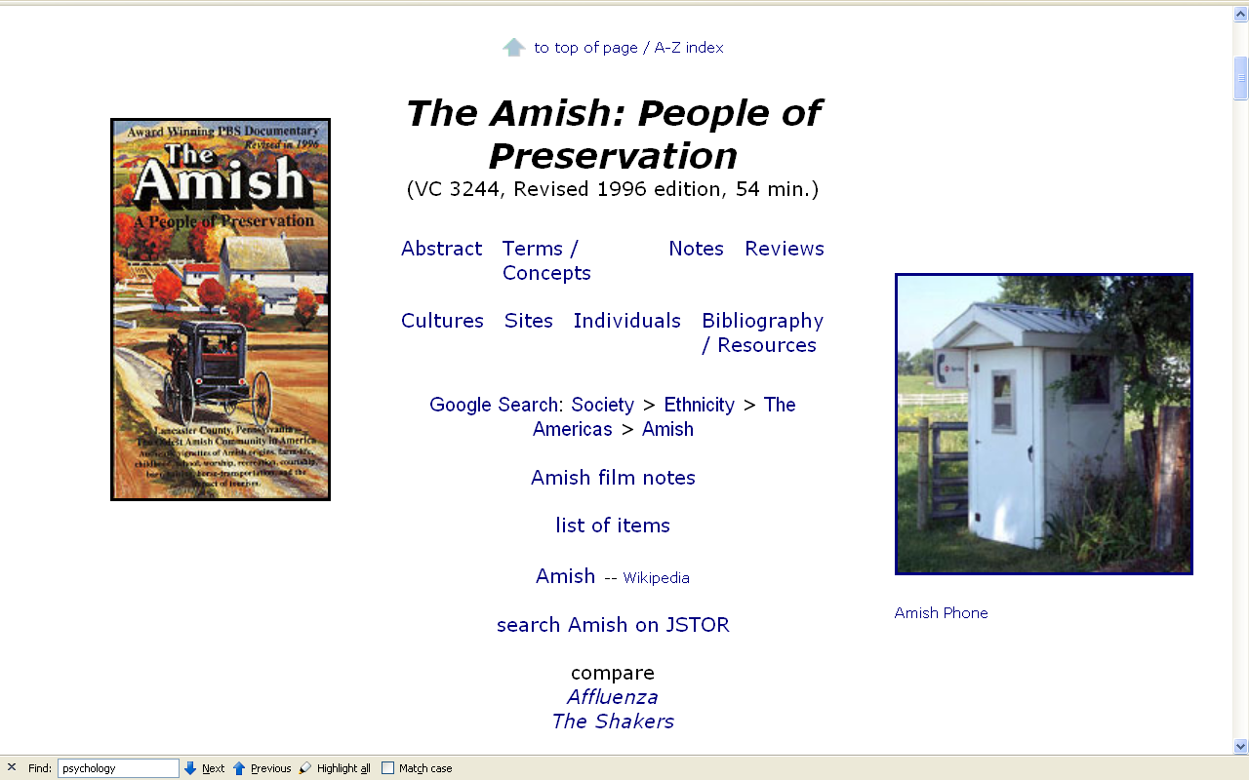
Notes:
62

Slide 63
as mentioned in the “Orientation”
units of analysis may include:
one person
the family
the community
a region
a “culture area”
a culture / “subculture”
a nation
the world
an item or action itself
a “cultural metaphor”
“Rom” (“Gypsies”)
The “Black Indians”
Catalans

Slide 64
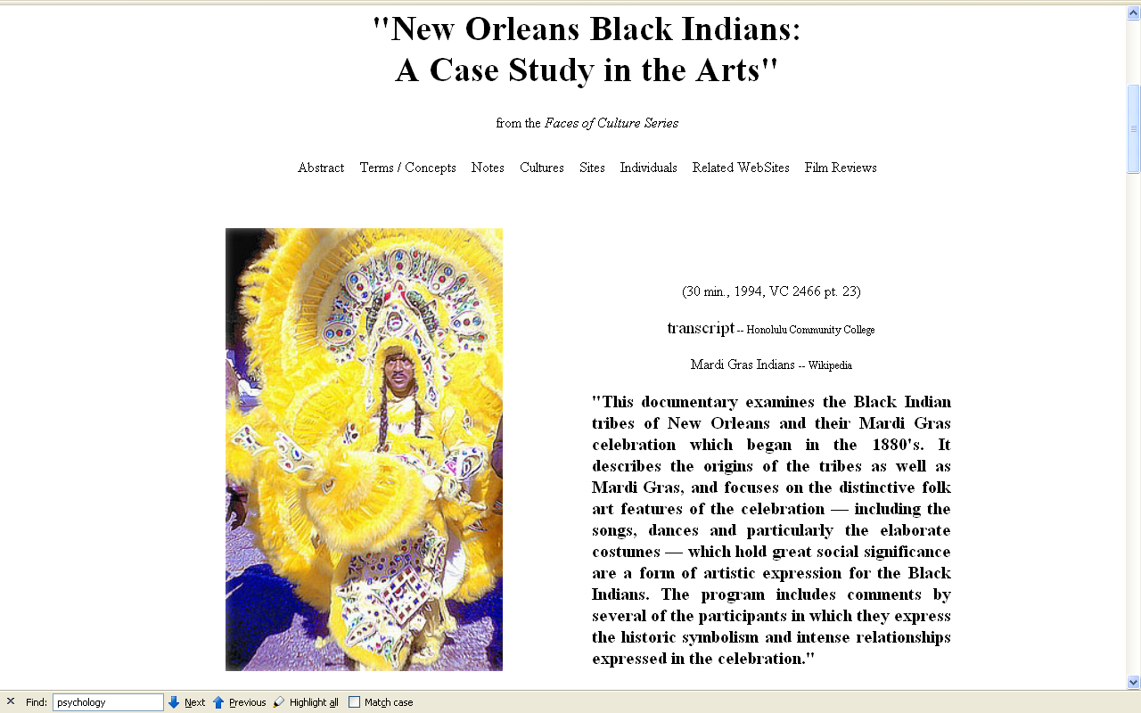
Notes:
64

Slide 65
units of analysis may include:
one person
the family
the community
a region
a “culture area”
a culture / “subculture”
a nation
the world
an item or action itself
a “cultural metaphor”

Slide 66
units of analysis may include:
one person
the family
the community
a region
a “culture area”
a culture / “subculture”
a nation
the world
an item or action itself
a “cultural metaphor”
~ “tribe” ?

Slide 67

Fox, Robin. The Tribal Imagination: Civilization and the Savage Mind. Harvard University Press, 2011.

Slide 68
units of analysis may include:
one person
the family
the community
a region
a “culture area”
a culture / “subculture”
a nation
the world
an item or action itself
a “cultural metaphor”
~ “tribe” ?
Sometimes the “tribe” is also a “nation”

Slide 69

Sometimes the “tribe” is also a “nation”

Slide 70
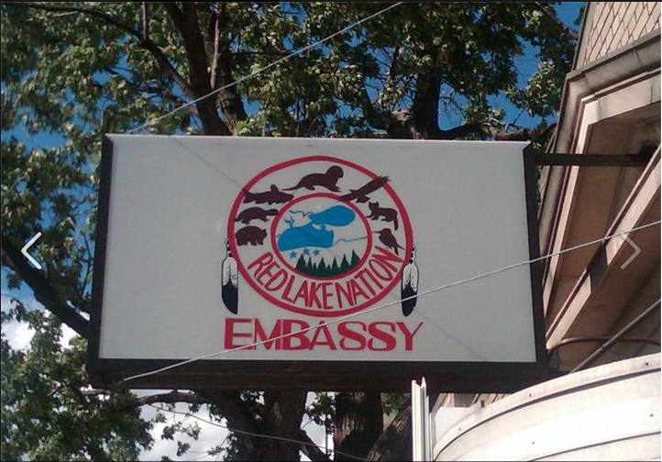
Sometimes the “tribe” is also a “nation”

Slide 71
units of analysis may include:
one person
the family
the community
a region
a “culture area”
a culture / “subculture”
a nation
the world
an item or action itself
a “cultural metaphor”
in summary
(so far)

Slide 72
as mentioned in the “Orientation”
units of analysis may include:
one person
the family
the community
a region
a “culture area”
a culture / “subculture”
a nation
the world
an item or action itself
a “cultural metaphor”

Slide 73
“units of analysis”
may also include:
a nation
(“national character studies”)
the item or action itself
(including “processes”)
a “cultural metaphor”

Slide 74
“units of analysis”
may also include:
a nation
(“national character studies”)
the item or action itself
(including “processes”)
a “cultural metaphor”

Slide 75
“units of analysis”
may also include:
a nation
(“national character studies”)
the item or action itself
(including “processes”)
a “cultural metaphor”

Slide 76
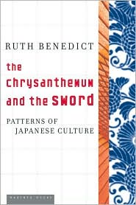
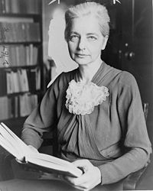
“national character studies”
Japan
Ruth Fulton Benedict
1887-1948
Patterns of Culture
1934

Slide 77
“units of analysis”
may also include:
a nation
(“national character studies”)
the item or action itself
(including “processes”)
a “cultural metaphor”

Slide 79
“units of analysis”
may also include:
a nation
(“national character studies”)
the item or action itself
(including “processes”)
a “cultural metaphor”
and there’s almost no end . . .

Slide 80
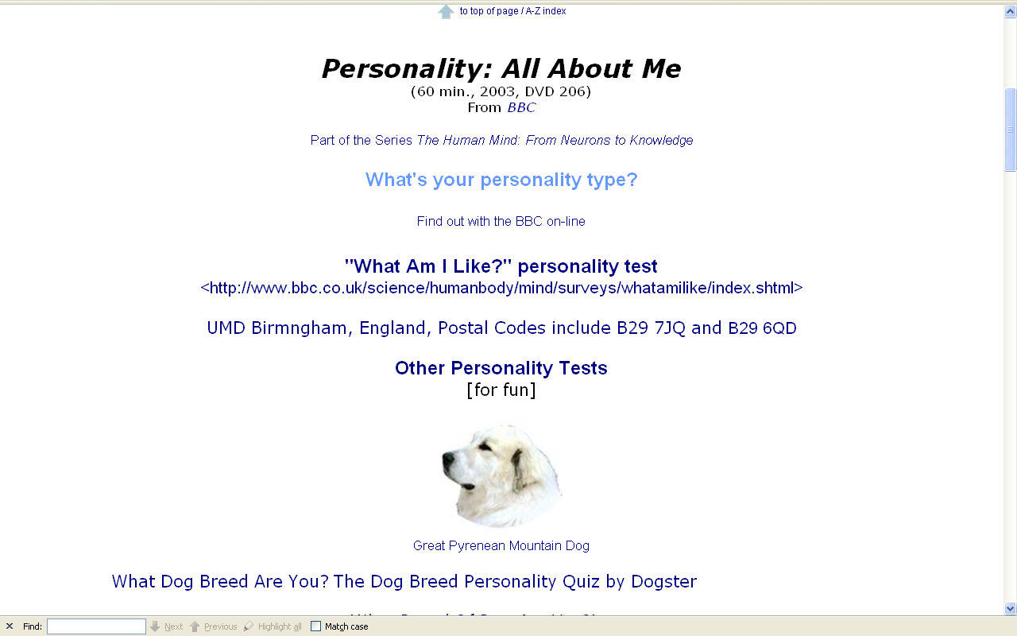
personality
Notes:
80

Slide 81
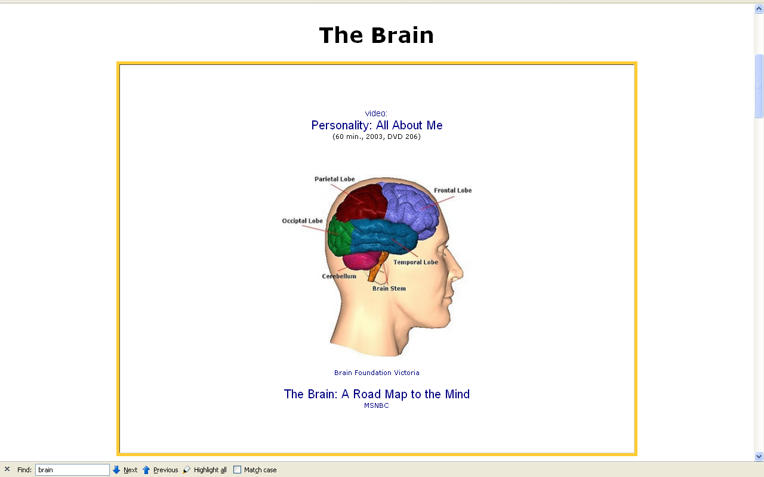
the brain
Notes:
81

Slide 82
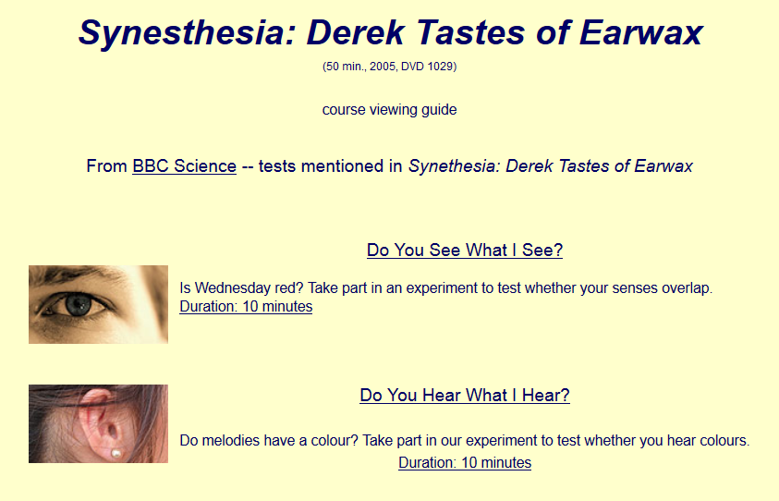
Synesthesia
Notes:
82

Slide 83
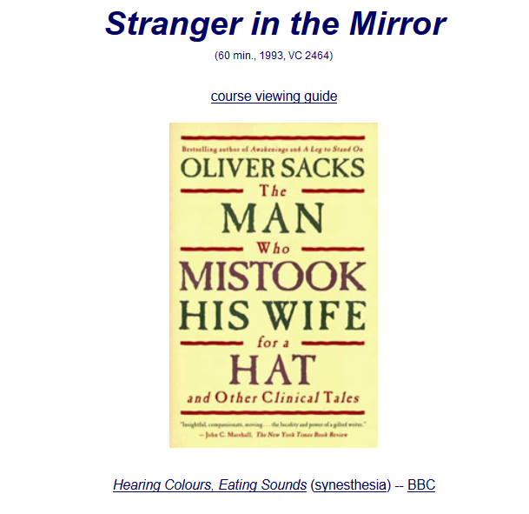
visual agnosia
Notes:
83

Slide 84
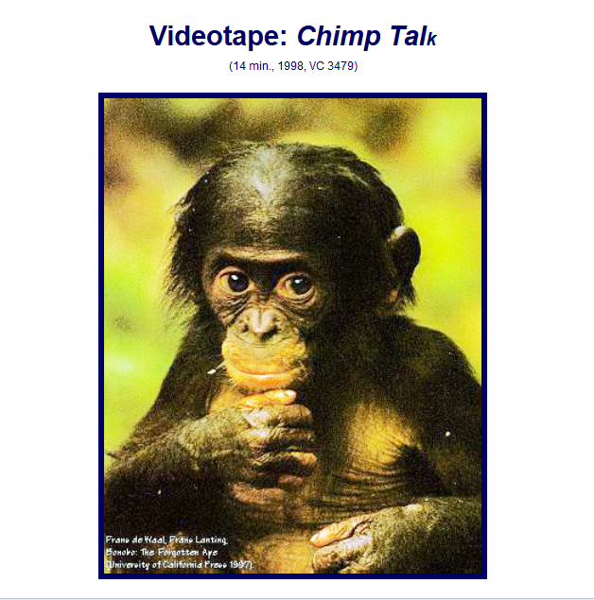
ape language
Notes:
84

Slide 85
autism
Temple Grandin
http://www.sassna.org/news/2015/3/21/temple-grandin-coming-to-sacramento-on-april-3rd

Slide 87
any of the many
culture-bound syndromes
Notes:
87

Slide 88
Notes:
88

Slide 89
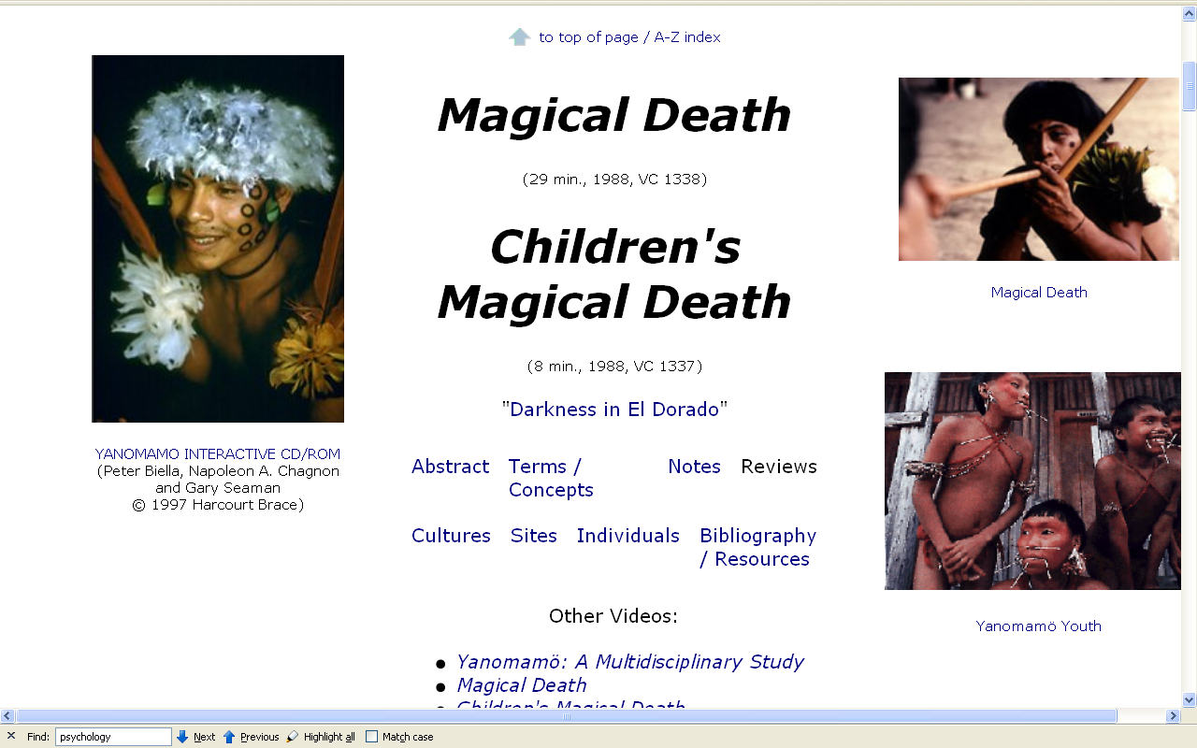
specific rituals
Notes:
89

Slide 90
demography / population
gender
ethnicity
nationalism
globalization
“development”
social / cultural change
decision-making
peasants
urbanism / urbanization
stratification
internal and transnational migration
“transnationalism”
networks
honor / shame values
patron-client relationships
literacy
“we” vs. “other”
rural / urban continuum
Parman's classic picks -- Tony Galt

Slide 91
“units of analysis”
may also include:
a nation
(“national character studies”)
the item or action itself
(including “processes”)
a “cultural metaphor”
in psychological anthropology
these often deal with
“national character studies”
and
“modal personality” traits

Slide 92
as mentioned in the “Orientation”
units of analysis may include:
one person
the family
the community
a region
a “culture area”
a culture / “subculture”
a nation
the world
an item or action itself
a “cultural metaphor”

Slide 93
as mentioned in the “Orientation”
units of analysis may include:
one person
the family
the community
a region
a “culture area”
a culture / “subculture”
a nation
the world
an item or action itself
a “cultural metaphor”
cultural metaphors use an item or event representative of a culture and analyze the culture with reference to that item or event

Slide 94
a cultural metaphor is a specialized use of an item or action or idea itself
as a Unit of Analysis . . .

Slide 95
a cultural metaphor is a specialized use of an item or action or idea itself
as a Unit of Analysis . . .
through analogy

Slide 96
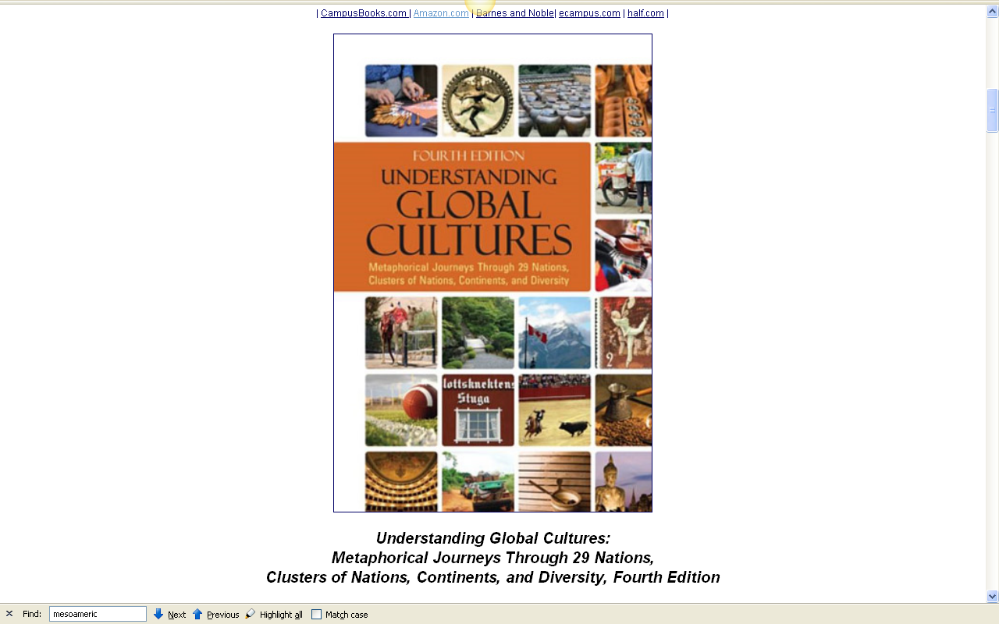
Martin J. Gannon uses cultural metaphors as the basis for his book on Global Cultures
www.d.umn.edu/cla/faculty/troufs/anth1095/index.html#text

Slide 97
Martin J. Gannon
(Ph.D., Columbia University) is Professor of International Management and Strategy, College of Business Administration, California State University San Marcos. He is also Professor Emeritus, Smith School of Business, University of Maryland at College Park. At Maryland he held several administrative positions, including the Associate Deanship for Academic Affairs and the Founding Directorship of the Center for Global Business, and received the University's International Landmark Award.
www.d.umn.edu/cla/faculty/troufs/anth1095/index.html#text

Slide 98
Gannon’s European Cultural Metaphors include
Compare . . .
Ch. 12. Irish Conversations
Ch. 17. The Traditional British House
Ch. 21. The Italian Opera
Ch. 22. Belgian Lace
Ch. 24. The Russian Ballet
Ch. 25. The Spanish Bullfight
Ch. 26. The Portuguese Bullfight

Slide 99
Gannon’s European Cultural Metaphors include
Compare . . .
Ch. 12. Irish Conversations
Ch. 17. The Traditional British House
Ch. 21. The Italian Opera
Ch. 22. Belgian Lace
Ch. 24. The Russian Ballet
Ch. 25. The Spanish Bullfight
Ch. 26. The Portuguese Bullfight
“machismo”
“fatalism”

Slide 100
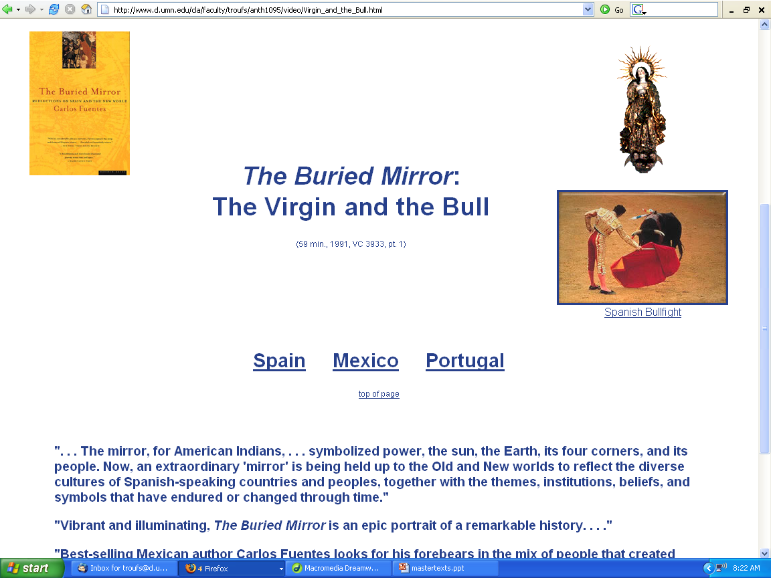
Compare . . .

Slide 101
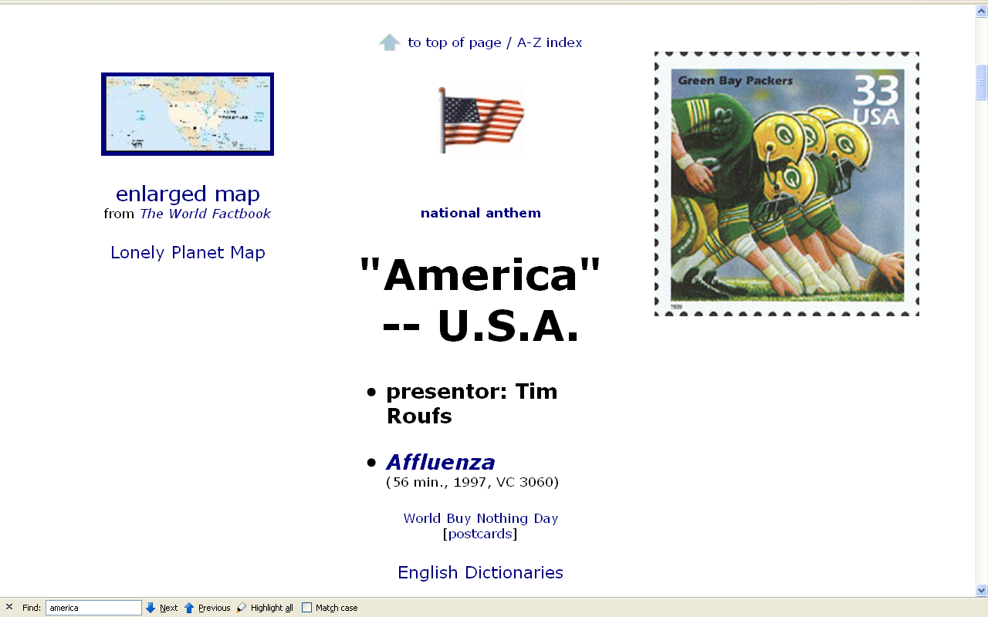
www.sciencedaily.com/releases/2008/07/080721152000.htm
Notes:
101

Slide 102
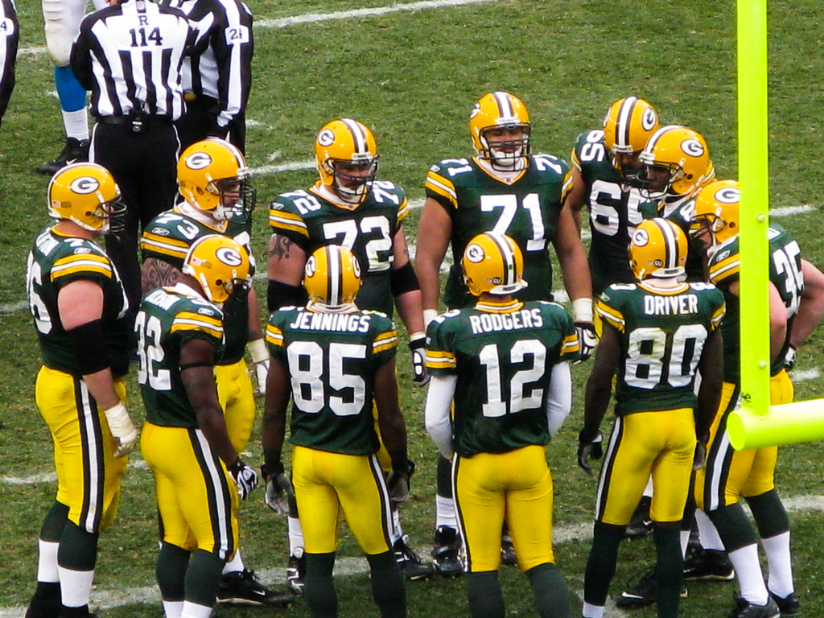
Gannon’s Cultural Metaphors include
Ch. 16 “American Football“
Notes:
102

Slide 103
Gannon’s Cultural Metaphors include
Ch. 6 "The Turkish Coffehouse"
Ch. 9 "Kimchi and Korea"
Ch. 14 "The Danish Christmas Luncheon"
Ch. 15 "French Wine"
Ch. 29 "The Singapore Hawker Centers“
Ch. 16 “American Football“

Slide 104
. . . but at least one professor thinks
the metaphor for America should be . . .
www.sciencedaily.com/releases/2008/07/080721152000.htm
Notes:
104

Slide 105

www.sciencedaily.com/releases/2008/07/080721152000.htm
Notes:
105

Slide 106

University Press of Florida, 2011
Notes:
106

Slide 107
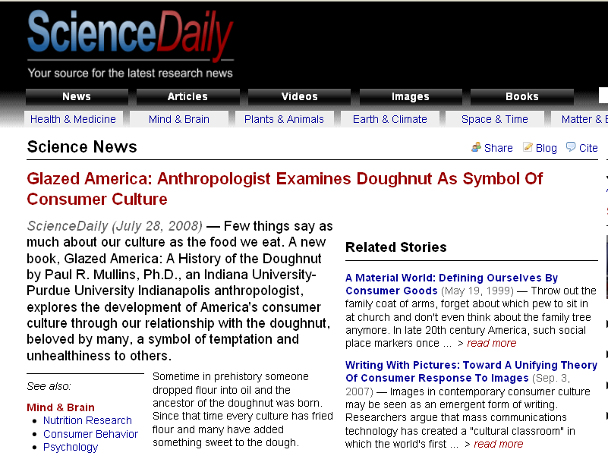
www.sciencedaily.com/releases/2008/07/080721152000.htm
Notes:
107

Slide 108
. . . but it could just as easily be . . .
www.sciencedaily.com/releases/2008/07/080721152000.htm
Notes:
108

Slide 109
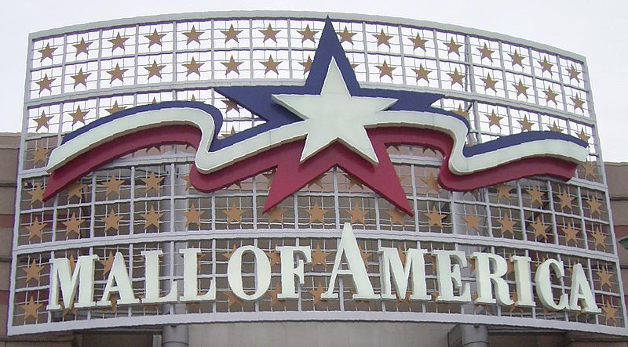
. . . and its related
cultural-bound syndrome . . .
Notes:
109

Slide 110

. . . and its related
cultural-bound syndrome . . .
Notes:
110

Slide 111
and the
Units of Analysis
can be combined

Slide 112
the family
the item itself
Notes:
112

Slide 113
the individual
the family
the community
Notes:
113

Slide 114
in summary . . .

Slide 115
as mentioned in the “Orientation”
units of analysis may include:
one person
the family
the community
a region
a “culture area”
a culture / “subculture”
a nation
the world
an item or action itself
a “cultural metaphor”

Slide 116
Units
of
Analysis re Psychological Anthropology
University of Minnesota Duluth
Tim Roufs
© 2010-2018

