Slide 1
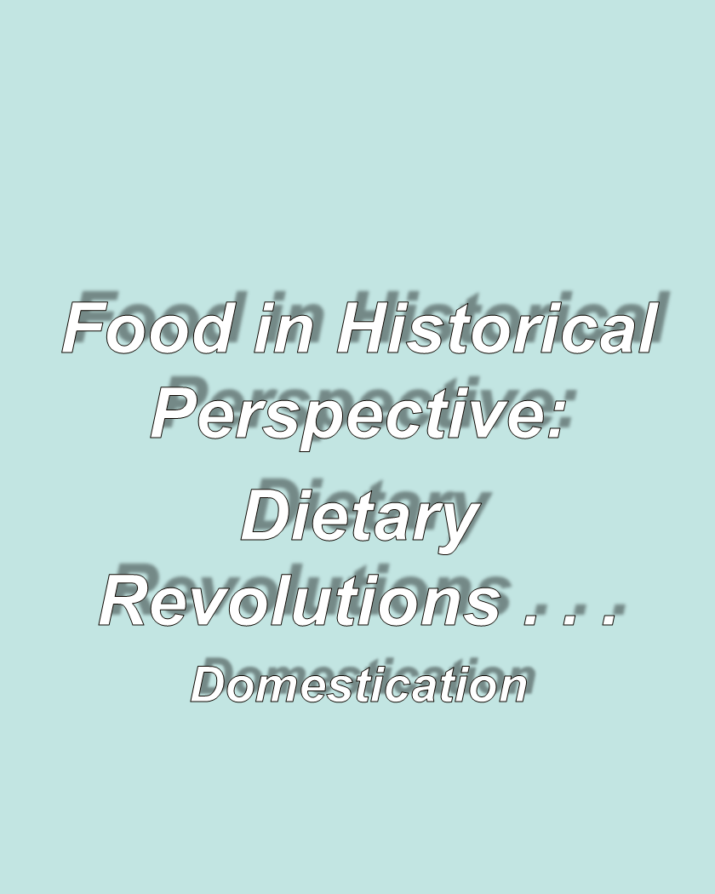
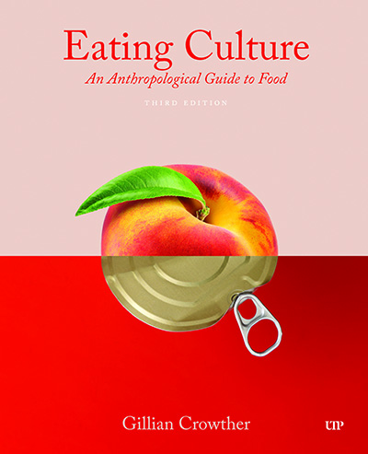
use your up/down arrow keys and/or
your space bar to advance the slides
Tim Roufs
© 2010-2026
Tim Roufs
© 2010-2026

Slide 2
Tim Roufs
© 2010-2026
Tim Roufs
© 2010-2026

Slide 3
Tim Roufs
© 2010-2026

Slide 4
Food in Historical Perspective: Dietary Revolutions
Food in Historical Perspective:
Dietary Revolutions
The Agricultural Revolution of the Neolithic Era
The Search for Spices
The Industrial Revolution
Early Technology
Domestication
Transportation
Refrigeration
Canning
The Scientific Revolution
Modern-Day Adaptations
Summary
Highlight: Vegetarian Diets: Then and Now

Slide 5
Food in Historical Perspective: Dietary Revolutions
Food in Historical Perspective:
Dietary Revolutions
The Agricultural Revolution of the Neolithic Era
The Search for Spices
The Industrial Revolution
Early Technology
Domestication
Transportation
Refrigeration
Canning
The Scientific Revolution
Modern-Day Adaptations
Summary
Highlight: Vegetarian Diets: Then and Now
was the foundation of . . .

Slide 6
Food in Historical Perspective: Dietary Revolutions
Food in Historical Perspective:
Dietary Revolutions
The Agricultural Revolution
The Search for Spices
The Industrial Revolution
Transportation, Refrigeration, and Canning
The Scientific Revolution
Modern-Day Adaptations
Summary
Highlight: Vegetarian Diets: Then and Now

Slide 7
About 12,000 years ago
(ca. 10,000 B.C.)
a dramatic change
in the way humans acquired their food began to unfold
The Cultural Feast, 2nd Ed., p. 48

Slide 8
Food in Historical Perspective: Dietary Revolutions
Food in Historical Perspective:
Dietary Revolutions
foraging
wild foods
in the
wilderness
foraging
wildly, foods
in the
supermarket
localvores
globalvores

Slide 9
Food in Historical Perspective: Dietary Revolutions
Food in Historical Perspective:
Dietary Revolutions
food
collection
food
production
ca., 12,000 ybp
people ate
a wide variety
of foraged foods
people eat
a small number
of domesticated plants and animals

Slide 10
Food in Historical Perspective: Dietary Revolutions
Food in Historical Perspective:
Dietary Revolutions
The Agricultural Revolution
The Search for Spices
The Industrial Revolution
Early Technology
Domestication
Transportation
Refrigeration
Canning
The Scientific Revolution
Modern-Day Adaptations
Summary
Highlight: Vegetarian Diets: Then and Now

Slide 11
Food in Historical Perspective: Dietary Revolutions
agricultural revolution
the growing of plants
(agriculture)
and the management of domesticated animals
(animal husbandry)
The Cultural Feast, 2nd Ed., p. 49

Slide 12
Food in Historical Perspective: Dietary Revolutions
agricultural revolution
the adoption of food production
the critical factor was domestication
The Cultural Feast, 2nd Ed., p. 49

Slide 13
Food in Historical Perspective: Dietary Revolutions
Food in Historical Perspective:
Dietary Revolutions
The Agricultural Revolution of the Neolithic Era
The Search for Spices
The Industrial Revolution
Early Technology
Domestication
Transportation
Refrigeration
Canning
The Scientific Revolution
Modern-Day Adaptations
Summary
Highlight: Vegetarian Diets: Then and Now

Slide 14
Food in Historical Perspective: Dietary Revolutions
domestication
control over plant and animal reproduction
genetic transformation of wild species into domesticated species through selective breeding
The Cultural Feast, 2nd Ed., pp. 48-49

Slide 15
agriculture
the propagation and exploitation of domesticated plants and/or animals by humans

Slide 16
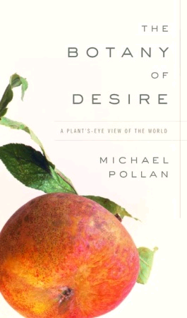
although Michael Pollan, in The Botany of Desire, essentially makes a delightfully interesting case that it was
the plants that domesticated the humans
www.randomhouse.com/catalog/display.pperl?isbn=9781588360083

Slide 17
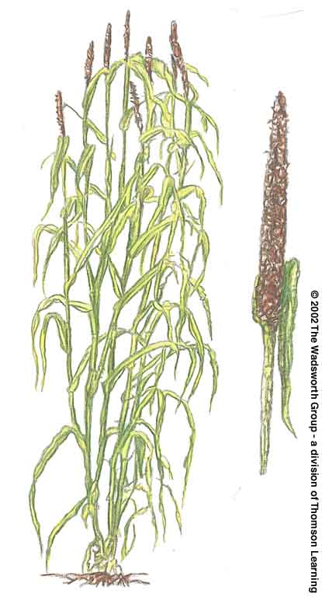
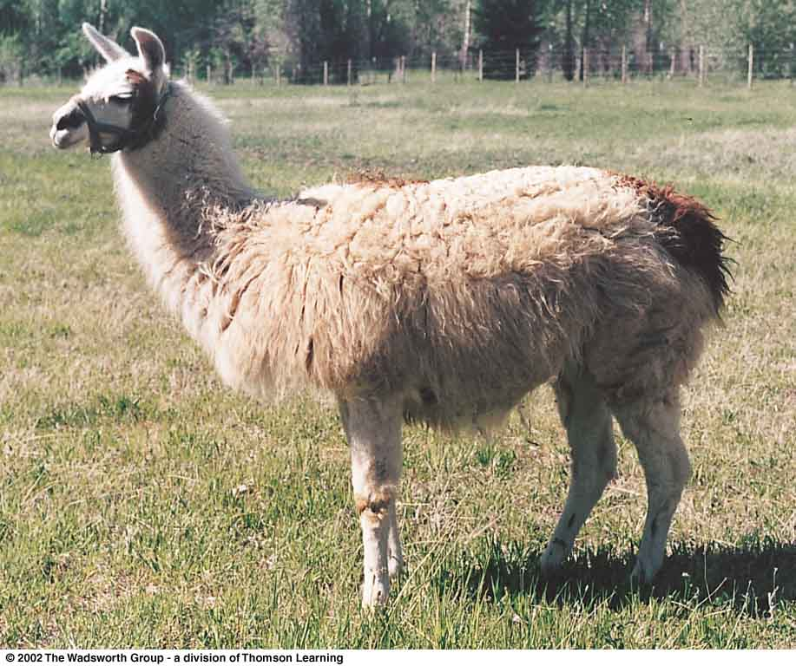
domestication
a state of interdependence between humans and selected plant or animal species
pearl millet
South American llama
Understanding Physical Anthropology and Archaeology, 8th Ed., pp. 421, 9th Ed., 347

Slide 18
domestication
an evolutionary process that requires genetic transformation of a wild species

Slide 19
agriculture
a cultural activity

Slide 20
agriculture
a cultural activity
a cultural activity associated with planting, herding, and processing domesticated species

Slide 21
Food in Historical Perspective: Dietary Revolutions
agricultural revolution
the growing of plants
(agriculture)
and the management of domesticated animals . . .
(animal husbandry)
began about 14,000 ybp
The Cultural Feast, 2nd Ed., p. 49

Slide 22
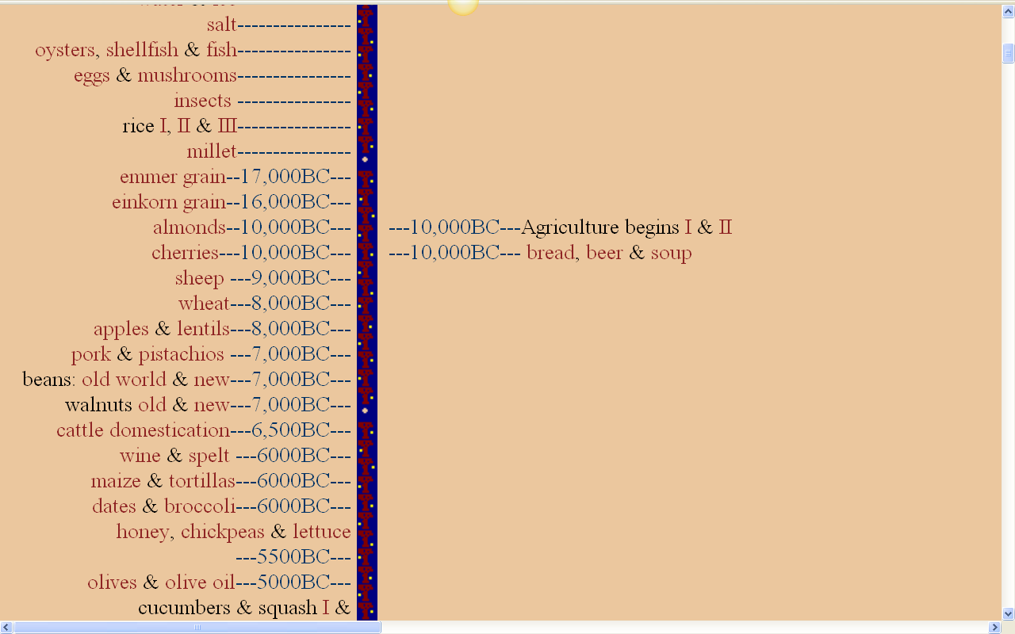
The food timeline
dogs
14,000BC---
one of the earliest domesticated animals was the dog
http://www.foodtimeline.org/

Slide 23
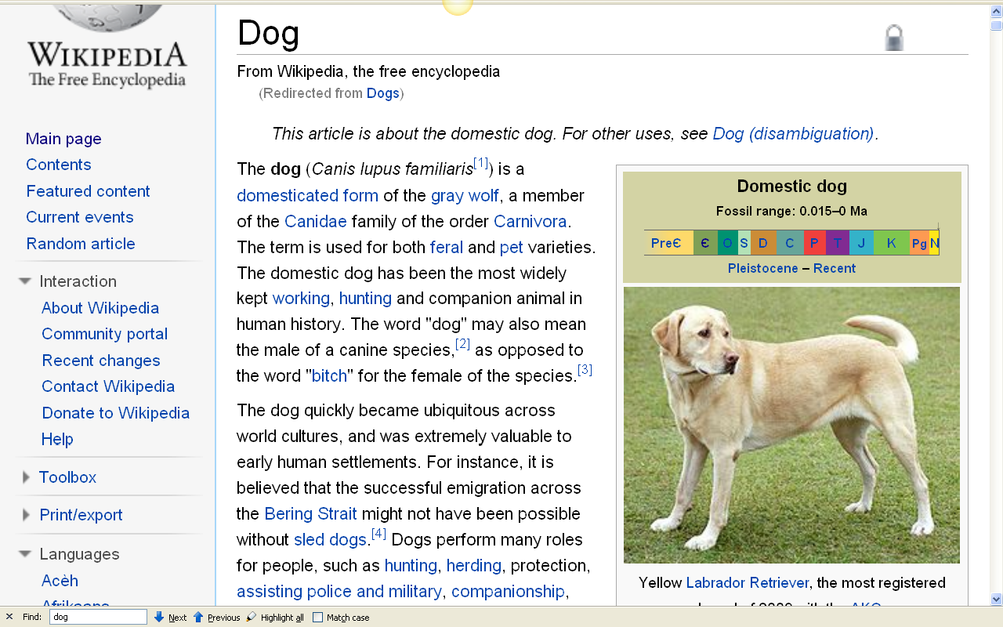
14,000 B.C. - present
http://en.wikipedia.org/wiki/Dogs

Slide 24
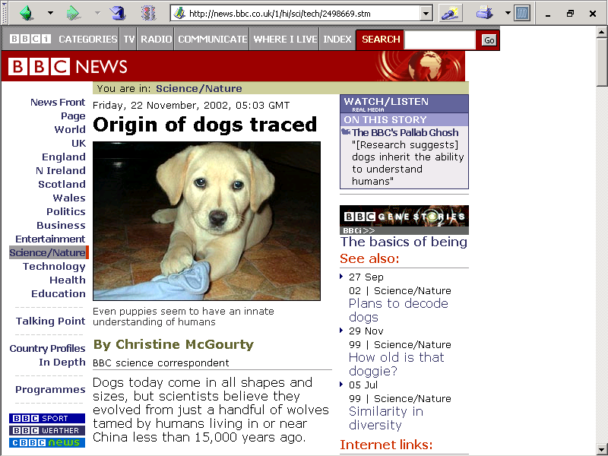
22 November 2002
http://news.bbc.co.uk/1/hi/sci/tech/2498669.stm

Slide 25
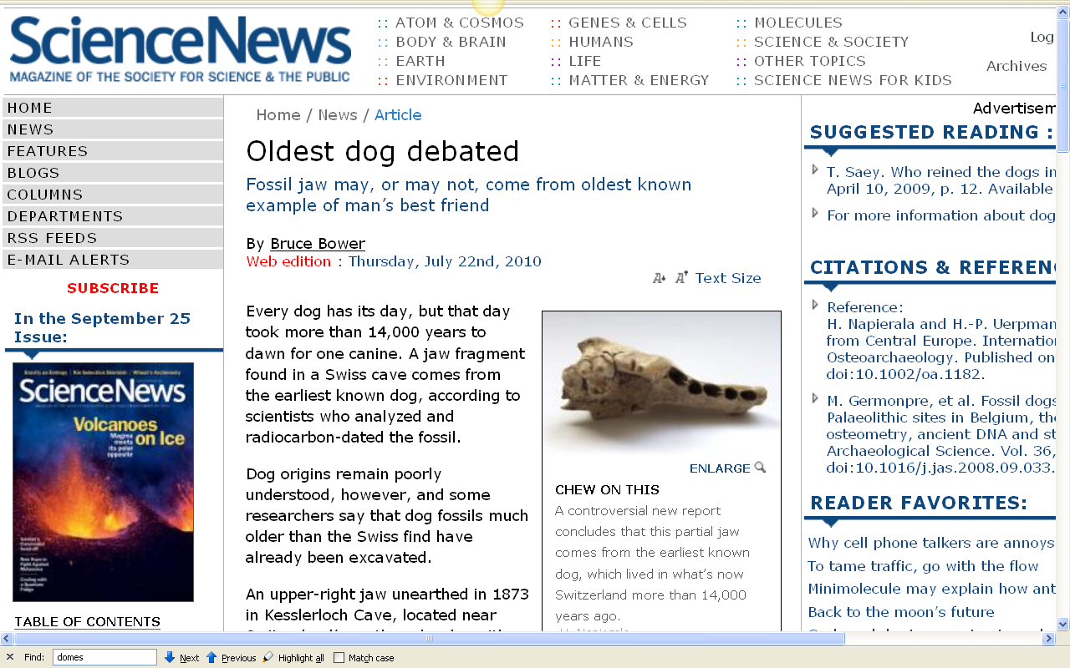
http://www.sciencenews.org/view/generic/id/61368/title/World%E2%80%99s_oldest_dog_debated

Slide 26
Domestication: Dogs
dogs were the first domesticated animals (ca. 13,000-14,000 B.C.)
first role was probably to help with hunting
as other animals were domesticated, dogs were likely used to herd, as working dogs
and possibly they acted as camp watch dogs . . .

Slide 27
Domestication: Dogs
and “garbage disposals”
and as food (for e.g., among the . . .)
Dakota
Aztecs
Chinese
Germans (formerly)
people in some parts of India
other cultures elsewhere
the burial of a puppy with a Natufian who died 10,000 ybp suggests dogs earned the role of pet very early

Slide 28

one of the earliest art works in the New World is of a dog . . .
Texquiquiac Dog Texquiquiac, Mexico ca., 22,000 years B.C.
http://en.wikipedia.org/wiki/Tequixquiac

Slide 29
The food timeline
sheep came next
http://www.foodtimeline.org/

Slide 30
The food timeline
then pigs
http://www.foodtimeline.org/

Slide 31
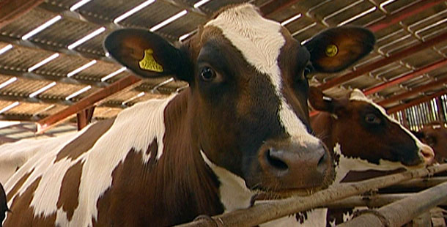
The food timeline
then cattle
http://www.foodtimeline.org/

Slide 32
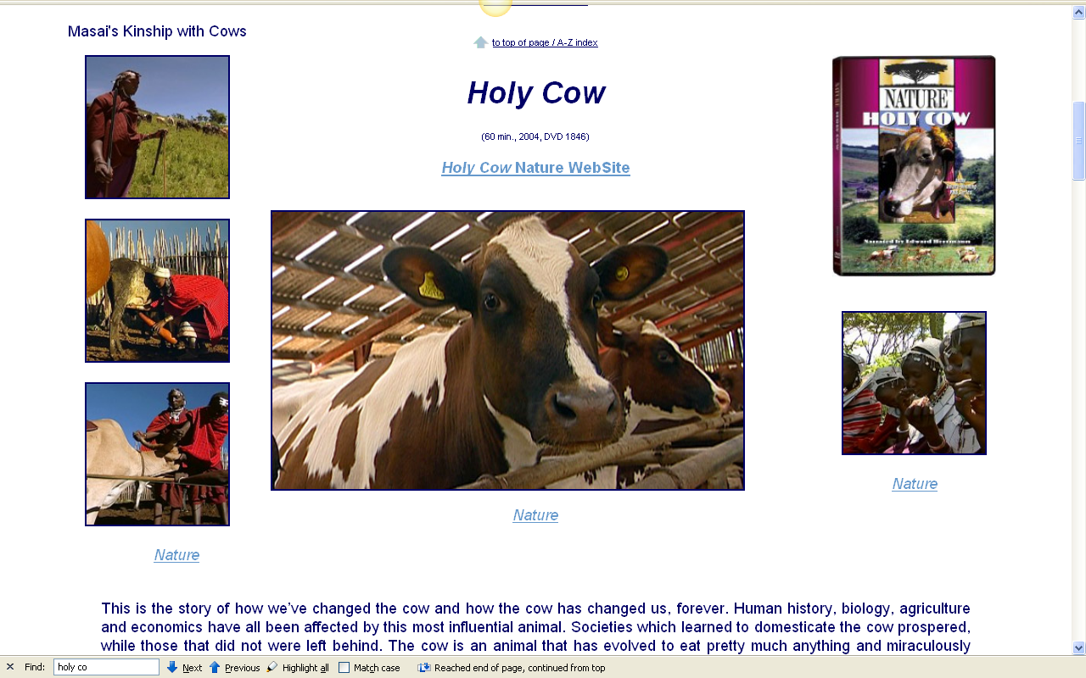
Cows are important — prehistoric and modern . . .

Slide 33
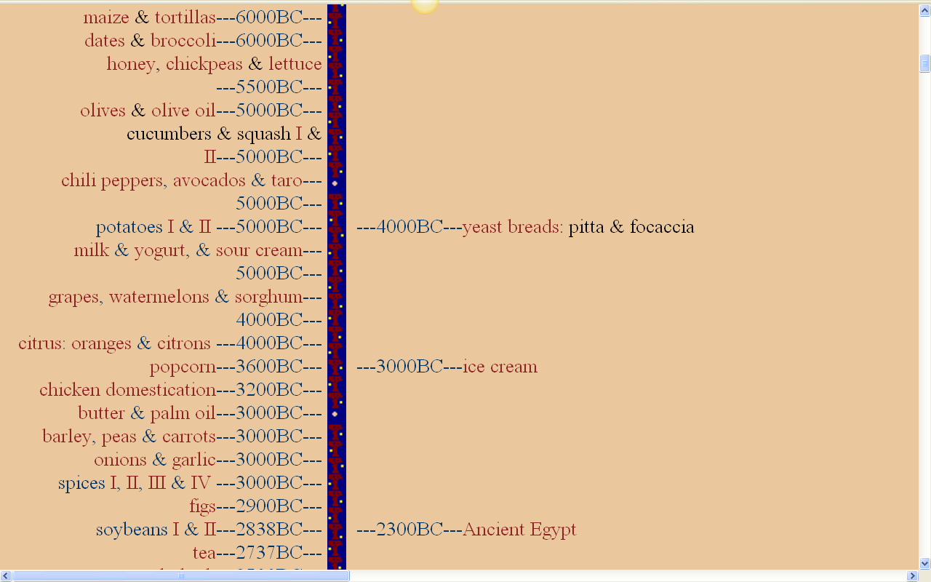
The food timeline
and eventually milk, yogurt, sour cream, and butter
http://www.foodtimeline.org/

Slide 34
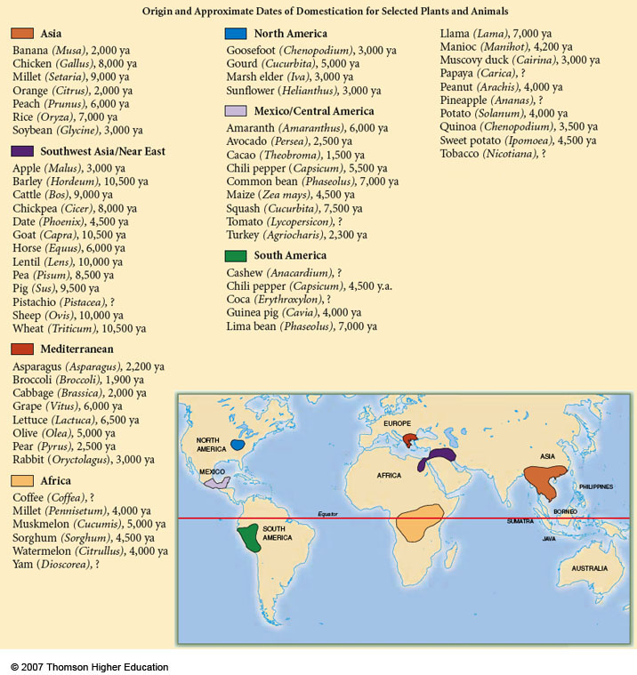
Origin and Approximate Dates of Domestication for Selected Plants and Animals
Understanding Physical Anthropology and Archaeology, 9th Ed., p. 417

Slide 35
Food in Historical Perspective: Dietary Revolutions
agricultural revolution
the growing of plants
(agriculture)
and the management of domesticated animals
(animal husbandry)
The Cultural Feast, 2nd Ed., p. 49

Slide 36
Food in Historical Perspective: Dietary Revolutions
plant domestication
how?
why?
where?
The Cultural Feast, 2nd Ed., pp. 48-49

Slide 37
as favorable plant traits developed, foragers would collect more of the plants with the favorable traits
this stimulated genetic changes in the plants and eventually
produced a cultigen

Slide 38
cultigen
a plant that is wholly dependent on humans
a domesticate

Slide 39
cultivars
wild plants fostered by human efforts to make them more productive
wild plants fostered by human efforts to make them more productive

Slide 40
as selection and isolation from other plants continued, plants became dependent on humans to disperse seeds

Slide 41
two main schools of though on the process of domestication include . . .
Functionalists
domestication emerged in response to a pressing need
Systems Approach
there is no single factor that propels domestication -- there are many factors

Slide 42
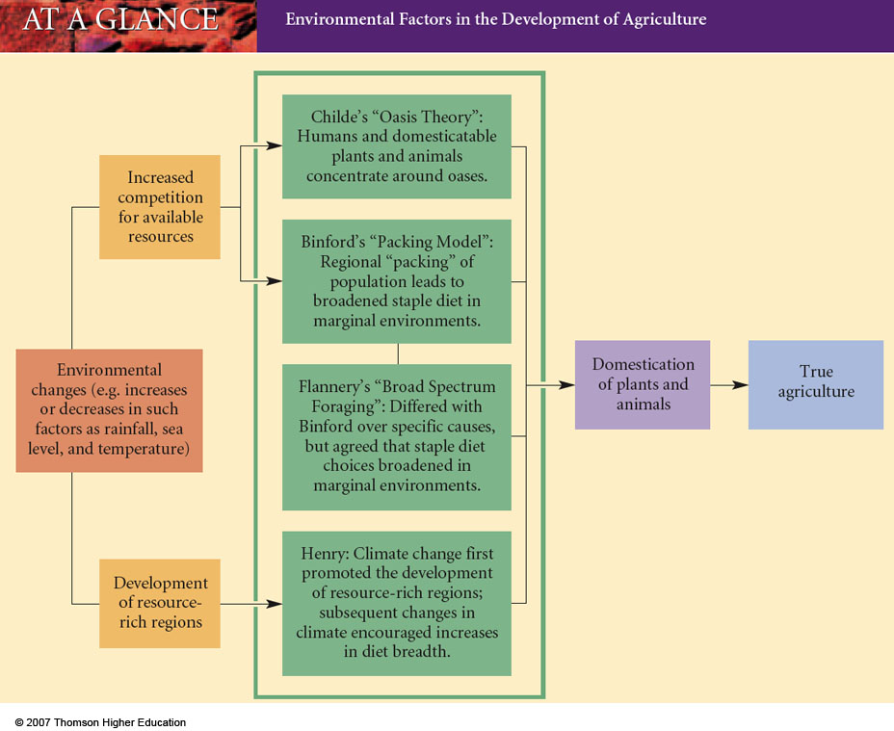
Environmental Factors in the Development of Agriculture
Understanding Physical Anthropology and Archaeology, 9th Ed., p. 338

Slide 43
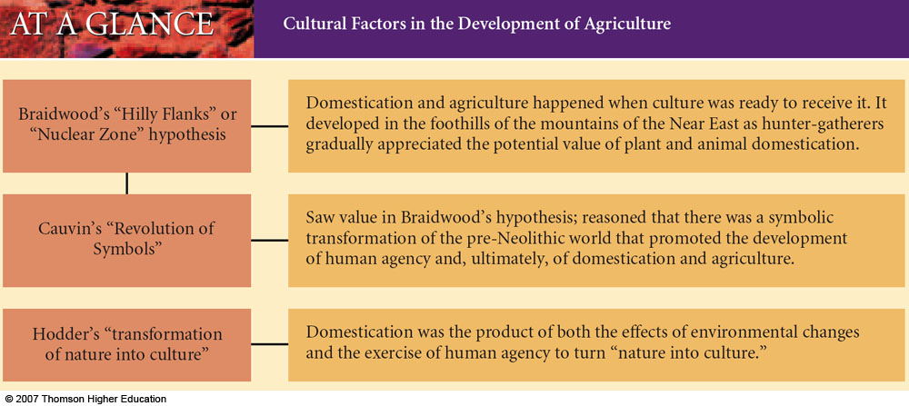
Cultural Factors in the Development of Agriculture
Understanding Physical Anthropology and Archaeology, 9th Ed., p. 340

Slide 44
“. . . contemporary foragers
(see Ch. 5 of The Cultural Feast)
manage the plants and animals in the environments in which they live, though not to the extent farmers and herders do.”
The Cultural Feast, 2nd Ed., p. 49

Slide 45
“… it is though that
women were responsible for much of the development of agriculture”
they probably did much of the gathering of plants and capturing of small animals
were probably more attuned to the plants in the environment
tend to stay closer to the home base than men
were in a position to observe the growth of plants from seeds
were a in a position to care for captured animals
The Cultural Feast, 2nd Ed., p. 49

Slide 46
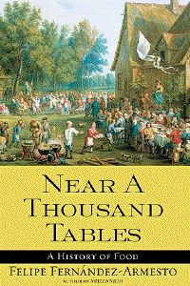
for more information see
Ch. 4 “The Edible Earth:
Managing Plant Life for Food”
Simon & Schuster 2003

Slide 47
REM Eight Food “Revolutions”
Invention of Cooking
Discovery that Food is More Than Sustenance
The “Herding Revolution”
Snail Farming
Use of Food as a Means and Index of Social Differentiation
Long-Range Exchange of Culture
Ecological Revolution of last 500 years
Industrial Revolution of the 19th and 20th Centuries
Simon & Schuster 2003

Slide 48
The food timeline
shellfish and fish were among the first “domesticates”
http://www.foodtimeline.org/

Slide 49
“… people switched very slowly from harvesting wild species to planting selected varieties.”
at first, the cultivated varieties served only as supplements to the wild plants and animals they consumed
through time, people grew increasingly dependent on cultivated plants and animals
eventually agriculture produced the vast majority of foods eaten
The Cultural Feast, 2nd Ed., p. 49

Slide 50
Archaeological Evidence for Domestication

Slide 51
archaeologists and prehistorians looking at world trends generally focus on
seven areas important in early domestication . . .

Slide 52
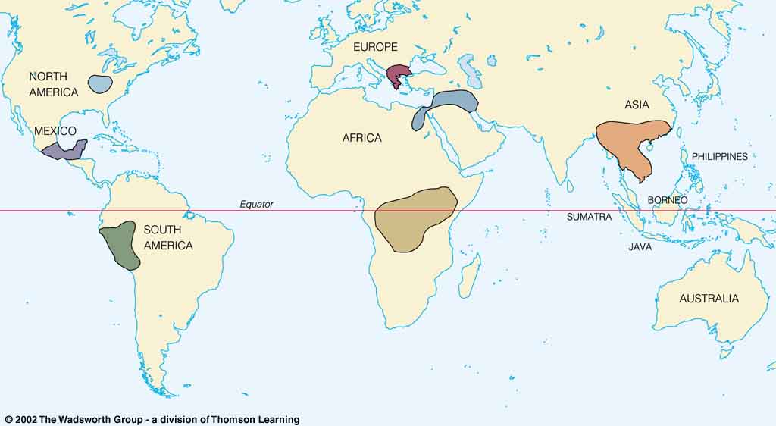
Origin of Domestication for Selected Plants
lettuce, grape, olive 6,500-5,000 ybp
gourd
5,000 ybp
rice
7,000 ybp
wheat
10,500 ybp
maize
4,500 ybp
millet
4,000 ybp
manioc
4,200 ybp
Understanding Physical Anthropology and Archaeology, 8th Ed., p. 417

Slide 53
these seven areas produced many of the foods we rely on today
Origin and Approximate Dates of Domestication for Selected Plants and Animals
Understanding Physical Anthropology and Archaeology, 9th Ed., p. 417

Slide 54
Origin of Domestication for Selected Plants
lettuce, grape, olive 6,500-5,000 ybp
gourd
5,000 ybp
rice
7,000 ybp
maize
4,500 ybp
wheat
10,500 ybp
millet
4,000 ybp
manioc
4,200 ybp
wheat was domesticated in the area of modern-day
Anatolia, Turkey, between 10,500 and 8,000 ybp
Understanding Physical Anthropology and Archaeology, 8th Ed., p. 417

Slide 55
The food timeline
http://www.foodtimeline.org/

Slide 56
along with many other plants and animals
Origin and Approximate Dates of Domestication for Selected Plants and Animals
Understanding Physical Anthropology and Archaeology, 9t^{h} Ed., p. 417

Slide 57
important (and famous) archaeological sites in that general area include . . .
Near Eastern Farmers
Jericho, Palestine
Çatalhöyük, Anatolia, Turkey
Jarmo, Iraq
Ali Kosh, Iran

Slide 58
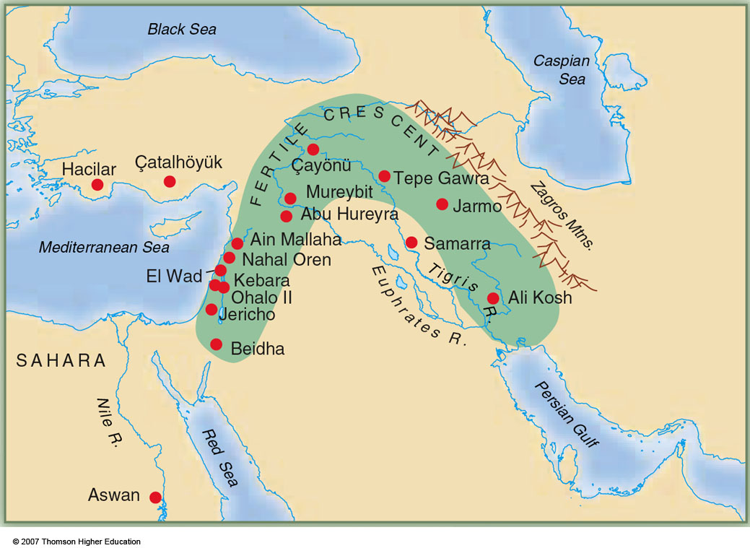
Early Neolithic sites of the Fertile Crescent
Understanding Physical Anthropology and Archaeology, 9th Ed., p. 349

Slide 59
Jericho
an early Neolithic community in Palestine
(yes, the same one Joshua blew his trumpet over)
Early Neolithic sites of the Fertile Crescent
Understanding Physical Anthropology and Archaeology, 9th Ed., p. 349

Slide 60
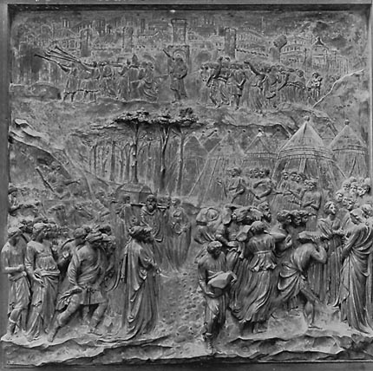
Lorenzo Ghiberti's 15th Century visualization of the attack
on the walls of Jericho
www.howardbloom.net/jericho.htm

Slide 61
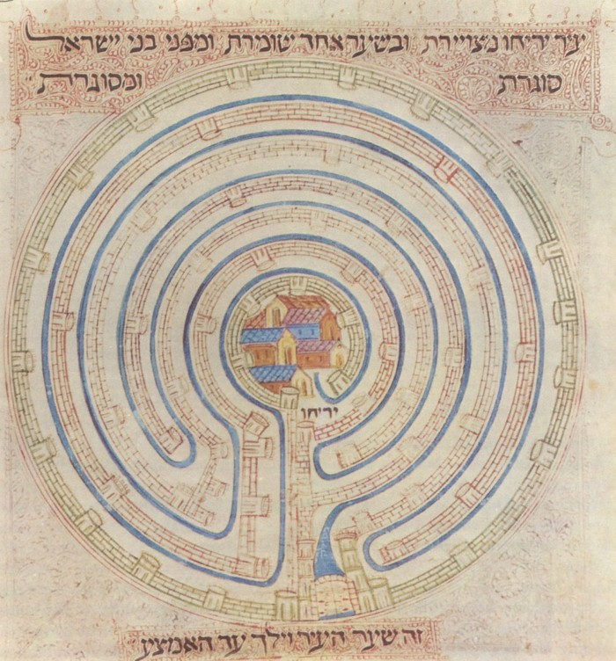
Map of Jericho in 14th century Farhi Bible
http://en.wikipedia.org/wiki/Jericho

Slide 62
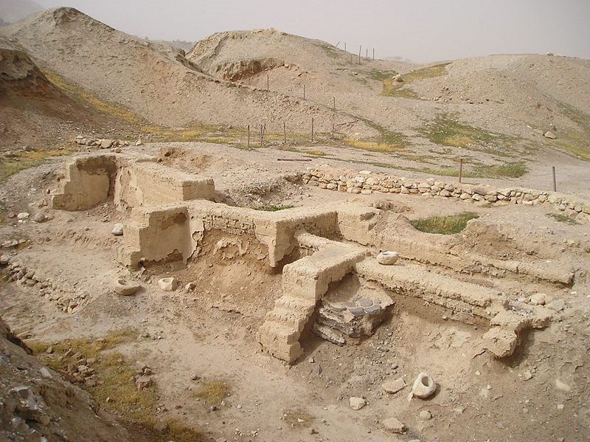
Dwelling foundations unearthed at Tell es-Sultan in
Jericho
http://en.wikipedia.org/wiki/Jericho

Slide 63
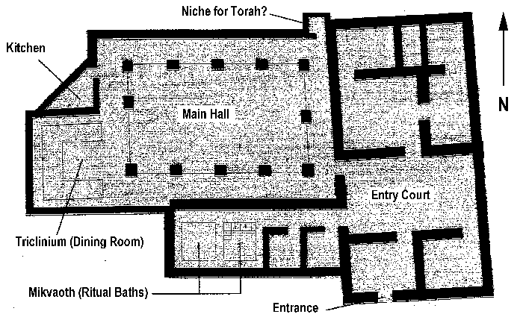
Jericho
http://faculty.smu.edu/dbinder/jericho.html

Slide 64
Çatalhöyük
an early Neolithic community in southern Anatolia, Turkey
Early Neolithic sites of the Fertile Crescent
Understanding Physical Anthropology and Archaeology, 9th Ed., p. 349

Slide 65
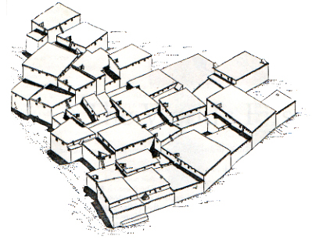
Çatalhöyük, Anatolia, or Turkey
Shane, Orrin C. III, and Mine Küçuk.
"The World's First City."
Archaeology 51.2 (1998): 43-47.

Slide 66
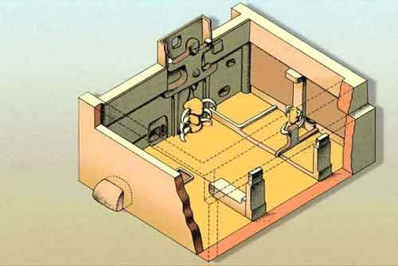
Çatalhöyük, Anatolia, or Turkey
http://www.ccny.cuny.edu/architecture/archprog/slide-232/pages/001%20Catal%20Huyuk.htm

Slide 67
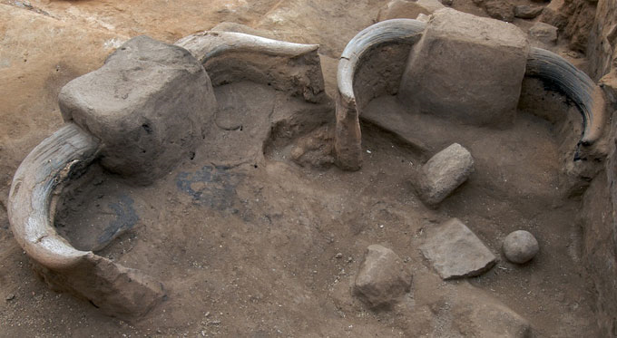
Wild bull horns on pillars in Building 77
Çatalhöyük
www.catalhoyuk.com/

Slide 68
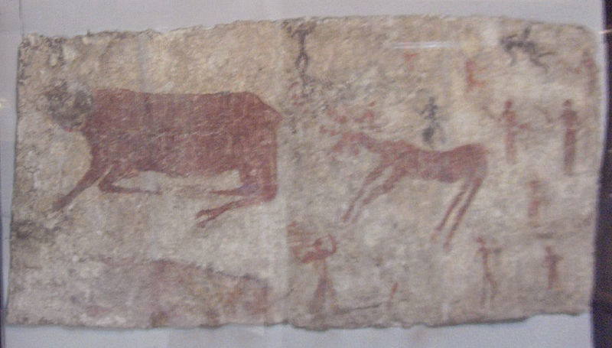
Mural of an aurochs, a deer, and humans from
Çatalhöyük sixth millennium B.C.
http://en.wikipedia.org/wiki/%C3%87atalh%C3%B6y%C3%BCk /

Slide 69
Jarmo
an early Neolithic community in northern Iraq . . .
the oldest known farming community in the world
ca. 7000 B.C.
Early Neolithic sites of the Fertile Crescent
Understanding Physical Anthropology and Archaeology, 9th Ed., p. 349
Understanding Physical Anthropology and Archaeology, 9th Ed., p. 349

Slide 70
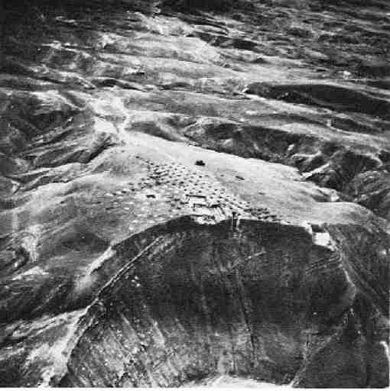
Jarmo, Iraq

Slide 71
Ali Kosh
an early site in the Fertile Crescent
a site known as a center for the invention and development of early pottery
Understanding Physical Anthropology and Archaeology, 9th Ed., p. 349

Slide 72
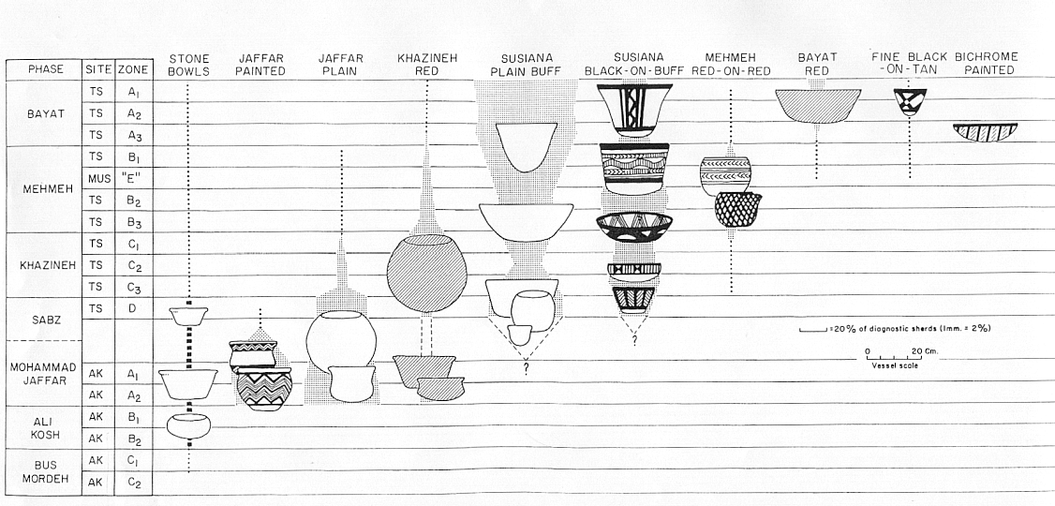
Pottery types from Deh Luran, Iran
Hole, Flannery and Neely, “Prehistory and Human Ecology
Of the Deh Luran Plain: An Early Village Sequence from
Khuzistan, Iran.” Ann Arbor: 1969, fig. 69

Slide 73
Near Eastern Farmers
Jericho, Palestine
Çatalhöyük, Anatolia, Turkey
Jarmo, Iraq
Ali Kosh, Iran
Ancient Egypt
and in that general area Ancient Egypt was also important

Slide 74
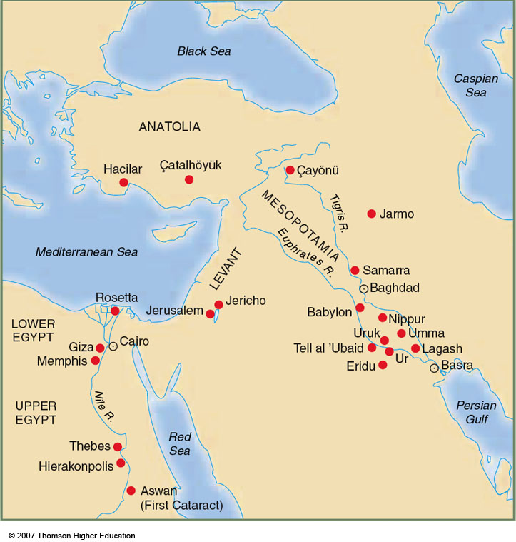
Egypt
Understanding Physical Anthropology and Archaeology, 9th Ed., p.378

Slide 75
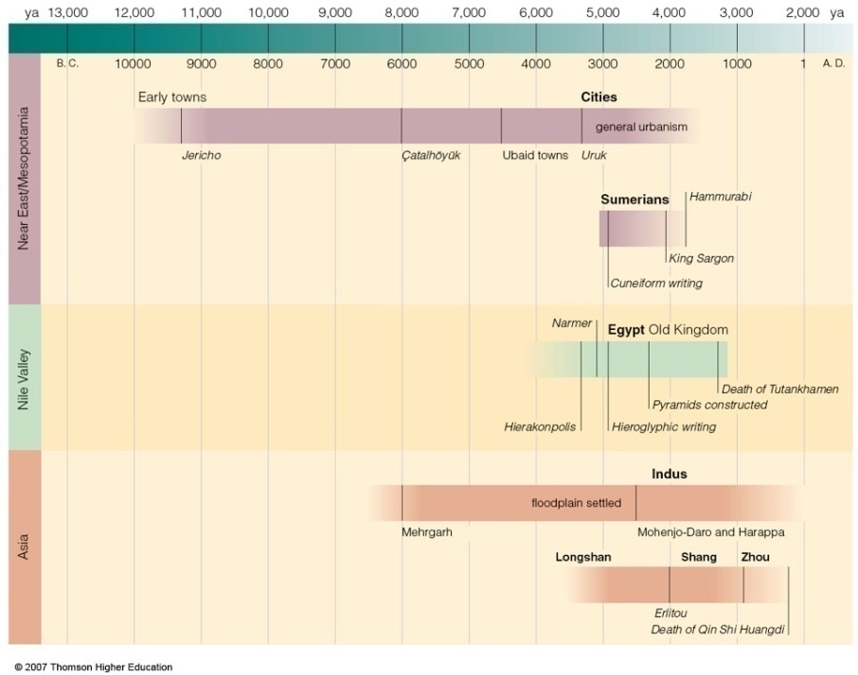
Understanding Physical Anthropology and Archaeology, 9th Ed., p. 449

Slide 76
Egypt
the Old Kingdom times marked the beginning of Nile valley civilization
(4,575 - 4,150 ybp)
the merger of Nile valley societies under one king created the world's first nation state

Slide 77
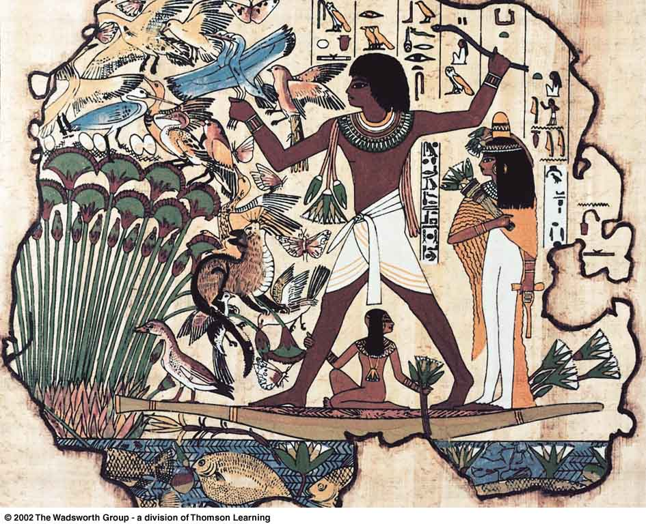
known for its . . .
Hieroglyphics
the picture-writing of ancient Egypt
Royal Egyptian Hunting marsh birds from a papyrus boat
Understanding Physical Anthropology and Archaeology, 9th Ed., p 463

Slide 78
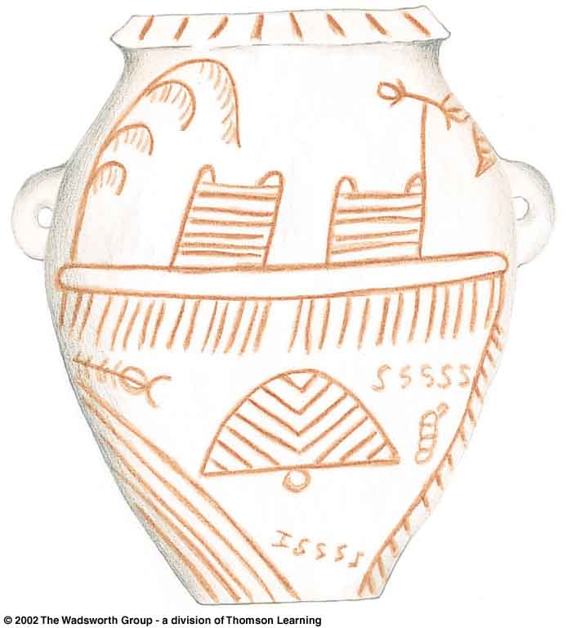
Decorated predynastic pottery jars, probably used for food storage
Nile valley,
Egypt
Understanding Physical Anthropology and Archaeology, 9th Ed., p. 461

Slide 79
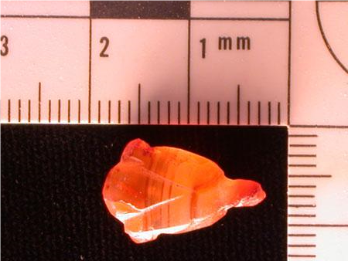
amber
fossil pine pitch or resin,
long valued for jewelry or offerings
amber lotus
Amber jewelry has been found in Egypt from as far back as
2,600 B.C.
www.aeraweb.org/artifacts.asp

Slide 80
Eight Food “Revolutions”
Invention of Cooking
Discovery that Food is More Than Sustenance
The “Herding Revolution”
Snail Farming
Use of Food as a Means and Index of Social Differentiation
Long-Range Exchange of Culture
Ecological Revolution of last 500 years
Industrial Revolution of the 19th and 20th Centuries
could this be related to snail farming?
Simon & Schuster 2003

Slide 81
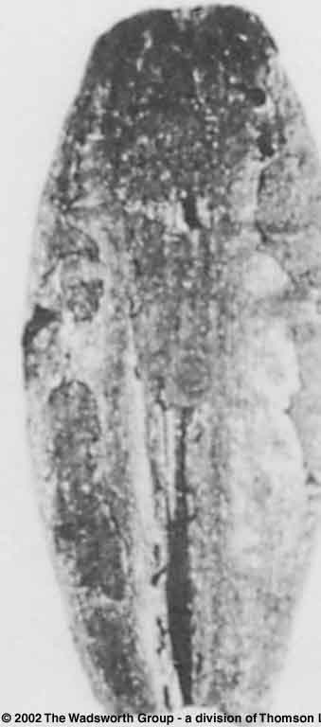
carbonized grain of
domesticated barley
from the Nile valley
Understanding Physical Anthropology and Archaeology, 8th Ed., p. 419

Slide 82
Origin of Domestication for Selected Plants
gourd
5,000 ybp
rice
7,000 ybp
lettuce, grape, olive . . . 6,500-5,000 ybp
wheat
10,500 ybp
maize
4,500 ybp
millet
4,000 ybp
manioc
4,200 ybp
as one might expect the early domesticates in southern Europe formed the basis of the Mediterranean diet . . .
Understanding Physical Anthropology and Archaeology, 8th Ed., p. 417

Slide 83
Origin and Approximate Dates of Domestication for Selected Plants and Animals
Understanding Physical Anthropology and Archaeology, 9th Ed., p. 417

Slide 84
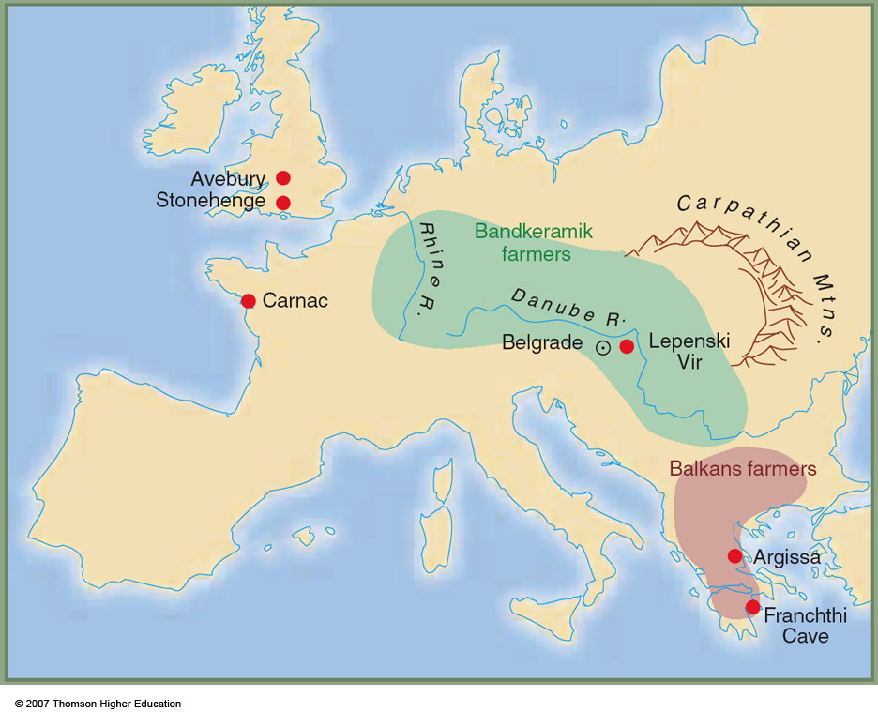
Early European farmers
Early Neolithic Sites of Europe
Understanding Physical Anthropology and Archaeology, 9th Ed., p. 354

Slide 85
Origin of Domestication for Selected Plants
lettuce, grape, olive 6,500-5,000 ybp
gourd
5,000 ybp
rice
7,000 ybp
wheat
10,500 ybp
maize
4,500 ybp
millet
4,000 ybp
manioc
4,200 ybp
rice early on became the staple food of Asia
Understanding Physical Anthropology and Archaeology, 8th Ed., p. 417

Slide 86
Origin of Domestication for Selected Plants
lettuce, grape, olive 6,500-5,000 ybp
gourd
5,000 ybp
rice
7,000 ybp
wheat
10,500 ybp
maize
4,500 ybp
although in India
millet was actually important first
millet
4,000 ybp
manioc
4,200 ybp
Understanding Physical Anthropology and Archaeology, 8th Ed., p. 417

Slide 87
The food timeline
http://www.foodtimeline.org/

Slide 88
along with other plants and animals
Origin and Approximate Dates of Domestication for Selected Plants and Animals
Understanding Physical Anthropology and Archaeology, 9th Ed., p. 417

Slide 89
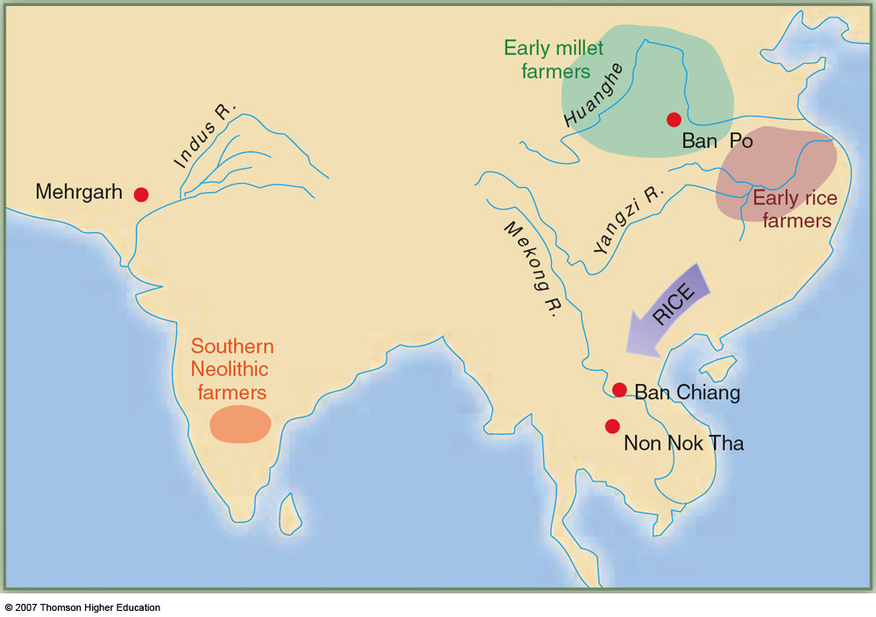
Mehrgarh was one of the earliest Neolithic settlements of southern Asia (in modern-day Pakistan)
includes one of the earliest examples of dentistry (the need for which was probably brought on by a change in diet following the adaptation of agriculture)
Early Farming in Asia
Understanding Physical Anthropology and Archaeology, 9th Ed., p. 352

Slide 90

Mehrgarh is a site featured in this latest major work on the social, political, and nutritional consequences of
“The Agricultural Revolution”
NY: Random House, 2010

Slide 91
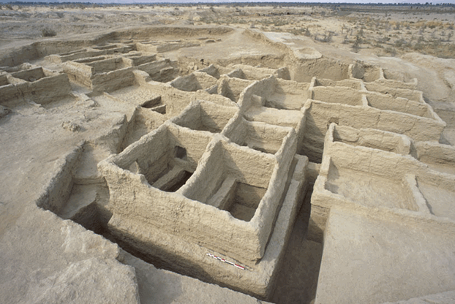
“Located at the base of an important pass,
the site of Mehrgarh in Baluchistan, Pakistan provides evidence for the earliest agricultural and pastoral communities in South Asia.”
“The first inhabitants of Mehrgarh, dating to around 6500 B. C., were farmers who cultivated wheat and barley as their main grain crops and had herds of cattle, sheep and goats.”
Early farming village in Mehrgarh, c. 7000 B.C., with houses built with mud bricks (Musée Guimet, Pari)
http://www.harappa.com/indus/indus4.html

Slide 92
Origin of Domestication for Selected Plants
lettuce, grape, olive 6,500-5,000 ybp
gourd
5,000 ybp
maize
4,500 ybp
rice
7,000 ybp
wheat
10,500 ybp
millet
4,000 ybp
Maize (corn) became the major staple crop of the
New World and made possible the development of several major ancient civilizations in
Mesoamerica and parts of North America
manioc
4,200 ybp
Understanding Physical Anthropology and Archaeology, 8th Ed., p. 417

Slide 93
The food timeline
http://www.foodtimeline.org/

Slide 94
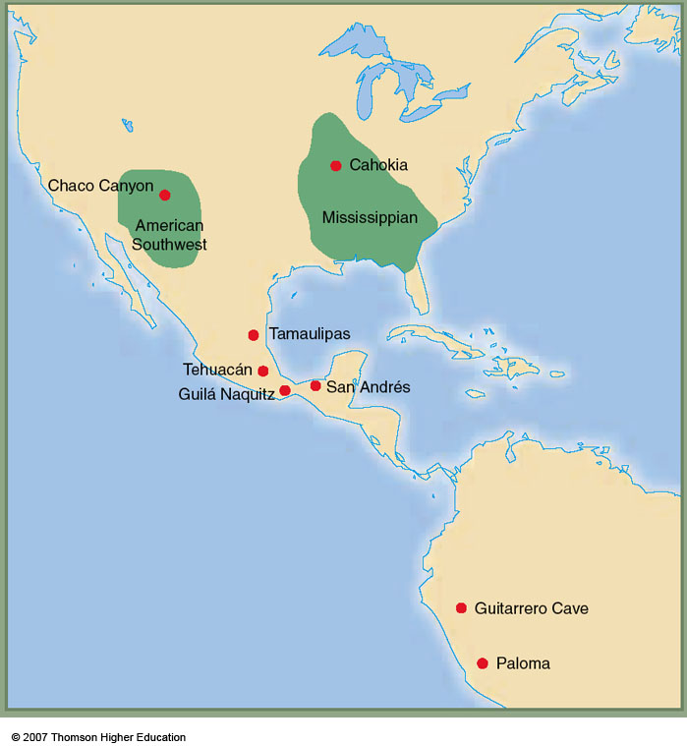
maize
4,500 ybp
The Tehuacán Valley, Puebla, Mexico,
is one of the most important sites in the world for tracing the development and diffusion of agriculture.
The Tehuacán Valley (or perhaps just a little west of it) is the center of the domestication of maize (corn), which became the major staple crop of the New World. Tehuacán is a featured site in The Cultural Feast, and there is a separate slide set devoted to Tehuacán. Please see that slide set for details.
(Don’t miss it!)
Early farming in the Americas
Understanding Physical Anthropology and Archaeology, 9th Ed., p. 358

Slide 95
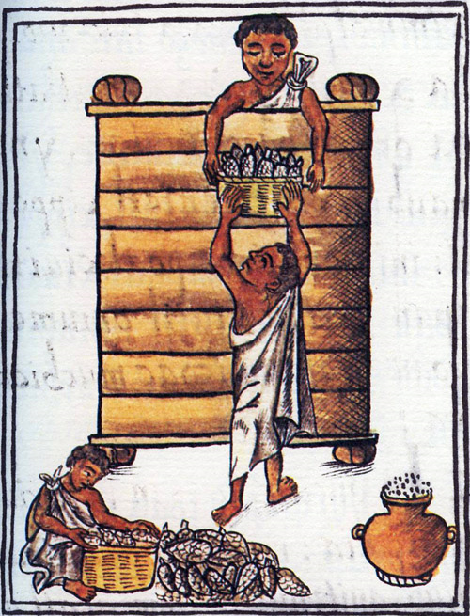
Aztecs storing maize Florentine Codex, late 16th century

Slide 96
Origin of Domestication for Selected Plants
lettuce, grape, olive 6,500-5,000 ybp
gourd
5,000 ybp
rice
7,000 ybp
wheat
10,500 ybp
maize
4,500 ybp
in South America manioc became important
(most of us are familiar with manioc in the form of tapioca)
millet
4,000 ybp
manioc
4,200 ybp
Understanding Physical Anthropology and Archaeology, 8th Ed., p. 417

Slide 97
but the South Americans domesticated
many plants and animals . . . including . . .
Origin and Approximate Dates of Domestication for Selected Plants and Animals
Understanding Physical Anthropology and Archaeology, 9th Ed., p. 417

Slide 98
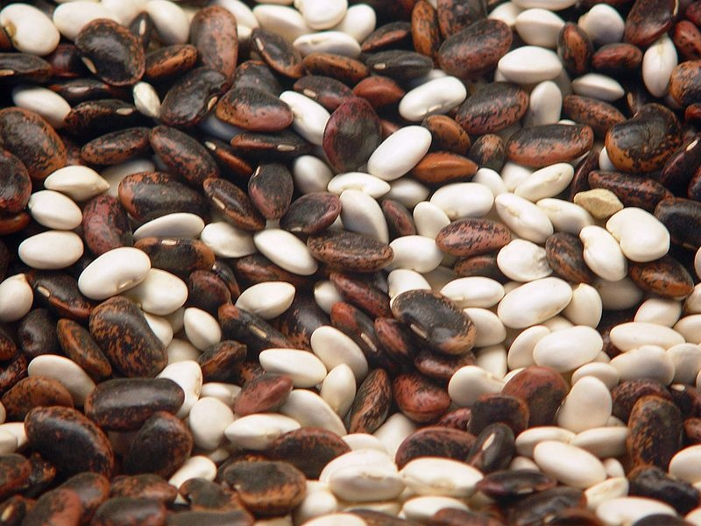
http://en.wikipedia.org/wiki/Beans

Slide 99
The food timeline
http://www.foodtimeline.org/

Slide 100
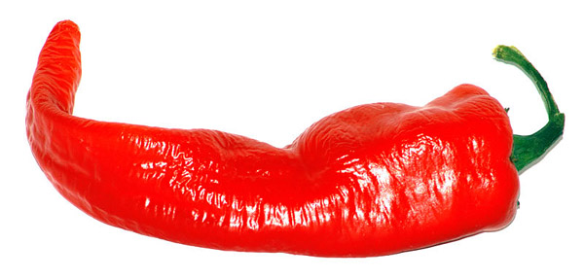
http://en.wikipedia.org/wiki/Chili_pepper

Slide 101
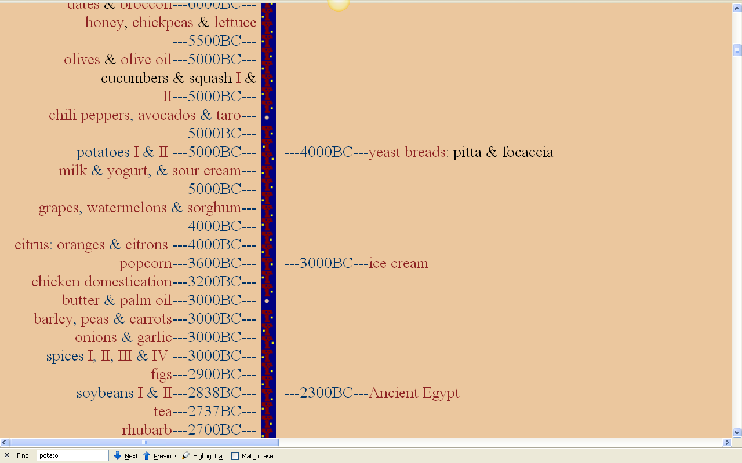
http://www.foodtimeline.org/

Slide 102
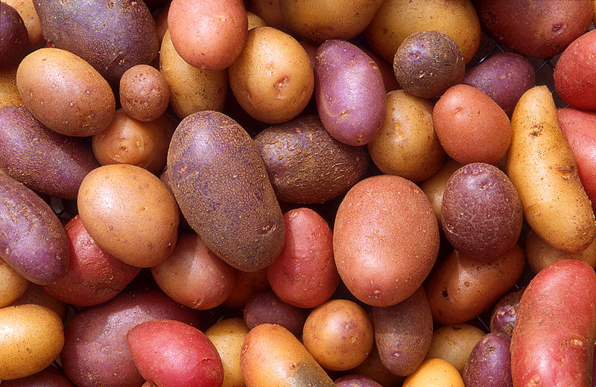
http://en.wikipedia.org/wiki/File:Patates.jpg

Slide 103
http://www.foodtimeline.org/

Slide 104
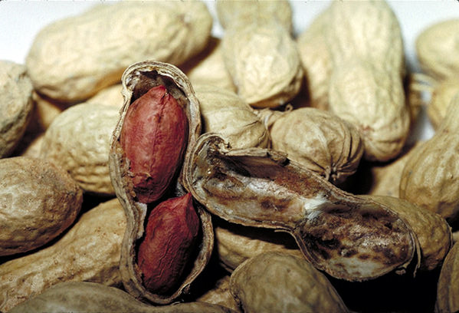
http://en.wikipedia.org/wiki/Peanut

Slide 105
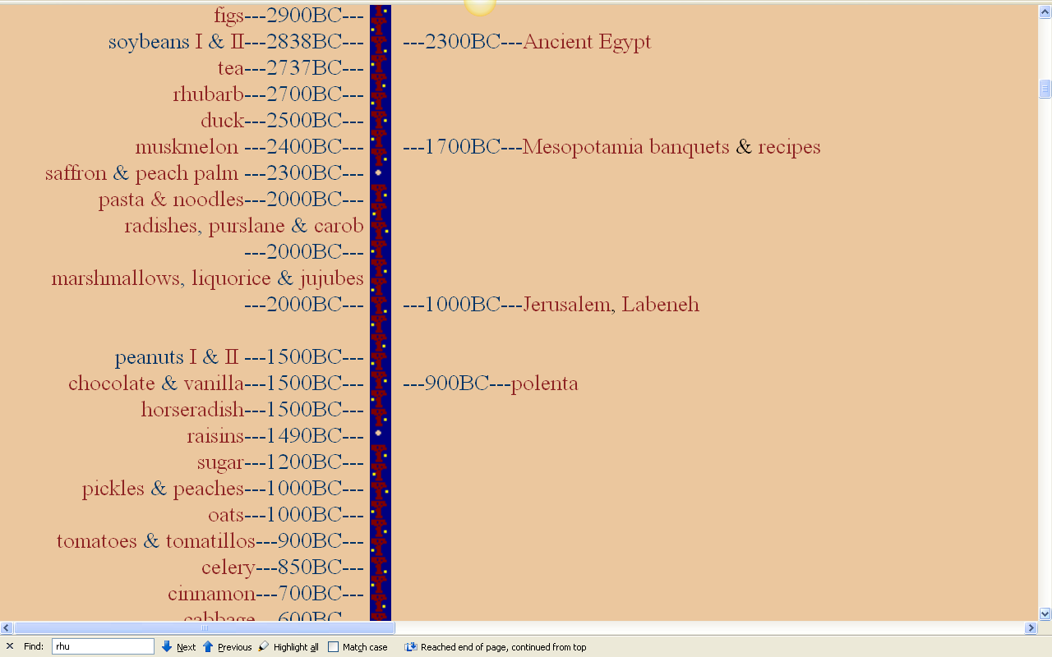
http://www.foodtimeline.org/

Slide 106
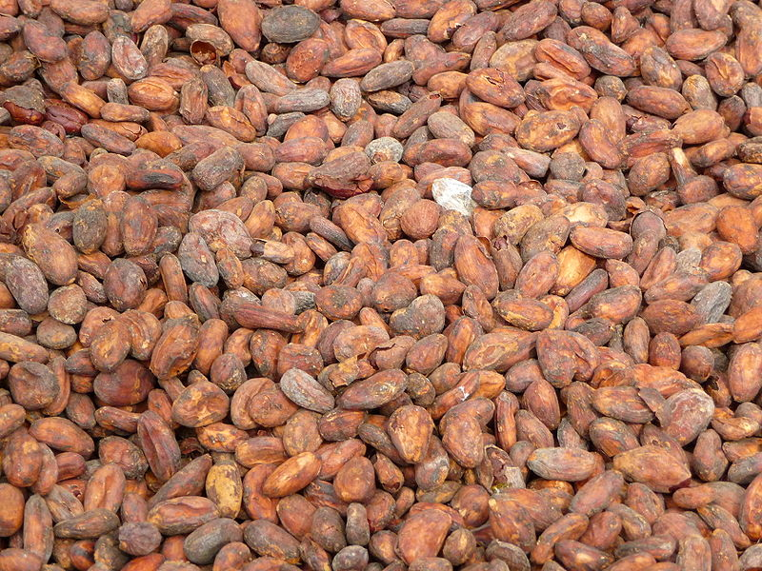
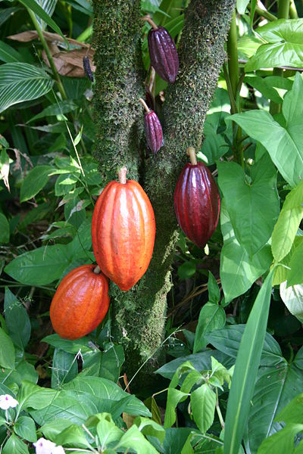
http://en.wikipedia.org/wiki/Cacao_bean

Slide 107
http://www.foodtimeline.org/

Slide 108
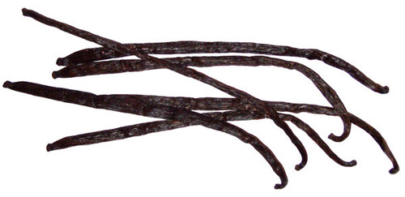
http://en.wikipedia.org/wiki/Vanilla

Slide 109
http://www.foodtimeline.org/

Slide 110
Origin of Domestication for Selected Plants
lettuce, grape, olive 6,500-5,000 ybp
gourd
5,000 ybp
rice
7,000 ybp
wheat
10,500 ybp
maize
4,500 ybp
manioc
4,200 ybp
millet
4,000 ybp
in Africa millet became a major staple very early on . . .
Understanding Physical Anthropology and Archaeology, 8th Ed., p. 417

Slide 111
supplemented by other plants and animals
Origin and Approximate Dates of Domestication for Selected Plants and Animals
Understanding Physical Anthropology and Archaeology, 9th Ed., p. 417

Slide 112
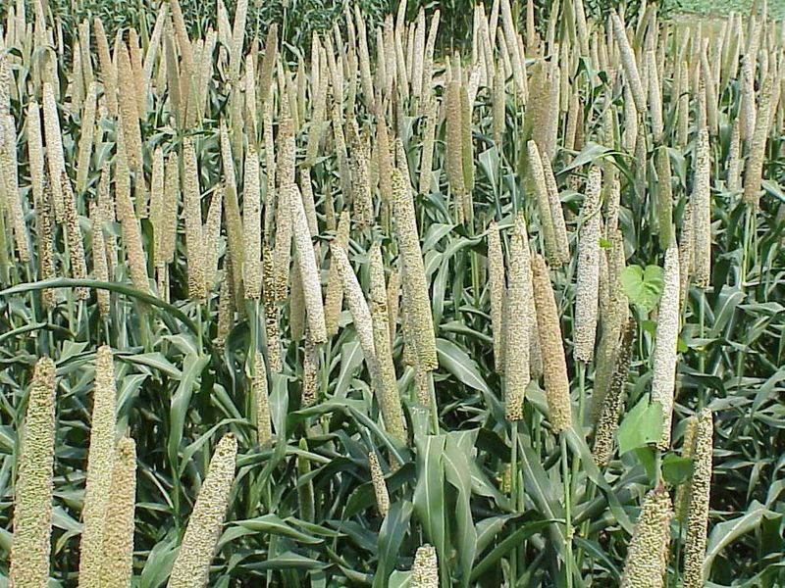
http://en.wikipedia.org/wiki/Millet

Slide 113
The food timeline
http://www.foodtimeline.org/

Slide 114
the changes toward dependence on agriculture was not always swift . . .

Slide 115
and it was not always healthful . . .

Slide 116
but the
Agricultural Revolution
clearly had . . .
major nutritional consequences . . .
and resulted in major social and political changes in society . . .

Slide 117
have a look at the slide sets . . .
“Nutritional Consequences:
Foragers and Agriculturalists”
and
“Social and Political Consequences
of the Agricultural Revolution”
for details

Slide 118
Tim Roufs
© 2010-2026
Tim Roufs
© 2010-2026

