Slide 1
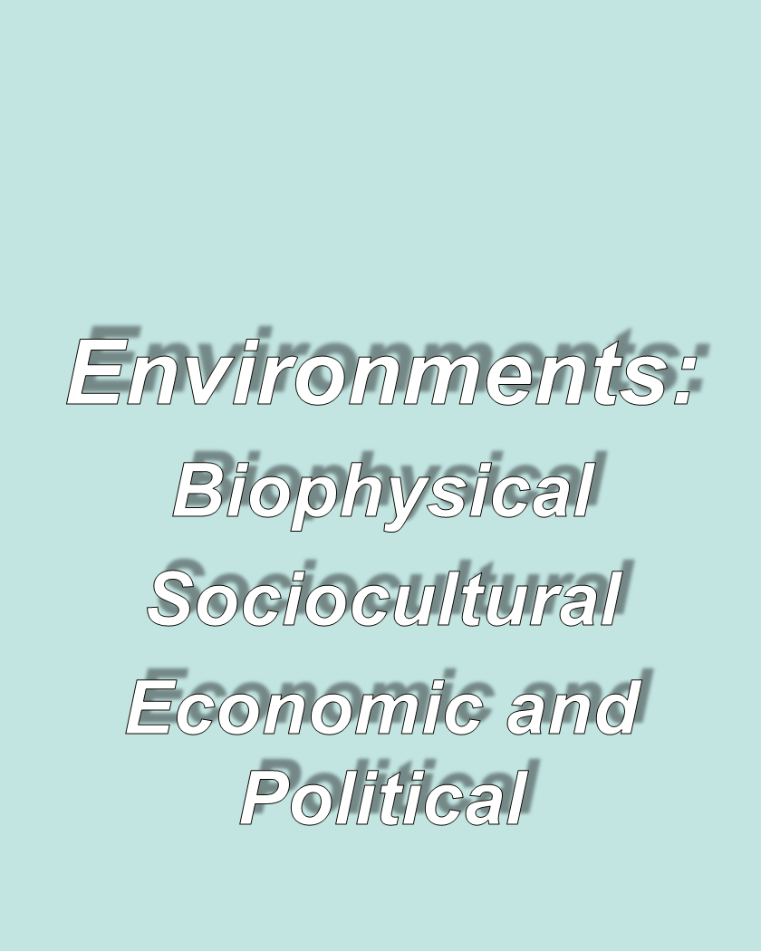

use your up/down arrow keys and/or
your space bar to advance the slides
Tim Roufs
© 2010-2026
Tim Roufs
© 2010-2026

Slide 2
Tim Roufs
© 2010-2026
Tim Roufs
© 2010-2026

Slide 4
Biocultural Framework
for the Study of Diet and Nutrition
individual
nutritional
needs
  Nutritional Status
  Biological Makeup
  Human Nutrient Needs
  Diet
  Cuisine
  The Environment
    Physical Environment
    Sociocultural Environment
    Economic and Political Environment
there are three main “environments” to consider . . .

Slide 5
Biocultural Framework
for the Study of Diet and Nutrition
individual
nutritional
needs
  Nutritional Status
  Biological Makeup
  Human Nutrient Needs
  Diet
  Cuisine
  The Environment
    Physical Environment
    Sociocultural Environment
    Economic and Political Environment

Slide 6
Biocultural Framework
for the Study of Diet and Nutrition
individual
nutritional
needs
  Nutritional Status
  Biological Makeup
  Human Nutrient Needs
  Diet
  Cuisine
  The Environment
    Physical Environment
    Sociocultural Environment
    Economic and Political Environment
and you see these as major parts of the
“Biocultural Framework for the Study of Diet and Nutrition” . . .

Slide 7
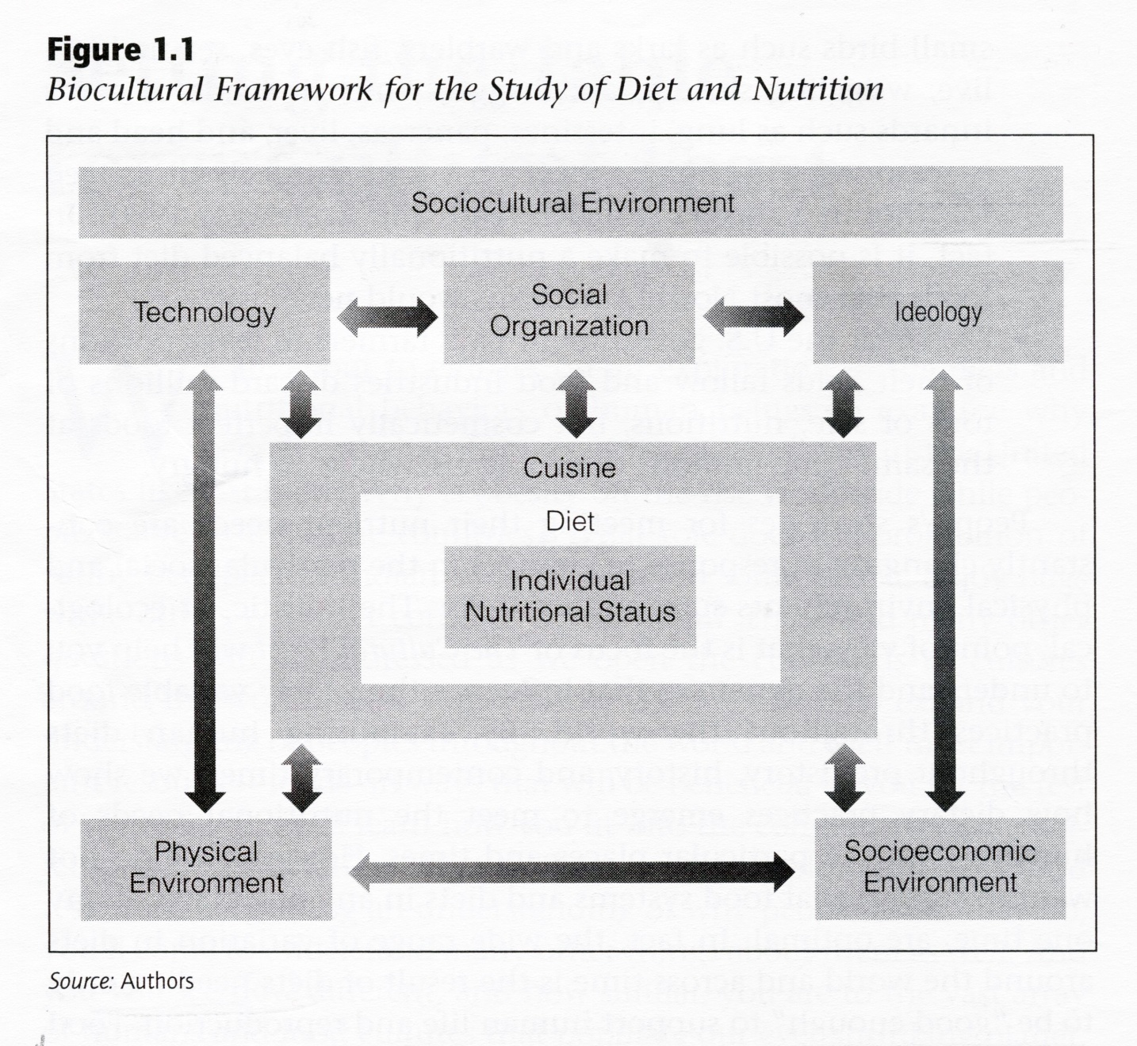
The Cultural Feast, 2nd ed., p. 4
The Cultural Feast, 2nd ed., p. 4

Slide 8
each of these environments provides important opportunities and constraints for human food consumption
The Cultural Feast, 2nd ed., p. 10

Slide 9
individuals and groups develop strategies that allow them to exploit the environments in which they live in order to meet their nutrient needs
The Cultural Feast, 2nd ed., p. 10

Slide 10
“both individuals and groups develop systems of preferred foods and tastes that
reflect the foods physically available and the methods of preparation to make those foods edible”
The Cultural Feast, 2nd ed., p. 10

Slide 11
“it would be tempting to suggest that, in contemporary times, the social/cultural environment has taken on greater importance for human than the physical/biological environment, but that would miss
two important points . . .”
The Cultural Feast, 2nd ed., p. 10

Slide 12
human beings, now and in the past, have always had an impact on their environments
    both social and physical
    humans (and all living creatures) change the environment just by existing in it
    humans, with a greater capacity for impact, as a result of using tools (technology), have, throughout their history, had a proportionately greater impact on their environments than other animals
The Cultural Feast, 2nd ed., p. 10

Slide 13
the physical environment around us continues to provide opportunities and constraints for diet and nutrition
    droughts
    floods
    hurricanes
    rising ocean levels
    the rise and spread of “new” diseases
    earthquakes
The Cultural Feast, 2nd ed., p. 10

Slide 14
the physical environment around us continues to provide opportunities and constraints for diet and nutrition
    global warming is resulting in major changes in food production patterns
      including changes in water resources, and allocation of water resources
(Global Warming itself is a fact.
What is in dispute are what are the causes of global warming.)
The Cultural Feast, 2nd ed., p. 10

Slide 15
“each of these environmental arenas is interconnected,
one affecting the other”
  and the interplay among influences is important for understanding the biocultural model
  aspects of social and physical environments influence basic nutrient needs of humans and the consumption of the foods that satisfy them
The Cultural Feast, 2nd ed., p. 11

Slide 16
Biocultural Framework
for the Study of Diet and Nutrition
  Nutritional Status
  Biological Makeup
  Human Nutrient Needs
  Diet
  Cuisine
  The Environment
    Physical Environment
    Sociocultural Environment
    Economic and Political Environment
individual
nutritional
needs

Slide 17
The Cultural Feast, 2nd ed., p. 4
The Cultural Feast, 2nd ed., p. 4

Slide 18
  The Physical / Biological Environment
    climate
    soils
    water resources
    plant and animal life
    predators
      including microbes and parasites
The Cultural Feast, 2nd ed., p. 11

Slide 19
  The Physical / Biological Environment
    “because people can eat only what is available, they develop systems of preferred foods and tastes that reflect both the foods available and the methods of preparation developed to make those foods edible”
The Cultural Feast, 2nd ed., p. 11

Slide 20
  The Physical / Biological Environment
    “humans respond to more subtle aspects of environments as well”
      e.g., agriculturalists who experience yearly fluctuations in rainfall often cultivate a number of different varieties of the same plant species
      including some that yield best in optimal conditions and others that yield better in suboptimal conditions
The Cultural Feast, 2nd ed., p. 11

Slide 21
“As with other components of the biocultural model,
the physical environment and human dietary practices influence each other.”
The Cultural Feast, 2nd ed., pp. 11-12

Slide 22
“All environments in which humans live can be truly understood only
within the context of the technologies that humans use to exploit those environments.”
The Cultural Feast, 2nd ed., pp. 11-12

Slide 23
“Even human groups
with relatively simple technologies
alter the environment,
especially the plants and animals in the environment,
to meet their needs.”
The Cultural Feast, 2nd ed., pp. 11-12

Slide 24
Biocultural Framework
for the Study of Diet and Nutrition
  Nutritional Status
  Biological Makeup
  Human Nutrient Needs
  Diet
  Cuisine
  The Environment
    Physical Environment
    Sociocultural Environment
    Economic and Political Environment
individual
nutritional
needs

Slide 25
The Cultural Feast, 2nd ed., p. 4
The Cultural Feast, 2nd ed., p. 4

Slide 26
  The Sociocultural
  Environment
    humans live and eat in a world filled with shared understandings
The Cultural Feast, 2nd ed., p. 12

Slide 27
  The Sociocultural
  Environment
    these conventional understandings are manifest in . . .
        artifacts
        (tools, houses, clothing . . .)
        social relationships
        values and beliefs
        behavioral patterns
The Cultural Feast, 2nd ed., p. 12

Slide 28
  The Sociocultural
  Environment
    “culture” refers to the
    shared understandings that characterize groups of people and distinguish them from other groups
The Cultural Feast, 2nd ed., p. 12

Slide 29
  The Sociocultural
  Environment
    culture is dynamic,
    changing in response to different circumstances and new information
The Cultural Feast, 2nd ed., p. 12

Slide 30
  The Sociocultural
  Environment
    Technology
    Social Organization
    Ideology
The Cultural Feast, 2nd ed., p. 12

Slide 31
The Cultural Feast, 2nd ed., p. 4
The Cultural Feast, 2nd ed., p. 4

Slide 32
  The Sociocultural
  Environment
    Technology
      includes the knowledge, practices, and tools a group uses to cope with the physical environment and meet its needs for shelter and subsistence
The Cultural Feast, 2nd ed., p. 12

Slide 33
  The Sociocultural
  Environment
    Technology
      includes the tools and techniques a society has for producing, processing, and preparing food
The Cultural Feast, 2nd ed., p. 12

Slide 34
  The Sociocultural
  Environment
    Technology
      includes the tools and techniques a society has for producing, processing, and preparing food
        e.g., Stone Age arrowheads, spear points, and choppers for butchering meat . . .
The Cultural Feast, 2nd ed., p. 12

Slide 35
  The Sociocultural
  Environment
    Technology
      includes the tools and techniques a society has for producing, processing, and preparing food
        e.g., Stone Age arrowheads, spear points, and choppers for butchering meat . . .
The Cultural Feast, 2nd ed., p. 12

Slide 36
  The Sociocultural
  Environment
    Technology
      includes the tools and techniques a society has for producing, processing, and preparing food
        e.g., early agriculturalists’ digging sticks, seed drills, plows, and scythes . . .
The Cultural Feast, 2nd ed., p. 12

Slide 37
  The Sociocultural
  Environment
    Technology
      In contemporary times, a wide range of tools and
      “adaptive strategies” are used to produce, preserve, and prepare foods . . .
The Cultural Feast, 2nd ed., p. 12

Slide 38
  The Sociocultural
  Environment
    Technology
      In contemporary times, a wide range of tools and
      “adaptive strategies” are used to produce, preserve, and prepare foods . . .
The Cultural Feast, 2nd ed., p. 12

Slide 39
  Adaptive Strategies
      foraging (hunting/gathering/fishing)
      horticulture
      intensive agriculture
      pastoralism
      industrialized agriculture
The Cultural Feast, 2nd ed., p. 12

Slide 40
  The Sociocultural
  Environment
    anthropologists have noted that societies with similar adaptive strategies and technologies share a number of social and cultural characteristics
      suggesting that a society’s technology interacts with other aspects of its culture
The Cultural Feast, 2nd ed., p. 12

Slide 41
  The Sociocultural
  Environment
these technologies are
described and discussed
with topics like . . .
“Food Technologies:
How People Get Their Food in Nonindustrial Societies”
and
“Food Technologies:
How People Get Their Food in Industrial Societies”
The Cultural Feast, 2nd ed., p. 12

Slide 42
  The Sociocultural
  Environment
these chapters explore how each of these technological strategies influences
the types
amounts
and quality
of the foods available
to the respective groups of peoples
The Cultural Feast, 2nd ed., p. 12

Slide 43
  The Sociocultural
  Environment
    Technology
    Social Organization
    Ideology
The Cultural Feast, 2nd ed., p. 12

Slide 44
The Cultural Feast, 2nd ed., p. 4
The Cultural Feast, 2nd ed., p. 4

Slide 45
  The Sociocultural
  Environment
    Social Organization
      refers to the way a social group organizes its members into
            families
            social strata
            communities
            and other groupings
The Cultural Feast, 2nd ed., p. 12

Slide 46
  The Sociocultural
  Environment
    Social Organization
      also includes norms that . . .
            regulate relationships
            provide templates for the way work is organized within households
            influence how the day is organized
The Cultural Feast, 2nd ed., p. 12

Slide 47
  The Sociocultural
  Environment
    Social Organization also includes . . .
        local patterns of leadership
        patterns of political organization
        systems of social stratification
        ethnic identity
        relationships between men and women, adults and children
        informal ways in which food and other goods are exchanged
The Cultural Feast, 2nd ed., p. 12

Slide 48
  The Sociocultural
  Environment
    Social Organization also . . .
        influences people’s diets in many ways, including access to food and the resources needed to obtain and use food
            e.g., access to land for cultivation and foraging
            e.g., food as a marker of ethnic and class differences
The Cultural Feast, 2nd ed., p. 12

Slide 49
  The Sociocultural
  Environment
    Technology
    Social Organization
    Ideology
The Cultural Feast, 2nd ed., p. 12

Slide 50
The Cultural Feast, 2nd ed., p. 4
The Cultural Feast, 2nd ed., p. 4

Slide 51
  The Sociocultural
  Environment
    Ideology
          values
          preferences
          meanings
          beliefs
      . . . that groups of people share with respect to food
The Cultural Feast, 2nd ed., pp. 12-13

Slide 52
  The Sociocultural
  Environment
    Ideology
      some of these values and beliefs are connected to systems of
      religious belief
      some to local medical knowledge
The Cultural Feast, 2nd ed., p. 13

Slide 53
  The Sociocultural
  Environment
    Ideology . . .
      also refers to
      symbolic meanings and associated values
      placed on specific foods
The Cultural Feast, 2nd ed., p. 13

Slide 54
  The Sociocultural
  Environment
    Ideology includes . . .
      accepted definitions of
      what constitutes food
      accepted definitions of
      what constitutes meals
      norms regarding the appropriate form and timing of meals
The Cultural Feast, 2nd ed., p. 13

Slide 55
  The Sociocultural
  Environment
    Ideology includes . . .
      accepted definitions of
      what constitutes food
      accepted definitions of what constitutes meals
      norms regarding the appropriate form and timing of meals
The Cultural Feast, 2nd ed., p. 13

Slide 56
  The Sociocultural
  Environment
    Ideology includes . . .
      accepted definitions of what
      constitutes food
      accepted definitions of
      what constitutes meals
      norms regarding the appropriate
      form and timing of meals
The Cultural Feast, 2nd ed., p. 13

Slide 57
  The Sociocultural
  Environment
    Ideology includes . . .
      accepted definitions of what constitutes food
      accepted definitions of what constitutes meals
      norms regarding the appropriate form and timing of meals
The Cultural Feast, 2nd ed., p. 13

Slide 58
  The Sociocultural
  Environment
Ch. 8 “Worldview, Religion, and Health Beliefs: The Ideological Basis of Food Practices”
examines beliefs and values placed on
foods by different cultural and ethnic groups
and
explores the impact of changing ideology and the conflicts over food ideology that are common “in our very interconnected world”
The Cultural Feast, 2nd ed., p. 13

Slide 59
  The Sociocultural
  Environment
Ch. 8 “Worldview, Religion, and Health Beliefs: The Ideological Basis of Food Practices”
examines beliefs and values placed on foods by different cultural and ethnic groups
and
explores the impact of changing ideology and the conflicts over food ideology that are common “in our very interconnected world”
The Cultural Feast, 2nd ed., p. 13

Slide 60
  The Sociocultural
  Environment
Ch. 8 “Worldview, Religion, and Health Beliefs: The Ideological Basis of Food Practices”
examines beliefs and values placed on
foods by different cultural and ethnic groups
and
explores the impact of changing ideology and the conflicts over food ideology that are common “in our very interconnected world”
The Cultural Feast, 2nd ed., p. 13

Slide 61
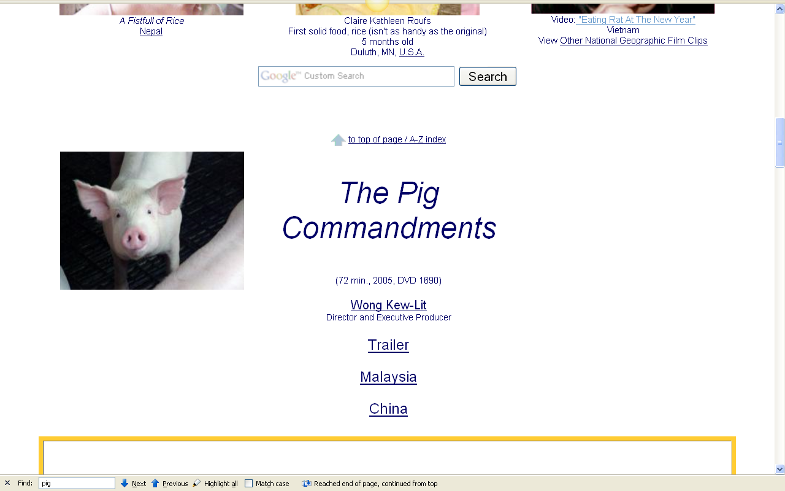
in the film The Pig Commandments we’ll see how the conflicts over food ideology can literally tear a culture apart

Slide 62
Biocultural Framework
for the Study of Diet and Nutrition
  Nutritional Status
  Biological Makeup
  Human Nutrient Needs
  Diet
  Cuisine
  The Environment
    Physical Environment
    Sociocultural Environment
    Economic and Political Environment
individual
nutritional
needs

Slide 63
The Cultural Feast, 2nd ed., p. 4
The Cultural Feast, 2nd ed., p. 4

Slide 64
  The Economic and Political
  Environment
    refers to the ways humans are organized and stratified . . .
      within groups and communities
      and among groups, communities, nations, and regions
The Cultural Feast, 2nd ed., p. 13

Slide 65
  The Economic and Political
  Environment
    it also includes the way in which societies manage the . . .
        production
        exchange
        consumption
        of all goods, including food
The Cultural Feast, 2nd ed., p. 13

Slide 66
  The Economic and Political
  Environment
    influences people’s access to food and other resources
      and the capacity to exploit those resources
The Cultural Feast, 2nd ed., p. 13

Slide 67
  The Economic and Political
  Environment
      in rural, poor countries, for e.g., fewer food opportunities exist
        diets depend greatly on access to land for food production or gathering
        and on the equipment needed to exploit the environment
The Cultural Feast, 2nd ed., p. 13

Slide 68
  The Economic and Political
  Environment
      national and international agricultural and economic policies are especially important
        agricultural subsidies affect both producers and consumers
The Cultural Feast, 2nd ed., p. 13

Slide 69
  The Economic and Political
  Environment
      national and international agricultural and economic policies are especially important
        agricultural subsidies affect both producers and consumers
The Cultural Feast, 2nd ed., p. 13

Slide 70
agricultural subsidies
to grow crops and raise animals
direct payments to farmers
guaranteed prices for products
discounted prices for inputs
The Cultural Feast, 2nd ed., p. 14

Slide 71

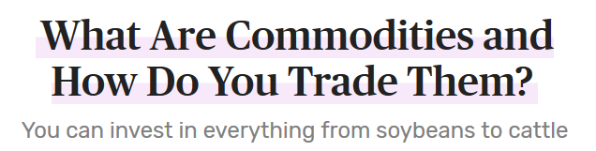
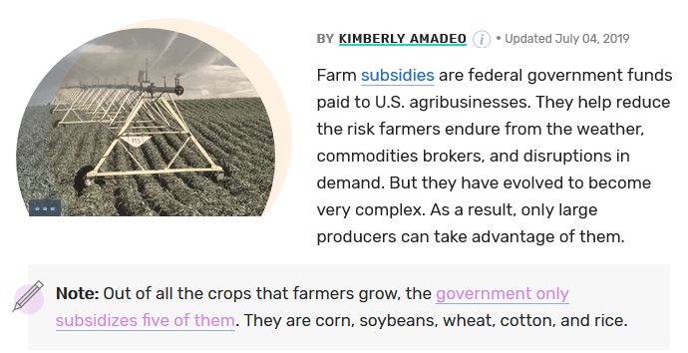
https://www.thebalance.com/farm-subsidies-4173885

Slide 72
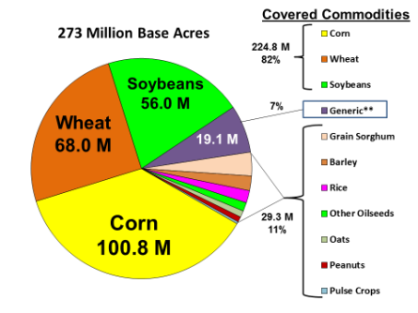
https://www.everycrsreport.com/reports/R45730.html

Slide 73
agricultural subsidies
to grow crops and raise animals
direct payments to farmers
guaranteed prices for products
discounted prices for inputs
The Cultural Feast, 2nd ed., p. 14

Slide 74
agricultural subsidies
to grow crops and raise animals
direct payments to farmers
guaranteed prices for products
discounted prices for inputs
The Cultural Feast, 2nd ed., p. 14

Slide 75
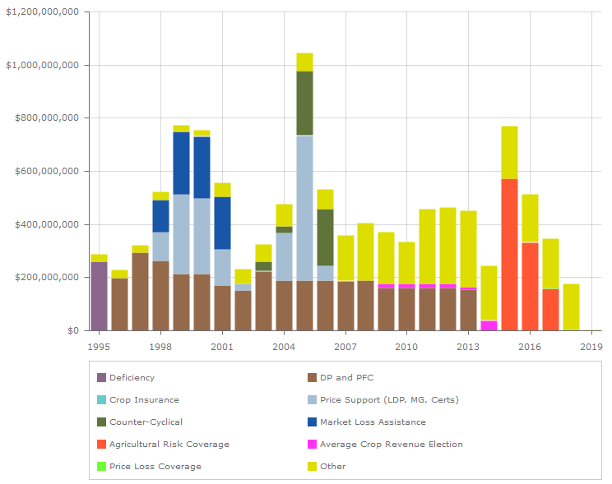

https://farm.ewg.org/progdetail.php?fips=27000&progcode=corn&regionname=Minnesota

Slide 76
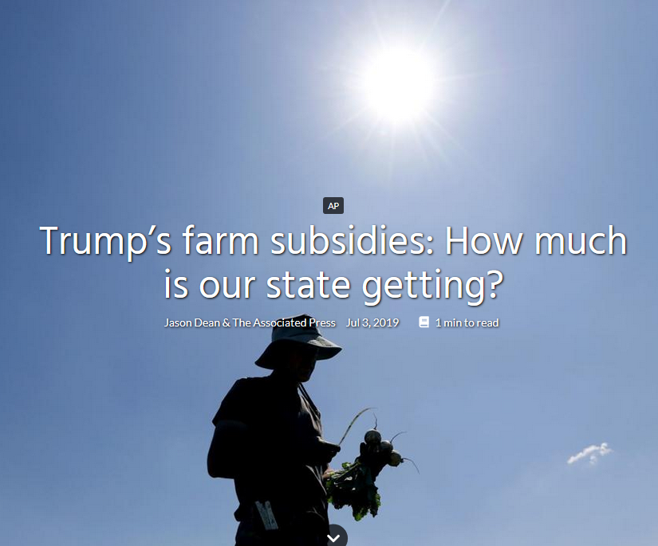

source

Slide 77
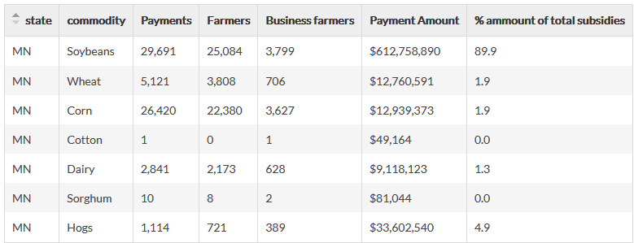
source

Slide 78
agricultural subsidies
to grow crops and raise animals
direct payments to farmers
guaranteed prices for products
discounted prices for inputs
The Cultural Feast, 2nd ed., p. 14

Slide 79
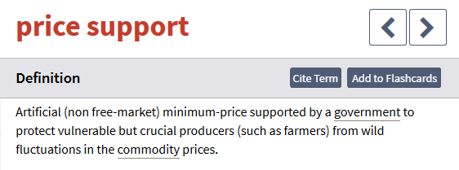

http://www.businessdictionary.com/definition/price-support.html

Slide 80
but sometimes
subsidies don’t always help
the farmers in the end . . .

Slide 81
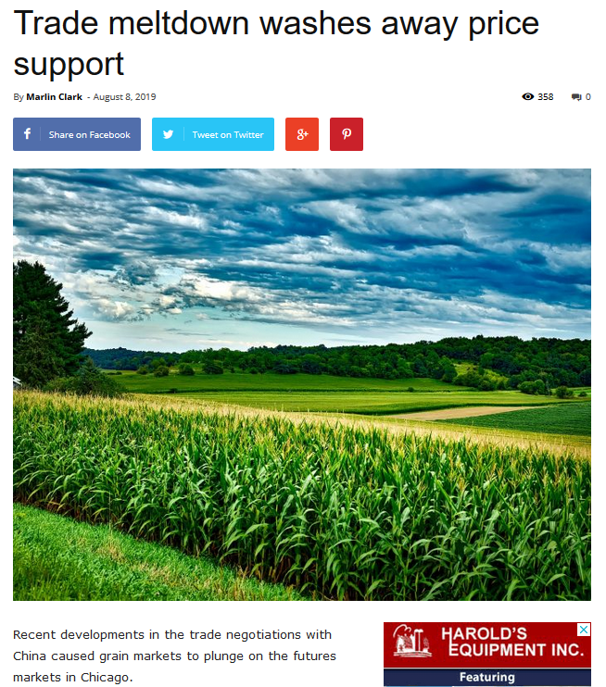

https://www.farmanddairy.com/top-stories/trade-meltdown-washes-away-price-support/568229.html

Slide 82
agricultural subsidies
to grow crops and raise animals
direct payments to farmers
guaranteed prices for products
discounted prices for inputs
The Cultural Feast, 2nd ed., p. 14

Slide 83
discounted prices for inputs
such as
seeds
fertilizers
water
land
marketing
The Cultural Feast, 2nd ed., p. 14

Slide 84
agricultural subsidies
there are also
indirect subsidies
e.g., corn-based ethanol production
The Cultural Feast, 2nd ed., p. 14

Slide 85
agricultural subsidies
there are also
indirect subsidies
e.g., corn-based ethanol production
for e.g., Minnesota Gov. Tim Pawlenty supported a ca. 52¢ / gal subsidy for corn-based ethanol to companies with profits as high as $150,000,000 – at the same time that he essentially raised the tuition for UMD students
So what?
“How does that affect me?”
The Cultural Feast, 2nd ed., p. 14

Slide 86
agricultural subsidies
there are also
indirect subsidies
e.g., corn-based ethanol production
for e.g., Minnesota Gov. Tim Pawlenty supported a ca. 52¢ / gal. subsidy for corn-based ethanol
to companies with profits as high as $150,000,000
– at the same time that he essentially raised the tuition for UMD students

Slide 87
agricultural subsidies
there are also
indirect subsidies
e.g., corn-based ethanol production
for e.g., Minnesota Gov. Tim Pawlenty supported a ca. 52¢ / gal subsidy for corn-based ethanol to companies with profits as high as $150,000,000 – at the same time that he essentially raised the tuition for UMD student
That was more or less
ca. $5.00 each time you to drive
to Minneapolis and back
(not including increased costs
due to protective tariffs)

Slide 88
agricultural subsidies
there are also
indirect subsidies
e.g., corn-based ethanol production
at that time “. . . US corn ethanol subsidies [were]
between $5.5 Billion and $7.3 Billion per year”
http://en.wikipedia.org/wiki/Farm_subsidies#United_States

Slide 89
agricultural subsidies
there are also
indirect subsidies
e.g., corn-based ethanol production
for e.g., Minnesota Gov. Tim Pawlenty supported a ca. 52¢ / gal subsidy for corn-based ethanol to companies with profits as high as $150,000,000 – at the same time that he essentially raised the tuition for UMD students
. . . US ethanol producers are in addition protected from imports of cheaper Brazilian ethanol by a
54-cent-per-gallon tariff
http://en.wikipedia.org/wiki/Farm_subsidies#United_States
That’s more or less
ca. $5.00 each time you to drive
to Minneapolis and back
(not including increased cost
due to protective tariff)

Slide 90
agricultural subsidies
there are also
indirect subsidies
e.g., corn-based ethanol production
e.g., “. . . demand resulting from biofuels increased the price of corn and other energy crops by an estimated 33 percent in early 2008 . . .”
– The World is Fat, Barry Popkin
(Penguin Avery, 2010, p. 91)

Slide 91
agricultural subsidies
there are also
indirect subsidies
e.g., corn-based ethanol production
A Side Question related to Food Ethics:
“How much of that 1/3 price increase
did the family farmer get?”
The statistics suggest that the average small farmer’s income actually went down

Slide 92
agricultural subsidies
there are also
indirect subsidies
e.g., corn-based ethanol production
“How much of that 1/3 price increase
did the family farmer get?”
The statistics suggest that the average small farmer’s income actually went down

Slide 93
It used to be thought that subsidies were in part initiated to help the small family farmer
When did that all change?

Slide 94
but that’s generally not the case . . .

Slide 95
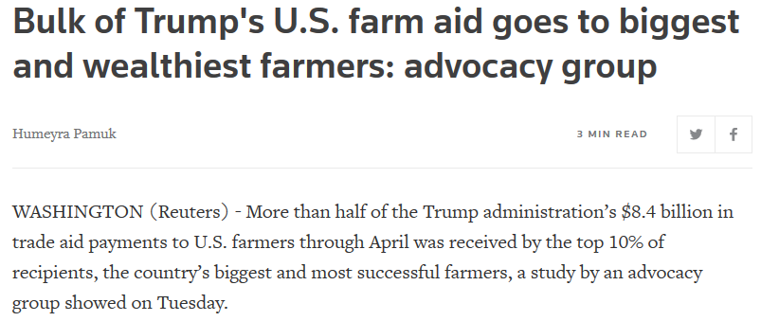
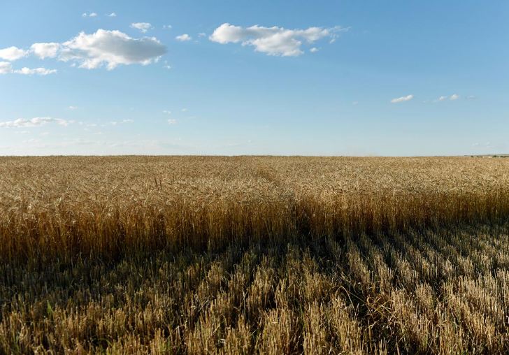

30 July 2019
in 2019 more than half of Trump’s bailout to farmers went to the top 10% of recipients . . . big corporate farms . . .
July 30, 2019

Slide 96
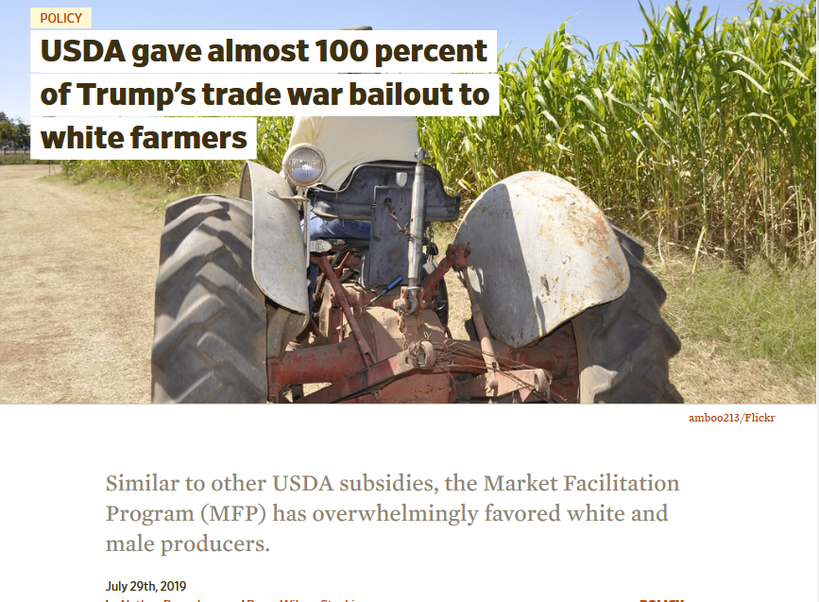

and almost all of the recipients of Trump’s bailout monies were white . . .
https://newfoodeconomy.org/usda-trump-trade-war-bailout-white-farmers-race/

Slide 97
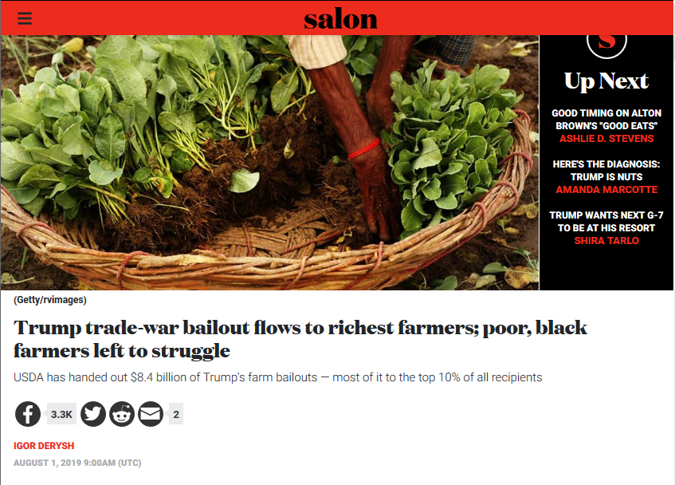
and the poor and black farmers were “left to struggle” . . .
https://www.salon.com/2019/08/01/trump-trade-war-bailout-flows-to-richest-farmers-poor-black-farmers-left-to-struggle/

Slide 98
and the poor and black farmers were “left to struggle” . . .
https://www.salon.com/2019/08/01/trump-trade-war-bailout-flows-to-richest-farmers-poor-black-farmers-left-to-struggle/

Slide 99
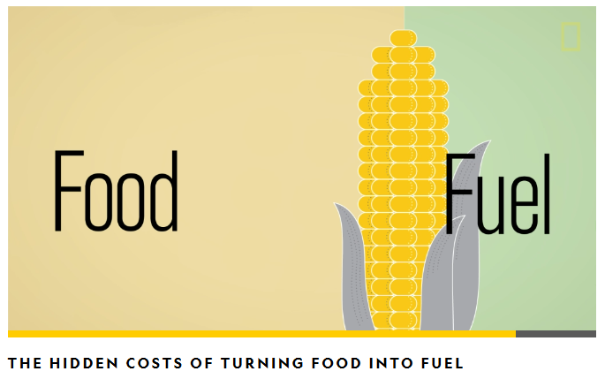
and as more food is diverted to ethanol . . .
National Geographic
https://www.nationalgeographic.com/environment/global-warming/biofuel/

Slide 100
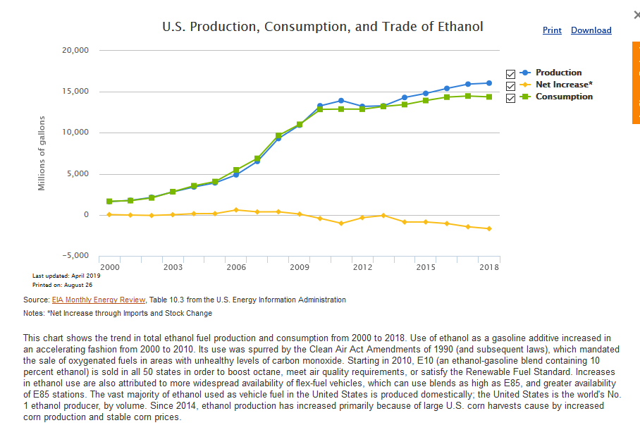
https://afdc.energy.gov/fuels/ethanol_production.html

Slide 101
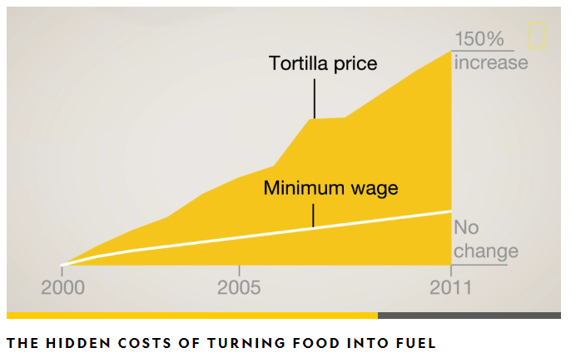
prices of related foods tends to increase . . .
National Geographic
https://www.nationalgeographic.com/environment/global-warming/biofuel/

Slide 102
prices of related foods tends to increase . . .
https://afdc.energy.gov/fuels/ethanol_production.html

Slide 103
but right now the ethanol industry is in trouble . . .
https://www.agriculture.com/news/business/largest-ethanol-maker-closes-indiana-plant-blames-epa-waivers

Slide 104
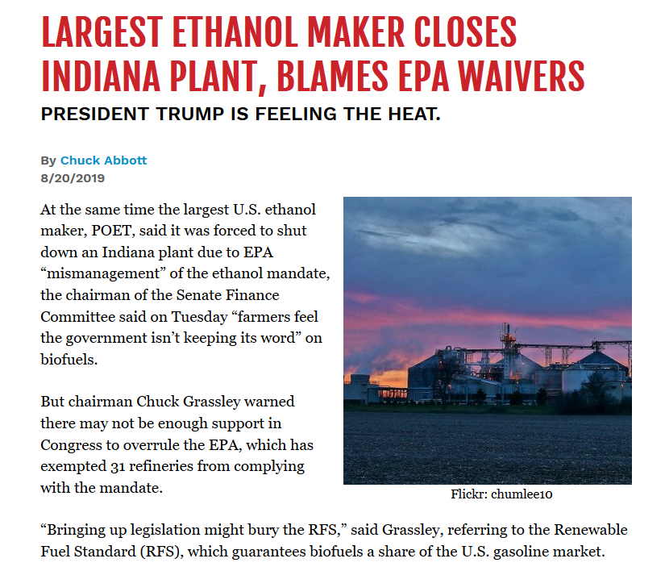

but right now the ethanol industry is in trouble . . .
https://www.agriculture.com/news/business/largest-ethanol-maker-closes-indiana-plant-blames-epa-waivers

Slide 105
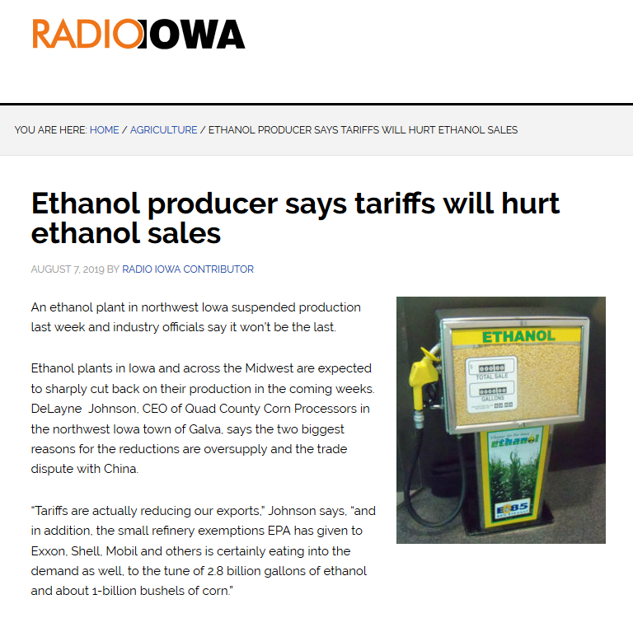
but right now the ethanol industry is in trouble . . .
https://www.radioiowa.com/2019/08/07/ethanol-producer-says-tariffs-will-hurt-ethanol-sales/

Slide 106
It used to be thought that subsidies were in part initiated to help the small family farmer
When did that all change?

Slide 107
It used to be thought that subsidies were in part initiated to help the small family farmer
When did that all change?

Slide 108
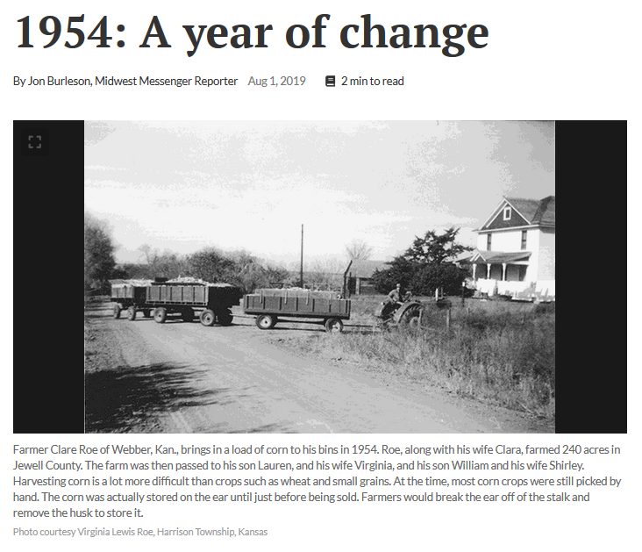

https://www.agupdate.com/midwestmessenger/lifestyles/rural_news/a-year-of-change/article_b13bd230-b4a7-11e9-ac92-a786af2cd8c0.html

Slide 109
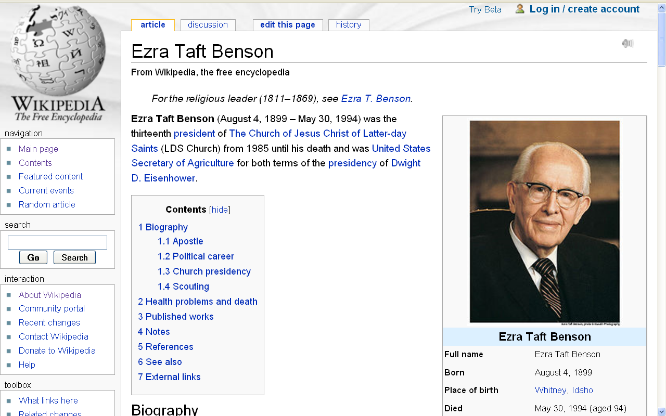
with Ezra Taft Benson
http://en.wikipedia.org/wiki/Ezra_Taft_Benson

Slide 110
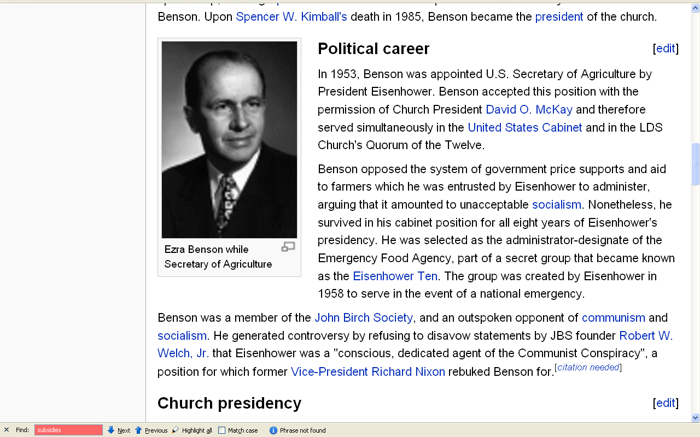
so U.S.A. government subsidies now largely go to non-small-family-farmers . . .
and, some argue, have for all practical purposes actually put many of the family farmers
“out of business “. . .
http://en.wikipedia.org/wiki/Ezra_Taft_Benson

Slide 111
agricultural subsidies:
they affect you in many ways

Slide 112
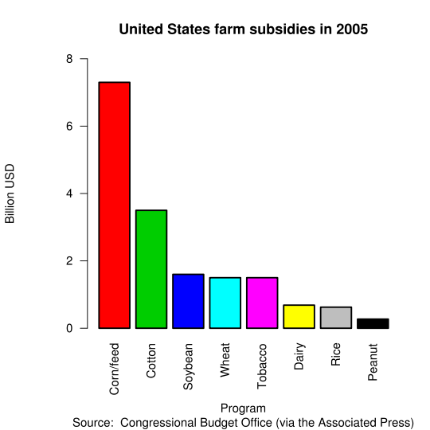
Corn: @ $10.9 billion / year
( / 327.2 million [2018] million people)
your share = $33.31
https://farm.ewg.org/progdetail.php?fips=27000&progcode=corn&regionname=Minnesota

Slide 113
so you pay for . . .
(1) higher prices for corn-based products
[included in about 1/5 of your grocery items]
(2) at the same time you pay MN companies ca. 52¢ / gal. to produce ethanol [now or eventually in taxes]
        (3) you pay higher tuition to support the MN State ethanol subsidy
    (4) and, of course, you paid the $5.5 - $10.9 billion Federal subsidy in the first place, basically to corporations like Cargill, ADM, ConAgra
    (5) the 54 cent protective tariff probably also increased the price of your gas

Slide 114
so you pay for . . .
(1) higher prices for corn-based products
[included in about 1/5 of your grocery items]
(2) at the same time you pay MN companies ca. 52¢ / gal. to produce ethanol [now or eventually in taxes]
        (3) you pay higher tuition to support the MN State ethanol subsidy
    (4) and, of course, you paid the $5.5 - $10.9 billion Federal subsidy in the first place, basically to corporations like Cargill, ADM, ConAgra
    (5) the 54 cent protective tariff probably also increased the price of your gas
and
(6) sometimes also through tax breaks on things like high sugar-content products . . .

Slide 115
so you pay for . . .
(1) higher prices for corn-based products
[included in about 1/5 of your grocery items]
(2) at the same time you pay MN companies ca. 52¢ / gal. to produce ethanol [now or eventually in taxes]
        (3) you pay higher tuition to support the MN State ethanol subsidy
    (4) and, of course, you paid the $5.5 - $10.9 billion Federal subsidy in the first place, basically to corporations like Cargill, ADM, ConAgra
    (5) the 54 cent protective tariff probably also increased the price of your gas
and
sometimes also through tax breaks on things like high sugar-content products . . .
and then the state sometimes taxes (some) foods on which you have already paid a half-dozen subsidies . . .

Slide 116
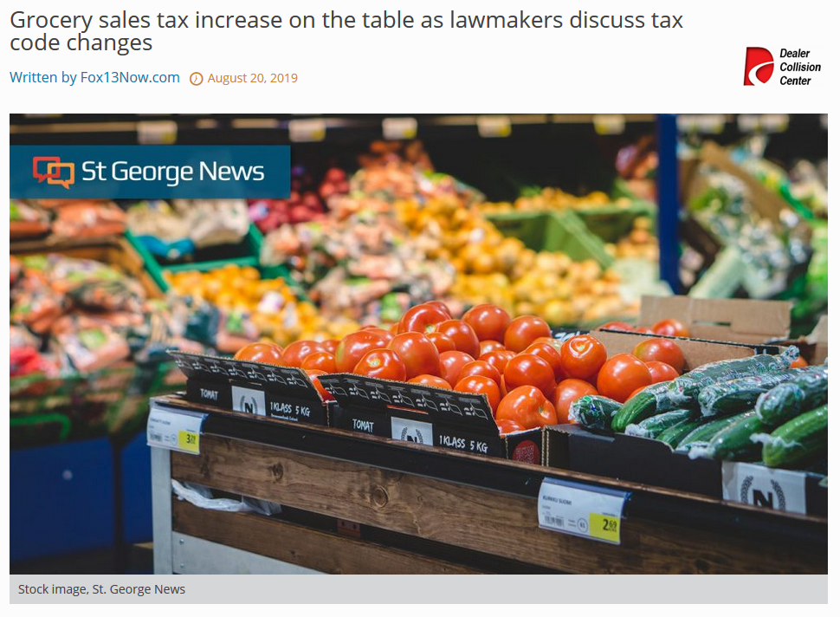
Source

Slide 117

this is the best book to explain how the system currently works
(mostly all very legal, by the way)

Slide 118
  The Economic and Political
  Environment
      international trade laws influence . . .
          the kind of crops farmers grow
          the prices they receive for their products in wholesale markets
          consumer retail costs
The Cultural Feast, 2nd ed., p. 14

Slide 119
  The Economic and Political
  Environment
      multinational food companies’ marketing strategies and distribution networks influence . . .
          what is available for purchase
          the prices at which these products are offered
The Cultural Feast, 2nd ed., p. 14

Slide 120
  The Economic and Political
  Environment
      the way national and international agricultural research organizations approach the development of . . .
            new seeds
            chemicals
            tools
            techniques of cultivation
          may have an impact on who benefits from improved technology and who does not
The Cultural Feast, 2nd ed., p. 14

Slide 121
  The Economic and Political
  Environment
the ways in which
the social and economic environment
national and international policies
and agricultural research and development
affect the availability and quality of food are
reviewed with topics like . . .
“Food and Social Organization”
and
“Hunger in Global Perspective”
and
“Addressing Global Food Issues”
The Cultural Feast, 2nd ed., p. 14

Slide 122
Biocultural Framework
for the Study of Diet and Nutrition
individual
nutritional
needs
  Nutritional Status
  Biological Makeup
  Human Nutrient Needs
  Diet
  Cuisine
  The Environment
    Physical Environment
    Sociocultural Environment
    Economic and Political Environment
Finally, keep in mind that all three environmental units
mutually interact with all of the other elements
in the Biocultural Framework . . .

Slide 123
The Cultural Feast, 2nd ed., p. 4

Slide 124
The Cultural Feast, 2nd ed., p. 4

Slide 125
Tim Roufs
© 2010-2026
Tim Roufs
© 2010-2026

