Slide 1
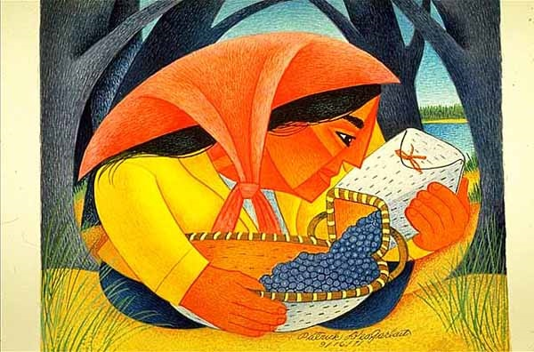
Start deck in “Slide Show” mode,
and use your up/down arrow keys and/or
your space bar to advance the slides
University of Minnesota Duluth
Tim Roufs
© 2010-2026

Slide 2
ANTH 3888
Anthropology of Food
Main
Characteristics of
Anthropology
University of Minnesota Duluth
Tim Roufs
© 2010-2026

Slide 3
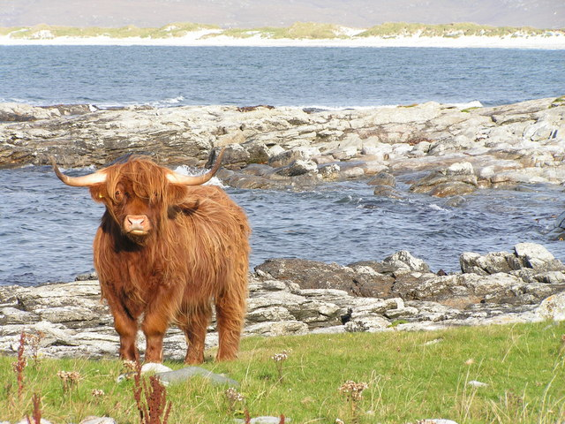
ANTH 3888
Anthropology of Food
Comparative Method
as a
Major Approach
University of Minnesota Duluth
Tim Roufs
© 2010-2026
http://en.wikipedia.org/wiki/Highland_cattle

Slide 4
American
Main Characteristics of˄Anthropology
1. the four fields of general anthropology
culture as a primary concept
comparative method as major approach
holism as a primary theoretical goal
fieldwork as a primary research technique

Slide 5
American
Main Characteristics of˄Anthropology
1. the four fields of general anthropology
culture as a primary concept
comparative method as major approach
holism as a primary theoretical goal
fieldwork as a primary research technique

Slide 6
Compare . . .
Main Characteristics
comparative method
  as a major approach to the study of human behavior
  the comparative method compares things (what else would a “comparative” method do?)

Slide 7
Compare . . .
Main Characteristics
comparative method
  One form of comparative method was pioneered by Fred Eggan
  (University of Chicago)
“Social anthropology and
the method of controlled comparison”
  American Anthropologist, 56:743-61 (1954)

Slide 8
Compare . . .
Main Characteristics
comparative method
  One form of comparative method was pioneered by Fred Eggan
  (University of Chicago)
“Social anthropology and
the method of controlled comparison”
  American Anthropologist, 56:743-61 (1954)

Slide 9
Compare . . .
Main Characteristics
the comparative method compares things
for e.g. . . .
In a similar manner Evan D. Fraser and Andrew Rimas compare
Feast, Famine, and the Rise and Fall of Civilizations
around the world. . .

Slide 10
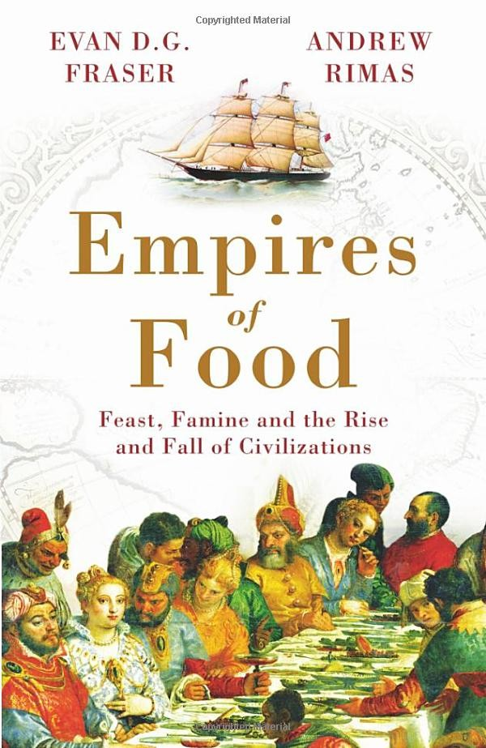
Mesopotamia
China
North America
South America
Europe
Asia
Africa
Pacific Islands
Berkeley: Counterpoint, 2012:
http://www.amazon.com/Empires-Food-Feast-Famine-Civilizations/dp/1582437939/ref=sr_1_1?ie=UTF8&qid=1452654498&sr=8-1&keywords=empires+of+food

Slide 11
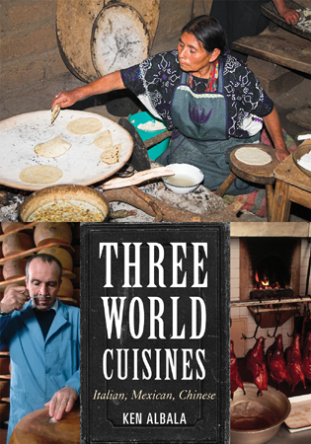
Italian
Mexican
Chinese
comparing cultures and cuisines

Slide 12
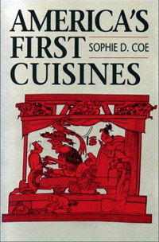
Aztec
Maya
Inca
Sophie D. Coe
America's First Cuisines
Austin: University of Texax Press, 1994.
comparing cultures and cuisines
www.d.umn.edu/cla/faculty/troufs/anthfood/aftexts.html#title

Slide 13
Aztec
Maya
Inca
Sophie D. Coe
America's First Cuisines
Austin: University of Texax Press, 1994.
comparing cultures and cuisines
www.d.umn.edu/cla/faculty/troufs/anthfood/aftexts.html#title

Slide 14

Text
comparing . . .
Omnivore’s Dilemma: A Natural History of Four Meals.
NY: Penguin, 2013.
www.d.umn.edu/cla/faculty/troufs/anthfood/aftexts.html#title

Slide 15

Comparing food transformation by . . .
Fire (Roasting)
Water (Boiling)
Air (Baking)
Earth (Fermenting)
comparing . . .
Cooked: A Natural History of Transformation.
NY: Penguin, 2013.
www.d.umn.edu/cla/faculty/troufs/anthfood/aftexts.html#title

Slide 16

Comparing food transformation by . . .
Soil
Land
Sea
Seed
Third Plate: Field Notes on the Future of Food
NY: Penguin, 2014.
http://www.amazon.com/Third-Plate-Field-Notes-Future/dp/0143127152/ref=sr_1_1?ie=UTF8&qid=1452655502&sr=8-1&keywords=the+third+plate

Slide 17
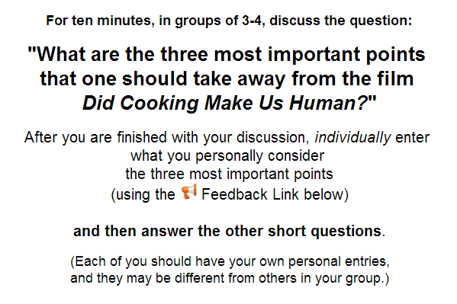
comparing films in class

Slide 18
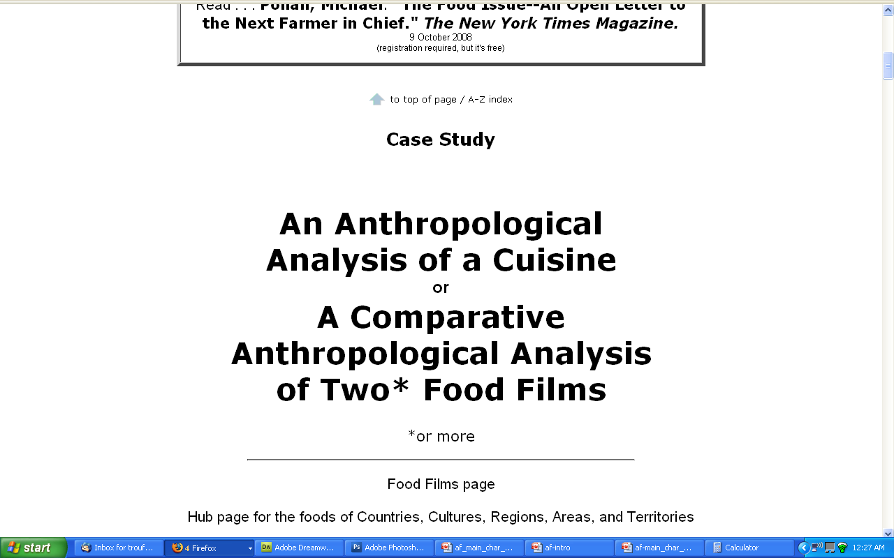
comparing cultures represented in two
“food flicks”
Extra Credit

Slide 19

Penguin Avery, 2009

Slide 20
The Popkin, 1950s
“typical multigenerational American family”
and 3 children
Superior, WI, U.S.A.
The “Jones, ” 2006
and 2 children
Suburban Cleveland, U.S.A.
Cesar and Ana Garcia
and 4 children
Immigrant Mexicans from Chiapas Mexico
Suburban Los Angeles
Rahul Desai and His Wife
and 4 children
Uttar Pradesh, Northern India
Gopal and Noopur Patel
and 3 children
Uttar Pradesh, Northern India
studied how lifestyle changes over the long term have affected the body composition of
Americans
80,000+ and 20,000
Chinese
22,000+
200+ communities
Russians
11,000+
300+ communities
Brazilians
Filipinos
Penguin Avery, 2009

Slide 21
The Popkin, 1950s
“typical multigenerational American family”
and 3 children
Superior, WI, U.S.A.
The “Jones, ” 2006
and 2 children
Suburban Cleveland, U.S.A.
Cesar and Ana Garcia
and 4 children
Immigrant Mexicans from Chiapas Mexico
Suburban Los Angeles
Rahul Desai and His Wife
and 4 children
Uttar Pradesh, Northern India
Gopal and Noopur Patel
and 3 children
Uttar Pradesh, Northern India
studied how lifestyle changes over the long term have affected the body composition of
Americans
80,000+ and 20,000
Chinese
22,000+
200+ communities
Russians
11,000+
300+ communities
Brazilians
Filipinos
including Superior, WI
(his home town)
Penguin Avery, 2009

Slide 22

comparing beer, wine, spirits,
coffee, tea, Coca-Cola

Slide 23
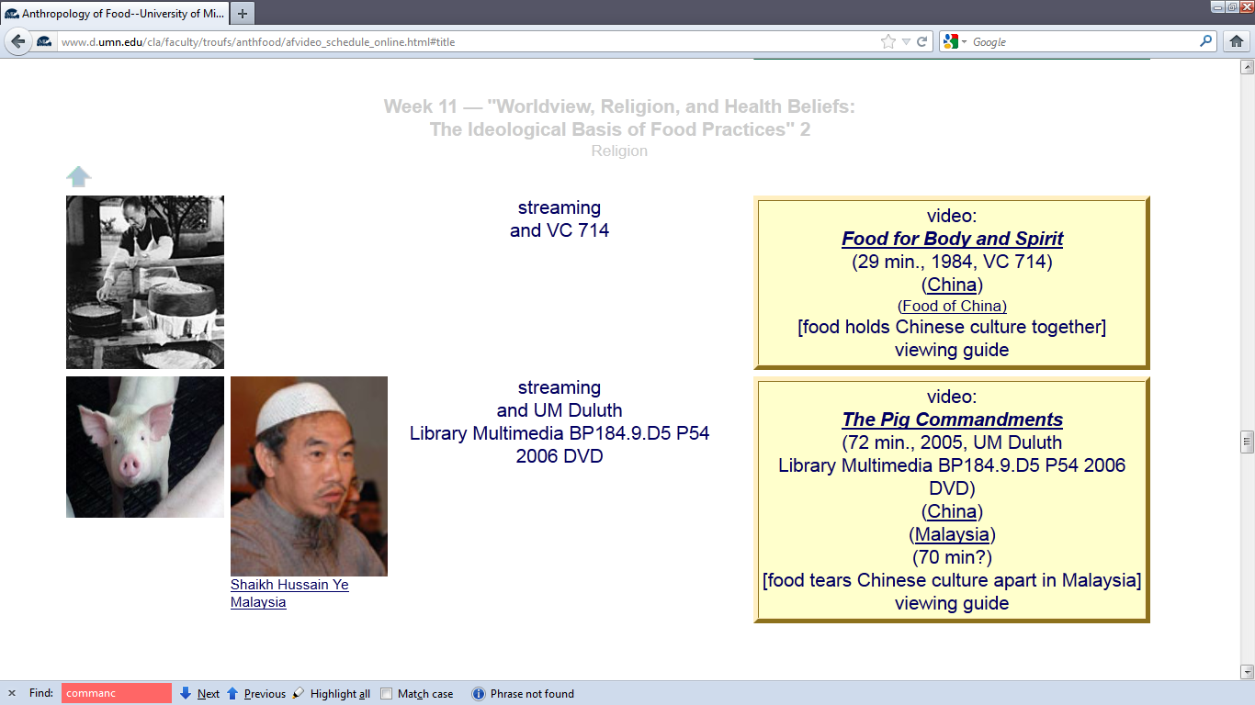
Videos
a controlled comparison of—
Chinese : Buddhism : Food
in China and Malaysia

Slide 24
Compare . . .
Main Characteristics
and items like “culture bound syndromes” are compared with similar phenomena that are thought to be “universal” . . . .

Slide 25
Main Characteristics
comparative method
often, for e.g.,
folks compare things regionally in an attempt
to understand process

Slide 26
Compare . . .
Main Characteristics
comparative method
  Other methods . . .
process
essentially refers to
how things change
or
how things came to be
the way they are now
compare things regionally
in an attempt to understand process

Slide 27
Compare . . .
Main Characteristics
comparative method
  Other methods . . .
process
essentially refers to
how things change
or
how things came to be
the way they are now
compare things regionally
in an attempt to understand process

Slide 28
Compare . . .
Main Characteristics
the comparative method compares things
for e.g. . . .
David Montgomery compares what happens when great civilizations around the world ignore problems they are having with top soil . . .
Spoiler: All failed

Slide 29
Compare . . .
Main Characteristics
the comparative method compares things
for e.g. . .
David Montgomery compares what happens when great civilizations around the world ignore problems they are having with top soil . . .
Spoiler: All failed

Slide 30
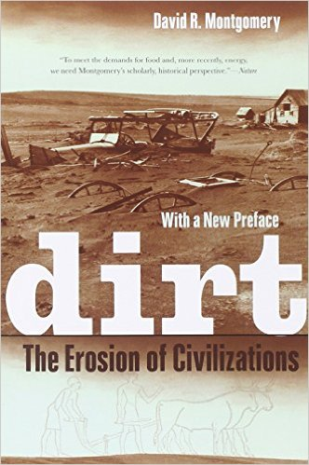
Mesopotamia
China
North America
South America
Europe
Asia
Africa
Pacific Islands
Berkeley: University of California, 2012
http://www.amazon.com/Empires-Food-Feast-Famine-Civilizations/dp/1582437939/ref=sr_1_1?ie=UTF8&qid=1452654498&sr=8-1&keywords=empires+of+food

Slide 31
Compare . . .
Main Characteristics
the comparative method compares things
for e.g. . . .
David Montgomery compares what happens when great civilizations around the world ignore problems they are having with top soil . . .
Spoiler: All failed

Slide 32
Compare . . .
Main Characteristics
the comparative method compares things, for e.g., process of domestication / civilization
    maize – Mexico
    wheat – Turkey
    rice – China
    manioc – Brazil
    millet – Africa

Slide 33
Compare . . .
Main Characteristics
the comparative method compares things, for e.g., process of domestication / civilization
    maize – Mexico
    wheat – Turkey
    rice – China
    manioc – Brazil
    millet – Africa

Slide 34
Compare . . .
Main Characteristics
the comparative method compares things, for e.g., process of domestication / civilization
    maize – Mexico
    wheat – Turkey
    rice – China
    manioc – Brazil
    millet – Africa

Slide 35
Compare . . .
Main Characteristics
the comparative method compares things, for e.g., process of domestication / civilization
    maize – Mexico
    wheat – Turkey
    rice – China
    manioc – Brazil
    millet – Africa

Slide 36
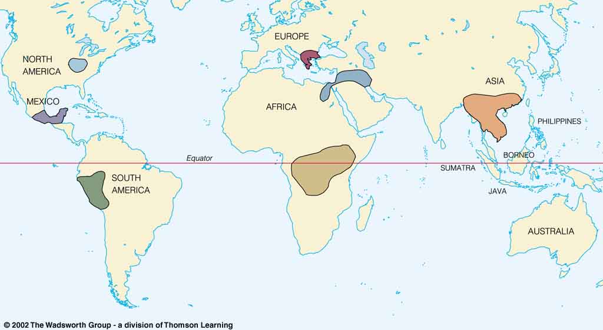
Origin of Domestication for Selected Plants
Compare . . .
wheat
10,500 ybp
maize
4,200 ybp
rice
7,000 ybp
manioc
4,200 ybp
millet
4,000 ybp
Understanding Physical Anthropology and Archaeology, 9th Ed., p. 342.

Slide 37
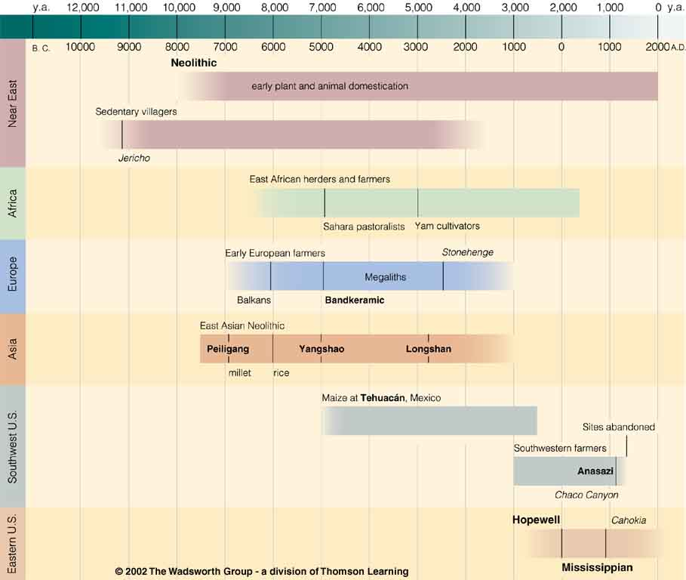
Neolithic
Time line for Ch. 14 Food Production
Understanding Physical Anthropology and Archaeology, 9th Ed., p. 333.

Slide 38

Chapter 14
Understanding Physical Anthropology and Archaeology, 9th Ed.
“Food Production”
A Biocultural Revolution
Neolithic
Time line for Ch. 14 Food Production
Understanding Physical Anthropology and Archaeology, 9th Ed., p. 333.

Slide 39
Neolithic
Tehuacán
Time line for Ch. 14 Food Production
Understanding Physical Anthropology and Archaeology, 9th Ed., p. 333.

Slide 40
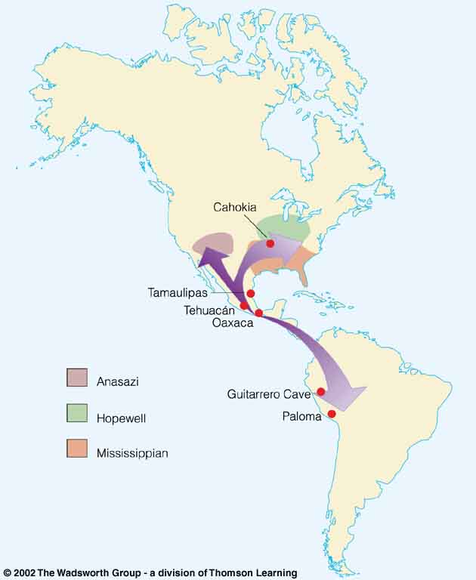
Compare . . .
Tehuacán Valley, Puebla, Mexico
maize
4,200 ybp
Understanding Physical Anthropology and Archaeology, 8th Ed., p. 432.

Slide 41
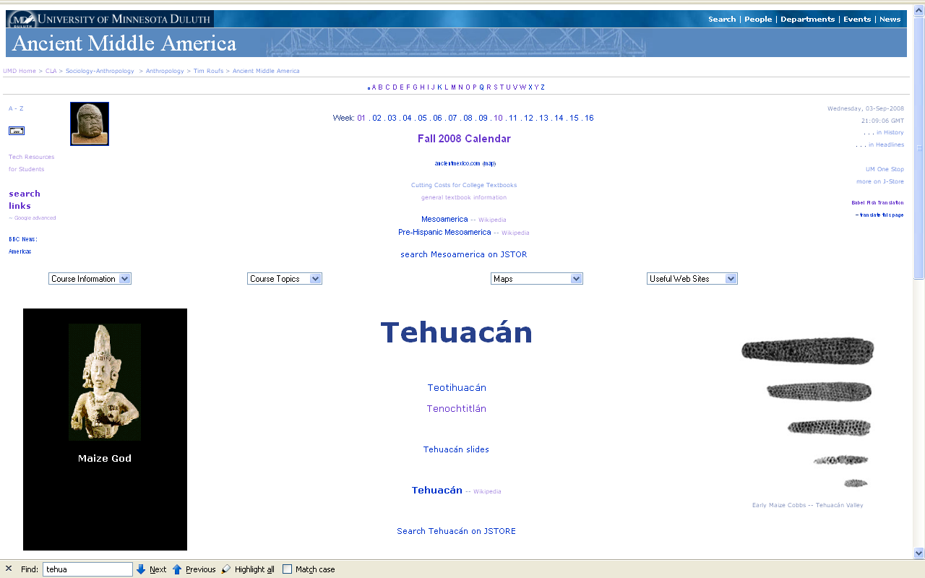
www.d.umn.edu/cla/faculty/troufs/anth3618/matehuac.html#title

Slide 42
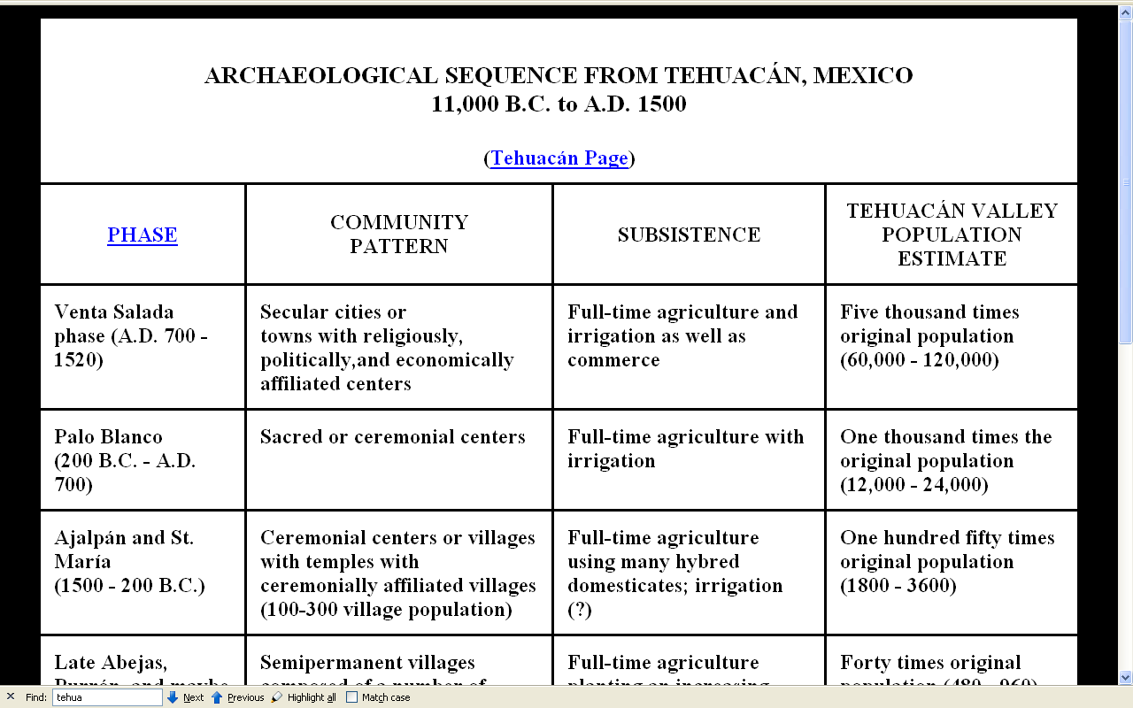
www.d.umn.edu/cla/faculty/troufs/anth3618/matehuac.html#title

Slide 43
Neolithic
Time line for Ch. 14 Food Production.
Understanding Physical Anthropology and Archaeology, 9th Ed., p. 333.

Slide 44
The Neolithic Revolution
=
The Agriculture Revolution

Slide 45
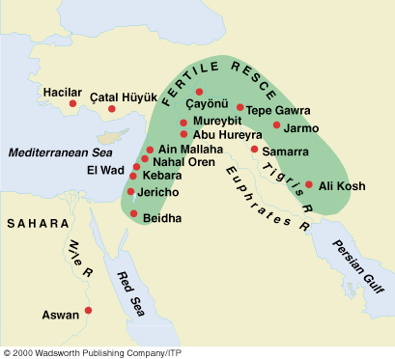
Compare . . .
Early Neolithic sites
Understanding Physical Anthropology and Archaeology, 9th Ed., p. 349.

Slide 46
Neolithic
Time line for Ch. 14 Food Production
Understanding Physical Anthropology and Archaeology, 9th Ed., p. 333.

Slide 47


Slide 48
Main Characteristics in a Nutshell

Slide 49
American
Main Characteristics of˄Anthropology
1. the four fields of general anthropology
culture as a primary concept
comparative method as major approach
holism as a primary theoretical goal
fieldwork as a primary research technique

Slide 50
The End
Comparative Method
as a
Major Approach
University of Minnesota Duluth
Tim Roufs
© 2010-2026
http://en.wikipedia.org/wiki/Highland_cattle

