Slide 1
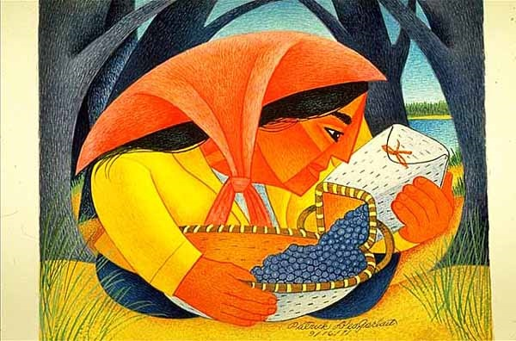
Start deck in “Slide Show” mode,
and use your up/down arrow keys and/or
your space bar to advance the slides
University of Minnesota Duluth
Tim Roufs
© 2010-2026

Slide 2
ANTH 3888
Anthropology of Food
University of Minnesota Duluth
Tim Roufs
© 2010-2026

Slide 3
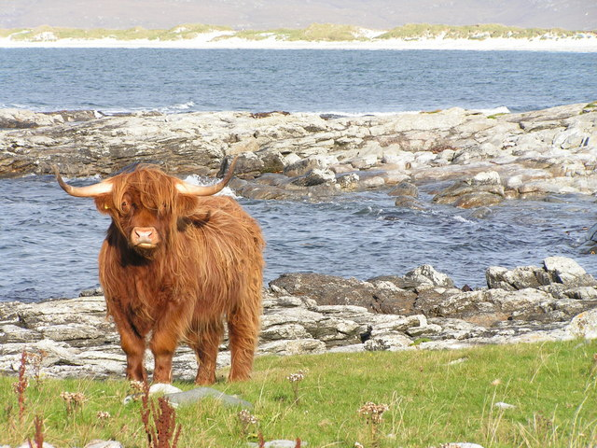
Main
Characteristics of
Anthropology
Anthropology of Food
University of Minnesota Duluth
Tim Roufs
© 2010-2026
http://en.wikipedia.org/wiki/Highland_cattle

Slide 4
American
Main Characteristics of˄Anthropology
1. the four fields of general anthropology
culture as a primary concept
comparative method as major approach
holism as a primary theoretical goal
fieldwork as a primary research technique

Slide 5
American
Main Characteristics of˄Anthropology
1. the four fields of general anthropology
culture as a primary concept
comparative method as major approach
holism as a primary theoretical goal
fieldwork as a primary research technique

Slide 6
Main Characteristics of Anthropology
1. the four fields of general anthropology
culture as a primary concept
comparative method as major approach
holism
or the study of "humankind" as a whole, as a primary theoretical goal
fieldwork as a primary research technique

Slide 7
with humans,
in anthropology,
holism looks at an item including the many subdisciplines in the areas of . . .

Slide 8
Holism tries to put all of the pieces together . . .
Anthropology of Food
and its . . .
cultural / social
physical
archaeology
linguistics
(Bio-physical)

Slide 9
let’s have a look at that on the
“Anthropology and . . . Its Parts” chart . . .

Slide 10
Main Characteristics of Anthropology
1. the four fields of general anthropology
culture as a primary concept
comparative method as major approach
holism as a primary theoretical goal
  Anthropology and its Parts chart
fieldwork as a primary research technique

Slide 11
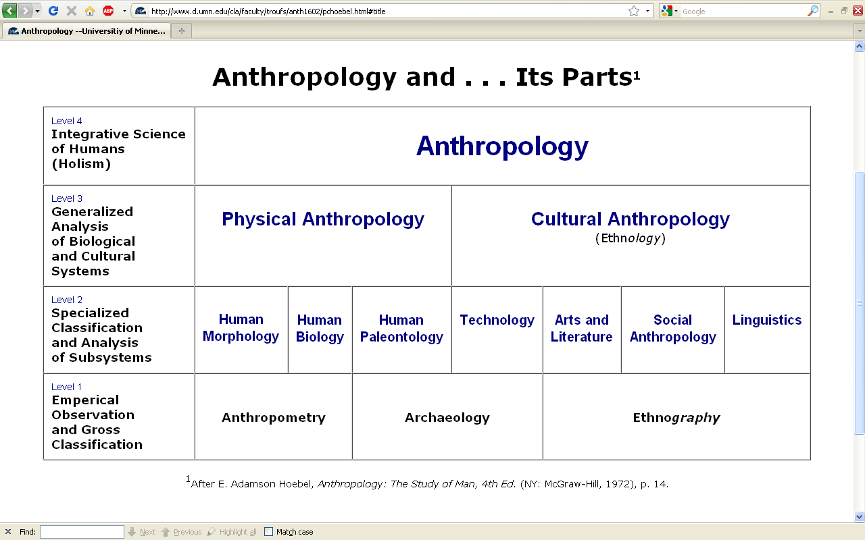
URL link to print: https://www.d.umn.edu/cla/faculty/troufs/anth1602/pchoebel.html#title

Slide 12
NOTE:
usually anthropologists read charts from the bottom up
that has to do with the fact that in archaeology the oldest layers are at the bottom of a site and the newer ones are on top

Slide 13
REM: We’re having a look at . . .
Food
and its . . .
cultural / social
physical
archaeology
linguistics
would appear on the chart as . . .

Slide 14
. . . but first note that the two main divisions
of Anthropology are
Bio-physical and Cultural . . .

Slide 15
Understanding Global Cultures
Anthropology
URL link to print: https://www.d.umn.edu/cla/faculty/troufs/anth1602/pchoebel.html#title

Slide 16
URL link to print: https://www.d.umn.edu/cla/faculty/troufs/anth1602/pchoebel.html#title

Slide 17
Understanding Global Cultures
Anthropology
Bio-physical
URL link to print: https://www.d.umn.edu/cla/faculty/troufs/anth1602/pchoebel.html#title

Slide 18
. . . Bio-physical involves
things like . . .

Slide 19

http://news.bbc.co.uk/2/hi/health/7120564.stm

Slide 20
. . . but ultimately anthropologists seek to study phenomena in terms of both physical and cultural aspects
. . .

Slide 21
Understanding Global Cultures
Anthropology
Bio-physical
Cultural
URL link to print: https://www.d.umn.edu/cla/faculty/troufs/anth1602/pchoebel.html#title

Slide 22
  for example, numerous studies have shown that exposure to images [cultural] of ultrathin models can lead to body dissatisfaction and eventually to unhealthy eating behaviors and physical illness [physical] . . .
The Cultural Feast, 2nd ed., p. 115

Slide 23

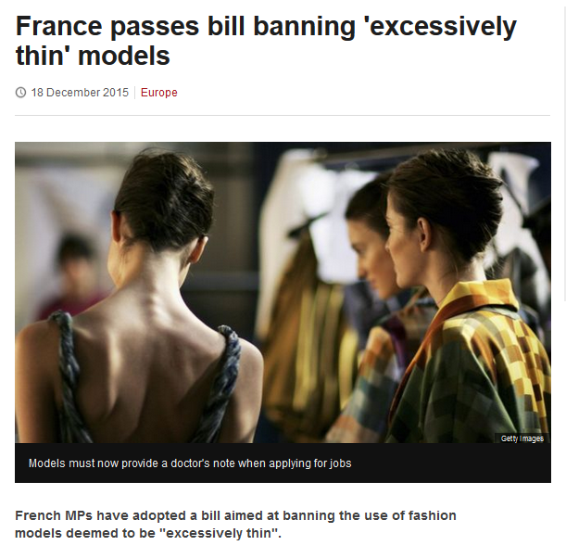
http://www.bbc.com/news/world-europe-35130792

Slide 24
Understanding Global Cultures
. . . but ultimately anthropologists seek to study phenomena in terms of both physical and cultural aspects
. . .
. . . as well as other aspects, for e.g., the psychological
. . .

Slide 25
NOTE:
There are four levels . . .
(REM: read from the bottom up)

Slide 26
URL link to print: https://www.d.umn.edu/cla/faculty/troufs/anth1602/pchoebel.html#title

Slide 27
URL link to print: https://www.d.umn.edu/cla/faculty/troufs/anth1602/pchoebel.html#title

Slide 28
URL link to print: https://www.d.umn.edu/cla/faculty/troufs/anth1602/pchoebel.html#title

Slide 29
URL link to print: https://www.d.umn.edu/cla/faculty/troufs/anth1602/pchoebel.html#title

Slide 30
HOLISM
Involves all four levels
and all
of the physical and cultural
components combined

Slide 31
holism
URL link to print: https://www.d.umn.edu/cla/faculty/troufs/anth1602/pchoebel.html#title

Slide 32
holism
holism
URL link to print: https://www.d.umn.edu/cla/faculty/troufs/anth1602/pchoebel.html#title

Slide 33
Anthropology
URL link to print: https://www.d.umn.edu/cla/faculty/troufs/anth1602/pchoebel.html#title

Slide 34
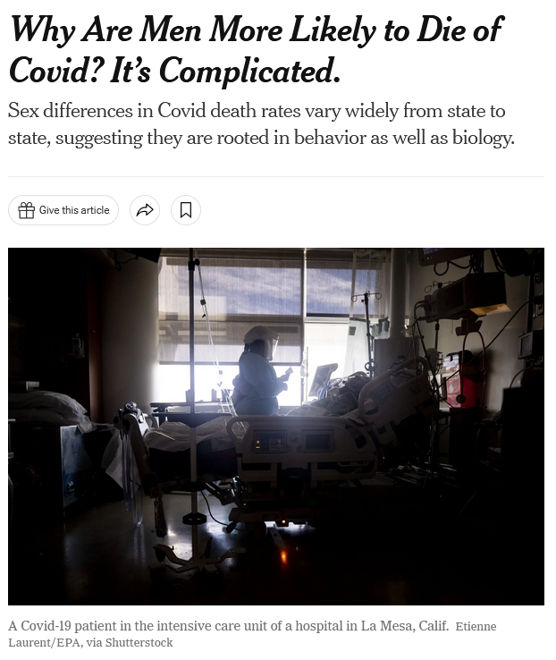
January 19, 2022
https://www.nytimes.com/2022/01/19/health/covid-gender-deaths-men-women.html?referringSource=articleShare

Slide 35
REM
. . . the two main divisions
of Anthropology are
Bio-physical and Cultural . . .

Slide 36
Understanding Global Cultures
Anthropology
URL link to print: https://www.d.umn.edu/cla/faculty/troufs/anth1602/pchoebel.html#title

Slide 37
Anthropology
Bio-physical
URL link to print: https://www.d.umn.edu/cla/faculty/troufs/anth1602/pchoebel.html#title

Slide 38
Anthropology
Bio-physical
Food and Culture
URL link to print: https://www.d.umn.edu/cla/faculty/troufs/anth1602/pchoebel.html#title

Slide 39
Bio-physical
Food and Culture
URL link to print: https://www.d.umn.edu/cla/faculty/troufs/anth1602/pchoebel.html#title

Slide 40
here is what that would look like
on the Biocultural Framework diagram from p. 4 of The Cultural Feast . . .

Slide 41
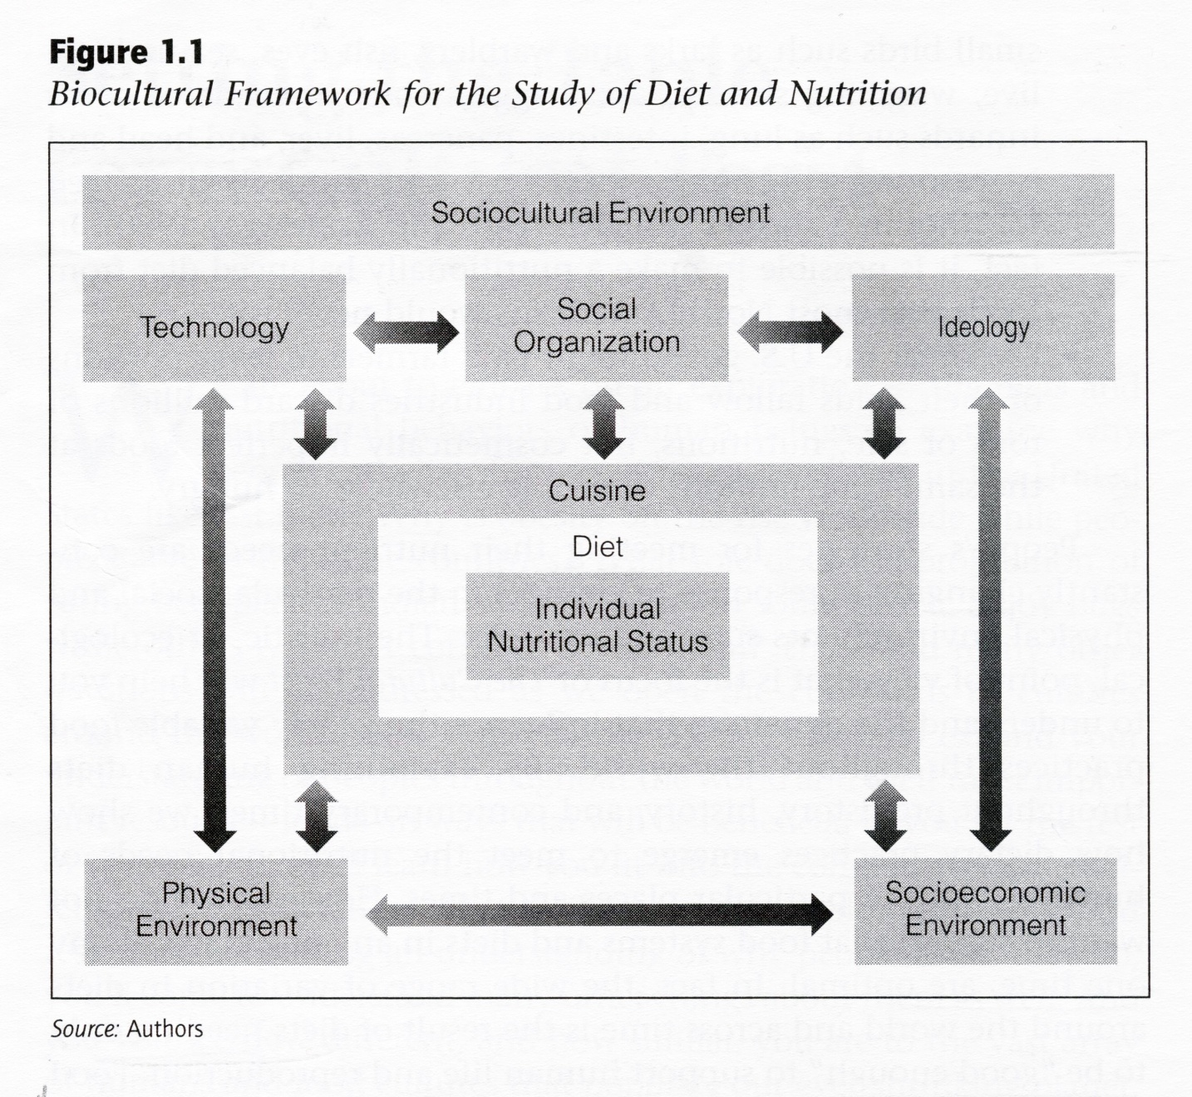
The Cultural Feast, 2nd ed., p. 4

Slide 42
Food and Culture
The Cultural Feast, 2nd ed., p. 4

Slide 43
Food and Culture
Physical Anthropology
The Cultural Feast, 2nd ed., p. 4

Slide 44
. . . Bio-physical involves
things like . . .

Slide 45
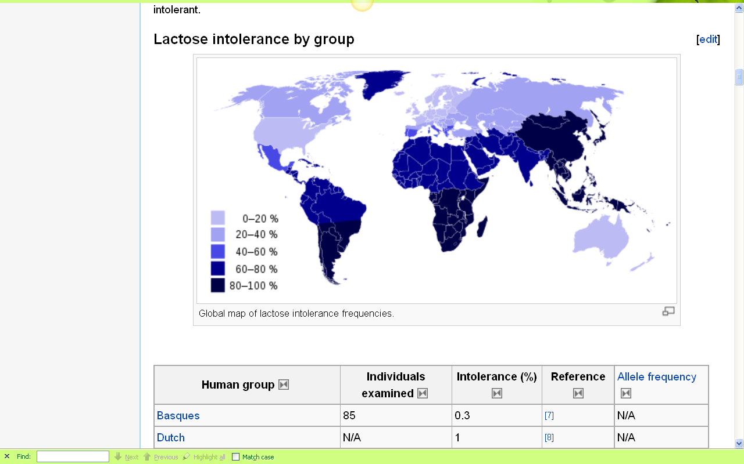
Europeans are some of the few peoples of the world that can drink milk without getting sick
http://en.wikipedia.org/wiki/Lactose_intolerance

Slide 46
http://news.bbc.co.uk/2/hi/health/7120564.stm

Slide 47
. . . but, as mentioned above, ultimately anthropologists seek to study phenomena in terms of both physical and cultural aspects
. . .

Slide 48
Anthropology
Bio-physical
Food and Culture
URL link to print: https://www.d.umn.edu/cla/faculty/troufs/anth1602/pchoebel.html#title

Slide 49
. . . and that ultimately involves lots of subdisciplines . . .

Slide 50
Anthropology
Bio-physical |
Food and Culture
URL link to print: https://www.d.umn.edu/cla/faculty/troufs/anth1602/pchoebel.html#title

Slide 51
Anthropology
Bio-physical |
Food and Culture
measuring
URL link to print: https://www.d.umn.edu/cla/faculty/troufs/anth1602/pchoebel.html#title

Slide 52
Anthropology
Bio-physical |
Food and Culture
measuring
excavating
URL link to print: https://www.d.umn.edu/cla/faculty/troufs/anth1602/pchoebel.html#title

Slide 53
Anthropology
Bio-physical |
Food and Culture
measuring
excavating
participant /
observation
URL link to print: https://www.d.umn.edu/cla/faculty/troufs/anth1602/pchoebel.html#title

Slide 54
Anthropology
Bio-physical |
Food and Culture
body
size/shape,
etc.
measuring
excavating
participant /
observation
URL link to print: https://www.d.umn.edu/cla/faculty/troufs/anth1602/pchoebel.html#title

Slide 55
Anthropology
Bio-physical |
Food and Culture
body
size/shape,
etc.
nutrition,
etc.
measuring
excavating
participant /
observation
URL link to print: https://www.d.umn.edu/cla/faculty/troufs/anth1602/pchoebel.html#title

Slide 56
Anthropology
Bio-physical |
Food and Culture
body
size/shape,
etc.
nutrition,
etc.
hunting /
meat eating
measuring
excavating
participant /
observation
URL link to print: https://www.d.umn.edu/cla/faculty/troufs/anth1602/pchoebel.html#title

Slide 57
Anthropology
Bio-physical |
Food and Culture
body
size/shape,
etc.
nutrition,
etc.
hunting /
meat eating
the
“Agricultural
Revolution”
measuring
excavating
participant /
observation
URL link to print: https://www.d.umn.edu/cla/faculty/troufs/anth1602/pchoebel.html#title

Slide 58
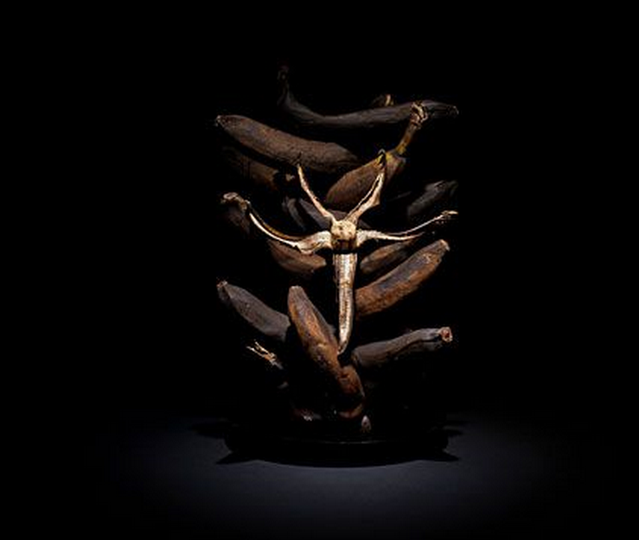
Forum discussion topic

Slide 59
Anthropology
Bio-physical |
Food and Culture
body
size/shape,
etc.
nutrition,
etc.
hunting /
meat eating
the
“Agricultural
Revolution”
food in
art
literature
measuring
excavating
participant /
observation
URL link to print: https://www.d.umn.edu/cla/faculty/troufs/anth1602/pchoebel.html#title

Slide 60
Anthropology
Bio-physical |
Food and Culture
body
size/shape,
etc.
nutrition,
etc.
hunting /
meat eating
the
“Agricultural
Revolution”
food in
art
literature
food and
society and
belief, etc.
measuring
excavating
participant /
observation
URL link to print: https://www.d.umn.edu/cla/faculty/troufs/anth1602/pchoebel.html#title

Slide 61
Anthropology
Bio-physical |
Food and Culture
body
size/shape,
etc.
nutrition,
etc.
hunting /
meat eating
the
“Agricultural
Revolution”
food in
art
literature
food and
society and
belief, etc.
food
and
language
measuring
excavating
participant /
observation
URL link to print: https://www.d.umn.edu/cla/faculty/troufs/anth1602/pchoebel.html#title

Slide 62
some examples of holistic comparative work include . . .

Slide 63

Penguin Avery, 2009

Slide 64
“I’m one of the few experts—if not the only expert—to have conducted large-scale, longitudinal surveys following obesity on a global scale.” (p. 2)
Penguin Avery, 2009

Slide 65
Barry Popkin’s work looks at . . .
(Trivia: Barry is from Superior, WI, and includes Superior in his comparisons in this book)

Slide 66
Anthropology
Bio-physical |
Food and Culture
body
size/shape,
etc.
nutrition,
etc.
hunting /
meat eating
the
“Agricultural
Revolution”
food in
art
literature
food and
society and
belief, etc.
food
and
language
measuring
excavating
participant /
observation

Slide 67
holism
holism

Slide 68
In some ways this chart business is all about
Theory
but key theory that is important to the understanding of the Anthropology of Food

Slide 69
theory
holism

Slide 70
theory
holism
and the theory ultimately also includes the
results of interdisciplinary study,
esp. with food history, nutrition studies, and the business of producing, distributing and marketing food . . .

Slide 71
theory
One excellent example of holism in action is
Nassim Nicholas Taleb’s
INCERTO. . .

Slide 72
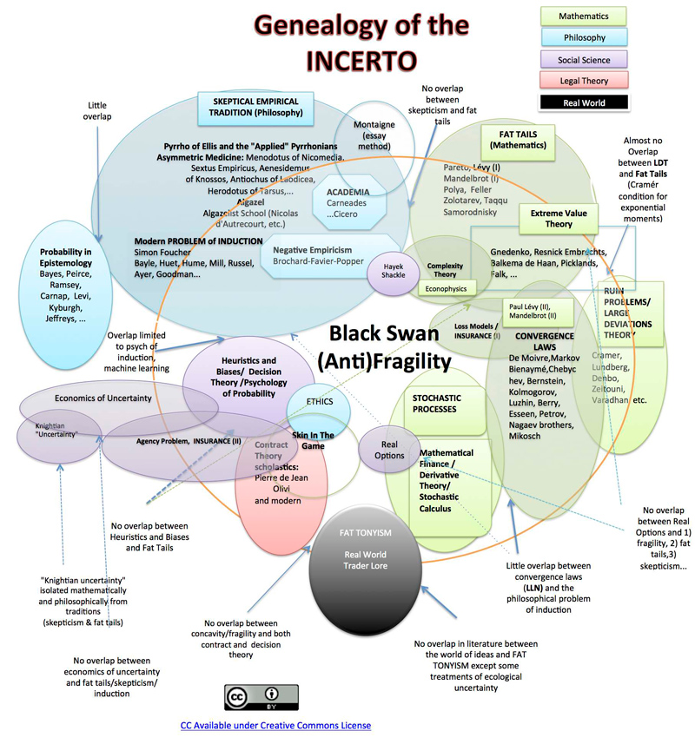

Slide 73
Main Characteristics
in a Nutshell

Slide 74
Main Characteristics of Anthropology
1. the four fields of general anthropology
culture as a primary concept
comparative method as major approach
holism as a primary theoretical goal
  Anthropology and its Parts chart
fieldwork as a primary research technique

Slide 75
The End
Main
Characteristics of
Anthropology
Anthropology of Food
University of Minnesota Duluth
Tim Roufs
© 2010-2026
http://en.wikipedia.org/wiki/Highland_cattle

