Slide 1
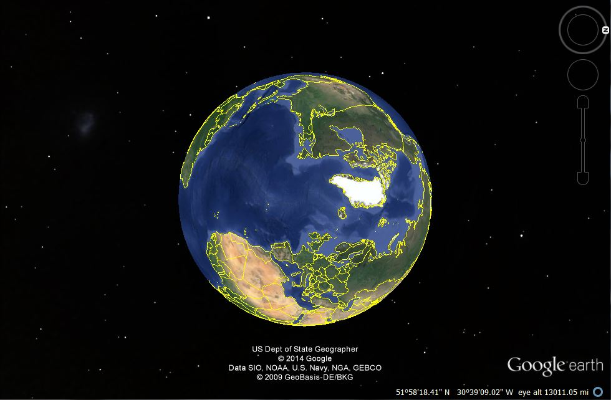

    In Canvas
    (1.) Enter Full Screen
    (2.) advance slides using < >
    (3.) adjust your screen size (if necessary)
© 2010-2026 Timothy G. Roufs, University of Minnesota Duluth

Slide 2
    In Canvas
    (1.) Enter Full Screen
    (2.) advance slides using < >
    (3.) adjust your screen size (if necessary)
OPTIONAL: Download PowerPoint (.pptx) and watch in “Slide Show” mode, and use your up/down arrow keys and/or your space bar to advance the slides.
© 2010-2026 Timothy G. Roufs, University of Minnesota Duluth

Slide 3
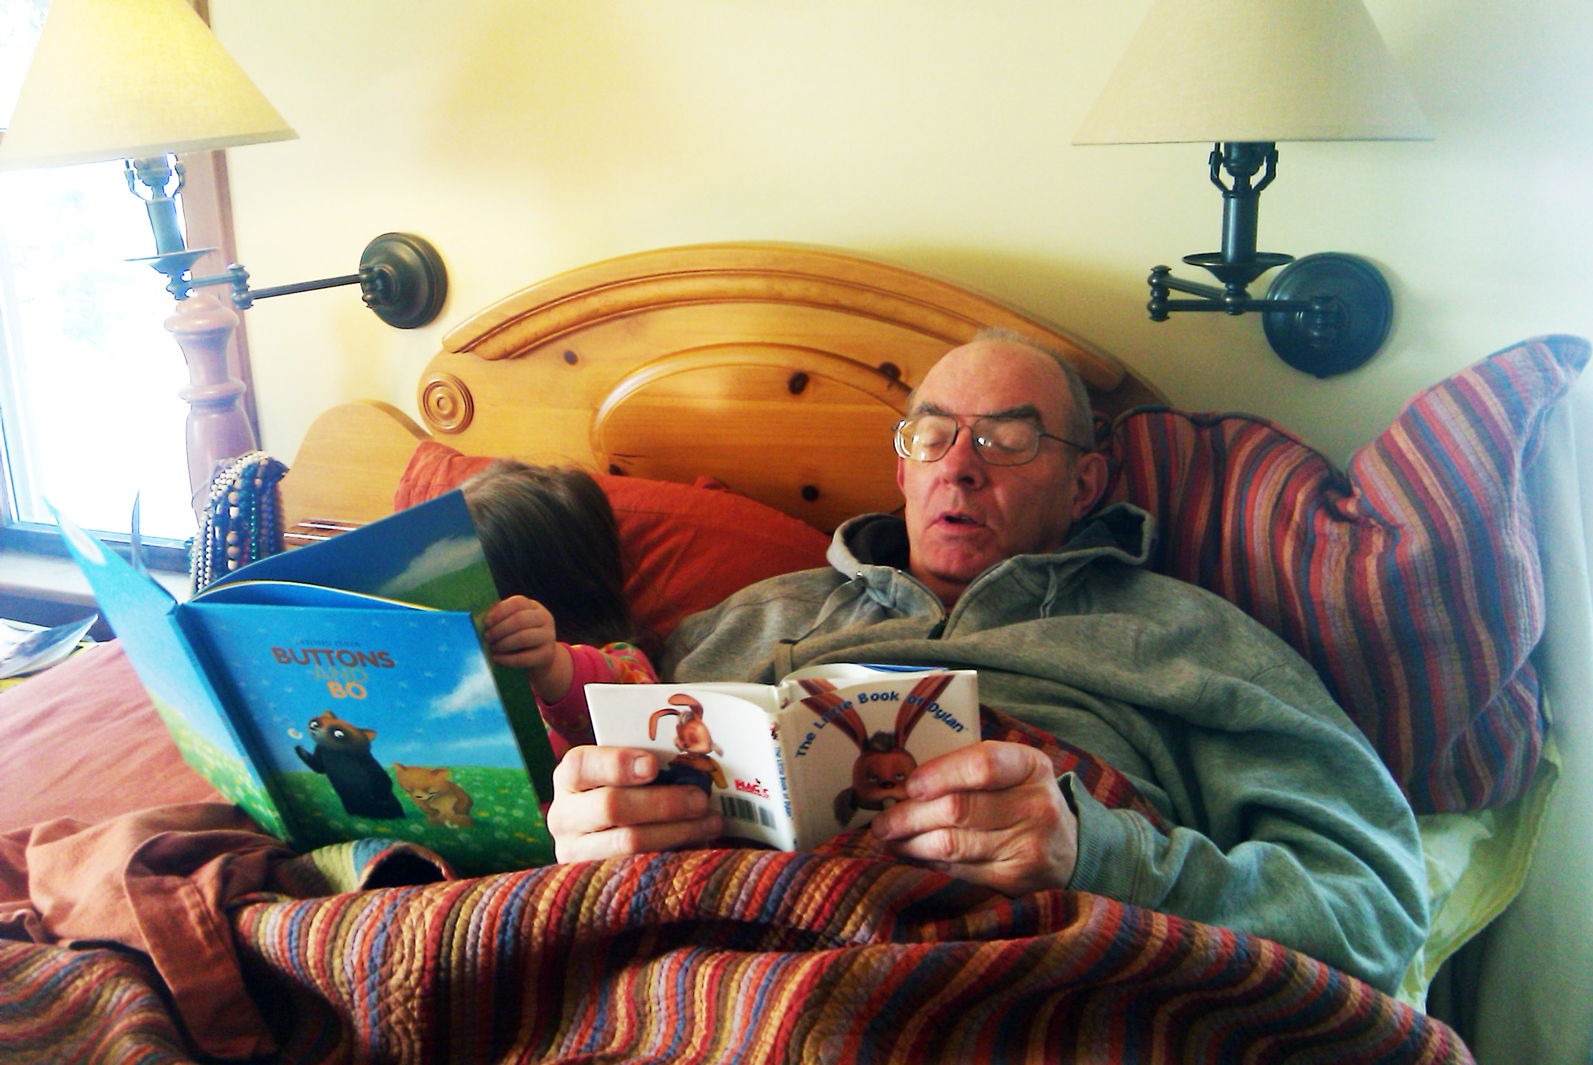
Meet Your Professor . . .
University of Minnesota Duluth
Tim Roufs
© 2010-2026

Slide 5
Hi
I'm Tim Roufs

Slide 6
When I ask students in face-to-face (f2f) classes "What would you like to know about your professor?"
they usually uniformly ask
"safe" questions
(which anthropologically-speaking is probably a good approach, although it's difficult for the last person to think of a "safe" question that hasn't been asked by one of the other students)

Slide 7
They ask questions like
"Where were you born?" . . .
"Where did you go to school?" . . .
"How long have you been teaching at UMD?" . . .
“Where have you been?” . . .
and that sort of thing . . .

Slide 8
To me, (judging by the looks on the faces of most in class) those questions, while safe, are actually pretty boring
But one or two folks seem to like to know about that sort of thing.
If you do, more than you probably really want or need to know is on
my UMD biography page . . .

Slide 9
To me, (judging by the looks on the faces of most in class) those questions, while safe, are actually pretty boring
But one or two folks seem to like to know about that sort of thing
If you do, more than you probably really want or need to know is on
my UMD biography page . . .

Slide 10
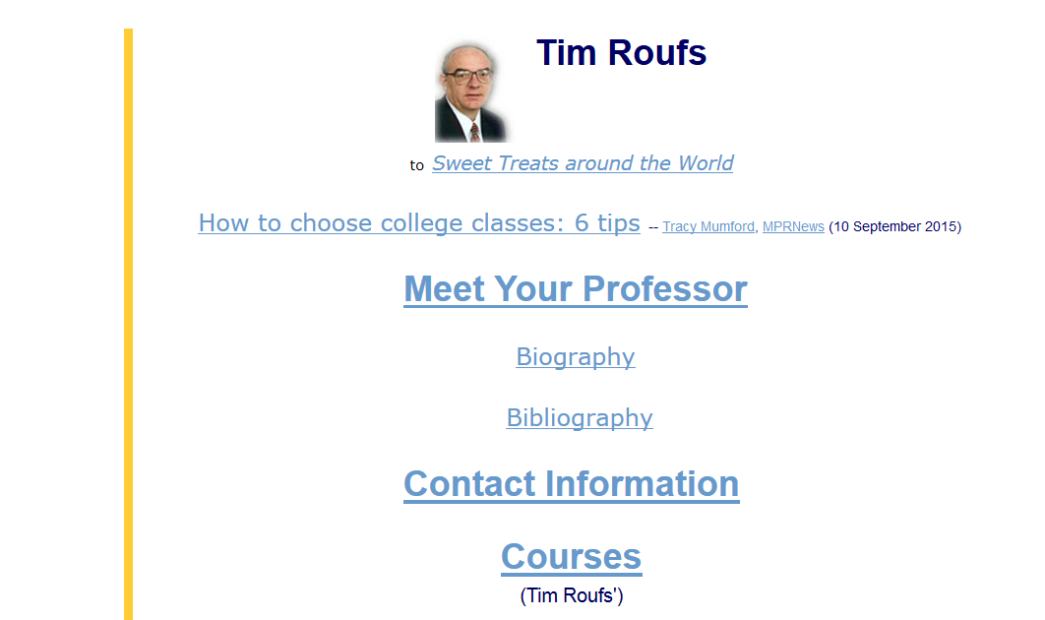

Slide 11
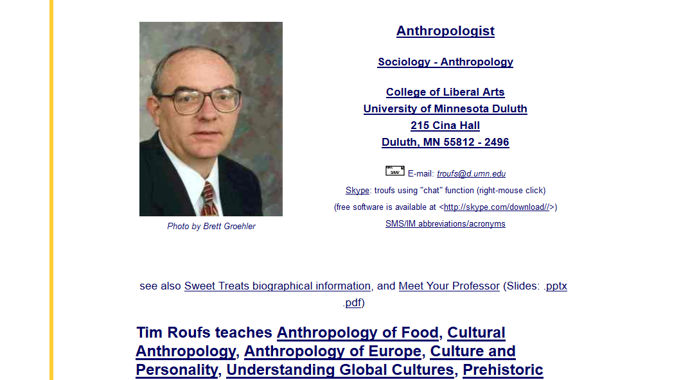

Slide 12
My "career" in American-style Anthropology began in second grade
Most students are curious about that.

Slide 13
My "career" in American-style Anthropology began in second grade
Most students are curious about that

Slide 14
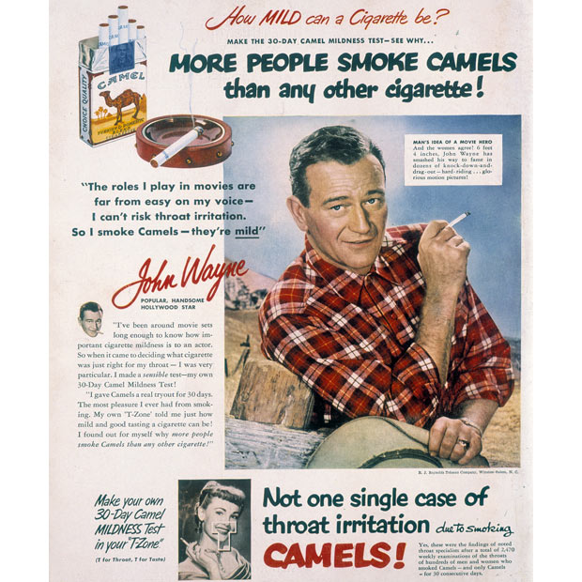
. . . my granddaughter, Claire,
when she was in the first grade,
was also very curious about the fact that it was also in the second grade that I quit smoking cigarettes—not candy cigarettes,
unfiltered Camels . . .

Slide 15
One of the
Main Characteristics of American Anthropology
is that it encompasses a
"four-fields approach" incorporating
Socio-Cultural Anthropology
Bio-Physical Anthropology
Archaeology
and Linguistics

Slide 16
It was in second grade of Holy Trinity Grade School that I really began to learn some of the important things in life
—and important things in anthropology

Slide 17
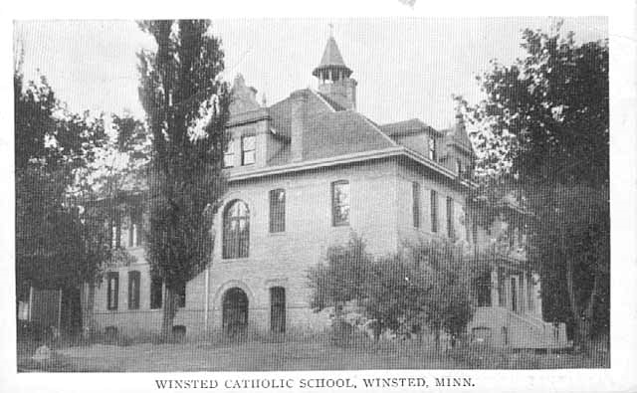
Winsted Catholic School, Winsted.
Minnesota Historical Society Photograph Collection, Postcard
ca. 1915
Location no. MM1.9 WN r4

Slide 18
By the end of third grade I had done fieldwork in all four fields of anthropology

Slide 19
These "Introduction" slides will talk about these "early" days in anthropology and, why I'm here

Slide 20
And you will hopefully see in this course why in more recent years I have been called one of the
"Pioneers in Online Instruction"
(Surfing the Syllabi: Online Resources for Teaching Archaeology)

Slide 21
Why should you care?
(And why do I tell you this stuff
when I really don't like to do it
--being a Lake Wobegon type person?)

Slide 22
Why should you care?
(And why do I tell you this stuff
when I really don't like to do it
—being a Lake Wobegon type person?)

Slide 23
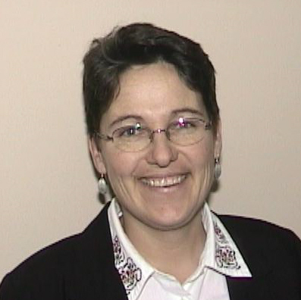
A long-time mentor, Helen Mongan-Rallis, says that research shows that three good things happen when you take time to find out a little about your teacher as a person
You learn more
You remember it better
And — equally important, I think—
you have more fun learning

Slide 24
A long-time mentor, Helen Mongan-Rallis, says that research shows that three good things happen when you take time to find out a little about your teacher as a person
You learn more
You remember it better
And — equally important, I think—
you have more fun learning

Slide 25
So it’s a good idea for you to have a look at these "Introduction" materials to according to Helen . . .
help you learn more
remember it longer
and (at least eventually) to have more fun

Slide 26
So back to some questions . . .

Slide 27
FAQs
Where did you grow up?
Where did you go to school?
How long have you been at UMD?
What are your favorite things to do?
How did you get into anthropology?
Where have you been?
            What are your pet peeves?

Slide 28
One of my very favorite things is being out in the yard putzing around,
talking to animals . . .
and to trees and plants too

Slide 29
One of my very favorite things is being out in the yard putzing around,
talking to animals . . .
and to trees and plants too . . .

Slide 30
And they talk back
(and scientists have recently discovered that they “talk” to one another – at least the trees do . . .)

Slide 31
And they talk back
(and scientists have recently discovered that
they “talk” to one another—at least the trees do . . .)

Slide 32
And I love doing anthropology

Slide 33
Here’s a picture of me doing anthropology . . .

Slide 34
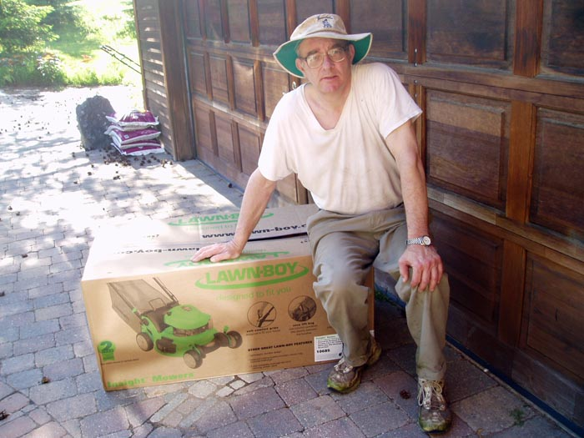

Slide 35
It may not look like anthropology,
but it is . . .
I’m contemplating my new lawn mower, a Lawn Boy . . .
Designed with the help of anthropologists.

Slide 36
It may not look like anthropology,
but it is . . .
I’m contemplating my new lawn mower,
a Lawn Boy . . .
Designed with the help of anthropologists.

Slide 37
It may not look like anthropology,
but it is . . .
I’m contemplating my new lawn mower,
a Lawn Boy . . .
Designed with the help of anthropologists

Slide 38
What can anthropologists do to design lawn mowers?
They do what anthropologists do . . .
go live with the “natives”
(that’s called “participant observation”)
they ask a lot of questions
(“interviewing”)
they take a lot of pictures
(ethnophotography)

Slide 39
What can anthropologists do to design lawn mowers?
They do what anthropologists do . . .
go live with the “natives”
(that’s called “participant observation”)
they ask a lot of questions
(“interviewing”)
they take a lot of pictures
(ethnophotography)

Slide 40
What can anthropologists do to design lawn mowers?
They do what anthropologists do . . .
they go live with the “natives”
(that’s called “participant observation”)
they ask a lot of questions
(“interviewing”)
they take a lot of pictures
(“ethnophotography”)

Slide 41
And so the anthropologists went out and studied the “tribe” of lawnmowers
And they watched them mow lawns
And they mowed some lawns themselves
And they administered questionnaires about lawn mowers and lawn mowing
They interviewed the lawnmower people
And they took a lot of videos and still photographs

Slide 42
And they discovered that women often mow lawns
And the women often had a different relationship than the men to the gas engines
(For e.g., they didn’t particularly get a thrill out of gapping the plugs, changing the oil, stabilizing the fuel, and the like.
And, they didn’t have a “cylinder index” of manhood to have to worry about.)
And they found out that the ladies liked a starting “handle” rather than a little knob, and a handle that adjusted to their (generally) smaller height
And they liked a mower that cut close to
the trees and buildings . . .
as, for some reason the mowing men
didn’t trim grass there.

Slide 43
And, in general, they learned a lot about the lawnmower people
And Toro, who now owned Lawn Boy, redesigned the mower, and the anthropological artifact arrived . . .
an anthropological masterpiece
ready to become part of that talking to trees and animals

Slide 44
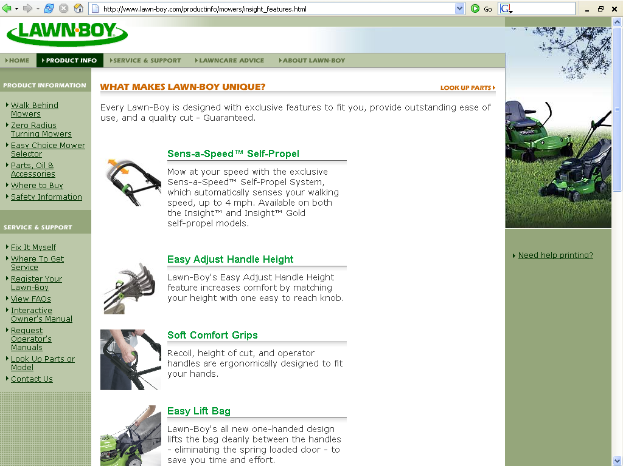
www.lawn-boy.com/productinfo/mowers/insight_features.html

Slide 45
And, one of the best listener-animals
is “Duncan” a pretty big Newfoundland . . .
well, actually, just a “normal” Newfoundland
Normal Newfoundlands are bred as water-rescue dogs, and they have webbed feet, and a second coat of hair so they can swim in Lake Superior in the winter, and all of that sort of thing.
Basically, Newfondlands LOVE water.

Slide 46
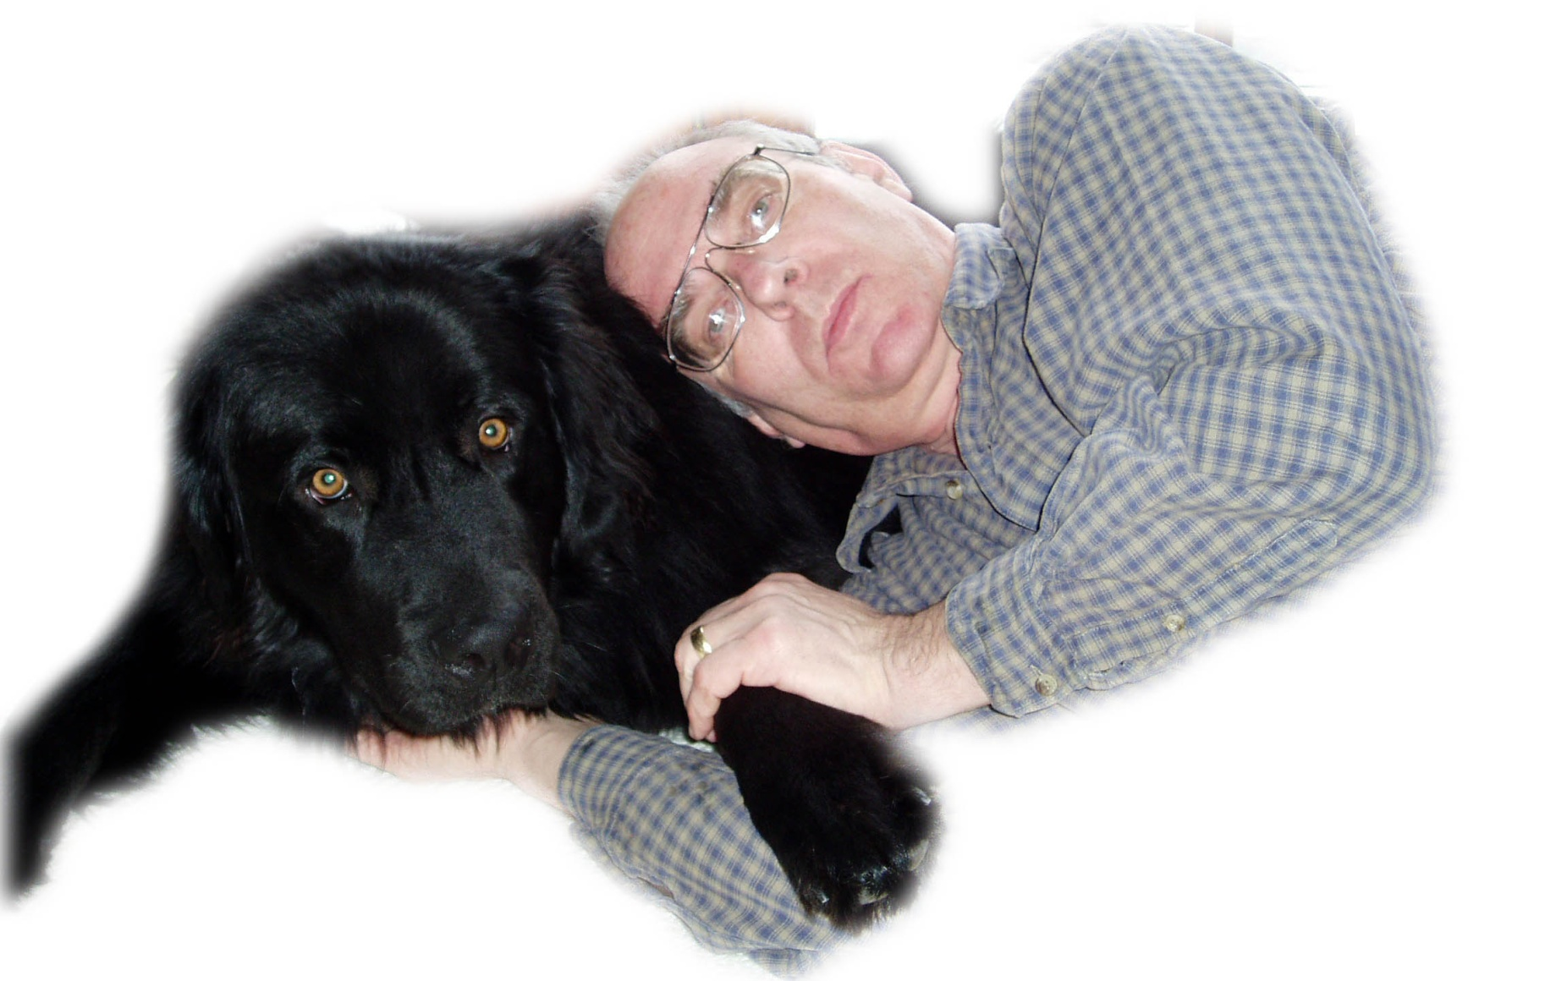

Slide 47

“Duncan” (on the left) was the proud Official Mascot of the Tau Kappa Epsilon (TKE) Fraternity, Upsilon-Gamma Chapter, University of Minnesota Duluth

Slide 48
And, one of the best listener-animals
is “Duncan” a pretty big Newfoundland . . .
well, actually, just a “normal” Newfoundland
Normal Newfoundlands are bred as water-rescue dogs, and they have webbed feet,
and a second coat of hair
so they can swim in Lake Superior in the winter,
and all of that sort of thing
Basically, Newfoundlands LOVE water

Slide 49
And, the best-listener-animal, Duncan, has his own “Newfoundland Crossing” sign, right by “Stonehenge”
“Stonehenge” is my prehistoric Irish version of the English Stonehenge
(but that Stonehenge is actually pre-British)
“Stonehenge” Duluth has a dozen standing-stones (menhir), just like the real thing.
And a wood-fired oven (with a 6 foot X ca. 3 foot baking chamber).
And a fourteen-ton lintel on top of the oven.

Slide 50
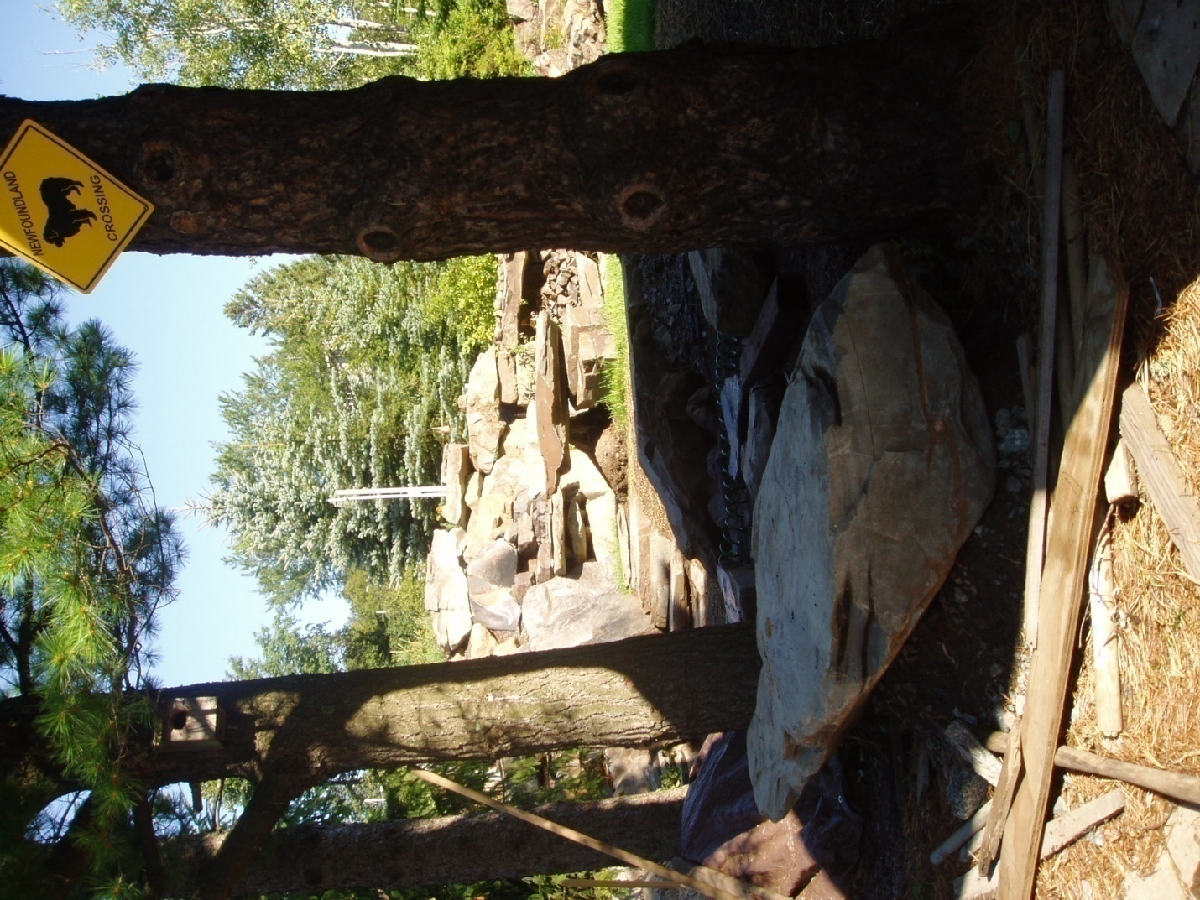
www.d.umn.edu/cla/faculty/troufs/anth1602/pcoven.html#title

Slide 51
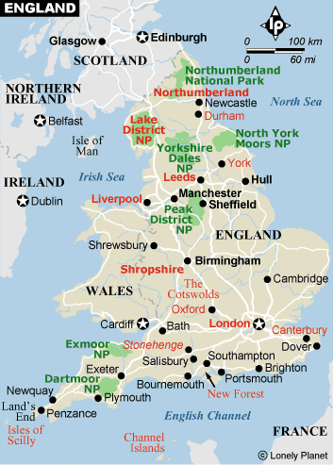
Stonehenge,
the original, is in England

Slide 52
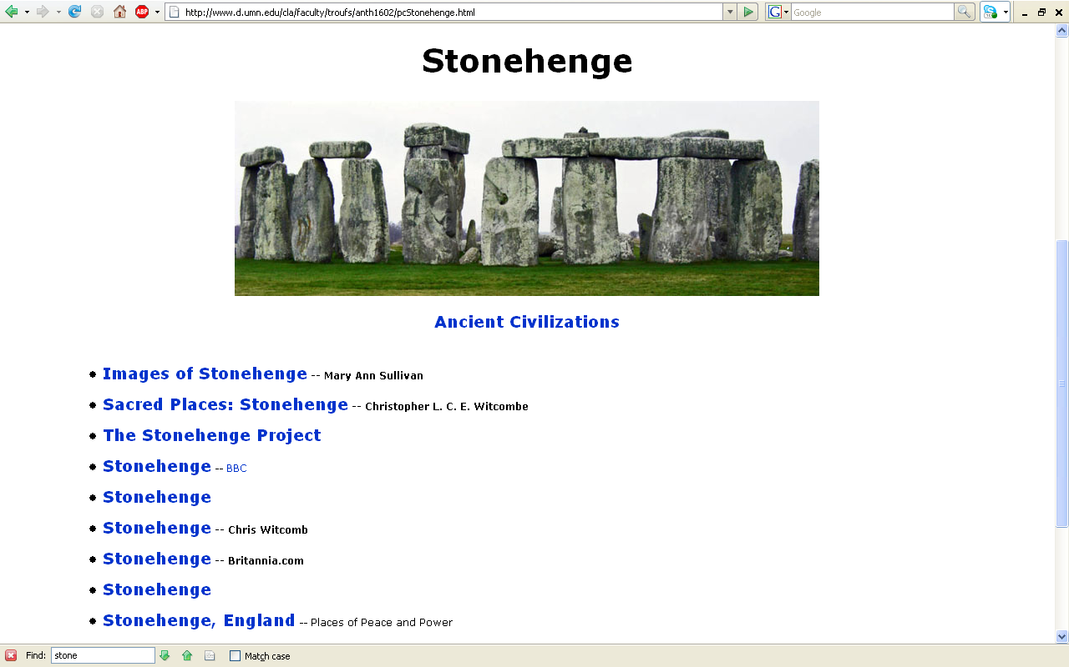
www.d.umn.edu/cla/faculty/troufs/anth1602/pcStonehenge.html

Slide 53
And, the best-listener-animal, Duncan, has his own “Newfoundland Crossing” sign, right by “Stonehenge”
“Stonehenge” is my prehistoric Irish version of the English Stonehenge
(but that Stonehenge is actually pre-British)
“Stonehenge” Duluth has a dozen standing-stones (menhir), just like the real thing
And a wood-fired oven
(with a 6 foot X ca. 3 foot baking chamber)
And a fourteen-ton lintel on top of the oven

Slide 54
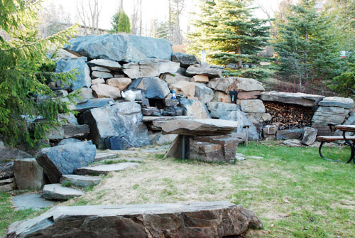
“Stonehenge”
Duluth
www.d.umn.edu/cla/faculty/troufs/anth1602/pcoven.html#title

Slide 55
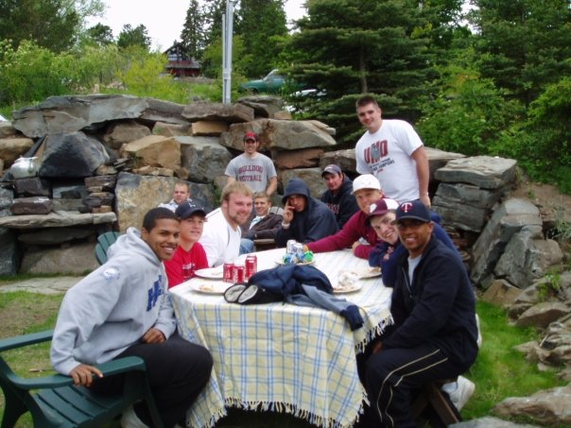
It is enjoyed by lots of folks
www.d.umn.edu/cla/faculty/troufs/anth1602/pcoven.html#title

Slide 56
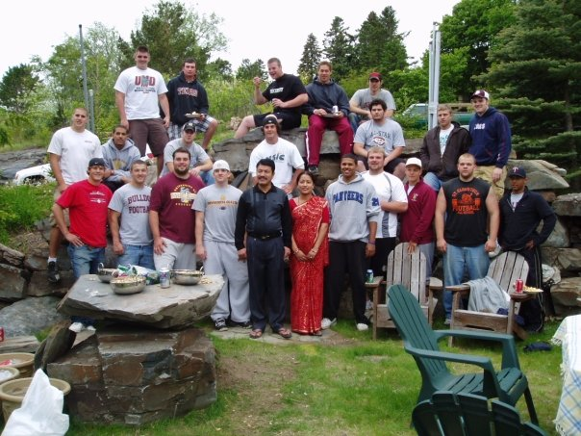
It is enjoyed by lots of folks
www.d.umn.edu/cla/faculty/troufs/anth1602/pcoven.html#title

Slide 57
And, the best-listener-animal, Duncan, has his own “Newfoundland Crossing” sign, right by “Stonehenge”
“Stonehenge” is my prehistoric Irish version of the English Stonehenge
(but that Stonehenge is actually pre-British)
“Stonehenge” Duluth has a dozen standing-stones (menhir), just like the real thing
And a wood-fired oven
(with a 6 foot X ca. 3 foot baking chamber)
And a fourteen-ton lintel on top of the oven

Slide 58
www.d.umn.edu/cla/faculty/troufs/anth1602/pcoven.html#title

Slide 59
One day I came by the “Newfoundland Crossing” sign heading by “Stonehenge” on the way to the back yard to talk to the animals and trees
Passing by the “Newfoundland Crossing” sign one would expect to pass by a Newfoundland, so when I caught what I though was “Duncan” (who actually lives in Lakeside, normally) in the little pond that we have to water the deer and ducks and other animals, I didn’t think twice—as after all, Newfoundlands are bred to be water dogs
But still, for a split second I though it was unusual as Duncan does not usually go in the pond

Slide 60
www.d.umn.edu/cla/faculty/troufs/anth1602/pcoven.html#title

Slide 61
One day I came by the “Newfoundland Crossing” sign heading by “Stonehenge” on the way to the back yard to talk to the animals and trees
Passing by the “Newfoundland Crossing” sign one would expect to pass by a Newfoundland, so when I caught what I though was “Duncan” (who actually lives in Lakeside, normally) in the little pond that we have to water the deer and ducks and other animals, I didn’t think twice—as after all, Newfoundlands are bred to be water dogs
But still, for a split second I though it was unusual as Duncan does not usually go in the pond

Slide 62
But it was a really hot August day, and even people were acting a little funny . . .
so only for a split second did I worry about Duncan in the pond
Until, a second split second later, I thought . . .
“What the hell . . .
Duncan doesn’t have peaked ears!!!!
His ears are big and floppy like every other Newfoundland . . .

Slide 63
www.d.umn.edu/cla/faculty/troufs/anth1602/pcoven.html#title

Slide 64
As it turns out,
it was so hot a bear arrived early to soak in the little pond
(they usually don’t arrive until about October)

Slide 65
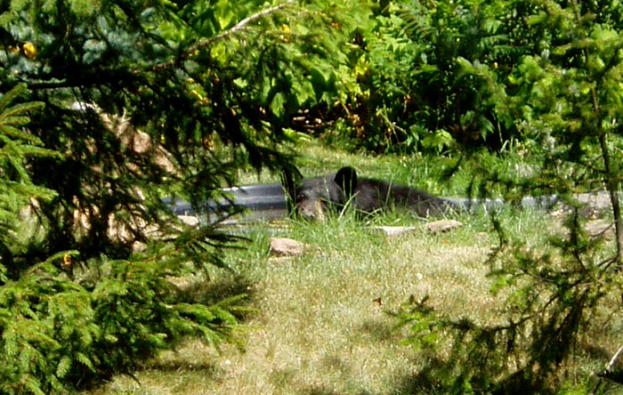

Slide 66
And for almost an hour the bear soaked in the little pond, and wouldn’t get out . . .
Until he decided to have some sunflower seeds . . .

Slide 67
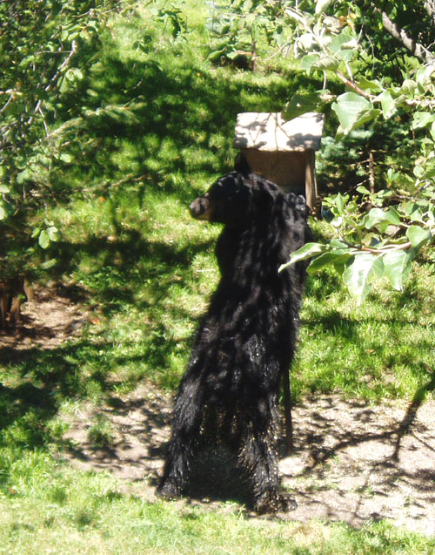

Slide 68
And he must have liked it all
because the next day he brought his friends over

Slide 69
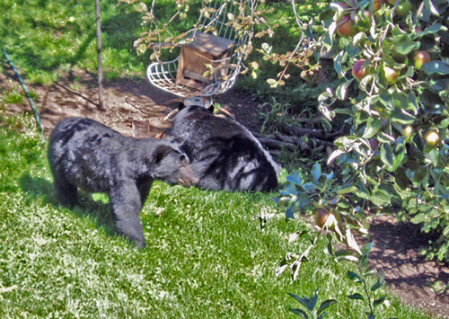

Slide 70
This is all happening, by the way,
less than the length of a football field away from UMD’s Parking Lot W
So if you live in the dorms
you too could one day be talking with the bears

Slide 71
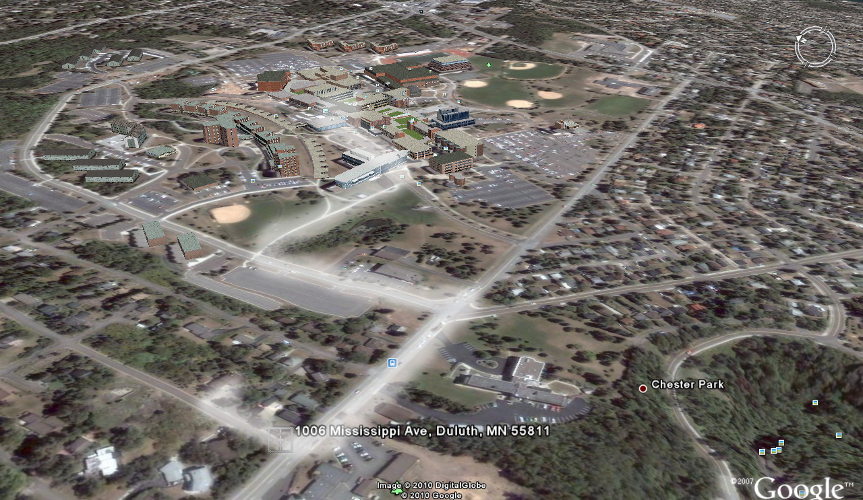
UMD’s Parking Lot W
Bears

Slide 72
And who knows, maybe you’ll be lucky and see some of the other animals that hang around the back yard,
presumably waiting to hear a little lecture on anthropology or something like that
There area a LOT of animals, mostly friendly . . .
Two of my favorites were “Fawzi” the pheasant
(who local “birders” think was an escapee from a game farm)
and a beautiful stag that came every year
until the third season of the fall bow-and-arrow hunt in the City of Duluth . . .

Slide 73
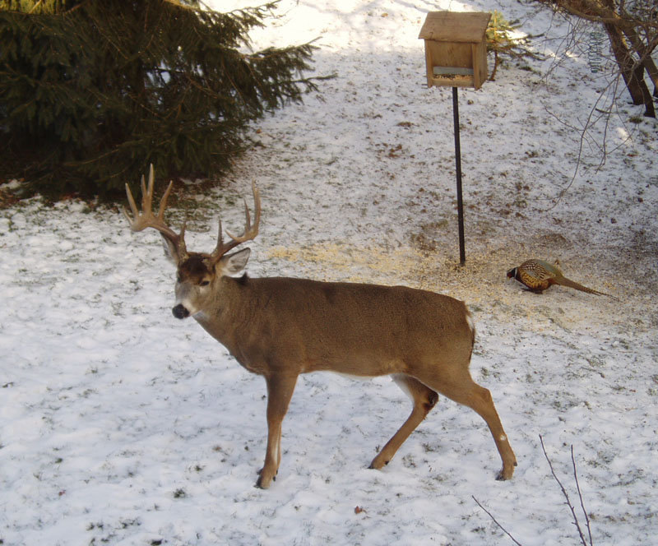

Slide 74
X

Slide 75
In the end, my friends will tell you . . .
I really liked the chickens best
My wife and I were licensed urban chicken farmers
The license to have 5 chickens in Duluth costs $10.00 a year,
which, if my math is correct, is $2 per chicken per year
The chickens themselves cost $2.35,
and you only have to pay for them once

Slide 76
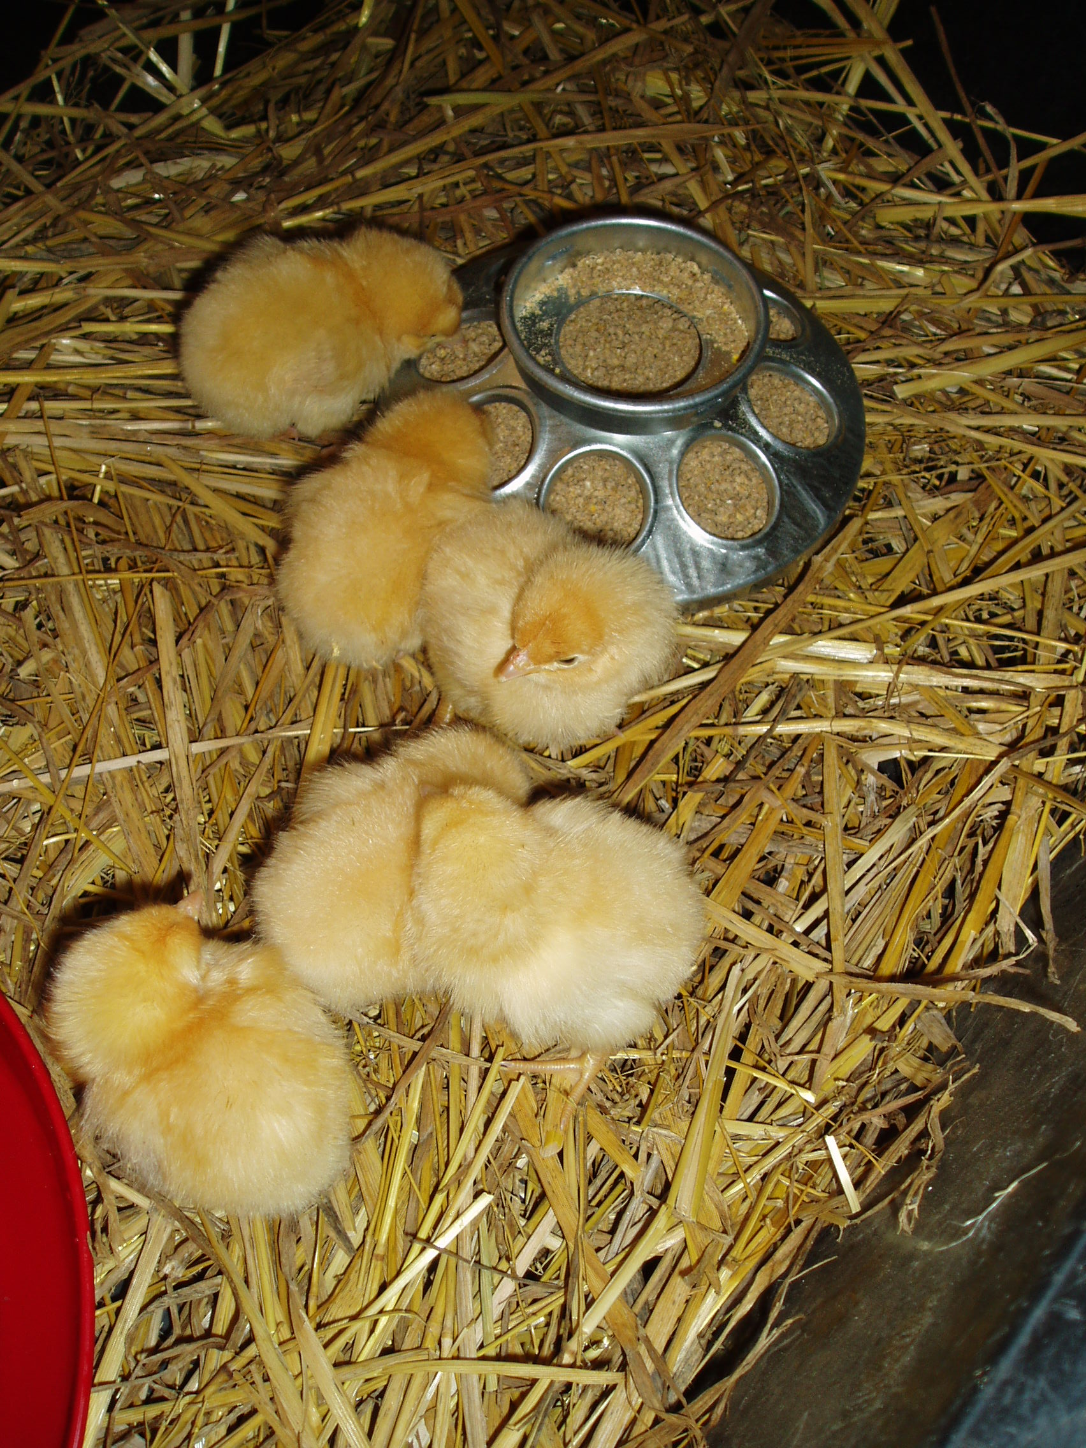

Slide 77
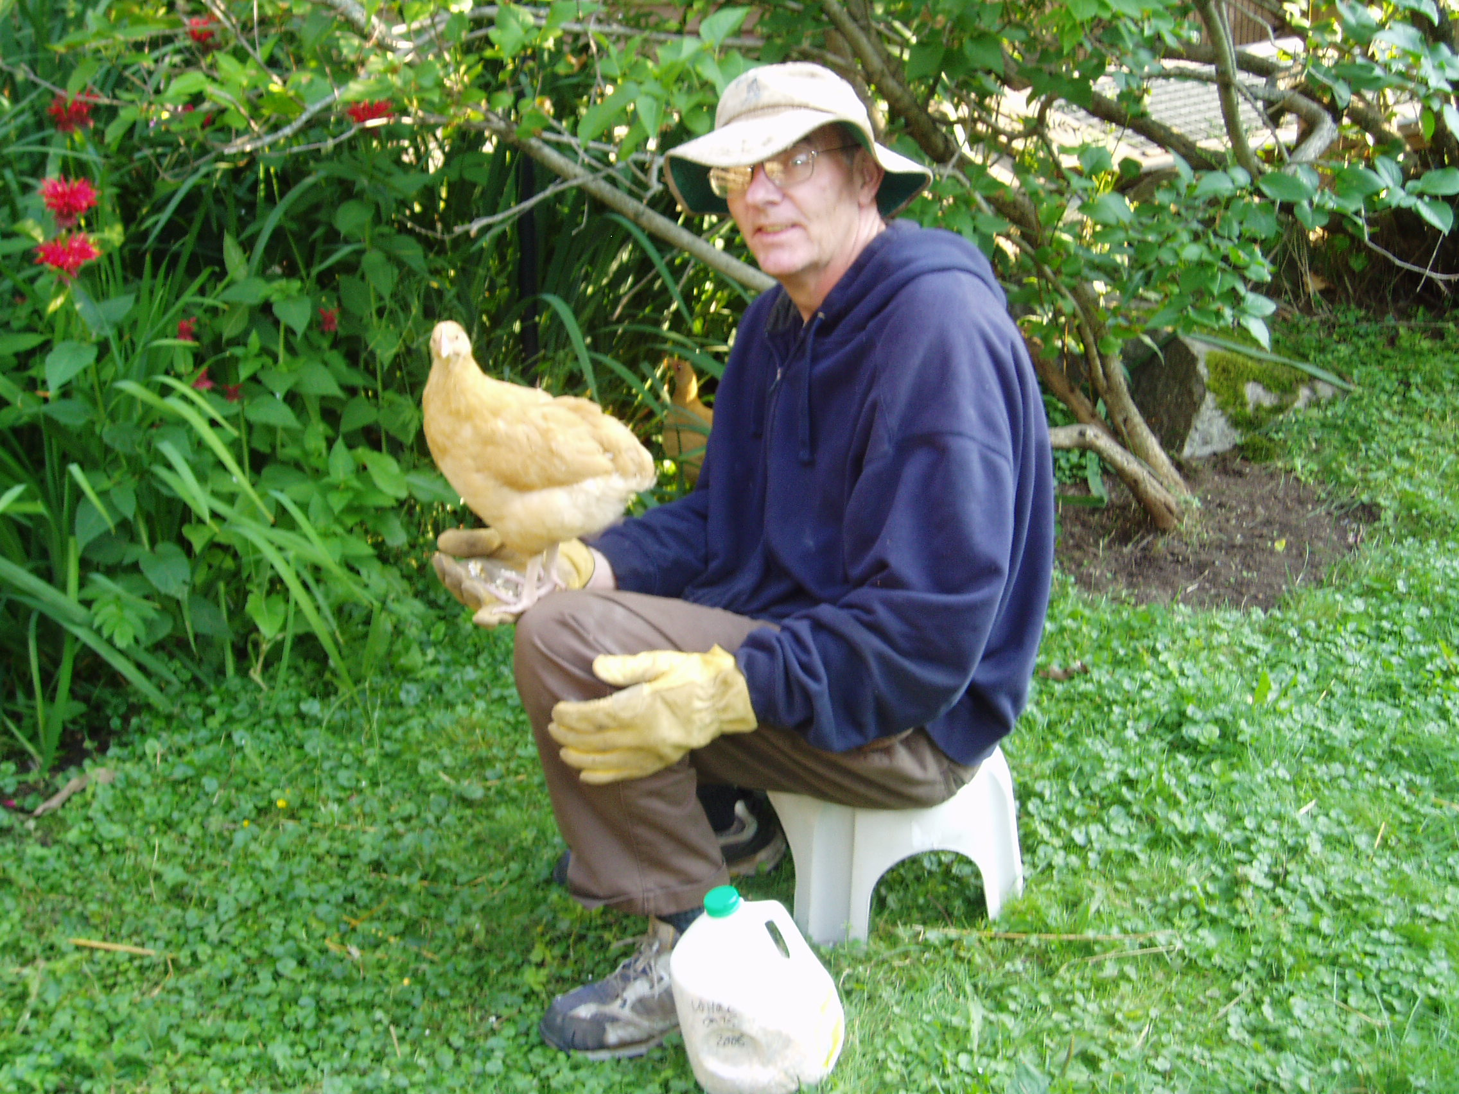

Slide 78
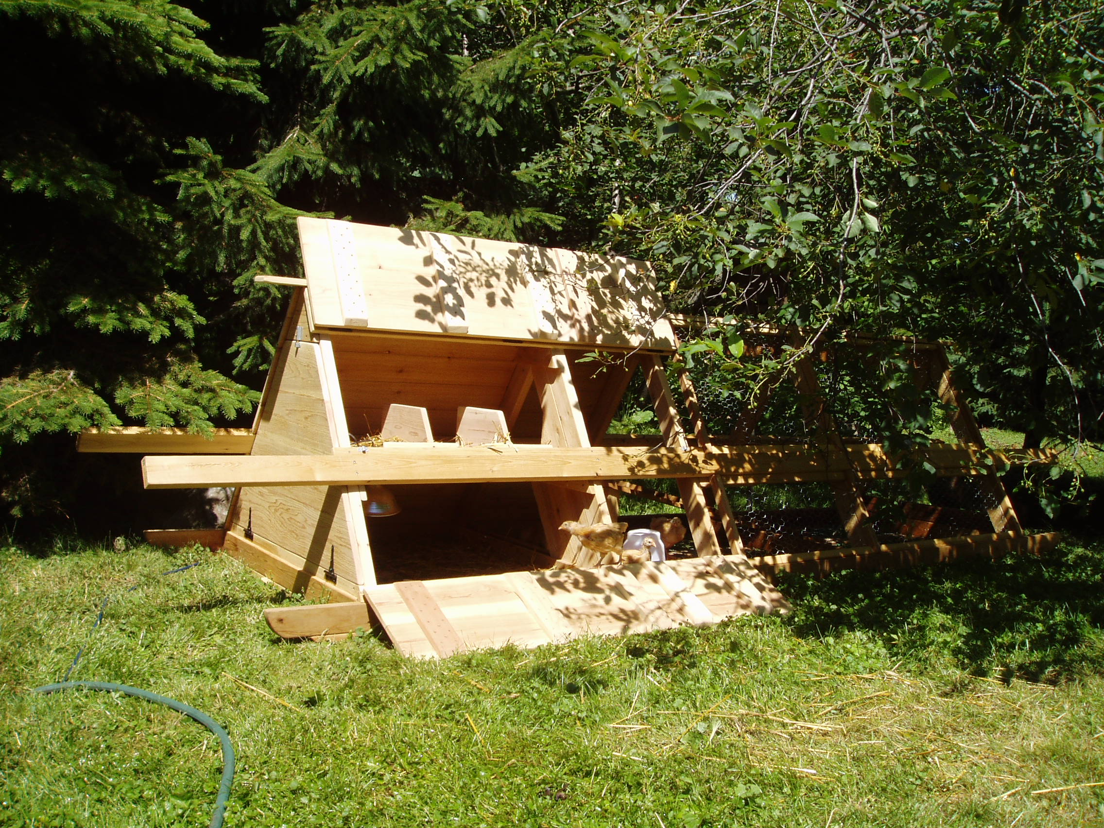

Slide 79
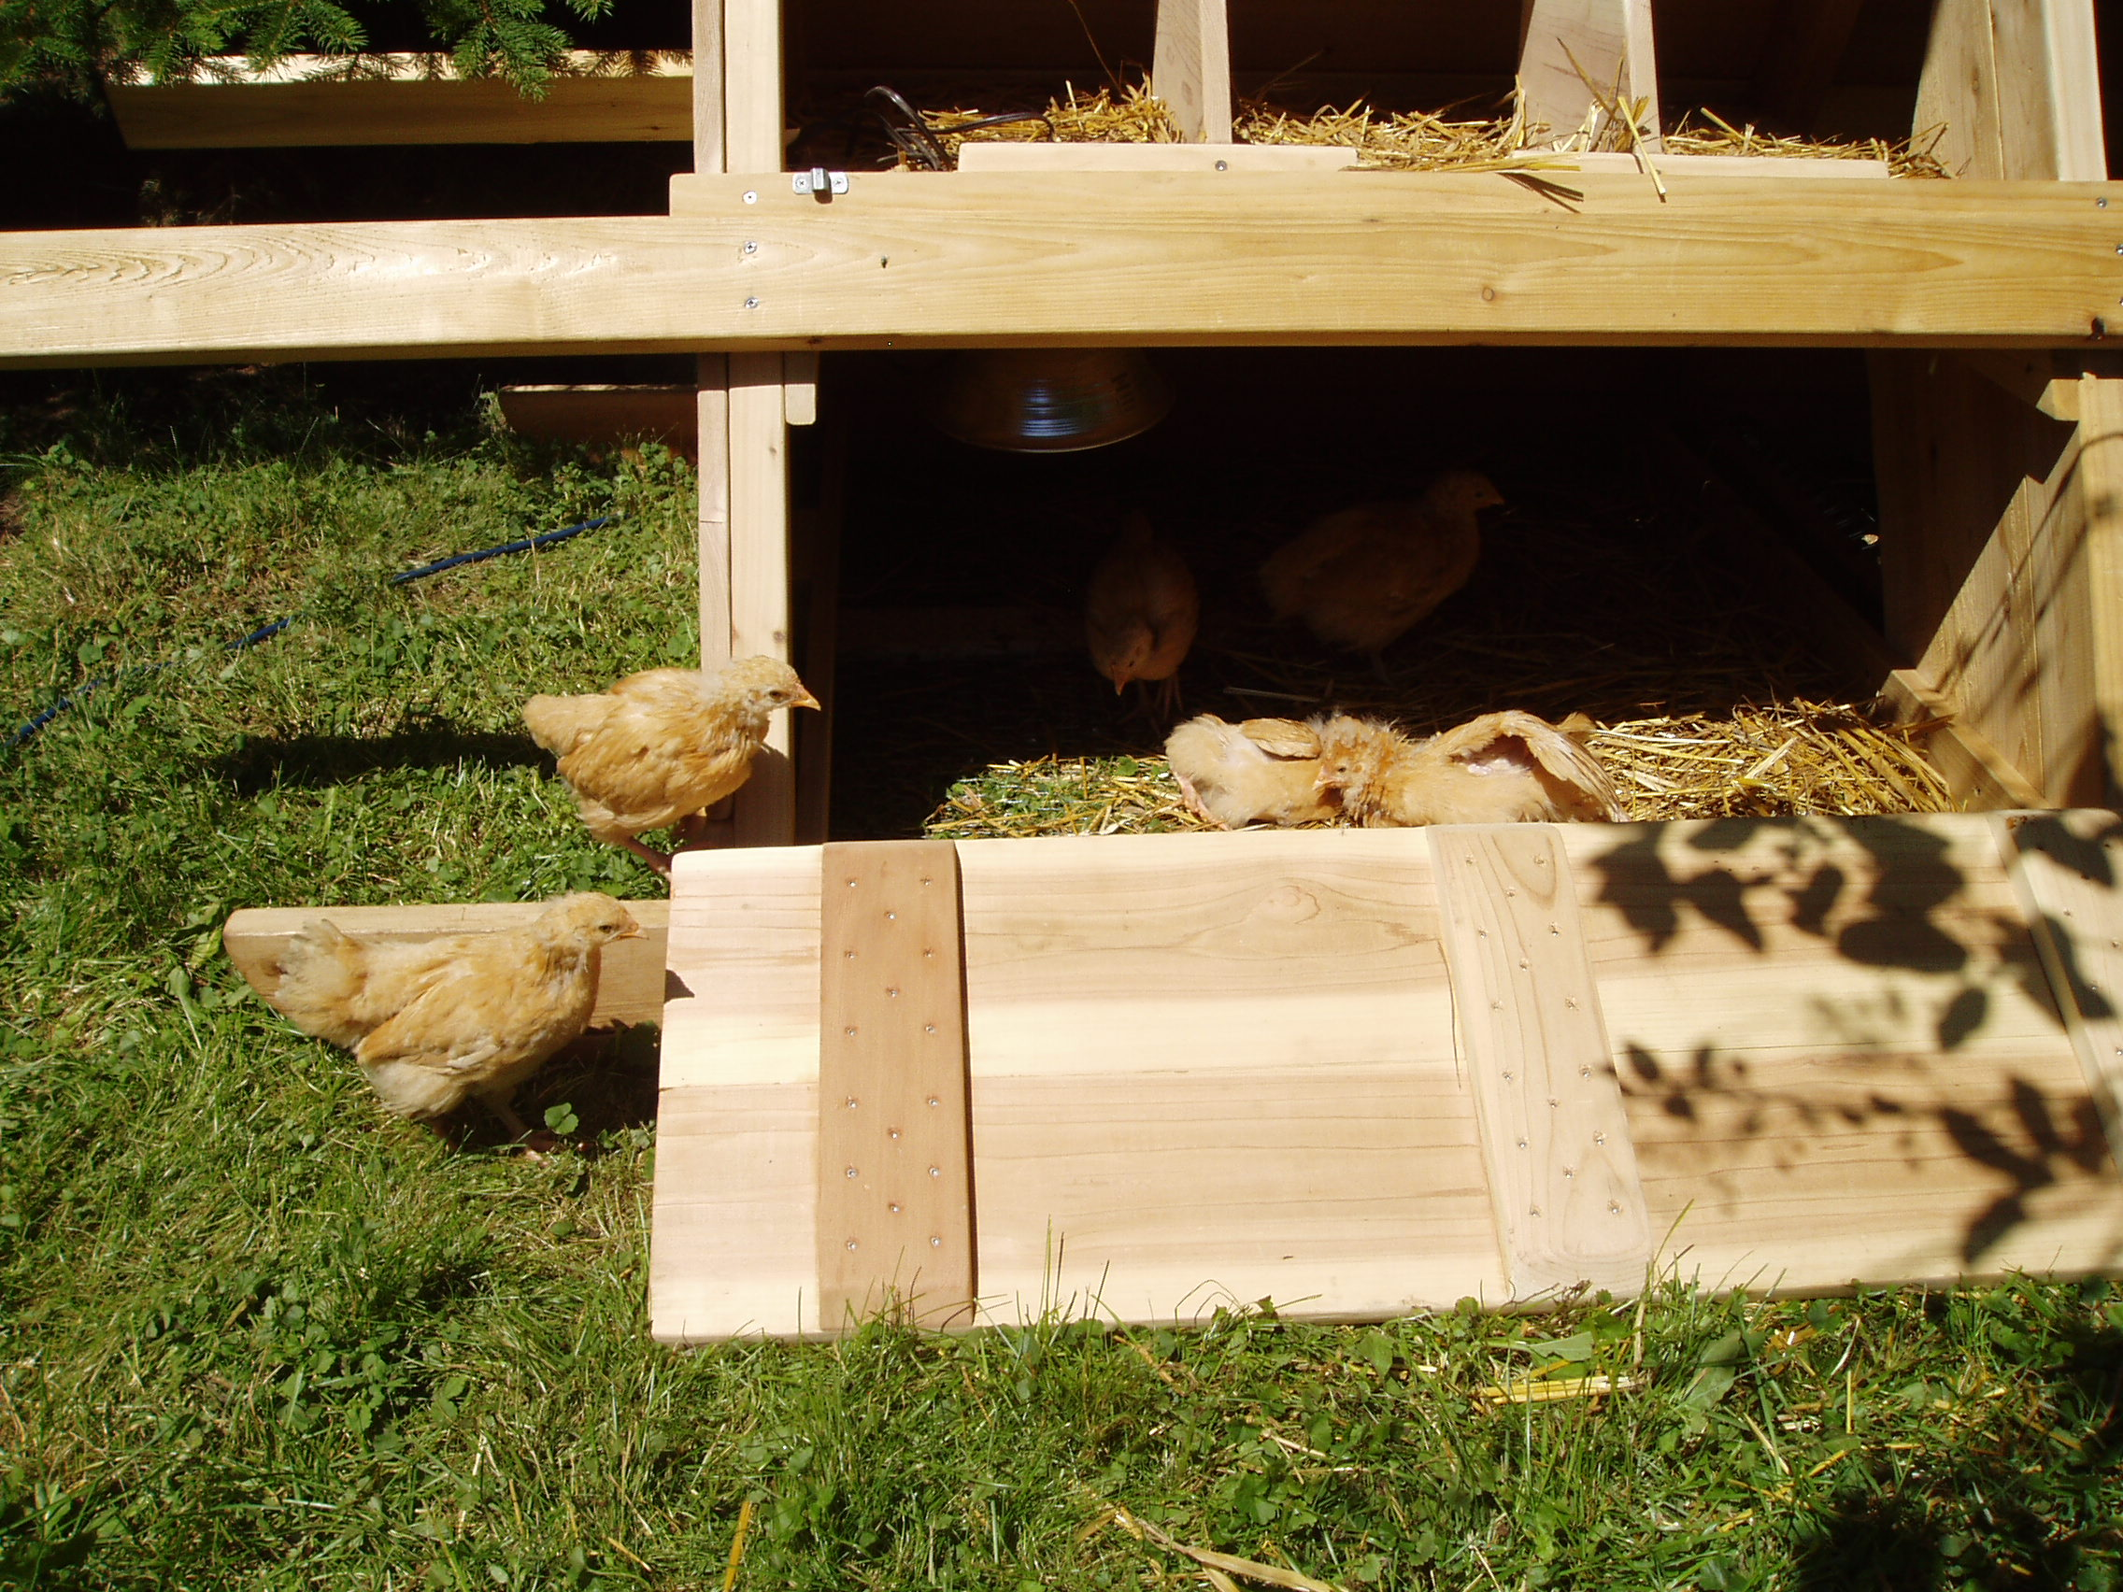

Slide 80
EVERYBODY seemed to like the chickens
Even Duncan . . .

Slide 81
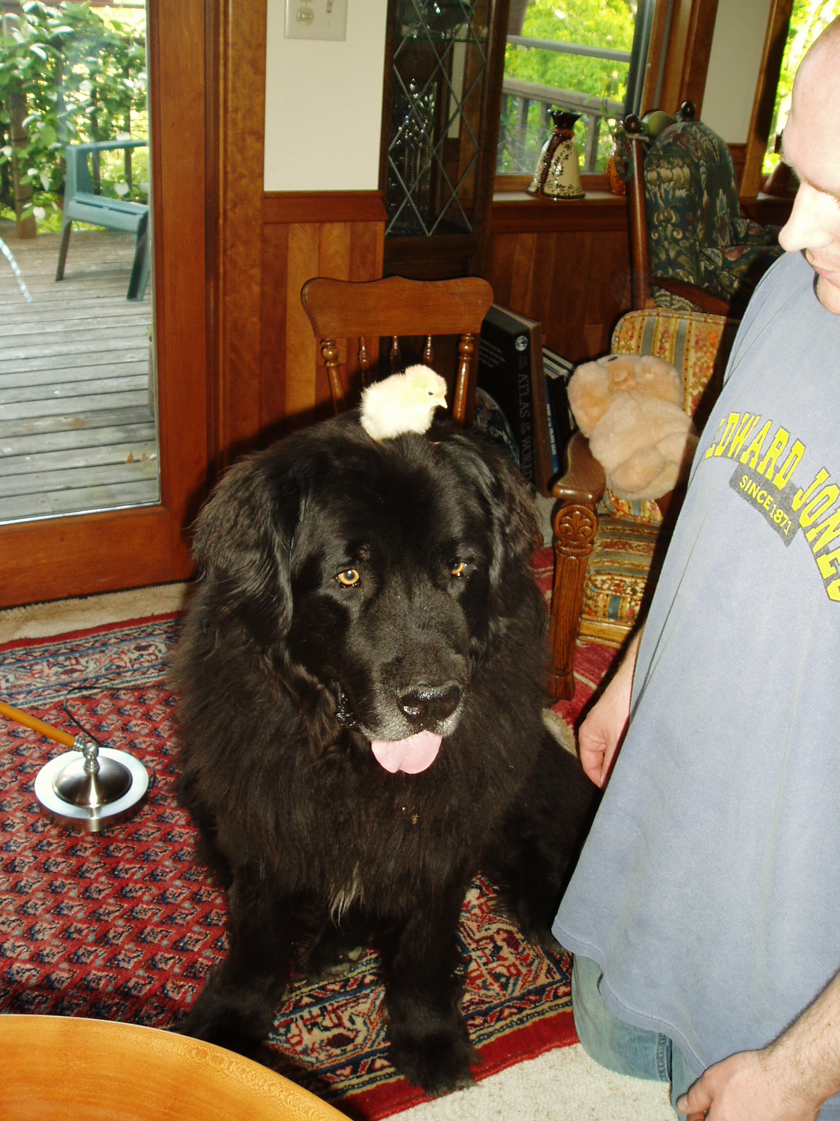

Slide 82
Duncan is pretty good at protecting people,
but he was NOWHERE in sight
the day the cougar came by
to check things out . . .

Slide 83
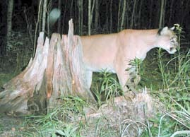
Duluth News Tribune
(Thursday, October 11, 2007, pp. A1, A5)

Slide 84
I have to say, to be honest about it, that although the cougar was a stunningly beautiful animal . . .
it scared the living cr.. right out of me
when I looked up
and it was looking me in the eye
from about twenty feet away
But it must not have liked the little anthropology stories that I was telling it because it hasn’t been back, and it’s been six or so years now since the first visit

Slide 85
But lots of other animals make up for it . . .
including a nice pair of greenhead mallards that stop by every once in awhile in the spring
and the raccoon.
But the fox, well, the fox got a chicken. It was a sad day all around the neighborhood. It took the chicken as I was working on a new chicken house door—not forty feet away. It’s indeed a sly fox, but a sly fox without the least bit of fear of humans.
But enough . . . on to more pleasant things.

Slide 86
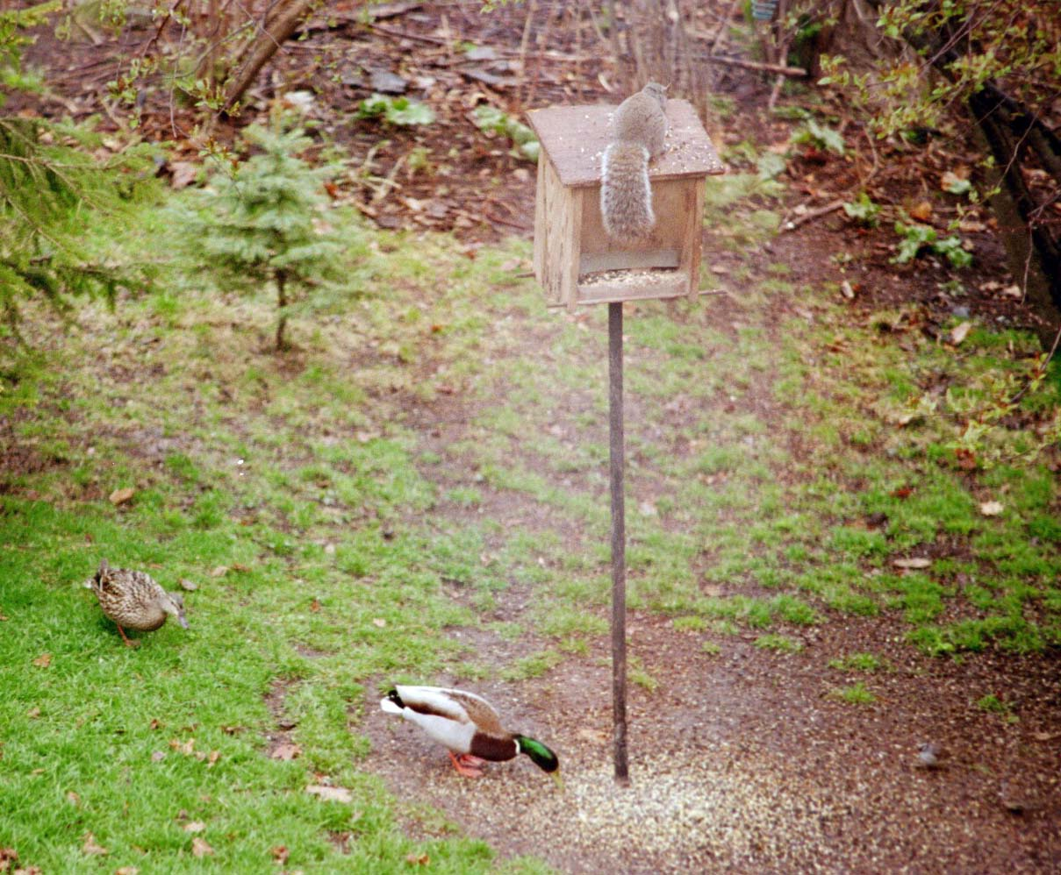

Slide 87
Duncan had a great life . . .
but then walked on over
“the rainbow bridge” . . .
www.d.umn.edu/cla/faculty/troufs/anth1602/pcoven.html#title

Slide 88
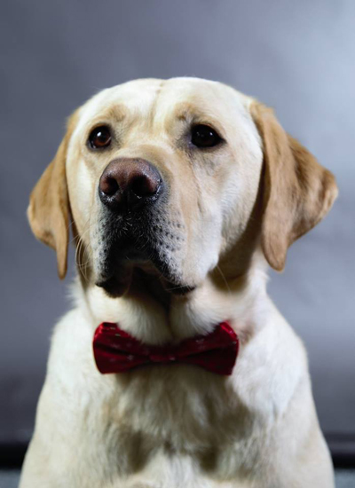

Bentley, who you will meet later on,
is now the UMD Tau Kappa Epsilon "Chapter Good Boy"

Slide 89
Everyone who knew Duncan still misses him . . .
(like I still miss my “Poochie”. But more on that later.)
And lots of other animals make up for it . . .
including a nice pair of greenhead mallards that stop by every once in awhile in the spring
and the raccoon . . .

Slide 90
But the fox, well, the fox got a chicken . . .
It was a sad day all around the neighborhood. It took the chicken as I was working on a new chicken house door—not forty feet away. It’s indeed a sly fox, but a sly fox without the least bit of fear of humans.
But enough . . . on to more pleasant things.

Slide 91
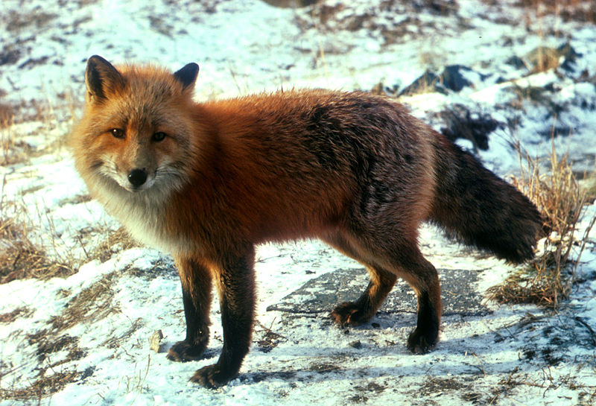
Wikipedia

Slide 92
But the fox, well, the fox got a chicken
It was a big-sad day all around the neighborhood
The fox took the chicken as I was working on a new chicken house door—not forty feet away
It’s indeed a sly fox . . .
but a sly fox without the least bit of fear of humans
But enough . . . on to more pleasant things

Slide 93
But the fox, well, the fox got a chicken
It was a big-sad day all around the neighborhood
The fox took the chicken as I was working on a new chicken house door—not forty feet away
It’s indeed a sly fox . . .
but a sly fox without the least bit of fear of humans
But enough! . . . on to more pleasant things

Slide 94
FAQs
Where did you grow up?
Where did you go to school?
How long have you been at UMD?
What are your favorite things to do?
How did you get into anthropology?
Where have you been?
            What are your pet peeves?

Slide 95
I grew up in Winsted, Minnesota, in the valley of the
Jolly . . .

Slide 96


Slide 97
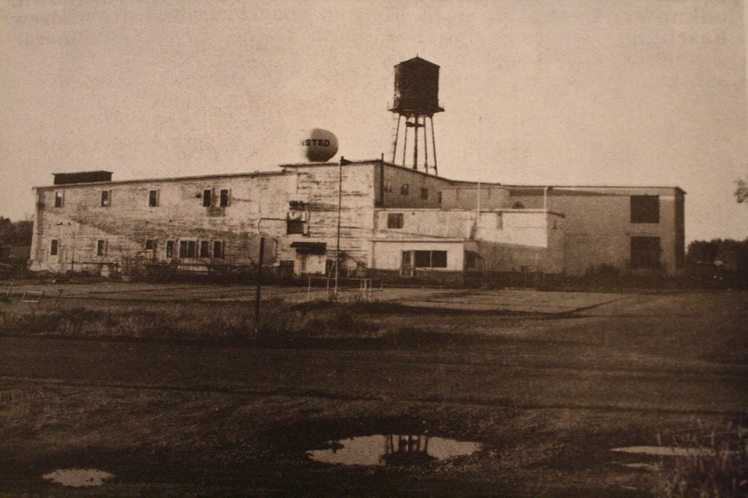
Green Giant Company Shortly Before it was Razed
Winsted, MN

Slide 98
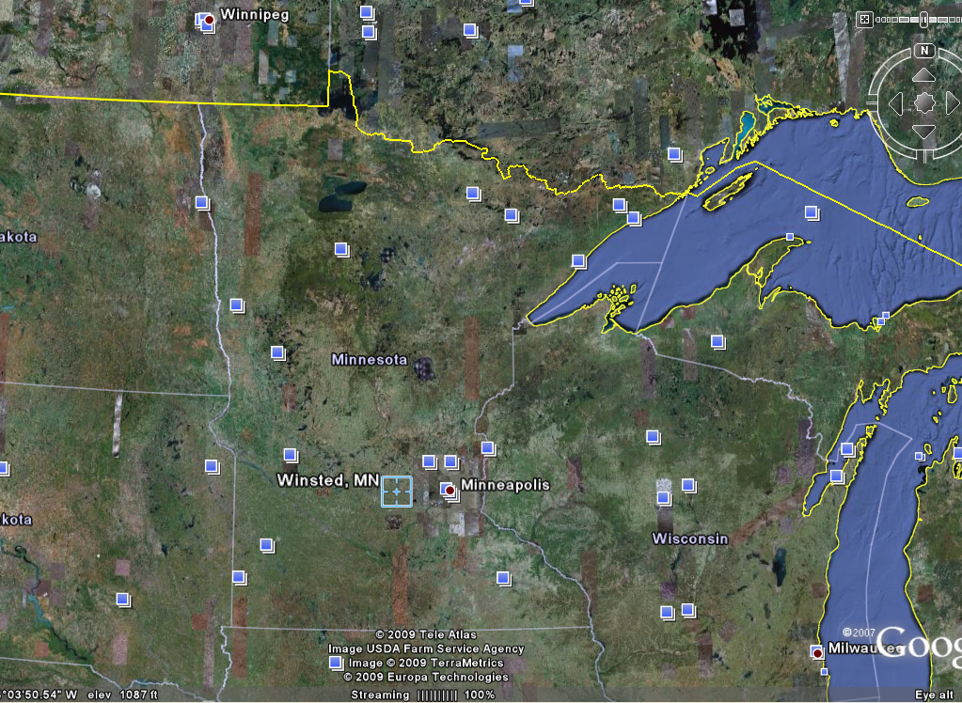

Slide 99
Winsted was a wonderful place to grow up,
except that I had a little problem once in awhile
with the adults,
especially my grandmother who loved me dearly
When I was growing up the Green Giant had a canning factory in Winsted,
where they canned their #1 “Niblets” corn . . .

Slide 100
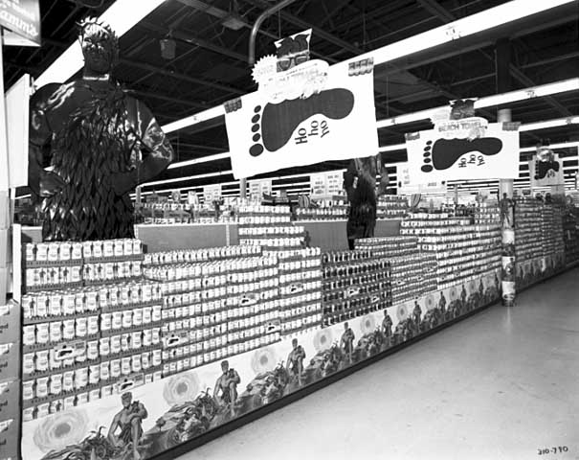
Green Giant display of canned goods in a grocery store
Photographer: Norton & Peel
Photograph Collection 1969
Location no. Norton & Peel 310790
Negative no. NP310790
http://collections.mnhs.org/visualresources/search.cfm?bhcp=1

Slide 101
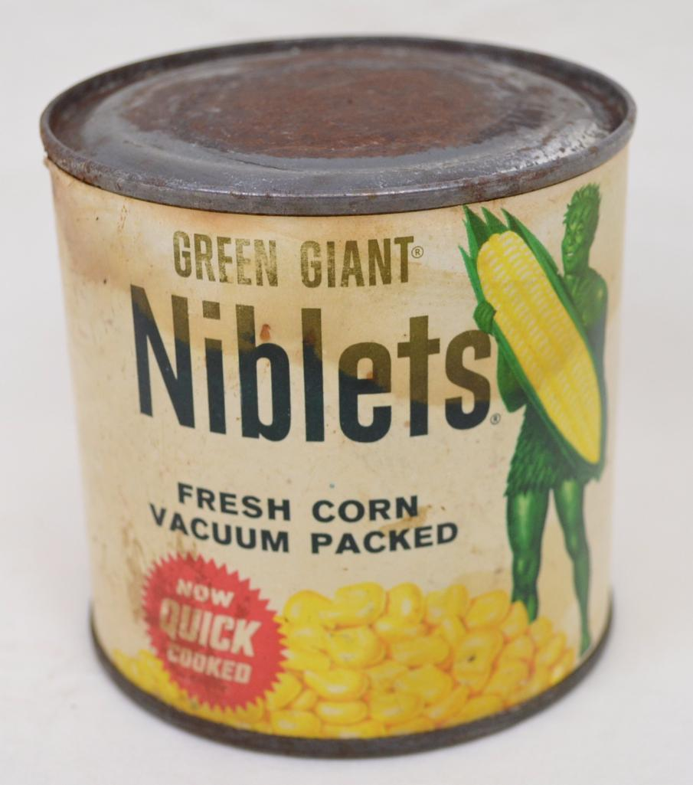
1960s Green Giant Niblets

Slide 102
In high school I worked seasonally at the Winsted Green Giant company, where they produced their high-end "Niblets" canned corn. I usually worked on the "boxer", where finished cans of corn were put in in the cardboard boxes. One interesting aspect of that, a lesson that influenced many of the food purchases for the rest of my life, was that during the seasonal "run" we boxed the cans without labels. The unsealed boxes were then stored, unsealed.
Two men were year-round employees in charge of putting labels on the cans as the orders came in for the canned corn. Yes, supermarket chains would purchase the corn and the plant would then put their labels on the cans. And, of course, in the stores the price of the corn varied, with the cans carrying the Green Giant "Niblets" label having the highest price.

Slide 103
Another interesting item learned, with life-long effect, has to do with the "Niblets belt". The Winsted plant had a step in the canning process where ladies (they were all ladies for that task) would sit on either side of two wide conveyor belts holding an empty corn can and pick out worms, and other "things". They were paid low wages but received a 5-cents bonus for each worm and other "things" that they picked from the belt. The Green Giant plant at Glencoe canned "cream style corn". They did not have a "Niblets belt".

Slide 104
One other interesting food-related influence early on was Betty Crocker. One of the original "Betty Crockers" was a good friend of both my family and Kim's family. "Betty Crocker" was a fictional character created by the company that became known as General Mills, headquartered in Golden Valley, Minnesota. "Betty Crocker" is still alive and well, the fictitious used by General Mills, not our family friend. She turned a hundred in 2021.

Slide 105
Back to the Jolly Green Giant . . .
1960s Green Giant Niblets

Slide 106
Those were the days before mechanical corn pickers, and to pick corn the Jolly Green Giant imported people “from Jamaica”
I didn’t have the foggiest idea where Jamaica might be (I was only in the second grade when I started to take notice of all of this)
but I knew Jamaica must be pretty far away as they Jamaicans didn’t look like anybody local . . .

Slide 107
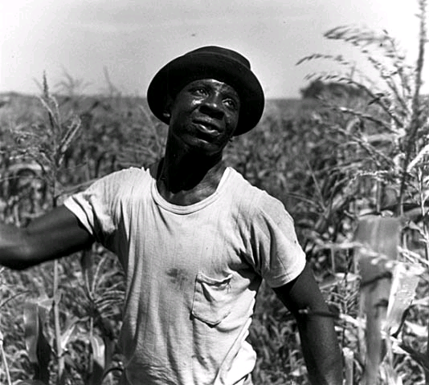
Minnesota Historical Society
Visual Resources Database
Migrant, Green Giant, LeSueur, Minn. 1953
Location no. AV1988.151.12
Photographer: Jerome Liebling
Fine Art Photo Collection 1953
http://collections.mnhs.org/visualresources/search.cfm?bhcp=1

Slide 108
And this is where I got my start in Anthropology . . .
in the 2nd Grade . . .
Remember?
American Anthropology is Four-Fold:
Cultural Anthropology
Physical Anthropology
Archaeology
Linguistics

Slide 109
And this is where I got my start in Anthropology . . .
in the 2nd Grade . . .
Remember?
American Anthropology is Four-Fold:
Cultural Anthropology
Physical Anthropology
Archaeology
Linguistics

Slide 110
My cultural career in Cultural Anthropology began when my grandmother
backed up by lots of other adults
said that I shouldn't talk to the Jamaicans
“because they kidnap little boys”
Now I was only in the 2nd grade
so it didn’t occur to me that there were no little boys missing in Winsted . . .

Slide 111
I lived about the length of a football field
from the city park
which was on the lake
and that was where
most of the Jamaicans
came at evening to cool off . . .

Slide 112
They came down by the lake because they only had little shacks to live in, with only a little light bulb in the room and not much of anything else
And it was really hot in those little shacks
I don’t remember too many details of the shacks as they existed at the time, but after the mechanical corn pickers arrived on the scene in Winsted the father of a girl in my class bought two of those little shacks and moved them to another lake and made a little cabin out of them
It was a popular place for lots of folks, especially high school students;
and by then we were sophomores in high school and could appreciate a cabin on the lake even if it didn’t have a lot of things, like running water, at first

Slide 113
So anyway, the Jamaican corn pickers
came down by the lake
right close to where I lived, to cool off
and to sing, and to tell stories, and to laugh, and to have lunch
The next picture is an aerial photo of the Winsted Lake (actually, technically, Lake Eleanor, but nobody called it that, and most probably didn’t even know that it was “supposed” to be Lake Eleanor)
and the yellow arrow is where the
Jamaican corn pickers would spend their evenings . . .
and the green arrow is where I lived . . .

Slide 114
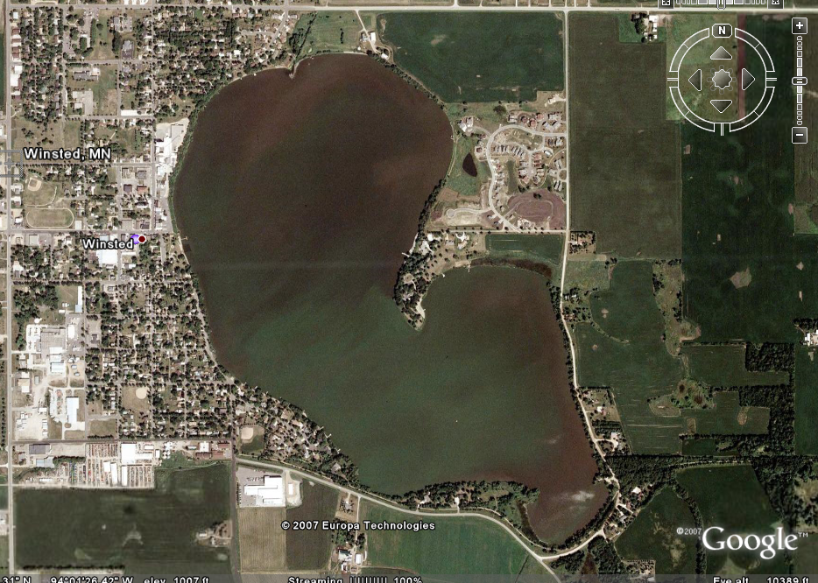
“archaeology” …

Slide 115
So anyway, you can see how it was almost inevitable that a curious young second-grader would sneak down and peek through the bushes
to see what these guys were up to
EVEN THOUGH that meant possibly being kidnapped

Slide 116
I wasn’t sure what kidnappers looked like, exactly,
but after watching the Jamaican corn pickers
for a long long time
when they weren’t picking corn
it slowly began to seem to me that these people
that the adults told us never to talk to
were actually pretty much like real human beings

Slide 117
Well you know how it is with 2nd grade boys,
and before I knew it I was actually talking with them
I don’t remember exactly the first one I talked with,
but it was probably one of them who was going to the bathroom near the bushes that I used to hide behind
Anyway, eventually I just went over and joined them
I really liked to hear them sing
(And this was long before Harry Belefonte was singing “Day-O”
[“Jamaica Farewell”]
—at least long before he was singing it in Winsted, MN.)

Slide 118
I got to know the Jamaican corn pickers about as well as any young boy could know an adult.
I loved to hear them sing,
and talk and laugh with one another
I went there—snuck down there—for several years, during the “corn pack” (aka “the pack”) in the fall
But you can see, I really had a big problem
Years later I learned in Introduction to Psychology as a sophomore at Notre Dame University that I had been experiencing what is called “cognitive dissonance”

Slide 119
I got to know the Jamaican corn pickers about as well as any young boy could know an adult.
I loved to hear them sing,
and talk and laugh with one another
I went there—snuck down there—for several years, during the “corn pack” (aka “the pack”) in the fall
But you can see, I really had a big problem
Years later I learned in Introduction to Psychology as a sophomore at Notre Dame University that I had been experiencing what is called “cognitive dissonance”

Slide 120
But chances are that even if I had known I was experiencing “cognitive dissonance,”
at that time, in 1950,
I wouldn't really have understood what it meant
What I did understand, even in the 2nd and 3rd grades, was that I had a big problem
—and that was that I was beginning to see that what my grandmother and her friends were telling me
wasn’t true
but that I couldn’t tell them it wasn’t true because I wasn’t supposed to be down there in the city park talking to “the Jamaicans” to know about it

Slide 121
One time, in the 3rd grade, I had one of those life-changing experiences. Probably my first, I don’t know.
I remember one of the Jamaican men talking to me about his “boy” “back home.”
I still had no idea where “back home” was,
but I knew that it must be at least someplace on the other side of Minneapolis.
I remember the man telling me about his boy,
and about how I reminded him of his son.
After a little bit of that he started to cry.

Slide 122
One time, in the 3rd grade, I had one of those life-changing experiences. Probably my first, I don’t know.
I remember one of the Jamaican men talking to me about his “boy” “back home.”
I still had no idea where “back home” was,
but I knew that it must be at least someplace on the other side of Minneapolis
I remember the man telling me about his boy,
and about how I reminded him of his son
After a little bit of that he started to cry.

Slide 123
That was the first adult male I ever saw cry
—other than my father who cried a lot
when my sister died
when she was just a day old
And everybody cried about that

Slide 124
Even at that young age I concluded that a man that cries like Mr. Jamaica isn’t going to kidnap anybody, and especially not anyone that reminds him of his son
(I know now that that was faulty logic,
the part about “especially not anyone that reminds him of his son.)
Literally from that day onward, every time I heard one of the adults say we shouldn’t talk with the Jamaicans because they would kidnap us or “who knows what” (and we kids didn’t know exactly “what” was “who knows what” in those days,
at least not in Winsted, but in retrospect, the adults probably did)
I thought . . .
“When I grow up I’m going to tell them what the Jamaicans are really like. They’re nice.”

Slide 125
Even at that young age I concluded that a man that cries like Mr. Jamaica isn’t going to kidnap anybody, and especially not anyone that reminds him of his son
(I know now that that was faulty logic,
the part about “especially not anyone that reminds him of his son.)
Literally from that day onward, every time I heard one of the adults say we shouldn’t talk with the Jamaicans because they would kidnap us or “who knows what” (and we kids didn’t know exactly “what” was “who knows what” in those days,
at least not in Winsted, but in retrospect, the adults probably did)
I thought . . .
“When I grow up I’m going to tell them what the Jamaicans are really like. They’re nice.”

Slide 126
But I was afraid to say that because then my grandmother and the other adults would know that I had been disobedient
And since 2nd graders didn’t go to Confession in those days, I was pretty much stuck with my big secret of knowing that what the adults were saying about the Jamaicans wasn’t true, but not being able to say it
I was in a real double bind!

Slide 127
But I was afraid to say that because then my grandmother and the other adults would know that I had been disobedient
And since 2nd graders didn’t go to Confession in those days, I was pretty much stuck with my big secret of knowing that what the adults were saying about the Jamaicans wasn’t true, but not being able to say it
I was in a real double bind!

Slide 128
By the time I was in the 3rd grade, I knew that when I grew up I was going to tell people that the Jamaicans were just like everybody else— that they laughed, they cried (even the MEN), they sang, they told stories, they kidded one another . . . and they even peed in the bushes like the Winsted menfolk did when they went hunting and fishing
And I thought that even though I still didn’t know at that time where Jamaica was

Slide 129
And, of course, I had no idea what anthropology was, or even that there were adults who had a job where they could tell others about how other people were humans too

Slide 130
Now it was also with the Jamaicans that I got my start as a “Physical Anthropologist”
REM: American Anthropology is Four-Fold:
Cultural Anthropology
Physical Anthropology
Archaeology
Linguistics

Slide 131
Now it was also with the Jamaicans that I got my start as a “Physical Anthropologist”
REM: American Anthropology is Four-Fold:
Cultural Anthropology
Physical Anthropology
Archaeology
Linguistics

Slide 132
One time I was down in the city park sitting with the Jamaicans in the shade of the old wooden bandstand that was there, not too far from the lake,
listening to the men sing
It was wonderful
And as they sang I remember wondering what that fuzzy hair they had felt like
I had often wondered that before, by this time, but I recall it was at that time when they were all singing and eating some kind of luncheon meat on plain crackers
(I loved plain crackers as a young boy)
that I asked one of them if I could feel his fuzzy hair

Slide 133
He more or less hollared out something like,
“D’ja hear that? Timmy wants to feel my hair?”
And I remember they all laughed out loud
and that I wished I hadn’t asked
But then he stood up, tall, took off his hat, and made a big bow and said it would be OK
And I felt his hair
It felt funny
And I felt funny
Scared . . . actually

Slide 134
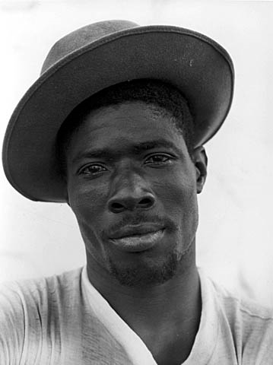
Minnesota Historical Society
Visual Resources Database
Migrant, Green Giant, LeSueur, Minn. 1953
Location no. AV1988.151.12
Photographer: Jerome Liebling
Fine Art Photo Collection 1953
http://collections.mnhs.org/visualresources/search.cfm?bhcp=1

Slide 135
But then they all started laughing some more
And I remember several of them took off their hats
and put their heads down
and called me over to feel their hair

Slide 136
Those are the specific things and times that I remember, but I also remember this general feeling of whatever sadness is to a grade school kid anytime I heard an adult say bad things about my friends
And when I ever felt that way I knew that when I grew up I would be able to explain to people how nice the Jamaicans really were

Slide 137
Yes, I remember thinking even then
that when I grew up
I was going to tell everybody about how nice the Jamaicans are,
and as a “participant-observer” (of sorts)
I felt pretty confident that they would listen

Slide 138
And, in a sense, my “career” in anthropology was launched,
and several events and situations
in subsequent years built upon that wonderful foundation set forever
by the shores of “Winsted Lake”
And, I thought,
“If I ever get to Minneapolis
(which on a really dark night we could see faintly glowing in the skies behind “The Point” of Winsted Lake)
I’m going to find out just where Jamaica is.”

Slide 139
And, in a sense, my “career” in anthropology was launched,
and several events and situations
in subsequent years built upon that wonderful foundation set forever
by the shores of “Winsted Lake”
And, I thought,
“If I ever get to Minneapolis
(which on a really dark night we could see faintly glowing in the skies behind “The Point” of Winsted Lake)
I’m going to find out just where Jamaica is”

Slide 140
It wasn’t only the Jamaicans that
some people in Winsted said bad things about
They also said things about
“The Gypsies”
We had what the adults always called “The Gypsies” come to town with the Carnival,
for “Winsted Homecoming Days” in those days

Slide 141
And once in awhile, at other times of the year,
“The Gypsies are in Town”
would spread faster than the “Gypsies” themselves
as they went from door to door selling wooden outdoor furniture
I don’t know much about the people selling furniture
—probably hand-made woven willow furniture—
but I do know a lot about “The Gypsies” who came to town with “The Carnival”

Slide 142
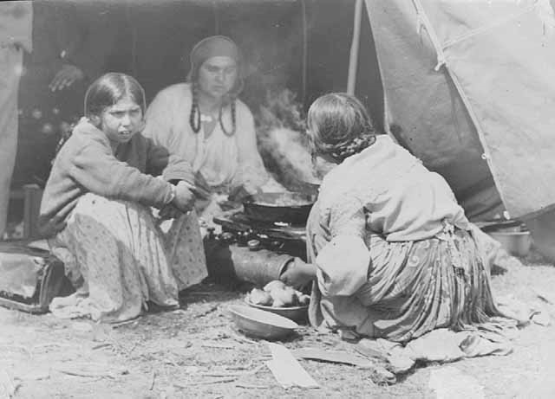
Minnesota Historical Society
Visual Resources Database
Scene in a gypsy camp, Jefferson Highway.
Photograph Collection 1933
Location no. GT3.19 r4
Negative no. 88510
http://collections.mnhs.org/visualresources/search.cfm?bhcp=1

Slide 143
And I know about them for the very same reason I know about the Jamaicans . . .
I used to sneak out and talk with them
I used to sneak down to where they were “setting up” [the carnival rides] and talk with them,
and with the families that lived in little trailers that travelled with “The Carnival”

Slide 144
“The Gypsies”
—as I remember—
weren’t as gentle as the Jamaicans,
and they didn’t sing, and joke,
and things like the Jamaicans,
but in retrospect that was probably because when I was down watching them “set up” they were working, not relaxing after work
But I don’t really know; that’s just a guess

Slide 145
I was older then, too. I was in the 3rd grade, but I talked with them even in the 4th grade
I remember the “Gypsy” moms and grandmothers looking after their children like my mom and grandmother did
—and I can only now imagine what “The Gypsy” grandmothers were telling their grandchildren about us . . .

Slide 146
I remember less about the people with “The Carnival”
I didn’t spend as much time there as with the Jamaicans by the lake. And they were only in town for a week or two
And they also spoke in a way that I couldn’t understand much of what they were saying

Slide 147
But I do remember that one of “The Gypsy” girls about my age was very kind . . .
and kind of cute,
or as cute as a girl can be to a 3rd grader
AND I remember she took my hand, right there by the concession stand of the little league ball park, and told my fortune
For free
I don’t remember what she said the future would bring

Slide 148
And, of course, I didn’t know ‘till college that they weren’t and didn’t want to be “Gypsies”
I didn’t know that until I left Winsted
I didn’t know that they were, and wanted to be . . .
“The Romani”

Slide 149
But my future in archaeology was clearer
Crystal-ball clear . . .
I was older at the time
But I was still in 3rd grade.

Slide 150
But my future in archaeology was clearer
Crystal-ball clear . . .
I was older at the time
But I was still in 3rd grade

Slide 151
My career in Archaeology,
the third of the four-fold disciplines
of American Anthropology,
began precisely on . . .

Slide 152
The early years . . .
“archaeology”
Good Friday
1952
at about
10:30 a.m.

Slide 153
The early years . . .
“archaeology”
Good Friday
1952
at about
10:30 a.m.

Slide 154
The reason that I remember that my
“Archaeological career” began about 10:30 a.m. on Good Friday in 1952 had to do with local customs . . .
Winsted was a German Catholic village at the time, and EVERYONE was expected to go to Church from 12:00 noon until 3:00 p.m. on Good Friday

Slide 155
In 1952 I was old enough to figure out that not everyone in Winsted could fit in the Catholic Church
(My father’s mother—a very kind, quiet woman who was in fact one of the town’s grandmas, and the whole town called here “Grandma Roufs”—was one of the very few people in town who were not Catholic, in 1952, so it was easy to see that with “the whole town Catholic,” the people of the town simply wouldn’t fit in the Church)
I honestly don’t remember if I or my good friend Bruce Fasching figured that out, but one of us did, and we essentially reasoned that since the whole town wouldn’t fit in the Church for the three-hour Good Friday service,
it might as well be us who were among those who couldn’t fit in

Slide 156
So, needing some place to go (or to hide out?) we decided to “dig for Indian graves”
over at “Old Man Littfin’s” farm
Now one might think that is sort of a wild thing to for two 3rd graders to be thinking of,
but it wasn’t—at least in Winsted
“Old Man Littfin” (whose title, by the was a term of endearment, and well-liked—sort of the male version of “Grandma Roufs”) had a private museum of “Indian relics” that he picked up on his farm while plowing. Eventually his granddaughter gave several five-gallon pails of arrowheads, for e.g., to the McLeod County Historical Society in Hutchinson

Slide 157
And over at the
McLeod County Historical Society
in Hutchinson those items are still known as
“The Littfin Collection”

Slide 158
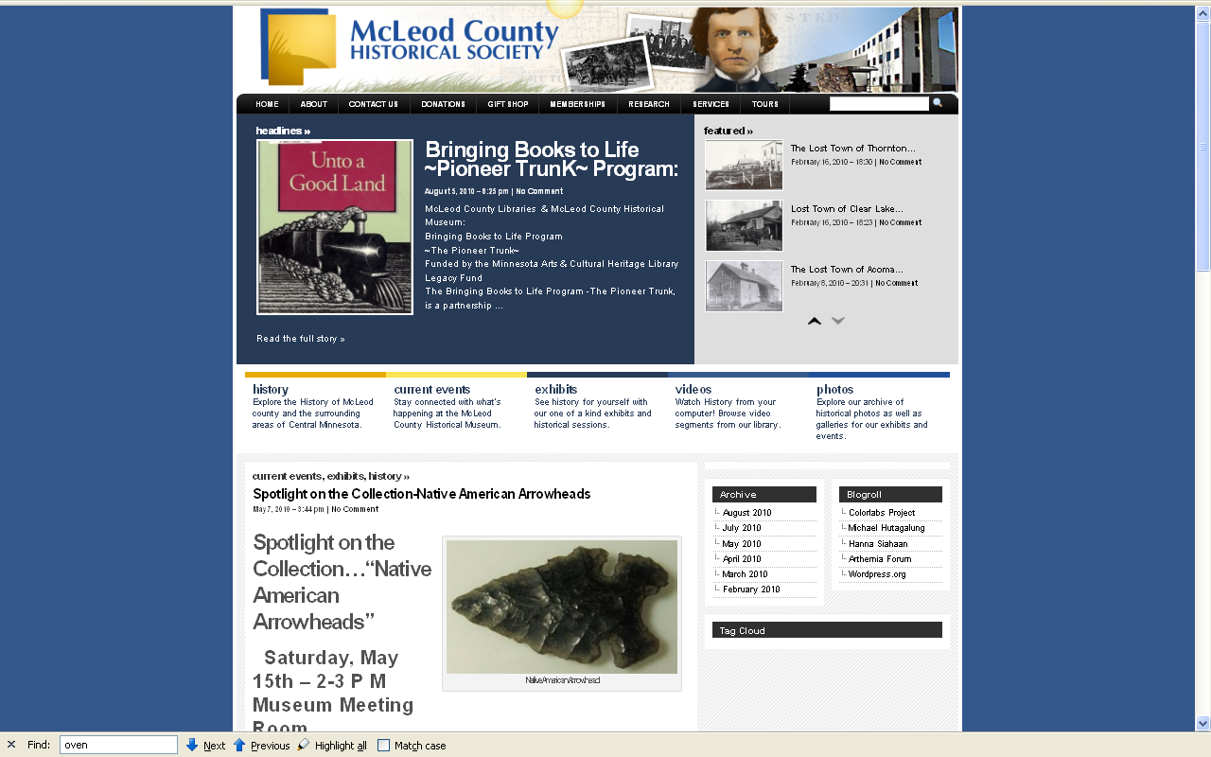
http://www.mcleodhistory.org/

Slide 159
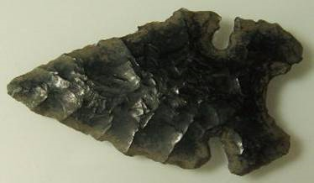
And Old Man Littfin’s farm was the “place to go” to look for arrowheads, anytime, but especially in the spring when he was plowing the fields and when they were percolating up
His farm was on the site of a Lakotah Village. And my oldest cousins told of how they remember the old people in town talking about the last Indian people who lived “on the point.”
http://www.mcleodhistory.org/

Slide 160
And Old Man Littfin’s farm was the “place to go” to look for arrowheads, anytime, but especially in the spring when he was plowing the fields and when they were percolating up
His farm was on the site of a Lakotah Village.
And my oldest cousins even told of how they remember the old people in town
talking about
“the last Indian”
who lived “on the point”

Slide 161
And one of the Indians in everyone’s memory,
if only from local folklore,
was “Chief Little Crow,”
who everyone said “was shot in the back by a farmer while picking berries over by ‘Hutch”’
“Hutch” was Hutchinson, the same place where part of “Old Man Littfin’s” arrowhead collection ended up
And every now and then one would hear the rumor
that Little Crow’s body was on display
someplace in “The Cities”

Slide 162
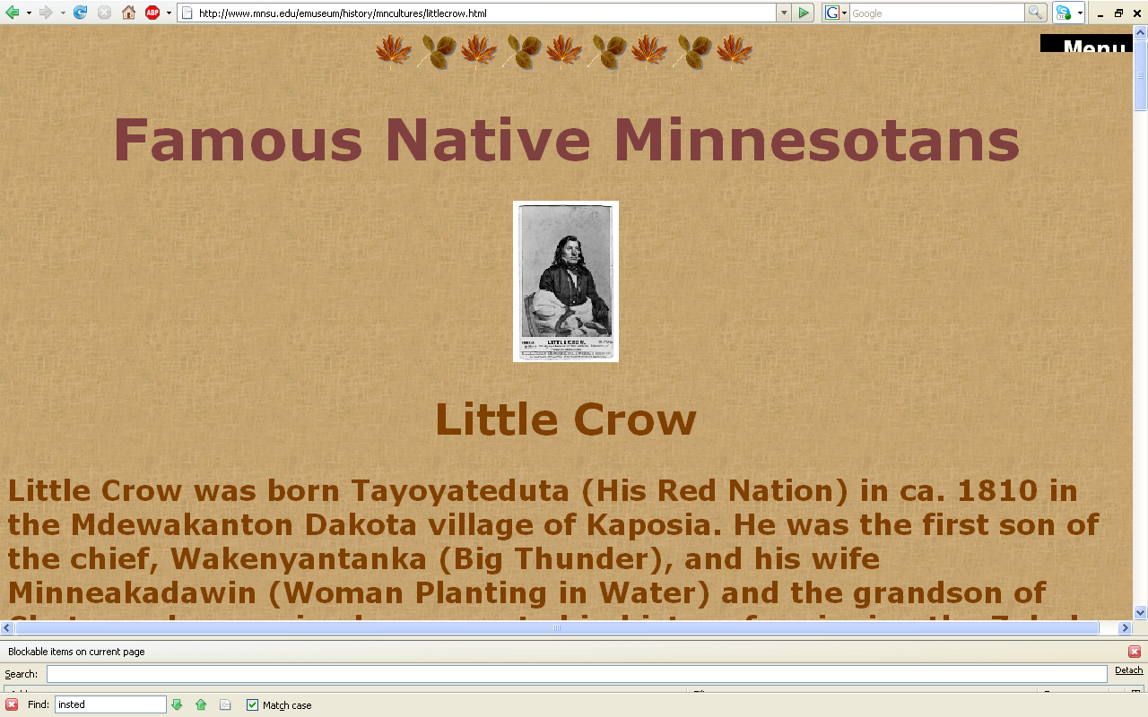
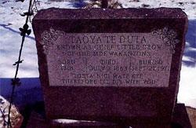
“archaeology” . . .
www.mnsu.edu/emuseum/history/mncultures/littlecrow.html

Slide 163
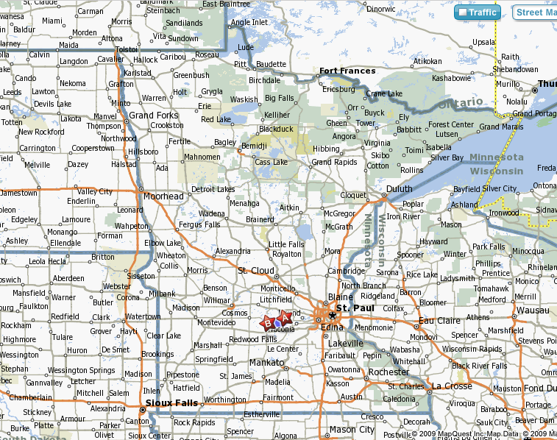
Winsted
Hutchinson

Slide 164
So everyone knew at least about Chief Little Crow,
and, of course everyone knew of the old Indian Village that used to be on “The Point,”
and everyone knew of the really wonderful “Indian artifact” collection of Old Man Littifin
And there was this not-too-often mentioned mystery of where Little Crow’s bones were
And they were someplace on display!

Slide 165
So everyone knew at least about Chief Little Crow,
and, of course everyone knew of the old Indian Village that used to be on “The Point,”
and everyone knew of the really wonderful “Indian artifact” collection of Old Man Littifin
And there was this not-too-often mentioned mystery of where Little Crow’s bones were
And they were someplace on display!

Slide 166
So it was only natural for a couple of 3rd graders who wanted to help ease the overcrowding in church to think about “digging up Indian graves”
(NOTICE: This sort of thing is ILLEGAL nowadays)
So we got a couple of shovels of some kind
and set off for “The Point.”

Slide 167
So it was only natural for a couple of 3rd graders who wanted to help ease the overcrowding in church to think about “digging up Indian graves”
(NOTICE: This sort of thing is ILLEGAL nowadays)
So we got a couple of shovels of some kind
and set off for “The Point”

Slide 168
It hadn’t occurred to us
that at about precisely 3:04
somewhere around 450 people
would be coming out of the overcrowded church
and walking down the front stairs
with a view straight on of . . .
“The Point”
. . . and two little kids digging something

Slide 169
“archaeology” …
“Old Man
Littfin’s”
farm
Church
“The Point”
“Grandma Roufs’”
mother was born
in this little farm
house

Slide 170
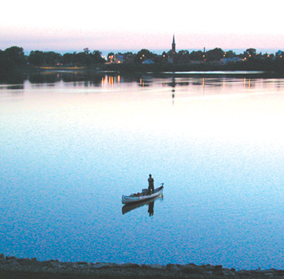
“archaeology” …
Modern-day view
of the church
from “The Point”

Slide 171
And, of course, as is normal in little villages,
it didn’t take long at all before all of the “inquisitive” villagers knew WHO the two little guys were,
and—we were told later, several times a year, for the duration of our days in Winsted—
that “the whole town” was curious
about what we were doing
And we were told—another untruth it turned out—that “the whole town was watching”
In reality it was probably
only about 450 people.

Slide 172
And, of course, as is normal in little villages,
it didn’t take long at all before all of the “inquisitive” villagers knew WHO the two little guys were,
and—we were told later, several times a year, for the duration of our days in Winsted—
that “the whole town” was curious
about what we were doing
And we were told—another untruth it turned out—that “the whole town was watching”
In reality it was probably
only about 450 people

Slide 173
My first two encounters with
Linguistics
—the fourth of the four-fold American Anthropology focus—
was by comparison rather straightforward . . .

Slide 174
The first babysitter that I can remember was Agusta “Gusty” (Karles) Norman. In the years before I was born people generally spoke German in Winsted. When my dad and mom started grade school, Holy Trinity Grade School in Winsted, their books were in German, and some instruction was in German. I still have my dad’s first grade reader, in German. Sermons in church were often in German (or so I was told).
Gusty, a native German speaker, turned out to be my first linguistics teacher. From Gusty I learned my first German poem--when I was quite young, before I could read or write. The poem went something like this (although to this day I’m not sure what the correct spelling might be) . . .

Slide 175
“Die Katze lief im Schnee
mit seinen Arsch in die height“
(the last word was Gusty's dialect for something like "air“, I am told;
I don't know how to spell it).
She told me “tell your dad and mom that you’re learning German, and then show them what you know.”
I did.
My father laughed.
My mom pretended to not be amused, but, I am told, the story was popular at the “Chic Chix” bridge club.

Slide 176
Gusty’s version was NOT
the traditional children’s song . . .
ABC, die Katze lief im Schnee
ABC, the Cat Ran in the Snow
http://german.about.com/library/blmus_kinderABCKatz.htm

Slide 177
A B C,
Die Katze lief im Schnee.
Und als sie wieder raus kam,
Da hat sie weiße Stiefel an.
O jemine!
Die Katze lief im Schnee.
A B C,
The cat ran in the snow.
When she came out again,
She had white boots on.
Oh, my! Oh, my!
The cat ran in the snow.
A B C,
Die Katze lief zur Höh'!
Sie leckt ihr kaltes Pfötchen rein
Und putzt sich auch die Stiefelein
Und ging nicht mehr,
Ging nicht mehr in den Schnee.
A B C,
The cat ran up high.
She licked her cold little paws
And also cleaned her booties
And did not go any more
Did not go any more into the snow.
http://german.about.com/library/blmus_kinderABCKatz.htm

Slide 178
I am told that people pretty much stopped using German publically in Winsted during WWII, so I don't remember too much, except that the old folks would still talk German, especially if they didn't want the young ones to know what they were talking about.
During the War, there was an internment camp for Germans over at Howard Lake (the neighboring town to the north), by the Wright County Fair Grounds. That probably didn’t help promote the speaking of German in public in those days.
And people also knew what they were doing to the Japanese living in America.

Slide 179
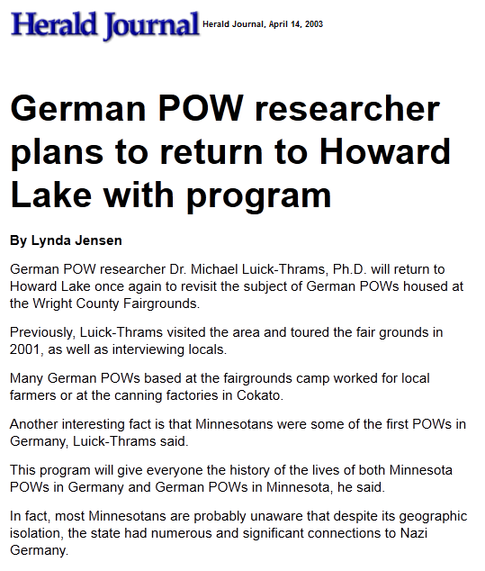
http://www.herald-journal.com/archives/2003/stories/pows.html

Slide 180
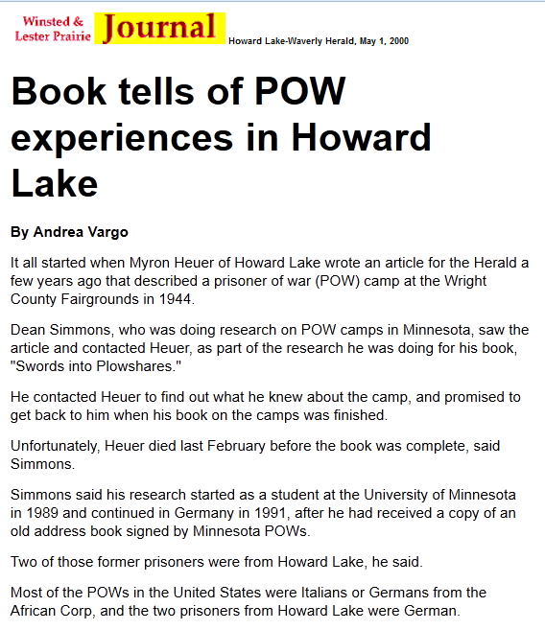
http://www.herald-journal.com/archives/1999/stories/pow.html

Slide 181
You will note at the Winsted cemetery that some tombstones in family plots changed from German to English during the War.
When I was growing up the Cemetery was divided into the Holy Trinity Catholic side, and the “protestant” side—and there was a fence dividing the two sides.
My dad’s mom and dad are buried on the former “protestant” side, and my mom’s dad and mother are buried on the Catholic side.
Today the fence is gone, and the dead get along quite well in Winsted.

Slide 182
My second adventure in linguistics was in Latin . . . as an altar boy.
At first I understood Latin about as well as I understood the poem that Gusty taught me.

Slide 183
In the same year as
the great Good Friday “archaeological” excavation
1952
little Timmy took up Latin with Sister Orentia
to become an altar boy
(thereby assuring his folks
that he will be
at the next year’s Good Friday services)

Slide 184
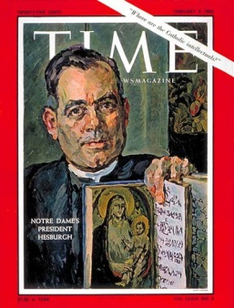
I liked being an altar boy. I was an altar boy from 1952 until I graduated from college.
At the University of Notre Dame I was a Mass server for Father Theodore Hesburgh’s private Masses in the crypt of Sacred Heart Church.
Hesburgh was, and is, truly a great person. In addition to holding the Guiness book of World Records title for having received the most honorary degrees, Father Hesburgh in a decent human being. He was also Notre Dame’s greatest President.

Slide 185
My last time serving Mass was a command performance, so to speak, with my brother Tommy.
One of the last wishes of my Aunt Elderine (my mother’s sister), was to have “Tommy and Timmy” serve her funeral Mass. In her mind, at the time, she probably thought we were still little boys.
Anyway, Tommy and I served Mass for her funeral. The problem was, Tommy and I only knew the responses IN LATIN. We didn’t know the English version. And the young priest didn’t know any of the prayers in Latin. So he said the Mass in English and Tommy and I answered the priest in Latin. I wish now that I would have added Gusty’s poem on to one of the prayers for old time’s sake. The young priest probably wouldn’t have known the German from the Latin.
And, as was Tommy and my trademark for serving funerals, we gave the deceased an extra shot of incense for the final blessing.

Slide 186
In the meantime, other events “transpire” . . .

Slide 187
It must have been about two or three years later we were over by Maple Plain at a Pee-Wee baseball tournament
It was the kind of tournament where you play a game in the morning and if you win you sit around waiting for the next game, sometimes two, to get over,
so you can play for “The Championship”
[the “championship” of the weekend Pee-Wee tournament,
not the championship of the state or region]

Slide 188
It happened that on that weekend
we won the first game
I was roaming around the nearby railroad tracks
in between games and came upon “a bum” making lunch on an open fire in a little woods near the tracks
We were also warned about
“The Bums” who stopped off in Winsted
[The Luce Line train still came through Winsted in those days]

Slide 189
But “Bums” didn’t seem to be so intent on “kidnapping little boys,” so we didn’t pay too much attention
And there weren’t many “bums” in Winsted anyway, and those that came didn’t seem to follow any calendar, like the Jamaicans and “Gypsies” did
I forget exactly how I got to talking with “The Bum” over by Maple Plain, but before long I was sitting next to the fire having a sandwich with him

Slide 190
I don’t remember too much about the conversation, but I still remember that he told me that he was “a bum”
He told me that he was from the “Eddy’s Bread family,” and at one time was “well to do”
He told me that alcohol was his problem
He told me never to let alcohol “get a hold” of me
And he cried
Like the Jamaican

Slide 191
I don’t remember too much about the conversation, but I still remember that he told me that he was “a bum”
He told me that he was from the “Eddy’s Bread family,” and at one time was “well to do”
He told me that alcohol was his problem
He told me never to let alcohol “get a hold” of me
And he cried
Like the Jamaican

Slide 192
I don’t remember how we did in the final game of that week’s Pee-Wee “championships”
But even when I got to college
I remembered the “Eddy’s Bread guy”
And I remembered the other bums that would stop by a diner-type café that my dad owned,
— run for my entire life in Winsted by a German lady from town —
asking for (and getting) a meal from my dad,
usually in exchange for a little wood splitting
those “bums” were really nice also . . .

Slide 193
And the “bums” I met personally
really never seemed to be like
the “bums” that people talked about . . .

Slide 194
And at Notre Dame,
almost ironically, one of my very first college papers,
in sociology was on
Nels Anderson’s book
The Hobo: The Sociology of the Homeless Man
-- for my mentor William V. “Bill” D’Antonio,
later a long-time CEO of the American Sociological Association . . ..

Slide 195
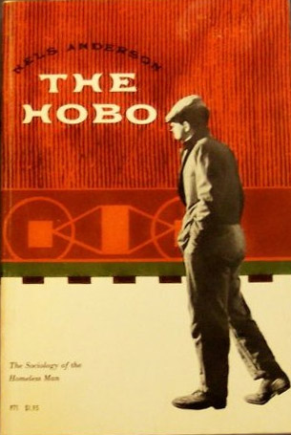
Occasionally
we had “bums”
passing through
on the Luce Line Railroad . . .

Slide 196
and while doing that paper,
arguing that Anderson argued
that real-life bums aren’t “bums,”
that I remembered well
the real-life “bums” in my real-life past
And, thought I, if this is sociology,
then I guess I’m a sociologist.

Slide 197
and while doing that paper,
arguing that Anderson argued
that real-life bums aren’t “bums,”
that I remembered well
the real-life “bums” in my real-life past
And, thought I, if this is sociology,
then I guess I’m a sociologist

Slide 198
And at Notre Dame I studied internationally-oriented sociology, graduating with a degree in Sociology
William Liu
— U.S.A. representative for the social sciences to China, after the ping-pong diplomacy of Richard M. Nixon —
was my senior honors director, my research mentor, and good friend . . .

Slide 199
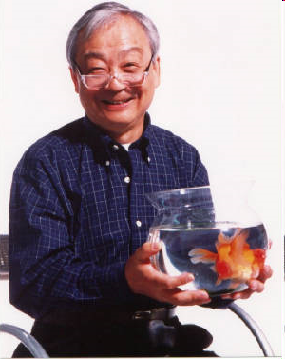
William T. Liu, Ph.D.
Professor Emeritus
1930 - 2008

Slide 200

The Essence of Chinese Cuisine.
1970. William T Liu and May L. Liu.
Nashville/London: Aurora.

Slide 201
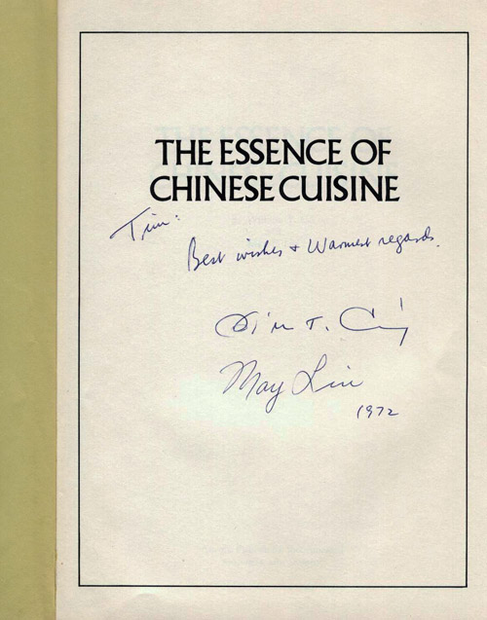
The Essence of Chinese Cuisine.
1970. William T Liu and May L. Liu.
Nashville/London: Aurora.

Slide 202
and at Notre Dame . . .
Julian Samora
— an anthropologist, and the first U.S. recipient of Mexico’s Aguila Azteca Award, the highest award given to foreigners by that country —
was my advisor and
primary anthropology professor . . .

Slide 203


Slide 204

and at Notre Dame . . .
one of the best “anthropology courses” I had was
Introduction to Art History, taught by another mentor . . .
Robert Leader

Slide 205
and at Notre Dame . . .
one of the best “anthropology courses” I had was
Introduction to Art History, taught by another mentor . . .
Robert Leader
. . . an experience which led in my senior year
to my Senior Honors Thesis on Anthropology and Art

Slide 206



Slide 207


and at Notre Dame . . .
Tim studied much of his philosophy with . . .
https://www.catholiceducation.org/
Ralph McInerny
-- a Thomas Aquinas scholar,
who wrote the Father Dowling Mysteries
. . . and Tim always loved the way Ralph approached his teaching as if he were solving a mystery

Slide 208

Ralph McInerny was arguably the most distinguished scholar ever to work at Notre Dame.
https://www.catholiceducation.org/

Slide 209
and later at the University of Minnesota
— as a National Institutes of General Medical Sciences Graduate Fellow in Anthropology —
I studied with . . .
Frank C. Miller
Pertti J. Pelto
E. Adamson Hoebel
Robert F. Spencer
Robert C. Kiste
Michael Z. Salovesh
Don Martindale
Richard E. W. Adams
Ward J. Barrett

Slide 210
All the while I was growing up my father, and godfather-uncle, the assistant priests, and other gentlemen of the town would help Father Cassian Osendorf, OSB, of the Red Lake Catholic Indian Mission, “collect clothing for the Indians”
They were, I am told, helping out by playing poker and drinking whiskey at my godfather-uncle’s cabin,
to help everyone relax, or something like that

Slide 211
But in the serious times when Father Cassian was around the family, we learned an awful lot about the conditions of life at Red Lake,
conditions that were not widely reported on
or known about in those days

Slide 212

Father Cassian Osendorf, OSB
was a missionary at
Red Lake Mission, 1956 –
Indian children at Red Lake
.
Minnesota Historical Society Photograph Collection 1956
Location no. E97.1 r95
Negative no. 58528

Slide 213

Indian family at Redby
Minnesota Historical Society Photograph Collection 1956
Location no. E97.1 r93
Negative no. 58529

Slide 214
And in the last few years, since going deaf, I thought a lot about Sharon, the tall, classmate, “the deaf girl” I sat behind in an early grade—during my early years as a cultural-physical-archaeological explorer
And I remember that in those days some people thought that Sharon, the gangly “deaf girl” with stringy red hair, who was always kind to me in the second grade, couldn’t hear because of god’s punishment for what one or other of her parents or some other relative had done. . . .

Slide 215
And that bothered me even then,
but probably mostly because
my mom and dad said it should bother me

Slide 216
Sharon didn’t stay with our class long. I think she came and went in the second grade . . .
or maybe it was the third
But I remember that some people weren’t kind to her
And I know, but I don’t know why, she never returned.
Perhaps she went to
the School for the Deaf at Faribault . . .

Slide 217


Slide 218
Those of you in the Anthropology of Food might be a little curious about my food background . . .

Slide 219
My Roufs family has been into food since at least 1702 . . .

Slide 220
In the Netherlands my family members were farmers in Nieuwstadt – Sittard until they migrated to the United States “to find a better life” for the children about 1842.

Slide 221

Some became millers.
The Roufs Mill in Sittard, Netherlands, today is a world center for the study of water mills.

Slide 222

Some became millers.
The Roufs Mill in Sittard, Netherlands, today is a world center for the study of water mills.

Slide 223
About 1842, reads the history in Nieuwstadt, my immediate ancestors migrated to the United States “to find a better life for the children”.

Slide 224
Family legend has it that two brothers from somewhere in Indiana brought some cows to Minnesota and Wisconsin and never returned.

Slide 225
My side of the family settled in Winsted, as you saw above.
In Winsted and went into the meat business, providing what would now be called “artisanal meats” – real home cured hams, sausages, etc.

Slide 226


Slide 227
My bedroom, until the 8th grade,
when we moved to
122 Lake Ave East.

Slide 228
My Grandfather, Father, and older Brother were the town butchers, and they ran
“The Butcher Shop” where . . .

Slide 229
They became regionally famous as the makers of the “Famous Winsted Bologna”

Slide 230


http://www.herald-journal.com/farmhorizons/2007/bologna.html

Slide 231
Early on, when freezing technologies were developed by Mr. Birdseye my father opened the town frozen locker business,

Slide 232
and eventually opened
“The Coffee Shop” – a very successful 1950s diner-like operation (juke box and all).

Slide 233
Some of the other “Bums” I met when a little boy were those who would come by the Coffee Shop looking for a free meal.
My father always had a pile of maple wood out back, for smoking hams and sausages in the Meat Market, and always let them chop a little wood in return for a nice meal or two. He never turned anyone down. . . .

Slide 234
He never turned anyone down who needed something to eat, either at the Coffee Shop, or at the Meat Market.
And very quietly, on the side, he provided food from the little grocery store attached to the Meat Market to the few in town who couldn’t always afford food for the entire month (because their little pensions ran out at the end of the month).

Slide 235
My father’s father died just before I was born.
He also was the town butcher, and in the early days the Roufs “slaughterhouse” [abattoir] was located at the edge of town
(following the European manner of locating slaughterhouses,
where “Benny Weinbeck’s apartments” are now located)

Slide 236
And more than once, when I was a young boy, I watched one or two of the less fortunate old bachelors in town come into the Meat Market and ask my dad for a “soup bone”.
My dad always made it a point to quietly give them one, making sure that it still had a lot of meat still on it, and quietly wrap it up and hand it to them as if they had paid for it.

Slide 237
I learned a lot about the anthropology of food watching people come and go in my dad’s, and later my brother’s, Meat Market and Coffee Shop . . .

Slide 238
And I will not get into the details of what I learned in my pre-teens, and especially my early teens, helping butcher hogs and cows with the likes of old timers like Joe Popberg, Larry Barrett, and Gilbert “Ungie” Unglaub . . . .
But it was quite a bit more than how butcher and process hogs and beef . . .

Slide 239
Rites of passage, anthropologists would call some of it . . . like watching a calf killed and butchered for the first time, to eventually shooting the animals yourself.
It was a bit like the scene in George Orwell’s “Shooting an Elephant”, but in small town America . . .

Slide 240

The Meat Market phone number was 43.
Our phones didn’t have a dial. I would just pick the receiver up and ask for “43 please” and Mrs. “Tony” Ollig would “patch” the call through, with a friendly “OK, Timmy”.
If I came home from school and my mom was not home I could just pick up the phone and ask Mrs. Ollig where mom was. Usually, without hesitation, she would say something like,”She’s down at Elderine’s [her sisters]. She’ll be home in about 20 minutes.”
Winsted Telephone Company Switchboard

Slide 241
Winsted Telephone Company Switchboard

Slide 242

I still remember going to the Telephone Company office and watching Mrs. Ollig (“Tony”) operate the switchboard.

Slide 243
Almost everyone had “party lines” those days—with a set signal for your number. . . Like Morse Code. Some folks in the country shared a line with 4-5 others.
And, of course, since everyone heard the signals, they often listened in on other peoples’ conversations, but in my family we were not allowed to listen in. That was too bad, as I’m sure I could have learned even more anthropology had I been allowed to listen in on the party line conversations . . .
Winsted Telephone Company Switchboard

Slide 244

my
Mom
“Mixie”
“Coddie”
Barrett
“Madge”
Carlson,
mother of
Paulette Carlson
0f
“Highway 101 Fame”
Mrs. Ollig was on my Mom’s Bowling Team

Slide 245

my
Mom
“Mixie”
“Coddie”
Barrett
Madge
Carlson,
mother of
Paulette Carlson
0f
“Highway 101 Fame”
Mrs. Ollig was on my Mom’s Bowling Team

Slide 246
my
Mom
“Mixie”
“Mixie” comes from the fact that my mom’s name was
Mary Magdaline Margaret Mary Juetta Campbell [Roufs].
When these girls were in high school, at Holy Trinity, a new Fransciscan Sister was asking the girls their names at choir practice. My mom said her full name, and one of the ladies said, “That’s a mixed up name”, and for the next 70+ years everyone knew her at “Mixie”. The last three generations generally didn’t know that her name was actually Mary . . .

Slide 247
my
Mom
“Mixie”
“Coddie”
Barrett
And these high school friends formed the Chick Chix bridge club that played bridge regularly for the next 60 years . . .
I also learned a lot about anthropology eavesdropping on their conversations over the years . . .

Slide 248

While in grade school and high school at Holy Trinity
I kept bees, and sold the honey in my at the Meat Market.
When I went off to college I had 15 hives of bees
(11 of which I inherited from Ferdinand Rhode after he died).
When I went off to college my dad kindly broke the news to me that he would do anything for me while I was at college
. . . except keep my bees.

Slide 249
Keeping bees for honey production actually involves quite a bit of work in the summer time.
So when I went away to Notre Dame my dad gave my bees to Magnus Jorgenson and his grandson.
They had a good home with the Jorgensons.

Slide 250

(The bees getting a new home wasn’t like the situation with my dog “Poochie”
Who
“went to college in California”
when I was
about 6 years old . . .)
R.I.P “Poochie”

Slide 251

Holy Trinity High School, Winsted.

Slide 252
In 1968 we sold the Meat Market and the Coffee Shop and my brother, Tom, went on to become an executive in the food industry, first with Wilson and company, then with John Morrell and Company . . .

Slide 253
It was with Wilson and Company, when he was stationed in Hamburg, NY, that he was instrumental in the development of the Buffalo Wings . . . to use up Wilson’s mounting mountain of chicken wings that early on became a problem when processors started cutting up chickens for sale in supermarkets (rather than selling whole chickens) . . . .

Slide 254
When I was growing up in Winsted, the men of the town would have booyas, just like “Booya Kings: Dads & Sons” in the “Food and Family” segment of the The Meaning of Food video seen in class which features the booya contest between the Police and Firemen in St. Paul, Minnesota.
And it was, like in the film, a genuine
"male bonding ritual"

Slide 255
When I was growing up in Winsted, the men of the town would have booyas, just like in the video in class. Usually spearheaded by folks like Gerry Sterner, Herman Peschken, My Dad (Mark), and the Volunteer Firemen (like in the video, except that our police “department” was the half-time Ben Heigel who patrolled the city street on foot, towards evening,
and didn’t cook booya.

Slide 256
In 2018 I went on to write a short article
on booya for
Jonathan Deutsch’s book
on unusual American foods . . .

Slide 257

Roufs, Timothy G. 2018. "Booyah." From We Eat What?: A Cultural Encyclopedia of Unusual Foods in the United States, by Jonathan Deutsch, (Ed.). Santa Barbara, CA: ABC-CLIO, pp. 30-36.

Slide 258
And, of course, once I got to Notre Dame and started working as a research assistant to Bill Liu, my horizons expanded into Chinese Food . . .
Although, interestingly enough, when I was little there were two restaurants I liked to go to, (1) The Buckhorn in Long Lake and (2) the old, old Nankin in downtown Minneapolis.
(This was all before McDonald’s hit the region.)
Bill Liu worked at the Nankin when he went to St. Thomas College in St. Paul
The Essence of Chinese Cuisine.
1970. William T Liu and May L. Liu.
Nashville/London: Aurora.

Slide 259
Ant the old Nankin in downtown Minneapolis was about as exotic as one could get in those days (and about as exotic as a boy from Winsted could even imagine . . .
And it was the only place known on earth where one could get strawberry sherbet (if you finished all of your food), and Chinese fortune cookies (which you received regardless of how much you ate).
It wasn’t until 30years later that I found out that Chinese fortune cookies were not Chinese, but American . . .
And 50 years later that I found out that they were Japanese American and not Chinese American . . .

Slide 260
The Buckhorn was great . . . It had . . .
Real live buffalo . . .
Real guns . . .
Tin buckets with water to washi your hands
after you got done eating their fried chicken . . .
And a game where, for a quarter, if you ate all of your food, you were allowed to play the arcade game where you shot a mechanical bear . . .

Slide 261

Winsted was also famous for its “Winsted Cheese” made by the Pure Milk Products Co., known for it’s sharp cheddar cheese
(Kraft Cracker Barrel)

Slide 262
When I was a little boy we could just walk in the cheese plant (at the back of “Pure Milk”) and watch the “Kettle” Barrett and the others make cheese. If our arms were long enough we could just reach in the big vats and grab a handful of wonderful cheese curds.
We liked to watch the men (and one woman) turn the cheese in the large vats, and pack it in the molds and send it off to the aging room.
And we liked to watch the big milk trucks unload—trucks with milk cans (as in the right-hand side of this picture), and later on the bulk trucks (as towards the center).

Slide 263
OH . . . !
The questions . . .

Slide 264
FAQs
Where did you grow up?
Where did you go to school?
How long have you been at UMD?
What are your favorite things to do?
How did you get into anthropology?
Where have you been?
            What are your pet peeves?

Slide 265
Lots of places . . .
like 30 or 40 cultures/countries . . .
the number depending on
what your “units of analysis” are
[more on “units of analysis” Week 1]
(Since 2012, for example, my wife Kim and I visited relatives and friends in England, Scotland, Ireland, Singapore, Australia,
New Zealand, and Hawaii, Hungary, Switzerland, France, Austria, Lichtenstein, Italy, Germany . . .)
I’ll talk about these places and peoples as it seems fitting and appropriate as we go along in the semester . . .

Slide 266
FAQs
Where did you grow up?
Where did you go to school?
How long have you been at UMD?
What are your favorite things to do?
How did you get into anthropology?
Where have you been?
            What are your pet peeves?

Slide 267
Somebody asked me for the first time about my pet peeves in class about five years ago,
and I though it was a good questions because I couldn’t think of any
—or rather it took me a full day of thinking to come up with a genuine “pet peeve” . . .

Slide 268
. . . you know when you buy two half-gallon cartons of milk in those paper cartons, and they’re glued together with a waxed cardboard strip?
Well, my pet peeve is when people put the two half-gallon cartons of milk into the refrigerator without taking that glued-on strip off.

Slide 269
. . . you know when you buy two half-gallon cartons of milk in those paper cartons, and they’re glued together with a waxed cardboard strip?
Well, my pet peeve is when people put the two half-gallon cartons of milk into the refrigerator without taking that glued-on strip off

Slide 270
Oh ya . . .
To those of you who may know one or more of the elders from Winsted, MN . . .
for the record I should say . . .
I did NOT “burn the town hall down” . . .

Slide 271
Oh ya . . .
To those of you who may know one or more of the elders from Winsted, MN . . .
for the record I should say . . .
I did NOT “burn the town hall down” . . .

Slide 272
But there was a cute small little white New England type “town hall” right across from the Catholic Church, and it DID catch on fire . . .
But it was an accident as I was cleaning up the backyard and “burning leaves” . . .
In those days most everyone “burned leaves” in the fall
The smell of burning leaves was a big part of the fall
in small-town America

Slide 273

East side First Street, Winsted.
Photograph Collection, Postcard ca. 1915
Visual Resources Database
Minnesota Historical Society
Location no. MM1.9 WN r5

Slide 274
The Town Hall earlier
Roufs’ City Meat Market

Slide 275

Yes, I did win third place in a regional cake baking contest when I was in grade school. The judging was held on the second floor of the old City Hall next to the Meat Market and Coffee Shop.

Slide 276
My prizewinning cake, an angel food, had a brilliant orange frosting. No one remembers what it tasted like.
Regional baking contests “Bake Offs” were sponsored by Pillsbury in those days . . .
. . . After “The War” and 40 years before the arrival of The Television Food Network . . .
to promote their flours.

Slide 277

Yes this is the same Winsted as in . . .
Yes this is the same Winsted as in Winfest

Slide 278



Slide 279

Tim and his Hearing Assistant Partner Bentley are graduates of the
Can Do Canine Assistance Dog training program, New Hope, MN.

Slide 280
Bentley is an internationally certified hearing assist dog.
Here he is looking over his diploma at “commencement”
from Can Do Canines . . .

Slide 281

"Total Confidence in Bentley,"
Can Do Canines Assistant Dog Feature Story,
6 February 2019
https://mail.google.com/mail/u/0/#inbox

Slide 282


Bentley is the proud UMD Tau Kappa Epsilon "Chapter Good Boy"

Slide 283

Timmy and Bentley
Gretchen Roufs, 2015

Slide 284
Over the years anthropological experiences have been wonderful . . .
And expecially the fieldwork experiences . . .

Slide 285
Over the years anthropological experiences have been wonderful . . .
And especially the fieldwork experiences . . .

Slide 286
Fieldwork friendships
last forever . . .
For example . . .

Slide 287
Fieldwork friendships
last forever . . .
For example . . .

Slide 288

Tim Roufs and Teo Espinosa have been good friends for 59 years . . .

Slide 289


Slide 290

Tim and Teo have been friends since
Teo began courting Mar . . . and became novios . . .

Slide 291
In 2014 Martha Elena Félix Brasdefer
and Teódulo Espinosa Victoria
(Mexico)
contributed to Tim and Kim’s book on
Sweet Treats around the World . . .

Slide 292

Santa Barbara, CA: ABC-CLIO. 2014.

Slide 293

Tim and Kim and Teo and Mar
have been friends over the years . . .
Photo by Three Sisters

Slide 294
. . . go to pp. 226-231
to see what the four of us have to say about Mexican cuisine . . .

Slide 295
and p. 477 for some of the secrets of the very same
Flan Casero
that won Teo’s heart . . .

Slide 296

Mar’s Flan Casero
that won Teo’s heart 50 years ago . . .

Slide 297

. . . over the years our children
have had fun together. . .

Slide 298


and we take great pride in the grandchildren . . .

Slide 299

. . . three generations . . .

Slide 300


. . . the third generation . . .

Slide 301



. . . the third generation loves to eat . . .

Slide 302


. . . the third generation . . .

Slide 303
. . . BFFs before
there were “BFsF” . . .

Slide 304
And the latest project . . .
later on . . .
(maybe . . .)

Slide 305


Slide 306
And maybe more about
the later years . . .
later on . . .
(maybe . . .)

Slide 307
And maybe more about
the later years . . .
later on . . .
(maybe . . .)

Slide 308
And maybe more about
the later years . . .
later on . . .
(maybe . . .)

Slide 309
Thanks for joining in
I hope you enjoy your stay.
If you have any questions, You will find the normal Instructor Contact Information in the General Block of the course.
Tim Roufs

Slide 310
Thanks for joining in
I hope you enjoy your stay
If you have any questions, You will find the normal Instructor Contact Information in the General Block of the course.
Tim Roufs

Slide 311

Thanks for joining in
I hope you enjoy your stay
If you have any questions, you will find the normal Instructor Contact Information in your
xxxxxxxxxxx folder
Tim Roufs

