Slide 1
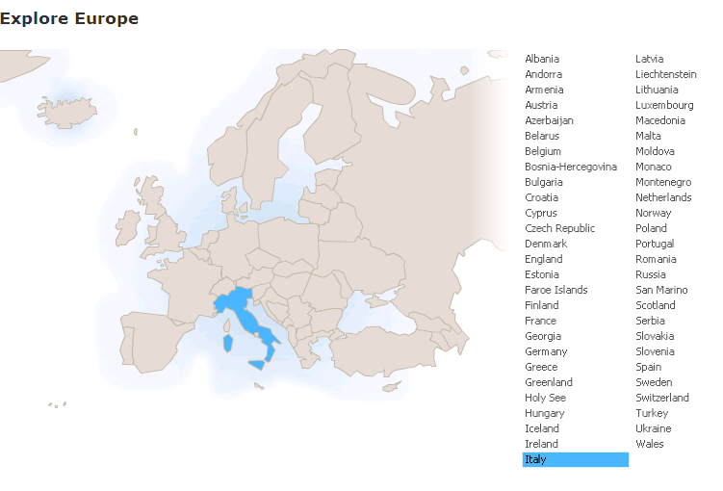
Run in “Slide Show” mode.
Use your up / down arrow keys and / or
your space bar to advance the slides
Metaphor: The Opera
Italy
© 2009-2026 Timothy G. Roufs, University of Minnesota Duluth

Slide 2
Italy
© 2009-2026 Timothy G. Roufs, University of Minnesota Duluth

Slide 3
Metaphor: The Opera
Italy
© 2009-2026 Timothy G. Roufs, University of Minnesota Duluth

Slide 4
Italy’s contemporary situation reflects a complex history, geography, ecology, demographic make up, world view, and so forth
. . .

Slide 5
So first, a bit of history and background . . .

Slide 6
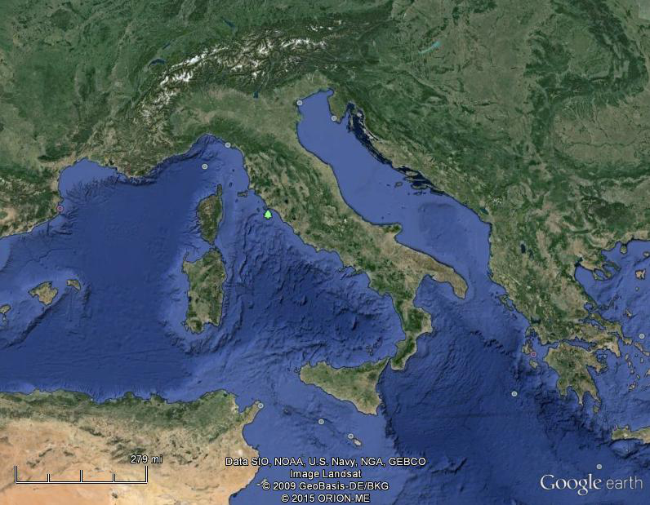
Of all European countries Italy, “the boot,” is probably the most recognizable . . .
Notes:
6

Slide 7
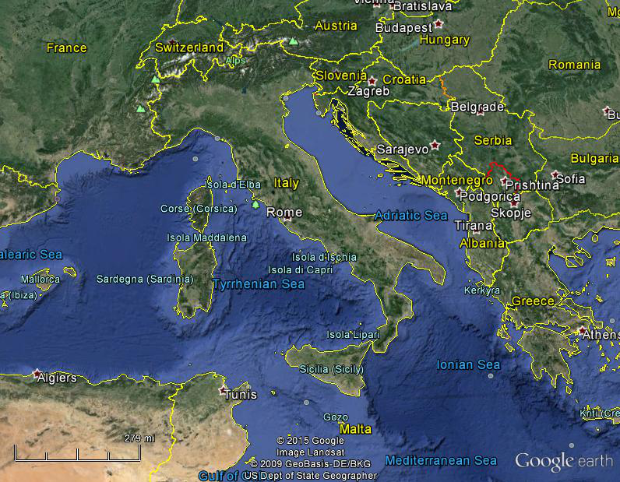
Italy, and her current neighbors . . .
Notes:
7

Slide 8
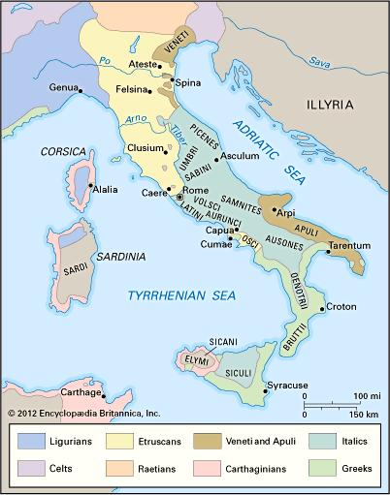
ancient Italic peoples:
Distribution of peoples of ancient Italy ca. 500 B.C.
©Encyclopædia Britannica, Inc.
https://www.britannica.com/topic/history-of-Italy
Notes:
8

Slide 9
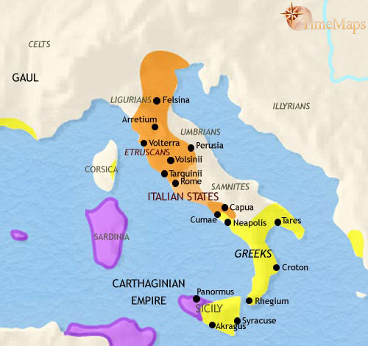
500 B.C.
http://www.timemaps.com/history/italy-500bc
Notes:
9

Slide 10
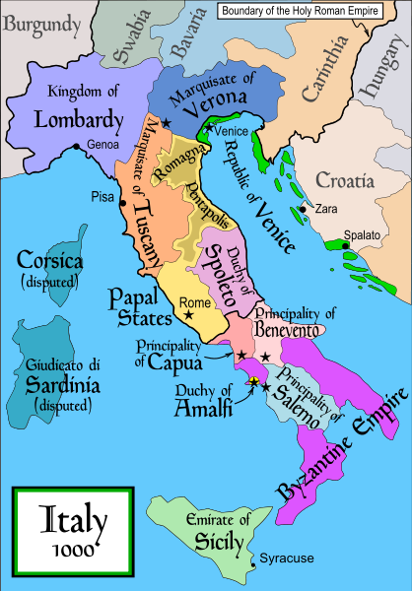
1000
Italy was divided for centuries into small kingdoms and city-states
http://en.wikipedia.org/wiki/Italy
Notes:
10

Slide 11
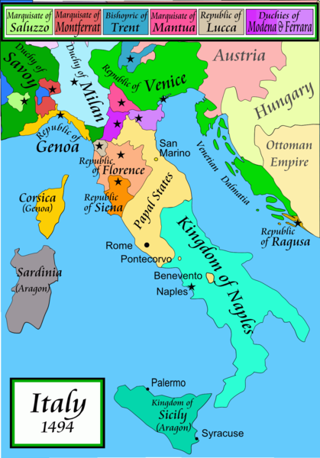
1494
Italy was divided for centuries into small kingdoms and city-states
http://en.wikipedia.org/wiki/Italy
Notes:
11

Slide 12
1494
Italy was divided for centuries into small kingdoms and city-states
http://en.wikipedia.org/wiki/Italy
Notes:
12

Slide 13
In 1494 Christopher Columbus from Genoa went on his second voyage to the New World
Italy was divided for centuries into small kingdoms and city-states
http://en.wikipedia.org/wiki/Italy
Notes:
13

Slide 14
In 1494 Christopher Columbus from Genoa is on his second voyage to the New World
Christopher Columbus was a sugar merchant from Genoa, married to the daughter of a sugar merchant from Madeira, Felipa Perestrello.
Columbus was looking for a way around Venice’s monopoly on things like sugar. . . .
Italy was divided for centuries into small kingdoms and city-states
http://en.wikipedia.org/wiki/Italy
Notes:
14

Slide 15
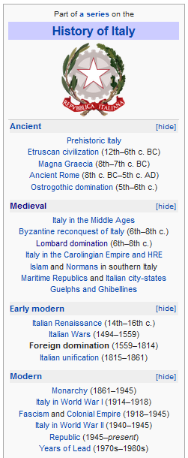
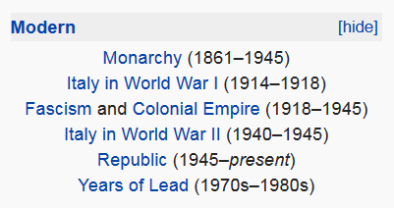
http://en.wikipedia.org/wiki/History_of_Italy_during_foreign_domination_and_the_unification
Notes:
15

Slide 16
http://en.wikipedia.org/wiki/History_of_Italy_during_foreign_domination_and_the_unification
Notes:
16

Slide 17
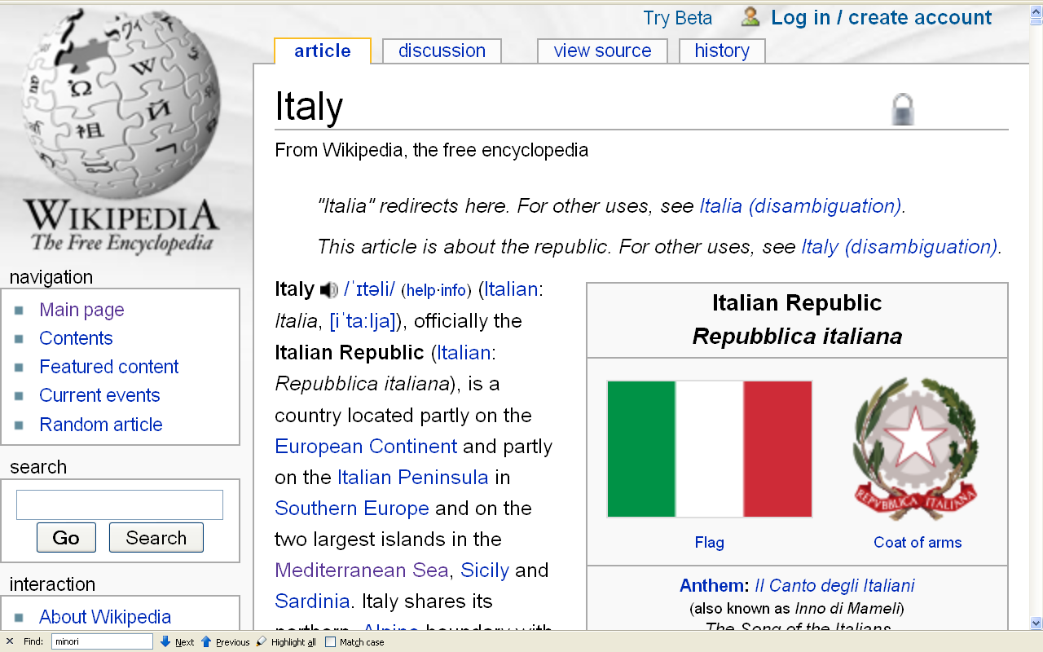
Formation of Italy
Unification —17 March 1861
Republic —2 June 1946
http://en.wikipedia.org/wiki/Italy
Notes:
17

Slide 18
Formation of Italy
Unification —17 March 1861
Republic —2 June 1946
http://en.wikipedia.org/wiki/Italy
Notes:
18

Slide 19
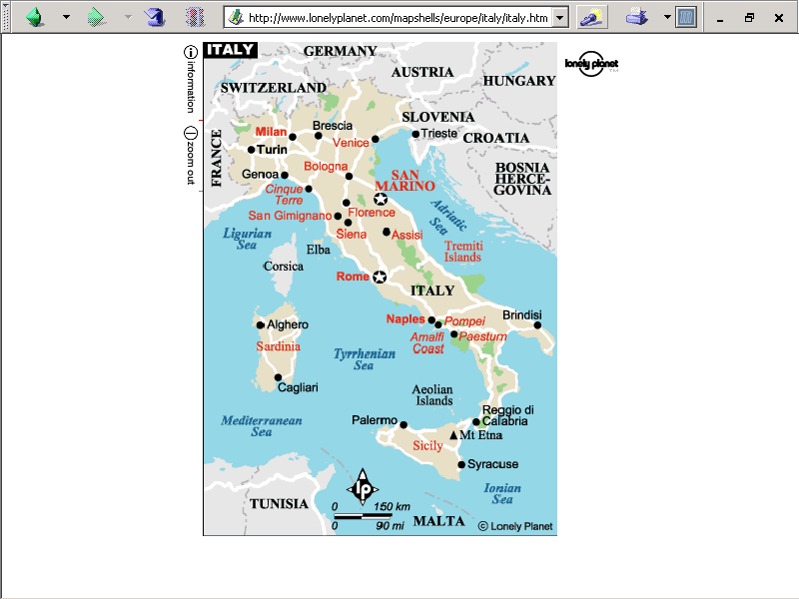
population size
62,390,364 (July 2021 est.)
https://www.worldometers.info/world-population/italy-population/

Slide 20
Note
Sicily

Slide 21
Note
Sardinia

Slide 22
Note
Kingdom of Tavolara
(unrecognized micronation)
https://en.wikipedia.org/wiki/Kingdom_of_Tavolara

Slide 23
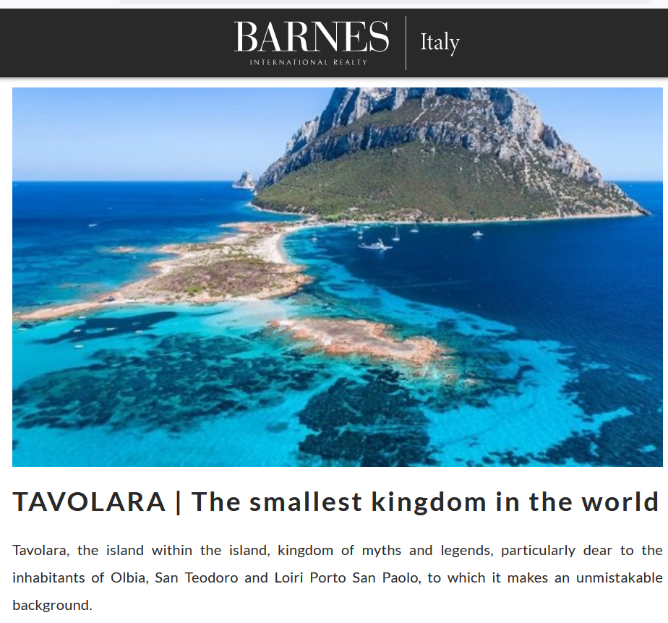
https://barnes-italy.com/tavolara-the-smallest-kingdom-in-the-world/
Notes:
23

Slide 24
Note
Corsica
(French)
Notes:
24

Slide 25
Principality of Seborga
(unrecognized micronation)
Note
https://en.wikipedia.org/wiki/Seborga
Notes:
25

Slide 26

Notes:
26

Slide 27
Note
Rome

Slide 28
The Holy See
(The Vatican)
an independent country
Note
Notes:
28

Slide 29
Note
Notes:
29

Slide 30
Note
The Most Serene Republic of San Marino
an independent country
Notes:
30

Slide 31
Metaphor: The Opera
Italy
© 2009-2026 Timothy G. Roufs, University of Minnesota Duluth

Slide 32
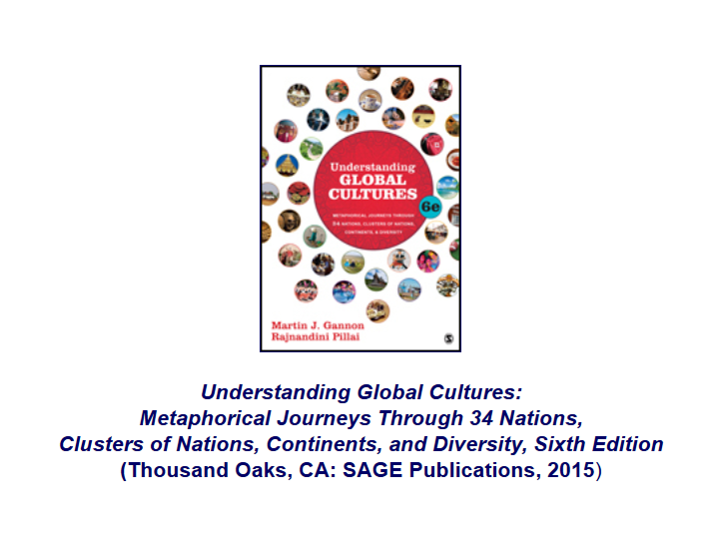
Following Gannon and Pillai. . .
http://www.d.umn.edu/cla/faculty/troufs/anth1095/index.html#text

Slide 33
http://www.d.umn.edu/cla/faculty/troufs/anth1095/index.html#text

Slide 34
a cultural metaphor
(analogy, by means of cultural metaphors)
as a
Unit of Analysis

Slide 35
“units of analysis” may include:
one person
the family
the community
a region
a “culture area”
a culture / “subculture”
a nation / region
the world
an item or action itself
a “cultural metaphor”

Slide 36
as mentioned in the “Orientation”
units of analysis may include:
one person
the family
the community
a region
a “culture area”
a culture / “subculture”
a nation
an item or action itself
a “cultural metaphor”
cultural metaphors use an item or event representative of a culture and analyze the culture with reference to that item or event

Slide 37
metaphor
“The use of a word or phrase to refer to something that it isn’t, invoking a direct similarity between the word or phrase used and the thing described . . . “
https://en.wiktionary.org/wiki/metaphor

Slide 38
a
cultural metaphor is a specialized use of an item or action or idea itself
as a Unit of Analysis . . .

Slide 39
a cultural metaphor is a specialized use of an item or action or idea itself
as a Unit of Analysis . . .
through analogy

Slide 40
analogy
“A relationship of resemblance or equivalence between two situations, people, or objects, especially when used as a basis for explanation or extrapolation.“
https://en.wiktionary.org/wiki/metaphor

Slide 41
Cultural Metaphors
the metaphor applies
to a group,
but not to every individual within the group

Slide 42
Cultural Metaphors
a good amount of evidence suggests that there are commonalities across regional, racial, and ethnic groups within each of the countries that can be captured effectively by cultural metaphors

Slide 43
http://www.d.umn.edu/cla/faculty/troufs/anth1095/index.html#text

Slide 44
Cultural Metaphors
unit of analysis is usually the nation or national culture
Understanding Global Cultures features 34 nations
(14 or 15 of the 34 are from Europe)
(6 / 37 cultures relate to food and food events)
there are approximately 200 nations in the world
193 according to The Times World Atlas (2004)

Slide 45
a country / nation
as a
Unit of Analysis:
Italy

Slide 46
“units of analysis” may include:
one person
the family
the community
a region
a “culture area”
a culture / “subculture”
a country / nation
the world
an item or action itself
a “cultural metaphor”

Slide 47
A key feature of
Italy, one prominently represented in the Opera is that . . .

Slide 48
Gannon and Pillai classify Italy as one of the
“Cleft National Cultures”
that they discuss

Slide 49
http://www.d.umn.edu/cla/faculty/troufs/anth1095/index.html#text

Slide 50
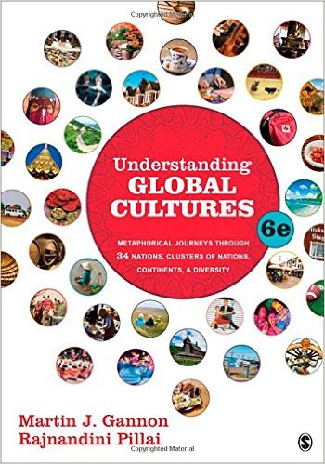
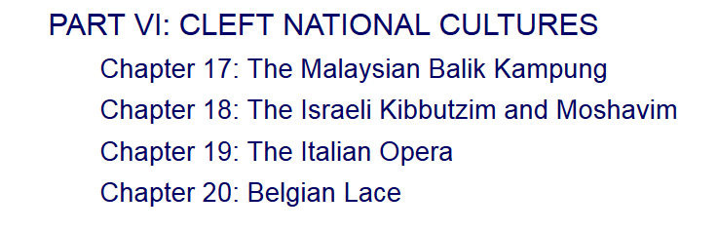


http://www.d.umn.edu/cla/faculty/troufs/anth1095/index.html#text

Slide 51
Cultural Metaphors
“Cleft National Culture”
one in which the subcultures
of the diverse ethnic groups
are difficult to integrate

Slide 52
the
Units of Analysis
can be combined
(and quite often are)

Slide 53
“units of analysis” may include:
one person
the family
the community
a region
a “culture area”
a culture / “subculture”
a country / nation
the world
an item or action itself
a “cultural metaphor”

Slide 54
“units of analysis” may include:
nation + metaphor
Ch. 19 The Italian Opera
Ch. 20 Belgian Lace
Ch. 22 The Turkish Coffehouse
Ch. 31 The Russian Ballet
Ch. 32 Estonian Singing
Ch. 33 The Polish Village Church
Ch. 34 The Spanish Bullfight
Ch. 35 The Portuguese Bullfight

Slide 55
but the
Units of Analysis
are often
the nation
or national culture
and the metaphor itself . . .

Slide 56
Metaphor: The Opera
Italy
© 2009-2026 Timothy G. Roufs, University of Minnesota Duluth

Slide 57


The most famous
opera house in the world is Teatro alla Scala
in Milan, Italy

Slide 58
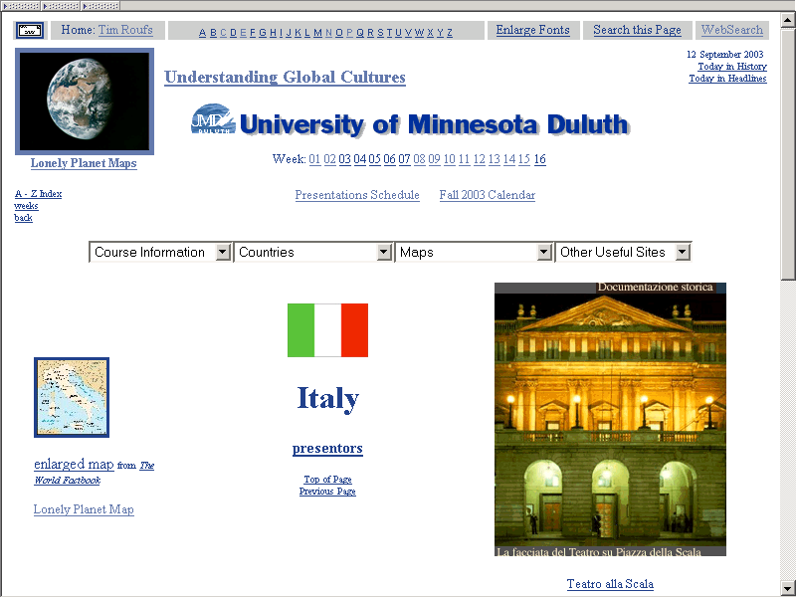
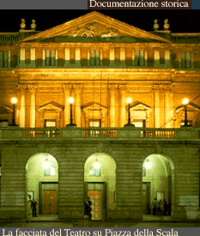

A National Treasure

Slide 59
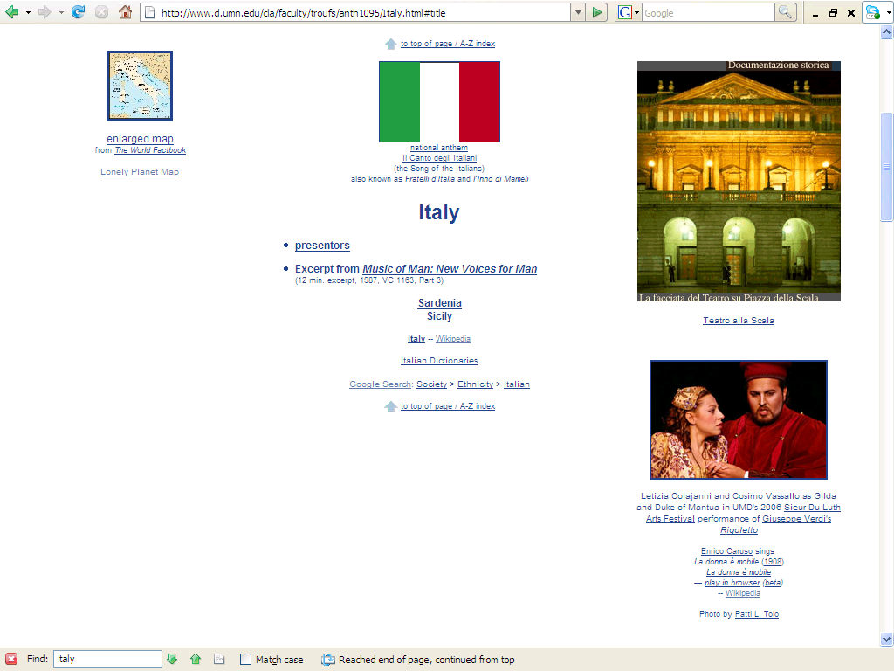
http://www.d.umn.edu/cla/faculty/troufs/anth1095/Italy.html#title

Slide 60
Participants in UMD’s former Italian Opera Program
http://www.d.umn.edu/cla/faculty/troufs/anth1095/Italy.html#title

Slide 61
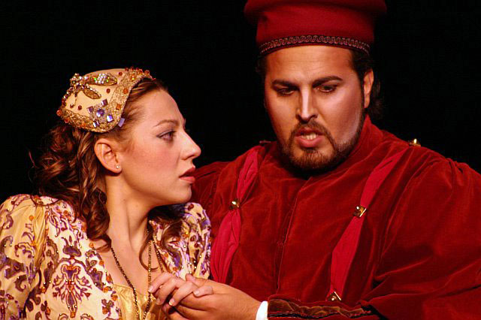
Letizia Colajanni
and
Cosimo Vassallo
http://www.d.umn.edu/cla/faculty/troufs/anth1095/Italy.html#title

Slide 62

The major features of the opera metaphor include . . .

Slide 63
Metaphor: The Opera
The Overture
Pageantry and Spectacle
Voice
Externalization
5. Chorus and Soloists
Italy
www.d.umn.edu/cla/faculty/troufs/anth1095/index.html#Gannon

Slide 64
Martin J. Gannon and Rajnandini Pillai Understanding Global Cultures
Why
is the Opera
a good metaphor for Italy?
www.d.umn.edu/cla/faculty/troufs/anth1095/index.html#Gannon

Slide 65
Martin J. Gannon and Rajnandini Pillai Understanding Global Cultures
“In Italy life is the theater, each act carefully played out for everyone to witness. Form this perspective the opera is not only helpful but [also] possibly essential for understanding Italian behavior and culture.”
www.d.umn.edu/cla/faculty/troufs/anth1095/index.html#Gannon

Slide 66
Martin J. Gannon and Rajnandini Pillai Understanding Global Cultures
In other words, proponents of Cultural Metaphors suggest . . .
“To understand Italy
it is a good idea to
look at the opera . . .”
www.d.umn.edu/cla/faculty/troufs/anth1095/index.html#Gannon

Slide 67
Martin J. Gannon and Rajnandini Pillai Understanding Global Cultures
. . . the art form
that Italians invented
and raised to its
highest level of achievement
and that represents most, if not all, of
the major features of Italian culture
www.d.umn.edu/cla/faculty/troufs/anth1095/index.html#Gannon

Slide 68
Martin J. Gannon and Rajnandini Pillai Understanding Global Cultures
. . . that art form
that Italians invented
and raised to its
highest level of achievement
and that represents most, if not all, of
the major features of Italian culture
Florence, Venice, and Rome were largely
the cradles of opera
starting towards the end of the 16th century
(in Florence 1597)
www.d.umn.edu/cla/faculty/troufs/anth1095/index.html#Gannon

Slide 69
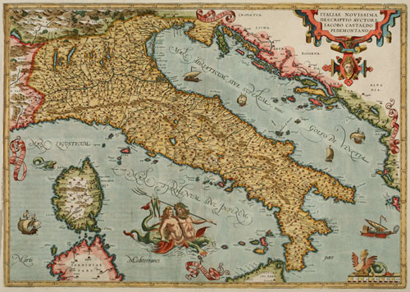
Venice
Florence
Genoa
Rome
Classic 16th Century Atlas Map of Italy
http://alteagallery.com/stock_detail.php?ref=9355
Notes:
69

Slide 70
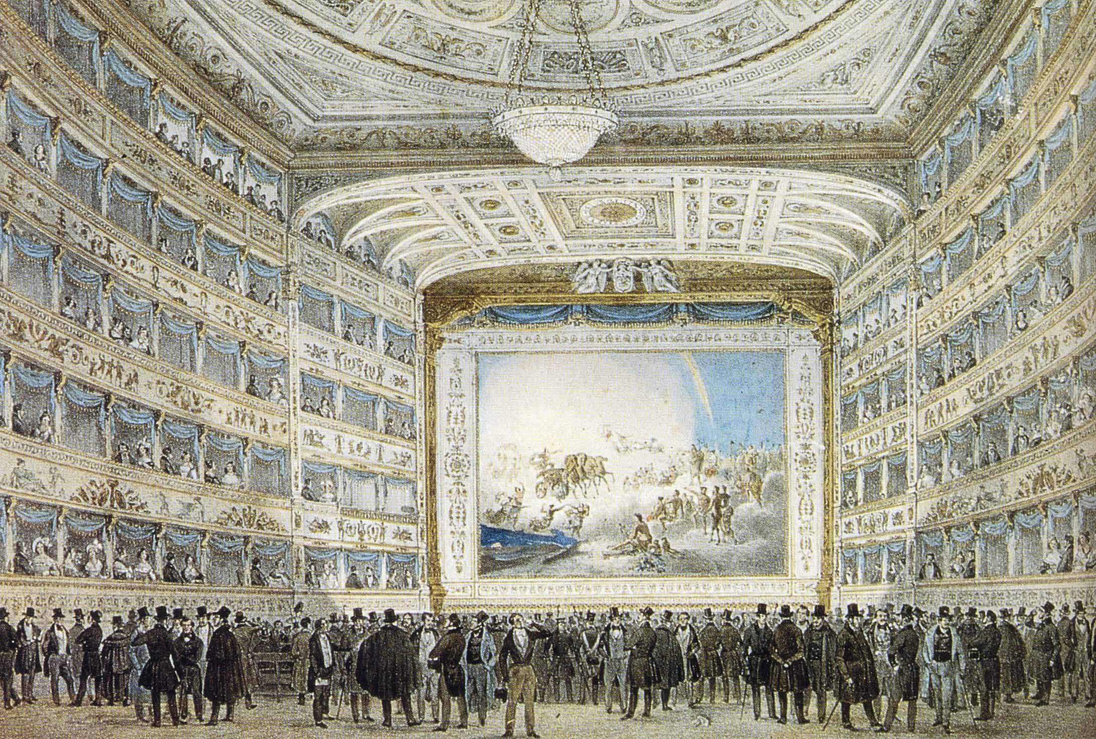
La Fenice opera house in Venice in 1837
https://en.wikipedia.org/wiki/Italian_opera

Slide 71
Martin J. Gannon and Rajnandini Pillai Understanding Global Cultures
The opera is a metaphor for Italy itself, because it encompasses . . .
music
dramatic action
public spectacle and pageantry
a sense of fate
www.d.umn.edu/cla/faculty/troufs/anth1095/index.html#Gannon

Slide 72
Martin J. Gannon and Rajnandini Pillai Understanding Global Cultures
It may be . . .
tragic or comic
intensely personal
or flamboyantly public
www.d.umn.edu/cla/faculty/troufs/anth1095/index.html#Gannon

Slide 73
Martin J. Gannon and Rajnandini Pillai Understanding Global Cultures
with the soloists and chorus expressing themselves through
language
gesture
music
and always through highly skilled acting
www.d.umn.edu/cla/faculty/troufs/anth1095/index.html#Gannon

Slide 74
Martin J. Gannon and Rajnandini Pillai Understanding Global Cultures
There is a
larger-than-life aura
surrounding operas,
and the audience is vitally engaged
in the opera itself,
showing great emotion and love toward a singer whose talents are able to express the common feelings that Italians tend to share
www.d.umn.edu/cla/faculty/troufs/anth1095/index.html#Gannon

Slide 75
Martin J. Gannon and Rajnandini Pillai Understanding Global Cultures
“Operas and operatic songs
reflect the essence of Italian culture,
and they are
embraced by Italians
with an emotional attachment that less dramatic peoples might find difficult to understand”
www.d.umn.edu/cla/faculty/troufs/anth1095/index.html#Gannon

Slide 76
Martin J. Gannon and Rajnandini Pillai Understanding Global Cultures
Gannon and Pillai focus on
five distinctive characteristics of the opera
and demonstrates how they illustrate Italian life . . .
www.d.umn.edu/cla/faculty/troufs/anth1095/index.html#Gannon

Slide 77
The Overture
Pageantry and Spectacle
Voice
Externalization
5. Chorus and Soloists
Italy
www.d.umn.edu/cla/faculty/troufs/anth1095/index.html#Gannon

Slide 78
Martin J. Gannon and Rajnandini Pillai Understanding Global Cultures
1. The overture
2. The pageantry and spectacle itself and the manner in which the opera-like activities are performed in the daily life of the Italians
3. The use and importance of voice to express words in a musical fashion
4. Externalization, which refers specifically to the belief that emotions and thoughts are so powerful that an individual cannot keep them within himself or herself and must express them to others
5. The importance of both the chorus and the soloists, which reflects the unity of Italian culture (chorus) but also regional variations, particularly between the north and south
www.d.umn.edu/cla/faculty/troufs/anth1095/index.html#Gannon

Slide 79
Martin J. Gannon and Rajnandini Pillai Understanding Global Cultures
The overture
The pageantry and spectacle itself and the manner in which the opera-like activities are performed in the daily life of the Italians
The use and importance of voice to express words in a musical fashion
Externalization, which refers specifically to the belief that emotions and thoughts are so powerful that an individual cannot keep them within himself or herself and must express them to others
The importance of both the chorus and the soloists, which reflects the unity of Italian culture (chorus) but also regional variations, particularly between the north and south
www.d.umn.edu/cla/faculty/troufs/anth1095/index.html#Gannon

Slide 80
The Overture
Pageantry and Spectacle
Voice
Externalization
5. Chorus and Soloists
Italy
www.d.umn.edu/cla/faculty/troufs/anth1095/index.html#Gannon

Slide 81
The Overture
Pageantry and Spectacle
Voice
Externalization
5. Chorus and Soloists
sets the mood
and gives some idea as to what one can expect
Italy
www.d.umn.edu/cla/faculty/troufs/anth1095/index.html#Gannon

Slide 82
Martin J. Gannon and Rajnandini Pillai Understanding Global Cultures
Essentially, the orchestra sets the mood for the opera
during the overture
and gives some idea as to what the audience can expect to occur
www.d.umn.edu/cla/faculty/troufs/anth1095/index.html#Gannon

Slide 83
Martin J. Gannon and Rajnandini Pillai Understanding Global Cultures
typically, the overture is about
5 minutes in length
and it frequently includes passages that are emotionally
somber
cheerful
reflective
and so forth
www.d.umn.edu/cla/faculty/troufs/anth1095/index.html#Gannon

Slide 84
Martin J. Gannon and Rajnandini Pillai Understanding Global Cultures
at various points, the overture is
quick
moderate
or slow in tempo
and it employs different instruments to convey the sense of what will happen in the various acts
—usually three—
into which the opera is divided
www.d.umn.edu/cla/faculty/troufs/anth1095/index.html#Gannon

Slide 85
Martin J. Gannon and Rajnandini Pillai Understanding Global Cultures
the overture was such an influential innovation that it
inspired the development of the German symphony
www.d.umn.edu/cla/faculty/troufs/anth1095/index.html#Gannon

Slide 86
Gannon and Pillai’s European Cultural Metaphors include
Ch. 7 The Swedish Stuga
Ch. 8 The Finnish Sauna
Ch. 9 The Danish Christmas Luncheon
Ch. 10 The German Symphony
Ch. 11 Irish Conversations
Ch. 14 French Wine . . .
Ch. 16 The Traditional British House
www.d.umn.edu/cla/faculty/troufs/anth1095/index.html#Gannon

Slide 87
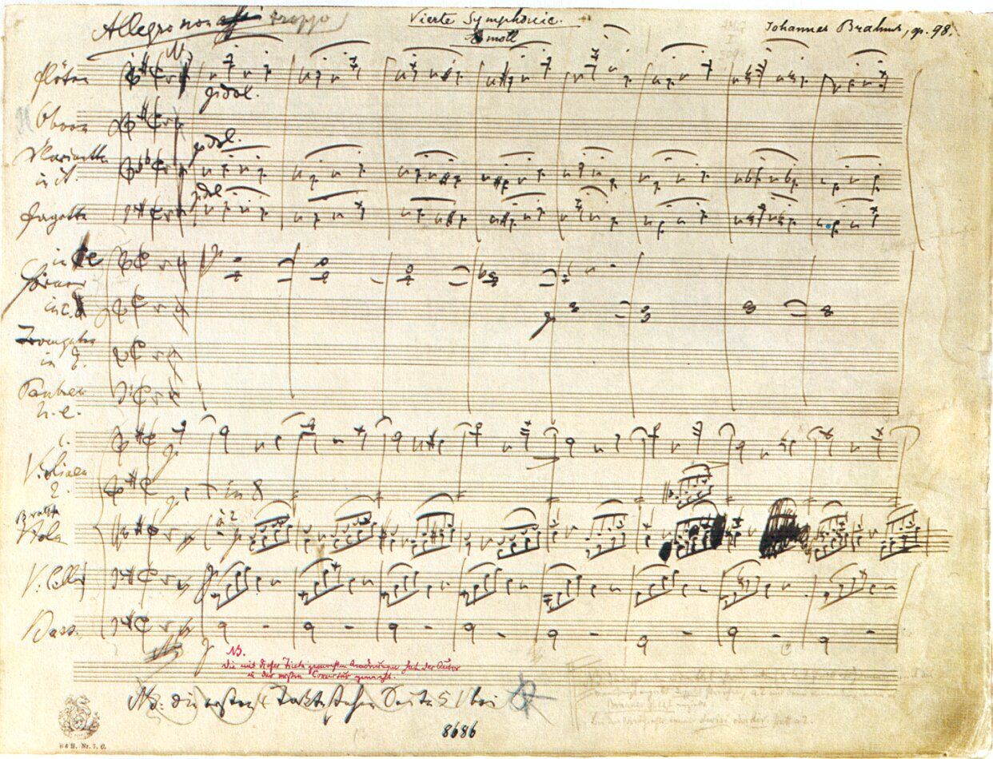
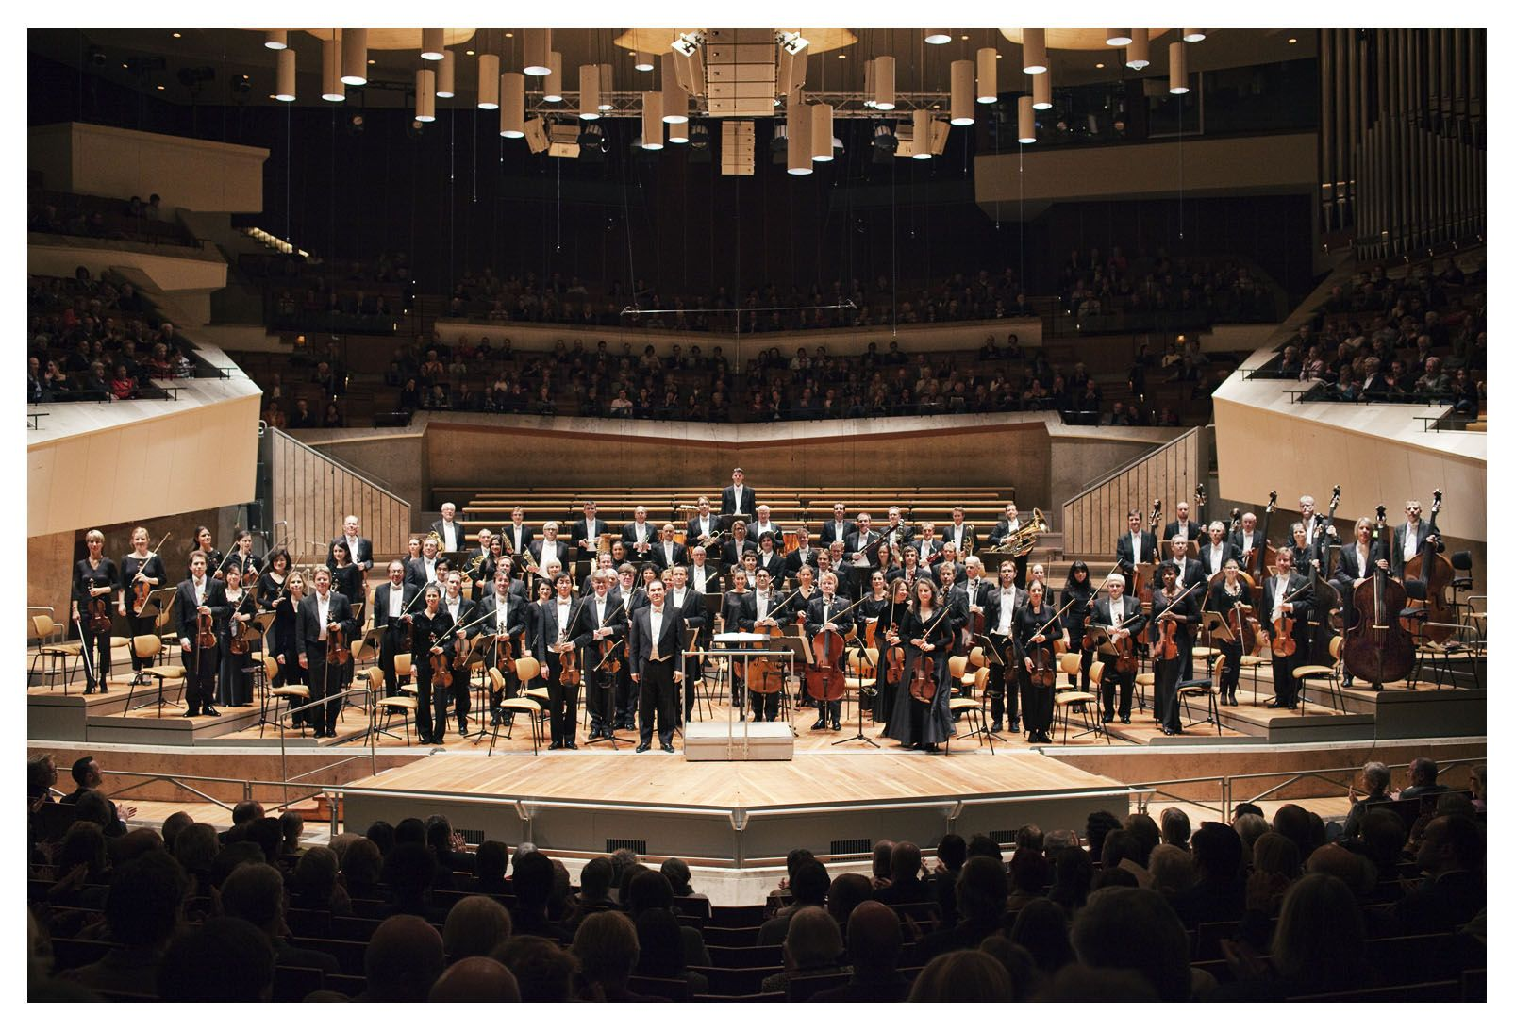
German Symphony Orchestra Berlin
http://www.mfiles.co.uk/manuscripts-pens-and-composers.htm

Slide 88
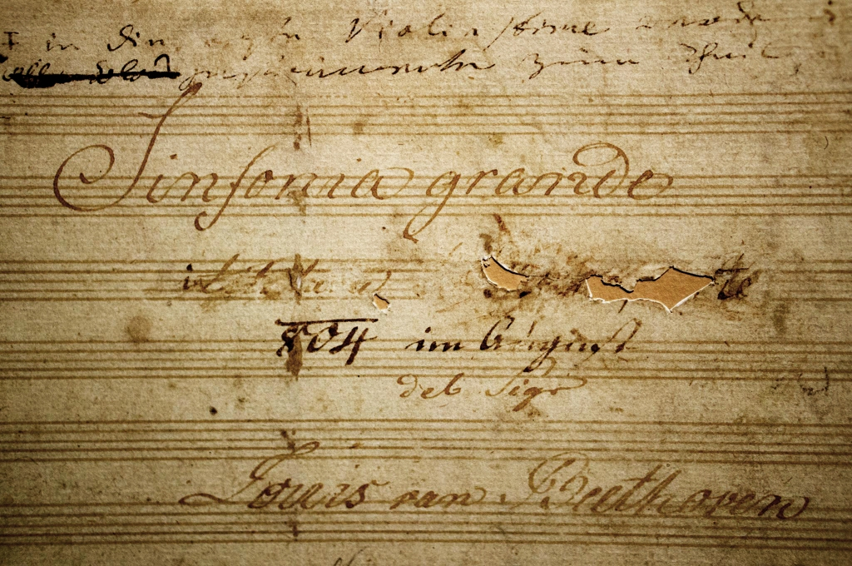
Title Page of Beethoven’s “Eroica” Symphony
https://commons.wikimedia.org/wiki/File:Eroica_Beethoven_title.jpg

Slide 89
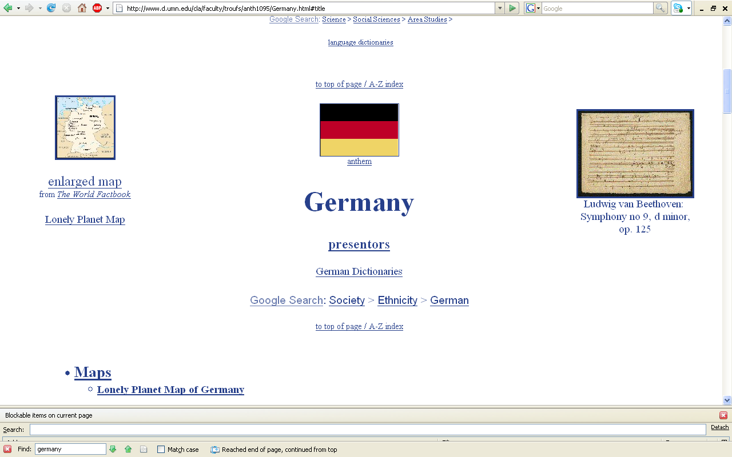
http://www.d.umn.edu/cla/faculty/troufs/anth1095/Germany.html#title

Slide 90
Martin J. Gannon and Rajnandini Pillai Understanding Global Cultures
“Italian culture emphasizes overtures. Italy stands somewhere in the middle of the continuum between American low-context culture and Asian high-context culture. American tend to ignore the overture and get down to business rather quickly. On the other hand, many Asians devote a significant amount of time getting to know their negotiating counterparts before doing business with them. . . .”
www.d.umn.edu/cla/faculty/troufs/anth1095/index.html#Gannon

Slide 91
Martin J. Gannon and Rajnandini Pillai Understanding Global Cultures
“Italian culture emphasizes overtures. Italy stands somewhere in the middle of the continuum between American low-context culture and Asian high-context culture. American tend to ignore the overture and get down to business rather quickly. On the other hand, many Asians devote a significant amount of time getting to know their negotiating counterparts before doing business with them. . . .”
American
(low context)
Italian
“Asians”
(high context)
www.d.umn.edu/cla/faculty/troufs/anth1095/index.html#Gannon

Slide 92
Martin J. Gannon and Rajnandini Pillai Understanding Global Cultures
“. . . Italians take a midway position on the issue of personal trust and knowledge, but they do tend to convey their feelings and thoughts at least partially at the beginning of a relationship. The other party has some understanding of what will unfold, but it is only a preview that is imperfect, because the unexpected frequently occurs.”
www.d.umn.edu/cla/faculty/troufs/anth1095/index.html#Gannon

Slide 93
Martin J. Gannon and Rajnandini Pillai Understanding Global Cultures
“. . . Italians take a midway position on the issue of personal trust and knowledge, but they do tend to convey their feelings and thoughts at least partially at the beginning of a relationship. The other party has some understanding of what will unfold, but it is only a preview that is imperfect, because the unexpected frequently occurs.”
X
(low personal trust)
Italian
Y
(high personal trust)
www.d.umn.edu/cla/faculty/troufs/anth1095/index.html#Gannon

Slide 94
Martin J. Gannon and Rajnandini Pillai Understanding Global Cultures
“. . . Italians take a midway position on the issue of personal trust and knowledge, but they do tend to convey their feelings and thoughts at least partially at the beginning of a relationship. The other party has some understanding of what will unfold, but it is only a preview that is imperfect, because
the unexpected frequently occurs.”
www.d.umn.edu/cla/faculty/troufs/anth1095/index.html#Gannon

Slide 95
Martin J. Gannon and Rajnandini Pillai Understanding Global Cultures
There are regional differences in the manner in which the overture is performed
In Milan, which has been influenced by its proximity to Switzerland and Germany, there is a tendency to shorten the overture
Still, it occurs, even in the smallest café that has only a few tables and a modest menu featuring sandwiches, in the form of a few minutes of conversation with the owner
www.d.umn.edu/cla/faculty/troufs/anth1095/index.html#Gannon

Slide 96
Martin J. Gannon and Rajnandini Pillai Understanding Global Cultures
There are regional differences in the manner in which the overture is performed
In Milan, which has been influenced by its proximity to Switzerland and Germany, there is a tendency to shorten the overture
Still, it occurs, even in the smallest café that has only a few tables and a modest menu featuring sandwiches, in the form of a few minutes of conversation with the owner
. . . but it is still there
www.d.umn.edu/cla/faculty/troufs/anth1095/index.html#Gannon

Slide 97

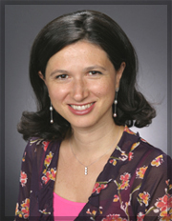
http://www.d.umn.edu/cla/faculty/troufs/anth1095/Germany.html#title

Slide 98
What did Manuela Fina first discuss in the initial meeting
about a cochlear implant?
(which eventually took a 7-hour operation,
with a surgical team of 10
and cost almost the price
of an average American house)
Dr. Manuela Fina and Kim Smyth Roufs discussed . . .

Slide 99

ladies’ Italian fine stockings

Slide 100
Martin J. Gannon and Rajnandini Pillai Understanding Global Cultures
There are regional differences in the manner in which the overture is performed
In the south, the overture can be much more involved
A person may visit a store, and chat with the owner, two or three times before purchasing something
Both parties have a good idea about the outcome, but there will be expressions of emotion, various uses of argument an persuasion, and different tones of vice that will help to facilitate the final outcome or sale
Still, the unexpected can, and does, occur, because fate is a critical element in the mix
www.d.umn.edu/cla/faculty/troufs/anth1095/index.html#Gannon

Slide 101
Martin J. Gannon and Rajnandini Pillai Understanding Global Cultures
There are regional differences in the manner in which the overture is performed
In the south, the overture can be much more involved
A person may visit a store, and chat with the owner, two or three times before purchasing something
Both parties have a good idea about the outcome, but there will be expressions of emotion, various uses of argument an persuasion, and different tones of vice that will help to facilitate the final outcome or sale
Still, the unexpected can, and does, occur, because fate is a critical element in the mix
www.d.umn.edu/cla/faculty/troufs/anth1095/index.html#Gannon

Slide 102
The Overture
Pageantry and Spectacle
Voice
Externalization
5. Chorus and Soloists
Italy
www.d.umn.edu/cla/faculty/troufs/anth1095/index.html#Gannon

Slide 103
The Overture
Pageantry and Spectacle
Voice
Externalization
5. Chorus and Soloists
The pageantry and spectacle itself and the manner in which the opera-like activities are performed in the daily life of the Italians
Italy
www.d.umn.edu/cla/faculty/troufs/anth1095/index.html#Gannon

Slide 104
Martin J. Gannon and Rajnandini Pillai Understanding Global Cultures
“By and large, Italy is a land of spectacle and pageantry. Italians tend to be more animated and expressive than most other nationalities.”
“Italians, particularly those in the south, revel when communicating in an expressive manner.”
www.d.umn.edu/cla/faculty/troufs/anth1095/index.html#Gannon

Slide 105
Martin J. Gannon and Rajnandini Pillai Understanding Global Cultures
“By and large, Italy is a land of spectacle and pageantry. Italians tend to be more animated and expressive than most other nationalities.”
The level of noise in Italy tends to be high in public places
And people tend to congregate rather than be isolated from one another
www.d.umn.edu/cla/faculty/troufs/anth1095/index.html#Gannon

Slide 106
Martin J. Gannon and Rajnandini Pillai Understanding Global Cultures
“By and large, Italy is a land of spectacle and pageantry. Italians tend to be more animated and expressive than most other nationalities.”
Some bystanders do not mind becoming part of the action
www.d.umn.edu/cla/faculty/troufs/anth1095/index.html#Gannon

Slide 107
Martin J. Gannon and Rajnandini Pillai Understanding Global Cultures
“Once the overture is over and the curtain goes up, the audience is greeted by a set so visually stunning that it elicits applause. This is the beginning of the pageantry and spectacle. They play such an important role in Italian life that people and things frequently tend to be judged first and foremost on their appearances.”
www.d.umn.edu/cla/faculty/troufs/anth1095/index.html#Gannon

Slide 108
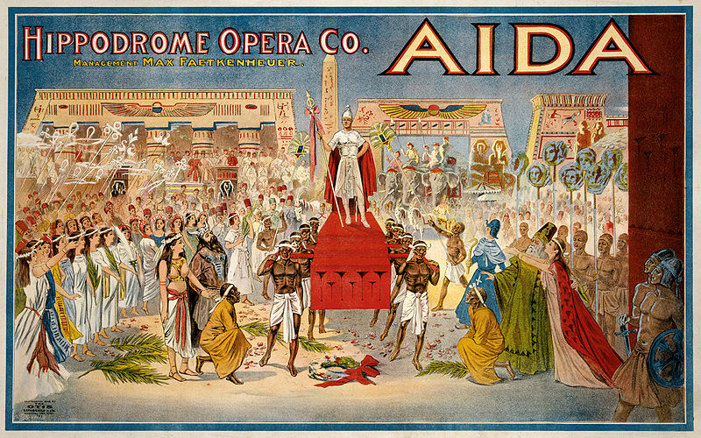
http://en.wikipedia.org/wiki/Aida

Slide 109
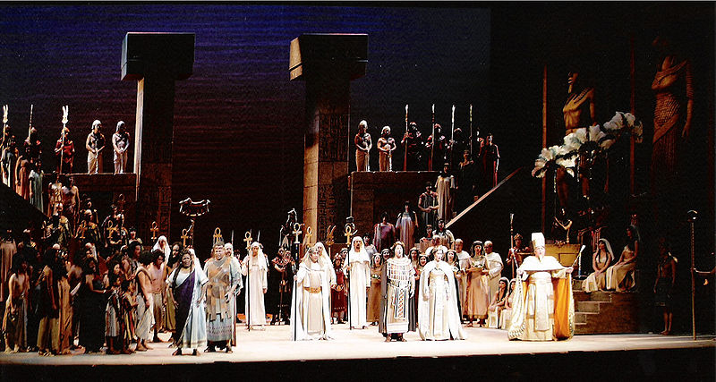
http://en.wikipedia.org/wiki/Aida

Slide 110
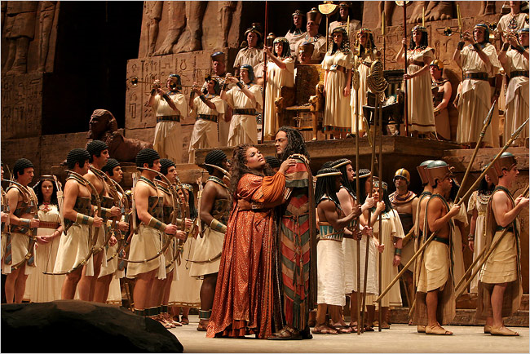
http://www.nedgallagher.com/journal/images/aida.jpg

Slide 111
Compare that with the starkness of the German Symphony Orchestra Berlin
http://www.mfiles.co.uk/manuscripts-pens-and-composers.htm

Slide 112
Martin J. Gannon and Rajnandini Pillai Understanding Global Cultures
“Once the overture is over and the curtain goes up, the audience is greeted by a set so visually stunning that it elicits applause. This is the beginning of the pageantry and spectacle. They play such an important role in Italian life that people and things frequently tend to be judged first and foremost on their appearances.”
www.d.umn.edu/cla/faculty/troufs/anth1095/index.html#Gannon

Slide 113
Martin J. Gannon and Rajnandini Pillai Understanding Global Cultures
“The surface of Italian life, playful, yet bleak and tragic at times, has many of the characteristics of a show . . .
It is, first of all, usually moving
entertaining
unreservedly picturesque
www.d.umn.edu/cla/faculty/troufs/anth1095/index.html#Gannon

Slide 114
Martin J. Gannon and Rajnandini Pillai Understanding Global Cultures
“The surface of Italian life, playful, yet bleak and tragic at times, has many of the characteristics of a show . . .
Second, all of its effects are skillfully contrived and graduated to convey a certain message to, and arouse particular emotions in, the bystanders
www.d.umn.edu/cla/faculty/troufs/anth1095/index.html#Gannon

Slide 115
Martin J. Gannon and Rajnandini Pillai Understanding Global Cultures
“The surface of Italian life, playful, yet bleak and tragic at times, has many of the characteristics of a show . . .
Italians are frequently great dramatic actors as we might expect of the creators of the opera
www.d.umn.edu/cla/faculty/troufs/anth1095/index.html#Gannon

Slide 116
Martin J. Gannon and Rajnandini Pillai Understanding Global Cultures
The first purpose of the show is to make life acceptable and pleasant
This attitude can be explained largely by the circumstances of history, both natural and
human-made, where four active volcanoes, floods, and earthquakes, as well as continuous invasions by outsiders, have created a
sense of insecurity
www.d.umn.edu/cla/faculty/troufs/anth1095/index.html#Gannon

Slide 117
Martin J. Gannon and Rajnandini Pillai Understanding Global Cultures
“Italians tend to make life’s dull and insignificant moments exciting and significant by decorating and ritualizing them.”
“This practice of embellishing everyday events was developed by a realistic group of people that tends to react cautiously because it believes that
catastrophes cannot be averted, only mitigated.”
www.d.umn.edu/cla/faculty/troufs/anth1095/index.html#Gannon

Slide 118
Martin J. Gannon and Rajnandini Pillai Understanding Global Cultures
“Italians tend to make life’s dull and insignificant moments exciting and significant by
decorating and ritualizing them.”
“This practice of
embellishing everyday events was developed by a realistic group of people that tends to react cautiously because it believes that catastrophes cannot be averted, only mitigated.”
www.d.umn.edu/cla/faculty/troufs/anth1095/index.html#Gannon

Slide 119
Martin J. Gannon and Rajnandini Pillai Understanding Global Cultures
“. . . Many Italians wish to portray a certain image to those around them. This is termed la bella figura, or the projection of ‘a confident, knowing, capable face to the world’” (Brint 1989)
Importance is attached to impressions
www.d.umn.edu/cla/faculty/troufs/anth1095/index.html#Gannon

Slide 120
Martin J. Gannon and Rajnandini Pillai Understanding Global Cultures
“. . . Many Italians wish to portray a certain image to those around them. This is termed la bella figura, or the projection of ‘a confident, knowing, capable face to the world’” (Brint 1989)
Importance is attached to impressions
www.d.umn.edu/cla/faculty/troufs/anth1095/index.html#Gannon

Slide 121
Martin J. Gannon and Rajnandini Pillai Understanding Global Cultures
“. . . Many Italians wish to portray a certain image to those around them. This is termed la bella figura, or the projection of ‘a confident, knowing, capable face to the world’” (Brint 1989)
Importance is attached to impressions
www.d.umn.edu/cla/faculty/troufs/anth1095/index.html#Gannon

Slide 122
Martin J. Gannon and Rajnandini Pillai Understanding Global Cultures
A large number of Italians pursue la bella figura
through material possession
Giving a good impression, not only with demeanor but also with material wealth, is important
www.d.umn.edu/cla/faculty/troufs/anth1095/index.html#Gannon

Slide 123
Martin J. Gannon and Rajnandini Pillai Understanding Global Cultures
A large number of Italians pursue la
bella figura through material possession
Various explanations have been offered for this tendency, including years of domination by foreign nations overcrowding in various areas natural disasters
www.d.umn.edu/cla/faculty/troufs/anth1095/index.html#Gannon

Slide 124
Martin J. Gannon and Rajnandini Pillai Understanding Global Cultures
A large number of Italians pursue la
bella figura through material possession
Whatever the explanation, it seems that the creation of a show through an eternal search
for pleasures and distractions
is an attempt to deal with difficult realities of everyday life
www.d.umn.edu/cla/faculty/troufs/anth1095/index.html#Gannon

Slide 125
Martin J. Gannon and Rajnandini Pillai Understanding Global Cultures
“This eternal search for surface pleasures and distractions is accompanied by garbo. Although this term cannot be translated exactly, it is the finesse that Italians use to deal with situations delicately and without offense.
Garbo turns Italian life into a work of art. Italians tend to have a very public orientation, are willing to share a lot, and are used to being on stage at all times.”
www.d.umn.edu/cla/faculty/troufs/anth1095/index.html#Gannon

Slide 126
Martin J. Gannon and Rajnandini Pillai Understanding Global Cultures
“This eternal search for surface pleasures and distractions is accompanied by garbo. Although this term cannot be translated exactly, it is the finesse that Italians use to deal with situations delicately and without offense.
Garbo turns Italian life into a work of art. Italians tend to have a very public orientation, are willing to share a lot, and are used to being on stage at all times.”
www.d.umn.edu/cla/faculty/troufs/anth1095/index.html#Gannon

Slide 127
Martin J. Gannon and Rajnandini Pillai Understanding Global Cultures
“This eternal search for surface pleasures and distractions is accompanied by garbo. Although this term cannot be translated exactly, it is the finesse that Italians use to deal with situations delicately and without offense.
Garbo turns Italian life into a work of art. Italians tend to have a very public orientation, are willing to share a lot, and are used to being on stage at all times.”
www.d.umn.edu/cla/faculty/troufs/anth1095/index.html#Gannon

Slide 128
Martin J. Gannon and Rajnandini Pillai Understanding Global Cultures
“This eternal search for surface pleasures and distractions is accompanied by garbo. Although this term cannot be translated exactly, it is the finesse that Italians use to deal with situations delicately and without offense.
Garbo turns Italian life into a work of art. Italians tend to have a very public orientation, are willing to share a lot, and are used to being on stage at all times.”
www.d.umn.edu/cla/faculty/troufs/anth1095/index.html#Gannon

Slide 129
Martin J. Gannon and Rajnandini Pillai Understanding Global Cultures
the Italian reliance on spectacle and garbo
helps people solve most of their problems
www.d.umn.edu/cla/faculty/troufs/anth1095/index.html#Gannon

Slide 130
Martin J. Gannon and Rajnandini Pillai Understanding Global Cultures
spectacle and garbo
govern public and private life and shape policy and political designs
www.d.umn.edu/cla/faculty/troufs/anth1095/index.html#Gannon

Slide 131
Martin J. Gannon and Rajnandini Pillai Understanding Global Cultures
The Italian reliance on spectacle and garbo helps people solve most of their problems
Spectacle and garbo govern public and private life and shape policy and political designs
They constitute one of the reasons that Italians have excelled in activities in which appearance is predominant
(more on this later)
www.d.umn.edu/cla/faculty/troufs/anth1095/index.html#Gannon

Slide 132
Martin J. Gannon and Rajnandini Pillai Understanding Global Cultures
The operatic pageantry of Italian life also occurs in
the rituals of the Catholic Church
Italians often prize these rituals for their pageantry, spectacle, and value in fostering family celebrations rather than for their religious significance
www.d.umn.edu/cla/faculty/troufs/anth1095/index.html#Gannon

Slide 133
Martin J. Gannon and Rajnandini Pillai Understanding Global Cultures
many Italians view the Church,
much like the opera
as a source of drama and ritual,
but not authority
www.d.umn.edu/cla/faculty/troufs/anth1095/index.html#Gannon

Slide 134
Martin J. Gannon and Rajnandini Pillai Understanding Global Cultures
although many do not attend church regularly,
the Church still exerts a strong cultural and social influence on behavior,
and almost all Italians identify themselves as Catholics
www.d.umn.edu/cla/faculty/troufs/anth1095/index.html#Gannon

Slide 135
Demographics
Religions
Roman Catholic 80%-90%
approximately
about one-third regularly attend services
Other 10-20%%
includes “mature Protestant” and Jewish communities
and a growing Muslim immigrant community
CIA World Factbook
https://www.cia.gov/the-world-factbook/countries/italy/

Slide 136
Martin J. Gannon and Rajnandini Pillai Understanding Global Cultures
The spectacle of Italian life is quite apparent in the area of communications
www.d.umn.edu/cla/faculty/troufs/anth1095/index.html#Gannon

Slide 137
Martin J. Gannon and Rajnandini Pillai Understanding Global Cultures
The spectacle of Italian life is quite apparent in the area of communications
Italians tend to be skilled conversationalists
Onlookers can frequently follow the conversation from a distance because of the gestures and facial expressions that area employed to convey different emotions
Similarly, one can understand many of the actions that take place in an opera without fully understanding what the actors are singing
www.d.umn.edu/cla/faculty/troufs/anth1095/index.html#Gannon

Slide 138
Martin J. Gannon and Rajnandini Pillai Understanding Global Cultures
The spectacle of Italian life is quite apparent in the area of communications
Italians tend to be skilled conversationalists
Onlookers can frequently follow the conversation from a distance because of the gestures and facial expressions that area employed to convey different emotions
Similarly, one can understand many of the actions that take place in an opera without fully understanding what the actors are singing
www.d.umn.edu/cla/faculty/troufs/anth1095/index.html#Gannon

Slide 139
Martin J. Gannon and Rajnandini Pillai Understanding Global Cultures
Pageantry and spectacle also apply to business presentations and negotiations
A manager should ensure that the aesthetics of a presentation should be clear and exact
S/he should demonstrate a mastery of detail and language
S/he should be well organized
Polish and elegance count for a great deal
www.d.umn.edu/cla/faculty/troufs/anth1095/index.html#Gannon

Slide 140
Martin J. Gannon and Rajnandini Pillai Understanding Global Cultures
Pageantry and spectacle also apply to business presentations and negotiations
A manager should ensure that the aesthetics of a presentation should be clear and exact
S/he should demonstrate a mastery of detail and language
S/he should be well organized
Polish and elegance count for a great deal
www.d.umn.edu/cla/faculty/troufs/anth1095/index.html#Gannon

Slide 141
Martin J. Gannon and Rajnandini Pillai Understanding Global Cultures
Pageantry and spectacle also apply to business presentations and negotiations
However, although pageantry is important in business presentations and negotiations, Italians also tend to expect good-faith bargaining
www.d.umn.edu/cla/faculty/troufs/anth1095/index.html#Gannon

Slide 142
Martin J. Gannon and Rajnandini Pillai Understanding Global Cultures
Although Italians tend to be emotional and dramatic, few decisions are influenced by sentiments, tastes, hazards or hopes, but usually by a careful evaluation of the relative strength of the contending parties
This is one of the reasons that, when negotiating even the smallest deal, Italians prefer to look each other in the face
www.d.umn.edu/cla/faculty/troufs/anth1095/index.html#Gannon

Slide 143
Martin J. Gannon and Rajnandini Pillai Understanding Global Cultures
Although Italians tend to be emotional and dramatic, few decisions are influenced by sentiments, tastes, hazards or hopes, but usually by a careful evaluation of the relative strength of the contending parties
This is one of the reasons that, when negotiating even the smallest deal, Italians prefer to look each other in the face
www.d.umn.edu/cla/faculty/troufs/anth1095/index.html#Gannon

Slide 144
Martin J. Gannon and Rajnandini Pillai Understanding Global Cultures
Although Italians tend to be emotional and dramatic, few decisions are influenced by sentiments, tastes, hazards or hopes, but usually by a careful evaluation of the relative strength of the contending parties
This is one of the reasons that, when negotiating even the smallest deal, Italians prefer to look each other in the face
www.d.umn.edu/cla/faculty/troufs/anth1095/index.html#Gannon

Slide 145
Martin J. Gannon and Rajnandini Pillai Understanding Global Cultures
Although Italians tend to be emotional and dramatic, few decisions are influenced by sentiments, tastes, hazards or hopes, but usually by a careful evaluation of the relative strength of the contending parties
They read the opponent’s expressions to gauge his or her position and can thus decide when it is safe to increase demands, when to stand pat, and when to retreat
www.d.umn.edu/cla/faculty/troufs/anth1095/index.html#Gannon

Slide 146
Martin J. Gannon and Rajnandini Pillai Understanding Global Cultures
Transparent deceptions are employed to give each person the feeling that s/he is a unique specimen of humanity, worthy of special consideration
www.d.umn.edu/cla/faculty/troufs/anth1095/index.html#Gannon

Slide 147
Martin J. Gannon and Rajnandini Pillai Understanding Global Cultures
In Italy,
few confess to being
“an average man”
www.d.umn.edu/cla/faculty/troufs/anth1095/index.html#Gannon

Slide 148
Martin J. Gannon and Rajnandini Pillai Understanding Global Cultures
“The operatic Italians must always project a capable face to the world”
Therefore, they prefer to engage only in work that will create the image of confidence and intelligence
www.d.umn.edu/cla/faculty/troufs/anth1095/index.html#Gannon

Slide 149
Martin J. Gannon and Rajnandini Pillai Understanding Global Cultures
“The operatic Italians must always project a capable face to the world”
Therefore, they prefer to engage only in work that will create the image of confidence and intelligence
In Italy, a middle-class person tends to work only when s/he has a profession, and not while s/he is a high school or university student
students specialize immediately in their first year in the universities and “do not dabble, as is the custom in the United States”
However there is no set term for most university careers, and so many Italians spend more time in school than their American counterparts
www.d.umn.edu/cla/faculty/troufs/anth1095/index.html#Gannon

Slide 150
Martin J. Gannon and Rajnandini Pillai Understanding Global Cultures
“Most . . . Italians feel that it is infinitely better to be rich than to seem rich. [But] the art of appearing rich has been cultivated in Italy as nowhere else.”
“Decoration and embellishment are important so that the realties of poverty, uncertainty, and a scantily endowed land can be changed into a spectacle of illusion.”
www.d.umn.edu/cla/faculty/troufs/anth1095/index.html#Gannon

Slide 151
Martin J. Gannon and Rajnandini Pillai Understanding Global Cultures
“Most . . . Italians feel that it is infinitely better to be rich than to seem rich. [But] the art of appearing rich has been cultivated in Italy as nowhere else.”
“Decoration and embellishment are important so that the realties of poverty, uncertainty, and a scantily endowed land can be changed into a spectacle of illusion.”
www.d.umn.edu/cla/faculty/troufs/anth1095/index.html#Gannon

Slide 152
Martin J. Gannon and Rajnandini Pillai Understanding Global Cultures
“The pageantry of Italian life is highlighted by its lack of a rigid social hierarchy”
There is no permanent and rigid class structure in Italy
Rather there are conditions upon which a person is judged
www.d.umn.edu/cla/faculty/troufs/anth1095/index.html#Gannon

Slide 153
Martin J. Gannon and Rajnandini Pillai Understanding Global Cultures
“The pageantry of Italian life is highlighted by its lack of a rigid social hierarchy”
There is no permanent and rigid class structure in Italy
Rather there are conditions upon which a person is judged
www.d.umn.edu/cla/faculty/troufs/anth1095/index.html#Gannon

Slide 154
Martin J. Gannon and Rajnandini Pillai Understanding Global Cultures
Rather there are conditions upon which a person is judged
occupation and the amount of authority a person has in that role
education
ancestry
and, in most instances, wealth
www.d.umn.edu/cla/faculty/troufs/anth1095/index.html#Gannon

Slide 155
Martin J. Gannon and Rajnandini Pillai Understanding Global Cultures
Rather there are conditions upon which a person is judged
However, the major focus is placed on social behavior
www.d.umn.edu/cla/faculty/troufs/anth1095/index.html#Gannon

Slide 156
The Overture
Pageantry and Spectacle
Voice
Externalization
5. Chorus and Soloists
Civilta
Italy
www.d.umn.edu/cla/faculty/troufs/anth1095/index.html#Gannon

Slide 157
Martin J. Gannon and Rajnandini Pillai Understanding Global Cultures
However, the major focus is placed on social behavior
The Italians term this focus civilta, or the extent to which someone is acculturated to the norms of the area (Keefe 1977)
These norms include styles of dress, manners, and even participation in the local community
www.d.umn.edu/cla/faculty/troufs/anth1095/index.html#Gannon

Slide 158
Martin J. Gannon and Rajnandini Pillai Understanding Global Cultures
However, the major focus is placed on social behavior
The Italians term this focus civilta, or the extent to which someone is acculturated to the norms of the area (Keefe 1977)
These norms include . . .
styles of dress,
manners, and
participation in the local community
www.d.umn.edu/cla/faculty/troufs/anth1095/index.html#Gannon

Slide 159
Martin J. Gannon and Rajnandini Pillai Understanding Global Cultures
However, the major focus is placed on social behavior
The Italians term this focus civilta, or the extent to which someone is acculturated to the norms of the area (Keefe 1977)
These norms include . . .
styles of dress,
manners, and
participation in the local community
www.d.umn.edu/cla/faculty/troufs/anth1095/index.html#Gannon

Slide 160
Martin J. Gannon and Rajnandini Pillai Understanding Global Cultures
position in the social hierarchy
can be clearly judged
by the amount of respect shown to a person and his or her family
by the members of the community
However, respect is also associated with age and family position
www.d.umn.edu/cla/faculty/troufs/anth1095/index.html#Gannon

Slide 161
Martin J. Gannon and Rajnandini Pillai Understanding Global Cultures
position in the social hierarchy
can be clearly judged
by the amount of respect shown to a person and his or her family
by the members of the community
However, respect is also associated with age and family position
www.d.umn.edu/cla/faculty/troufs/anth1095/index.html#Gannon

Slide 162
Martin J. Gannon and Rajnandini Pillai Understanding Global Cultures
“Inevitably, class consciousness and the social hierarchy will change as a result of industrialization, massive migration to urban areas, low birth rates, and aging population, and the Americanization of Italian youth. However, certain titles still command much respect, such as doctor, lawyer, and professor. Many people feel honored to speak or have affiliations with someone holding such a title and will refer to him or her in a respectful, subordinate manner.”
www.d.umn.edu/cla/faculty/troufs/anth1095/index.html#Gannon

Slide 163
Martin J. Gannon and Rajnandini Pillai Understanding Global Cultures
“Inevitably, class consciousness and
the social hierarchy will change as a
result of industrialization, massive migration to urban areas, low birth rates, and aging population, and the Americanization of Italian youth. However, certain titles still command much respect, such as doctor, lawyer, and professor. Many people feel honored to speak or have affiliations with someone holding such a title and will refer to him or her in a respectful, subordinate manner.”
www.d.umn.edu/cla/faculty/troufs/anth1095/index.html#Gannon

Slide 164
The Overture
Pageantry and Spectacle
Voice
Externalization
5. Chorus and Soloists
Santo Patrono
Italy
www.d.umn.edu/cla/faculty/troufs/anth1095/index.html#Gannon

Slide 165
Martin J. Gannon and Rajnandini Pillai Understanding Global Cultures
One final example of pageantry is appropriate, especially because it shows how some other cultures are similar to that of Italy . . .
(cf., “The Spanish Bullfight”) . . .
www.d.umn.edu/cla/faculty/troufs/anth1095/index.html#Gannon

Slide 166
Martin J. Gannon and Rajnandini Pillai Understanding Global Cultures
Once a year, in every village and city, there is a celebration in honor of its patron saint (santo patrono) in which a parade is featured. The statue of the saint is place in the lead position in the parade, followed by the clergy, members of the upper classes, and then all other citizens. A celebration follows in the piazza, or town center. This tradition al festival and parade help to strengthen the feeling of solidarity and permit people to escape from the regular routine in a dramatic, spectacular, and fun-filled manner.”
www.d.umn.edu/cla/faculty/troufs/anth1095/index.html#Gannon

Slide 167
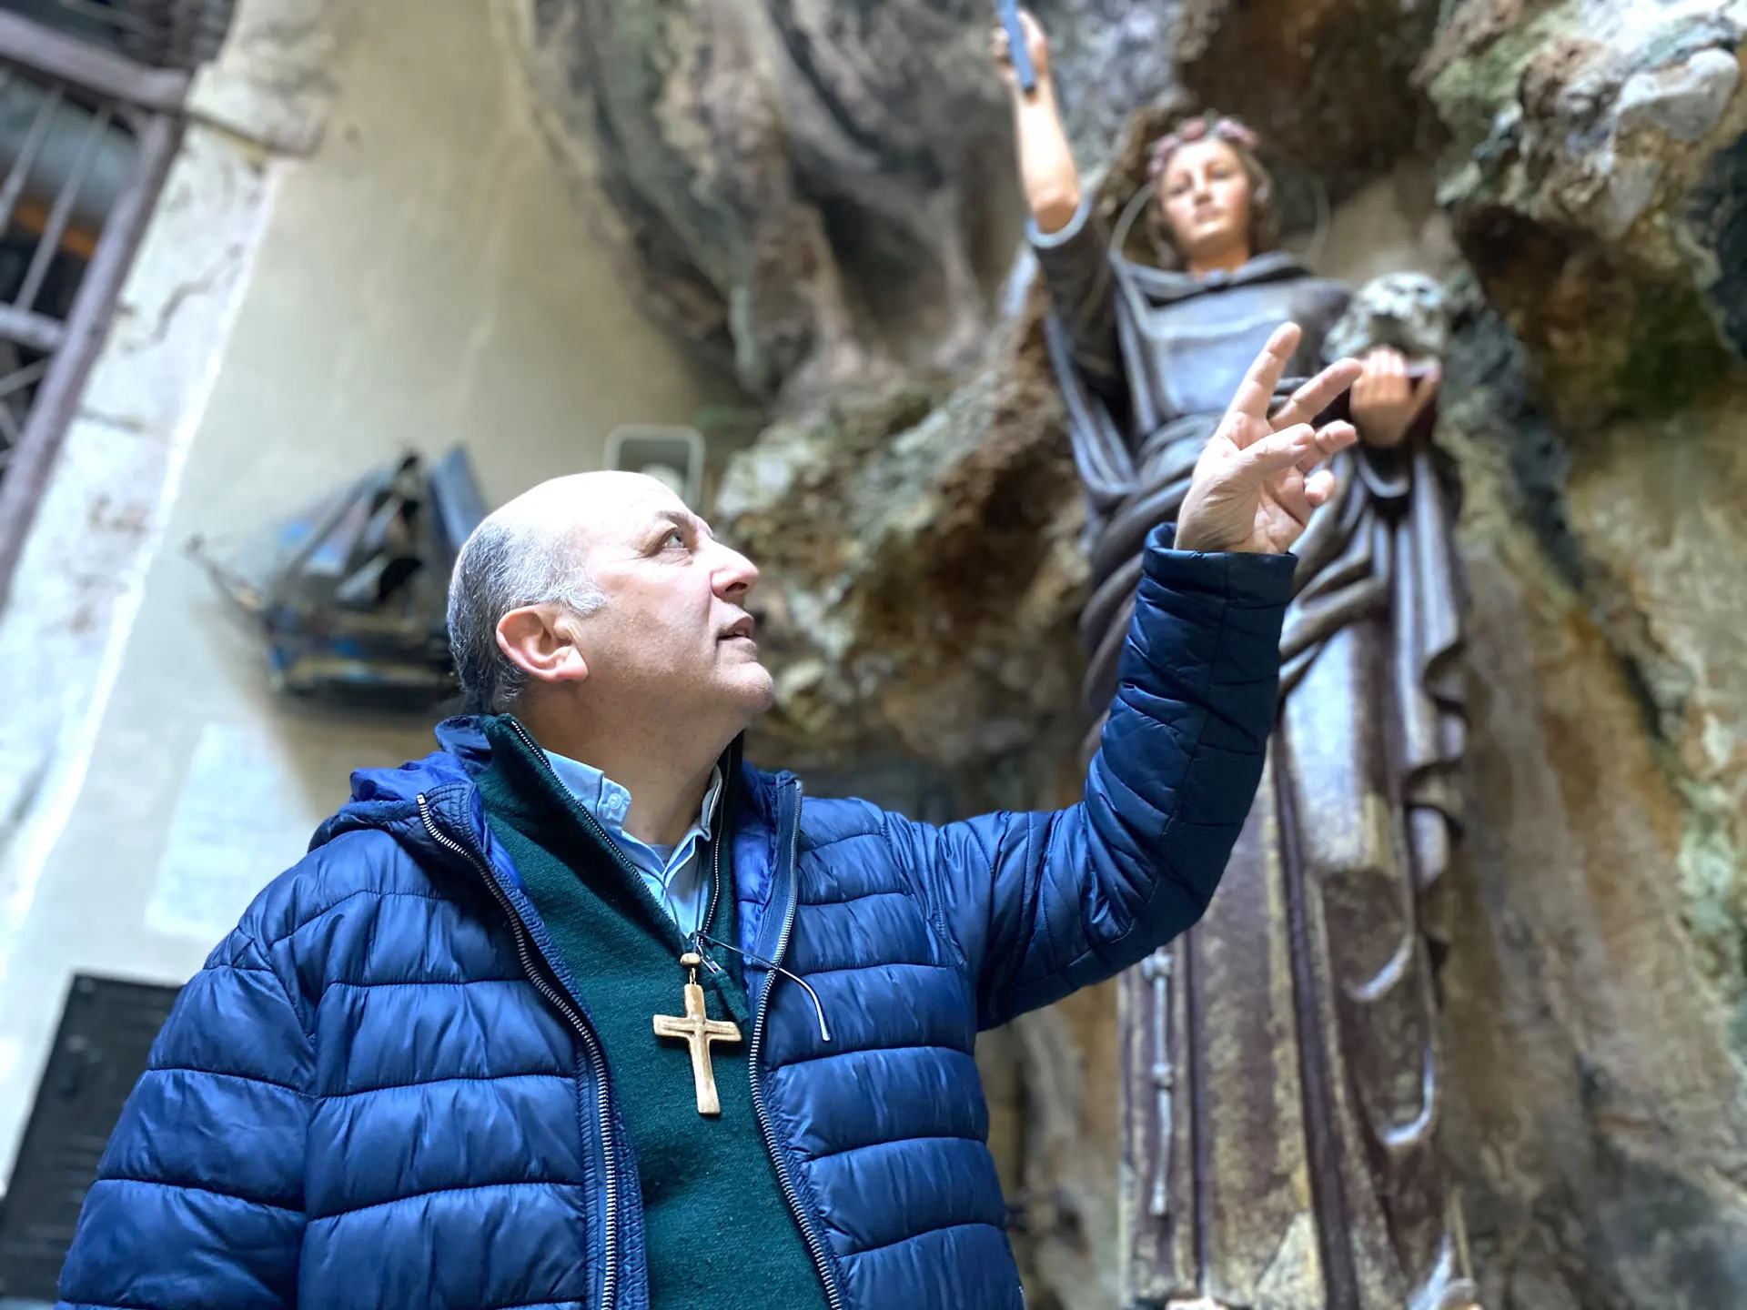

Palermo pins hopes on patron saint to rid Italy of coronavirus
Fri 13 Mar 2020 12.15 EDT
14 Mar 2020
Residents of Sicilian capital pray for another miracle from Saint Rosalia, who they say rescued the city from a deadly plague in 1625

Slide 168
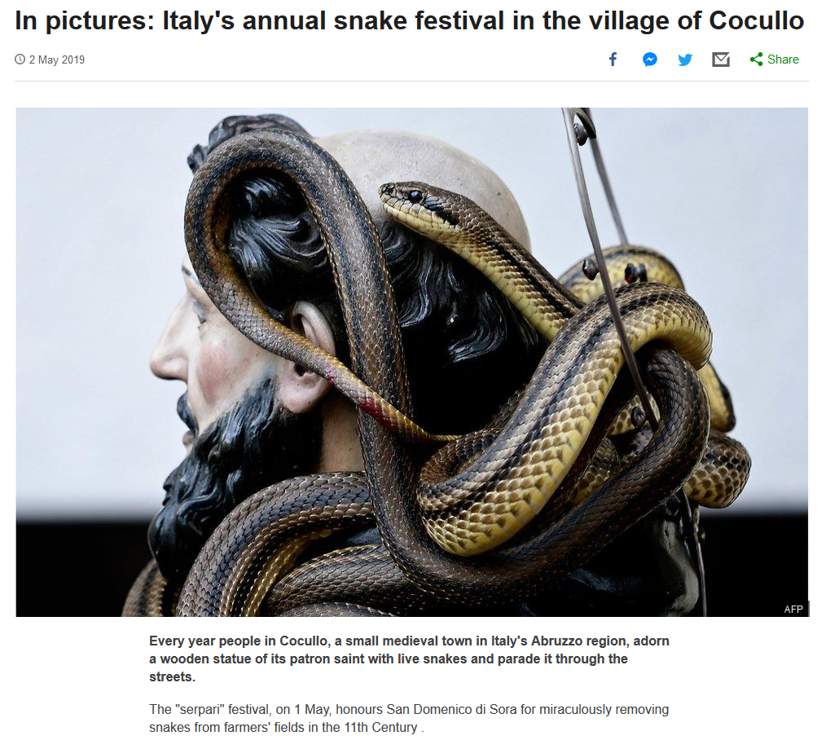
2 May 2019
Fri 13 Mar 2020 12.15 EDT
https://www.bbc.com/news/world-europe-48132701

Slide 169
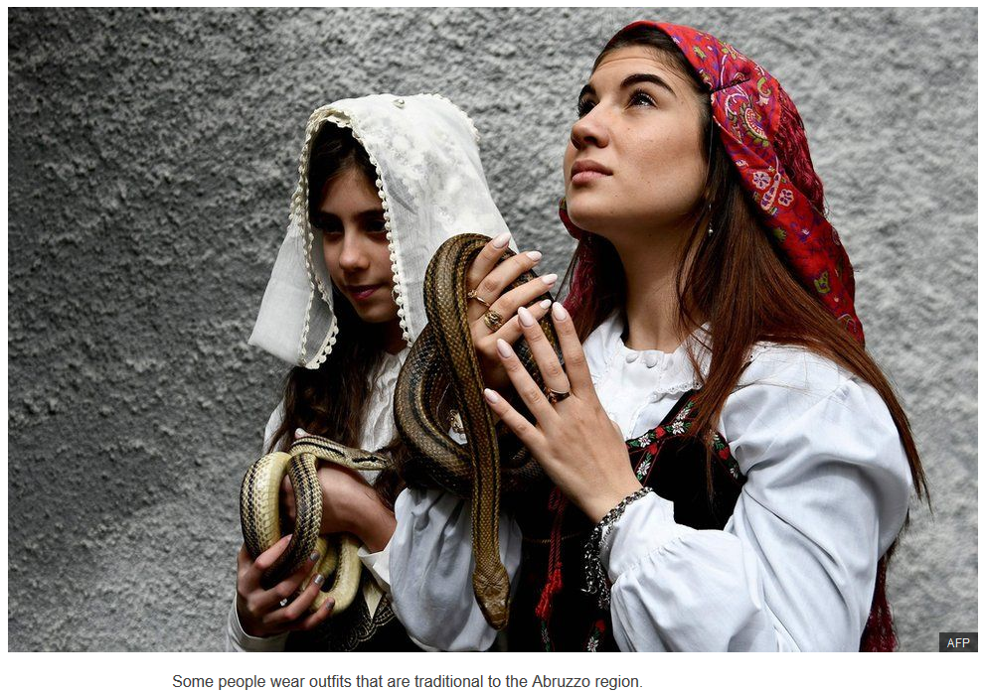
Fri 13 Mar 2020 12.15 EDT
2 May 2019
https://www.bbc.com/news/world-europe-48132701

Slide 170
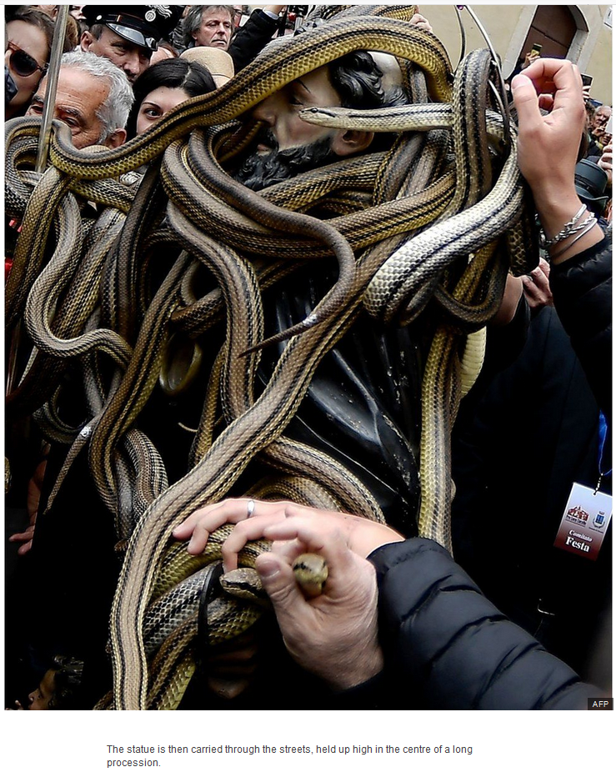
Fri 13 Mar 2020 12.15 EDT
2 May 2019
https://www.bbc.com/news/world-europe-48132701

Slide 171
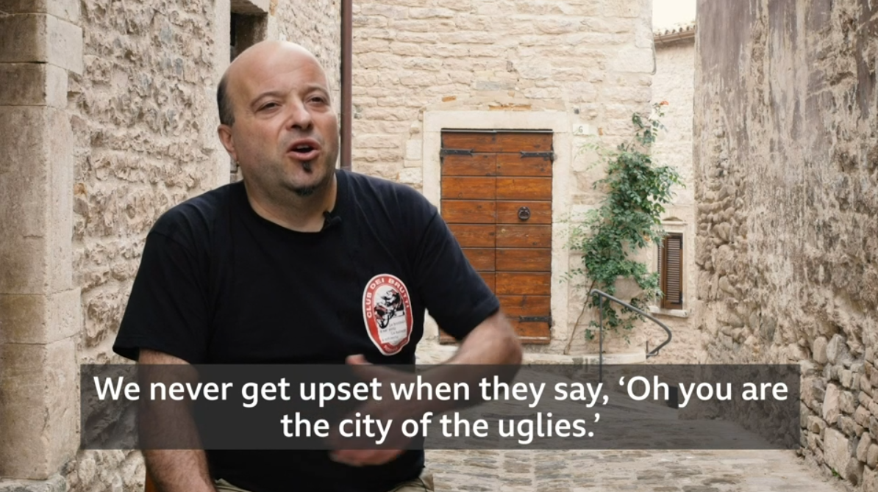
Fri 13 Mar 2020 12.15 EDT
11 December 2019
Giovanni Aluigi
President, Club Club dei Brutti
http://www.bbc.com/travel/story/20191210-the-italian-village-that-celebrates-ugliness?ocid=global_travel_rss&ocid=global_bbccom_email_12122019_travel

Slide 172
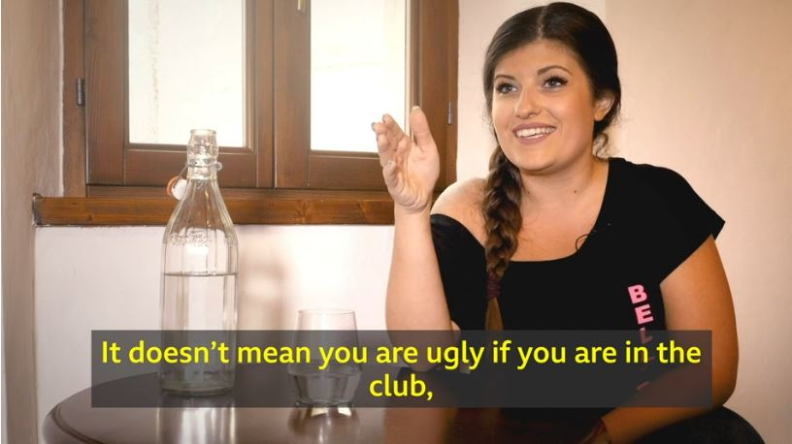
Fri 13 Mar 2020 12.15 EDT
11 December 2019
http://www.bbc.com/travel/story/20191210-the-italian-village-that-celebrates-ugliness?ocid=global_travel_rss&ocid=global_bbccom_email_12122019_travel

Slide 173
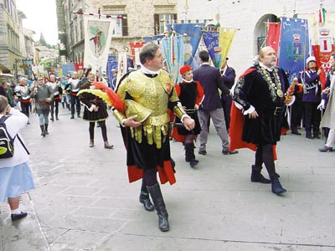
Le Marche ad Assisi celebrano San Francesco
http://giornale.regione.marche.it/archivio/num0400/art09.htm

Slide 174
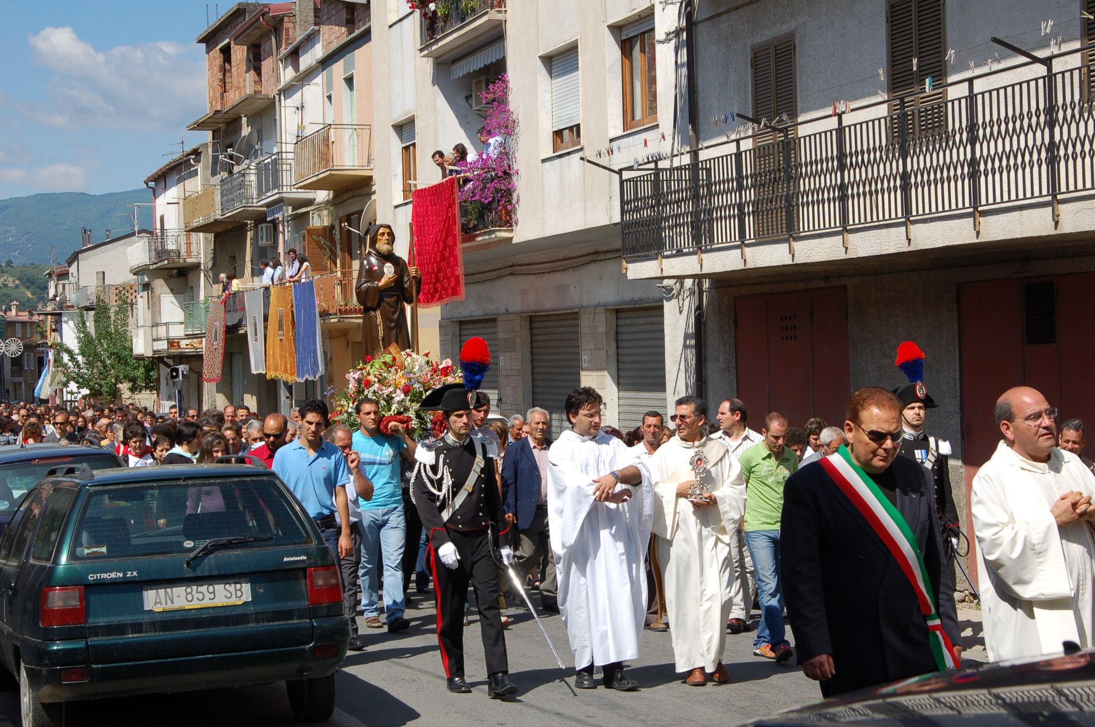
Processione del Santo Patrono di Roccabernarda San Francesco di Paola
www.panoramio.com/photo/4646218

Slide 175
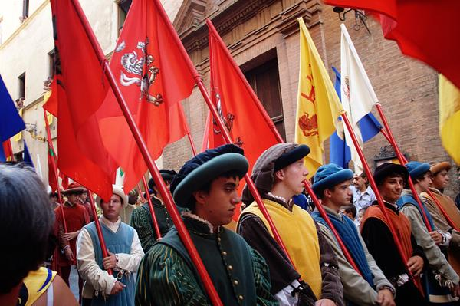
Palio di Siena, July 2, in honor of the Madonna of Provenzano
http://blog.kloppmagic.ca/palio-di-siena/

Slide 176
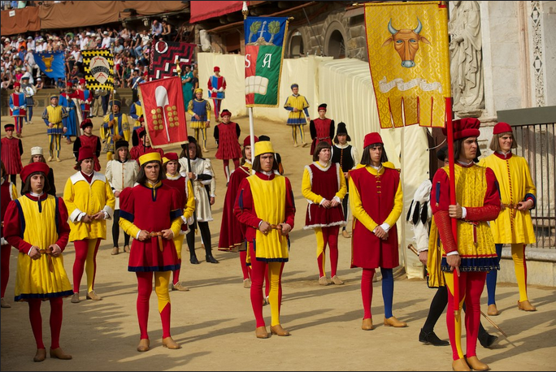
Palio di Siena, July 2, in honor of the Madonna of Provenzano
http://blog.kloppmagic.ca/palio-di-siena/

Slide 177
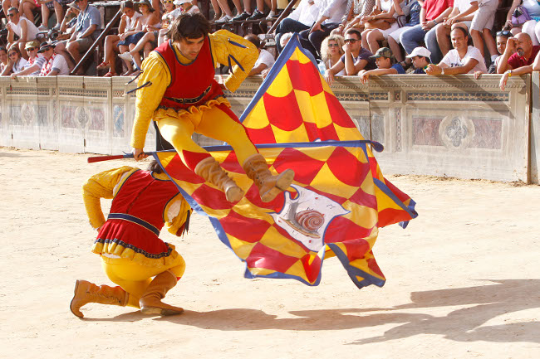
Palio di Siena, July 2, in honor of the Madonna of Provenzano
http://www.sienafree.it/palio-e-contrade/palio/36748-palio-di-siena-del-2-luglio-2012-corteo-storico-fotogallery-1/

Slide 178
Martin J. Gannon and Rajnandini Pillai Understanding Global Cultures
“The reliance on spectacle must be clearly grasped if one wants to understand the Italians.
Spectacle helps people solve most of their problems, and it governs public and private life. It is one of the reasons that Italians have always excelled in activities in which impressions are important: architecture, decoration, landscape gardening, opera, fashions, and the cinema.”
www.d.umn.edu/cla/faculty/troufs/anth1095/index.html#Gannon

Slide 179
Martin J. Gannon and Rajnandini Pillai Understanding Global Cultures
“The reliance on spectacle must be clearly grasped if one wants to understand the Italians.
Spectacle helps people solve most of their problems, and it governs public and private life. It is one of the reasons that Italians have always excelled in activities in which impressions are important: architecture, decoration, landscape gardening, opera, fashions, and the cinema.”
www.d.umn.edu/cla/faculty/troufs/anth1095/index.html#Gannon

Slide 180
The Overture
Pageantry and Spectacle
Voice
Externalization
5. Chorus and Soloists
Activities . . .
with Impressions
Italy
www.d.umn.edu/cla/faculty/troufs/anth1095/index.html#Gannon

Slide 181
Martin J. Gannon and Rajnandini Pillai Understanding Global Cultures
“The reliance on spectacle must be clearly grasped if one wants to understand the Italians.
Spectacle helps people solve most of their problems, and it governs public and private life.
It is one of the reasons that Italians have always excelled in activities in which impressions are important . . .
opera
architecture
industrial / technological design
decoration
landscape gardening
cinema
fashions
www.d.umn.edu/cla/faculty/troufs/anth1095/index.html#Gannon

Slide 182
Martin J. Gannon and Rajnandini Pillai Understanding Global Cultures
“The reliance on spectacle must be clearly grasped if one wants to understand the Italians.
Spectacle helps people solve most of their problems, and it governs public and private life.
It is one of the reasons that Italians have always excelled in activities in which impressions are important . . .
opera
architecture
industrial / technological design
decoration
landscape gardening
cinema
fashions
www.d.umn.edu/cla/faculty/troufs/anth1095/index.html#Gannon

Slide 183
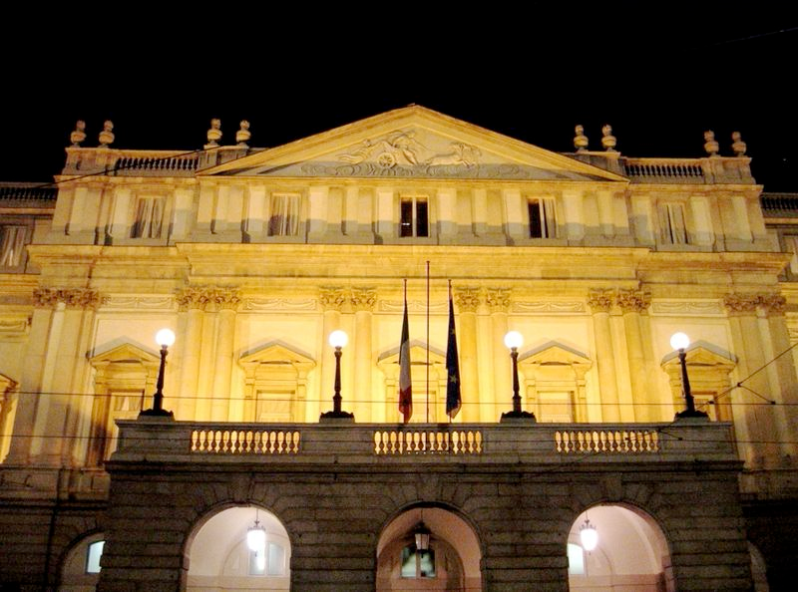
The Teatro alla Scala in Milan
http://en.wikipedia.org/wiki/Architecture_of_Italy

Slide 184
Martin J. Gannon and Rajnandini Pillai Understanding Global Cultures
“The reliance on spectacle must be clearly grasped if one wants to understand the Italians.
Spectacle helps people solve most of their problems, and it governs public and private life.
It is one of the reasons that Italians have always excelled in activities in which impressions are important . . .
opera
architecture
industrial / technological design
decoration
landscape gardening
cinema
fashions
www.d.umn.edu/cla/faculty/troufs/anth1095/index.html#Gannon

Slide 185
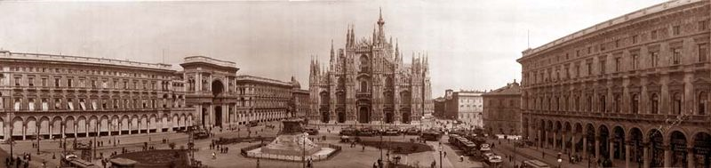
El Duomo
Milan
http://en.wikipedia.org/wiki/Architecture_of_Italy

Slide 186
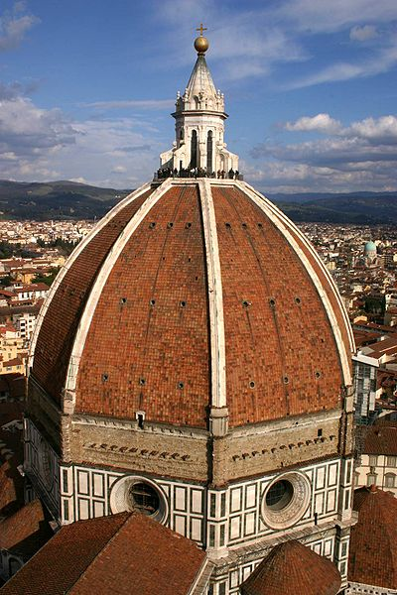
Brunelleschi's dome for the Duomo of Florence, Santa Maria del Fiore
http://en.wikipedia.org/wiki/Architecture_of_Italy

Slide 187

St. Peter’s Dome
Roma
http://en.wikipedia.org/wiki/Architecture_of_Italy

Slide 188
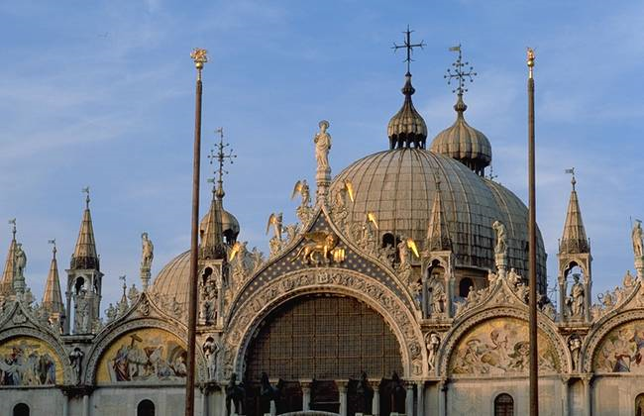
Saint Mark's Basilica
Venice
http://en.wikipedia.org/wiki/Architecture_of_Italy

Slide 189
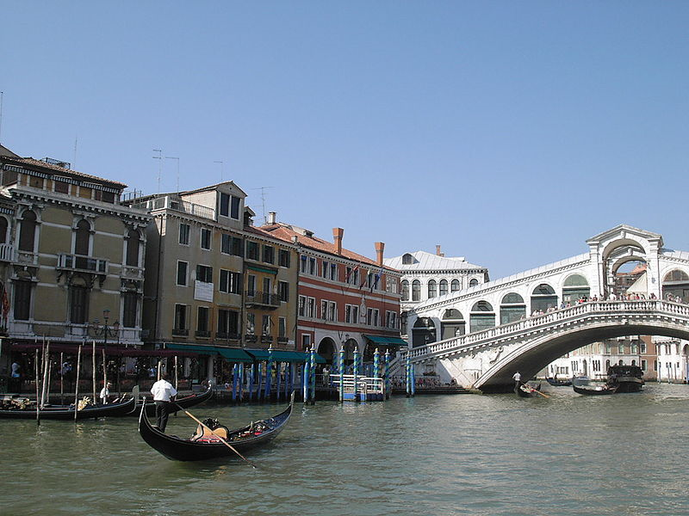
Venice and its Lagoon
http://en.wikipedia.org/wiki/Architecture_of_Italy

Slide 190
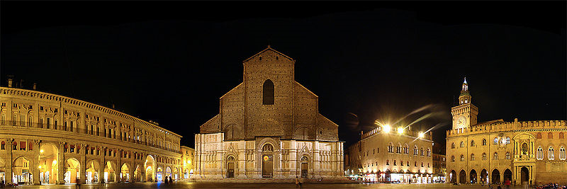
Bologna
http://en.wikipedia.org/wiki/Bologna

Slide 191
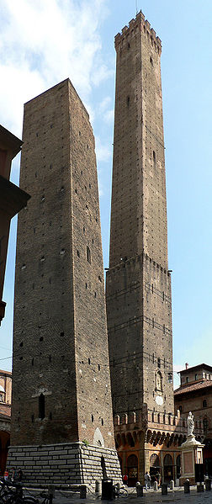
Two Towers
Bologna
http://en.wikipedia.org/wiki/Bologna

Slide 192
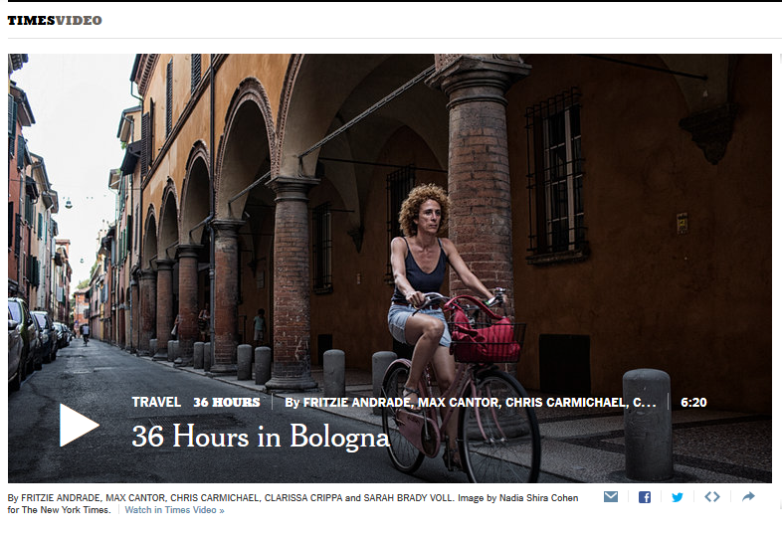
http://nyti.ms/1FFtb3D

Slide 193
The Teatro alla Scala in Milan
Said to be the greatest opera house in the world
http://en.wikipedia.org/wiki/Architecture_of_Italy

Slide 194
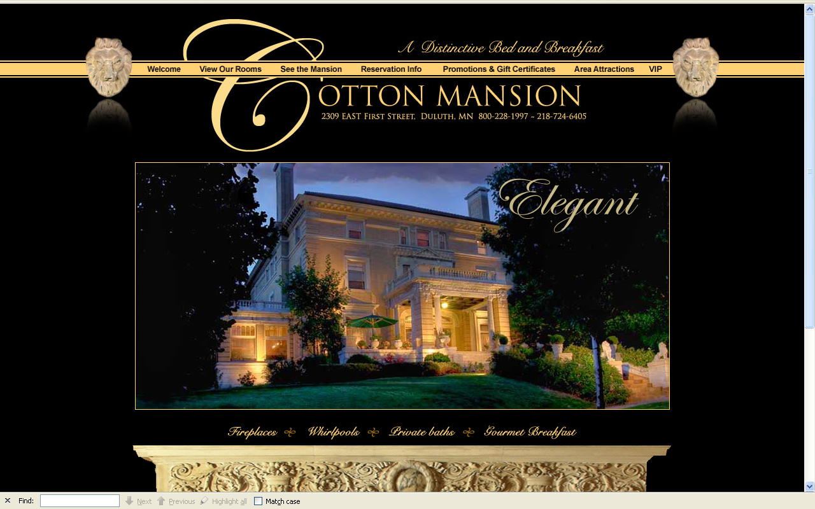
The Italian Renaissance Cotton Mansion
2309 East First Street
Duluth, Minnesota
1908

Slide 195
Martin J. Gannon and Rajnandini Pillai Understanding Global Cultures
“The reliance on spectacle must be clearly grasped if one wants to understand the Italians.
Spectacle helps people solve most of their problems, and it governs public and private life.
It is one of the reasons that Italians have always excelled in activities in which impressions are important . . .
opera
architecture
industrial / technological design
decoration
landscape gardening
cinema
fashions
www.d.umn.edu/cla/faculty/troufs/anth1095/index.html#Gannon

Slide 196
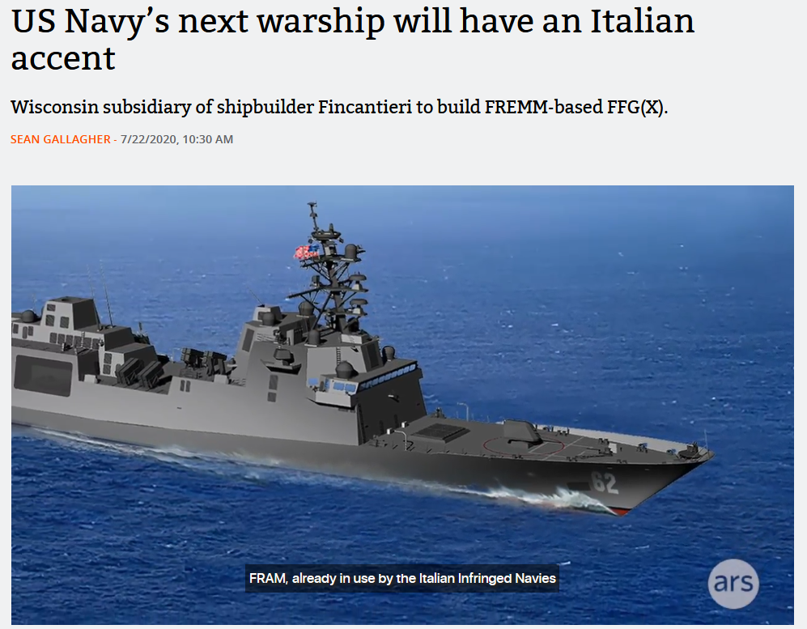

20 July 2020
https://arstechnica.com/information-technology/2020/07/us-navys-next-warship-will-have-an-italian-accent/

Slide 197


http://en.wikipedia.org/wiki/Italian_design

Slide 198

Geneva, Switzerland
http://www.fourseasons.com/geneva/celebrations/

Slide 199

Four Seasons Hotel
Geneva, Switzerland
http://www.fourseasons.com/geneva/celebrations/

Slide 200

Four Seasons Hotel
Geneva, Switzerland
http://www.fourseasons.com/geneva/celebrations/

Slide 201


Slide 202

Europa and the Bull Enlèvement d'Europe Nöel-Nicolas Coypel, c. 1726

Slide 203

2026 Lamborghini Revuelto
All yours for around $609,000.
https://www.caranddriver.com/lamborghini/revuelto

Slide 204

2024 Lamborghini Revuelto
All yours for around $608,358.
https://www.caranddriver.com/lamborghini/revuelto

Slide 205

2023 Lamborghini Huracan Sterrato
All yours for around $270,000.
https://blog.dupontregistry.com/lamborghini/new-2023-lamborghini-huracan-sterrato-is-revealed-602-hp-off-road-supercar/

Slide 206

2022 Lamborghini Sian
All yours for $3.6 million.
https://www.roadandtrack.com/news/a37294264/2022-lamborghini-countach/

Slide 207

2022 Lamborghini Countach
All yours for $2.64 million.
https://www.roadandtrack.com/news/a37294264/2022-lamborghini-countach/

Slide 208


Slide 209


Slide 210

2024 Alfa Romeo Stelvio Quadrifoglio
https://www.alfaromeousa.com/cars/giulia/quadrifoglio

Slide 211

2022/2023 Alfa Romeo Stelvio Quadrifoglio
Source

Slide 212


Slide 213

2026 Maserati GranTurismo

Slide 214

2024 Maserati GranTurismo

Slide 215

2022 Maserati MC20

Slide 216


Slide 217

2026 Ferrari Purosangue
starting at about $400,000
https://www.caranddriver.com/ferrari/purosangue

Slide 218

2024 Ferrari Purosangue
starting at $402,050
https://www.caranddriver.com/ferrari/purosangue

Slide 219

2023 Ferrari 296 GTS
https://www.motor1.com/reviews/621685/2023-ferrari-296-gts-first-drive/

Slide 220

Ferrari Icona: Monza SP1
https://www.ferrarilakeforest.com/manufacturer-information/upcoming-ferrari-models/

Slide 221

2016 Ferrari F80 Concept

Slide 222

2015 Ferrari F80 Supercar Concept

Slide 224


Slide 225


Slide 226

2026 Ducati Panigale V4
$19,595.00
https://www.wheelsinmotionmc.com/inventory/v1/Current/Ducati/Panigale/Panigale-V4/Red--Chatsworth-California---21336901?format=print

Slide 227

2024 Ducati Panigale V4
$24,995.00
https://www.wheelsinmotionmc.com/inventory/v1/Current/Ducati/Panigale/Panigale-V4/Red--Chatsworth-California---21336901?format=print

Slide 228


Slide 229


Slide 230

2026 Bugatti Tourbillion
Price: About $3.9 Million
https://auto.hindustantimes.com/auto/cars/2026-bugatti-tourbillon-hypercar-breaks-cover-with-1-775-bhp-445-kmph-top-speed-41718953938862.html

Slide 231

2024 Bugatti Mistral Roadster
Price: $5 Million
https://www.caranddriver.com/news/a40874138/2024-bugatti-mistral-5-cool-design-elements/

Slide 232

Sorry
Sold Out
2023 Bugatti W16 Mistral
Price: $5 Million

Slide 233

2022 Bugatti Chiron
Price: $3.6-$3.9 Million

Slide 234


Bugatti Niniette 66 yacht is a 1,000-hp Chiron for the Water

Slide 235


Slide 236
Martin J. Gannon and Rajnandini Pillai Understanding Global Cultures
“The reliance on spectacle must be clearly grasped if one wants to understand the Italians.
Spectacle helps people solve most of their problems, and it governs public and private life.
It is one of the reasons that Italians have always excelled in activities in which impressions are important . . .
opera
architecture
industrial / technological design
decoration
and yes, even toilets
www.d.umn.edu/cla/faculty/troufs/anth1095/index.html#Gannon

Slide 237

Laufen Alessi One wall-hung toilet and bidet
ILBAGNOALESSI
Stefano Giovannoni
Designer

Slide 238


https://gestione.aetitalia.it/download/sito/d27bded_sanitarisquarefoto23.jpg

Slide 239

https://gestione.aetitalia.it/download/sito/d27bded_sanitarisquarefoto23.jpg

Slide 240

Cielo
Italy
https://www.ceramicacielo.it/en/products/smile/floor+mounted+wc+%26+bidet/back+to+wall+one+hole+bidet/111

Slide 241
And even the Italian trains
are beautiful . . .

Slide 242

The Carolinian stopping
in Raleigh, North Carolina
in "Phase V" livery. Wikipedia
Trenitalia series ETR 500 at Venezia S.Lucia
http://commons.wikimedia.org/wiki/File:Trenitalia-series-ETR500.jpg

Slide 243

compare the Italian train to the U.S.A. train
The Carolinian stopping
in Raleigh, North Carolina
in "Phase V" livery. Wikipedia
Trenitalia series ETR 500 at Venezia S.Lucia
http://commons.wikimedia.org/wiki/File:Trenitalia-series-ETR500.jpg

Slide 244
Martin J. Gannon and Rajnandini Pillai Understanding Global Cultures
“The reliance on spectacle must be clearly grasped if one wants to understand the Italians.
Spectacle helps people solve most of their problems, and it governs public and private life.
It is one of the reasons that Italians have always excelled in activities in which impressions are important . . .
opera
architecture
industrial / technological design
decoration
landscape gardening
cinema
fashions
www.d.umn.edu/cla/faculty/troufs/anth1095/index.html#Gannon

Slide 245

Garden façade of Villa Cetinale 17th-century Tuscany
http://www.architecturaldigest.com/decor/2014-05/ned-lambton-villa-cetinale-siena-italy-slideshow

Slide 246

The cloister of the Abbey of Monreale, Sicily, Italy
http://www.suggestkeyword.com/aXRhbGlhbiBnYXJkZW5z/

Slide 247

Sting and Trudie Styler'sTuscan Paradise
http://www.architecturaldigest.com/celebrity-homes/2011/sting-trudie-styler-tuscan-garden-article

Slide 248
Martin J. Gannon and Rajnandini Pillai Understanding Global Cultures
“The reliance on spectacle must be clearly grasped if one wants to understand the Italians.
Spectacle helps people solve most of their problems, and it governs public and private life.
It is one of the reasons that Italians have always excelled in activities in which impressions are important . . .
opera
architecture
industrial / technological design
decoration
landscape gardening
cinema
fashions
www.d.umn.edu/cla/faculty/troufs/anth1095/index.html#Gannon

Slide 249
Federico

Slide 250
Federico
Fellini

Slide 251

Federico Fellini
Original movie poster by Giorgio Olivetti
http://giornale.regione.marche.it/archivio/num0400/art09.htm

Slide 252

Federico Fellini
http://news.bbc.co.uk/2/hi/europe/7925032.stm

Slide 253



Slide 254

La vita è bella
Roberto Benigni
http://en.wikipedia.org/wiki/La_vita_%C3%A8_bella

Slide 255


http://en.wikipedia.org/wiki/Academy_Award_for_Best_Foreign_Language_Film

Slide 256

Grand Budapest Hotel 2014 Best Costume Design
Milena Canonero
https://en.wikipedia.org/wiki/The_Grand_Budapest_Hotel

Slide 257
Martin J. Gannon and Rajnandini Pillai Understanding Global Cultures
“The reliance on spectacle must be clearly grasped if one wants to understand the Italians.
Spectacle helps people solve most of their problems, and it governs public and private life.
It is one of the reasons that Italians have always excelled in activities in which impressions are important . . .
opera
architecture
industrial / technological design
decoration
landscape gardening
cinema
fashions
www.d.umn.edu/cla/faculty/troufs/anth1095/index.html#Gannon

Slide 258

https://fashionista.com/2023/09/milan-fashion-week-spring-2024-trendhttps://fashionista.com/2023/09/milan-fashion-week-spring-2024-trends

Slide 259

21 June 2023
Milan men’s fashion week spring/summer 2024: the highlights – in pictures
https://www.theguardian.com/fashion/gallery/2023/jun/21/milan-mens-fashion-week-springsummer-2024-the-highlights-in-pictures

Slide 260

http://en.wikipedia.org/wiki/Italian_fashion

Slide 261

http://en.wikipedia.org/wiki/Italian_fashion

Slide 262

the list of
Italian fashion houses and luxury brands
is seemingly endless . . .
https://en.wikipedia.org/wiki/Italian_fashion#Italian_fashion_houses_and_luxury_brands

Slide 263


Slide 264


Slide 265

Gucci
$3,750

Slide 266


Slide 267

GIORGIO ARMANI
“the blue eyed designer
of the
spring-summer 2015 season!”
http://www.fashionavecpassion.com/an-emporio-armani-brand-new-fashion-ss15-the-futuristic-classic/

Slide 268


Slide 269


Slide 270
The Overture
Pageantry and Spectacle
Voice
Externalization
5. Chorus and Soloists
The use and importance of voice to express words
in a musical fashion
Italy
www.d.umn.edu/cla/faculty/troufs/anth1095/index.html#Gannon

Slide 271
The Overture
Pageantry and Spectacle
Voice
Externalization
5. Chorus and Soloists
Language
and Communication
Italy
www.d.umn.edu/cla/faculty/troufs/anth1095/index.html#Gannon

Slide 272
Many languages are spoken throughout Italy and in the very North, Italian is not the main language . . .

Slide 273
Main Languages
Italian (official)
German
parts of Trentino-Alto Adige region are predominantly German speaking
French
small French-speaking minority in Valle d'Aosta region (near France)
Slovene
Slovene-speaking minority in the Trieste-Gorizia area (near Slovenia)
CIA World Factbook
https://www.cia.gov/the-world-factbook/countries/italy/

Slide 274

Italian
http://en.wikipedia.org/wiki/Regions_of_Italy
Notes:
274

Slide 275
Main Languages
Italian (official)
German
parts of Trentino-Alto Adige region are predominantly German speaking
French
small French-speaking minority in Valle d'Aosta region (near France)
Slovene
Slovene-speaking minority in the Trieste-Gorizia area (near Slovenia)
CIA World Factbook
https://www.cia.gov/the-world-factbook/countries/italy/

Slide 276
German
http://en.wikipedia.org/wiki/Regions_of_Italy
Notes:
276

Slide 277
Main Languages
Italian (official)
German
parts of Trentino-Alto Adige region are predominantly German speaking
French
small French-speaking minority in Valle d'Aosta region (near France)
Slovene
Slovene-speaking minority in the Trieste-Gorizia area (near Slovenia)
CIA World Factbook
https://www.cia.gov/the-world-factbook/countries/italy/

Slide 278
French
http://en.wikipedia.org/wiki/Regions_of_Italy
Notes:
278

Slide 279
Main Languages
Italian (official)
German
parts of Trentino-Alto Adige region are predominantly German speaking
French
small French-speaking minority in Valle d'Aosta region (near France)
Slovene
Slovene-speaking minority in the Trieste-Gorizia area (near Slovenia)
CIA World Factbook
https://www.cia.gov/the-world-factbook/countries/italy/

Slide 280
Slovene
http://en.wikipedia.org/wiki/Regions_of_Italy
Notes:
280

Slide 281
http://en.wikipedia.org/wiki/Regions_of_Italy
Notes:
281

Slide 282

German
Slovene
French
Italian
www.jdbassc.com/maps/map_southern_italy.asp
Notes:
282

Slide 283


German
French
Slovene
Tuscany
Italian
In the neighboring Tuscany region
they speak Italian, which historically was based on the Florentine dialect . . .

Slide 284

Official language(s) | Italian
Regional language(s) | German, Neapolitan, Slovene, Piedmontese, Sardinian, Sardinian, Tabarchino, Sassarese, Gallurese, Ladin, Cimbrian, Mocheno, Venetian
Minority language(s) | Albanian, Catalan, German, Greek, Slovene, Croatian, French, Franco-Provençal, Friulian, Ladin, Occitan, Sardinia
Main immigrant language(s) | Romanian, Berber, Maghrebi Arabic, Albanian
Main foreign language(s) | English (25%) Spanish (17%) French (14%)
Dialects of Italy by Group
http://en.wikipedia.org/wiki/List_of_languages_of_Italy
Notes:
284

Slide 285
But throughout Italy as a whole, Italian is spoken as a main language . . .

Slide 286
Martin J. Gannon and Rajnandini Pillai Understanding Global Cultures
And throughout Italy, “Italians tend to believe that their language is the most beautiful one in the world.”
Italians put great emotion into their language, speaking with passion, rhythm, and changing tonality
www.d.umn.edu/cla/faculty/troufs/anth1095/index.html#Gannon

Slide 287
Martin J. Gannon and Rajnandini Pillai Understanding Global Cultures
And throughout Italy, “Italians tend to believe that their language is the most beautiful one in the world.”
Italians put great emotion into their language, speaking with passion, rhythm, and changing tonality
www.d.umn.edu/cla/faculty/troufs/anth1095/index.html#Gannon

Slide 288

take the word
cello
for instance
http://commons.wikimedia.org/wiki/File:Modigliani_%E2%80%93_Cello_Player.jpg

Slide 289
If you ever have the chance, ask a native Italian speaker to pronounce the name of this instrument.
cello
http://commons.wikimedia.org/wiki/File:Modigliani_%E2%80%93_Cello_Player.jpg

Slide 290
Pronunciation of “cello” in English:
chel’ oh
Listen: https://www.youtube.com/watch?v=2ap8VVxF0vM
Pronunciation of “cello” in Italian:
ˈtʃɛl’əʊ
Listen: https://www.youtube.com/watch?v=44JGT1hJA0s

Slide 291


Giuseppe Verdi
Rigoletto (on the left) Mantova, Italy

Slide 292
Giuseppe Verdi
Joe Green
Rigoletto (on the left) Mantova, Italy

Slide 293
this wouldn’t at all be the same translated into American English and mentioned by a Texan . . .
Giuseppe Verdi
Rigoletto (on the left) Mantova, Italy

Slide 294
And
“Joe Green”
Is just not the same as
“Giuseppe Verdi”
Listen: https://www.youtube.com/watch?v=aKbg9xDT93s
Giuseppe Verdi

Slide 295


29 Nov 2020
https://humanparts.medium.com/why-italians-use-dozens-of-words-for-simple-instructions-b3e499f2f0df

Slide 296
Martin J. Gannon and Rajnandini Pillai Understanding Global Cultures
And throughout Italy, “Italians tend to believe that their language is the most beautiful one in the world.”
Italians put great emotion into their language, speaking with passion, rhythm, and changing tonality
www.d.umn.edu/cla/faculty/troufs/anth1095/index.html#Gannon

Slide 297

Year in and year out Italian is voted one of the most beautiful languages in the world, even by non-Italians . . .
http://www.language-learning-advisor.com/most-beautiful-language-survey.html#spokenresults

Slide 298
Martin J. Gannon and Rajnandini Pillai Understanding Global Cultures
“Italians tend to believe that their language is the most beautiful one in the world.”
Much of the beauty of the Italian language derives form the fact that it has a higher proportion of vowels to consonants than all or more languages, which gives it something of a musical effect
www.d.umn.edu/cla/faculty/troufs/anth1095/index.html#Gannon

Slide 299
Martin J. Gannon and Rajnandini Pillai Understanding Global Cultures
“Italians tend to believe that their language is the most beautiful one in the world.”
sibilant
is a type of fricative or affricate consonant, made by directing a jet of air through a narrow channel in the vocal tract towards the sharp edge of the teeth
Wikipedia
www.d.umn.edu/cla/faculty/troufs/anth1095/index.html#Gannon

Slide 300

Martin J. Gannon and Rajnandini Pillai Understanding Global Cultures
“Italians tend to believe that their language is the most beautiful one in the world.”
“I speak Spanish to God,
Italian to women,
French to men
and
German to my horse”
Attributed to King Charles V
King of Spain and Holy Roman Emperor
1500–1558
www.d.umn.edu/cla/faculty/troufs/anth1095/index.html#Gannon
https://en.wikipedia.org/wiki/Charles_V,_Holy_Roman_Emperor

Slide 301


Martin J. Gannon and Rajnandini Pillai Understanding Global Cultures
Famous recent quote . . .
“The average Hollywood film star's ambition is to be
admired by an American,
courted by an Italian,
married to an Englishman
and have a French boyfriend.”
Katharine Hepburn
1907 –2003
www.d.umn.edu/cla/faculty/troufs/anth1095/index.html#Gannon

Slide 302
Another famous recent quote . . .
“She opened up a book of poems and handed it to me written by an Italian poet from the 13th century and every one of them words rang true and glowed like burning coal pouring off of every page like it was written in my soul from me to you.”
Bob Dylan
1941 –
by . . .
www.d.umn.edu/cla/faculty/troufs/anth1095/index.html#Gannon

Slide 303

http://www.nytimes.com/2016/10/14/arts/music/bob-dylan-nobel-prize-literature.html?smid=fb-nytimes&smtyp=cur&_r=0

Slide 304

Martin J. Gannon and Rajnandini Pillai Understanding Global Cultures
“Italians tend to believe that their language is the most beautiful one in the world.”
Bob Dylan
1941 –
Presidential Medal of Freedom 2012

Slide 305


Martin J. Gannon and Rajnandini Pillai Understanding Global Cultures
https://rockhall.com/inductees/bob-dylan/bio/

Slide 306

Martin J. Gannon and Rajnandini Pillai Understanding Global Cultures
http://amoralto.tumblr.com/post/60467020158/melody-maker-beatles-saydylan-shows-the-way

Slide 307
The Overture
Pageantry and Spectacle
Voice
Externalization
5. Chorus and Soloists
Local Dialects
Italy
www.d.umn.edu/cla/faculty/troufs/anth1095/index.html#Gannon

Slide 308


Cosimo Vassallo
is from
Palermo, Sicily
Letizia Colajanni
and
Cosimo Vassallo
/

Slide 309
Cossimo lives in
Mantova
503 miles away
(by air)
/
Letizia Colajanni
and
Cosimo Vassallo

Slide 310
If Cosimo speaks Italian with
his Palermo accent in
Montova, some
will have difficult understanding him
/
Cosimo Vassallo
is from
Palermo, Sicily
Letizia Colajanni
and
Cosimo Vassallo
/

Slide 311

/
My friend Martin Aricochi
who lives in
Brixen (Bressanone), Italy, spoke German until he went to school,
www.jdbassc.com/maps/map_southern_italy.asp
Notes:
311

Slide 312
/
My friend Martin Aricochi
who lives in
Brixen (Bressanone), Italy, spoke German until he went to school,
and they still speak German at home
www.jdbassc.com/maps/map_southern_italy.asp
Notes:
312

Slide 313
Martin J. Gannon and Rajnandini Pillai Understanding Global Cultures
The Italian history of invasions has produced many dialects, each the product of the particular regional invader
The language of Italy consists of both local dialects and Italian, a derivative of the Tuscan language
Although linguistic variations are disappearing to some extent due to the homogenizing effects of television and telecommunications, Italians still cling to the notion of having their own regional dialect
www.d.umn.edu/cla/faculty/troufs/anth1095/index.html#Gannon

Slide 314
Dialects of Italy by Group
http://en.wikipedia.org/wiki/List_of_languages_of_Italy
Notes:
314

Slide 315
Dialects of Italy by Group
http://en.wikipedia.org/wiki/List_of_languages_of_Italy
Notes:
315

Slide 316
compare these
with the old kingdoms
Dialects of Italy by Group
http://en.wikipedia.org/wiki/List_of_languages_of_Italy
Notes:
316

Slide 317
Martin J. Gannon and Rajnandini Pillai Understanding Global Cultures
The vocal selections of the chorus are directly comparable to the many regional variations of the Italian language
Although each section is important to the harmony of the chorus, each has its own melody
www.d.umn.edu/cla/faculty/troufs/anth1095/index.html#Gannon

Slide 318
Martin J. Gannon and Rajnandini Pillai Understanding Global Cultures
“Italians tend to believe that their language is the most beautiful one in the world.”
It is the quality of the way people speak that is of utmost importance
this bias is replicated in the opera in that there are several strikingly different types of voice registers, such as the soprano and the bass
www.d.umn.edu/cla/faculty/troufs/anth1095/index.html#Gannon

Slide 319
Martin J. Gannon and Rajnandini Pillai Understanding Global Cultures
“Italians tend to believe that their language is the most beautiful one in the world.”
And, like the opera, the sound and cadence of the communication play a role at least equal to the content of what is said in getting the message across
Italians are often much more interested in engaging and entertaining their listeners than in conveying their thoughts accurately
www.d.umn.edu/cla/faculty/troufs/anth1095/index.html#Gannon

Slide 320
Martin J. Gannon and Rajnandini Pillai Understanding Global Cultures
“Perhaps the most difficult operatic singing is associated with bel canto, or beautiful music, introduced by the romantic Italian composer Bellini. This form of music requires extraordinary exertion and ability on the part of the singers, especially when they are singing together to express their thoughts and emotions. Bel canto is so difficult a form of opera that there is only a limited number of singers who can perform it effectively, and only Italian composers have been very successful in this area.”
www.d.umn.edu/cla/faculty/troufs/anth1095/index.html#Gannon

Slide 321
Martin J. Gannon and Rajnandini Pillai Understanding Global Cultures
“Perhaps the most difficult operatic singing is associated with bel canto, or beautiful music, introduced by the romantic Italian composer Bellini. This form of music requires extraordinary exertion and ability on the part of the singers, especially when they are singing together to express their thoughts and emotions. Bel canto is so difficult a form of opera that there is only a limited number of singers who can perform it effectively, and only Italian composers have been very successful in this area.”
www.d.umn.edu/cla/faculty/troufs/anth1095/index.html#Gannon

Slide 322
Martin J. Gannon and Rajnandini Pillai Understanding Global Cultures
Italians tend to talk louder than many other nationalities
But more so in the south than in the north
Stories are told with passion, anger and joy
The air in Italy is filled with so many voices that one must frequently talk in a very loud voice to be understood, “thereby increasing the total uproar”
www.d.umn.edu/cla/faculty/troufs/anth1095/index.html#Gannon

Slide 323
Martin J. Gannon and Rajnandini Pillai Understanding Global Cultures
Oral communication in Italy is something of a show itself
Speaking is punctuated by elaborate gestures, befitting the Italian operatic tradition
Whatever the section of the country, Italians talk with their hands
Quick, agile, expressive movement of the hands, arms, and shoulders contribute emphasis and sincerity to the spoken words and facial expressions
www.d.umn.edu/cla/faculty/troufs/anth1095/index.html#Gannon

Slide 324


http://www.bbc.com/culture/story/20171207-dai-the-italian-word-with-many-meanings

Slide 325

The Hand Gesture Heard Round the World
Emperor Augustus
ruled Rome
27 BC to AD 14
6 January 2024
https://www.nytimes.com/2024/01/06/opinion/tommy-devito-football-italian.html?smid=nytcore-ios-share&referringSource=articleShare

Slide 326



Giants' Tommy DeVito shares the origin behind his pinched fingers touchdown celebration
26 November 2023
https://www.cbssports.com/nfl/news/giants-tommy-devito-shares-the-origin-behind-his-pinched-fingers-touchdown-celebration/
https://brobible.com/sports/article/giants-played-sopranos-theme-song-tommy-devito-entrance/

Slide 327

Martin J. Gannon and Rajnandini Pillai Understanding Global Cultures
“Italians tend to believe that their language is the most beautiful one in the world.”
Italians put great emotion into their language, speaking with passion, rhythm, and changing tonality
Emperor Augustus
ruled Rome
27 BC to AD 14
www.d.umn.edu/cla/faculty/troufs/anth1095/index.html#Gannon

Slide 328

Martin J. Gannon and Rajnandini Pillai Understanding Global Cultures
“Italians tend to believe that their language is the most beautiful one in the world.”
Italians put great emotion into their language, speaking with passion, rhythm, and changing tonality
Sophia Loren
ruled Hollywood,
at the 2009 Academy Awards
Emperor Augustus
ruled Rome
27 BC to AD 14
www.d.umn.edu/cla/faculty/troufs/anth1095/index.html#Gannon

Slide 329

Martin J. Gannon and Rajnandini Pillai Understanding Global Cultures
“Italians tend to believe that their language is the most beautiful one in the world.”
Italians put great emotion into their language, speaking with passion, rhythm, and changing tonality
Roberto Benigni
71st Academy Awards
Best Foreign Film
Best Actor
1999
www.d.umn.edu/cla/faculty/troufs/anth1095/index.html#Gannon

Slide 330

Martin J. Gannon and Rajnandini Pillai Understanding Global Cultures
“Italians tend to believe that their language is the most beautiful one in the world.”
Italians put great emotion into their language, speaking with passion, rhythm, and changing tonality
Roberto Benigni
2006
www.d.umn.edu/cla/faculty/troufs/anth1095/index.html#Gannon

Slide 331
Martin J. Gannon and Rajnandini Pillai Understanding Global Cultures
However, the gestures are not, as many believe, unrealistically exaggerated
In fact, the gestures are so realistic that they may be unapparent
www.d.umn.edu/cla/faculty/troufs/anth1095/index.html#Gannon

Slide 332
Martin J. Gannon and Rajnandini Pillai Understanding Global Cultures
The acting of the opera singers, derived directly from the Italian’s natural mimicry, contributes to the erroneous impression of excessive exaggeration
www.d.umn.edu/cla/faculty/troufs/anth1095/index.html#Gannon

Slide 333
Martin J. Gannon and Rajnandini Pillai Understanding Global Cultures
In reality,
Italian gestures are based on natural and “instinctive” movements
and therefore can be understood by the inexperienced at first sight
www.d.umn.edu/cla/faculty/troufs/anth1095/index.html#Gannon

Slide 334
Martin J. Gannon and Rajnandini Pillai Understanding Global Cultures
In addition to gestures, Italians
sometimes employ flattery and polite lies to make life decorous and agreeable
The purpose is to reduce the turbulence of the day-to-day living and to make life more acceptable
Flattery somehow makes the wariest of men feel bigger and more confident, similar to the larger-than-life opera singer
www.d.umn.edu/cla/faculty/troufs/anth1095/index.html#Gannon

Slide 335
Martin J. Gannon and Rajnandini Pillai Understanding Global Cultures
In addition to gestures, Italians
sometimes employ flattery and polite lies to make life decorous and agreeable
The purpose is to reduce the turbulence of the day-to-day living and to make life more acceptable
Flattery somehow makes the wariest of men feel bigger and more confident, similar to the larger-than-life opera singer
www.d.umn.edu/cla/faculty/troufs/anth1095/index.html#Gannon

Slide 336
Martin J. Gannon and Rajnandini Pillai Understanding Global Cultures
In addition to gestures, Italians
sometimes employ flattery and polite lies to make life decorous and agreeable
The purpose is to reduce the turbulence of the day-to-day living and to make life more acceptable
Flattery somehow makes the wariest of men feel bigger and more confident, similar to the larger-than-life opera singer
www.d.umn.edu/cla/faculty/troufs/anth1095/index.html#Gannon

Slide 337
Martin J. Gannon and Rajnandini Pillai Understanding Global Cultures
In addition to gestures, Italians
sometimes employ flattery and polite lies to make life decorous and agreeable
This perspective accounts for the fact that Italians sometimes make promises they know they cannot fulfill
Small lies can be justified in order to give pleasure, provoke emotion, or prove a point
Casualness toward promises is part of accepted Italian behavior
www.d.umn.edu/cla/faculty/troufs/anth1095/index.html#Gannon

Slide 338
Martin J. Gannon and Rajnandini Pillai Understanding Global Cultures
“Contentiousness is generally not far below the surface of the Italian personality”
This argumentativeness surprises many because it is discordant with the usual Italian demeanor
For most Italians, controversy is a hobby or a sport, something in which Italians take immense pleasure (Levine 1963)
www.d.umn.edu/cla/faculty/troufs/anth1095/index.html#Gannon

Slide 339
Martin J. Gannon and Rajnandini Pillai Understanding Global Cultures
Italians are frequently portrayed as joyful people with an operatic song on their lips
This is not completely true
They can be somber, just as many of their operas can end up in death and tragedy
This dark side is emphasized through humor, which tends to be more insulting than witty
www.d.umn.edu/cla/faculty/troufs/anth1095/index.html#Gannon

Slide 340
Martin J. Gannon and Rajnandini Pillai Understanding Global Cultures
Italians are frequently portrayed as joyful people with an operatic song on their lips
This is not completely true
They can be somber, just as many of their operas can end up in death and tragedy
This dark side is emphasized through humor, which tends to be more insulting than witty
www.d.umn.edu/cla/faculty/troufs/anth1095/index.html#Gannon

Slide 341
Martin J. Gannon and Rajnandini Pillai Understanding Global Cultures
Humor generally implies the ability to detach oneself form the object of wit
however, the Italians tend to be passionate people who identify easily with what they are talking about
www.d.umn.edu/cla/faculty/troufs/anth1095/index.html#Gannon

Slide 342
Martin J. Gannon and Rajnandini Pillai Understanding Global Cultures
“Italians make up for this type of humor by analyzing everything around them through conversation.”
Talking is a great pastime for most Italians, who frequently meet in cafés to discuss the latest news
Privacy is frequently lacking in any Italian community, even though Italians say they mind their own business
Ron R. . . .
www.d.umn.edu/cla/faculty/troufs/anth1095/index.html#Gannon

Slide 343
Martin J. Gannon and Rajnandini Pillai Understanding Global Cultures
“Unlike the reserved Englishman, the Italian is apt to tell an acquaintance of a half hour’s standing all about his financial status, his family’s health problems, and details of his current emotional attachments.”
Robin Blagburn and surgeon
www.d.umn.edu/cla/faculty/troufs/anth1095/index.html#Gannon

Slide 344
Martin J. Gannon and Rajnandini Pillai Understanding Global Cultures
“The Italian love of conversation as a pastime usually limits the chances of something secret staying so for very long, and it is this love of conversation (and voice) that is intimately related to externalization . . .”
www.d.umn.edu/cla/faculty/troufs/anth1095/index.html#Gannon

Slide 345
and sometimes Italy speaks from beyond the grave . . .

Slide 346


The Iceman’s Ax
Ötzi the Iceman
Bolzano, Italy

Slide 347

Catacombs of Rome
https://javitour.com/catacumbas-de-roma/

Slide 348
The Overture
Pageantry and Spectacle
Voice
Externalization
5. Chorus and Soloists
Italy
www.d.umn.edu/cla/faculty/troufs/anth1095/index.html#Gannon

Slide 349
Externalization, which refers specifically to the belief that feelings and emotions are so powerful that an individual cannot keep them within himself or herself and must express them to others
The Overture
Pageantry and Spectacle
Voice
Externalization
5. Chorus and Soloists
Italy
www.d.umn.edu/cla/faculty/troufs/anth1095/index.html#Gannon

Slide 350
Externalization, which refers specifically to the belief that feelings and emotions are so powerful that an individual cannot keep them within himself or herself and must express them to others
The Overture
Pageantry and Spectacle
Voice
Externalization
5. Chorus and Soloists
Italy
www.d.umn.edu/cla/faculty/troufs/anth1095/index.html#Gannon

Slide 351

14 Mar 2020
Coronavirus: Italians sang from their windows to boost morale
A countrywide lockdown due to coronavirus didn't stop Italians from bursting into morale-boosting song in a nationwide flashmob event.

Slide 352
Martin J. Gannon and Rajnandini Pillai Understanding Global Cultures
Externalization refers specifically to the fact that feelings and emotions are so overwhelming that the individual cannot keep them to himself or herself, but must express them to others
It also refers to the assumption that the event is more important than the actions of one individual, which is consistent with the Italian reaction to catastrophes and uncertaintysai
www.d.umn.edu/cla/faculty/troufs/anth1095/index.html#Gannon

Slide 353
Martin J. Gannon and Rajnandini Pillai Understanding Global Cultures
That is, the drama is of more significance to the viewers or community than to the individuals because of its symbolism and generality
This pattern of behavior is the opposite of that of the Anglo-Saxon, which emphasizes that a person should control emotions and not express them or, as the British say, keep a stiff upper lip
www.d.umn.edu/cla/faculty/troufs/anth1095/index.html#Gannon

Slide 354

Gannon and Pillai's European Cultural Metaphors include
Ch. 15. French Wine . . .
Ch. 17. The Traditional British House
Ch. 21. The Italian Opera
Ch. 22. Belgian Lace
Ch. 24. The Russian Ballet
Ch. 30. The Spanish Bullfight
Ch. 31. The Portuguese Bullfight
www.d.umn.edu/cla/faculty/troufs/anth1095/index.html#Gannon

Slide 355
Martin J. Gannon and Rajnandini Pillai Understanding Global Cultures
Add British metaphor slide here
www.d.umn.edu/cla/faculty/troufs/anth1095/index.html#Gannon

Slide 356
Martin J. Gannon and Rajnandini Pillai Understanding Global Cultures
That is, the drama is of more significance to the viewers or community than to the individuals because of its symbolism and generality
This pattern of behavior is the opposite of that of the Anglo-Saxon, which emphasizes that a person should control emotions and not express them or, as the British say, keep a stiff upper lip
www.d.umn.edu/cla/faculty/troufs/anth1095/index.html#Gannon

Slide 357
The Overture
Pageantry and Spectacle
Voice
Externalization
5. Chorus and Soloists
The piazza
Italy
www.d.umn.edu/cla/faculty/troufs/anth1095/index.html#Gannon

Slide 358
Martin J. Gannon and Rajnandini Pillai Understanding Global Cultures
Because of the importance of drama in everyday life, Italians value the piazza as the center of every town and village
It is the stage on which people gather to share conversation and relate experiences
The actions that take place in the piazza are minor dramas of Italian life
“everyone knows that gatherings will occur at regular times at the piazza, usually around noon and at 5 or 6 p.m. after work”
www.d.umn.edu/cla/faculty/troufs/anth1095/index.html#Gannon

Slide 359
Martin J. Gannon and Rajnandini Pillai Understanding Global Cultures
Because of the importance of drama in everyday life, Italians value the piazza as the center of every town and village
It is the stage on which people gather to share conversation and relate experiences
The actions that take place in the piazza are minor dramas of Italian life
“everyone knows that gatherings will occur at regular times at the piazza, usually around noon and at 5 or 6 p.m. after work”
www.d.umn.edu/cla/faculty/troufs/anth1095/index.html#Gannon

Slide 360

Piazza dei Mercanti, Milan
http://tintore.org/cgi-bin/article.cgi?article_id=110

Slide 361

Fontana del Nettuno in Piazza Navone, Rome
http://www.traveladventures.org/continents/europe/romefountains01.shtml

Slide 362

Trevi Fountain, Rome
https://en.wikipedia.org/wiki/Trevi_Fountain

Slide 363

Piazza of St. Peters, The Holy See
http://dl.lib.brown.edu:8080/exist/mjp/plookup.xq?id=BerniniGiovanni

Slide 364

1496
Piazza San Marco, Venice
http://dl.lib.brown.edu:8080/exist/mjp/plookup.xq?id=BerniniGiovanni

Slide 365

Piazza San Marco, Venice
(the same one that floods about four times a year)
“. . . acqua alta . . . water reaching 110 cm, at which point flooding covers 14 percent of Venice, happens about four times a year.”
https://www.walksofitaly.com/blog/venice/flooding-acqua-alta-tips
Notes:
365

Slide 366
Martin J. Gannon and Rajnandini Pillai Understanding Global Cultures
Even in Italian cities where there is no central piazza, it is well-known that
certain avenues serve as substitutes for them, and the village-like behavior is replaced along them
On these avenues there are many outdoor cafés
Italy has far more bars and restaurants per capita than comparable European nations
www.d.umn.edu/cla/faculty/troufs/anth1095/index.html#Gannon

Slide 367
Martin J. Gannon and Rajnandini Pillai Understanding Global Cultures
On these avenues there are many outdoor cafés
Italy has far more bars and restaurants per capita than comparable European nations
Italy: 257 (inhabitants per café and restaurant)
Britain: 451
France: 795
Germany: 558
Spain: 778
(Richard 1995)
www.d.umn.edu/cla/faculty/troufs/anth1095/index.html#Gannon

Slide 368

Piazza Sant'Egidio, Rome
http://www.liveromelikearoman.com/piazzatoday.htm

Slide 369
Martin J. Gannon and Rajnandini Pillai Understanding Global Cultures
Even in Italian cities where there is no central piazza, it is well-known that
certain avenues serve as substitutes for them, and the village-like behavior is replaced along them
And if there’s not a proper outdoor café there will still be tables and chairs and other places to sit and visit in the public space
www.d.umn.edu/cla/faculty/troufs/anth1095/index.html#Gannon

Slide 370

Castagneto Carducci, Province of Livorno, region of Tuscany, Italy
Willie Henderson

Slide 371

Piazza dei Signori, Vicenza, Northern Italy
www.bed-breakfast-italy.com/bars.htm

Slide 372
Martin J. Gannon and Rajnandini Pillai Understanding Global Cultures
Venezia (1997) suggests that the large
piazza is more descriptive of southern Italy, whereas bars (and the adjoining small parks) are more descriptive of northern Italy
www.d.umn.edu/cla/faculty/troufs/anth1095/index.html#Gannon

Slide 373

Bar in Piazza dei Signori, Vicenza, Northern Italy
www.bed-breakfast-italy.com/bars.htm

Slide 374
Martin J. Gannon and Rajnandini Pillai Understanding Global Cultures
In terms of orientation toward time, space, and the other culture-general concepts discussed by Gannon . . .
www.d.umn.edu/cla/faculty/troufs/anth1095/index.html#Gannon

Slide 375
Martin J. Gannon and Rajnandini Pillai Understanding Global Cultures
. . . as the discussion of the piazza suggests, Italians tend to be more polychronic than monochronic, performing many activities simultaneously
www.d.umn.edu/cla/faculty/troufs/anth1095/index.html#Gannon

Slide 376
Martin J. Gannon and Rajnandini Pillai Understanding Global Cultures
Italians tend to be
great spectators of life
The show at the piazza can be so engrossing that many people spend most of their lives just looking at it
www.d.umn.edu/cla/faculty/troufs/anth1095/index.html#Gannon

Slide 377
Martin J. Gannon and Rajnandini Pillai Understanding Global Cultures
Foreigners are frequently impressed by the fact that many Italians
seem to be
doing their jobs with whole-hearted dedication and enthusiasm
This does not mean that these Italians do everything with efficiency, speed, and thoroughness
www.d.umn.edu/cla/faculty/troufs/anth1095/index.html#Gannon

Slide 378
Martin J. Gannon and Rajnandini Pillai Understanding Global Cultures
Foreigners are frequently impressed by the fact that many Italians seem to be
doing their jobs with whole-hearted dedication and enthusiasm
Rather, they frequently complete their jobs with visible pleasure, as if work were not a punishment
Looking closely one can realize that many Italians have a theatrical quality that enhances but slightly distorts the actions of their work
www.d.umn.edu/cla/faculty/troufs/anth1095/index.html#Gannon

Slide 379
Martin J. Gannon and Rajnandini Pillai Understanding Global Cultures
Foreigners are frequently impressed by the fact that many Italians seem to be
doing their jobs with whole-hearted dedication and enthusiasm
Rather, they frequently complete their jobs with visible pleasure, as if work were not a punishment
Looking closely one can realize that many Italians have a theatrical quality that enhances but slightly distorts the actions of their work
www.d.umn.edu/cla/faculty/troufs/anth1095/index.html#Gannon

Slide 380
Martin J. Gannon and Rajnandini Pillai Understanding Global Cultures
In the opera, the best example of externalization is the crowd scene
“There are so many crowd scenes in Italian opera that some writers have identified them as one of its essential characteristics”
www.d.umn.edu/cla/faculty/troufs/anth1095/index.html#Gannon

Slide 381
http://en.wikipedia.org/wiki/Aida

Slide 382
http://en.wikipedia.org/wiki/Aida

Slide 383
http://www.nedgallagher.com/journal/images/aida.jpg

Slide 384
Martin J. Gannon and Rajnandini Pillai Understanding Global Cultures
In the opera, the best example of externalization is the crowd scene
Members of the crowd represent the chorus for the lead singers, and there is a dynamic interplay between the lead singers and the chorus
www.d.umn.edu/cla/faculty/troufs/anth1095/index.html#Gannon

Slide 385
Martin J. Gannon and Rajnandini Pillai Understanding Global Cultures
In the opera, the best example of externalization is the crowd scene
This interplay is analogous to the behavioral dynamics in a small village when there is a problem, and everyone comments on it in the piazza
www.d.umn.edu/cla/faculty/troufs/anth1095/index.html#Gannon

Slide 386

http://www.duluthnewstribune.com/articles/index.cfm?id=46549&section=Wave

Slide 387
Martin J. Gannon and Rajnandini Pillai Understanding Global Cultures
There is little, if any, private life for most Italians
Everything of importance occurs in public or is at least discussed in public
“There is no word for privacy in the Italian language, and information is shared widely”
www.d.umn.edu/cla/faculty/troufs/anth1095/index.html#Gannon

Slide 388


Martin J. Gannon and Rajnandini Pillai Understanding Global Cultures
There is little, if any, private life for most Italians
Everything of importance occurs in public or is at least discussed in public
“There is no word for privacy in the Italian language, and information is shared widely”
www.d.umn.edu/cla/faculty/troufs/anth1095/index.html#Gannon

Slide 389
Martin J. Gannon and Rajnandini Pillai Understanding Global Cultures
Business confidentiality can be a problem in Italy
People discuss secret business negotiations with both friends and family as well as the press
Therefore, leaks are common for most large business deals
www.d.umn.edu/cla/faculty/troufs/anth1095/index.html#Gannon

Slide 390
“Paparazzi”

Slide 391
“Paparazzi”
. . . originated in the 1960 film La dolce vita directed by Federico Fellini
Federico Fellini
Original movie poster by Giorgio Olivetti
http://giornale.regione.marche.it/archivio/num0400/art09.htm

Slide 392

http://en.wikipedia.org/wiki/Papparazzi

Slide 393
http://en.wikipedia.org/wiki/Papparazzi

Slide 394
Martin J. Gannon and Rajnandini Pillai Understanding Global Cultures
As indicated, dressing is important to Italians because it represents pageantry and spectacle in the form of la bella figura
Dressing is also an aspect of externalization, because it is an outward expression of the emotions that Italians feel and want to convey
www.d.umn.edu/cla/faculty/troufs/anth1095/index.html#Gannon

Slide 395
Martin J. Gannon and Rajnandini Pillai Understanding Global Cultures
Italians dress differently in public than at home at least in part because of this reason
In the business environment, clothing is well tailored and sophisticated
Through their clothing, Italians externalize the feeling of confidence
www.d.umn.edu/cla/faculty/troufs/anth1095/index.html#Gannon

Slide 396

Martin J. Gannon and Rajnandini Pillai Understanding Global Cultures
Many aspects of daily life yield endless opportunities for drama
Italian driving behavior
Downside: in 1997, Italy was a leader in road deaths per 100 million kilometers driven: 6,198 [reduced to 3,653 by 2012]
The average for all nations was 541
www.d.umn.edu/cla/faculty/troufs/anth1095/index.html#Gannon

Slide 397
Martin J. Gannon and Rajnandini Pillai Understanding Global Cultures
Many aspects of daily life yield endless opportunities for drama
Politics
Pageantry, voice, and externalization are important
Even though the Italian political system is changing radically, one can expect that such drama will continue to be part of the political process
www.d.umn.edu/cla/faculty/troufs/anth1095/index.html#Gannon

Slide 398
The Overture
Pageantry and Spectacle
Voice
Externalization
5. Chorus and Soloists
Weddings
Italy
www.d.umn.edu/cla/faculty/troufs/anth1095/index.html#Gannon

Slide 399
Martin J. Gannon and Rajnandini Pillai Understanding Global Cultures
Many aspects of daily life yield endless opportunities for drama
Weddings
The wedding scene is quite common in Italian opera
www.d.umn.edu/cla/faculty/troufs/anth1095/index.html#Gannon

Slide 400

Lucia di Lammermoor – Gaetano Donizetti (1797-1848)
<http://tours.360wichita.com/234/newsletter/lucia_di_lammermoor02_360connect.jpg>

Slide 401
Martin J. Gannon and Rajnandini Pillai Understanding Global Cultures
Many aspects of daily life yield endless opportunities for drama
Weddings
Considered the highlights of life and constitute an excellent example of externalized behavior
www.d.umn.edu/cla/faculty/troufs/anth1095/index.html#Gannon

Slide 402
Martin J. Gannon and Rajnandini Pillai Understanding Global Cultures
Many aspects of daily life yield endless opportunities for drama
Weddings
Italians often save for a lifetime to marry their daughters off in an appropriate manner
www.d.umn.edu/cla/faculty/troufs/anth1095/index.html#Gannon

Slide 403
Martin J. Gannon and Rajnandini Pillai Understanding Global Cultures
Many aspects of daily life yield endless opportunities for drama
Weddings
Guest lists frequently include the entire village
Kim – Chicago friend’s shower
www.d.umn.edu/cla/faculty/troufs/anth1095/index.html#Gannon

Slide 404
Martin J. Gannon and Rajnandini Pillai Understanding Global Cultures
Many aspects of daily life yield endless opportunities for drama
Weddings
The wedding ritual is often something of a mini-opera, beginning with the bridal party traveling in open automobiles to the church, with relatives and friends following
www.d.umn.edu/cla/faculty/troufs/anth1095/index.html#Gannon

Slide 405
Martin J. Gannon and Rajnandini Pillai Understanding Global Cultures
Many aspects of daily life yield endless opportunities for drama
Weddings
Throughout the wedding ritual, the emotions of sadness and joy are expressed by all
www.d.umn.edu/cla/faculty/troufs/anth1095/index.html#Gannon

Slide 406
Martin J. Gannon and Rajnandini Pillai Understanding Global Cultures
Many aspects of daily life yield endless opportunities for drama
Weddings
Throughout the wedding ritual, the emotions of sadness and joy are expressed by all
www.d.umn.edu/cla/faculty/troufs/anth1095/index.html#Gannon

Slide 407
Martin J. Gannon and Rajnandini Pillai Understanding Global Cultures
Many aspects of daily life yield endless opportunities for drama
Weddings
The success of the wedding ritual is judged by the number of cars, the size of the crowd, and the feast served
www.d.umn.edu/cla/faculty/troufs/anth1095/index.html#Gannon

Slide 408
Martin J. Gannon and Rajnandini Pillai Understanding Global Cultures
Many aspects of daily life yield endless opportunities for drama
Weddings
The success of the wedding ritual is judged by the number of cars, the size of the crowd, and the feast served
And the amount of food that is left over . . .
www.d.umn.edu/cla/faculty/troufs/anth1095/index.html#Gannon

Slide 409

Martin J. Gannon and Rajnandini Pillai Understanding Global Cultures
Many aspects of daily life yield endless opportunities for drama
Weddings
The success of the wedding ritual is judged by the number of cars, the size of the crowd, and the feast served
And the amount of food that is left over . . .
Mike Piancone
www.d.umn.edu/cla/faculty/troufs/anth1095/index.html#Gannon

Slide 410
Martin J. Gannon and Rajnandini Pillai Understanding Global Cultures
Many aspects of daily life yield endless opportunities for drama
Weddings
The wedding scene is quite common in Italian opera
Mike Piancone
www.d.umn.edu/cla/faculty/troufs/anth1095/index.html#Gannon

Slide 411

Farrar, Straus and Giroux, 2009

Slide 412
The Overture
Pageantry and Spectacle
Voice
Externalization
5. Chorus and Soloists
la Famiglia
Italy
www.d.umn.edu/cla/faculty/troufs/anth1095/index.html#Gannon

Slide 413
Martin J. Gannon and Rajnandini Pillai Understanding Global Cultures
The family and the extended kinship groups are the basic building blocks for externalization
www.d.umn.edu/cla/faculty/troufs/anth1095/index.html#Gannon

Slide 414
Martin J. Gannon and Rajnandini Pillai Understanding Global Cultures
“Italians have had a difficult history. The institutions have change, rulers have come and gone, and people have to survive. And people do survive, thanks to their personal, unofficial relationships. . . .”
www.d.umn.edu/cla/faculty/troufs/anth1095/index.html#Gannon

Slide 415
Martin J. Gannon and Rajnandini Pillai Understanding Global Cultures
The family and the extended kinship groups are the basic building blocks for externalization
Familial relationships tend to be close and emotional
The behaviors found in the piazza are replicated within the family
The family is generally seen as one’s greatest resource and protection against all troubles

Slide 416
Martin J. Gannon and Rajnandini Pillai Understanding Global Cultures
The family and the extended kinship groups are the basic building blocks for externalization
Familial relationships tend to be close and emotional
The behaviors found in the piazza are replicated within the family
The family is generally seen as one’s greatest resource and protection against all troubles
www.d.umn.edu/cla/faculty/troufs/anth1095/index.html#Gannon

Slide 417
Martin J. Gannon and Rajnandini Pillai Understanding Global Cultures
The family and the extended kinship groups are the basic building blocks for externalization
Familial relationships tend to be close and emotional
The behaviors found in the piazza are replicated within the family
The family is generally seen as one’s greatest resource and protection against all troubles
www.d.umn.edu/cla/faculty/troufs/anth1095/index.html#Gannon

Slide 418
Martin J. Gannon and Rajnandini Pillai Understanding Global Cultures
The family and the extended kinship groups are the basic building blocks for externalization
Children are critically important, and normally, everything is done for them, even to the extent of satisfying their smallest wishes
www.d.umn.edu/cla/faculty/troufs/anth1095/index.html#Gannon

Slide 419
Martin J. Gannon and Rajnandini Pillai Understanding Global Cultures
The family and the extended kinship groups are the basic building blocks for externalization
Parents often go without comforts to pamper the and to see that they go to school and reach a higher rung on the social ladder
www.d.umn.edu/cla/faculty/troufs/anth1095/index.html#Gannon

Slide 420
Martin J. Gannon and Rajnandini Pillai Understanding Global Cultures
The family and the extended kinship groups are the basic building blocks for externalization
This attitude can be linked directly to…
The constant influx of foreigners who compete with the Italians for jobs
Rapidly changing governments
The overwhelming natural disasters that have characterized Italian history
www.d.umn.edu/cla/faculty/troufs/anth1095/index.html#Gannon

Slide 421
Martin J. Gannon and Rajnandini Pillai Understanding Global Cultures
The family and the extended kinship groups are the basic building blocks for externalization
Externalization plays a part in this support, because the family views its children as public expressions
of its values and lifestyles
www.d.umn.edu/cla/faculty/troufs/anth1095/index.html#Gannon

Slide 422
Martin J. Gannon and Rajnandini Pillai Understanding Global Cultures
The family and the extended kinship groups are the basic building blocks for externalization
Family connections
are often
extremely important for handling problems and getting ahead
Outside the family, official and legal authority is frequently considered hostile until proven otherwise
www.d.umn.edu/cla/faculty/troufs/anth1095/index.html#Gannon

Slide 423
Martin J. Gannon and Rajnandini Pillai Understanding Global Cultures
The family and the extended kinship groups are the basic building blocks for externalization
Family connections
are often
extremely important for handling problems and getting ahead
Closeness within the family is transferred to outside relationships and brings a personal edge to most social interactions
www.d.umn.edu/cla/faculty/troufs/anth1095/index.html#Gannon

Slide 424
Martin J. Gannon and Rajnandini Pillai Understanding Global Cultures
In the Italian business environment,
family contacts tend to be necessary
to run a successful company
An example of the importance of contacts is the general lack of hiring policies
Hiring is usually accomplished through personal connections and recommendations
Many corporations select people on the basis of their relationship with that person or his or her family
www.d.umn.edu/cla/faculty/troufs/anth1095/index.html#Gannon

Slide 425
Martin J. Gannon and Rajnandini Pillai Understanding Global Cultures
“The family remains the center and stronghold of Italian life, despite all modern trends, where the
role of each member
is understood and performed as elaborately as any Italian opera.”
Although men are the official leaders of the families, and women are subordinate to them, the reality of family life is much more complex
www.d.umn.edu/cla/faculty/troufs/anth1095/index.html#Gannon

Slide 426
Martin J. Gannon and Rajnandini Pillai Understanding Global Cultures
“The main character in the family,
who might be compared to
the lead tenor, is the father.”
He is in charge of the family’s general affairs
Although he holds center stage, his wife is an equally important figure, like the lead soprano
www.d.umn.edu/cla/faculty/troufs/anth1095/index.html#Gannon

Slide 427
Martin J. Gannon and Rajnandini Pillai Understanding Global Cultures
“The Italian father may be the head of the family,
but the mother is its heart.”
Yielding authority to the father, she traditionally assumes total control of the emotional realm of the family
The mother usually manages the family in a subtle, almost imperceptible way
She soothes the father’s feelings while avoiding open conflicts
www.d.umn.edu/cla/faculty/troufs/anth1095/index.html#Gannon

Slide 428
Martin J. Gannon and Rajnandini Pillai Understanding Global Cultures
“The Italian father may be the head of the family,
but the mother is its heart.”
The woman of the house frequently has the last, unspoken word . . .
www.d.umn.edu/cla/faculty/troufs/anth1095/index.html#Gannon

Slide 429
Martin J. Gannon and Rajnandini Pillai Understanding Global Cultures
The factors that determine the strength of the family are placed in the hands of women
Wives engineer appropriate and convenient marriages
Keep track of distant relations
See to it that everyone does the suitable thing, not for individual happiness, but for the family as a whole
www.d.umn.edu/cla/faculty/troufs/anth1095/index.html#Gannon

Slide 430
Martin J. Gannon and Rajnandini Pillai Understanding Global Cultures
The fact that women form the predominant character of Italian life can be seen through many small signs
popular songs frequently highlight the role of mothers
www.d.umn.edu/cla/faculty/troufs/anth1095/index.html#Gannon

Slide 431

Martin J. Gannon and Rajnandini Pillai Understanding Global Cultures
https://pageshot.net/I7kl1o0RkGZTegU5/www.bbc.com

Slide 432
Martin J. Gannon and Rajnandini Pillai Understanding Global Cultures
However,
Italy tends to be a man’s world
About 62% of the workforce is still male
Today, Italy ranks 19th in terms of number of men per 100 women
94.3
www.d.umn.edu/cla/faculty/troufs/anth1095/index.html#Gannon

Slide 433
Martin J. Gannon and Rajnandini Pillai Understanding Global Cultures
However,
Italy tends to be a man’s world
About 62% of the workforce is still male
When a child is born, the proud parents tie a blue ribbon to the door for a son, but only sometimes do not-quite-so-proud parents of a girl put out a pink ribbon
similar to the way Baptisms are handled in Kypseli, on the island of Santorini, Greece
www.d.umn.edu/cla/faculty/troufs/anth1095/index.html#Gannon

Slide 434
Martin J. Gannon and Rajnandini Pillai Understanding Global Cultures
However,
Italy tends to be a man’s world
The principle of male superiority is enforced less strictly in the north than in the south
For e.g., in some Sicilian villages, unmarried women are supposed to sit indoors during the day when unchaperoned
www.d.umn.edu/cla/faculty/troufs/anth1095/index.html#Gannon

Slide 435

“Divorce Italian Style is
a comedy milestone. . . .
The movie also marked a breakthrough for foreign film in America, winning popular as well art-house success, Academy Award nominations for director Pietro Germi and star Marcello Mastroianni, and--the first of only a few foreign-language films to do so--the Oscar itself for Original Screenplay.” -- Richard T. Jameson

Slide 436
Martin J. Gannon and Rajnandini Pillai Understanding Global Cultures
Divorce and abortion have been legalized in Italy
Legal abortion symbolizes the loosening of individual morals and the breaking of the hold of the Catholic Church over the family
In 1974 civil divorce became legal, but it seems to be more a symbol of social independence than anything else
Not many marriages have actually ended in divorce
There are only 0.6 divorces per 1,000 population
In the U.S.A. there are 4.5 /1000
The number of separated couples, however, has increased significantly
www.d.umn.edu/cla/faculty/troufs/anth1095/index.html#Gannon

Slide 437
Martin J. Gannon and Rajnandini Pillai Understanding Global Cultures
Many Italians view divorce as unacceptable
because it chips away at the foundation of the family and entire clans
Others argue that it has not increased in popularity due to the fact that, without a husband, most women would be in dire financial straits
This argument is losing merit as industrialization ushers women into the workforce
www.d.umn.edu/cla/faculty/troufs/anth1095/index.html#Gannon

Slide 438
Martin J. Gannon and Rajnandini Pillai Understanding Global Cultures
Divorce is still viewed seriously
If a man leaves his wife, it is not uncommon for the ex-wife to move in with the husband’s family, while he is ostracized
www.d.umn.edu/cla/faculty/troufs/anth1095/index.html#Gannon

Slide 439

Family Meal Chef and author Gabrielle Hamilton follows her stomach (and heart) back to her Italian
[ex-]mother-in-law.
May 2011
http://en.wikipedia.org/wiki/Papparazzi

Slide 440
Martin J. Gannon and Rajnandini Pillai Understanding Global Cultures
The family frequently extracts everyone’s first loyalty
Italians raise their children to mutually supportive and contribute to the family
Separation from the family is generally not desired, expected, or accepted easily
www.d.umn.edu/cla/faculty/troufs/anth1095/index.html#Gannon

Slide 441
Martin J. Gannon and Rajnandini Pillai Understanding Global Cultures
The family frequently extracts everyone’s first loyalty
Italians raise their children to mutually supportive and contribute to the family
Separation from the family is generally not desired, expected, or accepted easily
www.d.umn.edu/cla/faculty/troufs/anth1095/index.html#Gannon

Slide 442
Martin J. Gannon and Rajnandini Pillai Understanding Global Cultures
Things that create conflict
in Italian families may be sources of celebration in other cultures . . .
www.d.umn.edu/cla/faculty/troufs/anth1095/index.html#Gannon

Slide 443
Martin J. Gannon and Rajnandini Pillai Understanding Global Cultures
Some normally joyful events that may cause “operatic sadness” are . . .
A job promotion that necessitates moving away from the family
Acceptance into a prestigious university in a foreign land
Getting married
www.d.umn.edu/cla/faculty/troufs/anth1095/index.html#Gannon

Slide 444
Martin J. Gannon and Rajnandini Pillai Understanding Global Cultures
Some normally joyful events that may cause “operatic sadness” are . . .
Although these experiences may be sources of personal growth for the individual, they are likely to be experienced negatively if they weaken the collective sense of family
www.d.umn.edu/cla/faculty/troufs/anth1095/index.html#Gannon

Slide 445
Martin J. Gannon and Rajnandini Pillai Understanding Global Cultures
Many Italians
view education and vocational training as
secondary to the security, affection, and sense of relatedness that the family has to offer
www.d.umn.edu/cla/faculty/troufs/anth1095/index.html#Gannon

Slide 446
Martin J. Gannon and Rajnandini Pillai Understanding Global Cultures
Personal identity
tends to be derived
primarily
from affiliation with the family,
not from one’s occupation
or personal success
www.d.umn.edu/cla/faculty/troufs/anth1095/index.html#Gannon

Slide 447
Martin J. Gannon and Rajnandini Pillai Understanding Global Cultures
Learning
is a threat to the family system
if it means that a young person will be unduly influenced by outside authorities and perhaps accept work abroad
www.d.umn.edu/cla/faculty/troufs/anth1095/index.html#Gannon

Slide 448
Martin J. Gannon and Rajnandini Pillai Understanding Global Cultures
Family connections
are extremely important for handling problems and getting ahead
Italians, not wanting to work for outsiders,
often start their own family business
The business naturally adds to the solidarity of the family
www.d.umn.edu/cla/faculty/troufs/anth1095/index.html#Gannon

Slide 449
Martin J. Gannon and Rajnandini Pillai Understanding Global Cultures
Family connections
are extremely important for handling problems and getting ahead
Italians, not wanting to work for outsiders,
often start their own family business
The business naturally adds to the solidarity of the family
www.d.umn.edu/cla/faculty/troufs/anth1095/index.html#Gannon

Slide 450

http://www.yarussos.com/

Slide 451

http://www.yarussos.com/

Slide 452

http://www.yarussos.com/

Slide 453
The Overture
Pageantry and Spectacle
Voice
Externalization
5. Chorus and Soloists
Outsiders
Italy
www.d.umn.edu/cla/faculty/troufs/anth1095/index.html#Gannon

Slide 454
Martin J. Gannon and Rajnandini Pillai Understanding Global Cultures
The characteristics of the chorus and soloist can also be applied to other aspects of Italian culture . . .
Italians tend to be individualistic people, yet they place importance on the group
The family is the primary group that influences individuals
www.d.umn.edu/cla/faculty/troufs/anth1095/index.html#Gannon

Slide 455
Martin J. Gannon and Rajnandini Pillai Understanding Global Cultures
Closeness within the family is strong,
but family members tend to be
much less trustful of those outside it
This helps to explain why Italians,
like operatic singers,
are emotionally passionate toward friends and extended family
www.d.umn.edu/cla/faculty/troufs/anth1095/index.html#Gannon

Slide 456
Martin J. Gannon and Rajnandini Pillai Understanding Global Cultures
Italians also try to avoid risk and uncertainty in everyday life,
preferring friends over strangers
and familiar over new or strange situations,
as their behavior in the piazza and externalization would confirm
www.d.umn.edu/cla/faculty/troufs/anth1095/index.html#Gannon

Slide 457
Martin J. Gannon and Rajnandini Pillai Understanding Global Cultures
As indicated earlier, the north of Italy has been very successful economically
Most of this success is due to the existence of small firms specializing in particular products
These firms both compete and cooperate with one another
If one firm cannot honor an order, a neighboring firm will help it produce the product so that the commitment can be kept
At the same time, firms will cut prices to move ahead of neighboring competitors
www.d.umn.edu/cla/faculty/troufs/anth1095/index.html#Gannon

Slide 458
Martin J. Gannon and Rajnandini Pillai Understanding Global Cultures
These types of close business relationships echo
family and village patterns
that are also expressed in the opera
www.d.umn.edu/cla/faculty/troufs/anth1095/index.html#Gannon

Slide 459
Martin J. Gannon and Rajnandini Pillai Understanding Global Cultures
The characteristics of the chorus and soloist can also be
applied to other aspects of Italian culture . . .
The family is the primary group that influences individuals
Whenever important decisions are made, the individual usually consults with family members to get their opinion and evaluation of the situation
Although the family’s opinion is important, the final evaluation is made by the individual
www.d.umn.edu/cla/faculty/troufs/anth1095/index.html#Gannon

Slide 460
Martin J. Gannon and Rajnandini Pillai Understanding Global Cultures
This is similar to the relationship between the chorus and soloists in the opera
The chorus frequently gives the soloist the facts and opinions about the drama unfolding on stage, yet the soloists are the ones who dramatically decide how to handle the peril or situation
www.d.umn.edu/cla/faculty/troufs/anth1095/index.html#Gannon

Slide 461
Martin J. Gannon and Rajnandini Pillai Understanding Global Cultures
The influence of the group is also felt
in the business environment
In business meetings people will externalize their feelings and opinions about a subject
They will listen to everyone’s ideas and freely give their own opinions
Business meetings tend to be productive in Italy due to the openness displayed by everyone
www.d.umn.edu/cla/faculty/troufs/anth1095/index.html#Gannon

Slide 462
Martin J. Gannon and Rajnandini Pillai Understanding Global Cultures
However, like the chorus and soloist, the decisions coming out of a meeting are frequently made by one or two dominant or domineering people
www.d.umn.edu/cla/faculty/troufs/anth1095/index.html#Gannon

Slide 463
Martin J. Gannon and Rajnandini Pillai Understanding Global Cultures
In spite of the influence of the group, Italians tend to be aggressive and materialistic individualists due to their bias toward spectacle and externalization
www.d.umn.edu/cla/faculty/troufs/anth1095/index.html#Gannon

Slide 464
Martin J. Gannon and Rajnandini Pillai Understanding Global Cultures
And, while the family and kinship are important,
Italians tend to cluster with those countries that are more accepting of individualism
and
aggressive, materialistic behavior,
all of which reflect
their externalized bias
www.d.umn.edu/cla/faculty/troufs/anth1095/index.html#Gannon

Slide 465
Martin J. Gannon and Rajnandini Pillai Understanding Global Cultures
“For Italians, and especially men, sex is seen as the essential life force.”
Although honor is a quality that all strive to have, virility and potency are still the basis upon which many men are judged
An adulterous wife, for example, is considered to be a direct reflection of her husband’s manliness
www.d.umn.edu/cla/faculty/troufs/anth1095/index.html#Gannon

Slide 466
Martin J. Gannon and Rajnandini Pillai Understanding Global Cultures
“The ideal man is not necessarily intelligent or well off
but rather of good character
and physically and sexually strong.”
www.d.umn.edu/cla/faculty/troufs/anth1095/index.html#Gannon

Slide 467
Martin J. Gannon and Rajnandini Pillai Understanding Global Cultures
Most Italians do not put much faith in what others say
Everyone is considered to be an outsider except members of the family
www.d.umn.edu/cla/faculty/troufs/anth1095/index.html#Gannon

Slide 468
Martin J. Gannon and Rajnandini Pillai Understanding Global Cultures
This overall fearful, suspicious attitude may be partially due to a quality upon which Italians place a high value . . .
cleverness
www.d.umn.edu/cla/faculty/troufs/anth1095/index.html#Gannon

Slide 469
Martin J. Gannon and Rajnandini Pillai Understanding Global Cultures
Because of the constant change and struggle in the country, those who can survive through
enterprise, cunning, imagination, and intelligence
are held in high esteem by others around them
In other words, those who can create the most imaginative show are admired by many Italians
www.d.umn.edu/cla/faculty/troufs/anth1095/index.html#Gannon

Slide 470
Martin J. Gannon and Rajnandini Pillai Understanding Global Cultures
Minor deceptions, cleverly and subtly executed, are acceptable even if not necessary
Because everyone is trying to outsmart everyone else, the population as a whole is placed on the defensive
Visitors to Italy often comment on this feature of Italian life
www.d.umn.edu/cla/faculty/troufs/anth1095/index.html#Gannon

Slide 471
Martin J. Gannon and Rajnandini Pillai Understanding Global Cultures
Whereas the family is the group that, above all else, dramatically influences the individual,
another important group,
the political party,
can be the difference between employment and unemployment
www.d.umn.edu/cla/faculty/troufs/anth1095/index.html#Gannon

Slide 472
Martin J. Gannon and Rajnandini Pillai Understanding Global Cultures
Italians move from group to group, feeling little remorse when doing so because
they tend to be skeptical of all groups besides the family
www.d.umn.edu/cla/faculty/troufs/anth1095/index.html#Gannon

Slide 473
Martin J. Gannon and Rajnandini Pillai Understanding Global Cultures
Members of groups often create
powerful coalitions
that are
used for gaining power and influence
These subcultures, groups, and parties allow for intergroup bargaining and dealing to gain coordination and cooperation between all involved
www.d.umn.edu/cla/faculty/troufs/anth1095/index.html#Gannon

Slide 474
Martin J. Gannon and Rajnandini Pillai Understanding Global Cultures
In Geert Hofstede’s study
of the cultural values of 53 countries,
Italians cluster with those countries emphasizing a large power distance between groups in society,
that is, they tend to accept the fact that some groups are and perhaps should be more powerful than others,
and they act accordingly
(1991)
www.d.umn.edu/cla/faculty/troufs/anth1095/index.html#Gannon

Slide 475
Martin J. Gannon and Rajnandini Pillai Understanding Global Cultures
Italy has a political system that since World War II has been based on
proportional representation from many minor political parties
There are more than 40 parties in the Chamber of Deputies
This system was put in place to guard against the rise of one-party rule, as happened under Fascism
www.d.umn.edu/cla/faculty/troufs/anth1095/index.html#Gannon

Slide 476
Martin J. Gannon and Rajnandini Pillai Understanding Global Cultures
the political system tends
to be extremely inefficient
because of the changes of government
and the system “tends to be corrupt”
“kickbacks” are “a regular business practice”
that is estimated to add 15% to 20% to the final price
www.d.umn.edu/cla/faculty/troufs/anth1095/index.html#Gannon

Slide 477
Martin J. Gannon and Rajnandini Pillai Understanding Global Cultures
“Italians of many persuasions would like to see the emergence of a genuine two-party system that is normally associated with much less corruption.”
Still, the sense of family and coalition behavior is so strong in Italy that we can expect many of the behaviors mentioned to persist.”
www.d.umn.edu/cla/faculty/troufs/anth1095/index.html#Gannon

Slide 478
Martin J. Gannon and Rajnandini Pillai Understanding Global Cultures
Externalization also influences the management style of Italians
There is little delegation of authority
or effective communication between the different levels of management
in most Italian firms
Employees have little say about decisions concerning the company or about their own work
www.d.umn.edu/cla/faculty/troufs/anth1095/index.html#Gannon

Slide 479
The Overture
Pageantry and Spectacle
Voice
Externalization
5. Chorus and Soloists
Immigrants
Italy
www.d.umn.edu/cla/faculty/troufs/anth1095/index.html#Gannon

Slide 480
Martin J. Gannon and Rajnandini Pillai Understanding Global Cultures
“One final example of externalization is somewhat disturbing, in that
Italy is experiencing difficulty integrating the large number of legal and illegal immigrants
flooding into their country,
particularly those from the African nations of Morocco, Nigeria, Senegal, and Tunisia.”
www.d.umn.edu/cla/faculty/troufs/anth1095/index.html#Gannon

Slide 481
Martin J. Gannon and Rajnandini Pillai Understanding Global Cultures
The poorest Italians are most affected in that they feel that these immigrants are taking jobs away from them.
Many Italians are upset by a trend of increasing “disturbing incidents” of violence against the immigrants
They have “externalized” the problem dramatically in newspapers, on television, and in the traditional piazza
www.d.umn.edu/cla/faculty/troufs/anth1095/index.html#Gannon

Slide 482

22 May 2019
https://www.nytimes.com/2019/05/22/world/europe/italy-palermo-immigrants-salvino.html

Slide 483

9 Aug 2019
https://www.nytimes.com/2019/08/09/business/italy-economy-debt.html

Slide 484

http://news.bbc.co.uk/2/hi/europe/8450083.stm

Slide 485

http://news.bbc.co.uk/2/hi/europe/8504591.stm

Slide 486
Martin J. Gannon and Rajnandini Pillai Understanding Global Cultures
“Although such outbreaks of violence are common in many societies, these
Italians are confronting the problem in an open manner involving everyone in the society,
and solutions are gradually being implemented.”
www.d.umn.edu/cla/faculty/troufs/anth1095/index.html#Gannon

Slide 487

10 January 2010
http://news.bbc.co.uk/2/hi/europe/8450657.stm

Slide 488

19 April 2015
http://www.bbc.com/news/world-africa-32366035

Slide 489

6 September 2015
http://www.bbc.com/news/world-europe-34162844

Slide 490


29 September 2019
Spirce

Slide 491



21 August 2021
https://www.indiatoday.in/world/story/vatican-urges-world-welcome-afghan-refugees-taliban-takeover-1843600-2021-08-21

Slide 492
Martin J. Gannon and Rajnandini Pillai Understanding Global Cultures
“Externalization
is directly related to the
mixing and balancing of diverse elements
in both the opera and Italian society.”
www.d.umn.edu/cla/faculty/troufs/anth1095/index.html#Gannon

Slide 493
Martin J. Gannon and Rajnandini Pillai Understanding Global Cultures
Because the entire community or audience is involved in the unfolding of the drama, several issues and factors come into play that involve numerous individuals
It is not an accident that the Italians have not specialized in one-person stage shows or dramas
www.d.umn.edu/cla/faculty/troufs/anth1095/index.html#Gannon

Slide 494
Martin J. Gannon and Rajnandini Pillai Understanding Global Cultures
Thus, Italy, while
primarily stressing individualism, is
oriented toward
specific aspects
of groupism or collectivism
www.d.umn.edu/cla/faculty/troufs/anth1095/index.html#Gannon

Slide 495
Martin J. Gannon and Rajnandini Pillai Understanding Global Cultures
Even though individuals might not give the country as a whole much consideration,
they place great importance
on local and regional affiliation
www.d.umn.edu/cla/faculty/troufs/anth1095/index.html#Gannon

Slide 496
The Overture
Pageantry and Spectacle
Voice
Externalization
5. Chorus and Soloists
The importance of both the chorus and the soloists,
which reflects the unity of Italian culture (chorus)
but also regional variations, particularly between the north and south
Italy
www.d.umn.edu/cla/faculty/troufs/anth1095/index.html#Gannon

Slide 497
Martin J. Gannon and Rajnandini Pillai Understanding Global Cultures
When Italians created the opera around 1600, there were no soloists
The first great Italian composer, Claudio Monteverdi, basically used different parts of the chorus to express the ideas and emotions
However, singers vied with one another for the spotlight and gradually soloists became prominent
www.d.umn.edu/cla/faculty/troufs/anth1095/index.html#Gannon

Slide 498
Martin J. Gannon and Rajnandini Pillai Understanding Global Cultures
“The tension and balance between
the chorus and soloists
epitomize the struggles between
the northern and southern regions,
in that each region retains certain
easily perceptible characteristics
among its inhabitants.”
www.d.umn.edu/cla/faculty/troufs/anth1095/index.html#Gannon

Slide 499
The Overture
Pageantry and Spectacle
Voice
Externalization
5. Chorus and Soloists
Home Townism
Italy
www.d.umn.edu/cla/faculty/troufs/anth1095/index.html#Gannon

Slide 500
Martin J. Gannon and Rajnandini Pillai Understanding Global Cultures
Most Italians define themselves by
the town where they were born,
and there is a sharp contrast between northern and southern Italy
www.d.umn.edu/cla/faculty/troufs/anth1095/index.html#Gannon

Slide 501
Martin J. Gannon and Rajnandini Pillai Understanding Global Cultures
“These regional differences are similar to the chorus and soloists in operas”
Soloists represent the regional differences in the culture
The chorus is the embodiment of the overall Italian culture
www.d.umn.edu/cla/faculty/troufs/anth1095/index.html#Gannon

Slide 502
Martin J. Gannon and Rajnandini Pillai Understanding Global Cultures
“These regional differences are similar to the chorus and soloists in operas”
Soloists represent the regional differences in the culture
The chorus is the embodiment of the overall Italian culture
www.d.umn.edu/cla/faculty/troufs/anth1095/index.html#Gannon

Slide 503
Martin J. Gannon and Rajnandini Pillai Understanding Global Cultures
The Italian word that expresses the idea of belonging first to a town, then to a region, and finally to a nation is campanilismo,
which means “bell tower”
It refers to the fact that people do not want to travel so far as to be out of sight of the piazza church steeple
www.d.umn.edu/cla/faculty/troufs/anth1095/index.html#Gannon

Slide 504

“Leaning Tower”
campanile, or freestanding bell tower, of the cathedral of the Italian city of Pisa
http://en.wikipedia.org/wiki/Leaning_Tower_of_Pisa

Slide 505

Campanile
of
St. Mark's Basilica
Venice
http://en.wikipedia.org/wiki/St_Mark%27s_Campanile

Slide 506
Two Towers
Bologna
http://en.wikipedia.org/wiki/Bologna

Slide 507

Bell tower of the Florence Cathedra from Brunelleschi's Dome
l
http://www.pictureninja.com/pages/italy/tuscany/image-bell-tower-florentine-cathedral.htm

Slide 508

Florence, with cathedral Santa Maria del Fiore and Palazzo Vecchio
http://www.sights-and-culture.com/Italy/Florence-city-view.html

Slide 509


Catholic Church at Winsted
Photograph Collection, Postcard 1907 Location no. MM1.9 WN r2
Minnesota Historical Society

Slide 510
Martin J. Gannon and Rajnandini Pillai Understanding Global Cultures
In the opera there is inherent inequity in the amount of fame given to each of the soloists
The same is true in the Italian economy
www.d.umn.edu/cla/faculty/troufs/anth1095/index.html#Gannon

Slide 511
Martin J. Gannon and Rajnandini Pillai Understanding Global Cultures
Because of industrialization, northern Italians have had the benefit of a thriving economy and a relatively prosperous existence
In contrast, southern Italians, who have relied on farming for their livelihood, have tended to be poorer and less educated
www.d.umn.edu/cla/faculty/troufs/anth1095/index.html#Gannon

Slide 512
Martin J. Gannon and Rajnandini Pillai Understanding Global Cultures
Today poverty still exists in some areas, particularly in the south
Italian industry has become increasingly successful, but success is not shared equally by everyone
Because northern companies believe there is a difference in the northern and southern work ethic, they are reluctant to locate branches in the south
www.d.umn.edu/cla/faculty/troufs/anth1095/index.html#Gannon

Slide 513
Martin J. Gannon and Rajnandini Pillai Understanding Global Cultures
The large migration of workers from the south to the north has left behind people who are not willing to give up customs and traditions that have been followed since early European civilization
www.d.umn.edu/cla/faculty/troufs/anth1095/index.html#Gannon

Slide 514
Martin J. Gannon and Rajnandini Pillai Understanding Global Cultures
“The people from the [northern and southern] regions are similar in that
they love life and enjoy
creating the illusion of a show.”
“However, the difference between the people from these two regions is that
southerners tend
to cling to past ways of living
whereas many northerners look toward the future.”
www.d.umn.edu/cla/faculty/troufs/anth1095/index.html#Gannon

Slide 515
Martin J. Gannon and Rajnandini Pillai Understanding Global Cultures
To most
northerners,
wealth
is the way to ensure the lasting defense and prosperity of the family and close friends
“The northerner is perpetually trying to acquire wealth in its various forms”
S/he wants a job, a good job, and then a better job
S/he also wants the scientific and technical knowledge that will ensure better paid employment and advancement
www.d.umn.edu/cla/faculty/troufs/anth1095/index.html#Gannon

Slide 516
Martin J. Gannon and Rajnandini Pillai Understanding Global Cultures
many
southerners,
on the other hand,
want above all
to be obeyed, admired,
respected, and envied
They want wealth too, but frequently as an instrument to influence people
Southerners are preoccupied with commanding the respect of the audience throughout the many operas of life
www.d.umn.edu/cla/faculty/troufs/anth1095/index.html#Gannon

Slide 517
Martin J. Gannon and Rajnandini Pillai Understanding Global Cultures
many southerners,
be they wealthy or poor,
want the gratitude of powerful friends and relatives,
the fear of their enemies,
and the respect of everybody
Southerners seek wealth as a means of commanding obedience and respect from others
www.d.umn.edu/cla/faculty/troufs/anth1095/index.html#Gannon

Slide 518
Martin J. Gannon and Rajnandini Pillai Understanding Global Cultures
in the south the culture centers around death
The Italians worry that the operatic drama of life will fall apart when a family member dies
The experience of dying and the fear of not being able to react properly to such an event has forced southerners to create a complex strategy to enable them to face and conquer death
The purpose of these rituals is to re-establish contact between the living and the dead, because according to southern beliefs, the family includes both the living and the dead
www.d.umn.edu/cla/faculty/troufs/anth1095/index.html#Gannon

Slide 519
Martin J. Gannon and Rajnandini Pillai Understanding Global Cultures
Each family member has reciprocal rights and duties, and people tend to attach great value to these obligations
The dead have to protect the living
The living have to keep alive the memory of the dead
www.d.umn.edu/cla/faculty/troufs/anth1095/index.html#Gannon

Slide 520
Martin J. Gannon and Rajnandini Pillai Understanding Global Cultures
This distinction between north and south can be found easily in Italian operas that tend to depict the characteristics
of one region or the other . . .
www.d.umn.edu/cla/faculty/troufs/anth1095/index.html#Gannon

Slide 521


Cavalleria
Rusticana
North
South
http://en.wikipedia.org/wiki/Tosca

Slide 522
Martin J. Gannon and Rajnandini Pillai Understanding Global Cultures
for e.g. . . .
Cavalleria Rusticana, by Pietro Mascagni, represents a classic southern opera with its emphasis on humble, folk, suspicion, and revenge
www.d.umn.edu/cla/faculty/troufs/anth1095/index.html#Gannon

Slide 523

http://en.wikipedia.org/wiki/Cavalleria_rusticana

Slide 524

http://en.wikipedia.org/wiki/Cavalleria_rusticana

Slide 525

the Piazza
http://en.wikipedia.org/wiki/Cavalleria_rusticana

Slide 526

An, of course, even in a small village they manage to get lots of people on stage.
Maria Markina and Brandon Jovanovich in Cavalleria Rusticana.
http://www.culturevulture.net/Opera/cavalleriahgo_10-08.htm

Slide 527

An, of course, even in a small village they manage to get lots of people on stage.
Maria Markina and Brandon Jovanovich in Cavalleria Rusticana.
http://www.culturevulture.net/Opera/cavalleriahgo_10-08.htm

Slide 528
Martin J. Gannon and Rajnandini Pillai Understanding Global Cultures
In contrast, Giuseppe Verdi’s
Tosca emphasizes the north,
as it takes place in elegant urban settings in which important personages display more subtle and complex feelings,
although no less passionate
(and perhaps even more so)
than those found among the southerners
www.d.umn.edu/cla/faculty/troufs/anth1095/index.html#Gannon

Slide 529

http://en.wikipedia.org/wiki/Tosca

Slide 530
The Overture
Pageantry and Spectacle
Voice
Externalization
5. Chorus and Soloists
Quiz . . .
Italy
www.d.umn.edu/cla/faculty/troufs/anth1095/index.html#Gannon

Slide 531
North or South?

Slide 532



North or South?
http://en.wikipedia.org/wiki/Tosca

Slide 533

North or South?
http://en.wikipedia.org/wiki/Tosca

Slide 534
The Overture
Pageantry and Spectacle
Voice
Externalization
5. Chorus and Soloists
education
Italy
www.d.umn.edu/cla/faculty/troufs/anth1095/index.html#Gannon

Slide 535
Martin J. Gannon and Rajnandini Pillai Understanding Global Cultures
Education
has been a major mechanism for bringing about
the modernization of Italy
and
minimizing the regional differences
By diffusing the national culture through the teaching of one Italian language and by raising literacy levels, Italians have stressed cultural unity and deemphasized regionalism to a greater degree than in the past
www.d.umn.edu/cla/faculty/troufs/anth1095/index.html#Gannon

Slide 536
Martin J. Gannon and Rajnandini Pillai Understanding Global Cultures
Although the Italian culture consists of many regional subcultures, the modernization of Italy has begun to unify these subcultures
The Italian culture is continuously changing to one where the melody of the regional soloists blends together into a harmonic chorus, “as political reforms confirm”
www.d.umn.edu/cla/faculty/troufs/anth1095/index.html#Gannon

Slide 537
The Overture
Pageantry and Spectacle
Voice
Externalization
5. Chorus and Soloists
business
Italy
www.d.umn.edu/cla/faculty/troufs/anth1095/index.html#Gannon

Slide 538
Martin J. Gannon and Rajnandini Pillai Understanding Global Cultures
Although many of the differences
between “the Two Italies”
have been defused and minimized through time
business dealings differ in the two regions . . .
www.d.umn.edu/cla/faculty/troufs/anth1095/index.html#Gannon

Slide 539
Martin J. Gannon and Rajnandini Pillai Understanding Global Cultures
Working with people from
northern Italy
a low-context subculture that
emphasizes written rules and agreements, is much like dealing with the Americans or Germans
Negotiating effectively with northern Italians essentially means communicating with them in A straightforward, sophisticated manner
social talk should be kept to a minimum in order to get down to business
www.d.umn.edu/cla/faculty/troufs/anth1095/index.html#Gannon

Slide 540
Martin J. Gannon and Rajnandini Pillai Understanding Global Cultures
When negotiating with people from
southern Italy
a high-context subculture in which oral communication and subtle nuances are stressed,
a visitor must spend time
establishing rapport
with his or her counterparts
long-term relationship are important to southern Italians, and trust must be built up before business dealings can become truly effective
www.d.umn.edu/cla/faculty/troufs/anth1095/index.html#Gannon

Slide 541
Martin J. Gannon and Rajnandini Pillai Understanding Global Cultures
In spite of these subtle differences,
most Italians use
a collaborative style of negotiating
in that they will continue a dialogue until everyone’s needs are met
Part of this style is due to the emotional nature of many Italians
The emotional nature of such Italians enables them to see past the words spoken to the emotions felt
www.d.umn.edu/cla/faculty/troufs/anth1095/index.html#Gannon

Slide 542
Martin J. Gannon and Rajnandini Pillai Understanding Global Cultures
In spite of these subtle differences,
most Italians use
a collaborative style of negotiating
in that they will continue a dialogue until everyone’s needs are met
communication involves much more than words
www.d.umn.edu/cla/faculty/troufs/anth1095/index.html#Gannon

Slide 543
Martin J. Gannon and Rajnandini Pillai Understanding Global Cultures
This insight helps them empathize and understand the needs of those with whom they negotiate
Such aggressive yet emotional Italians want to please everyone, including themselves
Therefore, the collaborative style of negotiating is common throughout Italy
www.d.umn.edu/cla/faculty/troufs/anth1095/index.html#Gannon

Slide 544
Martin J. Gannon and Rajnandini Pillai Understanding Global Cultures
Similar to the operative importance of both the chorus and soloists,
the regional Italian differences, combined with the overall Italian culture,
helped Italy gain economic strength
during the 1970s and 1980s
As noted, this strength of Italy lies in the proliferation of small-scale commercial and industrial enterprises, which are usually family run
www.d.umn.edu/cla/faculty/troufs/anth1095/index.html#Gannon

Slide 545
Martin J. Gannon and Rajnandini Pillai Understanding Global Cultures
People whose families used to be
southern farmers brought their deep-rooted traditions to the north
Some of these traditions and skills enabled many southerners to move their families from farming into the commercial market
The tradition of keeping ownership within the family combined with the skill of managing a diverse product mix and willingness to work long hours, makes the new entrepreneurs able to compete effectively with their European neighbors
www.d.umn.edu/cla/faculty/troufs/anth1095/index.html#Gannon

Slide 546
The Overture
Pageantry and Spectacle
Voice
Externalization
5. Chorus and Soloists
public debt
Italy
www.d.umn.edu/cla/faculty/troufs/anth1095/index.html#Gannon

Slide 547
Martin J. Gannon and Rajnandini Pillai Understanding Global Cultures
However, Italy is facing major economic problems, and
its public debt is still large
www.d.umn.edu/cla/faculty/troufs/anth1095/index.html#Gannon

Slide 548
Martin J. Gannon and Rajnandini Pillai Understanding Global Cultures
However, Italy is facing major economic problems, and
its public debt is large
131.8% of GDP
(2017 est.)
https://www.cia.gov/the-world-factbook/countries/italy/#introduction
www.d.umn.edu/cla/faculty/troufs/anth1095/index.html#Gannon

Slide 549
Martin J. Gannon and Rajnandini Pillai Understanding Global Cultures
However, Italy is facing major economic problems, and
its public debt is still large
$49,060 per capita
(2017 est.)
https://en.wikipedia.org/wiki/List_of_countries_by_government_debt
www.d.umn.edu/cla/faculty/troufs/anth1095/index.html#Gannon

Slide 550

http://en.wikipedia.org/wiki/List_of_countries_by_public_debt

Slide 551








Zimbabwe
Italy
Hungary
United States
https://en.wikipedia.org/wiki/List_of_countries_by_government_debt

Slide 552
Martin J. Gannon and Rajnandini Pillai Understanding Global Cultures
Some governments
in villages and even large towns
do not have the money to manage critical services . . .
www.d.umn.edu/cla/faculty/troufs/anth1095/index.html#Gannon

Slide 554


www.cbsnews.com/stories/2008/06/27/ap/entertainment/main4215219.shtml

Slide 555


19 October 2023
European court says Italy violated rights of residents near Naples over garbage crisis
https://static.independent.co.uk/2023/10/19/13/Italy_Naples_Trash_82494.jpg?quality=75&width=990&height=614&fit=bounds&format=pjpg&crop=16%3A9%2Coffset-y0.5&auto=webp

Slide 556
Martin J. Gannon and Rajnandini Pillai Understanding Global Cultures
To maintain a leading role in the European Union,
Italy must change this situation . . .
and they’re still working on
the problem . . .
www.d.umn.edu/cla/faculty/troufs/anth1095/index.html#Gannon

Slide 557
Martin J. Gannon and Rajnandini Pillai Understanding Global Cultures
“This, then, is Italy.
It is still a grand and larger-than-life society whose citizens
love pageantry and spectacle,
emphasize a range of voices
in everyday life,
externalize emotions and feelings,
and feel a commitment to the town and region of the country
in which they were born. . . .”
www.d.umn.edu/cla/faculty/troufs/anth1095/index.html#Gannon

Slide 558
Metaphor: The Opera
Italy
© 2009-2026 Timothy G. Roufs, University of Minnesota Duluth

