Slide 1
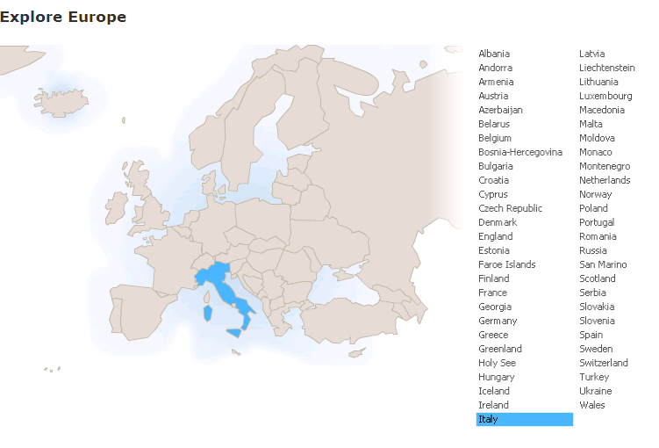
Run in “Slide Show” mode.
Use your up / down arrow keys and / or
your space bar to advance the slides
Politics
Italy
© 2009-2026 Timothy G. Roufs, University of Minnesota Duluth

Slide 2
Italy
© 2009-2026 Timothy G. Roufs, University of Minnesota Duluth

Slide 3
Politics
Italy
© 2009-2026 Timothy G. Roufs, University of Minnesota Duluth

Slide 4
Many of Italy’s contemporary political situations reflect a complex history, geography, ecology, demographic make up, world view, and so forth
. . .

Slide 5
So first, a bit of history and background . . .

Slide 6
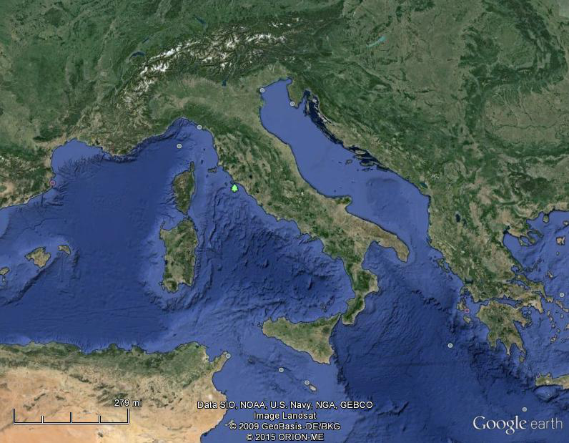
Of all European countries Italy, “the boot,” is probably the most recognizable . . .
Notes:
6

Slide 7
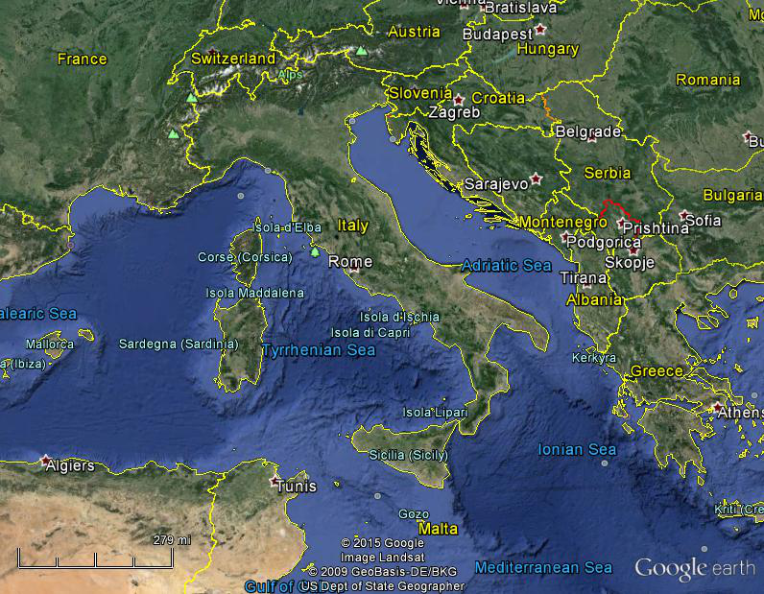
Italy, and her current neighbors . . .
Notes:
7

Slide 8
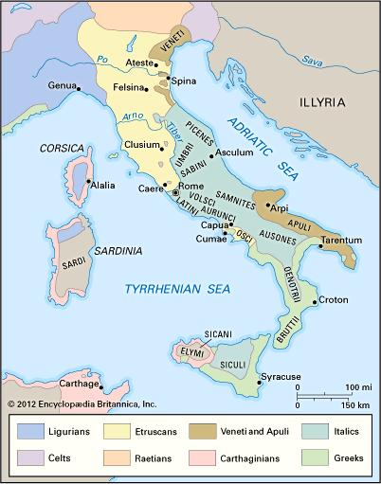
ancient Italic peoples:
Distribution of peoples of ancient Italy ca. 500 B.C.
©Encyclopædia Britannica, Inc.
https://www.britannica.com/topic/history-of-Italy
Notes:
8

Slide 9
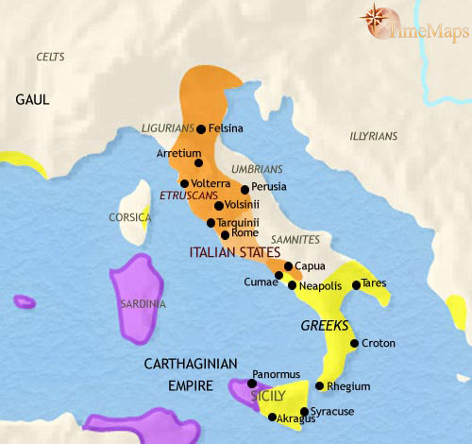
500 B.C.
http://www.timemaps.com/history/italy-500bc
Notes:
9

Slide 10
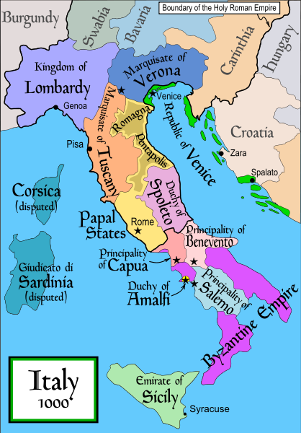
1000
Italy was divided for centuries into small kingdoms and city-states
http://en.wikipedia.org/wiki/Italy
Notes:
10

Slide 11
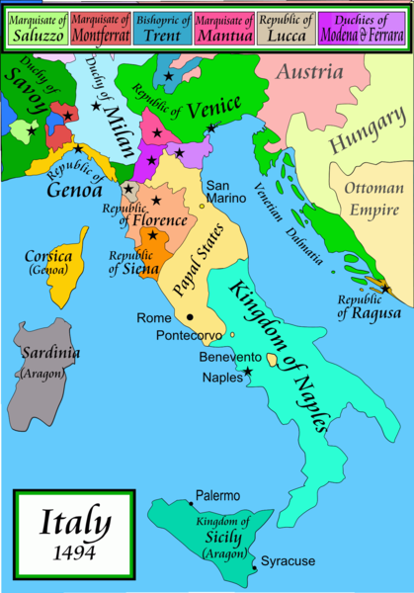
1494
Italy was divided for centuries into small kingdoms and city-states
http://en.wikipedia.org/wiki/Italy
Notes:
11

Slide 12
In 1494 Christopher Columbus from Genoa went on his second voyage to the New World
Italy was divided for centuries into small kingdoms and city-states
http://en.wikipedia.org/wiki/Italy
Notes:
12

Slide 13
In 1494 Christopher Columbus from Genoa is on his second voyage to the New World
Christopher Columbus was a sugar merchant from Genoa, married to the daughter of a sugar merchant from Madeira, Felipa Perestrello.
Columbus was looking for a way around Venice’s monopoly on things like sugar. . . .
Italy was divided for centuries into small kingdoms and city-states
http://en.wikipedia.org/wiki/Italy
Notes:
13

Slide 14
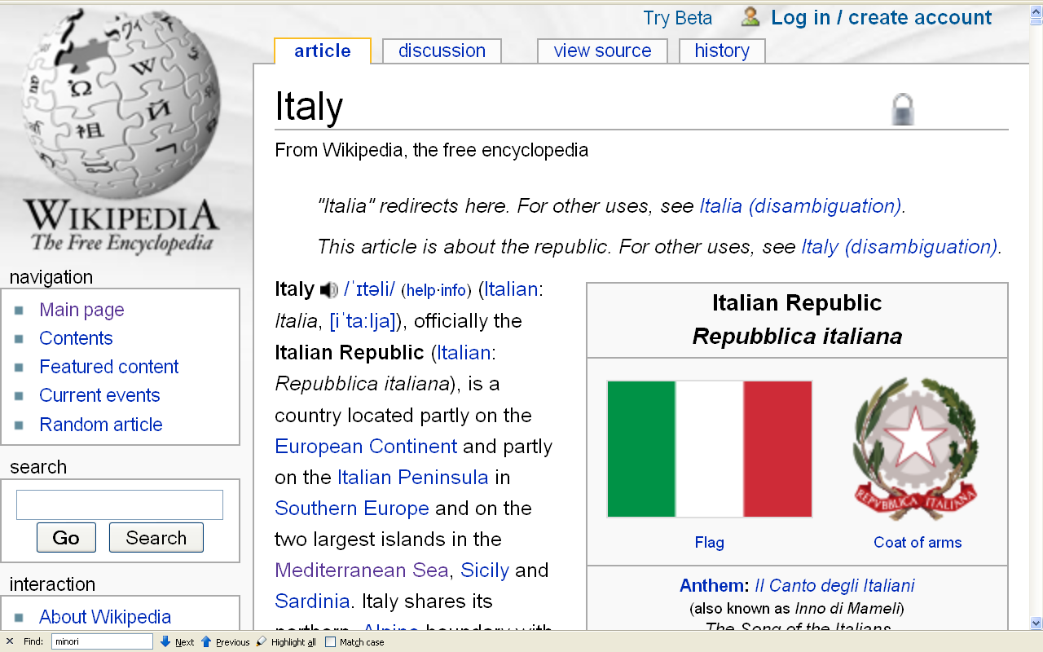
Formation of Italy
Unification —17 March 1861
Republic —2 June 1946
http://en.wikipedia.org/wiki/Italy
Notes:
14

Slide 15
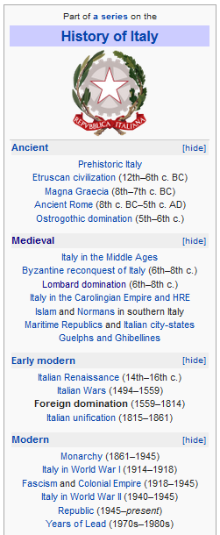
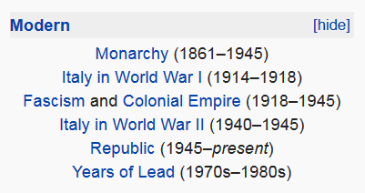
http://en.wikipedia.org/wiki/History_of_Italy_during_foreign_domination_and_the_unification
Notes:
15

Slide 16
http://en.wikipedia.org/wiki/History_of_Italy_during_foreign_domination_and_the_unification
Notes:
16

Slide 17
Formation of Italy
Unification —17 March 1861
Republic —2 June 1946
An important date . . .
http://en.wikipedia.org/wiki/Italy
Notes:
17

Slide 18
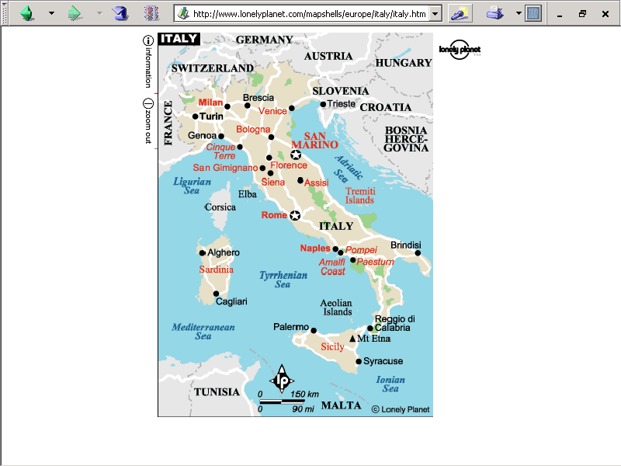
note. . .
population size
60,964,931 (2024 est.)
https://www.worldometers.info/world-population/italy-population/

Slide 19
Important features . . .
Note
Sicily

Slide 20
Note
Sardinia

Slide 21
Note
Kingdom of Tavolara
(unrecognized micronation)
https://en.wikipedia.org/wiki/Kingdom_of_Tavolara

Slide 22
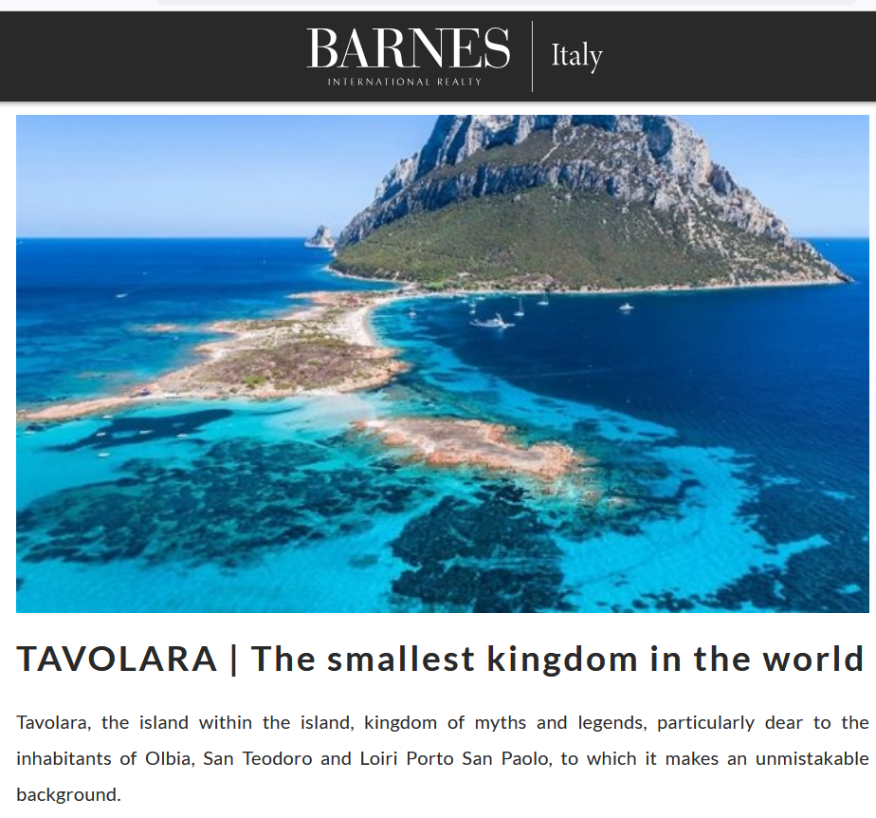
https://barnes-italy.com/tavolara-the-smallest-kingdom-in-the-world/
Notes:
22

Slide 23
Note
Corsica
(French)
Notes:
23

Slide 24
Principality of Seborga
(unrecognized micronation)
Note
https://en.wikipedia.org/wiki/Seborga
Notes:
24

Slide 25

Notes:
25

Slide 26
Note
Rome

Slide 27
The Holy See
(The Vatican)
an independent country
Note
Notes:
27

Slide 28
Note
Notes:
28

Slide 29
Note
The Most Serene Republic of San Marino
an independent country
Notes:
29

Slide 30
For Gannon and Pillai, a major feature is the . . .
Metaphor: The Opera
Italy
© 2009-2026 Timothy G. Roufs, University of Minnesota Duluth

Slide 31
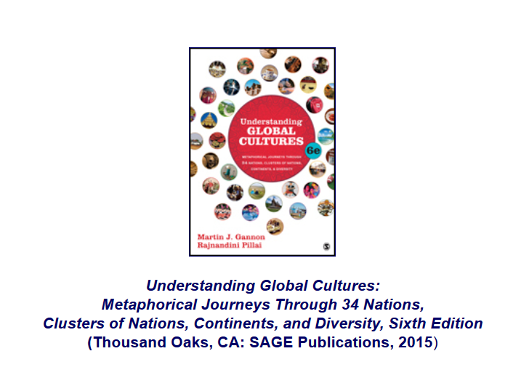
Gannon and Pillai . . .
http://www.d.umn.edu/cla/faculty/troufs/anth1095/index.html#text

Slide 32
metaphor
“The use of a word or phrase to refer to something that it isn’t, invoking a direct similarity between the word or phrase used and the thing described . . . “
https://en.wiktionary.org/wiki/metaphor

Slide 33
a
cultural metaphor is a specialized use of an item or action or idea itself
as a Unit of Analysis . . .

Slide 34
a cultural metaphor is a specialized use of an item or action or idea itself
as a Unit of Analysis . . .
through analogy

Slide 35
analogy
“A relationship of resemblance or equivalence between two situations, people, or objects, especially when used as a basis for explanation or extrapolation.“
https://en.wiktionary.org/wiki/metaphor

Slide 36



The major features of the Italian opera metaphor include . . .

Slide 37
Metaphor: The Opera
The Overture
Pageantry and Spectacle
Voice
Externalization
5. Chorus and Soloists
Italy
www.d.umn.edu/cla/faculty/troufs/anth1095/index.html#Gannon

Slide 38
Martin J. Gannon and Rajnandini Pillai Understanding Global Cultures
Gannon and Pillai focus on
five distinctive characteristics of the opera
and demonstrates how they illustrate Italian life . . .
www.d.umn.edu/cla/faculty/troufs/anth1095/index.html#Gannon

Slide 39
A key feature of
Italy, one prominently represented in the Opera is that . . .

Slide 40
Gannon and Pillai classify Italy as one of the
“Cleft National Cultures”
that they discuss

Slide 41
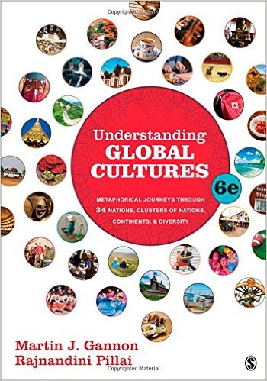
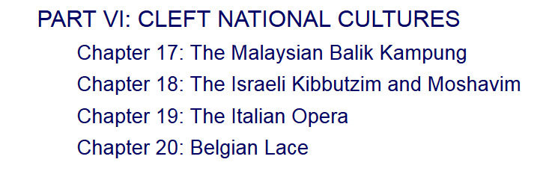


http://www.d.umn.edu/cla/faculty/troufs/anth1095/index.html#text

Slide 42
Cultural Metaphors
“Cleft National Culture”
one in which the subcultures
of the diverse ethnic groups
are difficult to integrate

Slide 43
in a nutshell . . .

Slide 44
Gannon and Pillai's European Cultural Metaphors include
Ch. 19 The Italian Opera
Ch. 20 Belgian Lace
Ch. 22 The Turkish Coffehouse
Ch. 31 The Russian Ballet
Ch. 32 Estonian Singing
Ch. 33 The Polish Village Church
Ch. 34 The Spanish Bullfight
Ch. 35 The Portuguese Bullfight
Italy is primarily culturally divided
“North - South”

Slide 45
Martin J. Gannon and Rajnandini Pillai Understanding Global Cultures
The country is divided into two main regions
“Continental Italy” (aka “The North”)
The Alps
The northern Italian plain
“Mediterranean Italy” (aka “The South”)
The Italian peninsula and the islands
www.d.umn.edu/cla/faculty/troufs/anth1095/index.html#Gannon

Slide 46
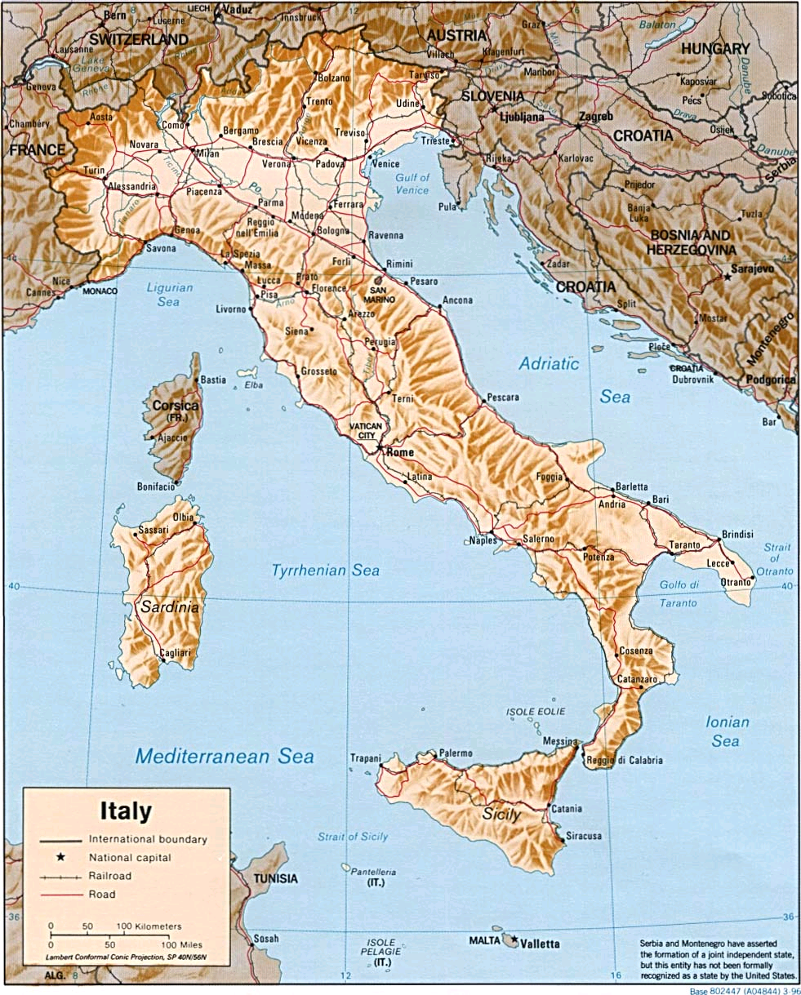
http://www.reliefweb.int/rw/RWB.NSF/db900LargeMaps/SKAR-64GDTU?OpenDocument

Slide 47
Martin J. Gannon and Rajnandini Pillai Understanding Global Cultures
The Apennine mountains run directly down the peninsula’s center, and its northern range almost completely cuts off the north from the south
This geographical division has led to extreme regionalism
www.d.umn.edu/cla/faculty/troufs/anth1095/index.html#Gannon

Slide 48
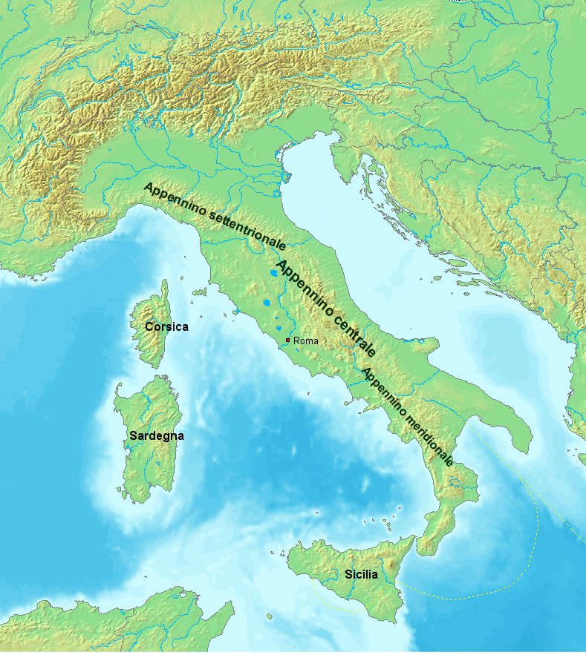
https://en.wikipedia.org/wiki/Apennine_Mountains

Slide 49
Martin J. Gannon and Rajnandini Pillai Understanding Global Cultures
The Apennine mountains run directly down the peninsula’s center, and its northern range almost completely cuts off the north from the south
Many Italians view Italy as two separate nations
The wealthier, industrial north
The poorer, more agrarian south
www.d.umn.edu/cla/faculty/troufs/anth1095/index.html#Gannon

Slide 50
Martin J. Gannon and Rajnandini Pillai Understanding Global Cultures
the north and south
are closely linked to one another culturally, even though there are regional differences
www.d.umn.edu/cla/faculty/troufs/anth1095/index.html#Gannon

Slide 51
Martin J. Gannon and Rajnandini Pillai Understanding Global Cultures
The civic traditions of the north and south
of Italy originated from
different sources
and these traditions have persisted for centuries
(Robert Putnam 1991)
www.d.umn.edu/cla/faculty/troufs/anth1095/index.html#Gannon

Slide 52
Martin J. Gannon and Rajnandini Pillai Understanding Global Cultures
In the
north
there has been a centuries-long legacy of
civic involvement through guilds
and democratic elections
that has held corruption in check
www.d.umn.edu/cla/faculty/troufs/anth1095/index.html#Gannon

Slide 53
Martin J. Gannon and Rajnandini Pillai Understanding Global Cultures
Today,
the north of Italy is as successful as or more successful than Germany,
whereas the south
languishes in poverty
even though millions of dollars have been devoted to eradicating it
www.d.umn.edu/cla/faculty/troufs/anth1095/index.html#Gannon

Slide 54
Martin J. Gannon and Rajnandini Pillai Understanding Global Cultures
But the economically prosperous north depends heavily on emigration from the south for its workforce . . .
www.d.umn.edu/cla/faculty/troufs/anth1095/index.html#Gannon

Slide 55
Martin J. Gannon and Rajnandini Pillai Understanding Global Cultures
the Northern League . . . periodically seeks to create two separate nations in Italy . . .
www.d.umn.edu/cla/faculty/troufs/anth1095/index.html#Gannon

Slide 56
the Northern League is “Lega” Nord . . .
Lega Nord per l'Indipendenza della Padania (Northern League for the Independence of Padania)

Slide 57
Sometimes the northern region is called
Padania . . .
Some even arguing that it should be an independent country . . .
https://en.wikipedia.org/wiki/Padanian_nationalism

Slide 58
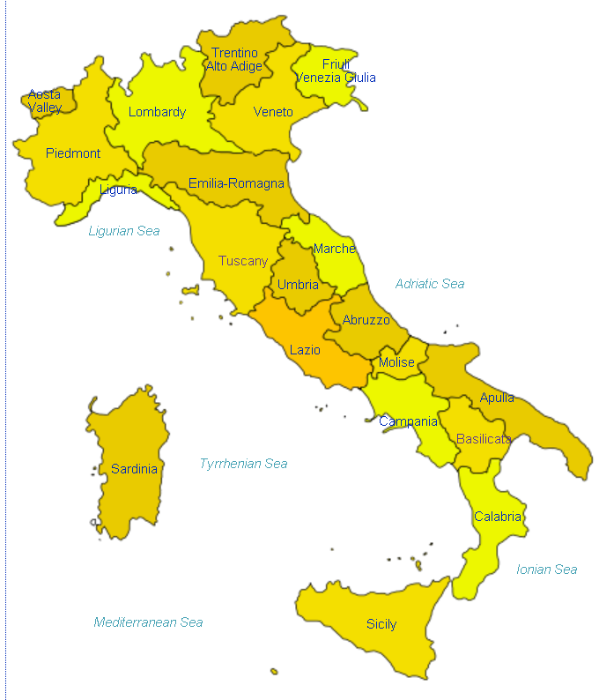
Padania
http://en.wikipedia.org/wiki/Regions_of_Italy
Notes:
58

Slide 59
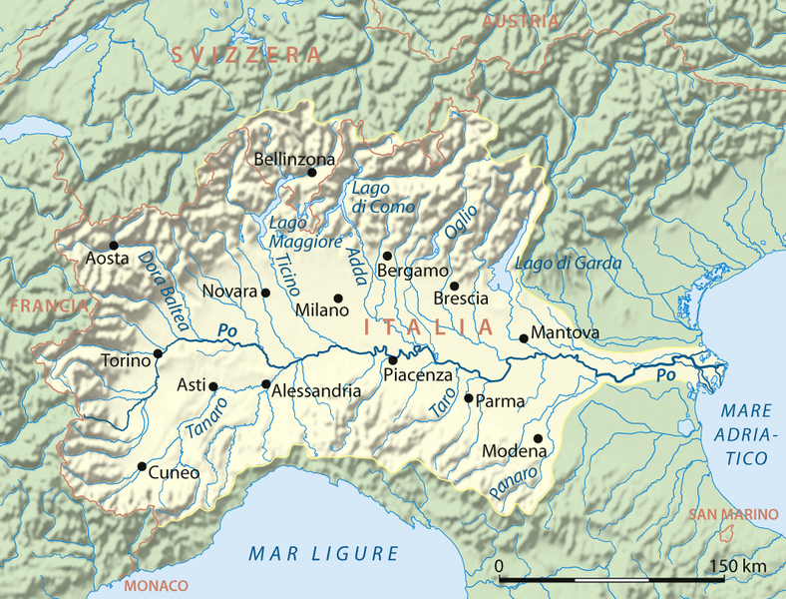
Padania
http://en.wikipedia.org/wiki/Regions_of_Italy
Notes:
59

Slide 60
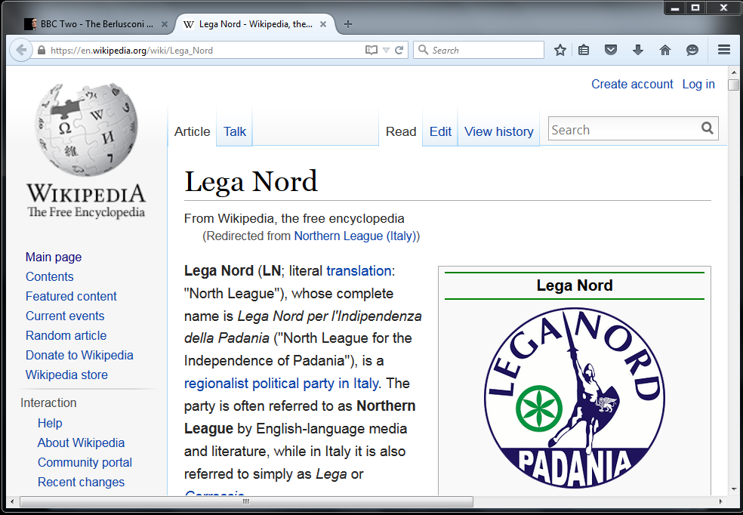
http://en.wikipedia.org/wiki/Northern_League_%28Italy%29
Notes:
60

Slide 61
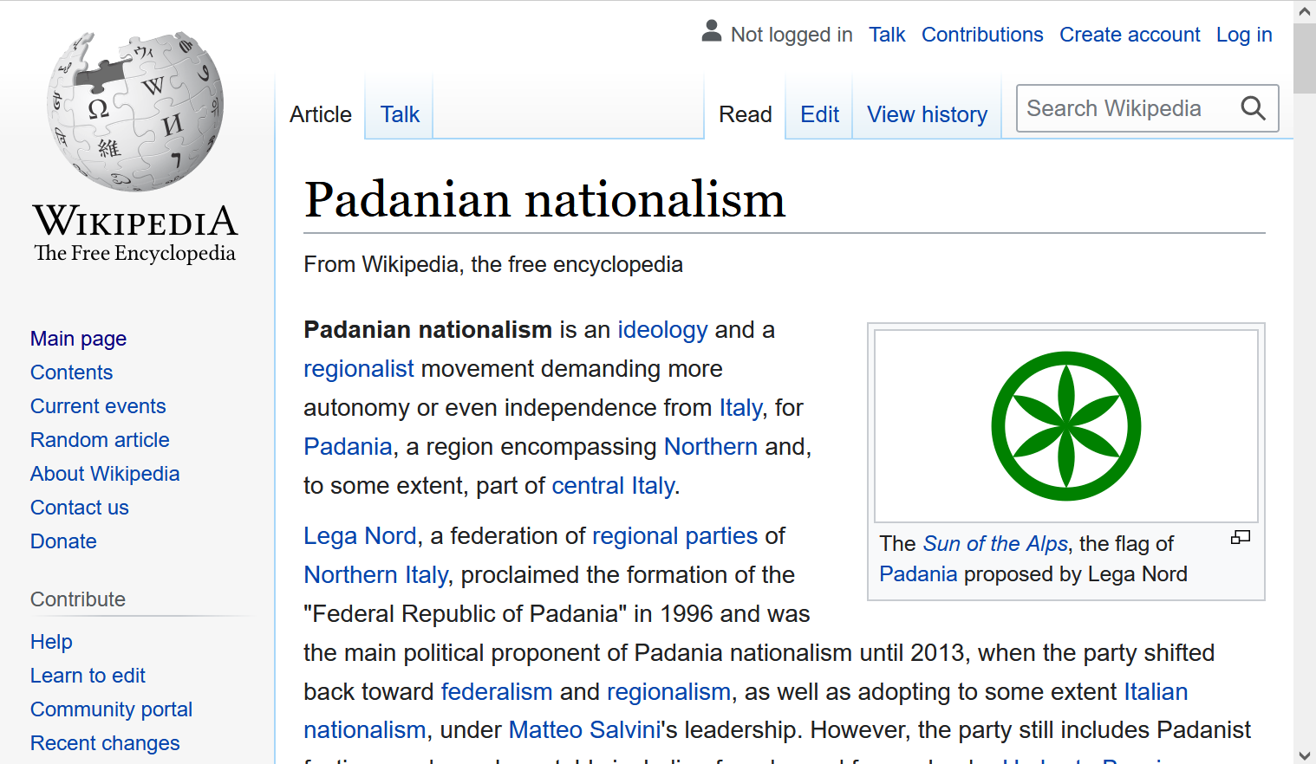
https://en.wikipedia.org/wiki/Padanian_nationalism
Notes:
61

Slide 62

Sometimes the northern region is called
Padania . . .
Some even arguing that it should be an independent country . . .
https://en.wikipedia.org/wiki/Padanian_nationalism

Slide 63
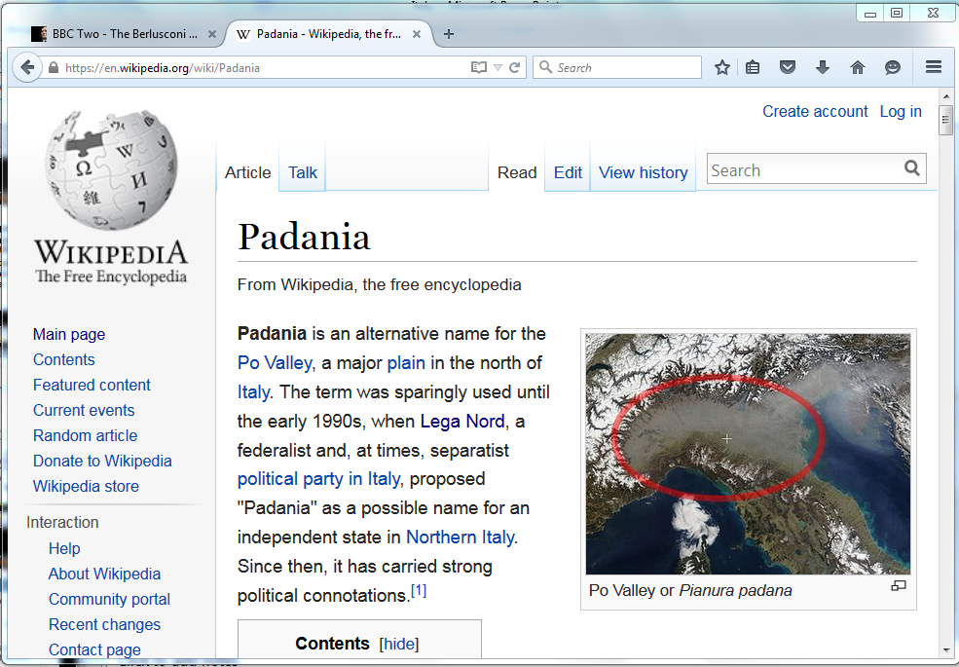
https://en.wikipedia.org/wiki/Padania
Notes:
63

Slide 64
Basic Demographics
Italy

Slide 65
Demographics
Population: 60,964,931
(2024 est.)
country comparison to the world: 24
Population growth rate: -0.08%
(2024 est.)
country comparison to the world: 201
65 years and over: 23.6%
(2024 est.)
CIA World Factbook
https://www.cia.gov/the-world-factbook/countries/italy/

Slide 66
Demographics
Italy has the third-largest population in the European Union and about the 23rd-largest population worldwide
The population density, at over
201.7 persons per km²
(over 522.4 / mi²)
is the 6th highest in the European Union
Wikipedia
http://en.wikipedia.org/wiki/Italy#Demographics

Slide 67
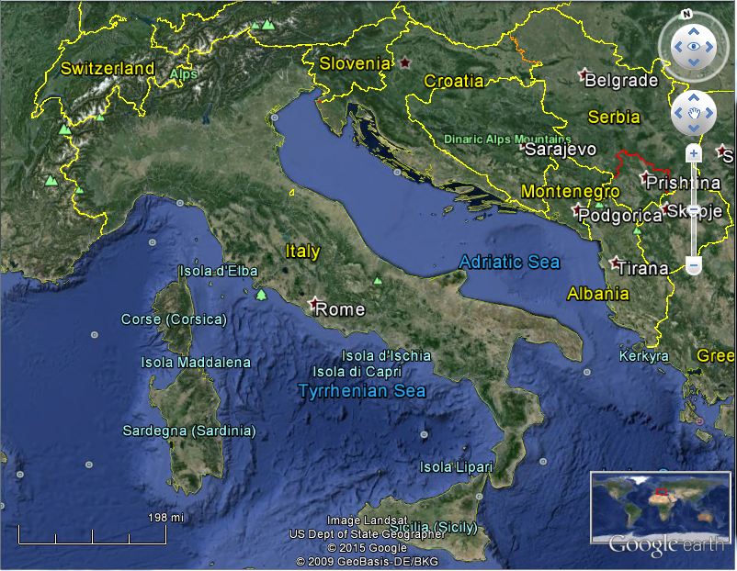
Population:
Italy: 60,964,931 (2024 est.)
Minnesota: 5,705,494 (2020 Census)
Population Density:
Italy: 522.4+ / mi² (201.7+ / km²)
Minnesota: 71.0 / mi² (27.4 / km²)

Slide 68
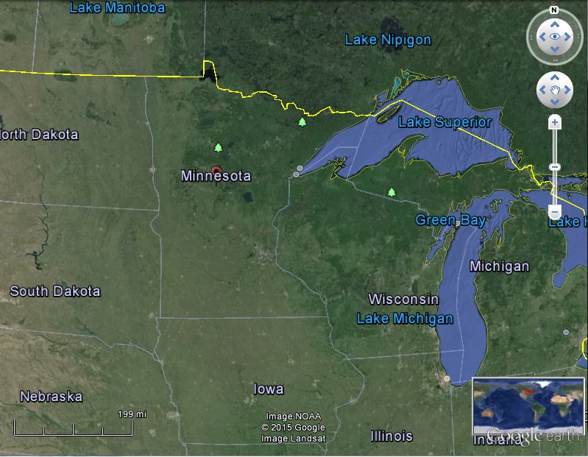
Coparisons with Minnesota
Population:
Italy: 60,964,931 (2024 est.)
Minnesota: 5,705,494 (2020 Census)
Population Density:
Italy: 532 / mi² (206 / km²)
Minnesota: 71.0 / mi² (27.4 / km²)

Slide 69
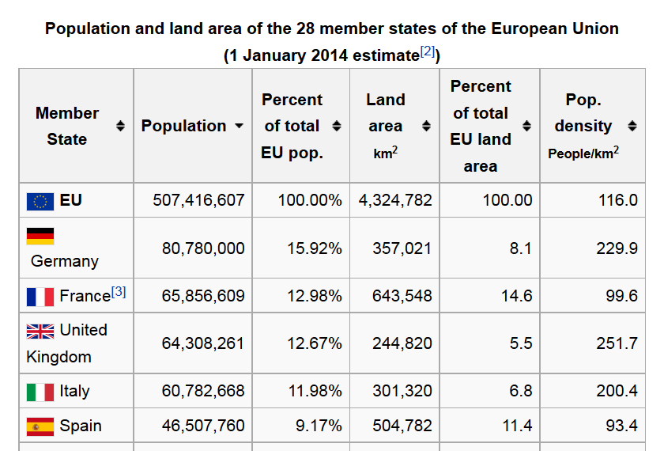
https://en.wikipedia.org/wiki/Demographics_of_the_European_Union#Population_by_nation
Notes:
69

Slide 70
Demographics
The highest population density is in Northern Italy,
as that one-third of the country contains almost half of the total population
Wikipedia
http://en.wikipedia.org/wiki/Italy#Demographics

Slide 71
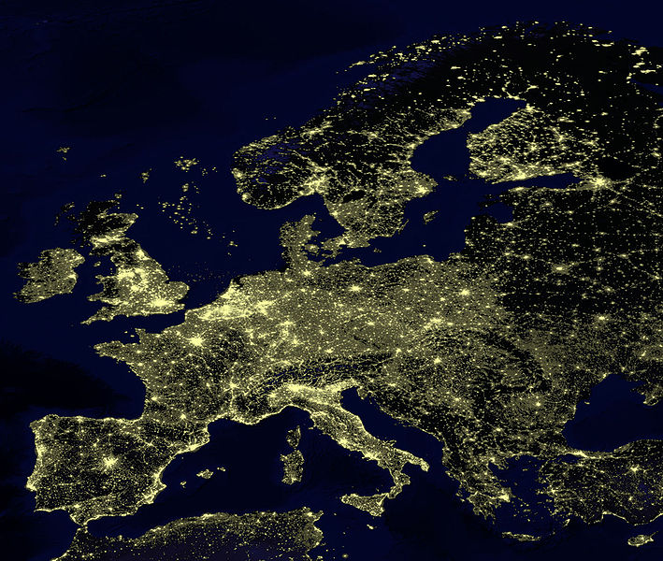
for Europe, at least, earthlight photos give you a sense of population density
https://commons.wikimedia.org/wiki/File:Earthlights_2002.jpg
Notes:
71

Slide 72
https://commons.wikimedia.org/wiki/File:Earthlights_2002.jpg
Notes:
72

Slide 73
https://commons.wikimedia.org/wiki/File:Earthlights_2002.jpg
Notes:
73

Slide 74
Oslo
Stockholm
St. Petersburg
Edinburgh
Glasgow
Copenhagen
London
Brussels
Paris
Milan
Venice
Rome
Madrid
Naples
Athens
https://commons.wikimedia.org/wiki/File:Earthlights_2002.jpg
Notes:
74

Slide 75
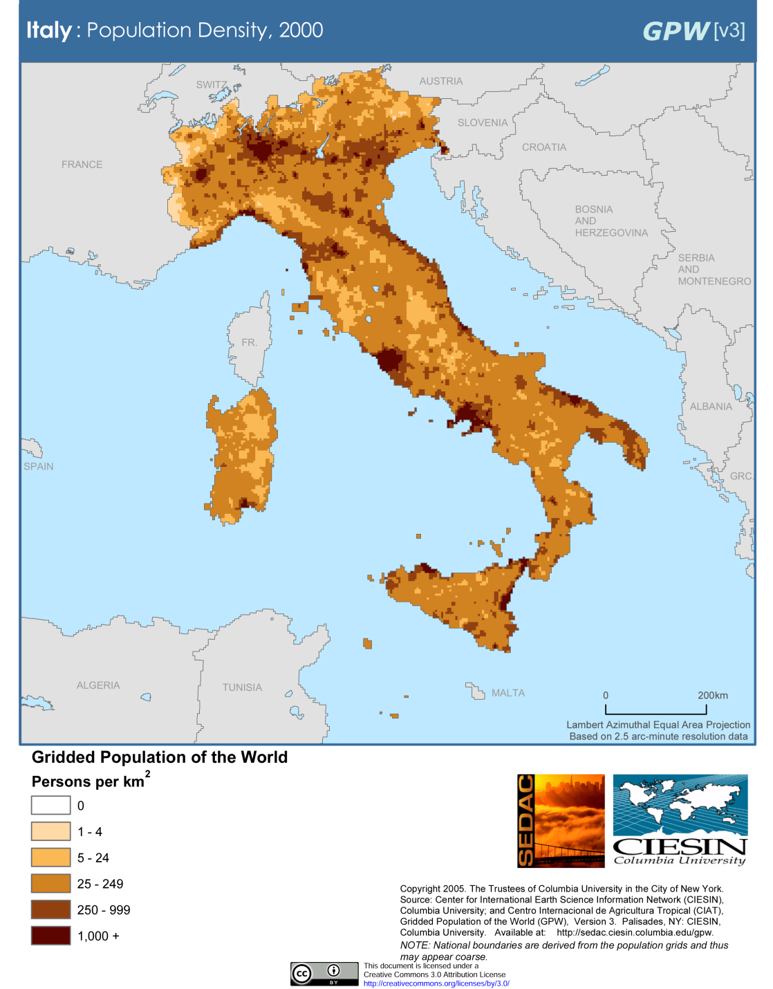
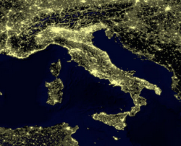
Milan
Venice
Rome
Milan
Venice
Naples
Rome
Naples
Population Density (2000)
Wikipedia
http://en.wikipedia.org/wiki/Italy#Demographics

Slide 76
Demographics
urban population:
72% of total population
(2023)
rate of urbanization: 0.27% annual rate of change
(2020-2025 est.)
Infant mortality rate:
total: 3.1 deaths/1,000 live births
(2024 est.)
country comparison to the world: 207
Life expectancy at birth:
total population: 83 years
(2024 est.)
country comparison to the world: 19
CIA World Factbook
https://www.cia.gov/the-world-factbook/countries/italy/

Slide 77
Demographics
Ethnic Groups
In the North
German-Italians
French-Italians
Slovene-Italians
In the South
Albanian-Italians
Greek-Italians
CIA World Factbook
https://www.cia.gov/library/publications/the-world-factbook/geos/it.html

Slide 78
the main languages of Italy reflect the main ethnic groups,
at least in the north,
and include . . .

Slide 79
Italy’s
Main Languages
Italian (official)
German
parts of Trentino-Alto Adige region are predominantly German speaking
French
small French-speaking minority in Valle d'Aosta region (near France)
Slovene
Slovene-speaking minority in the Trieste-Gorizia area (near Slovenia)
include . . .
CIA World Factbook
https://www.cia.gov/the-world-factbook/countries/italy/

Slide 80
Italian
throughout
http://en.wikipedia.org/wiki/Regions_of_Italy
Notes:
80

Slide 81
Main Languages
Italian (official)
German
parts of Trentino-Alto Adige region are predominantly German speaking
French
small French-speaking minority in Valle d'Aosta region (near France)
Slovene
Slovene-speaking minority in the Trieste-Gorizia area (near Slovenia)
CIA World Factbook
https://www.cia.gov/the-world-factbook/countries/italy/

Slide 82
German
http://en.wikipedia.org/wiki/Regions_of_Italy
Notes:
82

Slide 83
Main Languages
Italian (official)
German
parts of Trentino-Alto Adige region are predominantly German speaking
French
small French-speaking minority in Valle d'Aosta region (near France)
Slovene
Slovene-speaking minority in the Trieste-Gorizia area (near Slovenia)
CIA World Factbook
https://www.cia.gov/the-world-factbook/countries/italy/

Slide 84
French
http://en.wikipedia.org/wiki/Regions_of_Italy
Notes:
84

Slide 85
Main Languages
Italian (official)
German
parts of Trentino-Alto Adige region are predominantly German speaking
French
small French-speaking minority in Valle d'Aosta region (near France)
Slovene
Slovene-speaking minority in the Trieste-Gorizia area (near Slovenia)
CIA World Factbook
https://www.cia.gov/the-world-factbook/countries/italy/

Slide 86
Slovene
http://en.wikipedia.org/wiki/Regions_of_Italy
Notes:
86

Slide 87
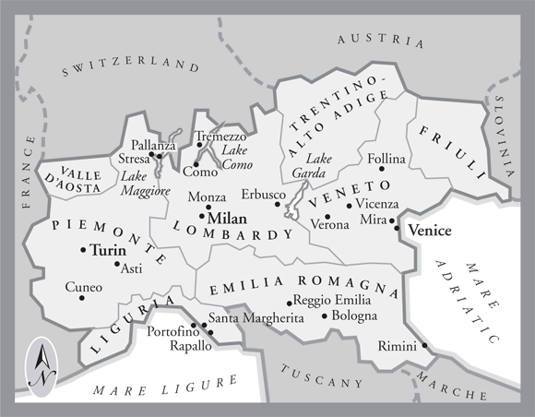

In northern Italy people in three regions speak a different primary language,
in addition to Italian . . .
German
Slovene
French
Italian
is spoken throughout Italy
Tuscany
www.jdbassc.com/maps/map_southern_italy.asp
Notes:
87

Slide 88
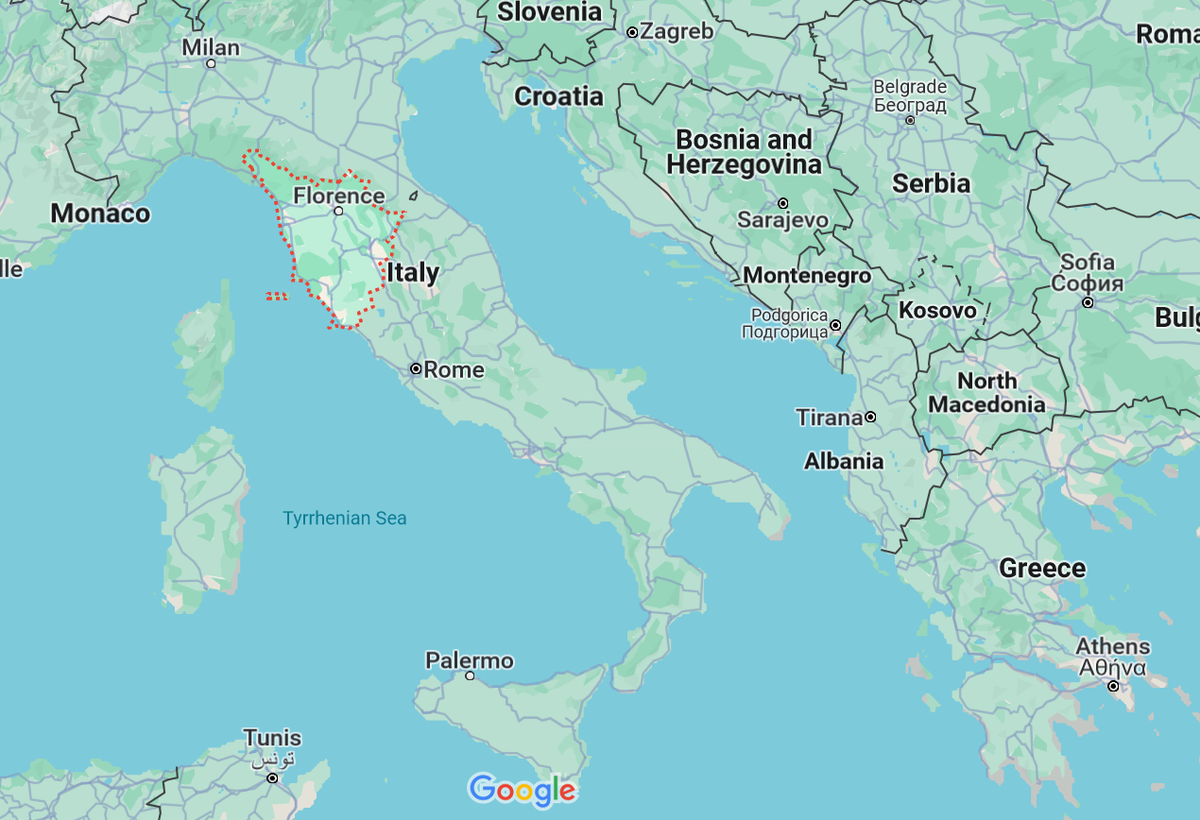

German
French
Slovene
Tuscany
Italian
In the neighboring Tuscany region
they speak Italian, which historically was based on the Florentine dialect . . .

Slide 89
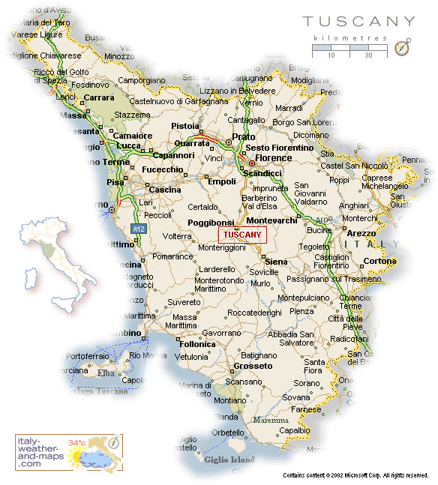
Florence
Pisa
http://healthmap.files.wordpress.com/2009/12/tuscany-map.gif

Slide 90
Italian
throughout
http://en.wikipedia.org/wiki/Regions_of_Italy
Notes:
90

Slide 91
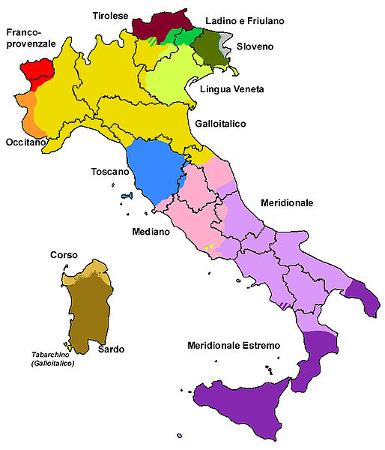
all the languages include . . .
Official language(s) | Italian
Regional language(s) | German, Neapolitan, Slovene, Piedmontese, Sardinian, Sardinian, Tabarchino, Sassarese, Gallurese, Ladin, Cimbrian, Mocheno, Venetian
Minority language(s) | Albanian, Catalan, German, Greek, Slovene, Croatian, French, Franco-Provençal, Friulian, Ladin, Occitan, Sardinia
Main immigrant language(s) | Romanian, Berber, Maghrebi Arabic, Albanian
Main foreign language(s) | English (25%) Spanish (17%) French (14%)
Dialects of Italy by Group
http://en.wikipedia.org/wiki/List_of_languages_of_Italy
Notes:
91

Slide 92
Martin J. Gannon and Rajnandini Pillai Understanding Global Cultures
The Italian history of invasions has produced many dialects, each the product of the particular regional invader
The language of Italy consists of both local dialects and Italian, a derivative of the Tuscan language
Although linguistic variations are disappearing to some extent due to the homogenizing effects of television and telecommunications, Italians still cling to the notion of having their own regional dialect
www.d.umn.edu/cla/faculty/troufs/anth1095/index.html#Gannon

Slide 93
Martin J. Gannon and Rajnandini Pillai Understanding Global Cultures
The vocal selections of the chorus in the Italian opera are directly comparable to the many regional variations of the Italian language
Although each section is important to the harmony of the chorus, each has its own melody
www.d.umn.edu/cla/faculty/troufs/anth1095/index.html#Gannon

Slide 94
Dialects of Italy by Group
http://en.wikipedia.org/wiki/List_of_languages_of_Italy
Notes:
94

Slide 95
1494
compare these
with the old kingdoms
Dialects of Italy by Group
http://en.wikipedia.org/wiki/List_of_languages_of_Italy
Notes:
95

Slide 96
1000
1494
compare these
with the old kingdoms
Dialects of Italy by Group
http://en.wikipedia.org/wiki/List_of_languages_of_Italy
Notes:
96

Slide 97
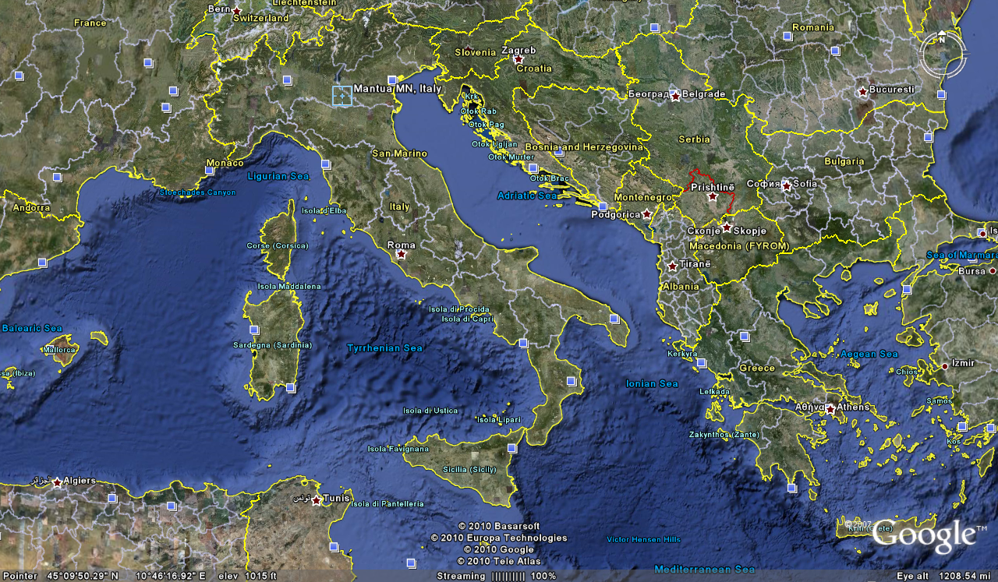
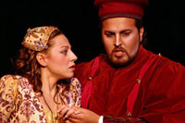
Cosimo Vassallo
is from
Palermo, Sicily
Letizia Colajanni
and
Cosimo Vassallo
/

Slide 98
Cossimo lives in
Mantova
503 miles away
(by air)
/
Letizia Colajanni
and
Cosimo Vassallo

Slide 99
If Cosimo speaks Italian with
his Palermo accent in
Montova, some
will have difficult understanding him
/
Cosimo Vassallo
is from
Palermo, Sicily
Letizia Colajanni
and
Cosimo Vassallo
/

Slide 100
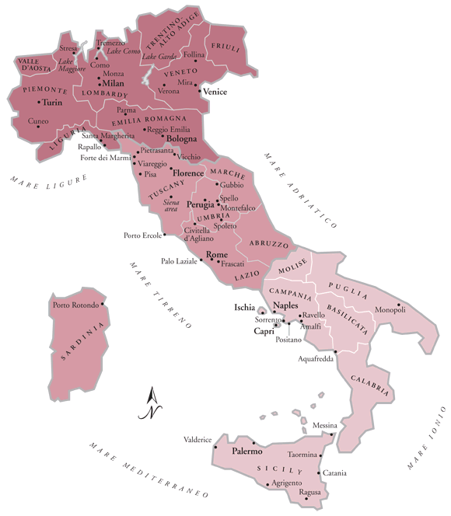
/
My friend Martin Aricochi
who lives in
Brixen (Bressanone), Italy, spoke German until he went to school,
www.jdbassc.com/maps/map_southern_italy.asp
Notes:
100

Slide 101
/
My friend Martin Aricochi
who lives in
Brixen (Bressanone), Italy, spoke German until he went to school,
and they still speak German at home
www.jdbassc.com/maps/map_southern_italy.asp
Notes:
101

Slide 102
the main religions include . . .

Slide 103
Demographics
Religions
Roman Catholic 80%-90%
approximately
about one-third regularly attend services
Other 10-20%%
includes “mature Protestant” and Jewish communities
and a growing Muslim immigrant community
CIA World Factbook
https://www.cia.gov/library/publications/the-world-factbook/geos/it.html

Slide 104
Demographics
Religions
Roman Catholic 80%-90%
approximately
about one-third regularly attend services
Other 10-20%%
includes “mature Protestant” and Jewish communities
and a growing Muslim immigrant community
CIA World Factbook
https://www.cia.gov/library/publications/the-world-factbook/geos/it.html

Slide 105
Literacy
definition: age 15 and over can read and write
total population: 99.2%
male: 99.4%
female: 99%
(2018 est.)
CIA World Factbook
https://www.cia.gov/library/publications/the-world-factbook/geos/it.html

Slide 106
One really important feature about Italy is their very low population growth rate,
a rate so low it will eventually cause big problems
(if not changed) . . .

Slide 107
Demographics
total fertility rate in Italy:
1.26 children born / 1,000 woman
(2024 est.)
country comparison to the world: 219
10.7 deaths / 1,000 population
(2021 est.)
country comparison to the world: 24
net migration rate:
3.2 migrant(s) / 1,000 population
(2021 est.)
country comparison to the world: 34
CIA World Factbook
https://www.cia.gov/the-world-factbook/countries/italy/

Slide 108
So what?

Slide 109
Demographics
total fertility rate in Italy:
1.26 children born / 1,000 woman
(2024 est.)
country comparison to the world: 221
10.7 / 1,000 population
(2021 est.)
country comparison to the world: 24
net migration rate:
3.2 migrant(s) / 1,000 population
(2021 est.)
country comparison to the world: 34
this is one of
the lowest rates in the world
CIA World Factbook
https://www.cia.gov/the-world-factbook/countries/italy/

Slide 110



Demographics
Just two years earlier . . .
total fertility rate in Italy:
1.47 children born / 1,000 woman
(2024 est.)
country comparison to the world: 219
1.26
net migration rate:
3.2 migrant(s) / 1,000 population
(2021 est.)
country comparison to the world: 34
it was one of the lowest rates
in the world even before COVID
and it is declining rapidly
CIA World Factbook
https://www.cia.gov/the-world-factbook/countries/italy/

Slide 111

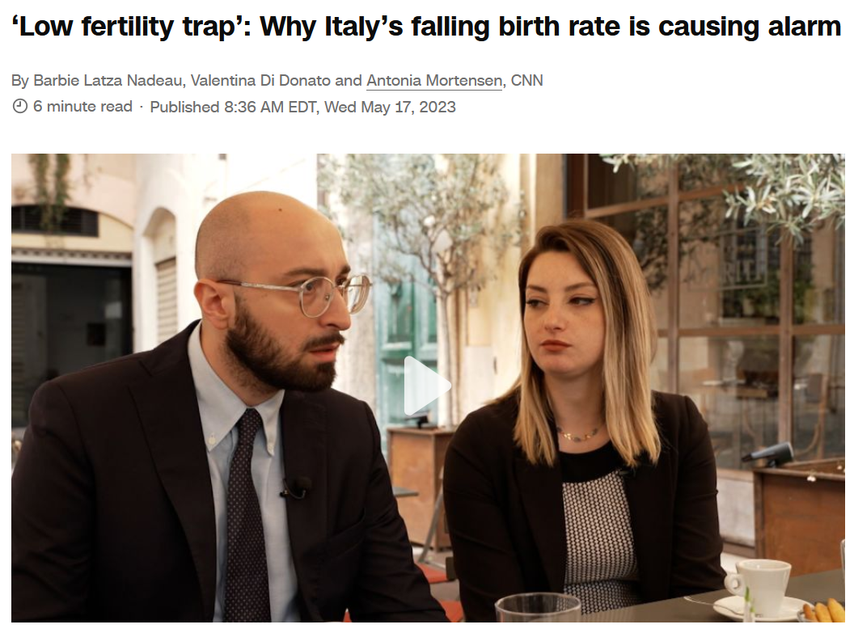
17 May 2023
10.7 deaths / 1,000 population
(2021 est.)
country comparison to the world: 24
net migration rate:
3.2 migrant(s) / 1,000 population
(2021 est.)
country comparison to the world: 34
https://www.cnn.com/2023/05/17/europe/italy-record-low-birth-rate-intl-cmd

Slide 112
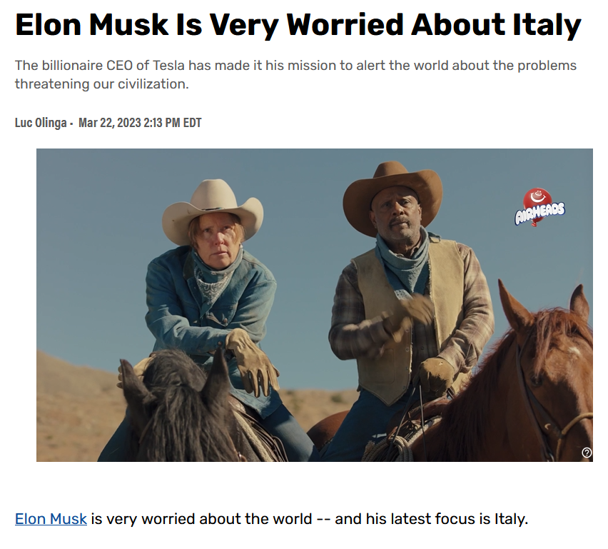

TheStreet
10.7 deaths / 1,000 population
(2021 est.)
country comparison to the world: 24
net migration rate:
3.2 migrant(s) / 1,000 population
(2021 est.)
country comparison to the world: 34
https://www.thestreet.com/technology/elon-musk-is-very-worried-about-italy

Slide 113
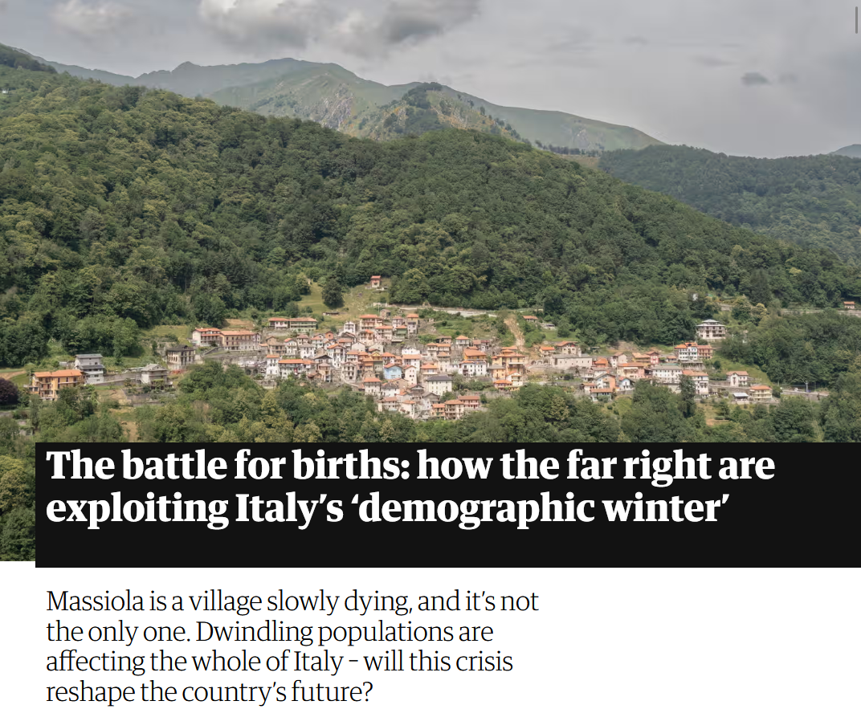

7 October 2023
net migration rate:
3.2 migrant(s) / 1,000 population
(2021 est.)
country comparison to the world: 34
https://www.theguardian.com/world/2023/oct/07/italy-births-far-right-demographic-winter?CMP=Share_iOSApp_Other

Slide 114
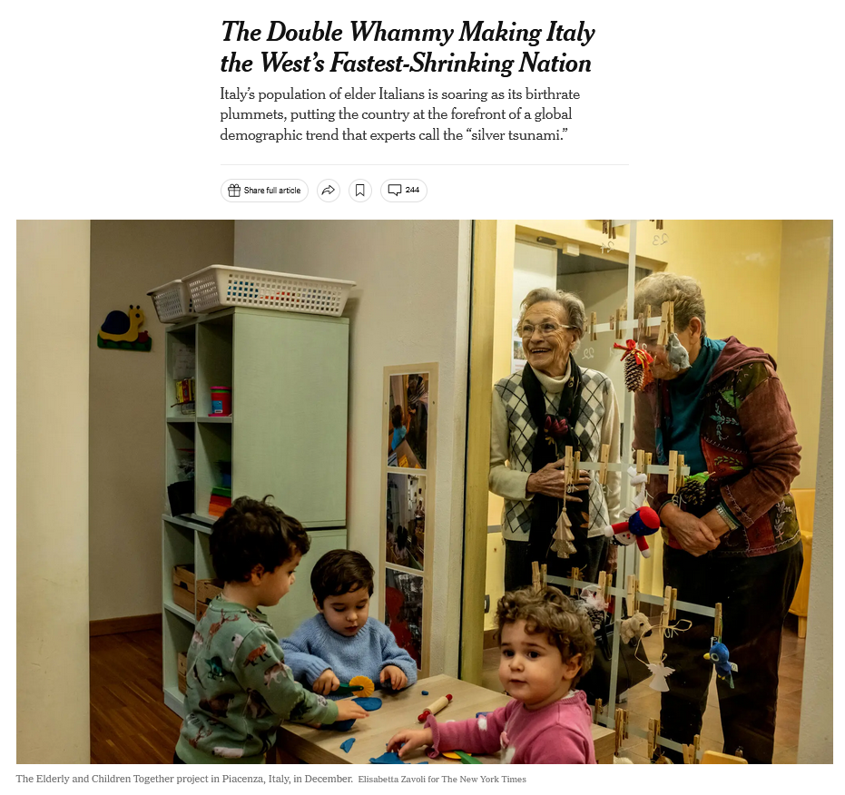
30 January 2023
net migration rate:
3.2 migrant(s) / 1,000 population
(2021 est.)
country comparison to the world: 34
https://www.nytimes.com/2023/01/30/world/europe/italy-birthrate.html?smid=em-share

Slide 115
Demographics
total fertility rate in Italy:
1.26 children born / 1,000 woman
(2024 est.)
country comparison to the world: 219
10.7 deaths / 1,000 population
(2021 est.)
country comparison to the world: 24
That means not enough children are being born to sustain the population . . .
CIA World Factbook
https://www.cia.gov/the-world-factbook/countries/italy/

Slide 116

Demographics
Population: 60,964,931
(2024 est.)
country comparison to the world: 24
Population growth rate: -0.08%
(2024 est.)
country comparison to the world: 201
65 years and over: 23.6%
(2024 est.)
CIA World Factbook
https://www.cia.gov/the-world-factbook/countris/italy/

Slide 117
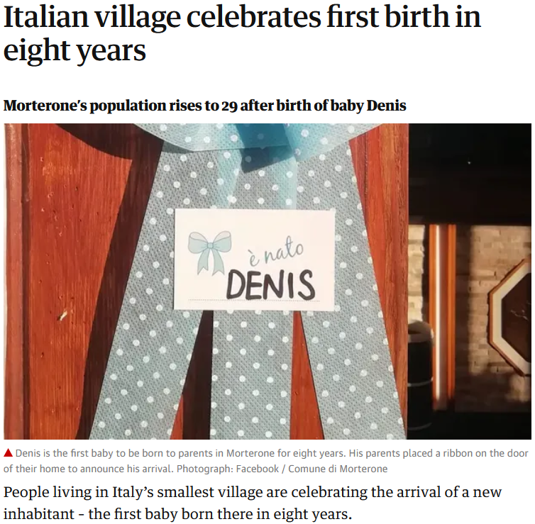
21 Jul 2020
https://www.theguardian.com/world/2020/jul/21/italian-village-morterone-celebrates-first-birth-in-eight-years?CMP=Share_iOSApp_Other

Slide 118
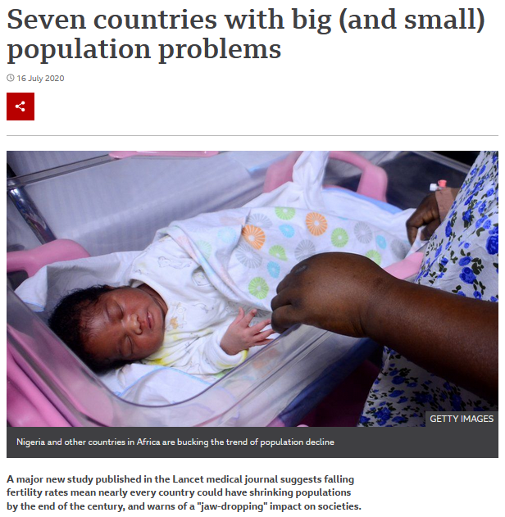

16 Jul 2020
Including Italy
https://www.bbc.com/news/world-53424726

Slide 119
Demographics
total fertility rate in Italy:
1.26 children born / 1,000 woman
(2024 est.)
country comparison to the world: 219
an overall total fertility rate of 2.1 is needed for the population in an area
to remain stable,
assuming no immigration or emigration occurs . . .
10.7 deaths / 1,000 population
(2021 est.)
country comparison to the world: 24
CIA World Factbook
https://www.cia.gov/the-world-factbook/countries/italy/

Slide 120
Demographics
total fertility rate in Italy:
1.26 children born / 1,000 woman
(2024 est.)
country comparison to the world: 209
The low birth rate is a huge
slow-moving crisis . . .
and unless something
is eventually done,
Italy as we know it will disappear . . .
10.7 deaths / 1,000 population
(2021 est.)
country comparison to the world: 24
net migration rate:
3.2 migrant(s) / 1,000 population
(2021 est.)
country comparison to the world: 34
CIA World Factbook
https://www.cia.gov/the-world-factbook/countries/italy/

Slide 121



Martin J. Gannon and Rajnandini Pillai Understanding Global Cultures
“Although Italian culture is justifiably renowned, it is in danger of extinction, as are the cultures of some other developed nations. It has one of the lowest fertility rate among nations: 1.19 children per woman. After Sweden, Italy has the oldest population among nations, with 16.1% of its population over 65.”
1.26
22.1
[23.6%]
[2024 est.]
www.d.umn.edu/cla/faculty/troufs/anth1095/index.html#Gannon

Slide 122
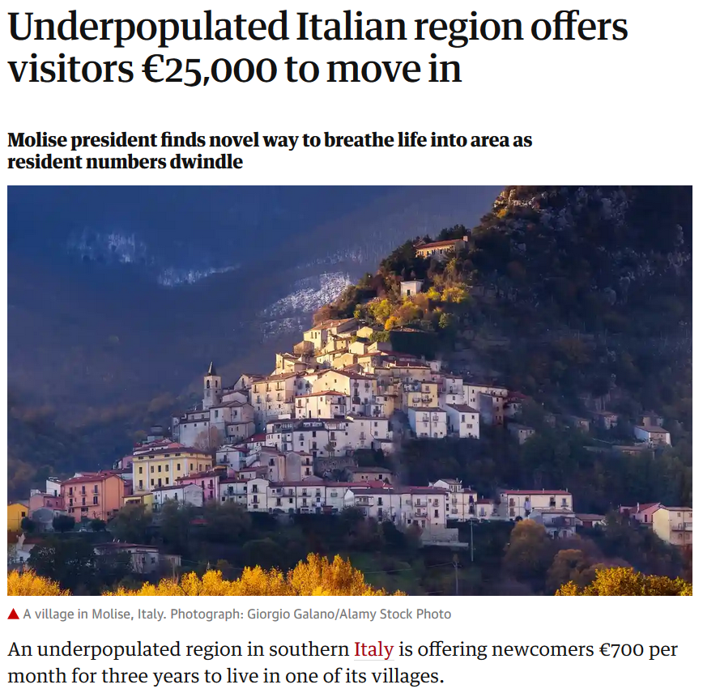
Wed 11 Sep 2019
https://www.theguardian.com/world/2019/sep/11/underpopulated-italian-region-molise?CMP=Share_iOSApp_Other

Slide 123
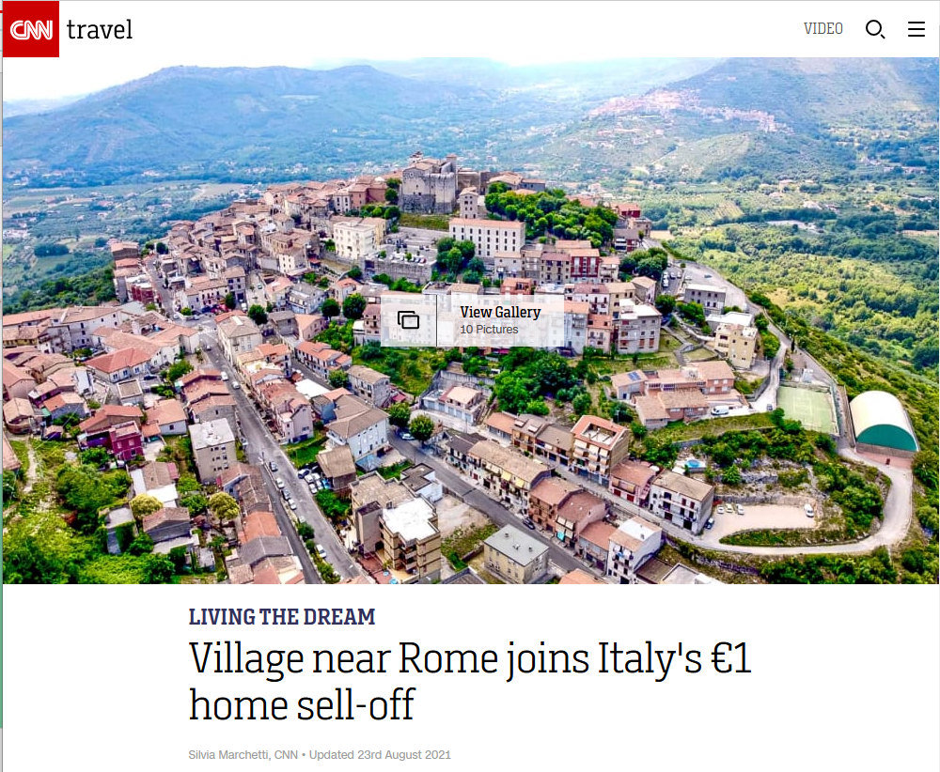





$1.18 USD
23 August 2021
http://edition.cnn.com/travel/article/italy-one-euro-homes-maenza-rome/index.html

Slide 124
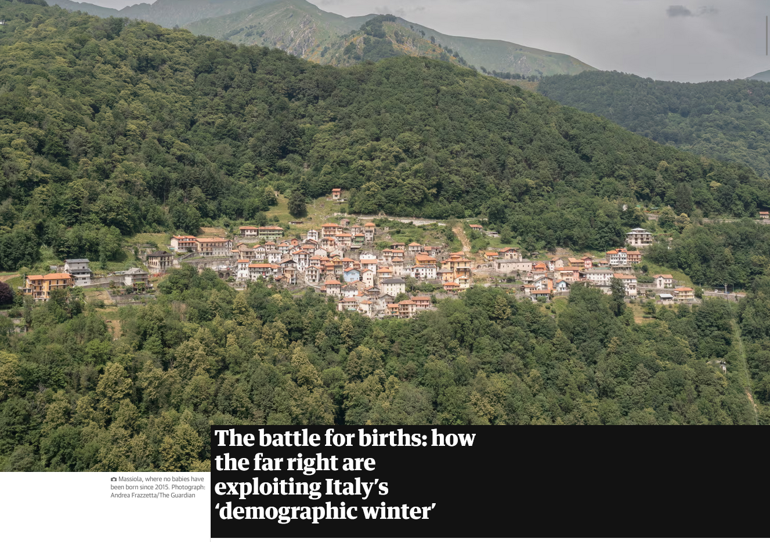
23 August 2021
https://www.theguardian.com/world/2023/oct/07/italy-births-far-right-demographic-winter?CMP=Share_iOSApp_Other

Slide 125
Demographics
total fertility rate in Italy:
1.26 children born / 1,000 woman
(2024 est.)
country comparison to the world: 209
and in the meantime, there will be big problems trying to support
an aging population . . .
10.7 deaths / 1,000 population
(2021 est.)
country comparison to the world: 24
net migration rate:
3.2 migrant(s) / 1,000 population
(2021 est.)
country comparison to the world: 34
CIA World Factbook
https://www.cia.gov/the-world-factbook/countries/italy/

Slide 126
Demographics
Population: 60,964,931
(2024 est.)
country comparison to the world: 24
Population growth rate: -0.08%
(2024 est.)
country comparison to the world: 201
65 years and over: 23.6%
(2024 est.)
CIA World Factbook
https://www.cia.gov/the-world-factbook/countries/italy/

Slide 127
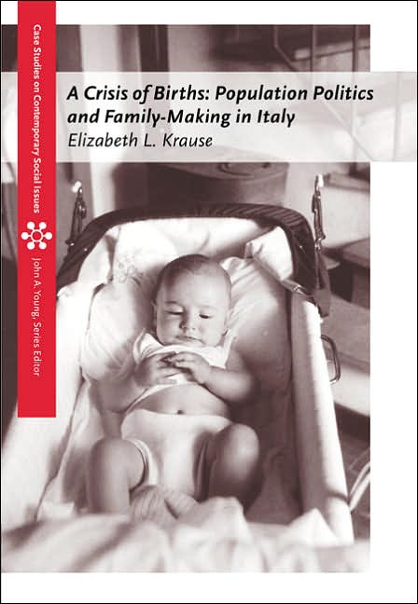
This is detailed in Betsy Krause’s excellent book
Elizabeth L. Krause
A Crisis of Births:
Population Politics and Family-Making in Italy
Belmont, CA: Thompson Wadsworth, 2005.
http://www.d.umn.edu/cla/faculty/troufs/anth3635/cetexts.html#CrisisofBirths

Slide 128
Here’s how that works . . .

Slide 129
Population change =
births minus deaths
plus net migration
(immigration minus emigration)

Slide 130
If you like formulas, here’s the formula:
∆p = (b-d) + (i-e)
∆p = population change
b = births
d = deaths
I = immigration
e = emigration

Slide 131
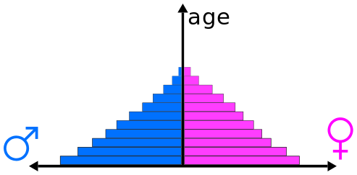
Population Pyramids
reflect population composition and change
https://en.wikipedia.org/wiki/Population_pyramid
Notes:
131

Slide 132
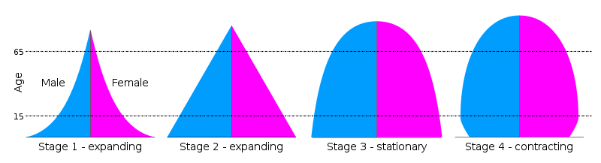
Population Pyramids for 4 Stages of the Demographic Transition Model
“. . . the transition from high birth and death rates to low birth and death rates as a country develops from a pre-industrial to an industrialized economic system”
population is expanding
https://en.wikipedia.org/wiki/Population_pyramid
https://en.wikipedia.org/wiki/Demographic_transition
Notes:
132

Slide 133
Population Pyramids for 4 Stages of the Demographic Transition Model
“. . . the transition from high birth and death rates to low birth and death rates as a country develops from a pre-industrial to an industrialized economic system”
population is expanding
https://en.wikipedia.org/wiki/Population_pyramid
https://en.wikipedia.org/wiki/Demographic_transition
Notes:
133

Slide 134
Population Pyramids for 4 Stages of the Demographic Transition Model
“. . . the transition from high birth and death rates to low birth and death rates as a country develops from a pre-industrial to an industrialized economic system”
population is stationary
https://en.wikipedia.org/wiki/Population_pyramid
https://en.wikipedia.org/wiki/Demographic_transition
Notes:
134

Slide 135
Population Pyramids for 4 Stages of the Demographic Transition Model
“. . . the transition from high birth and death rates to low birth and death rates as a country develops from a pre-industrial to an industrialized economic system”
population is contracting
https://en.wikipedia.org/wiki/Population_pyramid
https://en.wikipedia.org/wiki/Demographic_transition
Notes:
135

Slide 136
a major problem occurs with the large and growing
“dependent population”
(those not in the work force who must be supported by those in the work force)

Slide 137
“dependent population” =
the number of people that have to be supported by those of working age
Usually, it’s
(the population aged 0-14 + those 65 and over)
divided by
(the total population 15-64)

Slide 138
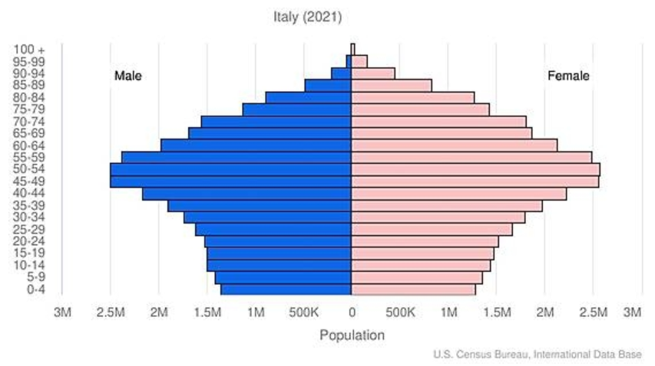
Population Pyramid
“dependent population”
“dependent population”
CIA World Factbook
https://www.cia.gov/the-world-factbook/countries/italy/
Notes:
138

Slide 139
Population Pyramid
People who have to support the “dependent population”
male
female
CIA World Factbook
https://www.cia.gov/the-world-factbook/countries/italy/
Notes:
139

Slide 140
Population Pyramid
Every 5 years
the lines move up one level
CIA World Factbook
https://www.cia.gov/the-world-factbook/countries/italy/
Notes:
140

Slide 141

Population Pyramid
And the “bulge”,
combined with the shrinking base groups, could be a big problem in the future as it moves up
CIA World Factbook
https://www.cia.gov/the-world-factbook/countries/italy/
Notes:
141

Slide 142

Population Pyramid
And the “bulge”,
combined with the shrinking base groups, could be a big problem in the future as it moves up
CIA World Factbook
https://www.cia.gov/the-world-factbook/countries/italy/
Notes:
142

Slide 143
Population Pyramid
And the “bulge”,
combined with the shrinking base groups, could be a big problem in the future as it moves up
CIA World Factbook
https://www.cia.gov/the-world-factbook/countries/italy/
Notes:
143

Slide 144
Population Pyramid
And the “bulge”,
combined with the shrinking base groups, could be a big problem in the future as it moves up
CIA World Factbook
https://www.cia.gov/the-world-factbook/countries/italy/
Notes:
144

Slide 145
Population Pyramid
And the “bulge”,
combined with the shrinking base groups, could be a big problem in the future as it moves up
CIA World Factbook
https://www.cia.gov/the-world-factbook/countries/italy/
Notes:
145

Slide 146
Population Pyramid
And the “bulge”,
combined with the shrinking base groups, could be a big problem in the future as it moves up
CIA World Factbook
https://www.cia.gov/the-world-factbook/countries/italy/
Notes:
146

Slide 147
Population Pyramid
And the “bulge”,
combined with the shrinking base groups, could be a big problem in the future as it moves up
CIA World Factbook
https://www.cia.gov/the-world-factbook/countries/italy/
Notes:
147

Slide 148
Population Pyramid
And the “bulge”,
combined with the shrinking base groups, could be a big problem in the future as it moves up
CIA World Factbook
https://www.cia.gov/the-world-factbook/countries/italy/
Notes:
148

Slide 149
Population Pyramid
And the “bulge”,
combined with the shrinking base groups, could be a big problem in the future as it moves up
CIA World Factbook
https://www.cia.gov/the-world-factbook/countries/italy/
Notes:
149

Slide 150
Population Pyramid
This bulge is a big problem
because it means that there
will eventually be lots of old people
(not working)
and fewer people who
are in the workforce to support them
combined with children
not in the workforce
for the workers to also support
CIA World Factbook
https://www.cia.gov/library/publications/the-world-factbook/geos/it.html
Notes:
150

Slide 151
so Italy has lots of seniors
(who are not in the work force) . . .

Slide 152
so Italy has lots of seniors
(not in the work force) . . .
and their younger population is contracting (therefore eventually fewer in the work will be forced to support those who are not) . . .

Slide 153
that is to say Italy has a large and growing
“dependent population”
(those not in the work force who must be supported by those in the work force)

Slide 154
to further complicate things, looking at the problem regionally . . .
and that causes further problems for the southern region,
the poorer part . . .

Slide 155
young people entering into the workforce want to go north (to the richer areas), or to another country to find work . . .
and that causes further problems for the southern region,
the poorer part . . .

Slide 156
young people entering into the workforce want to go north (to the richer areas), or to another country to find work . . .
and that causes further problems for the southern region,
the poorer part . . .

Slide 157
young people entering into the workforce want to go north (to the richer areas), or to another country to find work . . .
and it causes problems for families because Italian families generally do not like their young to leave the area of their family home . . .

Slide 158
Wed 11 Sep 2019
https://www.theguardian.com/world/2019/sep/11/underpopulated-italian-region-molise?CMP=Share_iOSApp_Other

Slide 159
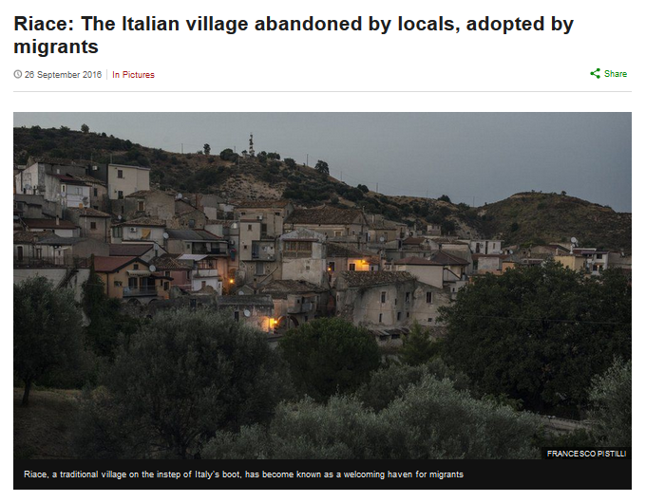
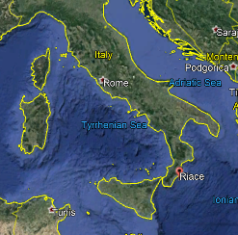
http://www.bbc.com/news/in-pictures-37289713

Slide 160
and these problems, in both the North and South,
go back a long ways . . .
and that causes further problems for the southern region,
the poorer part . . .

Slide 161

5 Dec 2019
Source

Slide 162
5 Dec 2019
And issues related to immigration have already severely affected Italian politics . . .
This is discussed in Betsey Krause’s book . . .
Source

Slide 163
and Italians often live long lives . . .
which makes the economics of the demographic situation worse . . .

Slide 164
Demographics
Population: 60,964,931
(2024 est.)
country comparison to the world: 24
Population growth rate: -0.08%
(2024 est.)
country comparison to the world: 201
65 years and over: 23.6%
(2024 est.)
CIA World Factbook
https://www.cia.gov/the-world-factbook/countries/italy/

Slide 165
Demographics
urban population:
72% of total population
(2023)
rate of urbanization: 0.27% annual rate of change
(2020-2025 est.)
Infant mortality rate:
total: 3.1 deaths/1,000 live births
(2024 est.)
country comparison to the world: 207
Life expectancy at birth:
total population: 83 years
(2024 est.)
country comparison to the world: 19
CIA World Factbook
https://www.cia.gov/the-world-factbook/countries/italy/

Slide 166

13 July 2022
Who’s the Oldest of Them All?
Two towns in Sardinia battle for the distinction of having the longest-living residents. One has the imprimatur of Guinness World Records.
https://www.nytimes.com/2022/07/13/world/europe/italy-sardinia-perdasdefogu-seulo-longevity.html?smid=em-share

Slide 167

1 January 2024
https://www.theguardian.com/world/2024/jan/01/italys-oldest-man-tripoli-giannini-dies-at-age-of-111?CMP=share_btn_link

Slide 168

http://www.nytimes.com/2016/10/20/world/what-in-the-world/rosemary-and-time-does-this-italian-hamlet-have-a-recipe-for-long-life.html?emc=edit_ne_20161019&nl=evening-briefing&nlid=60046204&te=1
Notes:
168

Slide 169


http://www.telegraph.co.uk/news/2016/09/05/want-to-live-to-be-100-these-italian-villagers-may-hold-the-secr/
Notes:
169

Slide 170

http://www.bbc.com/news/world-europe-39610937
Notes:
170

Slide 171

27 March 2023
https://www.nytimes.com/2023/03/25/world/europe/who-will-take-care-of-italys-older-people-robots-maybe.html?smid=nytcore-ios-share&referringSource=articleShare
Notes:
171

Slide 172
Demographics
total fertility rate:
1.26 children born / 1,000 woman
(2024 est.)
country comparison to the world: 219
11.2 deaths / 1,000 population
(2024 est.)
country comparison to the world: 22
net migration rate:
3.4 migrant(s) / 1,000 population
(2024 est.)
country comparison to the world: 33
CIA World Factbook
https://www.cia.gov/the-world-factbook/countries/italy/

Slide 173

Demographics
total fertility rate:
1.47 children born / 1,000 woman
(2020 est.)
country comparison to the world: 204
death rates changed with Covid-19
(2020 est.)
10.7 deaths / 1,000 population
(2020 est.)
country comparison to the world: 48
net migration rate:
4.1 migrant(s) / 1,000 population
(2015 est.)
country comparison to the world: 29
03 April 2020
CIA World Factbook
https://www.worldometers.info/coronavirus/country/italy/

Slide 174

“The issue of the country’s demographic crisis is shooting up the political agenda because Giorgia Meloni’s nationalistic government sees in the birthrate – as did Benito Mussolini – a symbol of patriotic vigour.”
Meloni in Rome, 17 December 2023.
Photograph: Alessandro Serran/Shutterstock

Slide 175
What else?

Slide 176
Population Pyramid
And all of that also means both their labor force and markets are shrinking over time . . . unless the pattern changes
(which is might with Covid-19)
CIA World Factbook
https://www.cia.gov/the-world-factbook/countries/italy/
Notes:
176

Slide 177
Population Pyramid
And all of that also means both their labor force and markets are shrinking over time . . . unless the pattern changes
(which is might with Covid-19)
CIA World Factbook
https://www.cia.gov/the-world-factbook/countries/italy/
Notes:
177

Slide 178







Italy Faces Ugly Future Without Reforms, Eurozone Exit -- Jake Huneycutt, Huneycutt Capital + Research
http://seekingalpha.com/article/1246651-italy-faces-ugly-future-without-reforms-eurozone-exit
Notes:
178

Slide 179
One solution to the demographic problem is to bring in outsiders (immigration) . . .
BUT . . .

Slide 180
One solution to the demographic problem is to bring in outsiders (immigration) . . .
BUT . . .

Slide 181
Population Pyramid
they can import people for the work force, but they only want certain kinds of people
(basically skilled, who are not immigrants of the boats from Africa or the Near East, or from Afghanistan)
CIA World Factbook
https://www.cia.gov/the-world-factbook/countries/italy/
Notes:
181

Slide 182
Population Pyramid
they can import people for the work force, but they only want certain kinds of people
(basically skilled, who are not immigrants of the boats from Africa or the Near East, or from Afghanistan)
CIA World Factbook
https://www.cia.gov/the-world-factbook/countries/italy/
Notes:
182

Slide 183
And the migration picture has been rapidly changing since 2015, with Italy, Greece, and Hungary under
“unprecedented pressure”
http://en.wikipedia.org/wiki/Italy
Notes:
183

Slide 184

[2015]
31 August 2020
https://www.bbc.com/news/world-europe-53925209

Slide 185

2015
http://qz.com/407275/the-human-trafficking-situation-in-europe-is-out-of-control/

Slide 186


2015
http://www.bbc.com/news/world-middle-east-34224619
Notes:
186

Slide 187


2015
http://www.bbc.com/news/world-europe-34278886
Notes:
187

Slide 188
as immigration to Italy
is high . . .
and immigration
is a hot political issue . . .

Slide 189
so although Italy really needs immigrants for its labor force,
it wants to have only certain kinds of immigrants . . .
and also limit the numbers of immigrants . . .

Slide 190
and to complicate the situation still further . . .

Slide 191
Martin J. Gannon and Rajnandini Pillai Understanding Global Cultures
“Still, the population is large, and these trends are likely to reverse. Also, there are many people who want to immigrate to Italy, and in fact, there are countless numbers of illegal aliens crossing its borders daily. Thus, although Italy will probably change, its cultural base should be relatively secure, at least for the foreseeable future.”
www.d.umn.edu/cla/faculty/troufs/anth1095/index.html#Gannon

Slide 192


Europe’s Open Back Door: Italian Migration Up 50% in 2023
Giorgia Meloni
4 January 2024
https://europeanconservative.com/articles/news/europes-open-back-door-italian-migration-up-50-in-2023/
Notes:
\\\

Slide 193
Martin J. Gannon and Rajnandini Pillai Understanding Global Cultures
“Still, the population is large, and these trends are likely to reverse. Also, there are many people who want to immigrate to Italy, and in fact, there are countless numbers of
illegal aliens crossing its borders daily. Thus, although Italy will probably change, its cultural base should be relatively secure, at least for the foreseeable future.”
www.d.umn.edu/cla/faculty/troufs/anth1095/index.html#Gannon

Slide 194


6 October 2023
Sunak, Meloni demand more urgency to combat migration
‘We are two of the closest friends in Europe today,’ British and Italian leaders write.
https://www.politico.eu/cdn-cgi/image/width=1920,quality=80,onerror=redirect,format=auto/wp-content/uploads/2023/10/06/GettyImages-1674680061-scaled.jpg
Notes:
194

Slide 195
Demographics
total fertility rate:
1.26 children born / 1,000 woman
(2024 est.)
country comparison to the world: 219
11.2 deaths / 1,000 population
(2024 est.)
country comparison to the world: 22
net migration rate:
3.4 migrant(s) / 1,000 population
(2024 est.)
country comparison to the world: 33
CIA World Factbook
https://www.cia.gov/the-world-factbook/countries/italy/

Slide 196
Martin J. Gannon and Rajnandini Pillai Understanding Global Cultures
“Still, the population is large, and these trends are likely to reverse. Also, there are many people who want to immigrate to Italy, and in fact, there are countless numbers of illegal aliens crossing its borders daily. Thus, although Italy will probably change, its cultural base should be relatively secure, at least for the foreseeable future.”
www.d.umn.edu/cla/faculty/troufs/anth1095/index.html#Gannon

Slide 197


Slide 198


https://www.statista.com/statistics/624866/top-immigrant-nationalities-declared-upon-landing-italy/

Slide 199


Immigration to Italy
If you are interested
in this situation,
check link below for details . . .
https://en.wikipedia.org/wiki/Immigration_to_Italy

Slide 200




16 August 2021
https://www.dailysabah.com/world/europe/number-of-migrants-arriving-in-italy-doubles-in-12-months

Slide 201



28 August 2021
https://thehill.com/policy/international/569879-italian-coast-guard-rescues-fishing-boat-with-over-500-migrants-on-board

Slide 202
Martin J. Gannon and Rajnandini Pillai Understanding Global Cultures
“Still, the population is large, and these trends are likely to reverse. Also, there are many people who want to immigrate to Italy, and in fact, there are countless numbers of illegal aliens crossing its borders daily. Thus, although Italy will probably change, its cultural base should be relatively secure, at least for the foreseeable future.”
And they’re willing to risk dying to get there . . .
www.d.umn.edu/cla/faculty/troufs/anth1095/index.html#Gannon

Slide 203
Thousands of migrants
drown each year
trying to reach Greece or Italy . . .
http://www.bbc.com/news/world-europe-24583286

Slide 204

Number of recorded deaths of migrants in the Mediterranean Sea from 2014 to 2021
https://www.statista.com/statistics/1082077/deaths-of-migrants-in-the-mediterranean-sea/

Slide 205

http://www.bbc.co.uk/news/world-europe-12876898
Notes:
205

Slide 206

http://www.bbc.com/news/world-europe-32371348
Notes:
206

Slide 207

http://www.bbc.com/news/world-africa-32311358
Notes:
207

Slide 208

http://www.bbc.com/news/world-europe-24583286

Slide 209
Martin J. Gannon and Rajnandini Pillai Understanding Global Cultures
“One final example of externalization is somewhat disturbing, in that
Italy is experiencing difficulty integrating the large number of legal and illegal immigrants
flooding into their country,
particularly those from the African nations of Morocco, Nigeria, Senegal, and Tunisia.”
www.d.umn.edu/cla/faculty/troufs/anth1095/index.html#Gannon

Slide 210

http://www.bbc.com/news/world-europe-24583286

Slide 211



04 August 2021
https://www.michigansthumb.com/news/article/Italy-presses-EU-nations-to-open-ports-to-rescued-16362678.php

Slide 212


16 April 2018
http://www.bbc.com/news/world-africa-32332767

Slide 213
Martin J. Gannon and Rajnandini Pillai Understanding Global Cultures
The poorest Italians are most affected in that they feel that these immigrants are taking jobs away from them.
Many Italians are upset by a trend of increasing “disturbing incidents” of violence against the immigrants
They have “externalized” the problem dramatically in newspapers, on television, and in the traditional piazza
www.d.umn.edu/cla/faculty/troufs/anth1095/index.html#Gannon

Slide 214

22 May 2019
https://www.nytimes.com/2019/05/22/world/europe/italy-palermo-immigrants-salvino.html

Slide 215

9 Aug 2019
https://www.nytimes.com/2019/08/09/business/italy-economy-debt.html

Slide 216

http://news.bbc.co.uk/2/hi/europe/8450083.stm

Slide 217

http://news.bbc.co.uk/2/hi/europe/8504591.stm

Slide 218

Martin J. Gannon and Rajnandini Pillai Understanding Global Cultures
“Although such outbreaks of violence are common in many societies, these
Italians are confronting the problem in an open manner involving everyone in the society,
and solutions are gradually being implemented.”
www.d.umn.edu/cla/faculty/troufs/anth1095/index.html#Gannon

Slide 219



10 January 2010
http://news.bbc.co.uk/2/hi/europe/8450657.stm

Slide 220



19 April 2015
http://www.bbc.com/news/world-africa-32366035

Slide 221



6 September 2015
http://www.bbc.com/news/world-europe-34162844

Slide 222




29 September 2019
Spirce

Slide 223





21 August 2021
https://www.indiatoday.in/world/story/vatican-urges-world-welcome-afghan-refugees-taliban-takeover-1843600-2021-08-21

Slide 224
as immigration to Italy
is high . . .
and immigration
continues to be a hot political issue . . .

Slide 225


4 January 2024
Italian Premier Meloni says curbing migrant arrivals from Africa is about investment, not charity
https://apnews.com/article/italy-eu-africa-migration-strategy-energy-bfffac3ff93ad2a97aead324caa11130

Slide 226

18 August 2021
https://www.nytimes.com/2021/08/18/world/europe/afghanistan-refugees-europe-migration-asylum.html

Slide 227


28 August 2021
https://www.jhalak.com/global-news-Italy-pushing-for-special-G20-meeting-on-Afghanistan-83161

Slide 228

Notes:
228

Slide 229
“The Schengen Agreement”

Slide 230
It is important to note that people can move freely within the EU and certain other countries because of
“The Schengen Agreement” . . .

Slide 231







https://en.wikipedia.org/wiki/Schengen_Agreement

Slide 232

Schengen Agreement
1995
“There are 26 countries in Schengen - 22 EU members and four non-EU.
Those four are:
Iceland and Norway (since 2001),
Switzerland (since 2008) and Liechtenstein (since 2011).”
http://www.bbc.com/news/world-europe-13194723

Slide 233
Schengen Agreement
1995
http://www.bbc.com/news/world-europe-13194723

Slide 234
“A surge of desperate migrants from the Middle East and Africa has put unprecedented pressure on EU countries, especially Italy, Greece, and Hungary.”
Schengen Agreement
1995
http://www.bbc.com/news/world-europe-13194723

Slide 235
It is expected that those
asylum seekers who are admitted will compete with current residents at the bottom of the social scale for existing low-paying jobs.
This quite likely will be a continuing source social unrest.
Schengen Agreement
1995
http://www.bbc.com/news/world-europe-13194723

Slide 236
Martin J. Gannon and Rajnandini Pillai Understanding Global Cultures
The poorest Italians are most affected in that they feel that these immigrants are taking jobs away from them.
www.d.umn.edu/cla/faculty/troufs/anth1095/index.html#Gannon

Slide 237
and, in the end, as in other countries, many “take it out” on and blame the immigrants and migrants for their problems . . .

Slide 238
and, in the end, as in other countries, many “take it out” on and blame the immigrants and migrants for their problems . . .
and that becomes a huge political problem in Italy and throughout Europe . . .

Slide 239
“The Dublin Regulation”
gives EU member states the right to transfer migrants to the first country of entry to the EU
https://en.wikipedia.org/wiki/Dublin_Regulation

Slide 240
“The Dublin Regulation”
essentially gives EU member states the right to transfer migrants to the first country of entry to the EU
https://en.wikipedia.org/wiki/Dublin_Regulation

Slide 241




https://en.wikipedia.org/wiki/Dublin_Regulation

Slide 242
And what are the mostly likely “ . . . responsible
Member State[s] . . . through which the asylum seeker[s] first entered the EU”?

Slide 243
The so-called
PIIGS
of Europe . . .
Portugal, Italy, Ireland, Greece, and Spain
https://en.wikipedia.org/wiki/PIGS_(economics)

Slide 244

ITALY
SPAIN
PORTUGAL
Portugal, Italy, Ireland, Greece, and Spain
http://www.bbc.com/news/world-europe-24583286

Slide 245
demographic features combined with economic indices and policies led to the
derogatory classification
of Italy as one of the
PIIGS of Europe . . .

Slide 246
Portugal, Italy, Ireland, Greece, and Spain
Notes:
246

Slide 247

Portugal, Italy, Ireland, Greece, and Spain
https://en.wikipedia.org/wiki/PIGS_%28economics%29
Notes:
247

Slide 248
https://en.wikipedia.org/wiki/PIGS_%28economics%29
Notes:
248

Slide 249

These are a problem because they have huge public sector debt with no growth . . . and a rapidly expanding “dependent population”
(old people and children not in the work force)
Author: Rannpháirtí anaithnid
https://en.wikipedia.org/wiki/PIGS_%28economics%29
Notes:
249

Slide 250
These are a problem because they have huge public sector debt with no growth . . . and a rapidly expanding “dependent population”
(old people and children not in the work force)
https://en.wikipedia.org/wiki/PIGS_%28economics%29
Notes:
250

Slide 251

http://www.bbc.com/news/world-europe-24583286

Slide 252

http://www.bbc.com/news/world-europe-24636868
Notes:
252

Slide 253

http://www.bbc.com/news/world-europe-24636868
Notes:
253

Slide 254
What about “outsiders”?

Slide 255
The Overture
Pageantry and Spectacle
Voice
Externalization
5. Chorus and Soloists
Outsiders
Italy
www.d.umn.edu/cla/faculty/troufs/anth1095/index.html#Gannon

Slide 256
Italians have generally been
leery of outsiders . . .
And, generally speaking, everyone is considered to be an outsider except members of the family . . .

Slide 257
Italians have generally been
leery of outsiders . . .
And, generally speaking, everyone is considered to be an outsider except members of the family . . .
www.d.umn.edu/cla/faculty/troufs/anth1095/index.html#Gannon

Slide 258
Martin J. Gannon and Rajnandini Pillai Understanding Global Cultures
Many Italians do not put much faith in what others who are not family members say . . .
www.d.umn.edu/cla/faculty/troufs/anth1095/index.html#Gannon

Slide 259
Martin J. Gannon and Rajnandini Pillai Understanding Global Cultures
The characteristics of the chorus and soloist can also be applied to other aspects of Italian culture . . .
Italians tend to be individualistic people, yet they place importance on the group . . .
The family is the primary group that influences individuals
www.d.umn.edu/cla/faculty/troufs/anth1095/index.html#Gannon

Slide 260
Martin J. Gannon and Rajnandini Pillai Understanding Global Cultures
The characteristics of the chorus and soloist can also be applied to other aspects of Italian culture . . .
Italians tend to be individualistic people, yet they place importance on the group . . .
The family is the primary group that influences individuals
www.d.umn.edu/cla/faculty/troufs/anth1095/index.html#Gannon

Slide 261
Martin J. Gannon and Rajnandini Pillai Understanding Global Cultures
Closeness within the family is strong,
and family members tend to be
much less trustful of those outside of their family
This helps to explain why Italians,
like operatic singers,
are emotionally passionate toward friends and extended family
www.d.umn.edu/cla/faculty/troufs/anth1095/index.html#Gannon

Slide 262
Martin J. Gannon and Rajnandini Pillai Understanding Global Cultures
Closeness within the family is strong,
and family members tend to be
much less trustful of those outside of their family
This helps to explain why Italians,
like operatic singers,
are emotionally passionate toward friends and extended family
www.d.umn.edu/cla/faculty/troufs/anth1095/index.html#Gannon

Slide 263
Martin J. Gannon and Rajnandini Pillai Understanding Global Cultures
Italians also try to avoid risk and uncertainty in everyday life,
preferring friends over strangers
and familiar over new or strange situations,
as their behavior in the piazza and externalization would confirm
www.d.umn.edu/cla/faculty/troufs/anth1095/index.html#Gannon

Slide 264
Martin J. Gannon and Rajnandini Pillai Understanding Global Cultures
As indicated earlier, the north of Italy has been very successful economically
Most of this success is due to the existence of small firms specializing in particular products
These firms both compete and cooperate with one another
If one firm cannot honor an order, a neighboring firm will help it produce the product so that the commitment can be kept
At the same time, firms will cut prices to move ahead of neighboring competitors
www.d.umn.edu/cla/faculty/troufs/anth1095/index.html#Gannon

Slide 265
Martin J. Gannon and Rajnandini Pillai Understanding Global Cultures
These types of close business relationships echo
family and village patterns
that are also expressed in the opera
www.d.umn.edu/cla/faculty/troufs/anth1095/index.html#Gannon

Slide 266
Martin J. Gannon and Rajnandini Pillai Understanding Global Cultures
The characteristics of the chorus and soloist can also be
applied to other aspects of Italian culture . . .
The family is the primary group that influences individuals
Whenever important decisions are made, the individual usually consults with family members to get their opinion and evaluation of the situation
Although the family’s opinion is important, the final evaluation is made by the individual
www.d.umn.edu/cla/faculty/troufs/anth1095/index.html#Gannon

Slide 267
Martin J. Gannon and Rajnandini Pillai Understanding Global Cultures
The influence of the group is also felt in
the business environment
In business meetings people will externalize their feelings and opinions about a subject
They will listen to everyone’s ideas and freely give their own opinions
Business meetings tend to be productive in Italy due to the openness displayed by everyone
www.d.umn.edu/cla/faculty/troufs/anth1095/index.html#Gannon

Slide 268
Martin J. Gannon and Rajnandini Pillai Understanding Global Cultures
This overall fearful, suspicious attitude may be partially due to a quality upon which Italians place a high value . . .
cleverness
www.d.umn.edu/cla/faculty/troufs/anth1095/index.html#Gannon

Slide 269
Martin J. Gannon and Rajnandini Pillai Understanding Global Cultures
Whereas the family is the group that, above all else, dramatically influences the individual,
another important group,
the political party,
can be the difference between employment and unemployment
www.d.umn.edu/cla/faculty/troufs/anth1095/index.html#Gannon

Slide 270
Martin J. Gannon and Rajnandini Pillai Understanding Global Cultures
Italians move from group to group, feeling little remorse when doing so because
they tend to be skeptical of all groups besides the family
www.d.umn.edu/cla/faculty/troufs/anth1095/index.html#Gannon

Slide 271
Martin J. Gannon and Rajnandini Pillai Understanding Global Cultures
Members of groups often create
powerful coalitions
that are
used for gaining power and influence
These subcultures, groups, and parties allow for intergroup bargaining and dealing to gain coordination and cooperation between all involved
www.d.umn.edu/cla/faculty/troufs/anth1095/index.html#Gannon

Slide 272
Martin J. Gannon and Rajnandini Pillai Understanding Global Cultures
In Geert Hofstede’s study
of the cultural values of 53 countries,
Italians cluster with those countries emphasizing a large power distance between groups in society,
that is, they tend to accept the fact that some groups are and perhaps should be more powerful than others,
and they act accordingly
(1991)
www.d.umn.edu/cla/faculty/troufs/anth1095/index.html#Gannon

Slide 273
Martin J. Gannon and Rajnandini Pillai Understanding Global Cultures
Italy has a political system that since World War II has been based on
proportional representation from many minor political parties
There are more than 40 parties in the Chamber of Deputies
This system was put in place to guard against the rise of one-party rule, as happened under Fascism
www.d.umn.edu/cla/faculty/troufs/anth1095/index.html#Gannon

Slide 274
Martin J. Gannon and Rajnandini Pillai Understanding Global Cultures
the political system tends
to be extremely inefficient
because of the changes of government
and the system “tends to be corrupt”
“kickbacks” are “a regular business practice”
that is estimated to add 15% to 20% to the final price
www.d.umn.edu/cla/faculty/troufs/anth1095/index.html#Gannon

Slide 275
Martin J. Gannon and Rajnandini Pillai Understanding Global Cultures
Many aspects of daily life yield endless opportunities for drama
Politics
Pageantry, voice, and externalization are important
Even though the Italian political system is changing radically, one can expect that such drama will continue to be part of the political process
www.d.umn.edu/cla/faculty/troufs/anth1095/index.html#Gannon

Slide 276
Recent Politics
Italy
© 2009-2020 Timothy G. Roufs, University of Minnesota Duluth

Slide 277
The latest government in Italy . . .

Slide 278

26 September 2022
https://www.bbc.com/news/world-europe-63029909

Slide 279



25 September 2022
https://www.npr.org/2022/09/24/1124685476/giorgia-meloni-italy-election

Slide 280
25 September 2022
Most far-right leader since WWII
69th Government in Italy since 1946
leader of Fratelli d'Italia, the Brothers of Italy party with Neo-Fascist roots
Italy's first female prime minister
Meloni's opposition to immigration animated her and her base
“An astute political operative”
https://www.npr.org/2022/09/24/1124685476/giorgia-meloni-italy-election

Slide 281
25 September 2022
Most far-right leader since WWII
leader of Fratelli d'Italia, the Brothers of Italy party with Neo-Fascist roots
https://www.npr.org/2022/09/24/1124685476/giorgia-meloni-italy-election

Slide 282

https://en.wikipedia.org/wiki/Brothers_of_Italy

Slide 283
25 September 2022
Meloni's opposition to immigration animated her and her base
https://www.npr.org/2022/09/24/1124685476/giorgia-meloni-italy-election

Slide 284
25 September 2022
https://www.npr.org/2022/09/24/1124685476/giorgia-meloni-italy-election

Slide 285


Martin J. Gannon and Rajnandini Pillai Understanding Global Cultures
Sergio Mattarella
is the President of the Italian Republic (since 3 February 2015)
Giorgia Meloni
is the nation's Prime Minister
(President of the Council of Ministers)
(Since 22 October 2022)
www.d.umn.edu/cla/faculty/troufs/anth1095/index.html#Gannon

Slide 286
Martin J. Gannon and Rajnandini Pillai Understanding Global Cultures
Sergio Mattarella
is the President of the Italian Republic (since 3 February 2015)
Giorgia Meloni
is the nation's Prime Minister
(President of the Council of Ministers)
(Since 22 October 2022)
The President is the “head of state”
www.d.umn.edu/cla/faculty/troufs/anth1095/index.html#Gannon

Slide 287
Martin J. Gannon and Rajnandini Pillai Understanding Global Cultures
Sergio Mattarella
is the President of the Italian Republic (since 3 February 2015)
Giorgia Meloni
is the nation's Prime Minister
(President of the Council of Ministers)
(Since 22 October 2022)
The Prime Minister is the “head of government”
www.d.umn.edu/cla/faculty/troufs/anth1095/index.html#Gannon

Slide 288
Martin J. Gannon and Rajnandini Pillai Understanding Global Cultures
Italy has rapidly changing governments
69 since World War II
(an average of one every 1.14 years.)
69th government with
Giorgia Meloni
as of 22 October 2022
www.d.umn.edu/cla/faculty/troufs/anth1095/index.html#Gannon

Slide 289
http://en.wikipedia.org/wiki/History_of_Italy_during_foreign_domination_and_the_unification
Notes:
289

Slide 290
Formation of Italy
Unification —17 March 1861
Republic —2 June 1946
http://en.wikipedia.org/wiki/Italy
Notes:
290

Slide 291

recent
Prime Minister of Italy
2021-2022
Mario Draghi
was (2021)
68th government
(“technocratic”)
https://www.theguardian.com/world/2021/feb/06/mario-draghi-secures-support-from-key-parties-to-form-new-italian-government

Slide 292
recent
Prime Minister of Italy
2021-2022
Mario Draghi
was (2021)
68th government
(“technocratic”)
https://www.theguardian.com/world/2021/feb/06/mario-draghi-secures-support-from-key-parties-to-form-new-italian-government

Slide 293


3 February 2021
Italy forms a governo tecnico—“technocratic government” (technical government)—consisting of people with expert skills, with no necessary connection to other political forces, in emergency situations caused by parliamentary stalemate(s).
https://atalayar.com/en/content/draghi-tasked-forming-technocratic-government-italy

Slide 294


31 January 2021
https://www.economist.com/the-economist-explains/2021/01/31/why-does-italy-go-through-so-many-governments

Slide 295


31 January 2021
https://italicsmag.com/2021/01/25/italy-is-ungovernable-thats-the-point-government-crisis/

Slide 296


http://www.bbc.com/news/world-europe-37289084

Slide 297
The Italian style
of “government”
has been going on for a long time . . .

Slide 298
“There is, in fact, no law or government at all [in Italy]; and it is wonderful how well things go on without them.”
Lord Byron
English Romantic poet and satirist
1788-1824
www.d.umn.edu/cla/faculty/troufs/anth1095/index.html#Gannon

Slide 299
The basic governmental unit
is the comune . . .
(plural: comuni)

Slide 300

Cosimo Vassallo
A new district in Northern Italy
was just established in 2009
Tim Roufs
Notes:
300

Slide 301
In Italy
the comune
(plural comuni)
is the basic administrative division of both provinces and regions, and may be properly approximated in casual speech by the English word township or municipality
Tim Roufs
Notes:
301

Slide 302

township or municipality
http://en.wikipedia.org/wiki/Municipalities_of_Italy
Notes:
302

Slide 303

Administrative divisions of Italy: Regions (black borders) Provinces (grey borders) Comuni (white borders)
http://en.wikipedia.org/wiki/Municipalities_of_Italy
Notes:
303

Slide 304
Political Parties . . .
In Italy there are
five “major” political parties, and about three dozen “minor” partie . . .s

Slide 305
Political Parties . . .
In Italy there are
five “major” political parties, and about three dozen “minor” parties . . .

Slide 306
Political Parties . . .
and they meet
in a bicameral Parliament currently consisting of
951 elected members . . .
(although it may soon be reduced in size)

Slide 307
Martin J. Gannon and Rajnandini Pillai Understanding Global Cultures
Whereas the family is the group that, above all else,
dramatically influences the individual,
another important group,
the political party,
can be the difference between employment and unemployment
www.d.umn.edu/cla/faculty/troufs/anth1095/index.html#Gannon

Slide 308
Martin J. Gannon and Rajnandini Pillai Understanding Global Cultures
But REM:
Italian citizens move from political group to political group, feeling little remorse when doing so because
they tend to be skeptical of all groups besides the family
www.d.umn.edu/cla/faculty/troufs/anth1095/index.html#Gannon

Slide 309
Martin J. Gannon and Rajnandini Pillai Understanding Global Cultures
Members of groups often create
powerful coalitions
that are
used for gaining power and influence
These subcultures, groups, and parties allow for intergroup bargaining and dealing to gain coordination and cooperation between all involved
www.d.umn.edu/cla/faculty/troufs/anth1095/index.html#Gannon

Slide 310
Martin J. Gannon and Rajnandini Pillai Understanding Global Cultures
In Geert Hofstede’s study
of the cultural values of 53 countries,
Italians cluster with those countries emphasizing a large power distance between groups in society,
that is, they tend to accept the fact that some groups are and perhaps should be more powerful than others,
and they act accordingly
(1991)
www.d.umn.edu/cla/faculty/troufs/anth1095/index.html#Gannon

Slide 311
Martin J. Gannon and Rajnandini Pillai Understanding Global Cultures
Italy has a political system that since World War II has been based on
proportional representation from many minor political parties
There can be more than 40 parties in the Chamber of Deputies (the lower house of Parliament)
This system was put in place to guard against the rise of one-party rule, as happened under Fascism
www.d.umn.edu/cla/faculty/troufs/anth1095/index.html#Gannon

Slide 312
Martin J. Gannon and Rajnandini Pillai Understanding Global Cultures
And REM:
the political system tends
to be extremely inefficient
because of the changes of government
and the system “tends to be corrupt”
According to some reports
“kickbacks” are “a regular business practice”
that is estimated to add 15% to 20% to the final price
www.d.umn.edu/cla/faculty/troufs/anth1095/index.html#Gannon

Slide 313
Martin J. Gannon and Rajnandini Pillai Understanding Global Cultures
“Italians of many persuasions would like to see the emergence of a genuine two-party system that is normally associated with much less corruption.”
Still, the sense of family and coalition behavior is so strong in Italy that we can expect many of the behaviors mentioned to persist.”
www.d.umn.edu/cla/faculty/troufs/anth1095/index.html#Gannon

Slide 314
and other factors sometimes need to be considered relative to political divisions . . .

Slide 315


30 November 2022
https://italystart.com/new-mafia-in-italy/

Slide 316

10 April 2020
https://www.theguardian.com/world/2020/apr/10/mafia-distributes-food-to-italys-struggling-residents?CMP=Share_iOSApp_Other

Slide 317

5 May 2020
https://www.bbc.com/news/world-europe-52537573

Slide 318

6 June 2021
https://www.bbc.com/news/world-europe-57357311

Slide 319

Wed 30 Oct 2019
https://www.theguardian.com/world/2019/oct/30/italy-mafia-networks-are-more-complex-and-powerful-says-minister?CMP=Share_iOSApp_Other

Slide 320

Thu 26 Dec 2019
https://www.theguardian.com/world/2019/dec/26/peace-goodwill-and-mafia-murders-mark-christmas-in-italy?CMP=Share_iOSApp_Other

Slide 321

Wed 15 Jan 2020
https://www.theguardian.com/world/2020/jan/15/sicilian-police-launch-dawn-raids-in-eu-subsidies-sting?CMP=Share_iOSApp_Other

Slide 322

12 November 2022
https://www.bbc.com/news/world-africa-63595025

Slide 323

Thurs 20 June 2019
https://www.theguardian.com/world/2019/jun/20/tomatoes-italy-mafia-migrant-labour-modern-slavery?CMP=Share_iOSApp_Other

Slide 324

Sat 9 Mar 2019
https://www.theguardian.com/world/2019/mar/09/woman-hired-sicilian-mafia-hitmen-to-kill-ex-lover-say-police?CMP=Share_iOSApp_Other

Slide 325
and still other factors also need to be considered . . .

Slide 326

Notes:
326

Slide 327

Notes:
327

Slide 328

Notes:
328

Slide 329

Notes:
329

Slide 330
one of the
“most colorful” Italian politicians of recent times was/is . . .

Slide 331

Martin J. Gannon and Rajnandini Pillai Understanding Global Cultures
Silvio Berlusconi
Four-time former Prime Minister
(President of the Council of Ministers)
In Office:
8 May 2008 – 16 November 2011
11 June 2001 – 17 May 2006
10 May 1994 – 17 January 1995
29 March 2009 – 16 November 2013
18 January 1994 – 27 March 2009
www.d.umn.edu/cla/faculty/troufs/anth1095/index.html#Gannon

Slide 332

http://www.bbc.com/news/world-europe-37962988

Slide 333

Source

Slide 334

Sept. 19, 2019
. . . . even in the cinema
https://www.nytimes.com/2019/09/19/movies/loro-review.html?smid=nytcore-ios-share

Slide 335

http://www.bbc.c https://www.cnn.com/2022/10/20/europe/italy-berlusconi-putin-friendship-leaked-audio-intl-hnk/index.html m/news/world-europe-37962988

Slide 336

Notes:
336

Slide 337

Berlusconi owned the Italian football [soccer] club A.C. Milan from 1986 to 2017
http://www.bbc.com/news/business-36721010
Notes:
337

Slide 338

he continues to be a “media tycoon” . . .
http://news.bbc.co.uk/2/hi/europe/3034600.stm
Notes:
338

Slide 339
In 2008
— according to Forbes magazine — Berlusconi was Italy's third richest person, with personal assets worth $9.4 billion (USD)
http://news.bbc.co.uk/2/hi/europe/3034600.stm
Notes:
339

Slide 340
In 2021
— according to Forbes magazine — Berlusconi was worth $8.1 billion (USD)
https://www.forbes.com/profile/silvio-berlusconi/?list=rtb/&sh=43d82d293e8f
Notes:
340

Slide 341


In 2022
— according to Forbes magazine — Berlusconi was worth $6.3 billion (USD)
https://www.statista.com/statistics/729819/forbes-ranking-of-the-10-richest-people-in-italy/
Notes:
341

Slide 342

http://www.bbc.co.uk/programmes/b00r8g99http://www.bbc.co.uk/programmes/b00r8g99
Notes:
342

Slide 343

Berlusconi was convicted of tax fraud in 2014 and was initially banned from running for political office until 2019, but an Italian court lifted the ban in May 2018, and Berlusconi won a seat in the European Parliament the following year. (Forbes)
Source
Notes:
343

Slide 344
Politics
Italy
© 2009-2024 Timothy G. Roufs, University of Minnesota Duluth

