Slide 1

Start deck in “Slide Show” mode,
and use your up/down arrow keys and/or
your space bar to advance the slides
© 2010-2026 Timothy G. Roufs, University of Minnesota Duluth

Slide 2
REM
indicates that the materials
are a REMinder
and are thus being repeated . . .
REMinder

Slide 3
ANTH 1080
Global Cultures
Main
Characteristics of
Anthropology
© 2010-2026 Timothy G. Roufs, University of Minnesota Duluth

Slide 4
American
Main Characteristics of˄Anthropology
1. the four fields of general anthropology
culture as a primary concept
comparative method as major approach
holism as a primary theoretical goal
fieldwork as a primary research technique

Slide 5
American
Main Characteristics of˄Anthropology
1. the four fields of general anthropology
culture as a primary concept
comparative method as major approach
holism as a primary theoretical goal
fieldwork as a primary research technique

Slide 6
Main Characteristics
“cultures”
    are groups of people sharing a common heritage
    (and usually a common language)

Slide 7
Main Characteristics
“cultures”
    are groups of people sharing a common heritage
    (and usually a common language)
cultures generally strive to preserve their cultural identity

Slide 8
The Concept of Culture
cultures
generally strive to preserve their identity with . . .
food
clothing
religion
ritual
music, dance, and other arts
language
cultural symbols . . .

Slide 9
The Concept of Culture
cultures
generally strive to preserve their identity with . . .
food
clothing
religion
ritual
music, dance, and other arts
language
cultural symbols . . .

Slide 10
The Concept of Culture
local groups (microcultures)
generally strive to preserve their cultural identity with . . .
food
clothing
religion
ritual
music, dance, and other arts
language
cultural symbols . . .

Slide 11
The Concept of Culture
microcultures can include ethnic groups within nations
  e.g., Anishinabe (Chippewa; Ojibwa)
  e.g., Irish “Travellers”
    sometimes incorrectly called “Gypsies”
  e.g., Australian Aboriginals
  e.g., Cajan
  e.g., Rom (Gypsies)
  e.g., Basques
  e.g., Kurds
. . . most often
cultures and microcultures are associated with their cuisine . . .
and can sometimes even be defined by their cuisine …

Slide 12
The Concept of Culture
microcultures can include ethnic groups within nations
  e.g., Anishinabe (Chippewa; Ojibwa)
  e.g., Irish “Travellers”
    sometimes incorrectly called “Gypsies”
  e.g., Australian Aboriginals
  e.g., Cajan
  e.g., Rom (Gypsies)
  e.g., Basques
  e.g., Kurds
. . . most often
these cultures are associated with their cuisine . . .
and can sometimes even be defined by their cuisine …
and they sometimes can even be defined by their cuisine . . .

Slide 13
The Concept of Culture
microcultures can include ethnic groups within nations
  e.g., Anishinabe (Chippewa; Ojibwa)
  e.g., Irish “Travellers”
    sometimes incorrectly called “Gypsies”
  e.g., Australian Aboriginals
  e.g., Cajan
  e.g., Rom (Gypsies)
  e.g., Basques
  e.g., Kurds
. . . and one’s cuisine is often a key factor in one’s own individual and collective identity . . .

Slide 14
How about a little game of . . .

Slide 15
How about a little game of
Jeopardy?

Slide 16

How about a little game of . . .
RIP Alex Trebek
1940 - 2020
https://www.usatoday.com/story/entertainment/celebrities/2020/11/08/alex-trebek-dies-ken-jennings-james-holzhauer-more-pay-tribute/6214106002/

Slide 17

How about a little game of . . .
Mike Richards
2021
https://www.nytimes.com/2021/08/11/arts/television/jeopardy-mike-richards-mayim-bialik-new-hosts.html

Slide 18

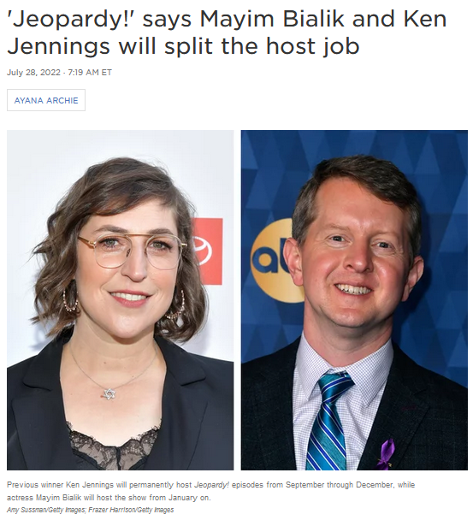
How about a little game of . . .
28 July 2022
15 Dec 2023
https://www.nytimes.com/2021/08/23/business/mayim-bialik-jeopardy-host.html

Slide 19
answer:
haggis
Finnan Haddie
spurtle
(theevil)

Slide 20
How about a clue?

Slide 21
answers:
haggis
Finnan Haddie
spurtle
(theevil)

Slide 22
How about one more clue?

Slide 23
answers:
haggis
Finnan Haddie
spurtle
( a.k.a. theevil)

Slide 24
How about a final clue?

Slide 25
answers:
haggis
Finnan Haddie
spurtle
( a.k.a. theevil)
cullen skink

Slide 26
question:
What do you think of
when someone says . . .

Slide 27
question:
What do you think of
when someone says . . .
“Scotland”?
or “Scot”?

Slide 28
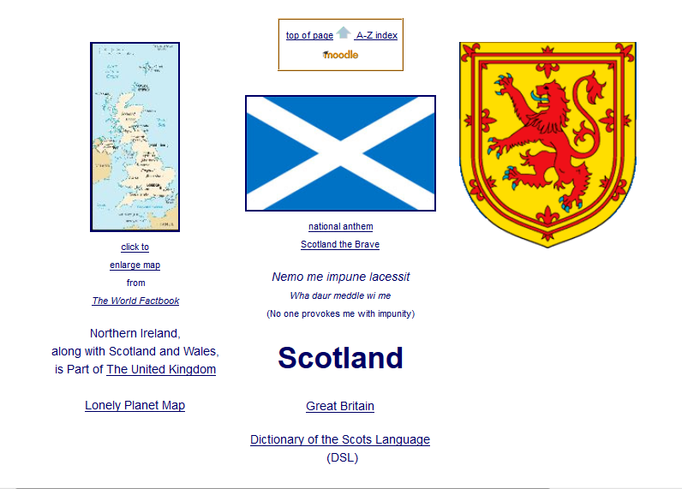

Slide 29
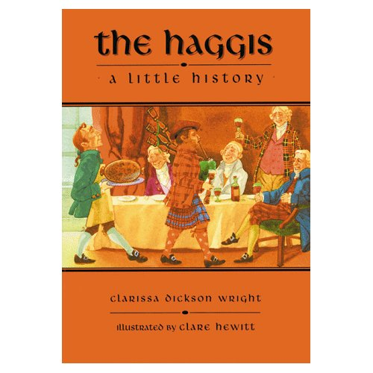
The Haggis: A Little History, Pelican, 1998

Slide 30
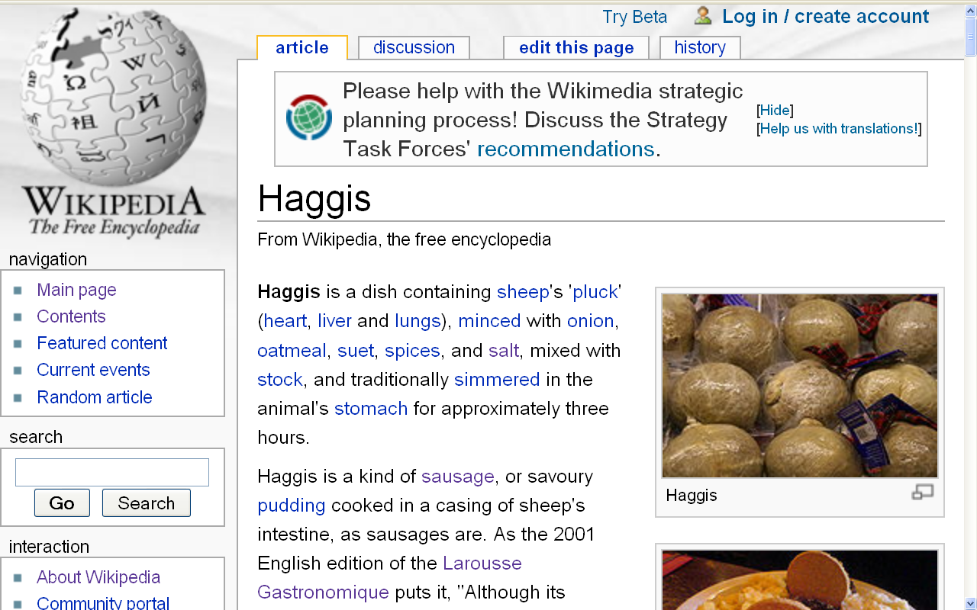
http://en.wikipedia.org/wiki/Haggis

Slide 31
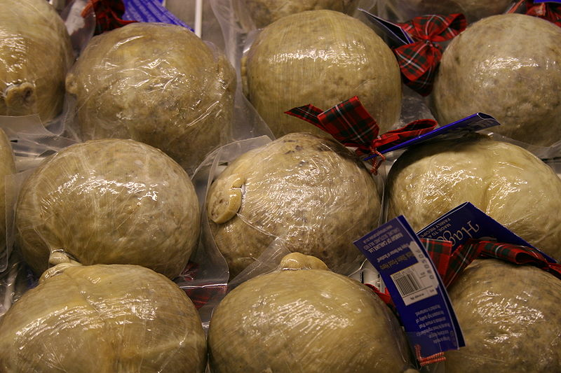
haggis
http://en.wikipedia.org/wiki/Spurtle

Slide 32
Food Trivia: The United State Government agencies does not allow “real” haggis to be sold in the United States
haggis
http://en.wikipedia.org/wiki/Spurtle

Slide 33
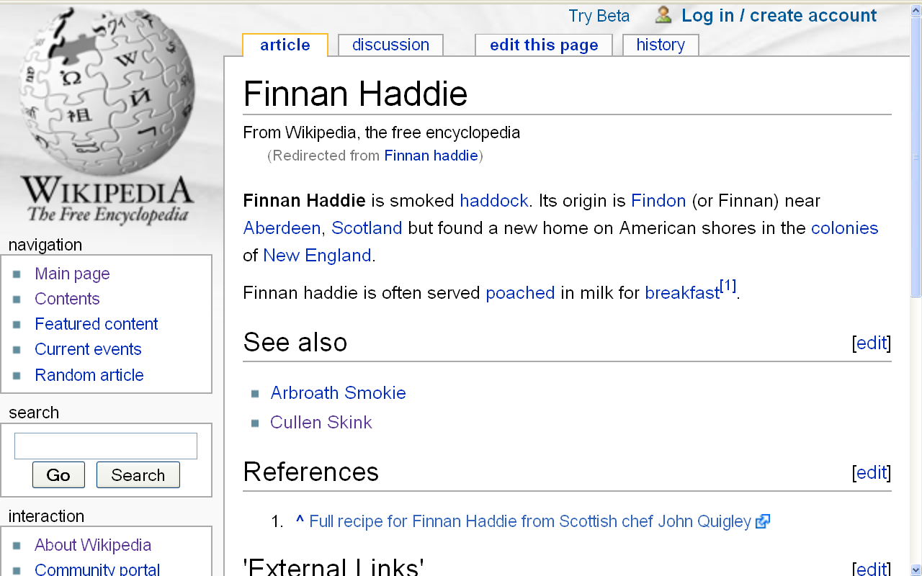
Finnan Haddie is smoked haddock
http://en.wikipedia.org/wiki/Finnan_haddie

Slide 34
Food Trivia: Its origin is Findon (or Finnan) near Aberdeen, Scotland, but found a new home on American shores in the colonies of New England
http://en.wikipedia.org/wiki/Finnan_haddie

Slide 35
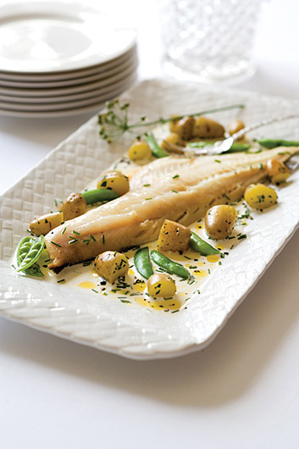
Finnan Haddie
http://en.wikipedia.org/wiki/Finnan_haddie

Slide 36
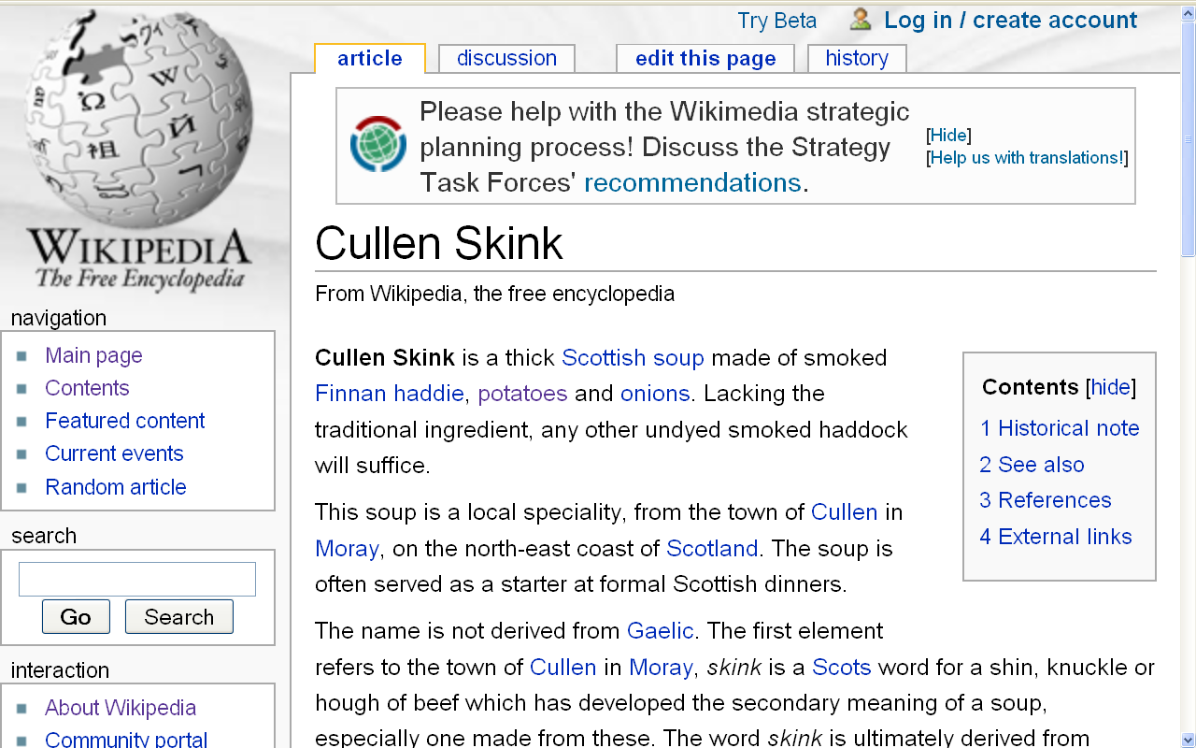
http://en.wikipedia.org/wiki/Cullen_Skink

Slide 37
Cullen Skink is a thick Scottish soup made of smoked Finnan Haddie, potatoes and onions
http://en.wikipedia.org/wiki/Cullen_Skink

Slide 38
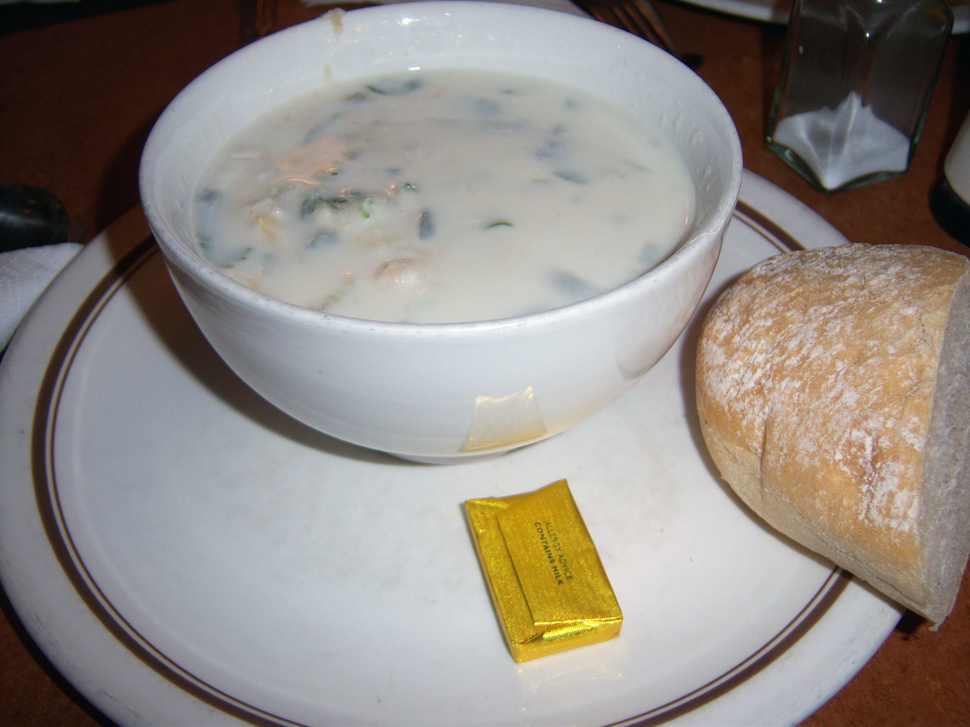
Cullen Skink
http://marthaandme.wordpress.com/2009/08/07/eating-our-way-across-the-uk/

Slide 39
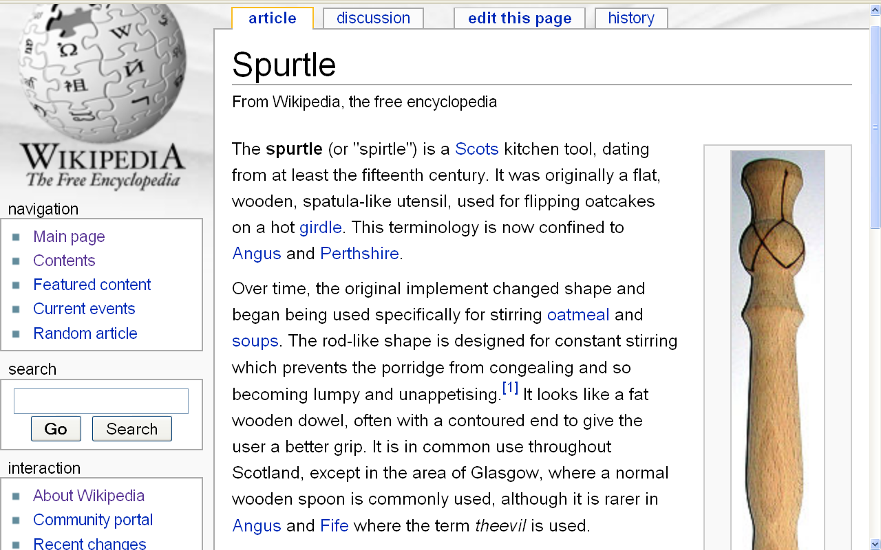
http://en.wikipedia.org/wiki/Spurtle

Slide 40
The spurtle (or "spirtle") is a Scots kitchen tool, dating from at least the fifteenth century. It was originally a flat, wooden, spatula-like utensil, used for flipping oatcakes on a hot griddle.
This terminology is now confined to
Angus and Perthshire.
http://en.wikipedia.org/wiki/Spurtle

Slide 41
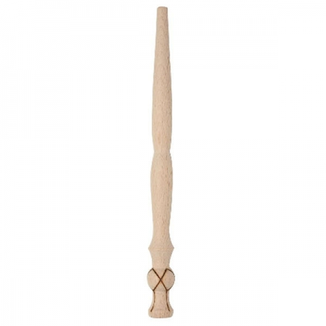
What famous person’s mother probably used one of these to cook him oatmeal?
spurtle
( a.k.a. theevil)

Slide 42
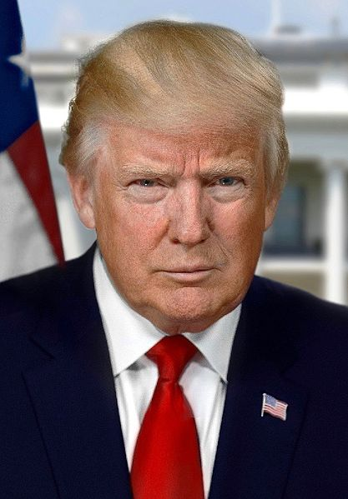
https://en.wikipedia.org/wiki/Donald_Trump

Slide 43
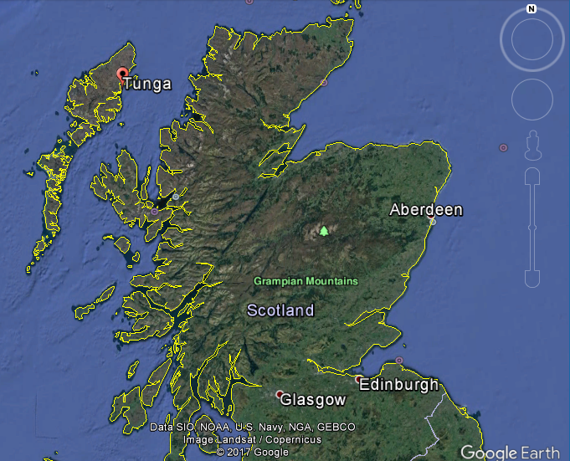
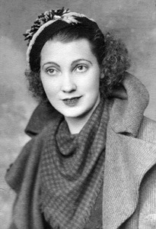
Mary Anne MacLeod Trump

Slide 45
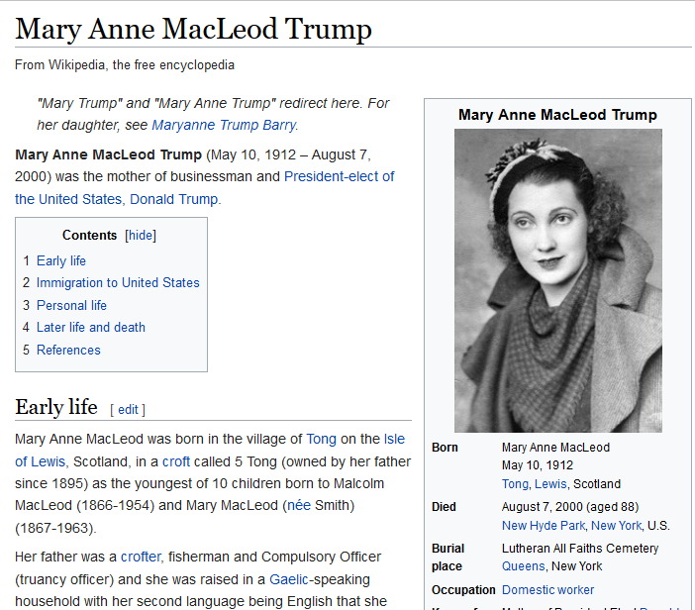
https://en.wikipedia.org/wiki/Mary_Anne_MacLeod_Trump

Slide 46
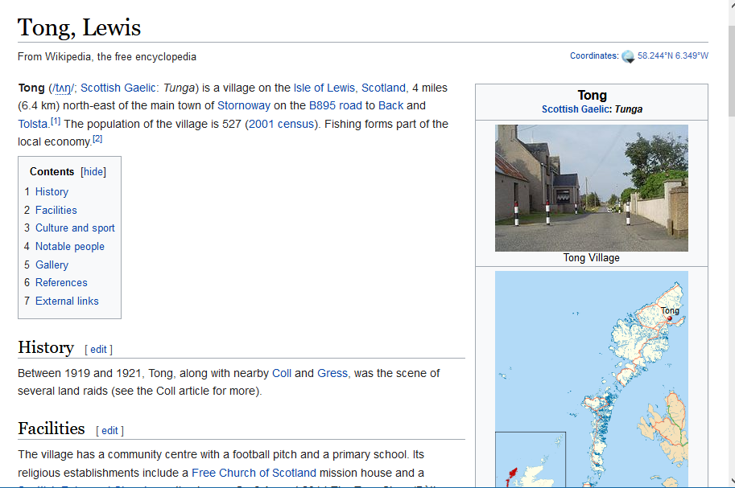

Slide 47
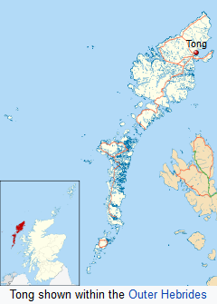
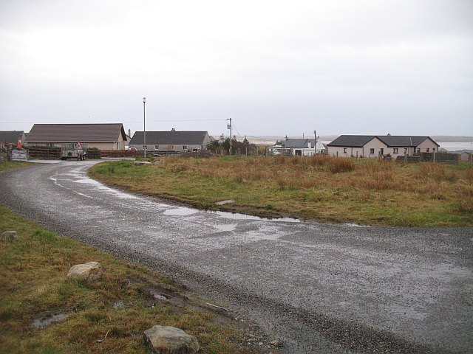
Tong, Lewis, Scotland
https://en.wikipedia.org/wiki/Tong,_Lewis

Slide 48
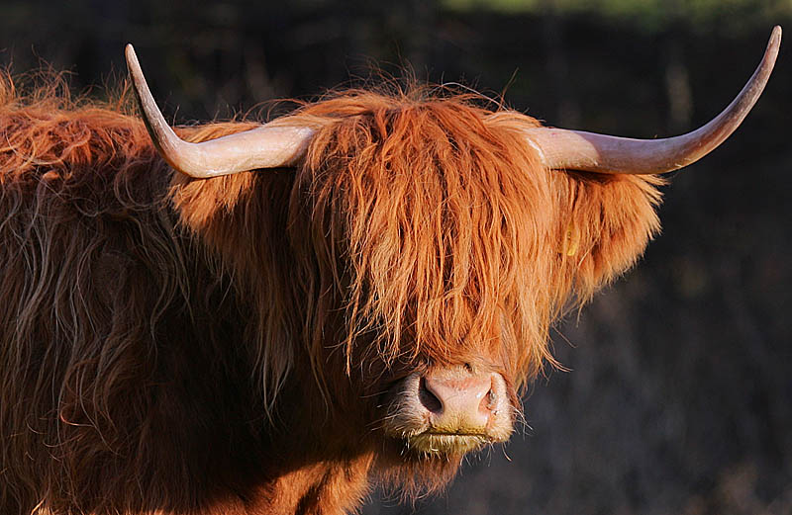
Scotland is also known for its highland cattle
http://en.wikipedia.org/wiki/Highland_cattle

Slide 49
A little more
JEOPARDY . . .

Slide 50
answer:
gulas
paprikas
kolbász
tokaji
Egri Bikavér

Slide 51
more clues . . .

Slide 52
answers:
gulas
paprikas
kolbász
tokaji
Egri Bikavér

Slide 53
question:
What do you think of
when someone says . . .
“Hungary”?
or “Hungarian”?

Slide 54
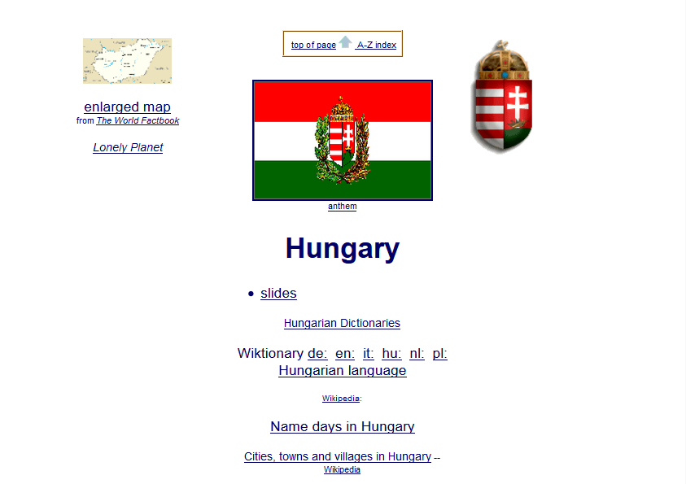

Slide 55
What do you think of
when someone says . . .
“Hungary” or Hungarian”?
these are Hungarikum, terms used to refer to uniquely Hungarian products, especially cuisine
http://en.wikipedia.org/wiki/Tokaji

Slide 56
What do you think of
when someone says . . .
“Hungary” or Hungarian”?
goulash
(gulas)

Slide 57
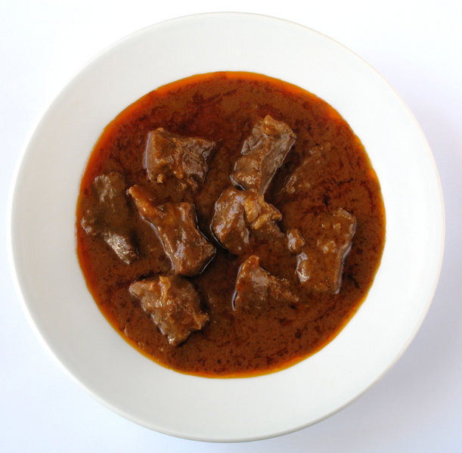
Gulas
http://en.wikipedia.org/wiki/Hungary

Slide 58
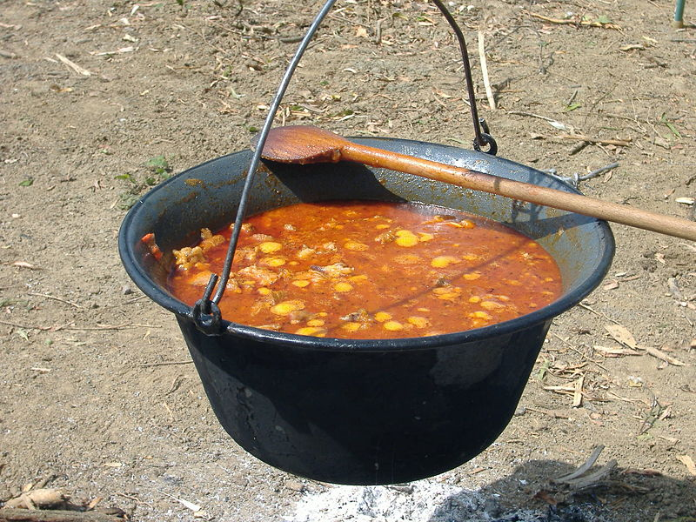
Gulas
http://en.wikipedia.org/wiki/Hungary

Slide 59
What do you think of
when someone says . . .
“Hungary” or Hungarian”?
and
Paprika
(paprikas)

Slide 60
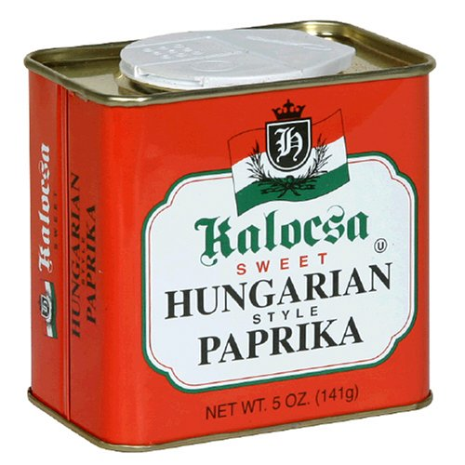
http://en.wikipedia.org/wiki/Hungary

Slide 61
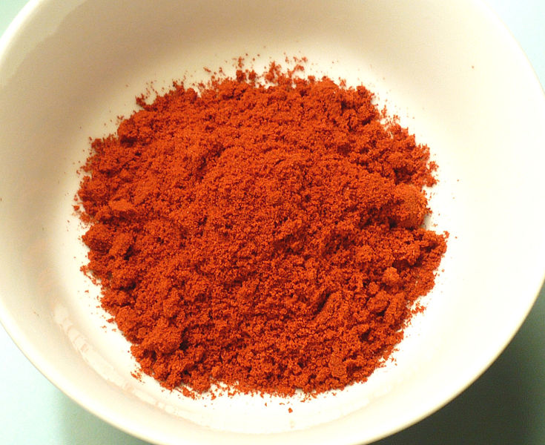
Hot Smoked Paprika
http://en.wikipedia.org/wiki/Hungary

Slide 62
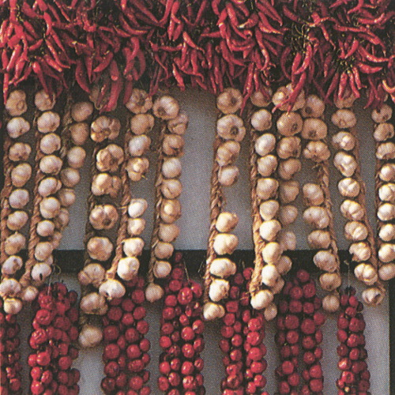
www.fsz.bme.hu/hungary/cuisine/cuisine.html

Slide 63
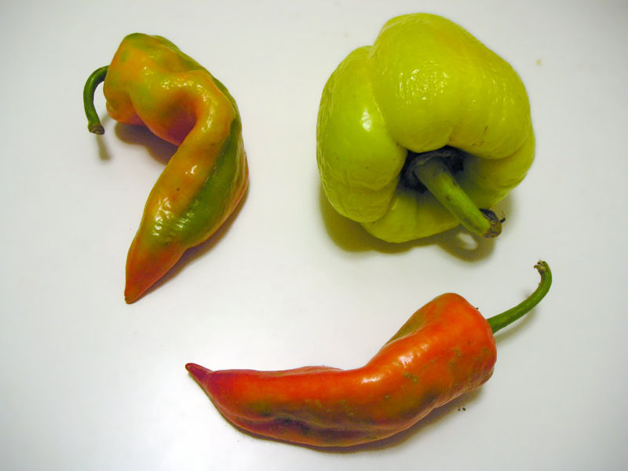
Capsicum Fruit Used to Make Paprika
http://en.wikipedia.org/wiki/Hungary

Slide 64
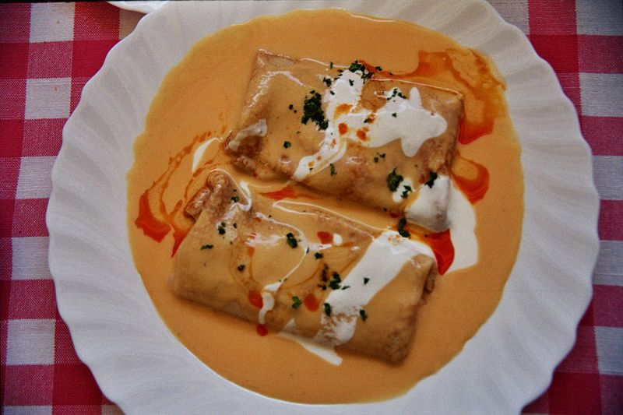
Hortobágyi palacsinta
http://en.wikipedia.org/wiki/Hungary

Slide 65
What do you think of
when someone says . . .
“Hungary” or Hungarian”?
and
sausages . . .
(kolbász)

Slide 66
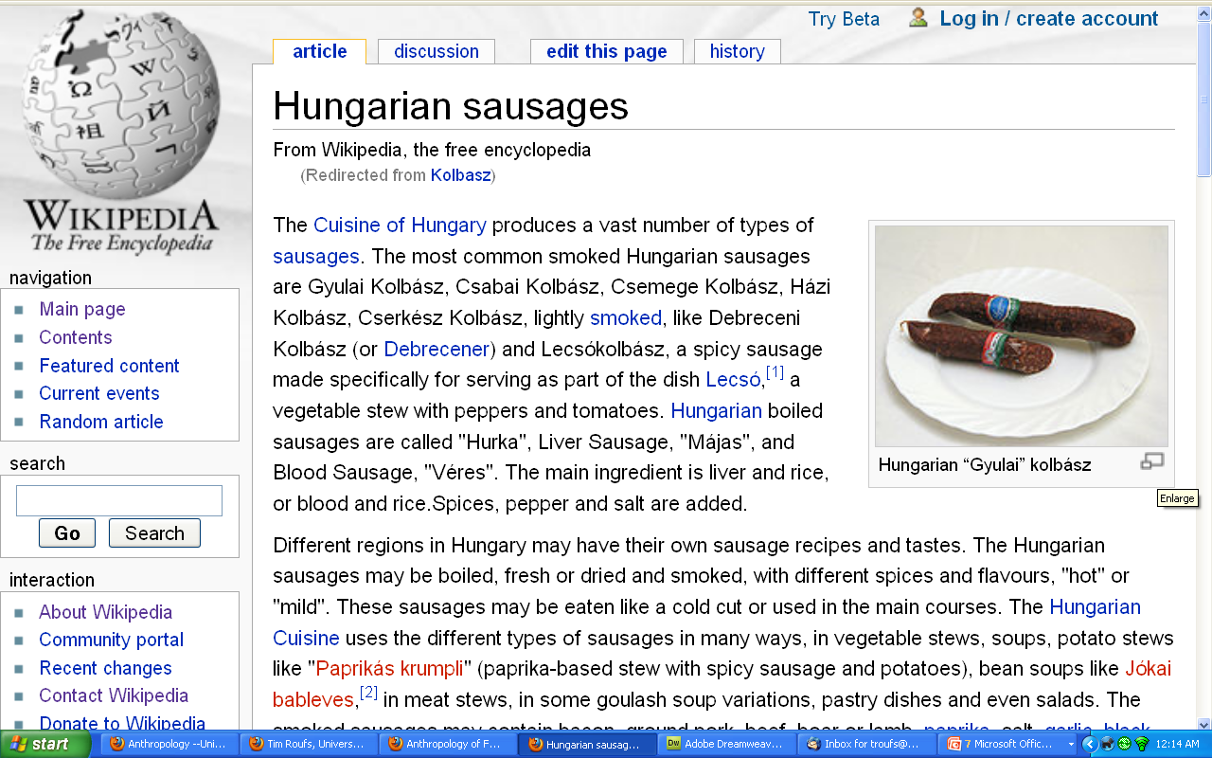
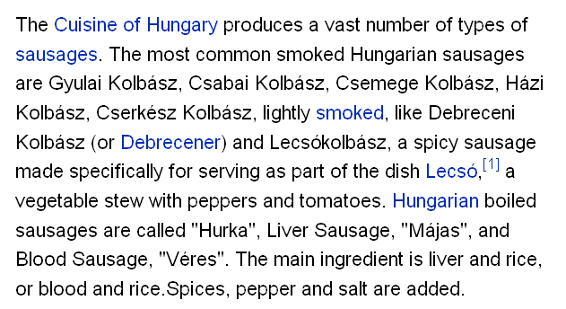
http://en.wikipedia.org/wiki/Kolbasz

Slide 67
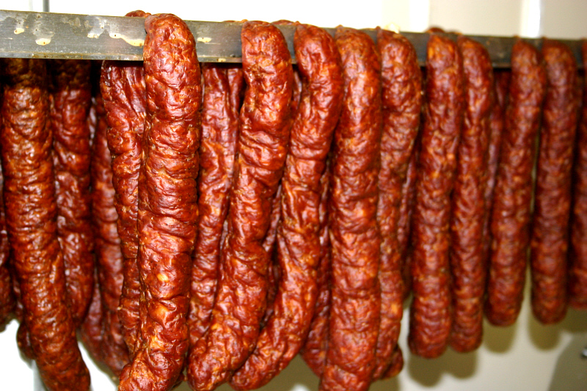
kolbász
(Hungarian sausages)
www.intlmeatsanddeli.com/products.htm

Slide 68
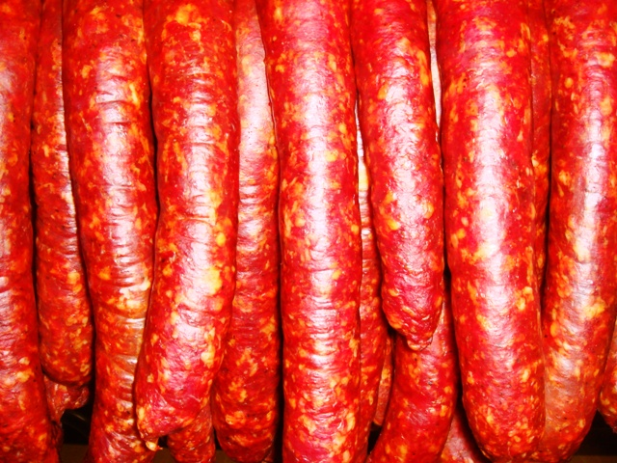
and more Hungarian sausages
www.hungariansupper.com/

Slide 69
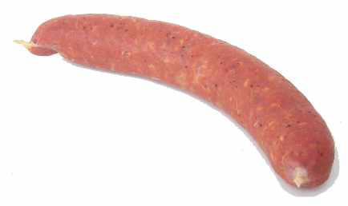
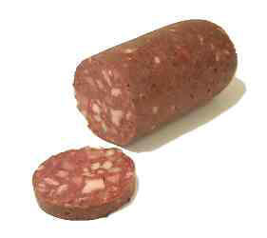
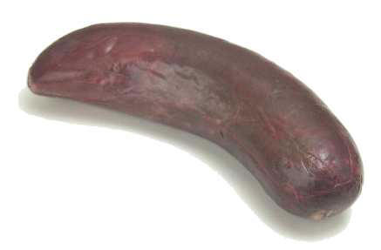
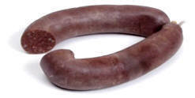
and still more Hungarian sausages
www.hungariansupper.com/

Slide 70
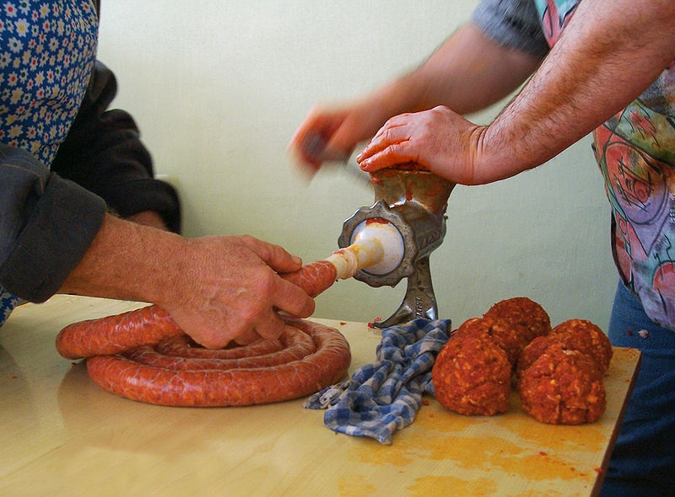
sausage making in Hungary . . .
http://en.wikipedia.org/wiki/File:Sausage_making-H-1.jpg

Slide 71
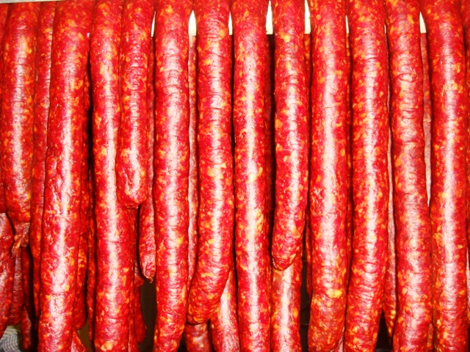
and even more Hungarian sausages
www.hungariansupper.com/

Slide 72
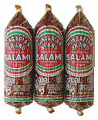
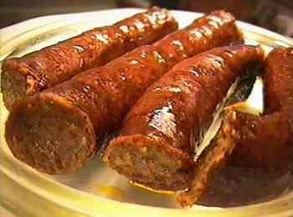
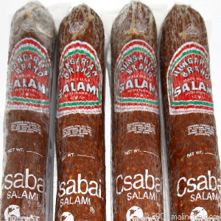
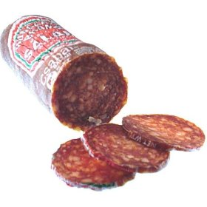
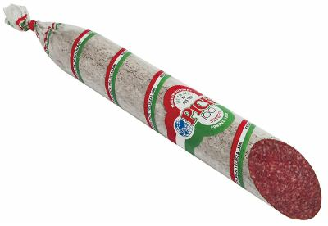
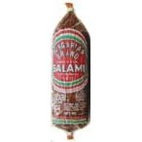
and Hungarian salami
www.hungariansupper.com/

Slide 73
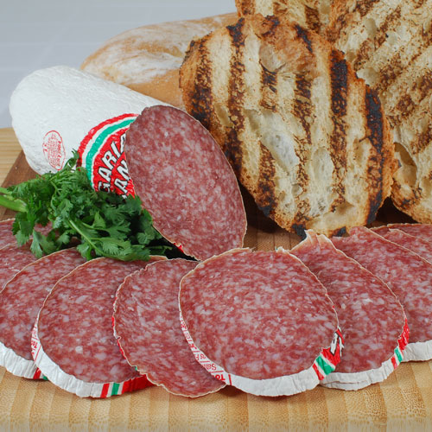
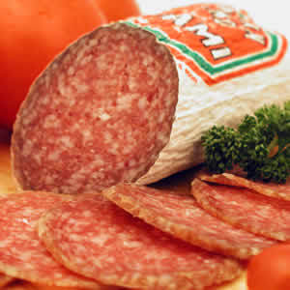
and more Hungarian salami . . .
www.intlmeatsanddeli.com/products.htm

Slide 74
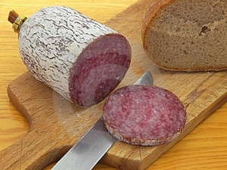
and still more Hungarian salami . . .
http://news.bbc.co.uk/1/hi/world/europe/4307700.stm

Slide 75
and . . .

Slide 76

2007
http://news.bbc.co.uk/1/hi/world/europe/4307700.stm

Slide 77
and . . .

Slide 78
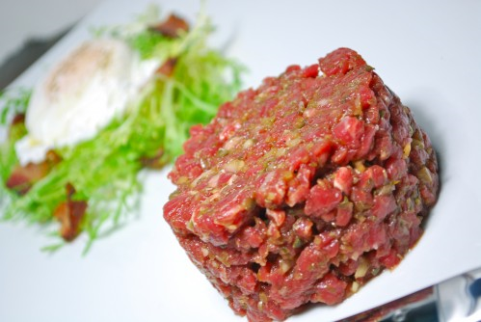
Steak Tartare
http://dhaleb.com/food-type/meat/steak-tartare/

Slide 79
What do you think of
when someone says . . .
“Hungary” or Hungarian”?
and
Tokaji and Egri wines
(from and Tokaj & Eger)
named after
the villages/regions
where they are produced . . .

Slide 80
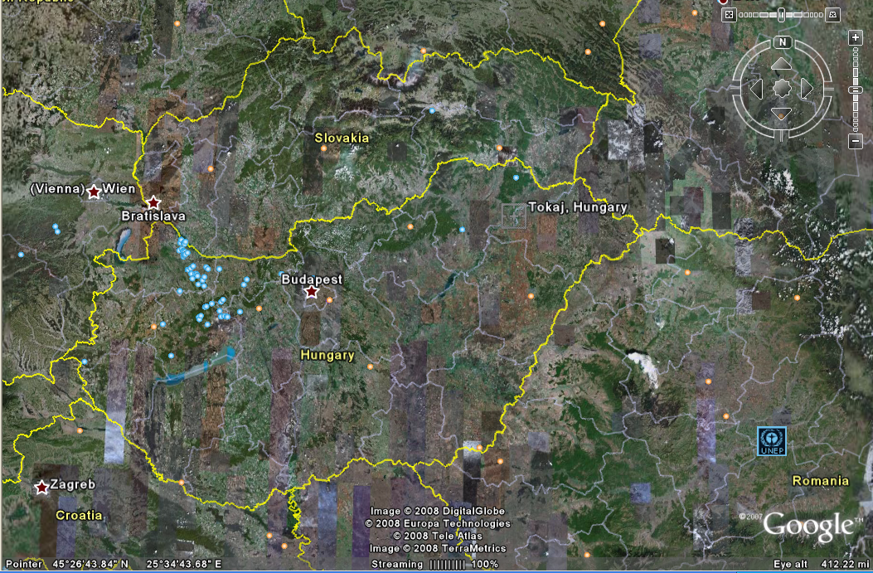
Tokaji
Tokaji, Hungary

Slide 81
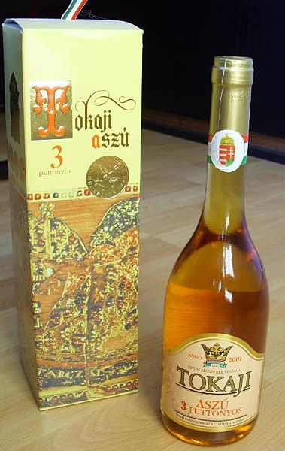
Tokaji, "Wine of Kings, King of Wines“, Louis XIV
http://en.wikipedia.org/wiki/Hungary

Slide 82
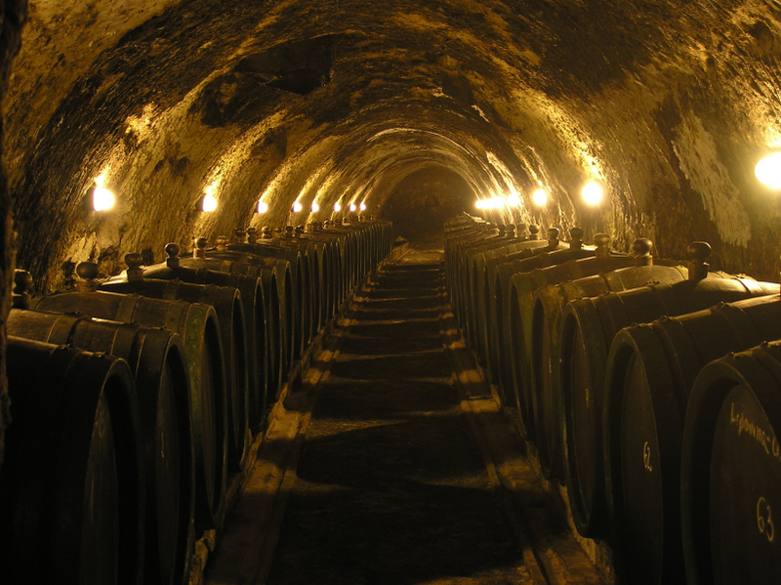
Tokaji, "Wine of Kings, King of Wines“, Louis XIV
http://en.wikipedia.org/wiki/Hungary

Slide 83

Tokaj-Hegyalja Wine Region
http://en.wikipedia.org/wiki/Hungary

Slide 84

Tokaj-Hegyalja Wine Region
http://en.wikipedia.org/wiki/Hungary

Slide 85

Tokaji
Tokaji
http://news.bbc.co.uk/1/hi/world/europe/4307700.stm

Slide 86
Eger
Eger
http://news.bbc.co.uk/1/hi/world/europe/4307700.stm

Slide 87
Eger
Egri Bikavér
“Bull’s Blood of Eger”

Slide 88

Egri Bikavér Wine
“Bull’s Blood of Eger”
http://en.wikipedia.org/wiki/Hungary

Slide 89

Egri Bikavér Wine
“Bull’s Blood of Eger”
http://en.wikipedia.org/wiki/Hungary

Slide 90

Eger Vinyard
http://en.wikipedia.org/wiki/Hungary

Slide 91

Eger
http://en.wikipedia.org/wiki/Hungary

Slide 92

Eger
http://en.wikipedia.org/wiki/Hungary

Slide 93
The Concept of Culture
macrocultures can include groups across nations
  e.g., Basques
  e.g., Rom (Gypsies)
  e.g., ? Al Qaeda

Slide 94
The Concept of Culture
macrocultures can include groups across nations
  e.g., Basques
  e.g., Rom (Gypsies)
  e.g., ? Al Qaeda
what is the cuisine of
Al Qaeda?
avoidance of pork
can you define a cuisine by avoidance of food?

Slide 95
The Concept of Culture
microcultures can include ethnic groups within nations
  Aztec
  Maya
  Zapata
  Mixtec
  Otomi
  Tarascan
  Yaqui
  Tarahumara . . .
contemporary
and
prehistoric

Slide 96
The Concept of Culture
microcultures can include ethnic groups within nations
  e.g., Anishinabe (Chippewa; Ojibwa)
  e.g., Irish “Travellers”
    sometimes incorrectly called “Gypsies”
  e.g., Australian Aboriginals
  e.g., Cajan
  e.g., Rom (Gypsies)
  e.g., Basques
  e.g., Kurds
. . . but sometimes a microculture just shares the cuisine
of its “mother culture” . . .…

Slide 97
The Concept of Culture
microcultures can include ethnic groups within nations
  e.g., Anishinabe (Chippewa; Ojibwa)
  e.g., Irish “Travellers”
    sometimes incorrectly called “Gypsies”
  e.g., Australian Aboriginals
  e.g., Cajun
  e.g., Rom (Gypsies)
  e.g., Basques
  e.g., Kurds

Slide 98

Gitana
Raimundo Madrazo
1841-1920
http://en.wikipedia.org/wiki/Main_Page

Slide 99

Roma boy in bear costume, part of entertainer team for working Christmas crowds. Budapest
http://en.wikipedia.org/wiki/Main_Page

Slide 100



Sándor Buffo Rigó
Tata Gypsy Band
Budapest Gypsy Orchestra
www.romaniworld.com/gal41.htm

Slide 101

(Hippocrene 2004)

Slide 102
more
JEOPARDY . . .

Slide 103
answer:
boxty
soda bread
stew
Guinness

Slide 104

http://en.wikipedia.org/wiki/Boxty

Slide 105
clues . . .

Slide 106
answers:
boxty
soda bread
stew
Guinness

Slide 107
one more clue . . .

Slide 108
answers:
boxty
soda bread
stew
Guinness

Slide 109


Slide 110


Slide 111

(RPC International Publications Ltd.; 2nd edition,1988)

Slide 112

http://en.wikipedia.org/wiki/Boxty

Slide 113

https://www.dublinpass.com/dublin-attractions/the-boxty-house.htmlhttps://www.dublinpass.com/dublin-attractions/the-boxty-house.html

Slide 114

https://www.dublinpass.com/dublin-attractions/the-boxty-house.htmlhttps://www.dublinpass.com/dublin-attractions/the-boxty-house.html

Slide 115

“The average consumption of potatoes per person in Ireland
[before the great potato famine of 1845]
was almost 8 lbs / day . . . and sometimes [potatoes were] the sole source of energy. . . .”
(Jeremy MacVeigh, International Cuisine, Delmar Cengage, 2009, p. 147)
The Irish are famous for their potato dishes
Wikipedia

Slide 116

Whole wheat soda bread
(known as “wheaten bread” in Northern Ireland)
Wikipedia

Slide 117

The Irish are famous for their corned beef and cabbage
http://s184.photobucket.com/albums/x318/RennyBA/StPatricksDayOslo2008/IrishStew.jpg

Slide 118


Slide 119

But that
is changing . . .
Gill & Macmillan, 2009

Slide 120
The Concept of Culture
microcultures can include ethnic groups within nations
  e.g., Anishinabe (Chippewa; Ojibwa)
  e.g., Irish “Travellers”
    sometimes incorrectly called “Gypsies”
  e.g., Australian Aboriginals
  e.g., Cajun
  e.g., Rom (Gypsies)
  e.g., Basques
  e.g., Kurds

Slide 121



Compare . . .
The Irish Tinkers: The Urbanization of an Itinerant People
by George Gmelch
1985

Slide 122
more
JEOPARDY . . .

Slide 123
answers:
gumbo
jambalaya

Slide 124

Roux-less gumbo with okra
http://en.wikipedia.org/wiki/Gumbo

Slide 125

Creole Jambalaya with shrimp, ham, tomato, and Andouille sausage
http://en.wikipedia.org/wiki/Jambalaya

Slide 126
The Concept of Culture
microcultures can include ethnic groups within nations
  e.g., Anishinabe (Chippewa; Ojibwa)
  e.g., Irish “Travellers”
    sometimes incorrectly called “Gypsies”
  e.g., Australian Aboriginals
  e.g., Cajun
  e.g., Rom (Gypsies)
  e.g., Basques
  e.g., Kurds

Slide 127


https://en.wikipedia.org/wiki/Louisiana

Slide 128


Slide 129
“Cajuns live to eat, not eat to live.”

Slide 130

“Cajuns live to eat , not eat to live.”
Wikipedia
Crab Legs, Crawfish Étouffée, Shrimp Gumbo, Shrimp, Corn, and Potatoes

Slide 131

Wikipedia
http://www.cajuncrawfishpie.com/cajun-recipes.html

Slide 132
[ by the way . . . ]
the local cultures of the
Cajuns
should not be confused with Creoles

Slide 133
Cajuns are
descendants of Acadian exiles
(French-speakers from Acadia in what are now The Maritimes of Eastern Canada)
In the United States Creoles are “people of any race or mixture thereof who are descended from settlers in colonial French Louisiana before it became part of the United States in 1803 with the Louisiana Purchase”
https://en.wikipedia.org/wiki/Cajun
https://en.wikipedia.org/wiki/Creole_peoples#Louisiana

Slide 134

Creole cuisine is similar to Cajun,
but they are not the same
http://en.wikipedia.org/wiki/Louisiana_Creole_cuisine

Slide 135

just ask Paul Prudhomme
http://www.nola.com/175years/index.ssf/2012/02/paul_prudhomme_the_times-picay.html

Slide 136
more
JEOPARDY . . .

Slide 137
answers:
Vegemite
ANZAC biscuits
Pavlova
(maybe)

Slide 138


Slide 139
clue . . .

Slide 140
answers:
Vegemite
ANZAC biscuits
Pavlova
(maybe)

Slide 141

answer:
Vegemite
ANZAC biscuits
ANZAC biscuits
http://en.wikipedia.org/wiki/ANZAC_biscuit

Slide 142
answers:
Vegemite
ANZAC biscuits
Pavlova
(maybe)

Slide 143

http://en.wikipedia.org/wiki/Pavlova_(food)

Slide 144


Slide 145


Slide 146
Except that . . .

Slide 147
Except that . . .
New Zealand wants in on the action . . .

Slide 148


Slide 149
The Pavlova Story: A Slice of
New Zealand's Culinary History

Slide 150
The Pavlova Story: A Slice of
New Zealand's Culinary History
A New Zealand Professor of Anthropology

Slide 151
And there are all of the other foods mentioned elsewhere . . .

Slide 152


Slide 153

baklava

Slide 154


A Tate of Greece
25th Annual Food Festival 2017

Slide 155
Montgomery, Minnesota

Slide 156

Czech
Montgomery, Minnesota
Kolacky Days Festival, est. 1929

Slide 157
Ely, Minnesota

Slide 158


Slovenia
http://www.duluthbudgeteer.com/community/4121672-simple-cooking-leads-success
Notes:
158

Slide 159
Duluth, Minnesota

Slide 160



Finland
lutefisk
Duluthian Beatrice Ojakangas inducted into the Scandinavian-American Hall of Fame
http://www.duluthbudgeteer.com/community/4121672-simple-cooking-leads-success
Notes:
160

Slide 161


http://www.mprnews.org/story/2016/09/13/npr-pho-central-to-vietnamese-identity
Notes:
161

Slide 162
Green Bay, Wisconsin

Slide 163


Wallonia
(Belgium)
Cadott, Wisconsin
https://www.travelwisconsin.com/events/fairs-festivals/booya-days-40367
Notes:
163

Slide 164
the list of foods central to cultural identity
goes on . . . and on . . .

Slide 165
the list of foods central to cultural identity
goes on . . . and on . . .

Slide 166
The Concept of Culture
microcultures can include ethnic groups within nations
  e.g., Anishinabe (Chippewa; Ojibwa)
  e.g., Irish “Travellers”
    sometimes incorrectly called “Gypsies”
  e.g., Australian Aboriginals
  e.g., Cajun
  e.g., Rom (Gypsies)
  e.g., Basques
  e.g., Kurds

Slide 167

The Desert People

Slide 168

The Desert People

Slide 169
enough fun and games . . .
back to our
main characteristics of anthropology

Slide 170
Main Characteristics in a Nutshell

Slide 171
American
Main Characteristics of˄Anthropology
1. the four fields of general anthropology
culture as a primary concept
comparative method as major approach
holism as a primary theoretical goal
fieldwork as a primary research technique

Slide 172
American
Main Characteristics of˄Anthropology
1. the four fields of general anthropology
culture as a primary concept
comparative method as major approach
holism as a primary theoretical goal
fieldwork as a primary research technique

Slide 173
ANTH 1080
Global Cultures
The End
Main
Characteristics of
Anthropology
© 2010-2026 Timothy G. Roufs, University of Minnesota Duluth

