Slide 1
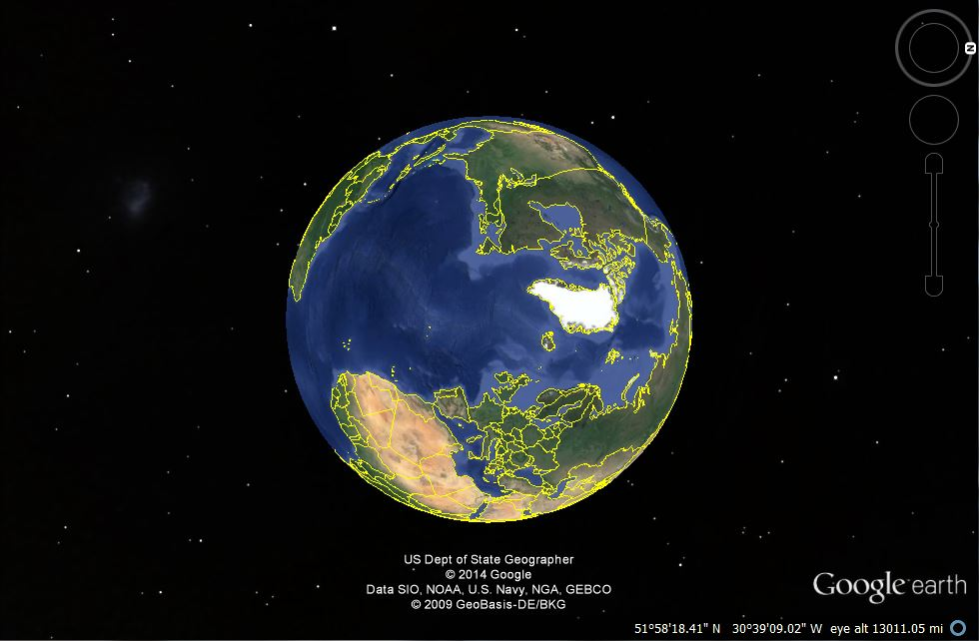
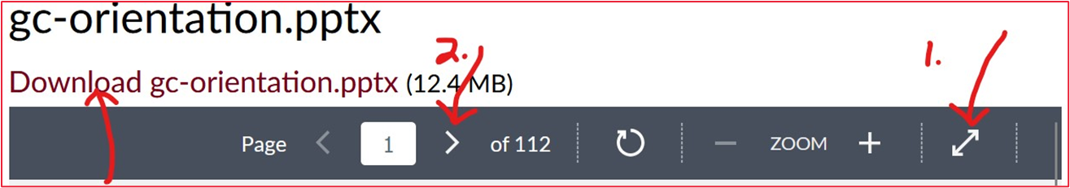
In Canvas
(1.) Enter Full Screen (2.) advance slides using < > (3.) adjust your screen size (if necessary)
© 2010-2026 Timothy G. Roufs, University of Minnesota Duluth

Slide 2
In Canvas
(1.) Enter Full Screen (2.) advance slides using < > (3.) adjust your screen size (if necessary)
OPTIONAL: Download PowerPoint (.pptx) and watch in “Slide Show” mode, and use your up/down arrow keys and/or your space bar to advance the slides.
© 2010-2026 Timothy G. Roufs, University of Minnesota Duluth

Slide 3
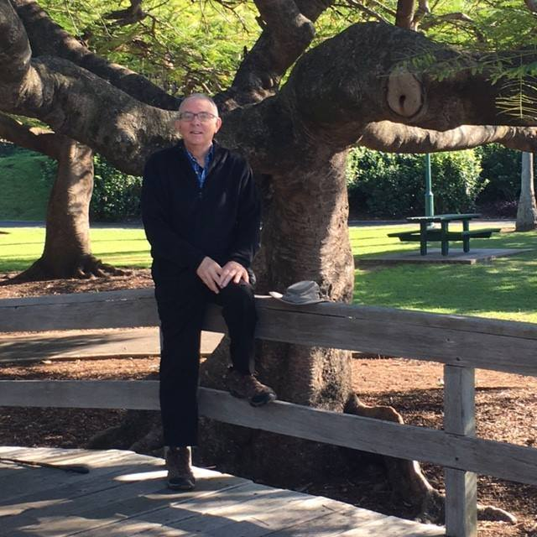
Welcome to
Global Cultures
Tim Roufs
Brisbane, Australia, 2017

Slide 4
This will be a great course . . .
you will see

Slide 5

(if you are not already in Canvas)
Go to your
course management site
and check it out . . .

Slide 6
https://canvas.umn.edu
(your browser may require that you double-click)
If your browser does not allow you to click on the above URL just enter it in your browser window . . .
Continue here for further instructions . . .
There is another link at the end of this program

Slide 7
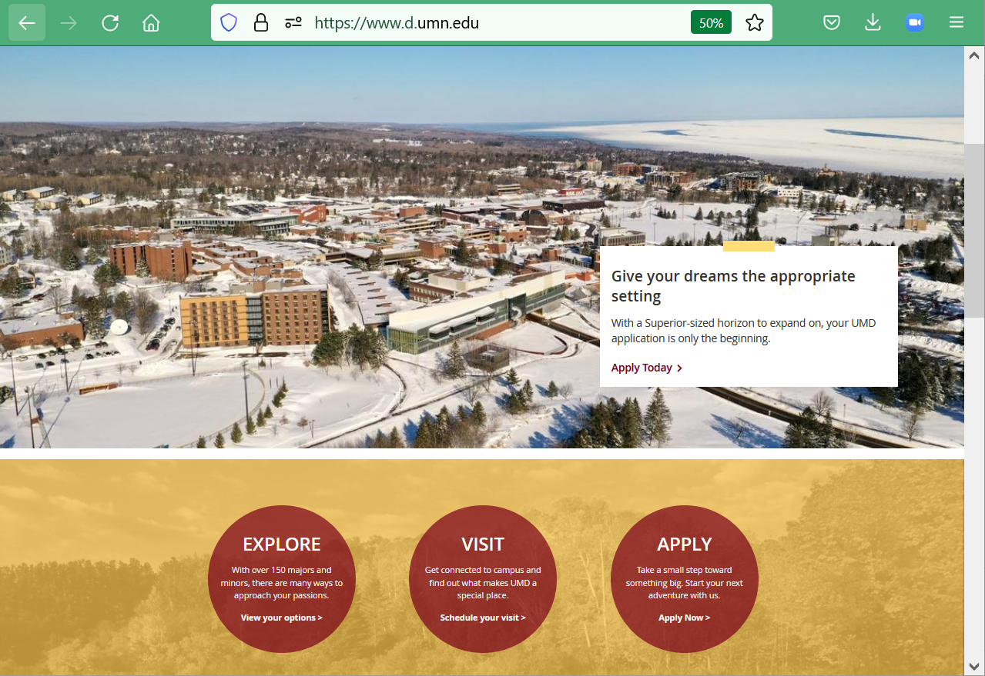
or enter:
canvas.umn.edu
here

Slide 8
Your Canvas “Dashboard” on your laptop
will look something like the following . . .
https://canvas.umn.edu/

Slide 9
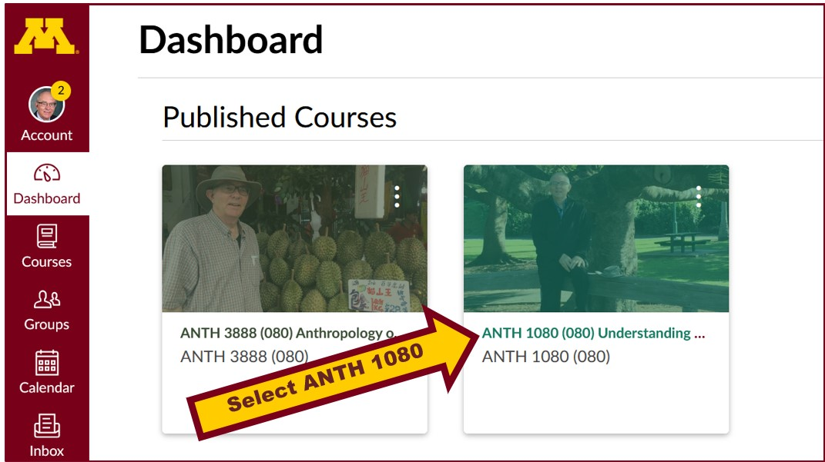
Your laptop Canvas “Dashboard” will look something like this . . .

Slide 10
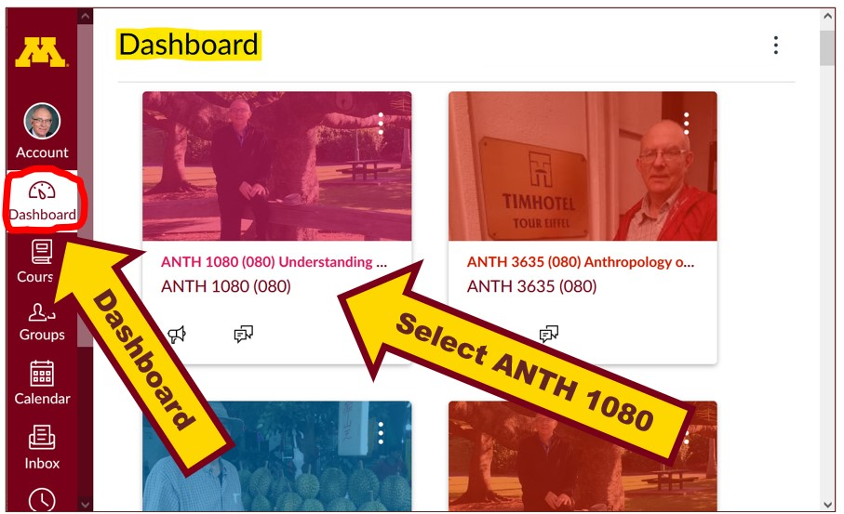
Your laptop Canvas “Dashboard” will look something like this . . .

Slide 11
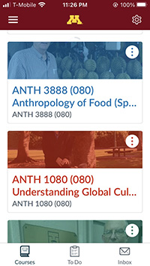
Your Canvas phone app
Dashboard screen
will look
something like this . . .

Slide 12
click on ANTH 1080

Slide 13
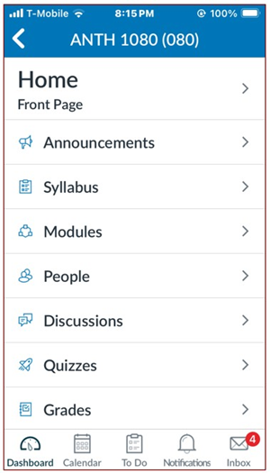
Your Canvas phone app
“Home” screen, for e.g.,
will look
something like this . . .

Slide 14
NOTE: Not all Canvas features work on phone apps . . .
And different phone models work differently . . .

Slide 15
Your Canvas “Home” screen
on your laptop
will look something like the following . . .

Slide 16
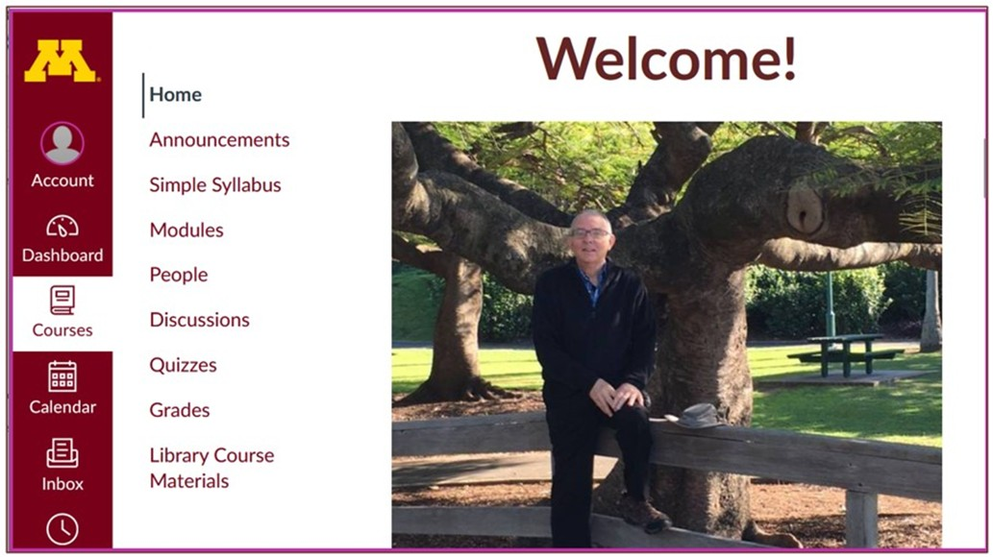
Your laptop Canvas “Home” screen will look something like this

Slide 17
Where to Begin?

Slide 18
Have a look at the Syllabus . . .

Slide 19
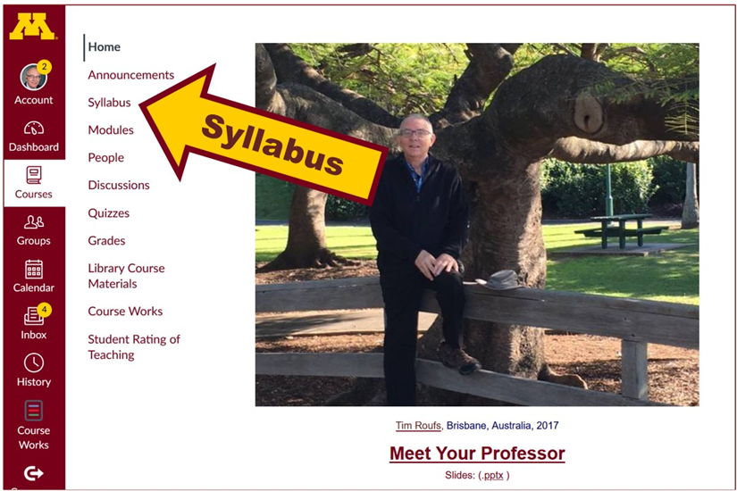

Slide 20
Your Canvas phone app
“Home” screen, for e.g.,
will look
something like this . . .
Syllabus

Slide 21
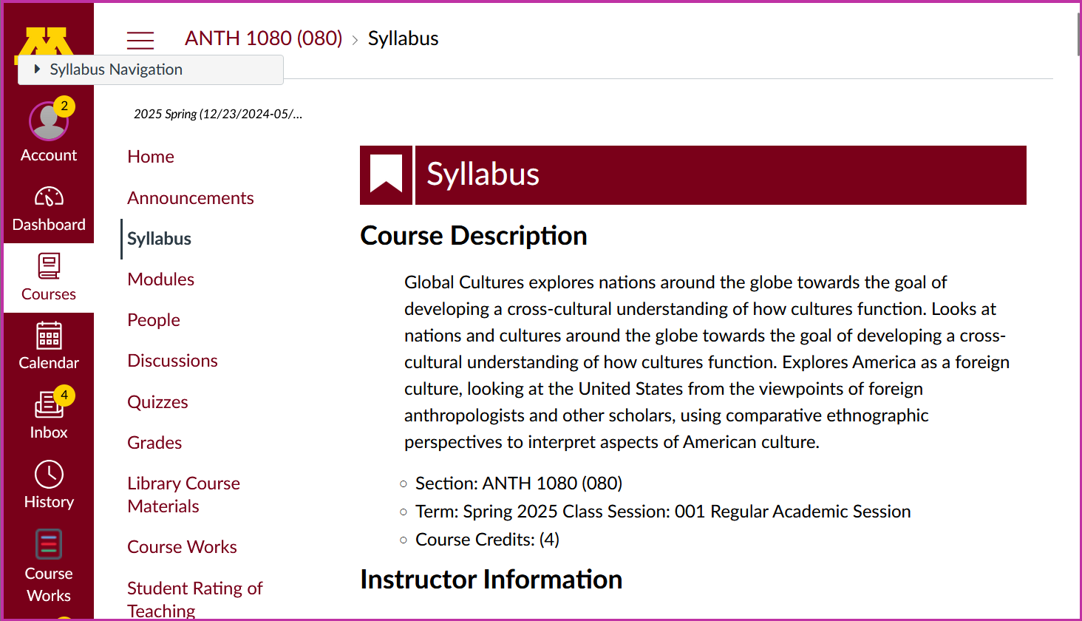

Use the Pull-down Navigation

Slide 22
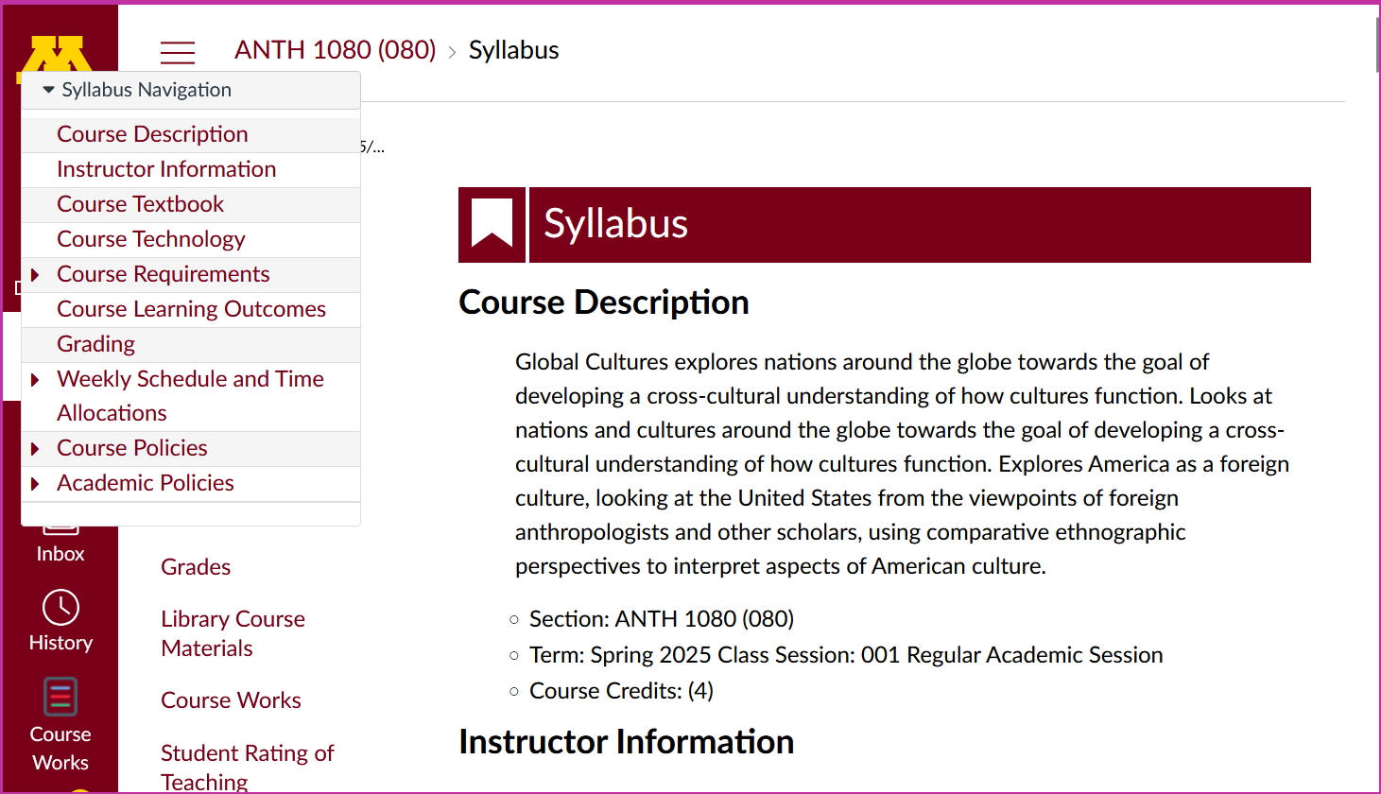

Slide 23
Then have a look at the “Getting Started” Module, Steps 1-6 . . .

Slide 24
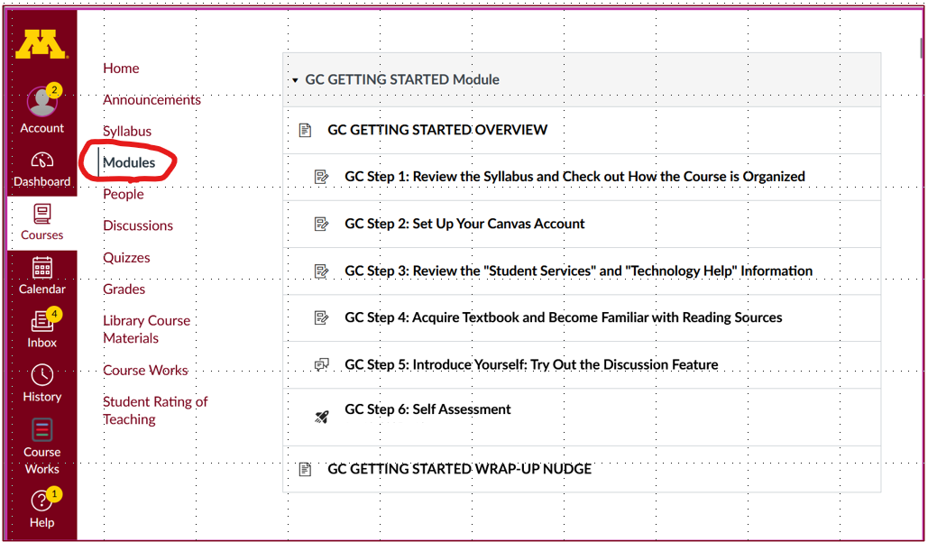
Getting Started

Slide 25
Have a look,
give it a try,
and if you have
any questions,
or suggestions,
or comments,
please let us know at troufs e-mail.

Slide 26

Once again . . .
Welcome to
Global Cultures
© 2010-2026 Timothy G. Roufs, University of Minnesota Duluth

Slide 27
Once again . . .
Welcome to
Global Cultures
Enjoy your stay!
© 2010-2026 Timothy G. Roufs, University of Minnesota Duluth

Slide 28
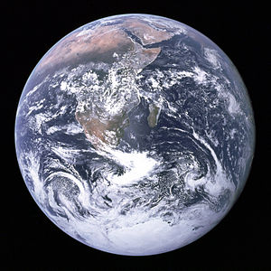
as we go
around the world . . .

Slide 29
© 2010-2026 Timothy G. Roufs, University of Minnesota Duluth

