Slide 1

Use your up / down arrow keys and / or
your space bar to advance the slides
Other
Important
Terms
© 2010-2026 Timothy G. Roufs, University of Minnesota Duluth

Slide 2
Other
Important
Terms
© 2010-2026 Timothy G. Roufs, University of Minnesota Duluth

Slide 3
© 2010-2026 Timothy G. Roufs, University of Minnesota Duluth

Slide 4
In a nutshell, ANTH 1080 Global Cultures
consists of three main segments:
I Orientation and Background
  Introduction
  Basic Concepts
  History
  Theory
  Methods and Techniques
II Explorations
Comparative / Cross-Cultural
Holistic
Ethnographic Case Studies from the Real World: Real People . . . Real Places from Around the Globe
III Student Presentations on Term Research Project
http://www.d.umn.edu/cla/faculty/troufs/anthfood/afproject.html

Slide 5
In a nutshell, ANTH 1080 Global Cultures
consists of three main segments:
I Orientation and Background
  Introduction
  Basic Concepts
  History
  Theory
  Methods and Techniques
II Explorations
Comparative / Cross-Cultural
Holistic
Ethnographic Case Studies from the Real World: Real People . . . Real Places from Around the Globe
III Student Presentations on Term Research Project
http://www.d.umn.edu/cla/faculty/troufs/anthfood/afproject.html

Slide 6
Other
Important
Terms
© 2010-2026 Timothy G. Roufs, University of Minnesota Duluth

Slide 7
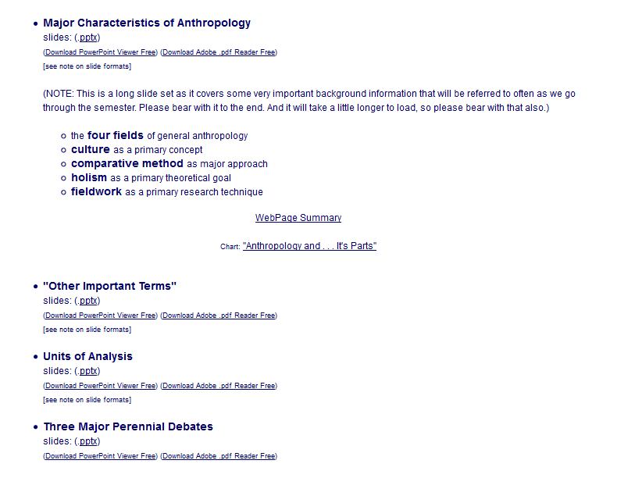

Slide 8
. . . and one or more of these term clarifications
might prove interesting, and even helpful with your class project

Slide 9
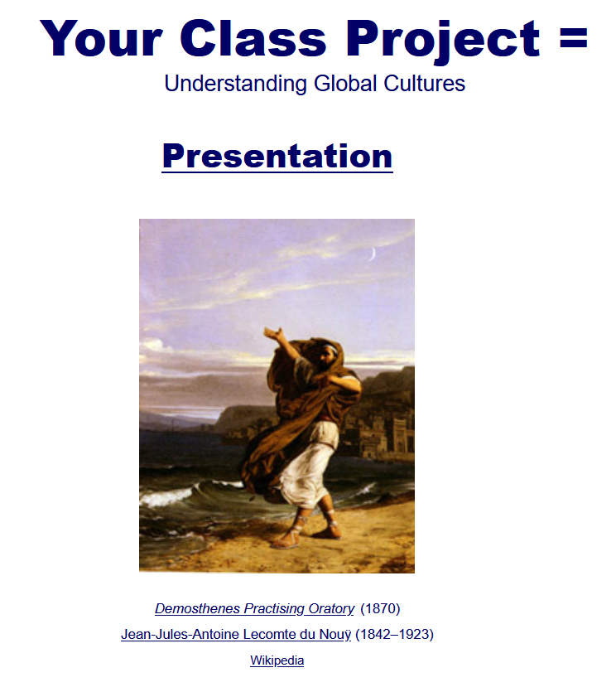

Slide 10
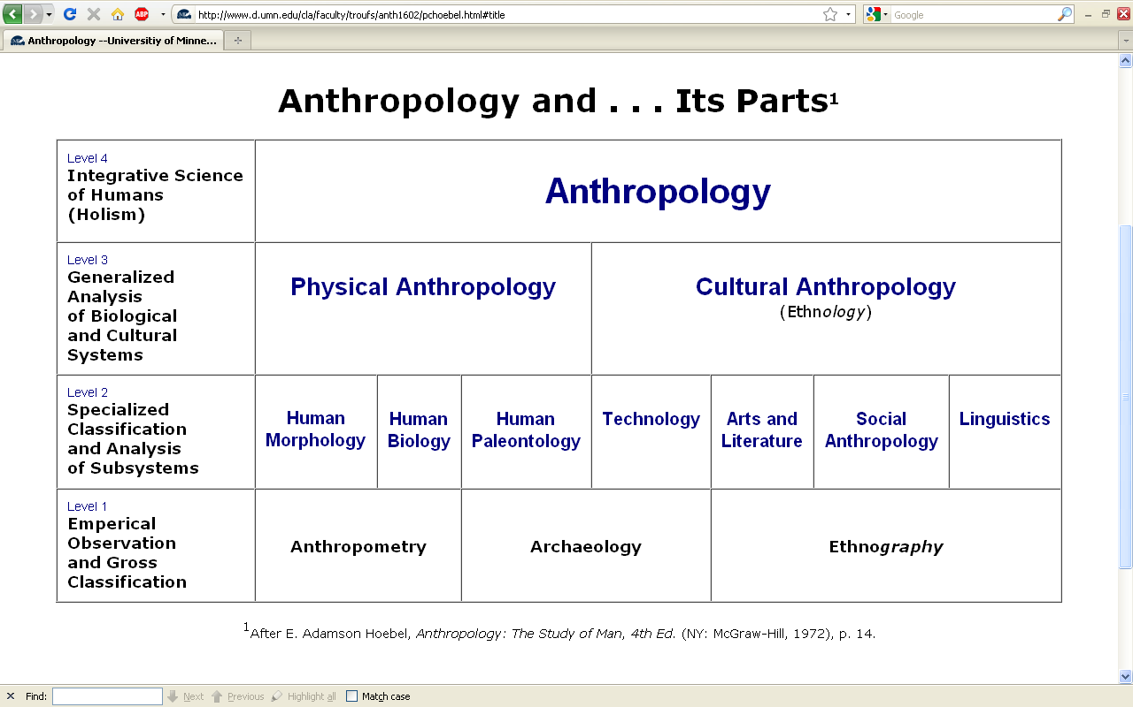
This is the same chart as in the
“Main Characteristics of Anthropology”
material

Slide 11
difficult terms

Slide 12
ethnography
  scientific description of cultures
  (“a portrait of a people”)

Slide 13
ethno – graphy
  graph from the Greek, meaning something “written” or “drawn”

Slide 14
ethno – graphy
  ethnography looks at “who,” “what,” “where” and “when”

Slide 15
ethnology
  comparative study of cultures

Slide 16
ethn – ology
  comparative study of cultures

Slide 17
ethn – ology
  ethnology looks at “why” and “how”

Slide 18
ethnology
  comparative study of cultures

Slide 19
ethnology
  comparative study of cultures
Take out the n and that yields an entirely different word . . .

Slide 20
ethology
  comparative study of cultures
  scientific study of the social behavior of animals, especially in their natural environments

Slide 21
primatology
  scientific study of the social behavior of primates, especially (non-human primates) apes and monkeys

Slide 22
“primatologist”
  usually refers to one who studies the behavior and social lives of chimpanzees, gorillas, orangutans, monkeys, etc.
      e.g., Jane Goodall, Diane Fossy
      Birute Galdikas-Brindamour

Slide 23
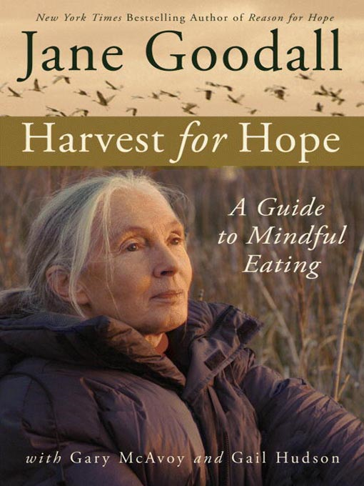
Jane Goodall (1934-2025) is the most famous primatologist of all time
Grand Central Publishing, 2006

Slide 24
“primates” include
    prosimians (“pre-monkeys”)
    monkeys
    apes
    and also humans

Slide 25
include
“primates”
    prosimians (“pre-monkeys”)
    monkeys
    apes
    and also humans

Slide 26
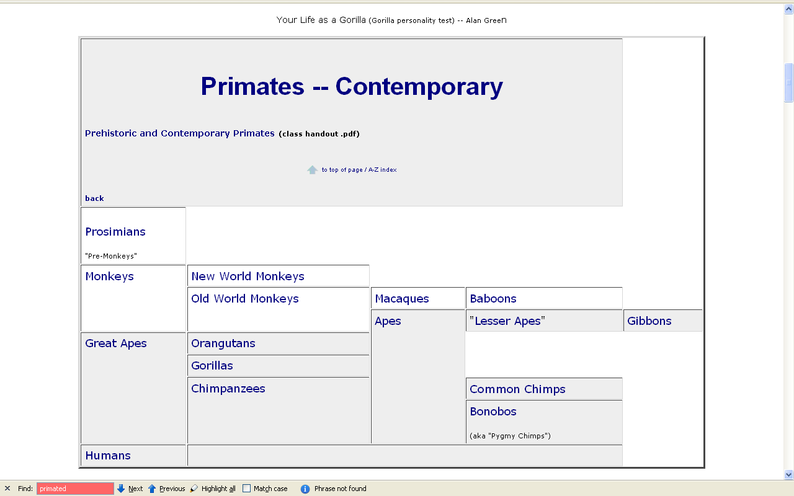

www.d.umn.edu/cla/faculty/troufs/anth1602/pcprim.html

Slide 27
“non-human primates” are
  prosimians (“pre-monkeys”)
  monkeys
  apes

Slide 28
“non-human primates”
www.d.umn.edu/cla/faculty/troufs/anth1602/pcprim.html

Slide 29
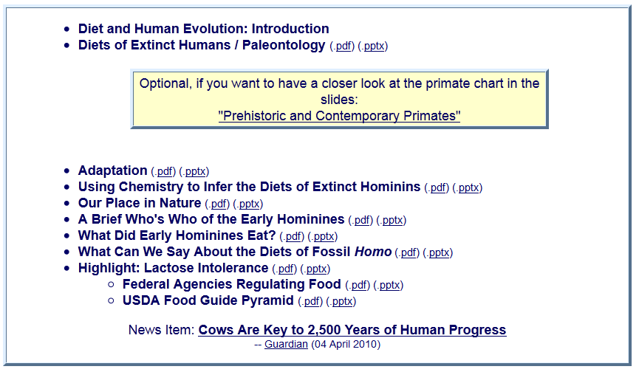
With regard to non-human primates, note one major relatively recent change

Slide 30
“hominins” is now generally used rather than “hominids”

Slide 31
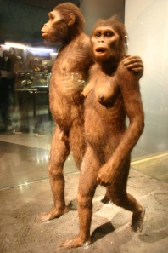
This reflects a relatively recent change in the classification of the Great Apes and many new prehistoric forms like “Lucy” . . . through the newest discovery, Homo naledi
“hominins” is now generally used rather than “hominids”

Slide 32
other important terms include . . .

Slide 33
ethnocentrism
  judging other cultures by the standards of one’s own culture rather than by the standards of that particular culture

Slide 34
two fundamental concepts in anthropology are . . .
ethnocentrism
  judging other cultures by the standards of one’s own culture rather than by the standards of that particular culture
cultural relativism

Slide 35
ethnocentrism
  is the mindset of judging other cultures by the standards of one’s own culture rather than by the standards of that particular culture

Slide 36
cultural relativism
  refers to the perspective that each culture must be understood in terms of the values and ideas of that culture and should not be judged by the standards of another

Slide 37
in recent times two types of cultural relativism have emerged . . .
cultural relativism
  absolute cultural relativism
  critical cultural relativism

Slide 38
the term as originally proposed came to be referred to as . . .
in recent times two types of cultural relativism have emerged . . .
cultural relativism
  absolute cultural relativism
  critical cultural relativism

Slide 39
absolute cultural relativism
  the perspective that says a person from one culture should not question the rightness or wrongness of behavior or ideas in other cultures because that would be ethnocentric

Slide 40
absolute cultural relativism
  was quickly criticized as unacceptable as, taken literally, [absolute] cultural relativism suggested we should accept anything and everything that was thought to be OK by the people under consideration

Slide 41
absolute cultural relativism
  critics quickly pointed to Hitler and the World War II Holocaust and (rightfully) said that no one should accept behaviors that resulted in The [WW II] Holocaust; that such behavior was unacceptable under any circumstances

Slide 42
absolute cultural relativism
  and the critics added enough other examples so that the original concept of cultural relativism was modified and resulted in today’s concept of
  critical cultural relativism

Slide 43
critical cultural relativism
  offers an alternative view that poses questions about cultural practices and ideas in terms of who accepts them and why, and who they might be harming or helping

Slide 44
critical cultural relativism . . .
answered many of the early critics
But—even accepting the modified concept—it is oftentimes not easy to figure out what “. . . in terms of who accepts them and why, and who they might be harming or helping” means

Slide 45
critical cultural relativism . . .
Let’s look at a several examples of where
“it is oftentimes not easy to figure out what ‘. . . in terms of who accepts them and why, and who they might be harming or helping’ means” . . .

Slide 46
And where do you draw the line with critical cultural relativism . . .?
This is a very difficult question,
so let’s look at a large number of items . . .

Slide 47
The rest of this slide deck is devoted to a large number of examples of
critical cultural relativism and
ethnocentrism
in various cultural situations around the world.
Take a break and come back if you get tired. The examples are interesting. . . .

Slide 48
absolute cultural relativism
  how about?
  doctor assisted suicide
  arranged “underage” forced marriage
  female genital mutilations
  withholding of medical treatment of children for religious reasons
  polygyny
  marriage of close cousins . . .

Slide 49

https://www.ncregister.com/cna/2025-saw-expanded-access-to-physician-assisted-suicide

Slide 50
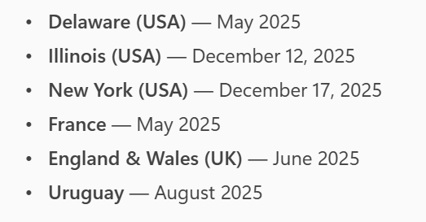
absolute cultural relativism
  how about?
  doctor assisted suicide
  arranged “underage” forced marriage
  female genital mutilations
  withholding of medical treatment of children for religious reasons
  polygyny
  marriage of close cousins . . .

Slide 51
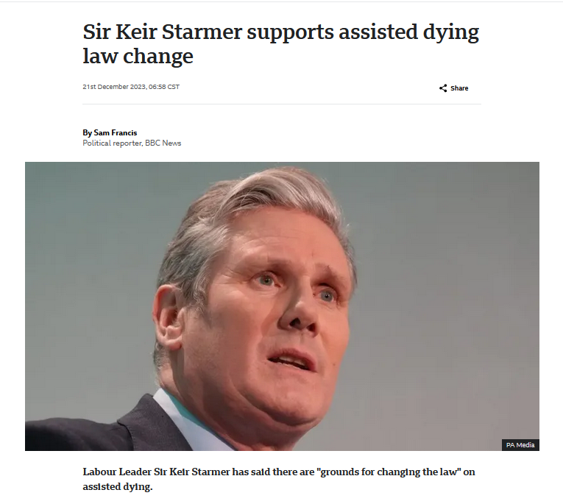

21 December 2023
UK Labour Leader
https://www.bbc.com/news/uk-politics-67785112

Slide 52
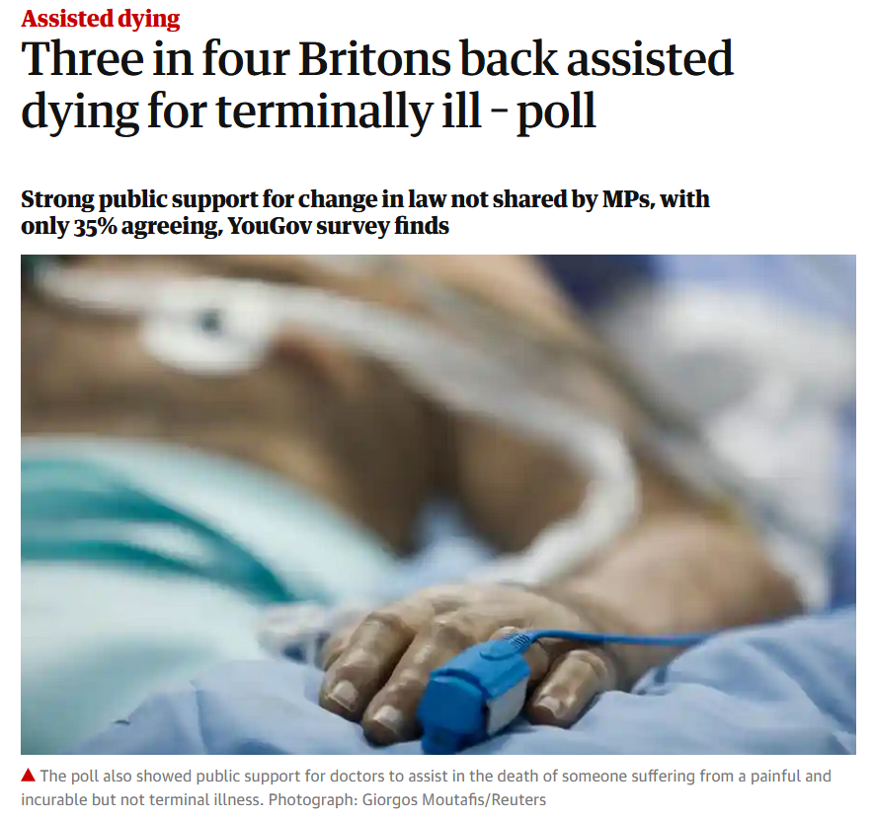

04 August 2021
https://www.theguardian.com/society/2021/aug/04/three-in-four-britons-back-assisted-dying-for-terminally-ill-poll

Slide 53
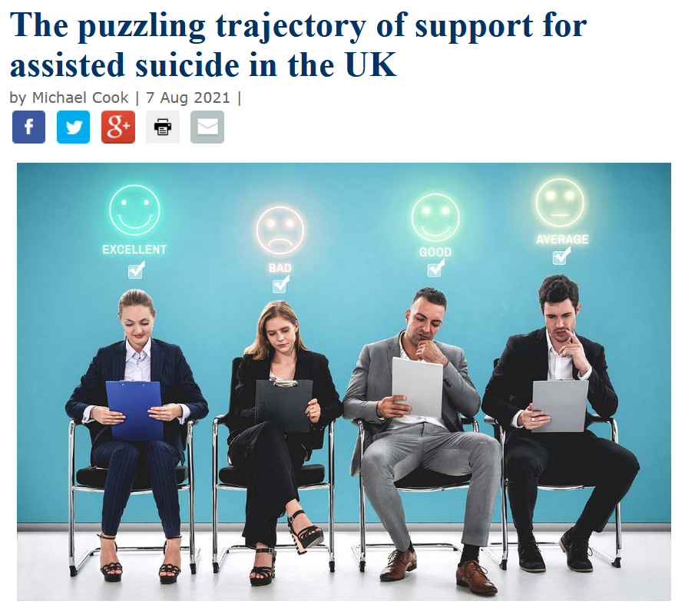

https://www.bioedge.org/bioethics/the-puzzling-trajectory-of-support-for-assisted-suicide-in-the-uk/13865

Slide 54
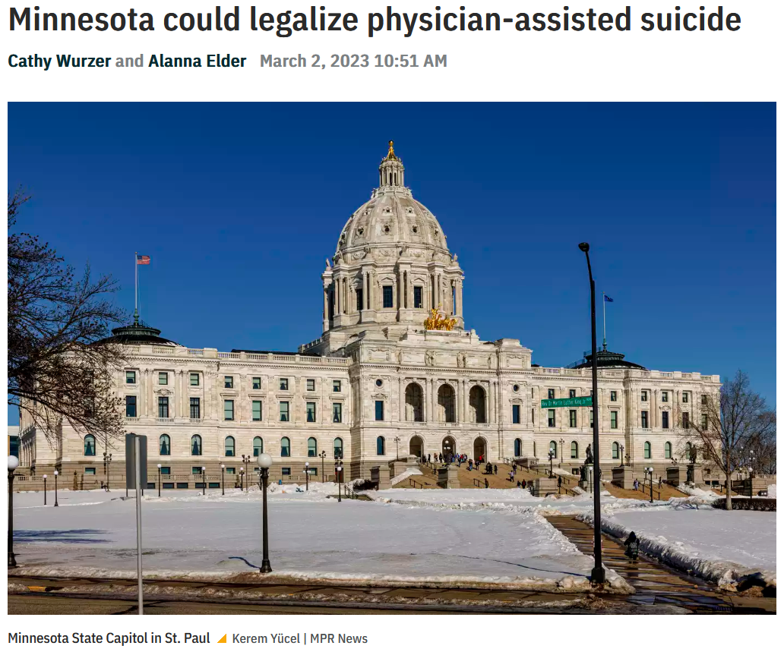

https://www.mprnews.org/episode/2023/03/02/minnesota-could-legalize-physicianassisted-suicide

Slide 55
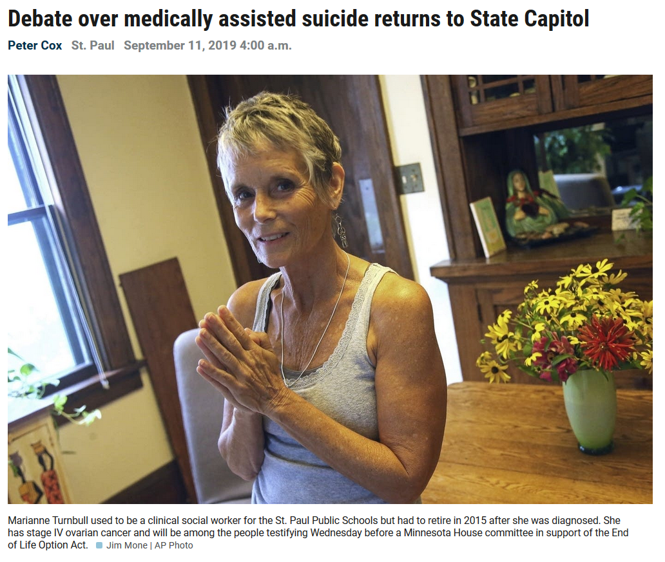

https://www.mprnews.org/story/2019/09/11/debate-over-medically-assisted-suicide-returns-to-minn-capitol

Slide 56
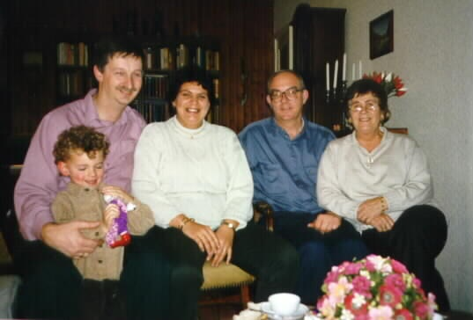
in many places doctor assisted suicide is legal, perfectly acceptable to many if not most, of the members of a culture

Slide 57
is that OK?

Slide 58
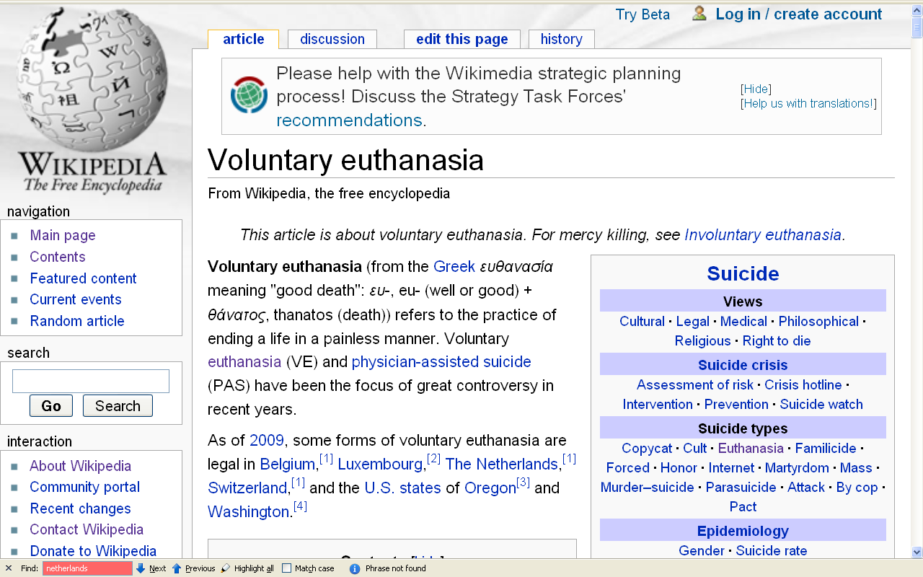
people living in the states of Oregon and Washington, and the countries of Belgium, Luxembourg, The Netherlands, Australia, and Switzerland and a lot of other places think so (for e.g.)
\ http://en.wikipedia.org/wiki/Voluntary_euthanasia

Slide 59
absolute cultural relativism
  how about?
  Doctor Assisted Suicide
  arranged “underage” forced marriage
  female genital mutilations
  withholding of medical treatment of children for religious reasons
  polygyny
  marriage of close cousins . . .

Slide 60
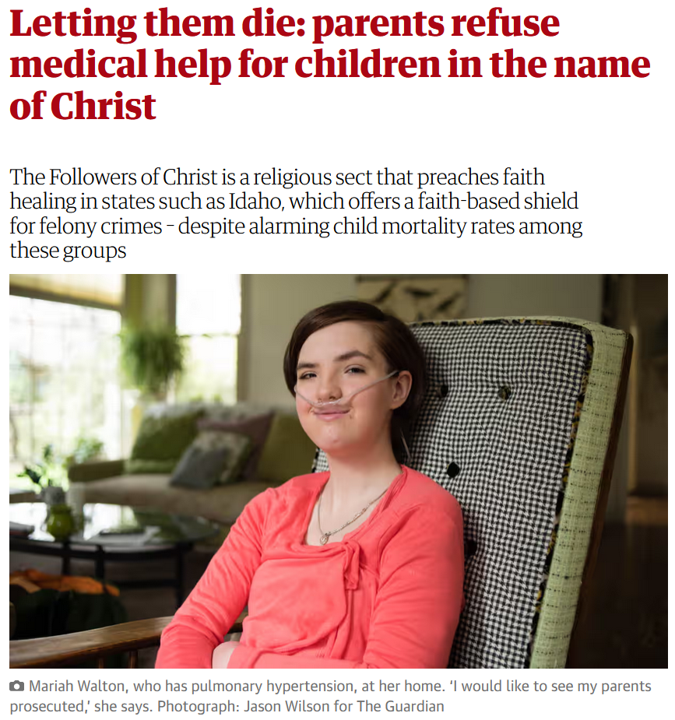
13 April 2016
https://www.theguardian.com/us-news/2016/apr/13/followers-of-christ-idaho-religious-sect-child-mortality-refusing-medical-help

Slide 61
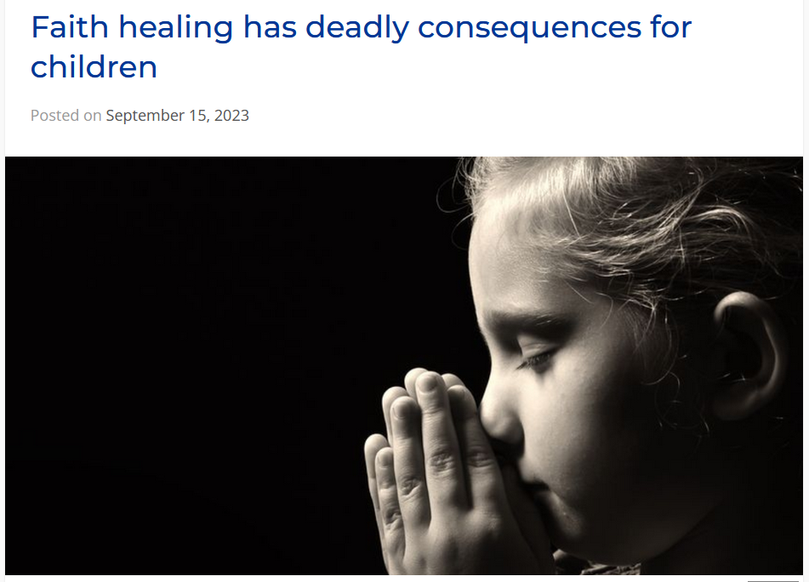

15 September 2023
https://secularaz.org/faith-healing/

Slide 62
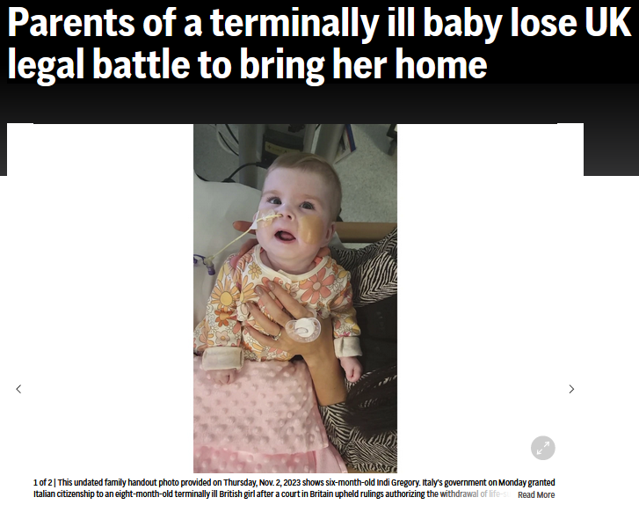

8 November 2023
https://www.theguardian.com/us-news/2016/apr/13/followers-of-christ-idaho-religious-sect-child-mortality-refusing-medical-help

Slide 63
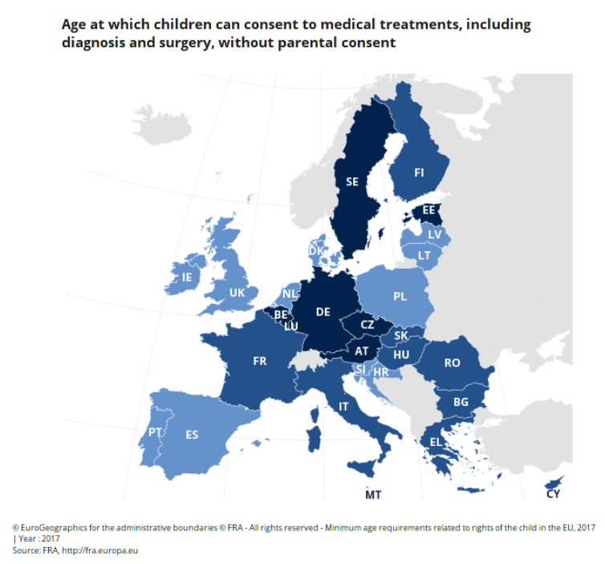

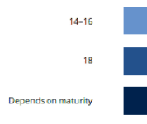
http://fra.europa.eu/en/publication/2017/mapping-minimum-age-requirements-concerning-rights-child-eu/consenting-medical-treatment-without-parental-consent

Slide 64
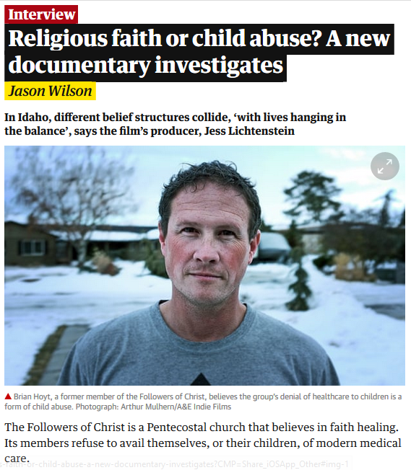
Sat 22 Sep 2018

Slide 65

www.wuwm.com/programs/news/view_news.php?articleid=2242

Slide 66
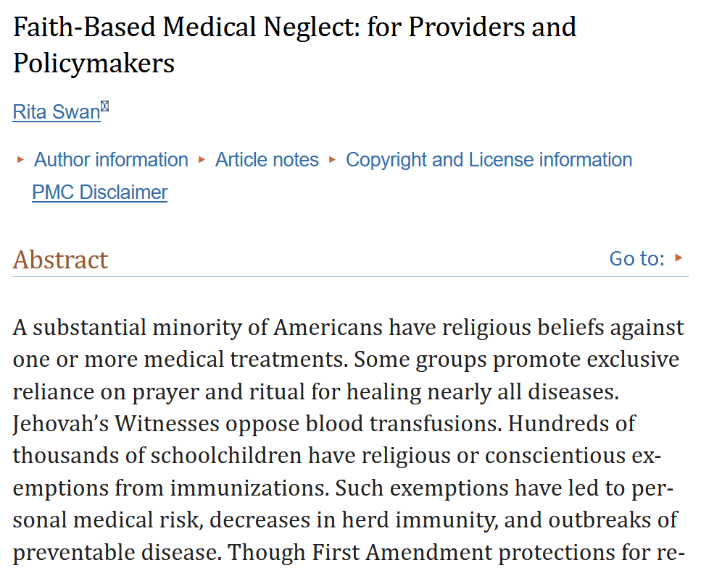
https://www.ncbi.nlm.nih.gov/pmc/articles/PMC7545013/

Slide 67

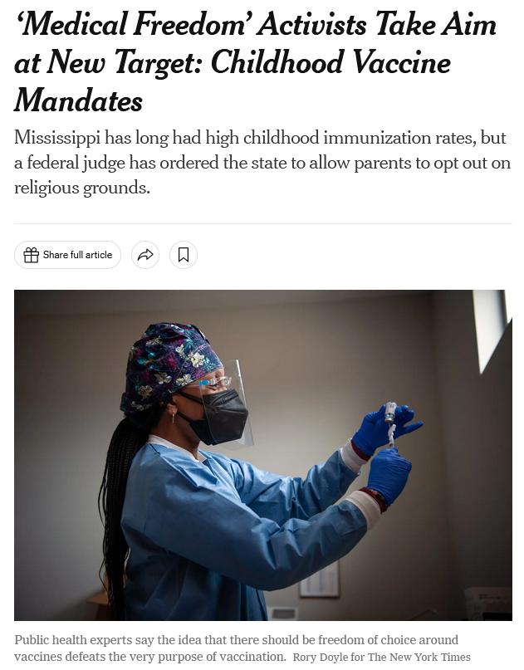
3 December 2023
https://www.nytimes.com/2023/12/03/us/politics/mississippi-childhood-vaccine-mandates.html

Slide 68
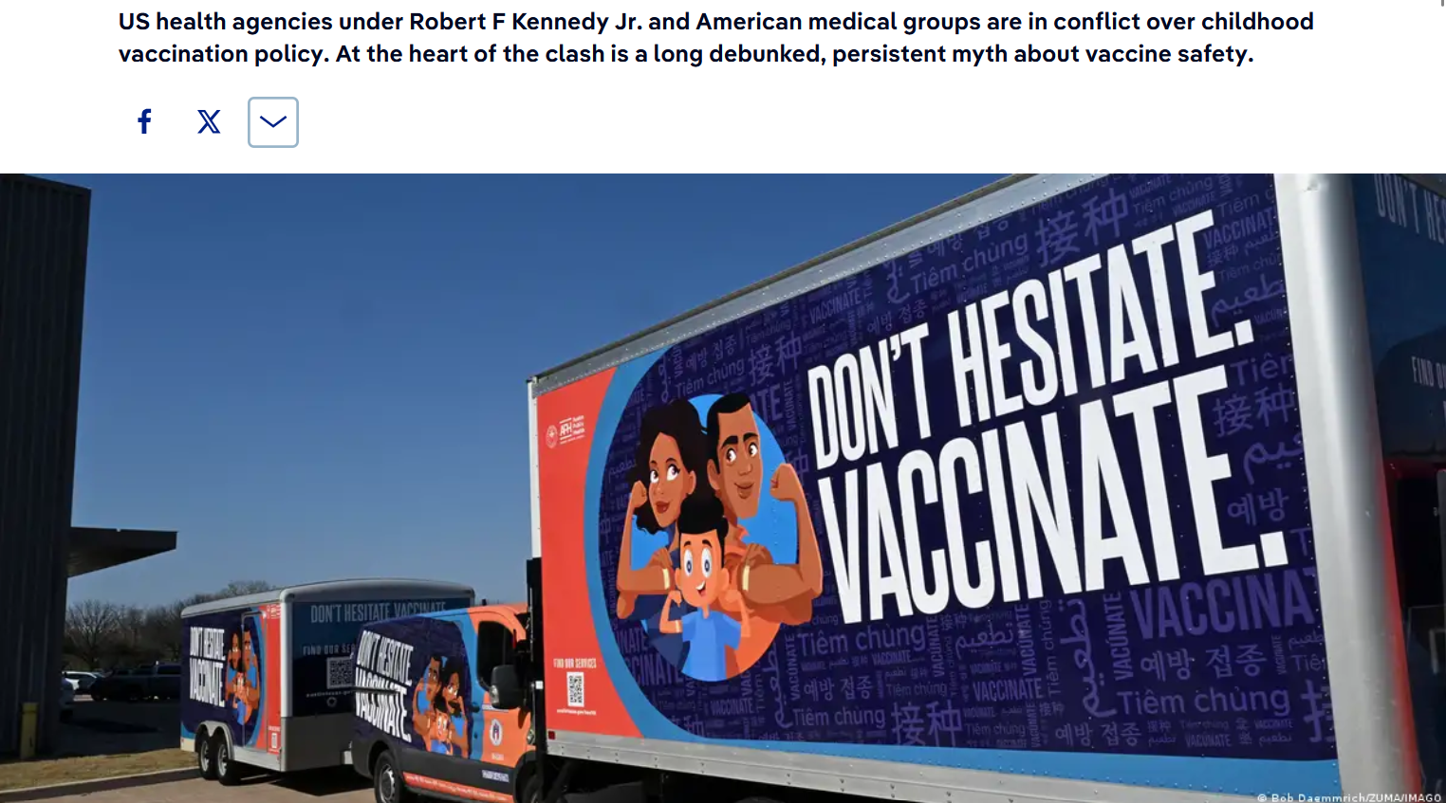
US health agencies under Robert F Kennedy Jr. and American medical groups are in conflict over childhood vaccination policy. At the heart of the clash is a long debunked, persistent myth about vaccine safety.
https://www.dw.com/en/medical-experts-are-pushing-back-on-new-us-vaccine-policy/a-75161898

Slide 69
absolute cultural relativism
  how about?
  Doctor Assisted Suicide
  arranged “underage” forced marriage
  female genital mutilations
  withholding of medical treatment of children for religious reasons
  polygyny
  marriage of close cousins . . .
  -- child exploitation in general?

Slide 70
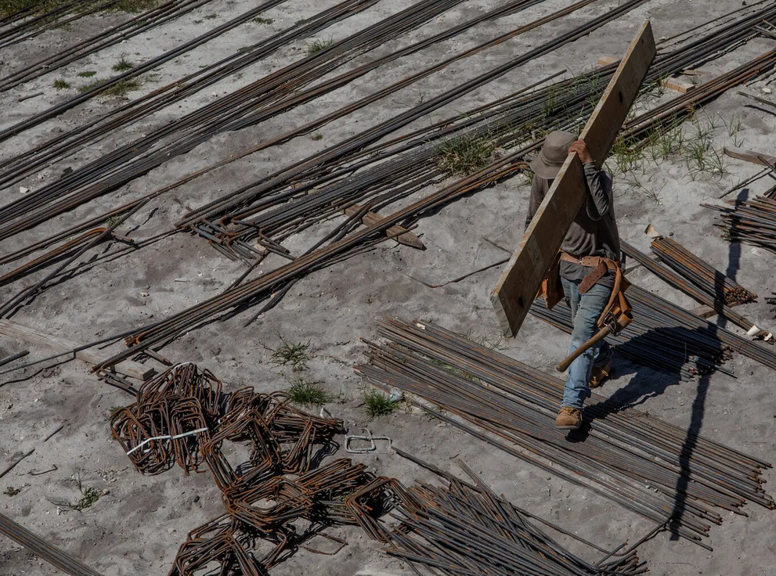

  2 February 2023
Alone and Exploited, Migrant Children Work Brutal Jobs Across the U.S.
Arriving in record numbers, they’re ending up in dangerous jobs that violate child labor laws — including in factories that make products for well-known brands like Cheetos and Fruit of the Loom.
source

Slide 71
  2 February 2023
Alone and Exploited, Migrant Children Work Brutal Jobs Across the U.S.
Cristian, 14, has been working in construction in North Miami for two years instead of going to school. Federal law bars minors from a long list of such jobs. Credit...Kirsten Luce for The New York Times
source

Slide 72

https://jhrmcgill.ssmu.ca/2025/10/06/the-human-cost-of-ice-stories-of-abuse-and-neglect/

Slide 73
absolute cultural relativism
  how about?
  Doctor Assisted Suicide
  arranged “underage” marriage
  female genital mutilations
  withholding of medical treatment of children for religious reasons
  polygyny
  marriage of close cousins . . .

Slide 74
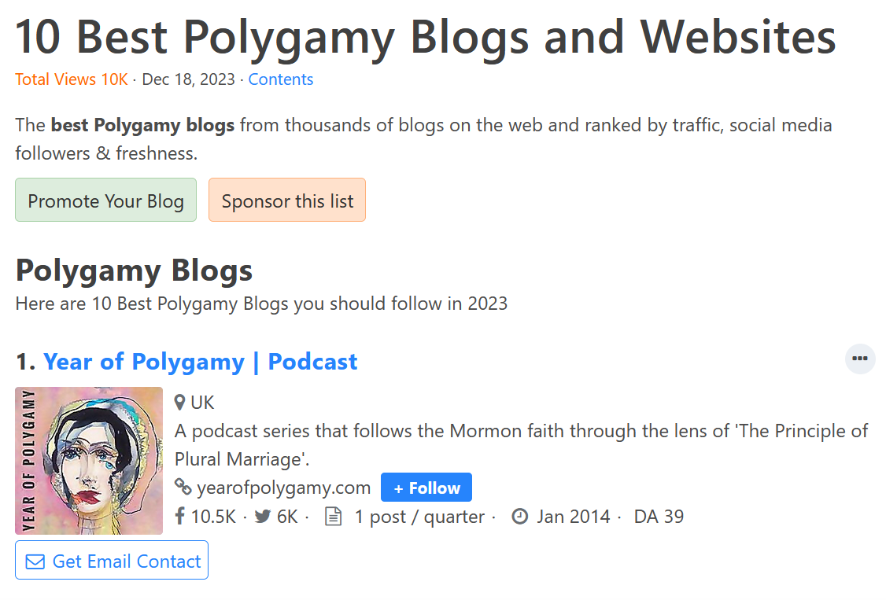
https://family.feedspot.com/polygamy_blogs/

Slide 75
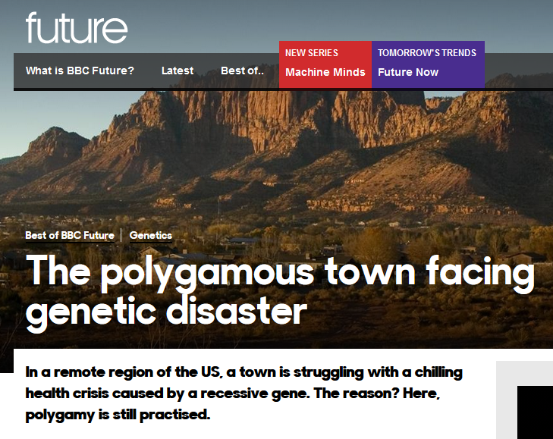
  26 July 2017

Slide 76
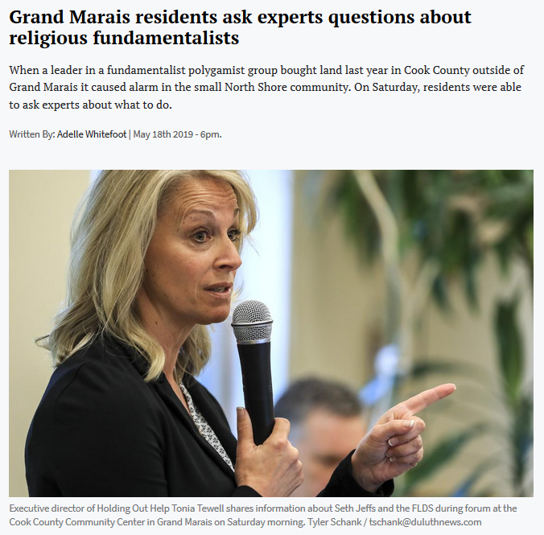

“When a leader in a fundamentalist polygamist group bought land last year in Cook County outside of Grand Marais it caused alarm in the small North Shore community. . . .”
  18 May 2019

Slide 77
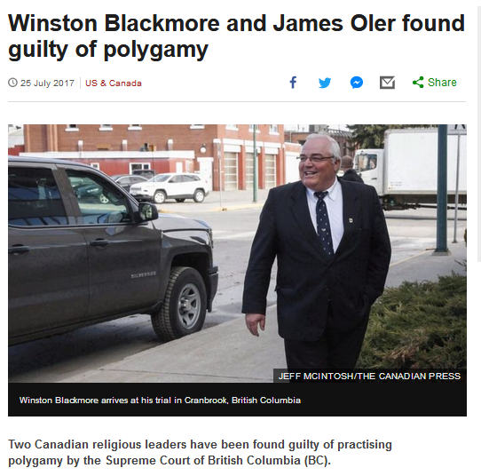
  25 July 2017
http://www.bbc.com/news/world-us-canada-40709250?ocid=global_bbccom_email_25072017_top+news+stories

Slide 78
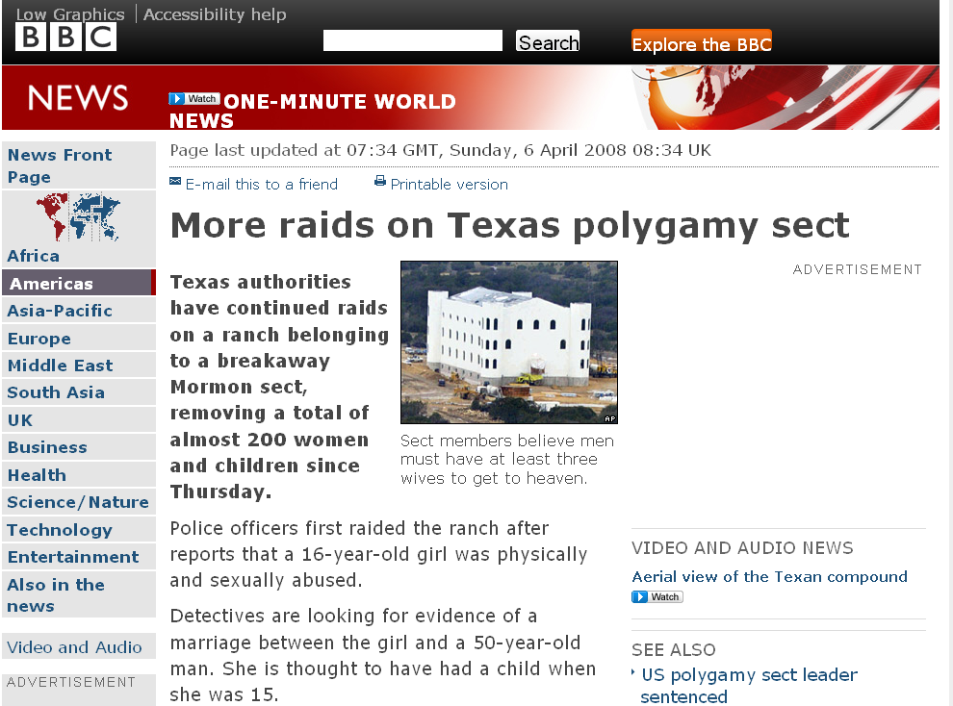
A classic case . . .
http://news.bbc.co.uk/2/hi/americas/7333004.stm

Slide 79
absolute cultural relativism
  how about the
  State of Texas authorities feeding food with preservatives to the Mormon children when they had them in custody?
  Doctor Assisted Suicide
  arranged “underage” marriage
  female genital mutilations
  withholding of medical treatment of children for religious reasons
  polygyny . . .

Slide 80
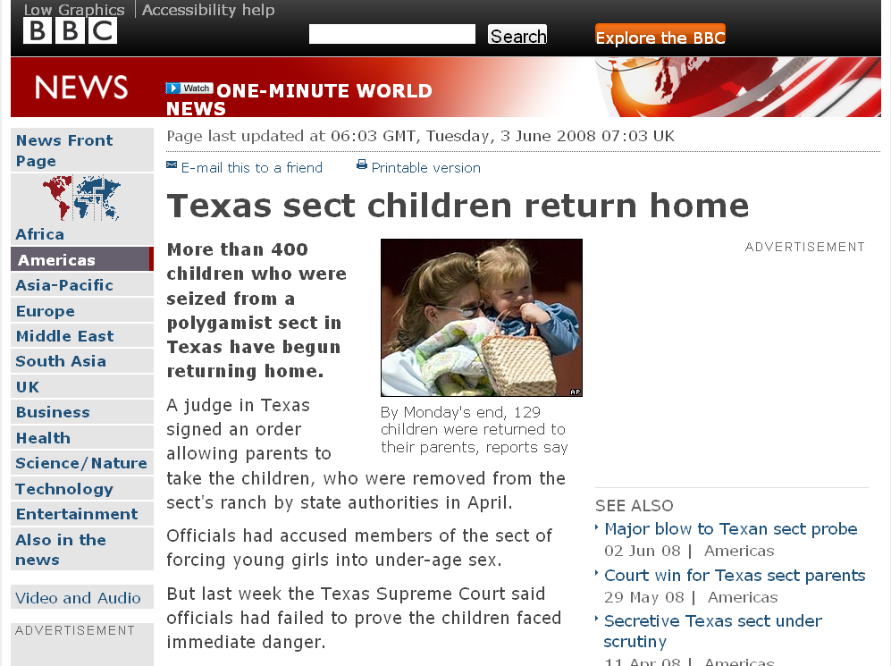
one of the complaints of the Mormons of Texas in court was that the State of Texas
was poisoning their children
with their [State provided] food
(with all it’s additives, sugars,
fats . . .)
http://news.bbc.co.uk/2/hi/americas/7431848.stm

Slide 81

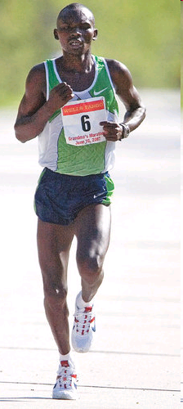
Grandma's Marathon: Remembering a fallen champion
Kevin Pates Duluth News Tribune
Published Sunday, June 15, 2008
There will be a moment of silence before the start of Saturday’s 32nd Grandma’s Marathon.
Standing on North Shore Drive, just south of Two Harbors, Stephen Muturi will gather his thoughts and emotions before the day’s task of running 26.2 miles.
He’ll remember close friend and countryman Wesly Ngetich, last year’s champion, who was killed Jan. 21 at Emarti village in Kenya’s Trans Mara district. Ngetich was caught in the middle of an incident that turned violent. He was 31 and had two wives and three children, ages 8, 6 and 1. “Wesly was a peacemaker. . . .”
www.duluthnewstribune.com/articles/index.cfm?id=68557
Notes:
81

Slide 82
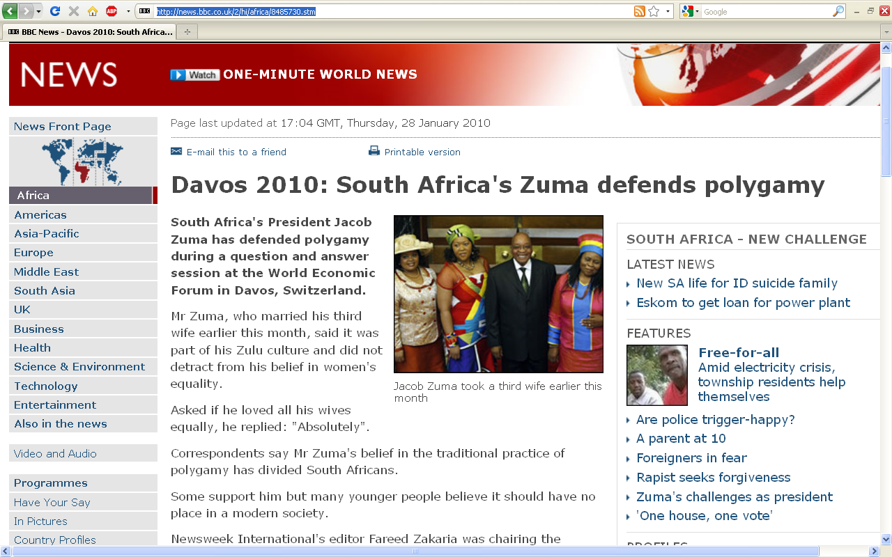
http://news.bbc.co.uk/2/hi/africa/8485730.stm
Notes:
82

Slide 83
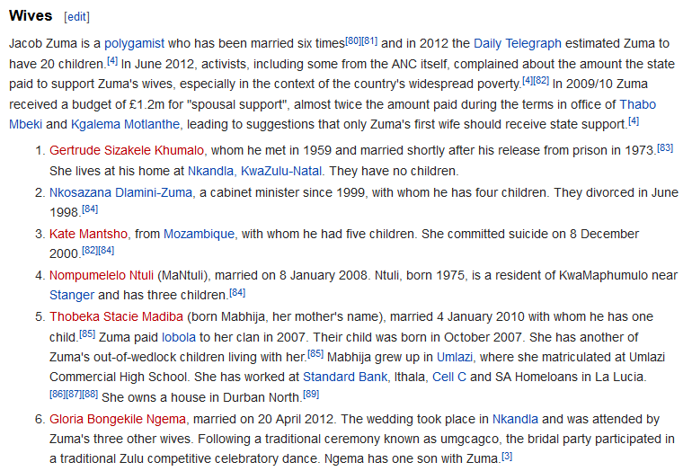
  How does the White House hadle official protocol at a state dinner when the President / Prime Minister of the other country has three or more wives?

Slide 84
  How does the White House handle official protocol at a state dinner when the President / Prime Minister of the other country has three or more wives?
  (at the same time, not successively as with some Presidents of the U.S.A.)

Slide 85
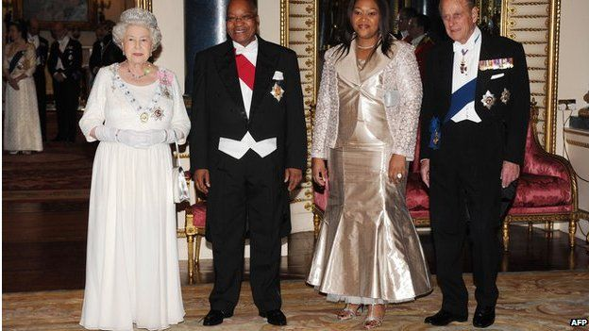
President Zuma attended a banquet at Buckingham Palace in 2010 with one of his wives, Tobeka Madiba Zuma
BBCNews

Slide 86
absolute cultural relativism
  how about?
  Doctor Assisted Suicide
  arranged “underage” forced marriage
  female genital mutilations
  withholding of medical treatment of children for religious reasons
  polygyny
  marriage of close cousins . . .

Slide 87
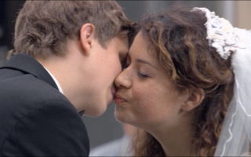
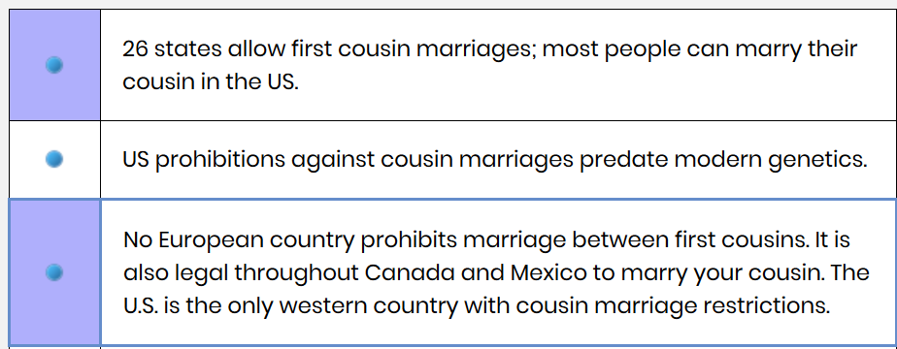
https://www.cousincouples.com/marriage-facts/
Notes:
87

Slide 88
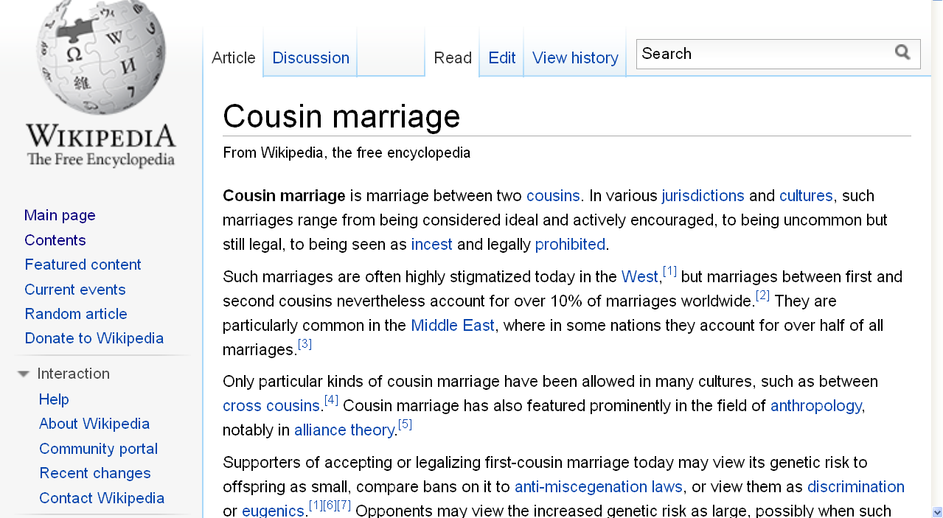
http://en.wikipedia.org/wiki/Cousin_marriage
Notes:
88

Slide 89
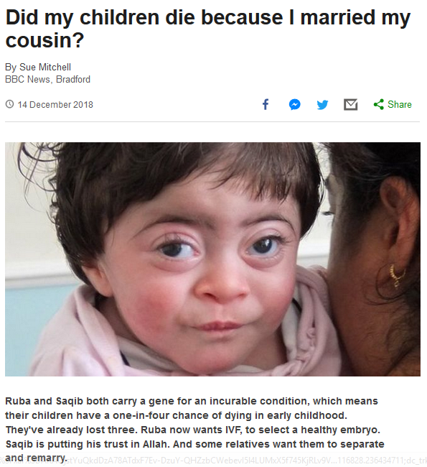

14 December 2018
Notes:
89

Slide 90
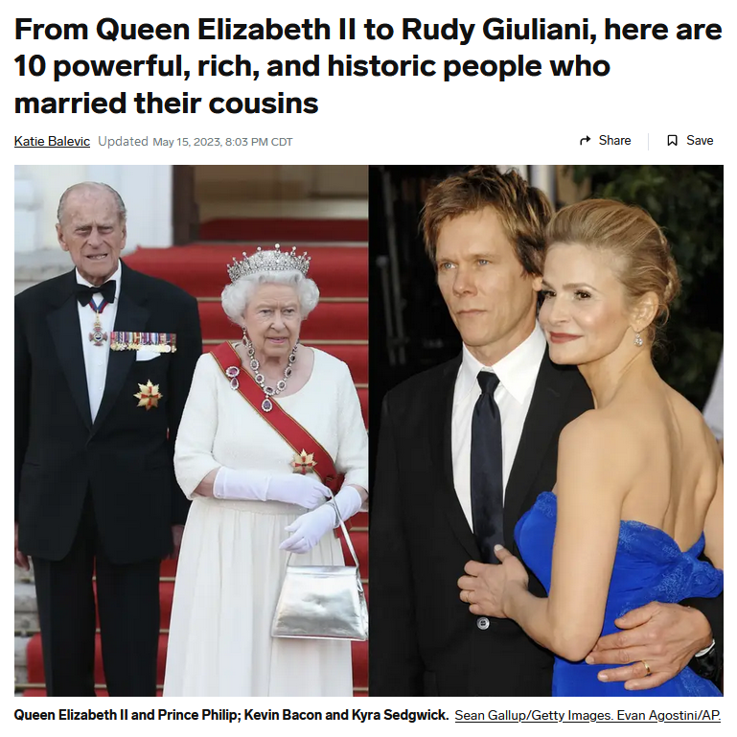
15 May 2023
https://www.insider.com/here-10-powerful-rich-historic-people-who-married-their-cousins-2022-12
Notes:
90

Slide 91
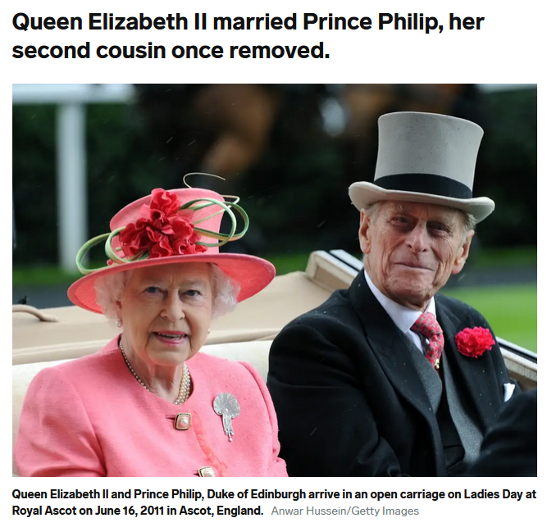
15 May 2023
https://www.insider.com/here-10-powerful-rich-historic-people-who-married-their-cousins-2022-12
Notes:
91

Slide 92
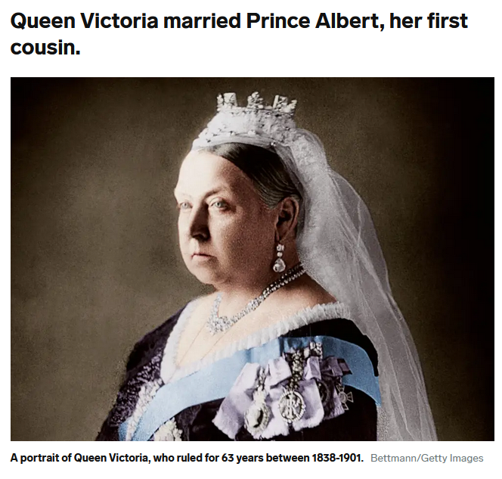
15 May 2023
https://www.insider.com/here-10-powerful-rich-historic-people-who-married-their-cousins-2022-12
Notes:
92

Slide 93
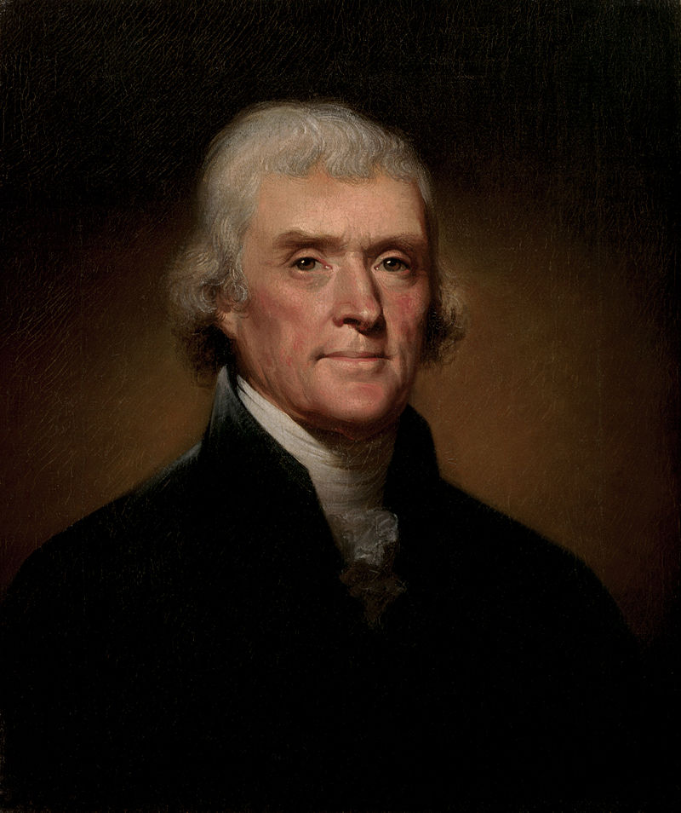
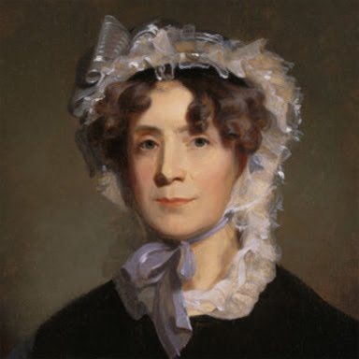
Thomas Jefferson
(1743 -1826)
married his third cousin
Martha Wayles Skelton
(1748-1782)
https://en.wikipedia.org/wiki/Thomas_Jefferson

Slide 94
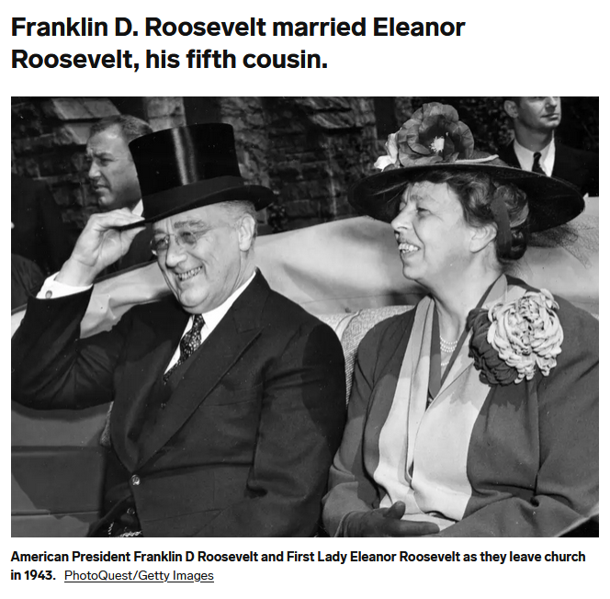
15 May 2023
https://www.insider.com/here-10-powerful-rich-historic-people-who-married-their-cousins-2022-12
Notes:
94

Slide 95
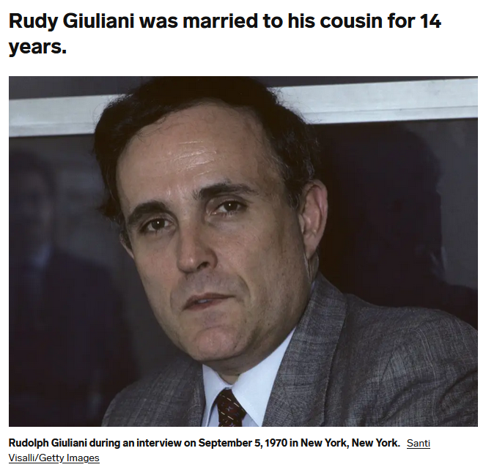
15 May 2023
https://www.insider.com/here-10-powerful-rich-historic-people-who-married-their-cousins-2022-12
Notes:
95

Slide 96
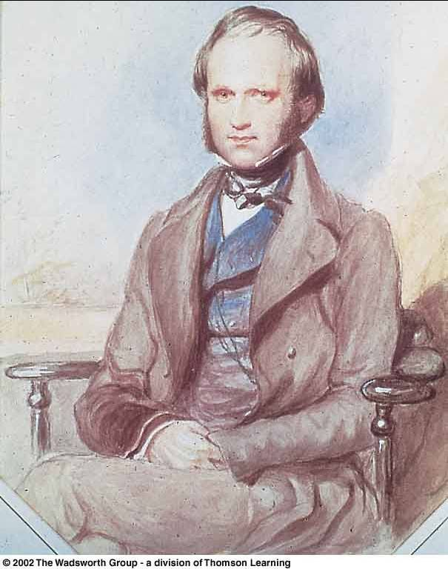
In 1839 Charles Darwin married his first cousin, Emma Wedgwood
Daughter of the younger Josiah Wedgwood, son of the Josiah Wedgwood who founded the pottery works
Darwin's mother Susannah was the sister of his wife’s father

Slide 97
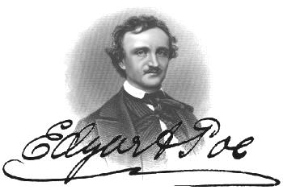
In 1835 Edgar Allan Poe married his widowed aunt’s daughter, Virginia Eliza Clemm
Virginia was 13 years old

Slide 98
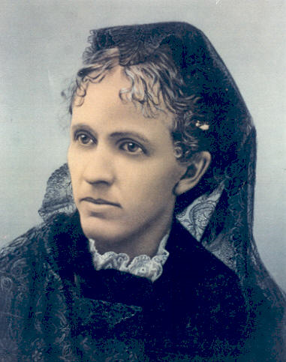
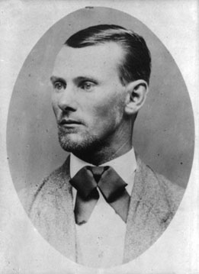
Jesse James married his first cousin
Zerelda "Zee" Mimms, named for his own mother
Zerelda "Zee" Mimms
“cousin of Jesse James and commonly accepted by historians as his wife”

Slide 99

In 1919 Einstein married
his second cousin, his second wife,
Elsa Lowenthal

Slide 100

Johann Sebastian Bach
(1685-1750)
married his second cousin
Maria Barbara Bach
(1685-1750)
the daughter of Johann Michael Bach
http://news.bbc.co.uk/2/hi/americas/6057004.stm

Slide 101

15 May 2023
https://www.insider.com/here-10-powerful-rich-historic-people-who-married-their-cousins-2022-12
Notes:
101

Slide 102

William and Mary
(English Monarchs William III and Mary II)
(Reigned 1689-1702/1694)
were first cousins
Mary was 15 when they married,
William was 26
https://en.wikipedia.org/wiki/William_and_Mary

Slide 103

College of
William and Mary in Williamsburg,
Virginia
https://en.wikipedia.org/wiki/William_and_Mary

Slide 104

1 March 2018
https://www.nytimes.com/2018/03/01/science/cousins-marriage-family-tree.html
Notes:
104

Slide 105

Jacob married two first cousins, Rachel and Leah
https://commons.wikimedia.org/wiki/Category:Paintings_of_Jacob_and_Rachel#/media/File:Spanish_-_Jacob_and_Rachel_at_the_Well_-_Google_Art_Project.jpg

Slide 106

Adam and Eve’s Grandchildren
http://commons.wikimedia.org/wiki/File:Jordaens_Fall_of_man.jpg

Slide 107

https://en.wikipedia.org/wiki/List_of_coupled_cousins
Notes:
107

Slide 108

http://www.cousincouples.com/info/states.shtml

Slide 109

http://en.wikipedia.org/wiki/Cousin_marriage
Notes:
109

Slide 110
usually children of brothers marry
FA-BR-DA
http://en.wikipedia.org/wiki/Cousin_marriage
Notes:
110

Slide 111

Harvard University Press , 2011
Notes:
111

Slide 112
absolute cultural relativism
  How about?
  Doctor Assisted Suicide
  arranged “underage” and arranged/forced marriage
  female genital mutilations
  withholding of medical treatment of children for religious reasons
  polygyny . . .

Slide 113

https://reliefweb.int/report/world/state-worlds-girls-2025-let-me-be-child-not-wife-girls-experiences-living-through-child-marriage

Slide 114

8 March 2021
https://www.nytimes.com/2021/03/08/world/asia/child-marriage-nepal-covid19.html?referringSource=articleShare

Slide 115

5 May 2023
https://www.theguardian.com/global-development/2023/may/05/child-marriage-in-decline-but-will-take-300-years-to-eliminate?CMP=share_btn_link

Slide 116


2 January 2022
https://www.npr.org/sections/goatsandsoda/2022/01/02/1066099271/child-grooms-are-often-overlooked-in-the-fight-to-stop-child-marriage

Slide 117

30 April 2022
https://www.theguardian.com/society/2022/apr/30/ethiopian-drought-leading-to-dramatic-increase-in-child-marriage-unicef-warns?CMP=share_btn_link

Slide 118

1 July 2018
https://www.bbc.com/news/world-asia-44672939

Slide 119

28 November 2023
https://www.bbc.com/news/world-africa-67549633

Slide 120

15 July 2020
https://www.bbc.com/news/world-africa-53420353

Slide 121

9 March 2021
https://www.bbc.com/news/stories-56337182

Slide 122

10 February 2021
https://www.theguardian.com/global-development/2021/feb/10/family-of-girl-12-forced-to-marry-abductor-condemn-pakistan-authorities?CMP=Share_iOSApp_Other

Slide 123


26 July 2021
https://www.usatoday.com/story/news/nation/2021/07/23/child-marriage-new-york-bans-all-minors-being-able-marry/8076855002/

Slide 124

15 Aug 2021
https://www.theguardian.com/us-news/2021/aug/15/north-carolina-child-marriage-new-bill

Slide 125

https://www.theguardian.com/world/2019/nov/04/new-zealand-accused-of-racism-after-visa-rule-throws-arranged-marriages-into-chaos?CMP=Share_iOSApp_Other
Notes:
125

Slide 126

https://www.theguardian.com/world/2019/nov/04/new-zealand-accused-of-racism-after-visa-rule-throws-arranged-marriages-into-chaos?CMP=Share_iOSApp_Other
Notes:
126

Slide 127

a 9-year-old requests a divorce in Yemen
http://news.bbc.co.uk/2/hi/middle_east/7711554.stm
Notes:
127

Slide 128

http://news.bbc.co.uk/2/hi/middle_east/7711554.stm
Notes:
128

Slide 129

Notes:
129

Slide 130

Birmingham, England
Notes:
130

Slide 131

Birmingham, England
1985 Asian Teen HelpLine
received ca. 1,400 calls / month

Slide 132

N!ai, one of the little girls in the film The Hunters,
was married to Gunda at the age of 8

Slide 133

27 May 2020
https://www.bbc.com/news/world-middle-east-52811631
Notes:
133

Slide 134

http://www.bbc.com/news/world-asia-36486974
Notes:
134

Slide 135
Glossary
  ?
absolute cultural relativism
  World War II Holocaust
  arranged “underage” marriage
  female infanticide
  collateral infanticide

Slide 136

https://www.dekoder.com/article/female-infanticide-and-foeticide-in-india-a-crisis-that-needs-immediate-attention

Slide 137

  1 November 2017
source

Slide 138


  26 January 2023
https://www.cbsnews.com/news/conjoined-twins-separated-texas-amielynn-jamielynn-finley/

Slide 139

  15 July 2019
https://www.bbc.co.uk/news/extra/PLNMqvmycN/conjoined-twins

Slide 140
absolute cultural relativism
  How about . . .

Slide 141
absolute cultural relativism
  “freak shows”?

Slide 142

12 April 2025
https://www.abc.net.au/news/2025-04-12/first-nations-ancestors-return-to-australia-from-london-museum/105169060

Slide 143

9 October 2023
https://www.theguardian.com/us-news/2023/oct/09/stoneman-willie-mummified-man-reading-pennsylvania?CMP=share_btn_link

Slide 144

https://www.mprnews.org/story/2017/08/22/history-state-fair-sideshow

Slide 145

Saartjie Baartman
1789 - 1815

Slide 146

Saartjie Baartman
1789 - 1815

Slide 147

Saartjie Baartman
1789 - 1815

Slide 148

Saartjie Baartman
1789 - 1815

Slide 149

Saartjie Baartman
1789 - 1815

Slide 150

http://en.wikipedia.org/wiki/Saartjie_Baartman

Slide 151
She died on 29 December 1815
Her skeleton, preserved genitals and brain were placed
on display in Paris' Musée de l'Homme until 1974.
Her remains were repatriated to her homeland, the Gamtoos Valley, on 6 May 2002 and she was
finally laid to rest on 9 August 2002
on Vergaderingskop, a hill in the town of Hankey
over 200 years after her birth.
Saartjie Baartman
1789 - 1815
http://en.wikipedia.org/wiki/Saartjie_Baartman

Slide 152
She died on 29 December 1815
Her skeleton, preserved genitals and brain were placed
on display in Paris' Musée de l'Homme until 1974.
Her remains were repatriated to her homeland, the Gamtoos Valley, on 6 May 2002 and she was
finally laid to rest on 9 August 2002
on Vergaderingskop, a hill in the town of Hankey
over 200 years after her birth.
Saartjie Baartman
1789 - 1815
http://en.wikipedia.org/wiki/Saartjie_Baartman

Slide 153

6 May 2002
Saartjie Baartman
1789 - 1815

Slide 154

6 May 2002
http://news.bbc.co.uk/1/hi/world/europe/1957240.stm

Slide 155
6 May 2002
http://www.judyshopsthemall.com/2009/08/bodies-the-exhibition-walks-into-controversial-debut-at-mall-of-america/

Slide 156
August 2009

Slide 157

BODIES Exhibit
in Paris
an at
The Mall of America
August 2009
http://www.judyshopsthemall.com/2009/08/bodies-the-exhibition-walks-into-controversial-debut-at-mall-of-america/

Slide 158
August 2009
http://www.judyshopsthemall.com/2009/08/bodies-the-exhibition-walks-into-controversial-debut-at-mall-of-america/

Slide 159
2023 - 2026

Slide 160


Real Bodies at Horseshoe Las Vegas
SEP 5 - JAN 8
August 2009
source

Slide 161

http://news.bbc.co.uk/2/hi/uk_news/scotland/edinburgh_and_east/7492386.stm
Notes:
161

Slide 162

“It all amounts to a 21st Century version of a circus freak show; no one is supposed to watch junk like that but everyone does.”
www.duluthsuperior.com/mld/duluthsuperior/news/editorial/15397954.htmhttp://www.duluthsuperior.com/mld/duluthsuperior/news/editorial/15397954.htm

Slide 163

1862 - 1890
https://www.theguardian.com/uk-news/2016/jun/09/elephant-man-skeleton-should-be-given-christian-burial-say-campaigners

Slide 164

http://www.bbc.com/news/magazine-37344210

Slide 165

http://www.bbc.com/news/magazine-37344210

Slide 166
absolute cultural relativism
  How about human body parts being sold on-line . . .?

Slide 167

POPULAR SCIENCE
18 August 2021
https://www.popsci.com/skeleton-keys-excerpt/

Slide 168

https://www.wbur.org/news/2025/12/22/harvard-medical-morgue-jeremy-pauley-sentenced-human-remains

Slide 169

23 August 2016
http://news.nationalgeographic.com/2016/08/human-skulls-sale-legal-ebay-forensics-science/

Slide 170

23 August 2016
http://news.nationalgeographic.com/2016/08/human-skulls-sale-legal-ebay-forensics-science/

Slide 171
absolute cultural relativism
  How about . . .

Slide 172
absolute cultural relativism
  lynching people because of rumors, or just because they do something you don’t like . . .

Slide 173

http://www.bbc.com/news/world-asia-india-34398433?ocid=global_bbccom_email_30092015_top+news+stories
Notes:
173

Slide 174

19 July 2019
https://www.bbc.com/news/world-asia-india-49049372
Notes:
174

Slide 175

23 February 2019
https://www.bbc.com/news/stories-47321871
Notes:
175

Slide 176
  Closer to home . . .

Slide 177



21 December 2023
now deleted
now denied
on X, formerly known as Twitter, at 9:02 p.m. Dec. 20
https://www.tmz.com/2023/12/21/dukes-of-hazzard-star-john-schneider-death-threat-joe-biden/
Notes:
177

Slide 178
absolute cultural relativism
  How about eating habits . . .?

Slide 179

http://www.bbc.com/news/world-asia-india-40428067
Notes:
179

Slide 180

http://www.bbc.com/news/world-asia-india-40393331
Notes:
180

Slide 181

http://www.bbc.com/news/world-asia-india-40116811
Notes:
181

Slide 182
absolute cultural relativism
  How about food stamps . . .?
  and school lunches for kids . . .?
  and federal bailouts to
  mega-farmers . . .?

Slide 183

http://www.mprnews.org/story/2015/09/19/npr-food-stamps
Notes:
183

Slide 184

4 December 2019
https://www.theguardian.com/us-news/2019/dec/04/food-stamps-snap-trum4 Dec 2019 18.18 ESTp-sonny-perdue?CMP=Share_iOSApp_Other
Notes:
184

Slide 185


15 August 2021
https://www.nytimes.com/2021/08/15/us/politics/biden-food-stamps.html
Notes:
185

Slide 186

19 March 2025
https://www.politico.com/news/2025/03/19/usda-halts-deliveries-food-banks-trump-00239453
Notes:
186

Slide 187
absolute cultural relativism
  How about food stamps . . .?
  and school lunches for kids . . .?
  and federal bailouts to
  mega-farmers . . .?

Slide 188

https://www.theguardian.com/commentisfree/2019/sep/08/why-school-cafeterias-should-be-the-frontlines-of-policy-change?CMP=Share_iOSApp_Other
Notes:
188

Slide 189
absolute cultural relativism
  How about food stamps . . .?
  and school lunches for kids . . .?
  and federal bailouts to
  mega-farmers . . .?

Slide 190


In the U.S.A., $28 billion in 2019, mostly to large corporate farms
https://www.marketplace.org/2019/12/12/these-are-the-states-benefiting-the-most-from-the-28-billion-farm-bailout/
Notes:
190

Slide 191

Interactive map
to see where your $539.0 billion went:
https://farm.ewg.org/progdetail.php?fips=00000&progcode=total&page=states
Notes:
191

Slide 192


https://www.latimes.com/business/hiltzik/la-fi-hiltzik-trump-farm-bailout-20190528-story.html
Notes:
192

Slide 193

20 Aug 2021
https://www.theguardian.com/us-news/2021/aug/20/black-indigenous-farmers-were-promised-reparations-debt-relief-all-but-four-farmers-are-still-waiting?CMP=Share_iOSApp_Other

Slide 194


19 February 2023
“In 2022, the federal government provided farms with $15.6 billion in subsidies, or direct farm program payments.” -- USDA
https://www.npr.org/2023/02/19/1156851675/in-2022-black-farmers-were-persistently-left-behind-from-the-usdas-loan-system

Slide 195
absolute cultural relativism
  How about food stamps . . .?
  and school lunches for kids . . .?
  When we have so much food, we can’t possibly eat it . . .
  (Until just recently we paid business people to use about 40% of our corn to make ethanol for cars.)

Slide 196

https://www.theguardian.com/food/2019/jan/10/america-cheese-surplus-production-dairy-farmers
Notes:
196

Slide 197


http://www.mprnews.org/story/2015/09https://www.vox.com/science-and-health/2018/6/28/17515188/us-cheese-surplus-billion-pounds19/npr-food-stamps
Notes:
197

Slide 198

http://www.mprnews.org/story/2015/09https://www.vox.com/science-and-health/2018/6/28/17515188/us-cheese-surplus-billion-pounds19/npr-food-stamps
Notes:
198

Slide 199
absolute cultural relativism
  How about food stamps . . .?
  and school lunches for kids . . .?
  When we have so much food, we can’t possibly eat it . . .
  . . . So, we feed it to our cars . . .

Slide 200
absolute cultural relativism
  Until just recently we
  (i.e., the U.S. and state Governments)
  paid business people to use about 40% of our corn to make ethanol for cars, and most states forced drivers to use it in their cars . . .
https://www.ers.usda.gov/data-products/chart-gallery/chart-detail?chartId=58346

Slide 201

https://www.agmrc.org/media/cms/article_1_picture_74EA1A08B9D90.png

Slide 202


Slide 203

“The USDA currently predicts 5.3 billion bushels of corn will go to ethanol production for 2023-’24.”
-- Ethanol 12 October 2023
*5.5 billion in 2025 . . .
*https://energy.agwired.com/2025/08/12/more-corn-shows-need-for-ethanol-expansion/

Slide 204

Globally, approximately 673 million people experienced hunger in 2024—that is, they literally went to bed hungry—that year. This figure represents roughly 8.2% of the world’s population.
https://riseagainsthunger.org/articles/673-million-people-face-hunger-2025/

Slide 205
absolute cultural relativism
  Around the world folks argue that the current practice is
  exactly opposite
  of good food, environmental, and health policy . . .

Slide 206
absolute cultural relativism
  how about . . .?
  cannibalism
  (Anthropophagy)

Slide 207

7 Dec. 2020
https://www.nytimes.com/2020/12/07/arts/design/Ouroboros-Steak-design-museum.html?referringSource=articleShare

Slide 208

Amazon link

Slide 209


Amazon link

Slide 210


Slide 211

VOGUE
Timothée Chalamet Is an Angsty Teen Cannibal in the First Teaser for Bones and All
https://www.vogue.com/article/bones-and-all-everything-you-need-to-know
Notes:
and

Slide 212

An engraving depicting the Tupi. (DeAgostini/Getty Images)
https://www.vox.com/2015/2/17/8052239/cannibalism-surprising-facts

Slide 213




https://www.cnsnews.com/commentary/john-horvat-ii/uk-professors-attempt-mainstream-cannibalism-normal

Slide 214

13 June 2019
https://www.theguardian.com/world/2019/jun/13/briton-mails-severed-toes-to-canada-for-use-in-notorious-cocktail?CMP=Share_iOSApp_Other

Slide 215

13 June 2019
https://www.theguardian.com/world/2019/jun/13/briton-mails-severed-toes-to-canada-for-use-in-notorious-cocktail?CMP=Share_iOSApp_Other

Slide 216


29 June 2016
https://www.aol.com/article/2016/06/29/places-where-modern-day-cannibalism-still-exists/21421203/

Slide 217

Cambridge University Press, 1986

Slide 218

http://www.bbc.com/news/world-africa-41072524

Slide 219

http://www.d.umn.edu/cla/faculty/troufs/anthfood/afcannibalism.html#title

Slide 220


Slide 221


10 June 2015
http://www.theguardian.com/science/2015/jun/10/brains-helped-papua-new-guinea-tribe

Slide 222

http://english.pravda.ru/science/19/94/377/14863_cannibalism.html

Slide 223

  Cannibalism from an Anthropological viewpoint
  Felipe Fernández-Armesto
Simon & Schuster 2003

Slide 224

http://www.bbc.com/news/science-environment-40886748?ocid=global_bbccom_email_10082017_top+news+stories

Slide 225
cannibalism
Moula-Gercy, France
“Bones Offer Evidence of a Neanderthal - Eat - Neanderthal World”
78 fragments from 6 skeletons
ca. 100,000 ybp
30 September 1999

Slide 226

http://dsc.discovery.com/news/2008/02/27/neanderthal-cannibalism.html
Notes:
226

Slide 227

http://news.nationalgeographic.com/news/2008/06/080604-human-sacrifice.html
Notes:
227

Slide 228

http://www.bbc.com/news/entertainment-arts-39329561

Slide 229


  “survival
  cannibalism”

Slide 230

Stephen King
“Survivor Type”
1985
  “survival
  cannibalism”

Slide 231

  “gustatory
  cannibalism”

Slide 232
  “ritual cannibalism”

Slide 233

cultural relativism?
  stealing peoples’ land and property
  infant cranial deformation
  Aztec human heart sacrifice
  cannibalism
  selling and eating children
  eating insects
  eating dogs
  . . .
  “ritual cannibalism”
e.g., Aztecs must sacrifice and eat humans
in order to please the gods
in order that the gods allow
the sun to rise each day,
so that the world doesn’t end

Slide 234
  but how about other forms of
  extreme cuisine . . .?

Slide 235


23 December 2020
This wild boar carnitas was made from a recipe by Texas-based chef and hunter Jesse Griffiths. Feral hogs are one of the destructive invasive species increasingly appearing on high-end restaurant menus.
Source

Slide 236

20 December 2019
Source

Slide 237


https://gastropod.com/are-insect-guts-the-secret-to-the-most-delicious-kimchi/

Slide 238

Ortolans (or ortolan buntings)
were said to be
French president François Mitterrand’s
favorite dish.
https://gastropod.com/are-insect-guts-the-secret-to-the-most-delicious-kimchi/

Slide 239

Ortolans (or ortolan buntings)
were said to be
French president François Mitterrand’s
favorite dish.
https://gastropod.com/are-insect-guts-the-secret-to-the-most-delicious-kimchi/

Slide 240

  . . . for example,
watch this short video . . .
National Geographic Video
http://video.nationalgeographic.com/video/skorea-liveoctopus-pp?source=relatedvideo

Slide 241
  other “extreme” treats include things like . . .

Slide 242

http://www.bbc.com/travel/story/20160620-weird-foods-only-a-local-could-love

Slide 243

http://www.bbc.com/travel/story/20160620-weird-foods-only-a-local-could-love

Slide 244

http://www.bbc.com/travel/story/20160620-weird-foods-only-a-local-could-love

Slide 245

http://www.bbc.com/travel/story/20160620-weird-foods-only-a-local-could-love

Slide 246

http://www.bbc.com/travel/story/20160620-weird-foods-only-a-local-could-love

Slide 247

http://www.bbc.com/travel/story/20160620-weird-foods-only-a-local-could-love

Slide 248


19 July 2019
https://www.livescience.com/63831-squirrel-brains-rare-disorder-creutzfeldt-jakob-disease.html

Slide 249
absolute cultural relativism
  how about . . .?

Slide 250
cultural relativism
  stealing peoples’ land and property
  infant cranial deformation
  Aztec human heart sacrifice
  cannibalism
  selling and eating children
  eating insects
  eating dogs
  . . .

Slide 251
cultural relativism
  stealing peoples’ land and property
  infant cranial deformation
  Aztec human heart sacrifice
  cannibalism
  selling and eating children
  eating insects
  eating dogs
  . . .

Slide 252


https://people.com/pets/how-to-stop-yulin-dog-meat-festival/

Slide 253
An estimated 10,000 pets are killed each year.
The Chinese Yulin Meat Festival is not endorsed by the local government, but it is also not illegal.
https://people.com/pets/how-to-stop-yulin-dog-meat-festival/

Slide 254

25 July 2020
https://www.bbc.com/news/av/world-asia-53514915

Slide 255
cultural relativism
  stealing peoples’ land and property
  infant cranial deformation
  Aztec human heart sacrifice
  cannibalism
  selling and eating children
  eating insects
  eating dogs
  eating horses

Slide 256

cultural relativism
  stealing peoples’ land and property
  infant cranial deformation
  Aztec human heart sacrifice
  cannibalism
  selling and eating children
  eating insects
  eating dogs
  eating horses
Source
Wikipedia

Slide 257

cultural relativism
  stealing peoples’ land and property
  infant cranial deformation
  Aztec human heart sacrifice
  cannibalism
  selling and eating children
  eating insects
  eating dogs
  eating horses
Wikipedia

Slide 258


8 June 2017
https://www.theatlantic.com/technology/archive/2017/06/horse-meat/529665/?utm_source=email&utm_medium=social&utm_campaign=share

Slide 259


Slide 260
absolute cultural relativism
  Questions about eating horses cause big concern in Europe.
  People in some countries eat horses, some do not.

Slide 261


  15 January 2013
http://news.nationalgeographic.com/news/2013/13/130212-horse-meat-beef-scandal-food-france-england-europe-science-taboo-horsemeat/

Slide 262


Slide 263

  15 January 2013

Slide 264


12 May 2020
https://www.foodnavigator.com/Article/2020/05/12/Beef-fraud-Counterfeit-products-the-biggest-threat-to-supply-chain#

Slide 265

  15 January 2013
http://www.bbc.com/news/world-europe-40624073

Slide 266

  29 August 2013

Slide 267

12 January 2023
https://www.irishtimes.com/opinion/2023/01/12/irish-horsemeat-scandal-changed-the-way-europe-looks-at-food-safety/

Slide 268

  15 January 2013

Slide 269

  15 January 2013
http://www.mprnews.org/story/2014/01/17/politics/congress-blocks-slaughtering-horses-for-meat-in-us

Slide 270

or how about eating gorilla?
Spring
2003
http://www.gastronomica.org/gastro/pages/sample3.2.html

Slide 271

Spring
2003
How about baiting, then killing Cecil the Lion to hang his stuffed head on your wall?
http://www.bbc.com/news/uk-england-oxfordshire-33782249

Slide 272
Spring
2003
Cecil was a well-known tourist attraction in Zimbabwe and was shot by dentist Walter Palmer from Minnesota, USA.
http://www.bbc.com/news/uk-england-oxfordshire-33782249

Slide 273
absolute cultural relativism
  how about . . .?

Slide 274
absolute cultural relativism
  jail for vegan/vegetarian parents who refuse to feed their children meat . . .?

Slide 275

http://www.bbc.com/news/world-europe-37034619

Slide 276
absolute cultural relativism
  how about . . .?
  so-called Christians training their young children for urban warfare . . .?

Slide 277

14 August 2019
https://www.theguardian.com/world/2019/aug/13/matt-shea-biblical-war-washington-team-rugged?CMP=Share_iOSApp_Other

Slide 278

https://www.theguardian.com/film/2016/jul/06/jesus-camp-christian-documentary-kids-10-years-later?CMP=oth_b-aplnews_d-1

Slide 279
absolute cultural relativism
  Or . . .

Slide 280


Does it matter that a handful of companies own the world’s major brands?
http://sploid.gizmodo.com/fascinating-graphic-shows-who-owns-all-the-major-brands-1599537576

Slide 281

green queen
16 July 2021
https://www.greenqueen.com.hk/big-food-corporations-market-dominance/

Slide 282
10 of the Biggest Food Companies Basically Own Every Grocery Item You Buy
https://www.wideopeneats.com/biggest-food-companies/

Slide 283
http://sploid.gizmodo.com/fascinating-graphic-shows-who-owns-all-the-major-brands-1599537576

Slide 284
absolute cultural relativism
  For e.g., JAB Holdings, the Luxembourg holding company run by the German billionaire Reimann family

Slide 285

https://www.businessinsider.com/jab-holding-building-a-coffee-and-bagel-empire-2017-4

Slide 286

https://www.businessinsider.com/jab-holding-building-a-coffee-and-bagel-empire-2017-4

Slide 287
absolute cultural relativism
  Or how about . . .

Slide 288

https://finance.yahoo.com/blogs/daily-ticker/how-four-companies-control-the-supply-and-price-of-beef--pork-and-chicken-in-the-u-s-eat-prices-224406080.html

Slide 289
  How about that rich handful of companies—and others—peddling “fake news”—propaganda—lies—”alternative facts” that is/are unfair and “damaging to public discourse”—and to people—and to society in general . . .?

Slide 290


Slide 291
For the record, this is the group from which news is generally taken for this course . . .

Slide 293
absolute cultural relativism
  How about . . .?

Slide 294
absolute cultural relativism
  . . . leniency for a kid who comes “from ‘good family’” . . .?

Slide 295

. . . like rich kids who kill and rape not held responsible because they are rich kids suffering from “affluenza”?
http://www.bbc.com/news/world-us-canada-35117311

Slide 296


Slide 297

How about the rich kid’s mother harboring a fugitive, and aiding and abetting (and even celebrating) his criminal behavior?
http://www.bbc.com/news/world-us-canada-35192267

Slide 298

http://www.bbc.com/news/world-us-canada-36040878

Slide 299


or maybe his genes made him do it . . .
source

Slide 300
source

Slide 301
absolute cultural relativism
  How about . . .?

Slide 302

absolute cultural relativism
  . . . a Supreme Court judge who testified in his own confirmation hearings that (at least in his own case) people shouldn’t be held accountable for things they do as minors, who later ruled as a Supreme Court Judge, and authored the Court opinion, that “Children Deserve Life in Prison with No Chance of Parole?”

Slide 303

22 April 2021
https://www.vanityfair.com/news/2021/04/brett-kavanaugh-life-in-prison

Slide 304
absolute cultural relativism
  how about . . .?
bullfighting
corrida de toros

Slide 305

http://www.bbc.com/news/world-europe-38063778

Slide 306

http://www.bbc.com/news/world-europe-37329315

Slide 307


http://www.telegraph.co.uk/news/2016/07/11/ritual-of-slaughtering-mother-of-bull-that-killed-spanish-matado/

Slide 308

https://www.theguardian.com/world/2019/oct/25/spain-young-bullfighters-a-photo-essay?CMP=Share_iOSApp_Other

Slide 309
absolute cultural relativism
  how about . . .?

Slide 310

https://www.bbc.com/reel/video/p06x2v5g/spain-s-elite-female-bullfighter

Slide 311
  Why might it be OK for males to kill bulls, but not for females to kill bulls?
https://www.bbc.com/reel/video/p06x2v5g/spain-s-elite-female-bullfighter

Slide 312
absolute cultural relativism
  how about . . .
  making it illegal for people with dwarfism to perform at bullfights?

Slide 313

12 July 2023
On the Front Line of a War Over Bullfighting Traditions
Opponents of Spain’s comic shows at bullfights by people with dwarfism say they are banned by a new law. But performers say the show must go on.
https://www.nytimes.com/2023/07/12/world/europe/spain-bullfights.html

Slide 314
absolute cultural relativism
  how about . . .
  dwarf tossing as bar and party entertainment in the U.S.A.?

Slide 315

https://dwarftossing.com/

Slide 316
absolute cultural relativism
  how about . . .?

Slide 317

21 October 2016
http://www.bbc.com/capital/story/20161020-where-its-common-to-get-nude-with-your-colleagues?ocid=ww.social.link.email

Slide 318

21 October 2016
http://www.bbc.com/capital/story/20161020-where-its-common-to-get-nude-with-your-colleagues?ocid=ww.social.link.email

Slide 319
absolute cultural relativism
  how about . . .?

Slide 320

http://www.telegraph.co.uk/news/2016/09/02/obese-patients-and-smokers-banned-from-all-routine-operations-by/

Slide 321
absolute cultural relativism
  how about . . .?

Slide 322
absolute cultural relativism
  “trigger warnings in college classes . . .?

Slide 323

Forbes
6 April 2023
Cornell University Rejects Students’ Call For Trigger Warnings
Michael T. Nietzel
source

Slide 324

http://www.telegraph.co.uk/news/2016/08/25/university-of-chicago-rejects-safe-spaces-and-trigger-warnings-i/

Slide 325
absolute cultural relativism
  “trigger warnings in college classes . . .?
  the theatre . . .?

Slide 326

https://www.nytimes.com/2018/11/18/theater/trigger-warnings-plays-theater.html?auth=login-email&login=email

Slide 327
absolute cultural relativism
  how about . . .?

Slide 328
absolute cultural relativism
  giving people licenses for public service who cannot speak English . . .?

Slide 329

https://www.theguardian.com/us-news/2016/aug/27/new-york-yellow-taxi-cab-drivers-english-test?CMP=Share_iOSApp_Other

Slide 330
absolute cultural relativism
  how about . . .?

Slide 331
absolute cultural relativism
  burkinis and burkas worn for religious purposes . . .?

Slide 332


https://hyphenonline.com/2023/09/06/burkini-abaya-ban-france-muslim-swimwear/

Slide 333

http://www.bbc.com/news/world-europe-39334111

Slide 334

https://www.theguardian.com/world/2016/aug/25/burkini-ban-sarkozy-calls-swimsuits-a-provocation-that-support-radical-islam?CMP=Share_iOSApp_Other

Slide 335

magnifique
exquis
en France
délicieux
https://www.theguardian.com/world/2016/aug/24/the-burkini-ban-what-it-really-means-when-we-criminalise-clothes?CMP=Share_iOSApp_Other

Slide 336
magnifique
provocant!
exquis
en France
délicieux
https://www.theguardian.com/world/2016/aug/24/the-burkini-ban-what-it-really-means-when-we-criminalise-clothes?CMP=Share_iOSApp_Other

Slide 337
provocative!
ok
ok
in France
ok
https://www.theguardian.com/world/2016/aug/24/the-burkini-ban-what-it-really-means-when-we-criminalise-clothes?CMP=Share_iOSApp_Other

Slide 338

provocative!
27 June 2019
in France
https://www.theguardian.com/world/2019/jun/27/france-city-shuts-down-public-pools-after-two-women-wear-burkinis

Slide 339

https://www.theguardian.com/world/2016/aug/11/cannes-mayor-bans-burqinis-beachwear-must-respect-secularism?CMP=Share_iOSApp_Other

Slide 340

http://www.telegraph.co.uk/news/2016/07/07/burka-ban-for-muslims-enforced-in-switzerland-with-fines-of-up-t/

Slide 341


14 February 2023
s/burkini-permitted-in-geneva-city-swimming-pools/48284212

Slide 342

29 April 2019
https://mail.google.com/mail/u/0/#search/rem+burkini/FMfcgxwCgVRJHkshQqqHGfFhpGjnFVzj

Slide 343

http://www.bbc.com/news/world-europe-37033286

Slide 344

http://www.telegraph.co.uk/news/2016/08/09/german-judges-could-be-banned-from-wearing-islamic-headscarves-o/

Slide 345

http://www.bbc.com/news/world-europe-37373324

Slide 346
critical cultural relativism
  how about . . .?

Slide 347

14 August 2019
. . . sitting next to someone on a flight from
Edinburgh, Scotland,
to Florence, Italy,
who has not showered or bathed in 9 or 15 years?
https://www.theguardian.com/lifeandstyle/2019/aug/05/i-dont-smell-meet-the-people-who-have-stopped-washing?CMP=Share_iOSApp_Other

Slide 348
14 August 2019
https://www.theguardian.com/lifeandstyle/2019/aug/05/i-dont-smell-meet-the-people-who-have-stopped-washing?CMP=Share_iOSApp_Other

Slide 349


https://www.theguardian.com/lifeandstyle/2019/aug/05/i-dont-smell-meet-the-people-who-have-stopped-washing?CMP=Share_iOSApp_Other

Slide 350
critical cultural relativism
  how about . . .?

Slide 351
critical cultural relativism
  prejudice against people who wear brown shoes . . .?

Slide 352


  In England you might not get a raise and/or a promotion if you wear brown shoes . . .
http://www.telegraph.co.uk/women/work/the-prejudice-against-brown-shoes-is-a-classic-case-of-class-sno/

Slide 353
http://www.telegraph.co.uk/women/work/the-prejudice-against-brown-shoes-is-a-classic-case-of-class-sno/

Slide 354
critical cultural relativism
and finally,
the BIG question . . .

Slide 355
critical cultural relativism
  what is “normal” / “abnormal”?

Slide 356
critical cultural relativism
  what is “normal”
  and
  what is “abnormal”?
Think about it!

Slide 357
critical cultural relativism
  We’ll let that one for another day.
  In the meantime . . .

Slide 358
always remember
that
people live in
multiple cultural worlds

Slide 359
multiple cultural worlds include
class
race
ethnicity
gender
age
institutions

Slide 360
multiple cultural worlds include
class
race
ethnicity
gender
age
institutions

Slide 361
multiple cultural worlds include
class
race
ethnicity
gender
age
institutions

Slide 362
multiple cultural worlds include
class
race
ethnicity
gender
age
institutions

Slide 363
multiple cultural worlds include
class
race
ethnicity
gender
age
institutions

Slide 364
multiple cultural worlds include
class
race
ethnicity
gender
age
institutions

Slide 365
multiple cultural worlds include
class
race
ethnicity
gender
age
institutions

Slide 366
multiple cultural worlds include
class
race
ethnicity
gender
age
institutions

Slide 367
multiple cultural worlds include
class
race
ethnicity
gender
age
institutions

Slide 368
We’ll investigate these worlds further as we go along . . .
© 2010-2026 Timothy G. Roufs, University of Minnesota Duluth

Slide 369
Other
Important
Terms
© 2010-2026 Timothy G. Roufs, University of Minnesota Duluth

