Slide 1
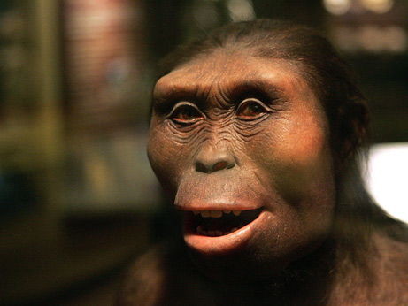
use your up/down arrow keys and/or
your space bar to advance the slides
Prehistoric Cultures
University of Minnesota Duluth
"Selam"
aka "Lucy's Baby”
Tim Roufs © 2010-2013
http://www.d.umn.edu/cla/faculty/troufs/anth1602/

Slide 2
Main
Characteristics of
Anthropology
Prehistoric Cultures
University of Minnesota Duluth
"Selam"
aka "Lucy's Baby”
Tim Roufs © 2010-2013
http://www.d.umn.edu/cla/faculty/troufs/anth1602/

Slide 3
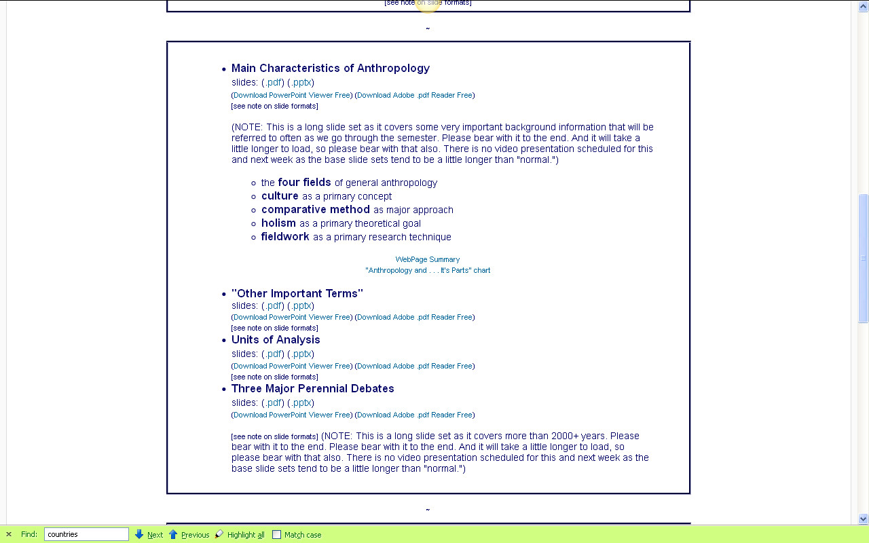
you’ve seen these listed in the
Week 1 “Topics” . . .

Slide 4
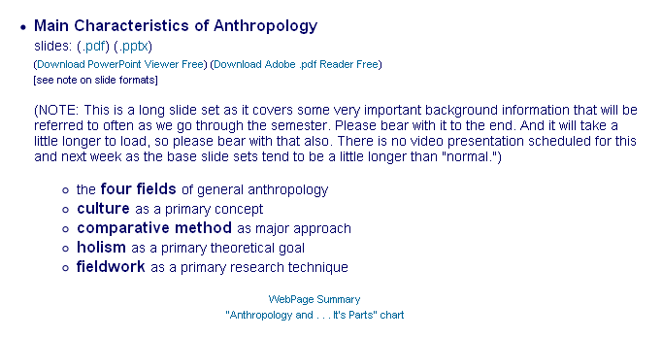
you’ve seen these listed in the
Week 1 “Topics” . . .

Slide 5
you’ve seen these listed in the
Week 1 “Topics” . . .
let’s have a closer look . . .

Slide 6
Main Characteristics of Anthropology
1. the four fields of general anthropology
culture as a primary concept
comparative method as major approach
holism as a primary theoretical goal
fieldwork as a primary research technique

Slide 7
Main Characteristics of Anthropology
1. the four fields
of general anthropology
culture as a primary concept
comparative method as major approach
holism as a primary theoretical goal
fieldwork as a primary research technique

Slide 8
you’ve already seen the fourfold approach of American Anthropology . . .
American Anthropology
cultural / social
physical
archaeology
linguistics

Slide 9
we’re going to have a closer look at . . .
Prehistoric Cultures
and its . . .
cultural / social
physical
archaeology
linguistics
aspects

Slide 10
Main Characteristics of Anthropology
1. the four fields of general anthropology
culture as a primary concept
comparative method as major approach
holism as a primary theoretical goal
fieldwork as a primary research technique

Slide 11
Main Characteristics
“culture” is
  learned
  shared
  transmitted from generation to generation
  based on symbols
  integrated

Slide 12
Main Characteristics
“culture”
  learned
  shared
  transmitted from generation to generation
  based on symbols
  integrated
some anthropologists
focus on the idea that culture involves
“shared understanding”

Slide 13
Main Characteristics
“culture”
    is not inherited
  (i.e., is not biological)
    is not “instinct”

Slide 14
Main Characteristics
“cultures”
    are groups of people sharing a common heritage
    (and usually a common language)

Slide 15

for e.g.,
Aztec
Maya
Inca
Sophie D. Coe
America's First Cuisines
Austin: University of Texax Press, 1994.
www.d.umn.edu/cla/faculty/troufs/anthfood/aftexts.html#title

Slide 16
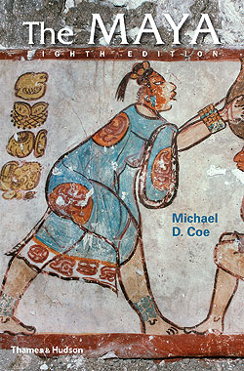
for e.g.,
www.d.umn.edu/cla/faculty/troufs/anth3618/matext.html#title

Slide 17
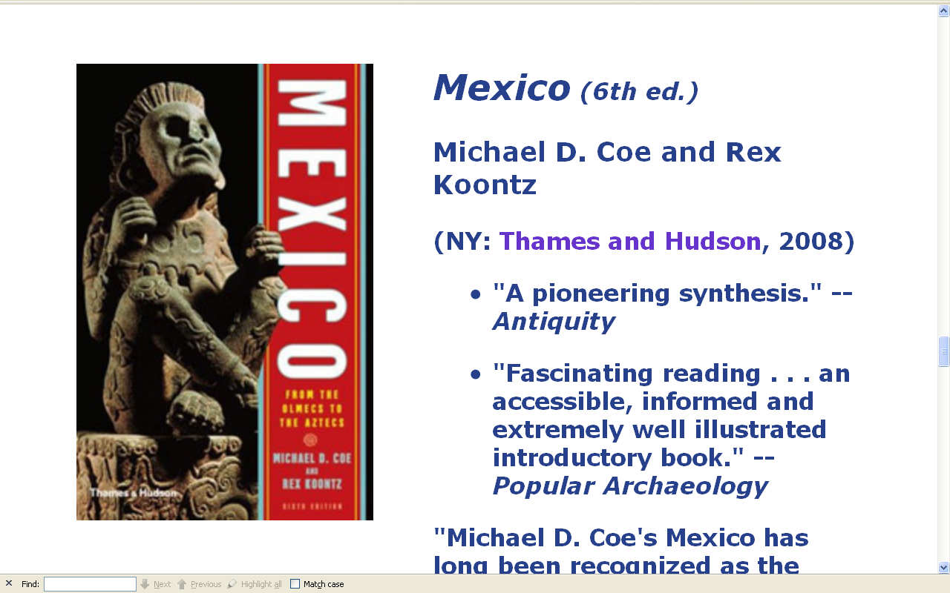
for e.g.,
www.d.umn.edu/cla/faculty/troufs/anth3618/matext.html#title

Slide 18
for e.g.,
but “Mexico”
includes many cultures . . .
Aztec
Toltec
Mixtec
Totonac
Tarascan
Zapotec
Olmec
Yaqui
and others
www.d.umn.edu/cla/faculty/troufs/anth3618/matext.html#title

Slide 19
for e.g.,
more about this
with
“local cultures”
(“microcultures”)
below
www.d.umn.edu/cla/faculty/troufs/anth3618/matext.html#title

Slide 20
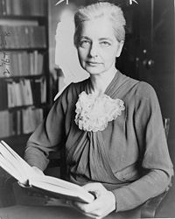
Main Characteristics
“cultures”
    are “integrated”
    -- an idea that was pioneered and emphasized by the “pioneer” anthropologist Ruth Benedict
Ruth Fulton Benedict
1887-1948
Patterns of Culture
1934

Slide 21
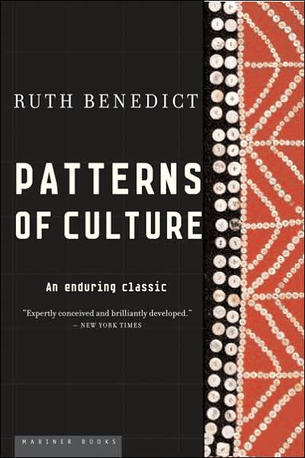
Ruth Fulton Benedict
1887-1948
Patterns of Culture
1934

Slide 22
Main Characteristics
“cultures”
    are integrated
    Interact and change
      the idea that some cultures
      (like “hunting and gathering” cultures, or the Amish)
      do not change is not correct

Slide 23
The Concept of Culture
Microculture
  are smaller groups with distinct pattern of learned and shared behavior and thinking found within larger cultures such as ethnic groups in localized regions
  some people like to think of these as
  “local cultures”

Slide 24
The Concept of Culture
Microculture
  are smaller groups with distinct pattern of learned and shared behavior and thinking found within larger cultures such as ethnic groups in localized regions
  some people like to think of these as
  “local cultures”

Slide 25
every region has its own
local cultures,
or microcultures . . .
Notes:
25

Slide 26
“units of analysis” may include:
  one person
  the family
  the community
  a region
  “culture area”
  a culture / “subculture”
    Ancient Middle America
      Chamula
      Lancandon
      Tzotzil
      Tzeltal
      Zoque
for e.g.,
Prehistoric Middle America
has all of these cultures . . .
and more . . .
    Yaqui
    Otomi
    Tarascan
    Mixtec
    Zapotec
    Olmec
    Toltec
    Aztec
    Teotihuacanos
    Tarahumara

Slide 27
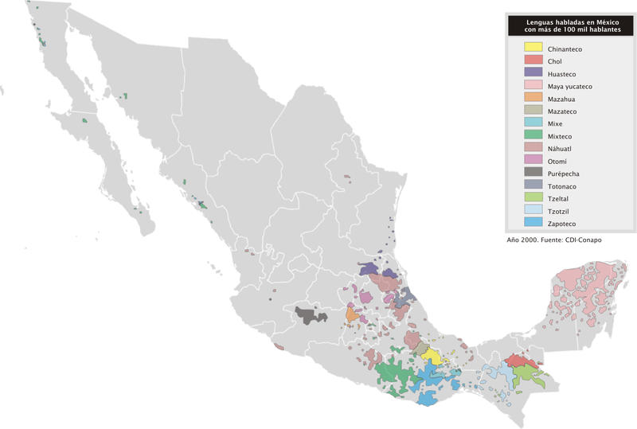
indigenous groups
with a population
of more than 100,000
http://en.wikipedia.org/wiki/Indigenous_peoples_of_Mexico#Indigenous_groups_with_a_population_of_more_than_100.2C000
Notes:
27

Slide 28
indigenous groups
with a population
of more than 100,000
http://en.wikipedia.org/wiki/Indigenous_peoples_of_Mexico#Indigenous_groups_with_a_population_of_more_than_100.2C000
Notes:
28

Slide 29
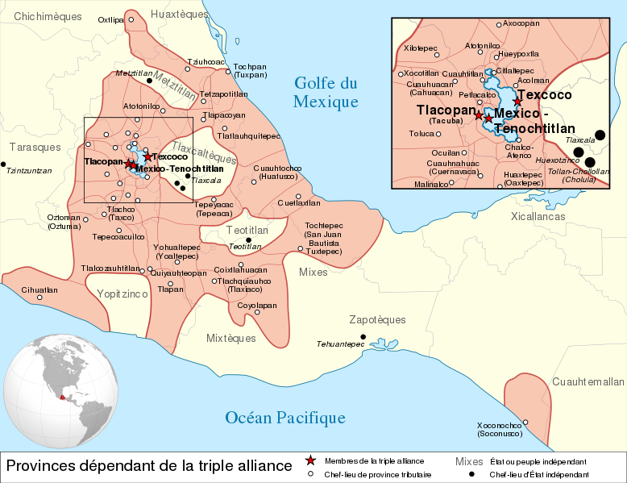
Aztec “Triple Alliance” . . .
http://en.wikipedia.org/wiki/Aztec
Notes:
29

Slide 30
“units of analysis” may include:
  one person
  the family
  the community
  a region
  “culture area”
  a culture / “subculture”
    Maya
      Chamula
      Lancandon
      Tzotzil
      Tzeltal
      Zoque
and
just the Maya
include all of these subcultures . . .
and more . . .

Slide 31
every region has its own
local cultures,
or microcultures . . .
Notes:
31

Slide 32
even Minnesota . . .
Notes:
32

Slide 33
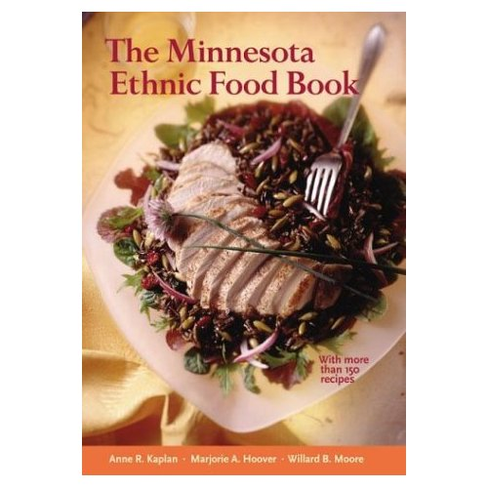
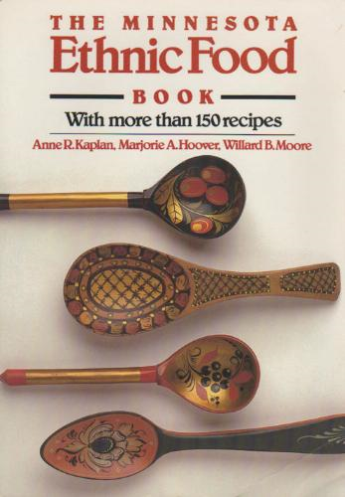
Minnesota Historical Society Press
Notes:
33

Slide 34
even in places like Minnesota
there are many “microcultures” . . .
for e.g., Anishinabe
(known less appropriately as
“The Ojibwa,” and “The Chippewa”) . . .
. . . and many groups have been in or near their present locality since prehistoric times
Notes:
34

Slide 35
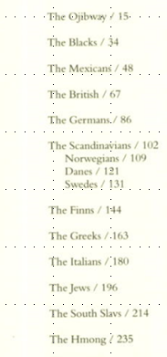
The Minnesota Ethnic Food Book
Notes:
35

Slide 36
even in places like Minnesota
there are many “microcultures” . . .
for e.g., Anishinabe
(known less appropriately as
“The Ojibwa,” and “The Chippewa”) . . .
. . . and many groups have been in or near their present locality since prehistoric times
Notes:
36

Slide 37
The Concept of Culture
microcultures can include ethnic groups within nations
  e.g., Anishinabe (Chippewa; Ojibwa)
  e.g., Irish “Travellers”
    sometimes incorrectly called “Gypsies”
  e.g., Rom (Gypsies)
  e.g., Basques
  e.g., Kurds
  e.g., Australian Aboriginals
local groups generally strive to preserve their cultural identity . . .
and you can often see that in the artifacts that they produce

Slide 38
The Concept of Culture
microcultures can include ethnic groups within nations
  e.g., Anishinabe (Chippewa; Ojibwa)
  e.g., Irish “Travellers”
    sometimes incorrectly called “Gypsies”
  e.g., Rom (Gypsies)
  e.g., Basques
  e.g., Kurds
  e.g., Australian Aboriginals
local groups generally strive to preserve their cultural identity with . . .
language
food
religion
clothing
cultural symbols

Slide 39

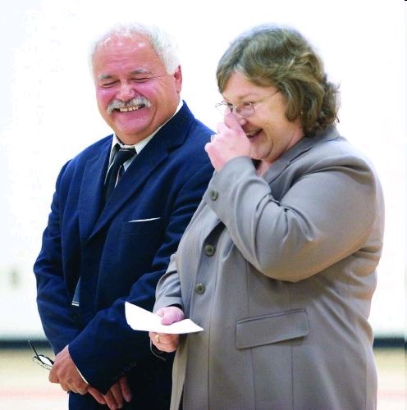
www.duluthnewstribune.com/articles/index.cfm?id=73293&section=homepage
Notes:
39

Slide 40
The Concept of Culture
microcultures can include ethnic groups within nations
  e.g., Anishinabe (Chippewa; Ojibwa)
  e.g., Irish “Travellers”
    sometimes incorrectly called “Gypsies”
  e.g., Rom (Gypsies)
  e.g., Basques
  e.g., Kurds
  e.g., Australian Aboriginals
local groups generally strive to preserve their cultural identity . . .
and you can often see that in the artifacts that they produce

Slide 41


you can probably see signs of this
in your area . . .
www.worldlicenceplates.com/usa/US_MNXX.html

Slide 42
these have prehistoric counterparts
. . .
www.worldlicenceplates.com/usa/US_MNXX.html

Slide 43
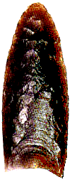
Clovis Point

Slide 44
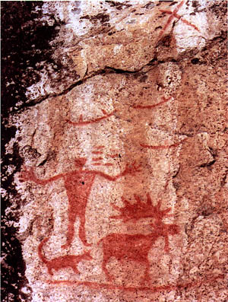
Pictograph from Hegman Lake, Minnesota

Slide 45
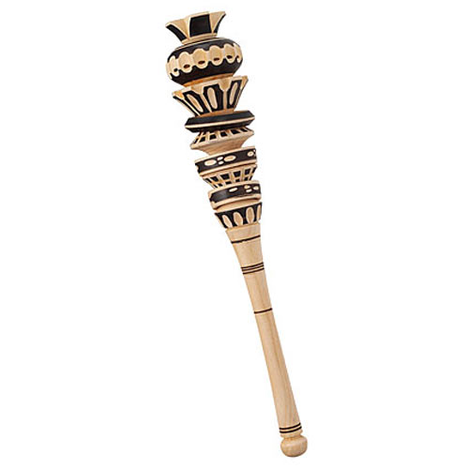
and prehistoric items sometimes have modern counterparts
Molinillo
Ancient Mexican Hot Chocolate Frother
http://www.thegreenhead.com/2009/01/molinillo-traditional-mexican-hot-chocolate-frother.php

Slide 46

but context is always important
What is this,
for e.g.?

Slide 47
but context is always important
What is this,
for e.g.?

Slide 48
it’s a “spurtle”
for stirring oatmeal
and soups
(in Scotland)
http://en.wikipedia.org/wiki/Spurtle

Slide 49
The Concept of Culture
microcultures can include ethnic groups within nations
  e.g., Anishinabe (Chippewa; Ojibwa)
  e.g., Irish “Travellers”
    sometimes incorrectly called “Gypsies”
  e.g., Rom (Gypsies)
  e.g., Basques
  e.g., Kurds
  e.g., Australian Aboriginals
. . . some areas of human activity tell us more than others . . .

Slide 50
The Concept of Culture
microcultures can include ethnic groups within nations
  e.g., Anishinabe (Chippewa; Ojibwa)
  e.g., Irish “Travellers”
    sometimes incorrectly called “Gypsies”
  e.g., Rom (Gypsies)
  e.g., Basques
  e.g., Kurds
  e.g., Australian Aboriginals
. . . food, for e.g., is almost always a key part of peoples’ cultural identity,
often dating back to their prehistoric past, and defining their history . . .

Slide 51
The Concept of Culture
microcultures can include ethnic groups within nations
  e.g., Anishinabe (Chippewa; Ojibwa)
  e.g., Irish “Travellers”
    sometimes incorrectly called “Gypsies”
  e.g., Rom (Gypsies)
  e.g., Basques
  e.g., Kurds
  e.g., Australian Aboriginals
and this often shows up in the archeological record . . .

Slide 52
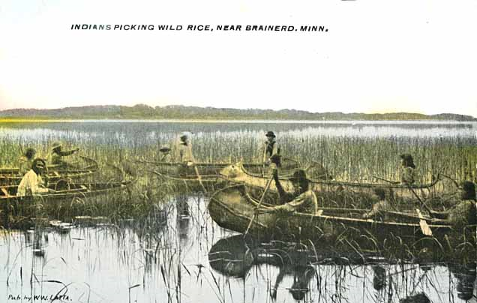
Indians harvesting wild rice near Brainerd, 1905
Minnesota Historical Society

Slide 53
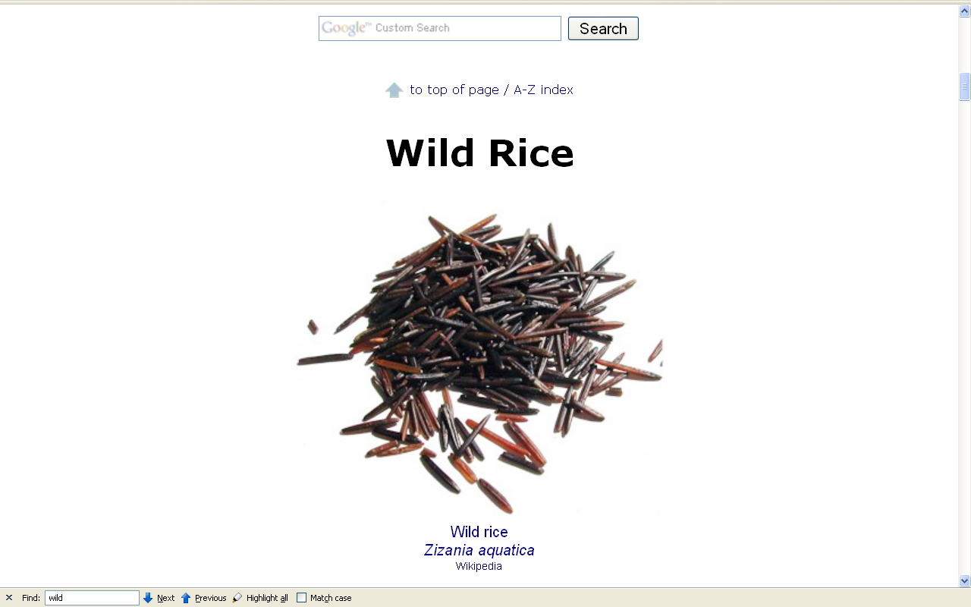
http://www.d.umn.edu/cla/faculty/troufs/anthfood/afwildrice.html#title

Slide 54
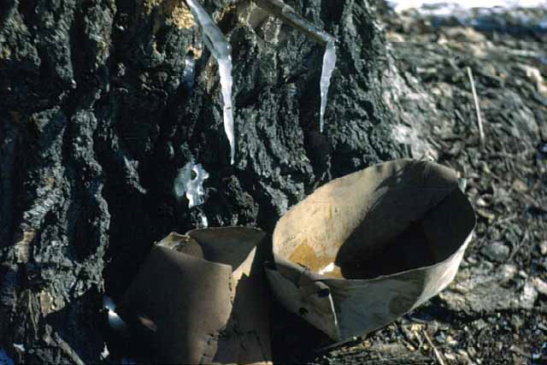
Maple Sugar
Day's Place, Frozen Sap, Lake Mille Lacs
Minnesota Historical Society

Slide 55
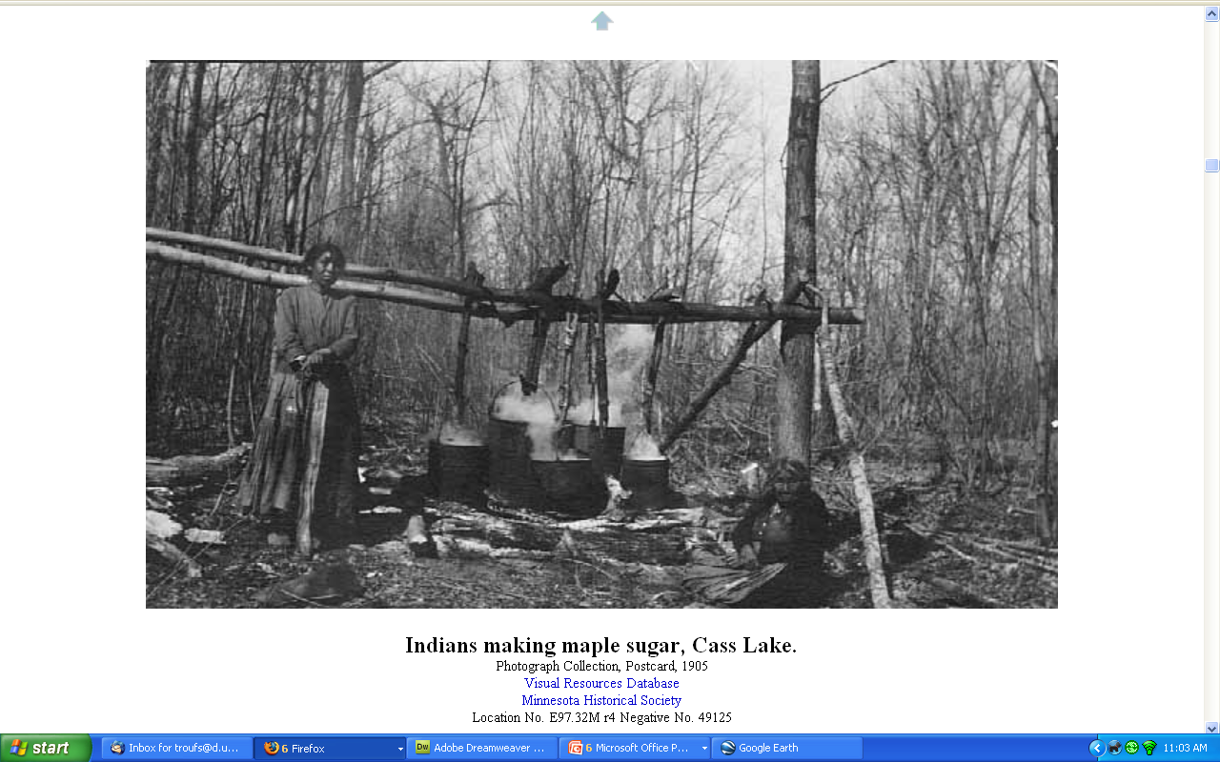
http://www.d.umn.edu/cla/faculty/troufs/Buffalo/PB07.html#title

Slide 56
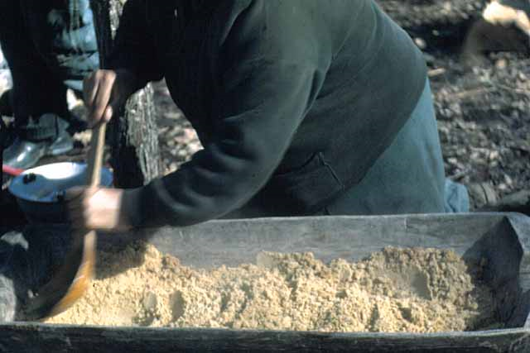
Mrs. Day Granulating Maple Sugar, Lake Mille Lacs
Minnesota Historical Society

Slide 57
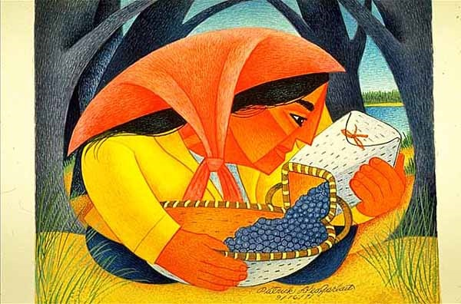
Woman and Blueberries.
Patrick DesJarlait (1912-1972)
Minnesota Historical Society

Slide 58
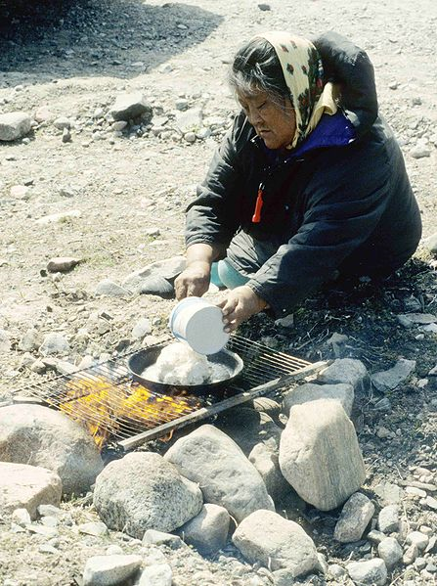
Bannock / Frybread
Wikimedia

Slide 59

and this is the case for almost every group . . .
Notes:
59

Slide 60
Main Characteristics of Anthropology
1. the four fields of general anthropology
culture as a primary concept
comparative method
as major approach
development and structure
holism as a primary theoretical goal
fieldwork as a primary research technique

Slide 61
Compare . . .
Main Characteristics
comparative method
  as a major approach to the study of human behavior
  the comparative method compares things

Slide 62
Compare . . .
Main Characteristics
comparative method
  One form of comparative method was pioneered by Fred Eggan
  (University of Chicago)
“Social anthropology and the method of controlled comparison”
  American Anthropologist, 56:743-61 (1954)

Slide 63
Compare . . .
Main Characteristics
comparative method
  One form of comparative method was pioneered by Fred Eggan
  (University of Chicago)
“Social anthropology and the method of controlled comparison”
  American Anthropologist, 56:743-61 (1954)

Slide 64
Compare . . .
Main Characteristics
the comparative method compares things
for e.g. . . .

Slide 65
Aztec
Maya
Inca
Sophie D. Coe
America's First Cuisines
Austin: University of Texax Press, 1994.
www.d.umn.edu/cla/faculty/troufs/anthfood/aftexts.html#title

Slide 66
Compare . . .
Main Characteristics
comparative method
  Other methods . . .
compare things regionally
in an attempt to understand process

Slide 67
Compare . . .
Main Characteristics
comparative method
  Other methods . . .
process
essentially refers to
how things change
or
how things came to be
the way they are now
compare things regionally
in an attempt to understand process

Slide 68
Compare . . .
Main Characteristics
comparative method
  Other methods . . .
anthropologists
for e.g.,
compare things regionally
in an attempt to understand
process

Slide 69
Compare . . .
Main Characteristics
the comparative method compares things, for e.g., process of domestication / civilization
    maize – Mexico
    wheat – Turkey
    rice – China
    manioc – Brazil
    millet – Africa

Slide 70
Compare . . .
Main Characteristics
the comparative method compares things, for e.g., process of domestication / civilization
    maize – Mexico
    wheat – Turkey
    rice – China
    manioc – Brazil
    millet – Africa

Slide 71
Compare . . .
Main Characteristics
the comparative method compares things, for e.g., process of domestication / civilization
    maize – Mexico
    wheat – Turkey
    rice – China
    manioc – Brazil
    millet – Africa

Slide 72
Compare . . .
Main Characteristics
the comparative method compares things, for e.g., process of domestication / civilization
    maize – Mexico
    wheat – Turkey
    rice – China
    manioc – Brazil
    millet – Africa

Slide 73
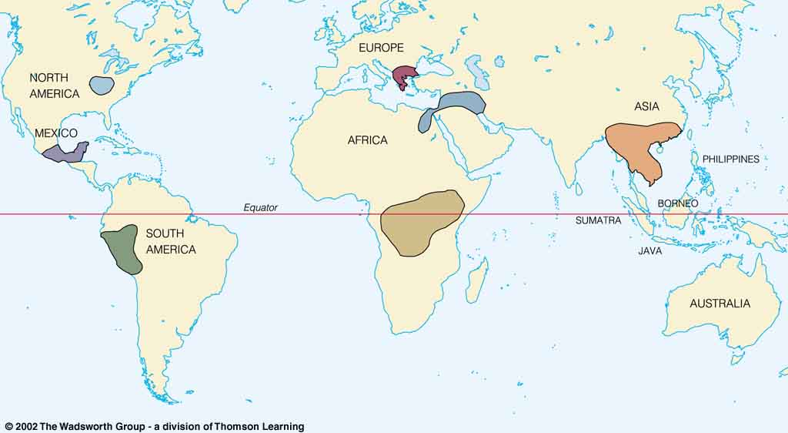
Origin of Domestication for Selected Plants
Compare . . .
wheat
10,500 ybp
maize
4,200 ybp
rice
7,000 ybp
manioc
4,200 ybp
millet
4,000 ybp
Understanding Physical Anthropology and Archaeology, 9th Ed., p. 342

Slide 74
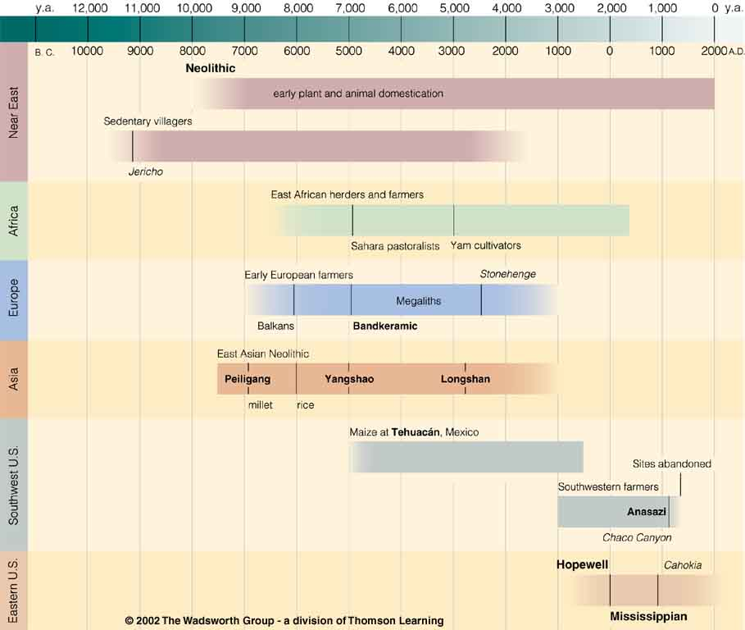

Chapter 14
Understanding Physical Anthropology and Archaeology, 9th Ed.
“Food Production”
A Biocultural Revolution
Neolithic
Time line for Ch. 14 Food Production
Understanding Physical Anthropology and Archaeology, 9th Ed., p. 333

Slide 75
Neolithic
one of the best places
in the world to look at
the process
of plant domestication
Tehuacán
Time line for Ch. 14 Food Production
Understanding Physical Anthropology and Archaeology, 9th Ed., p. 333

Slide 76
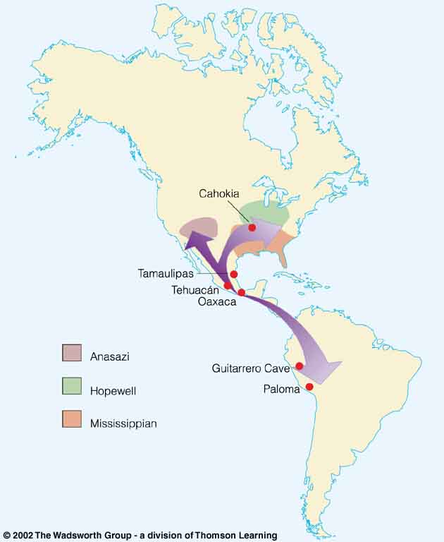
Compare . . .
Tehuacán Valley, Puebla, Mexico
maize
4,200 ybp
Understanding Physical Anthropology and Archaeology, 8th Ed., p. 432

Slide 77
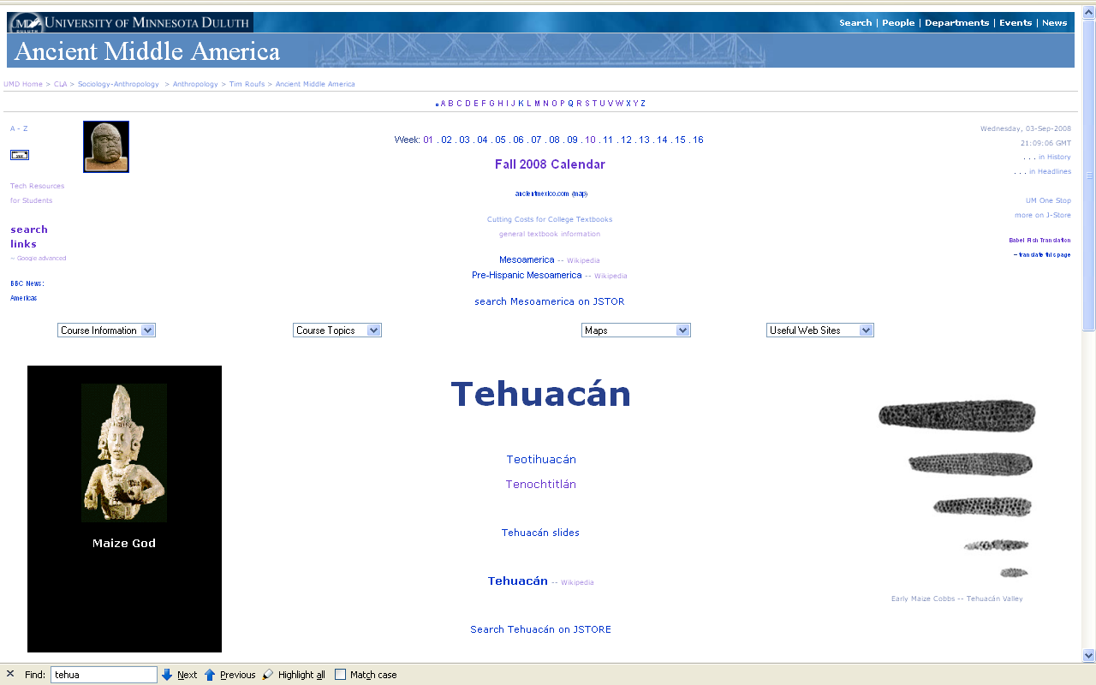
www.d.umn.edu/cla/faculty/troufs/anth3618/matehuac.html#title

Slide 78
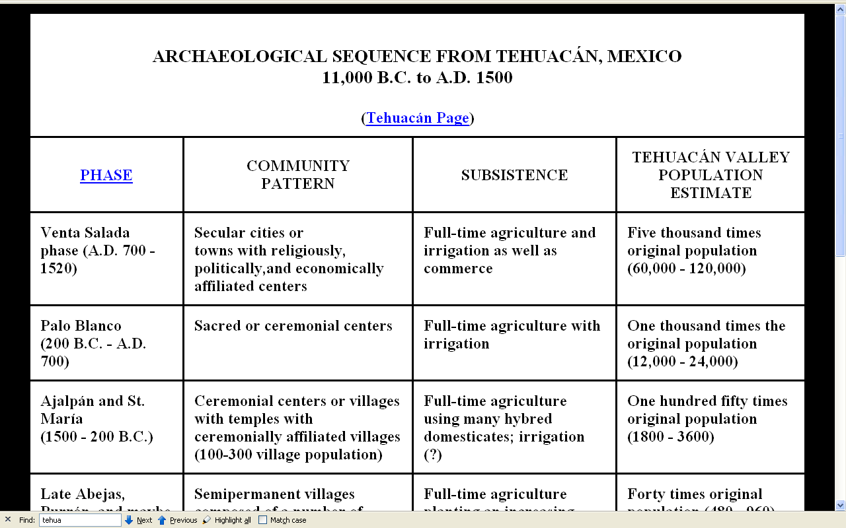
www.d.umn.edu/cla/faculty/troufs/anth3618/matehuac.html#title

Slide 79
Neolithic
Time line for Ch. 14 Food Production
Understanding Physical Anthropology and Archaeology, 9th Ed., p. 333

Slide 80
Neolithic
“The Neolithic Revolution”
“The New Stone Age”
in Prehistoric Middle America this is known as
The “Archaic”
and sometimes they’re all referred to as
“The Agriculture Revolution”
Time line for Ch. 14 Food Production.
Understanding Physical Anthropology and Archaeology, 9th Ed., p. 333

Slide 81
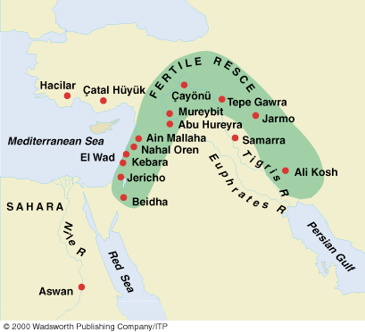
Compare . . .
Early Neolithic sites
Understanding Physical Anthropology and Archaeology, 9th Ed., p. 349

Slide 82
REM:
“The Neolithic Revolution”
“The New Stone Age”
in Prehistoric Middle America this is known as
The “Archaic”
and sometimes they’re all referred to as
“The Agriculture Revolution”

Slide 83
Neolithic
Time line for Ch. 14 Food Production
Understanding Physical Anthropology and Archaeology, 9th Ed., p. 333

Slide 84
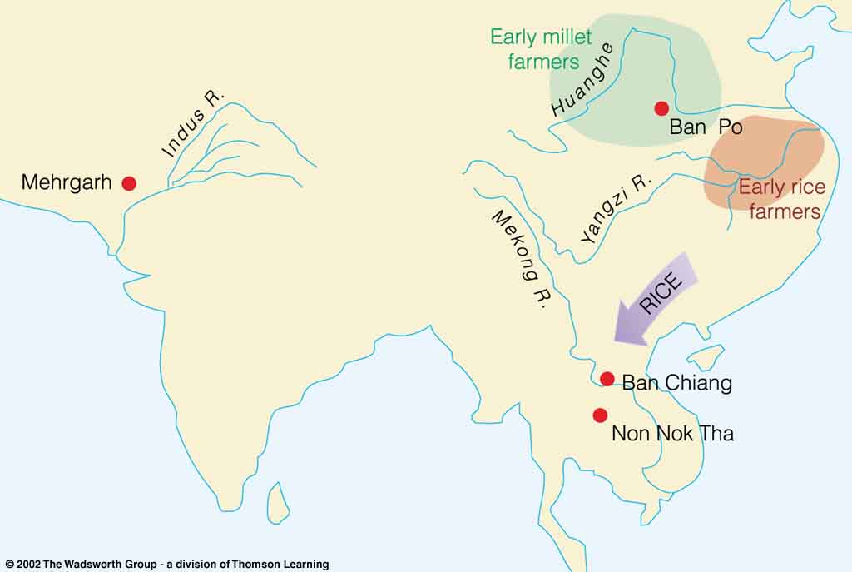
Compare . . .
Mehrgarh
One of the earliest Neolithic settlements of southern Asia, Pakistan
Understanding Physical Anthropology and Archaeology, 9th Ed., p. 352

Slide 85
Main Characteristics of Anthropology
1. the four fields of general anthropology
culture as a primary concept
comparative method
as major approach
development and structure
holism as a primary theoretical goal
fieldwork as a primary research technique
another e.g. . . .

Slide 86
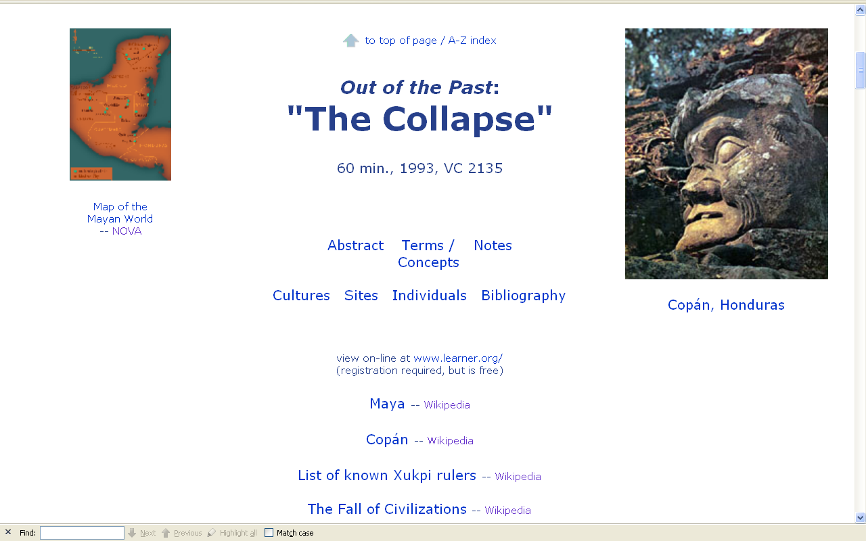
Compare . . .
comparing
the “fall of civilization”
around the world
www.d.umn.edu/cla/faculty/troufs/anth3618/video/Collapse.html#title

Slide 87
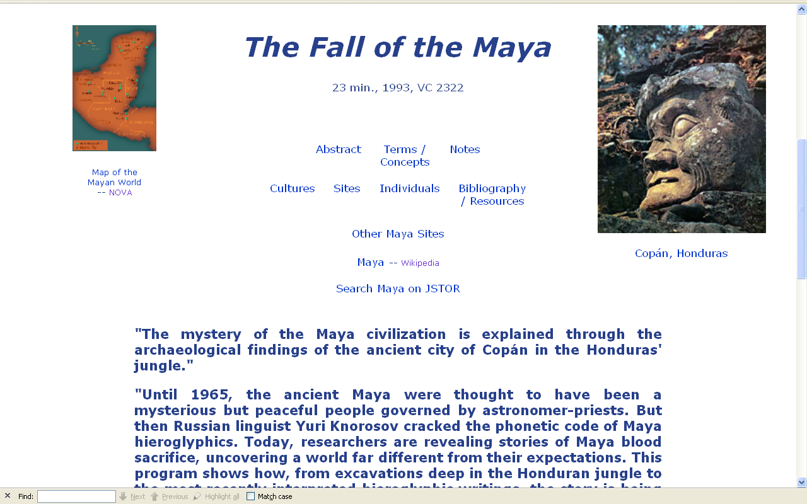
www.d.umn.edu/cla/faculty/troufs/anth3618/video/Fall_Maya.html#title

Slide 88
Main Characteristics of Anthropology
1. the four fields of general anthropology
culture as a primary concept
comparative method as major approach
holism
or the study of "humankind" as a whole, as a primary theoretical goal
fieldwork as a primary research technique

Slide 89
Holism tries to put all of the pieces together . . .
American Anthropology
cultural / social
physical (bio-physical)
archaeology
linguistics

Slide 90
let’s have a look at that on the
“Anthropology and . . . Its Parts” chart . . .

Slide 91
NOTE:
usually anthropologists read charts from the bottom up
that has to do with the fact that in archaeology the oldest layers are at the bottom of a site and the newer ones are on top

Slide 92
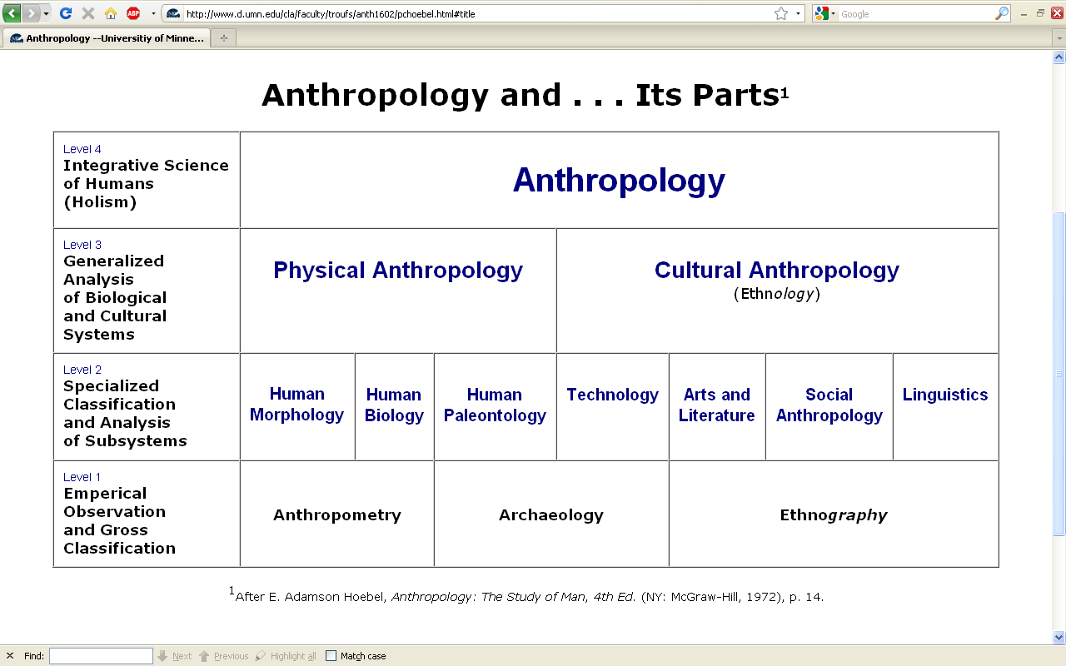

Slide 93
NOTE:
there are four levels . . .
(REM: read from the bottom up)

Slide 98
HOLISM
involves all four levels
and all
of the physical and cultural
components combined

Slide 99
holism

Slide 100
holism
holism

Slide 101
Anthropology

Slide 102
. . . and the two main divisions
of Anthropology are
bio-physical
and
socio-cultural . . .

Slide 103
Anthropology
Bio-physical |

Slide 104
Anthropology
Bio-physical |
Socio-cultural

Slide 105
. . . and ultimately
studies
involve lots of subdisciplines
and interdisciplinary studies
. . .

Slide 106
Anthropology
Bio-physical |
Food and Culture
Socio-cultural
measuring
excavating
participant /
observation

Slide 107
in some ways this chart business is all about
Theory
and that is important to the understanding of
many aspects of
Prehistoric Cultures

Slide 108
theory
holism

Slide 109
theory
holism
and the theory ultimately also includes the
results of interdisciplinary study

Slide 110
and finally,
we have the last
main characteristic of anthropology . . .

Slide 111
Main Characteristics of Anthropology
1. the four fields of general anthropology
culture as a primary concept
comparative method as major approach
holism as a primary theoretical goal
fieldwork
as a primary research technique --
involving “participant observation”

Slide 112
note two terms in the
“major characteristics of anthropology”
listing . . .

Slide 113
Main Characteristics
1. culture as a primary concept
2. comparative method as major approach to the study of human behavior
3. holism or the study of "humankind" as a whole, as a primary theoretical goal
4. fieldwork as a primary research
technique, involving “participant observation”

Slide 114
Main Characteristics
1. culture as a primary concept
2. comparative method as major approach to the study of human behavior
3. holism or the study of "humankind" as a whole, as a primary theoretical goal
4. fieldwork as a primary research
technique, involving “participant observation”
what’s the difference?

Slide 115
Main Characteristics
1. culture as a primary concept
2. comparative method as major approach to the study of human behavior
3. holism or the study of "humankind" as a whole, as a primary theoretical goal
4. fieldwork as a primary research
technique, involving “participant observation” = how you get information
= tool

Slide 116
Main Characteristics
1. culture as a primary concept
2. comparative method as major approach to the study of human behavior
3. holism or the study of "humankind" as a whole, as a primary theoretical goal
4. fieldwork as a primary research
technique, involving “participant observation” = how you get information
data gathering technique —
participant observation
(fieldwork)
= tool

Slide 117
Main Characteristics
Anthropologists use other tools . . . like questionnaires, interview schedules, psychological tests, documentary filming . . . but “participant observation” is a characteristic technique use by anthropologists, especially cultural anthropologists (ethnologists)
1. culture as a primary concept
2. comparative method as major approach to the study of human behavior
3. holism or the study of "humankind" as a whole, as a primary theoretical goal
4. fieldwork as a primary research
technique, involving “participant observation” = how you get information
= tool

Slide 118
Main Characteristics
Anthropologists use other tools . . . like questionnaires, interview schedules, psychological tests, documentary filming . . . but “participant observation” is a characteristic technique use by anthropologists, especially
cultural anthropologists are also
ethnologists
1. culture as a primary concept
2. comparative method as major approach to the study of human behavior
3. holism or the study of "humankind" as a whole, as a primary theoretical goal
4. fieldwork as a primary research
technique, involving “participant observation” = how you get information
NOTE:
= tool

Slide 119
Main Characteristics
1. culture as a primary concept
2. comparative method as major approach to the study of human behavior
3. holism or the study of "humankind" as a whole, as a primary theoretical goal
4. fieldwork as a primary research
technique, involving “participant observation” = how you get information
= tool

Slide 120
Main Characteristics
1. culture as a primary concept
2. comparative method as major approach to the study of human behavior
3. holism or the study of "humankind" as a whole, as a primary theoretical goal
4. fieldwork as a primary research
technique, involving “participant observation” = how you get information
= approach
how you use information
= tool

Slide 121
Main Characteristics
1. culture as a primary concept
2. comparative method as major approach to the study of human behavior
3. holism or the study of "humankind" as a whole, as a primary theoretical goal
4. fieldwork as a primary research
technique, involving “participant observation” = how you get information
= tool

Slide 122
Main Characteristics
1. culture as a primary concept
2. comparative method as major approach to the study of human behavior
3. holism or the study of "humankind" as a whole, as a primary theoretical goal
4. fieldwork as a primary research
technique, involving “participant observation” = how you get information
other tools include
things like . . .
= tool

Slide 123
Main Characteristics
surveys and questionnaires
various laboratory analyses of a variety of artifacts
ethological research techniques
(animal studies in the field)
1. culture as a primary concept
2. comparative method as major approach to the study of human behavior
3. holism or the study of "humankind" as a whole, as a primary theoretical goal
4. fieldwork as a primary research
technique, involving “participant observation” = how you get information
= tool
  after Marion Nestle, Food Politics, Rev. Ed., 2007, pp. 401-405

Slide 124
  various studies of laboratory animals
biochemical research
(“test tube”)
epidemiological research (populations)
clinical studies
(medical)
and others
  after Marion Nestle, Food Politics, Rev. Ed., 2007, pp. 401-405

Slide 125
Anthropologists often like to use a research “technique” based on
“unobtrusive measures” . . .
(either in the field or elsewhere)

Slide 126
  “unobtrusive measures”
  analysis of available data
  analysis of artifacts
  simply observing
  still and video photography
  and analysis of films and images
  and others
  after Marion Nestle, Food Politics, Rev. Ed., 2007, pp. 401-405

Slide 127
but most of all (generally)
Anthropologists
LOVE . . .

Slide 128
Main Characteristics of Anthropology
1. the four fields of general anthropology
culture as a primary concept
comparative method as major approach
holism as a primary theoretical goal
fieldwork
as a primary research technique --
involving “participant observation”

Slide 129
and as I mentioned in the
“. . . Note on Videos and Visual Anthropology”,
we would LOVE to take you along with us around the world,
but the next best thing we can do is bring the world to you in the form of films and videos.
And we’ll do a lot of that
(starting Week 1)

Slide 130
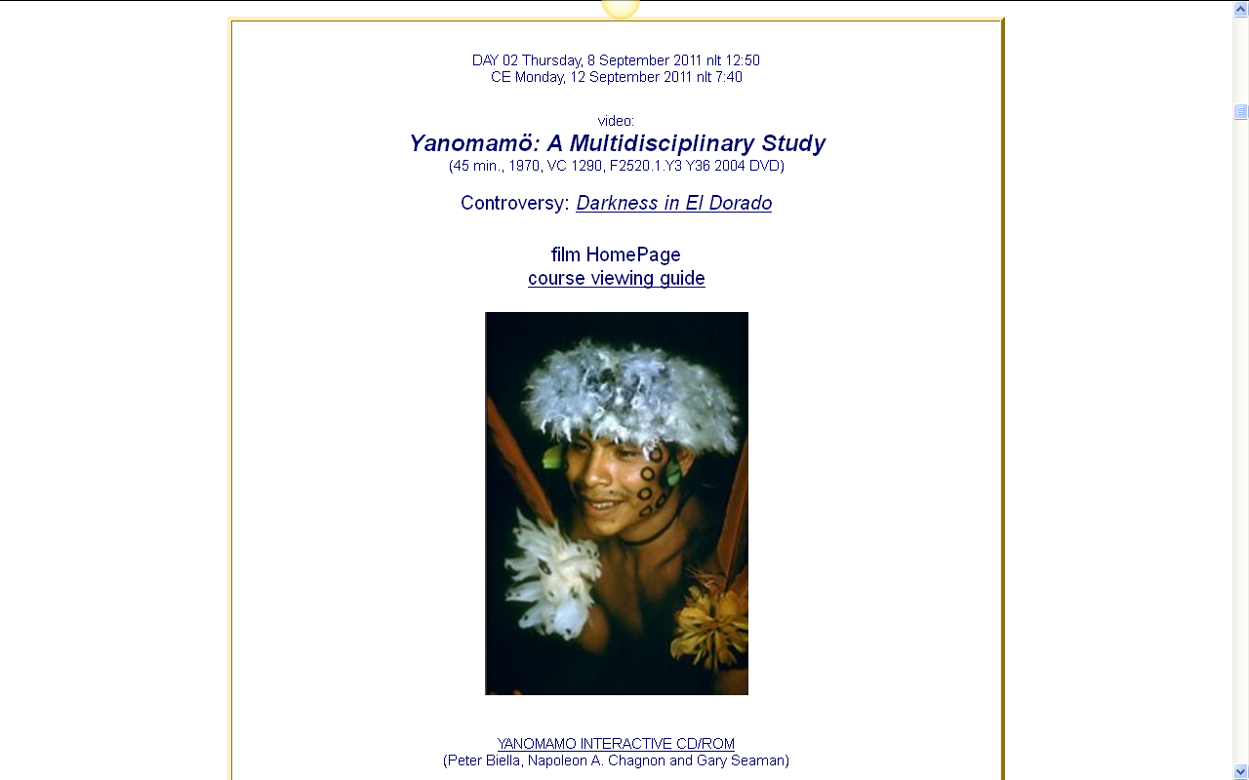
our first “field trip” . . .

Slide 131
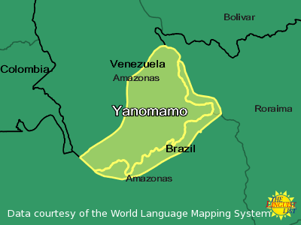
our first “field trip” . . .
http://rosettapanglossia.longnow.org/wiki/index.php/Yanomam%C3%B6_Language

