Slide 1
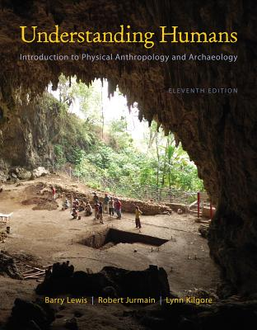
Gregor Johann Mendel
(1822 - 1884)
Tim Roufs
© 2010-2013

Slide 2
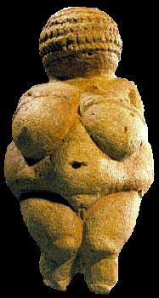
. . . or how to make sense
out of Ch. 3 of the text . . .
University of Minnesota Duluth
Tim Roufs
© 2010-2013
http://www.d.umn.edu/cla/faculty/troufs/anth1602/

Slide 3
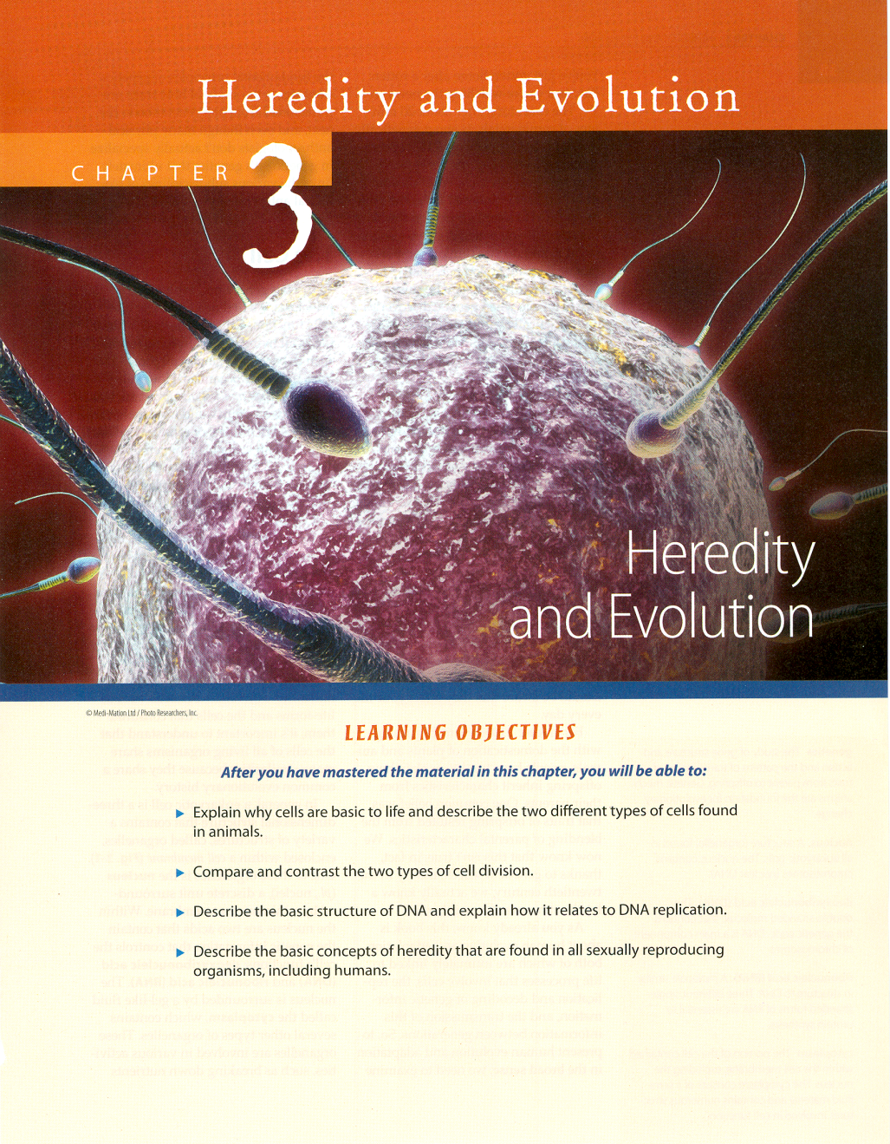

Slide 4
Important People / Works
Gregor Johann Mendel
(1822 - 1884)

Slide 5
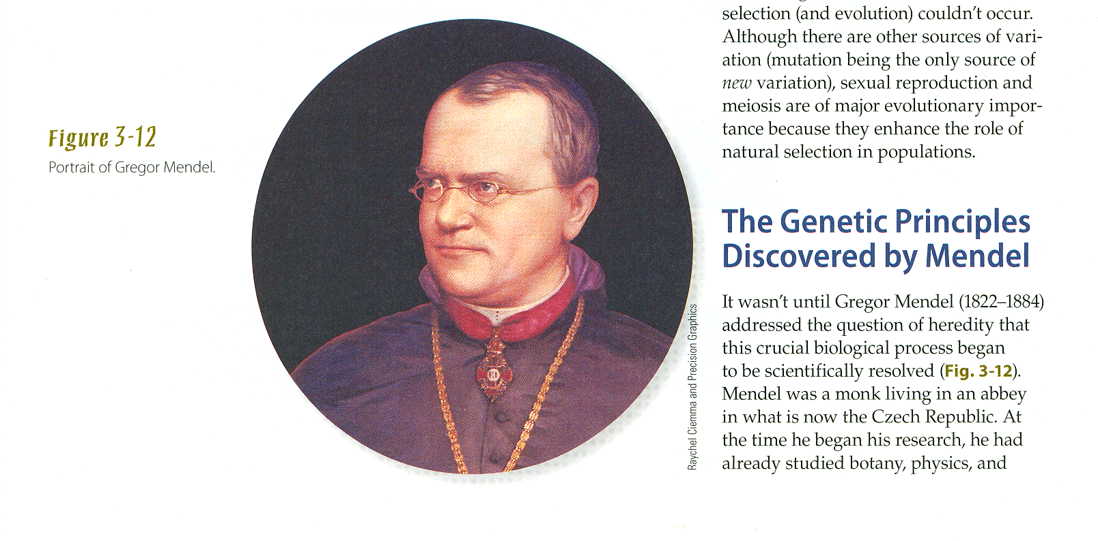
Important People / Works
Gregor Johann Mendel (1822 - 1884)
Understanding Physical Anthropology and Archaeology, 11th ed., p. 48
Notes:
5

Slide 6
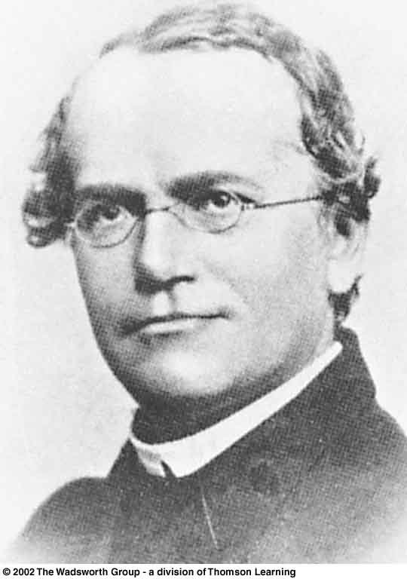
Gregor Mendel
Understanding Humans, 10th ed., p. 50

Slide 7
some basic terms . . .

Slide 8
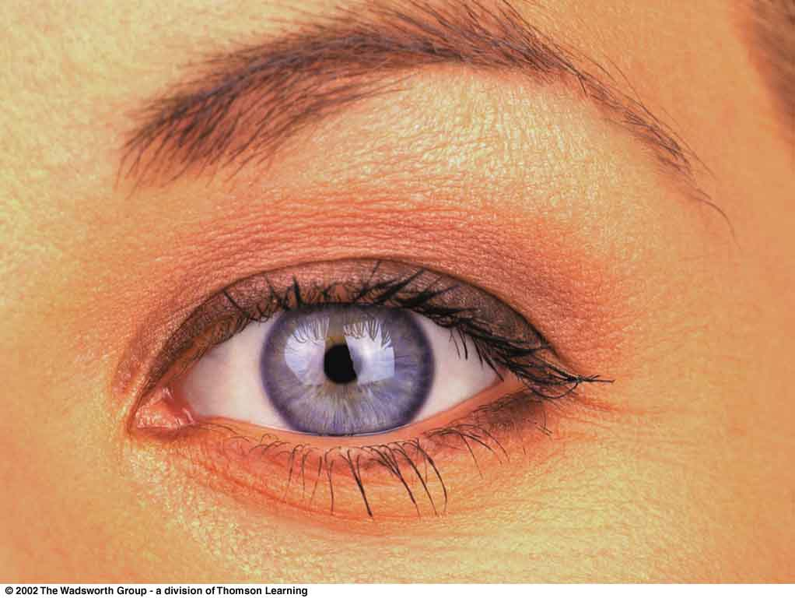
Glossary
“inherited characteristics”
genetically determined traits
e.g., eye color
11th Ed. p. 56

Slide 9
Glossary
“acquired characteristics”
learned traits
e.g., the ability to write

Slide 10
Glossary
blending inheritance
an earlier theory stating that offspring receive a combination of all characteristics of each parent through the mixture of their “bloods”

Slide 11
Glossary
blending inheritance
an outmoded theory superseded by Mendelian genetics

Slide 12
Glossary
particulate inheritance
physical traits are inherited as “particles”
Mendel did not know what the particles were
today they’re recognized as particles like chromosomes and DNA

Slide 13
chromosomes
discrete structures composed of DNA and protein found only in the nuclei of cells

Slide 14
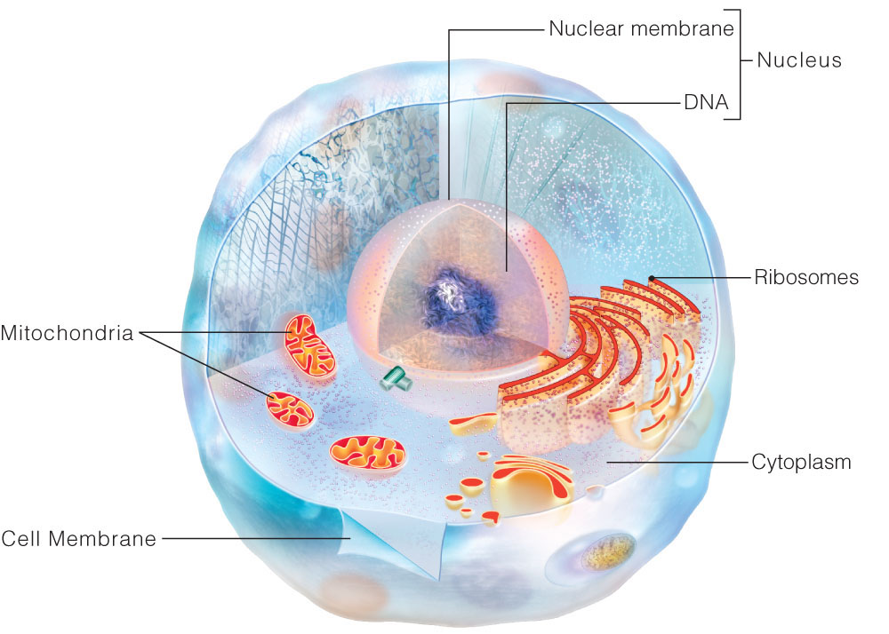
The cell’s three dimensional nature
Understanding Humans, 11th ed., p. 39

Slide 15
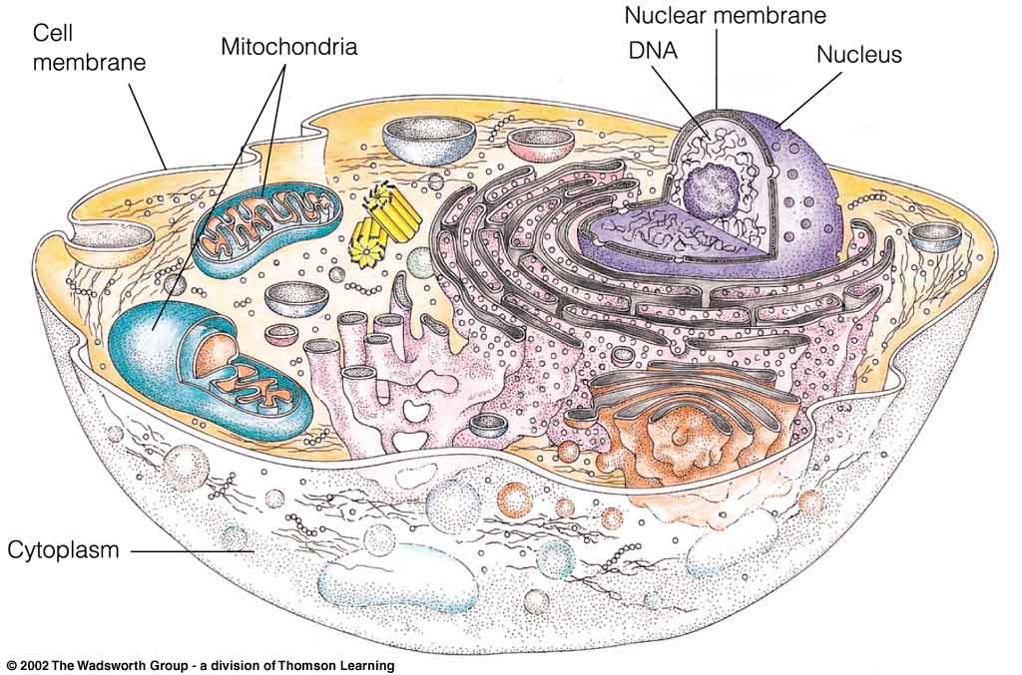
The cell’s three dimensional nature
Understanding Humans, 10th ed., p. 39

Slide 16
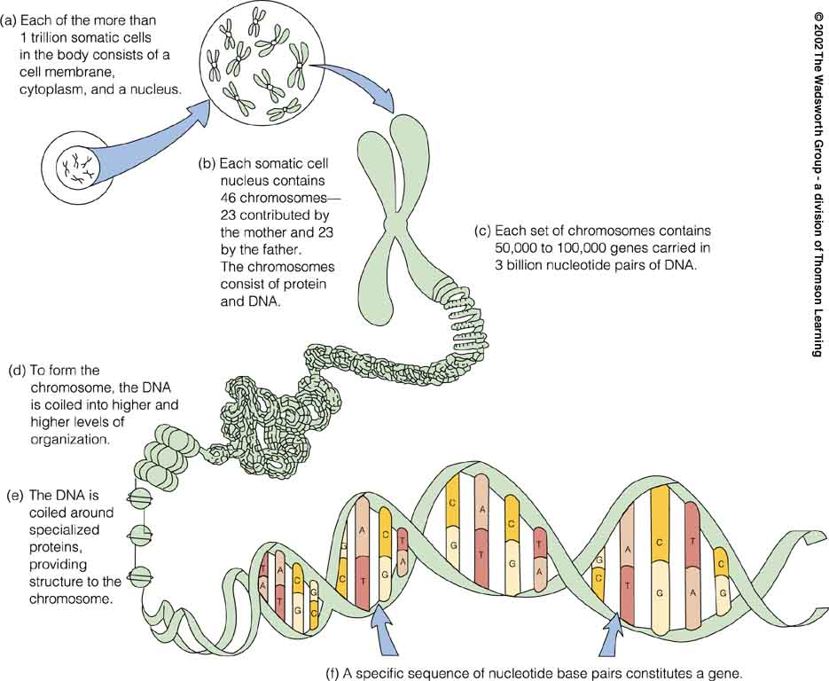
A model of a human chromosome
Understanding Humans, 11th ed., p. 44

Slide 17
Glossary
phenotype
genotype

Slide 19
Glossary
phenotype
genotype

Slide 20
Glossary
phenotype
the observable physical characteristics of an organism
the things you can see
the detectable expressions of genotypes

Slide 21
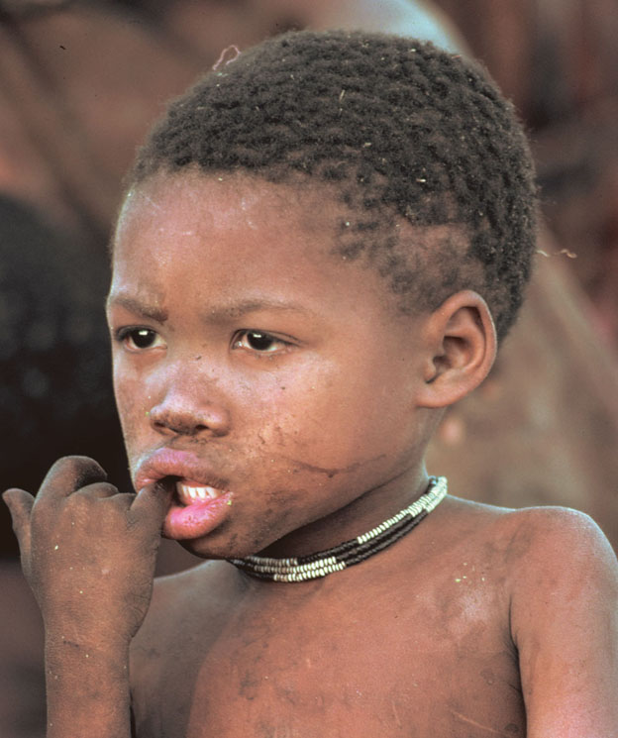
“Some examples of phenotypic variation among Africans.”
San (South African)
Understanding Humans, 10th ed., p. 76

Slide 22

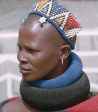
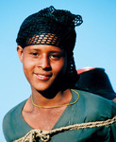
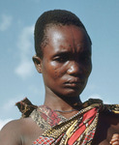
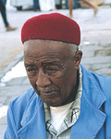
“Some examples of phenotypic variation among Africans.”
San (South African)
Understanding Humans, 10th ed., p. 76

Slide 23
Glossary
phenotype
genotype

Slide 24
Glossary
genotype
includes genetic items you can not see

Slide 25
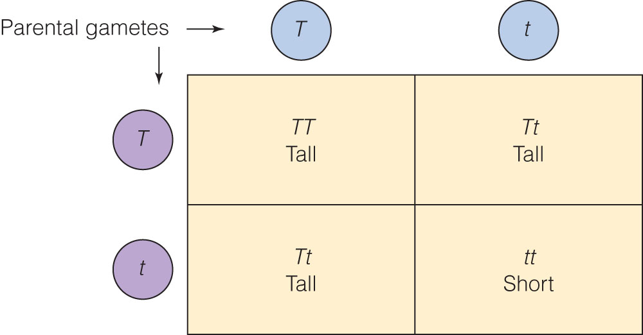
gametes are “reproductive cells
(eggs and sperm in animals)
developed from precursor cells
in ovaries and testes”
Punnett square representing
possible genotypes and phenotypes
Understanding Humans, 11th ed., p. 51

Slide 26
Punnett square representing
possible genotypes and phenotypes
Understanding Humans, 11th ed., p. 51

Slide 27
Punnett square representing
possible genotypes and phenotypes
Understanding Humans, 11th ed., p. 51

Slide 28
Punnett square representing
possible genotypes and phenotypes
Understanding Humans, 11th ed., p. 51

Slide 29
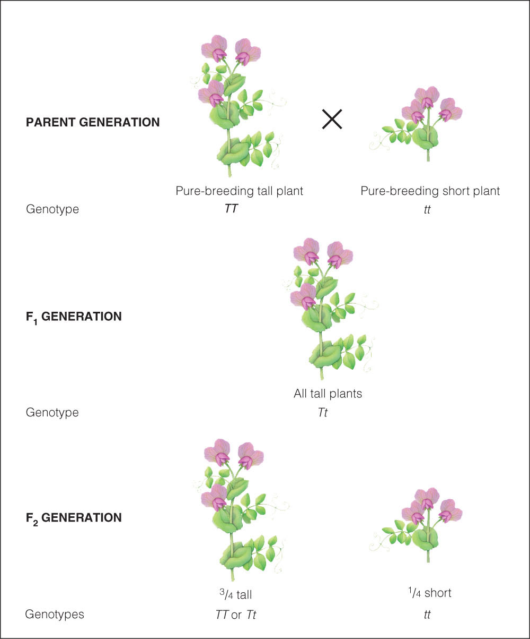
Understanding Humans, 11th ed., p. 50

Slide 30
Basic Concepts
genotype
phenotype

Slide 31
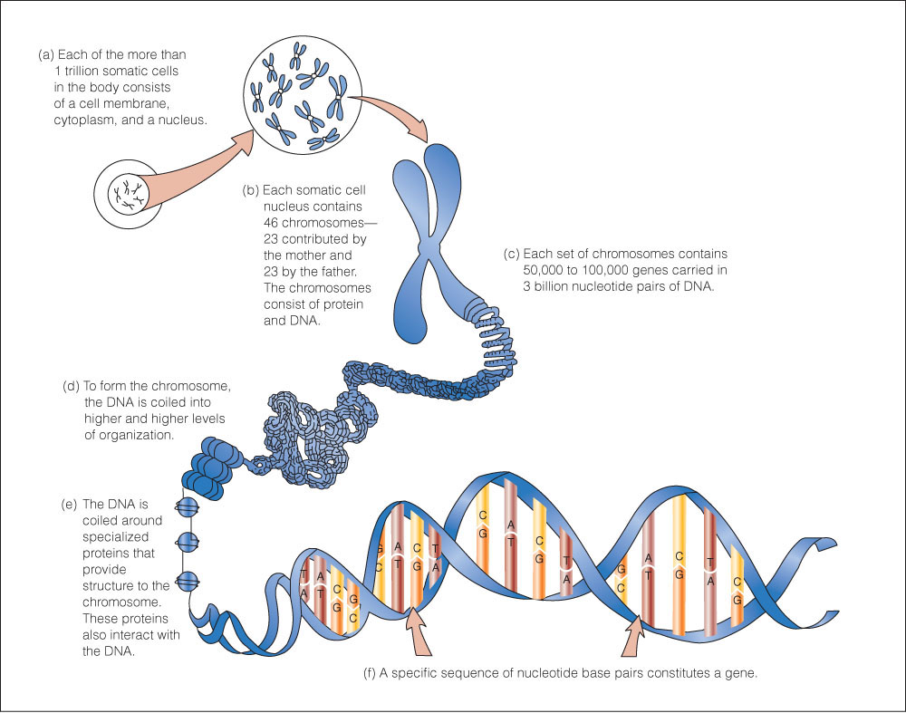
Understanding Humans, 11th ed., p. 44

Slide 33
Glossary
phenotype
the observable physical characteristics of an organism
the things you can see
the detectable expressions of genotypes

Slide 34
Glossary
genotype
includes genetic items you can not see

Slide 35
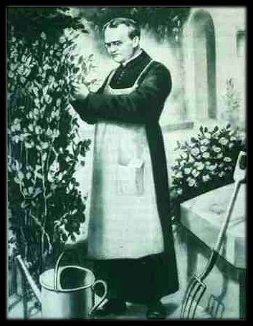
Gregor Mendel

Slide 36
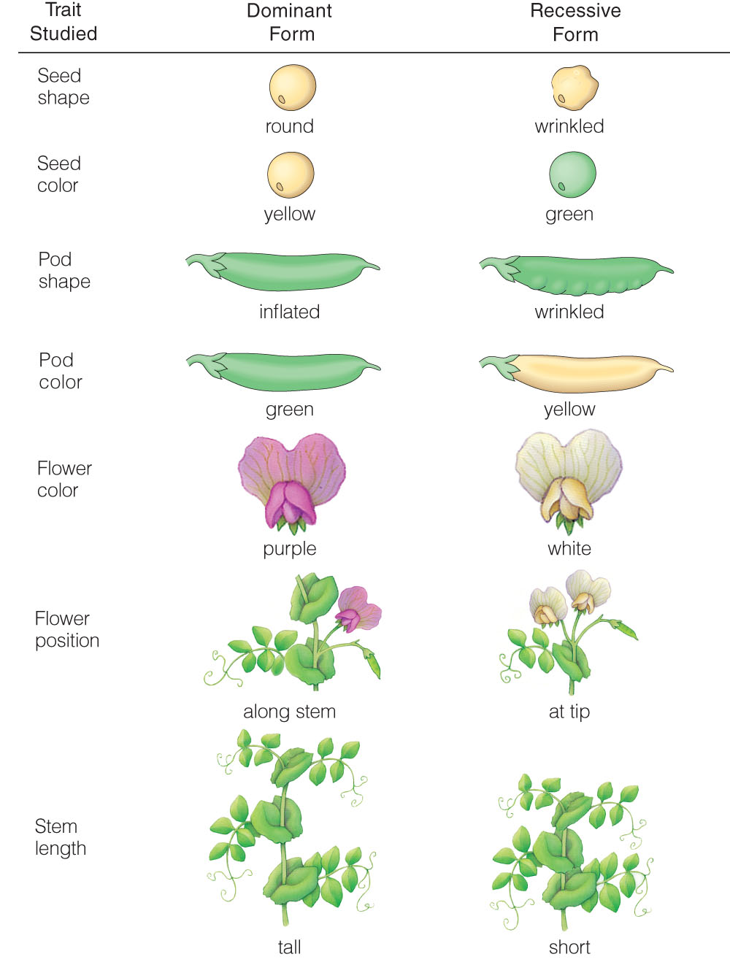
The traits Mendel studied in peas
Understanding Humans, 11th ed., p. 49

Slide 37
The traits Mendel studied in peas
Understanding Humans, 11th ed., p. 49

Slide 38
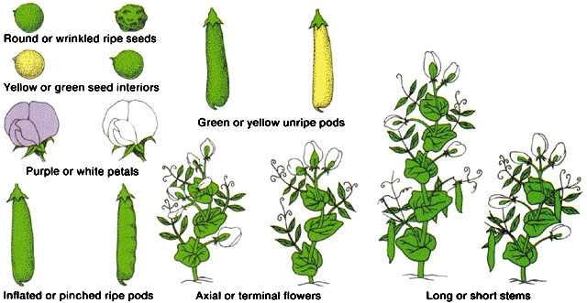
What Mendel Observed
http://nitro.biosci.arizona.edu/courses/EEB195-2007/Lecture02/Lecture02.html

Slide 39
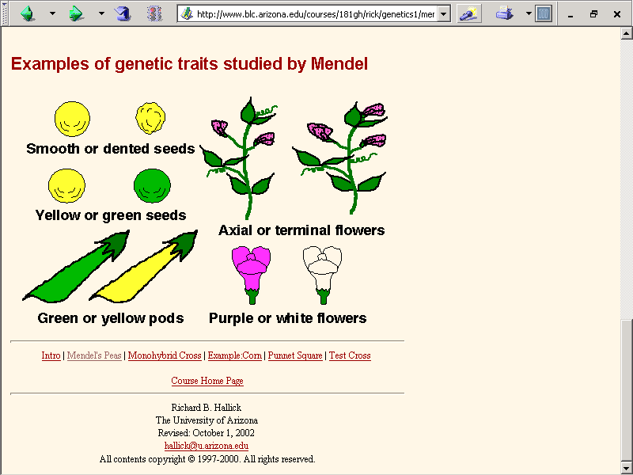
www.blc.arizona.edu/courses/181gh/rick/genetics1/mendel.html

Slide 40
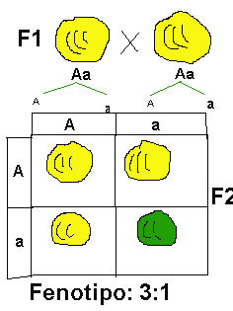
AA
aa
Punnett square representing possible genotypes
and phenotypes and their proportions in the F₂ generation.
Understanding Humans, 10th ed., p. 53
Conceptos básicos : Mendel: Experiment 1

Slide 41
Aa
Aa
Punnett square representing possible genotypes
and phenotypes and their proportions in the F₂ generation.
Understanding Humans, 10th ed., p. 53
Conceptos básicos : Mendel: Experiment 1

Slide 42

3:1 ratio of Yellow : Green in F2
http://nitro.biosci.arizona.edu/courses/EEB195-2007/Lecture02/Lecture02.html

Slide 43
Results of crosses when only one trait at a time is considered
Understanding Humans, 11th ed., p. 49

Slide 44
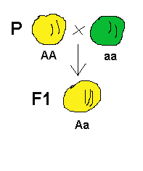
AA + aa
Aa + Aa
Genotypes and phenotypes in the F₁ generation.
Conceptos básicos : Mendel: Experiment 1

Slide 45
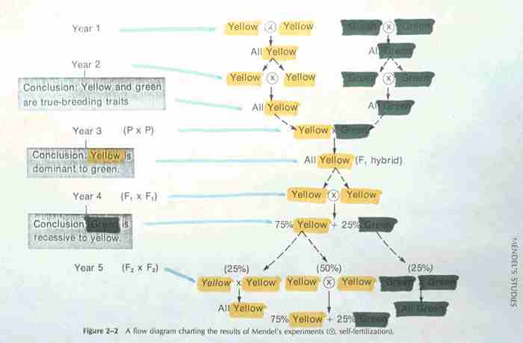
AA
aa

Slide 46
AA
aa
Aa

Slide 47
Aa
Aa

Slide 48
AA + 2 Aa
+ aa

Slide 49
25% + 50% + 25%

Slide 50
25% + 50% + 25%
AA
Aa
aa

Slide 51
75%
AA or Aa
25%
aa

Slide 52
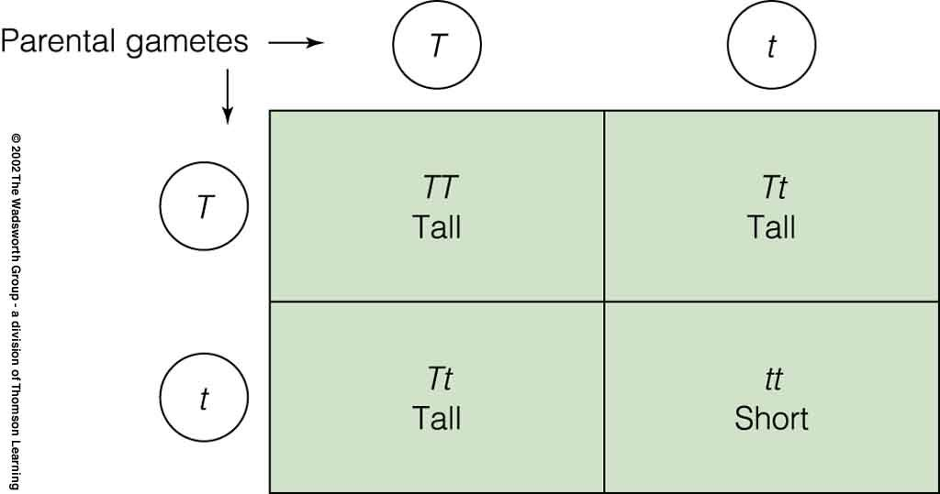
Punnett square representing possible genotypes
and phenotypes and their proportions in the F₂ generation.
Understanding Humans, 11th ed., p. 51

Slide 53
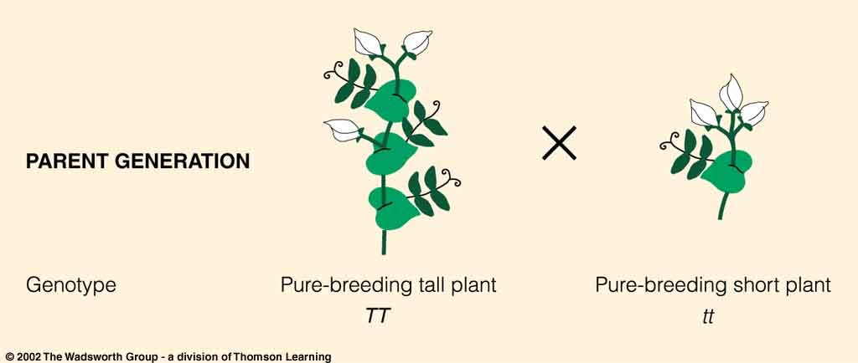
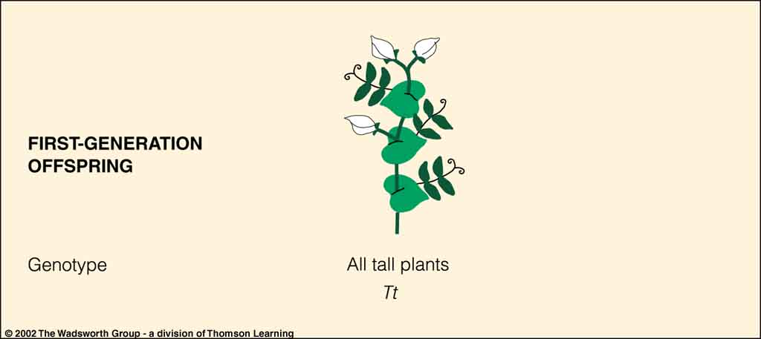
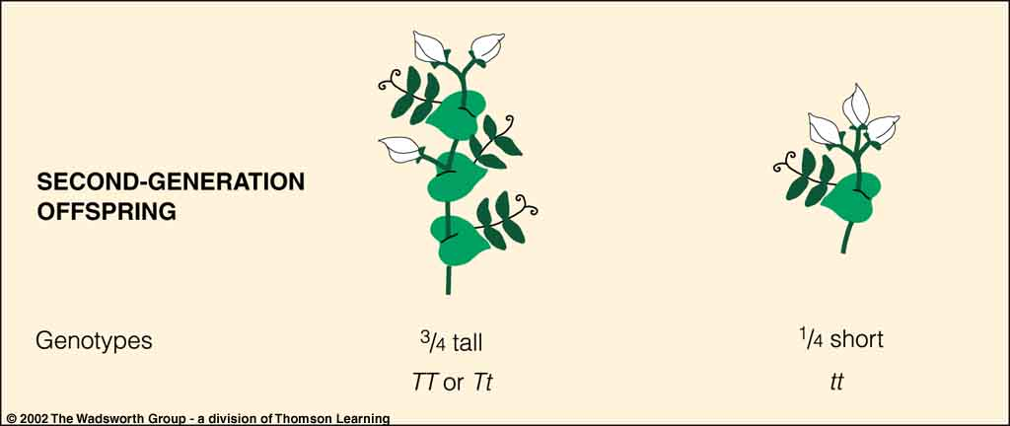
Result of crosses when only one trait at a time is considered
Understanding Physical Anthropology and Archaeology, 9th ed., p. 49

Slide 54
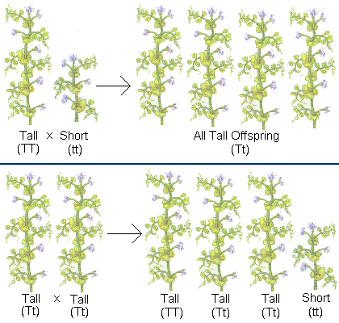
75%
25%
Punnett square representing possible genotypes
and phenotypes and their proportions in the F₂ generation.
Think-Quest: Introduction to Genetics

Slide 55
Glossary
dominant
describing a genetic trait governed by an allele
(one of a group of genes)
that can be expressed in the presence of another, different allele

Slide 56
Genotypes and phenotypes in the F₁ generation.
Conceptos básicos : Mendel: Experiment 1

Slide 57
Glossary
recessive
describing a genetic trait that is not expressed in heterozygotes
Aa
Tt

Slide 58
Glossary
recessive
for a recessive allele to be expressed, there must be two copies of the allele, i.e., the individual must be homozygous
aa
tt

Slide 59
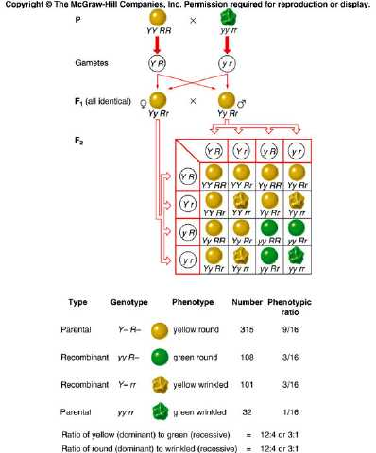
Crosses with Two traits
http://nitro.biosci.arizona.edu/courses/EEB195-2007/Lecture02/Lecture02.html

Slide 60
Glossary
sex-linked trait
traits carried by genes located on the X or Y sex chromosomes
genetically normal females: XX
genetically normal males: XY

Slide 61
Glossary
sex-linked trait
most X-linked characteristics are recessive in females
which means that unless they are present on both X chromosomes of a female, the trait is carried but not expressed

Slide 62
Glossary
sex-linked trait
males, with only one X chromosome, more commonly exhibit such traits phenotypically
e.g. hemophilia
e.g. red-green color blindness

Slide 63
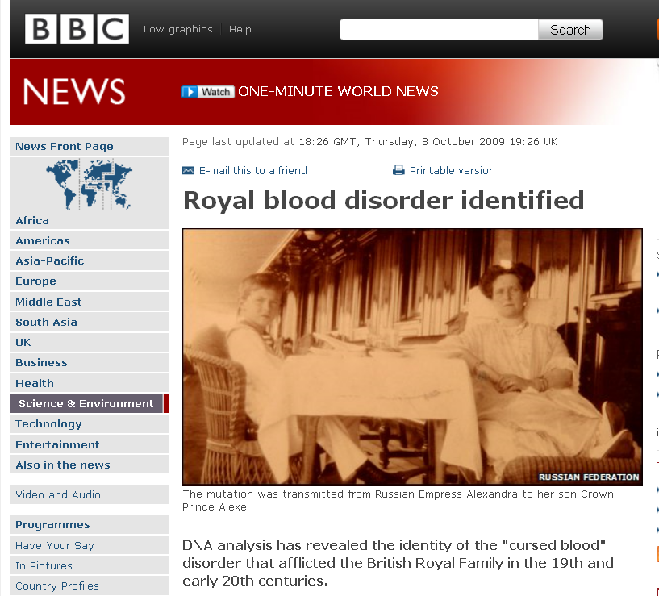
http://news.bbc.co.uk/2/hi/science/nature/8297467.stm

Slide 64
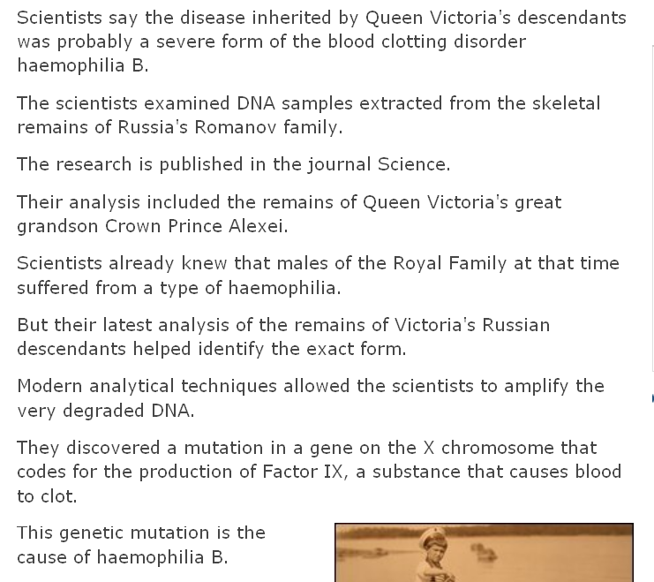
http://news.bbc.co.uk/2/hi/science/nature/8297467.stm

Slide 65
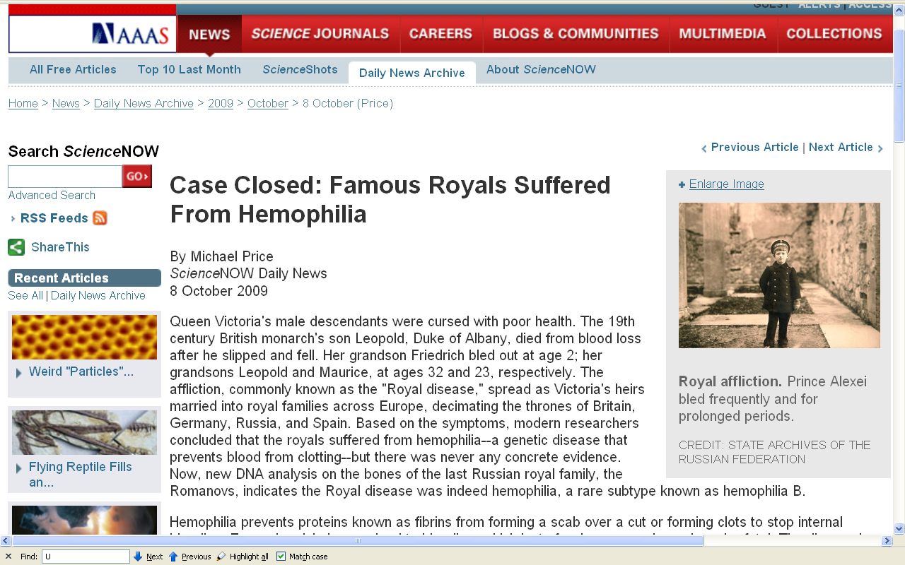
http://sciencenow.sciencemag.org/cgi/content/full/2009/1008/2

Slide 66
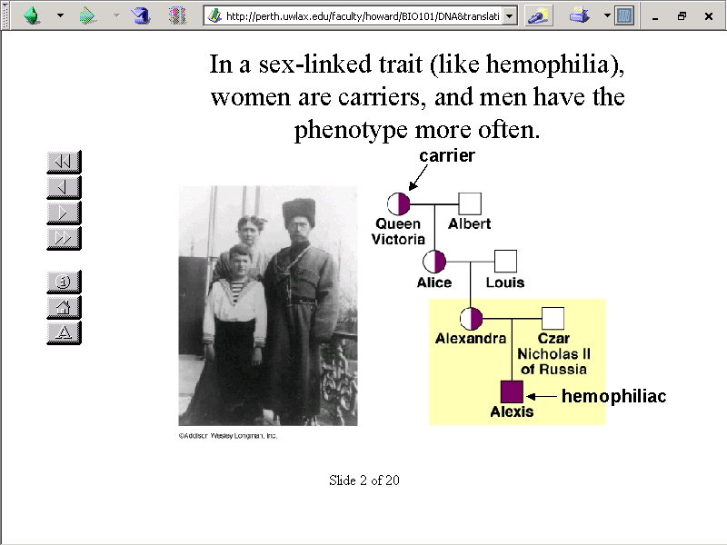
perth.uwlax.edu/faculty/howard/BIO101/DNA&translation/sld002.htm

Slide 67
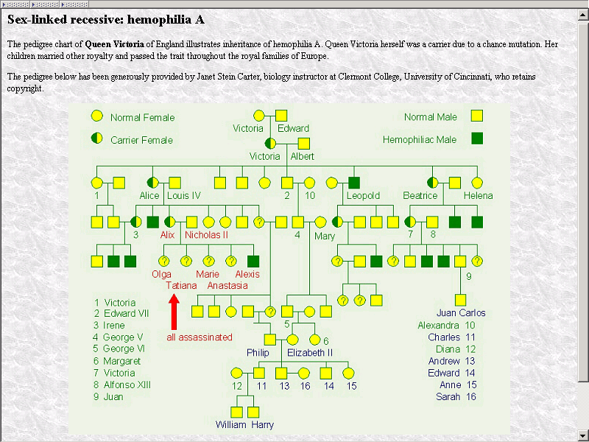
Diana
“Kate” Middleton
brie.medlabscience.med.ualberta.ca/de/genetics/70gen-hemophil.html

Slide 68
sex-linked trait
aka “Holandric Inheritance”
Y-linked traits, which are directly involved with determining maleness, are manifested only by males
known examples are rare but probably include the long hairs on the ear rims of some adult males in India, Ceylon, Israel and aboriginal Australia

Slide 69
Important People / Works
Hugo de Vries
(1848 - 1935)
in 1900 rediscovered Mendel’s work on plant hybrids

Slide 70
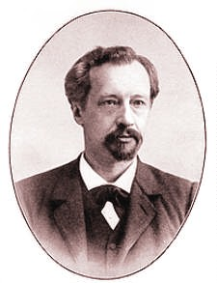
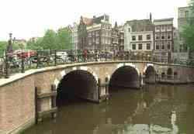
Hugo de Vries
1848-1935
Canal houses in Amsterdam.

Slide 71
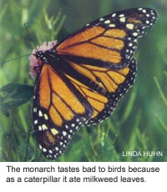
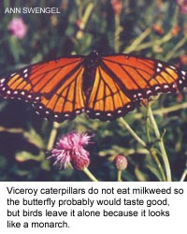
Mimicry
Minnesota Department of Natural Resources

Slide 72
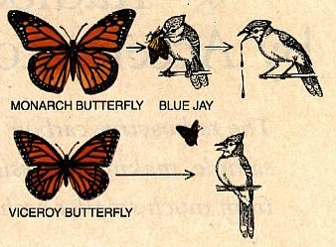
Mimicry
Predaatio: saaliin ja saalistajan kilpajuoksu

Slide 73
so where did
those pink
flowers
Come from?

Slide 74
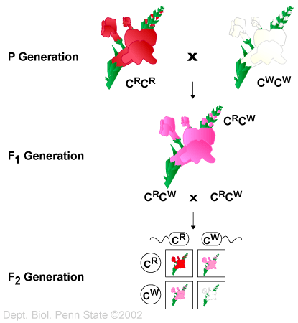
-- Penn State Biology Department
Incomplete dominance in snapdragon color http://courses.bio.psu.edu/fall2005/biol110/tutorials/tutorial5.htm

Slide 75
“In Mendel's experiments, offspring always looked like one of their two parents due to the complete dominance of one allele over the other.”
“This is not always the case because some genes display
incomplete dominance
and individuals with heterozygous alleles exhibit a phenotype intermediate between those with homozygous alleles.”
-- Penn State Biology Department
http://courses.bio.psu.edu/fall2005/biol110/tutorials/tutorial5.htm

Slide 76
“In Mendel's experiments, offspring always looked like one of their two parents due to the complete dominance of one allele over the other.”
“This is not always the case because some genes display
incomplete dominance
and individuals with heterozygous alleles exhibit a phenotype intermediate between those with homozygous alleles.”
-- Penn State Biology Department
http://courses.bio.psu.edu/fall2005/biol110/tutorials/tutorial5.htm

Slide 77
“Since neither allele dominates over the other, the use of an uppercase and lowercase version of the same letter is inappropriate. In this example, the character (i.e., flower color) is indicated by a letter (C), and the alleles (encoding the trait; i.e., white, blue or red) are listed as uppercase subscripts (recall, they are both uppercase because neither is dominant to the other).” -- Penn State Biology Department
http://courses.bio.psu.edu/fall2005/biol110/tutorials/tutorial5.htm

Slide 78
Misconceptions of Darwin’s Work
Some thought Darwin’s work was anti-religious
Wrong

Slide 79
Misconceptions of Darwin’s Work
Some thought Darwin took the position that humans descended from an ape
Wrong

Slide 80
“In the distant future . . .
light will be thrown on the origin of man and his history.” – Origin of Species, 1859

Slide 81
Important People / Works
Thomas H. Huxley
(1825 - 1895)
[Evidence as to] Man’s Place in Nature 1863

Slide 82
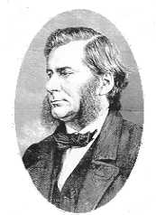
Thomas Henry Huxley
1825 - 1895

Slide 83
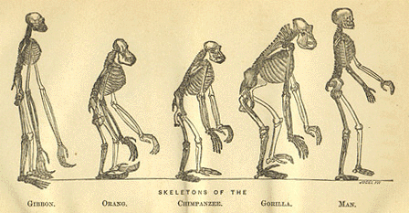
Frontispiece from T. H. Huxley's Evidence as to Man's Place in Nature
(London: Williams and Norgate, 1863)

Slide 84
Important People / Works
Charles Darwin
(1809 - 1882)
Origin of Species
1859
Descent of Man 1871

Slide 85
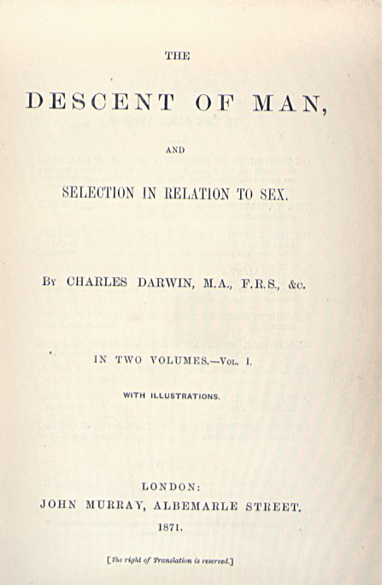
Charles Darwin
1871

Slide 86
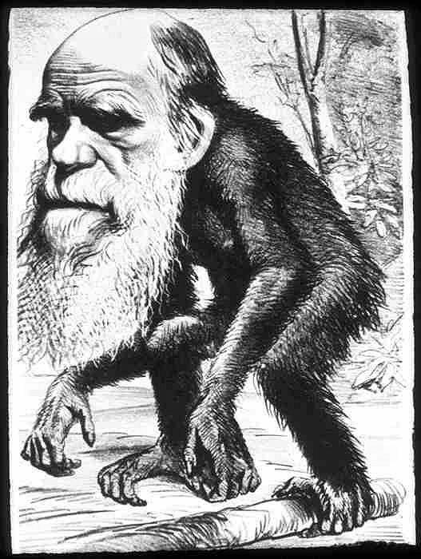

Slide 87
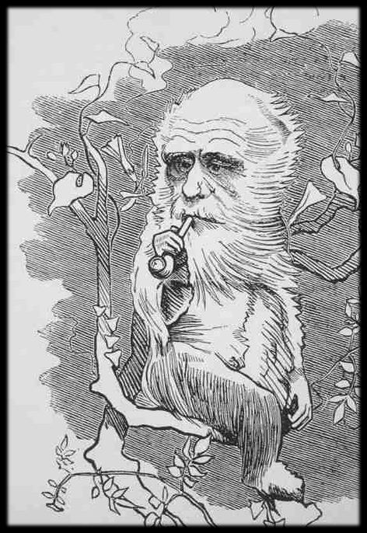

Slide 88
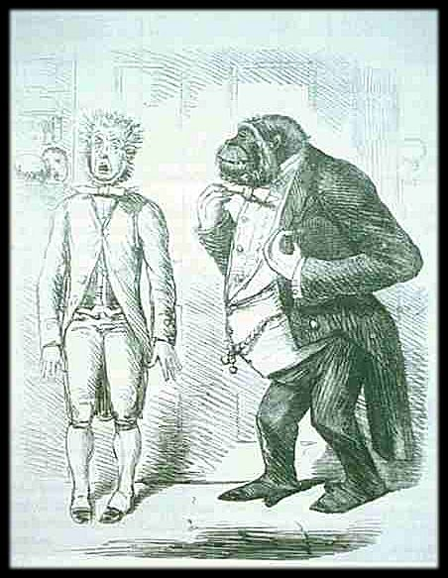

Slide 89
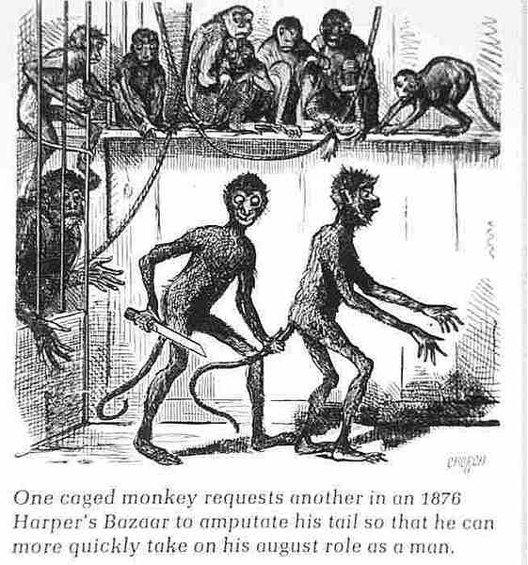

Slide 90
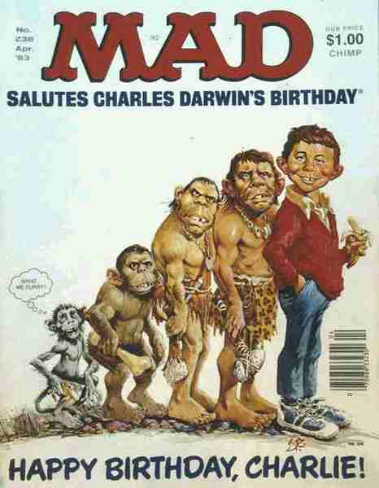

Slide 91
Prehistoric Cultures
Continue on to Set #06B
Conceptual Changes Between the 18th and 20th Centuries

