Slide 1
Prehistoric Cultures
Major Characteristics of Modern Physical Anthropology
#8

Slide 2
Modern Physical Anthropology
Work on population studies, including effect of population density on behavior

Slide 3
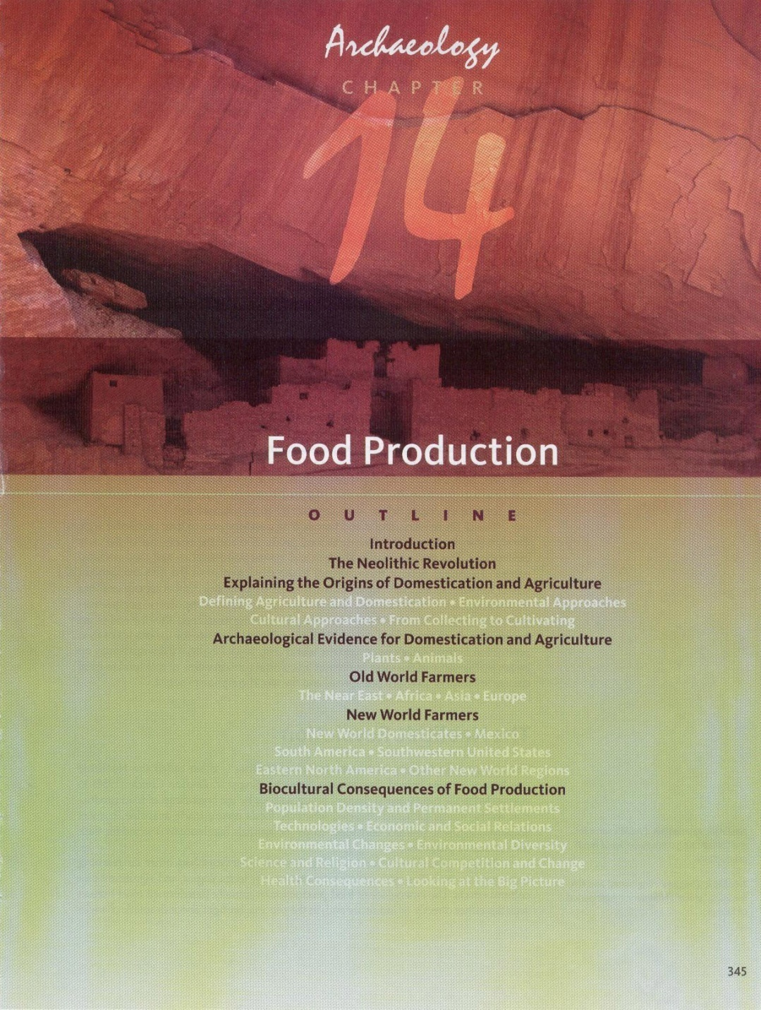

Slide 4
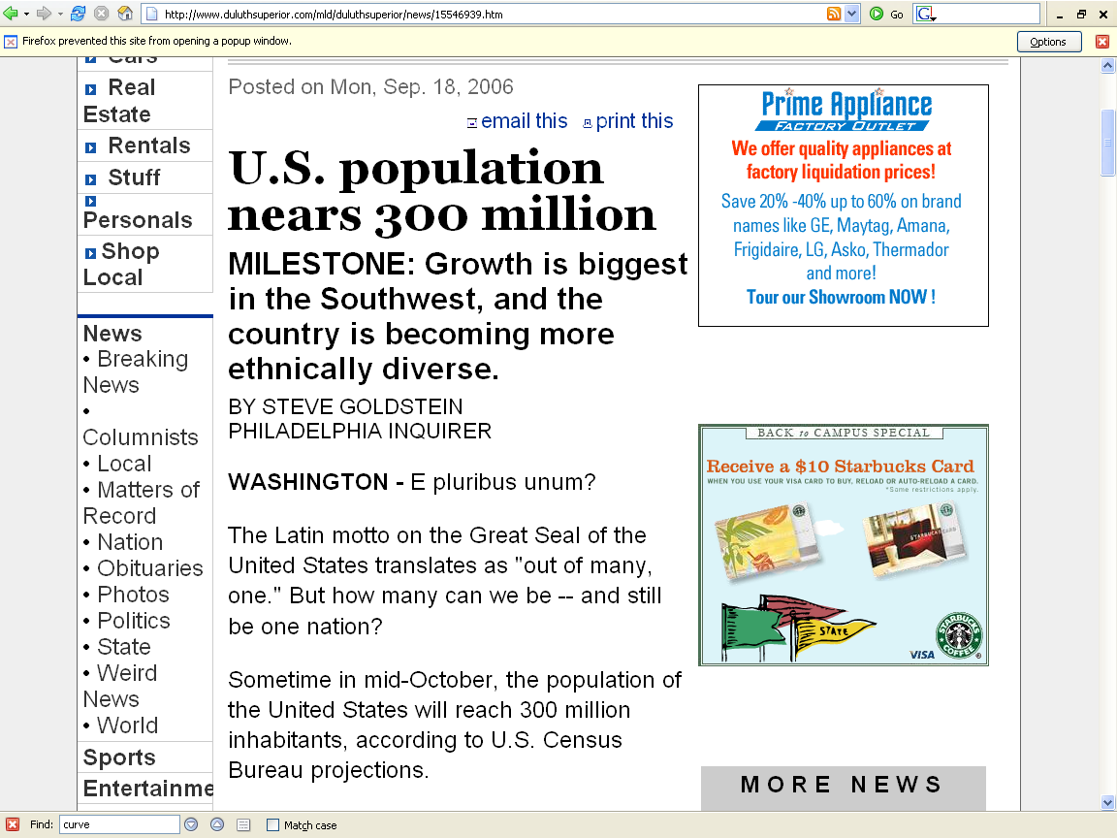
www.duluthsuperior.com/mld/duluthsuperior/news/15546939.htm

Slide 5

news.bbc.co.uk/2/hi/americas/6057004.stm

Slide 6
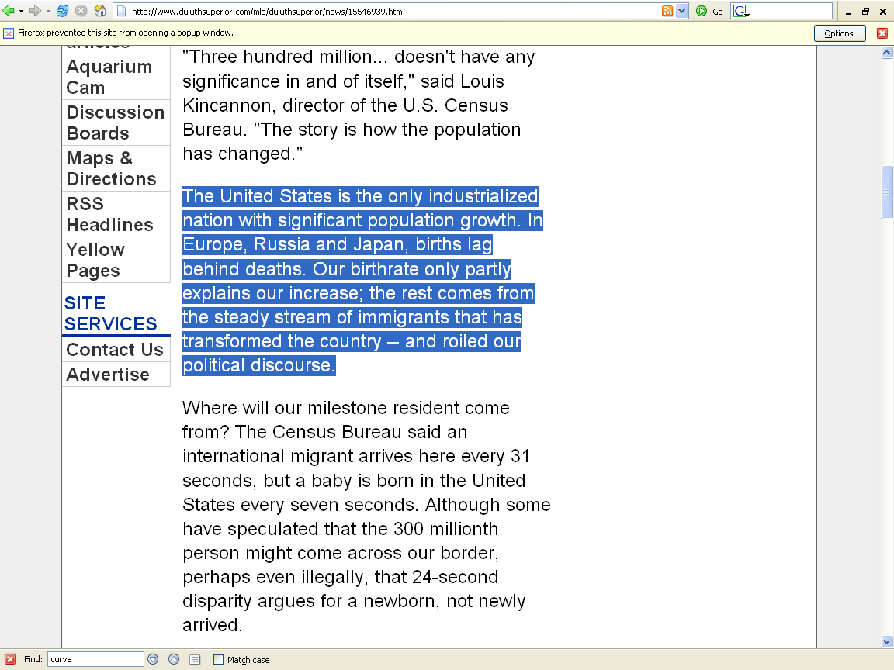
http://www.duluthsuperior.com/mld/duluthsuperior/news/15546939.htm

Slide 7
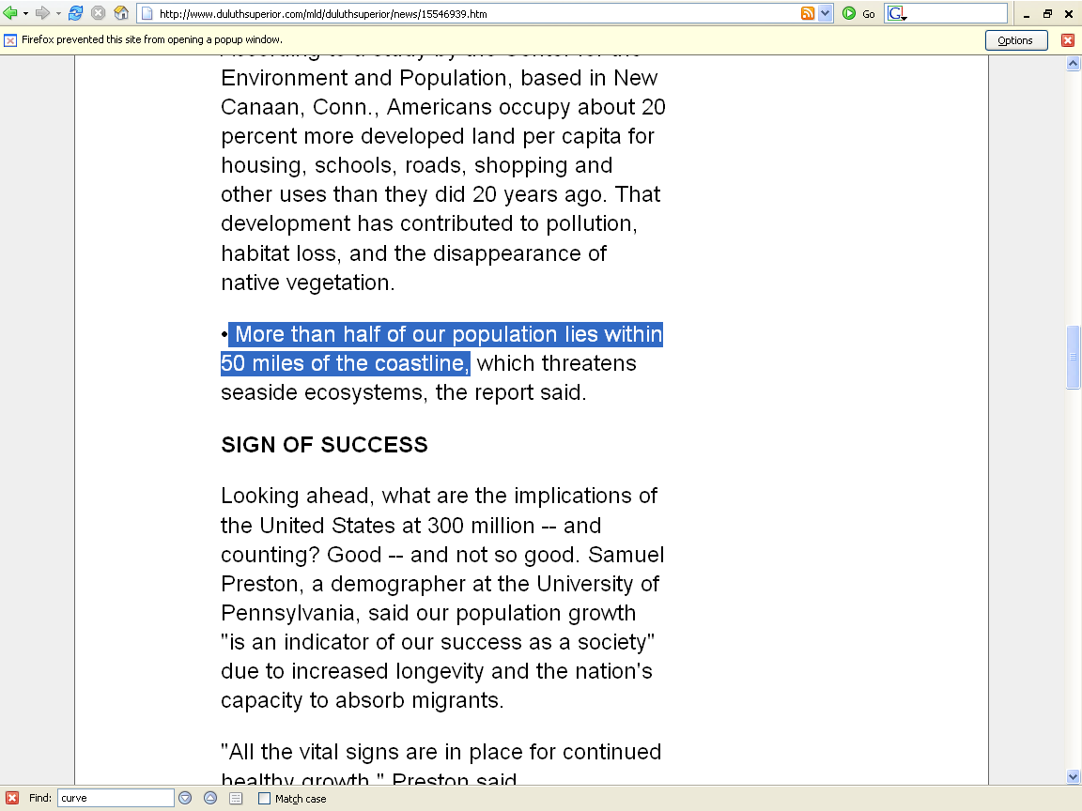
http://www.duluthsuperior.com/mld/duluthsuperior/news/15546939.htm

Slide 8
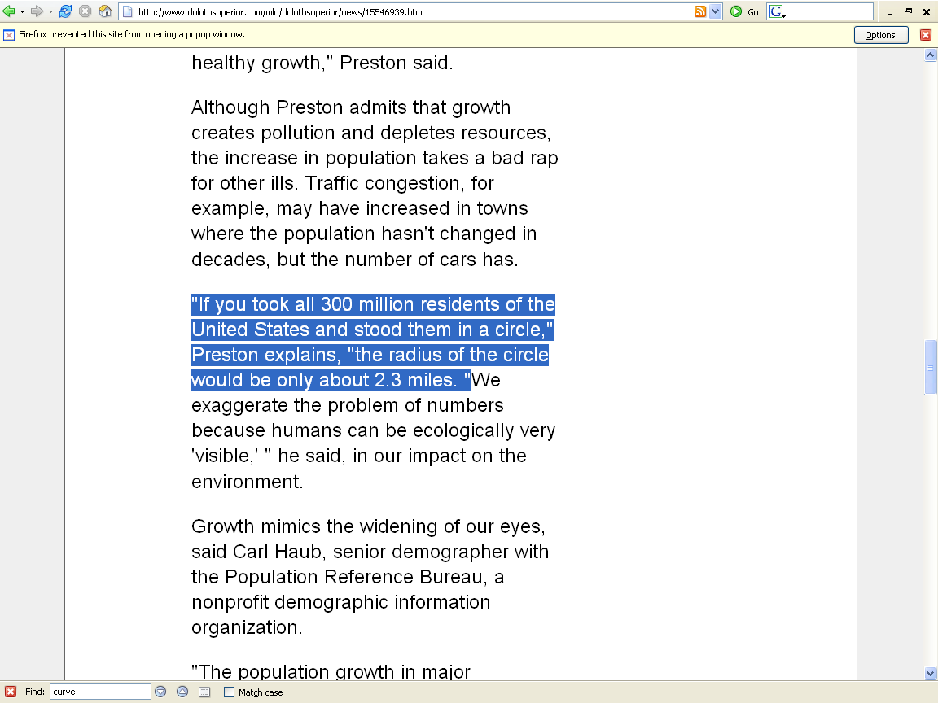
http://www.duluthsuperior.com/mld/duluthsuperior/news/15546939.htm

Slide 9
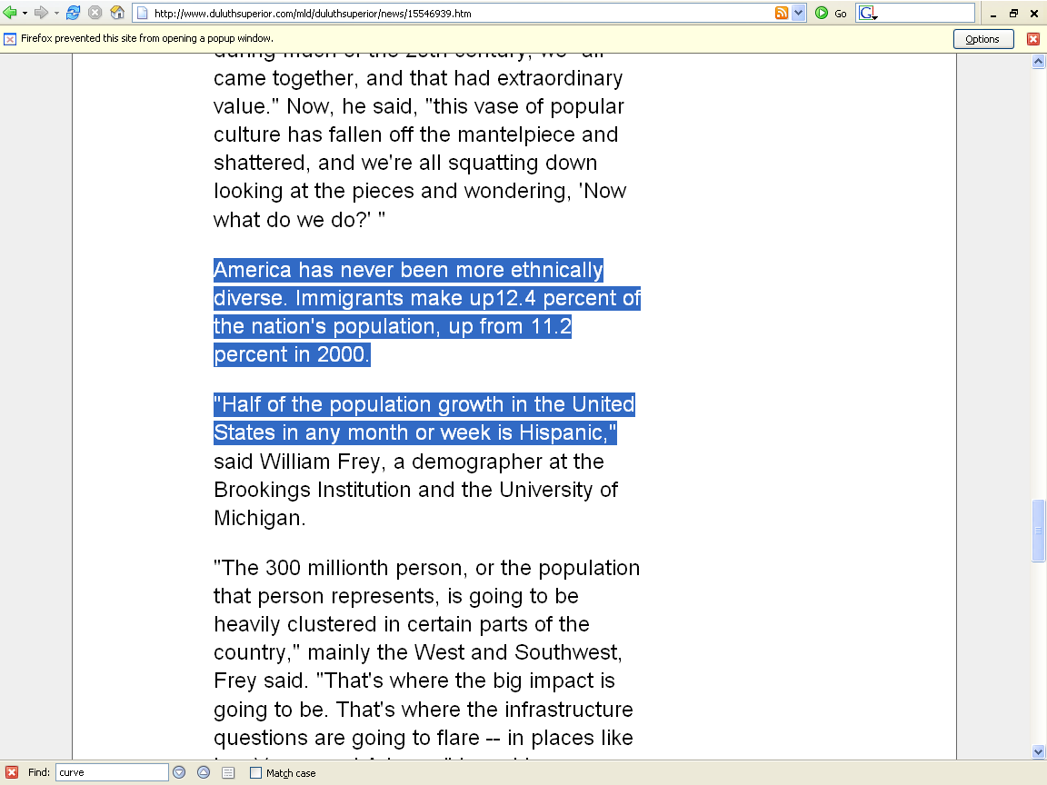
http://www.duluthsuperior.com/mld/duluthsuperior/news/15546939.htm

Slide 10
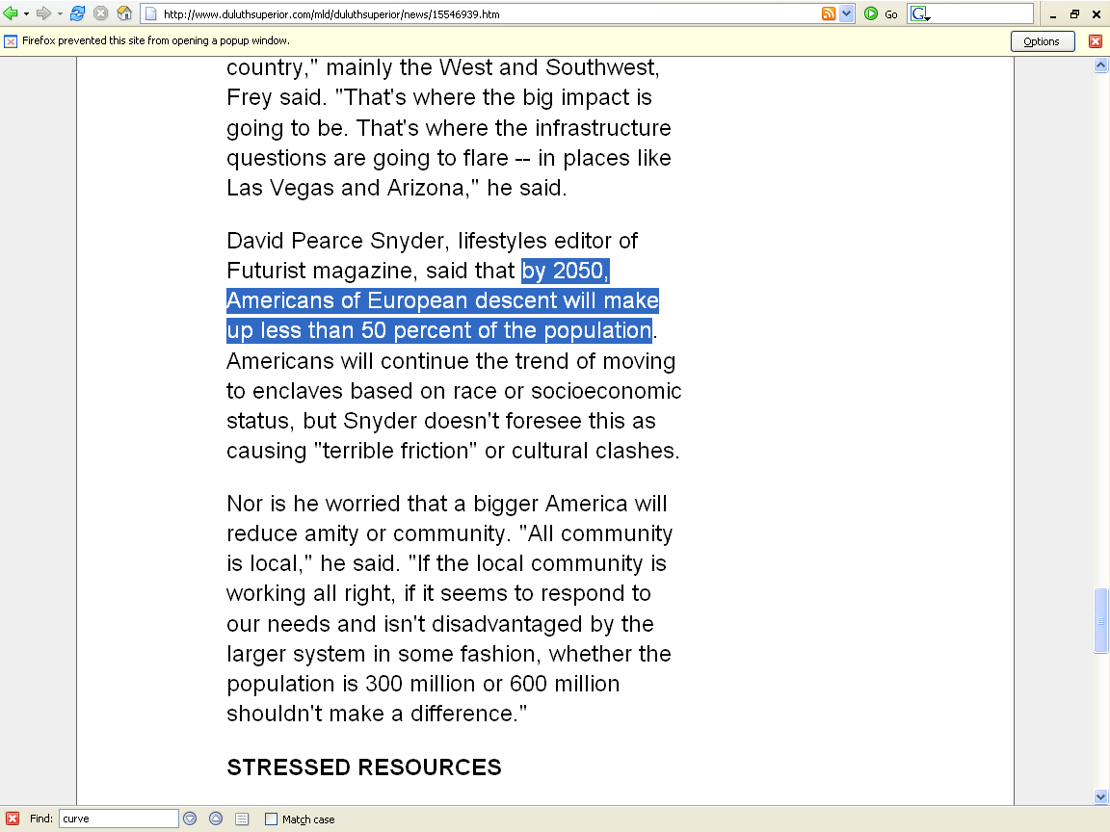
http://www.duluthsuperior.com/mld/duluthsuperior/news/15546939.htm

Slide 11
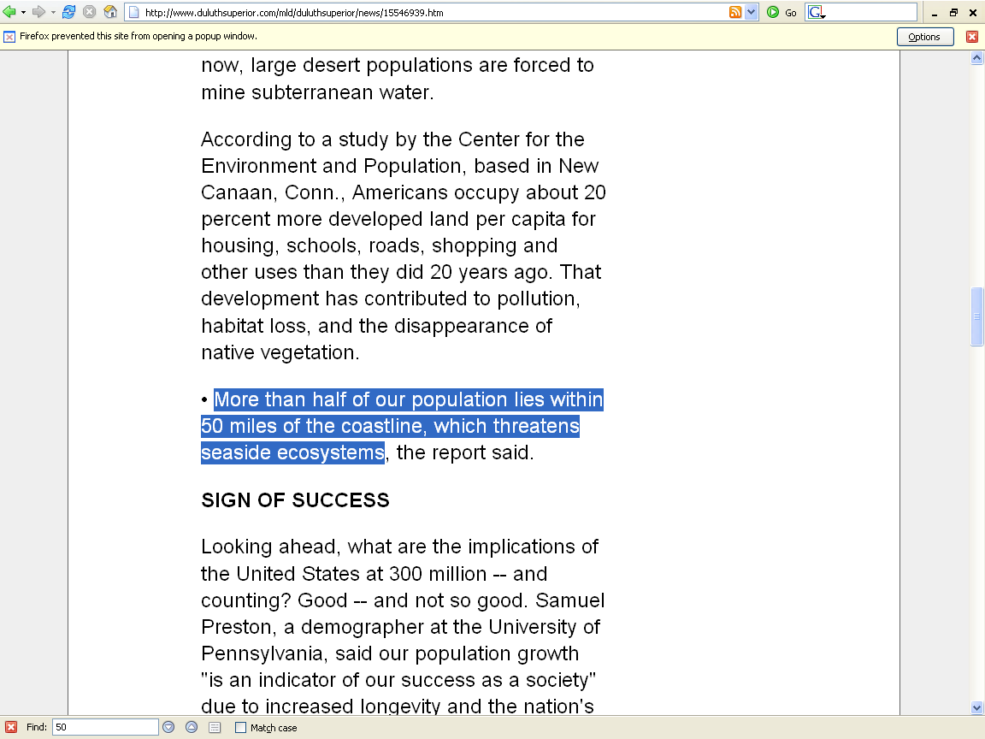
http://www.duluthsuperior.com/mld/duluthsuperior/news/15546939.htm

Slide 12
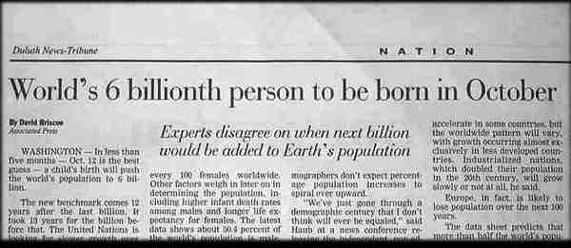
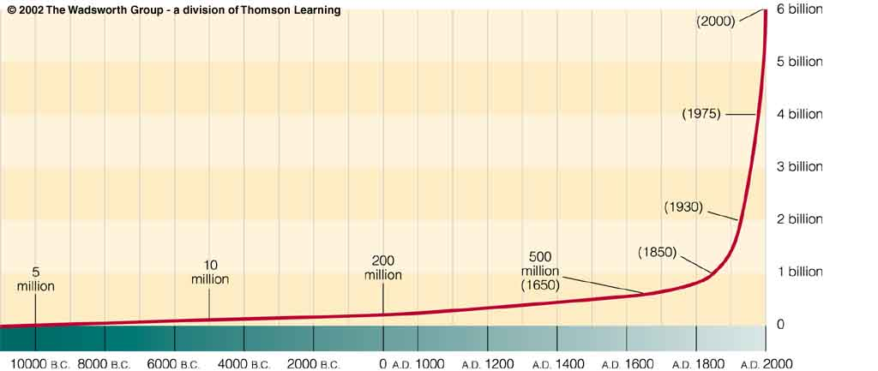
Understanding Physical Anthropology and Archaeology, 9th ed., pp. 365.

Slide 13
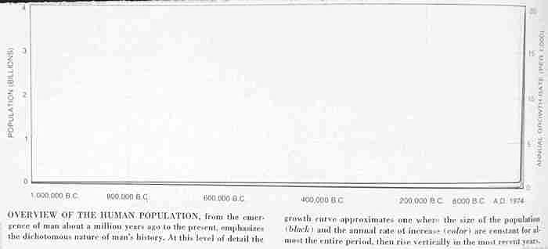

Slide 14
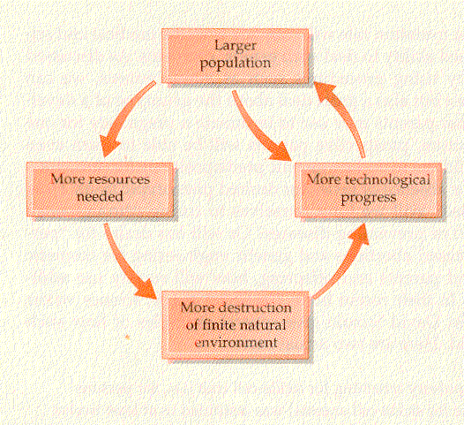
Campbell – Loy, Humankind Emerging, 7th ed., p. 545

Slide 15
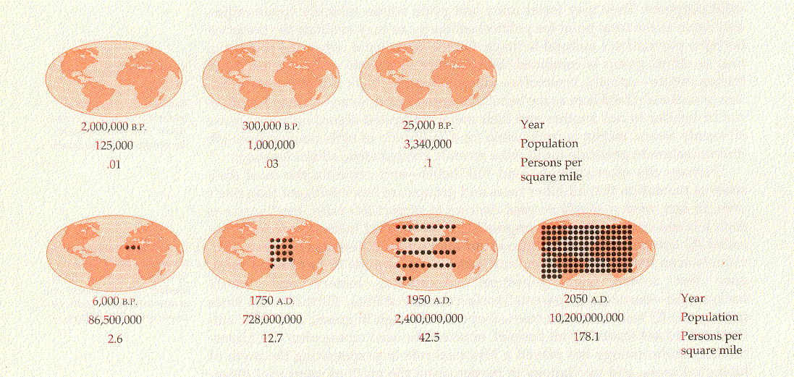
Campbell – Loy, Humankind Emerging, 7th ed., p. 542

Slide 16
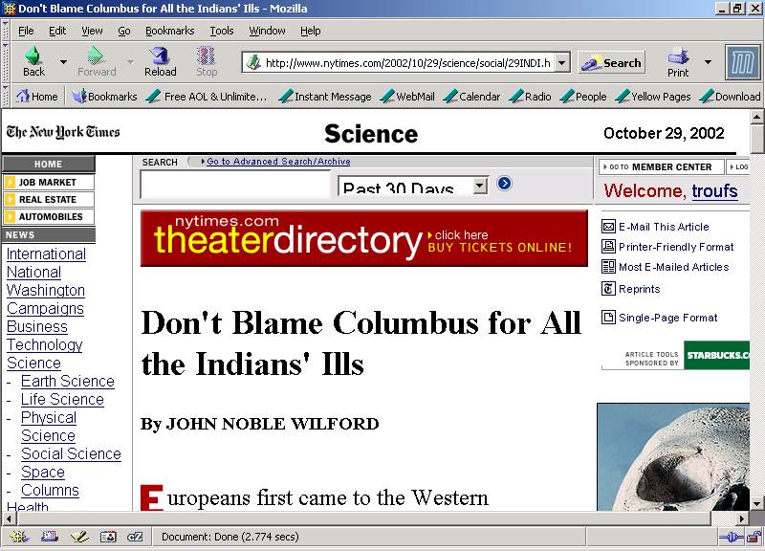
8.3

Slide 17
The Backbone of History: Health and Nutrition in the Western Hemisphere, Richard H. Steckel and Dr. Jerome C. Rose (Cambridge University Press, 2002).
“The researchers attributed the widespread decline in health in large part to the rise of agriculture and urban living.”
“The more mobile, less densely settled populations were usually the healthiest pre-Columbians.”
“Even so, in the simplest hunter-gatherer societies, few people survived past age 50. In the healthiest cultures in the 1,000 years before Columbus, a life span of no more than 35 years might be usual.”
8.3

Slide 18
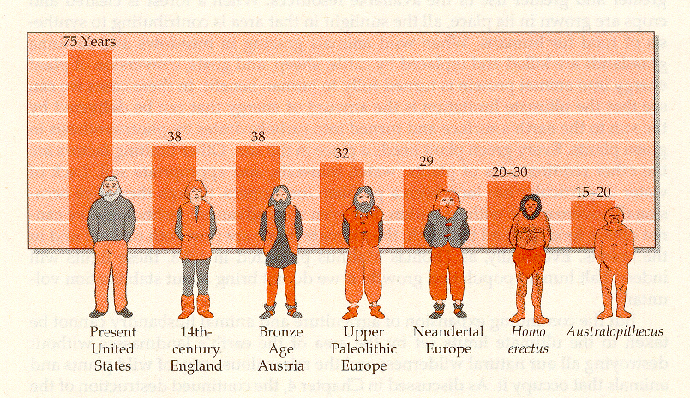
Campbell – Loy, Humankind Emerging, 7th ed., p. 544

Slide 19
Basic Concepts
average life span = ca. 76
“potential life span”
=
ca. 116

Slide 20
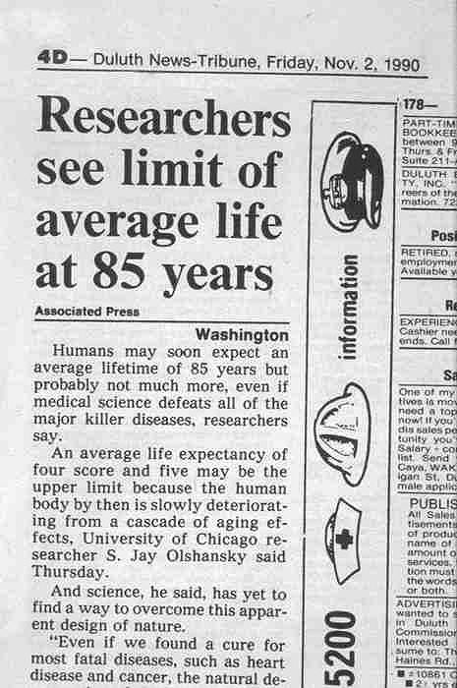

Slide 21
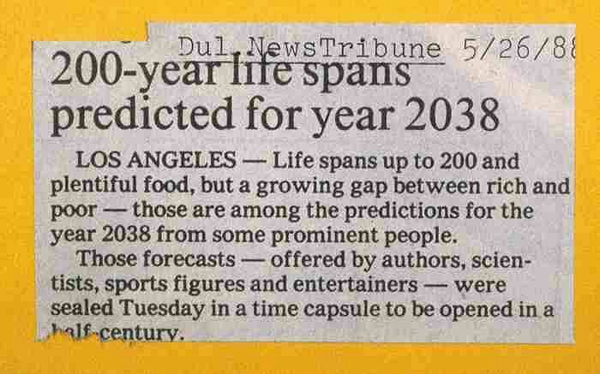

Slide 22
Modern Physical Anthropology
differential reproduction
differential survival

Slide 23
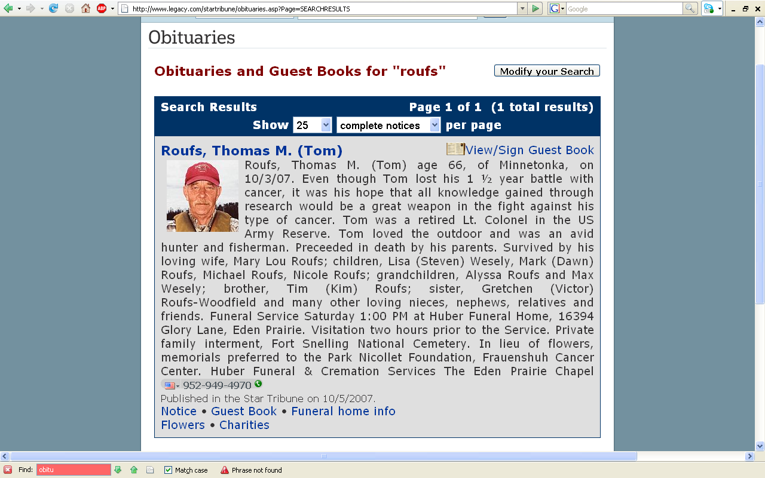
] 6
www.startribune.com/

Slide 24
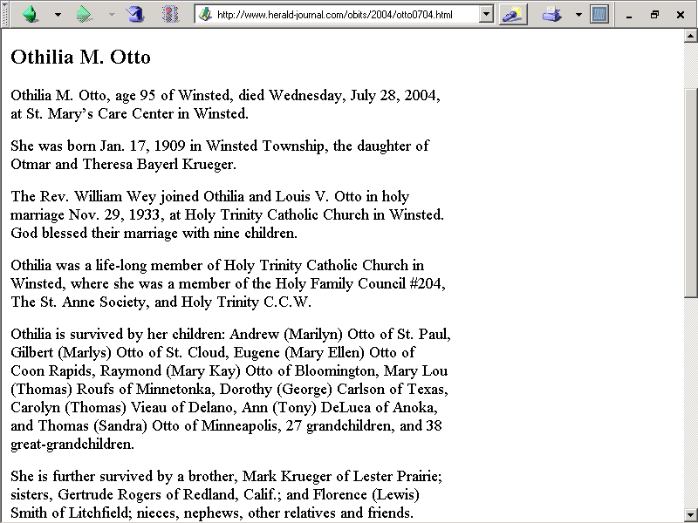
] 74
http://www.herald-journal.com/obits/2004/otto0704.html

Slide 25
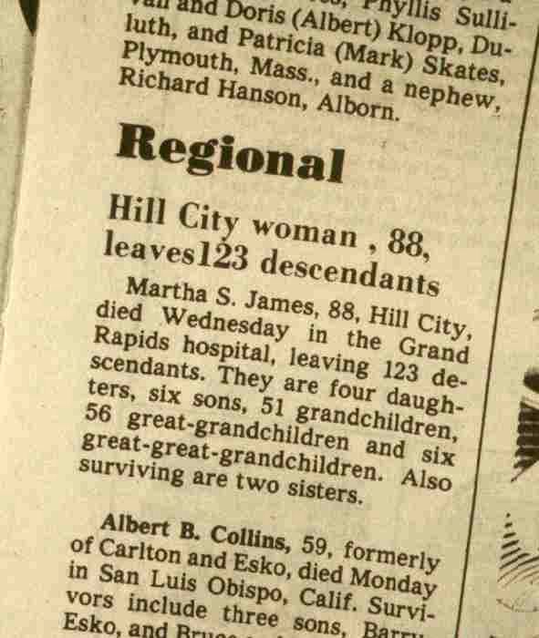

Slide 26
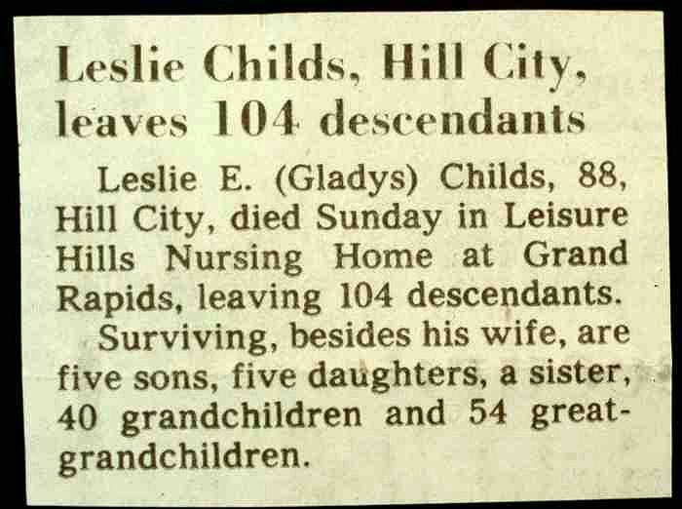

Slide 27
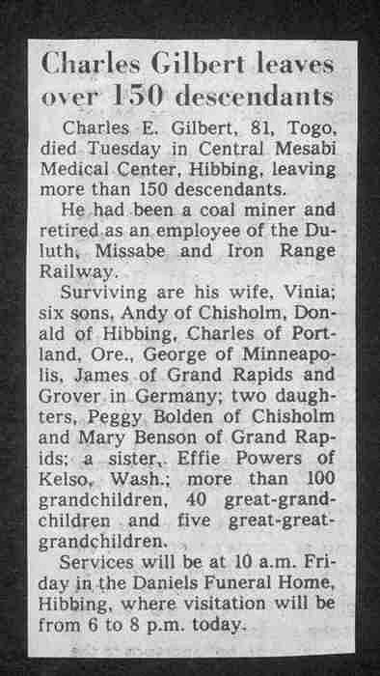

Slide 28
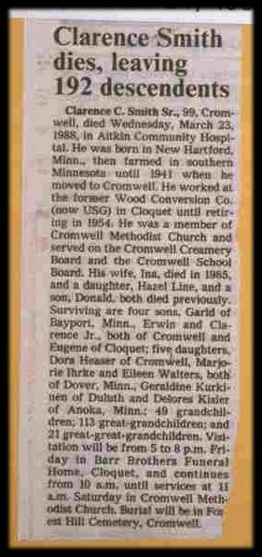

Slide 29
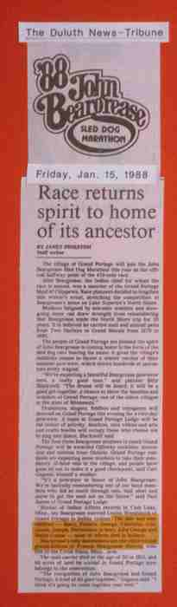

Slide 30
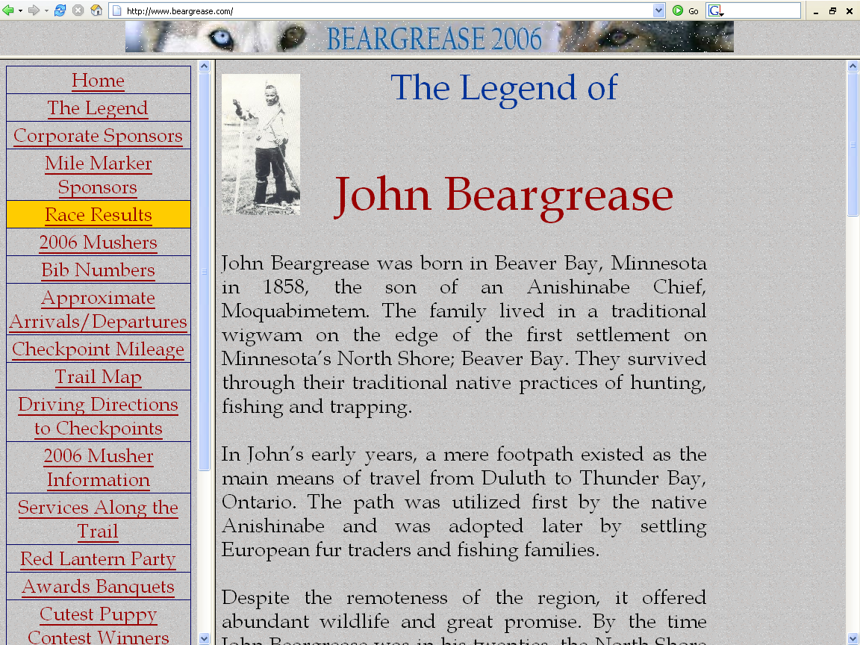
http://www.beargrease.com/

Slide 31
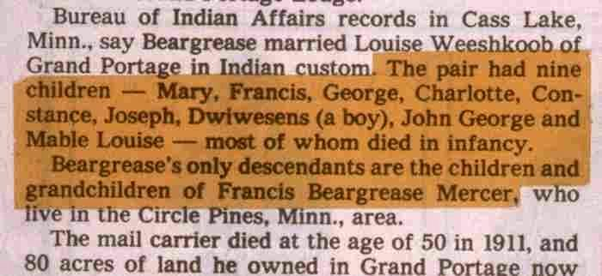

Slide 32
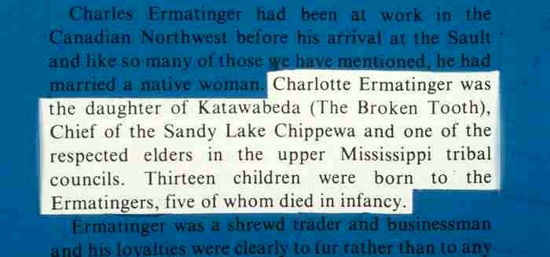

Slide 33
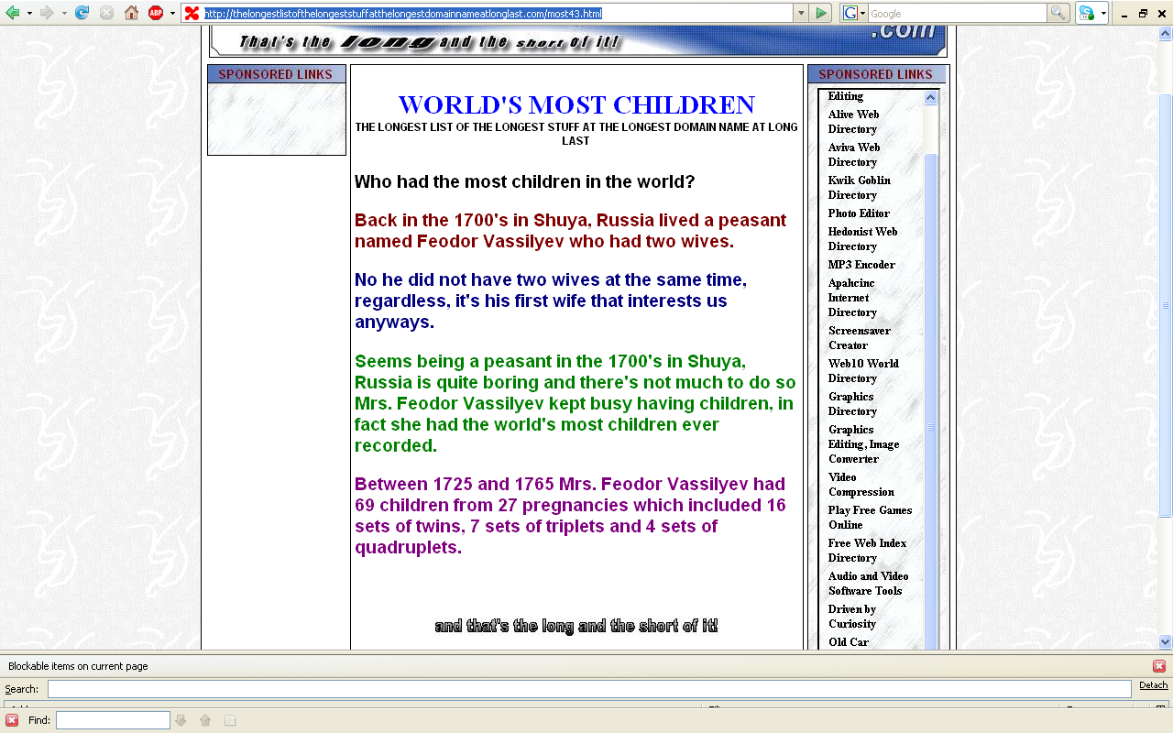
] 6
69 [
] 74
http://thelongestlistofthelongeststuffatthelongestdomainnameatlonglast.com/most43.html

Slide 34
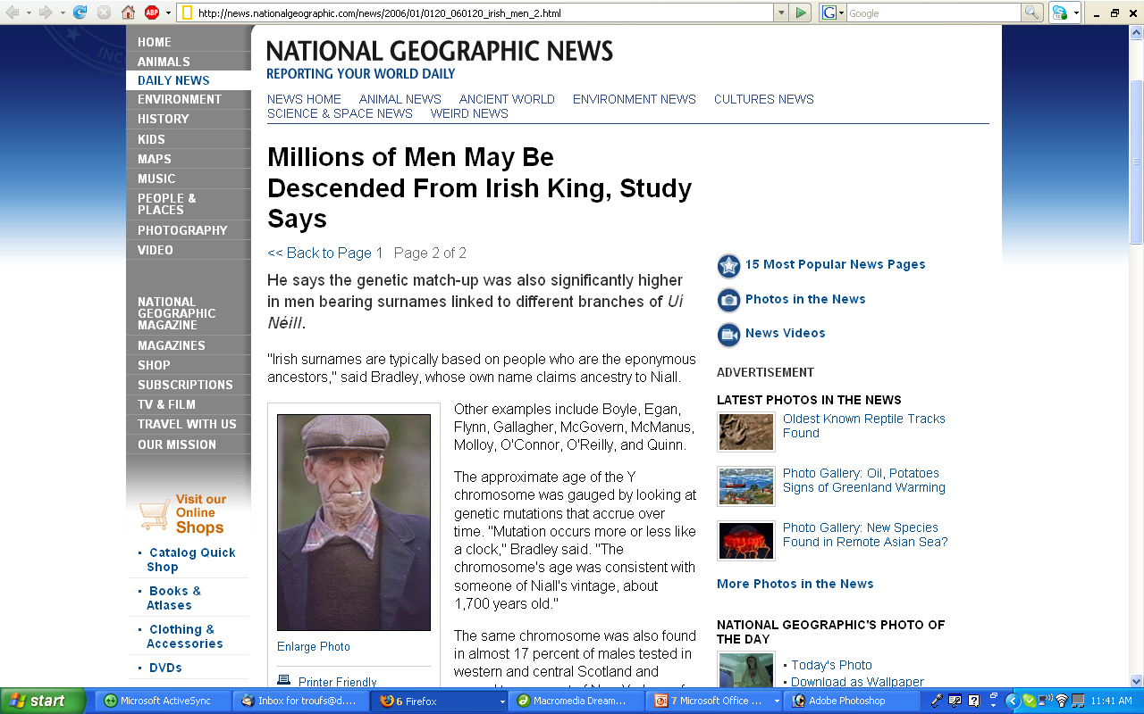
] 6
] 74
http://news.nationalgeographic.com/news/2006/01/0120_060120_irish_men_2.html/

Slide 35
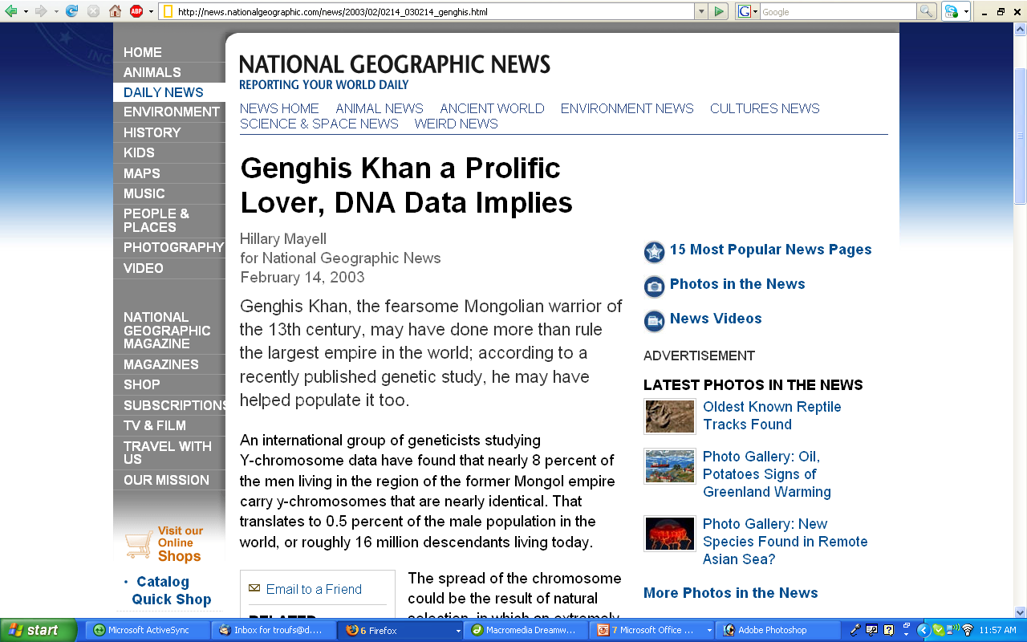
] 6
] 74
http://news.nationalgeographic.com/news/2003/02/0214_030214_genghis.html

Slide 36
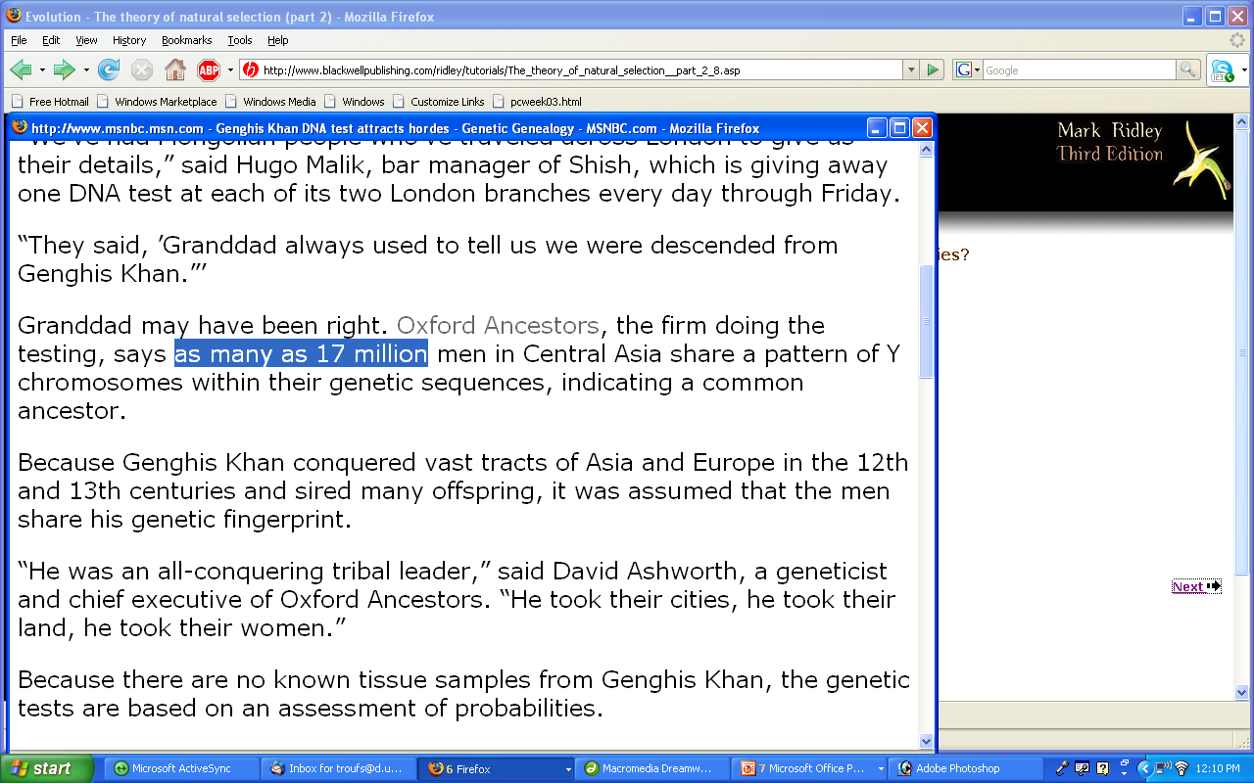
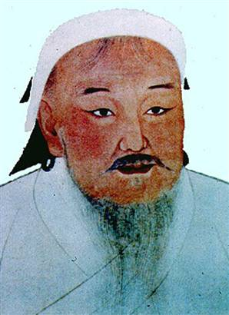
] 6
] 74
www.msnbc.msn.com/id/5379014/

Slide 37
Modern Physical Anthropology
special situations

Slide 38
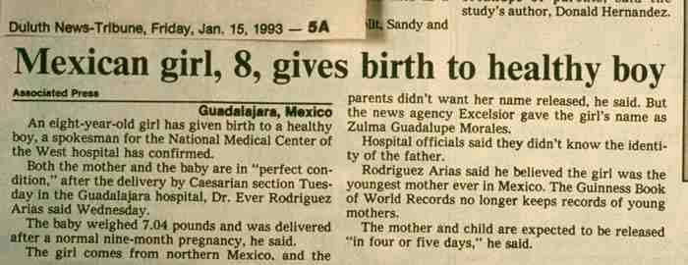

Slide 39
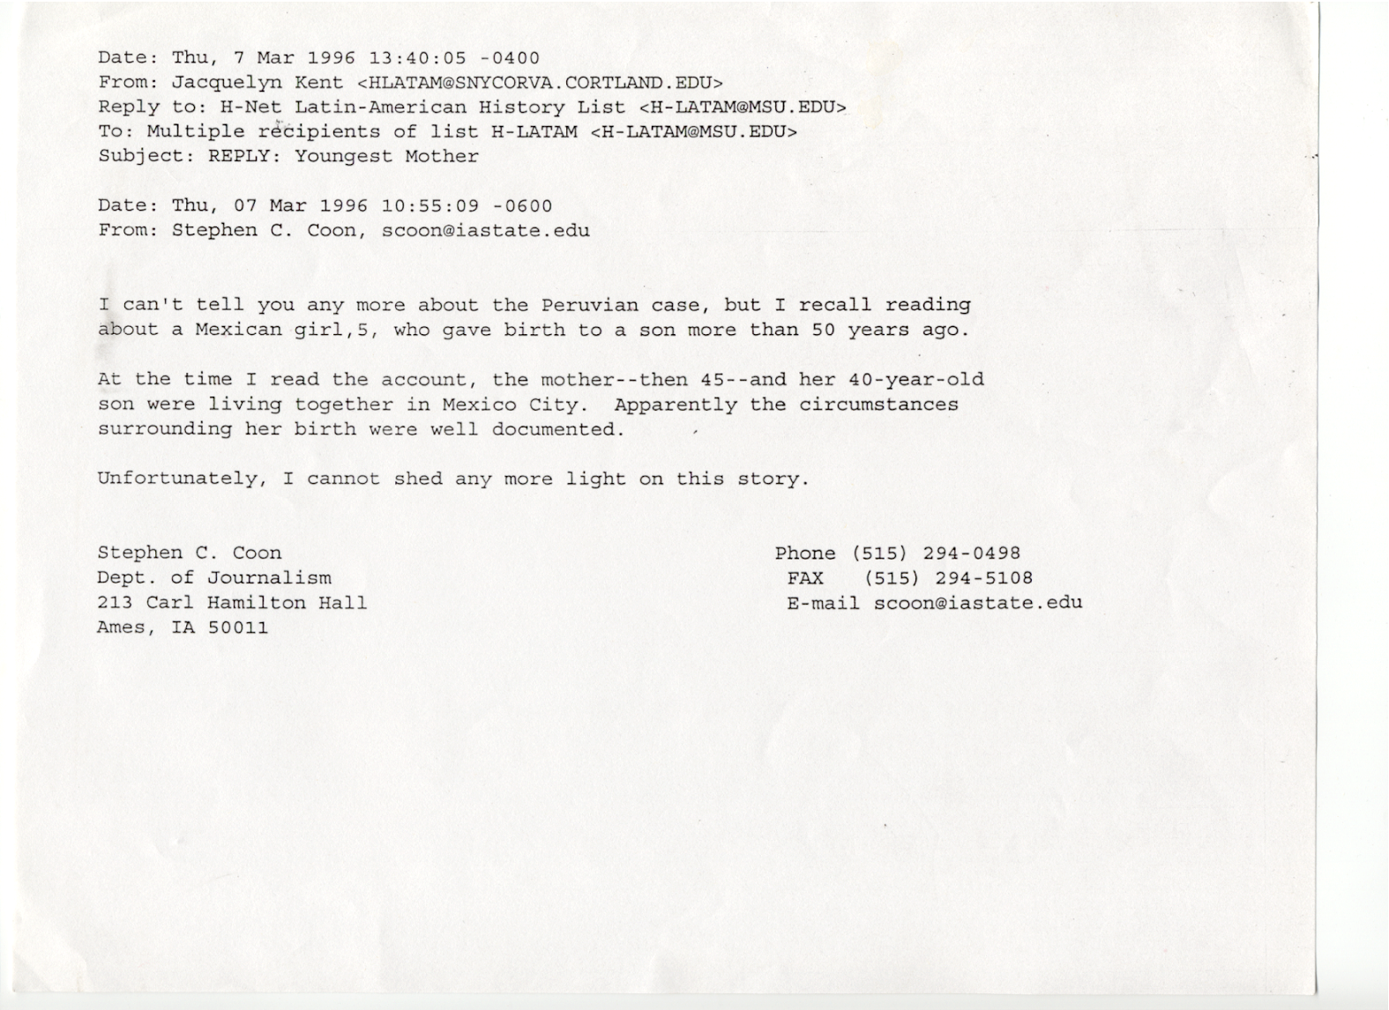

Slide 40
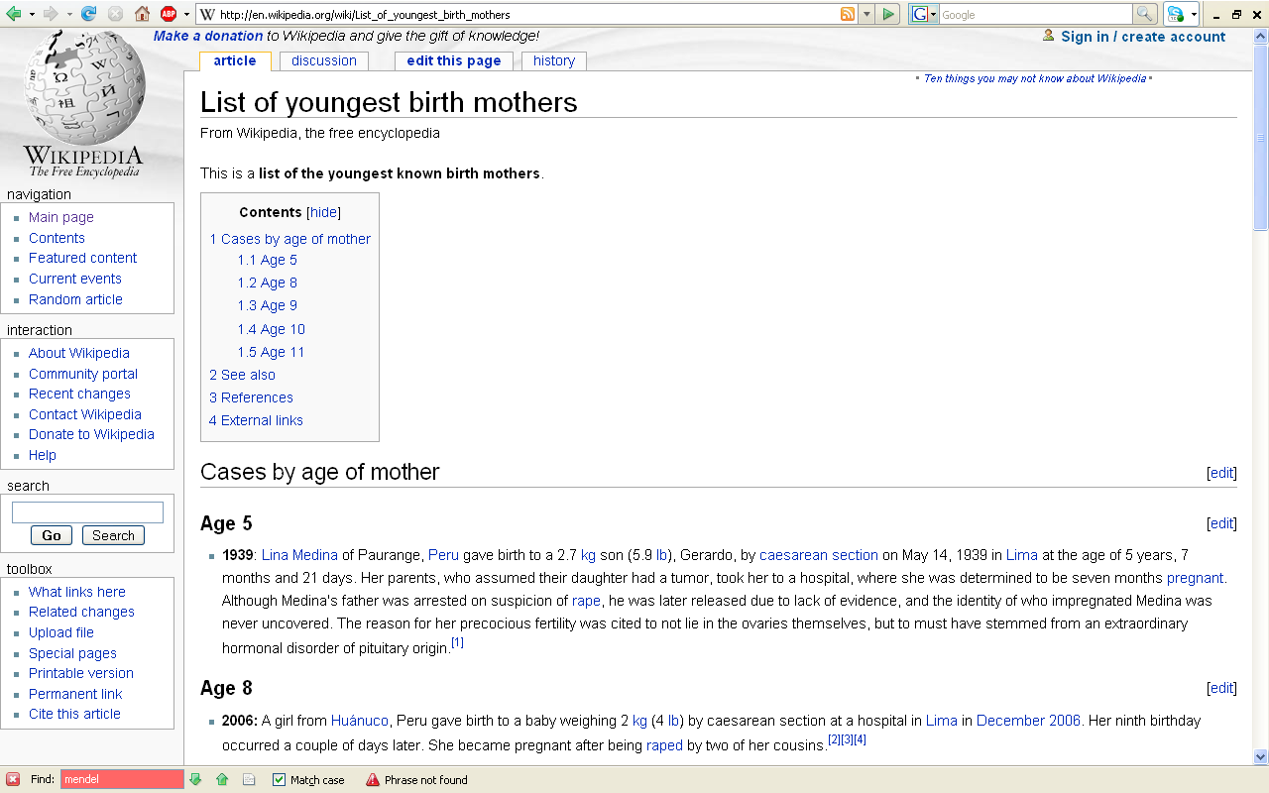
] 6
] 74
http://en.wikipedia.org/wiki/List_of_youngest_birth_mothers

Slide 41
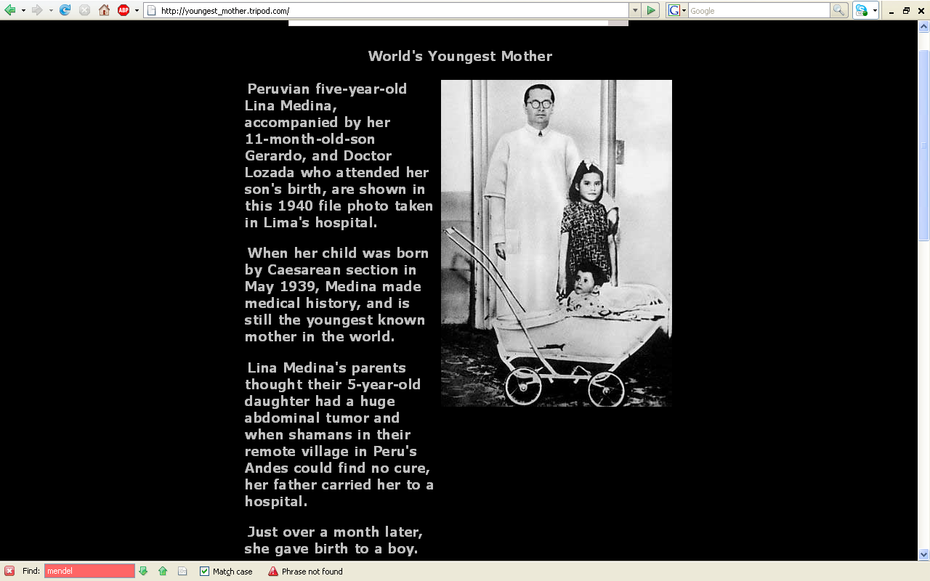
] 6
] 74
http://youngest_mother.tripod.com//

Slide 42
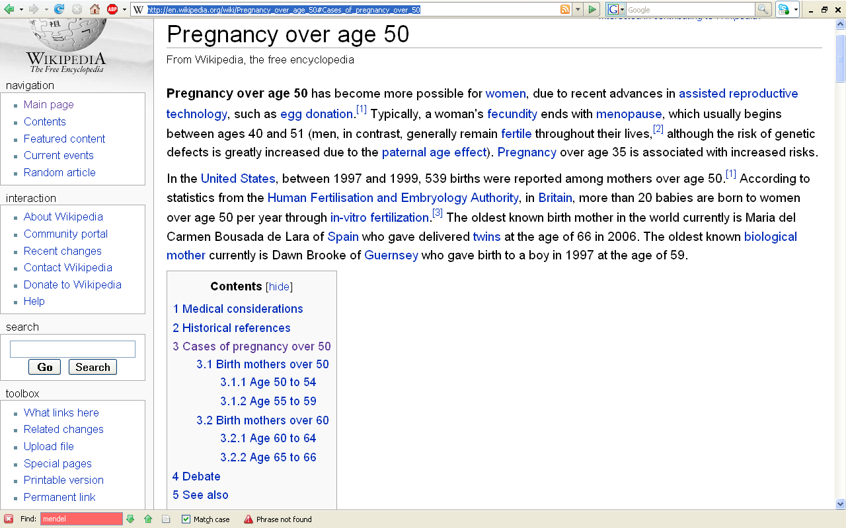
] 6
] 74
http://en.wikipedia.org/wiki/Pregnancy_over_age_50#Cases_of_pregnancy_over_50

Slide 43
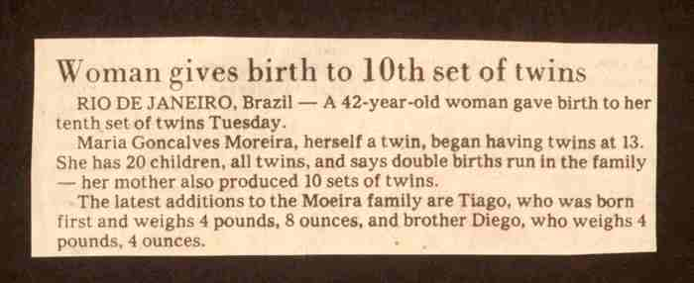

Slide 44
Modern Physical Anthropology
Continue on to Set #08
Work on Biocultural Evolution

